Slide 1
Lab Tutorial on Radar example using Ansys HFSS™ SBR+ Simulation
Dimitris Tzagkas Celia Gomez Molina
education@ansys.com

Slide 2
Received Power for Comms scenario
Assumptions:
Tx and Rx Antennas are impedance-matched
Tx and Rx Antennas are polarization-matched
Tx and Rx Antenna radiation efficiency $e_{r}$ is 1
Transmitter Antenna (Tx)
Incident wave propagation path ${(R}_{1})$
Radar Target
$S_{i}→Power Density \left[W/{m^{2}}\right]$
$P_{i}→$ $Power at antenna feed [W]$
$D_{i}→$ $Antenna Directivity$
$A_{i}→$ $Effective Antenna aperture \left[m^{2}\right]$
$G_{i}→$ $Antenna Gain$
$e_{i}→$ $Antenna efficiency$
$R_{i}→$ $Range [m]$
$$P_{t}$$
Reflected wave propagation path ${(R}_{2})$
Radar Target reflects / re-emits incident radar signal
Radar system
Receiver Antenna (Rx)
Power received
Power intercepted and reflected from target
$$P_{r}=S_{refl} A_{r} e_{r}$$
$$P_{r}$$
$$P_{refl}=S_{t} σ [W]$$
$${→P}_{r} = \frac{P_{refl}}{4πR_{2}^{2}} \frac{λ^{2}}{4π} D_{r} \frac{G_{r}}{D_{r}}$$
Power transmitted
$$P_{refl}=\frac{P_{t}}{4πR_{1}^{2}}G_{t} σ [W]$$
$$P_{t}=e_{t}{ A}_{t} S_{t} \left[W\right] (1)$$
$${→P}_{r} = \frac{\frac{P_{t}}{4πR_{1}^{2}}G_{t}}{4πR_{2}^{2}} \frac{λ^{2}}{4π} G_{r}$$
$$S_{t}=\frac{P_{t}}{4πR_{1}^{2}}G_{t}\left(θ,φ\right) [W/{m^{2}}]$$
$$→S_{r}=\frac{P_{refl}}{4πR_{2}^{2}} \left[W/{m^{2}}\right]$$
Power density at receiving antenna
where
$$A_{t}=\frac{λ^{2}}{4π}D_{t}\left(θ_{t},φ_{t}\right) [m^{2}]$$
Radar Equation
$$P_{r}=\frac{λ^{2}}{(4{π)}^{3}R^{4}}P_{t} σ G_{t}(θ_{t},φ_{t}) G_{r}(θ_{r},φ_{r}) [W]$$
$$G=e D$$
Notes:
In this slide you can see the equations used to reach the radar range equation. The equations use the transmit power, the power density and the antenna parameters such as the gain (G) and the directivity (D).

Slide 3
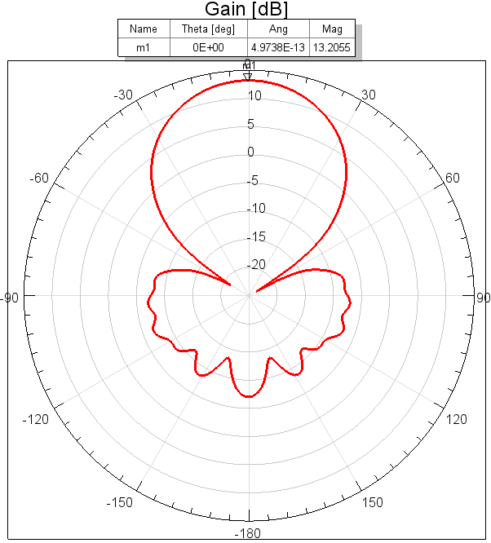
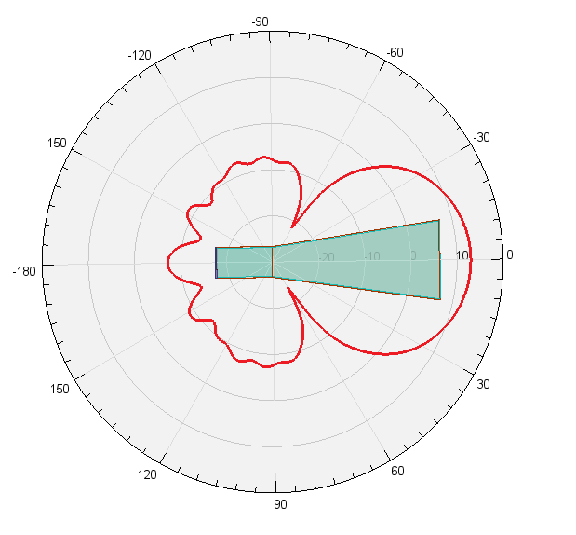
How to simulate the setup with Ansys HFSS SBR+
This tutorial uses Ansys HFSS™, the high-frequency electromagnetic simulation software
Parameters used:
Antenna model(s) in HFSS
Identical Horn Antenna at $f_{c}=2.4 GHz$,
with efficiency $e_{r}=1$,
with maximum gain at boresight of 20.92 (13.2 dB),
excitation power $P_{t}=1W$
Link and Setup configuration
Radar consists of receiver and transmitter antennas that are at the same location
Identical horn antennas for transmitter and receiver,
Target sphere is at the boresight of the antennas with radius of 0.5m
Variable distance between them R
Tx/Rx
Target
R

Slide 4
Radar equation scenario implemented in Ansys HFSS software
Radar received power level depending on the distance of the target sphere

Slide 5
How to create a radar scenario in Ansys HFSS Software

Slide 6
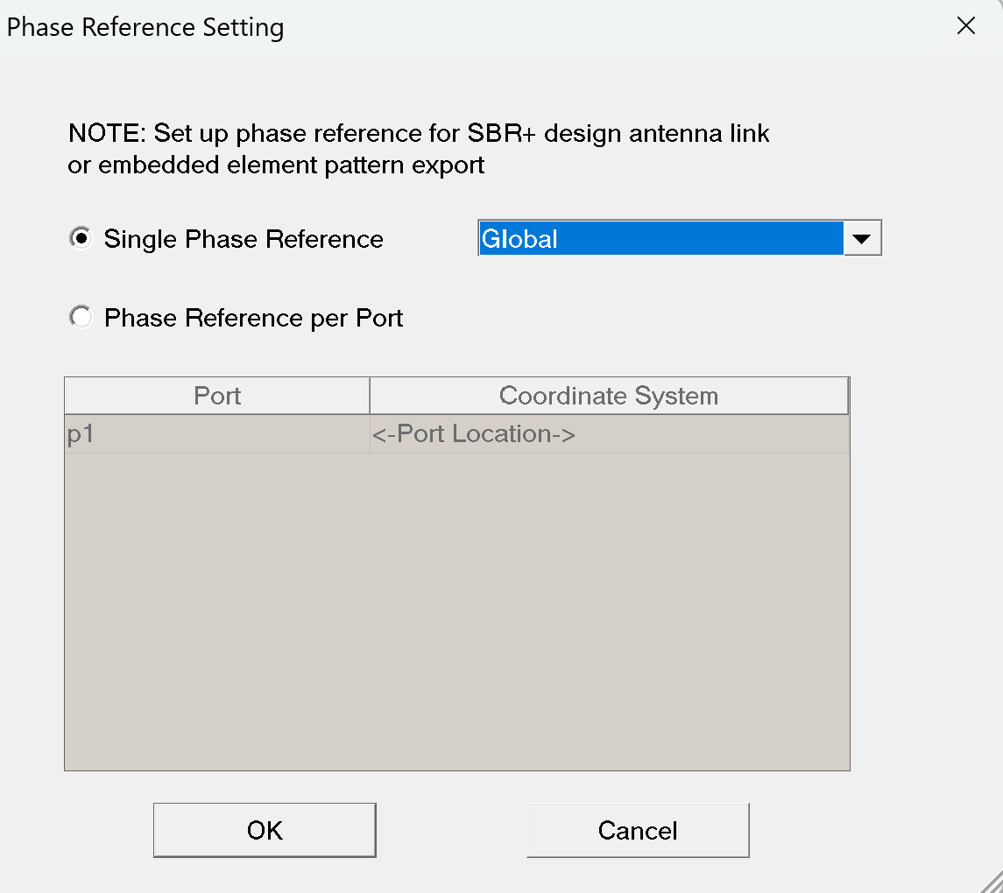
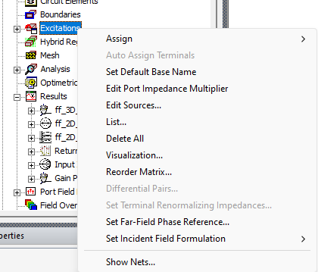
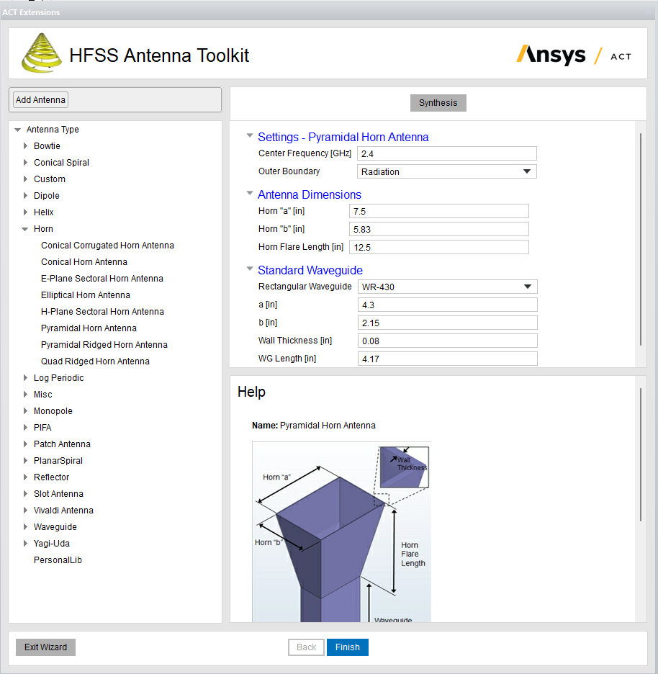
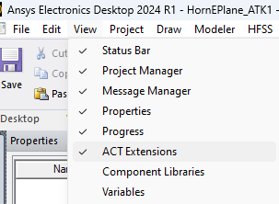
Antenna Design
Use an existing antenna OR generate using the ACT Antenna Toolkit in Ansys HFSS: View→ ACT Extensions → Launch Wizards →HFSS Antenna Toolkit → Any Antenna needed → Set parameters→ Synthesis → Finish The example next uses a pyramidal Horn Antenna at 2.4 GHz center frequency.
Excitations (right click) → Set Far-Field Phase Reference..
And then set a Far-Field Phase Reference point for the antenna.

Slide 7
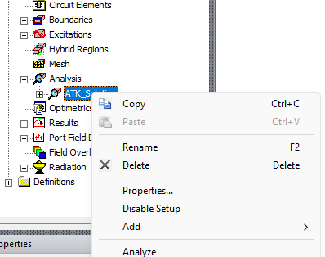
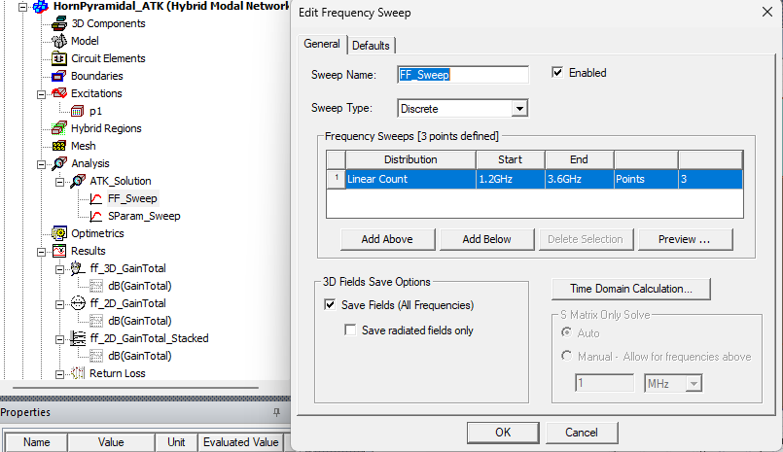
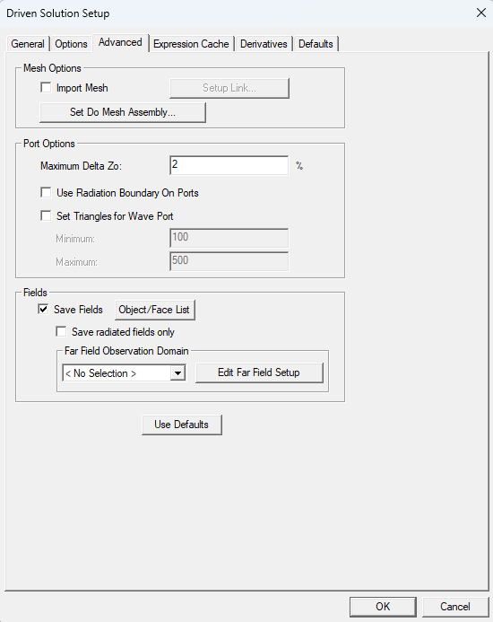
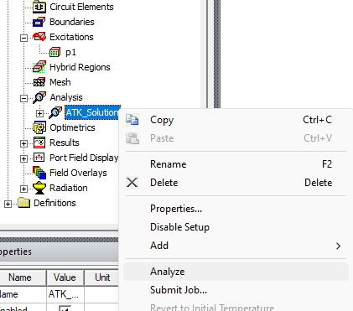
Analyze Antenna
Make sure Save Fields is checked…… Setup Freq Sweep ... and… Analyze
Step B
Step C
You can set sweep to specific frequencies OR even a single specific frequency
Step A

Slide 8
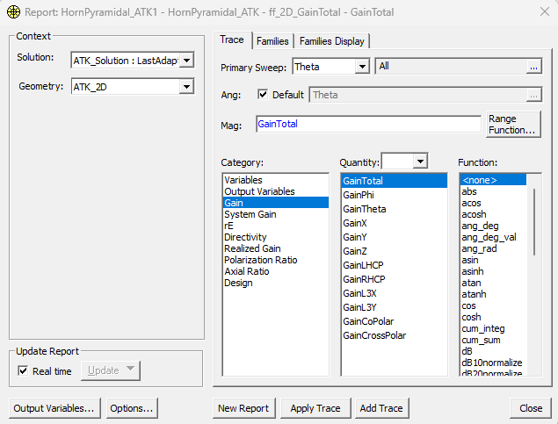
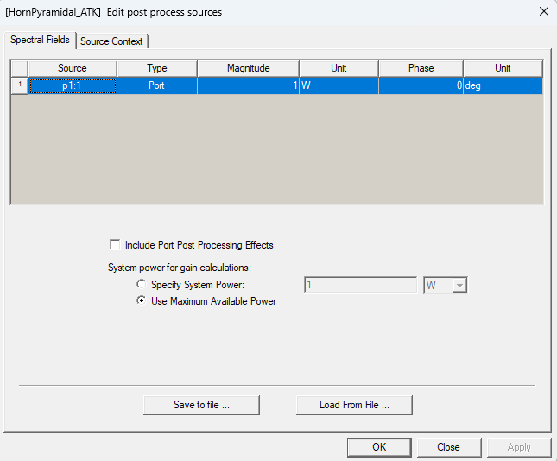
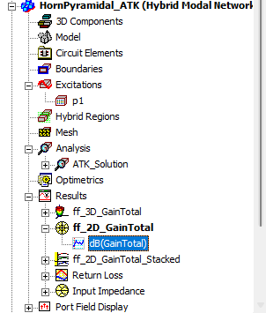
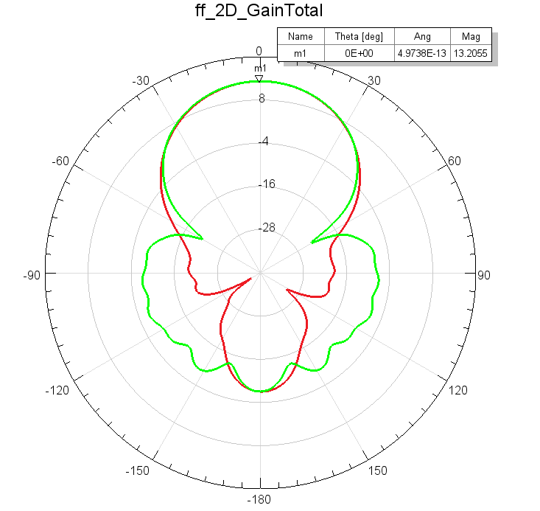
Antenna Parameters extraction
From Excitations we can set the input power [1 W in this case]
From Results we can get the Total Gain [20.9 or 13.2 dB]

Slide 9
Antennas for radar case
For the example you can either
Use the existing horn antenna created and analyzed for the previous project (this method is used in the current presentation)
OR
Create a new/different antenna OR load antenna parameters from different project

Slide 10
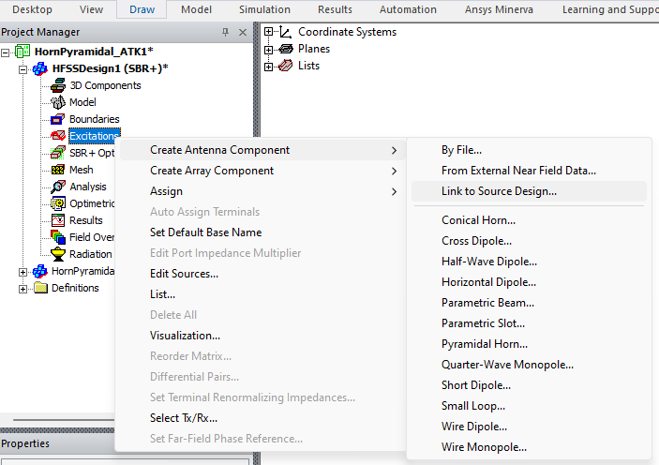
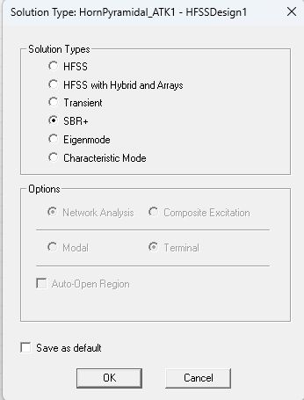
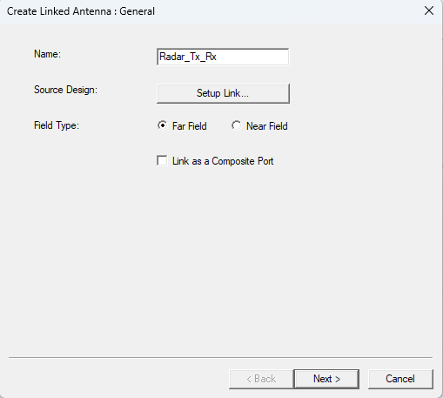
Setting Up the System Setup
Create Antenna Component via Link to Source Design..
Create New HFSS Design
Change Solution Type to SBR+
Name Appropriately the Antenna

Slide 11
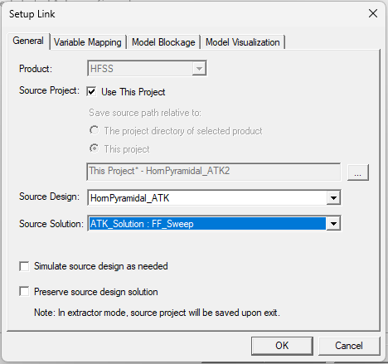
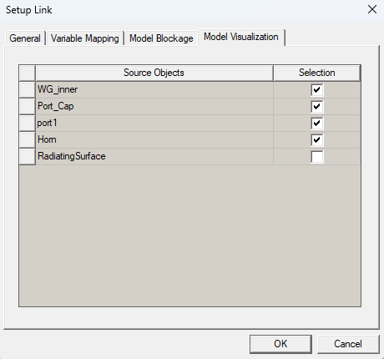
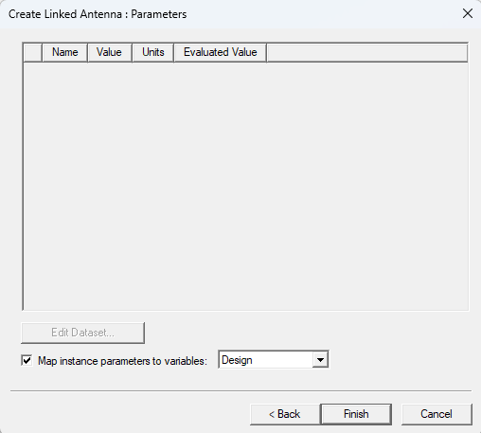
Setup Link – Working in the SBR+ design now
OK, Next and Finish
General Tab
Model Visualization Tab
Make sure you choose the correct Sweep

Slide 12
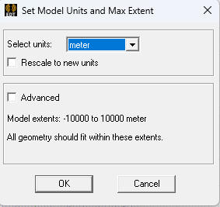
Linking the Receiver Antenna …
Change Units to appropriate scale..
Add Receiving antenna (Radar_Rx) at the same location of the Transmitting Antenna
Name Appropriately the Antenna
AND REPEAT THE SAME AS FOR THE Rx ANTENNA

Slide 13
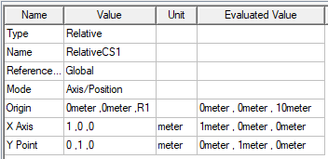
Adding the target coordinate system…
Change Units to appropriate scale..
Add parametric Relative Coordinate System ..
You can add the Relative CS anywhere and then modify the attributes as shown below
* R1 = 10 meter

Slide 14
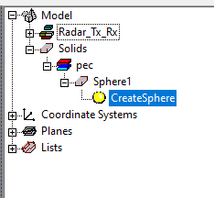
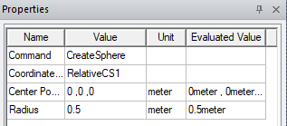
Adding the target at the Relative Coordinate System reference
Select the RelativeCS1 and then draw a sphere as a target When done → you will get the below setup
The sphere can be placed anywhere and then modify properties as here:

Slide 15
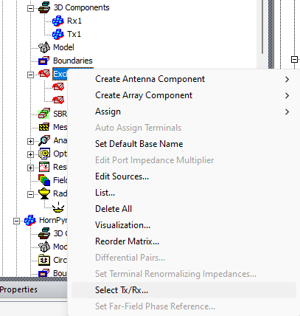
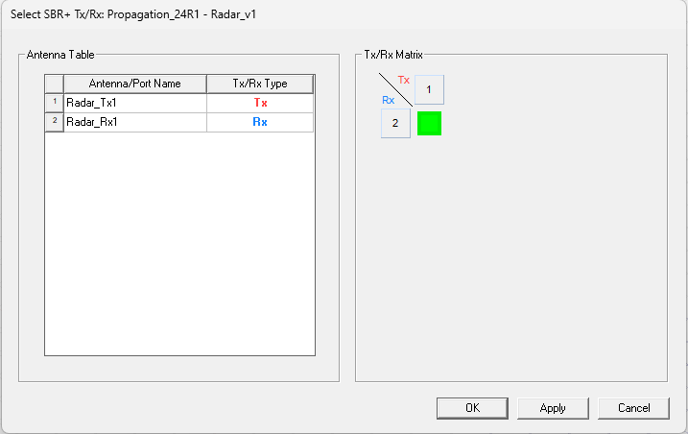
Assign Tx and Rx behaviors
Assign port and behavior type as shown below

Slide 16
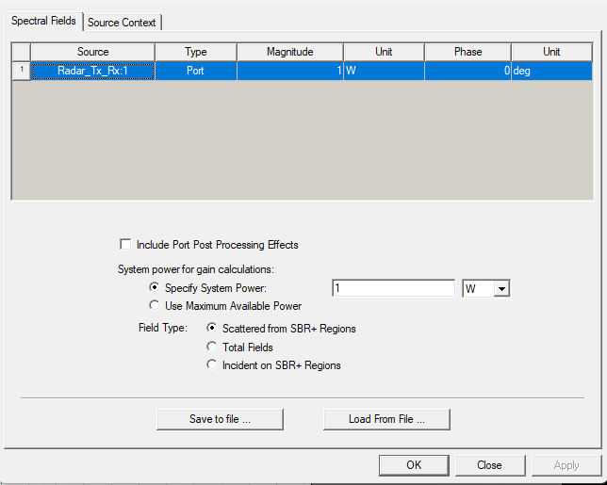
Excitation setup
Transmitter Antenna
From Excitations we can set the input power [1 W in this case]
Radar system
In a radar system there are 2 antennas: a) the transmit (Tx) antenna and b) the receive (Rx) antenna
Unless time-separated, the receive antenna receives the target-reflected signals but also the direct signal from the transmit antenna (unwanted).
In Ansys HFSS software, we can reject the direct transmitted signal (from Tx antenna) by selecting the Field Type to be the “Scattered from SBR+ Regions” (see below).
Receiver Antenna

Slide 17
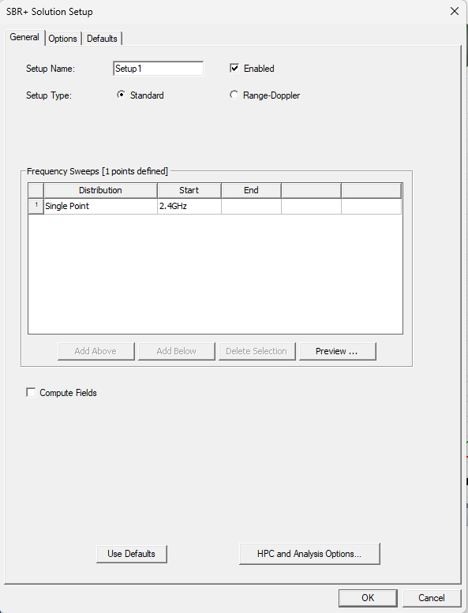
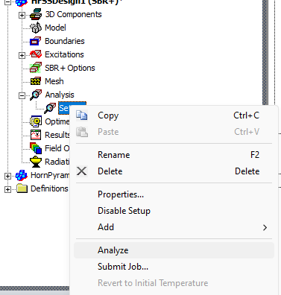
Setup Analysis and Run Analysis

Slide 18
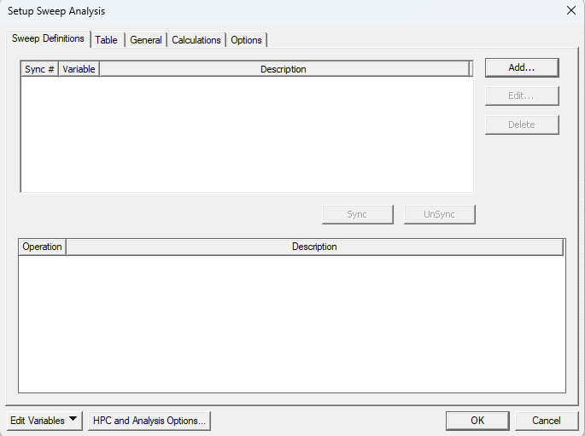
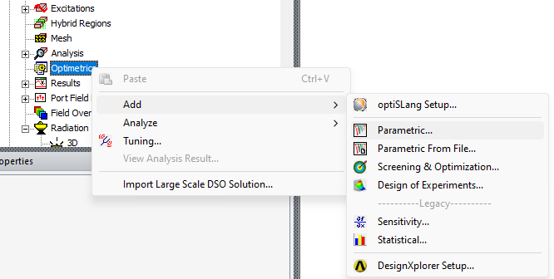
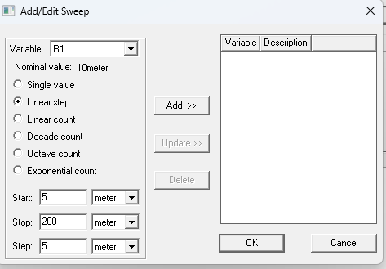
Analyze for different distance R1
Add Parametric setup for R1
You can define the start/stop/step accordingly. More steps mean more simulation time

Slide 19
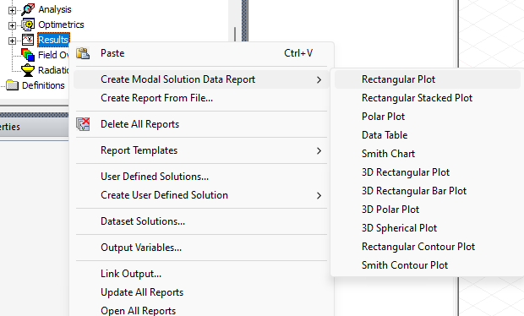
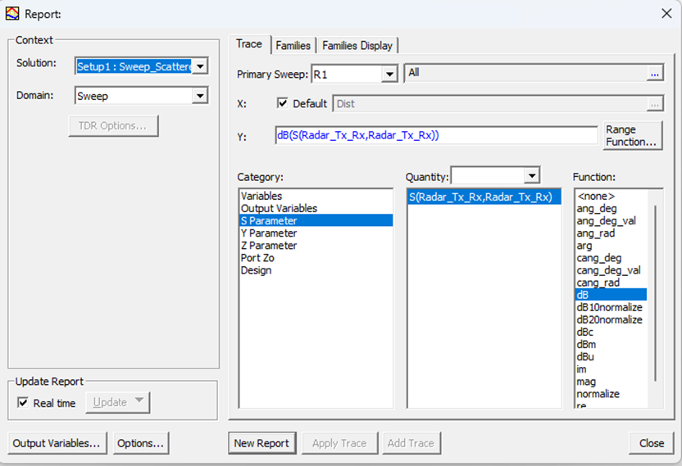
Plotting results

Slide 20
Results – Compared to calculated radar equation (imported)
Radar received power level depending on the distance of the target sphere
Notes:
For a comparison side by side you can export the simulation data OR import the calculated theoretical data in order to compare the simulated and calculated data in a single graph. In this example the calculated data are imported in HFSS

Slide 21
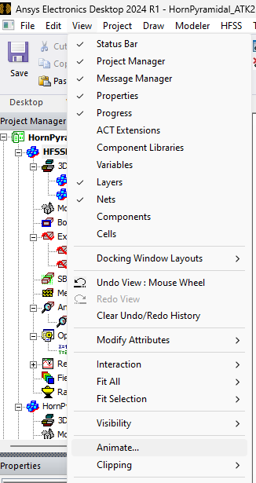
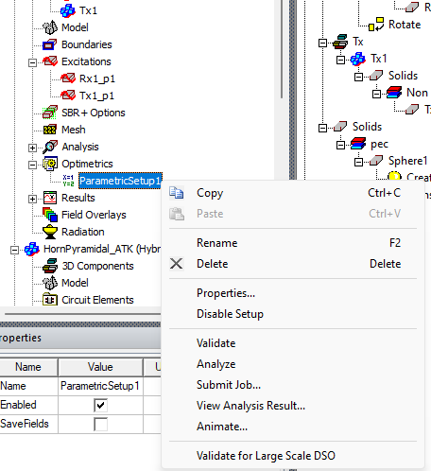
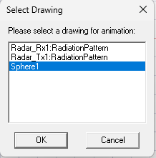
Creating animated picture
OR
THEN

Slide 22
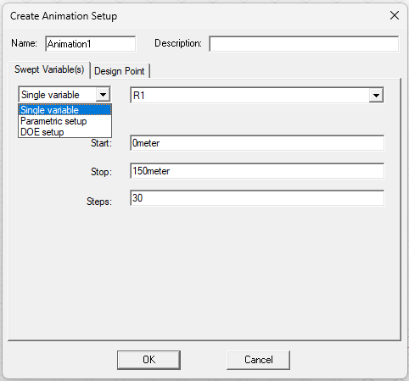
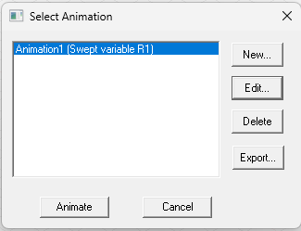
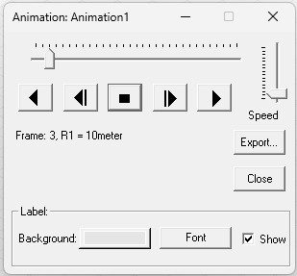
Creating animated picture
Setup animation and steps
Export (*.avi OR *.gif file)
Animate

Slide 23
Ansys Education Resources Feedback Survey
Here at Ansys, we rely on your feedback to ensure the educational content we create is up-to-date and fits your teaching needs.
Please click the link below to fill out a short survey (~7 minutes) to help us continue to support academics around the world utilizing Ansys tools in the classroom.
Feedback Survey Link
Notes:
Feedback Survey link for copy-paste method → https://ansys.typeform.com/to/jcattJI5

