Slide 1
Current Loop Simulation using the Ansys Maxwell Software
Pratap Vangol and Dr. Saharnaz Baghdadchi
University of California, San Diego
Dr. Celia Gómez Molina
Academic Development team, Ansys
education@ansys.com

Slide 2
Learning Objectives
Ansys software mentioned | Ansys Maxwell®, an advanced electromagnetic field solver
Intended Learning Outcomes
Knowledge and Understanding | Fundamental principles of magnetostatics and simulation workflows using the Ansys Maxwell software.
Skills and Abilities | Conducting simulations, visualizing magnetic fields, and validating results using industry-standard software.
Values and Attitudes | Emphasis on accuracy, validation, and bridging theory with real-world applications.
Resources
M. N. O. Sadiku, Elements of Electromagnetics, Oxford University Press, 2001.
Ulaby, Michielssen, and Ravaioli, Fundamentals of Applied Electromagnetics, Seventh Edition, Pearson Education, 2015.
Further reading/information
Ansys Academic
Ansys Innovation Courses
Ansys Education Resources
Built-in Assessment
Simulation instructions
Exercises

Slide 3
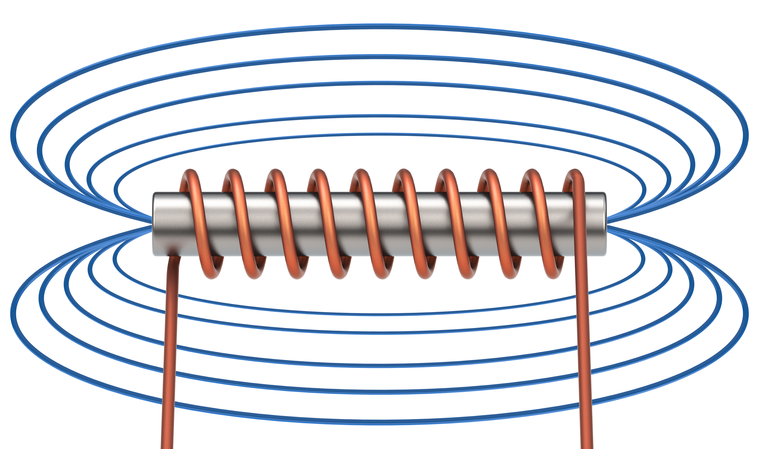
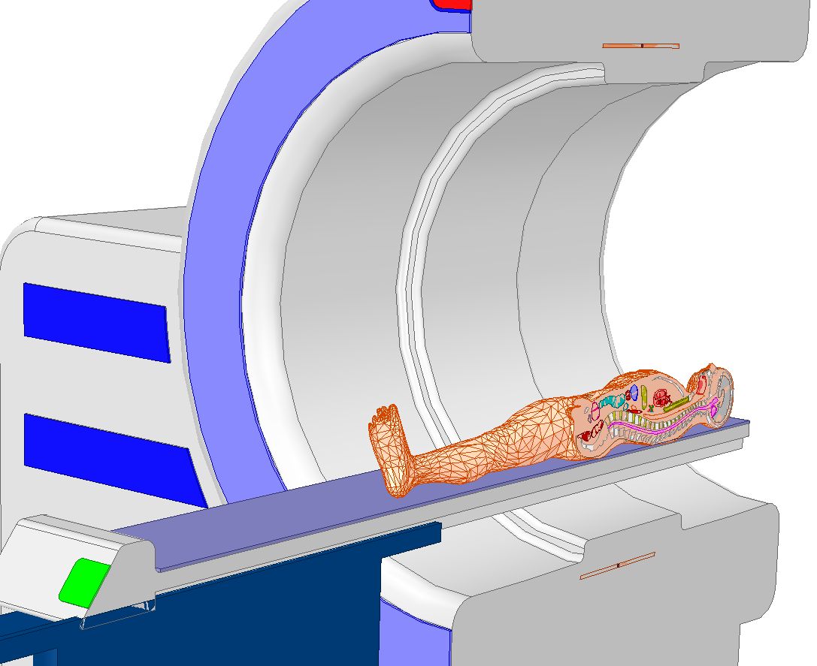
Magnetostatics
Magnetic fields that do not change with time, produced by steady (time-independent) electric currents or permanent magnets.
In today’s lesson we will study the magnetic field generated by a current-carrying loop.
Magnetostatics can be seen as special case of Maxwell's equations, where we assume that charges are either fixed or move as a steady current.
Commonly used sources that generate static magnetic fields are permanent magnets, current-carrying conductors and electromagnets.
Applications: transformers, inductors, electric motors, generators, magnetic storage devices, medical imaging…

Slide 4
Analytical Assignment
Calculate from the Biot-Savart law, the $\overline{B}$ field created by a current-carrying loop
Consider a loop of radius $R$ centered on the x − y plane. Find the magnetic flux density $B$ at the point $(0, 0, z_{0})$ from the loop, when the loop is carrying $I$ Amps of current.
$$z$$
Observation point
$$(0, 0, z_{0})$$
$$\overline{r}$$
$$θ$$
$$R$$
$$y$$
$$d\overline{l}$$
$$I$$
$$x$$

Slide 5
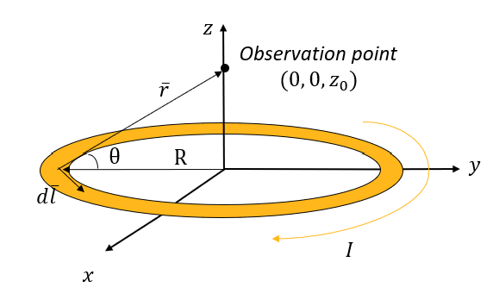
Theoretical derivations
Starting from the Biot-Savart Law:
$$B= \frac{μ_{0 }I }{4Π}\int_{0}^{2Π}{\frac{cosθ dl}{z_{0}^{2}+R^{2}}}$$
Now, particularly for our geometry
$$\overline{B}= \frac{μ_{0} }{4Π}\int{\frac{Iⅆ\overline{l}×\hat{r}}{r^{2}}}$$
And considering that
$$cosθ= \frac{R}{\sqrt{z_{0}^{2}+R^{2}}}$$
$$\int_{0}^{2Π}{dl=2πR}$$
and
where
$μ_{0}$ is the permeability of free space
$ⅆ\overline{l}$ is an infinitesimal segment of the current loop
$\overline{r}=r∙\hat{r}$ is the vector pointing
We finally obtain the magnetic flux density (𝐵) produced at $(0, 0, Z_{0})$ by the current-carrying loop
$$B= \frac{μ_{0} I R^{2}}{2 {\left(z_{0}^{2}+R^{2}\right)}^{\frac{3}{2}}}$$
(Tesla)

Slide 6
Problem statement
Simulate in Ansys Maxwell software a loop of radius $R=1m$, having a current of $I=1mA$ flowing through it.
Observe the magnitude of the $\overline{B}$ field created at $\left(0, 0, 1m\right)$.
Particularize the previously calculated theoretical solution to this case and compare it with the obtained simulated solution.
$$z$$
Observation point
$$(0, 0, 1m)$$
$$R=1m$$
$$y$$
$I=1mA$
$$x$$

Slide 7
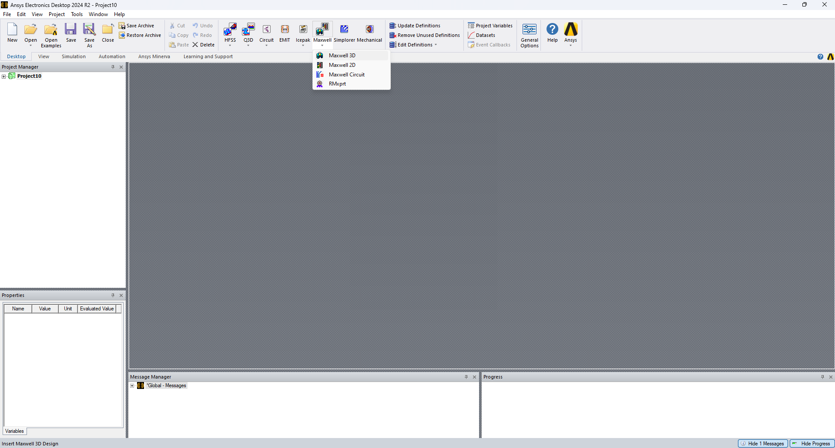
Maxwell Setup

Slide 8
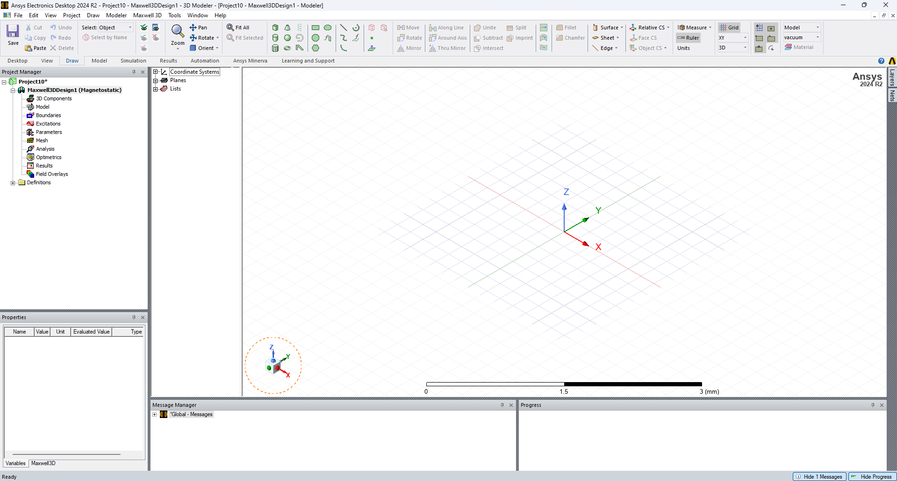
Familiarize yourself with the Ansys Maxwell Software Interface
3D Modeller Window
Draw 3D Objects
Draw 2D Objects
Project Manager window
Configuring the Simulation

Slide 9
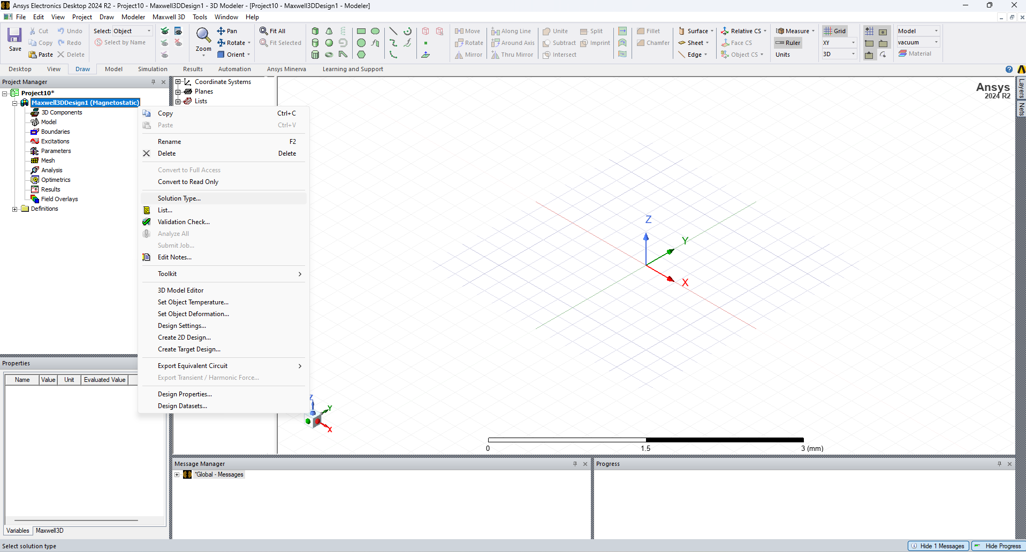
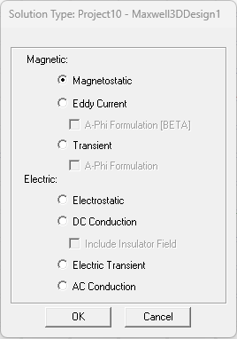
Maxwell Configuration – solution type
Right+Click

Slide 10
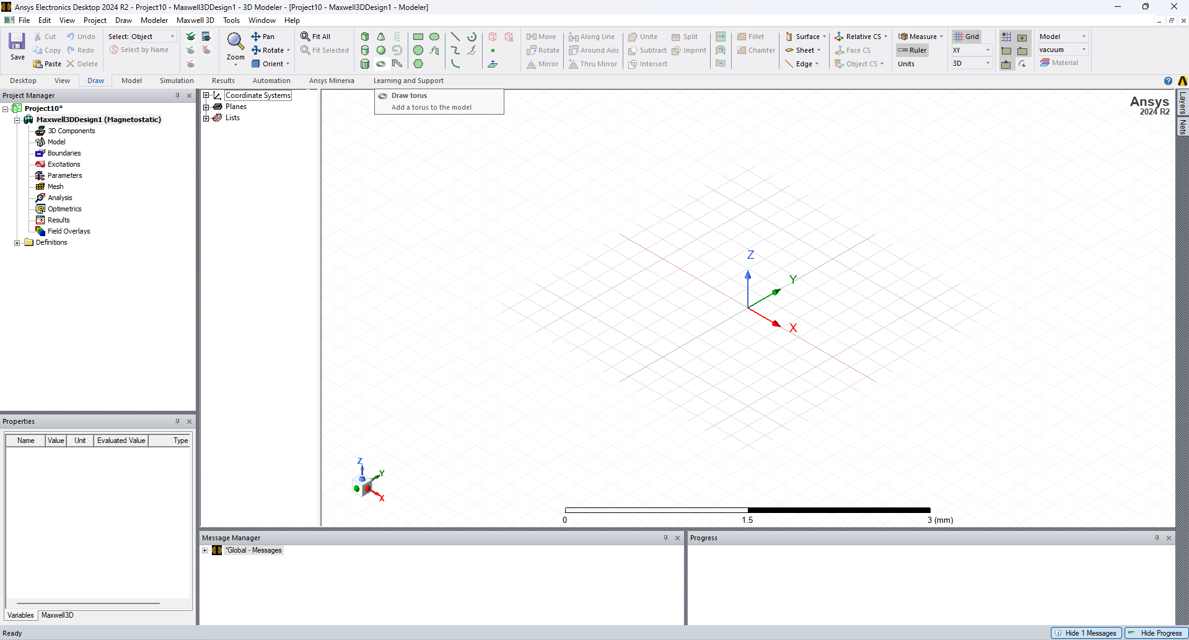
Step 1: Current Carrying Loop
The loop is represented as a Torus

Slide 11
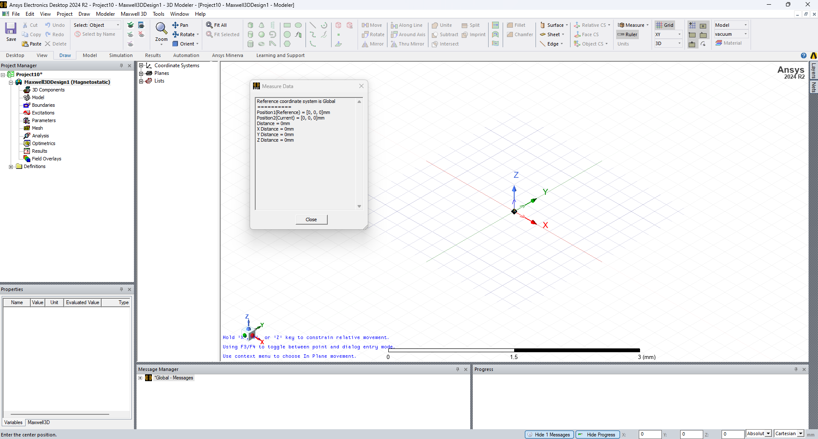
Step 1: Current Carrying Loop
Move the mouse approximately to the center of the coordinate system and left click
Move the mouse to define the radius of the Torus.

Slide 12
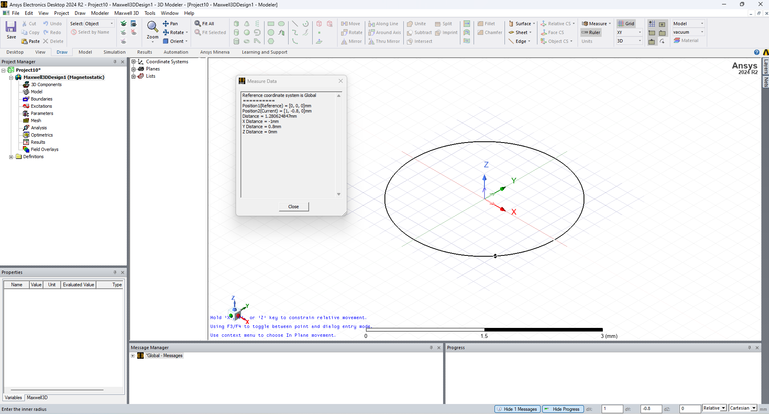
Step 1: Current Carrying Loop
Move the mouse inwards and left click again to define the inner radius of the torus

Slide 13
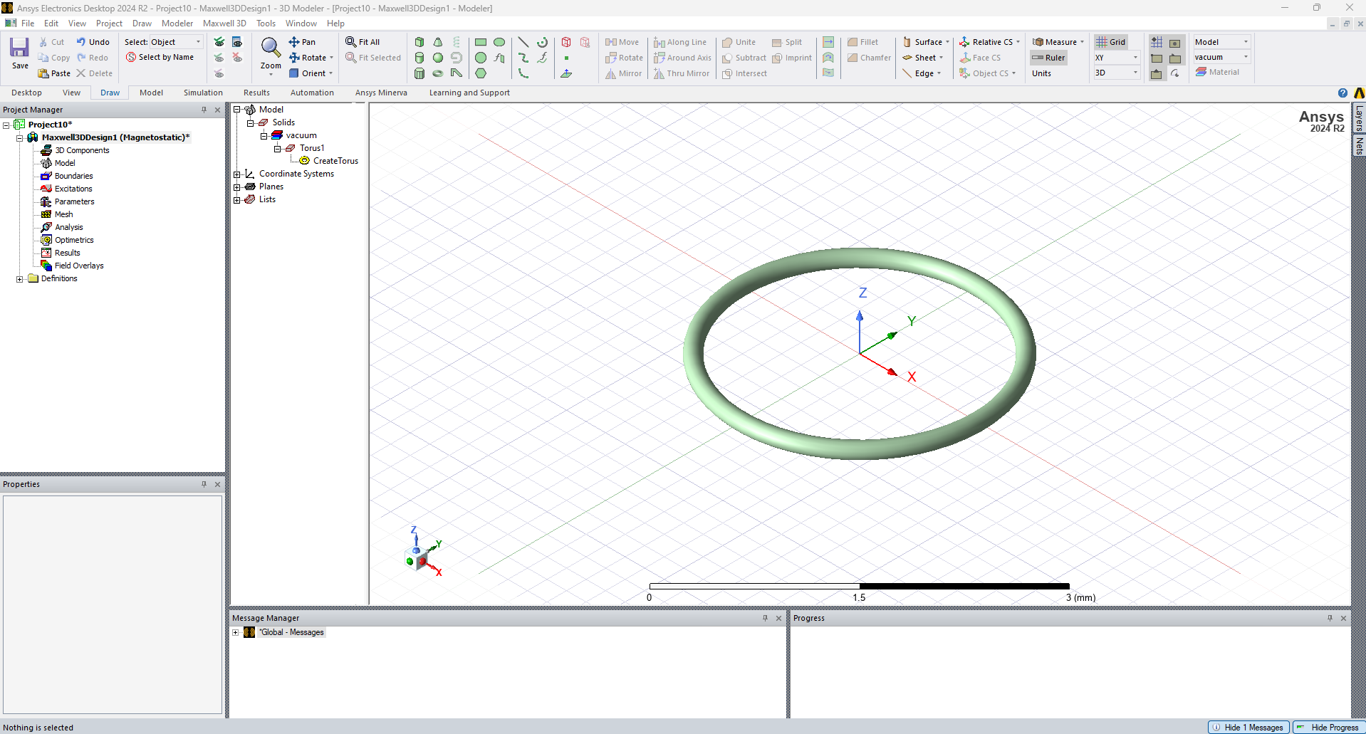
Step 1: Current Carrying Loop
The geometry should look similar to the adjoining figure
Double-click

Slide 14
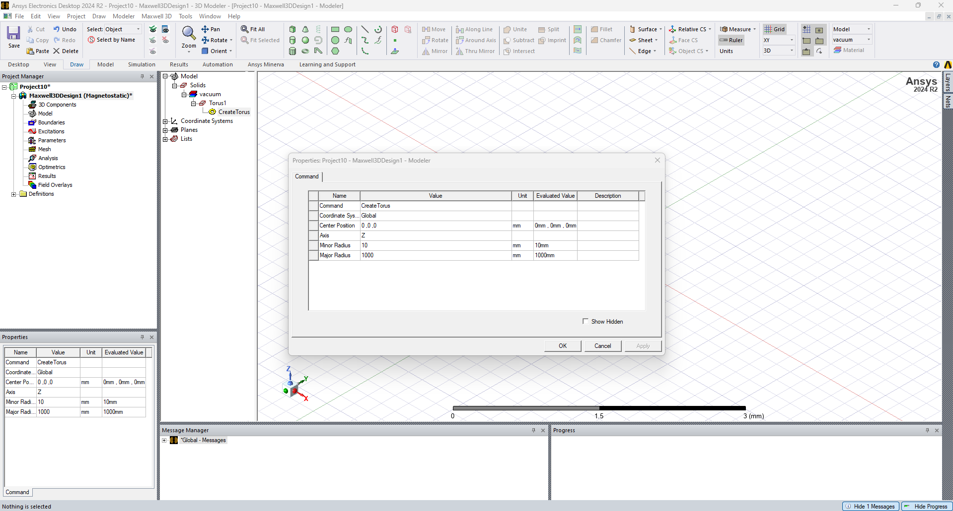
Step 1: Current Carrying Loop
Set the center to be (0,0,0)
Set Major Radius to be 1m = 1000mm Set the Minor radius to 10mm
The Minor radius defines the thickness of the wire loop

Slide 15
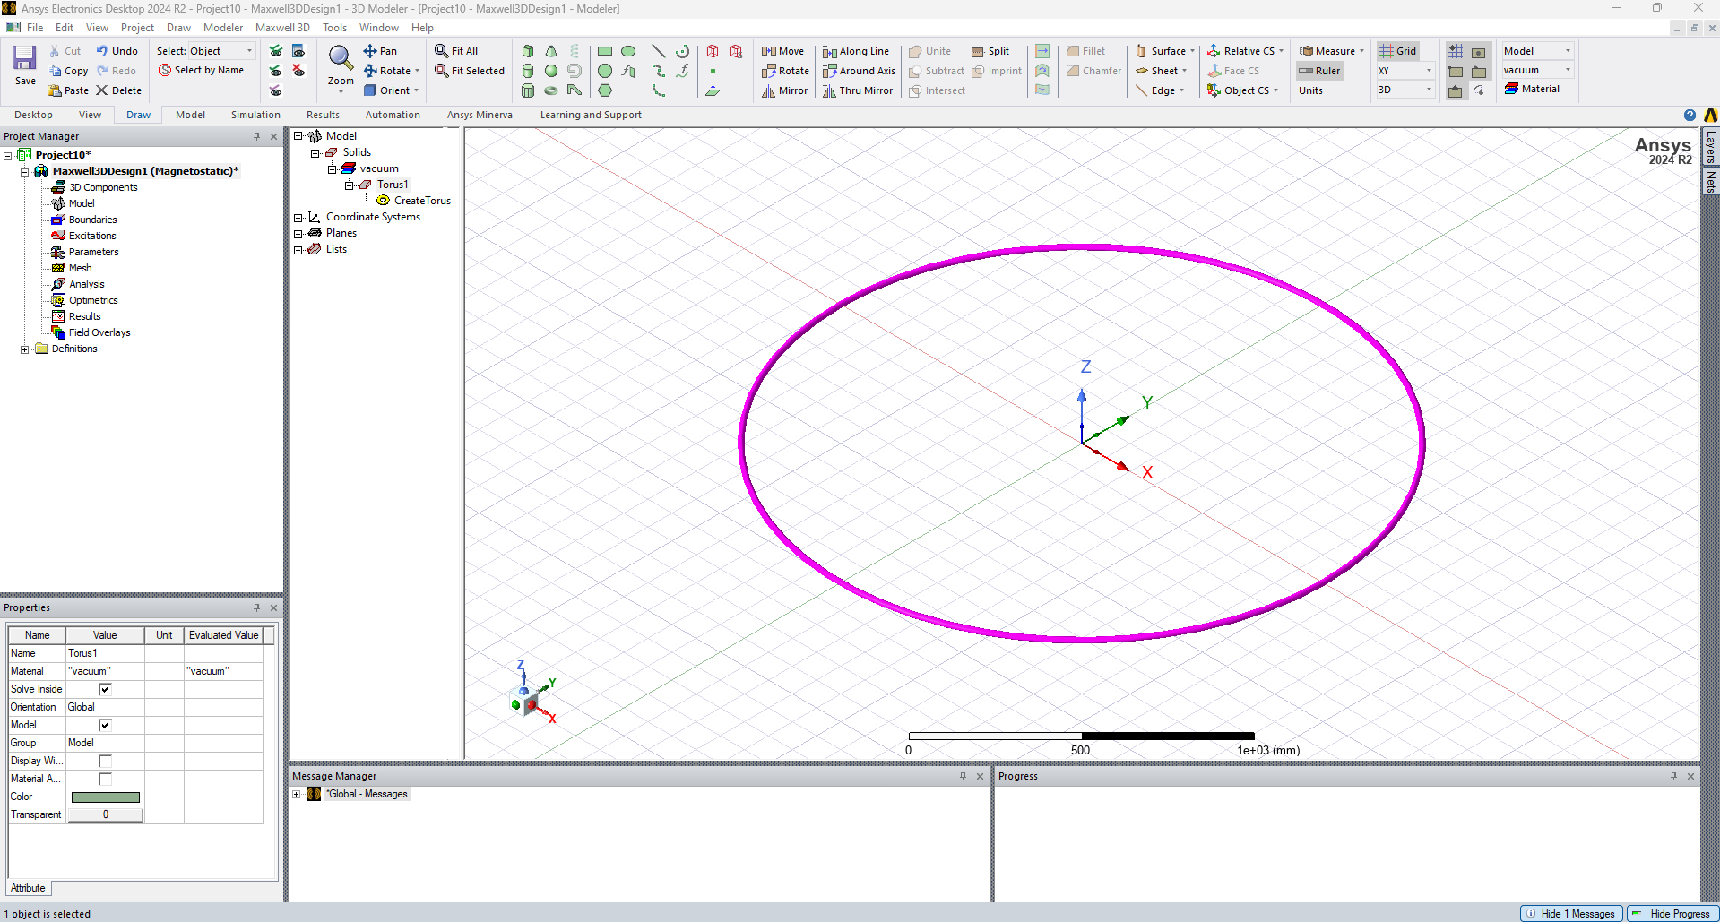
Step 2: Defining the Current
We will copy the torus to create a 2D cross section for the planar current source
Select the drawn Torus and make a copy of it by clicking Ctrl+C and Ctrl+V

Slide 16
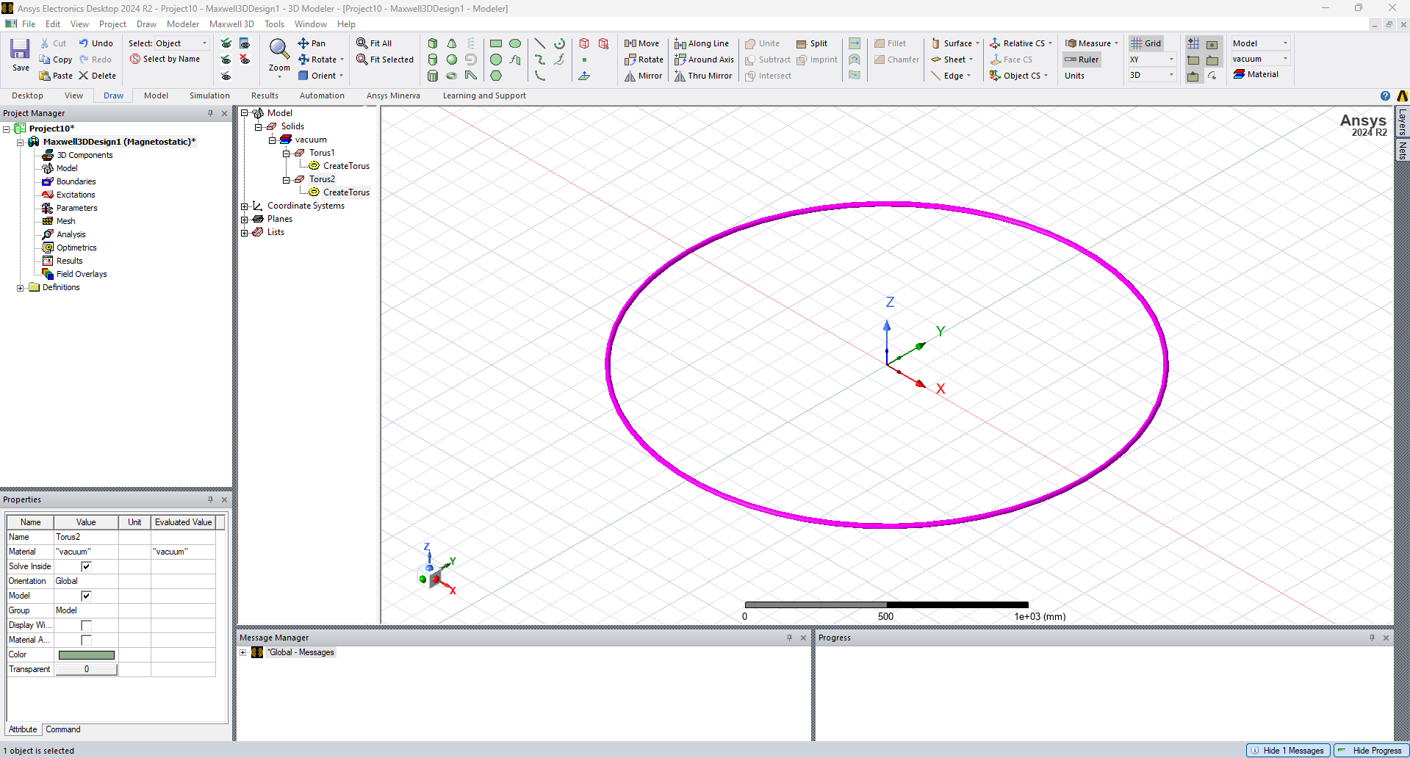
Step 2: Defining the Current
The resulting geometry is shown in the adjoining Figure

Slide 17
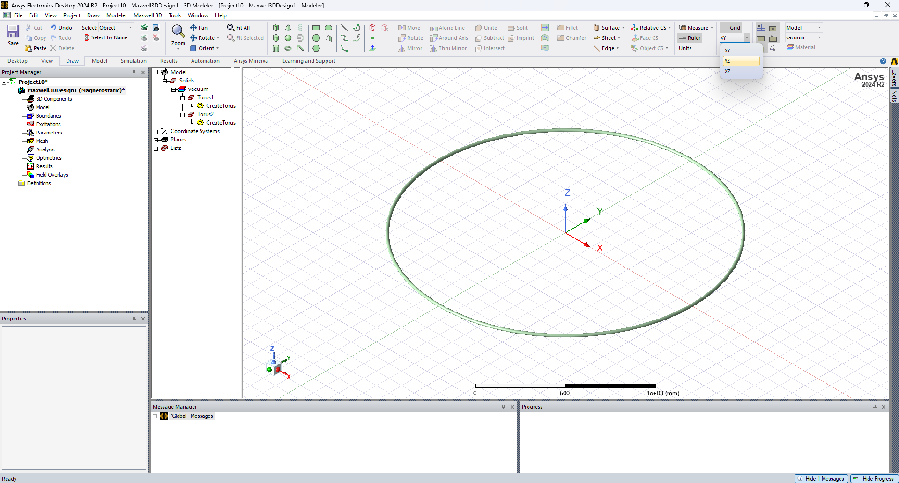
Step 2: Defining the Current
Ensure that you are in the Draw strip Select the YZ plane from the adjoining menu

Slide 18
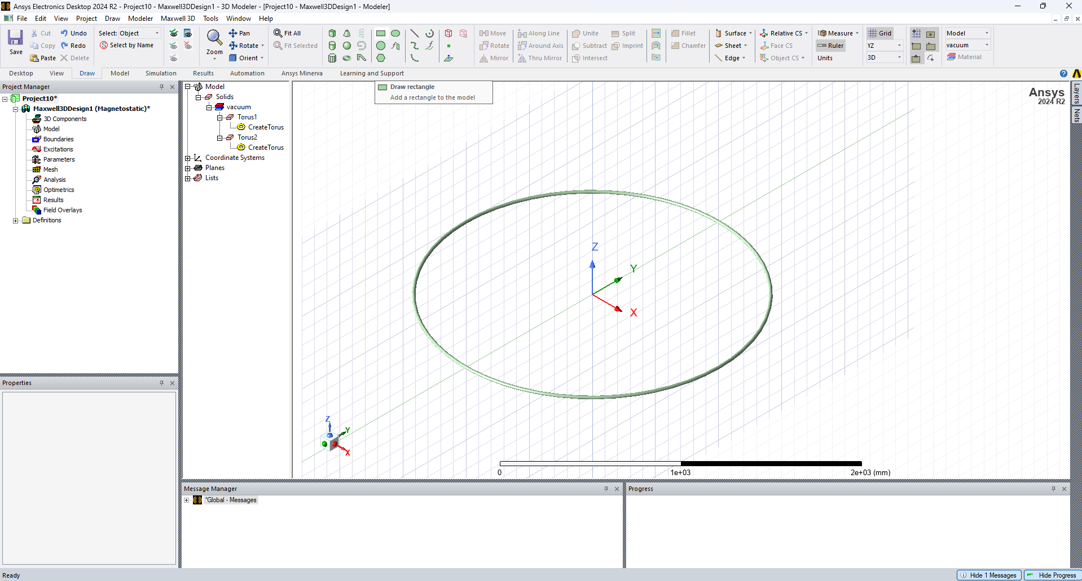
Step 2: Defining the Current
Select the draw rectangle option and draw an arbitrary rectangle which cuts through the torus once

Slide 19
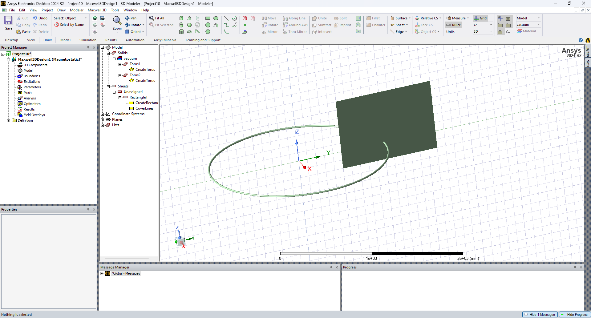
Step 2: Defining the Current
On drawing the rectangle, the geometry is as seen in the adjoining image
Note: For drawing the rectangle there is no specific coordinates. Any arbitrary size is acceptable, but has to intersect the torus

Slide 20
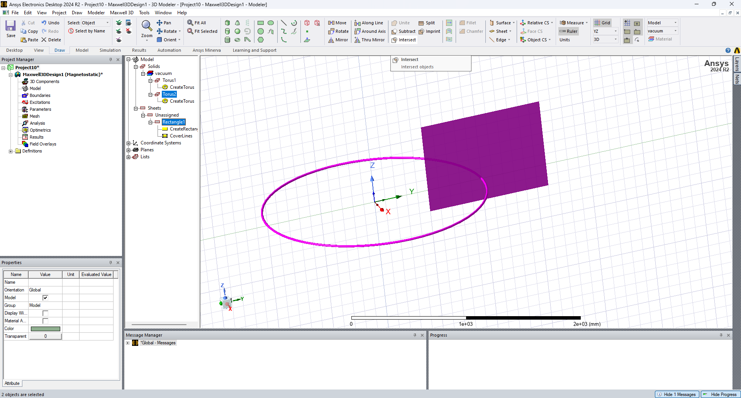
Step 2: Defining the Current
Select the Rectangle and then the Torus. Then select the intersect option
3
2
This creates a circular plane which will serve as a planar current source
1

Slide 21
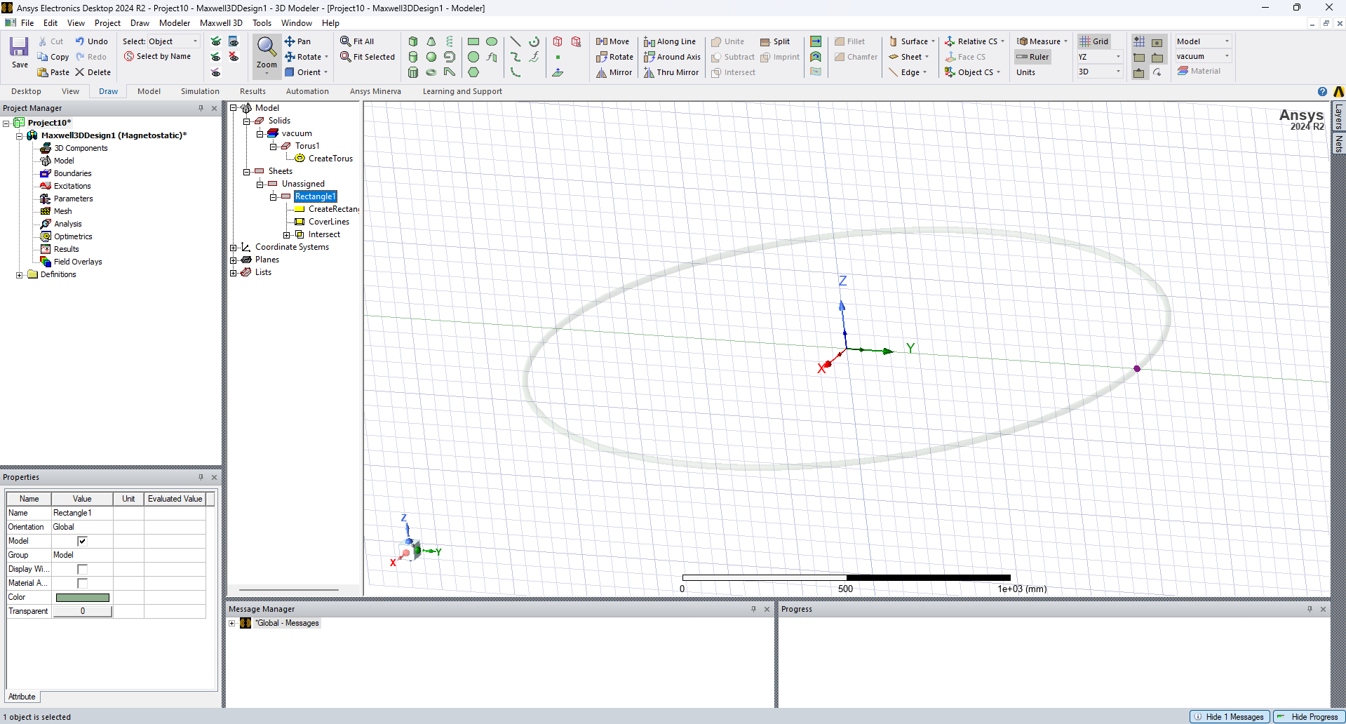
Step 2: Defining the Current
The final geometry is illustrated in the adjoining figure

Slide 22
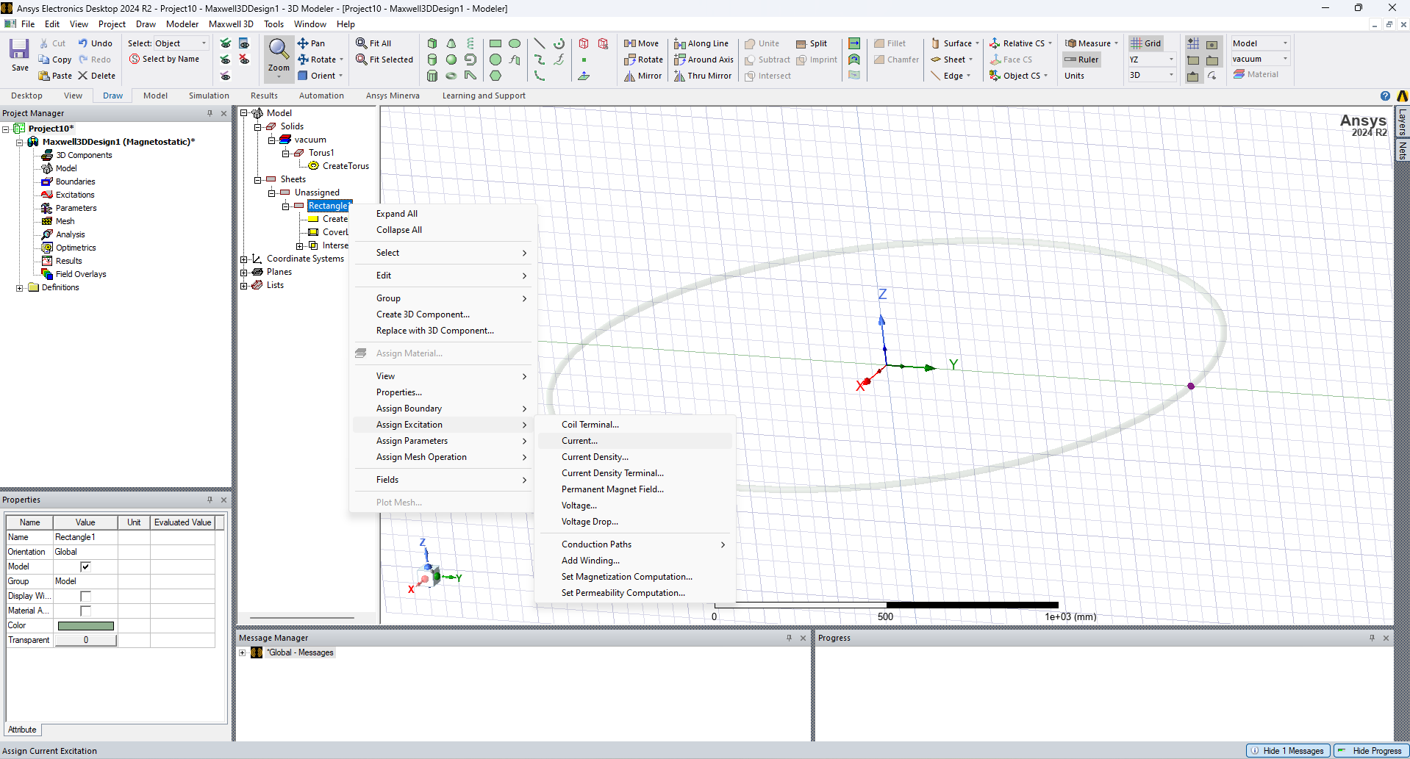
Step 3: Defining the Excitation
Select Right+Click

Slide 23
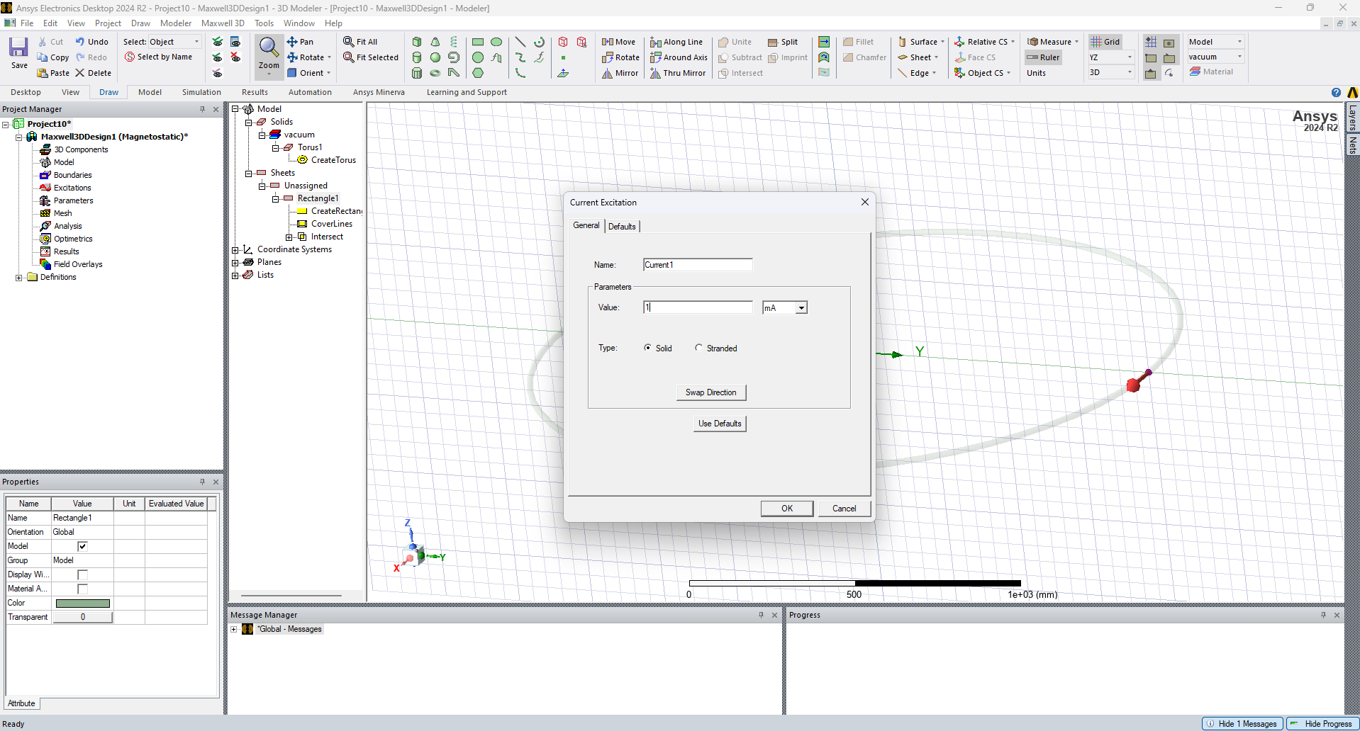
Step 3: Defining the Excitation
Set to 1mA

Slide 24
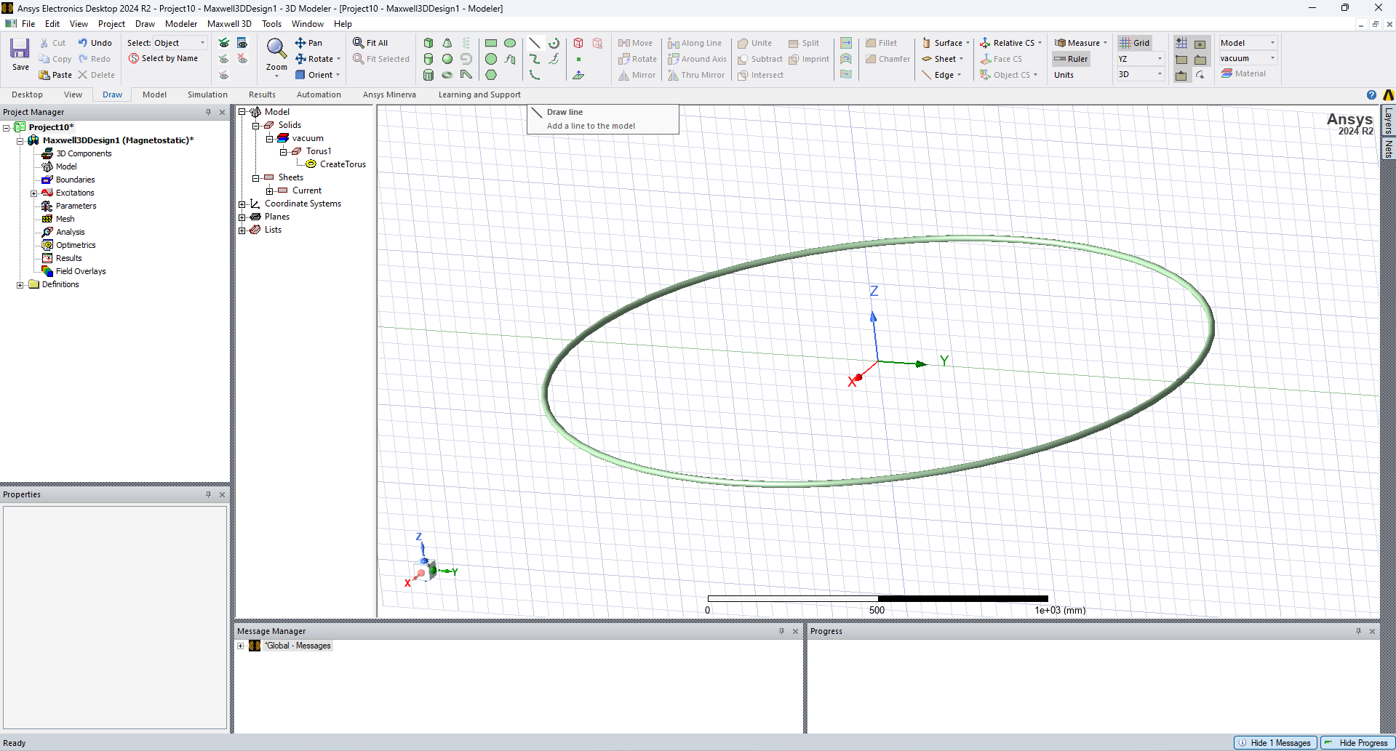
Step 3: Defining the Observation Line
Select the Draw Line
Draw an arbitrary line on the plane
In the next slide, the line length is set to be 2m

Slide 25
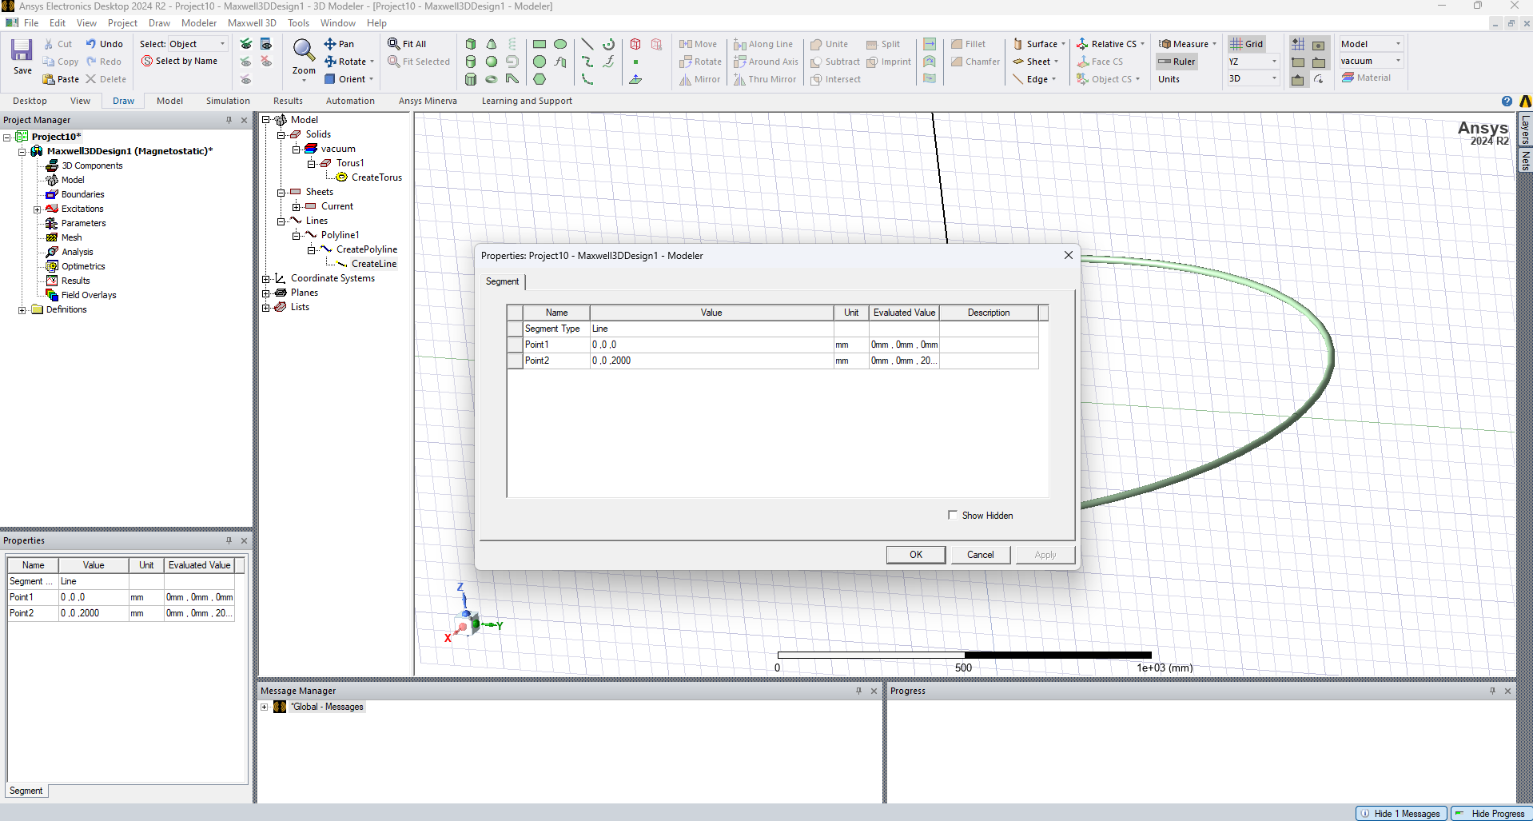
Step 3: Defining the Observation Line
Double click
Set point 1 to be at (0,0,0) and point 2 to be at (0,0,2000)

Slide 26
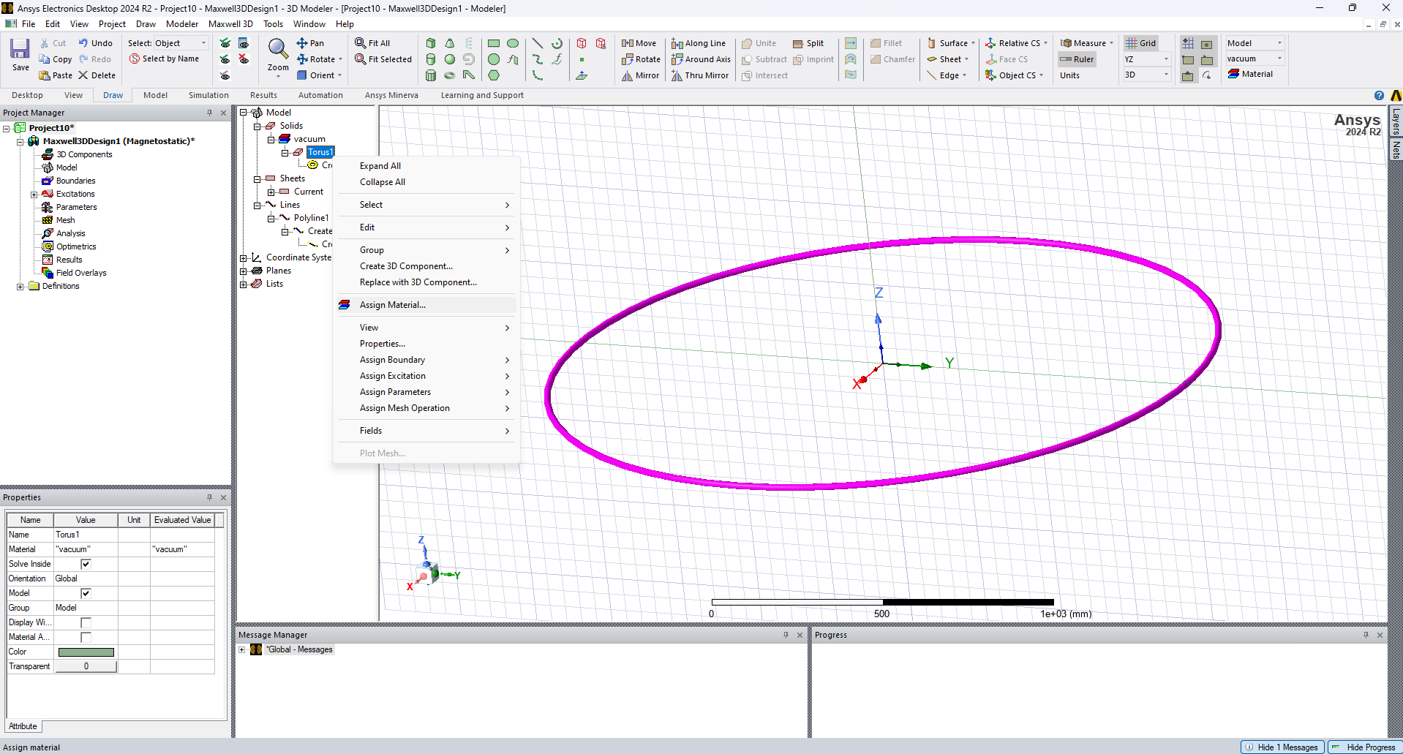
Step 4: Material Definition
Right+click

Slide 27
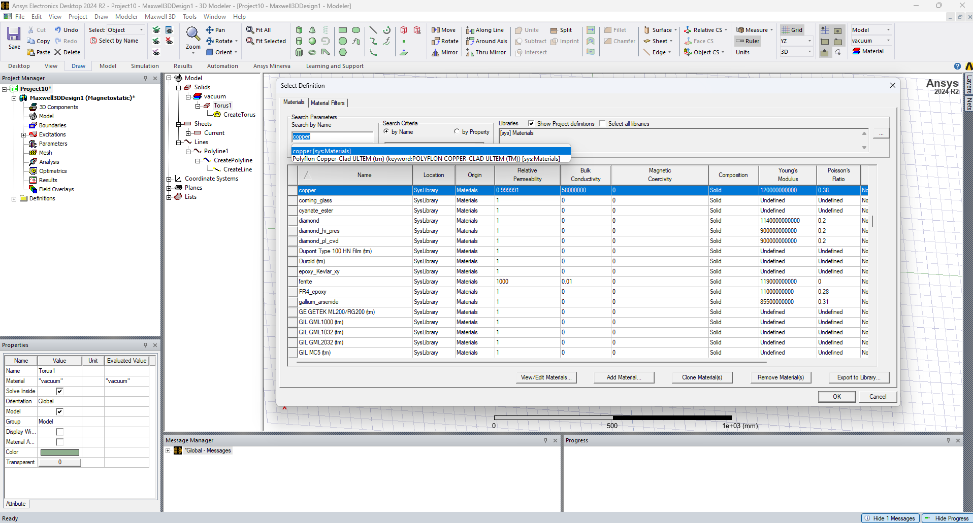
Step 4: Material Definition
Set the loop to be made of Copper

Slide 28
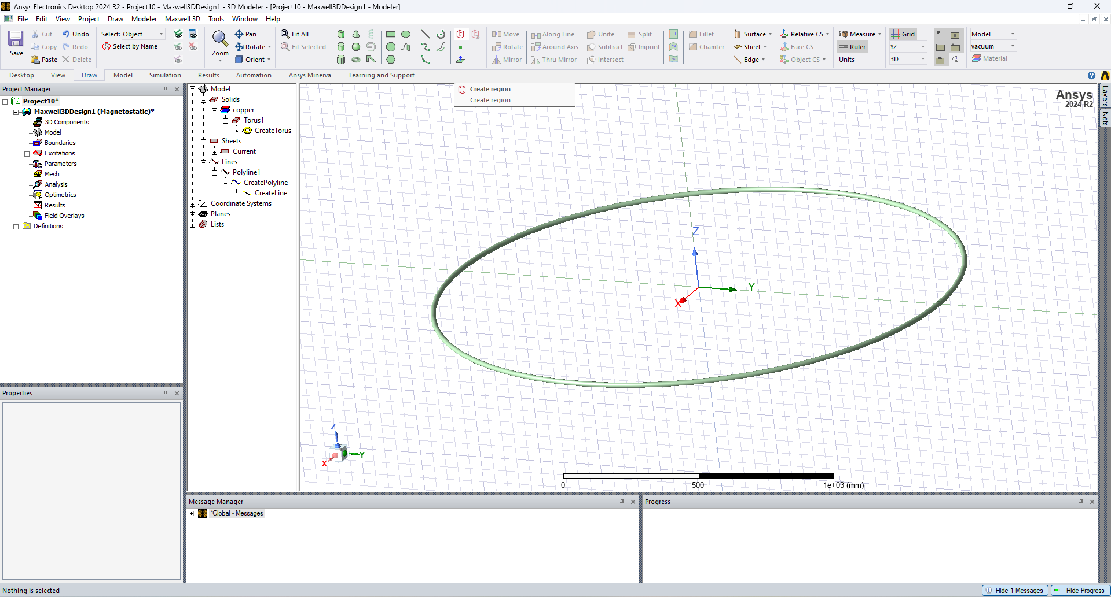
Step 5: Airbox Definition
Click on the create region command
Draw an arbitrary region. In the next slide, the dimensions will be edited

Slide 29
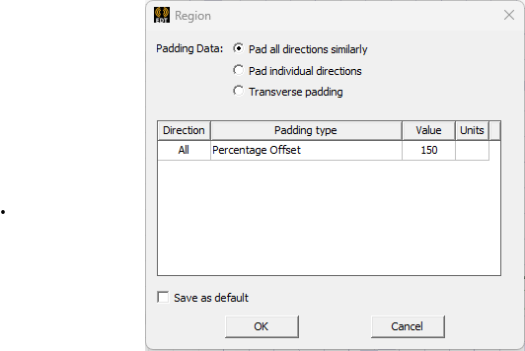
Step 5: Airbox Definition
Click on the create region command
And assign 150 as the value of the padding

Slide 30
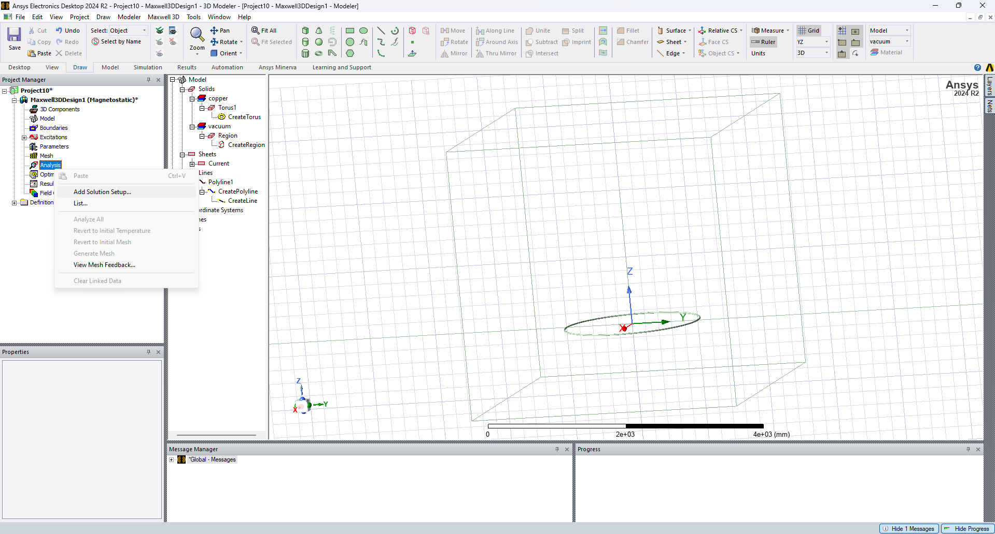
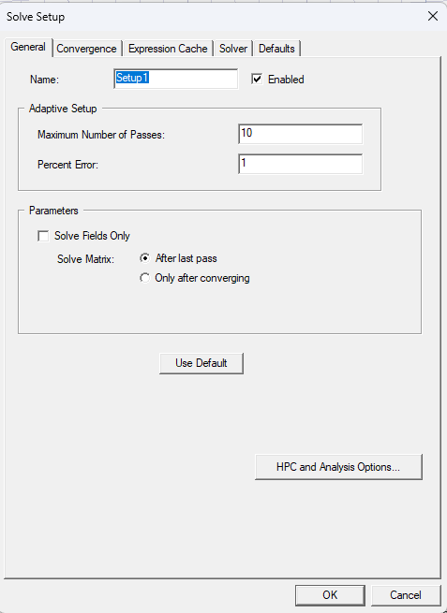
Step 6: Solution Setup
Select and Right+Click
Click on OK The default simulation setup is sufficient for this problem

Slide 31
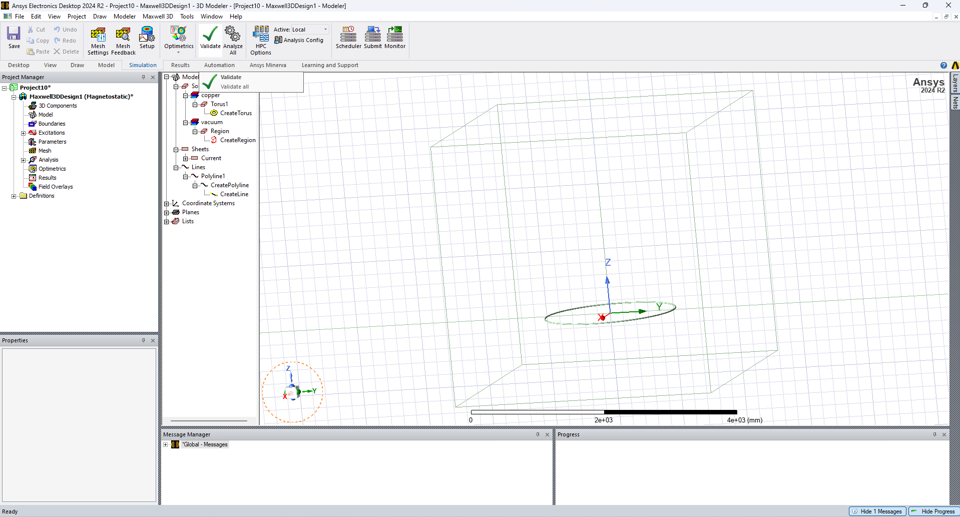
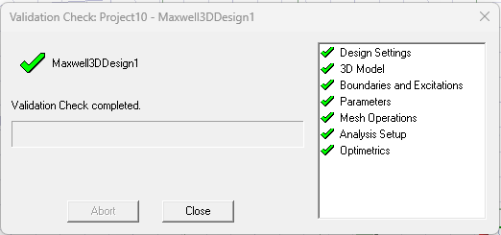
Step 7: Simulation Validation
(2)
(1)
Ensure that there are no errors in the simulation
If there are any errors, recheck the previous steps

Slide 32
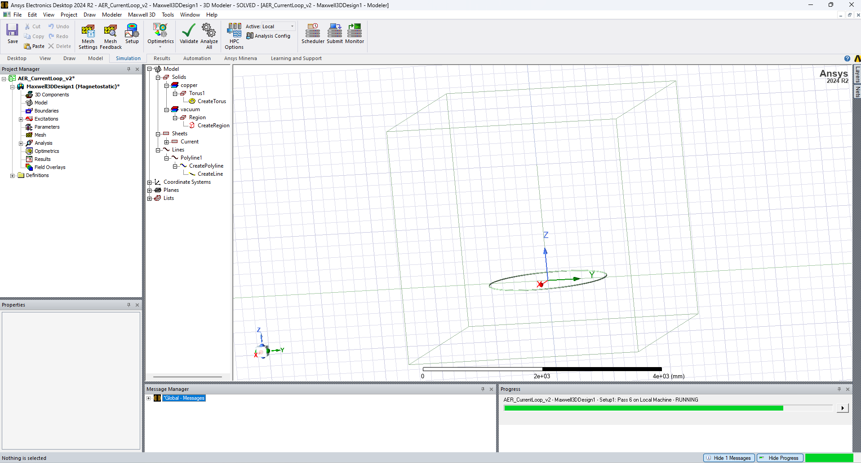
Step 8: Running the simulation
Finally, analyze the design

Slide 33
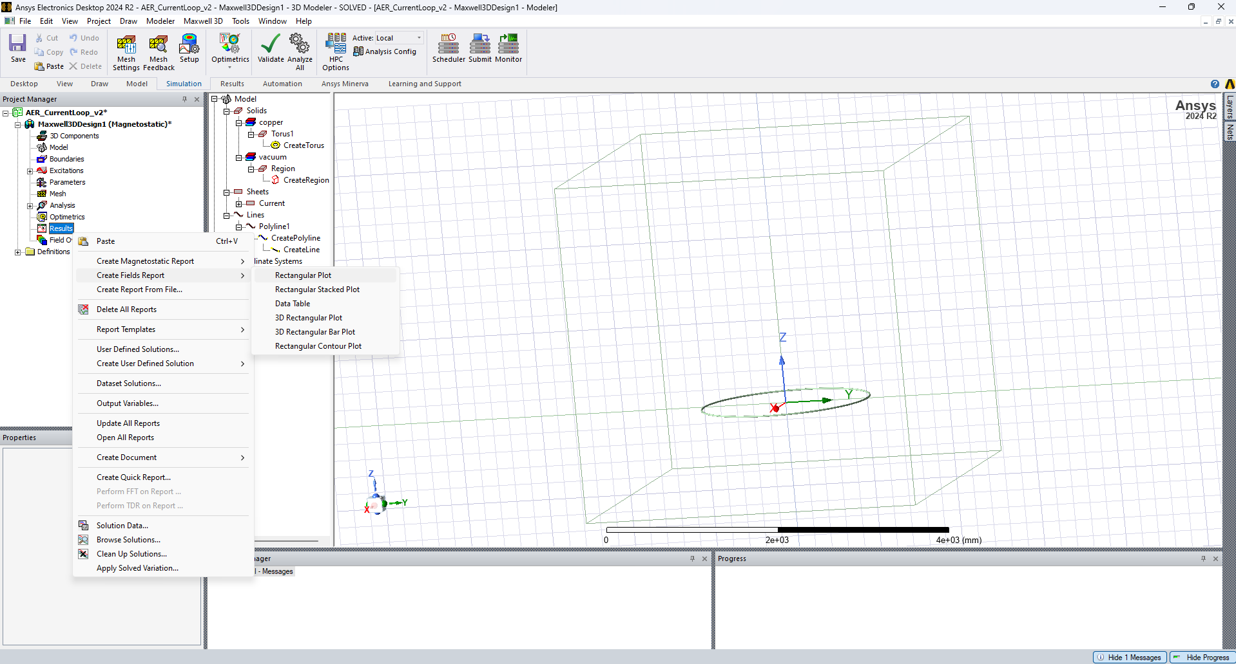
Step 9: Plotting the Results
Right+Click

Slide 34
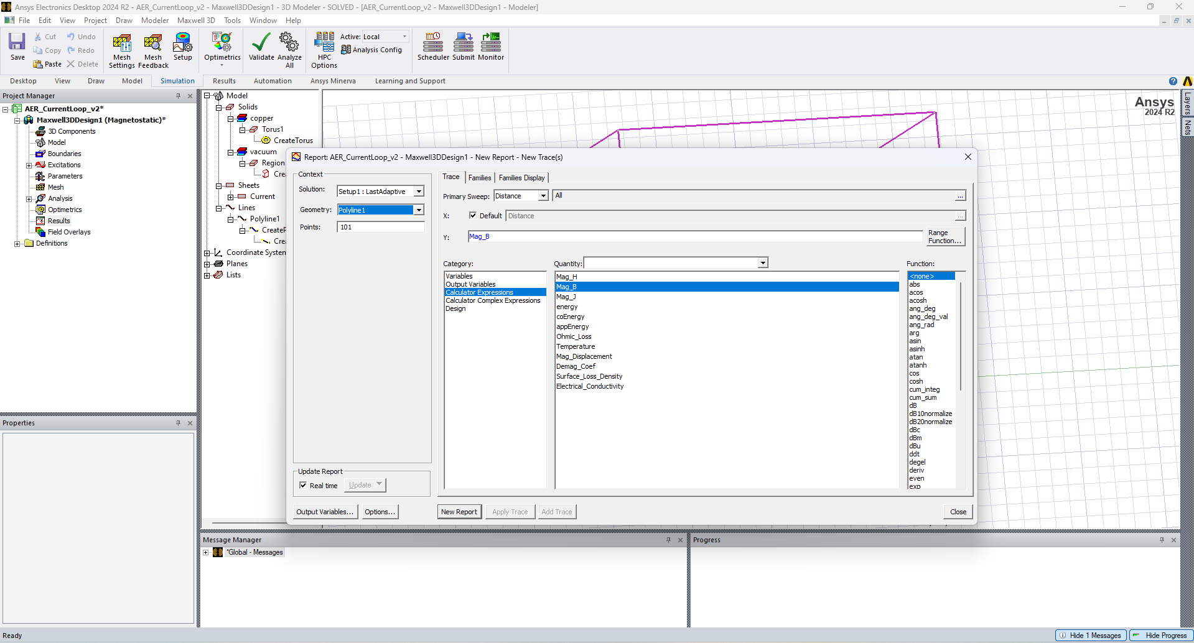
Step 9: Plotting the Results
Select the line we drew earlier
We will be plotting B field

Slide 35
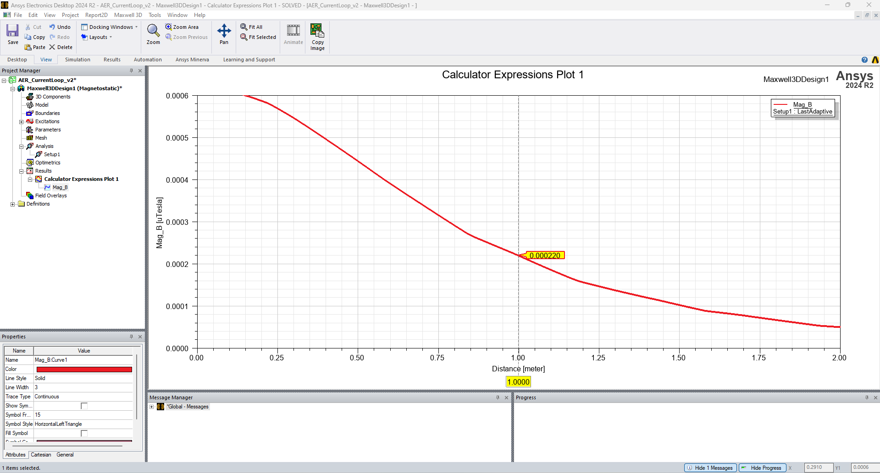
Step 9: Plotting the Results
Note: For the marker Right+Click -> X Marker You can drag it with your mouse along the X axis

Slide 36
Validation step
Does this value match your theoretical calculations?

Slide 37
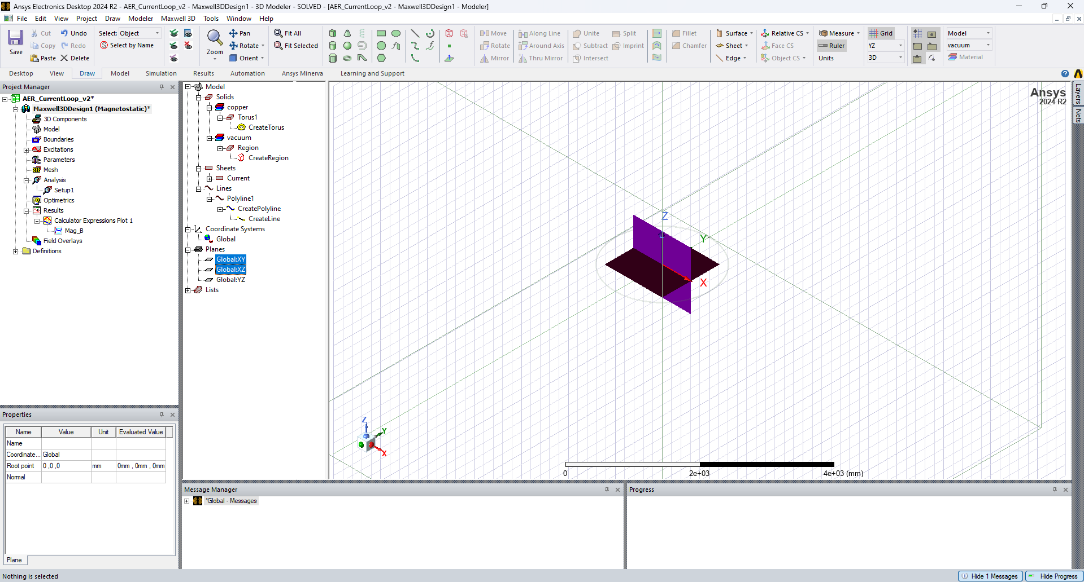
Step 10: Plotting the magnetic field
Select the planes:
-Global: XY
-Global: XZ

Slide 38
Step 10: Plotting the magnetic field
Right+Click

Slide 39
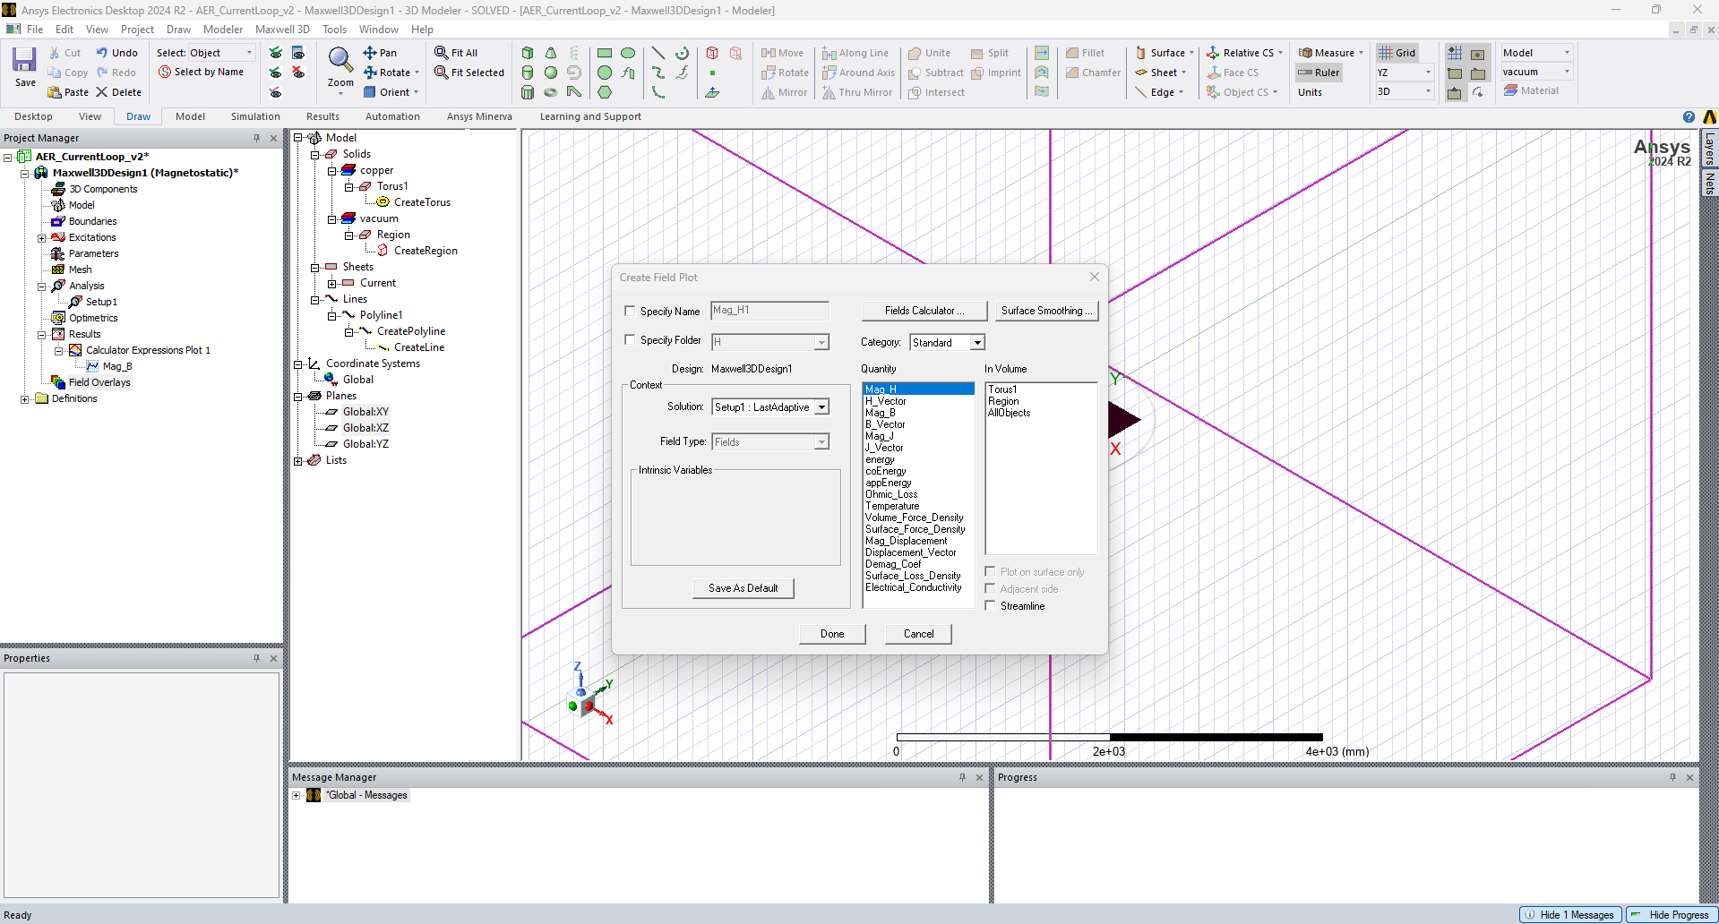
Step 10: Plotting the magnetic field
Select Mag_H and click on Done

Slide 40
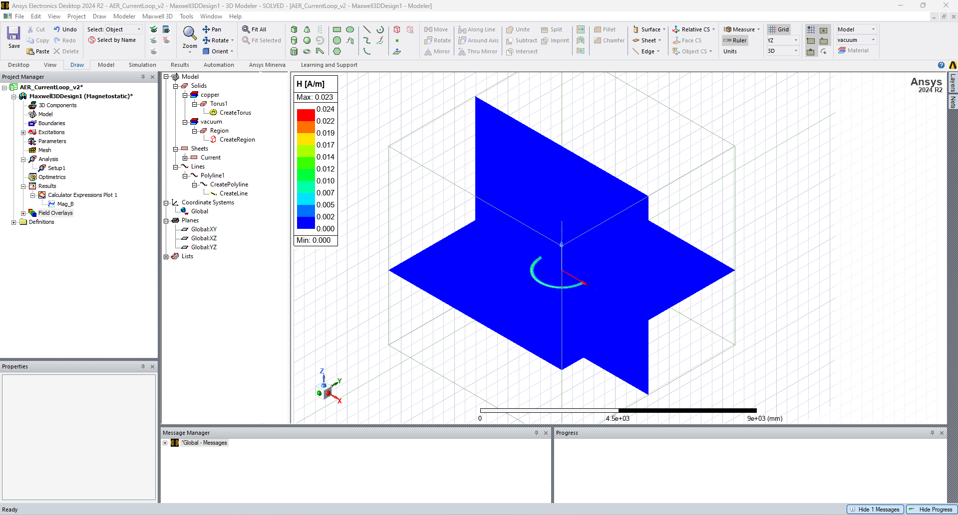
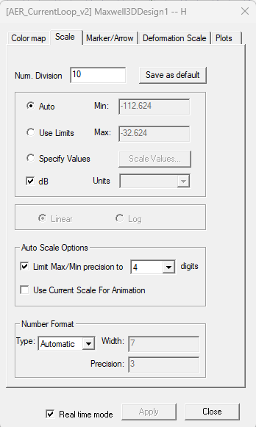
Step 10: Plotting the magnetic field
(1) Double-click on the color scale
(2) Select dB

Slide 41
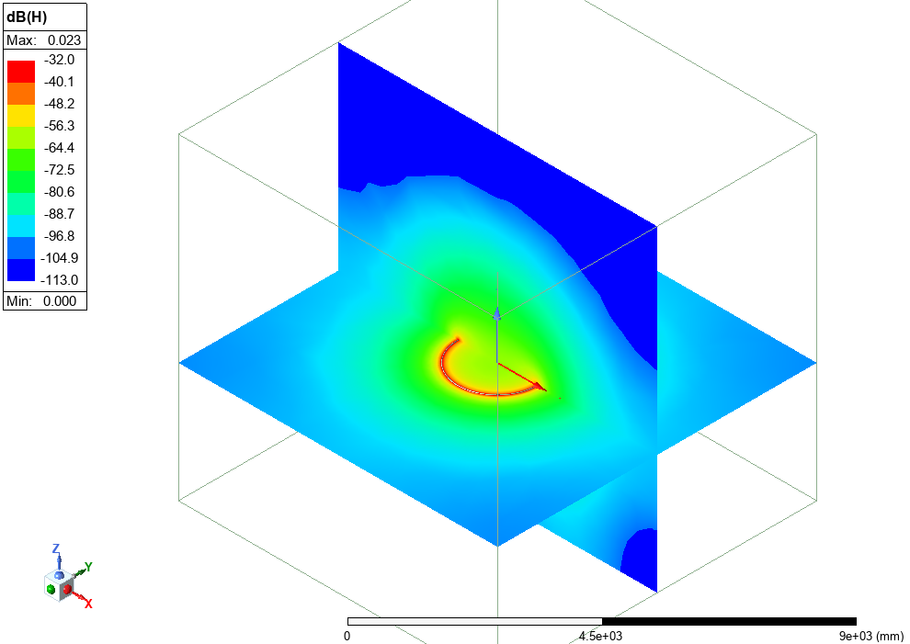
Step 10: Plotting the magnetic field

Slide 42
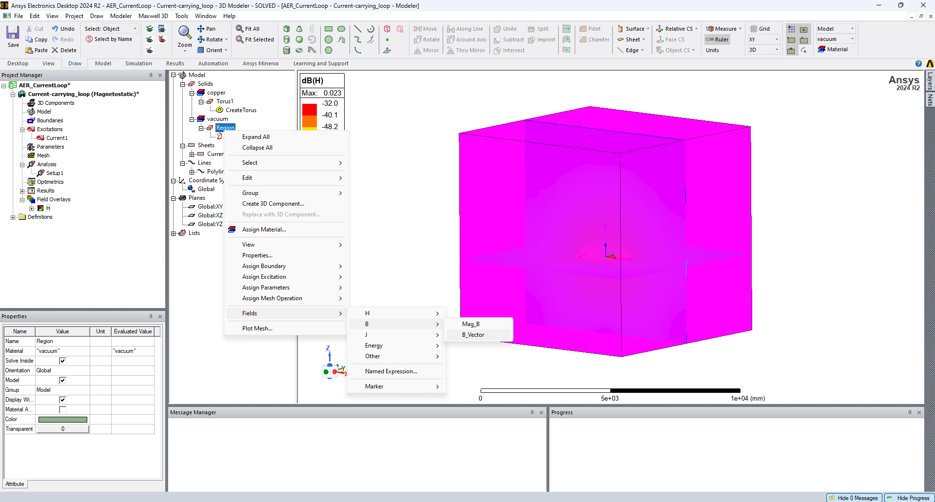
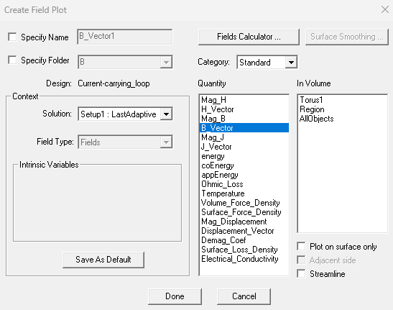
Step 10: Plotting the magnetic field
Select the vacuum Region and Right+Click
Select B_Vector and click on Done

Slide 43
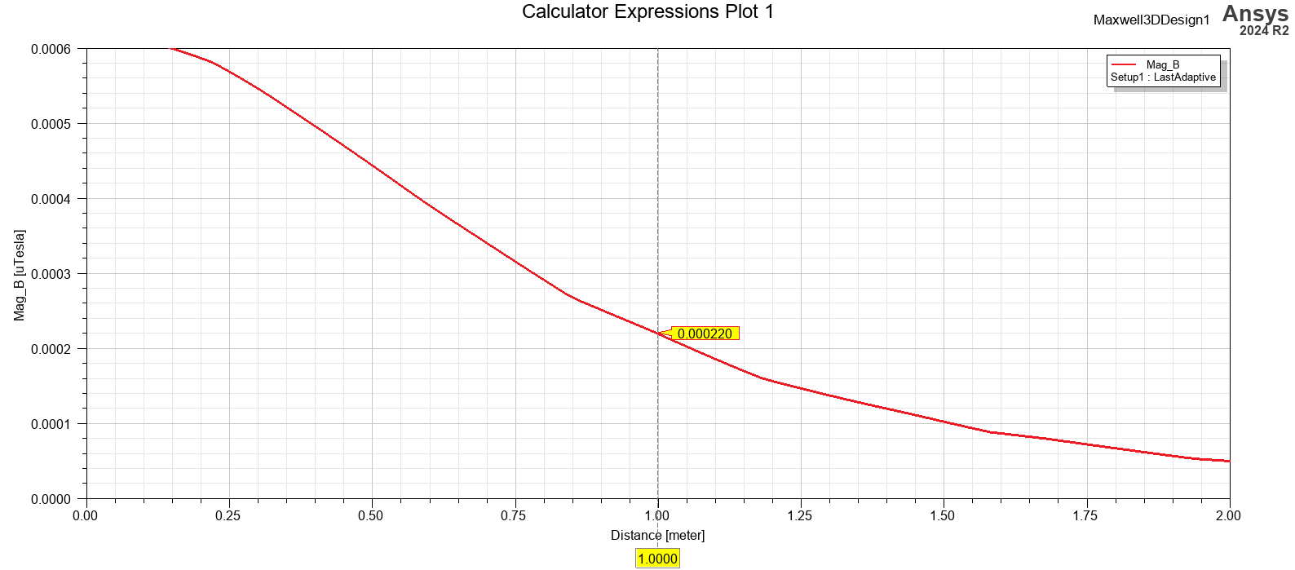
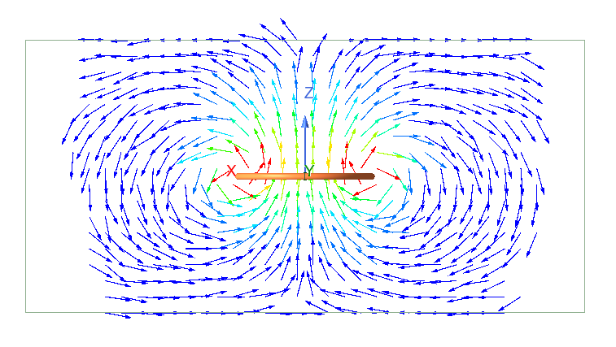
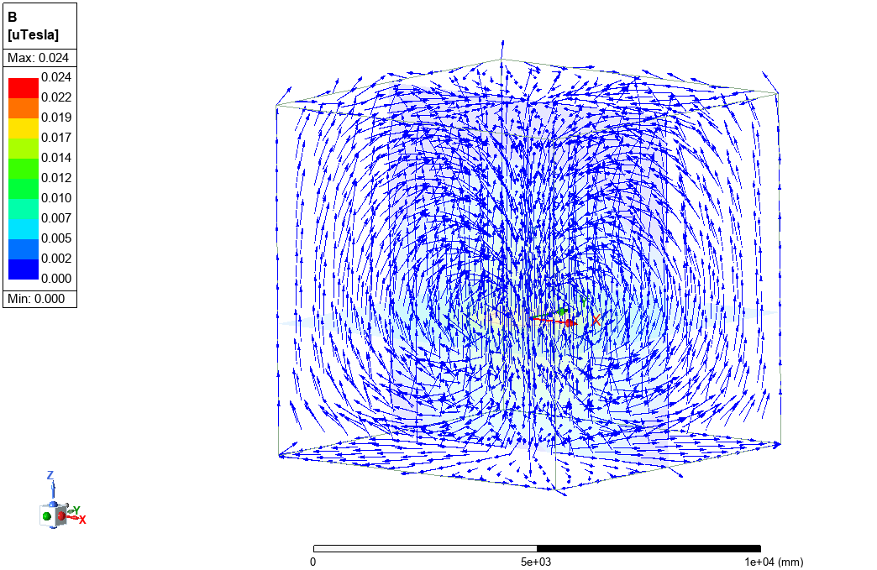
Results – Magnetic field created by a current loop
From theoretical derivations: $B=0.0022 μT$
In a current-carrying loop, the magnetic field lines form concentric circles around the conducting wire, in accordance with the right-hand rule.
Analytic results validated through simulation

Slide 44
Ansys Education Resources Feedback Survey
Here at Ansys, we rely on your feedback to ensure the educational content we create is up-to-date and fits your teaching needs.
Please click the link below to fill out a short survey (~7 minutes) to help us continue to support academics around the world utilizing Ansys tools in the classroom.
Feedback Survey Link
Notes:
Feedback Survey link for copy-paste method → https://ansys.typeform.com/to/jcattJI5

