Slide 1
Lab Tutorial on Communication example using Ansys HFSS™ SBR+ Simulation
Dimitris Tzagkas Celia Gomez Molina
education@ansys.com

Slide 2
Received Power for Comms scenario
Assumptions:
Tx and Rx Antennas are impedance-matched
Tx and Rx Antennas are polarization-matched
Tx and Rx Antenna radiation efficiency $e_{r}$ is 1
Transmitter Antenna
Receiver Antenna
$S_{i}→Power Density \left[W/{m^{2}}\right]$
$P_{i}→$ $Power at antenna feed [W]$
$D_{i}→$ $Antenna Directivity$
$A_{i}→$ $Effective Antenna aperture \left[m^{2}\right]$
$G_{i}→$ $Antenna Gain$
$e_{i}→$ $Antenna efficiency$
$R_{i}→$ $Range [m]$
Propagation path
Transmitter system
Receiver system
$$P_{t}$$
$$P_{r}$$
$$P_{r}=e_{r}{ A}_{r} S_{t} \left[W\right] (1)$$
$${→P}_{r}=e_{r} \frac{λ^{2}}{4π} D_{r}\frac{1}{4πR^{2}} P_{t}G_{t}$$
$$S_{t}=\frac{P_{t}}{4πR^{2}}G_{t}\left(θ,φ\right) [W/{m^{2}}]$$
$${→P}_{r}={\left(\frac{λ}{4πR}\right)}^{2}P_{t}G_{t} (e_{r}D_{r})$$
Friis Transmission Equation
where
$$A_{r}=\frac{λ^{2}}{4π}D_{r}\left(θ_{r},φ_{r}\right) [m^{2}]$$
$$P_{r}={\left(\frac{λ}{4πR}\right)}^{2}P_{t}{ G}_{t}(θ_{t},φ_{t}) G_{r}(θ_{t},φ_{t}) [W]$$
$$G=e D$$
Notes:
In this slide you can see the equations used to reach the Friis equation. The equations use the transmit power, the power density and the antenna parameters such as the gain (G) and the directivity (D).

Slide 3
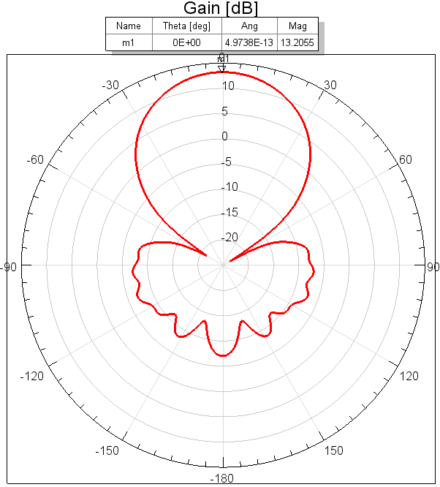
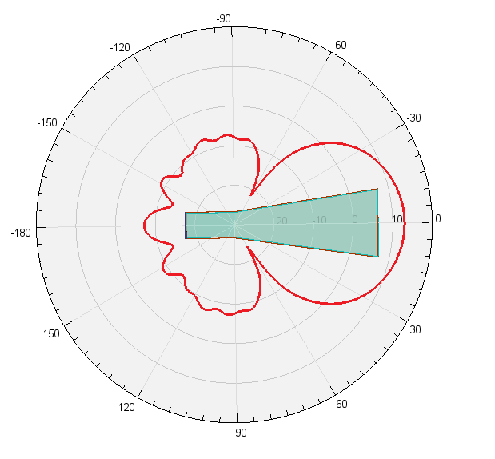
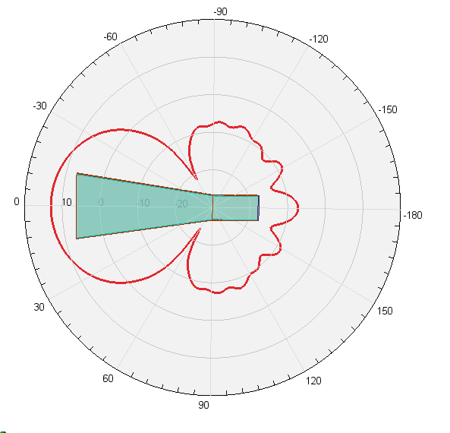
How to simulate the setup with Ansys HFSS SBR+
This tutorial uses Ansys HFSS™, the high-frequency electromagnetic simulation software
Parameters used:
Antenna model(s) in HFSS
Identical Horn Antenna at $f_{c}=2.4 GHz$,
with efficiency $e_{r}=1$,
with maximum gain at boresight of 20.92 (13.2 dB),
excitation power $P_{t}=1W$
Link and Setup configuration
Identical horn antennas for transmitter and receiver,
Antennas are aligned facing each other at maximum gain angle (boresight),
Variable distance between them R ,
Tx
Rx
R

Slide 4
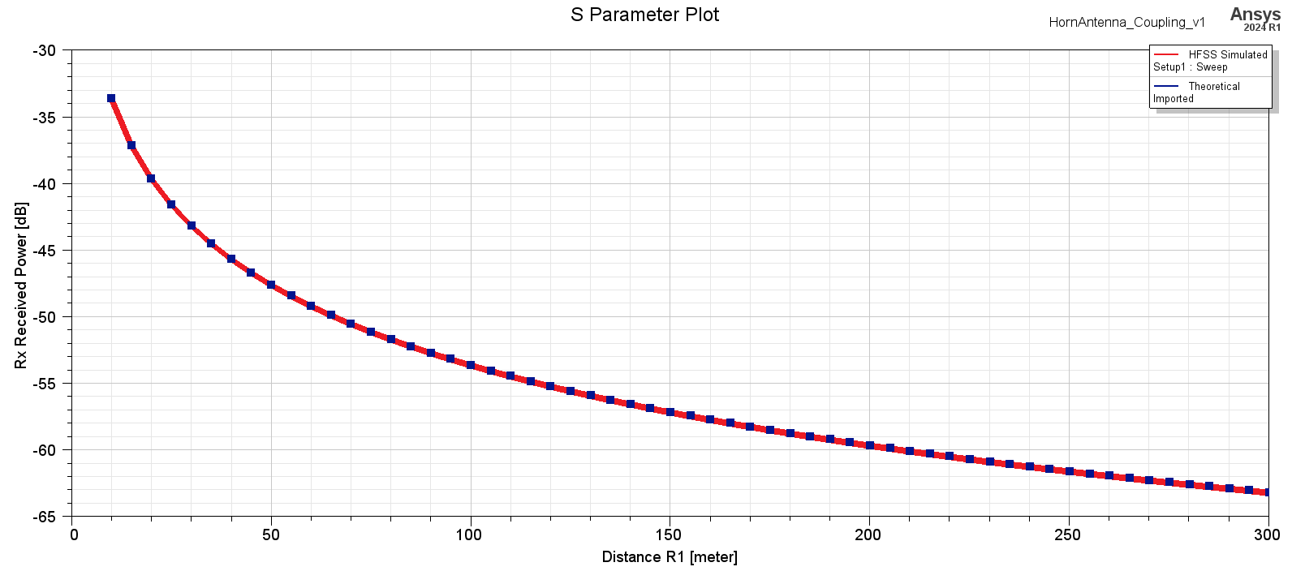
Friis equation scenario implemented in Ansys HFSS software
Antenna Coupling depending on the distance between the Tx and Rx antennas
Example visualization

Slide 5
How to create a communication scenario in Ansys HFSS Software

Slide 6
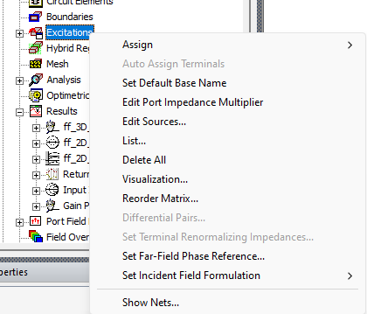
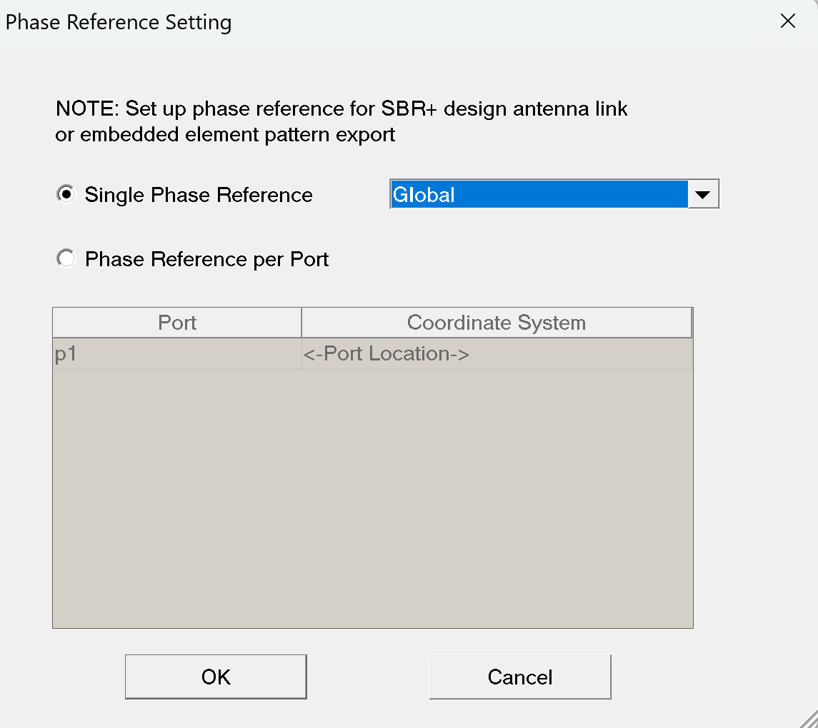
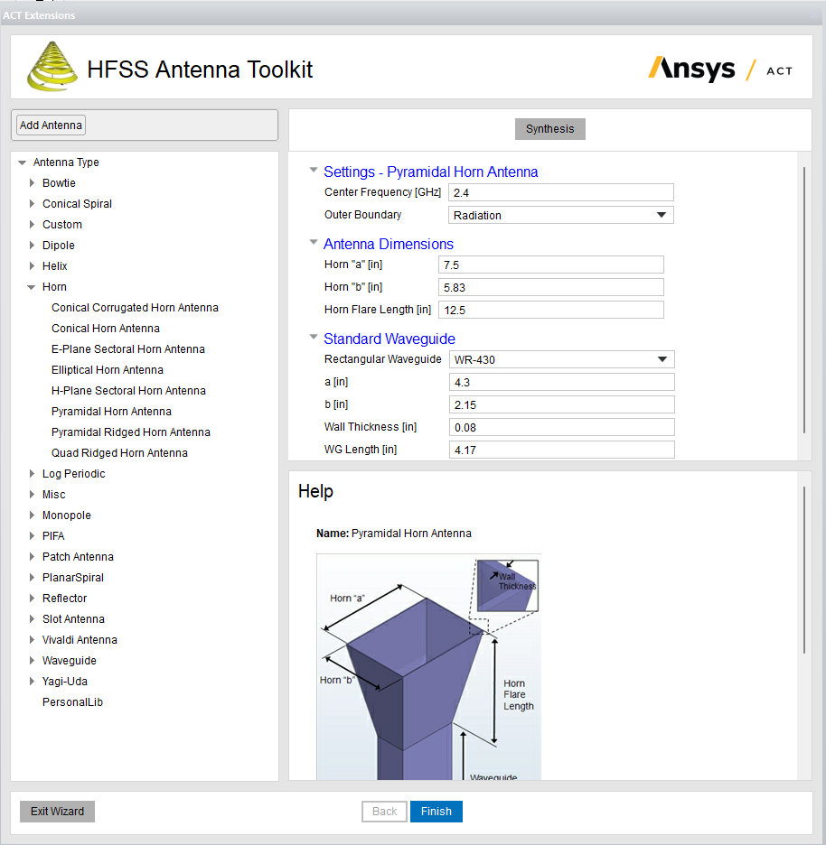
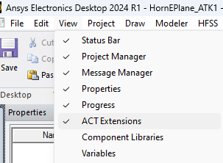
Antenna Design
Use an existing antenna OR generate using the ACT Antenna Toolkit in Ansys HFSS View→ ACT Extensions → Launch Wizards →HFSS Antenna Toolkit → Any Antenna needed → Set parameters→ Synthesis → Finish The example next uses a pyramidal Horn Antenna at 2.4 GHz center frequency.
Excitations (right click) → Set Far-Field Phase Reference..
And then set a Far-Field Phase Reference point for the antenna.

Slide 7
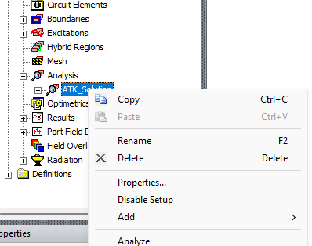
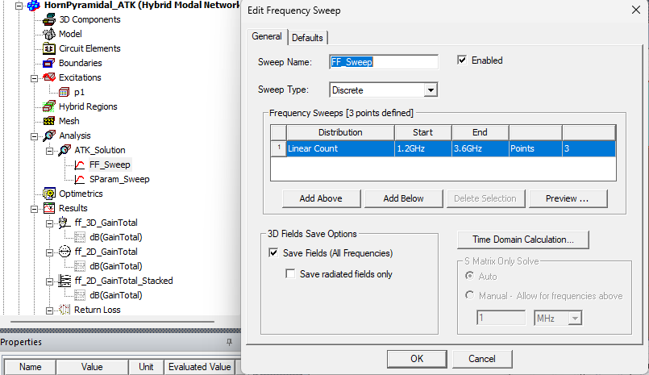
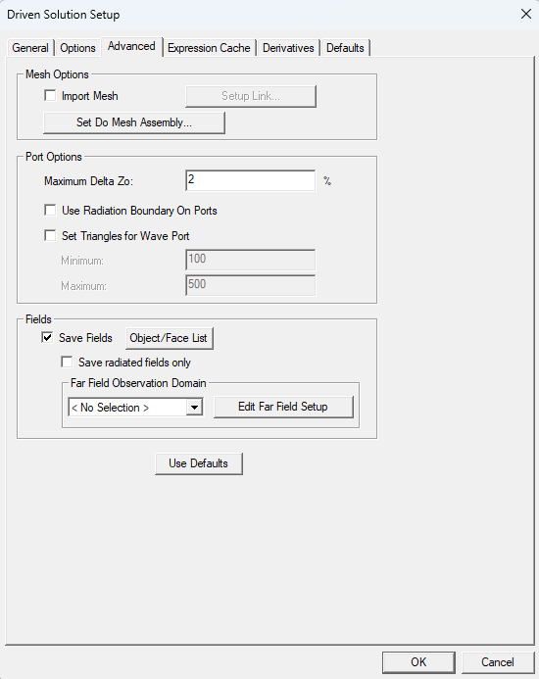
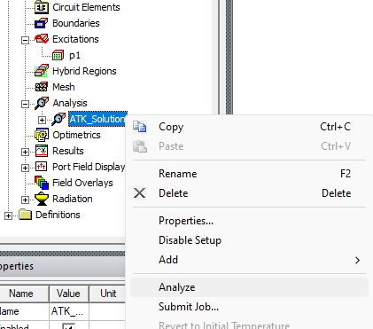
Analyze Antenna
Make sure Save Fields is checked…… Setup Freq Sweep ... and… Analyze
Step B
Step C
You can set sweep to specific frequencies OR even a single specific frequency
Step A

Slide 8
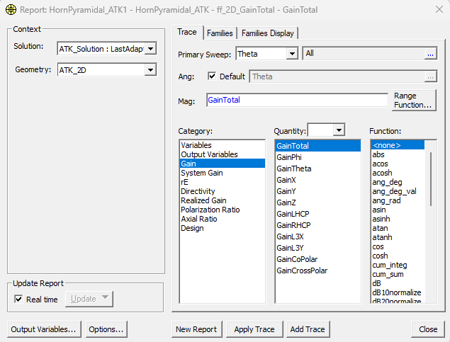
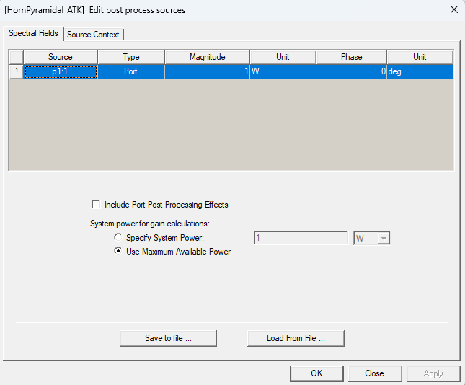
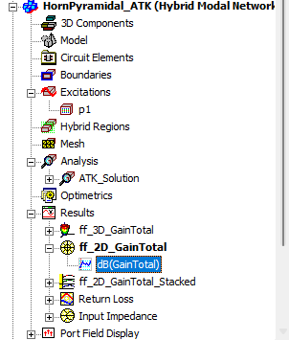
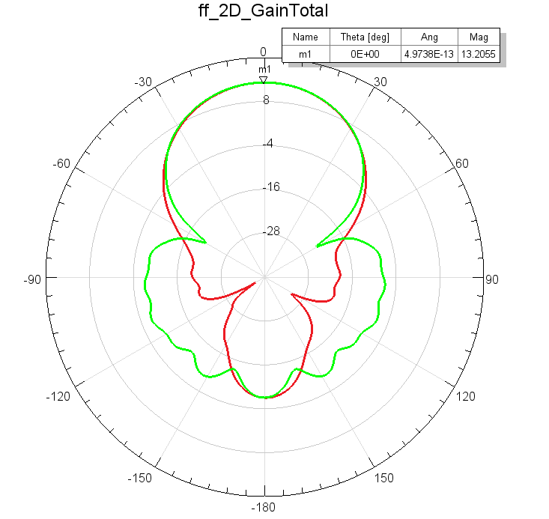
Antenna Parameters extraction
From Excitations we can set the input power [1 W in this case]
From Results we can get the Total Gain [20.9 or 13.2 dB]

Slide 9
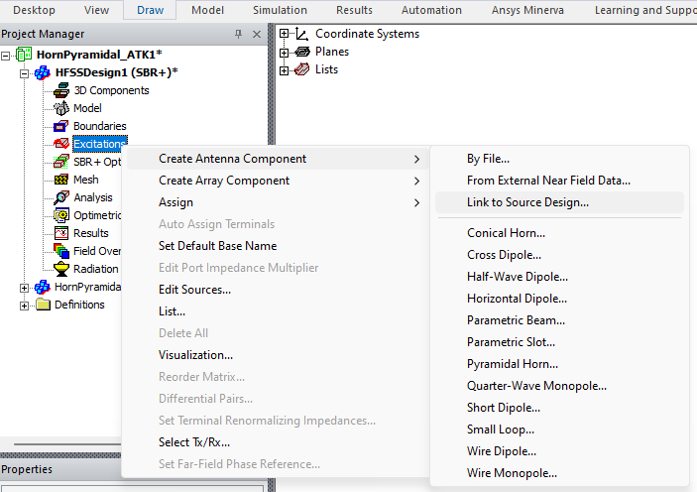
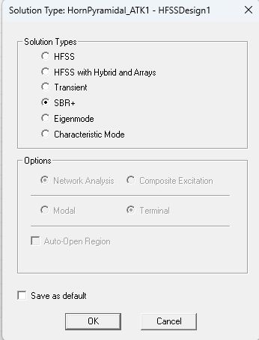
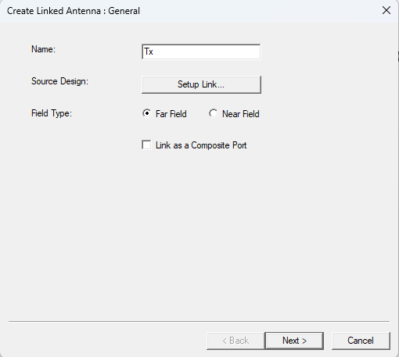
Setting Up the System Setup
Create Antenna Component via Link to Source Design..
Create New HFSS Design
Change Solution Type to SBR+
Name Appropriately the Antenna

Slide 10
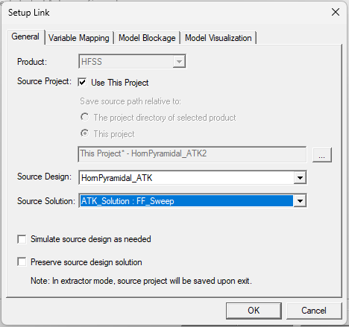
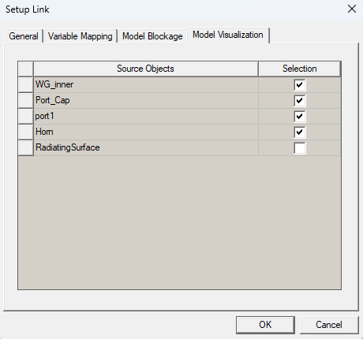
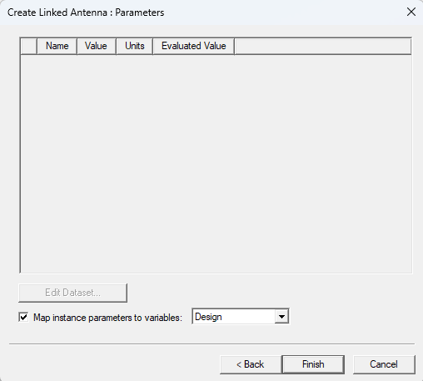
Setup Link – Working in the SBR+ design now
OK, Next and Finish
General Tab
Model Visualization Tab
Make sure you choose the correct Sweep

Slide 11
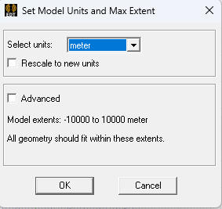
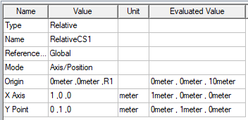
Before Linking Receiver Antenna …
Change Units to appropriate scale..
Add parametric Relative Coordinate System ..
You can add the Relative CS anywhere and then modify the attributes as shown below
* R1 = 10 meter

Slide 12
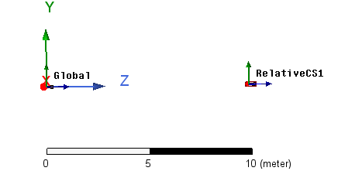
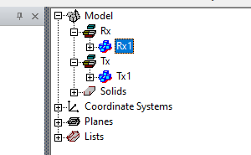
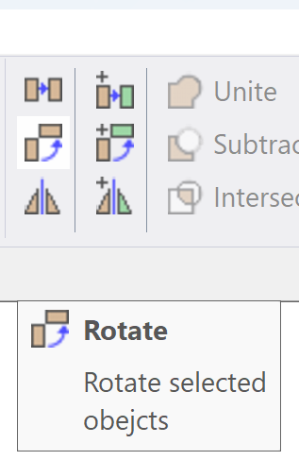
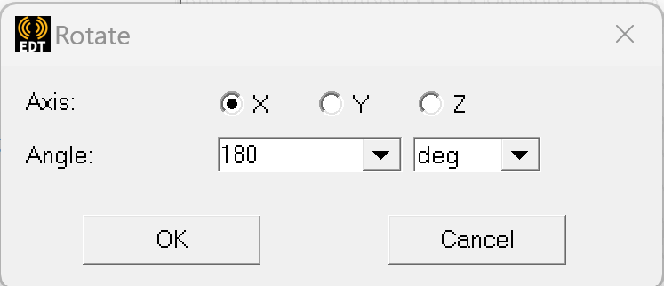
Adding the Receiver Antenna Instance
Select the RelativeCS1 and then add the receiver antenna (Rx) as a Link to Source Design shown previously When done → you will get the below setup
Select the Rx antenna and then rotate
Rotate antenna by 180 deg
Make sure the antennas are facing each other..

Slide 13
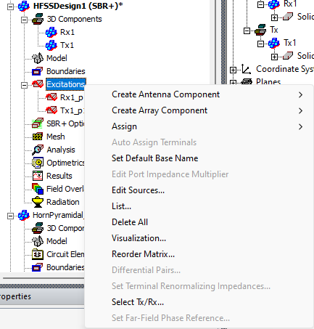
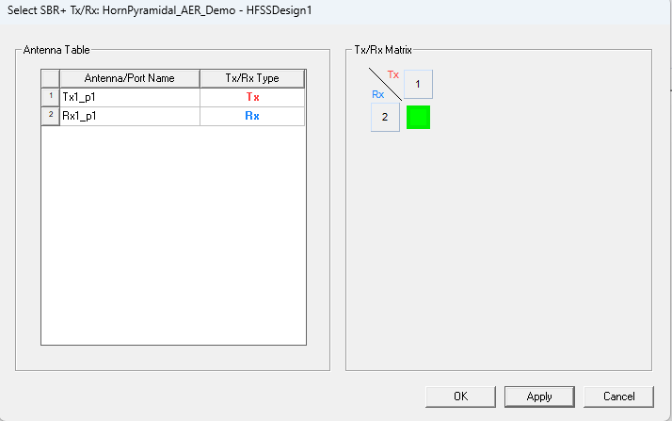
Assign Tx and Rx behaviors
Assign port and behavior type as shown below

Slide 14
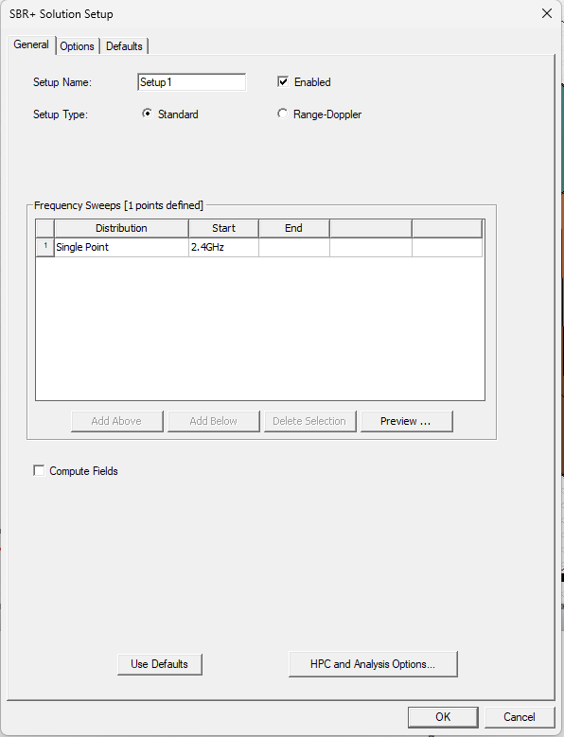
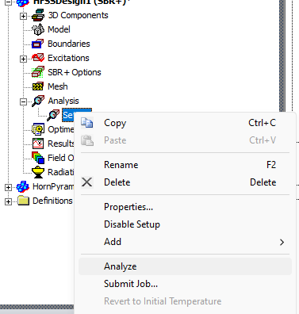
Setup Analysis and Run Analysis
Error?? Check next slide

Slide 15
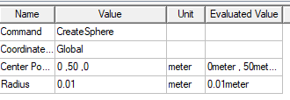
Important note!
A model/component should exist in SBR+ design… So for an antenna coupling example, a simple model is required.. Thus, we add a very small sized sphere very far away from the setup..
e.g.
Try to Analyze again now!

Slide 16
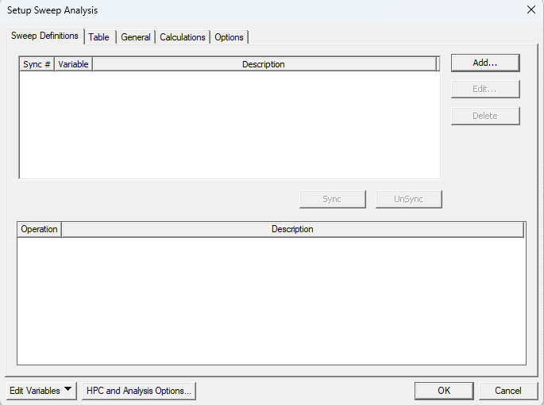
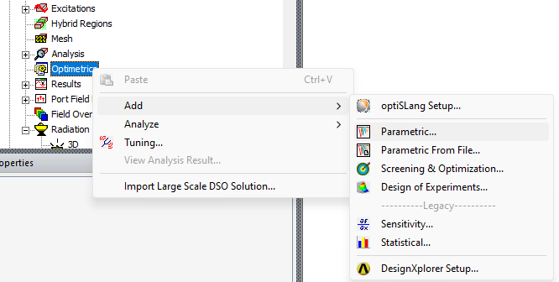
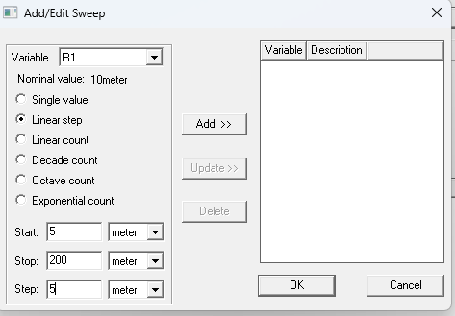
Analyze for different distance R1
Add Parametric setup for R1
You can define the start/stop/step accordingly. More steps mean more simulation time

Slide 17
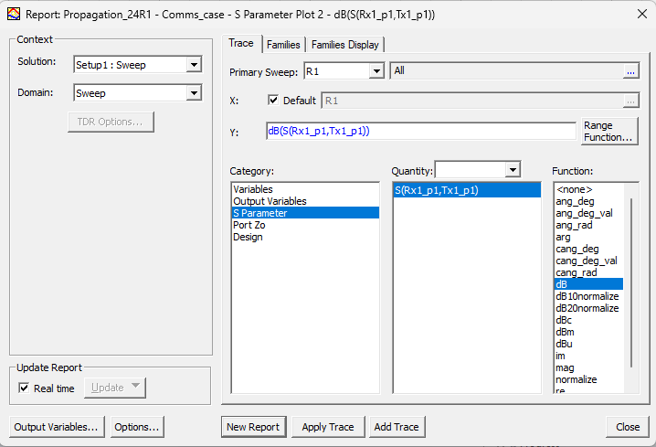
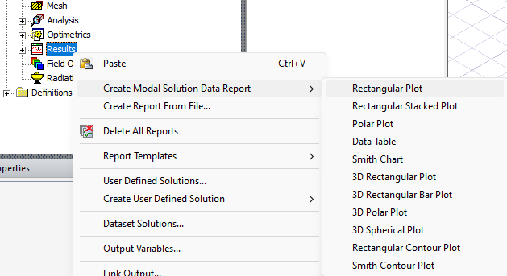
Plotting results

Slide 18
Results – Compared to calculated Friis equation (imported)
Antenna Coupling depending on the distance between the Tx and Rx antennas
Example visualization
Notes:
For a side by side comparison you can export the simulation data OR import the calculated theoretical data in order to compare the simulated and calculated data in a single graph. In this example the calculated data are imported in HFSS

Slide 19
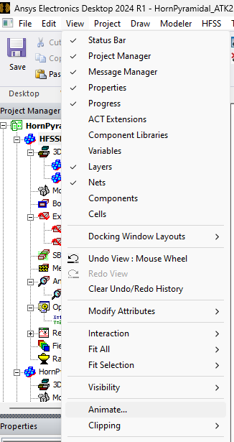
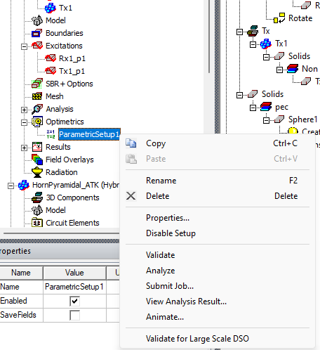
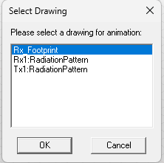
Creating animated picture
OR
THEN

Slide 20
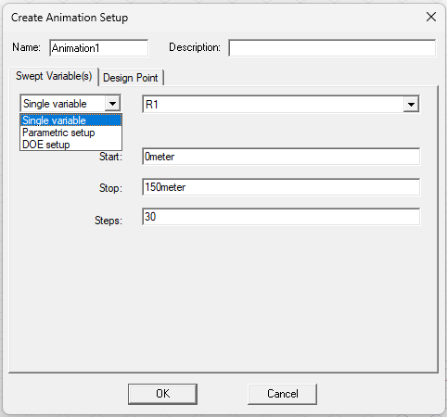
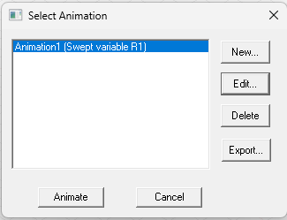
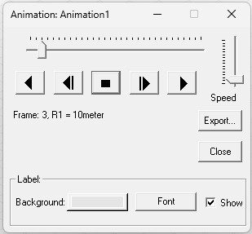
Creating animated picture
Setup animation and steps
Export (*.avi OR *.gif file)
Animate

Slide 21
Ansys Education Resources Feedback Survey
Here at Ansys, we rely on your feedback to ensure the educational content we create is up-to-date and fits your teaching needs.
Please click the link below to fill out a short survey (~7 minutes) to help us continue to support academics around the world utilizing Ansys tools in the classroom.
Feedback Survey Link
Notes:
Feedback Survey link for copy-paste method → https://ansys.typeform.com/to/jcattJI5

