Slide 1
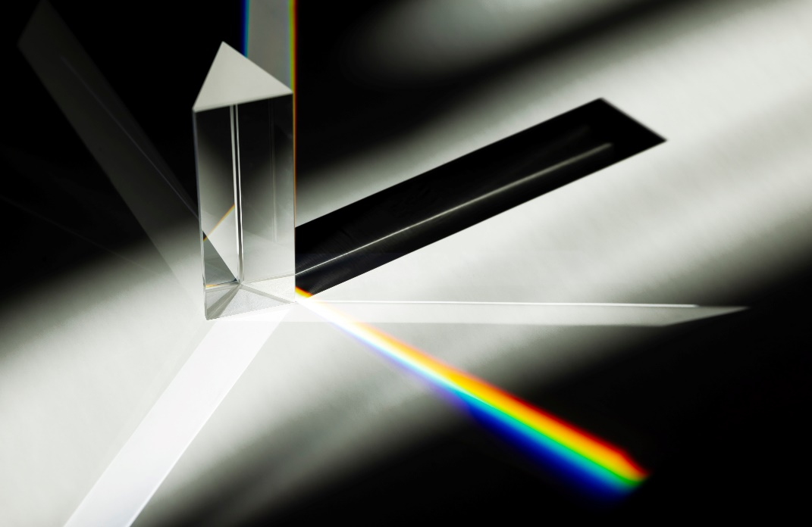
Lecture Unit
Introduction to Optics
Developed and curated by the Ansys Academic Development Team
Harriet Parnell
education@ansys.com

Slide 2
Learning objectives
Ansys software mentioned | Ansys Lumerical FDTDTM, an advanced 3D electromagnetic FDTD simulation software Ansys Zemax OpticStudio®, an optical system design and analysis software Ansys Speos®, an optical illumination design and simulation software Ansys Granta EduPackTM, a Set of teaching resources to support materials education
Intended Learning Outcomes
Knowledge and Understanding | Distinguish between the wave and particle nature of light and explain how these properties influence its behavior.
Skills and Abilities | Analyze the function of optical components, such as lenses, mirrors, and gratings, and predict their effect on light propagation.
Values and Attitudes | Explain the role of simulation tools in optimizing the design of optical systems.
Resources
Suggested reading: Pedrotti, F. L., Pedrotti, L. M., & Pedrotti, L. S. (2017). Introduction to Optics (3rd ed.). Cambridge: Cambridge University Press.
Further reading/information
Ansys Academic Ansys Innovation Courses Ansys Education Resources

Slide 3
Outline of lecture unit
Introduction to Optics
Section 1: Science of light
Section 2: Behavior of light
Section 3: Optical components
Section 4: Simulation tools in optics

Slide 4
Introduction
Exploring the science of light
What is light?
Notes:
Introduction
Light is unlike anything else in your day-to-day experience. It cannot be touched, and for the most part, it cannot be felt. But without it, there would be no life on earth.
Its existence gives us a daily sunrise and sunset. In stormy weather we see the flash of a lightning bolt, or a colourful rainbow. At night we may see the delights of a shooting star, or, if fortunate, the aurora borealis.
Its enigmatic nature has captivated humanity for millennia, sparking endless inquiry and fascination.
Today, we are fully immersed in technology that has benefited from years of scientific study. With just a quick scroll on your phone, you've already experienced the delights of LEDs and fiber-optic communications. Healthcare has advanced with light-based medical imaging, while industries increasingly adopt sustainable solutions such as solar energy.
But what is light? And how can we use it?

Slide 5
Historical understanding
Exploring the science of light
While early civilizations will have used light in various ways, the evolution of our understanding can be broadly split into four distinct eras.
Ancient Greeks
(circa 800 BC to 200 AD)
Islamic civilization
(circa 750 AD to 1200s)
Europeans
(circa 1300s to 1800s)
Modern era
(circa 1900s to present)
The Ancient Greeks focused on geometric theories, laying the groundwork for concepts like reflection and rays. Islamic civilization advanced early optics, delving into refraction and magnification. Europeans transitioned to wave theories, with Huygens and Young making significant contributions. In the modern era, quantum theories emerged, elucidating phenomena like the photoelectric effect and the particle-like nature of light.
Our perception of light has evolved significantly throughout history, in most part, fueled by our desire to answer the question: what is light?
Notes:
A short history of our understanding
Humans have been fascinated by light for millennia. While our understanding of it has evolved significantly, it remains incomplete.
For a more comprehensive history, you can explore the following sources: Zubairy, M.S. (2016). A Very Brief History of Light. In: Al-Amri, M., El-Gomati, M., Zubairy, M. (eds) Optics in Our Time. Springer, Cham. ISBN 978-3-319-31903-2

Slide 6
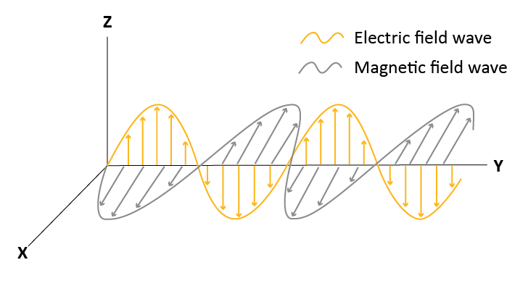
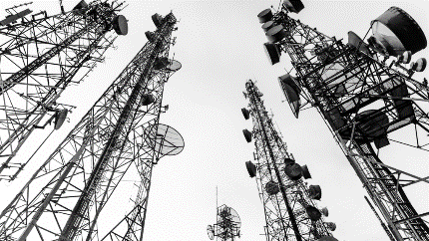
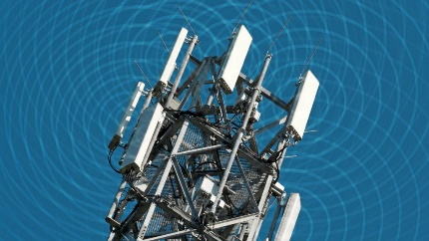
What is light?
Exploring the science of light
Light is an electromagnetic wave that consists of oscillating electric and magnetic fields that propagate perpendicularly to each other and to the direction of the wave's travel.
Ansys Innovation Course:
Electromagnetic Wave Propagation
Ansys Innovation Course:
Electromagnetic Plane Waves
Notes:
Light as an electromagnetic wave
Light is an electromagnetic wave which radiates at various wavelengths.
James Clerk Maxwell stumbled upon this discovery while investigating the equations of electricity and magnetism. He observed that their combined equation resembled wave equations, and further noted that the wave's speed closely matched the measured speed of light, c, approximately 3 ×10⁸ m/s.
You can learn more about electromagnetic wave in the linked Ansys Innovation Courses.

Slide 7
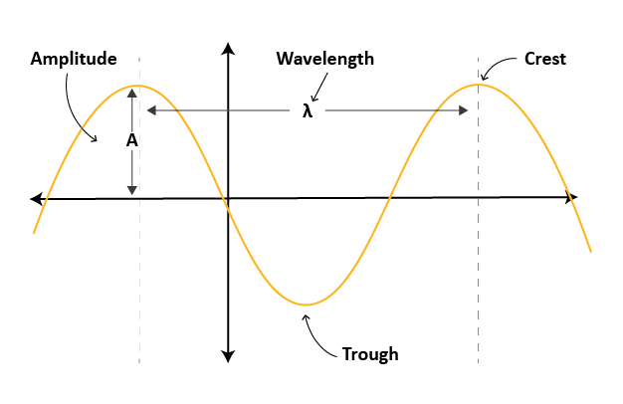
Wave elements
Exploring the science of light
Although not a true representation of an electromagnetic wave, the generic wave structure seen here can be useful for labelling the most important features of a wave.
Elements are defined below.
Element | Symbol | Units | Definition
Wavelength | λ | nm, μm | The distance between two consecutive crests
Frequency | f | Hz | How many wavelengths pass through a given point over time
Period | T | s | The inverse of frequency; how much time it takes for one wavelength to pass a particular point
Amplitude | A | nm, μm | Maximum displacement of a wave from its neutral rest position
Phase velocity | v | m/s | The rate at which a wave propagates through a medium
Crest |  |  | Sinusoidal maxima
Trough |  |  | Sinusoidal minima
Notes:
Characteristic wave elements
Knowing the characteristic elements of a wave provides a foundation for understanding the behavior of light and for designing and using optical systems and instruments. It also forms the basis for understanding many of the phenomena observed in the study of optics, some of which will be discussed later in this lecture.

Slide 8
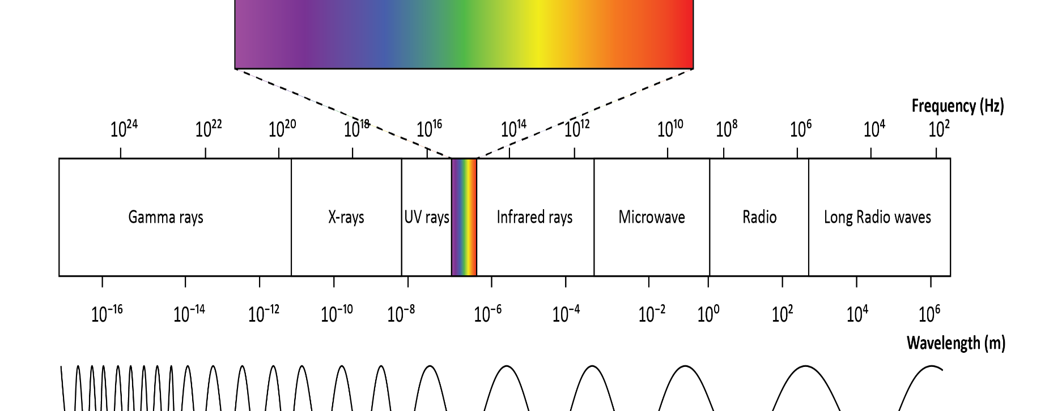
Electromagnetic spectrum
Exploring the science of light
Electromagnetic waves extend much beyond what we can see.
As demonstrated by Maxwell, when observed in a vacuum, all forms of electromagnetic radiation travel at the speed of light (3 x 10⁸ m/s).
The fundamental relationship between these properties is expressed in the wave equation c = λf. Where c = speed of light (m/s); λ = wavelength (meters); and f = frequency (Hz).
Notes:
Electromagnetic spectrum
Light, as we perceive it, is just a small portion of a larger continuum known as the electromagnetic spectrum.
This spectrum encompasses all types of electromagnetic radiation from gamma rays to long radio waves. Organized by wavelength and frequency, visible light is located between ultraviolet and infrared radiation, spanning approximately 400 nm to 700 nm.

Slide 9
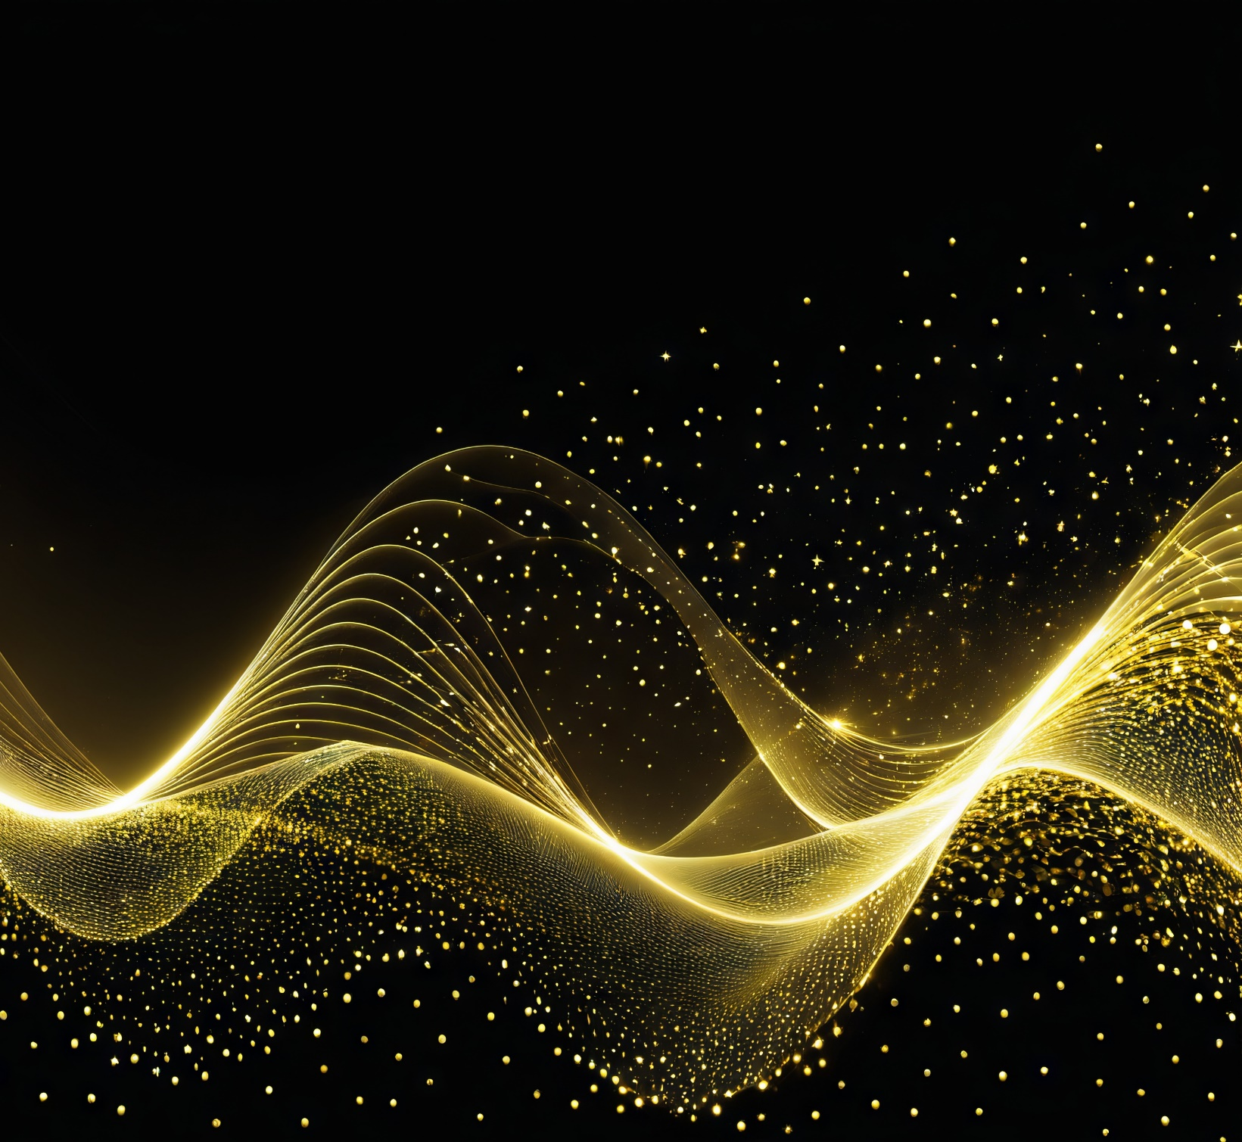
Duality of light
Image created with AI
Exploring the science of light
So light is a wave? Yes and no.
Light, as a form of electromagnetic radiation, exhibits wave-like behavior. However, as we shall explore in the next slide, historical observations also reveal its particle-like nature.
We refer to this as the wave-particle duality of light.
These seemingly contradictory models have sparked a grand debate, what is the true nature of light?
A question that remains partially unanswered to this day.
Notes:
Wave-particle duality of light
The duality of light refers to its nature as both a wave and a particle. This concept, known as wave-particle duality, suggests that light can exhibit properties of both waves and particles depending on the experimental context. This duality is fundamental to understanding phenomena in optics and quantum mechanics, and it plays a crucial role in the development of theories and technologies in these fields.

Slide 10
Historical understanding
Exploring the science of light
Date | Scientist | Theory supported | Explanation
1680 | Isaac Newton | Particle | Light casts sharp shadows of objects, in contrast to water and sound waves.
1690 | Christian Huygens | Wave | Speculated on the existence of some invisible medium - an ether. Derived the laws of reflection and refraction. Idea of secondary spherical wavelets from first wave points.
1800 | Thomas Young | Wave | Decisive double-slit experiment. Skip to Ansys demonstration (1) and (2).
1821 | Augustin Fresnel | Wave | Described diffraction and polarized light phenomenon. Developed Fresnel equations.
1860s | James Clerk Maxwell | Wave | Maxwells equations predicted that the speed of an electromagnetic wave was that of measured speed of light.
1900 | Max Planck | Particle | Derived the correct blackbody radiation spectrum from assumption that light emitted discrete energy chunks. Quanta and quantum mechanics was born.
1905 | Albert Einstein | Particle | Explanation of the photoelectric effect, where light acts as a stream of light quanta with energy related to frequency by Planck’s equation.
1913 | Niels Bohr | Particle | Explanation of the emission and absorption process of hydrogen atom.
1922 | Arthur Compton | Particle | Demonstrated the scattering of X-rays by electrons, showing particle-like collisions between the two.
1924 | Louis de Broglie | Wave | Speculated that subatomic particles can have wave properties. Demonstrated by Clinton Davisson, Lester Germer and Sir George Thomson with diffraction of a beam of electrons.
Notes:
Is light a particle or wave?
Our understanding of light has evolved significantly over time. In the 17th century, Christian Huygens proposed the wave theory of light, explaining phenomena like reflection and refraction. However, Isaac Newton's particle theory, which viewed light as a stream of particles, was also influential. In the 19th century, experiments by Thomas Young and Augustin-Jean Fresnel provided strong evidence for the wave nature of light through interference and diffraction patterns. The 20th century brought the discovery of the photoelectric effect by Albert Einstein, which demonstrated that light also behaves as particles, or photons. This dual wave-particle nature of light is now a fundamental concept in quantum mechanics.
The true nature of light is still not completely understood. Best explained by Einstein: “All the 50 years of conscious brooding have brought me no closer to the answer to the question: What are light quanta?”
For a more comprehensive review of the historical milestones, refer to:
Zubairy, M.S. (2016). A Very Brief History of Light. In: Al-Amri, M., El-Gomati, M., Zubairy, M. (eds) Optics in Our Time. Springer, Cham. https://doi.org/10.1007/978-3-319-31903-2_1
Pedrotti, F. L., Pedrotti, L. M., & Pedrotti, L. S. (2017). Introduction to Optics (3rd ed.). Cambridge: Cambridge University Press.

Slide 11
Three fields of study
Exploring the science of light
Geometrical Optics:
Studies light as rays and describes how it propagates through lenses, mirrors, and other optical elements by focusing on the paths of light. This field is applied at macroscopic scales, where the wavelength of light is much smaller than the dimensions of the optical elements involved. Geometric optics is crucial for designing practical optical systems such as telescopes, microscopes, and cameras, where light can be accurately modeled as rays.
Wave (Physical) Optics:
Describes light as electromagnetic waves and explains phenomena like diffraction, interference, and polarization, which are crucial for understanding and designing optical devices such as gratings, spectrometers, and interferometers. It becomes important when dealing with phenomena at the scale of the wavelength of light, where the wave nature of light is significant.
Quantum Optics: (not covered here)
Explores the quantum properties of light, such as its quantization into photons and interactions with matter at the microscopic level. It involves phenomena like photon entanglement, quantum superposition, and interactions with atoms and molecules. This field is essential for advanced technologies such as quantum computing, communication, and precise measurements.
Notes:
Main branches of optics
This lecture unit will primarily focus on geometric and wave optics. While quantum optics is an advanced and fascinating field with significant implications for fields like quantum computing and quantum information science, it is beyond the scope of this introductory course. Therefore, we will not be discussing quantum optics in this lecture unit, but it is a topic you may encounter in more advanced courses.

Slide 12
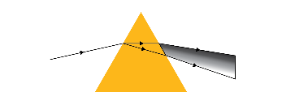
How does light travel
Light Behavior
There are several standard light behaviors which are critical to understand in order to create a functional optical system. Browse through the following slides or use the interactive links below to navigate quickly.
Color boxes indicate behaviors that fall under geometric and wave optics.
Reflection
Refraction
Diffraction
Young’s Double Slit Experiment
(with two Ansys Examples)
Dispersion
Polarization
Interference
Notes:
Light behaviors
Use this slide to navigate through some of the standard light behaviors.

Slide 13
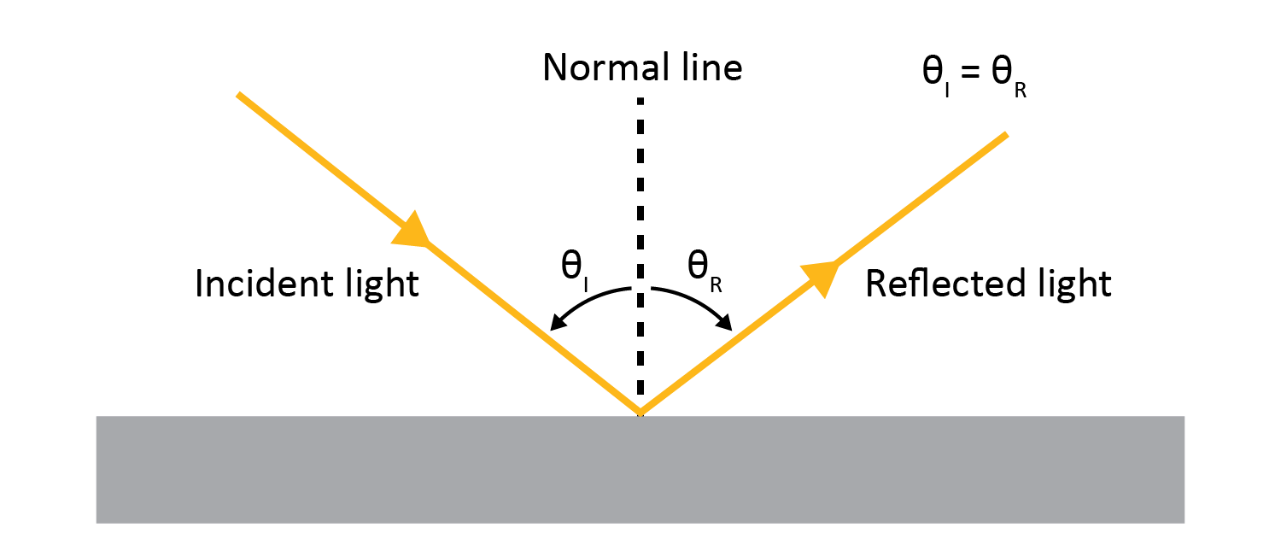
Reflection
Human Factors: Unwanted Reflections
Light Behavior
Reflection: is the redirection of light rays when encountered by an interrupting surface. It is the simplest method for changing which direction light travels in.
Law of reflection: when rays are reflected, the angle of reflection is equal to the angle of incidence θ _{I} = θ _{R}
This is shown below for a single ray approaching the surface. The standard convention for describing ray orientation relative to a surface is by measuring the angle relative to a line called the surface normal, which sits perpendicular to the substrate’s surface.
Continued >>
Notes:
Reflection (slide 1 of 2)
Here the basic concept of reflection is introduced which is a fundamental behavior of light. Reflection occurs when light rays bounce off a surface. The Law of Reflection states that the angle of incidence (the angle at which the incoming ray hits the surface) is equal to the angle of reflection (the angle at which the ray bounces off). This principle applies to all reflective surfaces, regardless of their material. The accompanying diagram illustrates this concept clearly, showing the incident ray, the reflected ray, and the normal line, which is perpendicular to the reflective surface at the point of incidence. Understanding this basic principle is essential for grasping more complex optical phenomena.
Learn More with Ansys: reflected light is not helpful. Using this case study, understand how to assess the common unwanted reflections found on the windscreen reflected from the Instrument Panel (IP) Topper. Ansys Speos is used to introduce the Human Factor’s topic.

Slide 14
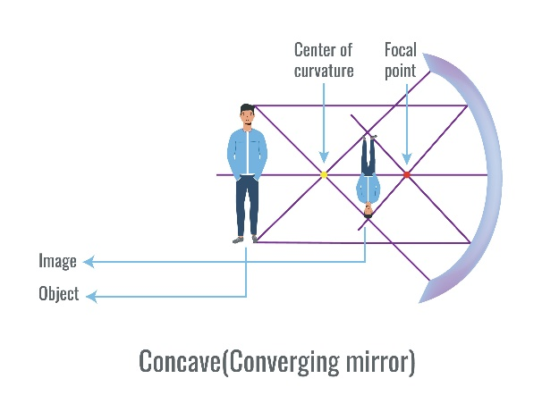
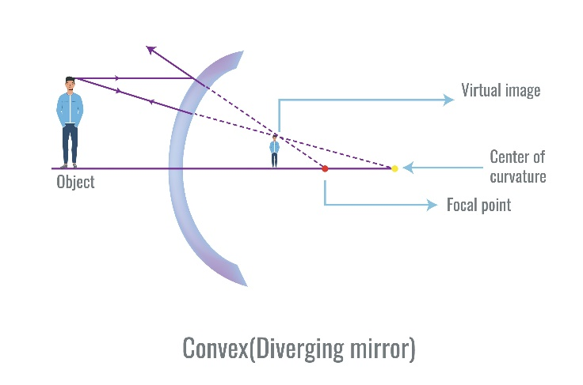
Reflection
Light Behavior
Surface shape:
Reflection also occurs at curved surfaces, like concave and convex mirrors, following the law of reflection.
Concave mirrors converge rays to a positive focal point, forming a real image, while convex mirrors make rays appear to converge to a negative focal point, forming a virtual image.
Concave mirrors are used in magnifying bathroom mirrors, while convex mirrors are used in side and rearview mirrors.
Multiple rays:
In most optical applications, multiple rays are present, including a set called parallel rays, where all rays travel in the same direction, such as sunlight.
A collection of rays will encounter two types of reflection:
Specular reflection: occurs when the surface is flat or smooth. An example would be a mirror.
Diffuse reflection: occurs when the surface is rough. An example would be the page of a book.
Notes:
Reflection (slide 2 of 2)
Here we explore how the shape of a surface—whether concave, convex, or flat—affects the reflection of light rays. For concave surfaces, which curve inward, incoming rays converge at a focal point after reflection, creating a ‘real’ image that can be projected onto a screen and typically appears inverted. Conversely, convex surfaces, which curve outward, cause rays to diverge as if they were emanating from a focal point behind the mirror, creating a ‘virtual’ image that cannot be projected onto a screen and typically appears upright.
We also discuss the difference between smooth (specular) and rough (diffuse) surfaces. Smooth surfaces reflect light rays in a uniform direction, maintaining the angle of reflection, whereas rough surfaces scatter light in many directions due to their irregularities.

Slide 15
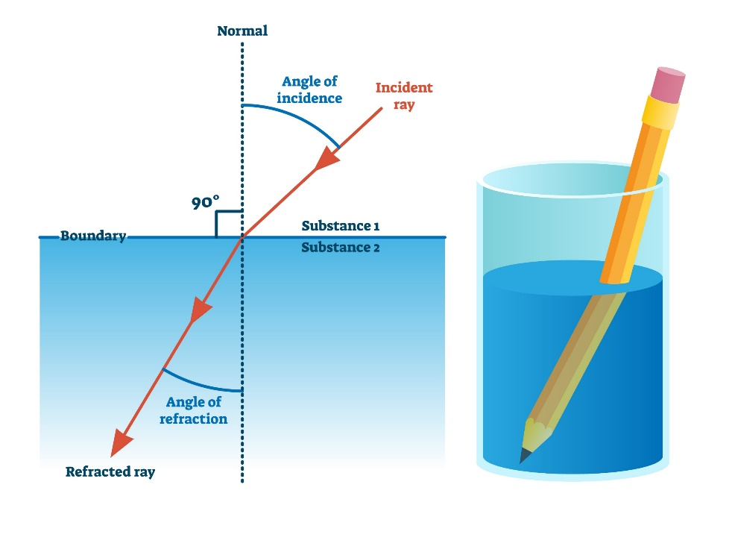
Refraction
Spatially varying refractive index due to strain
Light Behavior
Refraction: is the bending of light as it passes between transparent media. The amount of refraction depends on the refractive index and the angle of incidence, as described by Snell's Law.
Refractive index (n): n= c/v
a dimensionless value which dictates how fast or slow light will travel through a medium where c is speed of light and v is phase velocity.
Law of refraction (Snell’s Law): n₁sin(θ₁)= n₂sin(θ₂)
demonstrates the relationship between refractive index and the angle which rays will make to the normal line in different medium;
n₁ and n₂ are the refractive indices of the first and second medium, respectively.
θ₁ is the angle of incidence.
θ₂ is the angle of transmission (the angle the refracted ray makes with the normal in the second medium).
Remember: Refraction ≠ Reflection
Continued >>
Notes:
Refraction (slide 1 of 2)
In this slide, we introduce refraction, which is the bending of light as it passes from one transparent medium to another. This occurs because light changes speed when it enters a medium with a different refractive index. The refractive index is a measure of how much light slows down in a medium. Snell's Law, which combines the refractive indices of the two media and the angle of incidence, determines the angle of refraction.
Refraction can be easily demonstrated with a pencil in water. At the water's surface, refraction causes the pencil to appear bent.
Learn More with Ansys: did you know that a material’s refractive index can be altered when under strain?

Slide 16
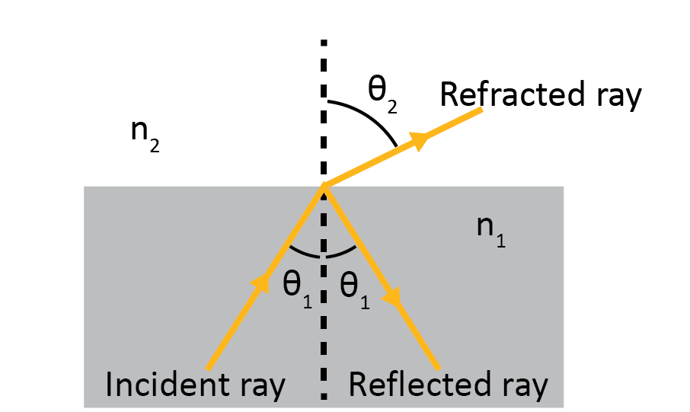
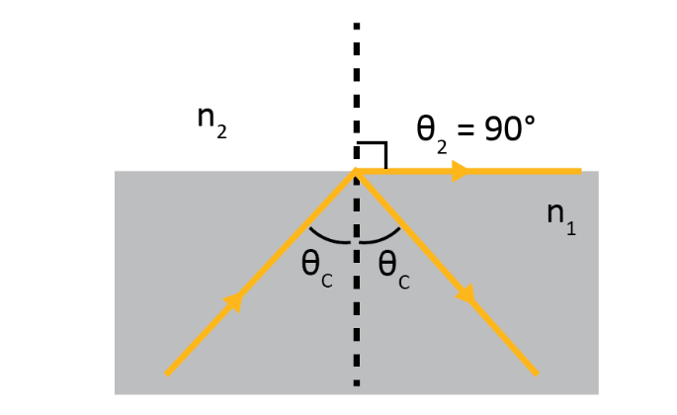
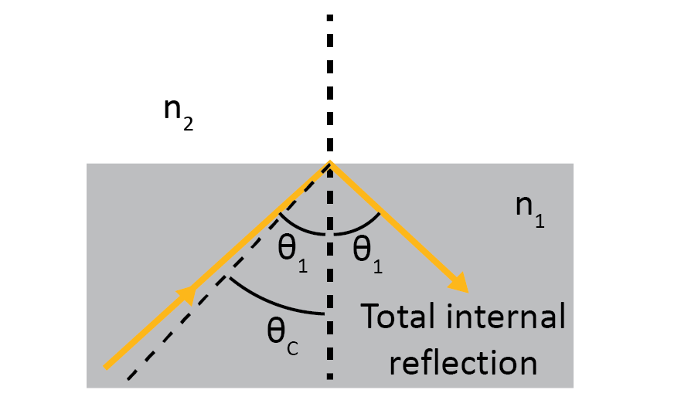
Refraction
Light Behavior
Total internal reflection occurs when a light ray traveling from a medium with a higher refractive index (n₁) to a medium with a lower refractive index (n₂), is completely reflected into the original medium. This happens when the angle of incidence exceeds a specific value called the critical angle.
Three scenarios are considered:
Incident ray is less than the critical angle (θ₁ < θ_{c}), it bends away from the normal and some portion of the light is reflected back into the original medium
Incident ray is equal to the critical angle (θ₁ = θ_{c}), light is refracted at an angle of 90°.
Incident ray is more than the critical angle (θ₁ > θ_{c}), total internal reflection occurs.
A useful application of this phenomena is fiber optics, where total internal reflection enables the transmission of light signals through thin, flexible strands of glass or plastic.
(1)
(2)
(3)
Notes:
Refraction (slide 2 of 2)
When light travels from a medium with a higher refractive index to one with a lower refractive index, it bends away from the normal. If the angle of incidence exceeds a certain threshold, known as the critical angle, the light is completely reflected back into the original medium, a phenomenon called total internal reflection. This principle is crucial in fiber optics and other technologies.

Slide 17
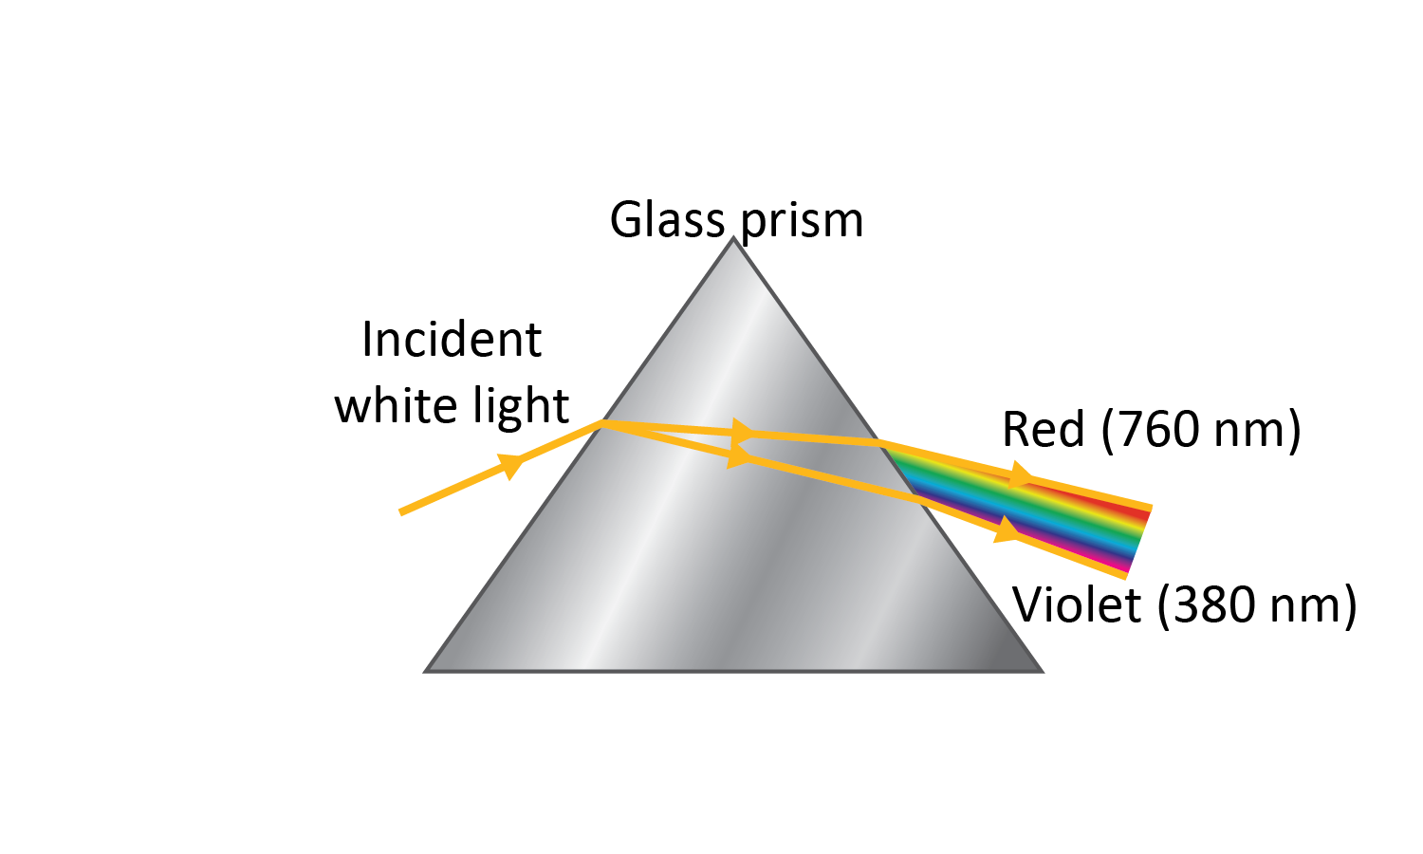
Dispersion
Light Behavior
Dispersion, the phenomenon responsible for rainbows observed through prisms, occurs when a light wave separates into its component colors as it travels through a material.
This specific type, known as chromatic dispersion, separates white light into its constituent colors because different wavelengths (colors) of light have slightly different refractive indices within the material. Consequently, these colors travel at varying speeds through the prism, causing the white light to split into its individual color wavelengths, creating the familiar rainbow effect.
Notes:
Dispersion
This slide explores the concept of (chromatic) dispersion, which is the separation of white light into its component colors as it passes through a medium. Dispersion occurs because different wavelengths of light travel at different speeds in a medium, causing them to spread out. This phenomenon is responsible for the formation of rainbows and the colorful patterns seen when light passes through a prism. The varying refractive index of the material with wavelength is a key factor in dispersion. Understanding dispersion is crucial for applications in spectroscopy, fiber optics, and the study of light behavior in different media.

Slide 18
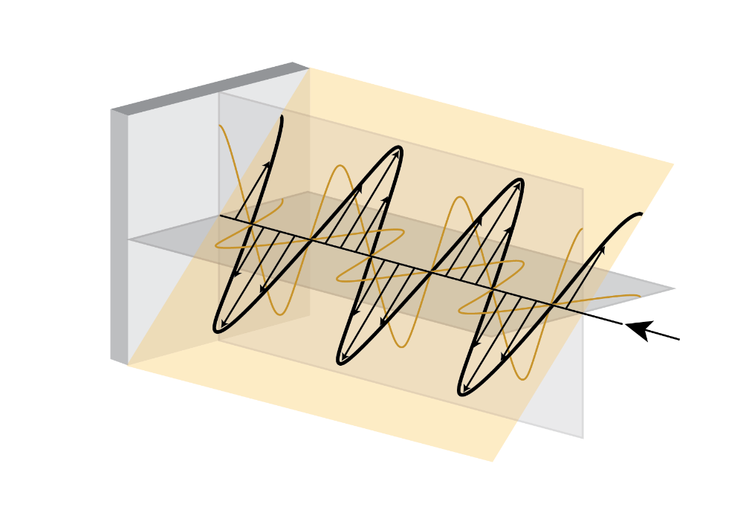
Polarization
Light Behavior
Polarization refers to the orientation of the electric field vector of a light wave.
As shown below, light waves can oscillate in multiple directions. Sunlight is a form of unpolarized light, consisting of waves vibrating in all possible directions perpendicular to their direction of propagation.
There are several ways to polarize light. Polarizing filters, or polarizers, are one such way and selectively transmit light waves with specific orientations while blocking others. This selective transmission makes polarized light useful in various applications, such as reducing glare in sunglasses and improving contrast in photography.
Multiple orientations of the electric field
Polarized light through a lens
Notes:
Polarization
Reminder: Light is a type of electromagnetic radiation that consists of a transverse wave with varying electric and magnetic fields that oscillate perpendicularly to the direction of propagation. Polarization refers to the orientation of the electric field.
You can polarize light through several methods:
Polarizing Filters: Passing light through a polarizing filter allows only waves vibrating in one plane to pass through.
Reflection: When light reflects off surfaces like water or glass, it becomes partially polarized parallel to the surface.
Scattering: Light scattered by particles in the atmosphere also becomes partially polarized, contributing to the blue sky's polarization.

Slide 19
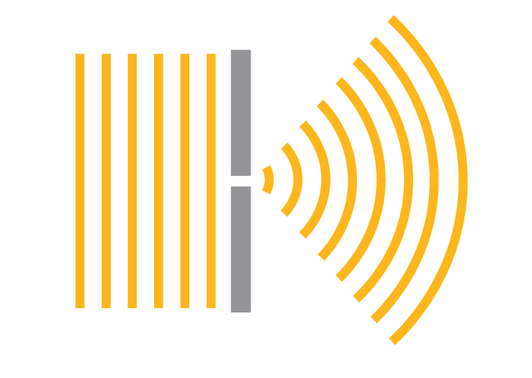
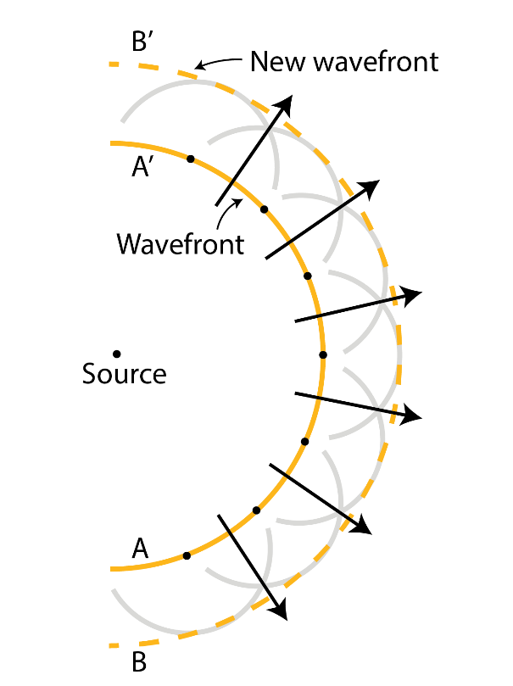
Diffraction
Light Behavior
Diffraction is the bending of light waves around obstacles or through narrow openings.
When light encounters an obstruction with dimensions comparable to its wavelength, it spreads out and forms patterns of alternating light and dark regions. This phenomenon explains why you can see light spreading around the edges of a shadow or the distinctive patterns when light passes through a narrow slit.
Huygens’s Principle: helps explain diffraction. It states that every point on a wavefront acts as a source of tiny wavelets that spread out in all directions at the same speed as the original wave. The new wavefront is the tangential line to all of these wavelets.
Notes:
Diffraction
Here the phenomenon of diffraction is explored.
Unlike refraction, which depends on the refractive index and involves light bending at an interface between two media, diffraction occurs without changing media and happens when light encounters an opaque obstacle. Diffraction is often accompanied by wave interference, where the bending light waves interact to create complex patterns. This is discussed more on the following slide.
Diffraction is a fundamental characteristic of all waves, not just light. Observing diffraction provides evidence that a phenomenon behaves as a wave.

Slide 20
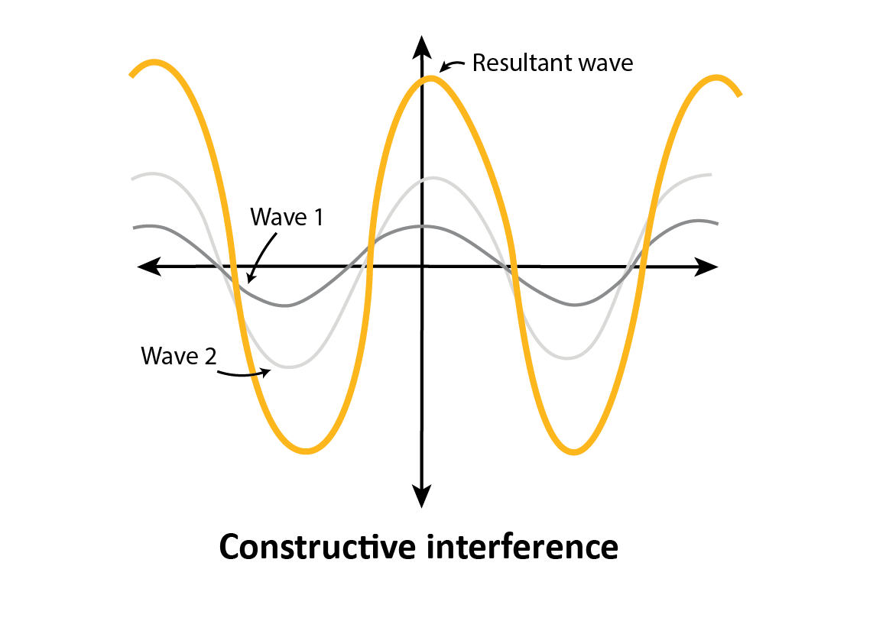
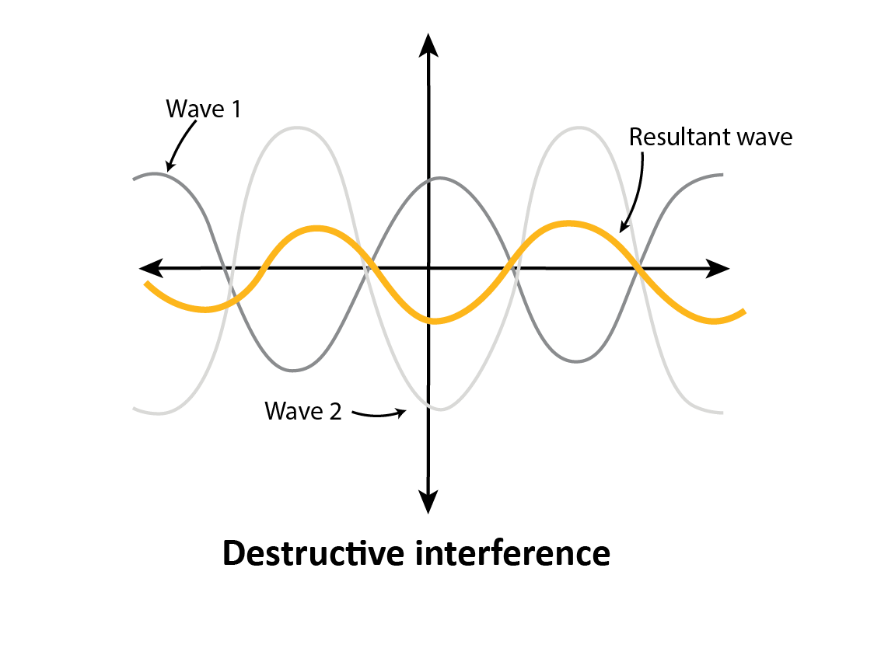
Interference
Light Behavior
Interference: Occurs when two or more light waves overlap and combine.
There are two types:
Constructive interference: when two or more waves collide in-phase with one another to create a resultant wave of larger amplitude.
Destructive interference: when two or more waves collide out of phase and create a resultant wave of smaller amplitude. This type is used in noise cancelling headphones.
Notes:
Interference
Light interference is a phenomenon where two or more light waves overlap and combine to form a new wave pattern. This can result in areas of increased brightness (constructive interference) or darkness (destructive interference), depending on how the waves align with each other. A common example is the colorful patterns seen in soap bubbles or oil slicks on water.

Slide 21
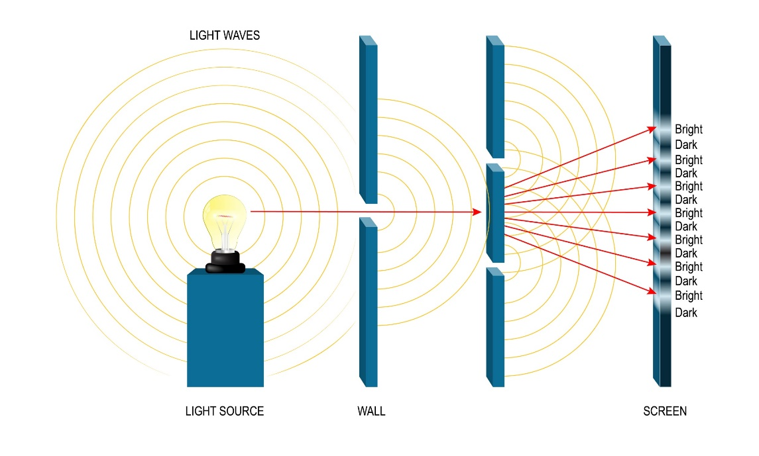
Young’s double slit experiment
Light Behavior
The double slit experiment by Thomas Young in 1801 provided pivotal evidence for the wave theory of light. Using the setup demonstrated here, Young showed that bright and dark fringes appear on a screen as a result of the constructive and destructive interference of light waves as they diffract through the slits.
Analysis:
The resulting interference pattern can be analyzed qualitatively by observing the fringe pattern and quantitatively using the coherence factor as a function of source width.
Using Ansys Software:
Ansys simulation software allows for the adjustment of parameters such as slit separation and wavelength to observe their effects on the interference pattern. The following slides summarize how this can be performed in two different ways using Lumerical FDTD and Zemax software tools.
Notes:
Young’s Double Slit Experiment
The double slit experiment, performed by Thomas Young in 1801, demonstrates interference and diffraction, showcasing the wave-like behavior of light. Bright and dark fringes result from constructive and destructive interference, while diffraction occurs as light spreads out through the slits. This experiment provided crucial evidence for the wave theory of light, marking a significant shift from the particle theory.

Slide 22
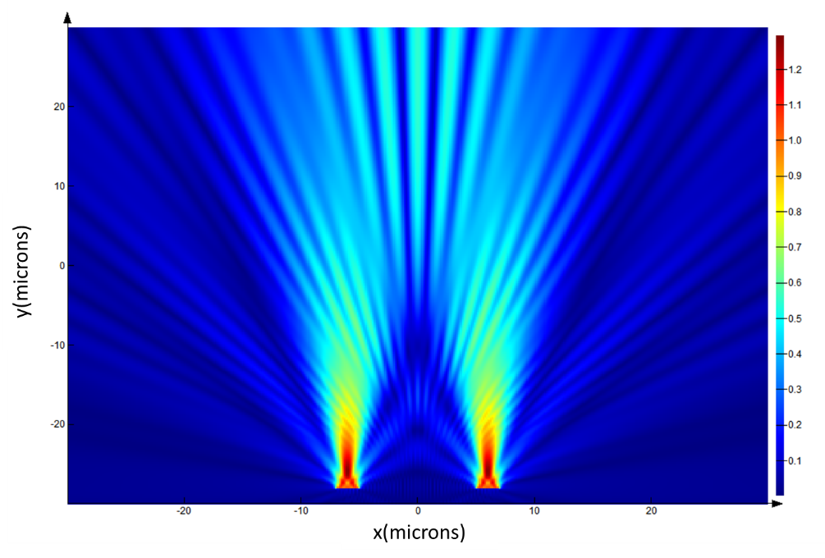
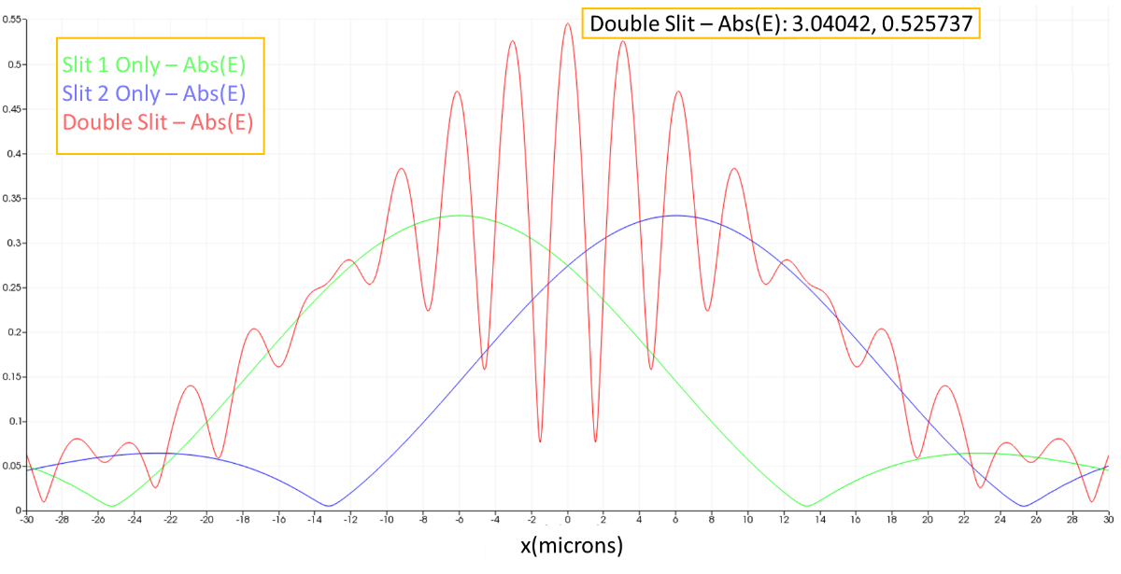
Young’s double slit experiment- Ansys Lumerical FDTD
Understanding light as a wave
Since diffraction has already been shown to occur when light waves pass through a slit, Young’s double slit experiment can be simply demonstrated using Ansys Lumerical FDTD tools. By using a diffracting plane wave source, you can observe the effects of constructive and destructive interference without the need for creating a physical structure. The options available under the Geometry tab allow the diffracting sources to be altered to a desired width and distance from one another.
The results shown here demonstrate the diffracting nature of the sources and their constructive and destructive interference. Moreover, the distance between the maxima is ~3.04 μm (microns), which is in good agreement with the analytical result.
Notes:
Young’s double slit experiment with Ansys Lumerical FDTD
This simple simulation demonstrates how diffracting plane wave sources work and, specifically, their application in the context of Young's Double Slit Experiment.
The diffracting plane wave source operates by propagating through a rectangular aperture defined on the Geometry tab. This source produces a diffraction pattern as the plane wave travels through the aperture. In contrast, the Bloch/Periodic Plane Wave Source automatically expands across the entire simulation region to simulate a pure plane wave.
The diffracting plane wave source is particularly useful in simulating the Double Slit Experiment, where it replaces each physical slit with a plane wave source. This eliminates the need for creating a physical structure representing the slits. In our example, the slits are spaced 12 µm apart, with each slit having a width of 2 µm. To simulate the screen that is 58 µm from the slits, we use a frequency domain field and a power monitor.
The spacing of the interference maxima on the projection plane can be calculated using the formula s=(zλ)/d​, where s is the spacing, z is the distance of the projection plane from the slits, λ is the wavelength, and d is the distance between the slits. For a wavelength of 633 nm, a simple calculation shows that the distance between the maxima should be approximately 3.05 µm.

Slide 23
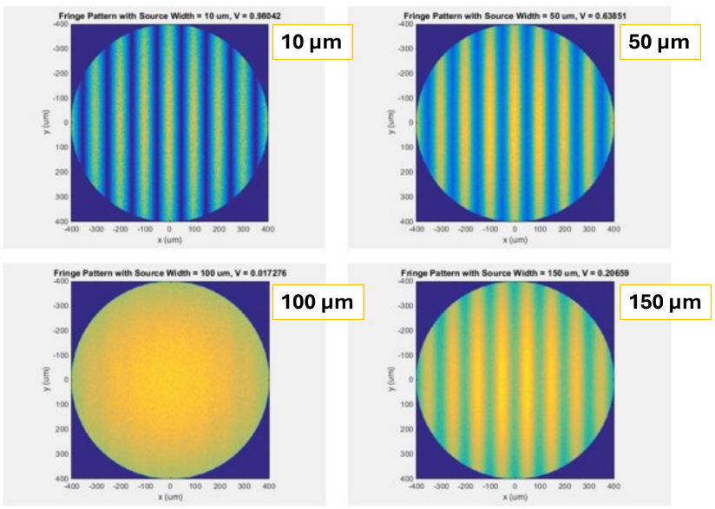
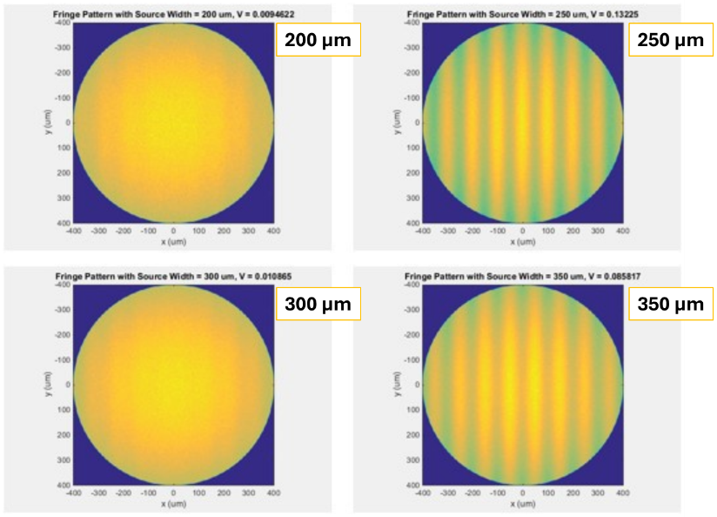
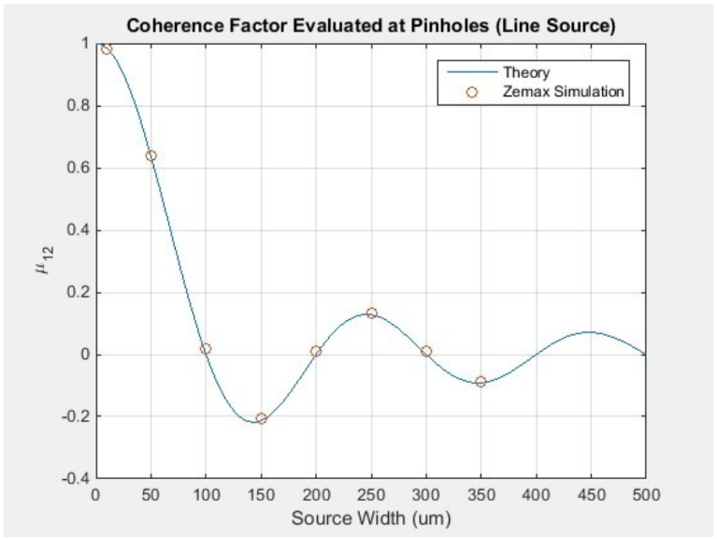
Young’s double slit experiment- Ansys Zemax Tools
Interference patterns can be better observed through an experiment using OpticStudio, where the size of the light source is altered. The visibility of the resultant fringe pattern is taken as a measure of the partial coherence of the light at the pinholes.
Using a scattering model, the experiment reveals an interesting phenomenon: when the size of the light source increases, the positions of the light and dark bands in the patterns switch at certain points, specifically when the source size changes from 50 to 150 μm and from 150 to 250 μm. Results of an analytical analysis are used for comparison with the ray trace simulation.
Resulting fringe patterns, source width is indicated
Notes:
Young’s double slit experiment with Ansys Zemax
This experiment presents the theory behind Young's Two-Pinhole experiment and simulates the setup in OpticStudio using geometrical ray tracing. The theoretical and simulated results are then compared.

Slide 24
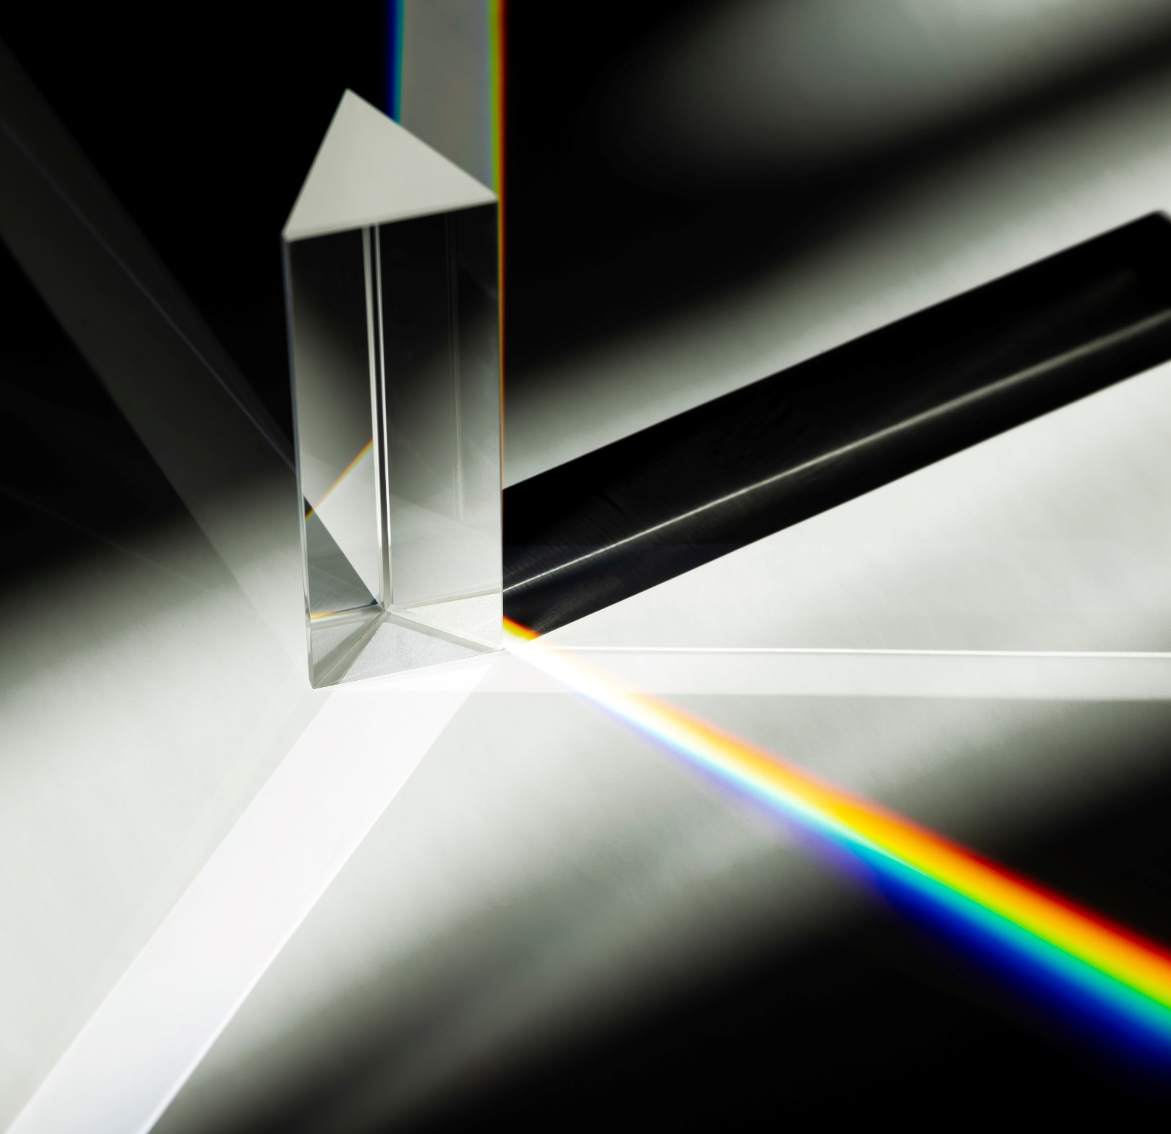
Optical components
Harnessing light for practical purpose
Now that we understand the fundamental properties of light, we can explore how various optical components utilize these properties to achieve specific functions.
Browse the following slides or use the interactive links below to navigate quickly.
Lenses
Mirrors
Prisms
Optical windows
Beam Splitters
Filters
Diffraction gratings
Fiber optics
Polarizers
Optical coatings
Notes:
Optical components
Use this slide to navigate through some common optical components.

Slide 25
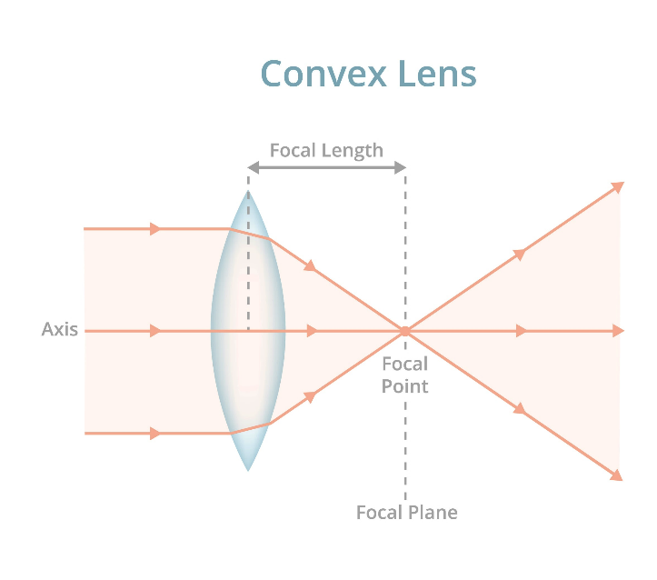
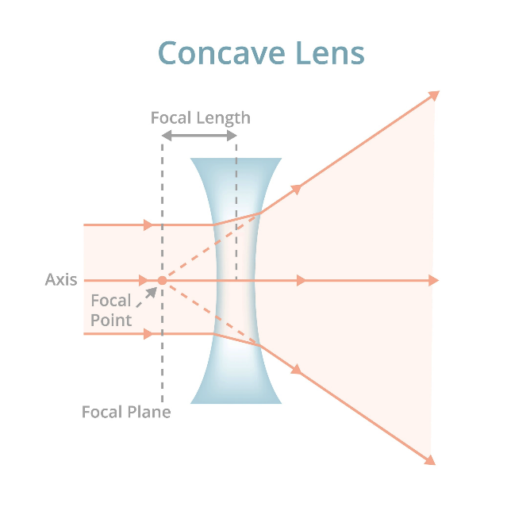
Lenses
Simplified microscopic imaging
Harnessing light for practical purpose
Lenses are curved pieces of transparent material (typically glass or plastic) that can focus or diverge light rays. They come in many different shapes and sizes, each dedicated to a unique manipulation of light. Applications include cameras, microscopes and telescopes. Two main categories are:
Convex (converging, positive) lenses: These lenses bulge outwards in the center. They converge parallel light to a focal point on the opposite side. Depending on the curvature, they can be further classified as converging lenses (biconvex) or converging-diverging lenses (meniscus). A magnifying glass would be an example.
Concave (diverging, negative) lenses: These lenses are indented in the center. They diverge light rays, causing them to spread out. They can be classified as diverging lenses (biconcave) or converging-diverging lenses (meniscus). Glasses to correct short-sightedness would be an example.
Notes:
Lenses
Lenses are used in optical systems to focus or disperse light. They are key components in devices like cameras, eyeglasses, microscopes, and telescopes, helping to produce clear images by bending light rays.
Learn More with Ansys: discover how to take raw data from a light simulation and turn it into an image that looks like something you'd see through a microscope.

Slide 26
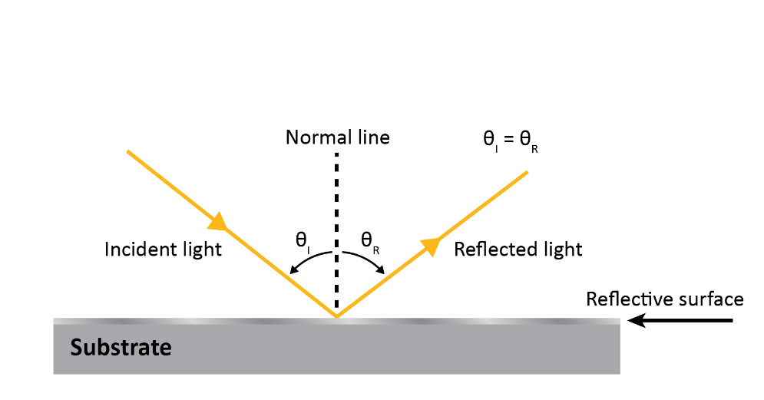
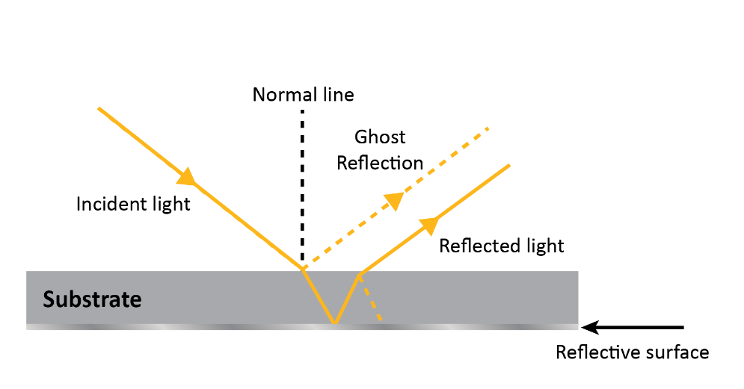
Mirrors
Head-Up Display (HUD)
Harnessing light for practical purpose
Mirrors reflect light rather than refracting it. They can be flat, concave (curving inward), or convex (curving outward). Mirrors are essential components in optical systems for redirecting light beams. They are used in telescopes, lasers, optical resonators, and various imaging systems.
Two main types:
First surface mirror: reflective coating is applied to the top surface of the main body material, best for precision applications. There is no protective layer.
Second surface mirror: reflective coating is applied to the inside of the bottom surface of the main body material, best for macro-applications where reflective coating is subject to environmental damage, consider a bathroom mirror.
Notes:
Mirrors
Mirrors are used in optical systems to reflect light. They are crucial in devices like telescopes and periscopes, enabling the redirection of light to create images or magnify distant objects. In cameras, mirrors are also used in SLR (single-lens reflex) cameras to reflect light from the lens to the viewfinder.
Ansys Learn More option: learn about the role of mirrors in head-up displays. Ansys OpticStudio designs and optimizes the HUD, while Ansys Speos validates and visualizes its performance, showing how mirrors ensure high-quality optical results in a real-world setting.

Slide 27
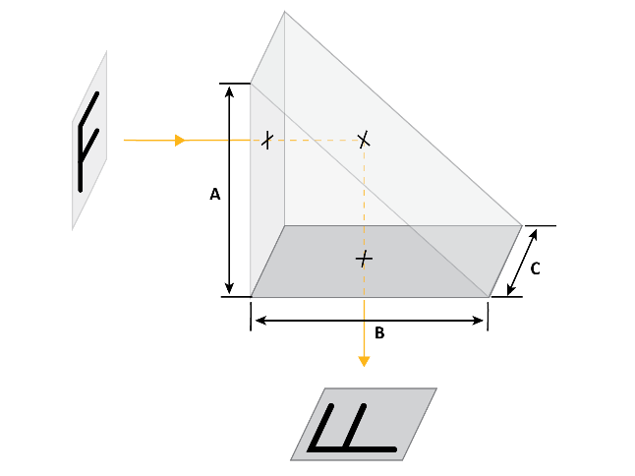
Prisms
Harnessing light for practical purpose
Right angle prism
Prisms are optical components with flat polished surfaces that refract and reflect light. They are often used to disperse light into its component wavelengths (dispersion) or to redirect light at precise angles. Finding applications in spectrometers, binoculars, and camera lenses, four common types are described below.
Prism Type | Function
Dispersion | Separates incident light into its component wavelengths
Deviation | Bends light by a fixed angle, typically used to redirect light beams or correct the alignment of optical systems.
Rotation | Rotates the image or light beam passing through it by a specific angle, useful for optical alignment or adjustment in instruments.
Displacement | Shifts the image or light beam passing through it without altering its direction, often used for beam displacement or in optical systems requiring precise alignment.
Penta prism
Notes:
Prisms
Prisms are used in optical systems to manipulate light. They are found in devices like cameras, binoculars, and spectrometers to redirect light beams, separate colors, or correct image orientation. Prisms are crucial for improving the clarity and functionality of optical instruments by controlling how light travels through them.

Slide 28
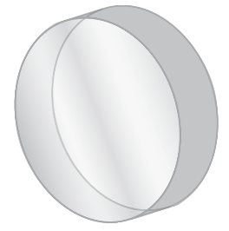
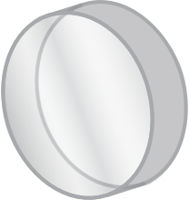
Optical windows
Harnessing light for practical purpose
Optical windows are flat, transparent slates of glass intended to maintain optimal transmission of light while mitigating reflection and absorption. They are used to physically protect small, complex, and fragile components of optical systems without impairing the ability for critical signals to pass to and from the part within an optical system.
When designing an optical window there are several material properties to consider.
Property | Definition | Importance
Refractive index | Measures how much a material slows down light compared to vacuum. | Influences transmission efficiency, anti-reflection coating design, and angle of incidence effects.
Abbe Number | Measures a material's dispersion. | Higher Abbe number reduces chromatic aberrations; important for maintaining image quality.
Density | Mass per unit volume. | Lighter materials preferred to reduce weight, especially in aerospace and portable devices.
Thermal expansion coefficient | Rate of material expansion with temperature change. | Low coefficient prevents shape changes and optical property alterations with temperature.
Surface quality | Presence of defects from manufacturing. | High quality reduces scattering and reflections, improving light transmission and image quality.
Thickness | Physical thickness of structure. | Optimize for mechanical strength, light transmission, and weight; too thick reduces transmission, too thin may lack strength.
Continued >>
Notes:
Optical windows
Optical windows are used in optical systems to protect sensitive components while allowing light to pass through. They are found in devices like cameras, telescopes, and lasers, serving to maintain the internal environment and ensure optical clarity. Optical windows are crucial for protecting lenses, sensors, and other optical elements from dust, moisture, and physical damage without interfering with the transmission of light.

Slide 29
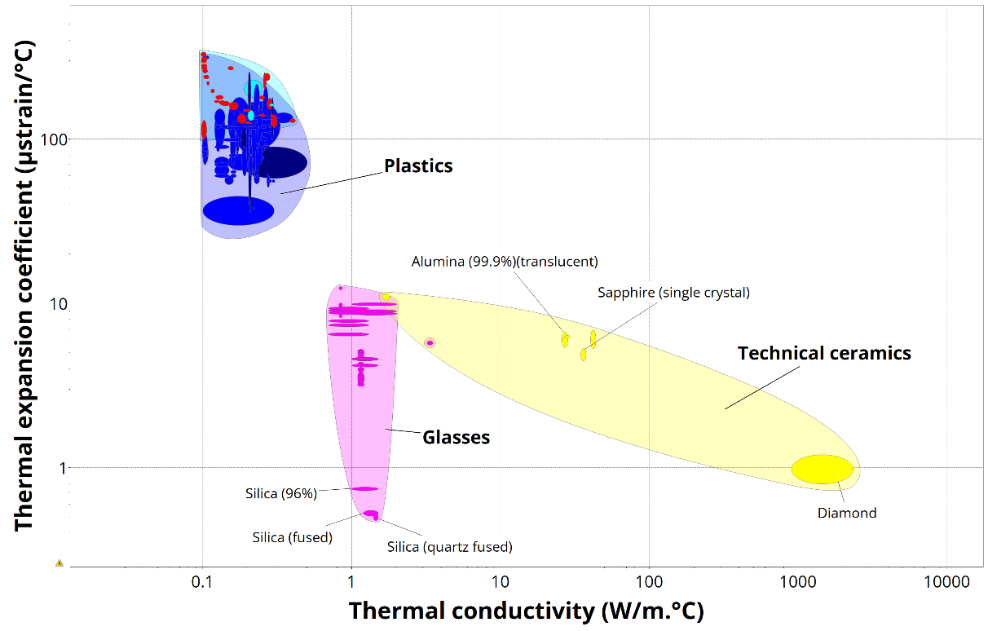
Optical windows- Ansys Granta EduPack Software
Harnessing light for practical purpose
Materials selection in optical design
The window through which the beam emerges from a high-powered laser must obviously be transparent to a specific wavelength of light. Even then, some of the energy of the beam is absorbed in the window and can cause it to heat and crack. This problem is minimized by choosing a window material with a high thermal conductivity λ (to conduct the heat away) and a low thermal expansion coefficient α (to reduce thermal strains), that is, by seeking a window material with a high value of
Use a limit stage at Level 3 to choose ‘bulk’ with ‘optical quality’ materials and a α - λ chart to identify the best material for an ultra-high powered laser window.
(You can ignore the few materials with negative thermal expansion, either using the Limit stage or by forcing the graph axes to be logarithmic.)
Possible candidates: Silica, Diamond, single crystal sapphire, and alumina.
Notes:
Materials selection of an optical window
Ansys Granta EduPack, utilizing the Ashby materials selection methodology, is a valuable tool for selecting the optimal materials for specific applications. This process involves defining the problem, screening out unsuitable materials, ranking the viable options based on performance indices, and thoroughly analyzing the top candidates. When choosing materials for an optical window, important factors include optical transparency, refractive index, mechanical strength, thermal stability, chemical resistance, density, and cost. By inputting some of these criteria into EduPack, we can efficiently filter and rank materials to identify possible candidates.

Slide 30
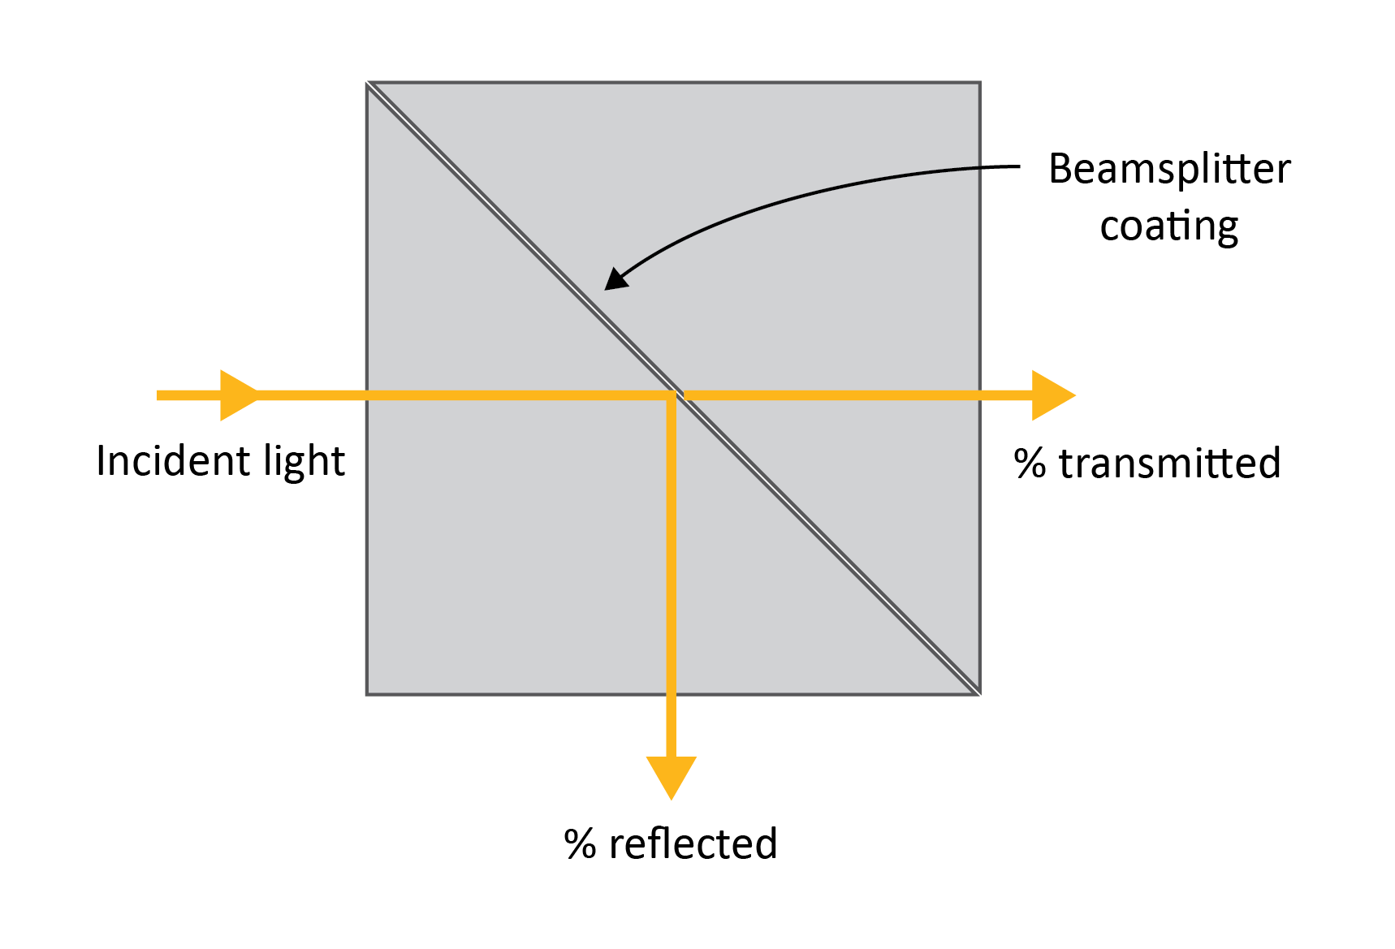
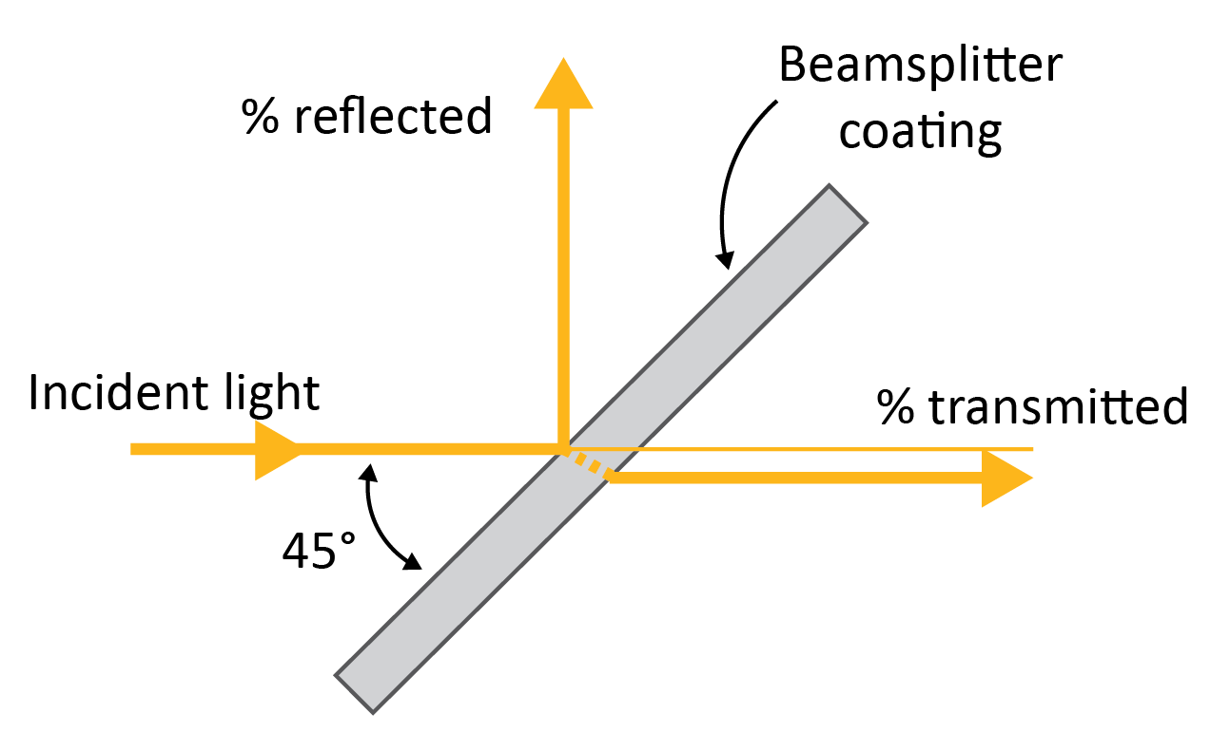
Beamsplitters
Harnessing light for practical purpose
Beamsplitters are optical devices that divide incoming light into two distinct beams at a specified ratio. They are typically categorized based on their construction, with the most common types being cube and plate.
Cube beamsplitter
Plate beamsplitter
Beamsplitters can also function in reverse, merging two separate beams into one, and they can manipulate both unpolarized and polarized light.
Notes:
Beamsplitters
Beamsplitters are used in optical systems to divide a single beam of light into two separate beams.
Two types:
Cube beamsplitters: two triangular prisms bonded together at their hypotenuse faces, with a partially reflective coating applied to the internal surface. This design allows the device to split the incident light into two beams, reflecting part of the light at a 90-degree angle while transmitting the rest straight through.
Plate beamsplitters: a thin, flat piece of glass or other optical material with a partially reflective coating on one side. It splits light by reflecting a portion of the incident beam while transmitting the remainder. Plates are often designed with an angle of incidence at 45°.
They are commonly found in devices like cameras, microscopes, and various scientific instruments, enabling simultaneous viewing or measurement of light in different paths, such as for imaging or analyzing different wavelengths.

Slide 31
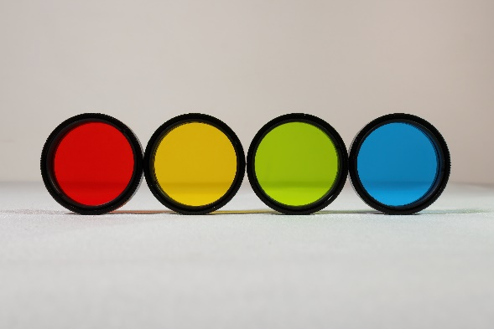
Filters
Harnessing light for practical purpose
Optical filters selectively transmit, absorb, or reflect light of certain wavelengths while blocking others. They are used to control the spectral content of light or to enhance contrast in optical systems. Filters can be made from colored glass, interference coatings, or other materials.
Absorptive filters | are made from glass or plastic with a dye that absorbs specific wavelengths, allowing desired wavelengths to pass through while absorbing unwanted ones. They find applications in photography, lighting, and scientific instruments.
Interference (dichroic) filters | use ultra-thin layers to selectively transmit colors by manipulating light interference. They offer precise control over light wavelengths, making them ideal for lasers, spectroscopy, and other demanding applications.
Optical filters are characterized by their wavelength range, bandpass, sharp cut-off, and optical density. These properties define their effectiveness in manipulating light in various applications.
Notes:
Filters
Filters are used in optical systems to selectively allow certain wavelengths of light to pass through while blocking others. They are commonly found in cameras, microscopes, and scientific instruments to enhance image quality, isolate specific wavelengths for analysis, and protect sensors from unwanted light.

Slide 32
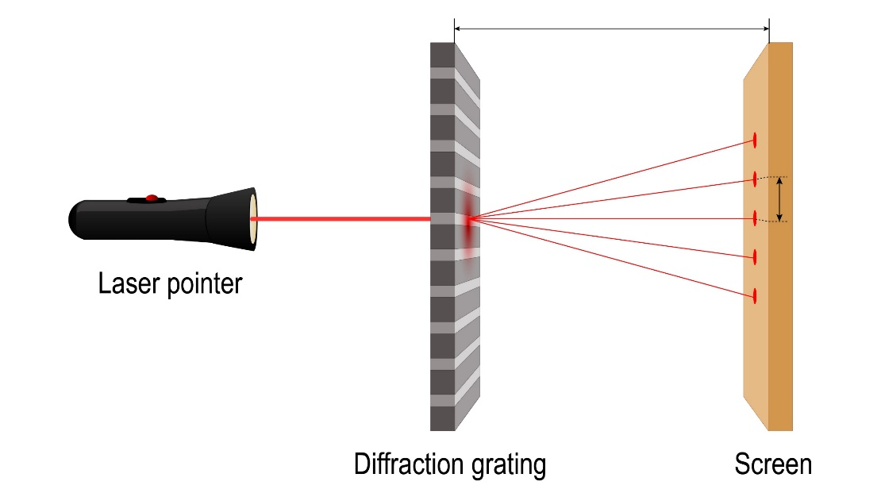
Diffraction gratings
Diffraction grating
Harnessing light for practical purpose
A diffraction grating is an optical device with a regular pattern of multiple lines or grooves. There are two main types: transmission and reflection gratings.
When light hits a diffraction grating, each line or groove acts like a source of light waves. These waves interfere with each other, creating a pattern of bright and dark spots.
The direction of these diffracted beams depends on the wavelength of the light and the spacing between the grating lines.
This is described by the grating equation: 𝑑sin⁡𝜃 = 𝑛𝜆
Where: 𝑑 is the distance between the lines, 𝜃 is the angle of the diffracted light, 𝑛 is the order of the diffraction pattern, 𝜆 is the wavelength of the light.
Notes:
Diffraction gratings
A diffraction grating is an optical component characterized by a regular pattern of lines or grooves that split and diffract light into several beams traveling in different directions. There are two main types of diffraction gratings: transmission gratings, where light passes through the grating, and reflection gratings, where light is reflected off the surface.
When light encounters a diffraction grating, each slit or groove acts as a source of secondary wavelets. These wavelets interfere constructively and destructively, creating a diffraction pattern. The angle of the diffracted light depends on the wavelength of the light and the spacing of the grating lines. This relationship is described by the grating equation dsin⁡θ = nλ
Diffraction gratings have numerous applications, particularly in spectroscopy, where they are used to separate light into its component wavelengths for analysis. They are also crucial in laser systems for controlling and manipulating laser beams, and in various optical instruments such as monochromators and spectrometers. The main advantages of diffraction gratings include their high resolution for spectral analysis, versatility in being designed for a wide range of wavelengths, and their durability and precision in production.
Ansys Learn More option: learn how to characterize a diffraction grating in response to a broadband planewave at normal incidence.

Slide 33
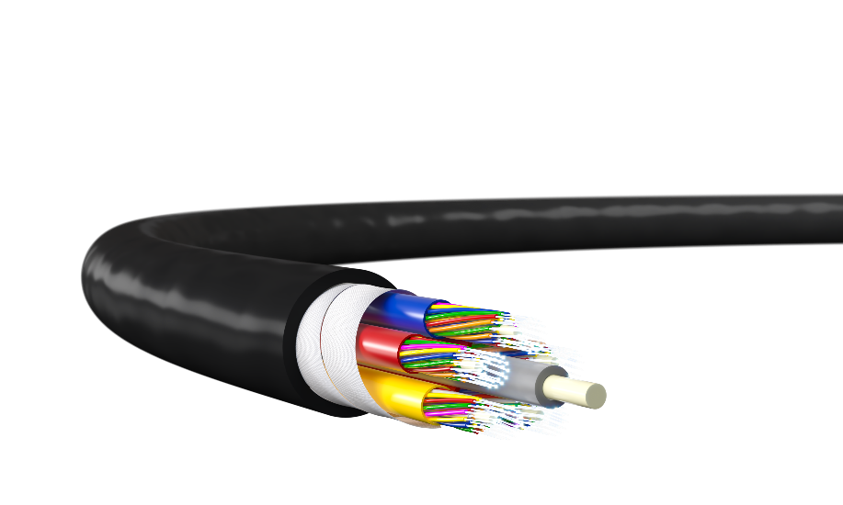
Fiber optics
Step-index and graded-index fiber (FDE)
Harnessing light for practical purpose
Fiber optic components are essential for transmitting light signals over remote, long distances with minimal loss.
Main components include:
Optical fiber: typical structure includes a solid core, either made from plastic or glass, which is transparent to the desired wavelength of light. Surrounding this will be a lower refractive index cladding, to enable total internal reflection. A protective layer encases the whole structure.
Connectors and splices: join fiber segments, ensuring minimal signal loss.
Couplers and splitters: used to combine or split light signals for distribution.
Optical amplifiers: a device that boosts the strength of optical signals directly in fiber optic communication systems without converting them to electrical signals.
Notes:
Fiber optics
Optical fibers: a flexible, transparent fiber made of high-quality glass or plastic, which is used to transmit light signals over long distances. The fiber consists of a core, where the light travels, surrounded by a cladding that reflects the light back into the core to prevent signal loss. This structure allows optical fibers to carry large amounts of data at high speeds, making them essential for telecommunications, internet connections, and medical imaging. The protective outer coating shields the fiber from physical damage and environmental factors. Optical fibers are favored for their high bandwidth, low signal attenuation, and resistance to electromagnetic interference. There are many different types, including hollow core fibers.
Connector: a device used to join optical fibers end-to-end, allowing light signals to pass from one fiber to another with minimal loss. Connectors are essential for creating detachable connections in fiber optic networks, making it easier to install, maintain, and reconfigure the system.
Splicer: a tool used to permanently join two optical fibers together by fusing their ends. This process, known as splicing, ensures a seamless connection with very low signal loss and reflection.
Coupler: devices that can combine two or more optical signals into one or split one optical signal into multiple paths. Categorized by function and construction, types include directional couplers, star couplers and Y couplers.
Splitter: similar to couplers in that they distribute optical signals, but they are more specifically designed for splitting one input signal into multiple output signals. Categorized based on splitting ratio and construction, types include fused biconical taper (FBT) splitters and planar Lightwave circuit (PLC) splitters.
Optical amplifier: a device used to amplify an optical signal directly, without the need to convert it to an electrical signal. Optical amplifiers are crucial components in fiber optic communication systems, as they boost the strength of optical signals that weaken over long distances, thereby enhancing the performance and range of optical networks. Types include Erbium-Doped Fiber Amplifiers (EDFAs), Raman amplifiers, and semiconductor optical amplifiers.
Ansys Learn More option: compare analytical and simulated results for a step-index and graded-index fiber.

Slide 34
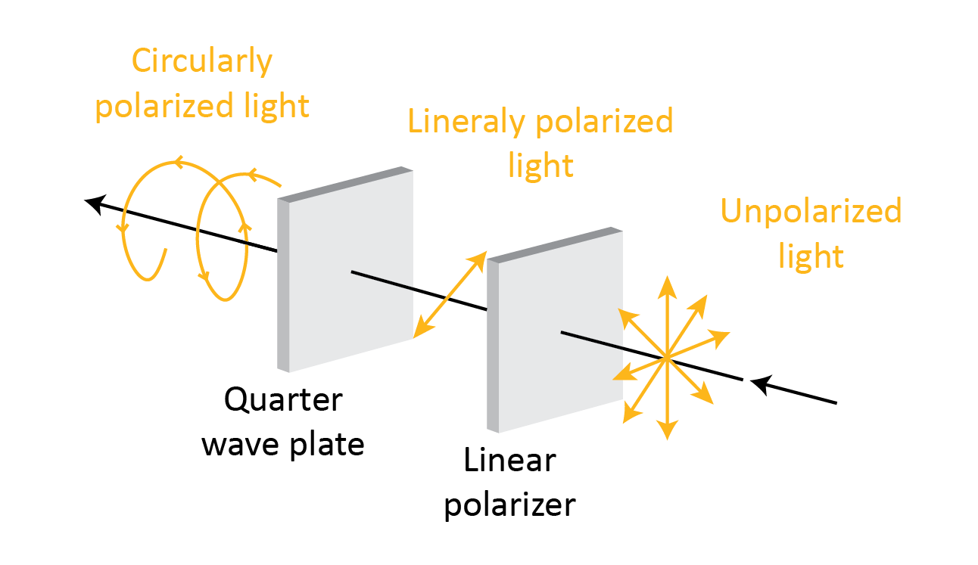
Polarizers
Antireflective circular polarizers in OLED display
Harnessing light for practical purpose
A polarizer is an optical devices that filter light waves, allowing only waves with a specific polarization to pass through.
There are two types:
Linear Polarizers: allow one orientation of the electric field vibrations to pass through the filter.
Circular Polarizers: Convert light into circularly polarized light, useful for reducing glare.
Polarizers are used in sunglasses to reduce glare by blocking horizontally polarized light. In cameras, they enhance contrast and reduce reflections in photographs. Microscopes use polarizers to improve contrast in samples and LCD screens rely on them to control light and display images.
Notes:
Polarizers
Polarizers are essential optical components that filter light waves based on their polarization, a concept we previously covered. They allow only light waves with a specific polarization direction to pass through, blocking other orientations.
Ansys Learn More option: learn how to use a circular polarizer to suppress the reflection and visualize its effect in a realistic environment by applying the physics-based Lumerical Sub-Wavelength model (LSWM) to a mock-up mobile phone.

Slide 35
Optical coatings
Harnessing light for practical purpose
Not necessarily an optical component, optical coatings are frequently applied to other components to provide optimization and protection benefits. There are several types, but some common ones are listed below.
Anti-Reflective (AR) Coatings | reduce reflection losses and increase the transmission, enhance contrast and eliminate ghost images. Typically, ¼ the thickness of the wavelength, AR coatings are used in applications such as eyeglasses, camera lenses, and photovoltaic cells.
Highly-Reflective (HR) Coatings - Metallic | Typically made from metals like aluminum, silver, or gold and are used to create mirrors with high reflectivity over a wide spectral range. Essential for applications requiring broad-spectrum reflectivity, such as telescopes, laser systems, and scientific instruments. Prone to scratches and other surface defects.
Highly-Reflective (HR) Coatings - Dielectric | Layers of material with alternative refractive indices to achieve greater reflection through constructive interference. Provide superior performance for laser optics and other precision optical instruments where high reflectivity and low absorption at certain wavelengths are critical.
Notes:
Optical coatings
Optical coatings are thin layers of materials applied to optical surfaces like lenses, mirrors, and prisms. They are designed to modify the reflectance, transmittance, and absorption characteristics of these surfaces. Coatings can improve optical performance by reducing reflections, enhancing contrast, and increasing light transmission, while also providing protection against environmental factors such as moisture and abrasion. Three types are described here.

Slide 36
Optical systems
Harnessing light for practical purpose
In this Introduction to Optics lecture unit, we have explored common optical components, such as lenses, mirrors, and filters, which perform specific functions with light, like focusing or reflecting it.
Typically, these components do not operate independently but are part of a connected optical system, consisting of multiple components working together to perform complex tasks, as seen in telescopes or cameras.
While this lecture unit focuses on the building blocks of optics, you can learn more about optical systems elsewhere.
Notes:
Ansys Innovation Courses
Fundamental Parameters of Optical Systems: This course takes a deeper dive into the fundamental parameters of optical systems, including lens anatomy, various numerical parameters for a system, and some more details on laser and illumination systems.
Software Design of Optical Systems: This course introduces lens design within OpticStudio software. You are not expected to have a license for OpticStudio, nor are you expected to complete the actions yourself. The purpose of this course is to give you a better understanding of the process of designing an optical system.

Slide 37
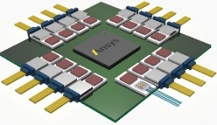
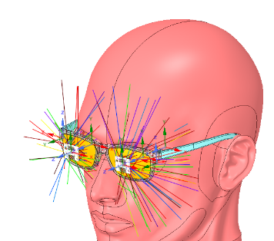
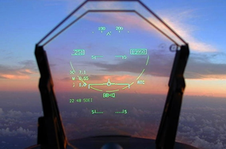
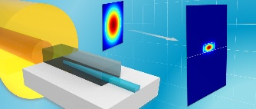
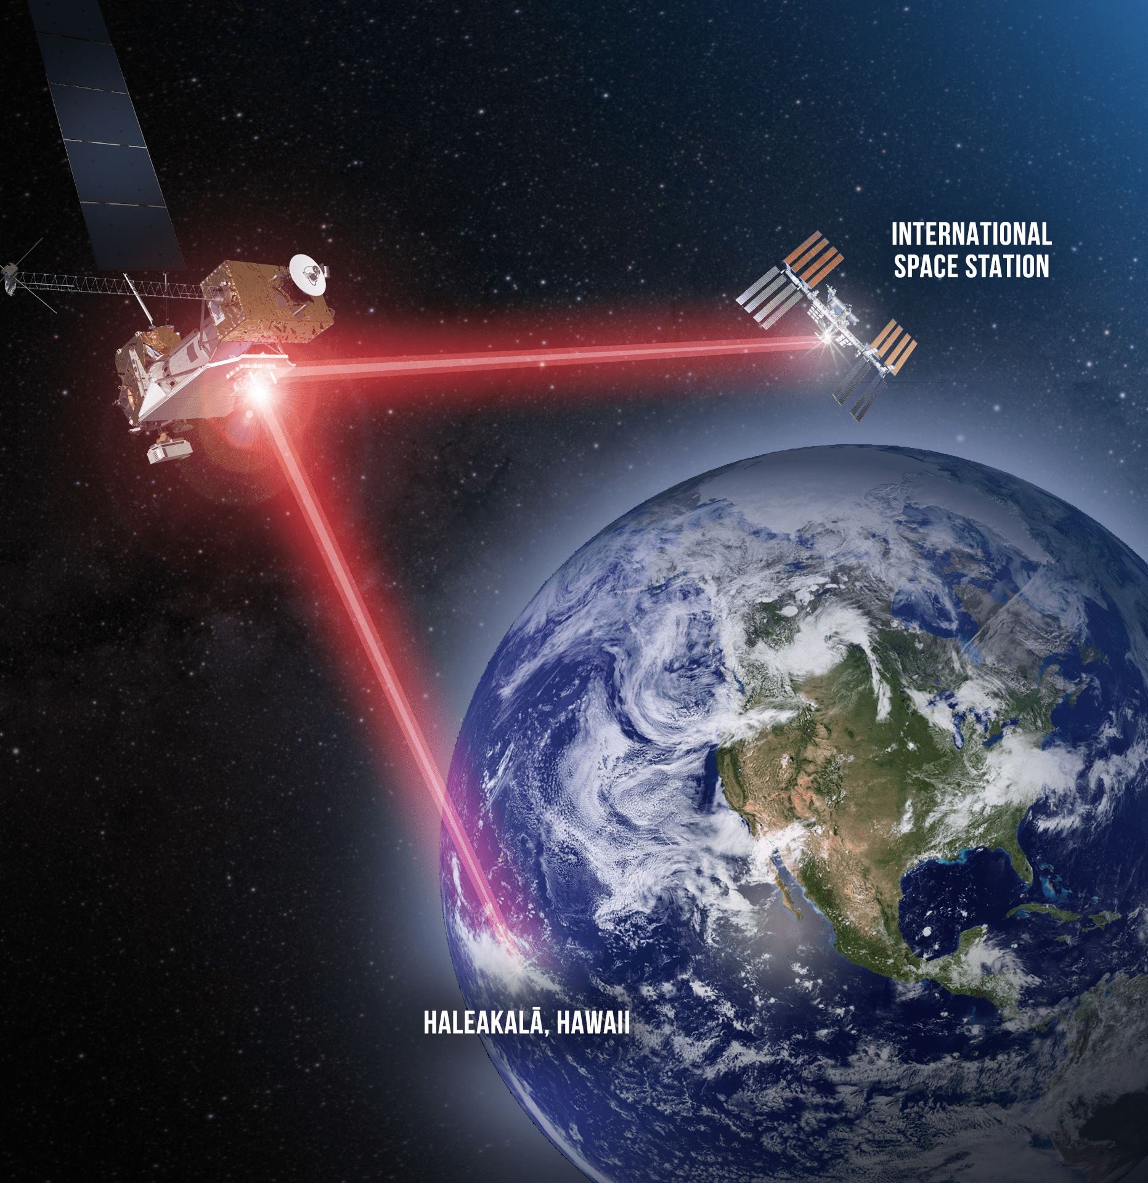
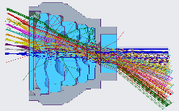
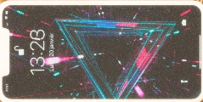
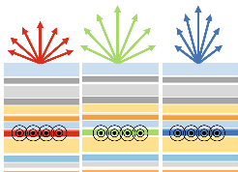
Power of simulation
Predicting optical performance
Designing and optimizing optical systems can be a complex task that involves intricate calculations and numerous design iterations. This is where optical design software is useful.
Simulates Light Behavior: Understand how light interacts with components without physical prototypes.
Visualizes Designs: Visualize light propagation and see potential issues as they appear.
Saves Time and Resources: Test multiple designs quickly and efficiently.
Improves Performance: Analyze and optimize design quality and efficiency.
Facilitates Communication: Create clear visualizations to explain designs to others.
Verifies Results: Validate experimental findings with simulations.

Slide 38
Multiphysics & Multiscale Simulation Platform
Predicting optical performance
From Nano
To Macro
To System
Ansys Lumerical
Photonic Design & Optimization
Nano-Chip-Level
Photonic components, circuits & systems
Tolerancing & Yield analysis
Diffractive optical elements & waveguides
Emissive and absorbing structures
Ansys Zemax
Optical Design & Modeling
Optical-Design-Level
Optical design
Optical validation
Optical tolerance analysis
Mechanical tolerance analysis
Ansys Speos
Optical System Modelling & Validation
System-Design-Level
Individual 3D environment integration
Lighting evaluation
Human Vision rendering
Customer’s perception for decision making
Notes:
Ansys Optics portfolio
Ansys offers a diverse range of optics simulation tools designed to support teaching and research across various scales of optical design, from nano to systems engineering.

Slide 39
Summary
This introductory lecture unit on optics examined the fundamental nature of light, exploring its wave-particle duality and its position within the electromagnetic spectrum. Key light behaviors were then defined, followed by exploration of how light can be manipulated through common optical components. Finally, the role of simulation tools in analyzing and designing optical systems was introduced.
For more teaching inspiration:
Ansys Academic | Simulation Software for Educators, Researchers and Students.
Ansys Innovation Courses : Free to Access to courses covering a variety of physics and software.
Ansys Education Resources: Specifically developed for Educators.
Ansys Learning Forum: Ask questions to the Ansys Community!
Ansys Learning : Ansys YouTube Channel with dedicated video playlists.

Slide 40
Ansys Education Resources Feedback Survey
Here at Ansys, we rely on your feedback to ensure the educational content we create is up-to-date and fits your teaching needs.
Please click the link below to fill out a short survey (~7 minutes) to help us continue to support academics around the world utilizing Ansys tools in the classroom.
Feedback Survey Link
Notes:
Feedback Survey link for copy-paste method → https://ansys.typeform.com/to/jcattJI5

