Slide 1
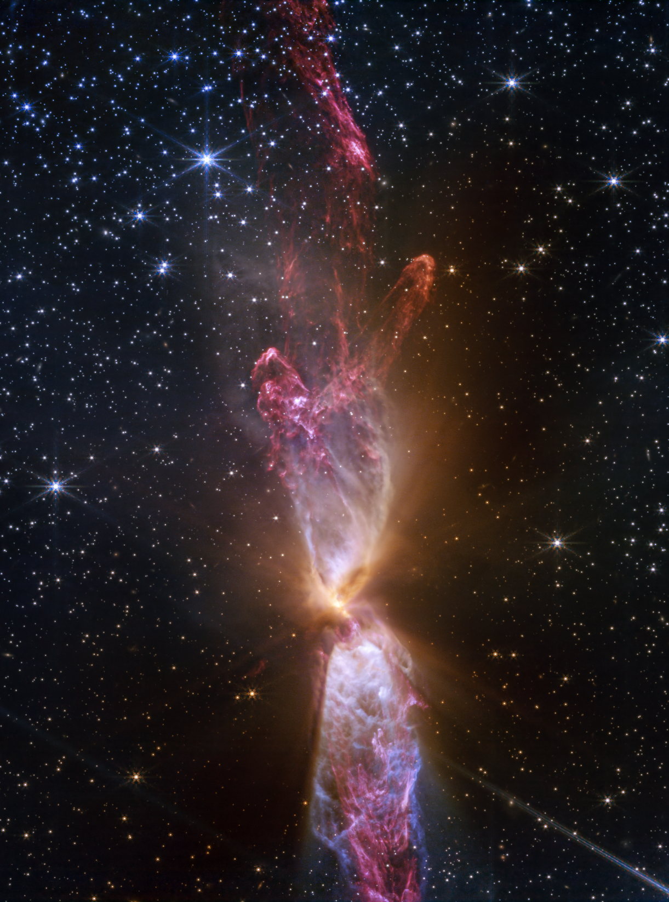
Modeling & Analysis of the James Webb Space Telescope (JWST) with Ansys Zemax OpticStudio
Samuel Kim, Prof. Saharnaz Baghdadchi, Prof. Nicholas Antipa
University of California San Diego
Curated by Harriet Parnell, Ansys Academic Program
Image credit: NASA

Slide 2
Learning Objectives
Ansys software mentioned | Ansys Zemax OpticStudio®, optical system design and analysis software.
This tutorial guides the user through modeling the JWST in OpticStudio, starting from a basic three-mirror anastigmat (TMA) design and optimizing the system by analyzing spot diagrams, wavefront maps, layout plots, and point spread functions.
Intended Learning Outcomes
Understand the Optical Design Principles of the JWST. Analyze Ray Tracing and Aberrations. Optimize the image plane by correcting for field curvature and utilizing optimization wizards. Introduce non-sequential components in modeling. Interpret Wavefront and PSF Data. Connect Simulation to Physical System Behavior.
For more learning and support:
Ansys Innovation Courses >
Ansys Academic >
Ansys Education Resources >

Slide 3
JWST Introduction
The James Webb Space Telescope (JWST) is designed to explore the universe's earliest galaxies. Unlike the Hubble Space Telescope, which orbits the Earth, the JWST orbits the Sun in an orbital region known as the second Lagrange point (L2), about 1.5 million km away from Earth. In this region, Earth's gravity has just enough influence to keep the JWST in its intended orbital position without consuming fuel, thus maximizing the lifespan of the telescope.
As the JWST is designed to search for the universe's first visible light, it must detect into the infrared since the UV and visible wavelengths from the universe's beginnings have been redshifted as our universe has expanded over the past 13.7 billion years. Furthermore, infrared light passes through the dense clouds of gas and dust, which would normally block visible wavelengths.
To accomplish its mission of detecting signs of our universe's beginnings, the JWST's cameras detect wavelengths from 0.6 um to 28 um, and thus the module itself must be cold (40 K) to avoid thermal noise in its readings. To achieve sharp, wide-field imaging, the JWST employs a three-mirror anastigmat (TMA) design which corrects for spherical aberrations, coma, and astigmatism. The most notable feature of the JWST is the large primary mirror which spans a diameter of 6.5 meters—over 2.5x the diameter of the Hubble telescope! From the Rayleigh criterion, angular resolution for a diffraction-limited system improves with aperture size. Thus, the JWST's large aperture enables it to resolve longer infrared wavelengths that were beyond Hubble's capabilities. This primary mirror is made of 18 hexagonal segments. Actuators placed at each of the segment's six corners can align the mirror with a precision of 0.1 um. In this tutorial, we will explore why such precision is necessary.

Slide 4

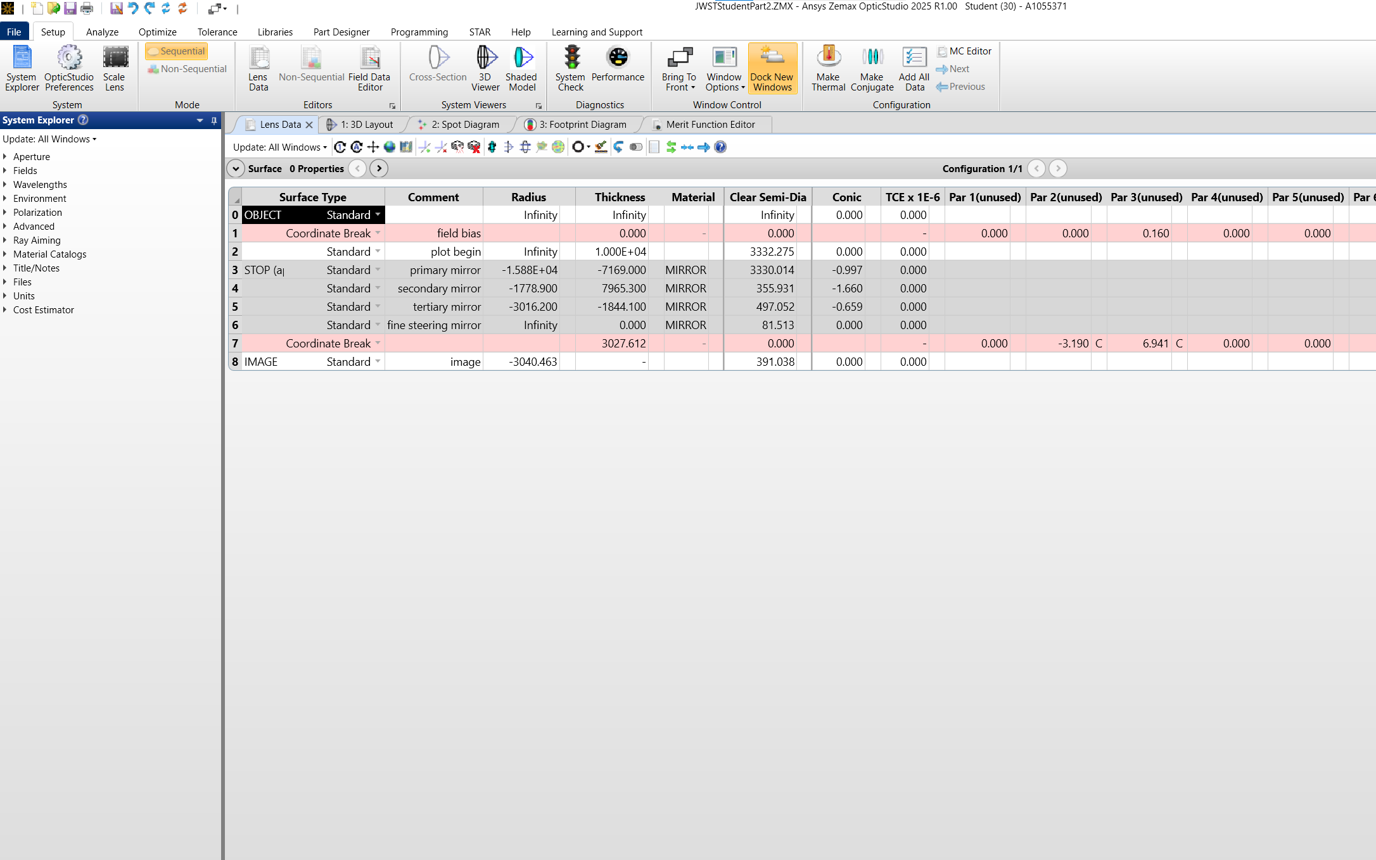
How to use this tutorial
Content: Simply follow the steps!
Images within a laptop frame are intended to help with navigation. Arrows will point to current navigation menus and will be numbered with the relevant step (x) or labeled accordingly.
(x)
If not already familiar with the basics of OpticStudio, we recommend referencing the free tutorial Getting Started with OpticStudio on Ansys, part of Synopsys, website.
For more information about any feature of OpticStudio, click on the whatever it is you would like to learn more about, and click on the help icon, displayed as a blue question mark.

Slide 5

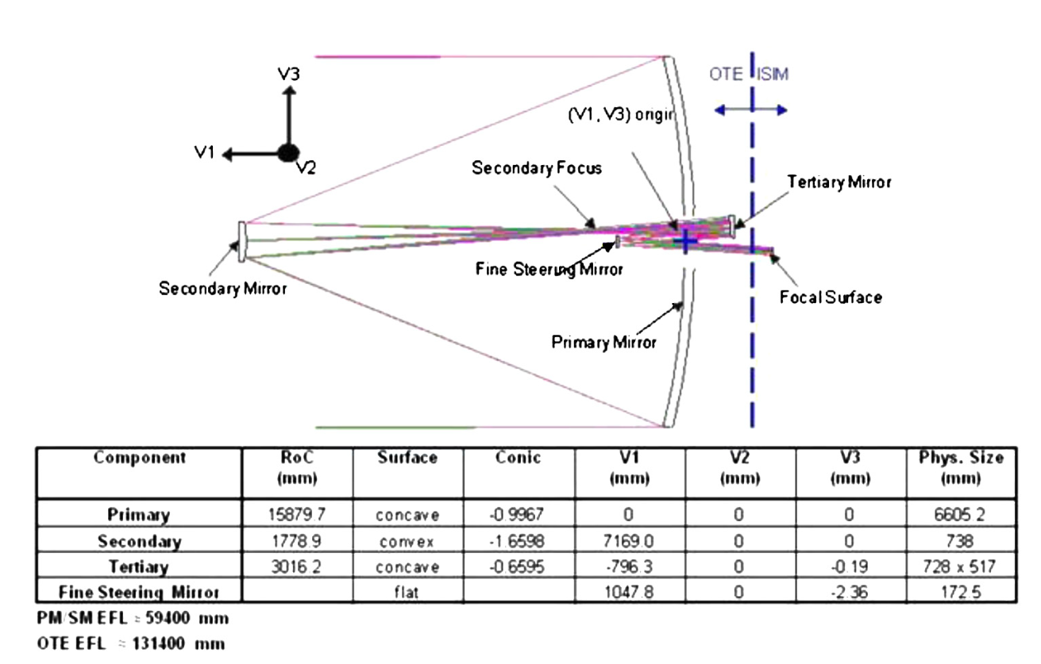
Specifications
Column
Definition
Figure 1 – Telescope Specifications
P.A. Lightsey, et al. Optical Engineering 51(1), 011003 (January 2012).
RoC
Radius of curvature (+) convex, (-) concave
Conic
Conic constant 𝐾, where K = 0 for a sphere and K = -1 for a perfect paraboloid
V1, V2
How far horizontally or vertically the mirrors are offset.
V3
Optical axis. This is how far from the origin the mirror is located.
Phys. Size
Diameter of each mirror component in mm
In the next few slides, we will initialize our JWST TMA design using the above specifications.

Slide 6
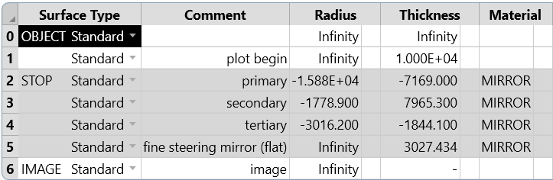
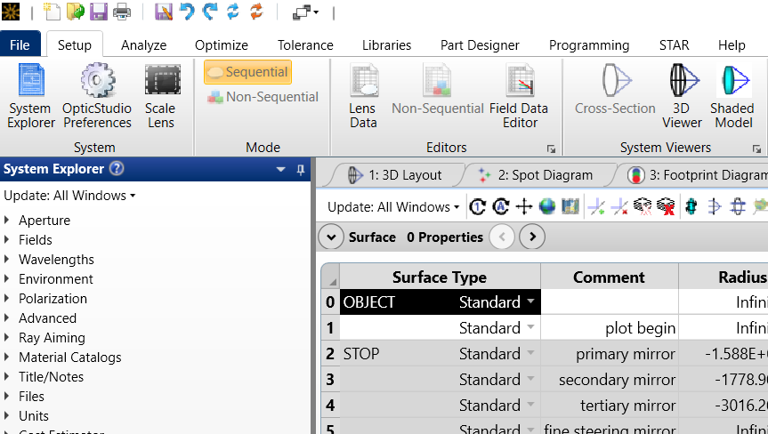
Initial Setup
(3)
(1)
Once you have OpticStudio open and have created a new file (File → New), you should see the Lens Data Editor (LDE) by default. The LDE will be used to create a sequential optical system. Each row defines a surface while the columns represent important parameters such as thickness, radius of curvature, and the material.
The LDE is accessible at any time by clicking on this icon within the Setup Menu
Surfaces
(2)
To create a new surface, left-click on the surface you would like to insert a surface before. Then, either right click → insert surface before, or press the insert key on your keyboard. Do this once to create a surface before the primary mirror (labeled STOP) (1) and three times before the image plane (labeled IMAGE) (2). In the comment column, we can label each surface (3).
Surface 0 is where the rays will originate. Surface 1 is our reference. We will build the rest of our system in relation to this surface. Surface 2 is the first surface the light will interact with—the primary mirror of the telescope. Light reflects of surface one and travels to surface 2, the secondary mirror where it again reflects. Surface 4 and 5 are the next mirrors where the rays will reflect off of until the rays reach the image plane (Surface 6).

Slide 7
Initial Setup
(1)
(2)
(3)
(4)
We proceed to input the parameter values as specified on Figure 1 on slide 5. We use the sign convention from ECE 181 in this tutorial, where a radius with respect to a point on the left of the lens is negative and a radius defined from the right of the surface is positive. Surfaces 2-5 are reflective so the material type should be set as MIRROR. Additionally, the thickness values, which defines how far the rays travel until they reach the next surface, must be adjusted from the specification values, which defines the primary mirror as the reference point. Plot begin sets the rays to travel 10 m before reaching the primary mirror. The rays reflect and travel negative (to the left) 7169 mm before reaching the secondary mirror. Set surface 2 thickness as –7169 mm (1). There, they are reflected and sent to the tertiary mirror, which lies 796.3 mm behind the primary mirror. Thus, we add 796.3 mm to 7169 mm to obtain a positive (to the right) thickness value of 7965.3 mm. Set surface 3 thickness as 7965.3 mm (2). Correcting for the different reference points between the spec sheet and how we define our system in OpticStudio, we set the thickness of the tertiary mirror to be –1844.1 mm (3). Finally, rays reflect off the fine steering mirror and travel a distance (thickness) of 3027.434 mm before reaching the image plane. Set the thickness of surface 5 to be 3027.434 mm (4).

Slide 8
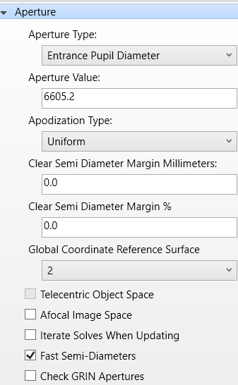
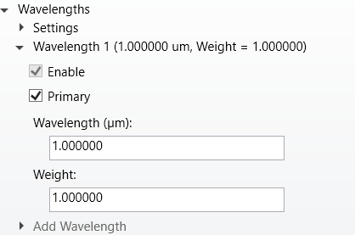
Initial Setup
(1)
The primary mirror defines the entrance pupil for the JWST with a size of 6605.2 mm. Setting the entrance pupil diameter tells OpticStudio which rays our system cares about. Within the System Explorer under Aperture, we set the Aperture Type to Entrance Pupil Diameter (1). The aperture type is set as Entrance Pupil Diameter with a value of 6605.2 mm (2). The other parameters can be left as default as shown.
Aperture
(2)
(3)
The wavelength value can be set to 1 micron (3) with a weight of 1 (4).
Concept Check: Does this value really matter for geometric ray tracing? (Hint: Law of Reflection)
(4)
Wavelengths

Slide 9
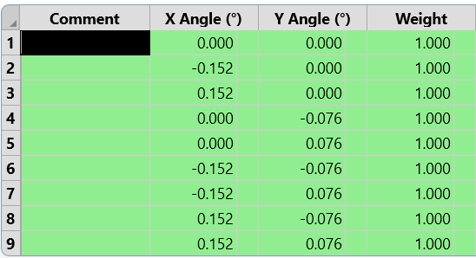
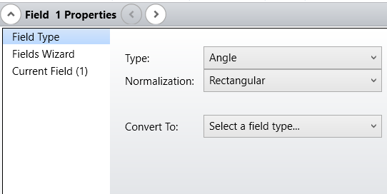
Initial Setup
(2)
(3)
(1)
We want to sample multiple points across our field of view to optimize our system for off-axis points, as well. After all, incoming starlight is not always on-axis. We accomplish this by creating a grid of field points centered around the optical axis. First, create 9 field entries within the FDE by right-clicking and selecting Insert Field or by pressing the Insert key on your keyboard (1) . Please set the X angles (2) and Y Angles (3) as shown. The weights should be set to 1 by default.
The FDE is accessible at any time by clicking on this icon within the Setup Menu
Fields
(4)
Since we are creating a rectangular grid of points, set the normalization type to rectangular (4).

Slide 10
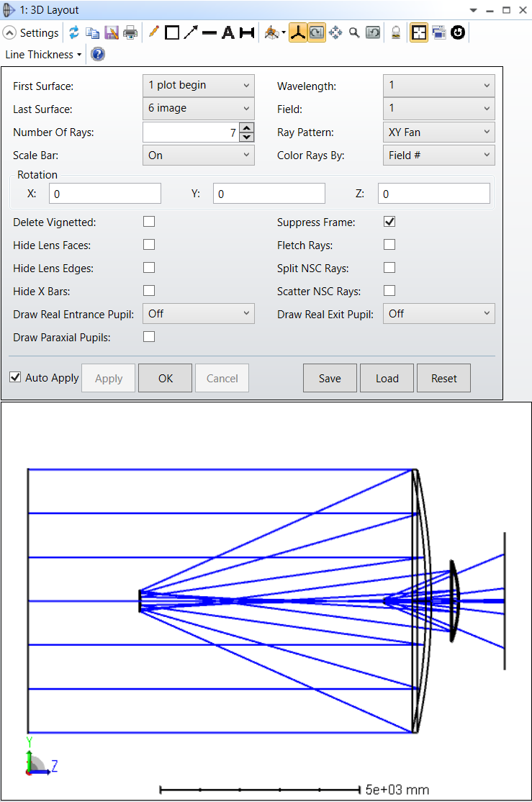
Initial Setup
(3)
(2)
(4)
Let's verify that our system looks as it should by viewing the 3D Layout by selecting the 3D Viewer (1) . We want to see our full system, so set the first surface as plot begin (2) and the last surface as image (3) . For simplicity, let's display only one field angle by setting Field to 1 (4). Press OK (5).
Can you identify each of the surfaces in the 3D Layout plot?
The 3D Viewer is accessible at any time by clicking on this icon within the Setup Menu
(1)
(5)
3D Layout

Slide 11
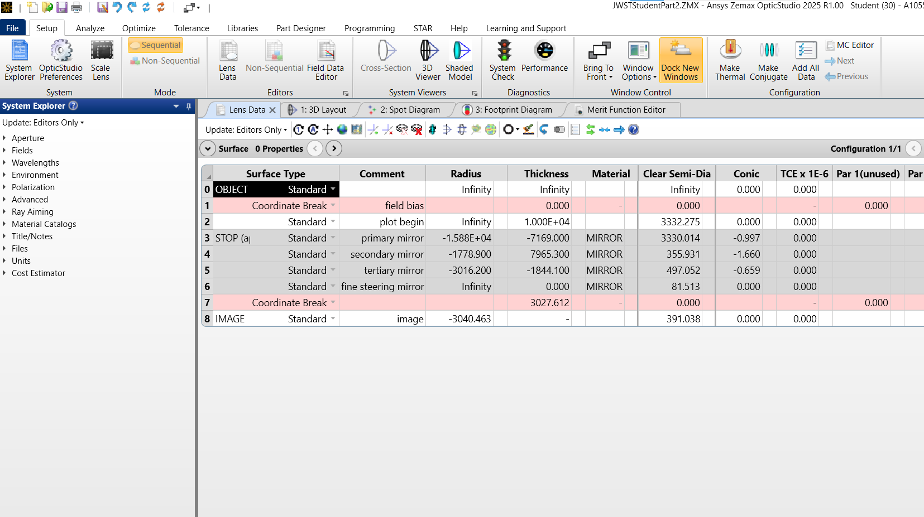
Quick Tips
To clean up your workspace, select Window Options → Dock All Windows to Workspace
Save your files as you go. "Save as" as often as you'd like to save your progress as a separate file so you can come back and work from that point if you ever get stuck. We recommend to "save as" after the basic TMA design analysis, after creating the hexagonal segments, and again after creating the non-sequential segments.
The blue arrow auto-fits your editor columns.
(optional): Set the Update setting to Editors Only. This way, open analysis windows won't update every time a parameter is changed, which could slow your device.
Tip 2
Tip 1
Tip 4
Tip 3

Slide 12
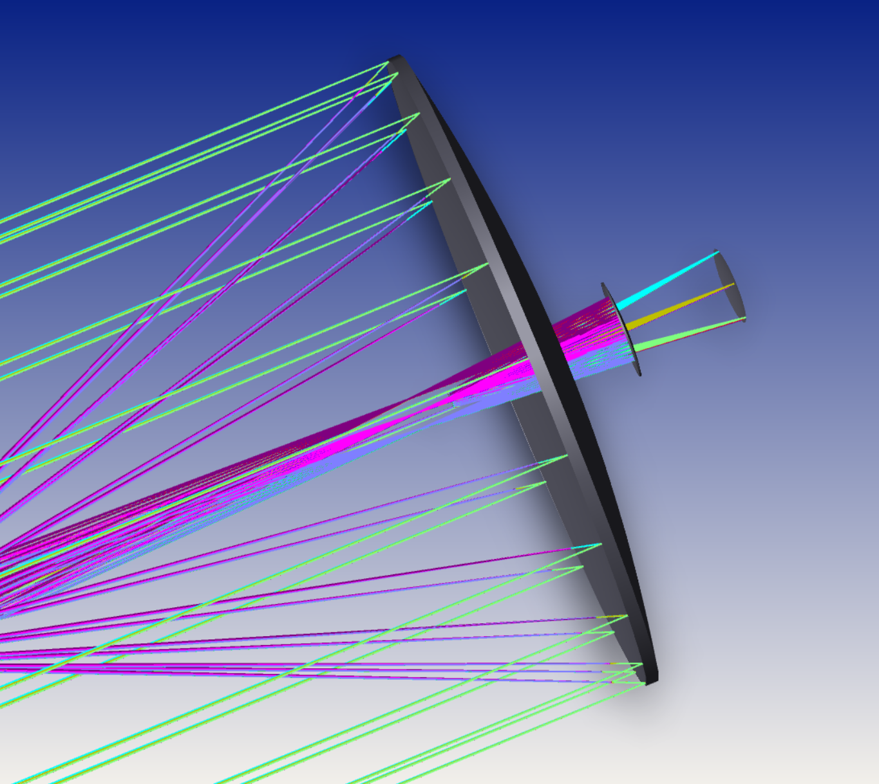
Conical mirrors
Telescopes utilize conic mirrors rather than spherical ones because spherical mirrors introduce substantial spherical aberration, preventing the accurate focusing of parallel rays to a single point. To address this in our system, we define the conic constants appropriately. A conic constant of -1 corresponds to a perfect parabola, which eliminates spherical aberration for on-axis light. However, parabolic mirrors introduce coma aberration, which causes off-axis light to distort into comet-shaped smears. To optimize off-axis performance, telescopes often adjust the conic constant to a value that balances spherical aberration and coma, improving image quality across the entire field of view.

Slide 13
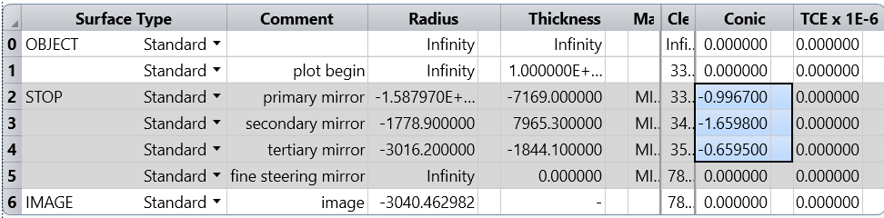
Conical mirrors
(1)
(2)
(3)
Surfaces
Let's proceed to set the conic constants for our curved surfaces, which are the primary, secondary, and tertiary mirrors. Within the LDE, the primary conic constant is set to –0.9967 (1), which is nearly a perfect parabola. Perfect parabolas have a perfect focal point on-axis but acquire coma rapidly for off-axis points. Thus, we use a slightly adjusted value with off-axis points in consideration. The secondary mirror is set to a conic constant of –1.6598 (2), making it a hyperbolic mirror. Finally, the tertiary mirror is set to a conic constant of –0.6595 (3).
Concept check: Go to the Wikipedia page for conic constant. What type of surface is the tertiary mirror?

Slide 14
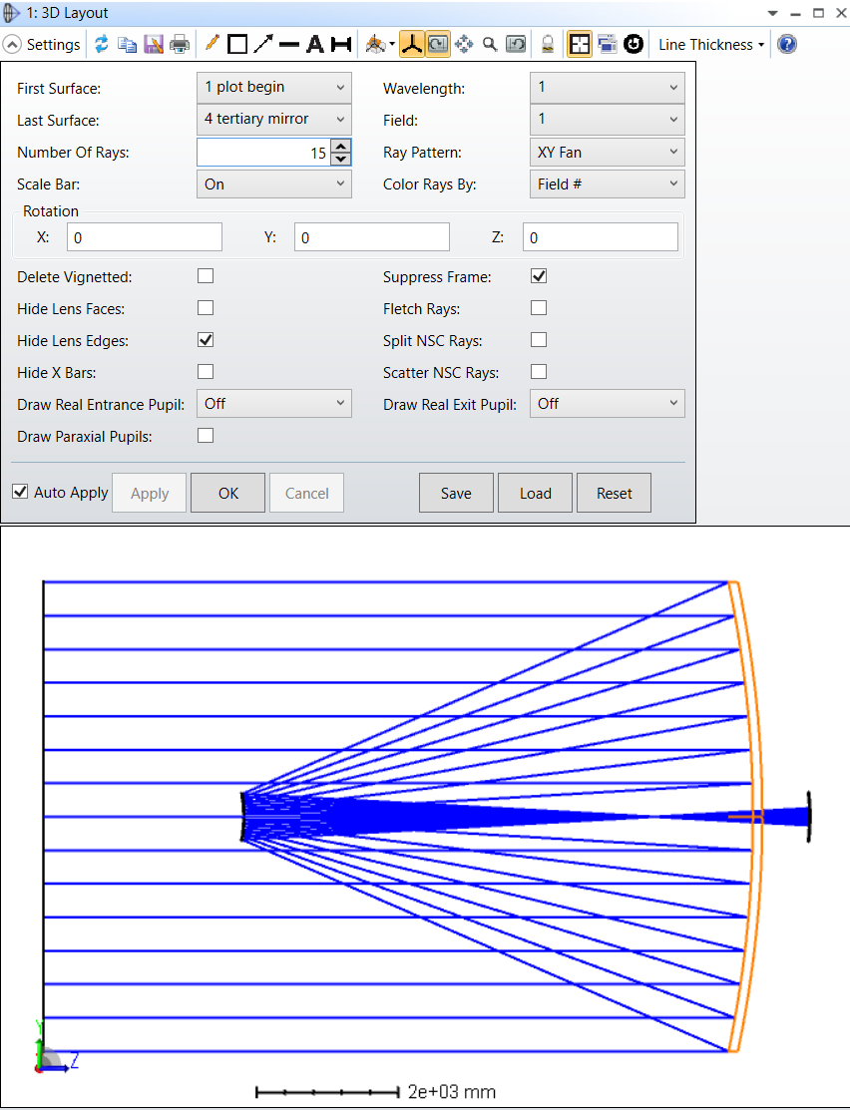
Conical mirrors
(1)
(2)
To further clean up our model, select the last surface as "4 tertiary mirror" (1) and select the hide lens edges setting (2). Notice the rays coming to a focus at the thin point after the secondary mirror.

Slide 15
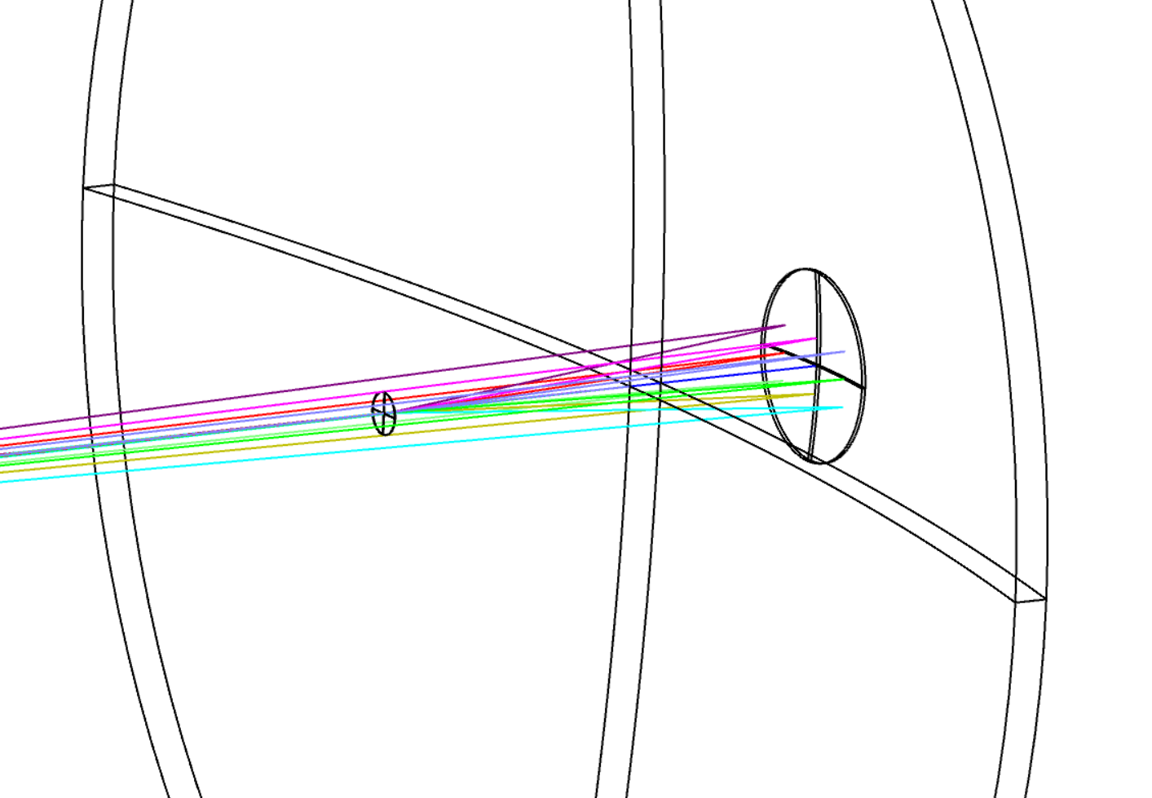
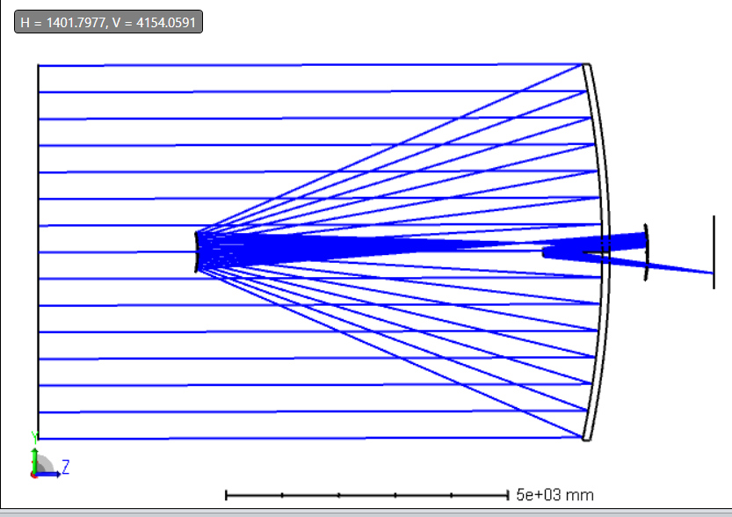
Field Bias
Notice the path of the rays. Rays from the stars are collected by the first mirror onto the second mirror, where they are focused before reaching the tertiary mirror, folded back to the fine steering mirror, and then onto the image plane. Oddly, the rays are magically passing through the fine steering mirror as it travels from the secondary to the tertiary mirrors, and then magically passes through the tertiary mirror as it travels from the fine-steering mirror to the image plane.
(2)
(1)
The JWST handles this using a field bias, which means the on-axis field point of the telescope is placed slightly off-axis. Within the LDE, we add a Coordinate Break surface type before the plot begin surface (1). Then, set the tilt about X to 0.16 degrees (2), thus tilting the telescope slightly off-axis. This sets a constant offset in angle for the whole telescope.
Can you trace the path described above in the 3D layout?

Slide 16
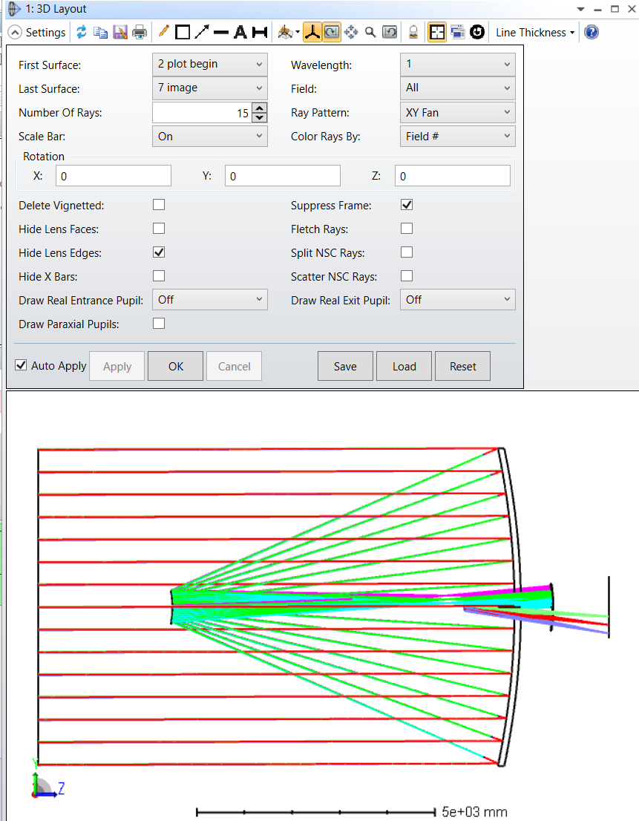
Initial TMA Analysis
Now, turn on all the field angles in the 3D layout settings (1). Recall, the incoming rays are collimated as they are from stars "infinitely" far away. The field angles are the angle of the incoming collimated rays. Thus, different angles image to different points on the image plane.
(1)

Slide 17
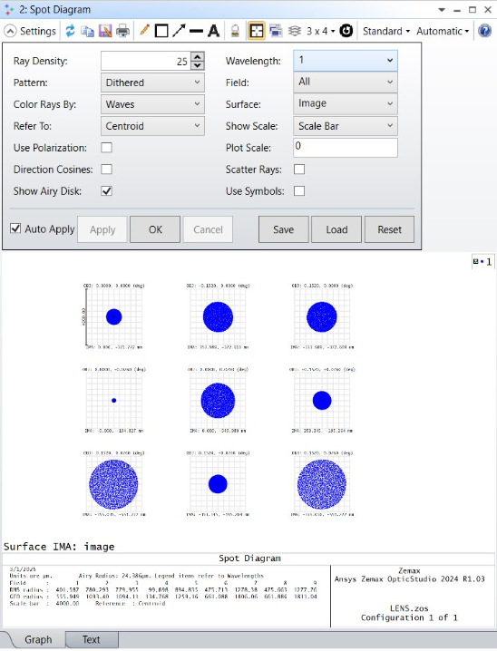
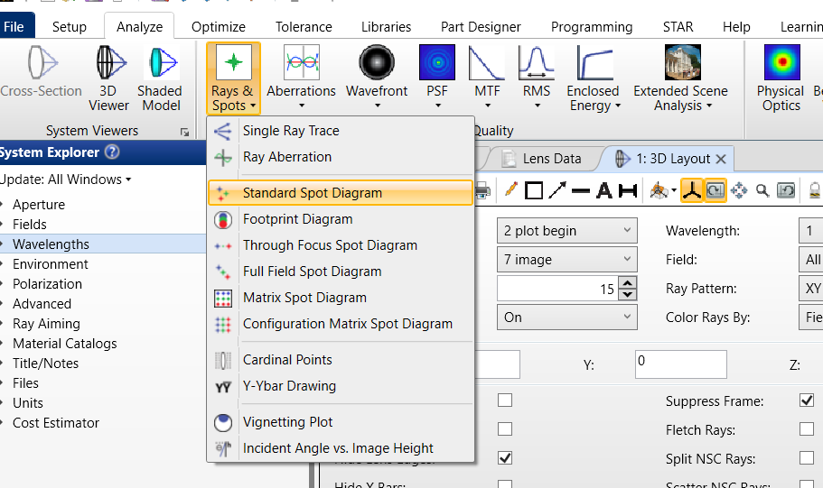
Initial TMA Analysis
(1)
Spot Diagram
(2)
The Standard Spot Diagram is accessible at any time under Rays & Spots within the Analyze Menu
Within the Analyze Menu, under Rays & Spots, open the Standard Spot Diagram. As we want to optimize our system for all field angles, set the Field parameter as All (1). Press OK (2).

Slide 18
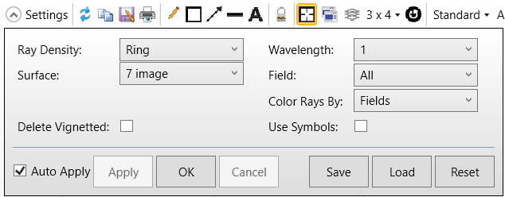
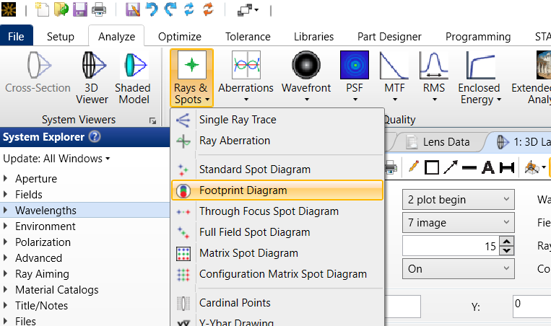
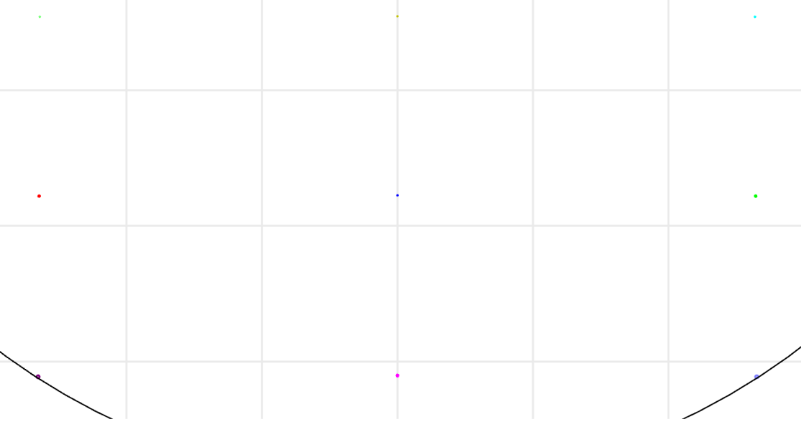
Initial TMA Analysis
Now, check the footprint diagram (Analyze → Rays & Spots → Footprint Diagram). We would like to analyze the image plane so set the surface to 7 image (1). Deselect Delete Vignetted (2). Press OK (3).
Footprint Diagram
(1)
(2)
(3)
The Footprint Diagram is accessible at any time under Rays & Spots within the Analyze Menu

Slide 19
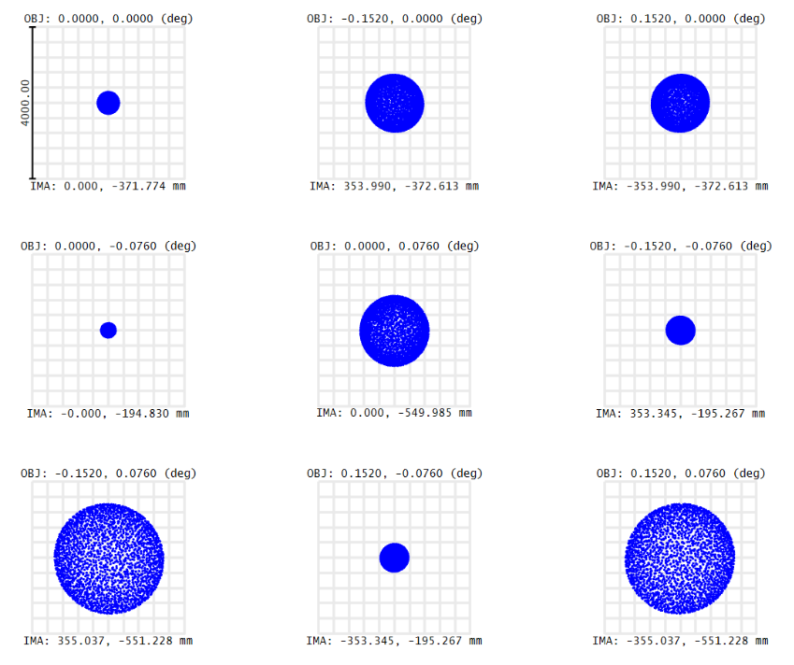
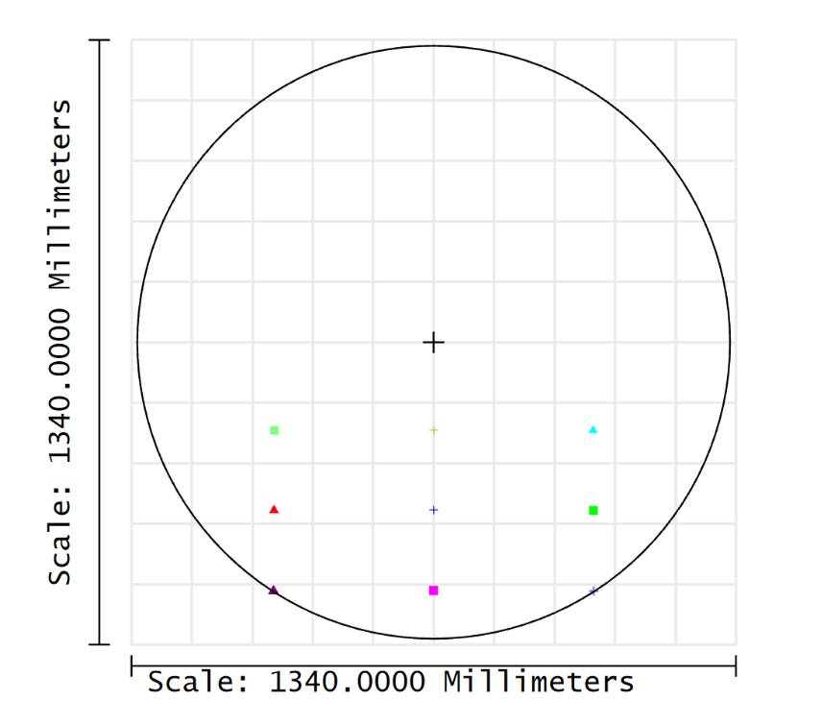
Initial TMA Analysis
Zoom into the points on the image plane. What do you notice about the size of the spots as you move down the y-axis? They get larger! Why does this indicate that our image plane should be tilted?
What is the difference between the footprint diagram and the spot diagram? When should you use one over the other?

Slide 20
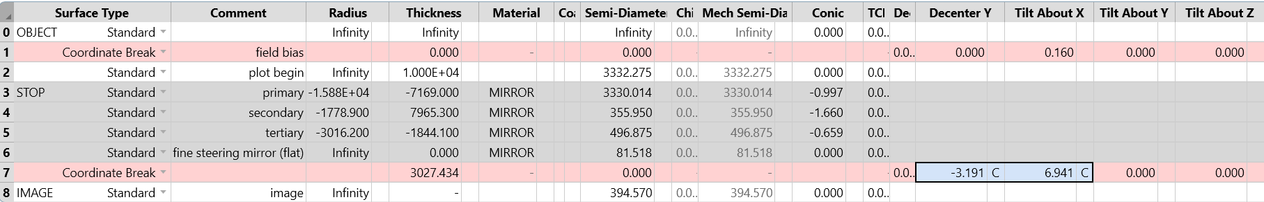
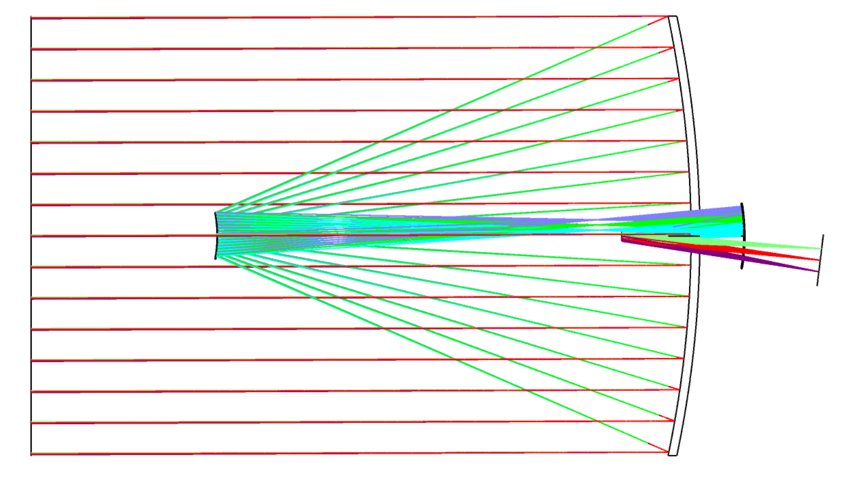
Tilting our Image Plane
To tilt the image plane, add a surface in the LDE above the image plane and set the type as Coordinate Break (1). Copy the thickness of surface 6 (the fine steering mirror) and paste it into the thickness entry box for surface 7 (our new coordinate break) (2). Set the thickness of surface 6 to be zero (3).
We will now perform a chief ray solve to calculate the amount of shift in y and tilt in x needed for the image plane. To do this, we simply set the boxes next to the Decenter X and Decenter Y columns of surface 7 as a chief ray solve (C) (4) & (5).
(1)
(2)
(3)
(4)
(5)
Concept check: Follow the chief ray in the 3D layout by setting the Field value to 1 in 3D Layout Settings.
Why would we want to optimize our system using the chief ray?
3D layout

Slide 21
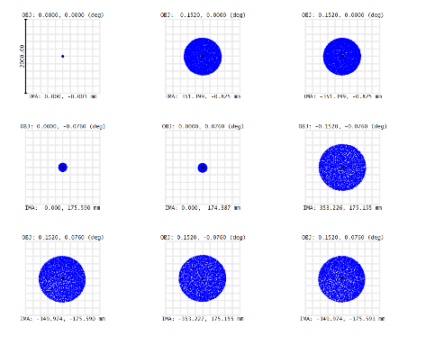
Tilting our Image Plane
On the spot diagram, we see now that the sizes of the four corners of the field are balanced {[R3, C1:C3] and [R2, C3]} while the on-axis points are in-focus {[R1 ,C1] , [R2 ,C1], [R2,C2]}.
Since we have out-of-focus spots on the corners and in-focus spots on-axis, this clearly indicates that we have some field curvature. To bring these points into focus, our image plane must match the field curvature. Remember, we are not placing detectors at the image plane, which would be difficult to curve. We are instead placing pick-off mirrors that direct light to various instruments on the telescope. Therefore, we can introduce the curvature that we need without worrying about manufacturing constraints.

Slide 22
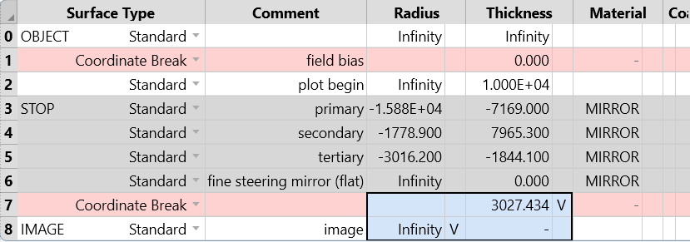
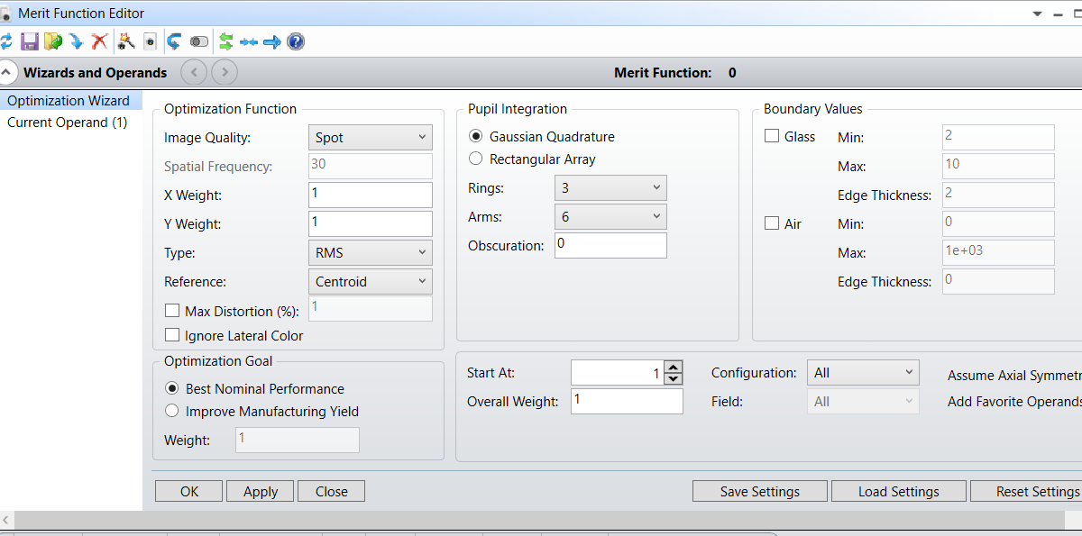
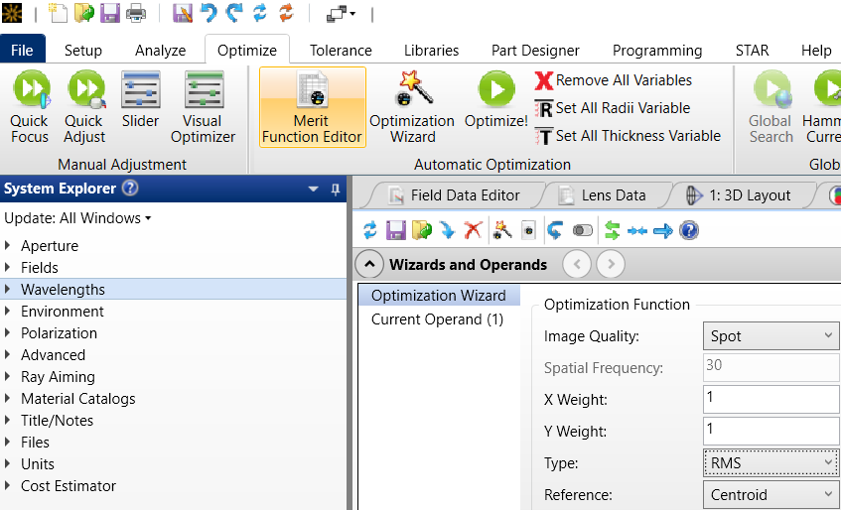
Curving our Image Plane
To curve our image plane to bring the off-axis points into focus, we set the radius to be variable (V) (1) and thickness of the image surface to be variable (V) (2), enabling it to have a radius of curvature that matches the field curvature of the telescope.
(2)
(4)
(1)
(3)
(5)
In the optimize tab, open the Merit Function Editor and open Wizards and Operands (3). Our design utilizes circular apertures, and thus we set our settings to sample across a circular domain. Type should be set to RMS by default. Set the Image Quality Parameter to be Spot (4), which bases it on spot radius. Press OK (5). We should now notice a slight shift in position and some curvature of our image plane.
Once again, we want a moderate number of rays to balance computational speed and accuracy. By default, we have one center ray when utilizing a Gaussian quadrature. By setting 3 rings and 6 arms, we get (6*3) + 1 = 19 rays!

Slide 23
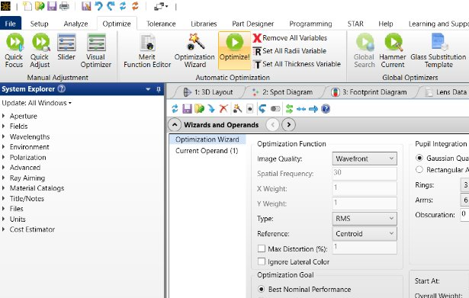
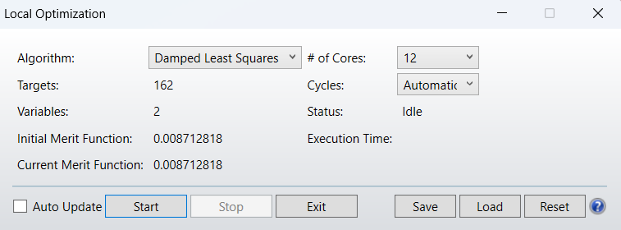
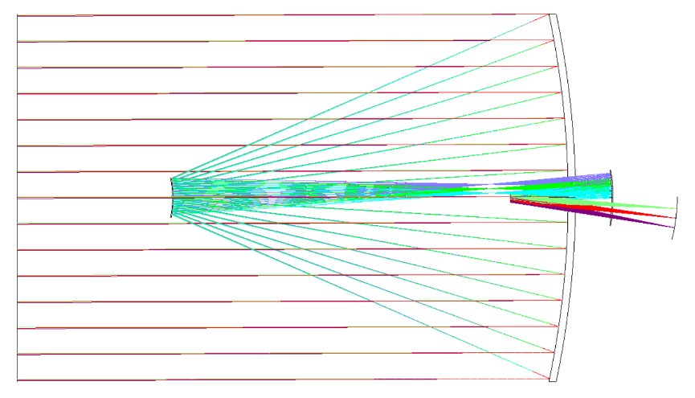
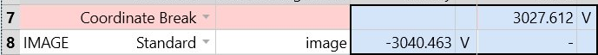
Curving our Image Plane
(1)
Now, we can run the optimization! Click the big green Optimize button within the Optimize menu (1). Select "Start" (2) within the pop-up menu that populates.
(2)
Verify that the thickness and radius values for surfaces 7 and 8 are –3040.463 mm and 3027.612 mm, respectively (3) & (4). Also, verify that the 3D Layout updates as shown (5).
(4)
(5)
(3)

Slide 24
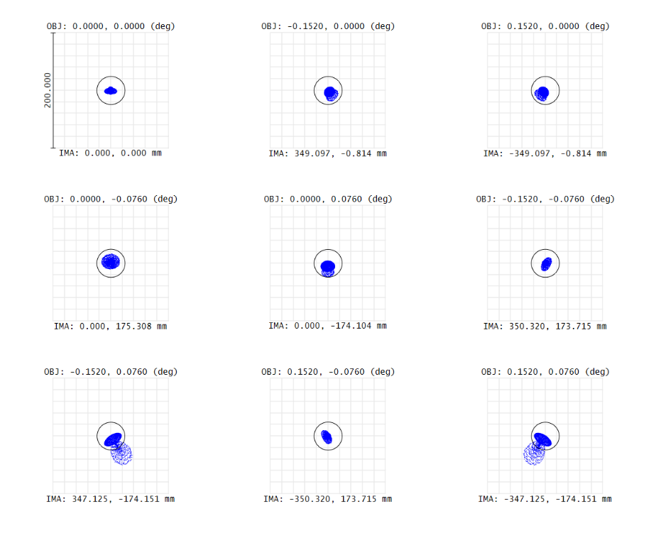
Initial TMA Analysis
The spot diagram shows a significant improvement in image quality. The spot sizes across the field are mostly smaller than or comparable to the Airy disk, indicating that the system is approximately diffraction-limited over the full field of view.
If the geometric spot size is smaller than the Airy disk, diffraction effects dominate and further improvement through aberration correction becomes negligible. In other words, a system is performing at the theoretical maximum resolution possible for its aperture size and wavelength if the RMS spot size is no larger than the Airy disk.

Slide 25
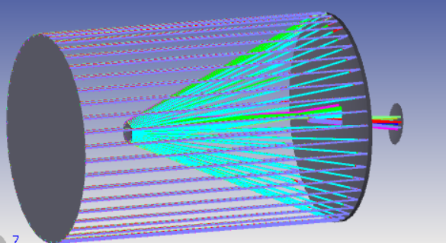
Tilting our Image Plane
This is our basic three-mirror anastigmat design of the James Webb Space Telescope. Google the James Webb Space Telescope for an interactive visual of the system. Compare it to the shaded model in OpticStudio (Analyze → Shaded Model), does the system make sense?
Parallel rays from distant stars are collected by the primary mirror and reflected onto the secondary mirror, which redirects the light through an opening at the center of the primary mirror toward the tertiary mirror. The tertiary mirror further refines the focus and directs the light to the fine steering mirror—a flat, adjustable mirror that stabilizes the image in real time. From there, the light reaches the imaging plane, where it is directed to various scientific instruments that convert the optical signals into binary bits for transmission back to Earth.

Slide 26
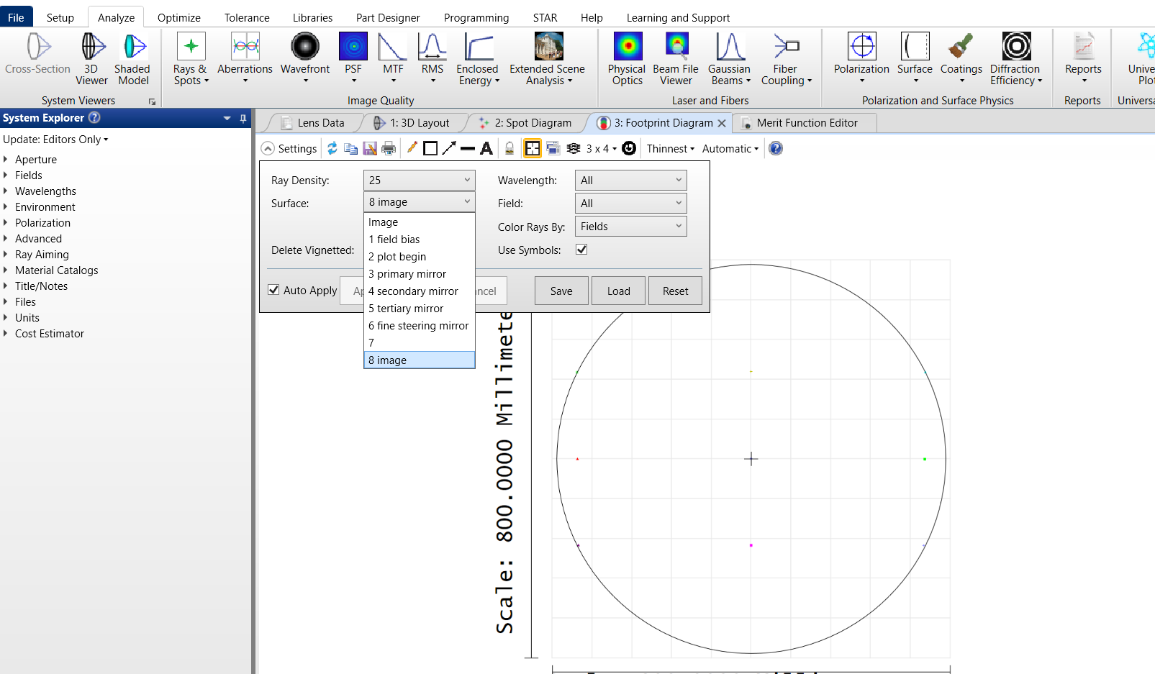
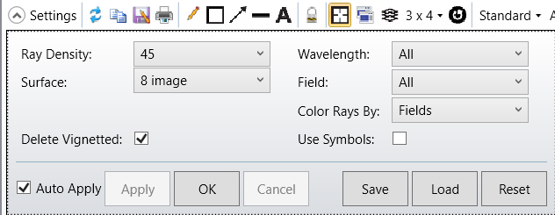
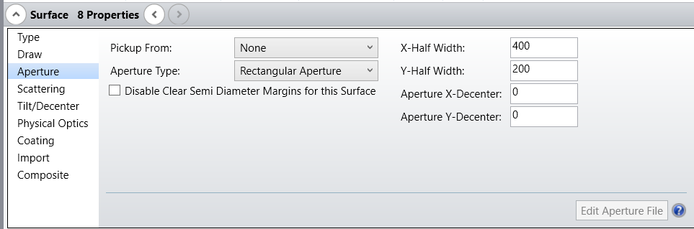
Surface Apertures
Within the footprint diagram, check the image plane by setting the Surface as 8 image (1). Select Delete Vignetted (2). Notice that the rays form a rectangular pattern, indicating that we need a rectangular aperture for the image plane.
Footprint Diagram
(1)
(2)
(4)
To do this, we add a rectangular aperture by going into the LDE and selecting the aperture type for surface 8 as Rectangular Aperture (3). Set the X-Half Width as 400 mm (4). Set the Y-Half Width as 200 mm (5).
(5)
(3)
Before proceeding to the next slide... Check the footprint diagrams for surface 5 and surface 6. What types of apertures do we need for these surfaces?

Slide 27
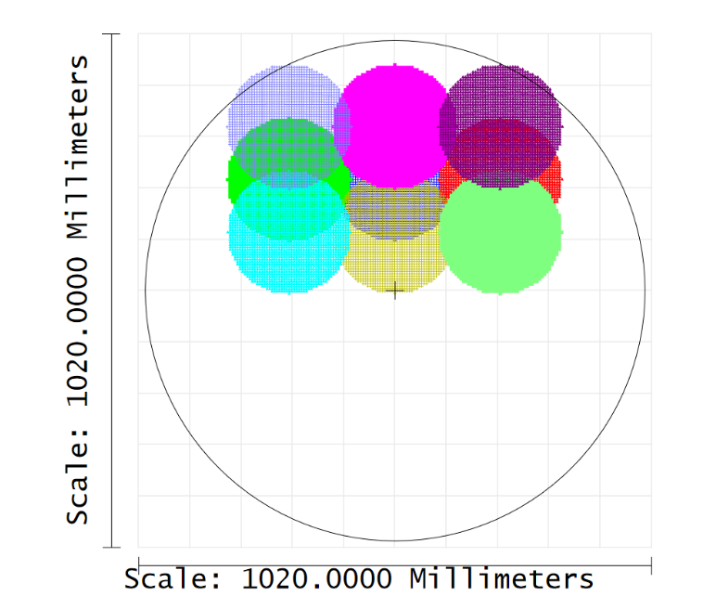
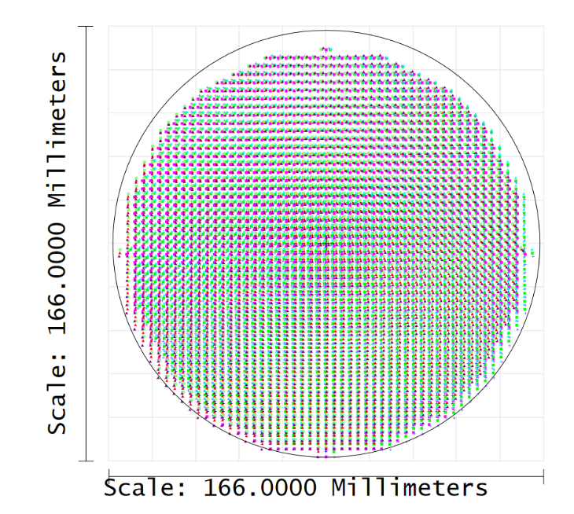
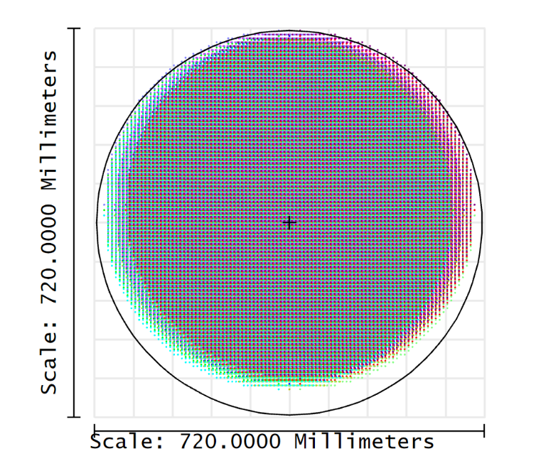
Surface Apertures
From the footprint diagram, we observe that we need a circular aperture for surface 4, a rectangular aperture for surface 5, and a circular aperture for surface 6.
Surface 5
Surface 6
Surface 4

Slide 28
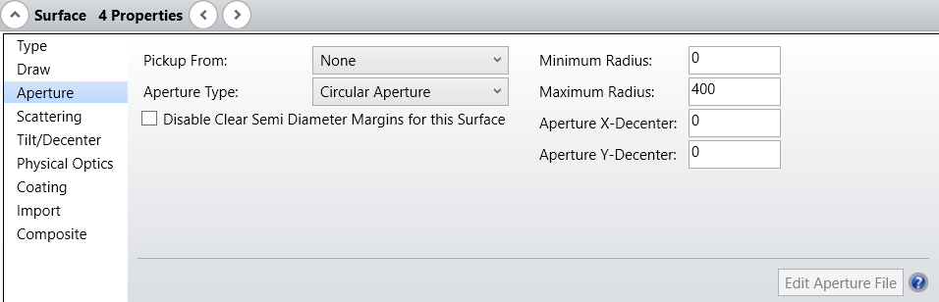
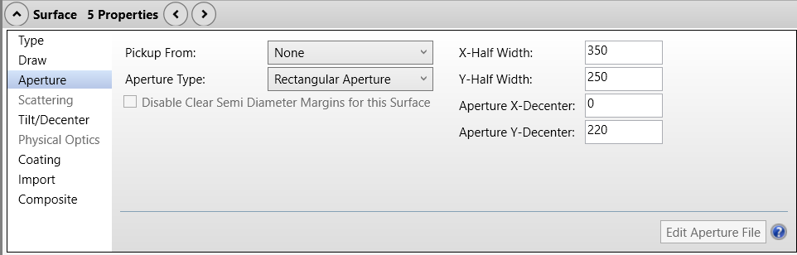
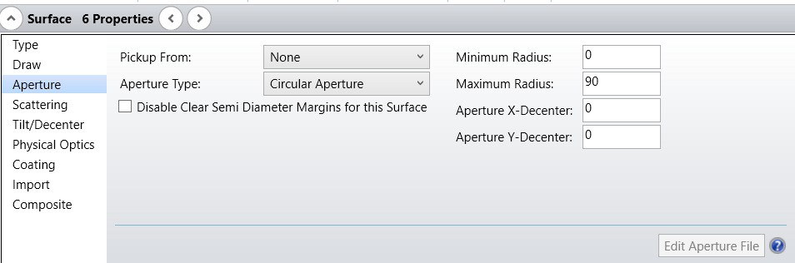
Surface Apertures
Set the Aperture Type for Surface 4 as Circular Aperture (1) and set the Maximum Radius as 400 mm (2). Set the Aperture Type for Surface 5 as Rectangular Aperture (3). Set the X-Half Width as 350 mm (4), Y-Half Width as 250 mm (5), and Aperture Y-Decenter as 220 mm (6). For surface 6, set the Aperture Type as Circular Aperture (7). Set the Maximum Radius as 90 mm (8).
(2)
(1)
(4)
(5)
(6)
(7)
(3)
(8)
Note: We set the maximum radius to 90 to leave some margin for error for our beam footprint.

Slide 29
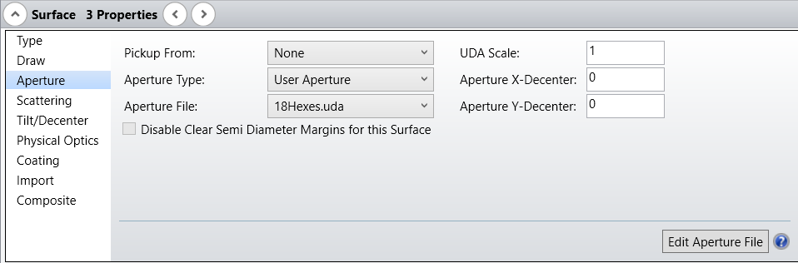
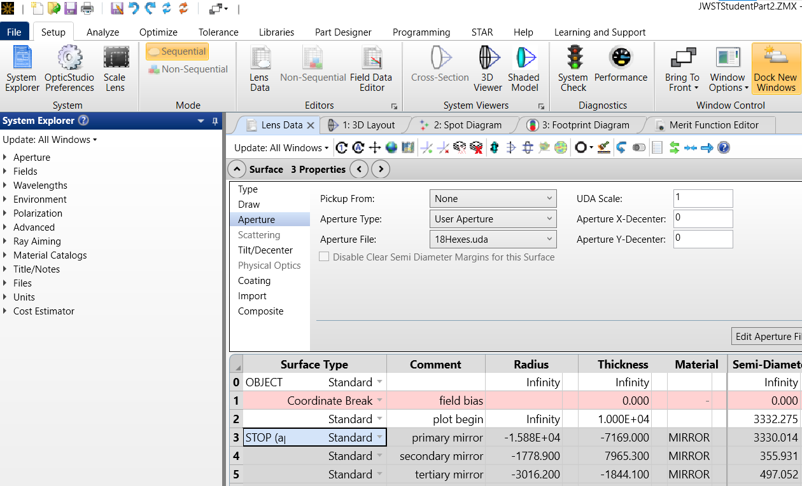
Surface Apertures
Now, we will create our hexagonal mirror segments. The User Defined Aperture file (UDA) has been provided, which is simply a text file specifying the hexagonal shape, dimensions, and spacing.
Remember to download the article attachments JamesWebb-ST2-Files.zip and extract the UDA zip file into the Zemax → Objects → Apertures folder.
Once the zip file has been extracted, set the Aperture Type for Surface 3 as User Aperture (1). Set the Aperture File as 18Hexes.uda (2).
(1)
(2)
Using a moderate ray density (i.e. 45), check the spot diagrams for each of the surfaces

Slide 30
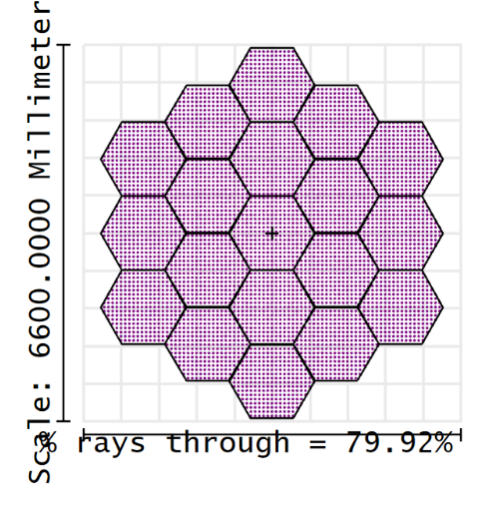
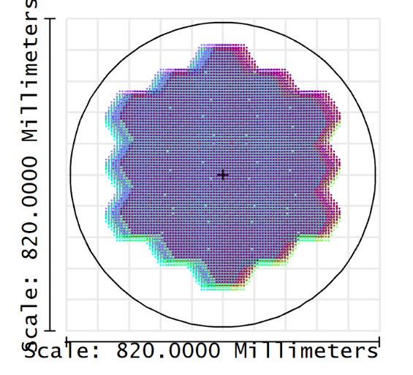
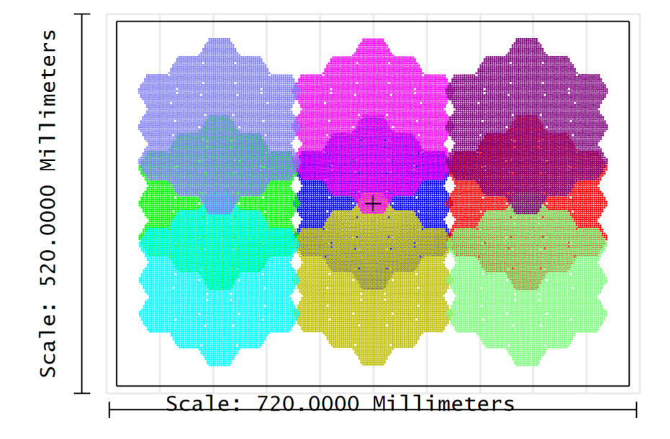


Surface Apertures
Your footprint diagrams should now align with the following figures:
Primary mirror
Secondary mirror
Tertiary mirrors
Fine-steering mirror
Select surface
Before proceeding to the next slide... Go through each of the surfaces in the footprint diagram. Which one is the aperture stop?

Slide 31


Surface Apertures
Feel free to check your 3D Layout, select the isometric view (1). Can you recognize the rectangular image plane and the rectangular tertiary?
Now, check the spot diagram. What conclusions can you draw about our system? Hint: What do you notice about the corners? Why would adding hexagonal apertures introduce vignetting?
View Settings (1)
Further thoughts... How does the JWST account for the aberrations and vignetting that we observe in our system?

Slide 32



Wavefront Map
(1)
Now, go to Analyze → Wavefront → Wavefront Map. First, let's try a sampling resolution of 512 x 512 (1). Set the Surface as 8 image (2).
The wavefront map provides a visualization of our wavefront aberrations for a specified wavelength, field, and surface.
You may notice some gaps missing in the wavefront map. Try increasing the sampling resolution. What happens?
(Feel free to reference the OpticStudio User Guide for a more detailed explanation of the Wavefront Map settings.)
(2)
Wavefront Map
Residual coma
Gaps missing due to low sampling resolution.

Slide 33


FFT Point Spread Function (PSF)
(1)
(2)
Size of grid of points for computation
Now, we would like to analyze the diffraction point spread function (PSF), first using the Fast Fourier Transform (FFT) method. To perform this operation, go to Analyze → PSF → FFT PSF Select an initial sampling resolution of 512 x 512 (1), display resolution as 1024 x 1024 (2), and the Image Delta as 1 (3) (this will zoom in into the core). Set the Surface as Image (4). If not already set by default, set Show As to False Color (5). Press OK (6)
(5)
(3)
(4)
The point spread function shows us how a system responds to a single point source - an impulse response! This shows us the quality of our system by showing us how points are blurred within our image.
(6)
FFT PSF
The FFT PSF is a very fast computation due to a few assumptions. The main assumptions to consider are:
the FFT PSF assumes the image plane is perpendicular to the chief ray at the reference point
it assumes the far-field (Fraunhofer) regime. Don’t worry if this doesn't make sense yet. In the next section, we'll try the Huygen's PSF and the shortcomings of the FFT PSF should become clearer. (Note, the FFT PSF can only be computed for sequential systems)
Reference OpticStudio User Guide for a more detailed explanation of the FFT PSF settings and assumptions.

Slide 34



FFT PSF
Our linear plot looks as follows:
Clearly, details are hard to see, especially within regions where errors are small. Thus, we want to view the logarithmic plot. In your PSF settings, simply change the Type from Linear to Logarithmic (1).
(1)
From these patterns, we see our 6 "arms" that take the structure of the diffraction pattern we'd expect from our hexagonal apertures. In addition, we see the core take a shape reminiscent of a hexagon.

Slide 35
Huygen's PSF
The Huygen's PSF treats the wavefront as a collection of spherical secondary wavelets, where each point on the wavefront acts as a secondary source that emits its own spherical wavelets. The generated diffraction pattern is then the interference, or complex sum, of all the spherical wavelets radiated from points across the aperture. To compute this, a grid of rays is traced through the optical system, where each ray carries a specific amplitude and phase. The intensity is the squared magnitude of the complex sum of these wavelets at that location. This process is repeated across the entire image grid to generate the full PSF. Clearly, summing up the contributions from an array of spherical wavelets is a significantly more computationally demanding task than the FFT PSF, which performs one operation for each point.
Unlike the FFT PSF, the Huygen's PSF is performed on a tangent plane that follows the actual image surface, which is often tilted or curved in optical systems, at the chief ray intercept. This means that it accounts for subtle changes in the diffraction pattern caused by local surface geometry that the FFT PSF misses by assuming a flat, orthogonal image plane.
(Feel free to reference the OpticStudio User Guide for more detailed discussion of how the Huygen's PSF is calculated and other advantages of the Huygen's PSF)
Concept Check: Given the Huygen's PSF's several advantages, why don't we always use the Huygen's PSF for analysis of our optical systems?

Slide 36


Huygen's PSF
(1)
To run the Huygen's PSF, simply select the menu option for Huygen's PSF in the sidebar next to where you selected the FFT PSF (1). Keep in mind that increasing the pupil and image sampling resolutions will significantly slow the computation time. We recommend starting with a lower value and working up to a resolution that takes a reasonable amount of time on your device. A reasonable resolution on the average device appears to be a 512 x 512 pupil sampling (2) and 1024 x 1024 image sampling (3), which should take around 5 minutes to run. The type specifies the logarithmic scaling from 1 to 5 decades. Log –5 is useful for inspecting the finest structures in our PSF. Set Type to Log –5 (4). If not set by default, set Show As to False Color (5). Press OK (6).
Note, this operation will take some time (5+ minutes). Feel free to lower the image sampling resolution if the operation takes too long.
Reference OpticStudio User Guide for a more detailed explanation of these settings.
(2)
(3)
(4)
(5)
(6)

Slide 37


Huygen's PSF
Our linear plot looks as follows:
Log –5, 512 x 512 Pupil Sampling, 1024 x 1024 Image Sampling:
Compared to the FFT PSF, the Huygen's PSF exhibits clearer details, particularly near the centroid. The differences between the two PSF's differ significantly as one moves from the center to the outer edges of the plot.
From our analysis of the FFT PSF, does the generated Huygen's PSF also make sense? What conclusions can you draw?

Slide 38

Non-Sequential Mirror Segments
We will now set up the primary mirror as a non-sequential segment within the sequential system. Setting up non-sequential elements allows us to analyze the diffraction effects of the sequential model while giving us the advantages for stray light analysis on the primary mirror. We will also soon see that creating non-sequential mirror segments allows us to optimize each mirror segment individually, which allows us to fine-tune our system for maximum performance.
Create two new surfaces after the primary mirror within the LDE (1) and leave the primary mirror as the STOP. Remove the radius, thickness, material, and conic (2). Label surface 4 and 5 as the Non-Sequential Entrance Port (3) and Non-Sequential Exit Port (4) (our new primary lens). Set the surface 4 Surface Type as Non-Sequential Component (5). These entrance ports should be large. Set them to 3500 mm (6). Ignore error messages for now. These are due to rays not tracing properly as we have not yet set our mirror in place.
(6)
(1)
(5)
(3)
(2)
(4)
*Reference OpticStudio User Guide for more information

Slide 39

Non-Sequential Mirror Segments
Rays should enter this entrance port and reflect in the reverse direction. To enable this, set the reverse rays column of surface 4 as 1 (1). Set the draw port column to 3 (2) so that the layout plot shows both the entry and exit ports*. The exit location should be set to be about 100 mm behind the entrance port (3).
(2)
(3)
(1)
Now that surface 3 is no longer set as the primary mirror, set the aperture type for surface 3 as None within the LDE Surface 3 Properties (4).
(4)
*Reference OpticStudio User Guide for more information.

Slide 40


Non-Sequential Mirror Segments
Non-Sequential Component Editor
In the non-sequential component editor, set the object type to Standard Surface (1). Label this as the single primary (2). Set the z-position to be 600 mm with respect to the entrance port (3). Set the material type as MIRROR (4). Set the radius as –15879.7 mm (5), which was the radius of curvature of the primary mirror. Set the conic constant to –0.9967 (6). The maximum aperture will be set to 3500 mm (7).
Now, we set our mirror using the specifications shown in the beginning of this tutorial. Our maximum aperture is set to 3500 to provide ample ray coverage.
(1)
(2)
(3)
(4)
(5)
(6)
(7)
Since the exit port is –100 mm from the entrance pupil and we have set the z-position with respect to the entrance port to be 600 mm, this means our primary mirror has been shifted 700 mm to the right. Hence, we add 700 mm to our original thickness of –7169 mm to get value of –6469 mm to set as our surface 5 thickness within the LDE (8).
(8)

Slide 41


Non-Sequential Mirror Segments
Check the 3D Layout & Spot Diagrams
Does the path make sense?
Are any of the rays being trimmed?
Are the entrance and exit ports placed appropriately?
How do we expect our spot diagrams to change once we load our hexagonal apertures?

Slide 42




Non-Sequential Mirror Segments
To keep the hexagonal structure, go to the non-sequential component editor (NSCE), select object 1 properties, and under user defined aperture, select 18Hexes.uda (1).
(1)
Check the spot diagrams and 3D layout again. Verify that things look as they should.

Slide 43


Non-Sequential Mirror Segments
Now, let's separate the segments so that we can adjust each mirror separately.
Within the non-sequential component editor (NSCE), select the user defined aperture file as Hex10.uda (1). This should give us a single on-axis segment (which you can see in the 3D layout).
(1)

Slide 44

Non-Sequential Mirror Segments
Now, we must copy the object properties for the 19 mirror segments. In the NSCE, make 19 copies for the 19 segments by selecting the left-most column of the first object, right-clicking and selecting "copy object", creating a new object after the first, and then pasting the object into the new row.
Recommendation: To speed things up, after creating two new copies, select the first three objects and copy them as a group. Now, you can paste three copies at a time until you have 19 objects in total (you will have to delete your extra copies to have a total of 19). Update the comments section to reflect which hex segment it is (i.e. hex 1, hex 2, etc.)

Slide 45
Non-Sequential Mirror Segments
For each object, open the properties and selected the UDA file that correspond with that hex segment number (e.g. Hex1.uda for hex )
Select corresponding UDA file
Remember to repeat this step for hexes 1 through 19. Once finished, verify that all segments are present in your 3D layout.

Slide 46


Non-Sequential Mirror Segments
Now, we can adjust the tilt of the mirror segments. In the z-position entries we want to adjust some of the values by half a micron (recall that the mirrors must be aligned within 0.1 um of precision on the JWST to focus incoming light and produce a diffraction-limited image). To do this, we first go into OpticsStudio Preferences and change the decimals dropdown box from 3 to a higher value. I've set it to 6 (1).
(1)

Slide 47


Non-Sequential Mirror Segments
Go back to the Non-Sequential Component Editor (NSCE) and add 0.5 um to the z-position of surface 2 (1) and subtract 0.5 um from surface 5 (2).
(1) & (3)
(2) & (3)
The wavefront map should reflect the z-axis change (aka "piston") on two of the hexagonal segments. Notice that this change does not affect our spot diagram by much, just our wavefront map.
Why do you think this is? (Hint: spot diagram is determined by the geometric ray trajectory)
You can now revert the altered Z Position values back to 600 mm (3).

Slide 48


Non-Sequential Mirror Segments
[No step required] If we proceeded to change the tilt values within the NSCE, we would introduce tilt AND piston, yielding the following wavefront map. Notice that the center of the tilted segment is not red, indicating that the segment has been translated along the z-axis and tilted.
To avoid this, we can add a pivot point.
In the NSCE, add an object before hex 8 (1). The center of hex 8 is set to 2598 mm so we set the Y-position of the pivot point to be 2598 mm. This means hex 8 must be shifted down by the same amount to maintain its original position. Thus, we add a pickup to surface 8 with a scale factor of –1 (2) and set the reference object column ("Ref Object" ) for object 9 as object 8 as shown (3).
(1)
(2)
(2)

Slide 49



Non-Sequential Mirror Segments
To check that our segment is tilting correctly, we can set an arbitrary value for Tilt About X. For the following diagram, we used a value of 1e-4 (1).
Can you identify why the tilt is now correctly performed?
(Hint: compare with the figure on the last slide)
(1)
Note that the tilt will change the trajectory of some of the rays, which we see reflected in the spot diagram.

Slide 50


Non-Sequential Mirror Segments
We've demonstrated how the JWST can tilt each of its mirror segments. We can continue this process for each of the eighteen mirrors to achieve optimal precision. To try it yourself, the next slide includes the necessary X and Y Position Values to input into your NSCE.
Final Wavefront Map
Final Spot Diagrams

Slide 51


Non-Sequential Mirror Segments

Slide 52
Key Outcomes
In this tutorial, we learned how...
A Three-Mirror Anastigmat (TMA) design corrects aberrations and improves image quality.
A segmented, large-aperture primary mirror can achieve high angular resolution for IR imaging.
To utilize OpticStudio Analysis tools to identify aberrations and assess image quality.
To use tilt and curvature adjustments to bring off-axis field points into focus.
To utilize OpticStudio Optimization Wizards during optimization.
To interpret Wavefront and PSF Data.
To balance computational efficiency vs. accuracy (i.e. the advantages and disadvantages of the FFT PSF vs. the Huygen's PSF)
To model the segmented primary mirror as a non-sequential system, which allows for additional fine-tuning.

Slide 53
Further References & Work Cited
Ansys Zemax OpticStudio User Guide, Ansys Support, https://ansyshelp.ansys.com/public/account/secured?returnurl=/Views/Secured/Zemax/v252/en/OpticStudio_User_Guide/index.html
“JWST Part 1 – Designing the James Webb Space Telescope Webinar.” Zemax Support, https://support.zemax.com/hc/en-us/articles/1500005489621-JWST-part-1-Designing-the-James-Webb-Space-Telescope-webinar .
“JWST Part 2 – Modeling the James Webb Telescope Segments in OpticStudio Webinar.” Zemax Support, https://support.zemax.com/hc/en-us/articles/1500005577422-JWST-part-2-Modeling-the-James-Webb-Telescope-segments-in-OpticStudio-webinar.
Lightsey, P. A., et al. “Large Deployable Cryogenic Telescope in Space.” SPIE Digital Library, vol. 51, no. 1, 2012, doi:10.1117/1.OE.51.1.011003. https://www.spiedigitallibrary.org/journals/optical-engineering/volume-51/issue-1/011003/James-Webb-Space-Telescope--large-deployable-cryogenic-telescope-in/10.1117/1.OE.51.1.011003.full .
"Conic Constant" Wikipedia, Wikimedia Foundation, 27 April 2024. https://en.wikipedia.org/wiki/Conic_constant .

Slide 54
Ansys Education Resources Feedback Survey
Here at Ansys, we rely on your feedback to ensure the educational content we create is up-to-date and fits your teaching needs.
Please click the link below to fill out a short survey (~7 minutes) to help us continue to support academics around the world utilizing Ansys tools in the classroom.
Feedback Survey Link
Notes:
Feedback Survey link for copy-paste method → https://ansys.typeform.com/to/jcattJI5

