Slide 1
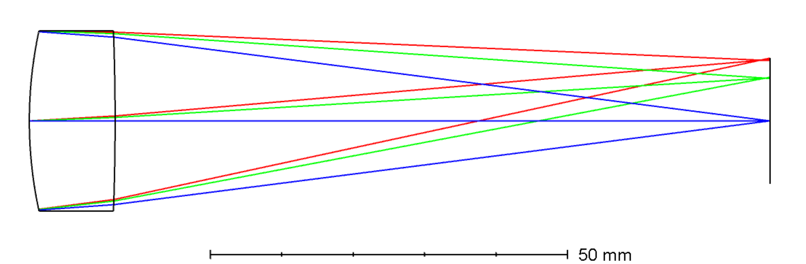
Design Your First Lens: An Introduction to Imaging Systems
Developed and curated by the Ansys Academic Team
Harriet Parnell
education@ansys.com

Slide 2
Learning Objectives
Ansys software mentioned | Ansys Zemax OpticStudio®, optical system design and analysis software.
This tutorial introduces the fundamentals of designing a simple imaging system using OpticStudio software. Designed for complete beginners, it provides an easy step by step example of how to create an optimized single lens system. While it is perhaps the simplest of designs, the principles covered lay the foundation for understanding real-world applications, be that compact, high-performance lenses found in modern smartphone cameras or disease diagnosis with optical coherence tomography.
Intended Learning Outcomes
1. Set up and configure an optical system in OpticStudio software
2. Analyze and interpret system performance using OpticStudio tools
3. Optimize an optical system to meet design goals
Further reading/information
Ansys Academic Ansys Innovation Courses Ansys Education Resources

Slide 3

How to use the tutorial
/ Structure: This tutorial has been divided into three sections.
Part 1: Setup
Introduction to software and design specification translation
Skip ahead >
Part 2: Analyze
Evaluate performance of starting singlet with common analysis tools
Skip ahead >
Part 3: Improve
Introduction to optimization and the Merit Function Wizard
Skip ahead >
/ Teaching support: Alongside ready-to-use slides, each one includes detailed teaching notes to support delivery. Many slides also feature additional discussion prompts and mini exercises designed to challenge students, deepen understanding, and encourage active learning. The goal is for students to develop confidence in solving basic imaging system problems independently, rather than simply following this example as a step-by-step guide.

Slide 4
Part 1: Setup your system
What does this section cover?
This module introduces students to OpticStudio’s Sequential Mode Tool and covers the essential steps for setting up a basic singlet lens system. The focus is on converting system specifications into a functional optical model.
Learning outcomes:
Navigate the OpticStudio interface in Sequential Mode.
Set up a basic singlet lens using the Lens Data Editor.
Apply Solves to enforce design constraints like F/# and focal length.
Understand the role of the STOP surface and its impact on ray tracing and system behavior.
Interpret field angles and image height in the context of system geometry.

Slide 5

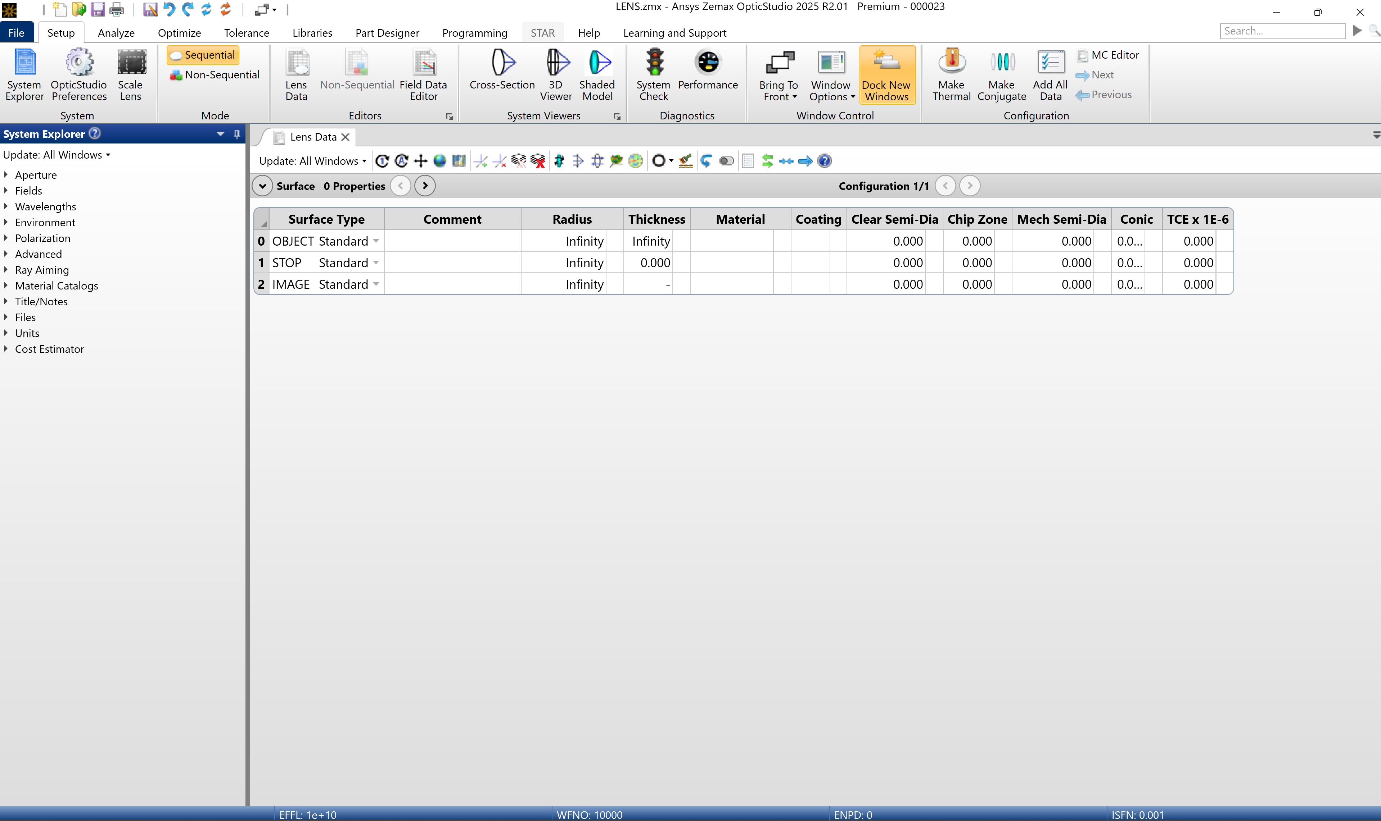
Sequential Mode Overview Starting interface
Ribbon
User-definable toolbar
clustered into task-oriented tabs
Lens Data Editor
Found within the workspace.
A spreadsheet format that allows the software to trace from one surface to the next in the order they are listed.
System Explorer
System-specific optical data, typically set at the start of design and rarely changed afterward.
Where can you go to find help or additional resources?
Status bar
Notes:
Teaching notes:
What is Sequential Mode? Sequential Mode traces the rays through a predetermined sequence of surfaces originating from the Object plane until they reach the Image plane.
When you open OpticStudio, you’ll see a blank Lens Data Editor in the main workspace. This is a spreadsheet-style interface where most of your lens data is entered. Each row represents a surface, one of which must be defined as the STOP (aperture stop).
To the left of the workspace, you’ll find the System Explorer. This panel contains system-specific information like aperture settings, field definitions and wavelengths.
Suggested answer: The ‘Learning and Support’ tab in the ribbon toolbar contains links to extra learning e.g. Ansys Innovation Courses.

Slide 6
Optical System of interest Singlet lens
For this tutorial we will design and optimize an F/4 singlet lens made of N-BK7 glass.
The final design should meet the following specifications and constraints:
Specification | Constraint
Focal Length | 100 mm
Semi-Field of View (SFOV) | 5 degrees
Wavelength | 632.8 nm (HeNe)
Center Thickness of singlet | Between 2 mm to 12 mm
Edge Thickness of singlet | Larger than 2mm
Optimization criteria | RMS Spot Size averaged over FOV
Object location | At infinity
Why is the object placed at infinity in this design?
Why do we set edge thicknesses?
Can you think of a common application for singlet lenses?
Notes:
Suggested answer:
1. Answer: Placing the object at infinity simulates a collimated beam entering the system, which is typical for imaging systems like telescopes or cameras focused on distant objects. It simplifies ray tracing and is ideal for evaluating paraxial performance.
2. We set edge thicknesses to ensure the lens is mechanically robust and manufacturable.If the edge is too thin, the lens can chip or break during fabrication and handling. Minimum edge thickness also allows for safe mounting in lens holders and prevents stress or distortion during assembly.
3. Magnifying glass
While it represents the simplest imaging system in OpticStudio, this example is an excellent starting point for beginners. It not only introduces the software interface but also reinforces fundamental optical design principles and methodologies that underpin more advanced systems.

Slide 7
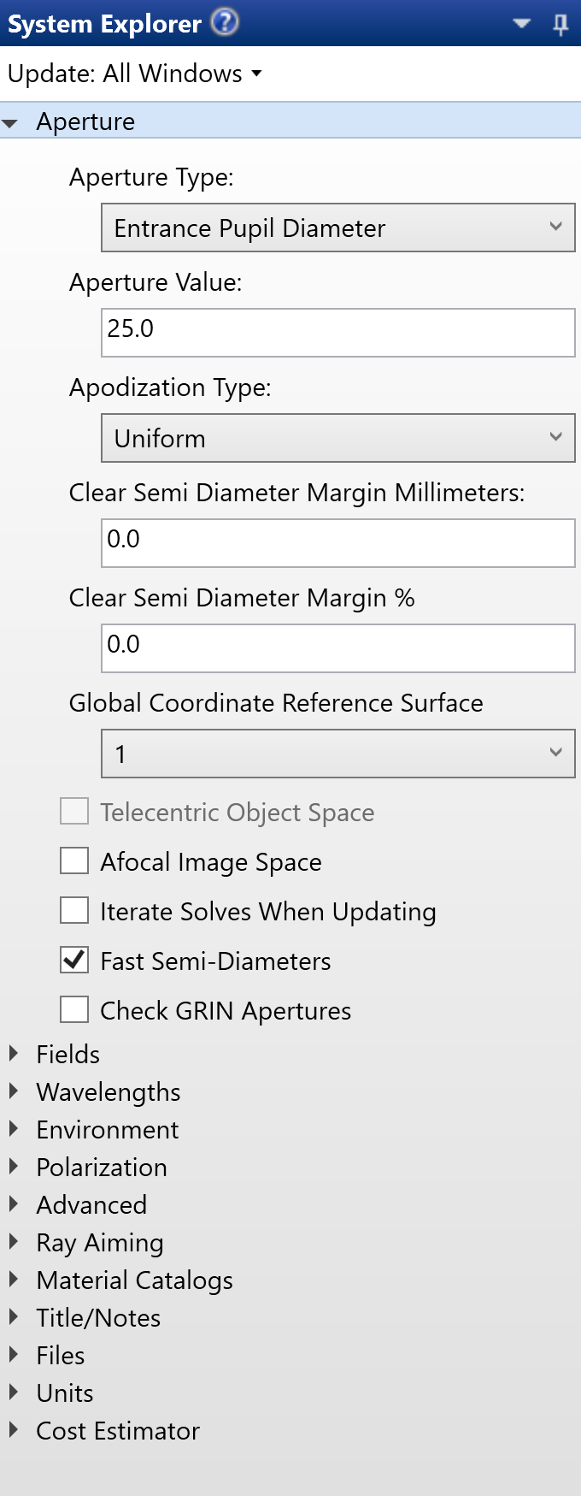
System Settings Defining Aperture
/ Step: Set Entrance Pupil Diameter (EPD) to 25 mm in the System Explorer.
The system aperture defines beam size and initial ray directions.
Common aperture types include Entrance Pupil Diameter (EPD), Image Space F/#, Object Space NA, Float By Stop Size, etc.
Ensure Lens Units = millimeters under System Explorer, Units.
Mini Exercise: Demonstrate why is the EPD set to 25 mm for an F/4 lens with a 100 mm focal length.
$$F/\#=\frac{\text{Effective} \text{Focal} \text{Length}}{\text{Entrance} \text{Pupil} \text{Diameter}}$$
Notes:
Teaching notes:
When starting a new design in OpticStudio, the system aperture is usually the first parameter to define. It controls the size of the beam traced and sets the initial direction cosines for rays from each field point.OpticStudio offers several aperture definitions, but Entrance Pupil Diameter (EPD) is the most common and convenient for this example. EPD is the diameter of the pupil as seen from object space.
For our singlet lens:
With F/# = 4 and focal length = 100 mm, the EPD will be 25 mm.
Always confirm system units before entering data. OpticStudio supports millimeters, centimeters, inches, or meters. For this design, select millimeters under System Explorer, then the dropdown Units.
Suggested answer: We can easily determine the EPD required for the singlet lens. The singlet lens must have an F/# equal to four and an effective focal length of 100 mm. Since the F/# is the ratio of the paraxial effective focal length at infinite conjugates over the paraxial entrance pupil diameter, the appropriate EPD is 25 mm.

Slide 8
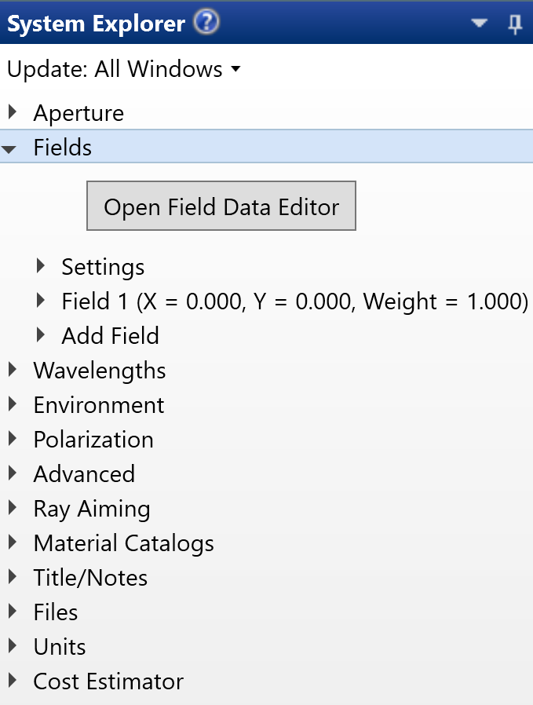
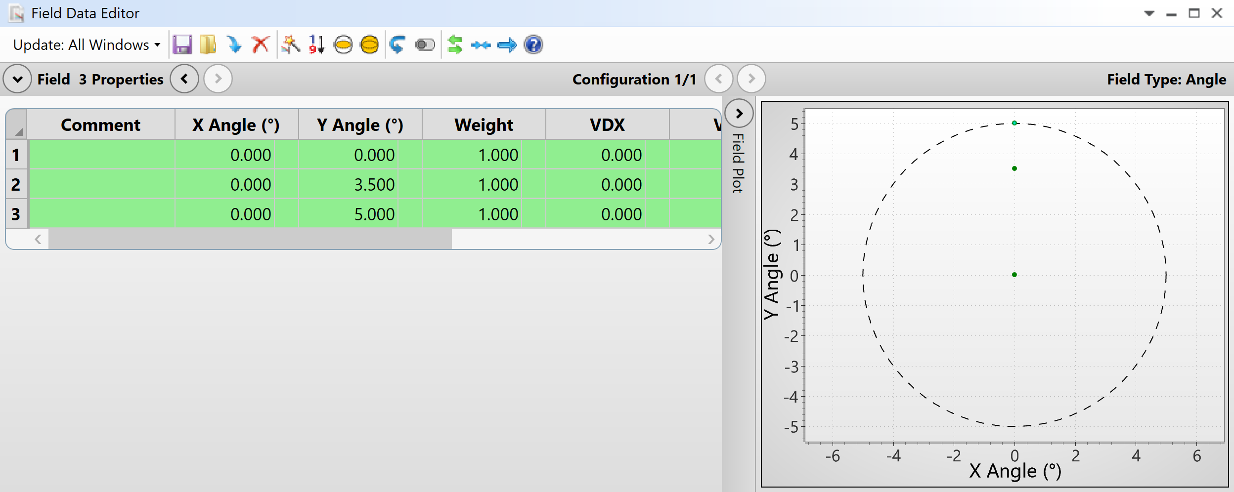
System Settings Defining Fields
/ Step: Define three field angles in System Explorer, Field Data Editor: 0°, 3.5°, 5°. Field angles are applied to the Y Angle specifically.
Fields represent positions across the Field of View (FOV).
Multiple field points allow performance checks on-axis and off-axis.
For this design:
Object at infinity → use angular fields.
All field weights = 1.
What is the significance of defining three field angles (e.g. 0°, 3.5°, 5°)?
Using the small-angle approximation, calculate the paraxial image height for a 5° field angle.
Image Height ≈ f⋅tan(θ)
Where f is focal length and θ FOV
Notes:
Teaching notes:
When defining fields in OpticStudio, we specify where rays originate across the field of view. For a singlet lens with an object at infinity, angular fields are most appropriate.
Rather than a single field angle, we define three points (0°, 3.5°, 5°) within the required 5° FOV. This ensures we can evaluate performance both on-axis and off-axis.
OpticStudio supports up to 12 fields in Standard Edition (more in Professional/Premium). Each field can have a weight, which is useful for optimization, but here all weights remain at 1.
For this simple example, we will only apply field angles in the Y direction.
Suggested answer:
These field angles represent different positions across the field of view (FOV). By analyzing performance at multiple field points, you can assess how well the lens performs across the image plane, not just on-axis. This is crucial for minimizing aberrations and optimizing image quality.
Image Height ≈ (100)⋅tan(5) ≈ 8.75 mm.

Slide 9
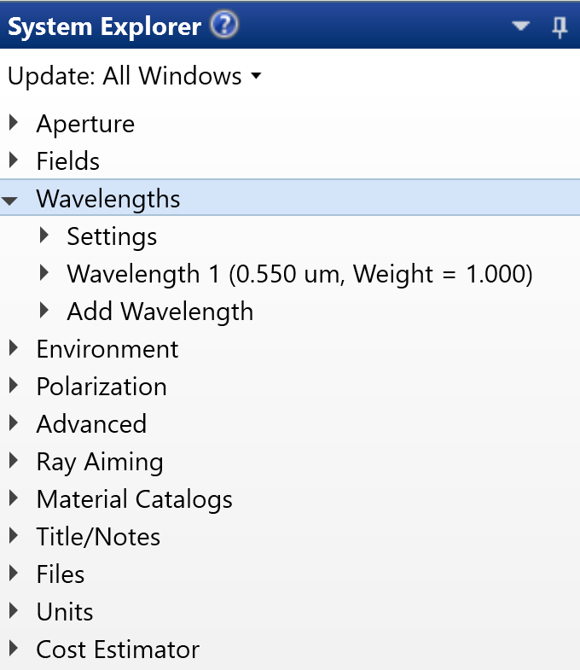
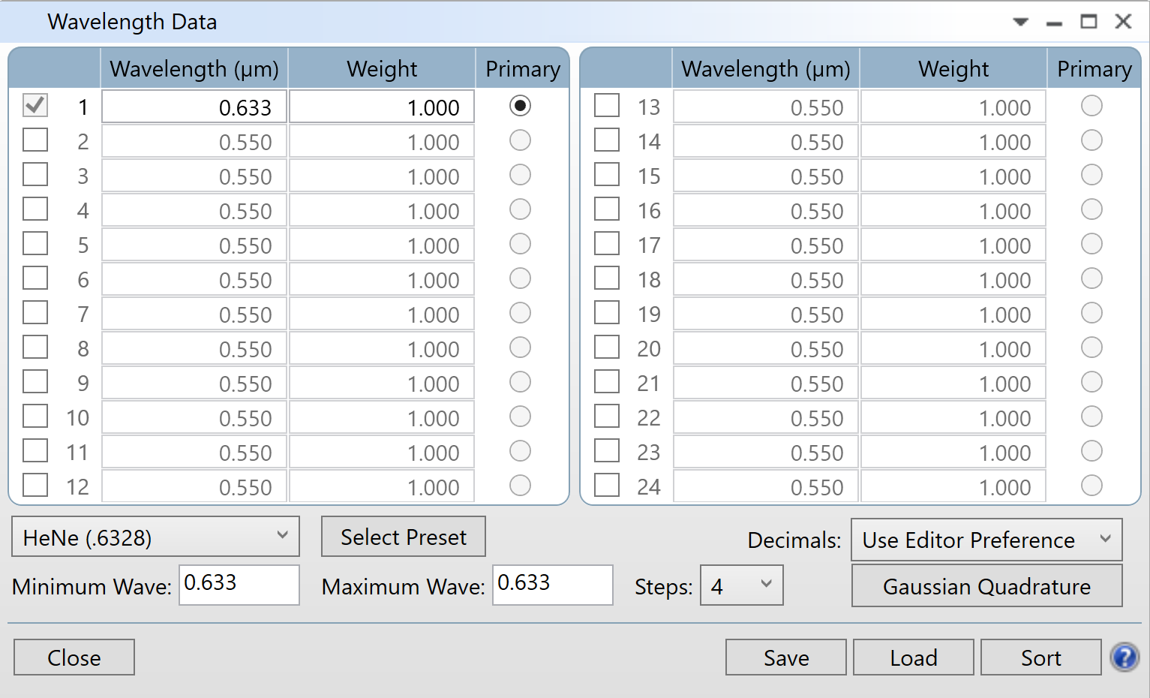
System Settings Wavelength Setup
/ Step: Set design wavelength to HeNe laser (0.6328 μm) in System Explorer, Wavelength Data. Press ‘Select Preset’ to accept change.
Wavelength impacts chromatic aberration and refractive index.
For this design:
Monochromatic (single wavelength).
Use HeNe preset for convenience.
OpticStudio always uses microns for wavelength entry.
1
2
How would the design change if we used multiple wavelengths instead of a single HeNe wavelength?
Notes:
Teaching Notes:
When setting up a lens design, wavelength is critical because it determines how light interacts with materials and affects chromatic aberration. For this singlet lens, we use a monochromatic design based on a HeNe laser at 632.8 nm (0.6328 μm).
In OpticStudio, wavelengths are always entered in microns, regardless of the system’s lens units. You can type the value manually or select the HeNe preset from the Wavelength Data dialog. For this exercise, keep all wavelength weights at unity.
Why choose HeNe for this teaching example?
Stable and precise wavelength: HeNe lasers emit at a well-defined 632.8 nm, making calculations and comparisons straightforward.
Common in labs: HeNe lasers are widely used in education and research, so students can relate the design to real-world setups.
Monochromatic simplicity: Using a single wavelength avoids chromatic aberration, which simplifies the design process for beginners.
Good material compatibility: N-BK7 glass has excellent transmission and well-characterized refractive index at this wavelength.
Suggested answer: Using multiple wavelengths introduces chromatic aberration because different wavelengths refract differently through glass. This means the lens would no longer focus all colors at the same point. To address this, designers must:
Add more complex elements (e.g., achromatic doublets) or
Use optimization strategies that include multiple wavelengths and weighting.
This significantly increases design complexity compared to a monochromatic system, which is why we start with HeNe for simplicity.

Slide 10
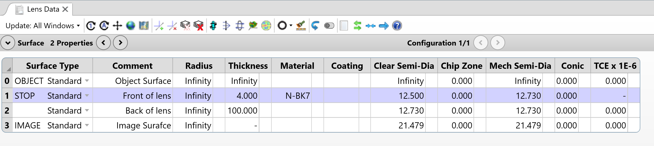
Lens Data Editor Surface Setup and Lens Data
/ Step: Enter surface data in Lens Data Editor (LDE)
Each row represents one surface.
A singlet lens requires four surfaces:
Object plane
STOP Front lens surface (aperture stop)
Back lens surface
Image plane
/ Step: Enter lens data in Lens Data Editor (LDE)
Enter lens data:
Material: N-BK7
Lens center thickness: 4 mm
Radius: Infinity (to be optimized)
Surface 2 thickness: 100 mm
Why is the STOP placed at the front surface of the lens in this design?
Why is N-BK7 chosen as the lens material?
Notes:
Teacher notes:
After defining system settings, the next step is entering surface-specific data in the Lens Data Editor (LDE).
The LDE is a spreadsheet where each row represents a surface.
In sequential design, rays trace from OBJECT to STOP to Lens to IMAGE.
For a singlet lens, we need 4 surfaces:
Object (OBJ) – where rays originate
Front lens surface (STOP) – also the aperture stop
Back lens surface – rays exit to air
Image (IMA) – final ray destination
By default, OpticStudio starts with 3 surfaces, so you’ll need to insert an extra surface using <Insert> or right-click. Use the Comment column to label surfaces for clarity.
Next, enter lens data:
Material: N-BK7 (OpticStudio automatically retrieves refractive index from its Glass Catalog)
Center thickness: 4 mm (reasonable starting point for a 25 mm aperture)
Radius: Infinity for now (will be optimized later)
Surface 2 thickness: 100 mm (distance to image plane)
Tip: These parameters will later be set as variables for optimization.
Suggested answer:
The aperture stop controls the cone of light entering the system, which directly affects image brightness and aberrations. Placing the STOP at the front surface ensures the entrance pupil is clearly defined and minimizes vignetting for off-axis fields because the aperture is at the first interaction point. This position also helps manage aberrations by controlling chief ray paths early in the system, leading to better overall performance. Additionally, this arrangement reflects common practice in simple optical systems like magnifiers and camera objectives.
N-BK7 is a common optical glass with good transmission in the visible spectrum and a well-characterized refractive index. It’s widely available, cost-effective, and suitable for introductory designs like a singlet lens.

Slide 11
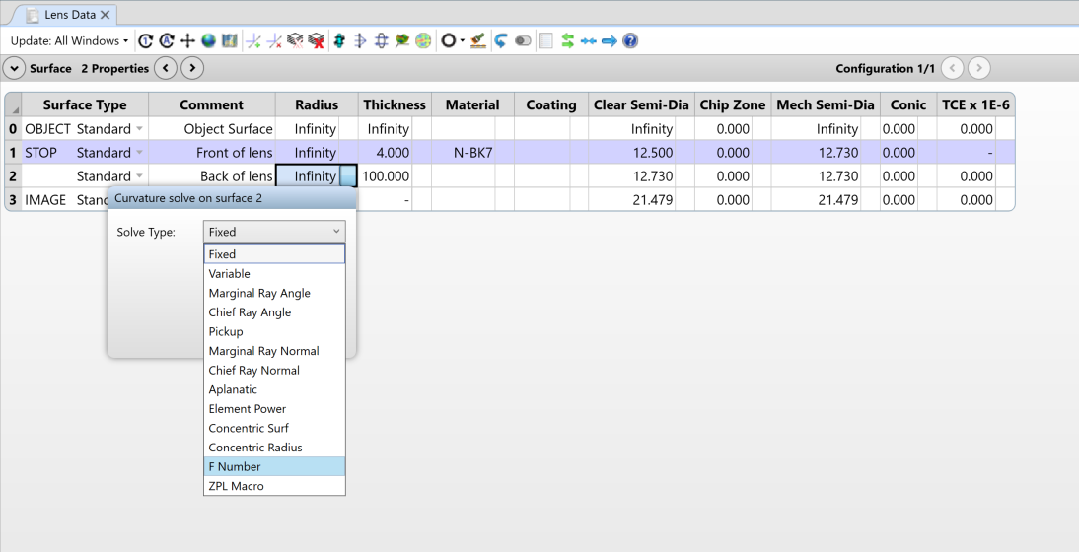
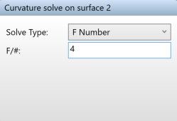
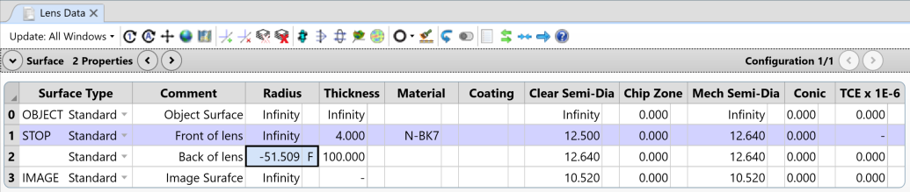
Lens Data Editor Using Solves
/ Step: Add an F/# Solve on Surface 2 Radius
Solves enforce constraints automatically.
For this design:
Use F Number Solve on Surface 2 radius.
Set F/# = 4 to maintain focal length (100 mm).
OpticStudio software adjusts curvature whenever parameters change.
Benefits:
Faster than using Merit Function constraints.
Eliminates unnecessary variables.
What are the trade-offs between manual constraints and automatic solves?
Notes:
Teaching notes:
In OpticStudio, constraints can be upheld in two ways:
Make parameters variables and add boundary constraints in the Merit Function Editor.
Use built-in solves to enforce constraints automatically.
The second method is preferred because boundary constraints can slow down optimization, while solves instantly maintain the specified condition.
For this design, we use an F Number Solve on the radius of Surface 2. This ensures the curvature adjusts automatically to maintain the desired F/# (4) and focal length (100 mm).
Once set, OpticStudio recalculates the radius whenever other lens parameters change, simplifying the design process.
Suggested answer: Manual constraints give flexibility because you can optimize multiple goals and apply complex conditions, but they slow execution and add complexity since the optimizer must iterate through many cycles. They also risk over-constraining the system. Automatic solves, by contrast, enforce constraints instantly without adding variables, making the design process faster and simpler—ideal for straightforward conditions like maintaining F/#. However, solves reduce optimization freedom later because they lock a parameter to one condition.

Slide 12
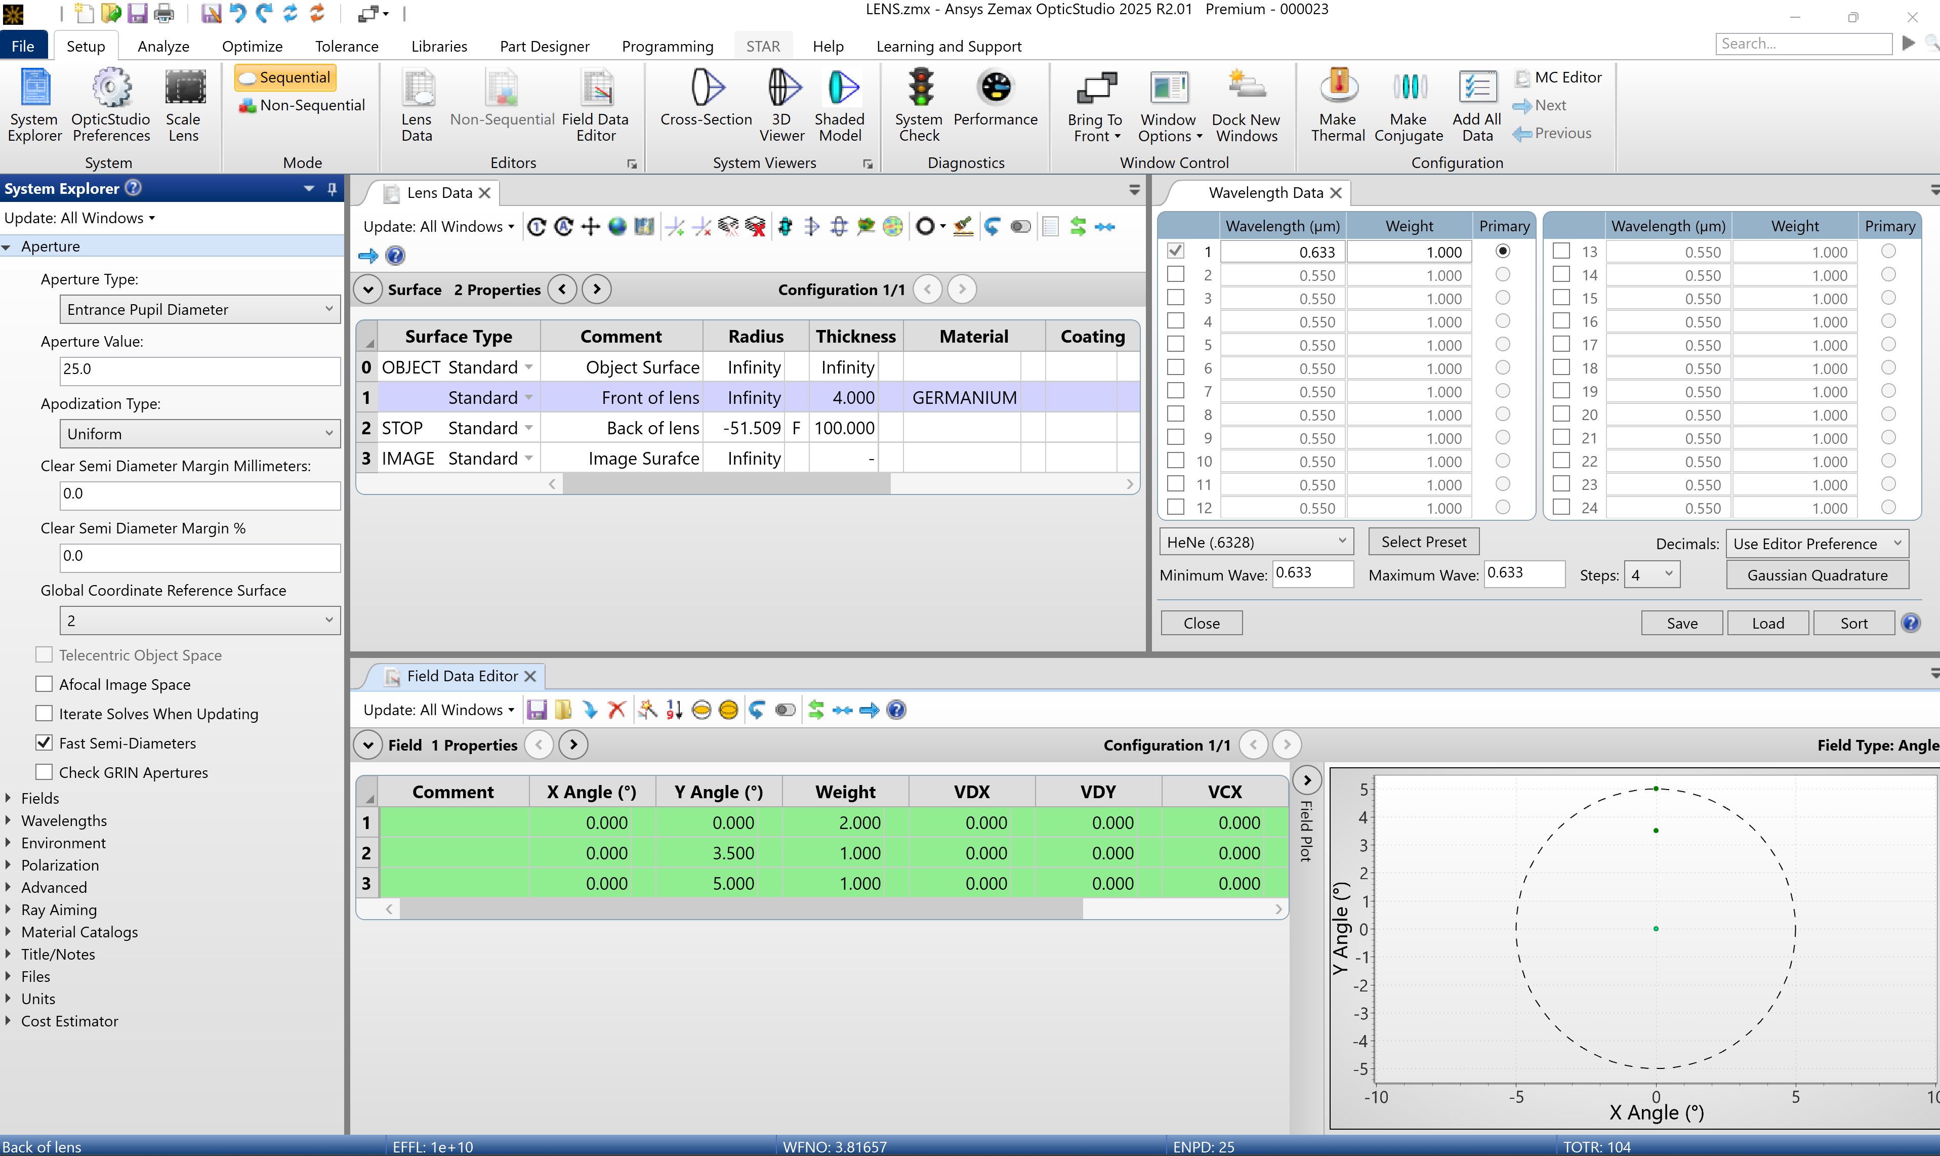
Test your understanding
/ Activity:
With the same specifications and constraints from Part 1, identify all the mistakes in this student’s setup.
Discuss how each error would affect the performance and success of the optical system.
(Answers revealed with animation)
Notes:
Answers:
STOP placed at the back of the lens instead of the front
Why it’s an error: The STOP defines the aperture and controls the cone of light entering the system. Placing it at the back changes the entrance pupil location and alters chief ray paths.
Impact on performance:
Increased vignetting for off-axis fields because the aperture is not at the first interaction point.
Different ray bundles may pass through the lens incorrectly, leading to higher aberrations (coma, astigmatism).
F/# calculations and optimization assumptions become inaccurate.
Germanium chosen as lens material instead of N-BK7
Why it’s an error: Germanium is opaque at visible wavelengths, and we have chosen the HeNe wavelength (0.6328 μm). Looking at its transmission data in the Materials Catalogue, you can see Germanium is suitable for infrared systems but not visible light applications.
Impact on performance:
Lens would not transmit light at the design wavelength, making the system unusable.
Even if modeled, refractive index data for visible wavelengths is invalid, so all calculations (focal length, aberrations) are wrong.
Demonstrates importance of matching material transparency to wavelength.
Weight of 2 applied to the 0° field instead of equal weights
Why it’s an error: Field weights influence optimization priorities. Giving extra weight to the on-axis field biases the optimizer toward improving central performance at the expense of off-axis fields.
Impact on performance:
Final design may have excellent on-axis quality but poor off-axis performance, leading to uneven image quality across the field of view.
RMS spot size averaged over FOV will not reflect true system performance.

Slide 13
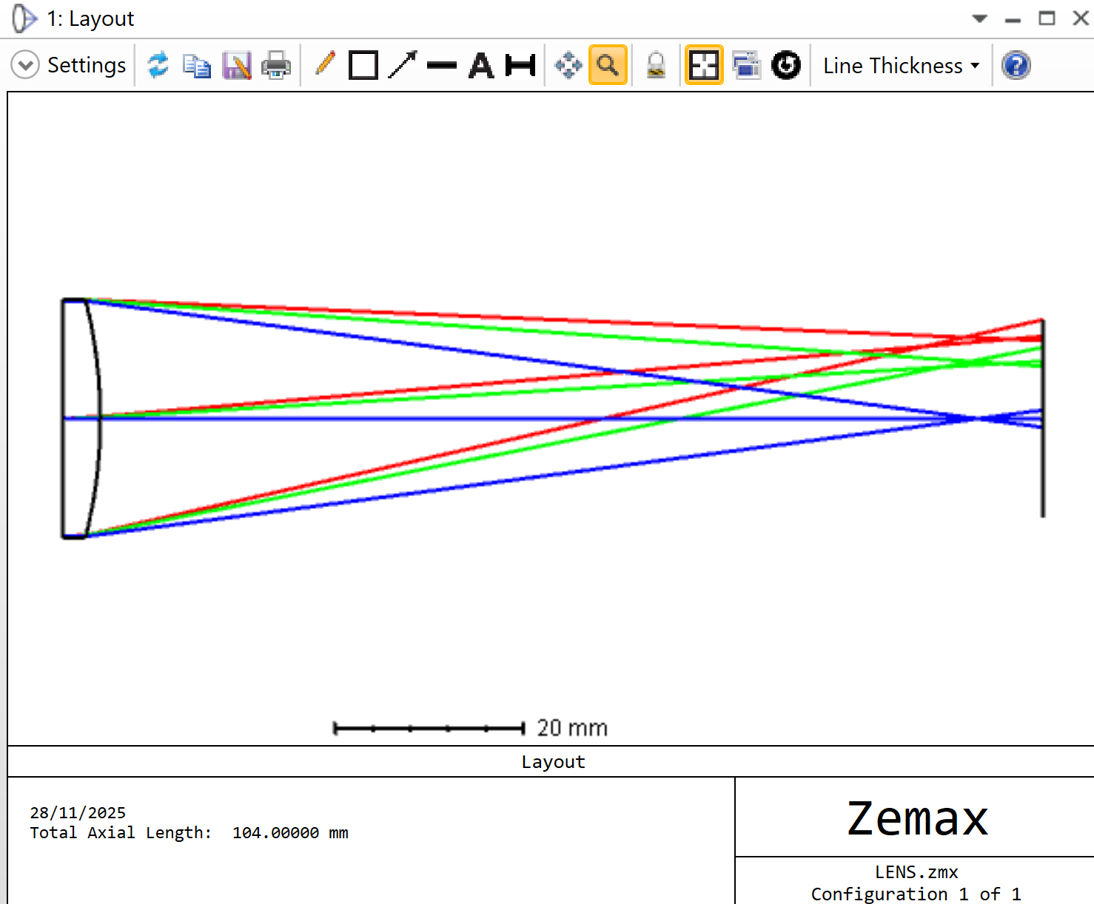
Part 1 Recap Summary & Next Steps
System Setup & Lens Data Editor
Introduced Sequential Mode for ray tracing.
Assigned aperture, wavelength and fields in System Explorer.
Built a singlet lens in Lens Data Editor
Applied F/# Solve to maintain design constraints.
Continue to part 2 for system analysis…
Notes:
Teaching notes:
This section aimed to introduced students to OpticStudio’s Sequential Mode and the essential steps for converting specifications into a functional optical model.
Key skills covered:
Navigating the interface and setting global parameters.
Building a basic singlet lens and applying solves for constraints.
We also embedded thinking points and mini exercises to encourage active learning and critical thinking, such as calculating image height, discussing STOP placement, and exploring trade-offs between solves and manual constraints.

Slide 14
Part 2: Analyze the System
What does this section cover?
This section introduces key analysis tools in OpticStudio to evaluate the performance of the singlet lens before optimization. You’ll learn how to use the Layout view for a visual system check, interpret Spot Diagram, OPD Fan, and Ray Fan plots to identify aberrations, and apply the Quick Focus tool to reposition the image plane for best focus.
Learning outcomes:
Use Layout and analysis tools (Spot Diagram, OPD Fan, Ray Fan) to evaluate lens performance.
Identify common aberrations from visual and quantitative analysis plots.
Apply the Quick Focus tool to reposition the image plane for best focus.
Compare system performance before and after adjustments using RMS and geometrical spot size.

Slide 15
OpticStudio Analysis Tools
OpticStudio has many tools available to evaluate optical performance. In this section, we focus on four key analyses:
Analysis tool | Description
Layout | Plots a YZ cross section through the lens, and is only valid for rotationally symmetric, axial systems. A layout diagram is always a useful visual representation of the current optical system.
Spot Diagram | Gives indication of the image of a point object. In the absence of aberrations, a point object will converge to a perfect image point. By default, OpticStudio software plots the spot diagram for each field point.
OPD Fan | A plot of the optical path difference as a function of pupil coordinate. In a perfect optical system, the optical path of the wavefront will be identical to that of an aberration-free spherical wavefront in the exit pupil.
Ray Fan | Plots ray aberrations as a function of pupil coordinate. Generally, a given ray which passes through the optical system and onto the image surface, its point of intersection falls on some small but nonzero distance away from the chief ray. Once again, in a perfect optical system, the ray aberrations should be zero across the pupil.
Why is it important to evaluate system performance before optimization?
Notes:
Teaching notes:
This slide introduces the concept of analysis tools in OpticStudio. Emphasize that these tools help diagnose system performance before optimization.
Layout provides a quick visual check of the system and image plane position.
Spot Diagram shows how well the lens focuses light and highlights blur or asymmetry.
OPD Fan reveals deviations in optical path length, indicating wavefront errors.
Ray Fan illustrates how rays deviate from the ideal image point, helping identify aberrations like coma or astigmatism.
Explain that while interpreting specific aberrations from these plots is beyond the scope of this exercise, students should understand what each tool represents and why it matters.
Suggested answer: Analyzing first helps identify which aberrations are present and how severe they are. This informs which parameters need adjusting during optimization. Without analysis, optimization might improve one metric while worsening others.

Slide 16
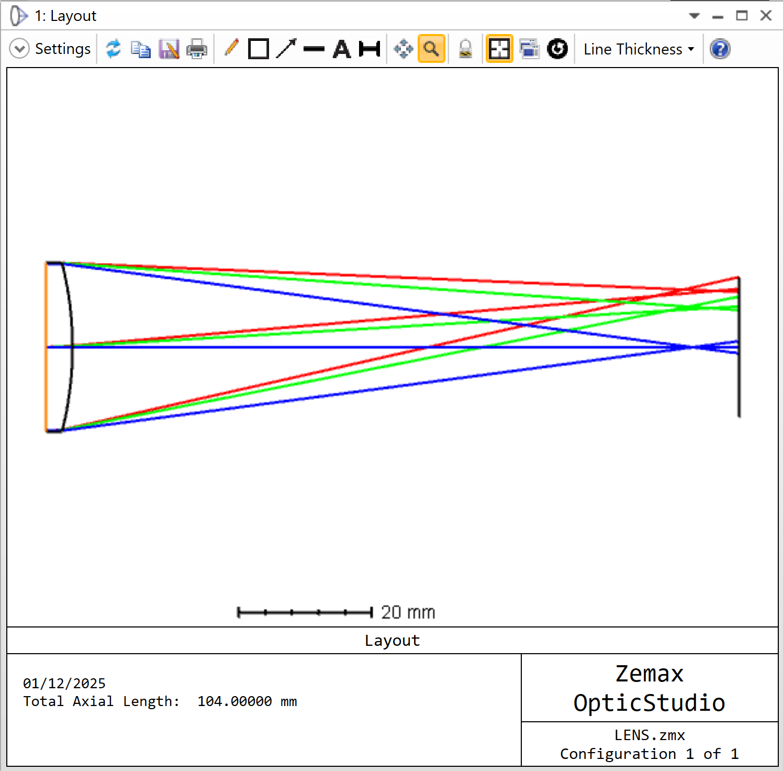
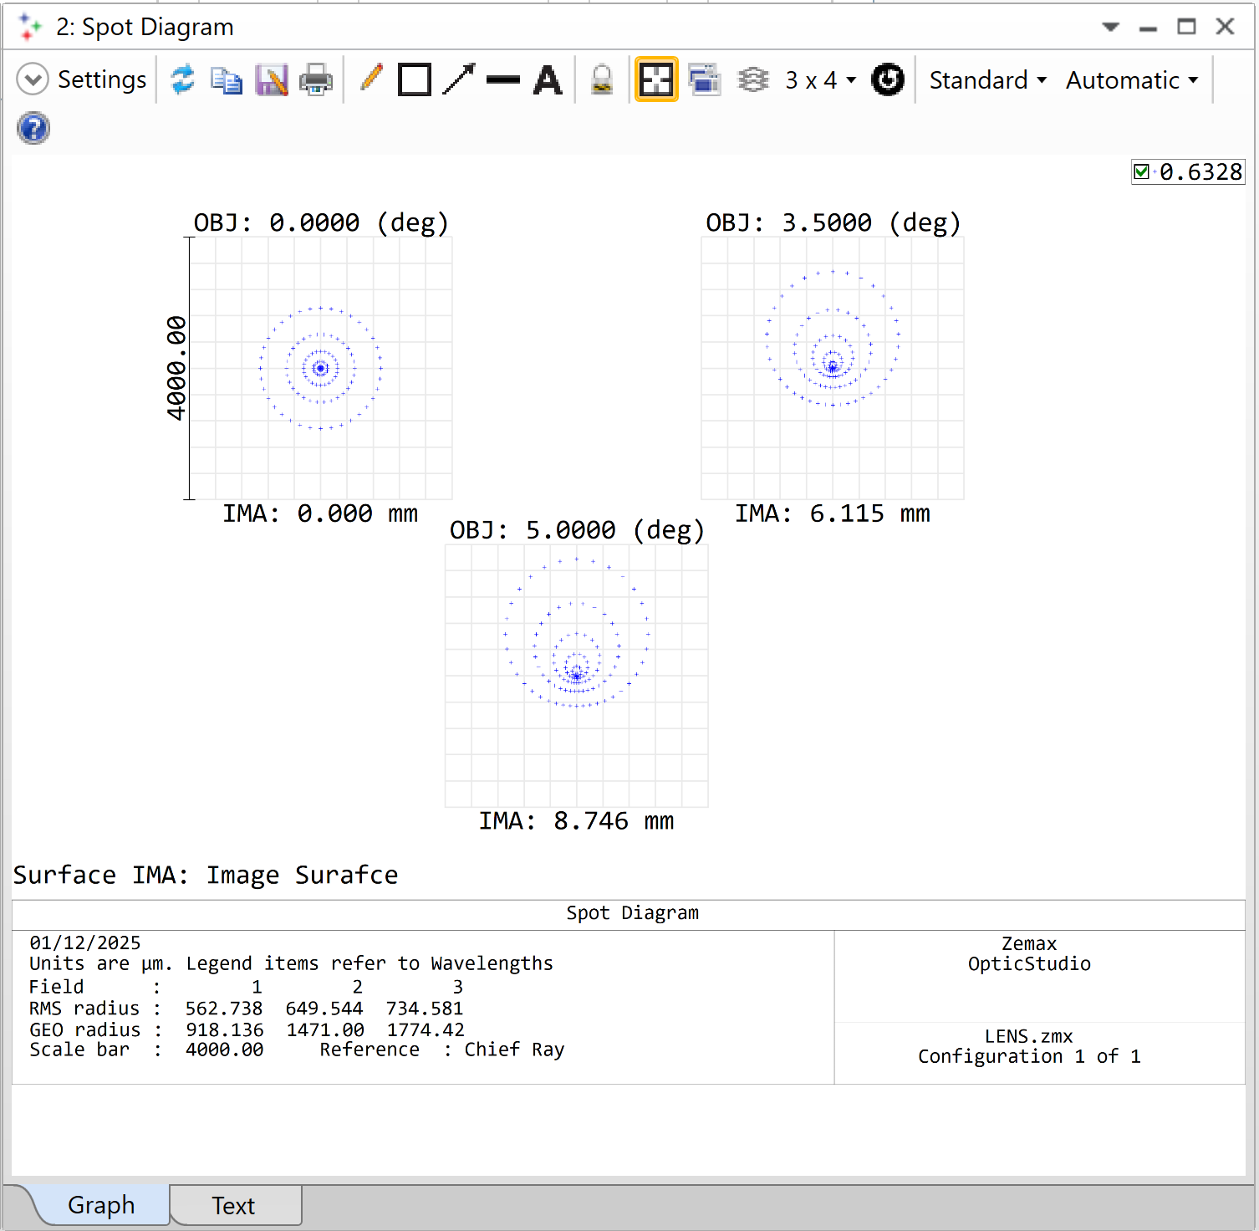
OpticStudio Analysis Tools Layout & Spot Diagram
/ Step: Open the layout by navigating to Analyze…SystemViewers…Cross Section.
/ Step: Open the spot diagram by navigating to Analyze…Image Quality…Rays & Spots…Standard Spot Diagram.
Observe where the rays converge. What does this indicate about the current system setup?
Compare the RMS and Geometrical (GEO) spot radii. What does each measure, and how do they differ?
Notes:
Teaching notes:
Layout
Highlight that the Layout view is a quick diagnostic tool. If rays converge before or after the image plane, the system is not at best focus. This causes defocus and increases aberrations such as spherical and coma. Explain that this is why analysis before optimization is critical—students should understand that poor image plane placement can make even a simple lens appear much worse than it really is. The Quick Focus tool will later correct this by adjusting the image plane position automatically.
Suggested answer: Before optimization, the rays converge before the image plane, meaning the it is not positioned at best focus. This misalignment introduces defocus, which significantly degrades image quality.
Spot Diagram
Explain that the Spot Diagram is a key tool for assessing image quality.
RMS Spot Radius gives a statistical measure of the spread of rays, making it a good indicator of overall performance.
GEO Spot Radius shows the worst-case deviation, which can reveal outliers or asymmetry in the spot.
Highlight that both metrics are important: RMS for general quality, GEO for extremes. Ask students why the off-axis fields (3.5° and 5°) have larger spot sizes—this leads to a discussion about field-dependent aberrations like coma and astigmatism.
Suggested answer:
RMS Spot Radius: Root-mean-square distance of all rays from the reference point (chief ray or centroid). It represents the average spread of rays and is useful for comparing overall image quality.
Radii have greater spread towards edge of field i.e. 0°: 562.7 μm; 3.5°: 649.5 μm; 5°: 734.6 μm.
GEO Spot Radius: Distance from the reference point to the farthest ray. It represents the maximum extent of the spot and is sensitive to outliers.
Radii have greater spread towards edge of field i.e. 0°: 918.1 μm; 3.5°: 1471.0 μm; 5°: 1774.4 μm

Slide 17
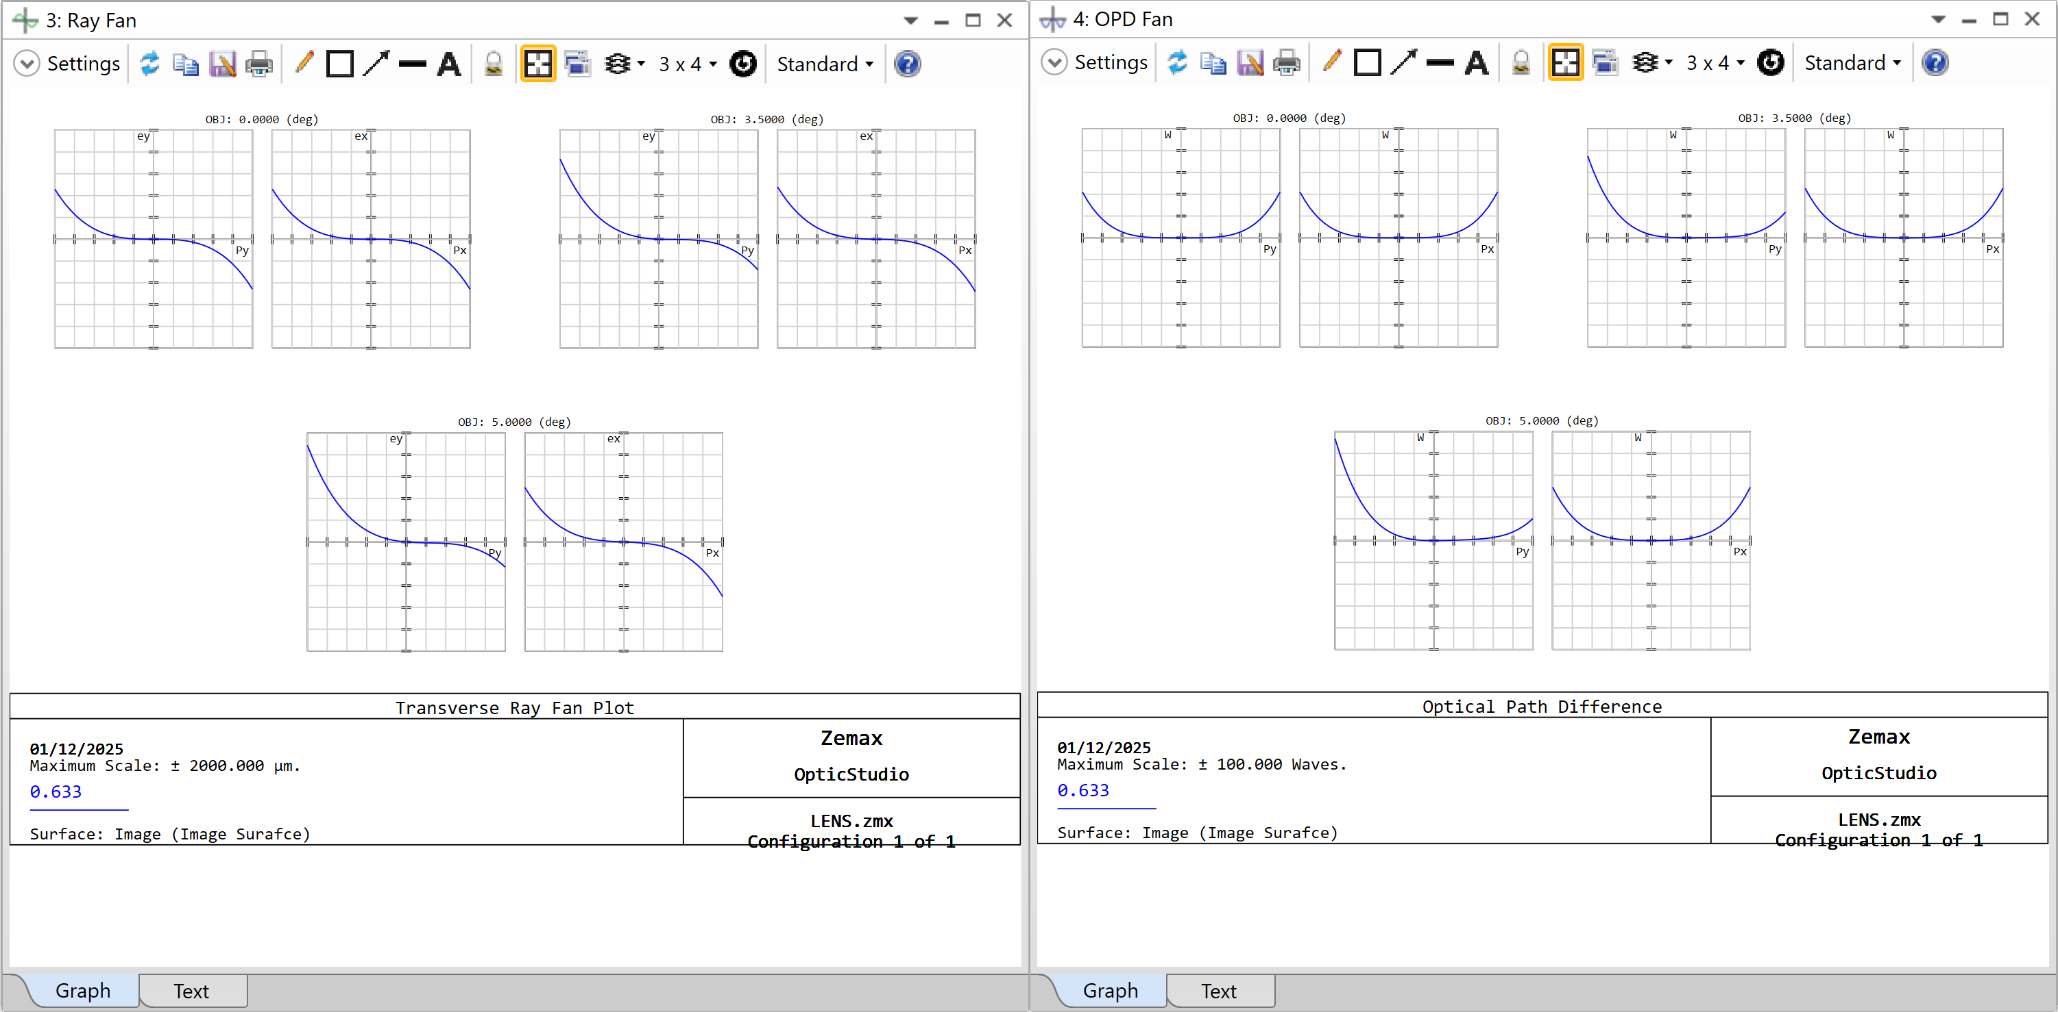
OpticStudio Analysis Tools Ray Fan & OPD Fan
/ Step: Open the Ray Fan plot by selecting Analyze…Image Quality…Aberrations…Ray Aberration.
/ Step: Open the Optical Path Difference (OPD) fan by selecting Analyze…Image Quality…Aberrations…Optical Path.
Look at the Ray Fan plot. What do the curve shapes tell you about aberrations in the system?
What does the OPD Fan plot reveal about the wavefront quality?
Notes:
Teaching notes:
Ray Fan:
Explain that the Ray Fan plot shows how rays deviate from the ideal image point across the pupil. In a perfect system, these deviations would be zero (flat line). The shape of the curve gives clues about the type of aberration: Symmetry (spherical aberration); Tilt (coma); Different slopes (astigmatism). For this introductory tutorial, students are not expected to identify specific aberrations though.
Suggested answer: Therefore, in our singlet lens, the curves are not flat, confirming significant aberrations
OPD Fan:
OPD Fan measures wavefront error compared to an ideal spherical wavefront. In a perfect system, the plot would be flat. Curvature indicates spherical aberration, and mismatched tangential vs sagittal curves indicate astigmatism. Emphasize that OPD Fan connects wavefront quality to image performance; students should understand why wavefront error matters for high-quality imaging. They are not expected to identify specific aberrations though.
Suggested answer: The plot is not flat, so the wavefront is not ideal. A curved OPD Fan suggests spherical aberration whereas a different curvature for tangential and sagittal rays indicates astigmatism. A flat OPD Fan would mean all rays have equal optical path lengths (ideal wavefront).

Slide 18
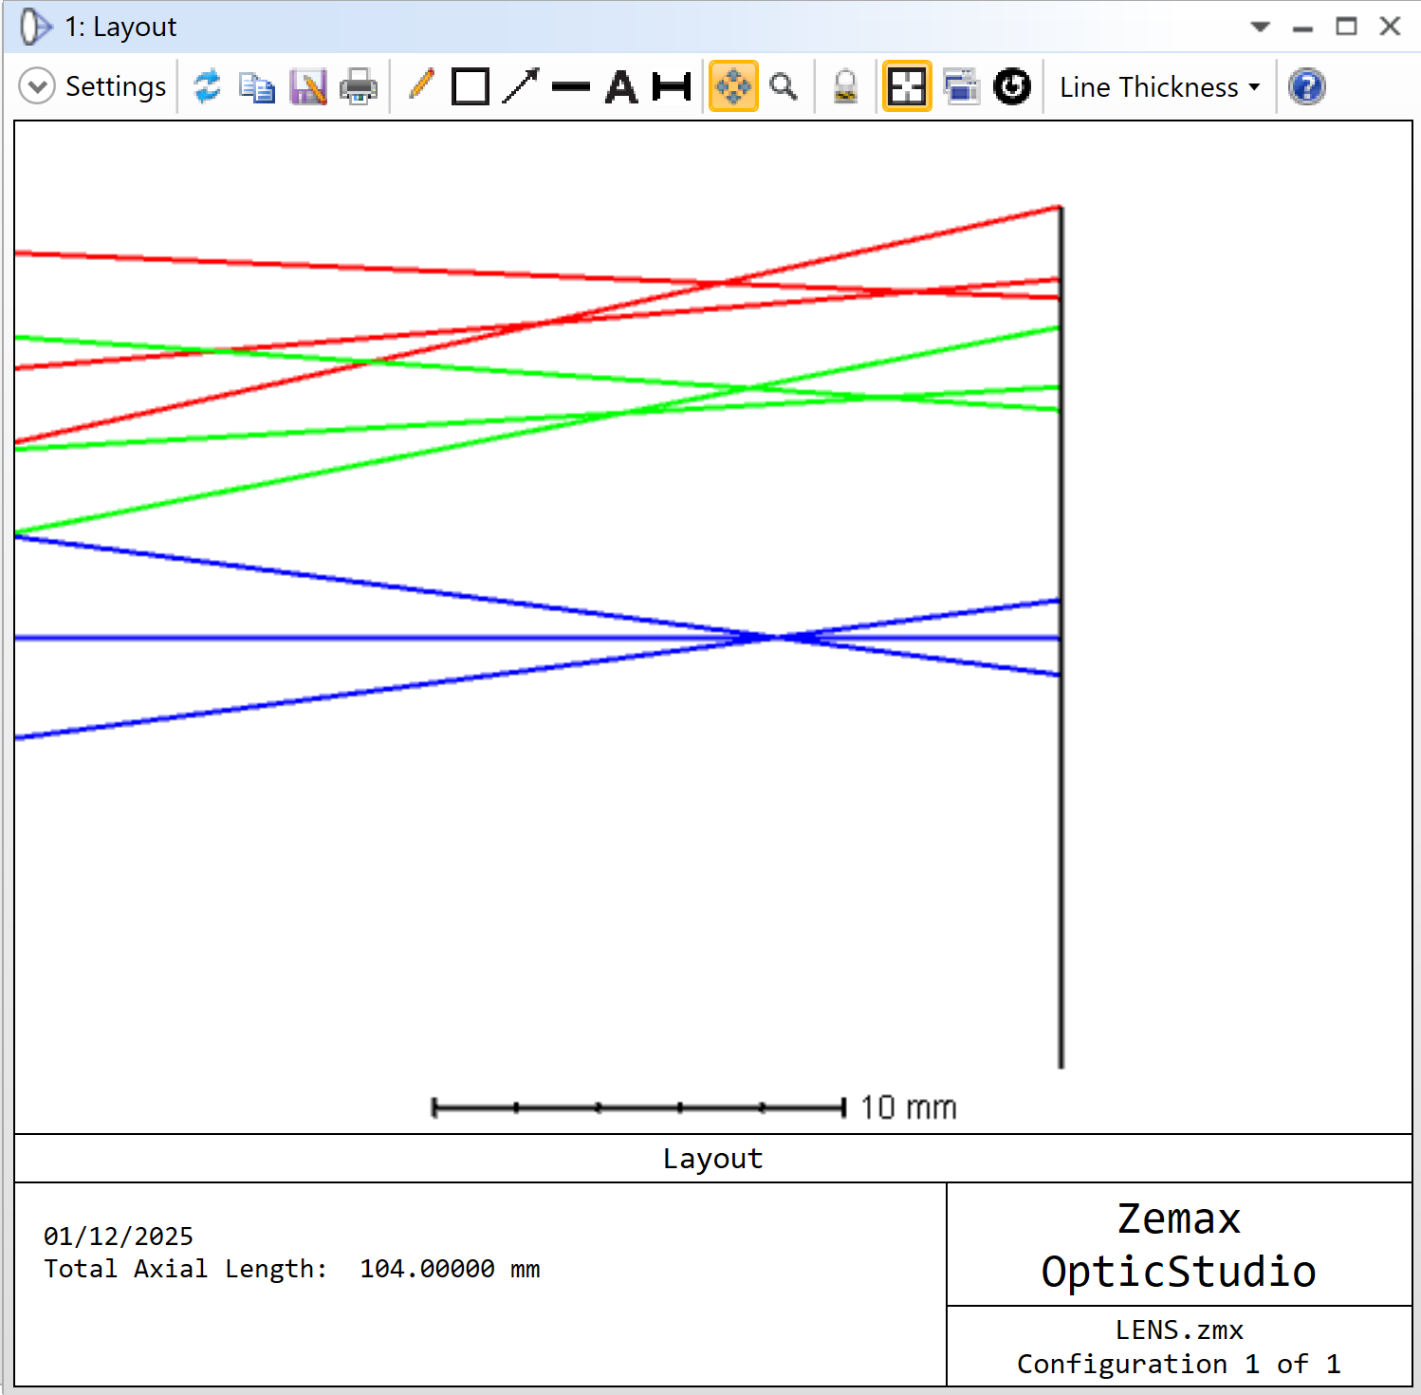
Initial evaluation of the singlet lens Overview
Based on the four analysis plots, the initial optical system exhibits:
Significant aberrations including spherical, coma, distortion, defocus, field curvature, astigmatism.
At the maximum field angle, the Spot Diagram shows:
RMS radius ≈ 734.6 μm
GEO radius ≈ 1774.4 μm
Layout indicates the image plane is not at best focus, contributing to poor performance.
Next explore the Quick Focus tool.
Mismatch between convergence and image plane
Notes:
Teaching notes:
This initial evaluation highlights why analysis before optimization is essential.
The singlet lens shows multiple aberrations, which is expected for a simple, unoptimized design.
The Spot Diagram confirms large blur sizes, especially off-axis, indicating poor image quality.
The Layout view reveals that the image plane was placed arbitrarily and does not coincide with the best focus position. This misalignment introduces defocus, making the system appear worse than it could be.
Explain that the next step (using the Quick Focus tool) will correct the image plane position and immediately improve performance without changing lens shape.

Slide 19

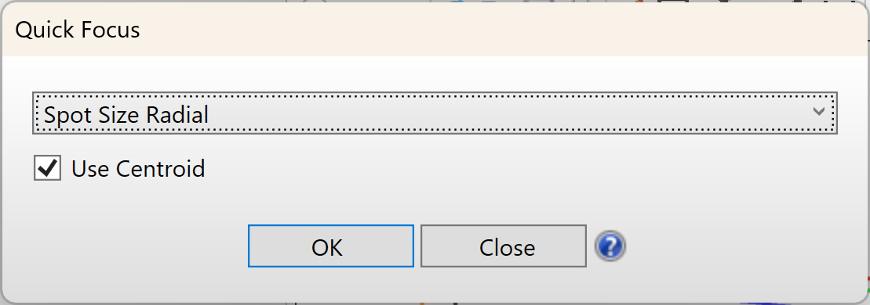
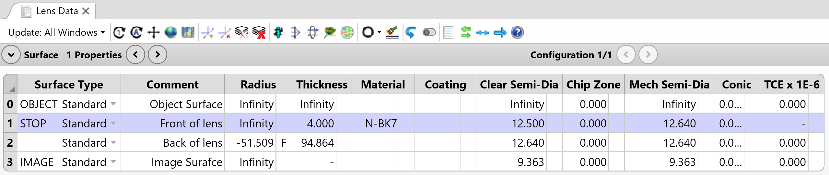
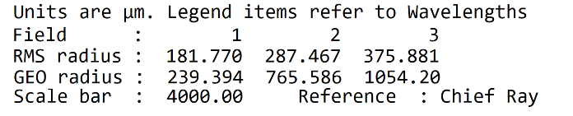
Quick Focus tool Useful step prior to optimization
Quick Focus is a feature in OpticStudio software which adjusts the thickness of the surface prior to the image plane to minimize the RMS aberrations.
/ Step: Open the Quick Focus dialog by selecting Optimize...Manual Adjustment...Quick Focus or by pressing <Shift + Ctrl + Q> on the keyboard. For this singlet example, we will use radial spot size with respect to the centroid. Click OK to run and close the Quick Focus tool dialog.
Note the automatic change to the thickness of the surface prior to the image plane. You should see fairly significant changes in performance simply due to the new selection of the image plane location. Most importantly, the RMS and Geometrical spot sizes at the maximum field decreased by nearly a factor of two.
Notes:
Teaching notes:
Purpose of Quick Focus: Explain that Quick Focus is not an optimization tool, it simply adjusts the image plane position to achieve best focus by minimizing RMS spot size. This step is essential before running a full optimization because defocus can make the system appear worse than it really is.
Why it matters: Students should understand that poor image plane placement introduces defocus, which inflates spot sizes and masks the true performance of the lens. Correcting this first ensures that subsequent analysis and optimization are meaningful.
How it works: Quick Focus changes the thickness of the surface before the image plane automatically. It uses a chosen criterion (here, radial spot size with respect to the centroid) to minimize RMS aberrations.
Impact on performance:
Before Quick Focus: large RMS and GEO spot sizes due to defocus.
After Quick Focus: RMS radius ≈ 375.88 μm, GEO radius ≈ 1054.20 μm (nearly a factor of two improvement at the maximum field).This demonstrates how a simple adjustment can significantly improve image quality without changing lens shape.

Slide 20

Group challenge Diagnose and Improve a Poorly Performing Singlet Lens
/ Objective: work in small groups to analyze a poorly performing singlet lens using only visual and quantitative analysis tools in OpticStudio software. The goal is to diagnose the issues and propose manual adjustments to improve performance (i.e. without using the optimization tool).
/ Suggested workflow
Visual Inspection:
Use the Layout tool to examine ray paths.
Identify whether rays converge at the image plane.
Look for signs of aberrations (e.g., skewed rays, uneven convergence).
Quantitative Analysis:
Generate Spot Diagrams for all field points.
Plot Ray Fan and OPD Fan diagrams.
Record RMS spot sizes and wavefront errors.
Diagnosis:
Identify the dominant aberrations.
Determine if the image plane is at best focus.
Discuss how curvature, spacing, or material might be contributing to poor performance.
Manual Adjustments:
Use Quick Focus to reposition the image plane.
Try adjusting lens curvature or thickness manually.
Re-run analysis tools after each change.
Presentation
Each group presents:
Their initial diagnosis
The steps they took
Before/after plots
What they would optimize next if allowed
OpticStudio Tools Allowed:
Layout; Spot Diagram; Ray Fan; OPD Fan; Quick Focus; Manual Edits in Lens Data Editor
Notes:
Teaching notes:
Purpose of the Activity: This exercise encourages collaborative problem-solving and critical thinking. Students apply analysis tools to diagnose optical issues and make manual adjustments, reinforcing concepts from earlier modules.
Key Learning Outcomes:
Understand how to interpret Layout, Spot Diagram, Ray Fan, and OPD Fan plots.
Recognize common aberrations (e.g., spherical, coma, astigmatism) and their visual indicators.
Appreciate the importance of image plane placement and lens geometry in system performance.
Facilitation Tips:
Remind students that the goal is diagnosis and manual improvement, not full optimization.
Encourage discussion on why certain aberrations occur and how changes in curvature or spacing affect performance.
Suggest starting with Quick Focus to correct defocus before making other adjustments.
Prompts for Discussion:
What does the Layout view reveal about ray convergence?
How do RMS and GEO spot sizes change after adjustments?
Which aberrations dominate and why?If optimization were allowed, what parameters would you vary next?
Expected Outcomes:
Students should demonstrate improved performance through manual edits (e.g., reduced RMS spot size).
Groups should present before/after plots and explain their reasoning for each adjustment.
Instructor Role:
Circulate among groups to guide interpretation of plots.
Ask probing questions to deepen understanding (e.g., Why does moving the image plane reduce RMS error?).
Highlight connections between manual adjustments and automated optimization strategies.

Slide 21
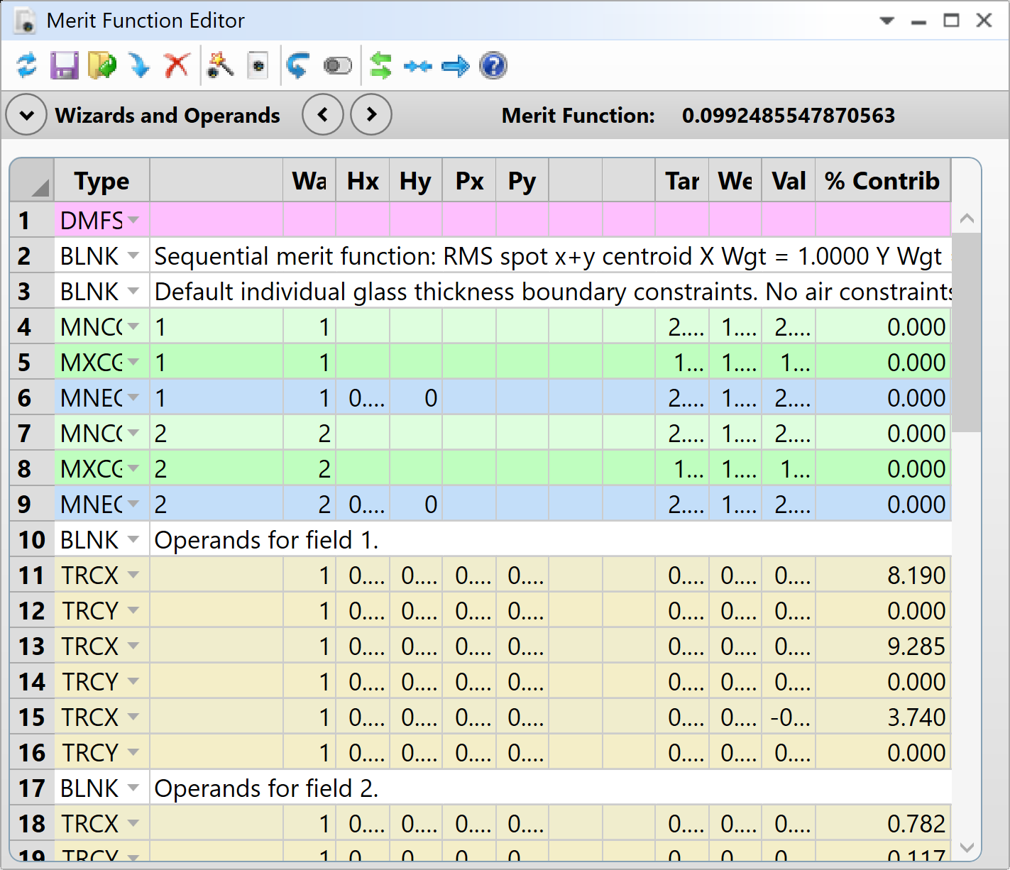
Part 2 Recap Summary & Next Steps
OpticStudio Analysis Tools & Quick Focus
Evaluated lens performance using Layout and key analysis tools: Spot Diagram, OPD Fan, and Ray Fan.
Identified common aberrations through visual inspection and quantitative plots.
Repositioned the image plane for best focus using the Quick Focus tool.
Compared system performance before and after adjustments using RMS and geometrical spot size metrics.
Continue to part 3 for optimization…
Notes:
Teaching notes:
This section emphasizes why analysis is essential before optimization. Remind students that tools like Layout, Spot Diagram, OPD Fan, and Ray Fan provide complementary insights into system performance: Layout checks ray convergence, Spot Diagram shows image quality, and OPD/Ray Fan reveal wavefront and ray aberrations. Highlight the role of Quick Focus in correcting defocus, which significantly improves performance without changing lens geometry. Finally, encourage students to compare RMS and Geometrical spot sizes and discuss why RMS is a better indicator of overall image quality. Conclude by noting that the next module will build on this foundation with optimization techniques.

Slide 22
Part 3: Improve your system
What does this section cover?
This module covers the basics of optical system optimization. You’ll learn how to set parameters as variables, use the Merit Function Wizard to measure design quality, and perform an automatic optimization. Finally, we’ll evaluate the optimized system’s performance.
Learning outcomes:
Explain the purpose of optimization in optical design
Set parameters as variables in the Lens Data Editor
Construct and interpret a Merit Function using the Optimization Wizard
Perform an automatic optimization and evaluate results
Discuss trade-offs and constraints in optimization

Slide 23
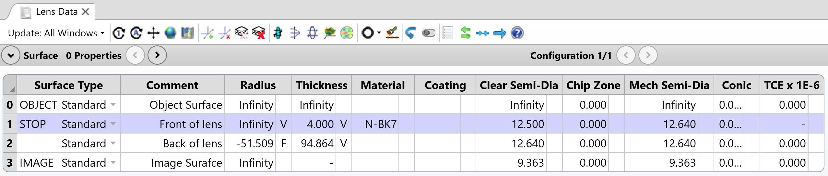
Identifying variables And assigning them in OpticStudio software
A singlet lens has limited performance, but optimization can improve it. To optimize, we first identify degrees of freedom i.e. the parameters that can vary. Optimization only works on adjustable parameters, so knowing what is fixed and what is variable is essential.
/ Step: Identify variables
Surface 2 Radius: fixed (controlled by F/# solve).
Variables:
Surface 1 Radius (front curvature)
Surface 1 Thickness (lens center thickness)
Surface 2 Thickness (distance to image plane)
/ Step: Assign variables in the Lens Data Editor.
either:
Apply the Variable Solve from dropdown in Lens Data Editor.
Or, shortcut: Ctrl + Z → select Variable.
“V” indicates parameter is now a variable.
Why do we need to set variables in OpticStudio software instead of letting the software adjust everything automatically?
Once the variables are set, we can construct the default Merit Function...
Notes:
Teaching notes:
Why this matters: Optimization works by adjusting free parameters to minimize a performance metric (here, RMS spot size). Students need to understand which parameters are locked and why.
Degrees of Freedom: Explain that Surface 2 Radius is fixed because of the F/# constraint i.e. changing it would break the focal length requirement. This illustrates how design constraints limit optimization flexibility.
Setting Variables in OpticStudio:
Demonstrate how to apply a Variable Solve in the Lens Data Editor:
Click the box next to the parameter or use Ctrl + Z.
Select Variable in the dialog.
The letter “V” confirms the parameter is now adjustable.
Do this for all three free parameters.
Transition to Merit Function: Once variables are set, OpticStudio can optimize them using a Merit Function. Explain that the Merit Function is a numerical score representing how well the design meets its goals—lower is better.
Suggested answer: Variables are set so the optimizer only adjusts parameters that are relevant and safe to change. If OpticStudio were allowed to modify everything, it could break key design constraints (such as focal length, F/#, or mechanical limits) resulting in an unrealistic lens. By choosing specific variables, we keep optimization focused on improving performance while respecting these constraints. It also makes the process faster and more predictable because the optimizer doesn’t waste time on parameters that should remain fixed.

Slide 24
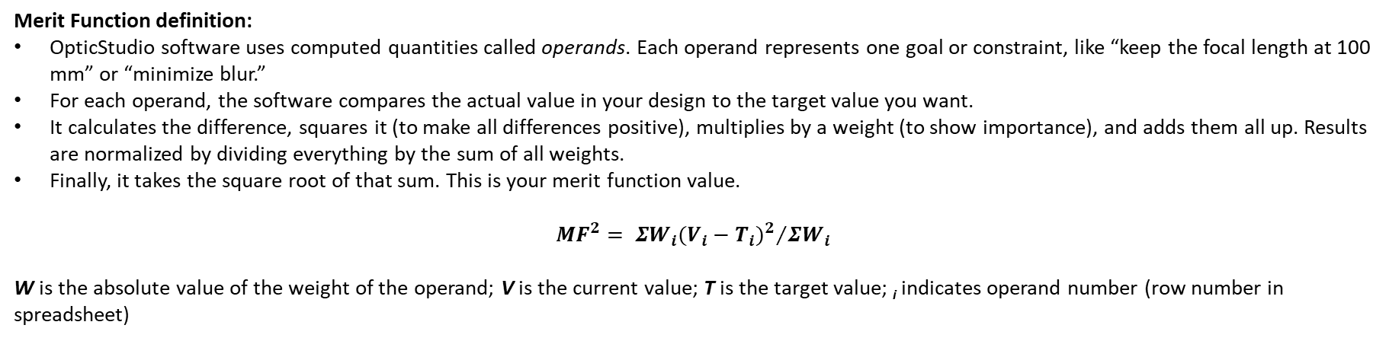
Merit Function Overview
What is it? A numerical score that represents how closely an optical system meets its design goals. It is central to the optimization process because OpticStudio software uses this value to guide adjustments to lens parameters.
Merit Function definition:
OpticStudio software uses computed quantities called operands. Each operand represents one goal or constraint, like “keep the focal length at 100 mm” or “minimize blur.”
For each operand, the software compares the actual value in your design to the target value you want.
It calculates the difference, squares it (to make all differences positive), multiplies by a weight (to show importance), and adds them all up. Results are normalized by dividing everything by the sum of all weights.
Finally, it takes the square root of that sum. This is your merit function value.
$${MF}^{2}= {ΣW_{i}{(V_{i}−T_{i})}^{2}}/{ΣW_{i}}$$
W is the absolute value of the weight of the operand; V is the current value; T is the target value; _{i} indicates operand number (row number in spreadsheet)
Why is this useful?
The optimization algorithm tries to make this number as small as possible. So, the Merit Function should reflect what matters most in your design.
If the merit function is zero, your design is perfect i.e. it meets all goals exactly.
Notes:
Teaching notes:
Overview: The Merit Function is the core metric that OpticStudio uses during optimization. It’s not a physical property of the lens; it’s a mathematical score that tells the software how close the design is to meeting its goals. Think of it as a checklist converted into a single number. Each design goal, like focal length, RMS spot size, or thickness limits, is represented by an operand. For each operand, OpticStudio compares the actual value in your design to the target value you want.
What is it calculating?
It calculates the difference between actual and target.
Squares the difference so everything is positive.
Multiplies by a weight to show importance.
Divides everything by sum of all weights to normalize data.
Adds all these up and takes the square root.
The result is your Merit Function value.
Explain it’s use: The optimizer tries to make this number as small as possible. So, the Merit Function should reflect what matters most in your design. If the value were zero, the design would perfectly meet all goals, but we aim for the lowest practical value.

Slide 25
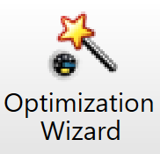
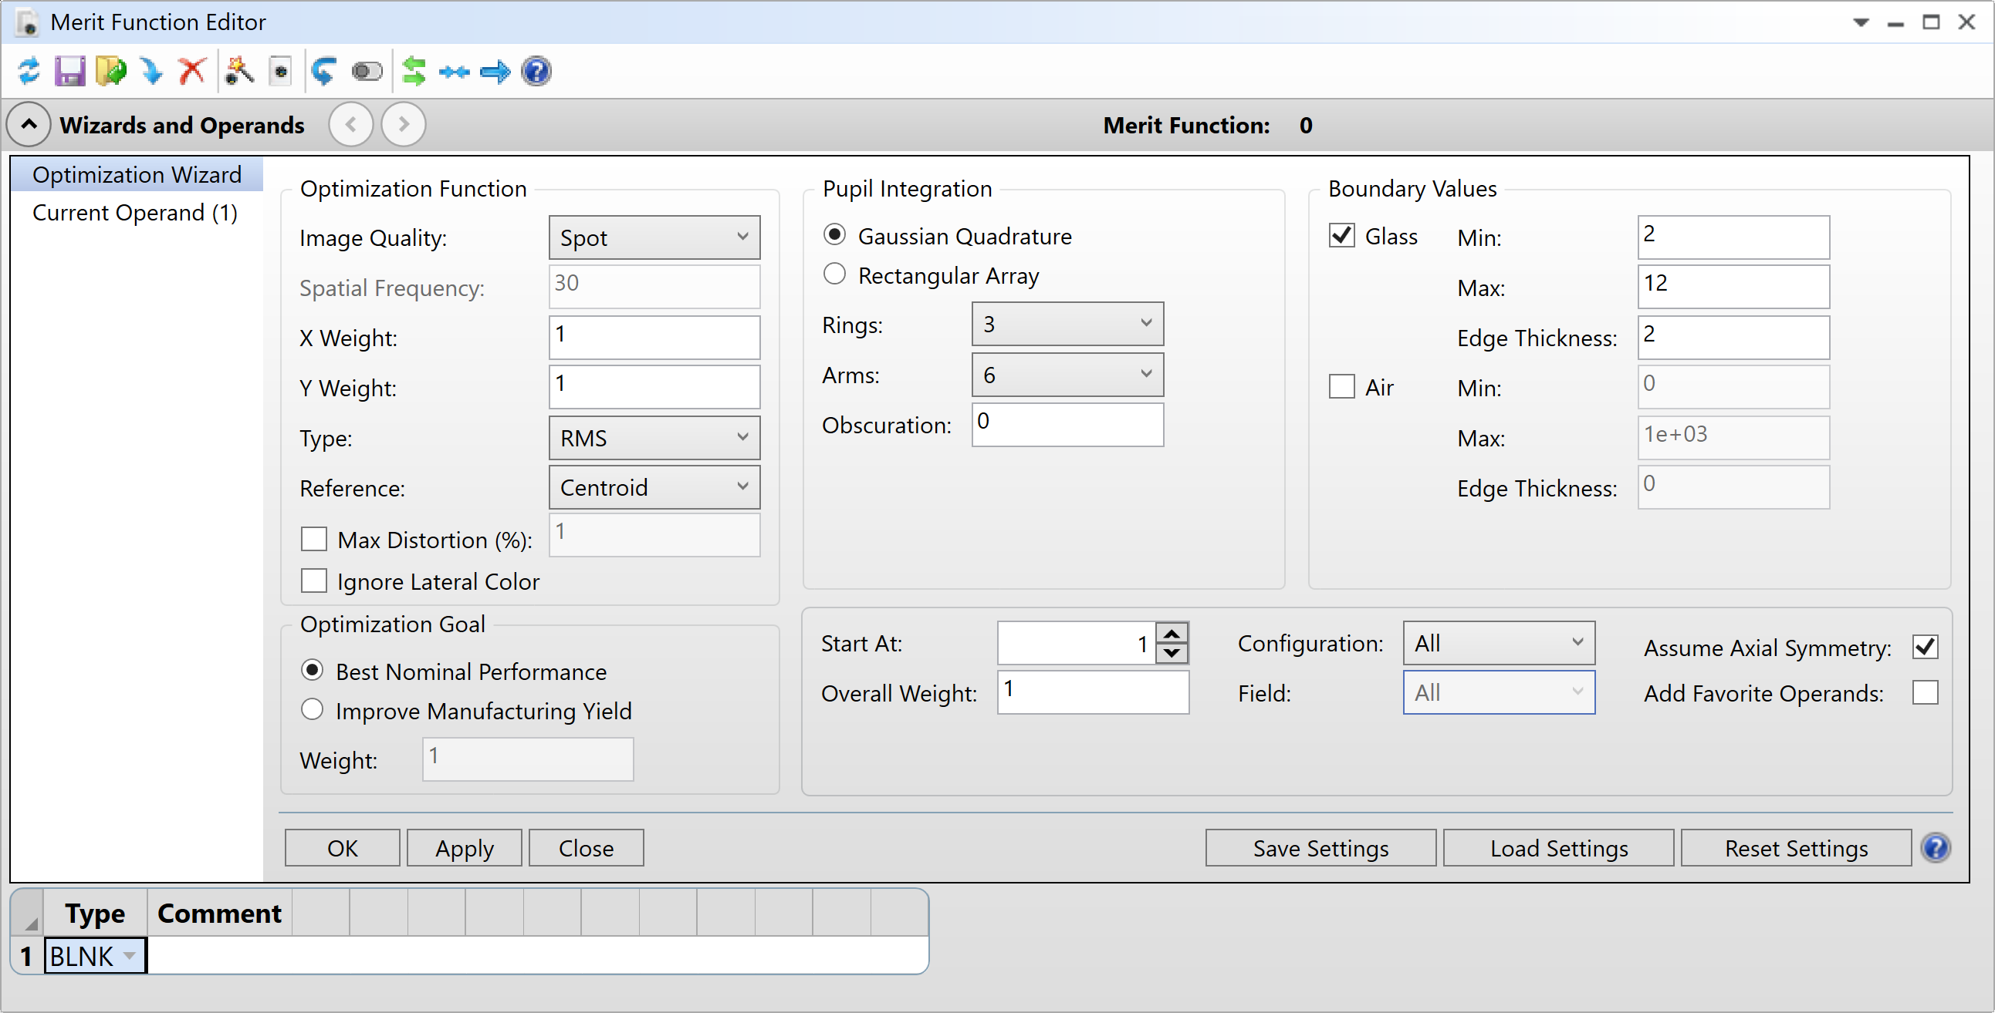
Merit Function Optimization Wizard
You can create a Merit Function manually by adding operands yourself or use the Optimization Wizard to automatically generate a default one based on common goals like minimizing RMS Spot Radius while enforcing boundary constraints.
Optimization Wizard split into 5 parts:
Optimization Function defines the overall criterion we want to improve upon.
Pupil Integration defines the rays to be traced.
Boundary Conditions set the constraints on the glass and air thicknesses.
Optimization Goal
Start At line tells OpticStudio software which row to insert the Merit Function.
1
2
3
4
5
Notes:
Teaching notes:
Once we understand the Merit Function, the next step is building it efficiently. OpticStudio gives us two options:
Manual method: adding operands one by one for full control.
Optimization Wizard: a quick way to generate a default Merit Function based on common goals.
The Wizard saves time and ensures that all essential constraints are included. It’s especially helpful for beginners because it automatically sets up a Merit Function that minimizes RMS Spot Radius while enforcing practical limits like lens thickness.

Slide 26
Adapting Optimization Wizard Based on Design Specification
For the current example, the singlet is to be optimized for RMS Spot Radius with respect to the centroid, all of which are options already built-in to OpticStudio’s Optimization Wizard.
/ Step: adapt Optimization Wizard to reflect design specifications.
In Optimization Function, select:
Type: RMS
Criterion: Spot
Reference: Centroid
In Boundary Values, check Glass and set:
Min thickness 2 mm
Max thickness 12 mm
Edge thickness >2 mm
Leave other parameters as default
Click ok to generate Merit Function
Why do we apply boundary constraints when building a Merit Function? What trade-offs does this introduce?
Notes:
Teaching notes:
Now that we know how the Optimization Wizard works, let’s adapt it to our specific design requirements for the singlet lens.
First, under Optimization Function, we choose RMS Spot Radius with respect to the centroid. This ensures the optimizer focuses on minimizing the average blur across the image rather than just the worst-case deviation.
Next, we apply boundary constraints. These are critical because they prevent the optimizer from creating a lens that is optically great but physically impractical e.g. a lens that’s too thin and fragile or too thick and heavy.
For this exercise, the center thickness must be between 2 mm and 12 mm, and the edge thickness greater than 2 mm. These limits come directly from our system requirements.
Once these settings are applied we leave all other parameters as default and click OK. The Wizard will now generate a Merit Function that reflects both optical performance and manufacturability.
Suggested answer: Boundary constraints ensure the design is manufacturable and mechanically robust. For example, a lens thinner than 2 mm could break during handling, while one thicker than 12 mm might be impractical or too heavy. However, these limits reduce optimization flexibility. Sometimes a thinner lens could minimize aberrations, but if it violates the constraint, the optimizer cannot choose it. This illustrates the balance between performance and practicality.

Slide 27
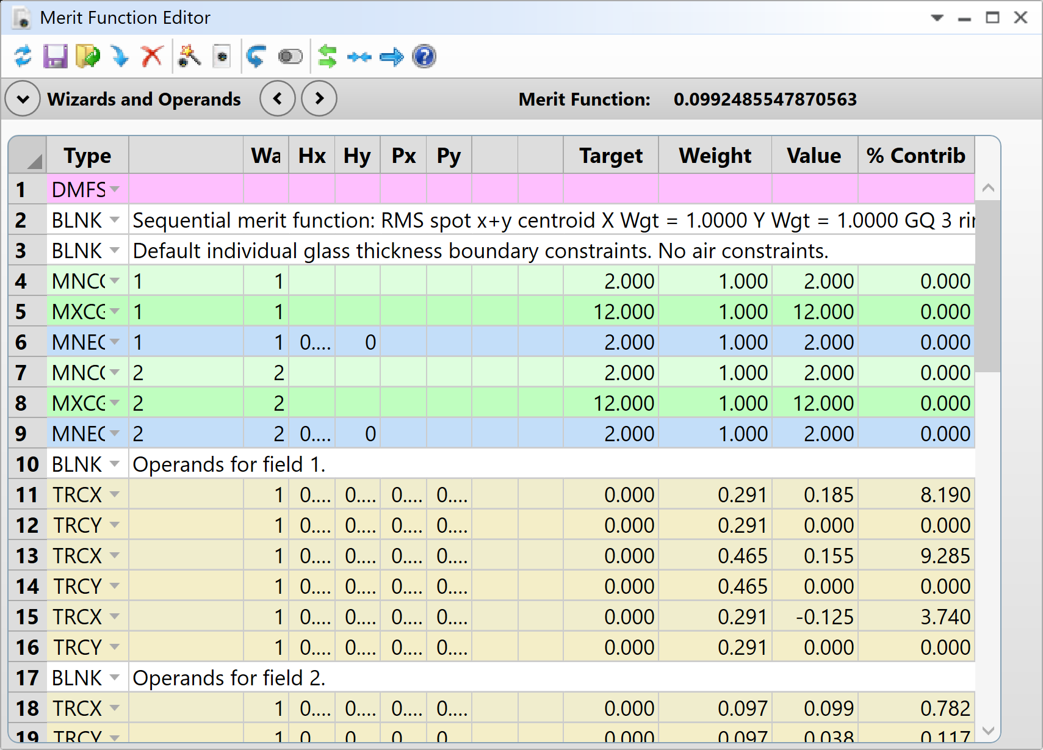
Merit Function Resulting Operands
After using the Optimization Wizard, Operands are automatically inserted into the Merit Function Editor
Each operand includes:
Target – desired value
Weight – importance of the goal
Value – current performance
Merit Function value shown in upper-left corner
Example: Current MF = 0.0992
These operands collectively define how the optimizer evaluates design quality
Why is it important to assign weights to operands in the Merit Function? What could happen if all weights were equal?
Notes:
Teaching notes:
After running the Optimization Wizard, OpticStudio automatically populates the Merit Function Editor with a set of operands. These represent the goals and constraints we specified earlier, such as, minimizing RMS Spot Radius and enforcing thickness limits.
Each operand has three key attributes:
Target: The ideal value we want to achieve
Weight: How important that goal is compared to others
Value: The current performance of the design
In the upper-left corner, you’ll see the overall Merit Function value. This is the score the optimizer tries to minimize. For example, here it’s about 0.0992. Lower is better.
Suggested answer: Weights indicate the relative importance of each goal. If all weights are equal, the optimizer treats every constraint as equally critical (even minor ones) potentially sacrificing key performance metrics like image quality to satisfy less important conditions. Assigning appropriate weights ensures the design prioritizes what matters most, such as minimizing blur over maintaining a secondary thickness preference.

Slide 28
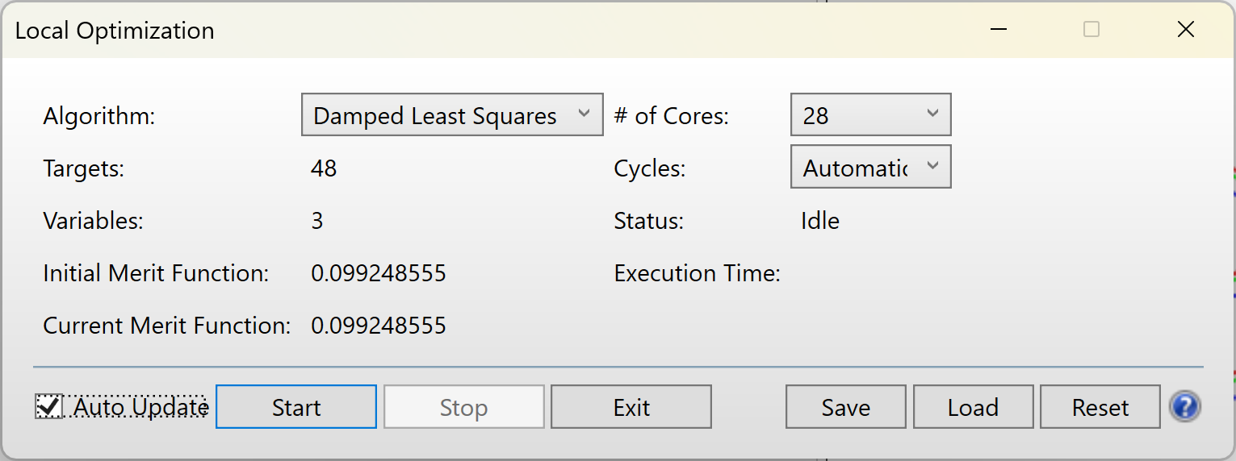
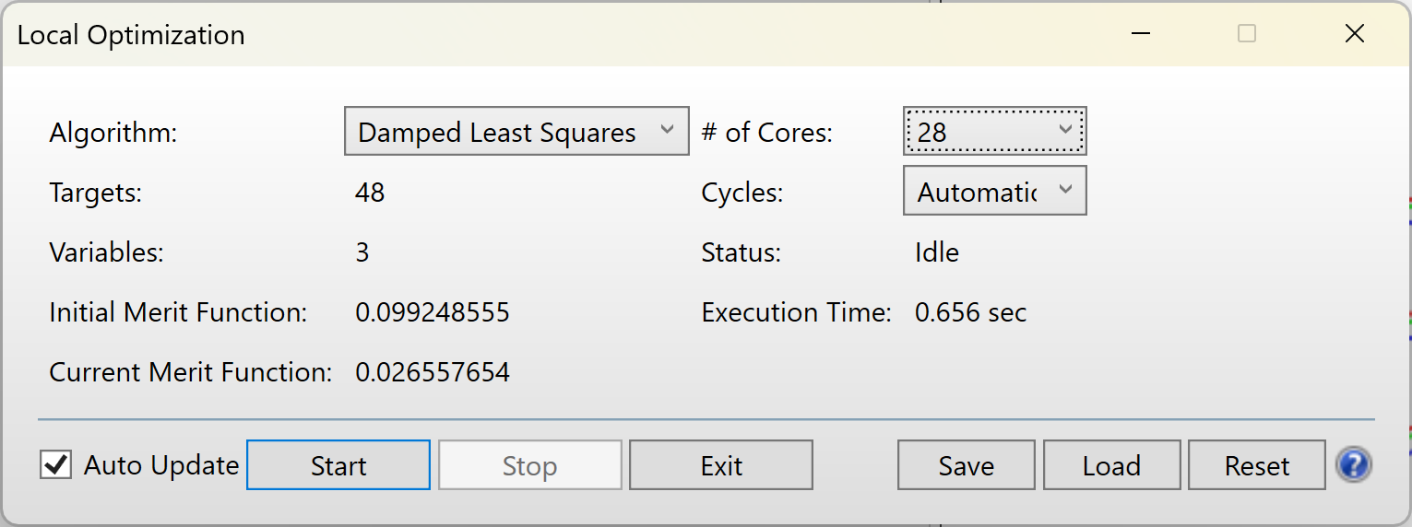
Running Optimization
/ Step: Optimize! the system
Before optimization… 0.099248555
To optimize the system, select Optimize…Automatic Optimization…Optimize!.
This will open the Optimization dialog box. Note that within the Optimization dialog, there are several different cycles to choose from. Selecting Automatic will ask OpticStudio to run the optimization routine until it has found a local minimum, a solution to the current Merit Function.
Note that OpticStudio reports both the Initial MF as well as the Current MF values. Run the optimization by selecting the Automatic dropdown, then pressing Start. Note the change in the Merit Function value.
1
2
After optimization… 0.026557654
The optimizer reduced the Merit Function from 0.0992 to 0.0266. Does this guarantee that the lens now meets all design goals? If not, why not?
3
Notes:
Teaching notes:
Now that the Merit Function is set, we can run the optimization. This is where OpticStudio adjusts the variables we defined earlier to minimize the Merit Function value.
To start, go to Optimize → Optimize!. This opens the Optimization dialog box. Here, you’ll see several cycle options, these control how aggressively the optimizer searches for a solution. For this exercise, select Automatic. This tells OpticStudio to run until it finds a local minimum, a solution that satisfies the current Merit Function.
Notice that OpticStudio displays both the Initial MF and the Current MF. Before optimization, our MF was about 0.0992. After running Automatic, it drops to around 0.0266 which is a significant improvement.
Suggested answer: No, a lower Merit Function does not guarantee that all design goals are met. The Merit Function is simply a weighted score based on the specific operands included in the optimization process, so it only reflects how well the system satisfies those chosen goals, such as minimizing RMS spot size and respecting thickness limits. While the drop from 0.0992 to 0.0266 shows significant improvement, the optimizer may have found only a local minimum rather than the global best solution. In addition, any constraints or practical considerations not included in the Merit Function, such as manufacturability, tolerance to misalignment, or chromatic performance, will not be accounted for. Finally, improving one metric can sometimes worsen others if weights are not balanced. Therefore, a lower Merit Function indicates progress toward the defined objectives, but it does not guarantee that the lens meets every real-world requirement.

Slide 29
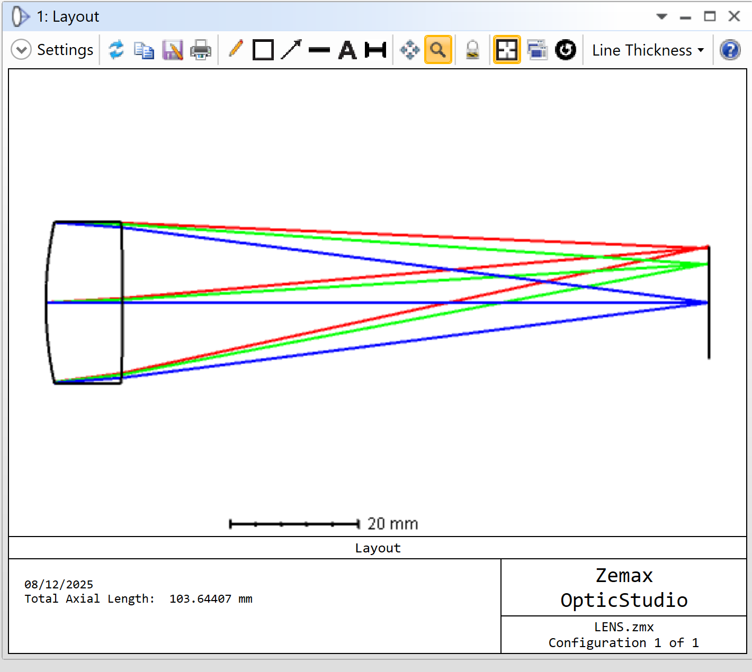
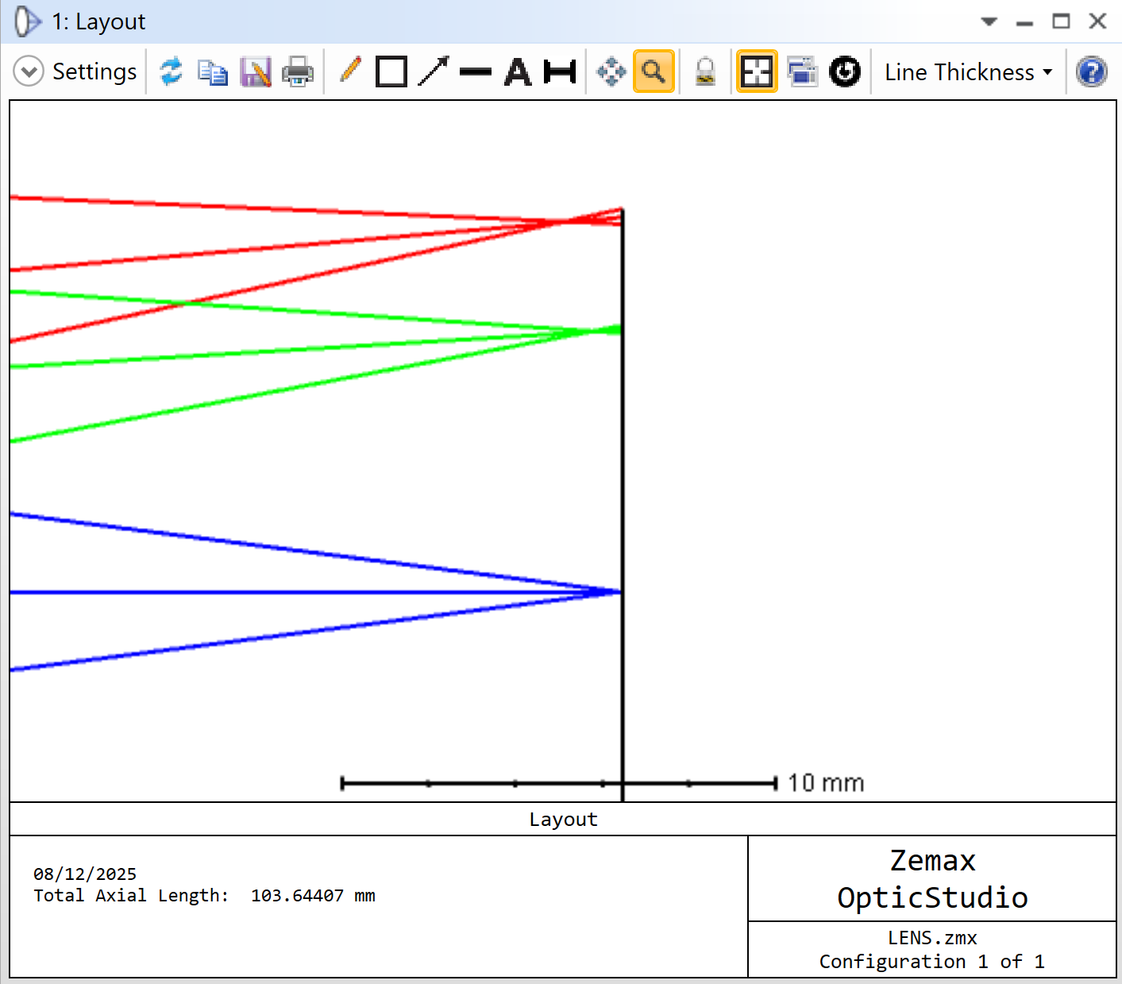
Evaluate Optimized System Layout Analysis
/ Step: Open the layout by navigating to Analyze…SystemViewer…Cross Section.
Observations:
Improved Ray Convergence: After Quick Focus, rays converge much closer to the image plane (axial length reduced from 104.00 mm → 103.64 mm).
Better Alignment: Defocus is significantly reduced, improving overall image sharpness.
Remaining Aberrations: Field curvature persists. On-axis rays focus nearer than off-axis rays (3.5° & 5°), which worsen toward the edge of the field.
Why do off-axis rays still fail to converge at the same point as on-axis rays after optimization? What does this reveal about the limitations of a singlet lens?
Notes:
Teaching notes:
As already mentioned, the Layout tool provides a quick visual check of system geometry and ray paths. After applying Quick Focus, the image plane is repositioned to minimize RMS spot size, reducing defocus and improving convergence. The axial length change from 104.00 mm to 103.64 mm reflects this adjustment. However, the diagram still shows field curvature: off-axis rays (3.5° and 5°) intersect further from the image plane than on-axis rays. This is a fundamental limitation of singlet lenses i.e. they cannot correct all aberrations simultaneously because of limited degrees of freedom. Emphasize that optimization improves performance within constraints but does not make the system perfect. This observation sets up a discussion about why more complex designs (e.g., doublets, triplets, or aspheric elements) are needed for high-quality imaging systems.
Suggested answer: Off-axis rays still show different focus positions because of field curvature and other aberrations inherent to single-element lenses. A singlet cannot simultaneously correct spherical aberration, coma, and field curvature due to limited design flexibility. This illustrates a key principle in optical design: improving one metric (like RMS spot size) does not guarantee uniform performance across all fields. To achieve consistent focus, designers often introduce additional lens elements or aspheric surfaces, which increase complexity but allow better aberration correction.

Slide 30
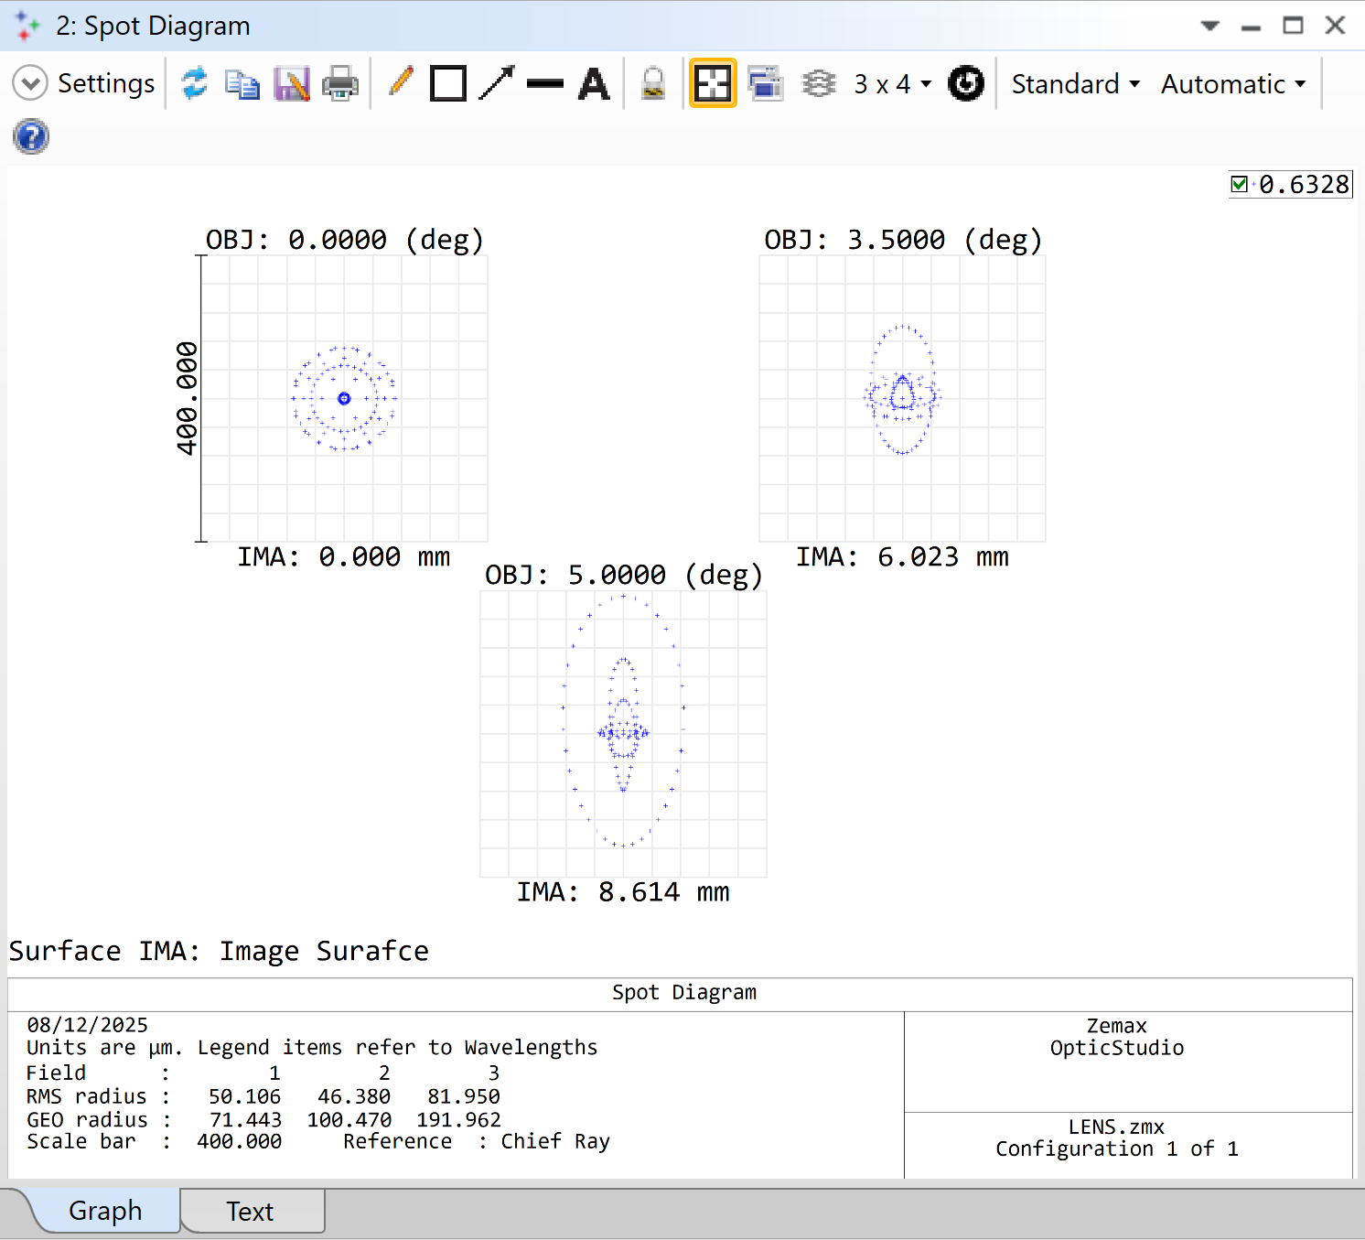
Evaluate Optimized System Spot Diagram
/ Step: Open the spot diagram by navigating to Analyze…Image Quality…Rays & Spots…Standard Spot Diagram.
Observations:
Significant Improvement: RMS spot radius reduced from 562–734 μm to 46–82 μm across fields.
GEO Spot Radius: Dropped from 918–1774 μm to 71–192 μm, showing tighter ray clustering.
Off-axis fields (5°) still have larger spots; evidence that residual aberrations remain.
Why do off-axis fields still show larger spot sizes even after optimization?
Notes:
Teaching notes:
The Spot Diagram is a key tool for assessing image quality. RMS Spot Radius gives a statistical measure of the spread of rays, while GEO Spot Radius shows the worst-case deviation. After optimization, RMS values at 5° dropped by nearly an order of magnitude (e.g., 734 μm to 82 μm), and GEO values also improved significantly. However, off-axis fields still exhibit larger spots, indicating residual aberrations like coma and astigmatism. Emphasize that optimization improves performance but cannot make a singlet lens diffraction-limited. This sets the stage for discussing why more complex designs are needed for high-quality imaging.
Suggested answer: Off-axis fields suffer from aberrations such as coma and astigmatism, which a single lens element cannot fully correct. Optimization reduces overall blur but cannot eliminate these field-dependent errors because the design lacks sufficient degrees of freedom. Multi-element systems or aspheric surfaces would address this.

Slide 31
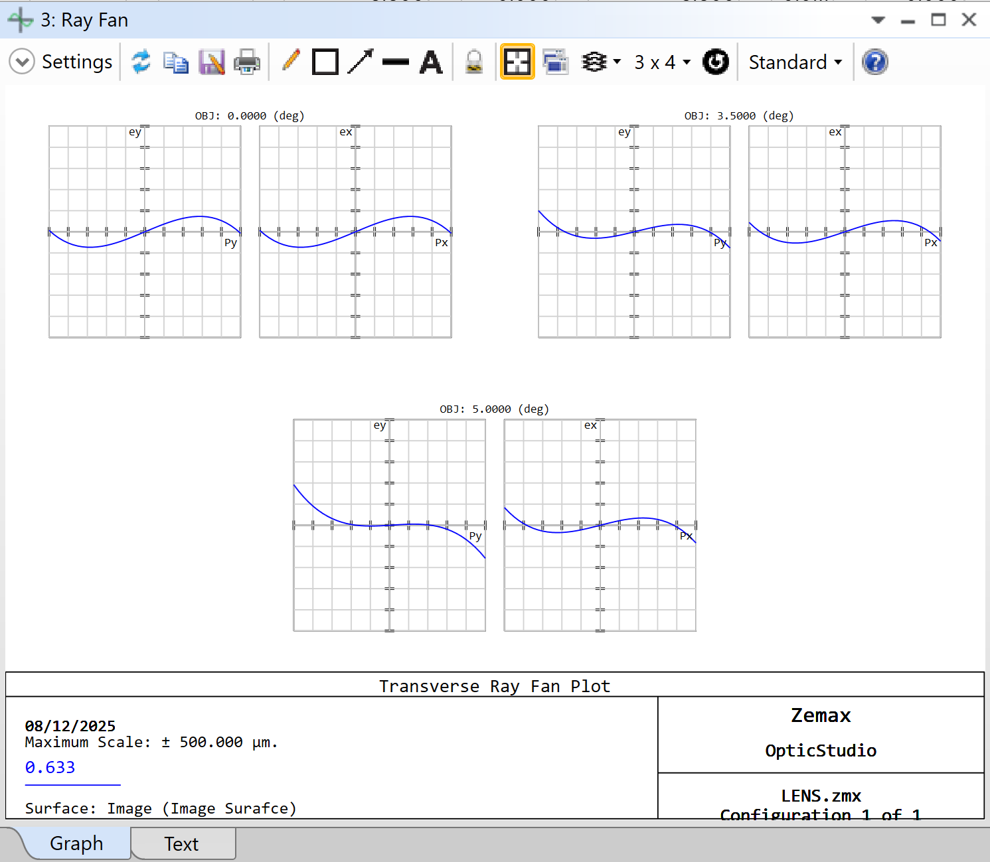
Evaluate Optimized System Ray Fan
/ Step: Open the Ray Fan plot by selecting Analyze…Image Quality…Aberrations…Ray Aberration.
Observations:
Scale Reduction: Maximum deviation reduced from 2000 μm to 500 μm.
Flatter Curves: Indicates improved performance, but remaining asymmetry and slope suggests residual aberrations.
If the Ray Fan plot is flatter but not perfectly flat, what does that tell us about the system’s limitations?
Notes:
Teaching notes:
A reminder that the Ray Fan plot shows how rays deviate from the ideal image point across the pupil. A perfect system would have flat curves. After optimization, deviations are much smaller and curves are flatter, but asymmetry and slope remain, confirming residual aberrations. This tool is useful for diagnosing which aberrations dominate and why optimization cannot fully correct them in a simple lens.
Suggested answer: It means the lens still suffers from aberrations like coma and astigmatism. While optimization reduces their magnitude, the design lacks enough degrees of freedom to achieve zero deviation. This highlights why complex systems are needed for high-quality imaging.

Slide 32
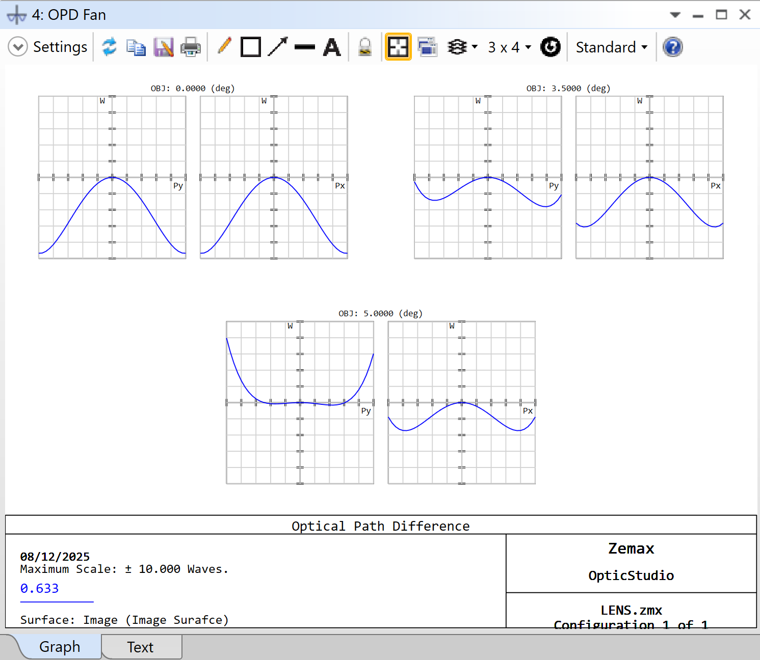
Evaluate Optimized System OPD Fan
/ Step: Open the Optical Path Difference (OPD) fan by selecting Analyze…Image Quality…Aberrations…Optical Path.
Observations:
Wavefront Error: Improved from 100 waves to 10 waves.
Curves Still Not Flat: Indicates spherical aberration and astigmatism remain.
Why is improving wavefront error important for imaging quality?
Notes:
Teaching notes:
Reminder that OPD Fan plots measure wavefront error compared to an ideal spherical wavefront. After optimization, the error drops significantly, but the curves are still curved, meaning the wavefront is not perfect. This confirms that aberrations persist even after optimization, reinforcing the need for more complex designs for diffraction-limited performance.
Suggested answer: Because wavefront error directly affects image sharpness and contrast. A flat OPD plot means all rays have equal optical path lengths, producing a perfect focus. Residual curvature means the system cannot achieve ideal performance.

Slide 33
Optimization Review
OpticStudio successfully optimized the singlet lens within the original design constraints.
Performance Gains: RMS and Geometrical Spot radii improved by nearly a factor of 10 compared to the initial design.
Design Compliance: Lens thickness and edge thickness meet all specified requirements.
Key Insight: While the optimized singlet is not diffraction-limited, the same process can be applied to more complex systems for improved performance.
Notes:
Teaching notes: This slide wraps up the optimization process and reinforces key learning outcomes. Emphasize that the optimization routine significantly improved image quality while respecting mechanical constraints such as lens thickness and edge robustness. However, the design remains limited by the physics of a single-element lens—aberrations like field curvature and coma cannot be fully corrected without additional degrees of freedom. This is a great opportunity to highlight the broader principle: optimization is powerful, but its success depends on the complexity of the system and the constraints applied. Encourage students to think about how these methods scale to multi-element systems, aspheric surfaces, or achromatic designs.

Slide 34
Part 3 Recap Summary
Defined variables in the Lens Data Editor for optimization.
Built a Merit Function using the Optimization Wizard to measure design quality.
Performed automatic optimization to minimize RMS spot size while respecting constraints.
Evaluated optimized system performance using Layout, Spot Diagram, Ray Fan, and OPD Fan plots.
Discussed trade-offs between optical performance and practical constraints.

Slide 35
Ansys Education Resources Feedback Survey
Here at Ansys, we rely on your feedback to ensure the educational content we create is up-to-date and fits your teaching needs.
Please click the link below to fill out a short survey (~7 minutes) to help us continue to support academics around the world utilizing Ansys tools in the classroom.
Feedback Survey Link
Notes:
Feedback Survey link for copy-paste method → https://ansys.typeform.com/to/jcattJI5

