Slide 1
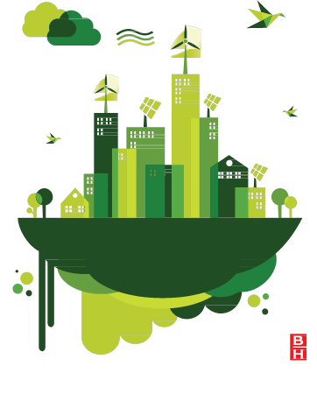
What is a
sustainable development?
a materials perspective
Mike Ashby
Department of Engineering,
University of Cambridge

Slide 2
Learning objectives for this lecture unit
Ansys software mentioned | Ansys Granta EduPack™­, a teaching software for materials education
Intended Learning Outcomes
Knowledge and Understanding | Understanding the role of materials in sustainable development
Skills and Abilities | Ability to analyze a proposed development
Values and Attitudes | Realization of the complexity of sustainable development
Resources
Text: “Materials and Sustainable Development”, by Mike Ashby, Didac Ferrer Balas and Jordi Segalas Coral, Butterworth Heinemann, Oxford, 2015
Ansys Granta EduPack software Sustainability Database
Notes:
Learning Objectives
These Intended Learning Outcomes are based on a taxonomy of knowledge and understanding as the basis, skills and abilities as necessary for the practical use of knowledge and understanding, followed by acquired values and attitudes enabling assessments and responsible use of these abilities.
Combined with a suitable assessment, they should be helpful in the context of accreditations or for the CDIO Syllabus.
The Texts listed are from books authored or co-authored by Mike Ashby but other texts are also referred to in the Science Notes.

Slide 3
Outline of the lecture unit
The idea of sustainable development
Triple bottom line and the three capitals
Stakeholders
Fact finding
Integration and reflection on outcomes
The Ansys Granta EduPack Sustainable Design database
Case study: Wind Turbines
Notes:
Resources
The book “Materials and Sustainable Development” by M.F. Ashby (2016), Butterworth Heinemann, Oxford (ISBN: 978-0-08-100176-9) provides useful background for this unit

Slide 4
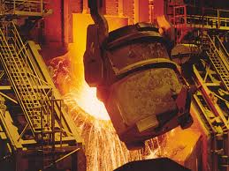

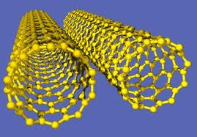

The evolution of materials science
Yesterday
Today
Tomorrow (2)
Tomorrow (1)
Sustainability
Environmental
Economic, Legal
Social impacts
Mechanics,
Structures
Design
Economics
Metallurgy
Polymer science
Ceramic science
Materials systems
and design
Materials science
Sustainability
Notes:
The evolution of Materials Science
As little as 50 years ago what we now call Materials Science was still a set of separate, largely unconnected, subjects of metallurgy, plastics technology and ceramic technology, taught in separated courses, often in different Universities. Over the course of the 20th century these were absorbed into the single, more integrated subject we know as Materials Science. Taught in parallel with courses on mechanics, structures, economics, design etc., the scope of materials science now extends down to the atomic scale. And the scale and impact of trade in materials and in products made from them is no longer just a national issue, it is global. As a result, the study of materials must incorporate not just technical, but also economic, environmental and societal issues and integrated them into a single program than might be called Materials Science, Systems and Design.
The study of Sustainability requires just such an integrated approach, integrating the economic, the environmental and social aspects of materials in the product design, manufacture and use.

Slide 5
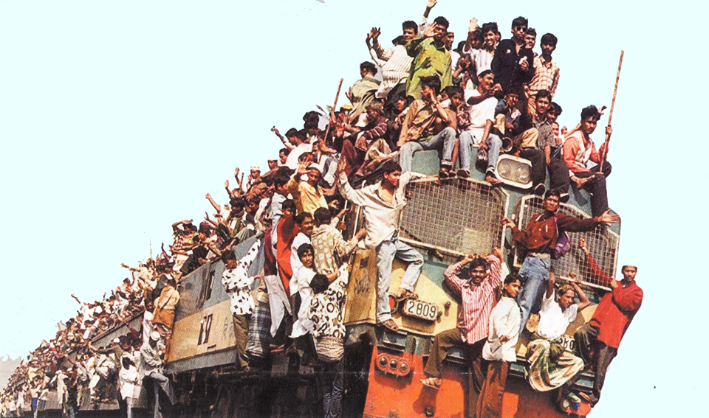
Fuel efficient, but sustainable?
Notes:
Fuel efficient, but sustainable?
Energy and materials are key players in assessing sustainable development. This image shows a mode of transport that, per passanger-mile must be one of the world’s most efficient. There are, however, issues of safety, it way may not be legal and – in risk-averse European nations – it might be seen as socially unacceptable. Is it a sustainable mode of transport? Probably not.
In much of the world we solve the problem of transport in another way, shown in the next frame.

Slide 6
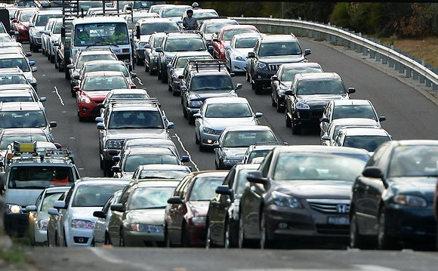
Safe, but sustainable?
SUSTAINABILITY ?
Energy
Materials
Environment
Emissions
Safety
Legality
Social acceptance
Space
Economics
Notes:
Safe, but sustainable?
Here is transport in the Western world – it is legal, it is socially acceptable and it is relatively safe. But it clearly uses a lot of material and space, it is not energy-efficient, its emissions are harmful to the environment and it is expensive. Even auto-makers recognize that, in the long run, this may not be a sustainable mode of transport.
So any discussion of sustainable development is complex. In describing just these two images we’ve used, or touched on, the following topics:.
Energy
Materials
Environment
Safety
Legality
Social acceptance
Space
Emissions
All of these (and more) influence sustainable development. How can we introduce students to such a complex topic?

Slide 7
The starting point
Mission statement
Provide a framework within which a student can form
critical, independent assessments of “Sustainable Developments”
“Sustainable development is development that meets the needs of the present without compromising the ability of future generations to meet their own needs”
Report of the Brundtland commission of the UN, 1987
But how?
And where do materials fit in?
Notes:
Defining Sustainable Development
Any discussion of “Sustainability” has to start with its most widely quoted definition, that of the Brundtland Commission*, reproduced on this frame. By this reckoning, sustainable development requires that each generation leave to its successor at least as large a productive base as it had itself inherited.
It is hard to disagree with the Bruntland definition of sustainability. But so general that it sheds little immediate light on ways of achieving it. We need a more explicit formulation.
Note the distinction between “Sustainability”, an absolute term, (something is either sustainable or it is not) and “Sustainable development”, a relative term (meaning technology that moves us towards a state of sustainability).
*United Nations General Assembly (March 20, 1987). "Report of the World Commission on Environment and Development: Our Common Future; Transmitted to the General Assembly as an Annex to document A/42/427 - Development and International Co-operation: Environment; Our Common Future, Chapter 2: Towards Sustainable Development; Paragraph 1". United Nations General Assembly

Slide 8
Headlines
“Chinese company produces world’s largest 16 MW wind turbine ” (Global times, 23 November 2022).
“The SDG Summit in September (2023) must be a moment of unity to provide a renewed impetus and accelerated actions for reaching the SDGs”
– Antonio Guterres, United Nations Secretary-General, 2023
“Half of all new cars must be electric by 2030 to meet emission targets”
– The Times, 26 November (2015)
“Recycling turbine blades: the Achilles heel of wind power” (euronews.com 27 June 2021)
“Articulations” of sustainable development
Notes:
Pause for Demo
Here is a good point to show the structure and content of the Sustainability database.

Slide 9
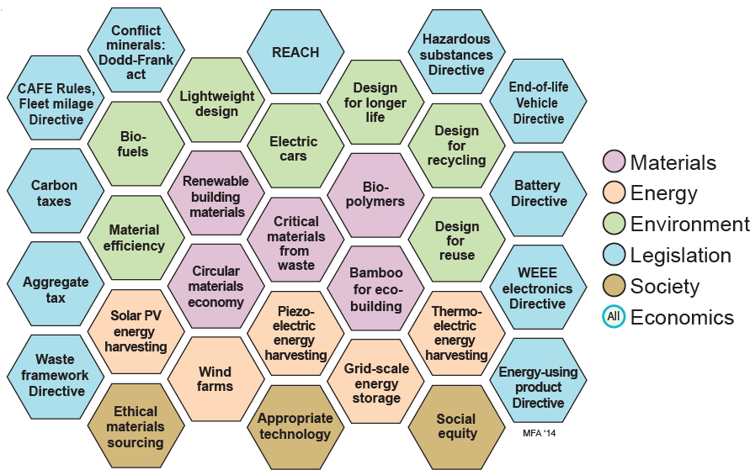
“Articulations” of sustainable development
Notes:
Mapping articulations
There are many possible articulations of sustainable development. Some are shown here. All involve materials and energy in some way, and all have economic, environmental, legal and social dimensions. Often one aspect is dominant. This (animated) frame distils out six key aspects of sustainable developments.
The picture is complicated further by the fact that the articulations may conflict, as we saw two frames back.
These articulations are derived from reports in the following journals: *World Journal of Science, Technology and Sustainable Development, ISSN: 2042-5945. World Journal of Science, Technology and Sustainable Development, ISSN: 2042-5945. Journal of technology management & innovation, ISSN 0718-2724. Journal of Clean Technology and Environmental Sciences, ISSN: 1052-1062. Clean Technologies and Environmental Policy, ISSN: 1618-9558.

Slide 10
Objective, size and time-scale
Motivation
(Prime objective)
Size and time
scale
…….
Articulation
….….
Reduce dependence on oil
Develop
Bio-polymers
20% of all polymer production by 2025
Stimulate low-carbon economy
Impose
carbon tax
€ 40 per tonne by 2030
Stimulate circular materials economy
Mandatory car recycling
85% was to be recycled by 2015 (EU)
Each articulation has a
Objective
Size scale
Time scale
Layer 1
Define objective, size and timing
Needs
FACTS
Notes:
Step 1: clarify the objective
Efforts to contribute to sustainable technology take many forms, each sometimes presented as the solution. Think of each of these, instead, as an “articulation” of sustainable technology. Here are four. Each has the feature that it addresses one of the concerns about sustainability by each also conflicts with other such concerns. It has a physical scale and a time scale; if the articulation is going to make a difference it has to operate on a scale comparable with the problem that it addresses.
The first step is to is clarify the objective of the articulation and its physical scale and time scale. We assemble these requirements on Layer 1, the starting point of the assessment.
See: “What is sustainable technology?” edited by K. Mulder, D. Ferrer and H. van Lente, Greenleaf Publishing, Sheffield, UK (2011). ISBN 978-1-906093-50-1.

Slide 11
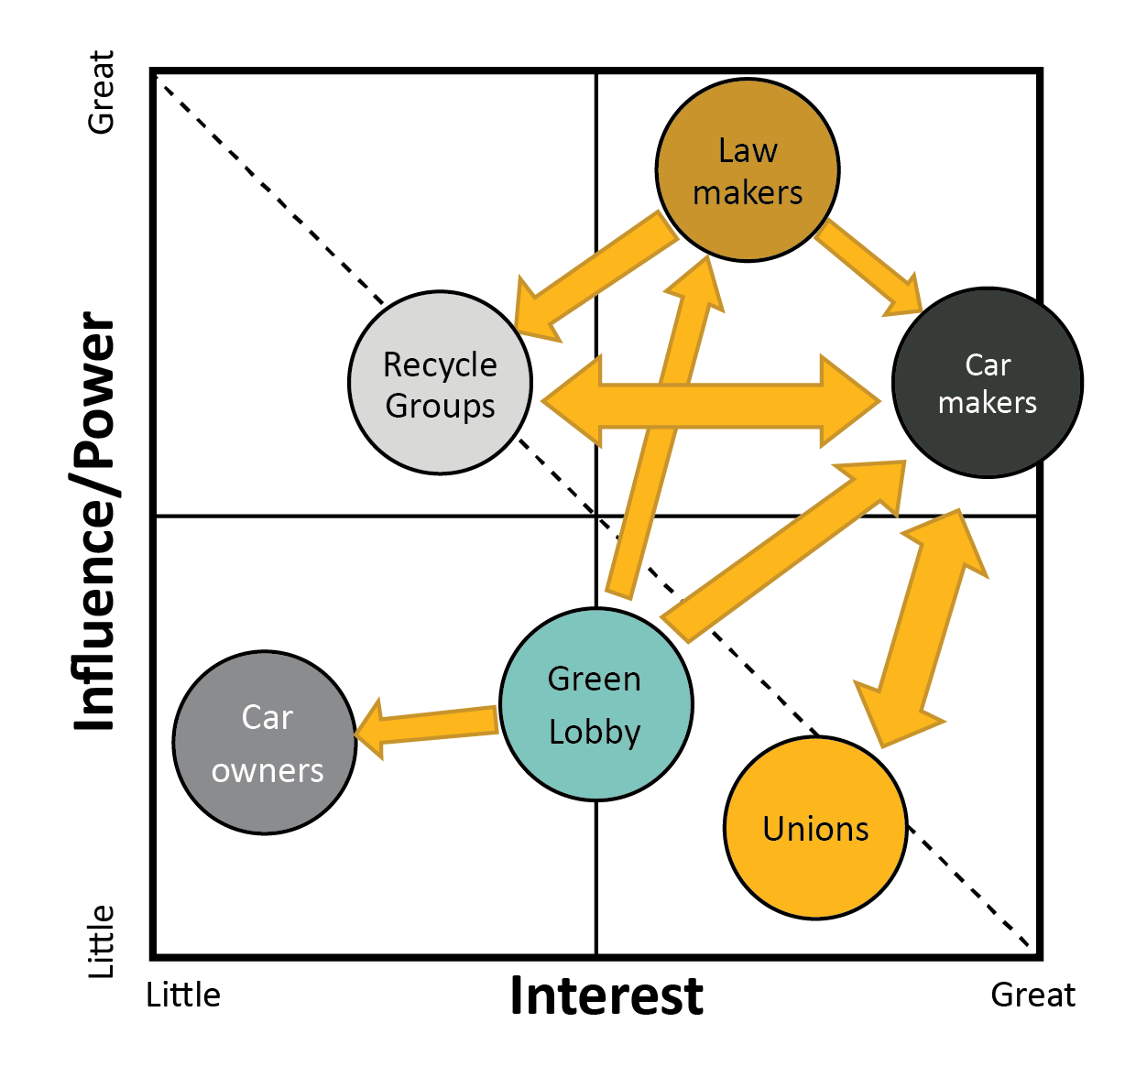
The context: stakeholders
Stakeholders
Who are they?
What are their concerns?
What power do they have?
Mandatory recycling of cars
Government
The public
Local communities
Owners
Manufacturers
Suppliers
Trade Unions
Customers
Lobbyists
Investors
National press
Managers, colleagues, team
Layer 2
Stakeholders and their concerns
Needs FACTS
Notes:
Step 2: Stakeholders and their interest and influence
Stakeholders are individuals, groups or organizations that are in any way affected by the articulation. Some, like the originators of the articulation in question, wish to see it succeed. Others may have reservations or voice outright opposition. It is important to identify the stakeholders and their concerns. If the concerns are not addressed the articulation will face obstacles and may fail to gain acceptance. If this happens the articulation is not sustainable.
Stakeholders and their concerns are identified by interviewing, conducting surveys, listening to pressure groups and via the national press, radio and television.
Stakeholders differ in their level of interest and the influence or power that they can exert. The stakeholder diagram, shown here, has Stakeholder Interest and Influence as axes. The likely behavior a particular stakeholder depends, to some extent, on the position they occupy on this diagram. Once positioned, it is possible to reflect on the mutual influence or dependence of the stakeholders, shown here by arrows. The second step, then, is to identify the stakeholders and their concerns – they set the context in which the assessment is carried out. This forms Layer 2.

Slide 12
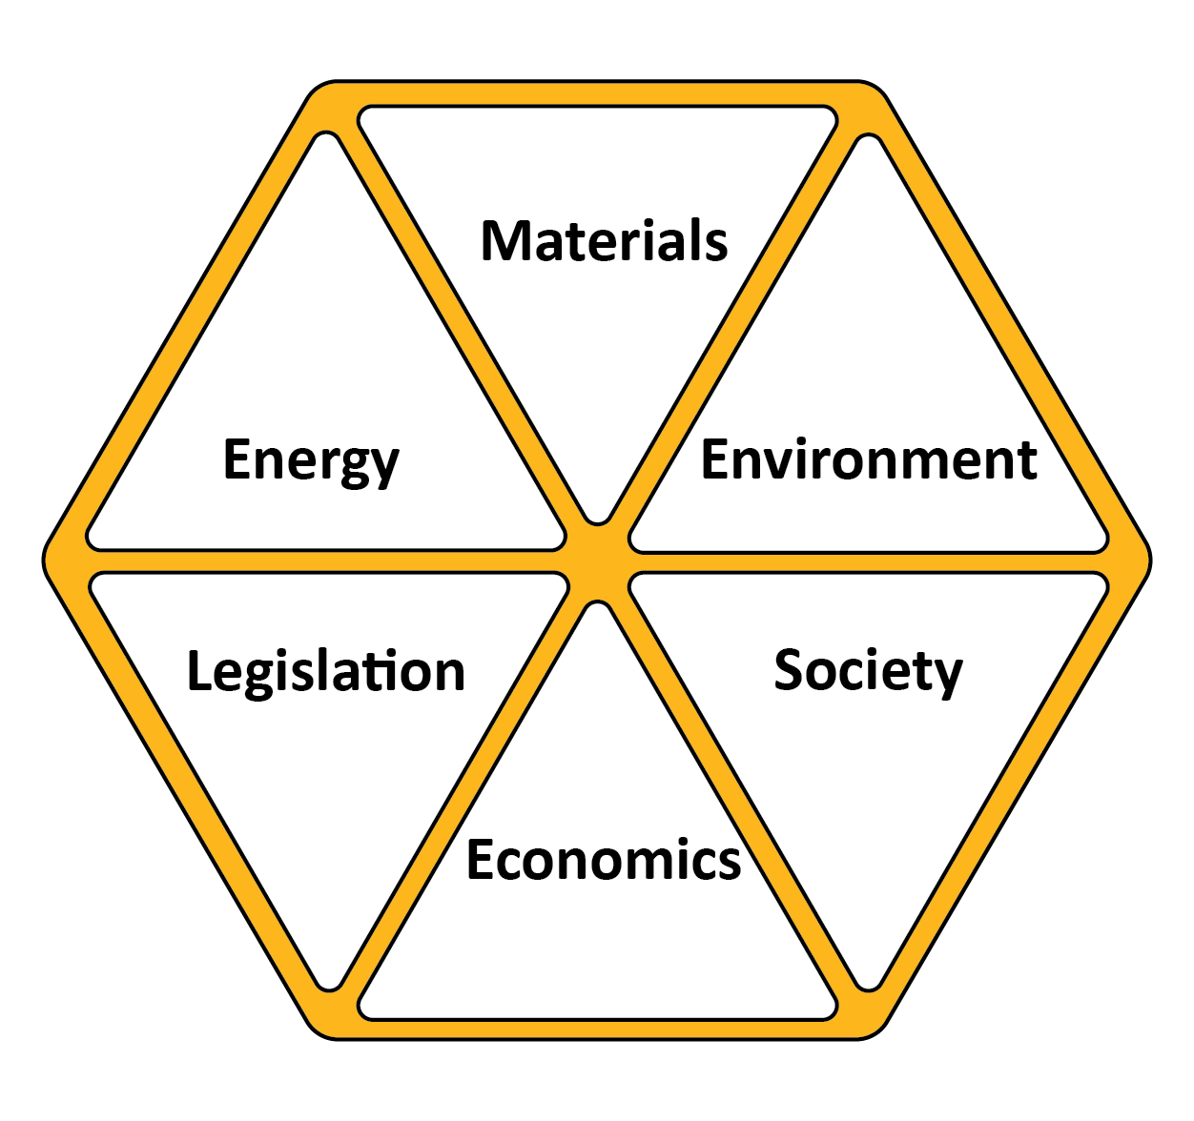
What FACTS do we need?
Material-efficient design
Resource-efficient design
Eco-design
Sustainable design
Layer 3
Fact-finding
12
Notes:
Step 3: Fact finding
Examination of a longer list of articulations from which the previous frame come (drawn from journals reporting from research on sustainable technology*) suggests that the central issues might be grouped under the six broad headings shown here. Each heads a check-list for what might be called “sustainability analysis” of a design, scheme, project or product.
Materials and Manufacture: ethical sourcing, supply-chain risk, recycle potential.
Energy: demand, efficiency,.
Environment: preserving clean air, water and land.
Regulation: awareness of, and compliance with, National and International Agreements, Legislation, Directives, Restrictions and Agreements.
Society: Health, education, shelter, employment, equity, happiness.
Economics: cost and benefit
The third step is that of fact-finding, which can be done systematically and objectively.
Facts that establish what the articulation is; what materials and energy are required to make or operate it; what environmental impact it has. Is it legal? Are there regulations with which is must comply? What will it cost? Is it fair and equitable?
Facts that relate to the stakeholder concerns. Are the concerns justified? What information is needed to confirm or refute them?
Facts relating to essential infrastructure. What will have to be in place to support the articulation if it goes ahead?
Each of these questions can be researched in an objective way using generally-available books, databases and the Internet, guided by check-lists. Fact-finding follows the stakeholder analysis as Layer 3.

Slide 13
The business view: triple bottom line accounting
Planet
Viable
Liveable
Sustain
- able
Prosperity
People
Fair
Corporate sustainability report (SR):
Financial bottom line
Social / ethical performance
Environmental performance
Notes:
The Business view: Triple bottom line accounting
The idea of a “Triple bottom line” is that a corporation’s ultimate success or health should be measured not just by the traditional financial bottom line, but also by its social/ethical and environmental performance. They are known as the 3P’s: Planet, Prosperity and People.
This approach finds use in assessing the progress of a commercial enterprise. A business that, in a given year, shows an operating profit, takes steps to improve working conditions and takes steps to reduce heat-loss from its plant can claim to have a positive balance in all three columns of account.
But what guidance does it give to an engineering designer? And how does it help with selecting materials? It is still too far removed from the decisions required by these. To get further we must decouple the rings and unpack their meaning.
http://en.wikipedia.org/wiki/Triple_bottom_line

Slide 14
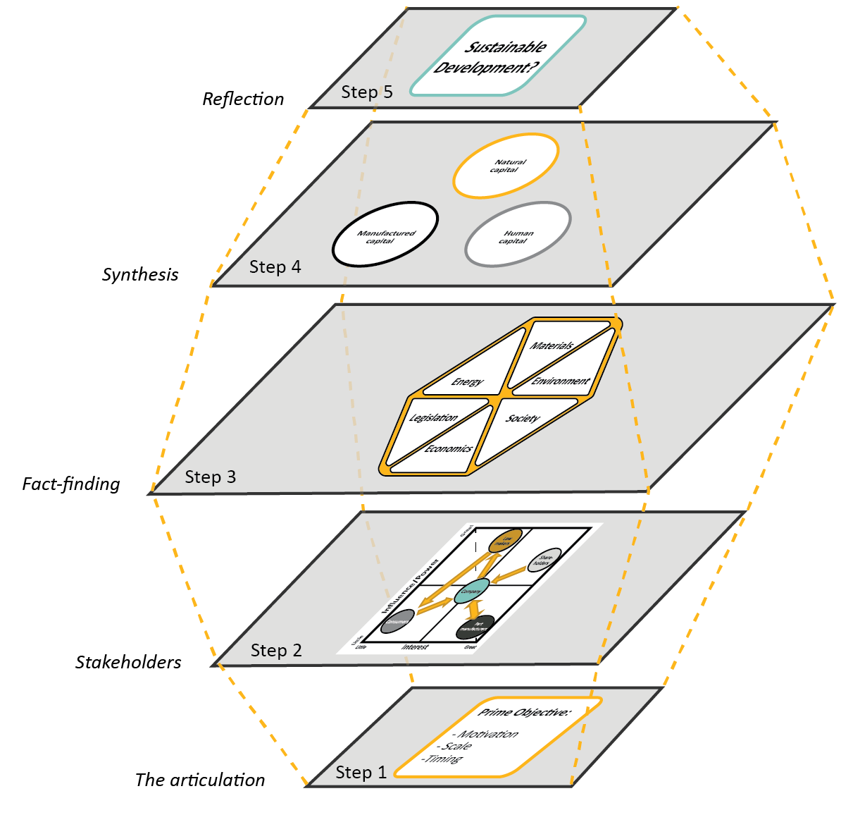

Analyzing an “articulation”
Reflection
1 Objective
Synthesis
(Subjective)
2 Stakeholders
3 Fact-finding
4 Synthesis
Fact-finding
(Objective)
5 Reflection
Interaction between layers
Stakeholder
analysis
Define objective
Notes:
Assembling the layers
We can now assemble the layers. At the bottom, Layer 1, is the statement of the articulation, with its size and time scale. Stakeholders are involved: they are identified and classified in Layer 2 Their concerns, plus background about the articulation itself, can be researched in a systematic, objective way, using the heading in the hexagon as prompts for fact-finding (Layer 3). Armed with the facts, a debate about the practicality of the articulation and its impact on the three capitals becomes possible (Layer 4 - synthesis). The final step (Layer 5) is one of reflection on the articulation and its impacts, considering its overall merits or difficulties and considering whether it could be improved by change.
The lower layers inform the ones above, so that the approach has a direction and a sequence, from bottom to top. As explained earlier, the layer-based approach clearly separates the objective, fact-based aspects of the problem from the more difficult value-based aspects. It encourages thinking about interaction within each layer, and gives a logical path to explore the interaction between layers.

Slide 15







Ansys Granta EduPack Sustainability Database for fact-finding
Materials
Power
generation
Processes
Energy
storage
Regulation
Nations
Notes:
The Ansys Granta EduPack software Sustainability Database
The Granta EduPack software provides a computer-based resource for assessing articulations of sustainable technology and the place of materials in them.
It is an expansion of the Level 3 database to include three major additions. The first is a data-table of Regulation, listing legislation, regulations and incentives to encourage or restrict the use of materials or of practices such as recycling that relate to material use. The second, the Nations of the World data-table, contains records for the world’s 210 nations, with data for population, governance, economic development, energy use and engagement with human rights, together with information that may bear on security of supply and the ethical sourcing of materials. The new data-tables are linked to the pre-existing Materials and Process Level 3 data-tables, allowing individual materials to be linked to legislation that affects them and to the nations from which they are sourced. The materials records themselves have been expanded to include a ranked list of the Countries of Origin and a Critical Material status. The Materials data-table has further links to two further data-tables relating to energy: one with records for Electric-Power generating systems, the other for Energy Storage systems. This frame shows the structure.

Slide 16

Fact finding alignment
Notes:
The Ansys Granta EduPack Sustainability database and Fact-Finding Step
The Sustainability database is a resource to support the assessment of a proposed sustainable development. The database contains and connects information about materials and processes, energy, the environment, materials-related legislation and regulation, society and economics. The data it contains can be manipulated and plotted in ways that are helpful both in analysis and in presenting and explaining conclusions about the six sectors of the Sustainable Development Fact-finding hexagon.

Slide 17
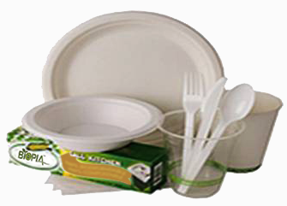
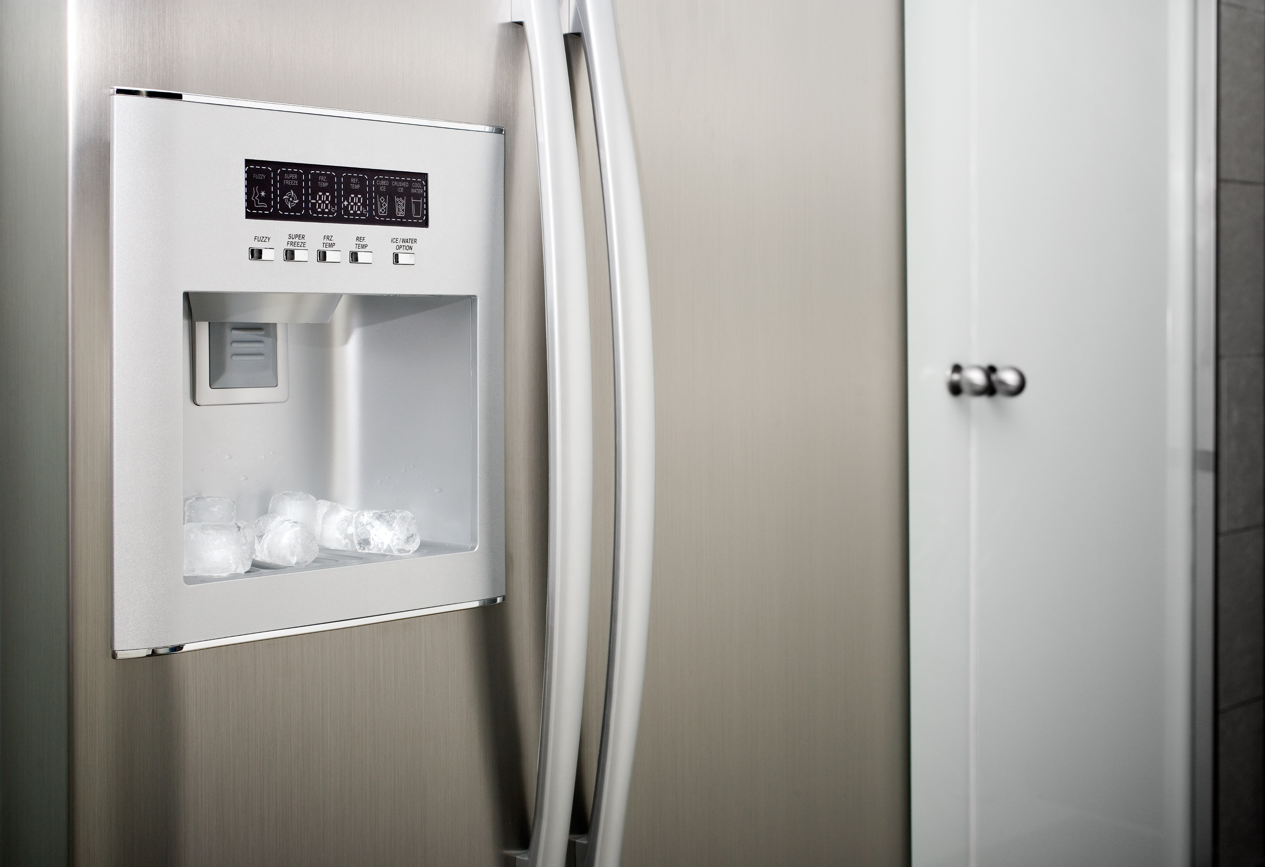

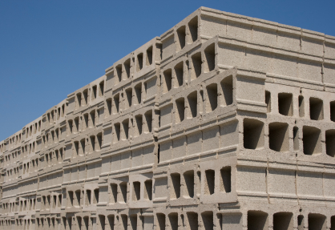
Case studies
Biopolymers
Plastic Books
Electric Appliances
Built Environment
Wind farms
Notes:
Worked Case Studies
The text “Materials and Sustainable Development” includes a number of Case Studies illustrating the use of the method for project-based teaching. All follow a standard pattern. Each starts with an Introduction and Background information, providing context and basic, relevant, facts. This leads into the 5-step analysis.
Step 1 is a statement of the Prime Objective, size scale and time scale. Sometimes these are explicitly stated in the description of the project. When they are not, we need common-sense estimates.
Step 2 is the identification of Stakeholders and their concerns, ideally through interviews and questionnaires. When this is not possible the National Press plus a web-based search of news reports, Government and NGO position-papers, letters to editors and magazine surveys reveals a great deal about them.
Step 3 is Fact-finding, mining published literature and internet-searches to research both the factual background of the articulation and the validity of the concerns expressed by the stakeholders. Facts should, if possible, be check against a second, independent source.
Step 4 Synthesis is an examination of how the facts influence Human, Natural and Manufactured Capital. It is the most difficult step. Mapping the findings of the Fact-finding step onto the Synthesis matrix shown on the previous frame helps to assemble a big picture.
Step 5, the final step, is that of informed Reflection, assessing the picture that has emerged and considering priority changes. It is valuable to do this with two time-scales in mind. Many articulations appear, in the short term, to be impractical or misguided because the infrastructure essential for their success in not in place and cannot be created in the short time frame visualized when the articulation was first formulated. In the longer (40 year) term, however, it might be achievable. Thus many present-day articulations of sustainable development are, as it were, first steps on a longer journey. The question for debate: does the long-term gain justify the short-term pain?
One of the cases studies – that for electric cars – follows in this PowerPoint presentation.

Slide 18

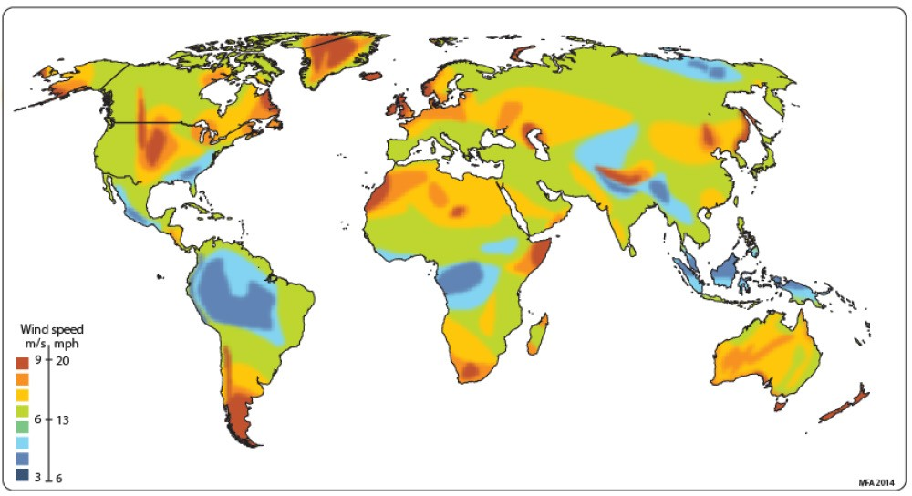
Step 1: the articulation, objective, size, and time scale
Objective: to reduce global carbon emissions and increase energy self-sufficiency
Size scale: Growing currently installed capacity of wind turbines to 3,200GW which averages 300GW of newly installed every year
Time scale: by 2030
Layer 1
A global map of average wind speed
Notes:
Case Study: Wind turbines
Are wind turbines realistic? To answer that we need to know a number of things. What demands for materials will this building program create? Can they be met? By how much is the carbon footprint of electrical power from wind lower than that from fossil fuels? And will 3,200 GW of this lower carbon power make any significant reduction to global carbon emissions?
MacKay, D.J.C (2009) “Sustainable energy – without the hot air” UIT Press, Cambridge, UK and Ashby, M.F. (2013) “Materials and the Environment” Butterworth Heinemann, Oxford.

Slide 19

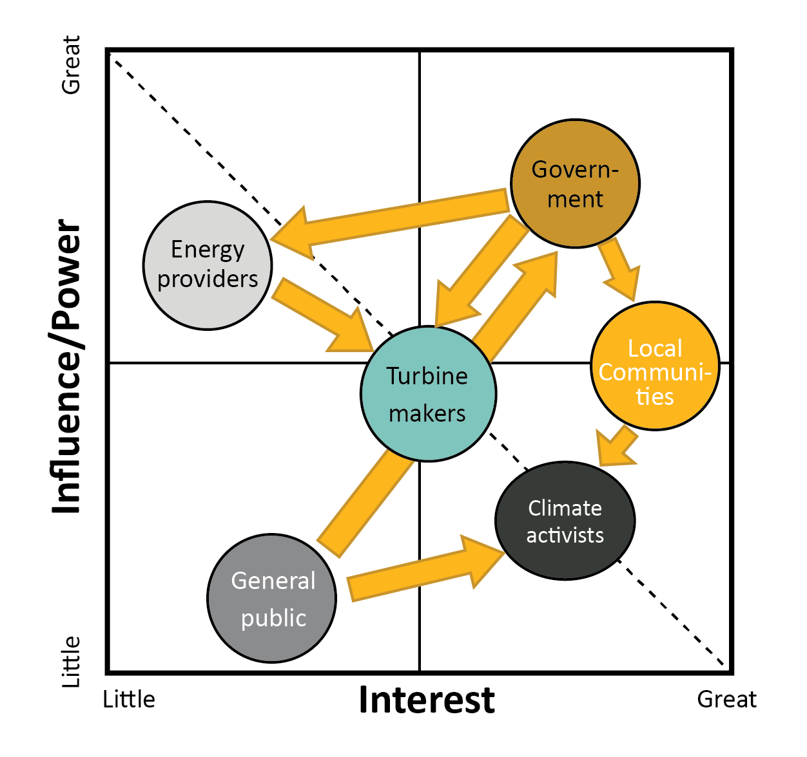
Step 2: stakeholders and concerns
Summary of the significant concerns
The security of supply of the critical materials on which wind turbines depend.
Wind farms don’t reduce carbon emissions
Wind farms are uneconomic without subsidies
Wind farms are visually unacceptable.
Wind farms are a danger to wild life
Turbine blades raise landfill concerns as not recyclable
Layer 2
Notes:
Step 2: Stakeholders and their concerns.
The national press reports the views of government, industry and the public about energy generation, identifying most of the stakeholders. Stakeholders need to be heard, reassured, persuaded or compensated if the large-scale use of, for example, electric cars is to be sustainable. Identifying stakeholders can be run as an exercise. Here is a list assembled from the press cuttings on the previous frame and general observation. Among them are:
National Governments: Commitments to reduce carbon emissions over a defined time period
Energy providers: Carbon taxes or carbon trading schemes and carbon penalties .
Wind turbine makers and their suppliers: Consistency of Government policy to support a market and a secure source for essential materials. They are uncertain of public acceptance of wind turbines, making investment decisions difficult.
Labor Unions are concerned about job-creation, stable employment and improved pay and working conditions in the energy sector.
Local communities and the wider public: The acoustic and visual intrusion of wind turbines and their power- distribution system is controversial.

Slide 20
Step 2: stakeholder details
  National and Local Government. National Administrations have made commitments to reduce carbon emissions over a defined time period. They see wind farms as able to contribute, but also as a source of local wealth and employment. To encourage their construction they subsidize renewable energy production and impose taxes on carbon emission
  Energy providers. Carbon taxes or carbon trading schemes and carbon penalties create financial incentives for energy providers to reduce the use of fossil fuels.
  Wind turbine makers. Turbine makers want assurance that government policy on renewable energy is consistent and transparent, that incentives will not suddenly be withdrawn and that the supply chain for essential materials is secure.
  Local communities and the wider public. The acoustic and visual intrusion of wind turbines and their power- distribution system is seen as unacceptable by some, as is the danger they pose for birds or other ocean wildlife.
  Recycling companies. While 90% of a wind turbine can be recycled, there are no options available at the end of life for blades, outside of landfill or incineration.

Slide 21
Step 3: fact-finding
Summary of significant facts
Wind power can produce electrical power with significantly lower carbon emissions than gas or coal-fired power stations
The construction energy of a wind farm is returned as electrical energy in 4-6 months
Compact, efficient turbines require neodymium, categorized as critical, with significant supply-chain risk
End of life scenario for the composite blades are not satisfactory
The cost of energy from a wind farm has significantly dropped, reaching levels or below levels that of gas or coal-fired stations. This asset is mitigated as grid-scale energy storage is needed to smooth the intermittent generation.
Wind farms are intrusive to the communities in which they are sited. If wind farms are to contribute a significant fraction (say 15%) of energy needs this intrusion becomes widespread.
Layer 3
Notes:
Step 3: Fact-finding
What information is needed to support or refute the claims made for them and the concerns expressed about them? What additional facts do we need for a rational discussion of the Prime Objective - to reduce global carbon emissions and increase energy self-sufficiencyby 2030. This frame gives an overview. The following frames explore the segments of the hexagon.

Slide 22
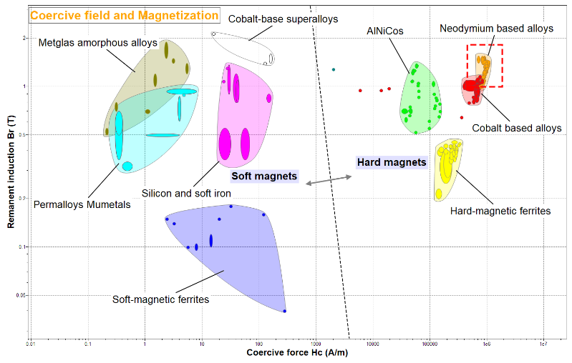
Fact-finding 3a
The remanent magnetization and coercive force of magnets, plotted from Ansys Granta EduPack software 2023 R2 sustainability lvl 3 database. Nd-B magnets rectangled in red.
Notes:
Using the Sustainable Development database for fact-finding for electric cars
This animated frame suggests the way the database can be used for fact-finding. Key elements can be traced to their countries of origin via the “Countries of origin” entry in their Materials records. The links to Nations in these two records takes you to records for the countries with information about their governance, development, freedom of speech, prosperity and other characteristics. The data-table for Energy storage allows the energy density (stored energy per unit weight) of storage systems, including batteries, to be plotted. Magnetic materials are also well documented. These are just some of the connections that the links between the data-tables enable.
The essence of fact-finding is that it should be non-judgmental.

Slide 23
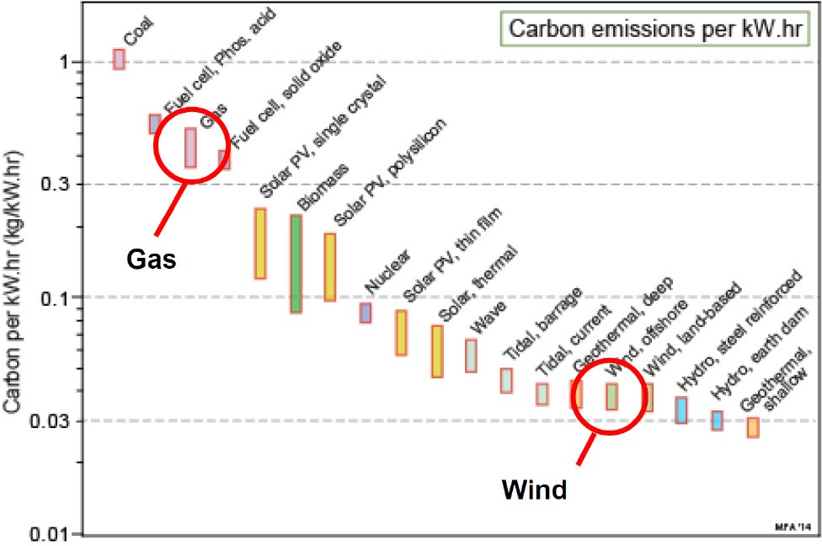
Fact-finding 3b
The carbon emission per kW.hr of delivered power for alternative systems. They are approximate, but sufficiently precise to establish that wind power has the ability to generate electrical power with significantly lower carbon emissions than gas or coal fired power stations when averaged over life.
Notes:
Emissions for different energy systems

Slide 24
Fact-finding 3c
Neodymium is co-produced with other rare-earth metals, of which it forms 15% on average. The table lists the nations that produce rare earths and the quantities they produce.
https://pubs.usgs.gov/periodicals/mcs2023/mcs2023.pdf
Notes:
Rare earth metal resources

Slide 25
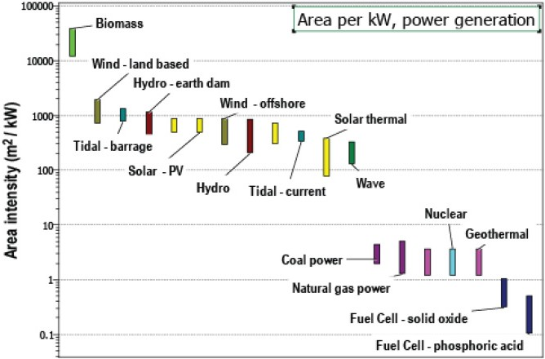
Fact-finding 3d
Wind farms require a land-area per unit of generating power that is almost 1000 times greater than that of a gas-fired power station and while this land can still be used for agriculture the scale of the intrusion is considerable.
Notes:
Land use for different energy systems

Slide 26
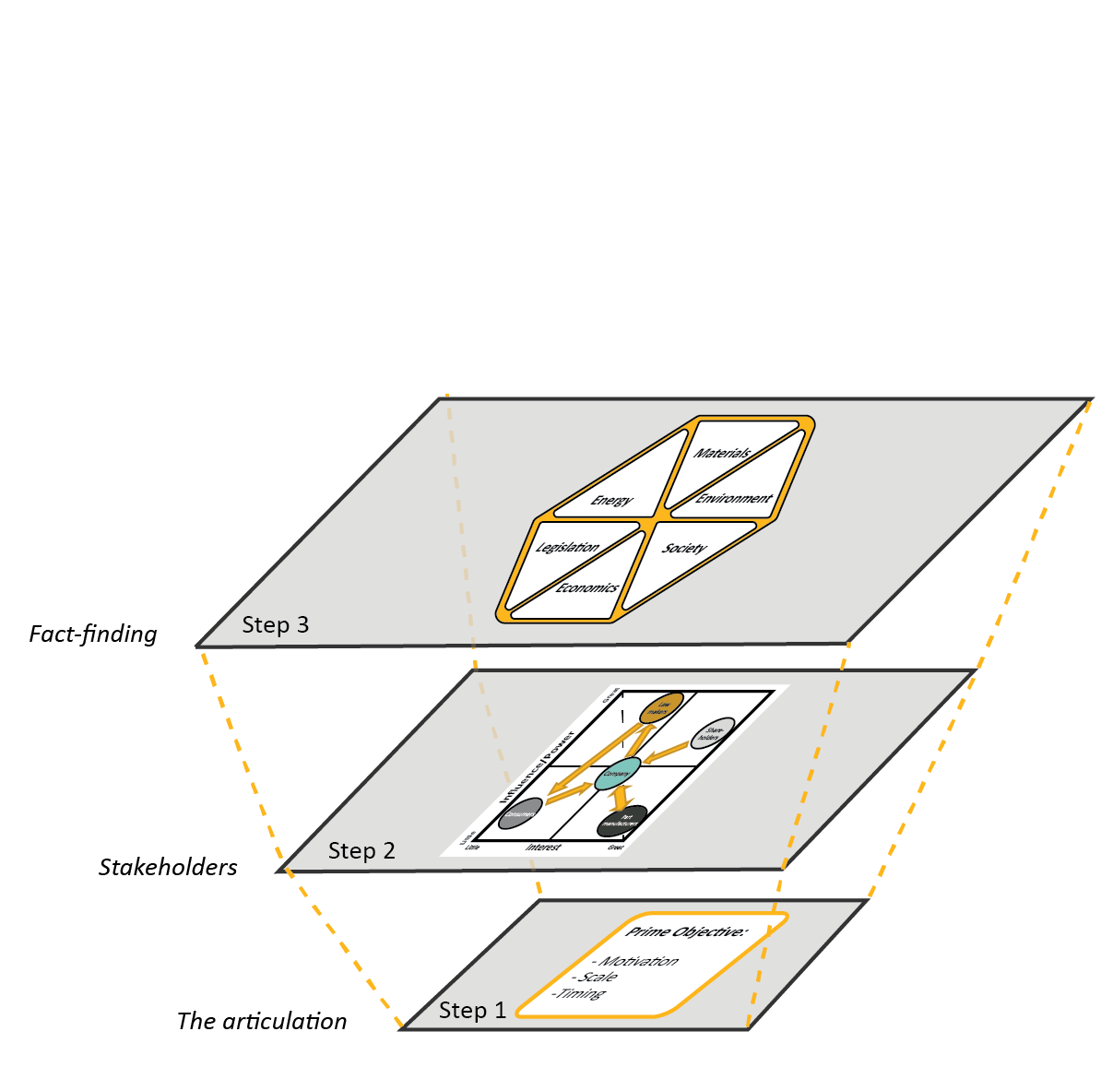
Step 4: Stacking the first three layers
?
Notes:
Assembling the layers
We can now assemble the layers. At the bottom, Layer 1, is the statement of the articulation, with its size and time scale. Stakeholders are involved: they are identified and classified in Layer 2 Their concerns, plus background about the articulation itself, can be researched in a systematic, objective way, using the heading in the hexagon as prompts for fact-finding (Layer 3). Armed with the facts, a debate about the practicality of the articulation and its impact on the three capitals becomes possible (Layer 4 - synthesis). The final step (Layer 5) is one of reflection on the articulation and its impacts, considering its overall merits or difficulties and considering whether it could be improved by change.
The lower layers inform the ones above, so that the approach has a direction and a sequence, from bottom to top. As explained earlier, the layer-based approach clearly separates the objective, fact-based aspects of the problem from the more difficult value-based aspects. It encourages thinking about interaction within each layer, and gives a logical path to explore the interaction between layers.

Slide 27

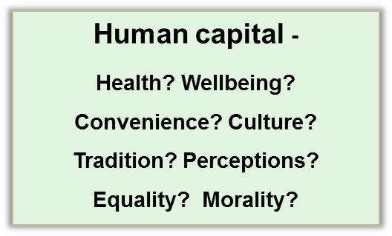
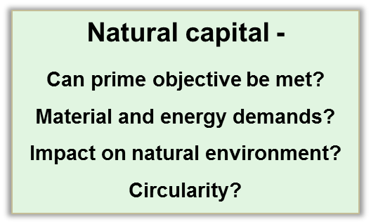
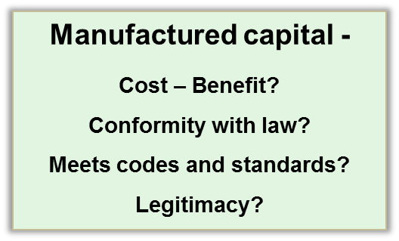
Step 4: forming a judgement
Assess impact
Good? +
Bad? -
Debate acceptability
Notes:
Time for discussions?

Slide 28
4a. Human and social Capital
On the positive side, large-scale deployment of wind farms creates employment. If these jobs and the wealth they generate are distributed in a fair and equitable way, a contribution is made to Human Capital. The reduction in emissions is a contribution to a healthier population. The mix of energy sources increases independence and a distributed rather than a centralized power system is more robust, harder to disrupt and less vulnerable to a single catastrophic event.
On the negative side, the visual and acoustic intrusion, already mentioned, represents to many people a significant loss of quality of life. Schemes to re-invest a proportion of the revenues generated by the wind farm in the local community in ways that help everyone, coupled with research to reduce the acoustic problem, offer a way forward.
Notes:
Human capital

Slide 29
4b. Natural Capital
The Prime Objective in building wind farms was to reduce green-house gas emissions. The studies cited above suggested that they can. The dependence on critical elements, particularly neodymium, for the turbines, is a concern for manufacturers in non-mining countries. The placement of wind turbines being fixed and known, and large groups of them are managed by a single operator, this can be addressed by making sure their recovery, reconditioning or recycling at end of life are scheduled. Encouraging a full life cycle management of wind farm is also a way forward in dealing with end-of-life scenario of fiber composite turbine blades, which management is not satisfactory.
Injury to bird life might be dismissed as trivial when domestic cats kill far more, but this is not a productive way to respond to stakeholder concerns – a more considered response and exploration of mitigating measures (ultrasound, perhaps) is a better way forward.
Notes:
Natural capital

Slide 30
4c. Manufactured and financial Capital
The typical design-life of a wind turbine is 25 years. Building the equivalent of 300GW of turbines per year is a significant investment in energy infrastructure. Is it a good investment? Recent farm deployments have competitive or even cheaper prices than fossil plants equivalents which can be a sign to encourage future investments by banks and hedge funds. However much questions remains on grid investments needed to cope with intermittency and decentralized characteristics of wind energy. Levels of financial gains will depend on storage technology evolution (like batteries) over the next 25 years and the cost of carbon-induced climate change.
Notes:
Manufactured capital

Slide 31



Step 4: Summary
Natural Capital
x Visually and (sometimes) acoustically intrusive
Provides electrical power with lower emissions than
gas or coal
x materials of some components have scarcity or recycling issues
Manufacture Capital
  LCOE is competitive with other energy systems, construction costs per kW.hr are projected to continue dropping by 2030
  X Energy storage needed to smooth intermittent generation
  X Manufacturing capacities necessary to match ambitious goals do not exist
Human and Social Capital
x Visual intrusion impacts quality of life
  Provides clean energy and a degree of
energy independence
Notes:
The findings can be assembled into suitable pros and cons for an overview

Slide 32
Step 5: Stacking the top layers
Notes:
Assembling the layers
We can now assemble the layers. At the bottom, Layer 1, is the statement of the articulation, with its size and time scale. Stakeholders are involved: they are identified and classified in Layer 2 Their concerns, plus background about the articulation itself, can be researched in a systematic, objective way, using the heading in the hexagon as prompts for fact-finding (Layer 3). Armed with the facts, a debate about the practicality of the articulation and its impact on the three capitals becomes possible (Layer 4 - synthesis). The final step (Layer 5) is one of reflection on the articulation and its impacts, considering its overall merits or difficulties and considering whether it could be improved by change.
The lower layers inform the ones above, so that the approach has a direction and a sequence, from bottom to top. As explained earlier, the layer-based approach clearly separates the objective, fact-based aspects of the problem from the more difficult value-based aspects. It encourages thinking about interaction within each layer and gives a logical path to explore the interaction between layers.

Slide 33

Step 5 – reflection, short and long-term
Short term
The Prime Objective of wind farms – to generate electrical power with a low carbon footprint – appears to be met, making a contribution to Natural Capital. By mixing onshore and off shore farm types and stressing out local employment and benefit distribution sites can be found for them without major disruption, and the reduction in emissions is a positive contribution to Human Capital. While wind energy has become economic, current manufacturing capacity cannot meet the deployment pace required by nations’ pledges.
Long term
Energy is one of mankind’s most basic needs and electrical energy is the most versatile and valuable form it takes. We are in transition from a carbon-powered economy to one powered in other ways but the detailed shape of the future is not yet clear. In recent reports wind is forecasted to cover up to 15% of electricity demand worldwide. Some countries like Denmark have wind providing already 50 % of Power generation of the country. Enabling such large-scale shift while solving the natural, manufacturing and human challenges raised here would not be an easy task.
Was the objective right?
Alternative strategies?
Notes:
Step 5: Reflection
This is the moment to consider alternatives. Can the Prime Objective be achieved in the way assumed in the remit – by replacing petrol-driven cars by EVs that are used in the same way? It does not seem so because EVs can’t provide the range, convenience of refuelling or (at present) the economy that consumers expect.
The central issue for electric generation and transport is that of energy density. Suppose we accept that transport is best powered by high energy-density fuels with which batteries cannot compete. Technology exists for synthesizing hydrocarbons from CO₂. Rather than using electrical power to charge batteries, could it be used to synthesize methanol or ethanol to drive efficient IC-powered cars? The infra-structure for fuel distribution and maintenance already exits, and by drawing the CO₂ from industries that emit it such as power-stations, or cement works or from the atmosphere, true carbon-neutrality might be possible.

Slide 34
Summary
Energy is one of mankind’s most basic needs and electrical energy is the most versatile and valuable form it takes. We are in transition from a carbon-powered economy to one powered in other ways but the detailed shape of the future is not yet clear.
A distributed energy-mix in the economy is desirable. Recent improvements in wind technology has made its economic case stronger and no longer subsidy dependent. However the impact of the cost of energy storage needed to smooth the intermittent power from wind is still under debate.
No completely “right” answer to questions of sustainable development
Instead, a thoughtful, well-researched response recognising the conflicting facts and interests, seeking best compromise
Layer-based approach database provides a practical framework
Meets many ABET, CDIO and EUR-ACE Accreditation criteria
Well suited for capstone projects and Problem-Based Learning (PBL)
Notes:
Final summary
The method described in this talk is in use in a number of Universities as a way of introducing students to ideas of sustainable development. The layered approach gives a structure that students find helpful; it is supported by check-lists for each of the five steps – the check lists, and six other worked case studies can be found in the book “Materials and Sustainable Development” by M. F. Ashby, D. Ferrer Balas and J . Segolas Coral, Butterworth Heinemann, Oxford (2015).

Slide 35
Ansys Education Resources Feedback Survey
Here at Ansys, we rely on your feedback to ensure the educational content we create is up-to-date and fits your teaching needs.
Please click the link below to fill out a short survey (~7 minutes) to help us continue to support academics around the world utilizing Ansys tools in the classroom.
Feedback Survey Link
Notes:
Feedback Survey link for copy-paste method → https://ansys.typeform.com/to/jcattJI5

