Slide 1
Objectives in conflict:
trade off methods and penalty functions
Dominated
solution
Light Metric 2: Mass m Heavy
Non-dominated
solution
Mike Ashby
Department of Engineering,
University of Cambridge
Trade-off
surface
Cheap Metric 1: Cost C Expensive

Slide 2
Learning objectives for this lecture unit
Ansys software mentioned | Ansys Granta EduPack™­, a teaching software for materials education
Intended Learning Outcomes
Knowledge and Understanding | Knowledge on graphical trade-off methods and penalty functions
Skills and Abilities | Ability to select systematically when design objectives conflict
Values and Attitudes | Appreciation of the value of compromise in engineering design
Resources
  Text: “Materials Selection in Mechanical Design”, 5th Edition by M.F. Ashby, Butterworth Heinemann, Oxford, 2016.
  Chapters 8-9
  Text: “Materials and the Environment”, 2nd Edition by M.F. Ashby, Butterworth-Heinemann, Oxford 2012, UK. Chapters 9-10
Notes:
Learning Objectives
These Intended Learning Outcomes are based on a taxonomy of knowledge and understanding as the basis, skills and abilities as necessary for the practical use of knowledge and understanding, followed by acquired values and attitudes enabling assessments and responsible use of these abilities.
Combined with a suitable assessment, they should be helpful in the context of accreditations or for the CDIO Syllabus.
The Texts listed are from books authored or co-authored by Mike Ashby but other texts are also referred to in the Science Notes.

Slide 3
Outline of lecture unit
Dominated
solution
Almost always 2+ objectives – they conflict
Light Metric 2: Mass m Heavy
Trade-off methods
Non-dominated
solution
Penalty functions and exchange constants
Two-objective minimisation using
the Ansys Granta EduPack software
Trade-off
surface
Cheap Metric 1: Cost C Expensive
Notes:
Outline
This is the eighth Unit of a course on Material and Process Selection. The Units link closely to the first two Texts listed on the previous frame but can equally by used in conjunction with texts such as Callister, Budinski, Askeland and others. The relevant chapters of the Texts are listed on the Outline frame of each Unit. The methods developed in the course are implemented in the Ansys Granta EduPack software, which is structured to evolve in pace with the student throughout a four-year engineering program. This first Unit introduces materials and processes, and the way in which information about them can be classified, stored, retrieved and explored.

Slide 4
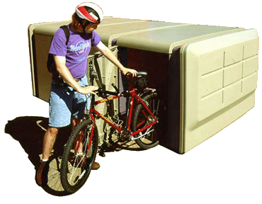
The selection strategy: materials
Design requirements:
expressed as
Constraints and
Objectives
Data:
Material attributes
Process attributes
Documentation
Comparison engine
Screening
Ranking
Documentation
Able to be molded
Water and UV resistant
Stiff enough
Strong enough
As cheap as possible
(As light as possible)
Density
Price
Modulus
Strength
Durability
Process compatibility
More…….
Notes:
4
A reminder: the selection strategy
This frame illustrates the decision-making strategy applied to the selection of a material.
The Design requirements (upper left) are expressed as constraints that the material must meet and the objectives, defined in a moment, that are chosen as measures of the excellence of choice
The Data (upper right) takes the form of a database of the attributes of the materials and processes that are possible candidates for the design
The comparison engine applies the constraints, eliminating materials that cannot meet the requirements, and then ranks the survivors, using the objectives, to create a short list. It is common to have at least two objectives to at the same time

Slide 5
Multiple constraints and objectives
Design requirements set constraints – criteria for screening
objectives – criteria for optimising
Typical constraints
The material must be
Electrically conducting
Optically transparent.....
And meet target values of
Stiffness
Strength…..
And be able to be
Die cast
Welded ......
Typical objectives
Minimize
Mass m (satellite components)
Volume (mobile phones)
Energy consumption (fridges)
Carbon footprint (cars)
Embodied energy (materials)
Cost C (everything)
Dealing with multiple constraints is straightforward
Dealing with multiple objectives needs trade-off methods
Take, as example, simultaneously minimizing mass m and cost C
Notes:
Multiple constraints and objectives
This frame lists, on the left, typical constraints that a material must meet. Dealing with multiple constraints is straightforward – just apply them using Limit, Graph and Tree stages. On the right is a list of typical objectives. Dealing with multiple objectives is more complicated.
An objective, it will be remembered from Units 6 and 7, defines a performance metric. If the objective is to minimize mass, then the mass becomes the metric of “goodness” or “badness” of a given choice: the lightest solution that meets all the constraints of the problem is the best choice. If the objective is to minimize cost, then the cheapest solution that meets all constraints is the best choice. The metric allows solutions to be ranked. This frame lists common design objectives; there are, of course, many more. It is rare that a design has only one objective. And when there are two a conflict arises: the choice that minimizes one metric – mass say – does not generally minimize the other – cost, for example. Then a compromise must be sought. To reach it we need some simple ideas drawn from the field of multi-objective optimization.

Slide 6
Multi-objective optimization: the words
“Solution”: a candidate that meets the constraints, but not necessarily optimum by either objective
Dominated
solution
Plot solutions.
(Convention: express objectives to be minimized)
Light Metric 2: Mass m Heavy
Non-dominated
solution
“Dominated solution”: one that is definitely non-optimal
Trade-off
surface
“Non-dominated solution”: one that is optimal by one metric (but not usually by both)
Cheap Metric 1: Cost C Expensive
“Trade-off surface”: the surface on which the non-dominated solutions lie (Pareto Front). In our case a 2-dimensional curve
Notes:
The terminology of multi-objective optimization
Multi-objective optimization is a technique for reaching a compromise between conflicting objectives. It lends itself to visual presentation in a way that fits well with methods developed here thus far. This frame explains the words. They are illustrated by the diagram on the right in which we have specialized a problem to a trade-off between the mass of a component and its cost.
The first bullet point on the frame defines a solution: a choice of material to make a component that meets all the necessary constraints and is thus a candidate for the design, although not perhaps the best one. The little circles each represent a solution; each describes the mass and cost of the component if made from a given material. The next two bullet points distinguish between a dominated solution (meaning that other solutions exist that are both lighter and cheaper) and a non-dominated solution (one that is lighter than all others that cost less and cheaper than all others that are lighter – thus there is no other solution that is both lighter and cheaper than it is). The lower envelope links non-dominated solution. It defines the trade-off surface or Pareto front. Solutions that lie on or near the trade-off surface are a better choice than those that do not. For 2-D charts, it would be a trade-off curve.
We adopt the convention that each performance metric is defined in such a way that a minimum is sought for it. For mass and cost, that is exactly what we want. But if the metric were maximum speed v (a performance objective for a sports car, for instance) we must invert it and seek a minimum for 1/v. With this convention the trade-off curve must have a negative slope everywhere, as that in the schematic does. A positive slope would link non-dominated solutions.
With this background we can examine strategies for finding the best compromise. There are three.

Slide 7

Finding a compromise: strategy 1
Make a trade-off plot
Sketch a trade-off curve
Use intuition to select a solution on the trade-off curve
Light Mass m Heavy
“Solutions” nearest the surface offer the best compromise between mass and cost
Trade-off
curve
8 out of 50
Cheap Cost C Expensive
Choose from among these - depends on how highly you value light weight
Notes:
Strategy 1: the simplest approach
The solutions on or near the trade-off curve, here colored red, offer a better compromise between mass and cost than those that do not. This immediately isolates a subset of the entire population of solutions, identifying these as the best candidates. It is a big step forward, but it still leaves us with a choice: which part of the trade-off curve is the best? The first strategy is to use intuition (experience, good judgment, common sense – call it what you like) for guidance, selecting materials from among the non-dominated (red-colored) set.

Slide 8
Finding a compromise: strategy 2
Reformulate all but one of the objectives as constraints, setting an upper limit for it
Upper limit
on C
OK if budget limit
Light Mass m Heavy
BUT….cheating
Cost is treated as constraint, not objective.
Trade-off
curve
Best
choice
Cheap Cost C Expensive
Notes:
Strategy 2: treating objectives as constraints
The second tactic is to impose an upper limit on one of the metrics – cost, say – allowing any choice that is less than this limit. Then it’s easy. Choose the solution on the trade-off curve that comes just under the limit. If you were choosing a car and wanted the fastest but had a definite budget limit, then this is the way to do it. But it is an extreme sort of optimization: cost has been treated as a constraint, not an objective. Strategies 1 and 2 help with all trade-off problems in material selection, but they rely to some extent on judgment. A more systematic method is possible – it comes next.

Slide 9
Finding a compromise: strategy 3
Define locally-linear
Penalty function Z
Seek solution with smallest Z
Z₂
Z₃
Z₄
Z₁
Contours of
constant Z
Make trade-off plot
Trade-off
curve
Light Mass m Heavy
Plot on it contours of Z
Lines of Z have slope -1/α
(needs linear scales)
Optimum
solution,
minimising Z
Decreasing
values of Z
Read off solution with lowest Z
Cheap Cost C Expensive
Two issues:
(Q1) What is the so called exchange constant, α ?
(Q2) What if we have Log, not Linear scales?
Notes:
Strategy 3 – define a Penalty function
There is a more formal, systematic, way to find the best compromise, although it is not always practical to use it. We define a locally-linear penalty function Z (a global objective) combining the two metrics mass, m, and cost, C:
Z = αm + C
and seek the solution that minimizes Z (assuming we have a value for the so-called exchange constant α). That can be done by simply calculating Z for each solution and ranking the solutions by this value, or it can be done graphically in the way shown on this frame. Rearranging the equation for Z gives
m = (-1/α)C+(1/α)Z
This equation describes a family of parallel lines with slope -1/α, each line corresponding to a value of Z, as shown. The best choices lie near the point at which one of these lines is tangent to the trade-off curve, since this minimizes Z.
To plot the contours we need a value for α. That depends on the application. We analyse this in a moment, but first some examples.

Slide 10
(Q1) Example of graphical solution for teaching
α determines a location on the trade-off curve and reflects priorities (price per kilo)
Notes:
Q1 Example
A realistic case using a database of bicycles. The best bikes by mass and cost are near the red trade-off curve.
The exchange constant, α, here corresponds to how much the bike costs per kilo in each search direction

Slide 11



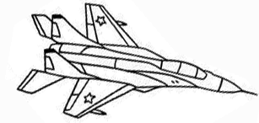

(Q1) Example: materials for transport systems
Choice of material depends on system
Mass, in transport systems, means fuel
$
kg
Life cost = Initial cost, C + Fuel cost over life, scaling with mass m
$/kg
Penalty function
Must establish exchange constant,
Steel Steel / Alu Alu / (composite) Alu / Ti / composites Composites
α
($/kg)
3 – 6 6 – 20 100 – 600 600 – 2,000 (?) 5,000 – 10,000
Notes:
11
The importance of the exchange constant
Now a materials selection example: structural materials for transport systems. Five systems are shown along the top of the frame, with the dominant choice of structural material listed beneath ranging from steel on the left, aluminum in the middle and advanced composites on the right.
The goal is to minimize life cost. It is the sum of the initial cost and the cost over life, dominated by fuel cost (fuel consumption scales with mass). The two are combined in a penalty function Z. The quantity α is called an exchange constant (or “parameter influence coefficient” ) because it converts the units of one metric – mass – into the other – cost (like the currency exchange rate that converts one currency into another). It measures the value of a unit change of the performance metric m: it is the value associated with unit reduction in mass, and so has the units €/kg or $/kg.
Unit 7 developed indices for mass and cost for components loaded in bending (the commonest mode of loading) – they are listed on the frame, and combined to give the penalty function. To evaluate it we need a value for the exchange constant, α – the cost-penalty of mass.
The table lists approximate values for the exchange constant α for transport systems, based on the economic benefit of a reduction in structural mass of 1kg, all other things remaining the same. For the family car it is calculated from the fuel saving over a life of 100,000 km. For the truck, aircraft and spacecraft it is calculated from the value of an additional 1 kg of payload over the operating life.
The values vary widely. The value of weight saving in a car is small; that is one reason that it is difficult to replace steel with a lighter metal in cars – the weight (and thus fuel) saving does not compensate for the higher cost of the material. But in space it is different: here, because launch costs per kg are so enormous, the saving of mass is valued highly, making it economic to use even very expensive materials if they save weight.
These values for exchange constants are based on engineering criteria. Sometimes, however, value is set in other ways. The perceived value of a product is an important factor in marketing. It is measured – or estimated – by market surveys, questionnaires and the like.

Slide 12
(Q2) Linear penalty functions go with linear axes
Set your axes to linear before plotting property charts for linear penalty functions
Logarithmic scales give the same best choice but Z no longer appears as straight
Notes:
(Q2) Linear penalty functions go with linear axes
The penalty function so far has been discussed for linear scale axes. But bubble charts are usually Logarithmic in scales.

Slide 13
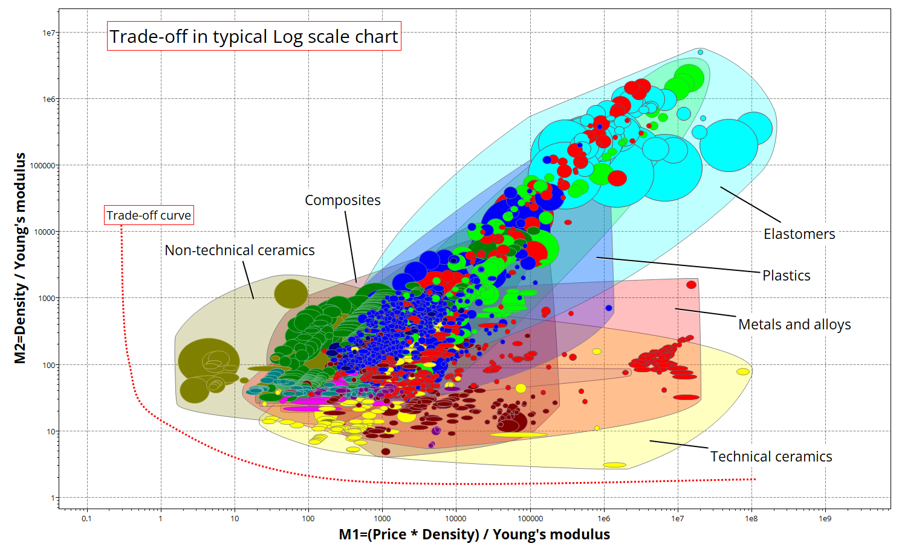
(Q2) Example of two-objective Log chart
Minimum mass and cost for member in tensile or compressive load and stiffness-limited design: Log scale axes
Minimize
M2 = ρ / E
Minimize M1 = C_{m} * ρ / E
Notes:
Two objective log chart example
In Lecture unit 7, we plot a combination of material properties as an objective on the Y-axis.
In this case, instead of maximizing E^{1/2} / ρ we will minimize ρ / E (which gives light and stiff Tie in tension). On the X-axis, we minimize the price per volume, which is expressed as the price per kilo multiplied with the density: C_{m} * ρ
The materials with the best performance will then be found near the trade-off curve (towards the origin).

Slide 14
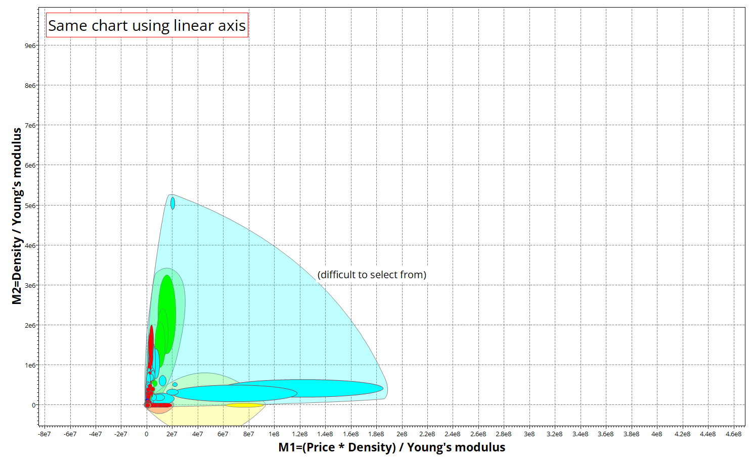
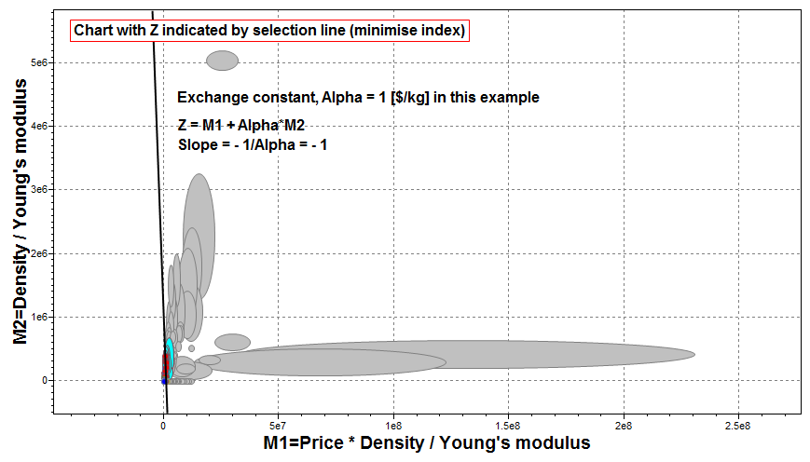
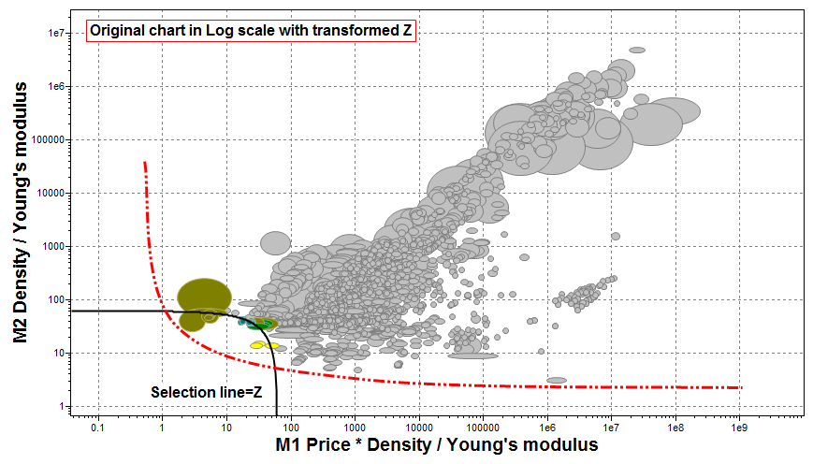
(Q2) How to use a penalty function in bubble charts
(2) Convert to linear scales
(double-click on axes)
(1) Make trade-off plot
(3) Convert back to log scales
Selection line now curved
Move down until few materials left
(3) Apply selection line, slope -1/α. Select “minimize index”
Notes:
Bubble charts
Here is a sequence describing how to handle penalty functions in bubble charts.

Slide 15
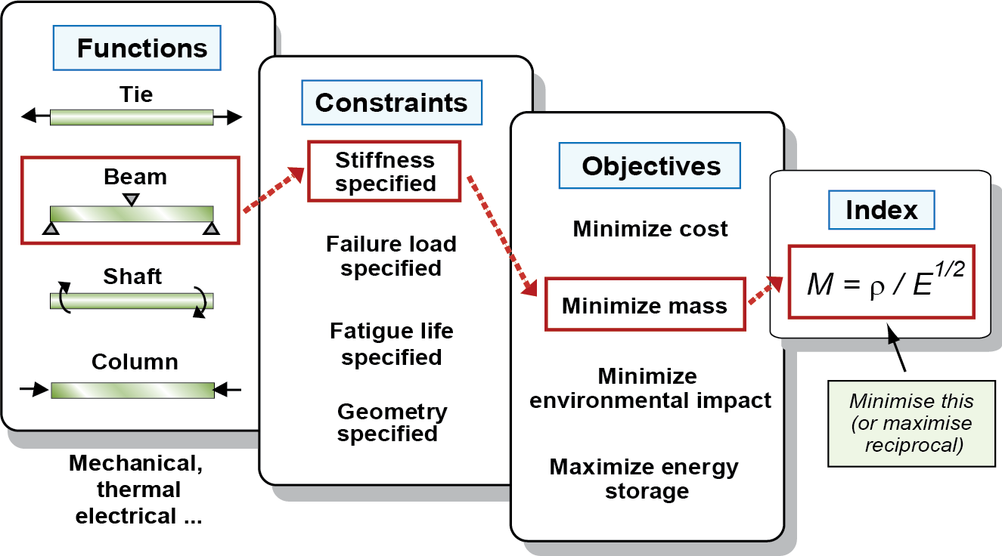
Performance Index finder methodology
A performance index is a group of material properties that limits the performance of a design
Notes:
The Performance index finder sequence
The specification of function, objective and constraint leads to materials index. The combination in the highlighted boxes lead to the index E^{1/2}/ρ.

Slide 16
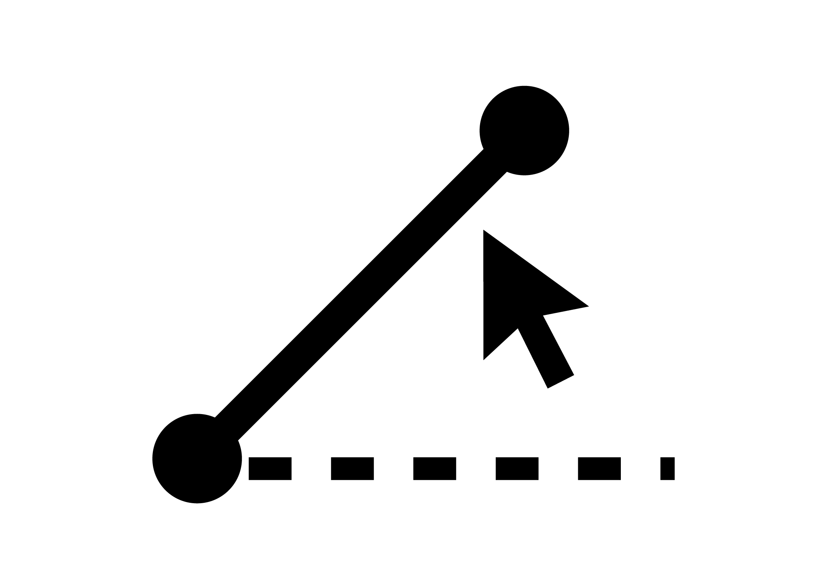
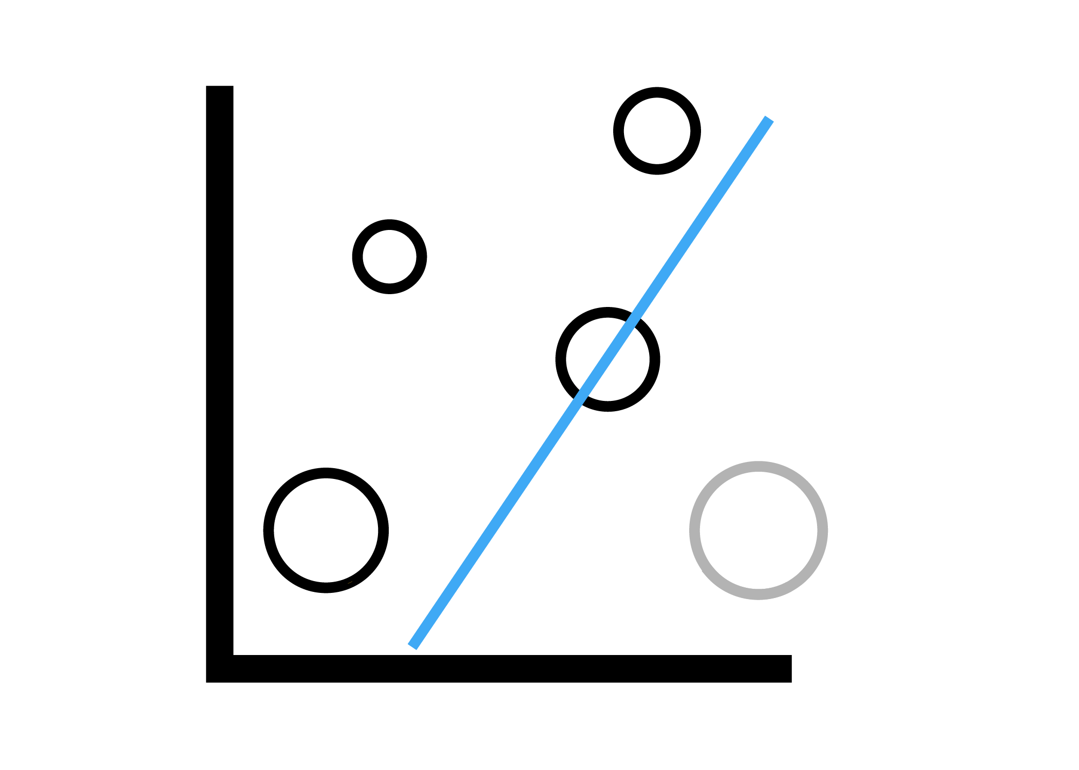
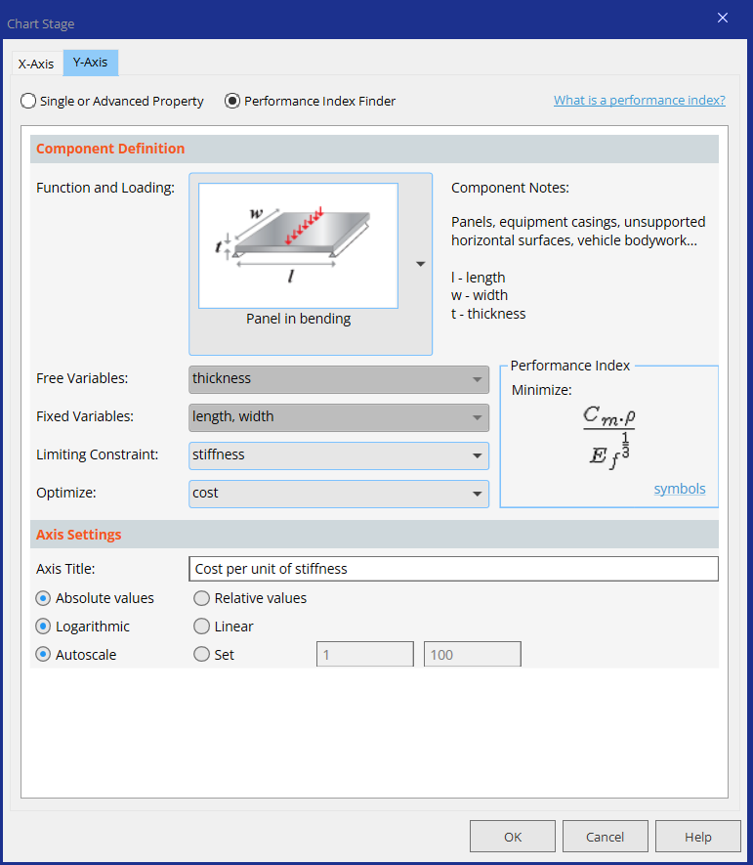
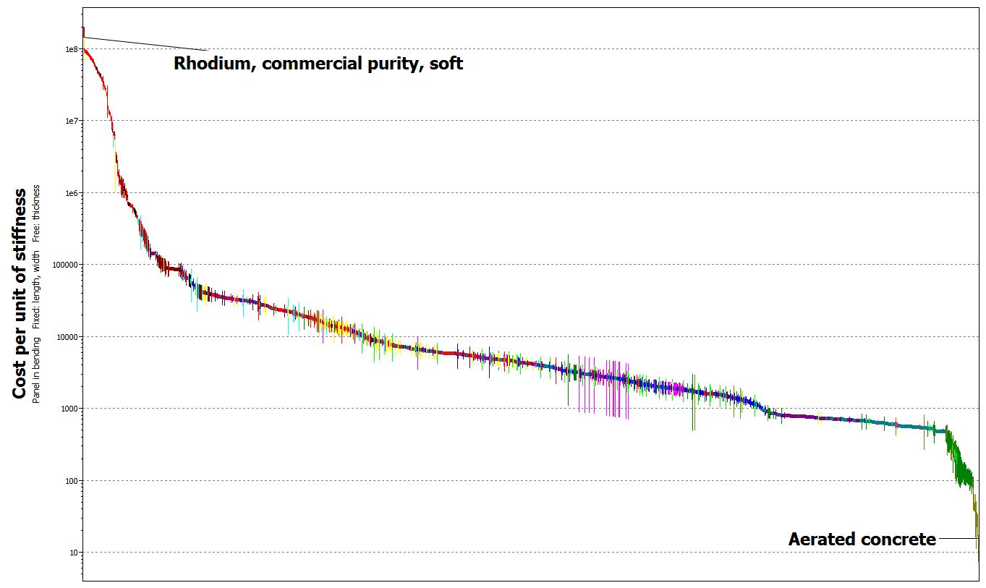
Performance Index finder
To plot a performance index, click here and choose the model that best fits your function and loading.
Chart/Index
Then choose the Limiting constraint and the property you want to optimise - the ‘performance index’ is automatically generated and plotted.
Notes:
The Performance Index finder is embedded in the Chart Function in the Advanced databases. It allows for selection from various functions and loading conditions to aid in selection.
Identify Function:
We will choose panel in bending for demonstration here. There is a choice of 43 functions.
Identify free variables:
Identify the free variables. This may be section area, wall thickness, section shape dimensions, etc. depending on which function and loading is selected.
Identify constraints:
Choose from the design constraints: stiffness, strength, etc.
Identify objective:
Usually the default is to minimize. The default is set to minimize your performance index.

Slide 17
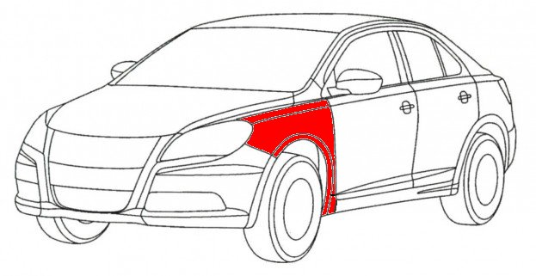
Example: trade-off between cost and weight
The scenario:
  Select a material for an exterior panel of a vehicle
  It must be as light and cheap as possible
  Stiffness is the most important constraint
Define locally-linear
Penalty function Z
Z = α m + C
Seek solution with smallest Z ⁽¹⁾
  α: how much are you willing to pay for each extra kg (exchange constant)?
  Granta EduPack software
Notes:
Example
Now for an exercise on how to use the Ansys Granta EduPack software to select materials for an exterior panel of a vehicle.
The panel must be as light and as cheap as possible, which is a difficult trade-off, and it should not deform too much, so it’s a stiffness limited design.
Let us now define a penalty function, Z.
This penalty function is a kind of cost over the lifetime of the panel. It has a certain upfront cost and for every extra kg of mass that is transported over the life time of the vehicle, the vehicle owner is willing to pay (alpha), the exchange constant, or trade-off constant.
But before going into the software, let us consider what are the potential values for this exchange constant in the transportation sector in the next slide.

Slide 18
The exchange constant α for transport
Transport system
α ($ per kg)
Family car 3 to 6
Truck 5 to 20
Civil aircraft 100 to 500
Military hardware 500 to 2000
Space vehicle 3000 to 10,000
How to get values of α?
Full life costing: fuel saving, extra payload
Analysis of historic data;
Interviews, surveys
Notes:
Exchange constant, α
The table lists approximate values for the exchange constant α for transport systems, based on the economic benefit of a reduction in structural mass of 1kg, all other things remaining the same. For the family car it is calculated from the fuel saving over a life of 100,000 km. For the truck, aircraft and spacecraft it is calculated from the value of an additional 1kg of payload over the operating life.
The values vary widely. The value of weight saving in a car is small; that is one reason that it is difficult to replace steel with a lighter metal in cars – the weight (and thus fuel) saving does not compensate for the higher cost of the material. But in space it is different: here, because launch costs per kg are so enormous, the saving of mass is valued highly, making it economic to use even very expensive materials if they save weight.
These values for exchange constants are based on engineering criteria. Sometimes, however, value is set in other ways. The perceived value of a product is an important factor in marketing. It is measured – or estimated – by market surveys, questionnaires and the like.

Slide 19
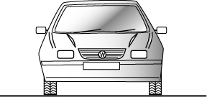
Two ways to find materials for auto bumpers
Beam
Function
Absorb impact, transmit load to energy-absorbing units or supports
Objectives
Minimize mass and material cost
Criteria
Mass m per unit
bending strength
Cost C per unit
bending strength
Beam in bending
Index to minimize:
C_{m} = Material cost / kg
ρ = Density, kg/m³
= Yield strength, MPa
= exchange constant , $/kg
Penalty function
Notes:
(An example) Balancing cost and mass for an auto component: first method in a bar chart
Bumpers of road vehicles protect the vehicle and its passengers in the event of impact. The bumper is part of the vehicle; it adds to its weight and thus to its fuel consumption. We can now evaluate the penalty function derived earlier to select materials for different classes of vehicle. To do so we evaluate the penalty function, using the “Advanced” facility to plot it.

Slide 20
Bar chart selection using the penalty function
Use the “Advanced” facility to make the penalty function
The value of the
exchange constant
(Density / (Yield strength^0.66))
*(Price + 10)
+
-
/
*
^
(
)
List of properties
Density
Price
Tensile strength
etc
Notes:
20
Using the function-generator to plot penalty functions
The penalty function Z is plotted as a bar chart in the way shown here. The best choice of material – the one that minimizes life-cost – is that with the lowest value of Z. The result depends on the value of the exchange constant.

Slide 21
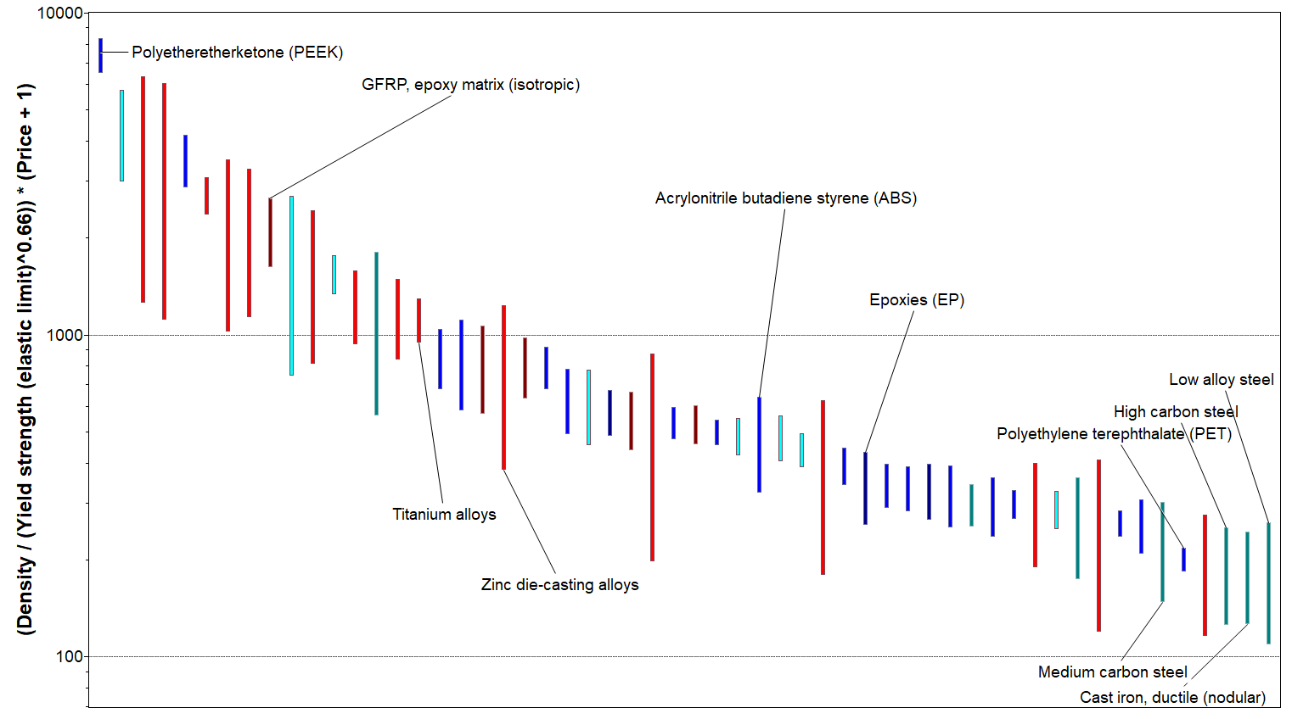
Bar chart selection using the penalty function
α = $1/kg
Best choice: steels
Notes:
21
The penalty function with α = 1
The penalty function Z is plotted as a bar chart in the way shown here. The best choice of material – the one that minimizes life-cost – is that with the lowest value of Z. The result depends on the value of the exchange constant.

Slide 22
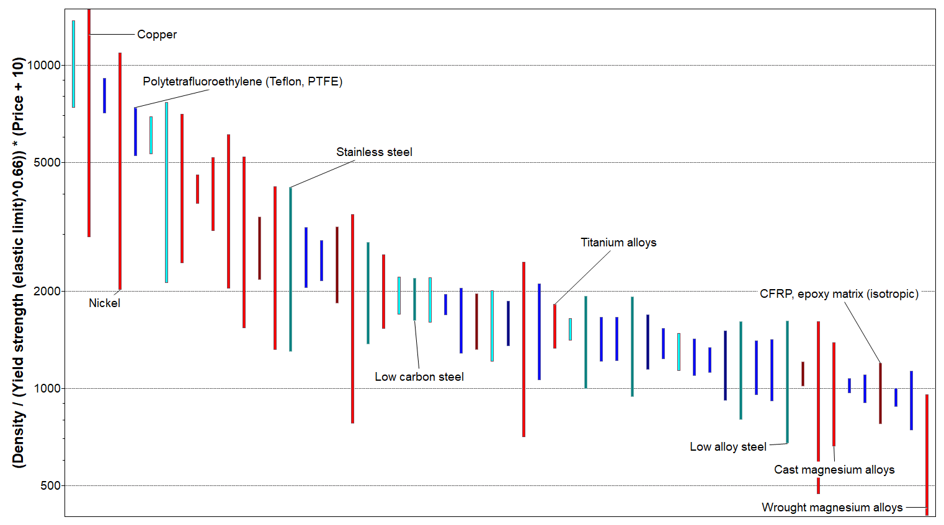
Bar chart selection using the penalty function
α = $10/kg
Best choice: Mg alloys
Notes:
22
The penalty function with α = 10
The penalty function Z is plotted as a bar chart in the way shown here. The best choice of material – the one that minimizes life-cost – is that with the lowest value of Z. The result depends on the value of the exchange constant.

Slide 23
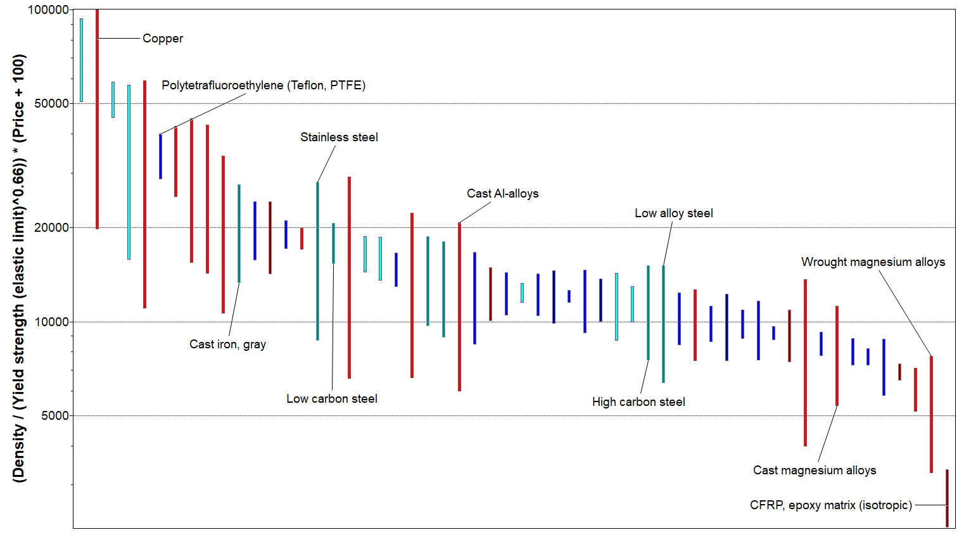
Bar chart selection using the penalty function
α = $100/kg
Best choice: CFRP
Notes:
23
The penalty function with α = 100
The penalty function Z is plotted as a bar chart in the way shown here. The best choice of material – the one that minimizes life-cost – is that with the lowest value of Z. The result depends on the value of the exchange constant.

Slide 24
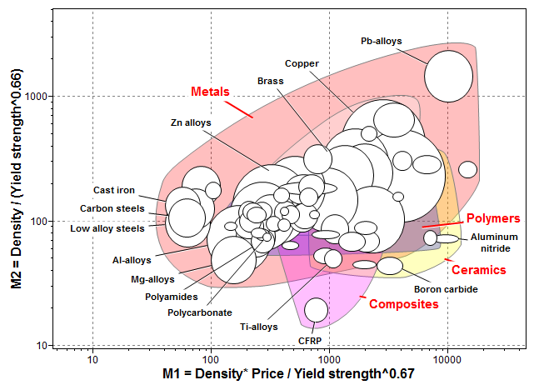
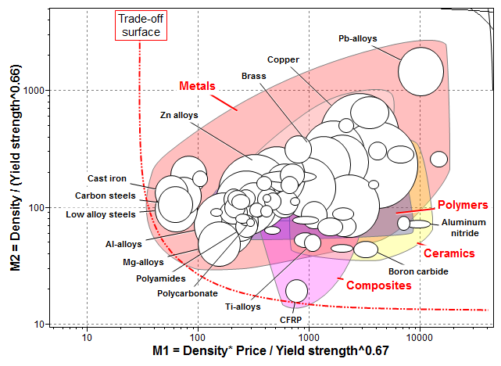
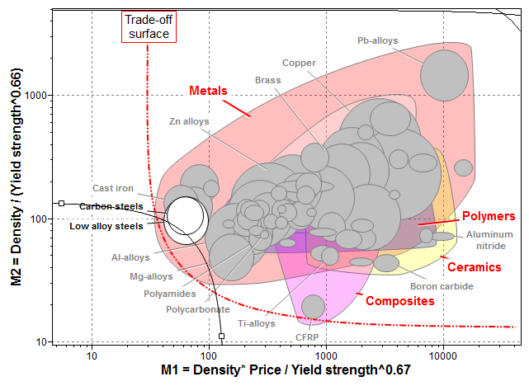
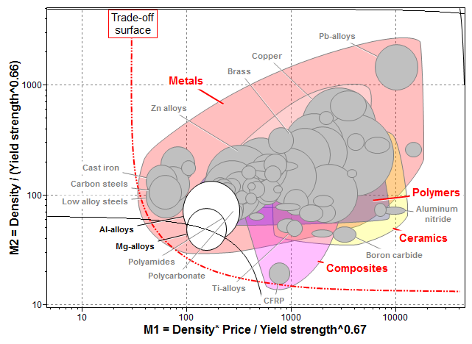
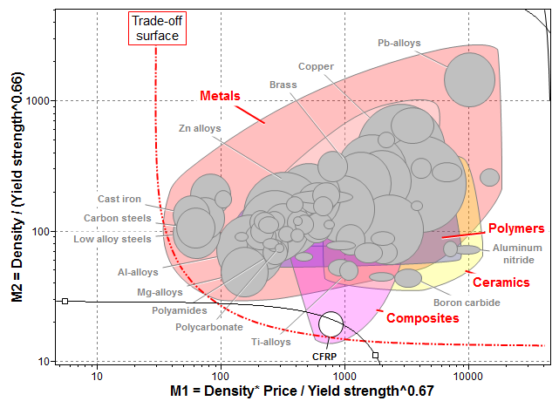
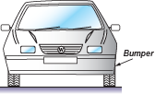
Bubble chart selection using penalty function
Strong bumper, minimum weight and cost
Minimize weight
Minimize cost
= 1 $/kg Low alloy steels, Carbon steels,
Penalty function
= 10 $/kg Aluminum alloys, Magnesium alloys
= 100 $/kg Carbon-fiber reinforced composites
Notes:
An alternative view
The same problem can be solved using a bubble chart with the two conflicting objectives plotted on each axis. A selection line with the option to minimize the index can be used as the penalty function, implemented in a chart with linear scale axes, as shown previously. α=1, 10 and 100 $/kg correspond to slopes: -1/α=-1, -0.1 and -0.01, respectively. The results can be extracted from the bubble chart with Log axes (several index lines can be plotted simultaneously in the Granta EduPack software).

Slide 25
Summary
Real design involves conflicting objectives –
often technical performance vs. economic performance (cost).
Trade-off plots reveal options
If the exchange constant is known –
penalty function allows unambiguous choice
The penalty function technique can be applied to bar charts or bubble charts in the Ansys Granta EduPack software for interactive and visual selection
Notes:
Summary
This unit has introduced ways of dealing with conflicting objectives in materials selection. The key concept is that of the trade-off plot – it alone is often enough to identify good choices. If greater precision is required, the penalty function method provides it. This technique can be applied both in property Bar charts and Bubble charts using the Ansys Granta EduPack software.

Slide 26
Ansys Education Resources Feedback Survey
Here at Ansys, we rely on your feedback to ensure the educational content we create is up-to-date and fits your teaching needs.
Please click the link below to fill out a short survey (~7 minutes) to help us continue to support academics around the world utilizing Ansys tools in the classroom.
Feedback Survey Link
Notes:
Feedback Survey link for copy-paste method → https://ansys.typeform.com/to/jcattJI5

