Slide 1
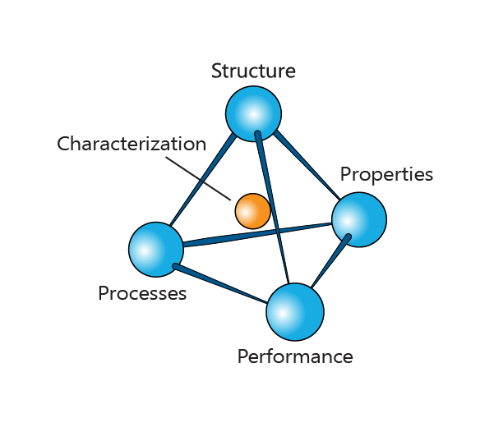
Materials Science and Engineering Database:
an overview
Mike Ashby
Department of Engineering,
University of Cambridge

Slide 2
Learning objectives for this lecture unit
Ansys software mentioned | Ansys Granta EduPack™­, a teaching software for materials education
Intended Learning Outcomes
Knowledge and Understanding | Understanding what is available in the MS&E database
Skills and Abilities | Ability to plot property trajectories as a function of processing
Values and Attitudes | Appreciation of the Processing, Structure, and Properties relationship
Resources
  Text: “Materials: engineering, science, processing and design” 3rd edition by M.F. Ashby, H.R. Shercliff and D. Cebon, Butterworth Heinemann, Oxford 2014, Chapter 19.
  Text: Callister, Budinski, Askeland and others – recommended reading in Science Notes
  Ansys Granta EduPack software, The Materials Science and Engineering database
  White Paper: The Granta EduPack Materials Science and Engineering Package
Notes:
Learning Objectives
These Intended Learning Outcomes are based on a taxonomy of knowledge and understanding as the basis, skills and abilities as necessary for the practical use of knowledge and understanding, followed by acquired values and attitudes enabling assessments and responsible use of these abilities.
Combined with a suitable assessment, they should be helpful in the context of accreditations or for the CDIO Syllabus.
The Texts listed are from books authored or co-authored by Mike Ashby but other texts are also referred to in the Science Notes.

Slide 3
Lecture unit outline
Teaching Materials Science and Engineering
The MS&E Package and homepage
Elements data-table
Material records in MS&E
Process records in MS&E
Phase Diagram Tool
Process-Property Profiles
Characterization techniques data-table
Notes:
Outline
This Units link to the first two Texts listed on this frame but can be used in conjunction with texts such as Callister, Budinski, Askeland and others. The Ansys Granta EduPack software is useful both for a design-driven and a science-driven approach, structured to evolve in pace with the student throughout an engineering program. The unit briefly introduces fundamental software tools to explore phase diagrams and the relationship between process parameters and material properties.

Slide 4

Challenges to 1st year materials-teaching
Large classes, varied backgrounds
Divergent aspirations
Understanding materials – the science
Using materials – selection and design
Vast range of scale and concept
Electrons (quantum mechanics) to
Spacecraft (Newtonian mechanics)
(teddy-rised CC BY-NC-ND 2.0)
Notes:
Material Science and Engineering
This is a package put together to help with material science and engineering teaching.
There are some tricky problems when teaching materials sciences. Often the class size is very large, a few hundred students sometimes. Each student also has his or her own aspirations in the field, some are interested in pursuing materials science and some engineers are interested in using materials rather than the fundamentals of where the properties come from. Also, the topic, to understand all materials, is huge! It can be a challenge to deal with this spectrum in a way a first year class can understand.

Slide 5
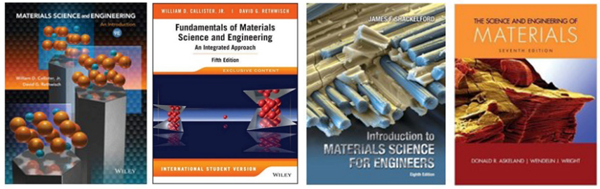
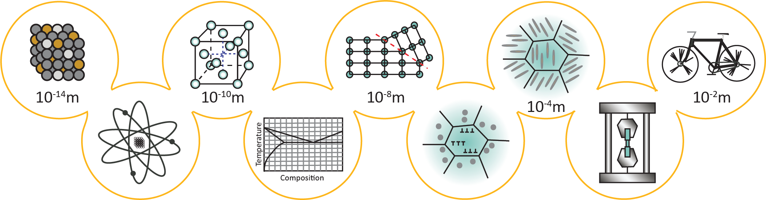



Materials Science and Engineering: approaches
Science-driven approach
10⁻¹⁴ m
10⁻² m
Design-driven approach
Ansys Granta EduPack software MS&E Package: a set of resources to support both approaches
Notes:
Approaches to teaching
From the atomic core, about 10⁻¹⁴ m, to bigger structures in the range of 10km, material properties can be altered depending on each of these levels. In between those are the aspects of a material which determine its properties. Electronic level, crystal structure, thermodynamic equilibrium structure, defect and non–equilibrium structures, structures brought about by processing (work hardening) or alloying and heat treatments. All of these contribute to the properties and the engineer draws on these in order to design a product.
Behind all this is a history of teaching the subject. The science-driven approach is to start from the left hand side and proceed to the right, starting with atoms and electrons and crystal structure and building up through the properties to get to the design.
There is another approach that starts at the product level. The design-driven approach identifies the design limiting properties of the performance of a product and asking what lies behind those properties and how can we control them to manipulate them.

Slide 6
The Materials Science and Engineering package
A linked set of resources to support many approaches to teaching
Features
Learning by discovery
Intuitive interface to comprehensive Materials Science database
“Teach Yourself” units for Phase Diagrams and Crystallography
MicroProjects to stimulate self-motivated discovery
Lecture unit and exercises with solutions
Teaching package: for instructor and student
Notes:
The Material Science and Engineering Package
This package is a linked set of resources which facilitate the of teaching material science and engineering. Both the science driven approach and the design driven approach are supported.
The main features of the package are listed in this slide.

Slide 7
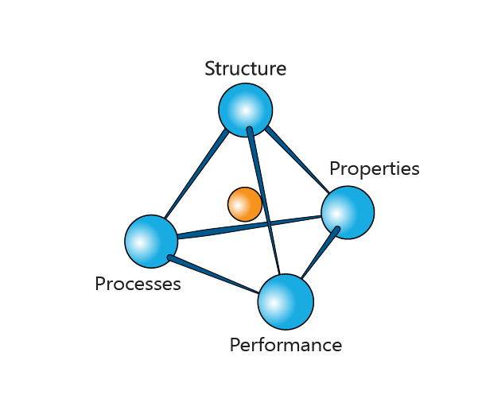



Basic insight of materials science
The basic insight of Materials Science:
The Process – Structure – Properties – Performance tetrahedron
What do we mean by structure?
Pre-1900:
Empiricism
Notes:
Key insight
The understanding of materials and their behaviour is based on the links between these 4 aspects: processes, performance, properties, and structure.
Historically, different processes were tried out and material performance was developed by trial and error.
More recently, we are able to examine how materials change structure (electron microscopy) how structure affects properties (testing), and how properties are used to influence performance (the design bit).
But, what do we mean by structure?

Slide 8


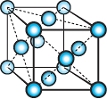
What we mean by “structure”
Structure at electronic and atomistic levels
Structure at the lattice and phase levels
Nucleus and Bonding-sensitive properties
Microstructure-sensitive properties
Density
Modulus
Specific heat
Expansion coefficient
Saturation magnetization
Strength
Toughness
Elongation
Electrical, thermal conductivities
Coercive field, Energy product
Notes:
What is structure?
Here, we consider two levels: Bonding-sensitive properties that derive from structure at the low level (such as stiffness), and Microstructure-sensitive properties, which derive from the next level up of structure (such as strength). Understanding of how processes can change properties at both these structural levels is vital.

Slide 9
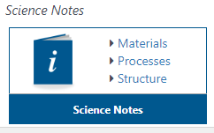
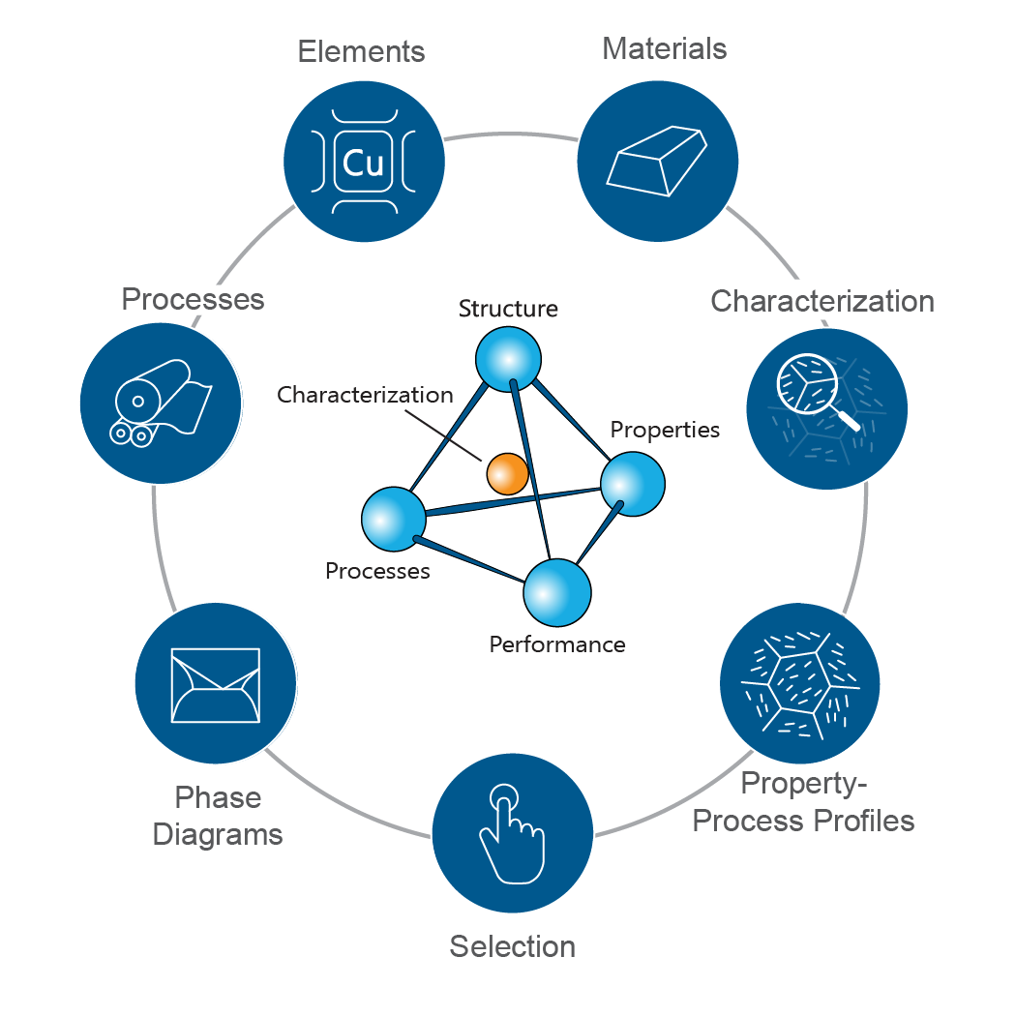
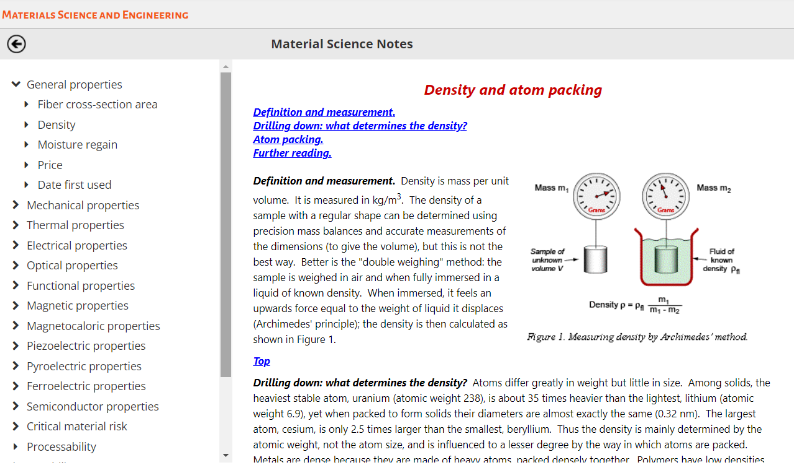
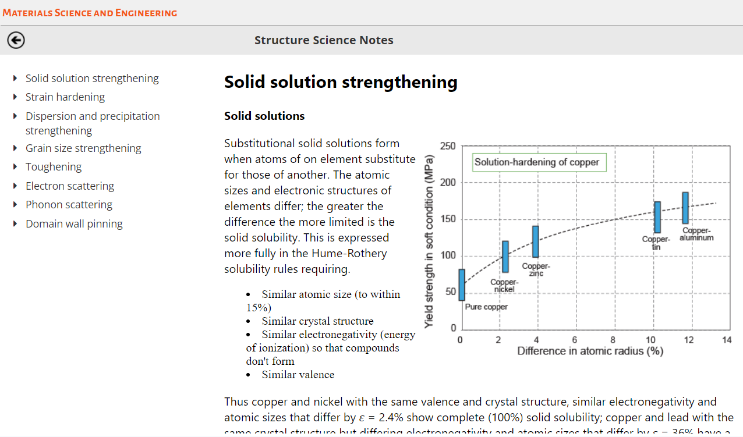
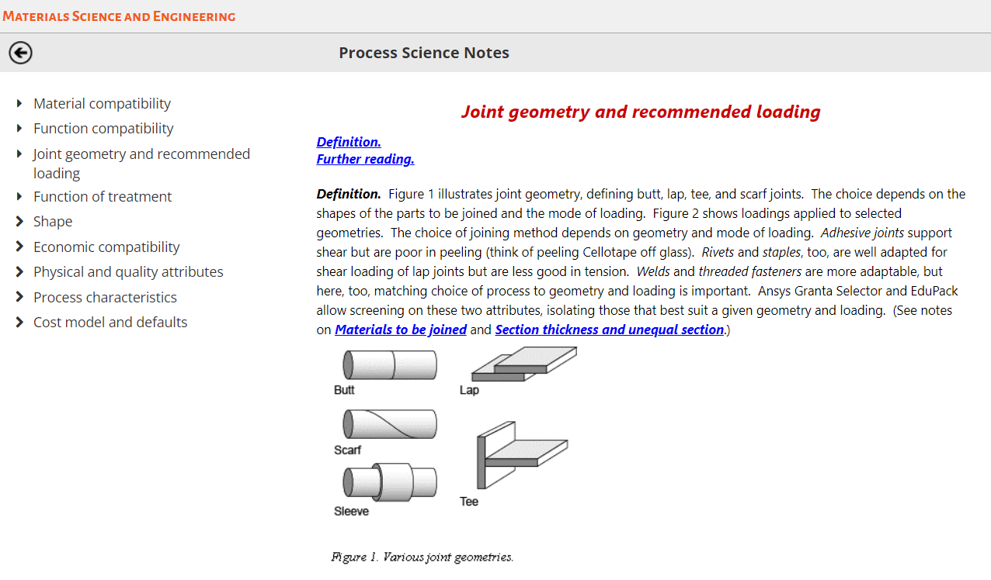
The MS&E main homepage
Directly accessible from the homepage
Unique interaction point for the user
All-in-one homepage
Notes:
Home page
This is the layout of the homepage. It is the main interaction point for the user and there is direct access to science notes, all accessible from this one place. Hovering over each of the 4 corners of the tetrahedron will highlight which data tables are relevant. This interface is simple and intuitive to navigate.
The available science notes are an extended compilation of the regular science notes in the material and process records which you can open. Each field name in these records has a little i next to it. If you click on the i there are some notes which link to the definitions. If you change the database, the science notes change - they are a way of accessing material properties and their origin. In addition to these, there is a new set of structure science notes that describes fundamental mechanisms involving microstructure.

Slide 10
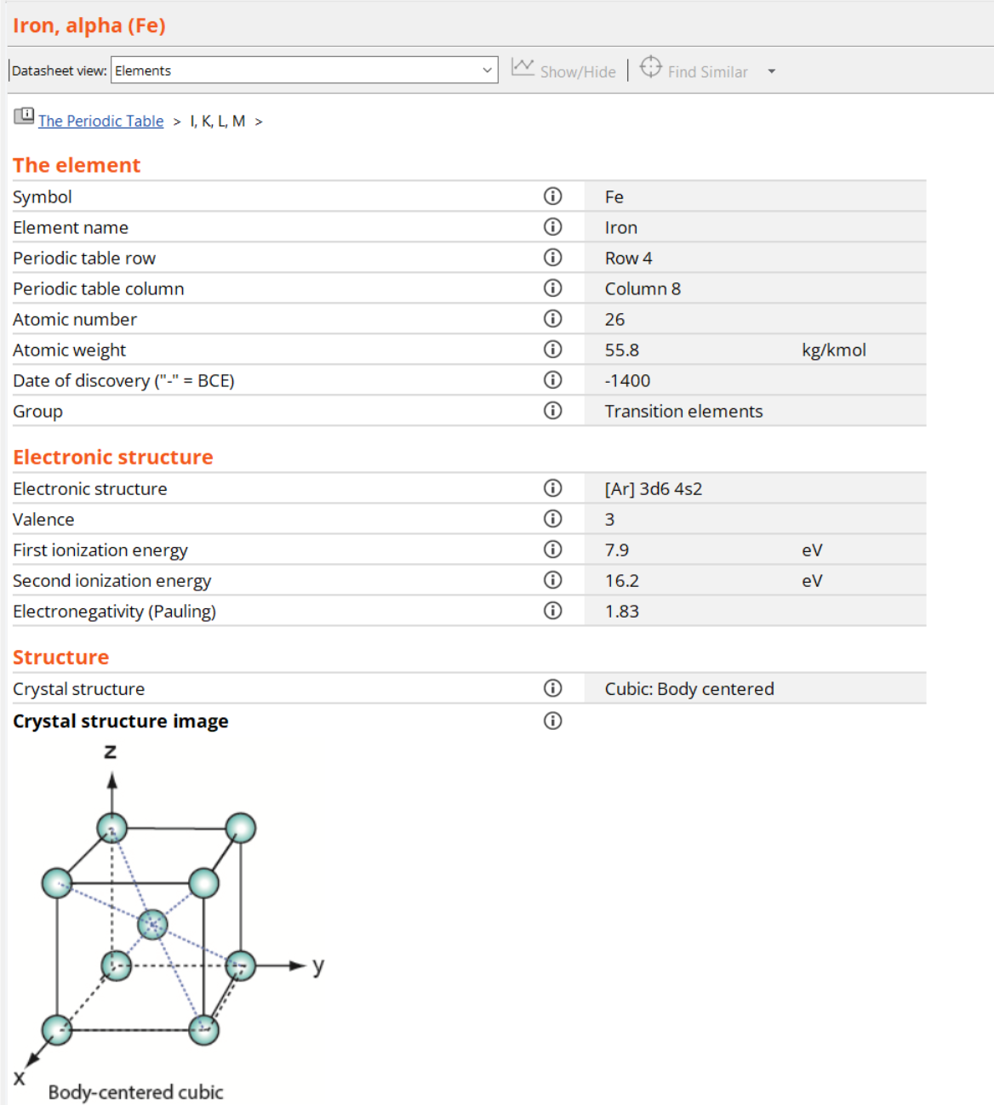
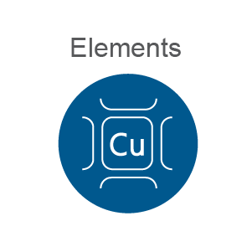

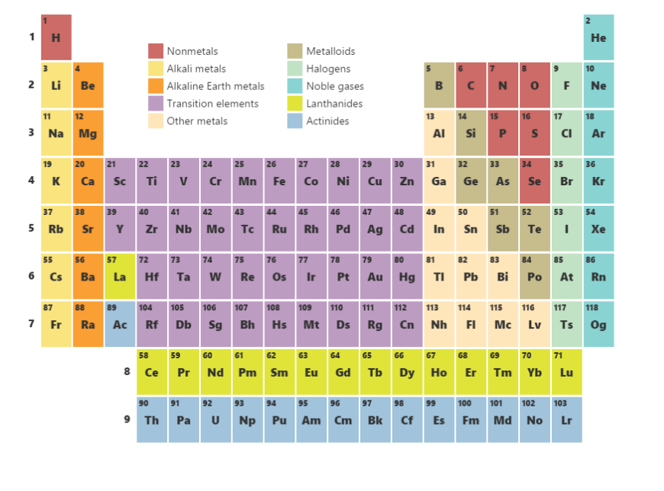
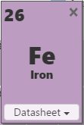
The Elements data-table
Properties of the Elements
Nuclear
Mechanical
Thermal
Electrical and superconducting
Electronic Structure
Magnetic
Environmental
Explore
Nucleus and Bonding-sensitive
properties
Notes:
Elements data table
Selecting the elements data-table gives access to data for all the elements in the periodic table. This has been included in the Ansys Granta EduPack software so you may recognize it. Clicking on an element in the periodic table will open each data sheet.
Each record has data about, both electronic and crystal structure. Students can explore how structure and properties are linked.

Slide 11
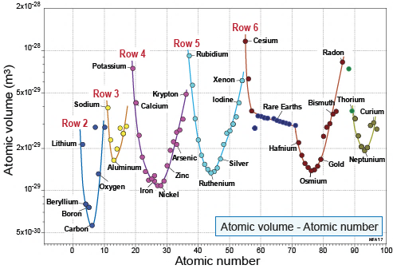
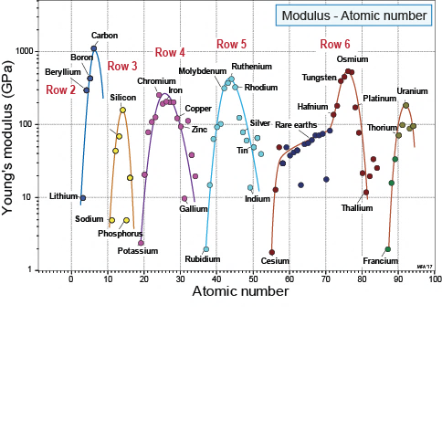
Variation of properties across the Periodic Table
Bonding-packing sensitive properties
10⁻⁹ m
Notes:
Example plots
Here are some diagrams that students can make with the Ansys Granta EduPack software chart function, which show periodic patterns across the table. Both geometric properties and mechanical properties.

Slide 12
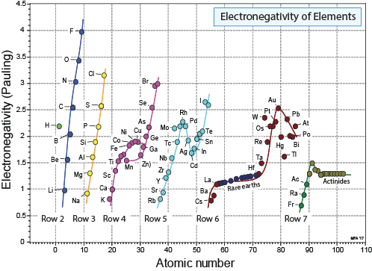
Electronegativity and bonding
Low electronegativity :
Metallic bonding
Alloys
Covalent
Metallic
Difference in electronegativity > 1.7
Ionic bonding
Difference in electronegativity < 1.7
Covalent bonding
Hume-Rothery rules for solid solutions:
Atoms size difference less than 15%
Similar electronegativity
Valence is similar
Notes:
More example plots
The electronegativity of the elements is plotted against atomic number on this graph. This allows students to dig deeper into alloy-theory. Fluorine holds its electrons very tightly. The ones at the bottom with a low electronegativity are metals and the ones at the top are covalent or semiconducting.
If the difference in electronegativity is greater than 1.7 it will generally be ionic bonding. A difference in electronegativity less than 1.7 corresponds to covalent bonding.
Students can also explore the Hume-Rothery rules. It is possible to then apply the Hume-Rothery rules to predict whether two different elements would form a solid solution, for example a Cu-Ni system. See White paper or The Elements lecture Unit for more information.

Slide 13
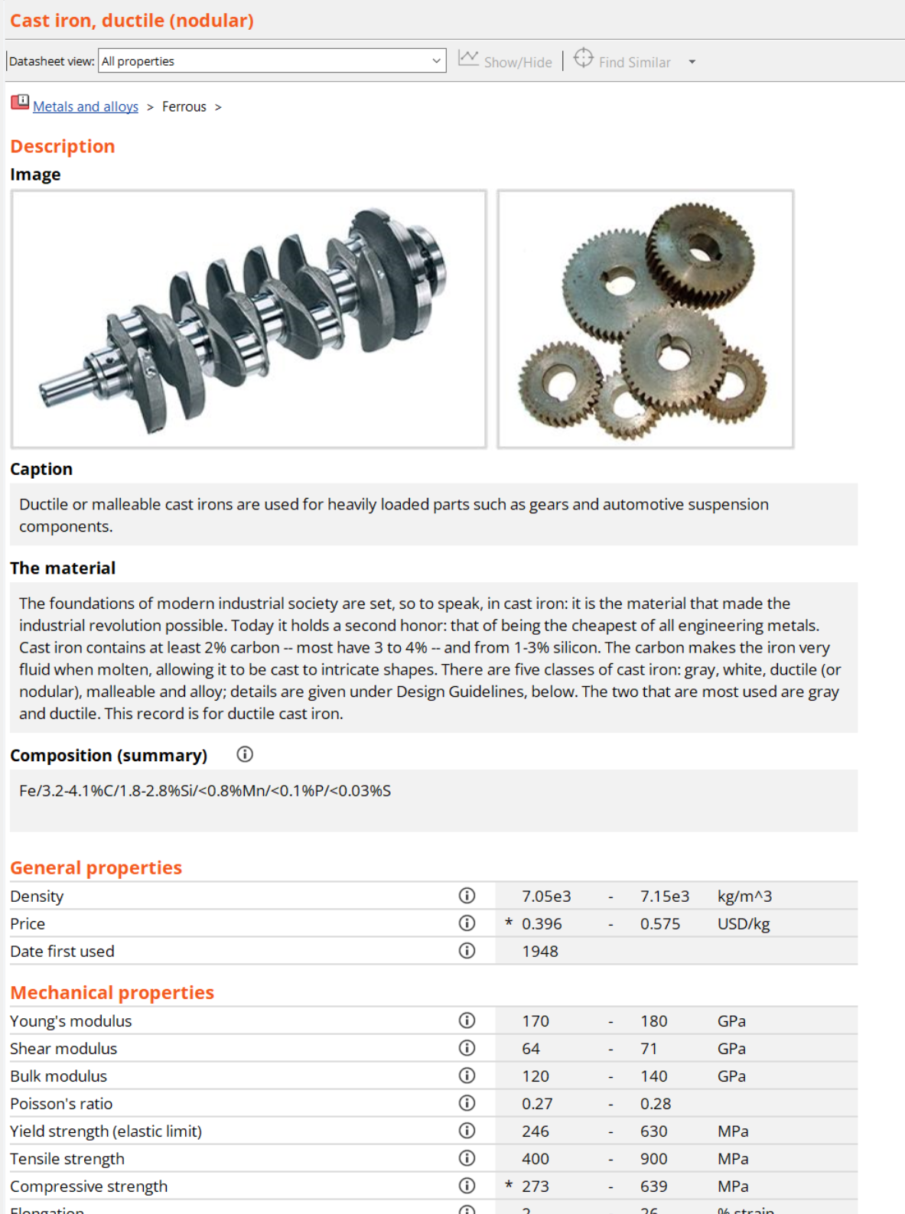
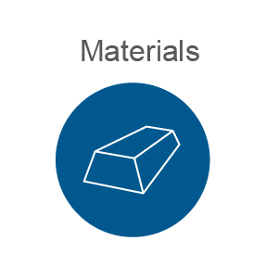
Materials data-table
Notes:
The materials data table
The materials data table has properties for engineering materials. A typical record is displayed on the slide. The records are linked to the relevant elements contained in the material.

Slide 14
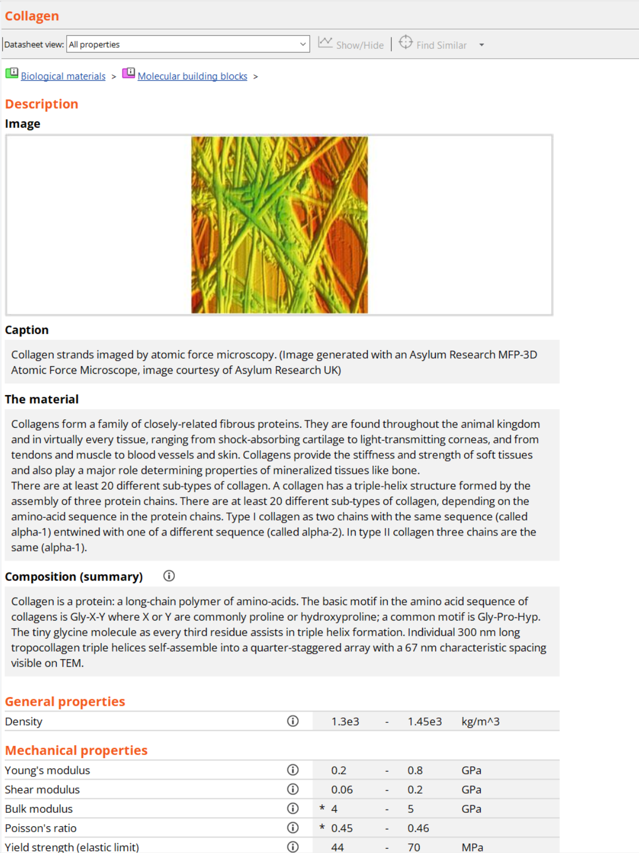
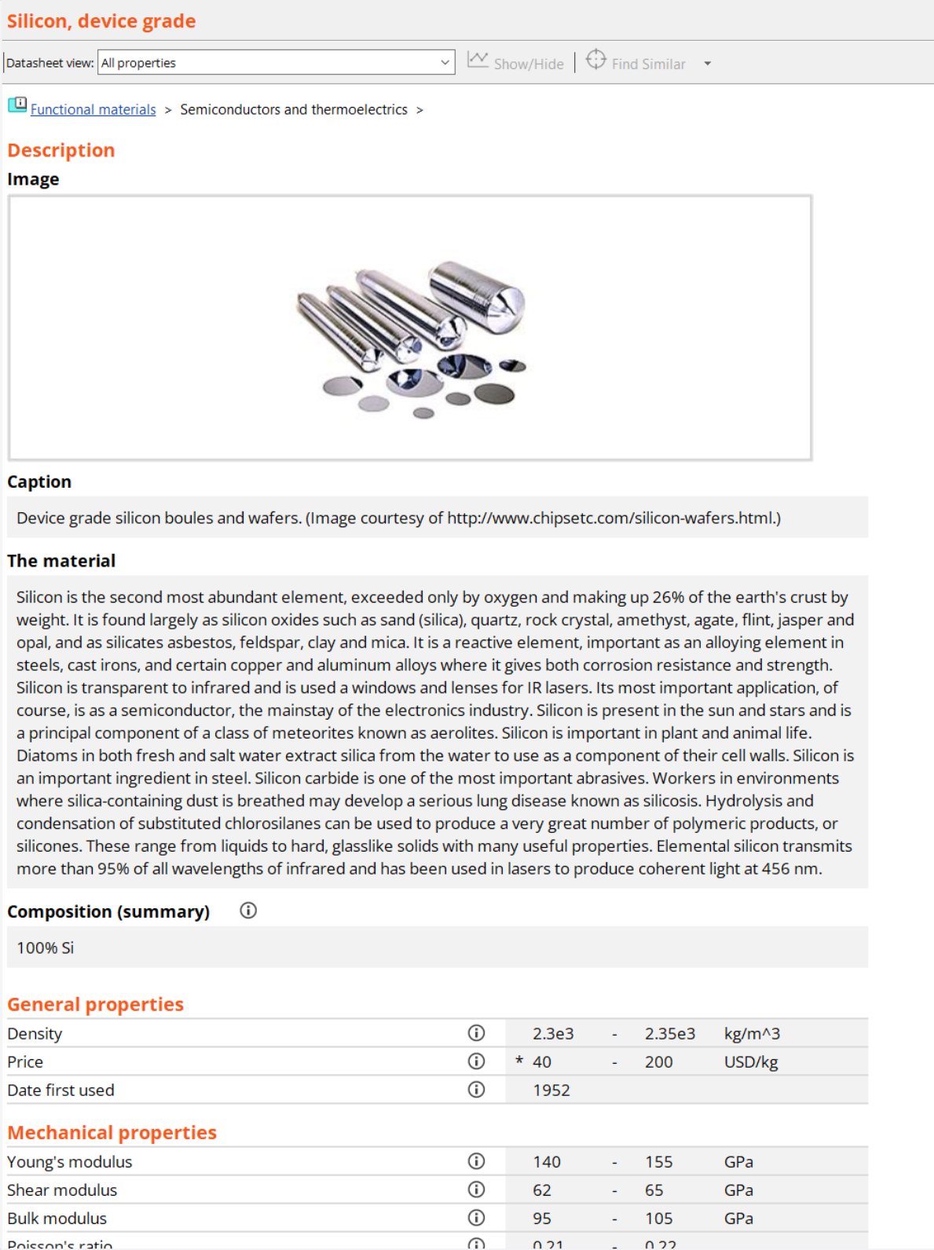
Materials records
95 Engineering materials
88 Biological materials
46 Functional materials
Notes:
Material Records
The Level 2 database has been expanded considerably for MS&E. Not just engineering materials, but biological materials too, as well as functional materials. They all have the same format with a picture, description and property data.

Slide 15
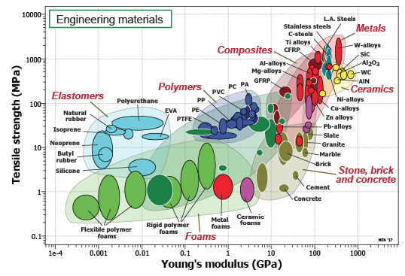

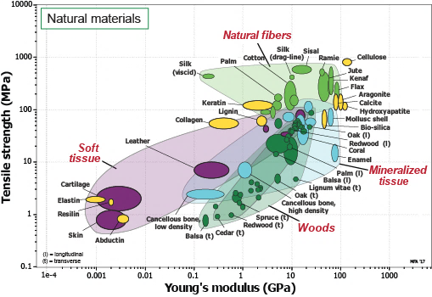

Engineering and natural materials
Carbon steel
Coral
Notes:
Bubble charts
Using the chart function, you can plot the materials on a chart to show their properties. The chart is interactive and clicking on a material bubble gives you the record and image.
Biomaterials cover almost the same area as the engineering materials when plotted even though their composition is completely different.

Slide 16
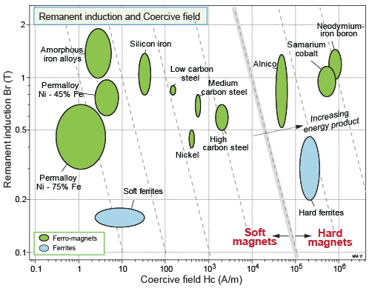
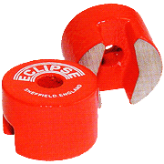
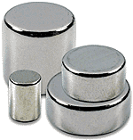
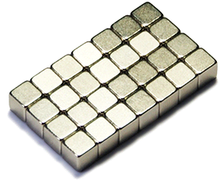
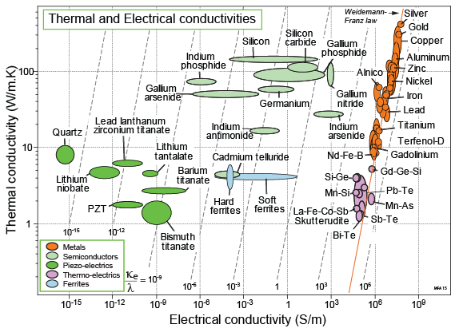
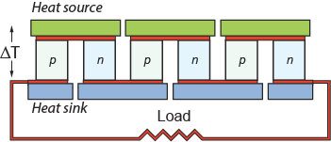
Magnetic and thermoelectric materials
Alnico Co-Sm Nd-Fe-B
Thermo-electric energy harvester
Notes:
Functional materials
Two graphs here with remanent induction vs. coercive field, and thermal vs. electrical conductivity on their axes. Clicking on the bubble brings up records for each one.

Slide 17
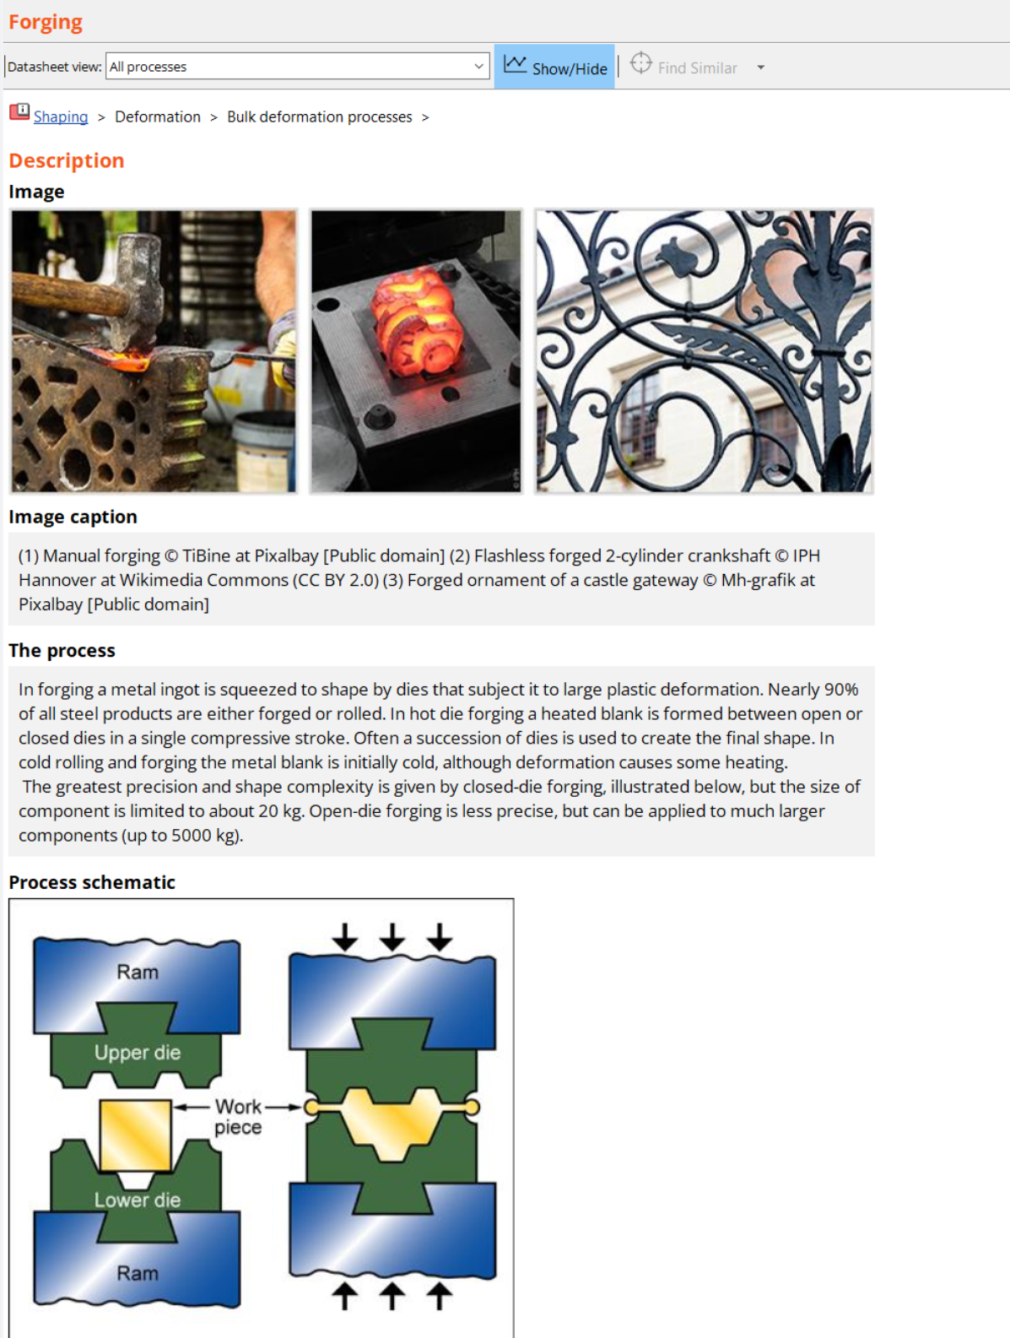

Processes data-table
Notes:
Processes data table
The process records are linked to the materials that can be processed in that way, as before. There are three heat treatment processes in the ProcessUniverse (Carburizing and carbonitriding, Induction and flame hardening, Laser surface hardening and melting, and Nitriding)

Slide 18
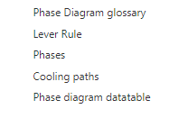
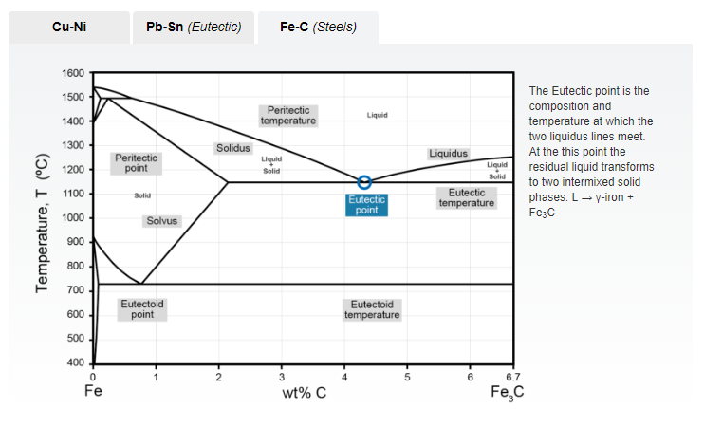
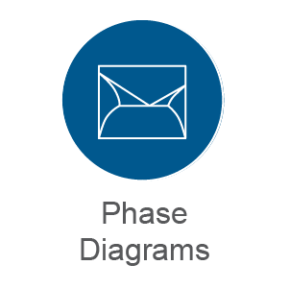
Phase diagrams
Phase Diagrams
Notes:
Phase diagrams
Phase diagrams tell you important things about the microstructure, for example when cooling slowly from the liquid phase into the solid phase, and the influence of composition.
Linked to the elements, and materials in the data table, e.g. 7030 brass, means students can go from materials to phase diagrams to the elements themselves, etc.
The phase diagram glossary, shown here, gives definitions of the phase diagrams.
Also included in this database is a tool to help with the Lever Rule, a tool to explore the microstructures of some important phases and another one to see how it changes upon solidification.
We have compiled some of the most common binary phase diagrams in a separate data-table and thee is also a teach yourself phase diagram PDF which can be downloaded to facilitate student self-study.

Slide 19
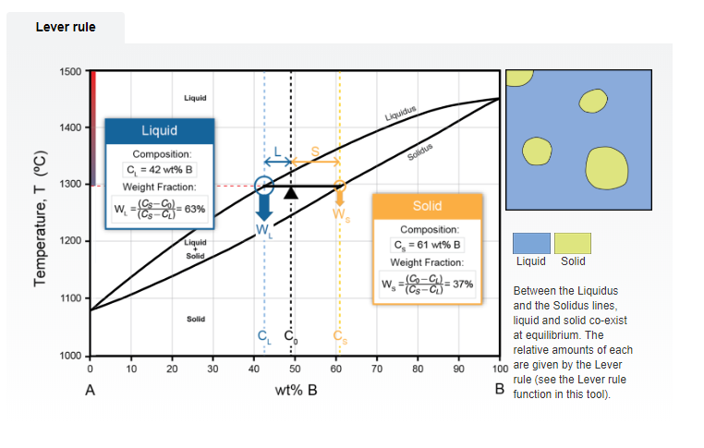
Lever rule
Phase Diagrams
Reports liquid composition and weight fraction
Dynamic – pull bar down
Schematic of phases present
Notes:
The Lever Rule
The Lever Rule is always difficult to teach, so we have made an interactive tool. The pull down bar can be pulled from liquid into the two-phase field and eventually into solid, and the thermometer scale on the left hand side indicates the cooling which is occurring. The composition and the corresponding weight fractions for the liquid phase and the solid phase are displayed in the boxes. These change corresponding to the position of the bar.
On the right there is a schematic of the phases present, as well as an explanation in words.

Slide 20
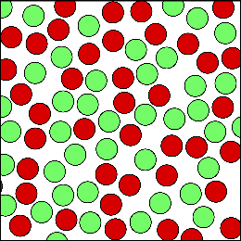

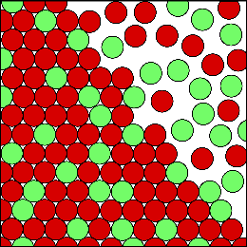

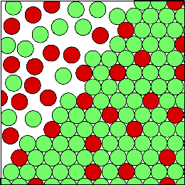
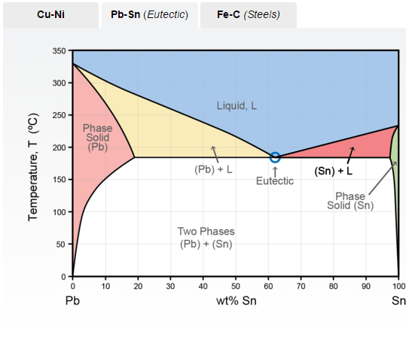
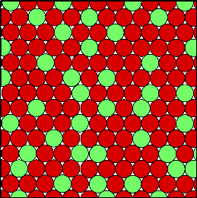
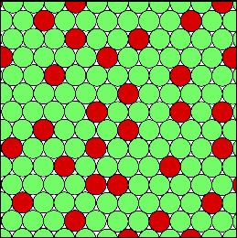
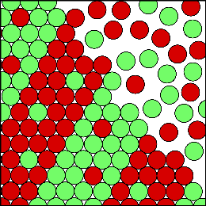
Phases
Liquid
Phase Diagrams
(Pb) + Liquid
(Sn) + Liquid
(Pb) Solid
(Sn) Solid
Eutectic
Notes:
Phases
The Phase Structure is interesting. Are they two-phase fields or single phase fields? Here is the Pb-Sn Phase diagram. Hovering over each field will present the corresponding fields with a schematic structure. In the middle we have eutectic, and we see the lamellar structure when we hover over this phase. There are 3 diagrams to explore, corresponding to Cu-Ni, Pb-Sn, and Fe-C.

Slide 21

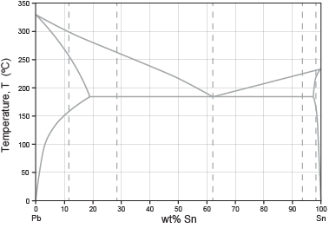
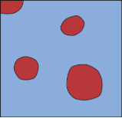
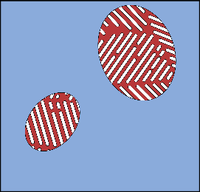

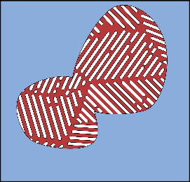
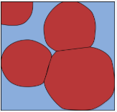
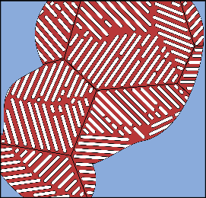
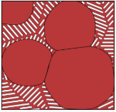
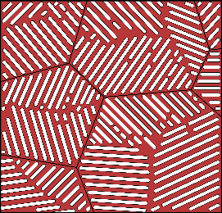
Cooling paths
Lead Tin diagram
Phase Diagrams
Path 2
Path 1
Notes:
Cooling Paths
Cooling Paths for key compositions are also illustrated in the software. Suppose we take path 1 on the Pb-Sn diagram, we start in the liquid phase at the top and drift down to the solid phase near room temperature. Once it reaches the eutectic point, the eutectic grows and grows and eventually impinges and becomes only eutectic.
On Path 2, as you cross into the two phase field, the solid increases steadily and eventually, near room temperature, the remaining space fills with eutectic. Feel free to explore the other paths yourself.

Slide 22
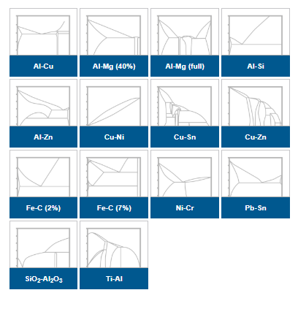


Phase diagram data-table
Phase Diagrams
Notes:
Phase Diagrams
There is a catalogue of the 14 most used binary phase diagrams, for example Cu-Zn and Fe-C. These are drawn by Granta and are free to print off and study.
A student can copy the data easily. There are two elements associated with this particular one, there are also some alloys associated with it. For this reason this datatable is linked to the elements as well as the materials datatables in the software.

Slide 23


Characterization data-table
Notes:
New for 2025R1, this data-table focuses on introducing students to characterization techniques commonly used by materials scientists to determine material properties

Slide 24


Datasheet example
Notes:
An example of the type of information found in the characterization data table can be found here, including schematics of the technique and material compatibility

Slide 25



Process-Property Profiles data-table
Notes:
Process-Property Profiles
All micro-structure sensitive properties are manipulated by processes. Most textbooks will show you how one property changes during processing but that rather conceals the fact that all the microstructure sensitive properties change if you change the microstructure. It is educational for students to understand that and realise there is often a trade off where you can improve one property by processing but in doing so you may diminish another property.
This dataset shows how one process changes all the properties of a given material. There are 7 data-sets as shown in the slide.

Slide 26

Process-Property Profiles data-table
Notes:
Alloying, work-hardening and precipitation hardening
As an example, we show the folder-level record with information on heat treatment of low carbon steels. From the included plot we can see where we get the best combination of high conductivity and strength. Each of the 7 sets has an explanatory sheet with it. What’s in it, what can you do with it, and where can you learn more?

Slide 27

Solution hardening, work hardening, ppt hardening
Work
hardening
Precipitation
hardening
Solid solution
hardening
Notes:
The effect of processing
In this chart, we explore the effect of work hardening, precipitation hardening and alloying of copper. The example shows the trajectories of thermal conductivity and yield strength upon increased hardening.

Slide 28




Filling, blending, reinforcement (composition)
Fiber
reinforced
Mineral
filled
Blending
Notes:
Example: Polypropylene with fillers
Here, we can see, by taking one material (polypropylene) and doing various processes to it, the consequences on two important mechanical properties; strength and stiffness. This lends itself to some nice exercises for students to explore.
The yield strength and Young’s modulus of polypropylene can be seen at the center, in bright green. If you add fillers (talc/ calcium carbonate), the modulus goes up and the strength goes down a bit. If you add fiber reinforcement (chopped fiber or continuous fiber), both the strength and the modulus go up. If you blend it with elastomers like EPDM what you find is the modulus drops a lot and the strength drops somewhat.

Slide 29





Systematic selection for performance, environment
2
Notes:
Material selection
The material property charts can, of course, still be used for selection based on performance indices, as described in the textbooks by Mike Ashby. The selection tool allows for plotting any of the properties in the records of the MS&E database (level 2).

Slide 30

Learning resources
Notes:
Learn
The Learn button allows student to access open access information resources. Access to glossaries, Ansys Innovation Courses, a getting started guide, and selection tools are all available. It’s an enormous resource which can be explored in a number of ways and encourages students to learn themselves.

Slide 31






MS&E-related resources on the Ansys Education Resources Page
White Papers
Exercises with Solutions
Lecture Units
Micro-projects
Teach Yourself...
Multiple Choice Questions
GIFT format
for Moodle
Notes:
Resources
Additional MS&E resources are available on our website and in a MS&E Teaching package: www.ansys.com/education-resources

Slide 32
Ansys Education Resources Feedback Survey
Here at Ansys, we rely on your feedback to ensure the educational content we create is up-to-date and fits your teaching needs.
Please click the link below to fill out a short survey (~7 minutes) to help us continue to support academics around the world utilizing Ansys tools in the classroom.
Feedback Survey Link
Notes:
Feedback Survey link for copy-paste method → https://ansys.typeform.com/to/jcattJI5

