Slide 1



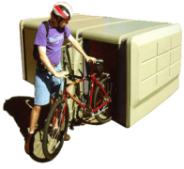
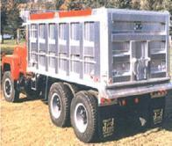
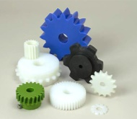

The Materials of Engineering:
an Intro to the Ansys Granta EduPack Software
Mike Ashby
Department of Engineering,
University of Cambridge

Slide 2
Learning objectives for this lecture unit
Ansys software mentioned | Ansys Granta EduPack™­, a teaching software for materials education
Intended Learning Outcomes
Knowledge and Understanding | Understanding of what is meant by material and process properties
Skills and Abilities | Ability to find material property data and scientific background to these
Values and Attitudes | Appreciation of the classification and organization of materials information
Resources
Text: “Materials: engineering, science, processing and design” 4th edition by M.F. Ashby, H.R. Shercliff and D. Cebon, Butterworth Heinemann, Oxford, 2019, Chapters 1-2
Text: “Materials Selection in Mechanical Design”, 5th edition by M.F. Ashby, Butterworth Heinemann, Oxford, 2016, Chapters 1-2
Texts: Callister, Budinski, Askeland and others – recommended reading in records
Ansys Granta EduPack software
Notes:
Learning Objectives
These Intended Learning Outcomes are based on a taxonomy of knowledge and understanding as the basis, skills and abilities as necessary for the practical use of knowledge and understanding, followed by acquired values and attitudes enabling assessments and responsible use of these abilities.
Combined with a suitable assessment, they should be helpful in the context of accreditations or for the CDIO Syllabus.
The Texts listed are from books authored or co-authored by Mike Ashby but other texts are also referred to in the Science Notes.

Slide 3


Lecture Outline
Background: the motivation
Materials: classification and properties
Ansys Granta EduPack software: structure and content
Notes:
Outline
This is the first lecture that could be used in a course on Material and Process Selection. The Units link closely to the first two Textbooks listed on the previous slide but can equally by used in conjunction with texts such as Callister, Budinski, Askeland and others.
The relevant chapters of the Texts are listed in each Unit. The methods developed in the slides are implemented in the Ansys Granta EduPack software, which is structured to evolve in pace with the student throughout a four-year engineering program. This first Unit introduces materials and processes, and the way in which information about them can be classified, stored, retrieved and explored.

Slide 4
Teaching materials to engineering students
The starting point
Engineers make things. They make them out of materials, using processes.
What do they need to know?
  Perspective of the world of materials and processes
  Understanding material properties
  An ability to select
  Information and tools
Ansys Granta EduPack software: resources to achieve this
- a tool for later profession (like CAD or FE)
Notes:
What do engineering students need to know about materials?
This methodology takes a design-led approach to the selection of materials and manufacturing processes. The philosophy is outlined in this frame.
Engineering students need to know how to choose and shape materials to meet a set of design requirements; developing new alloys, polymer blends and the like is the job of the materials scientist, who also needs to understand material properties.
The methods developed here give students tools for design. The underlying science is not ignored but is introduced where relevant to the understanding of the design-limiting attributes of materials.

Slide 5

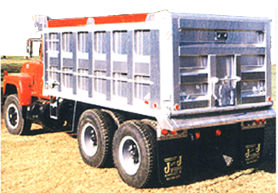
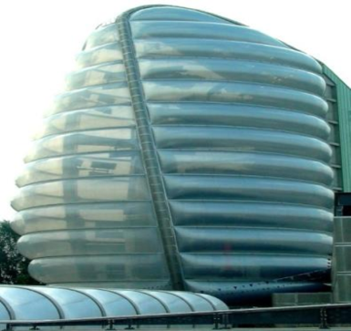


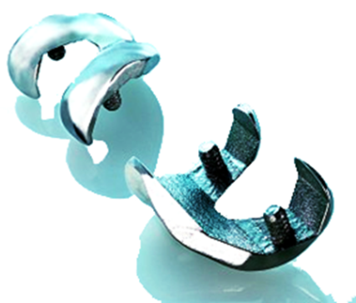
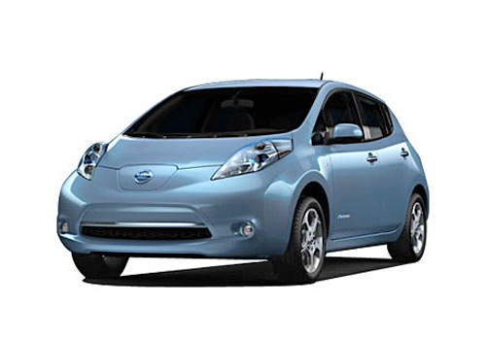

Which courses? Campus-wide?
Materials science General engineering Polymer engineering
Aerospace engineering Architecture Bioengineering
Product design Environmental engineering Sustainability assessment
Notes:
The range of courses supported by the
|Ansys Granta EduPack Software
The Ansys Granta EduPack software offers databases for Materials Science, for General Mechanical Engineering and for more specialized courses, among them Polymer and Aerospace Engineering, Architecture and Bioengineering. It also has tools ranging from estimating composite and structural hybrid properties to battery design.

Slide 6
Organizing information
Select on material properties
The
database
Select on process properties
References
data-table
DATA FOR
Metals & alloys
Polymers
Ceramics & glasses
Hybrids
DATA FOR
Joining
Shaping
Surface treatment
Materials
data-table
Links
Processes
data-table
Suppliers
data-table
Select on links
Notes:
Database structure
This overhead shows the basic structure of the Ansys Granta EduPack software database. It contains 4 linked data-tables:
Materials: metal, polymers, ceramics and hybrids
Processes for shaping, joining and finishing materials
References to more information about any given record in the data-tables
Supplier information for materials or processes
Each record in the Materials data-table contains data for material properties, and is linked to similar records for the processes that can shape, join and finish it. Each record in the Process data-table is similarly linked to the materials it can treat and to reference and supplier information. This allows selection of materials by specifying required properties, or by specifying how it can be processed. In the next frame the Materials data-table is expanded.
The Advanced tools (Eco Audit tool, the Hybrid Synthesizer tool and the Sustainable Development Assessment methodology) have more complex structures described in the relevant PowerPoint Lecture Units and White Papers.

Slide 7
Organizing information: the Materials Tree
MaterialUniverse
Family
Class
Member
Attributes
Ceramics
& glasses
Metals
& alloys
Polymers
& elastomers
Hybrids
Al 6463
Density
Mechanical props.
Thermal props.
Electrical props.
Optical props.
Corrosion props.
Documentation
-- specific
-- general
Al 6060
Density
Mechanical props.
Thermal props.
Electrical props.
Optical props.
Corrosion props.
Documentation
-- specific
-- general
Steels
Cu-alloys
Al-alloys
Ti-alloys
Ni-alloys
Zn-alloys
1000
2000
3000
4000
5000
6000
7000
8000
Al 6061
Density
Mechanical props.
Thermal props.
Electrical props.
Optical props.
Durability props.
Documentation
-- specific
-- general
Materials
data-table
Material records
Notes:
The Hierarchical structure of records of the Materials data-table
Here we show a tree-like classification for materials, one typifying that used in handbooks and in the software described in a moment. The Universe of materials contains the four families shown earlier. That for metals is partly expanded to show classes, each of which contains sub-classes (not shown) and – at the tips of the branches of the tree – members. Each member is characterized by a set of attributes – the numeric, non-numeric properties and supporting information that describes it.. A listing of these attributes makes up a record for that material. Some of it is numeric and can be structured into tables. Some is in the form of text, images or graphs and cannot be organize in the same way. We refer to this as unstructured data.

Slide 8
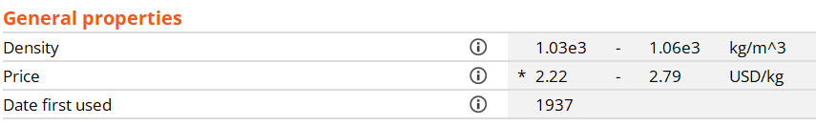
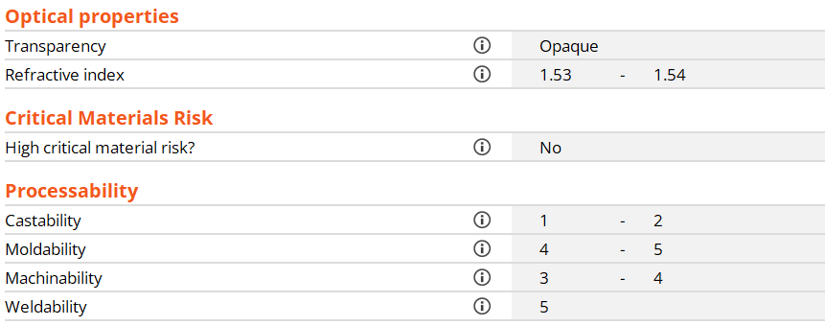
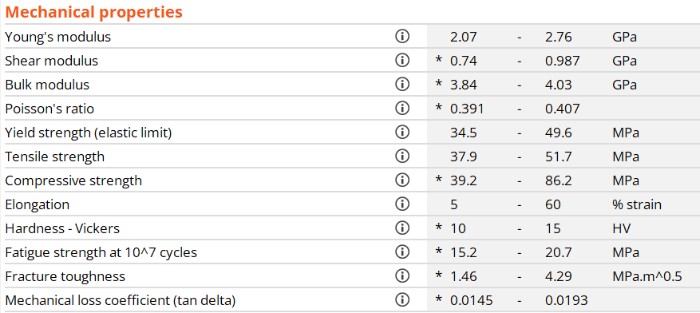
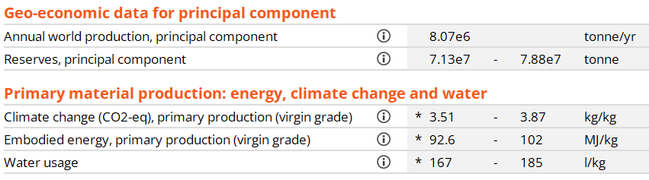
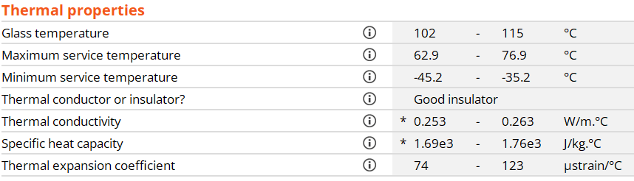

Structured information for ABS*
Acrylonitrile-butadiene-styrene (ABS)
Links to Processes
*Excerpts from the Ansys Granta EduPack software Level 2 database
Notes:
Structured (numeric, tabular) data for a material
This is an example structured data, here for ABS. Numeric properties are reported as ranges (material properties have permitted range of values because of latitude in permitted compositions and methods of production). Non-numeric properties are shown as rankings here: very poor, poor, average, good, very good. Ideally, structured data should contain no “holes” – missing data – because this compromises its use for selection. (The Ansys Granta EduPack software databases have no holes.) Links provide the connections to processes that can be applied to ABS.

Slide 9
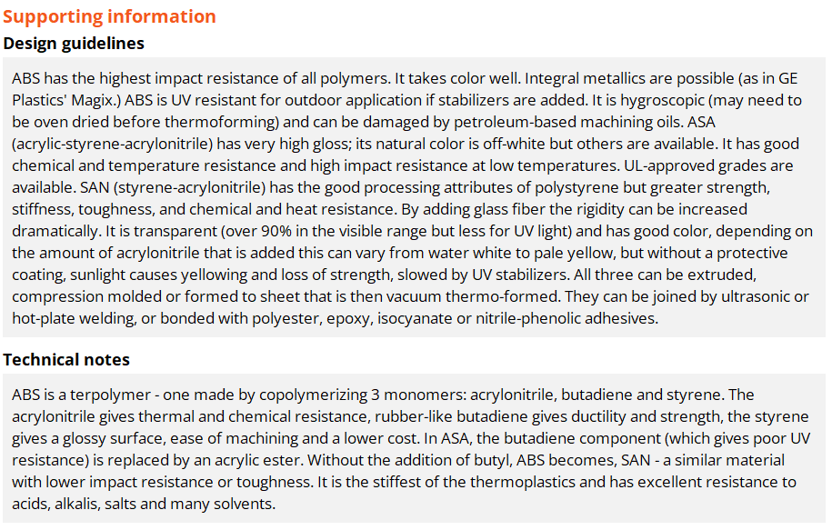
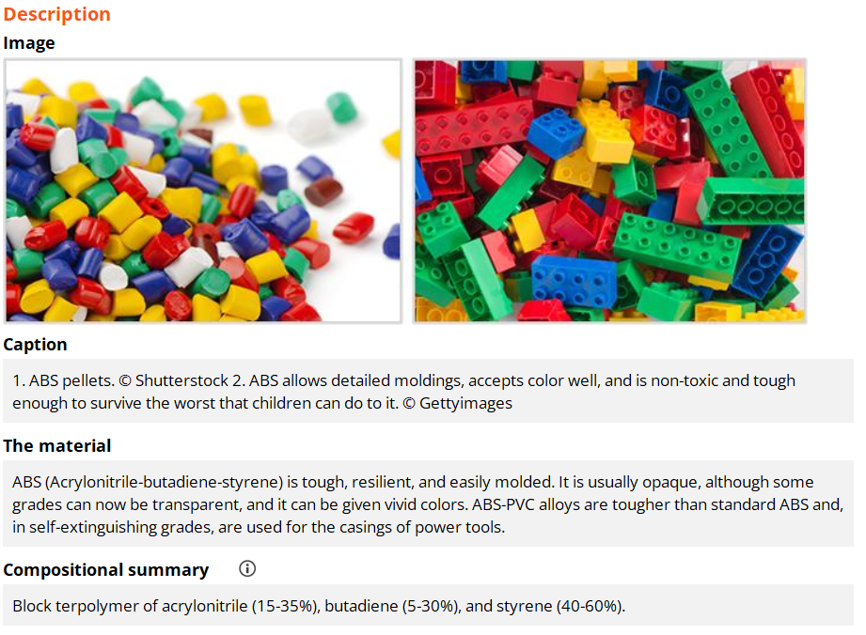
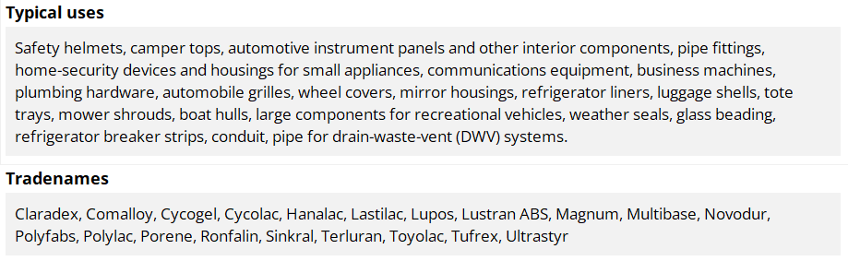
Unstructured information for ABS*
*Excerpts from the Ansys Granta EduPack software Level 2 database
Notes:
Unstructured (text, image) data for a material
This is the other half of the story: unstructured data. It is text and image based, providing design guide-lines, environmental information, typical applications and warnings. The images capture a lot of information: that ABS can be brightly colored and accept a high finish, that – since Lego is designed for small children – it is totally non-toxic and strong and wear resistant enough to survive the worst that children can do to it. All this is of primary use to the designer seeking a material for a new application.
The record provides Design guidelines, Technical notes, Typical uses, Environmental notes and Trade-names.

Slide 10
Organizing information: the ProcessUniverse
The
database
References
data-table
DATA FOR
Metals & alloys
Polymers
Ceramics & glasses
Hybrids
DATA FOR
Joining
Shaping
Surface treatment
Materials
data-table
Links
Processes
data-table
Suppliers
data-table
Notes:
The content of the Process data-table
Each record in the Process data-table is similarly linked to the materials it can treat and to reference and supplier information. This allows selection of materials by specifying required properties, or by specifying how it can be processed. The next frame shows some of the content of the process data-table.

Slide 11
Organizing information: the Process Tree
ProcessUniverse
Family
Class
Member
Attributes
Casting
Deformation
Molding
Composite
Powder
Rapid prototyping
RTM
Material
Shape
Size Range
Min. section
Tolerance
Roughness
Economic batch
Documentation
-- specific
-- general
Blow molding
Material
Shape
Size Range
Min. section
Tolerance
Roughness
Economic batch
Documentation
-- specific
-- general
Compression
Rotation
Injection
RTM
Blow
Injection molding
Material
Shape
Size Range
Min. section
Tolerance
Roughness
Economic batch
Documentation
-- specific
-- general
Joining
Shaping
Surfacing
Processes
data-table
Process records
Notes:
The Hierarchical structure of records of the Process data-table
Each material can be processed in a number of different ways. The manufacturing process records, like the Materials records, are organize in the hierarchical Process tree, shown here. The Process Universe is divided into families. That for shaping is partly expanded to show classes: casting, molding and so on. In this schematic one of these – molding – is expanded to show members. Each member has certain attributes: the materials it can handle, the shapes it can make, their size, precision and cost. A list of these attributes makes up a record for the process.

Slide 12
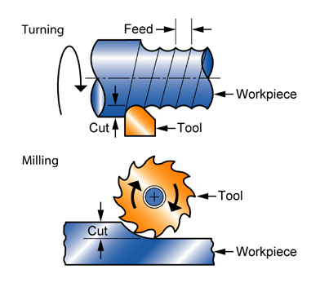
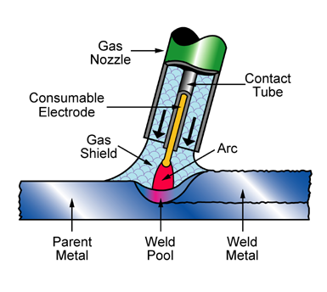
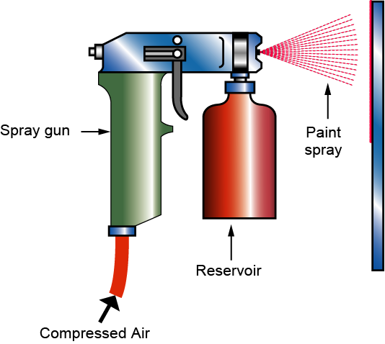
Organizing info: manufacturing processes
Primary
shaping
Secondary
shaping
Injection moulding
Machining
Surface
treating
Joining
Welding
Painting
Notes:
Examples of processes
These schematics introduce the three families of manufacturing processes:
those that create shape, subdivided into primary and secondary (shape modifying processes – principally machining methods)
those that join shapes together, and
those that coat, treat or finish the surface.
These are explored in more depth in Unit 10

Slide 13
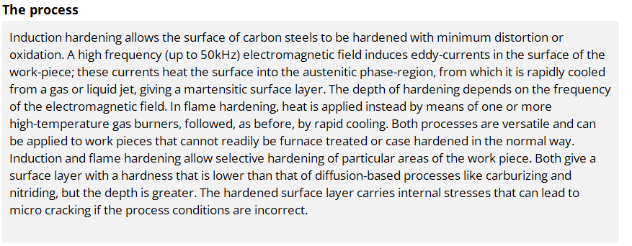
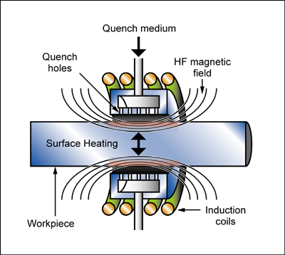
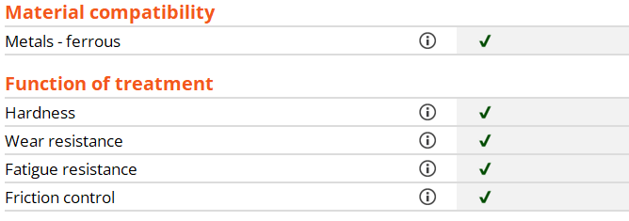
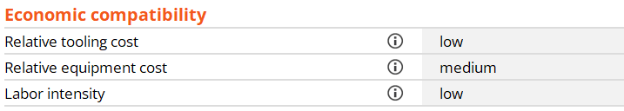
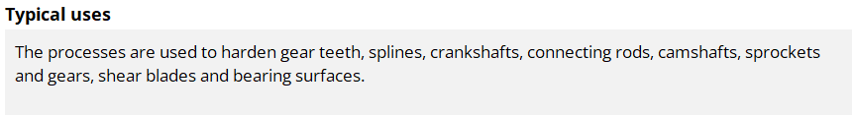
A surface-treatment record*
Links to Materials
*Excerpts from the Ansys Granta EduPack software Level 2 database
Notes:
The key steps in choosing a surface treatment process
This frame shows structured and unstructured data for a surface treatment process. The most critical attributes are the function that the treatment is required to provide and the materials to which it will be applied, accessed via the links.
The key constraints when selecting a surface treatment process are the material to be treated and the function of the treatment.

Slide 14






Ansys Granta EduPack software and education resources
Software + Knowledge
www.ansys.com/education-resources
Notes:
More than just software
The Ansys Granta EduPack software, which implements the methods developed in the Textbooks (see below), enables self-teaching and project work, both elementary and advanced.
Access to PowerPoint Units, with notes
Access to White Papers describing databases, teaching methods, with notes
Access to the Ansys Education Resources site with over 200 resources, continually updated, organised by Subject, Type, Level etc.
The Text “Materials: Engineering, Science, Processing and Design” 4th Edition provides an introduction to the ideas, methods and software for the teaching of materials and process selection.
The Text “Materials Selection in Mechanical Design” 5th edition (ISBN: 978-0-08-100599-6) develops methods for material selection for engineering design.
The Text “Materials and the Environment” 2nd edition (ISBN 978-0-12-385971-6) focuses on eco-informed materials choice.
The Text “Materials and Design, the Art and Science of Product Design” 2nd Edition (ISBN-10: 0750655542) focuses on the industrial design aspects of materials.
The Text “Materials and Sustainable Development” (ISBN 9780081001769) provides a structure and framework for assessment and analysis of sustainable developments focusing on the role of materials.
All five texts are available from Butterworth Heinemann, Oxford.

Slide 15

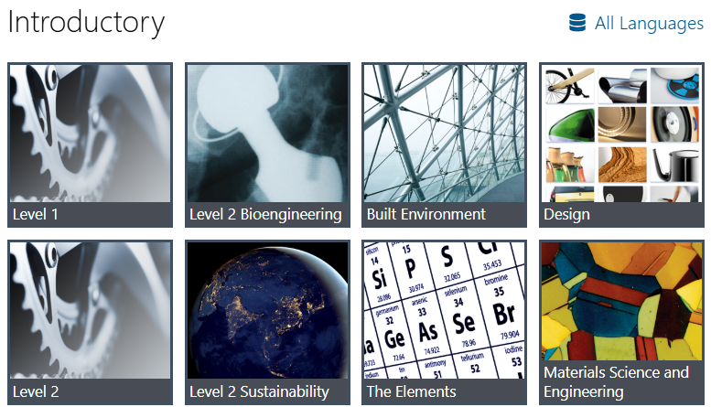
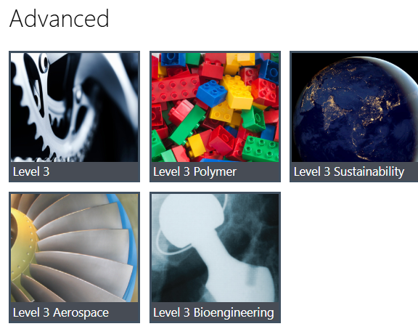
Ansys Granta EduPack software 2025R2
Level 1, general
Schools, 1st year college
69 materials, 74 processes
Level 3, general
3rd-4th year, masters and research
4000+ materials, 225+ processes
Level 2, general
1st-3rd year students of Engineering, Materials Science and Design
100 materials, 116 processes
The Elements Database
Schools-University students
149 records, periodic table
Notes:
The opening screen
The Ansys Granta EduPack software opening screen displays the available databases. On the left are the Introductory databases. Level 1 General Engineering is intended for an introductory course on materials. It contains records for 69 common structural materials and 74 processes. Level 2 General engineering has records for 100 materials and 116 processes with much more extensive data for each, including technical notes, design guidelines, environmental and economic notes. A database on the Elements is useful for most applications as a reference. It also contains Geo-economic and Eco-data of general interest. New from 2020 is the Medical Devices and Design databases.
On the right are the more advanced databases. Level 3 General Engineering has approximately 4200 materials (with records for specific grades in specific states of heat treatment) and 247 processes. It allows real design problems to be tackled. Additionally, there are specialized databases for Bioengineering, Architecture, Polymers, Aerospace materials, Energy-related materials and for the teaching of Eco Design and Sustainability.
All three levels provide supporting information through the Help Menu

Slide 16
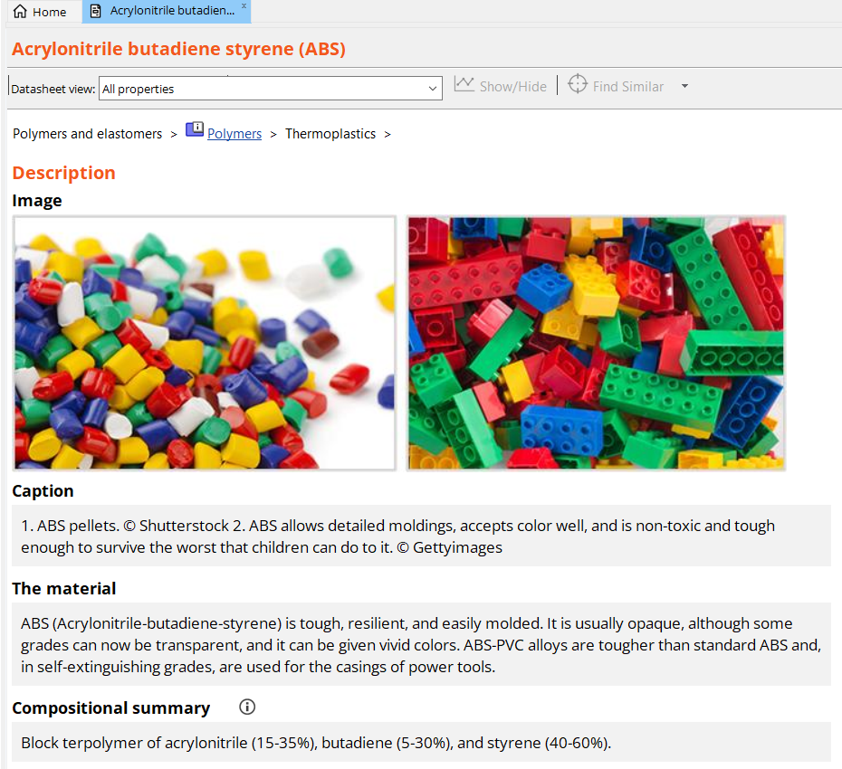
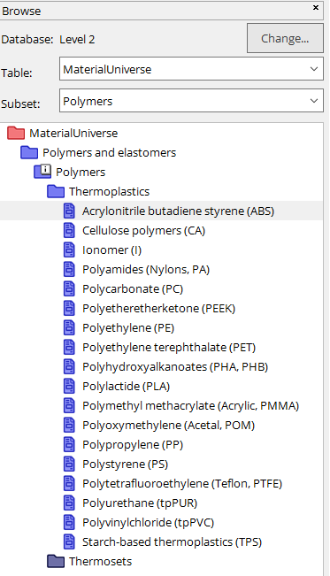
Tools to find information- Browse function
Change datatable of interest here
Notes:
The three primary navigation tabs
Three buttons – Browse, Search and Chart/Select – open the three ways to access information and selection tools.
Clicking on the Browse button on the main toolbar it is possible to use Ansys Granta EduPack software data very much like an interactive textbook. Here we will look at the record for ABS at level 1. You can see that the property information is stored as a range. At Levels 1 and 2 there is only one record available for ABS so as not to overwhelm the student; at Level 3, there are many, describing different grades and blends. The Level 1/2 record shown here effectively summarizes the range of property values for all the standard grades of ABS available.
Scrolling down the record we can see that a limited number of mechanical, thermal, electrical, optical and eco properties are included along with typical uses. At the very bottom of the record there are links to the other data-tables. Clicking on the ProcessUniverse link takes you through to all the processes at Level 1 & 2 that can be applied to ABS. Here we will look at one of the primary shaping processes, Injection Molding.

Slide 17
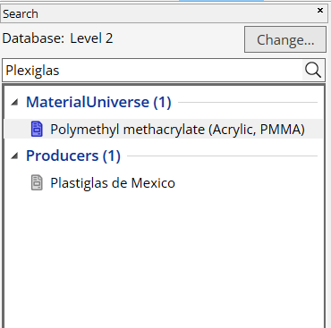
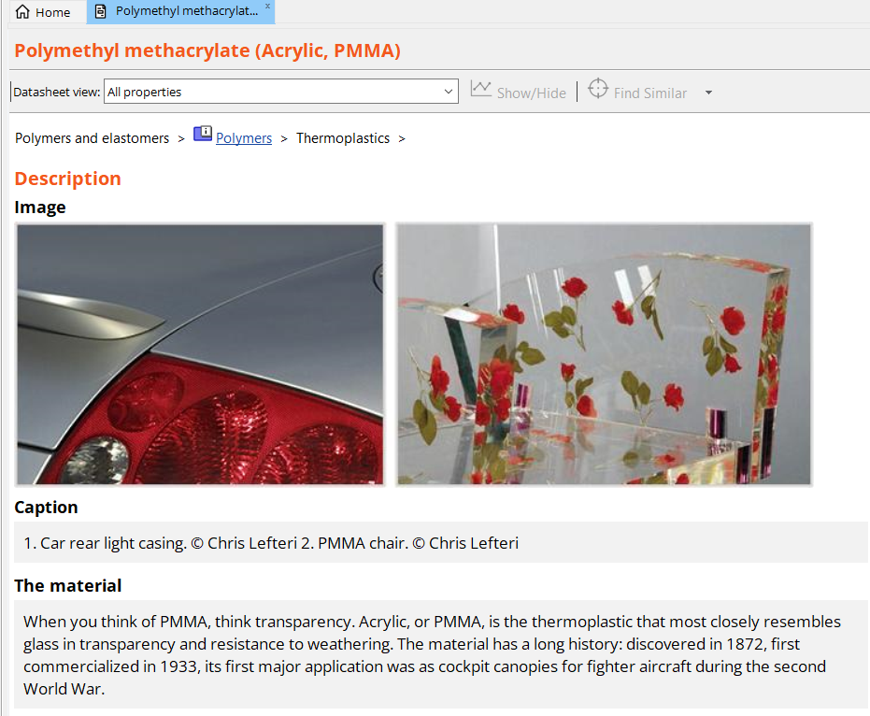
Tools to find information- Search function
About the search function:
Not sensitive to CASE but to spelling
Searches all data-tables
Operators AND, OR, NOT, * …
Categorizes all results
Highlights search term in datasheet
Notes:
The Search engine
The second button on the main toolbar opens a powerful and fast Search engine. The user enters a search term or string at the top of the Search window. The Search engine carries out a full-text search of all the records in the database, listing its findings in the window. This allows searches on both the technical and the trade-names of materials or process, on applications and on conditions.

Slide 18
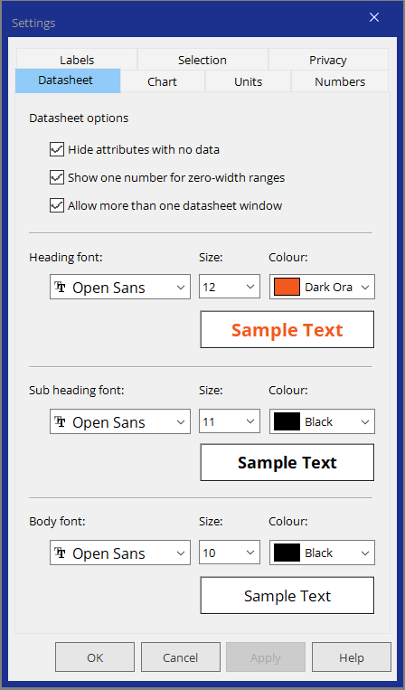
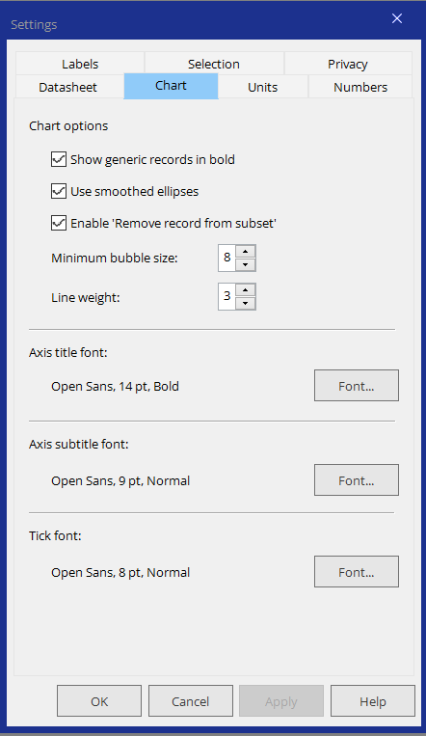
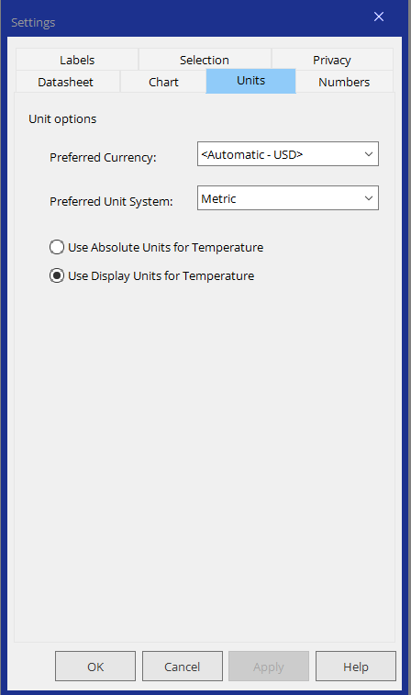
Changing the data settings (units etc.)
Notes:
Changing the Units and adjusting Fonts, Labels and Graphs
All UNITS can be changed. Currency units are selected from pull down menus offering an international range of currencies. The base rate in the software is the US dollar; all others are calculated using exchange rates, upgraded annually. Data units are selected from a second pull down menu offering Metric, SI, US Imperial and UK Imperial.
Temperature can be show in absolute units (Kelvin) or in the display units of the chosen units system: Centigrade in Metric, Fahrenheit in Imperial.

Slide 19
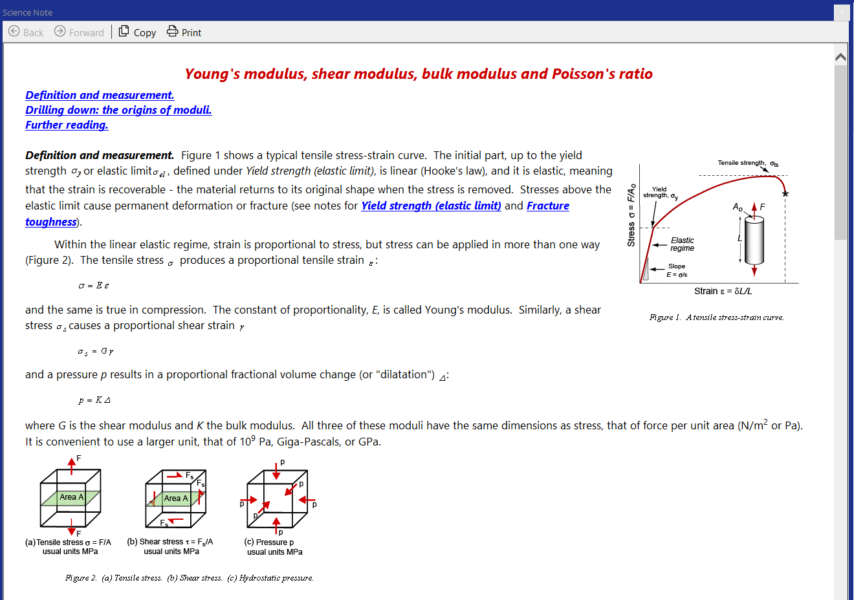
Adding the science
Click the “i” icon next to any attribute
With relevant textbooks listed for
Further Reading
Notes:
Accessing the science behind the properties
Each attribute name in a record for a material is linked to pages of Science notes; text and figures explaining what the property is, how it is measured and introducing the Materials Science behind the property. Each note ends with references to chapters in standard Materials Science texts in which more information about the property can be found. The Ansys Granta EduPack software can thus be used as an adjunct to courses based on these texts.

Slide 20
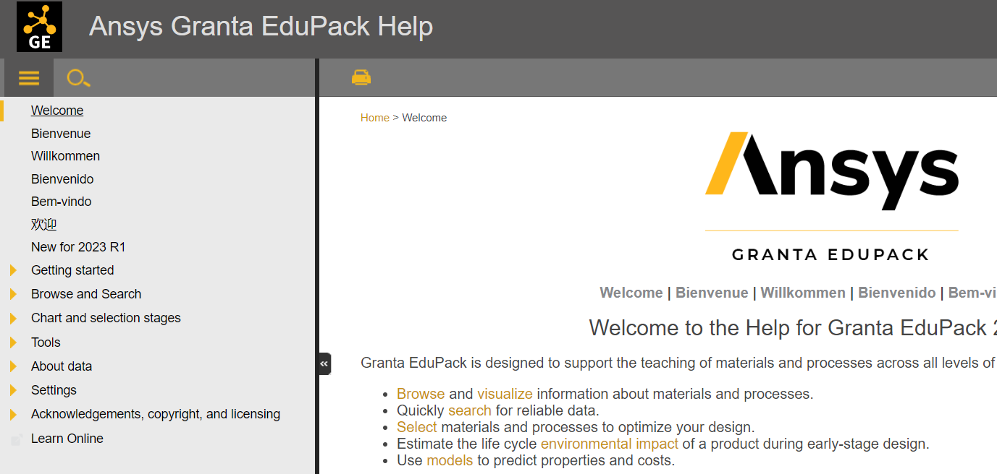
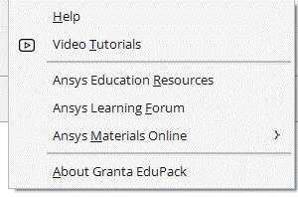
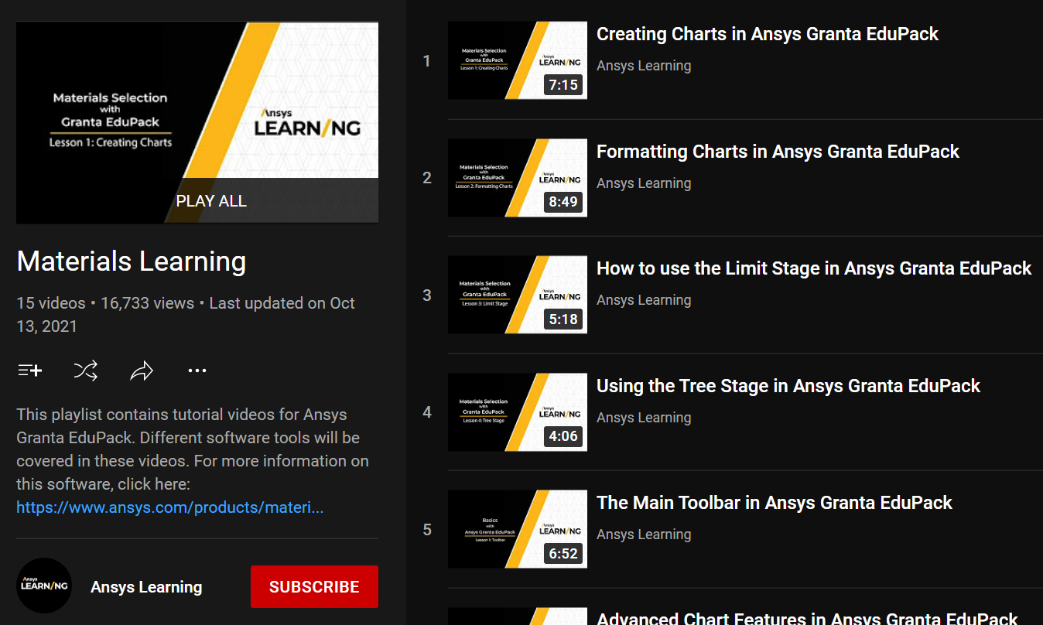
HELP! Video tutorials, White Papers… more
Notes:
Navigating the HELP facility
Extensive context-dependent Help is available both from the Help menu, within records and in dialog-windows for selection.
A comprehensive set of Video-Tutorials introduces the Databases, and demonstrates Browsing, Searching and Selecting
A “Getting Started” guide, down-loaded as a PDF, gives students a quick start
White Papers, documenting the Ansys Granta EduPack software databases and methods, can be printed or downloaded as PDFs
Lists of Material Indices and much more can be down-loaded as pdf files from within Help

Slide 21


Ansys Education Resources
Browse 200+ teaching resources
by Resource Type, Software, Key Discipline,
Specialty Topic, & Language
Exercises with Worked Solutions
PowerPoint Lecture Units
Case Studies
White Papers
Recorded Webinars
Posters
www.ansys.com/education-resources
Notes:
Ansys Education Resources
Ansys Education Resources Website aims to support teaching of materials-related courses in Engineering, Science and Design. The resources come in various formats and are aimed at different levels of student; primarily undergraduate level.
The website also contains resources contributed by Ansys Granta EduPack software users.
The teaching resource website contains both resources that require the use of the software and those that don’t.
Many resources are open access, these resources can also be accessed by students. Other resources are only accessible by educators with an active Ansys software license. Simply fill out the form on the related resource page to get access. For questions, please reach out to the Ansys Academic Development Team at education@ansys.com.

Slide 22
Summary
Classification lets materials data be organized and retrieved
Data take two broad forms:
(a) Numeric, non-numeric data that can be structured
(b) Documentation, usually in the form of text, graphs and images
Ansys Granta EduPack software allows access to data via
  Browse or Search
Underlying science provided via
  Science notes linked to material property names
  White Papers accessed via Help
  References to leading texts
Notes:
Final summary
The two key concepts here are those of classification (an essential step in organizing information of any sort) and structured and unstructured data for both materials and processes. This unit introduced these and the ways in which the records in the Granta EduPack can be Browsed and Searched.

Slide 23
Ansys Education Resources Feedback Survey
Here at Ansys, we rely on your feedback to ensure the educational content we create is up-to-date and fits your teaching needs.
Please click the link below to fill out a short survey (~7 minutes) to help us continue to support academics around the world utilizing Ansys tools in the classroom.
Feedback Survey Link
Notes:
Feedback Survey link for copy-paste method → https://ansys.typeform.com/to/jcattJI5

