Slide 1
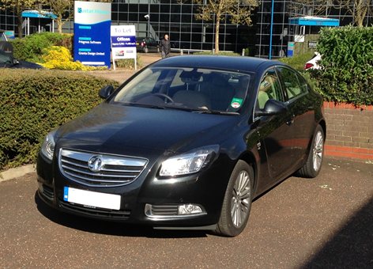
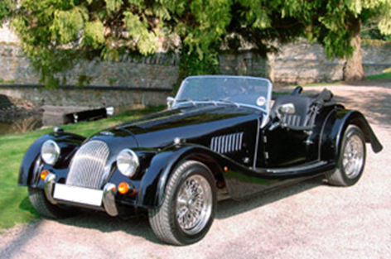
Materials in Industrial Design:
Why do consumers buy products?
Mike Ashby
Department of Engineering,
University of Cambridge

Slide 2
Learning objectives for this lecture unit
Intended Learning Outcomes
Knowledge and Understanding | Understanding of Industrial Design attributes
Skills and Abilities | Ability to analyze product character
Values and Attitudes | Reflection on product value, character and personality
Resources
Text: “Materials and Design, the Art and Science of Materials Selection in Product Design”, 2nd edition, by Mike Ashby and Kara Johnson, Butterworth Heinemann, Oxford UK, 2010.
Text: “Materials Selection in Mechanical Design”, 4th Edition by M.F. Ashby Butterworth Heinemann, Oxford, 2011, Chapter 16.
Poster: Industrial Design
Notes:
Learning Objectives
These Intended Learning Outcomes are based on a taxonomy of knowledge and understanding as the basis, skills and abilities as necessary for the practical use of knowledge and understanding, followed by acquired values and attitudes enabling assessments and responsible use of these abilities.
Combined with a suitable assessment, they should be helpful in the context of accreditations or for the CDIO Syllabus.
The Texts listed are from books authored or co-authored by Mike Ashby but other texts are also referred to in the Science Notes.

Slide 3
Outline
Why is Industrial Design important?
What gives a product its character?
Making charts for sensory properties
Design: creating associations and perceptions
Notes:
Materials in Industrial Design
This Lecture Unit is about materials and how they are used in Industrial Design. By the end of the lecture you will have learnt about why Industrial Design in important, what is it what gives a product its character, how to make charts of sensory properties, and how to create associations and perceptions in design.

Slide 4
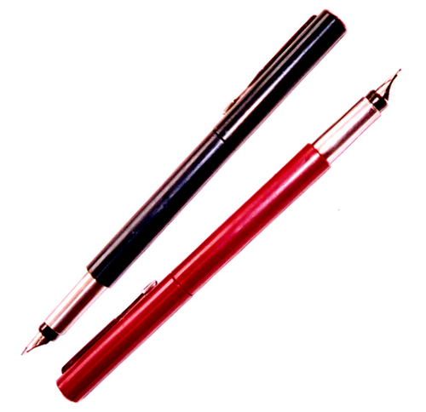
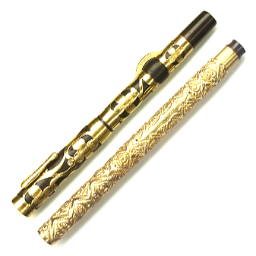
Product value
A product has a cost C the true cost of manufacture, marketing etc.
price P the price at which it is offered to the consumer
value V what the consumer thinks it is worth
Product success requires that
C < P < V
Do they write 375 times better ?
My Parker pens,
8 euros each
Parker special edition 3000 euros
What determines cost ? Technical design, materials, processes, labour
price ? Cost plus margin
value ? Both technical and industrial design;
-- aesthetics, associations, perceptions
Notes:
Product value
This Unit concerns Industrial Design – the aspect of design that relates to the visual, tactile, and aesthetic qualities of a product. Successful products use materials not only to fulfil a function, but also to provide satisfaction. The pens on the left cost 8 Euros each. Those on the right cost about 3000 Euros. Do they write 375 times better? Unlikely – those on the left write perfectly well. Yet there is a market for the expensive pens. Why? It is a question of aesthetics, associations and perceptions, words that are explained in a moment. Our interest is in exploring how materials are used to provide these. We start by examining the ingredients of product design, shown on the next slide.

Slide 5
Why does Industrial Design (ID) matter ?
Product maturity and market saturation
In a crowded market ID allows differentiation
and consumer-group targeting
In a crowded market ID allows differentiation
and consumer-group targeting
Corporate identity
• ID creates corporate image
• ID creates brand loyalty
• ID creates corporate image
• ID creates brand loyalty
The environment, in the broadest sense
• ID contributes to quality of life
• ID contributes to quality of life
Notes:
Importance of Industrial Design
Products are part of our environment. Products that give pleasure, explicit or sub-conscious, enhance our environment.
The room you are currently in has a certain feel to it. This is a combined effort of color, texture, lay-out, and lighting. All of which combine to give an overall impression of a place or space.

Slide 6
Product design
Three facets
Aesthetics
Industrial
design
Satis-
faction
Product must be
life-enhancing
Associations
Unfamiliar territory
Perceptions
Product
design
Usability
Product must be easy
understand and use
Technical
design
Familiar engineering
concepts
Functionality
Product must work, be safe, economical
Notes:
Product design
What are the ingredients of a successful product? First, its functionality: the product must work well, be safe and economical. Second, its usability: good functionality is not much use if the consumer for whom the product is intended is unable to make it work. Functionality and usability alone are not enough. To succeed in today’s markets, in which many nearly identical products compete, the product must give satisfaction; be life-enhancing. And here these three words appear again – satisfaction has to do with aesthetics, associations and perceptions. Product design, then, requires a combination of technical and industrial design.
The lower part of the pyramid tends to be called “Technical design”, the upper part, “Industrial design” suggesting that they are separate activities. It is better to think of think of all three tiers as part of a single process that we shall call “Product design”.

Slide 7
What gives a product its character?
Who, what
Context
where, when
why
Product
design
Notes:
Building product character (1) : Context
So let us examine what gives a product its character. The product – central circle in this diagram – performs a function for which a market need exists. The first step is to characterize this market, seeking answers to five questions that establish the context:
Who?
What?
Where?
Why?
When?
The next frame elaborates.

Slide 8
Establishing the context
Men / Women
Children / Elderly
Sportsmen / Disabled ...
Who?
What ?
Where ?
When ?
Why?
Functionality?
Context
Home / Office
Europe / Africa...
These set the MOOD
Day / Night
Occasionally / All the time...
To fill a basic need
To meet an aspiration ...
Notes:
Establishing context
So, let us examine what gives a product its character. The product – central circle in this diagram – performs a function for which a market need exists. The first step is to characterise this market, seeking answers to five questions that establish the context:
Who? Who are the target consumers – men, women, children, the elderly, those with disabilities?
What? What functionality will the product require?
Where? Will the product be used in the home, the office, indoors, outside…..?
When? When will the product be used: continuously or only occasionally? During the day or at night?
Why? Does the product fill a basic need, is it a life-style statement, is it bought to enhance self-image….?
The answers to these questions do not “design” the product, but they define the context, and inform or influence all the decisions that follow: they set the mood.

Slide 9
What gives a product its character?
Product
“character”
Who, what
Context
where, when
why
Aesthetics
Associations
Personality
Perceptions
Metals,
ceramics
Materials
polymers,
composites
Product
design
Shaping
joining
Processes
surface
treatment
Biometrics
Usability
Bio-mechanics
Product “physiology”
Product “psychology”
Notes:
Building product character (2) : Product physiology and psychology
Back to product character. Products are made of materials, shaped by processes, shown on the left. They provide the flesh and bones, so to speak; they create what you might call the physiology of the product. Usability, as we have said, is important. It is a question of matching the product to the physical and mental capabilities of the user. And finally there is personality – the visual and tactile qualities of the product, its associations and they way it is perceived. They create what you might call the psychology of the product. The whole combination create the product character.

Slide 10
Technical and industrial design
Satis-
faction
Usability
Functionality
Product must work,
be safe and economical
Sound technical design
Proper choice of materials
Proper choice of manufacturing process
Plenty of tools to do this
Notes:
Functionality
What determines product value? Functionality, provided by sound technical design, clearly plays a role. The requirements pyramid shown here has this as its base: the product must work properly, be safe and economical.

Slide 11
Usability (“ergonomics”)
Satis-
faction
Product must be easy
to understand and use
Usability
Functionality
Three aspects
Interaction with the human body - biometrics
Interaction with the mind - intelligibility
Interaction with the human environment
Current topics
Notes:
Usability
Functionality alone is not enough: the product must be easy to understand and operate, and these are questions of usability, the second tier of the figure. This has three aspects, listed here.

Slide 12



Usability (“ergonomics”)
Scale, movement,
posture, work height
Force (<230 N, lifting),
Energy (<230 watts)
Attention span
Bio-metric
Bio-mechanical
Physical
matching
Text,
Symbols
Embossed keys, knobs
Audible signals
Visual signals
Operation
Feedback
Usability
Information
transfer
Noise
Vibration
Illumination
Climate
Toxicity
30DB < noise level < 80DB
Acceleration < 0.2 m/s²
Light 200 - 3000 lumens
Temp, humidity within limits
No toxicity
Environmental
disturbance
Notes:
Usability
Aspects of usability are classified here following the broad families listed on the previous frame.

Slide 13
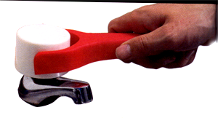
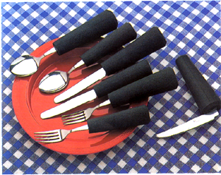
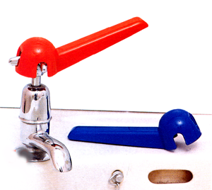
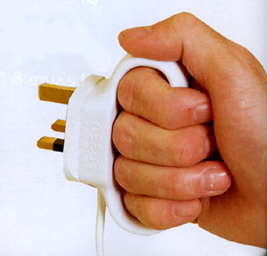
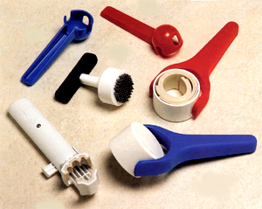
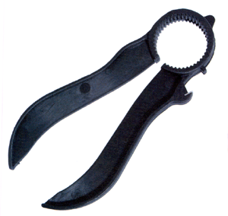
Examples of bio-mechanical matching
Notes:
Examples
Examples of design to provide usability to compensate for impaired hand and wrist actions.

Slide 14
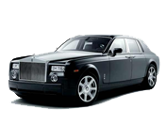
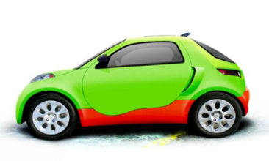

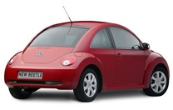

Product personality
Colour, transparency
Form
Feel, texture
Taste, smell
Sound
Aesthetics
The reaction of the 5 senses
Wealth (Rolls Royce)
Military hardware (Land Rover)
Aerospace (many US cars)
Plants/animals (VW Beetle)
Children’s toys (Smart)
Product personality
Associations
What does it remind you of ?
Playful -- Silly
Responsible -- Irresponsible
Feminine – Masculine
Rugged -- Threatening
And - if you owned it ...
Proud -- Disappointed
Life-enhancing -- Life diminishing
Really cool – Absolute rubbish
Perceptions
How does it make you feel ?
Notes:
Product personality
We are interested here in product personality and the ways in which materials contribute to it. It is a question of aesthetics, associations and perceptions.
Anaesthetics dull the five senses. Aesthetics stimulate them. I will use the word here to mean just that: the reaction of the five senses. Thus, aesthetics refers to colour, form, feel, texture, sound, smell and taste.
Associations: what does the product suggest or remind you of? Wealth? A Rolls Royce is designed to do just that. Military hardware? SUVs like Land Rover exploit the form and colour of military vehicles to suggest ruggedness. Aerospace? American cars of the 1970s derived their styling from aircraft and rockets. Assigning associations is not controversial – most people would agree with those interpretations.
Perceptions are another matter. What are your feelings about the product? Does it strike you as feminine or masculine – and do you like it if it does? Is it desirably rugged or undesirably threatening? Attractively playful or just silly? Here different users perceive products differently; the skilful designer creates associations and perceptions that appeal to the user group for which the product is intended.

Slide 15
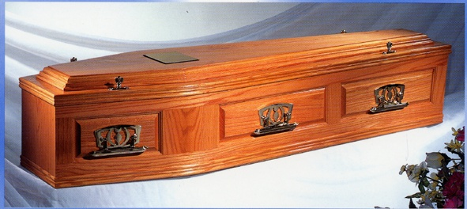
Material personalities
NO intrinsic personality?
- materials acquire one through the way they are used?
Wood in fine furniture – craftsmanship
in railway sleepers – cheap utility
Gold in jewelry – luxury, wealth
in micro-circuits – technical efficiency
Glass in a camera lens – precision engineering
in beer bottle – disposable packaging
Made of polished walnut ?
Or made of polystyrene foam – recycled yoghurt pots ?
Notes:
Material Personalities
Materials contribute to product personality, but can the material itself be said to have a personality? At first sight – no. A material is like an actor – it can take on many characters; it really depends on how it is used. The overhead lists three examples in which a material, when used in different ways, carries different associations and perceptions.
But wait. The image in the lower part of this frame show a product with a solemn and – one hopes – dignified function. Polished hardwood, bronze fittings seem appropriate to the occasion on which it is to be used. But if I told you that this one was made of plastic – of expanded polystyrene – would you feel the same about it? The character would change to something which feels cheap and less respected.
So materials do, it seems, have a personality – a shy one, to be coaxed out by the designer. The next overhead gives some examples.

Slide 16
Material moods
Wood,
leather
Aesthetics: tactile, warm, textured, it ages well
Associations of fine furniture, musical instruments
Perceptions of craftsmanship, tradition, heritage, quality
Metals
Aesthetics: cold, clean, hard, stiff, strong, often ages well
Associations of machinery, precision instruments, weapons
Perceptions of strength, precision, durability, quality
Ceramics
and glass
Aesthetics: hard, abrasion resistant, permanence of color, fragility
Associations of culture, luxury, sophistication
Perceptions of refinement, quality
Polymers
“Cheap plastic imitation”
Aesthetics: colorful, warm, soft, smooth, flexible, do not age gracefully
Associations of mass production, substitutes for metals, glass, wood
Perceptions: deceptive, cheap, imitation ….but adaptable.
Notes:
Material Moods
The overhead gives examples of aesthetics, associations and perceptions of material classes. The perceptions are, as explained earlier, a matter of background, culture and taste – one possible set is listed here. With that background we shall examine some products to see how materials have been used.

Slide 17
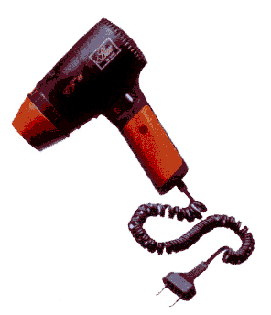
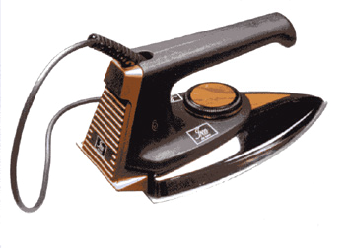
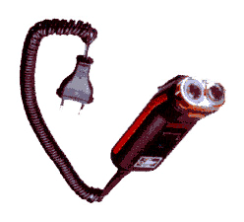
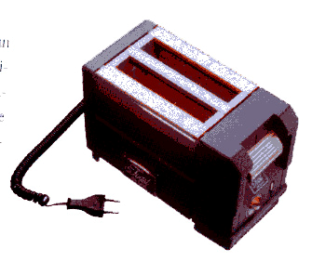
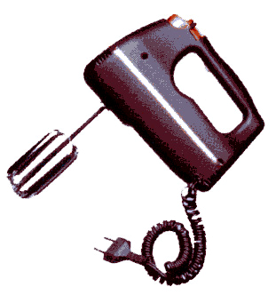
Five products: redesign them for a new market
The KOODI CODE, U. of Arts and Design, Helsinki
Hairdryer
Iron
Shaver
Toaster
Mixer
Notes:
Perceptions (2)
This and the next two frames illustrate, in an extreme way, how products can be redesigned to create different associations and perceptions. Here are 5 familiar products, all designed in a conventional way. (Source: The KOODI CODE, U. of Arts and Design, Helsinki, Finland).

Slide 18
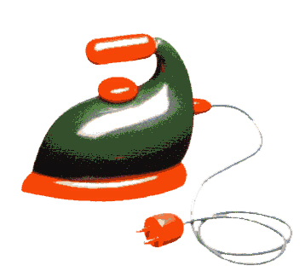
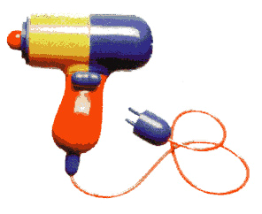
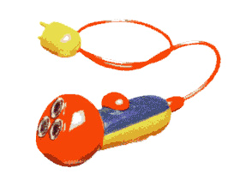
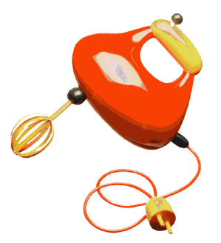
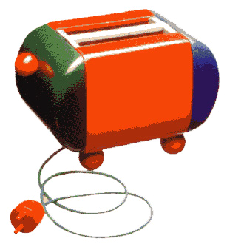
Redesign 1: Cuddlesome
TURBO-PUFF dryer
HISS iron
LOLLIPOP shaver
PIGGY toaster
JELLIMIX mixer
The KOODI CODE, U. of Arts and Design, Helsinki
Notes:
Perceptions (2)
Here the same products are redesigned to appeal to a different consumer group – one seeking friendly, light-hearted associations. (Source: The KOODI CODE, U. of Arts and Design, Helsinki, Finland).

Slide 19
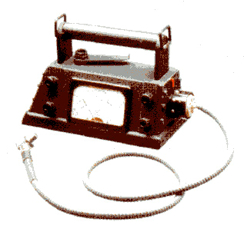
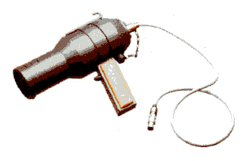
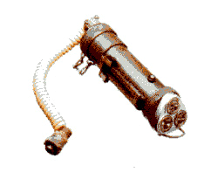
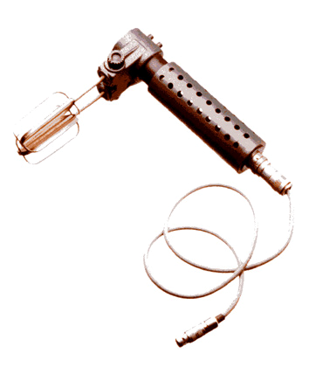
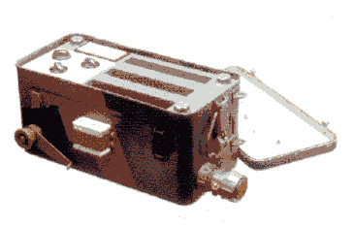
Redesign 2: Ruggedized
M/95 heavy duty hairdryer
STEALTH shaver
BOLT ACTION iron
JUNKERS FRONT LINE toaster
KALASHNIKOV mixer
The KOODI CODE, U. of Arts and Design, Helsinki
Notes:
Perceptions (3)
Here are the same products again, redesigned to suggest robust, military-strength, no-nonsense functionality. (Source: The KOODI CODE, U. of Arts and Design, Helsinki, Finland).

Slide 20
Creating associations and perceptions
Context
The office
Continuous
use…..
Context
Children
Bedroom
Intermittent
use ….
Materials
Pressed
steel
Powder
coated
Materials
injection
molded acrylic
Desk lamp.
Lamp, same spec.
Aesthetics: colour cream, angular metallic shape, smooth texture, heavy.
Aesthetics: Pastel colours, smooth curves, translucent, light
Associations: Colour and form like that of computer consoles and keyboards.
Associations: Form derived from nature, cartoons, comic strips.
Perceptions: Subdued, modern, efficient; rugged, fit for purpose
Perceptions: Funny, playful, cheerful, clever.
but also: dull, impersonal, suggesting
the work-place
but also: eccentric, frivolous, a bit silly
Notes:
Case studies (1)
Here is an example of designs to create associations and perceptions.
The lamp on the left is designed for the office (the where?), will be used by executives (who?), and probably remain on all day (when?). Aesthetics, associations and perceptions are listed. To achieve these, the designer has used pressed steel, powder coated – the same materials that computer cases are made from.
The lamp on the right has the same technical specification as that on the left, but in every other way it is different. It is intended for a child’s bedroom (when folded it acts as a night-light), and for intermittent use only. This context has led the designer to develop a different set of aesthetics (curved form, pastel colours), associations (nature, cartoon characters... ) and perceptions (funny, playful… ). To do this he or she has chosen translucent, injection moulded, acrylic as the principal material.

Slide 21
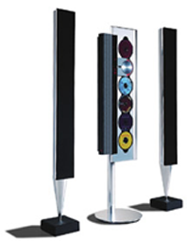
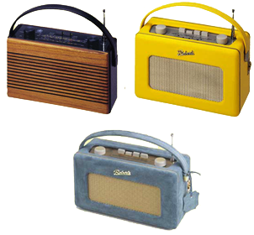
Materials create associations and perceptions
Bang & Olufsen
Roberts
Context
Contemporary
drawing-room,
Board room
Context Older people,
bedrooms
Materials:
Brushed
aluminum,
Black enamel
Materials:
Wood,
leather,
suede
Aesthetics: use of primitives; brushed metal, black/matt finishes
Aesthetics: soft shape and material, muted colour.
Associations: Organ pipes, the Arts, Music and Culture
Associations: Handcrafted furniture and fittings, unashamedly retro.
Perceptions: High tech, advanced, sophisticated. Symbol of discerning taste. “Only the best is good enough”.
Perceptions: Old style craftsmanship, durable
reassuring, non-technical design
but also: Design with a capital D; overstated
but also: mumsy – like a hand-bag
Notes:
Case studies (2)
A second pair of products – this time electronic – are shown here. Those on the left aim at the perception of high tech, sophisticated Design (with a capital D). The organ-pipe shape suggests music, hence culture, sophistication. It is achieved through the use of brushed aluminium, black enamel and black nylon webbing.
The radios on the right have a styling that is now 45 years old. The aesthetics (soft shapes and materials, muted colours), the associations (hand-crafted, upholstered furniture, leather handbags), and the perceptions (durable, comfortable, straightforward design) are achieved through the use of leather, suede and wood.

Slide 22
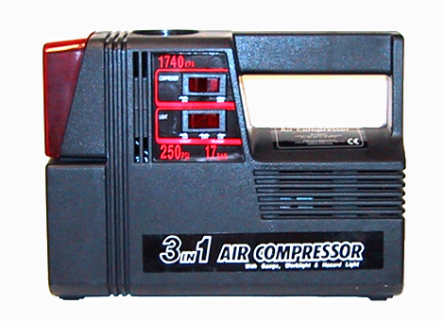
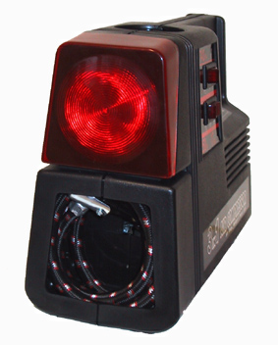
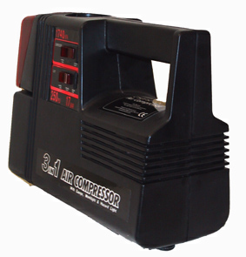
Case study: cheap compressor
What aesthetics?
What associations?
What perceptions?
What is the designer saying?
Notes:
Case studies (3)
Here is a third example: it is a small (and very cheap) 12 volt compressor designed as an emergency tool for motorists. What associations and perceptions are the designer trying to create? What, in a word, is he trying to say? The next two frames analyse the sources.

Slide 23
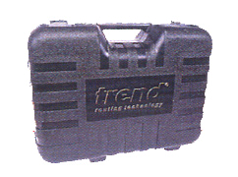
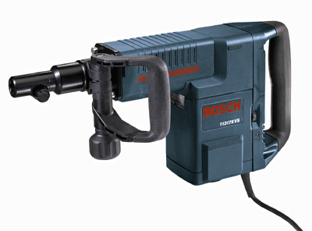
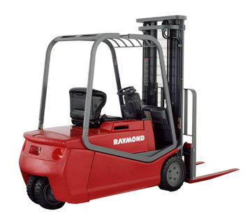
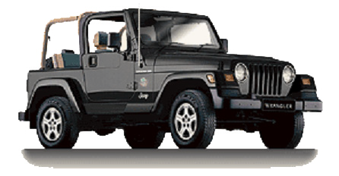
Robust “industrial strength” mood
Angular, straight-edged forms
Repeated horizontal
Upward-converging diagonals
Subdued color
Use of texture to create contrasts
Minimal decoration
Notes:
Visual associations: “Industrial-strength” gear
Here are four products that epitomize “industrial strength” design:
The carrying-case of a power tool
A professional hammer drill
A fork-lift truck
A robust off-road vehicle
They have certain features in common:
Angular, straight-edged forms
Repeated horizontal
Upward-converging diagonals
Subdued color
Use of texture to create contrasts
Minimal decoration
Now let us return to the compressor (next frame)

Slide 24
The low-cost air compressor
Angular, straight-edged forms
Repeated horizontal
Upward-converging diagonals
Subdued color
Use of texture to create contrasts
Minimal decoration
Notes:
Visual associations: the little pump
The compressor uses exactly the design features listed on the previous frame. The associations are those of power tools and commercial or military vehicles, the perceptions are those of robustness and fitness for purpose. The message is: this is not a toy, it is a serious bit of kit.

Slide 25
Summary
(1) See product as a whole
Satis-
faction
(2) Think of it in more than one way
What does the product do?
Who will use it? Where? When? Why?
What are their aspirations, self-image…?
Usability
Functionality
(3) The element of satisfaction is central to contemporary product design
Notes:
What to take away from this unit (1)
What messages can be drawn from all this? The first is a way to think about product design:
Context: who is it designed for, and why?
Product character: is it functional? Is it usable? Does is give satisfaction – at least to the consumers at which it is aimed?

Slide 26
Summary
Train yourself - look at products and ask:
What aesthetics? Why?
What associations? How did the designer do it? Why?
What perceptions? What made you feel that way?
How (intentionally or unintentionally) did the designer do it?
And finally: what was the designer trying to say?
Notes:
What to take away from this unit (2)
What are the further messages? It is rewarding to train yourself to analyse products – particularly those that appeal to you.
Aesthetics: what materials, colors, forms has the designer used, and why?
Associations: what does the product suggest? What do you think of when you look at it or pick it up?
Perceptions: what is your reaction to the product? If you like or dislike it, why?
And finally: what is the designer trying to say?

Slide 27
Ansys Education Resources Feedback Survey
Here at Ansys, we rely on your feedback to ensure the educational content we create is up-to-date and fits your teaching needs.
Please click the link below to fill out a short survey (~7 minutes) to help us continue to support academics around the world utilizing Ansys tools in the classroom.
Feedback Survey Link
Notes:
Feedback Survey link for copy-paste method → https://ansys.typeform.com/to/jcattJI5

