Slide 1
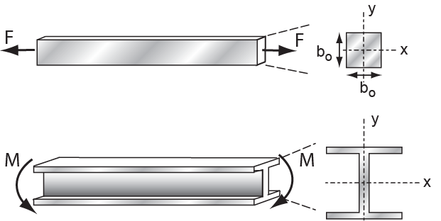
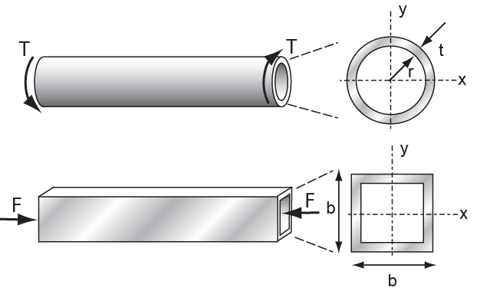
Material and shape
Materials for efficient structures
Mike Ashby
Department of Engineering,
University of Cambridge

Slide 2
Learning objectives for this lecture unit
Ansys software mentioned | Ansys Granta EduPack™­, a teaching software for materials education
Intended Learning Outcomes
Knowledge and Understanding | Understanding of the concept of shape efficiency Understanding of how to explore and optimize mechanical design structures
Skills and Abilities | Ability to select efficient material-shape combinations Ability to select structural sections for prescribed design requirements
Values and Attitudes | Awareness of how materials and shape interact Appreciation of how shape and material properties interact
Resources
Text: “Materials Selection in Mechanical Design”, 5th edition by M.F. Ashby, Butterworth Heinemann, Oxford, 2016, Chapters 10-11
Software: The Ansys Granta EduPack software Structural sections data-table and the Built Environment Level 2 database
Notes:
Learning Objectives
These Intended Learning Outcomes are based on a taxonomy of knowledge and understanding as the basis, skills and abilities as necessary for the practical use of knowledge and understanding, followed by acquired values and attitudes enabling assessments and responsible use of these abilities.
Combined with a suitable assessment, they should be helpful in the context of accreditations or for the CDIO Syllabus.
The Texts listed are from books authored or co-authored by Mike Ashby but other texts are also referred to in the Science Notes.

Slide 3
Outline
Efficient shapes: tubes, I-beams etc
The shape factor and shape limits
Material indices that include shape
Graphical ways of dealing with shape
The Ansys Granta EduPack software Structural Sections data-table

Slide 4
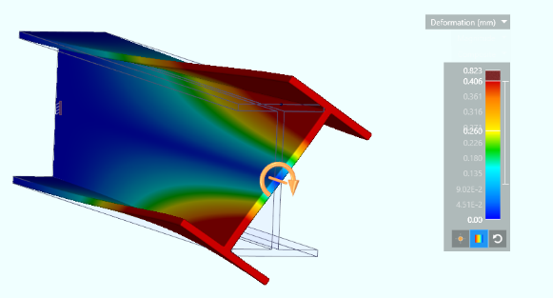
Shape efficiency
When materials are loaded in bending, in torsion, or are used as slender columns, section shape becomes important
”Shape” = cross section formed to a
tubes
I-sections tubes hollow box-section sandwich panels ribbed panels
“Efficient” = use least material for given stiffness or strength
Shapes to which a material can be formed are limited by the material itself
Goals: understand the limits to shape develop methods for co-selecting material and shape
Notes:
Shape efficiency
In many applications section shape is not a variable. But when components carry bending, torsion or compressive loads, both the area and shape of the cross-section are important. By shape we mean that the cross-section is formed to a tube, I-section or the like. Efficient shapes use the least material to achieve a given stiffness or strength. It might seem that the way forward is to first choose the shape, then form the material into that shape. But some materials are routinely made into efficient shapes while are some or not, either because of manufacturing difficulties or because they buckle too easily (more on that later). So material and shape are coupled, requiring a method of choosing them together.

Slide 5
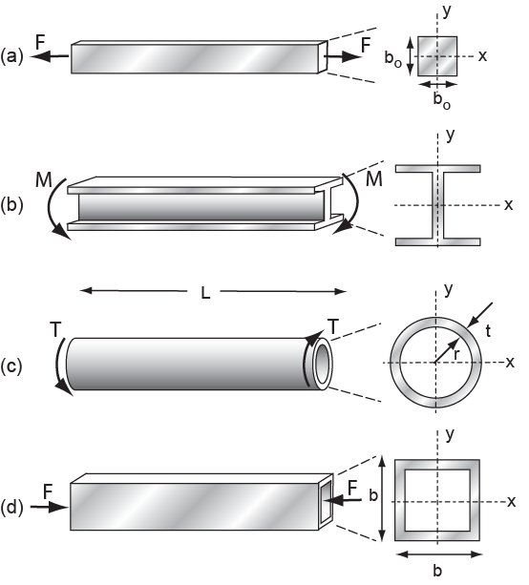
Shape and mode of loading
Standard structural members
Area A matters,
not shape
Tie
Beam
Torsion bar
Column
Area A and shape I_{XX}, I_{YY} matter
Area A and shape J matter
Area A and shape I_{min} matter
Certain materials can be made to certain shapes: what is the best combination?
Notes:
Loading
The choice of section shape is linked to the mode of loading. I-sections resist bending but are poor in torsion. Tubes resist torsion well. Tubes and box sections are good as columns, though I-sections are often used because their entire surface can be reached for painting and inspection, whereas the inner surface of tubes and boxes cannot.

Slide 6
Shape efficiency: bending stiffness
Take ratio of bending stiffness S of shaped section to that (S_{o}) of a neutral reference section of the same cross-section area
Define a standard reference section: a solid square with area A = b²
Second moment of area is I; stiffness scales as EI.
Area A is
constant
Area A and modulus E unchanged
Area A = b²
b
b
Define shape factor for elastic bending, measuring efficiency, as
Notes:
Bending
The obvious way to measure shape efficiency is to compare the behavior of a shaped section with that of a standard section with the same area – and thus the same mass of material per unit length. We take the standard section to be a solid square. If the square section is reshaped into a tube or I-section, the cross-section area stays the same but the bending stiffness increases. Bending stiffness is proportional to EI where E is Young’s modulus and I is the second moment of area of the cross section. The standard and the shaped beam are the same material, so E does not change. The second moment I increases from
I₀ = A²/12
to I, so the bending stiffness increases by the factor
φ_{e} = I/I₀ = 12 I/A²
The quantity φ_{e} measures the efficiency of the shape when stiffness is the goal. It is called the elastic shape factor.

Slide 7
Properties of the shape factor
The shape factor is dimensionless – a pure number.
It characterizes shape.
I-sections,
Circular tubes,
Increasing size at constant shape
Each of these is roughly 10 times stiffer in bending than a solid square section of the same cross-sectional area
Notes:
Shape factor
Area A has dimensions (m²) but shape φ_{e} , does not – it is a pure number. The frame shows I-sections and tubes with φ_{e} = 10, meaning that they are 10 times stiffer in bending than a solid square section of the same area. The three I-sections differ in size, but all have the same shape factor – each is a magnified version of the one on its left. The same is true of the tubes.

Slide 8
Shape efficiency: bending strength
Take ratio of bending strength F_{f} of shaped section to that (F_{f,o}) of a neutral reference section of the same cross-section area
Section modulus of area is Z; strength scales as
Area A is
constant
Area A = b²
Area A and yield strength
unchanged
b
b
Define shape factor for onset of plasticity (failure), measuring efficiency, as
Notes:
Bending
A parallel argument leads to the definition of the shape factor for the onset of yield or failure in bending. Here the act of shaping increases the section modulus Z. The efficiency is the ratio of this to the value
Z₀ = A^{2/3}/6
for the solid square section, giving the shape factor
φ_{f} = Z/Z₀ = 6Z/A^{3/2}
The quantity φ_{f} , the plastic shape factor, measures the efficiency of the shape when strength is the goal. Shapes with high φ_{e} have high φ_{f} as well. Similar shape factors characterize stiffness and strength in torsion.

Slide 9
Tabulation of shape factors
Notes:
Shape factors
The quantities I, Z and A can all be calculated from the dimensions of the section, allowing e φ to be calculated when these are known. This frame shows a small part of a larger table listing these (See “Materials Selection in Mechanical Design”). Note that the square section has a shape factor of 1; that for a solid circular section is very close to 1 (3/π = 0.95). That for thin wall tubes, box and I-sections is much larger.

Slide 10
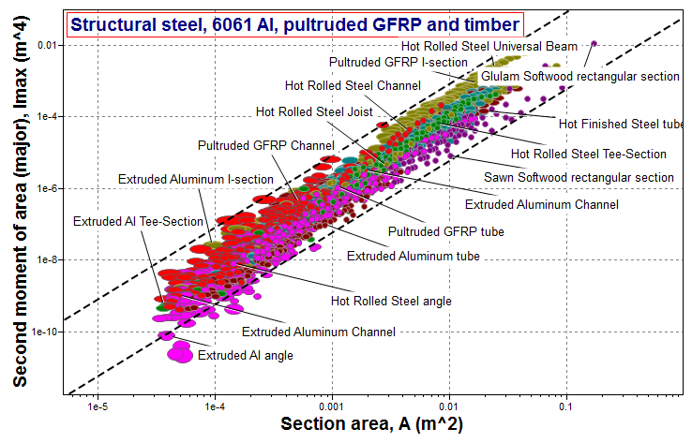
What values of ϕ_{e} exist in reality?
Notes:
Values of shape factors
Steel, aluminum, GFRP and timber are marketed as standard sections. There are a very large number of these. The figure on this frame shows I and A for about 1900 of them. Remember that the elastic shape factor is
φ_{e} = I/I₀ = 12 I/A²
from which
I = φ_{e} A²/12
The scales are logarithmic, allowing φ_{e} to be shown as lines of slope 2. Two of these are shown, one for φ_{e} =1 and one for φ_{e} =100. Timber is available as square section beams (φ_{e} =1 ), but almost all other sections are more efficient than this. Few have an efficiency greater than about 65 – and none exceed 100 – it represents an upper limit for shape efficiency. A similar plot for Z and A allow the upper limiting values of φ_{f} to be explored. The picture is more complex than this. The only sections with φ_{e} > 45 are structural steel. The other materials have lower maximum shape factors. Each material has a different limit.

Slide 11
Limits for shape factors ϕ_{e} and ϕ_{f}
There is an upper limit to shape factor for each material
Material Max ϕ_{e} Max ϕ_{f}
Steels 65 13
Aluminum alloys 44 10
GFRP and CFRP 39 9
Unreinforced polymers 12 5
Woods 8 3
Elastomers <6 -
Other materials ...can calculate
Limit set by: (a) manufacturing constraints
(b) local buckling
Modulus
Theoretical limit:
Yield strength
Notes:
Limits of shape factors
The table lists empirical upper limits for shape factors for a number of materials. The limit is sometimes set by manufacturing constraints. But if these are overcome there is a practical upper limit related to the tendency of the section to buckle. Buckling is an unpredictable mode of failure, influenced by small geometric imperfections, and it can be catastrophic.
Yielding is benign – it gives warning. The more slender the structure the more easily it buckles. So the upper limit on slenderness and thus on φ_{e} , is set by the requirement that the structure yields before it buckles catastrophically, giving the equation shown on this frame.

Slide 12
Indices that include shape
F
Function
Area A
Beam (shaped section).
Constraint
Bending stiffness = S:
L
I is the second moment of area:
m = mass
A = area
L = length
ρ = density
b = edge length
S = stiffness
I = second moment of area
E = Youngs Modulus
Objective
Minimise mass, m, where:
Chose materials with smallest
Notes:
Derivation
The derivation here parallels that for a light stiff being given in Lecture Unit 7. The only difference is that, for the square beam of Lecture Unit 7
I_{o} = A²/12
whereas for the shape beam
I = φ_{e} A²/12.
The resulting equation for the metric m shows how the mass of the beam depends on the mechanical constraint it must meet (S) on the section shape (φ_{e} ) and on the material of which it is made (ρ/E^{1/2}). The quantity ρ /(φ_{e} E)^{1/2} can be thought as a “shaped-material index”.

Slide 13
Selecting material-shape combinations
Materials for stiff, shaped beams of minimum weight
Fixed shape (ϕ_{e} fixed): choose materials with low
Shape ϕ_{e} a variable: choose materials with low
Material ρ, Mg/m³ E, GPa ϕ_{e,max}
1020 Steel 7.85 205 65 0.55 0.068
6061 T4 Al 2.70 70 44 0.32 0.049
GFRP 1.75 28 39 0.35 0.053
Wood (oak) 0.9 13 8 0.25 0.088
Commentary: Fixed shape (up to ϕ_{e} = 8): wood is best
Maximum shape (ϕ_{e} = ϕ_{e,max}): Al-alloy is best
Steel recovers some performance through high ϕ_{e,max}
Notes:
Selection
The table shows an example of the comparison of materials for light stiff beams. When materials are compared with the same shape, it is sufficient to rank them by their value of ρ/E^{1/2}. But when their shapes differ, they must be ranked by ρ/(φ_{e} E)^{1/2}. The table shows that when these four materials are compared at constant shape (which must be less than φ_{e} =8 because timber is not available in more efficient shapes than this) then timber is the lightest. But if each material is shaped to its maximum value of φ_{e} , the lightest beam is that made of aluminum alloy; GFRP is close behind; and the steel beam is slightly lighter than the wooden one.

Slide 14
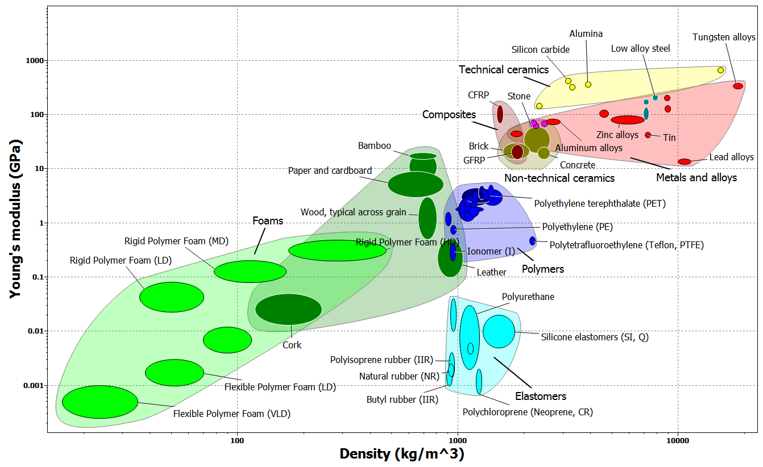
Shape on selection charts
Note that New material with
Al: ϕ_{e} = 1
Al: ϕ_{e} = 44
Notes:
Charts
The same comparison can be performed graphically – and this gives an interesting insight into the structural efficiency of wood. The shaped-material index can be re-expressed in terms of ρ* = ρ/φ_{e} and E* = E/ φ_{e}
The shape of the material can be thought of as a new material with “properties” ρ* and E* allowing it to be plotted on the E-ρ chart as shown here. The construction is shown here for aluminum, first as a solid square section when it lies at the values of ρ and E of aluminum, and second at the point (E/ φ_{e,} ρ/φ_{e} ).
A selection line for the index E^{1/2}/ ρ is shown. Shaping has carried the aluminum across the line, into a region not occupied by an unshaped materials.

Slide 15
Data organization: structural sections
Standard
prismatic sections
Universe
Family
Material and Member
Attributes
Steel Hot Rolled Joist
General properties: ρ, E, σ_{y}
Dimensions: Max depth, width,...
Section: Area, I, Z, K, Q ...
Structural: EI, σ_{y} Z, ...
Angle
Channel
I-section
Rectangular
T-section
Tube
Aluminium
Glass Vinyl Ester
Steel
Structural sections
Hot Rolled Steel
A record
Notes:
Structural sections
Standard sections are widely available in structural steel, extruded aluminum alloy, pultruded GFRP and wood. They have the shape shown here – rectangular, box, cylinder, tube, I-sections, U-sections and angles. A good way to get a feel for how shape efficiency is used in practice is to examine these. The Ansys Granta EduPack software structural sections data-table contains 1881 records covering the full range of standard sections. The data organization is shown here. The first level – the families – refers to shape. The choice of shape, it will be remembered, is dependent on the way the section will be loaded: I, L an U-sections are good in bending but poor in torsion; closed circular and box sections carry both torsion and bending well. The second level of the tree is the material – here we list the three for which standard sections are widely available. Each of these comes in many different sizes, and for each size there is a set of attributes. The records in the database detail these attributes: material properties, dimensions, section properties such as I and Z, and structural properties such as E.I and σ_{y}.Z.

Slide 16
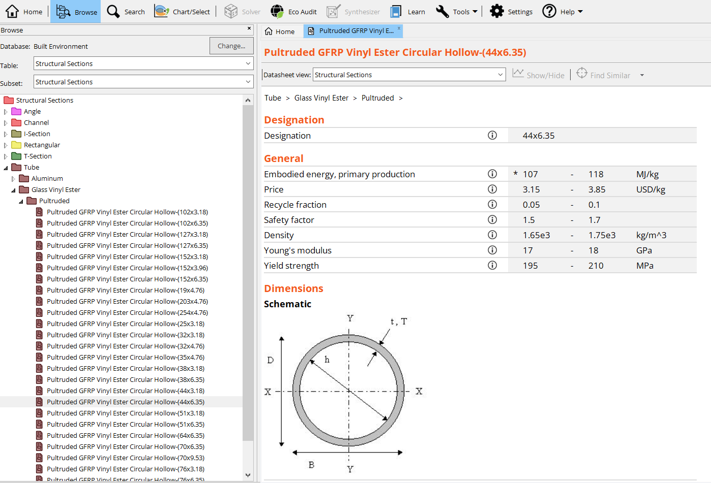
Ansys Granta EduPack software database for the Built Environment
Records for
1881 sections

Slide 17
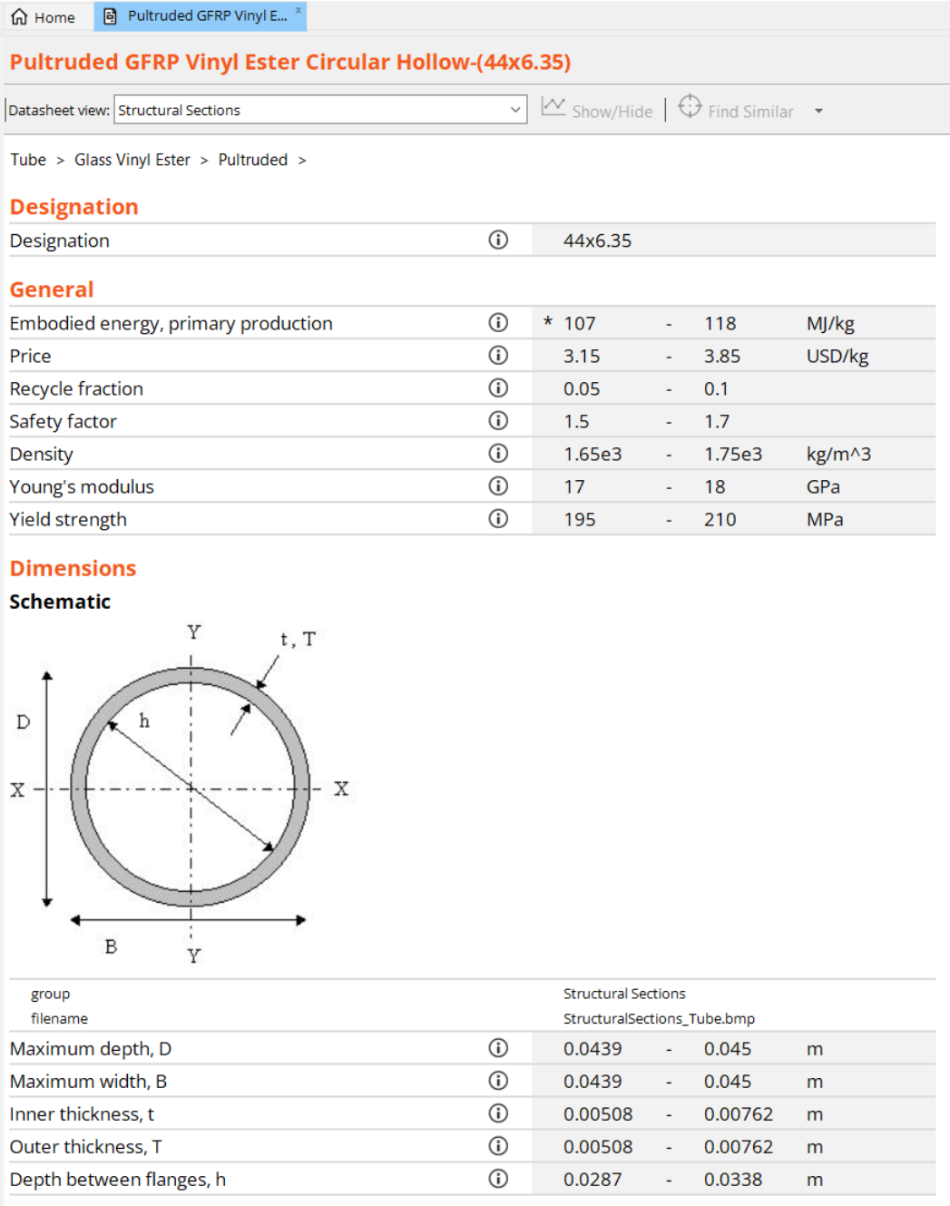
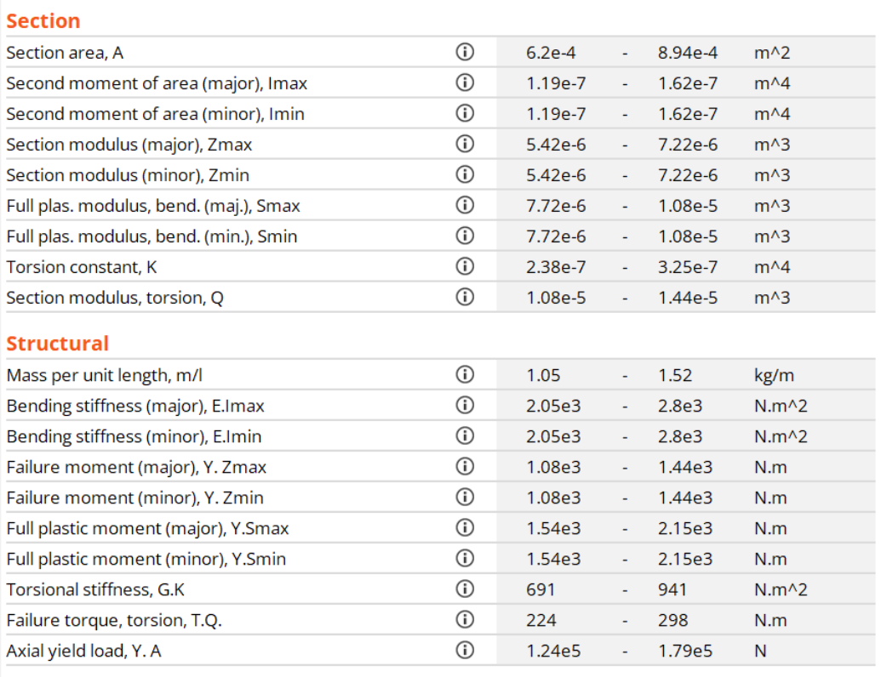
Part of a record for a structural section
Pultruded GFRP Vinyl Ester Circular Hollow-(44 x 6.35)
*A selection of attributes are shown
Notes:
Example
This shows part of a typical record – one for a pultruded GFRP tube. The fields are defined, the units are listed and values are given. The record lists material properties, section dimensions, section properties like I and Z, and structural properties like EI and YZ.

Slide 18
Example: selection of a beam
Specification
F
B
Custom Subset
Structural SubSections
D
Function
Beam
D = beam depth
B = width
I = second moment of area
E = Young’s modulus
Z = section modulus
σ_{y} = yield strength (Y in database)
Constraints
Required stiffness:
E I_{max} > 10⁵ N.m²
Required strength:
σ_{y} Z > 10³ N.m
Dimension
Width B < 150 mm
Depth D < 200 mm
Notes:
Example
The database can be used to find sections that meet a set of constraints, and to select from among these the lightest, the cheapest or the one with the lowest embodied energy. A specification is listed here. There are constraints on minimum bending stiffness E.I and strength σ_{y}.Z (called YZ in the database), and on the maximum dimensions of the depth and the width. The best approach is to apply all the constraints using a limit stage, then, in a graphical stage, apply a selection line that isolates those with the lowest mass per unit length or cost per unit length or embodied energy per unit length.
To access the Structural Subset in the software for graphing, you can use either the Tree Stage function or create a Custom subset within the data selection screen.

Slide 19
Applying constraints with a Limit stage
Dimensions Minimum Maximum
Max depth, D m
Max width, B m
Structural Attributes
Bending stiffness E.I_{max} N.m²
Failure moment Y. Z_{max} N.m
5
15
0.2
0.15
100000
1000
Custom subset of Structural Section
Result : 294 sections out of 1881 meet these constraints
Objectives
(a) Find lightest beam
(b) Find cheapest beam
(c) Find beam with lowest embodied energy
That meets the constraints
Notes:
Constraints
Constraints are most easily applied in a limit stage, illustrated here for the example of the last frame.

Slide 20
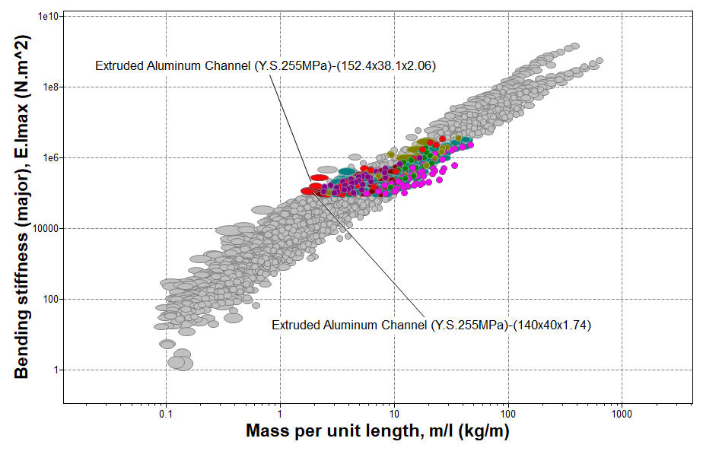
Minimizing mass for given EI_{max}
Bending Stiffness EI vs.
mass per unit length
Results
Extruded Aluminum Channel (140x40x1.74)
Extruded Aluminum Channel (152.4x28.6x1.75)
Extruded Aluminum Channel (130x50x1.82)
Notes:
Minimizing mass
Optimization requires a graphical stage with mass/length, m/l, on one axis. Here is one way to do it. The bending stiffness E.I has been used as the other axis. The limit stage has a minimum set at E.I = 100,000 Nm², which is one of the constraints. The “Results” window, shows the intersection of this stage and that of the preceding limit stage, where a few best candidates can be identified (towards the left on the chart). If the scale of m/l is replaced by one of price/kg x m/l (giving the cost in pounds per unit length), the cheapest beam meeting all the requirements is found. The result is shown on the next frame.

Slide 21
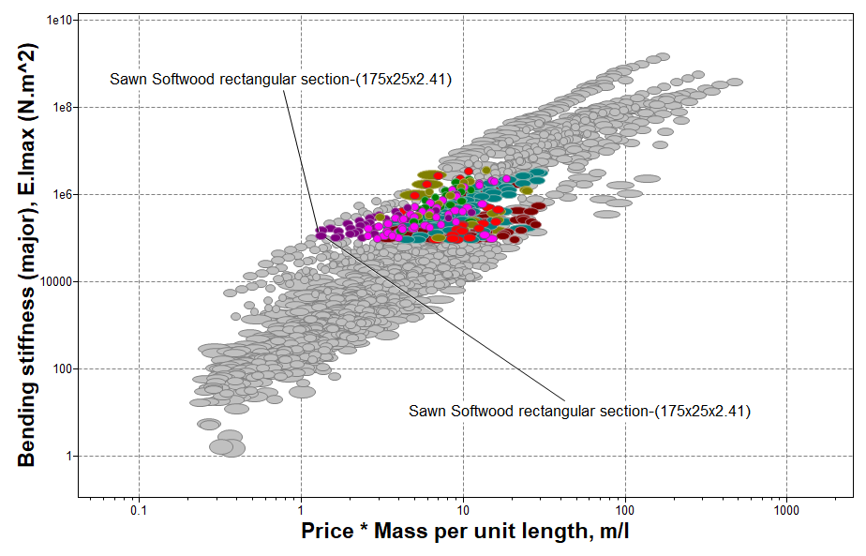
Minimizing cost for given EI_{max}
Bending Stiffness EI vs.
price per unit length
Results
Sawn Softwood section-(175x25x2.41)
Sawn Softwood section-(200x22x2.42)
Sawn Softwood section-(200x25x2.75)
Notes:
Minimizing cost
Here the selection is for the beam with the lowest price that meets all the constraints. The price per unit length is plotted by multiplying the price per unit weight by the mass per unit length, using the Advanced facility in the axis-choice dialog box (it is described in full in Lecture Unit 2).

Slide 22
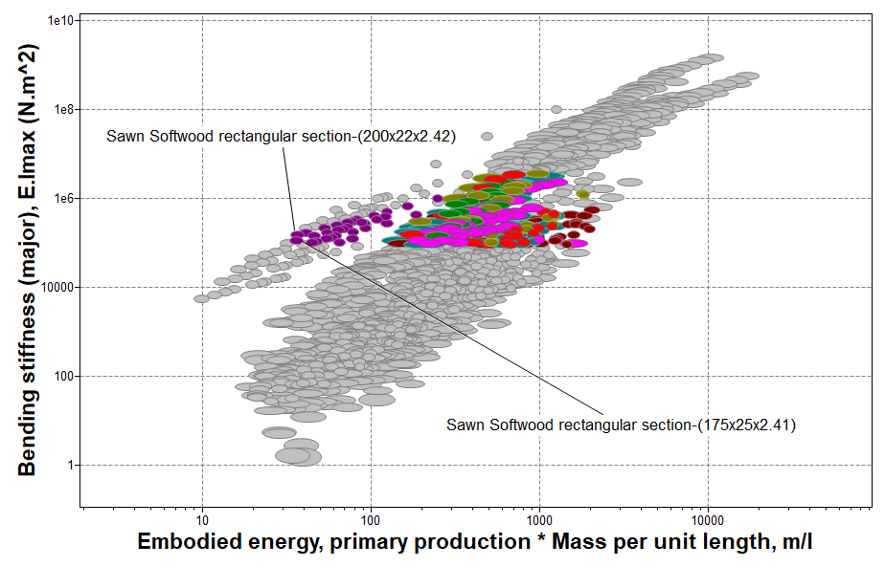
Minimizing embodied energy for given EI_{max}
Bending Stiffness EI vs.
Embodied energy per unit length
Results
Sawn Softwood section-(175x25x2.41)
Sawn Softwood section-(200x22x2.42)
Sawn Softwood section-(200x25x2.75)
Notes:
Minimizing embodied energy
Here the selection is for the beam with lowest embodied energy that meets all the constraints, following a procedure like that in the previous frame. Not surprisingly, solid wood sections are the optimum choice.

Slide 23
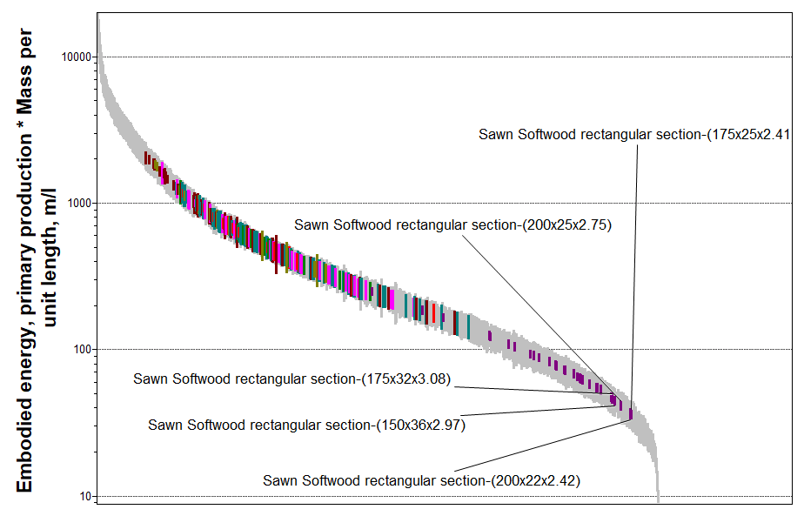
Minimizing embodied energy for given EI_{max}
Results
Sawn Softwood section-(175x25x2.41)
Sawn Softwood section-(200x22x2.42)
Sawn Softwood section-(200x25x2.75)
Sawn Softwood section-(150x36x2.97)
Notes:
There is an alternative way to find the optimize by any one the three objectives. It is to plot the objective as a bar chart, as shown here for embodied energy per unit length. Each colored bar describes a section that meets all of the constraints – those that fail have been hidden using the Hide-failed materials tool. The optimum choice is then the subset that lie lowest on this chart.

Slide 24
Summary
When materials carry bending, torsion or axial compression, the section shape becomes important.
The “shape efficiency” is the amount of material needed to carry the load. It is measured by the shape factor, ϕ.
If two materials have the same shape, the standard indices for bending (e.g. ) guide the choice.
If materials can be made -- or are available -- in different shapes, then indices which include the shape (e.g. ) guide the choice.
The Ansys Granta EduPack software Structural sections data-table and the Built Environment database allows standard sections to be explored and selected to meet multiple constraints
It introduces the idea of choice to optimize weight, price or environmental impact

Slide 25
Ansys Education Resources Feedback Survey
Here at Ansys, we rely on your feedback to ensure the educational content we create is up-to-date and fits your teaching needs.
Please click the link below to fill out a short survey (~7 minutes) to help us continue to support academics around the world utilizing Ansys tools in the classroom.
Feedback Survey Link
Notes:
Feedback Survey link for copy-paste method → https://ansys.typeform.com/to/jcattJI5

