Slide 1
Manufacturing processes and cost modeling
Mike Ashby
Department of Engineering,
University of Cambridge

Slide 2
Learning objectives for this lecture unit
Ansys software mentioned | Ansys Granta EduPack™­, a teaching software for materials education
Intended Learning Outcomes
Knowledge and Understanding | Understanding of the cost model included in Ansys Granta EduPack software
Skills and Abilities | Ability to use a simple cost model to guide manufacturing process choice
Values and Attitudes | Appreciation of how costs influence the choice of material and processes
Resources
Text: “Materials: engineering, science, processing and design” 4th edition by M.F. Ashby, H.R. Shercliff and D. Cebon, Butterworth Heinemann, Oxford, 2019, Chapters 1-2
Text: “Materials Selection in Mechanical Design”, 5th edition by M.F. Ashby, Butterworth Heinemann, Oxford, 2016, Chapters 1-2
Texts: Callister, Budinski, Askeland and others – recommended reading in records
Ansys Granta EduPack software
Notes:
Learning Objectives
These Intended Learning Outcomes are based on a taxonomy of knowledge and understanding as the basis, skills and abilities as necessary for the practical use of knowledge and understanding, followed by acquired values and attitudes enabling assessments and responsible use of these abilities.
Combined with a suitable assessment, they should be helpful in the context of accreditations or for the CDIO Syllabus.
The Texts listed are from books authored or co-authored by Mike Ashby but other texts are also referred to in the Science Notes.

Slide 3
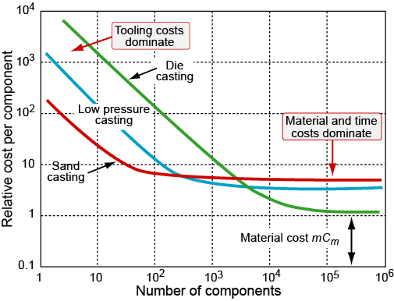
Outline of lecture unit
ProcessUniverse and its organization
Shaping, Joining and Surface treatment
Price, cost and value
Cost information in Ansys Granta EduPack software
Inputs to a cost model for selection
The model and its implementation
Additive manufacturing
Part cost estimator
Notes:
Outline
This is the tenth Unit of a course on Material and Process Selection. The Units link closely to the first three Texts listed the previous frame but can equally by used in conjunction with texts such as Callister, Budinski, Askeland and others. The relevant chapters of the Texts are listed on the Outline frame of each Unit. The methods developed in the course are implemented in the Ansys Granta EduPack software, which is structured to evolve in pace with the student throughout a four-year engineering program. This first Unit introduces materials and processes, and the way in which information about them can be classified, stored, retrieved and explored.

Slide 4
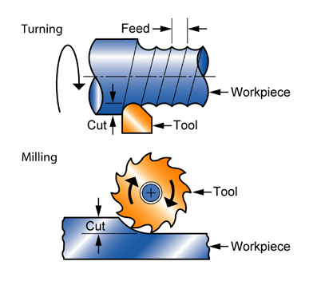
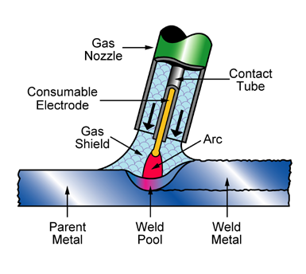
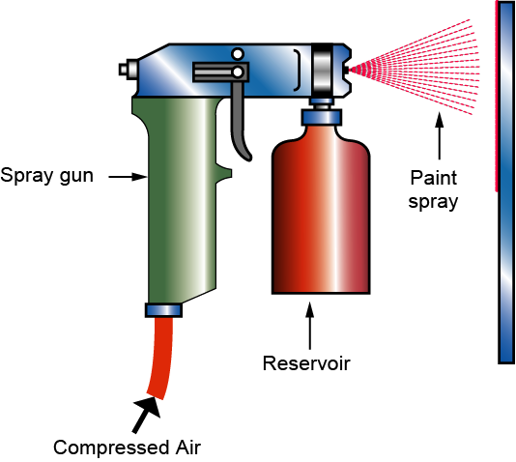
Organizing info: manufacturing processes
Primary
shaping
Secondary
shaping
Injection moulding
Machining
Surface
treating
Joining
Welding
Painting
Notes:
The families of processes
These schematics introduce the three families of manufacturing processes:
those that create shape, subdivided into primary and secondary (shape modifying processes – principally machining methods)
those that join shapes together, and
those that coat, treat or finish the surface

Slide 5
Organizing information: the PROCESS TREE
ProcessUniverse
Family
Class
Member
Attributes
Casting
Deformation
Molding
Composite
Powder
Rapid prototyping
RTM
Material
Shape
Size Range
Min. section
Tolerance
Roughness
Economic batch
Documentation
-- specific
-- general
Blow molding
Material
Shape
Size Range
Min. section
Tolerance
Roughness
Economic batch
Documentation
-- specific
-- general
Compression
Rotation
Injection
RTM
Blow
Injection molding
Material
Shape
Size Range
Min. section
Tolerance
Roughness
Economic batch
Documentation
-- specific
-- general
Joining
Shaping
Surfacing
Processes
data-table
Process records
Notes:
The Hierarchical structure of the Process data-table, showing the Shaping branch
Each material can be processed in a number of different ways. Here we digress for one frame to look at the Process tree, showing classification and data structure for manufacturing processes. To capture this information it is first necessary to structure data for processes. In the hierarchical structure shown here the Universe of processes is divided into families. That for shaping is partly expanded to show classes: casting, molding and so on. In this schematic one of these – molding – is expanded to show members. Each member has certain attributes: the materials it can handle, the shapes it can make, their size, precision and cost. A list of these attributes makes up a record for the process.

Slide 6
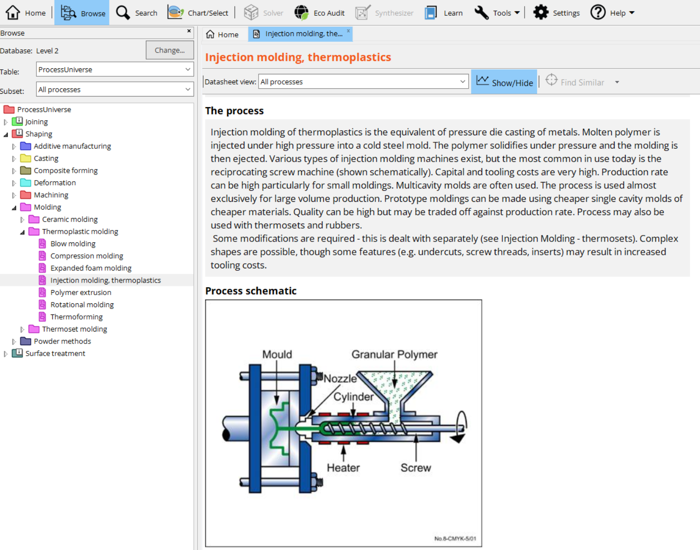
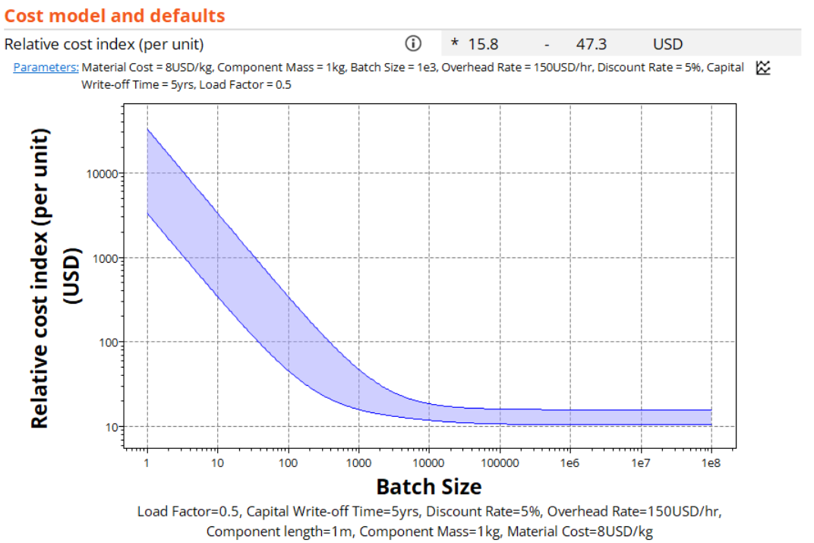
Finding information in the Ansys Granta EduPack Software
The cost model is implemented for selected shaping records
Notes:
Navigating the Process data-table
All three levels of the software use the same, familiar, interface. This frame shows the principal tool bar and two of its buttons.
The Browse button lets you explore the contents of a data table by roaming through its “tree”. When you click on the button, the first level of the tree (Families) appears. Each family can be expanded to show classes and members. Double clicking on a member opens its record.
The Search button allows a full text search on part or all of the records in database, finding all records that contain a word or word-string entered by the user in the search box.

Slide 7
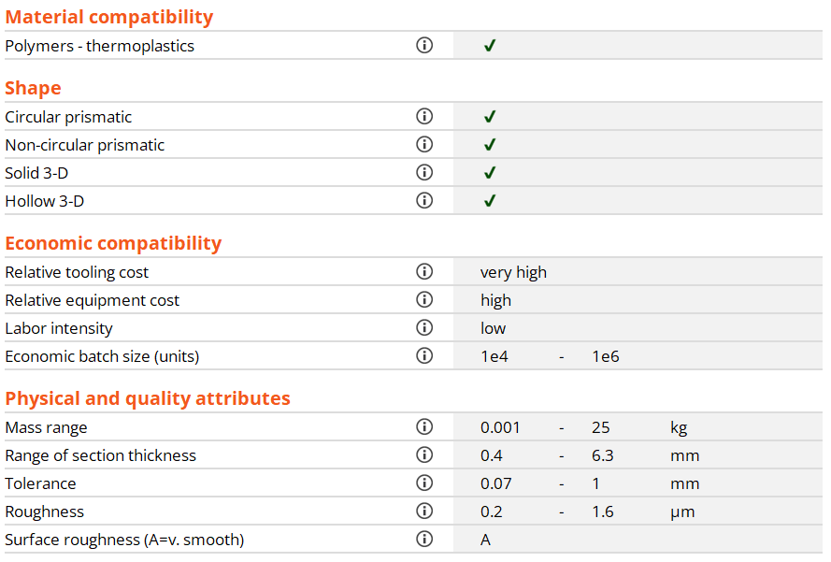

A shaping datasheet*
Injection molding, thermoplastics
Links to materials
Key constraints in choosing a shaping process
Excerpts from Ansys Granta EduPack software Level 2
Notes:
The key steps in choosing a shaping process
We now return to the attributes. This is an example of structured data for a shaping process. The physical attributes include the shape and size of part that can be made (the mass range), the surface roughness, the minimum thickness of section (often limited by the ability of material to flow into narrow channels) and the precision or tolerance of which it is capable. Structured information includes an identification of the process as discrete (like stamping) or continuous (like wire-drawing), and information about economics, most usefully, the economic batch size (the production run needed to justify the cost of the dies, molds or other tooling).
Key constraints in choosing a process are the shape, the batch size and the material that is to be shaped, captured by the links to materials.

Slide 8
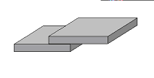
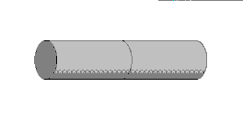
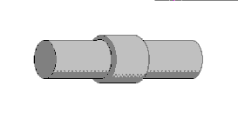
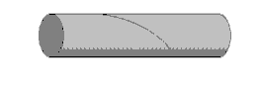
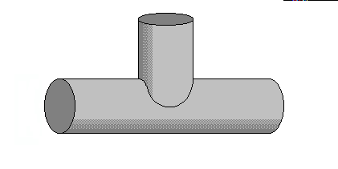
Data organization: joining processes
Kingdom
Family
Class
Member
Attributes
Brazing
Soldering
Gas
Ultrasonic
Friction...
Gas welding
Material
Joint geometry
Size Range
Section thickness
Relative cost ...
Documentation
Gas welding
Material
Joint geometry
Size Range
Section thickness
Relative cost ...
Documentation
Adhesives
Welding
Fasteners
Gas welding
Material
Joint geometry
Size Range
Section thickness
Relative cost ...
Documentation
Joining
Processes
Shaping
Surface
treatment
Lap
Butt
Sleeve
Scarf
Tee
Joint
geometry
Notes:
The Joining branch of the Process tree
So far we have discussed only shaping processes. The other two families – joining and surface treatment – can be structured and selected in similar ways. This frame shows the joining tree, with the class of welding expanded to show members and some of their attributes.
Certain attributes are unique to joining. One of these is the geometry of the joint that the process can make. It is illustrated in the lower part of the frame.

Slide 9
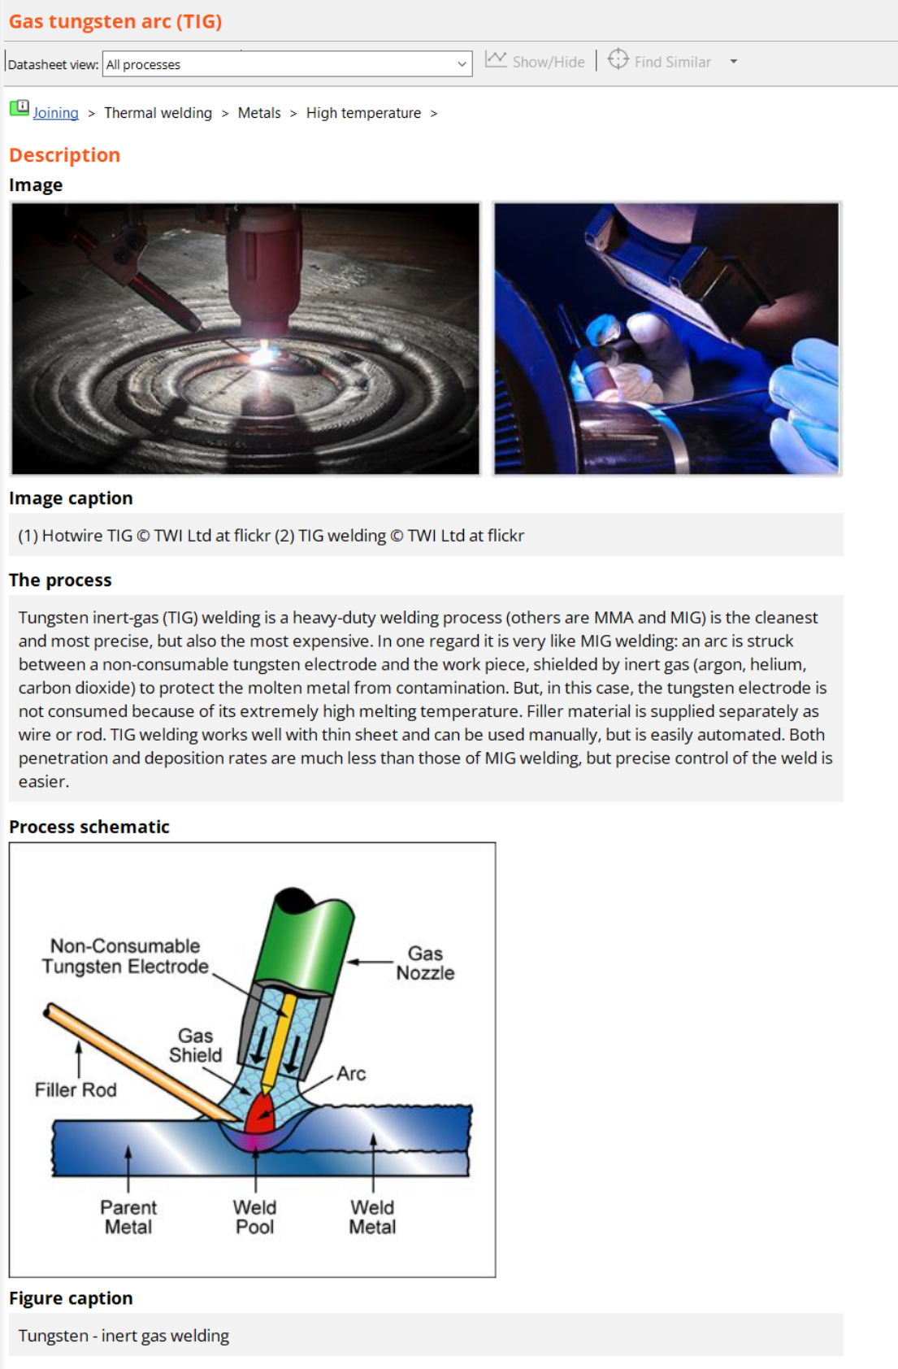
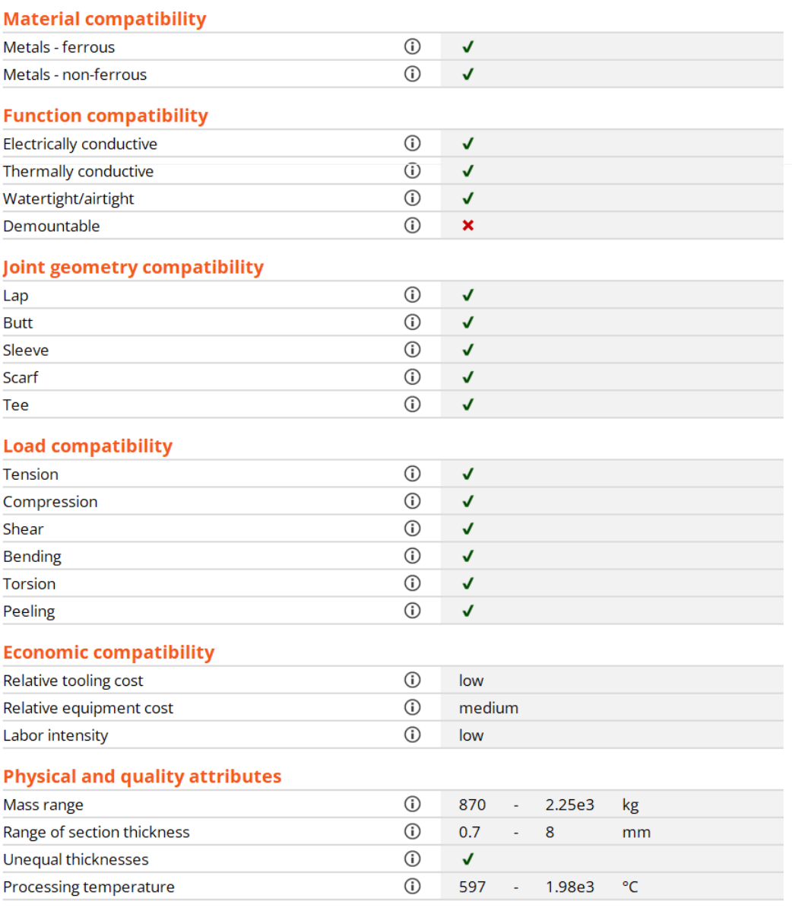
A joining datasheet*
Links to materials
Key constraints in choosing a joining process
*Excerpts from Ansys Granta EduPack software Level 2
Notes:
The key steps in selecting a joining process
This frame shows data for a joining process. The attributes are those that engineers use to select a joining process. They differ in many ways (not unexpectedly) from those for shaping. Some attributes – material, size, and general economic information – are common to all processes. But the rest – the geometry of the joint, the ability to join dissimilar materials or to allow disassembly etc. – are specific to joining.
The key constraints when selecting a joining process are the materials to be joined and the joint geometry.

Slide 10
Data organization: surface treatment
Kingdom
Family
Class
Member
Attributes
Joining
Anodize
Material
Why treatment?
Coating thickness
Surface hardness
Relative cost ...
Documentation
Anodize
Material
Why treatment?
Coating thickness
Surface hardness
Relative cost ...
Documentation
Anodize
Material
Function of treatment
Coating thickness
Surface hardness
Relative cost ...
Documentation
Processes
Shaping
Heat treat
Paint/print
Coat
Polish
Texture ...
Electroplate
Anodize
Powder coat
Metallize...
Surface
treatment
Increased hardness
Wear resistance
Fatigue resistance
Corrosion resistance
Oxidation resistance
Thermal insulation
Electrical insulation
Color
Texture
Decoration ….
Process records
Function of
treatment
Notes:
The Surface treatment branch of the Process tree
So far we have discussed shaping and joining processes. The remaining family – surface treatment – can be structured and selected in similar ways. This frame shows the surface treatment tree, with the class of coating expanded to show members and some of their attributes. An attribute unique to surface treatment is the function of the treatment. Typical functions are listed in the lower part of the frame.

Slide 11
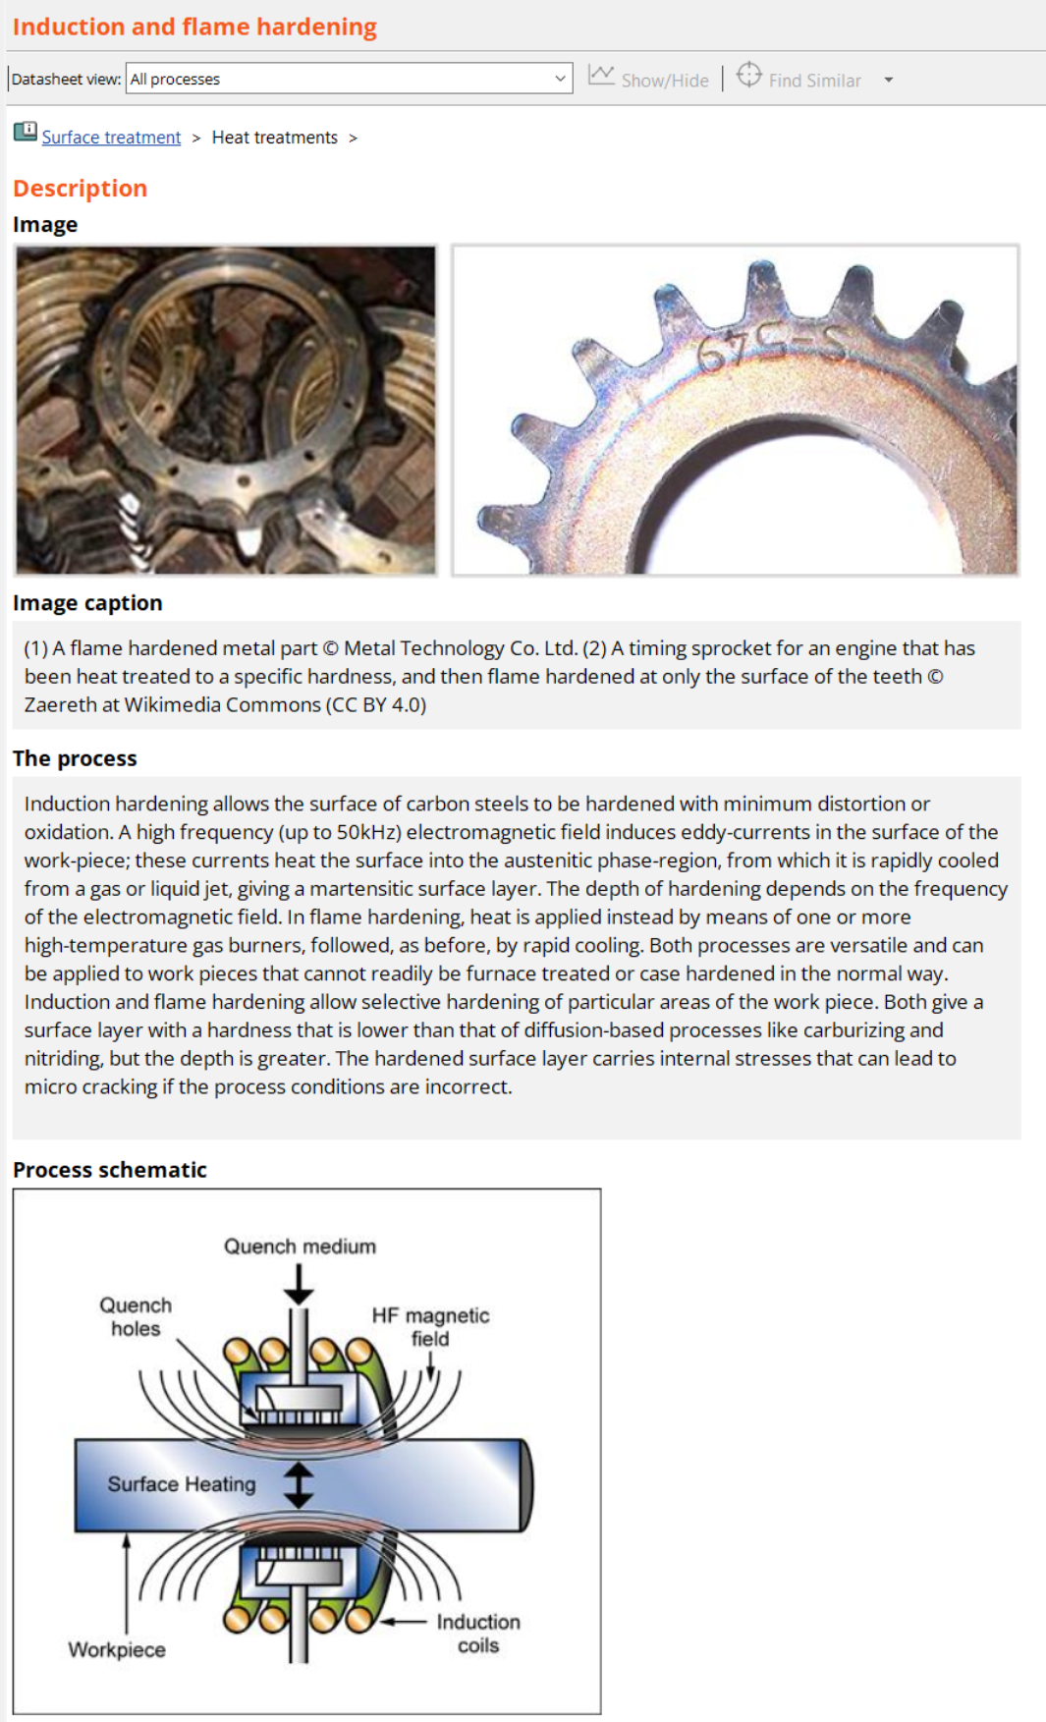
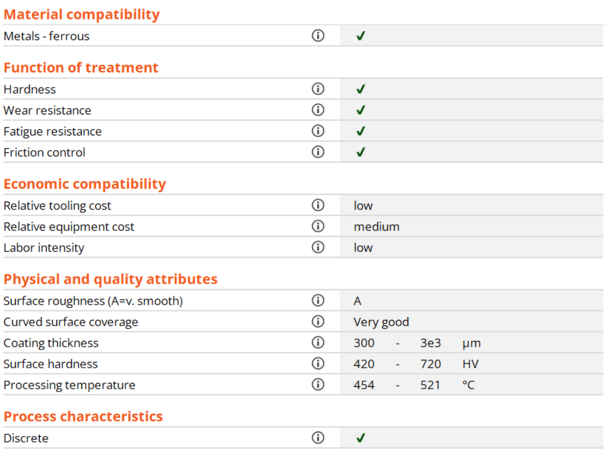
A surface-treatment datasheet*
Links to materials
Key constraints in choosing a joining process
*Excerpts from Ansys Granta EduPack software Level 2
Notes:
The key steps in choosing a surface treatment process
This frame show structured and unstructured data for a surface treatment process. The most critical attributes are the function that the treatment is required to provide and the materials to which it will be applied, accessed via the links.
The key constraints when selecting a surface treatment process are the material to be treated and the function of the treatment.

Slide 12
Cost, price and value
Cost = what it actually costs to make the part or product
Price = the sum you sell it for
Value = the worth the consumer puts on the product
The real requirement is
Cost < Price < Value
C < P < V
To maximize profit, P - C
we seek to minimize C
“Not worth the price” means P > V
“Good value for money” means P < V
The cost of producing a component of or product is made up of
the material cost
the cost of manufacture
Notes:
Cost, price and value
This first frame introduces the distinction between cost C, price P and value V. Materials and processes are chosen to maximize value and minimize cost, giving the greatest scope for profit P – C. This is achieved by minimizing material and manufacturing cost without compromising quality.

Slide 13
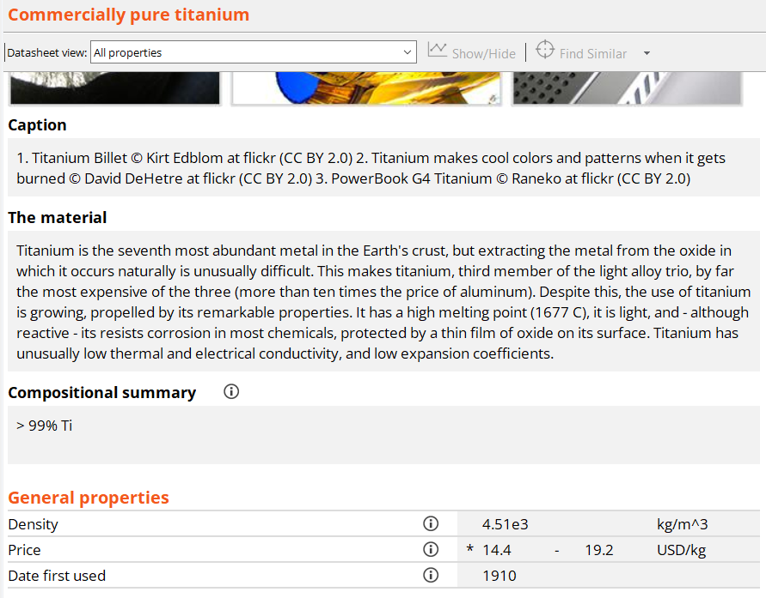
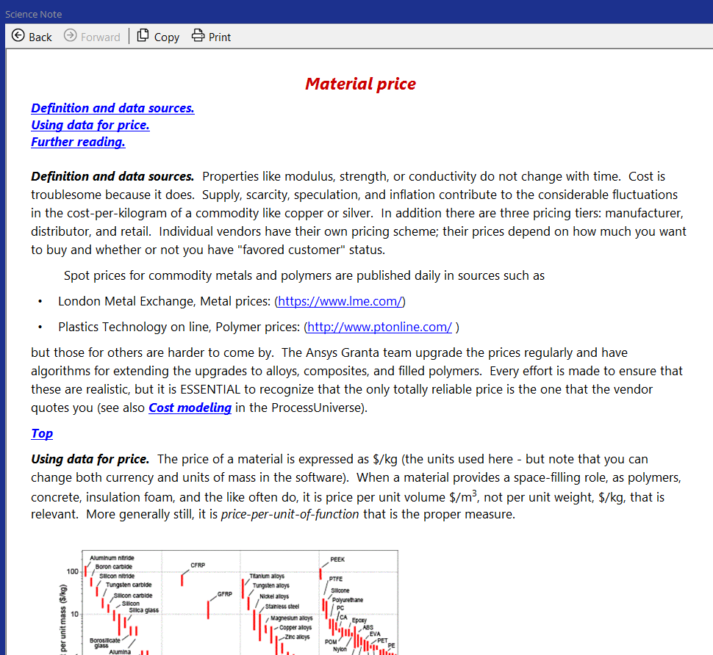
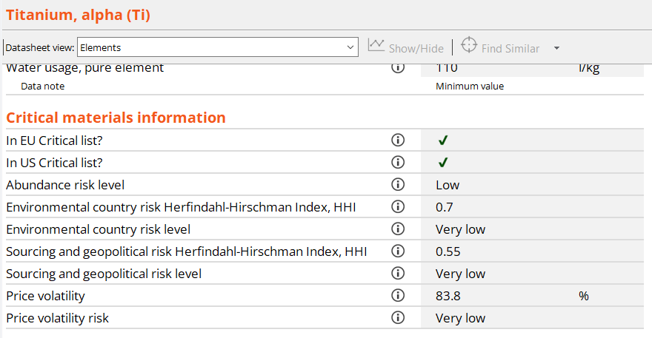
The material cost
The Elements database reflects price volatility
Material prices are updated once per year…
Science Note highlights price/cost issues
Notes:
Materials cost information
There is approximate cost information for materials that is updated once every year with the editions. This information should be used with caution, since it is mainly for comparisons between material. In the Elements database, there is additional information on price variability and risk.

Slide 14
Estimating cost
When alternative material-process combinations meet the constraints, it is logical to rank them by cost
Cost estimate for competitive bidding -- absolute cost is wanted, to
Cost estimate for ranking -- a relative cost is OK – but need generality
Generic inputs to any manufacturing process:
Materials
Energy
All have an associated cost
Manufacturing
process
Capital
Product
Time
Information
Waste materials and energy
Notes:
Cost estimation
The nature and detail of cost modelling depends on the purpose for which it is done. Cost estimation for competitive bidding for a contract is a skilled job: an error of 5% can mean the difference between profit and loss. Our purpose here is quite different: it is to estimate relative cost with just enough precision to compare competing processes.
The manufacture of a component consumes resources, shown in the lower part of this frame. Each has an associated cost. The final cost is the sum of those of the resources it consumes. They are defined in the next frame.

Slide 15
Inputs to a generic cost estimator
Generic = can be applied to any process
Resource | Symbol | Unit
Materials including consumables | C_{m} | $/kg
Capital cost of equipment cost of tooling | C_{t} C_{c} | $ $
Time overhead rate (including labor) | C_{oh} | $/hr
Energy cost of energy | C_{e} | $/hr
Information R&D or royalties | C_{i} | $/year
Lump into overhead rate C_{oh}
Notes:
The components of the cost model
The cost of producing a component of mass m entails:
The cost C_{m} ($/kg) of the materials and consumable feed-stocks from which it is made.
The cost of dedicated tooling, C_{t} ($).
The cost of the capital equipment, C_{c} ($), in which the tooling will be used.
The cost of time, chargeable at an overhead rate (thus with units of $/hr), in which we include the cost of labor, administration and general plant costs.
The cost of energy, C_{e} which is sometimes charged against a process-step if it is very energy intensive but more usually is treated as part of the overhead and lumped into the overhead, as we shall do here.
The cost of information, meaning that of research and development, royalty or license fees; this, too, we view as a cost per unit time and lump it into the overhead.

Slide 16
The cost per unit of output
materials
tools
capital
overhead
f = fraction lost
Characteristics of the process
Cost of equipment C_{c}
Cost of tooling C_{t}
Production rate
The database has approximate value-ranges for these
Site-specific, user defined parameters
Batch size n
Mass of component m
Capital write-off time t_{wo}
Load factor L
Discount rate d
Overhead rate
These are entered by the user via a dialog box
Notes:
The basic cost equation
Consider now the manufacture of a component (the “unit of output”) weighing m kg, and made of a material costing C_{m} $/kg. The first contribution to the unit cost is that of the material mC_{m} magnified by the factor 1/(1-f) to account for the fraction that is lost.
The cost C_{t} of a set of tooling – dies, molds, fixtures and jigs – is what is called a dedicated cost: one that must be wholly assigned to the production run of this single component. It is written off against the numerical size n of the production run, giving the second term in this frame
The capital cost of equipment, C_{c}, by contrast, is rarely dedicated. A given piece of equipment – a powder press, for example – can be used to make many different components by installing different die-sets or tooling. It is usual to convert the capital cost of non-dedicated equipment and the cost of borrowing the capital itself into an overhead by dividing it by a capital write-off time, t_{wo}, (5 years, say) over which it is to be recovered. The quantity C_{c}/t_{wo} is then a cost per hour – provided the equipment is used continuously. That is rarely the case, so the term is modified by dividing it by a load factor, L – the fraction of time for which the equipment is productive. It is also modified by a discount rate, d. This gives an effective hourly cost of the equipment, like a rental charge, which gives the third term above.
Finally there is the general background hourly overhead rate for labor, energy and so on. This is again converted to a cost per unit by dividing by the production rate units per hour, giving the fourth term.
The total cost per part, C_{s}, is the sum of these four terms, C₁ to C₄, giving the final equation. This establishes the bare bones of a tool for estimating the relative cost producing a unit of output. It can be refined in many ways. The Granta software has a slightly more refined version, implemented for shaping processes.

Slide 17
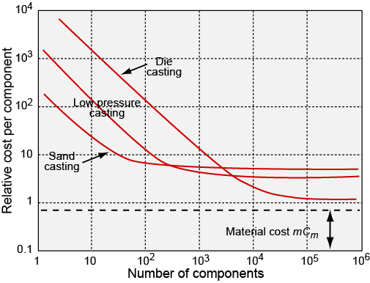

Features of a cost model
Casting alloy con-rod
Tooling costs dominate
Material and labor costs dominate
Sand
casting
LP
casting
Die
casting
Identify most economic process
Dependence on overhead rate etc.
Notes:
Navigating the Process data-table
The schematic shows the basic features of the output of the model – the relative cost versus batch size plot

Slide 18
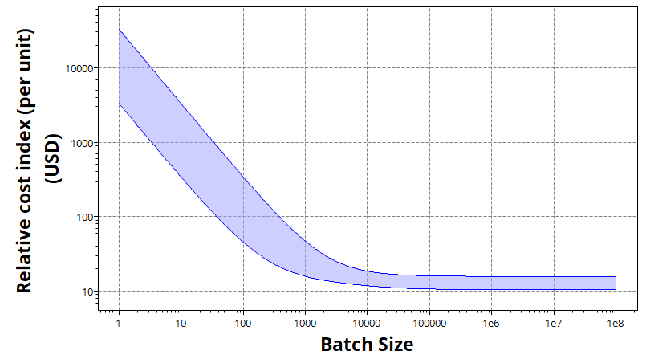
Cost model in Ansys Granta EduPack software Levels 2 and 3
Cost modeling
Relative cost index (per unit) 15.8-47.3 USD
Parameters: Material Cost = 8USD/kg, Component Mass = 1kg, Batch Size = 1e3, Overhead Rate = 150USD/hr, Discount Rate= 5%, Capital Write-off Time = 5yrs, Load Factor = 0.5
Name | Limits | Value
Capital Write-off Time (yrs) | 1-25 | 5
Component Mass (kg) | 0.001-10000 | 1
Component Length (m) | 0.01-100 | 1
Discount Rate (%) | 0-100 | 5
Load Factor | 0.1-1 | 0.5
Material Cost (USD/kg) | 0.1-10000 | 8
Overhead Rate (USD/hr) | 1-500 | 150
Notes:
The cost interface and output
This is one way in which cost data can be plotted in Ansys Granta EduPack software process datasheets. It is a graph of cost against batch size for a single process, here injection molding, in the manner of the earlier figure. The user-defined parameters are listed on it. The band width derives from the ranges of the economic attributes: a simple shape, requiring only simple dies, lies near the lower edge; a more complex one, requiring multi-part dies, lies near the upper edge.

Slide 19
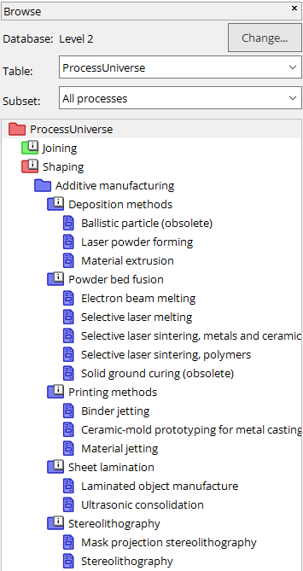
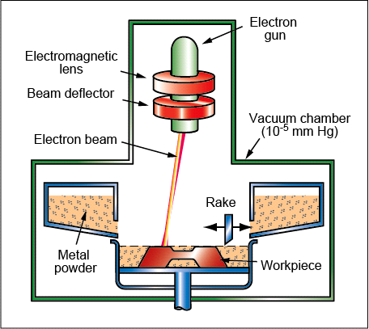
15 additive manufacturing processes
e-beam melting
ELECTRON BEAM MELTING (EBM) is a powder bed fusion technique similar to SLM. In this process a high-energy electron beam is scanned across a thin layer of metallic powder, causing local melting and resolidification. A thin layer of powder is then spread on top by a wiper or milling head and the process repeated until the object is complete. To maintain a steady-state uniform temperature throughout the build, the substrate is heated before laying the powder bed. Operating at an elevated temperature results in a grain pattern more similar to cast microstructures. As with other additive manufacturing processes, a CAD solid model of the part is used to create the code to guide the electron beam.
This process is also known as in-situ shelling.
Notes:
Additive manufacturing processes
Example: Electron Beam melting (this image)

Slide 20
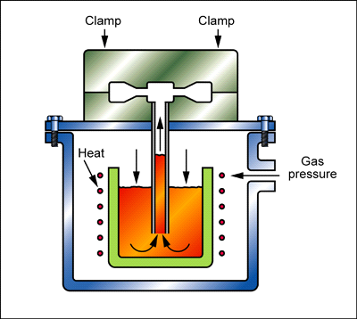
Comparison of manufacturing processes
Low pressure die
e-beam melting
Traditional vs Additive
In LOW PRESSURE DIE CASTING, molten metal is displaced upwards into a die by low pressure gas. The die cavity is filled slowly upwards which minimizes entrained air and gives high soundness. Such castings have better metallurgical integrity than conventional die castings, and they can be heat-treated. The process has most of the benefits of die casting without the disadvantages. The dies are made from cast iron which is comparatively cheap and easy to machine. Tool steel inserts may be used for high production runs of complex castings. Tooling costs are about half those for pressure die casting. The process is only suitable for low melting point alloys (Tm < 950 C). Shapes are of average complexity and undercuts are possible but expensive.
ELECTRON BEAM MELTING (EBM) is a powder bed fusion technique similar to SLM. In this process a high-energy electron beam is scanned across a thin layer of metallic powder, causing local melting and resolidification. A thin layer of powder is then spread on top by a wiper or milling head and the process repeated until the object is complete. To maintain a steady-state uniform temperature throughout the build, the substrate is heated before laying the powder bed. Operating at an elevated temperature results in a grain pattern more similar to cast microstructures. As with other additive manufacturing processes, a CAD solid model of the part is used to create the code to guide the electron beam.
Notes:
Cost comparison
Example: Low pressure die vs e-beam melting

Slide 21
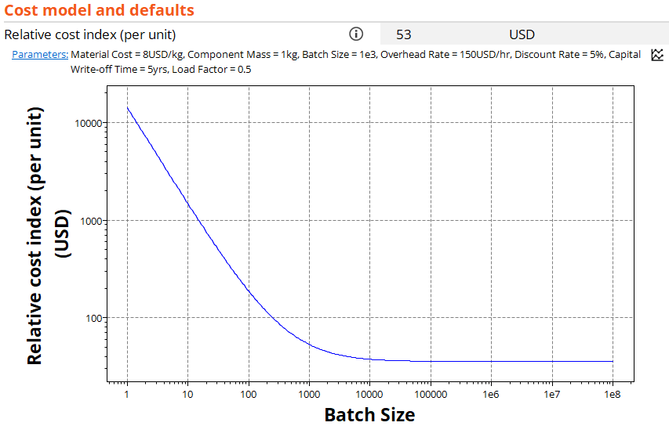
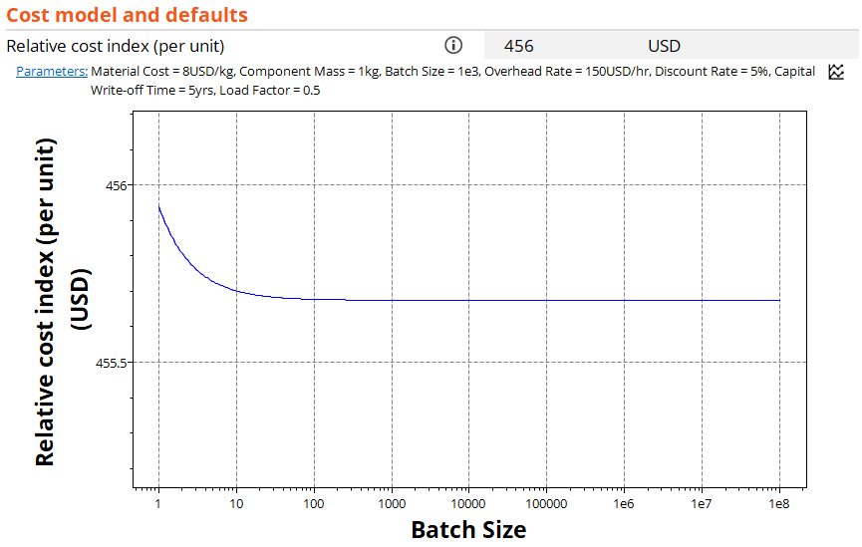
Comparison of manufacturing processes
Low pressure die
e-beam melting
Traditional vs Additive
Notes:
Cost comparison
Example: Low pressure die vs e-beam melting

Slide 22
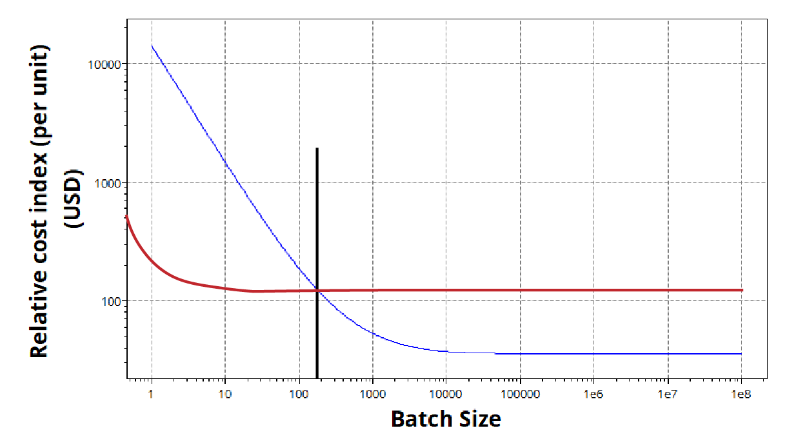
Comparison of manufacturing processes
Low pressure die
e-beam melting
Traditional vs Additive
Cross-over point: ~200 parts
Notes:
Cost comparison
Example: Low pressure die vs e-beam melting

Slide 23
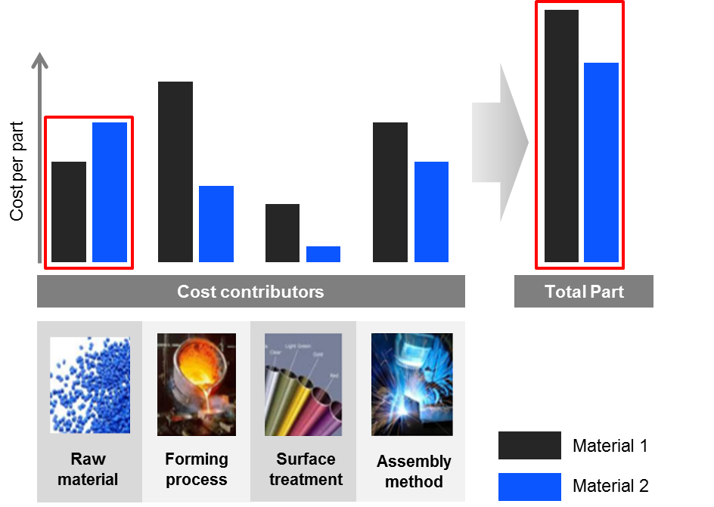

Synthesizer model for part cost
PP-20% mineral filled door panel
15% saving in vehicle weight but what about cost?
Quickly estimate the cost to manufacture a component
Compare different classes of materials and processing routes
Notes:
Part costs
What can you do with the part cost estimator?

Slide 24
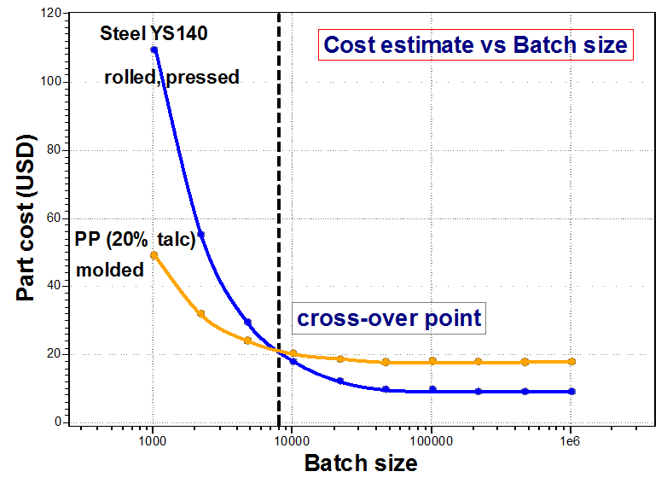

Part cost comparison: Door panel
Notes:
Part costs
We have seen how the Synthesizer tool and its hybrid models can be used to estimate properties for some interesting material structures. The Synthesizer tool can also be used for estimation of other manufacturing and materials-based properties, using Ansys Granta EduPack software data. The part cost estimator allows you to study and compare manufacturing costs. We will use the car door panel from the previous case study as an example…

Slide 25
Summary
Processes can be organised into a tree structure containing records for structured data and supporting information, Links connect processes to materials
Select on primary constraints
Shaping: material, shape and batch size
Joining: material(s) and joint geometry
Surface treatment: material and function of treatment
Simple cost model introduces the basic features of process costs adequate for ranking
The cost of a product consists of material cost and manufacturing cost
Additive manufacturing has the same unit cost for all batch sizes
The part cost estimator in the Synthesizer tool can be used to estimate manufacturing costs for different options
Notes:
Final summary
Processes can be classified and information about them stored and manipulated in ways that parallel those for materials. In this Unit we have explored:
How information for processes can be organized in a hierarchical structure
How to find information for shaping, joining and surface treatment, and
How processes are selected to meet a set of constraints by using simple screening stages.
The final choice of process is guided by the insight derived from the search for Documentation, and by a more detailed analysis of costs (Unit 11).

Slide 26
Ansys Education Resources Feedback Survey
Here at Ansys, we rely on your feedback to ensure the educational content we create is up-to-date and fits your teaching needs.
Please click the link below to fill out a short survey (~7 minutes) to help us continue to support academics around the world utilizing Ansys tools in the classroom.
Feedback Survey Link
Notes:
Feedback Survey link for copy-paste method → https://ansys.typeform.com/to/jcattJI5

