Slide 1
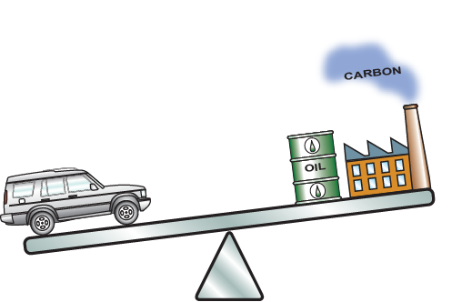
Eco Design and the Eco Audit Tool introducing students to life-cycle thinking
Mike Ashby
Department of Engineering,
University of Cambridge

Slide 2
Learning objectives for this lecture unit
Ansys software mentioned | Ansys Granta EduPack™­, a teaching software for materials education
Intended Learning Outcomes
Knowledge and Understanding | Knowledge and understanding of the material life-cycle
Skills and Abilities | Ability to use Eco Audits in the design process
Values and Attitudes | Awareness that environmental design objectives influence material selection
Resources
Text: “Materials and the Environment”, 3rd Edition by M.F. Ashby, Butterworth-Heinemann, Oxford 2021, UK. Chapters 1-10
Text: “Materials: engineering, science, processing and design”, 4th Edition by M.F. Ashby, H.R. Shercliff and D. Cebon, Butterworth Heinemann, Oxford 2019, Chapter 20
Text: “Materials Selection in Mechanical Design”, 5th Edition by M.F. Ashby, Butterworth Heinemann, Oxford, 2016. Chapter 14
White Paper: Ansys Granta EduPack software Eco Audit Tool
Poster: Eco Design
Notes:
Learning Objectives
These Intended Learning Outcomes are based on a taxonomy of knowledge and understanding as the basis, skills and abilities as necessary for the practical use of knowledge and understanding, followed by acquired values and attitudes enabling assessments and responsible use of these abilities.
Combined with a suitable assessment, they should be helpful in the context of accreditations or for the CDIO Syllabus.
The Texts listed are from books authored or co-authored by Mike Ashby but other texts are also referred to in the Science Notes.

Slide 3
Agenda
Eco data in the Ansys Granta EduPack software
The product life-cycle
Different strategies for eco-performance
Performance index derivation: PET bottle
Eco-selection with bubble charts
LCA vs Eco Audit
The Eco Audit tool
Add your own data and records
Comparisons of products over life-cycle
The Advanced Eco Audit tool
Notes:
Outline
This is the twelfth Unit of a course on Material and Process Selection. The Units link closely to the first three Texts listed on the previous frame but can equally by used in conjunction with texts such as Callister, Budinski, Askeland and others. The relevant chapters of the Texts are listed on the Outline frame of each Unit. The methods developed in the course are implemented in the Ansys Granta EduPack software, which is structured to evolve in pace with the student throughout a four-year engineering program. This first Unit introduces materials and processes, and the way in which information about them can be classified, stored, retrieved and explored.

Slide 4
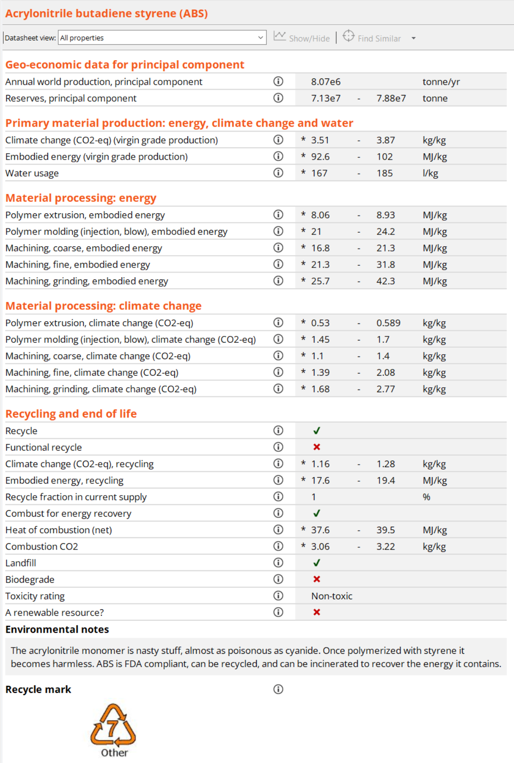
Typical data records show eco-properties too
Notes:
The eco-data in the Ansys Granta EduPack software records
This frame shows the eco-data contained in the records in the Ansys Granta EduPack software. Each record contains:
Geo-economic data – annual world production, reserves, etc.
Embodied energy and carbon footprint for the material
Processing energy and carbon emissions for manufacturing processes
Environmental data pertinent to the end-of-life
In addition there are tables of data for electronics, for transport, and for energy.

Slide 5
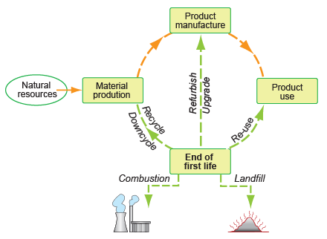
Life-cycles and eco-informed design
Eco-informed design
80% of eco-impact tied in at design stage
Build-in eco criteria at the design stage
Target the largest environmental load first
The product life-cycle
The drivers for eco-design
Focus on carbon footprint, ISO 14067
Legislation (Carbon taxes, EuP, REACH)
Incentives (Subsidies, concessions)
Urge for “responsible” manufacture
Doing more with less = $$$
Notes:
The need for eco-informed decisions early in the design process
It is estimated that 80% of the final eco-demands (and the cost) of a product are built in at the design stage. Many governments have committed their nations to reducing green-house gas emissions and interpret this as reducing the release of carbon to the atmosphere. In Europe the Energy-using Products (EuP) Directive requires an eco-analysis of products and a demonstration that the designers have considered the use of energy in their product as it relates to materials, manufacture, packaging transport and distribution, use, and end of life. Registration, Evaluation, Authorization and Restriction of Chemical Substances (REACH) Directive places responsibility on manufacturers to manage risks from chemicals and to find substitutes for those that are most dangerous. Carbon taxes, subsidies for low-carbon emitting products and other incentives all exert pressure to improve eco-design.
The Ansys Granta EduPack software Sustainability database contains a data-table of Legislation and Regulations (See Lecture Unit What is a Sustainable Development).

Slide 6
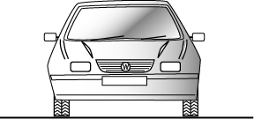

Materials for crash barriers – two important strategies
Mobile barrier
Static barrier
Function: Absorb impact, transmit load to energy-absorbing units or supports
Material
dominates
Minimize embodied energy
Use
dominates
Minimize mass
Dominant
phase of life:
Energy
M Mf Tr Use
M Mf Tr Use
Criterion:
Bending strength
per unit embodied energy
Bending strength
per unit mass
Performance Index:
Notes:
Case Study: Crash barriers
Barriers to protect driver and passengers of road vehicles are of two types: those that are static – the central divider of a freeway, for instance – and those that move – the fender of the vehicle itself (this frame). The static type line tens of thousands of miles of road. Once in place they consume no energy, create no CO₂ and last a long time. The dominant phases of their life in the sense of Frame 4 are those of material production and manufacture. The fender, by contrast, is part of the vehicle; it adds to its weight and thus to its fuel consumption. The dominant phase here is that of use. This means that, if eco-design is the objective, the criteria for selecting materials for the two sorts of barrier will differ.
This frame shows the two types of barrier and a schematic eco-audit for each. For the static barrier on the left it is the material phase of life that is dominant, making the reduction of material energy the objective in redesign. For the mobile barrier on the right it is the contribution of the barrier mass to the mass of the vehicle that, over life, results in the largest commitment of energy, making a reduction in mass the objective in redesign.
In use (that is, in a crash situation) the barriers are loaded in bending – they must be strong enough in bending to transmit the load to the supports of the road barrier or to the energy-absorbing crush units on the car. The bottom line shows the relevant index. That for the static barrier on the left characterizes materials with low embodied energy per unit bending strength; that on the right characterizes low mass per unit bending strength. Both are plotted on the frames that follow.

Slide 7
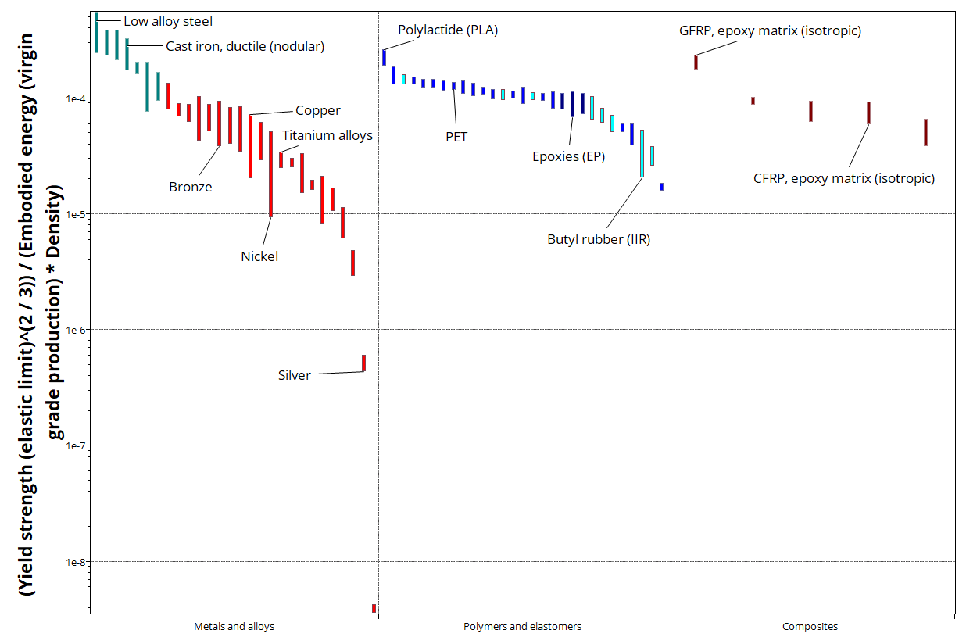
Static barrier: the Performance Index directly as bar chart
Metal Polymers Composites
Selected materials: Steels, Cast irons
Notes:
Plot of the index for the static barrier
The Y-axis of this chart is the index for the static barrier, made with Ansys Granta EduPack software Level 2. The green selection box isolates the materials with the largest values of this index. They are all ferrous alloys – steels and cast irons. They minimize the life-energy of a static barrier by minimizing the most energy-intensive phase – that of material extraction, casting and rolling.

Slide 8
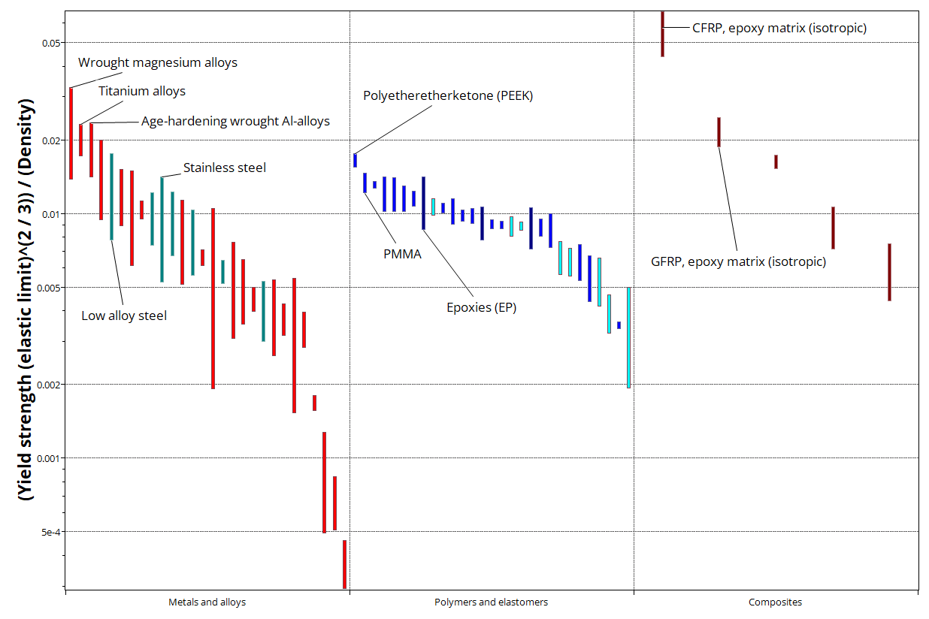
Mobile barrier: the Performance Index directly as bar chart
Metal Polymers Composites
Selected materials: CFRP, Mg alloys, Ti alloys, Al alloys
Notes:
Plot of the index for the mobile barrier
The Y-axis of this chart is the index for the mobile barrier, again made with Ansys Granta EduPack software Level 2. The green selection box isolates the materials with the largest values of this index: CFRP and light alloys. They minimize the life-energy of a mobile barrier by minimizing the most energy-intensive phase – that of product use.

Slide 9

Eco-selection for a fizzy drink bottle
400
300
200
100
0
-100
-200
Material
dominates
Eco Audit
Minimize embodied energy
Energy (MJ)
End of life
Material Manufacture Transport Use
100% virgin PET
with recycling
Translation
Constraints
Able to be molded
Transparent / translucent
Able to contain pressure
Objectives
Minimize embodied energy of bottle
Minimize material cost of bottle
Improve green credentials of bottle
Design brief
Notes:
A pressurized drink bottle (a mini pressure vessel)
Here is an example: systematic selection for the carbonated drink bottle. In its present form it is made of polyethylene terephthalate, PET. The audit shows that the material-energy of the bottle itself is the phase of life that consumes the most energy and releases the most carbon. The design brief is to improve the eco-profile of the bottle, which must at the same time be transparent (or at least translucent) so that the contents are visible, and the bottle must withstand the internal pressure and any accidental overloads without yield or bursting. The objective is to minimize the embodied energy per bottle.

Slide 10
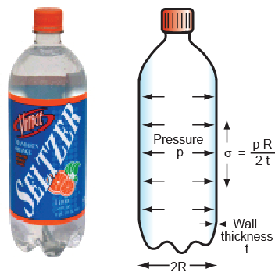
Modeling the bottle
Cylindrical pressure vessel
Circumferential stress
Embodied energy per unit area of wall
Embodied energy / kg of material
Find material with lowest energy, seek largest
R= Bottle radius
t = Thickness of bottle wall
p = Internal pressure
σ_{y} = Yield strength of material
ρ = Density of material
H_{m} = Embodied energy of material/kg
E = Embodied energy/m² of wall
C_{m} = Material cost per kg
Find material with lowest cost, seek largest
Price / kg of material
Notes:
Modelling to identify the material indices
The bottle is modelled as a cylindrical pressure vessel. The internal pressure p creates a stress in the wall of the bottle, as indicated in the diagram. The circumferential stress is the larger one – its value is listed at the top. This stress must not exceed the yield strength of the material of the bottle, setting a minimum value for the wall thickness, t.
The embodied energy E of the bottle per unit area of wall is given by the second expression. The pressure p and the bottle radius R are fixed by the design. The energy E is minimized by seeking materials with the lowest value of the material property group H_{m}ρ/σ_{y}, or the maximum value of its reciprocal. The quantity is the material index for the problem.

Slide 11
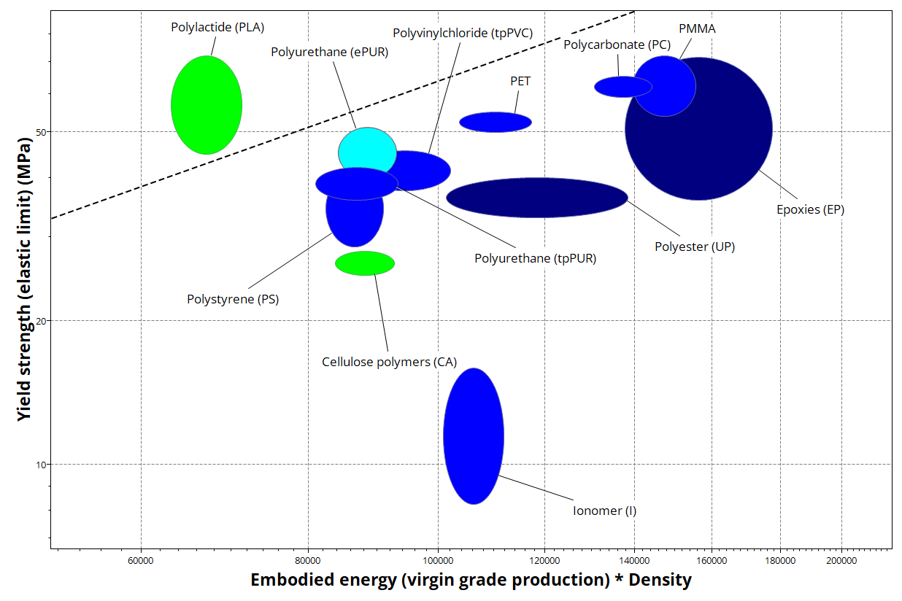
Selection to minimize embodied energy
First apply constraints, then use index to optimize choice
Increasing
Further Constraints to Apply
Able to be molded
Transparent / optical quality
1
Bio-polymers are colored green
PLA meets the constraints at lowest embodied energy
Notes:
Choice to minimize embodied energy
This is a chart of yield strength vs. embodied energy per unit volume for polymers that are translucent or transparent. The contours show the index from the previous frame. Biopolymers are shown in green to distinguish them from those that are derived from oil, shown in blue. Two of these – polylactide, PLA and polyhydroxyalkanoates (PHA) perform exceptionally well. PLA, in particular, offers a reduction of embodied energy per bottle of about 40%.

Slide 12
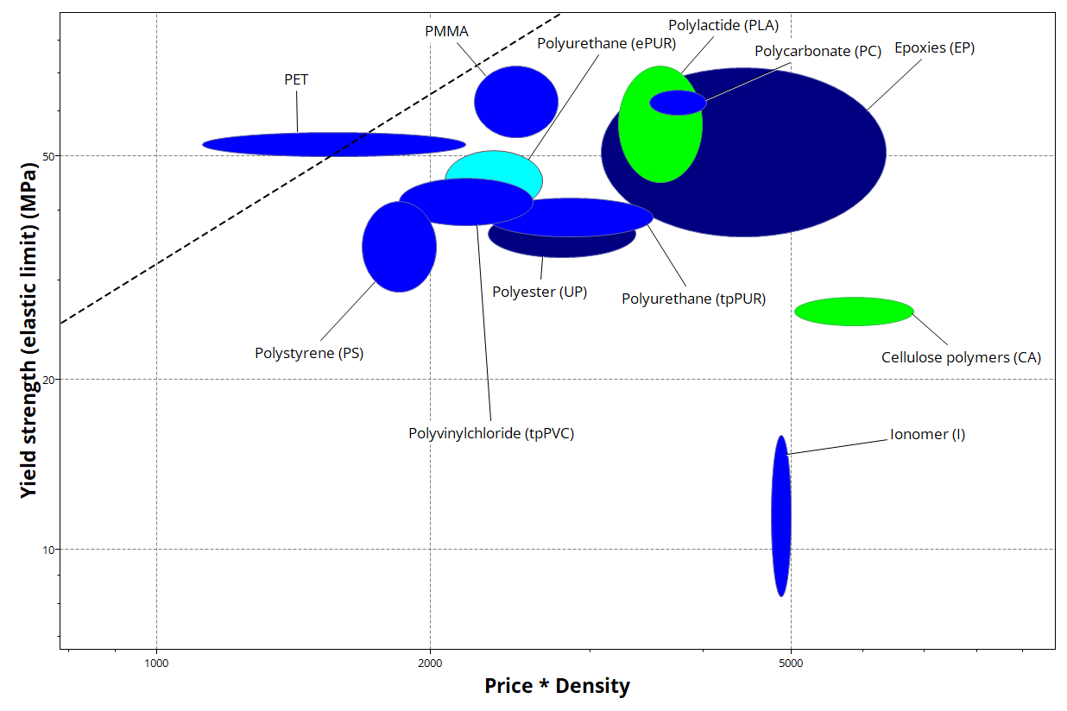
Selection to minimize cost
Can’t ignore cost
Increasing
Bio-polymers are colored green
1
PET meets the constraints at lowest cost
Notes:
Choice to minimize cost
Why, then, are so few bottles made of PLA? Here is a chart of yield strength vs. cost per unit volume for the bottle. The contours show the material cost per unit area of bottle wall. By this criterion the bio-polymers (green) do not do so well. The cheapest material is PET – the material of choice for almost all pressurized drink bottles…

Slide 13
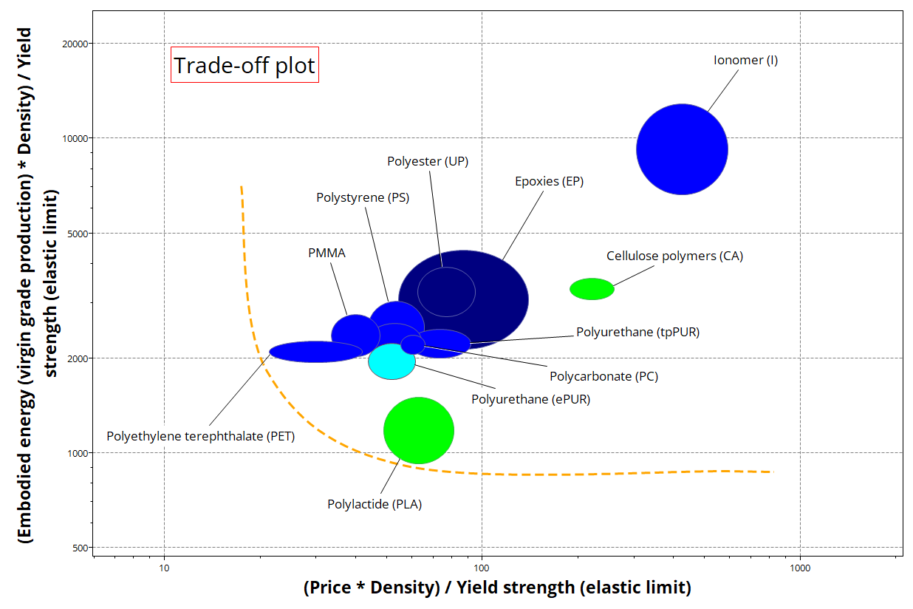
Trade-off plot
Minimizing both embodied energy and cost
Bio-polymers are colored green
In a trade-off plot, the properties on the axes are to be minimized.
If cost/energy priority not established, both are good candidates
Notes:
The trade-off between embodied energy and cost
This is a plot of the embodied energy index against the cost index – we wish to minimize both. The trade-off surface is sketched. The materials nearest to the surface are the best choices: PET and PLA.
To distinguish between them we need a penalty function, which requires a value for the exchange constant linking cost and embodied energy (the value of saving embodied energy or carbon) – and thus far there is no agreement on this value. This highlights a difficulty in reaching unambiguous selection for eco-problems: the value of the environment is a matter for debate.

Slide 14

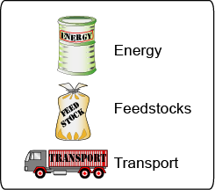

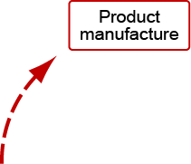
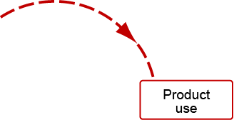


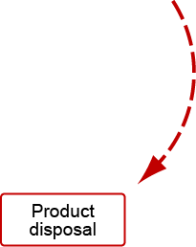

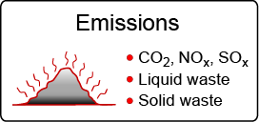

The product life-cycle in detail – 4 phases in first life (cradle-grave)
Resources
Emissions and waste
Notes:
14
The life cycle of products and the materials they contain
This frame shows the materials lifecycle. Ore and feedstock, drawn from the earth’s resources, are processed to give materials. These are manufactured into usable products, and at the end of their lives are discarded with only a fraction entering the recycling loop. The rest are committed to incineration or land-fill. Energy and materials are consumed at each point in this cycle (we shall call them “phases”), with an associated penalty of CO₂, SO_{x}, NO_{x}, and other emissions – heat, and gaseous, liquid and solid waste, collectively called environmental “stressors”. These are assessed by the technique of life-cycle analysis (LCA).
ISO 14000 and PAS 2050 of the International Standards Organization defines a family of standards for environmental management systems. ISO 14000 contains the set IS0 14040, 14041, 14042 and 14043 published between 1997 and 2000, prescribing broad procedures for conducting the four steps of an LCA: setting goals and scope, inventory compilation, impact assessment and interpretation. The standard is an attempt to bring uniform practice and objectivity into life-cycle assessment and its interpretation, but implementation is cumbersome and expensive.
PAS 2050 (2008) is a more recent set of draft standards for the carbon assessment of products.

Slide 15
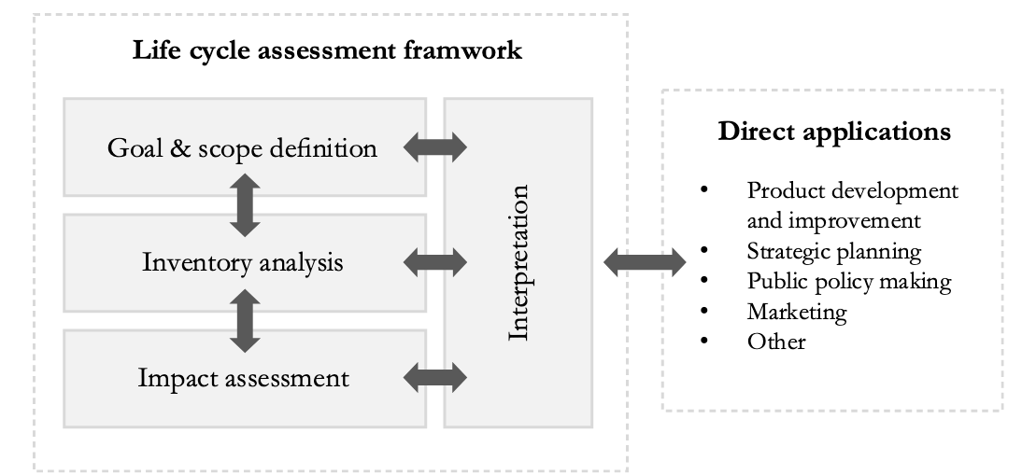
Life cycle assessment (LCA)
Typical LCA output
Aluminum cans, per 1000 units
Bauxite 59 kg
Oil fuels 148 MJ
Electricity 1572 MJ
Energy in feedstock 512 MJ
Water use 1149 kg
Emissions: CO₂ 211 kg
Emissions: CO 0.2 kg
Emissions: NO_{x} 1.1 kg
Emissions: SO_{x} 1.8 kg
Particulates 2.47 kg
Ozone depletion potential 0.2 X 10⁻⁹
Global warming potential 1.1 X 10⁻⁹
Acidification potential 0.8 X 10⁻⁹
Human toxicity potential 0.3 X 10⁻⁹
ISO 14040 series, International Standard
Resource
consumption
Emissions
inventory
Impact
assessment
Simplified Life-Cycle Inventory (LCI) with Eco Audit
LCA Framework in ISO 14044:2006
Full LCA is expensive, and requires great detail and experience – and even then is subject to uncertainty
How can a designer use these data?
Notes:
15
Life cycle assessment (LCA)
The upper part of this slide lists the typical output of an LCA that meets the ISO 14040 guidelines. A full LCA is time-consuming, expensive and it cannot cope with the problem that 80% of the environmental burden of a product is determined in the early stages of design when many decisions are still fluid.
There is a second problem: what is a designer supposed to do with this information? How are CO₂ and SO_{x} productions to be balanced against resource depletion, toxicity or ease of recycling when choosing a material? This question has led to efforts to condense the eco-information about a material into a single measure or eco-indicator, giving the designer a simple, numeric ranking. The use of a single-valued indicator is criticized by some. The grounds for criticism are that there is no agreement on normalization or weighting factors used in the calculations and that the method is opaque since the indicator value has no simple physical significance.

Slide 16
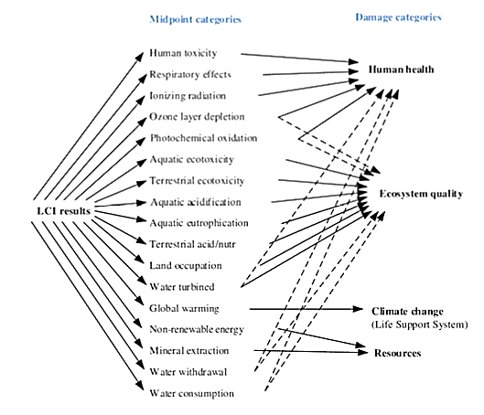
Life cycle assessment (LCA) vs Life-cycle Inventory (LCI)
PAS 2050 by the British Standards Institute (BSI)
ISO 14040 series, International Standard
-Intermediate Categories-
-Damage Categories for
- Impact Assessment -
Human Health
Ecosystem Degradation
-LCI Results-
Climate Change
Simplified Life-Cycle Inventory (LCI) with Eco Audit
Resources
Notes:
16
Life cycle assessment (LCA)
The upper part of this slide lists the typical output of an LCA that meets the ISO 14040 guidelines. A full LCA is time-consuming, expensive and it cannot cope with the problem that 80% of the environmental burden of a product is determined in the early stages of design when many decisions are still fluid.
There is a second problem: what is a designer supposed to do with this information? How are CO₂ and SO_{x} productions to be balanced against resource depletion, toxicity or ease of recycling when choosing a material? This question has led to efforts to condense the eco-information about a material into a single measure or eco-indicator, giving the designer a simple, numeric ranking. The use of a single-valued indicator is criticized by some. The grounds for criticism are that there is no agreement on normalization or weighting factors used in the calculations and that the method is opaque since the indicator value has no simple physical significance.

Slide 17
Design guidance vs product assessment
Market need
Problem statement
Alternative schemes
Layout and
materials
CAD, FE analysis,
optimization, costing
Concept
Design guidance
Embodiment
Eco Audit
ability
Detail
Product specification
Product assessment
LCA, Life-cycle
assessment
Production
Notes:
A typical design process
Design starts with the identification of a market need. Concepts (general working principles) are identified to fill the need. The most promising of these are developed into sketches or diagrams indicating configuration, lay-out and scale (“embodiment”). One or more of these is selected for detailed development, analyzing performance, safety and cost. The output is a design enabling the construction of a prototype that, after testing and development, goes to manufacture.
Material information enters all stages of the design. At the concept stage the design is fluid, and all materials are candidates. Here the need is the ability to scan the entire MaterialsUniverse, but at a low resolution. As the design evolves and the requirements become sharper, so does the need for fewer materials at a higher level of precision. In the final, detailed stage when optimization and other analyses are undertaken, the need for data with just one or a very few materials at the highest precision is evident. The screening process narrows the initially wide material search space containing all materials ultimately leading to a final single choice.

Slide 18




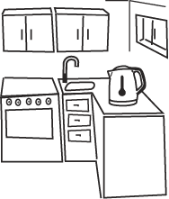
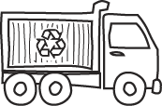

Life-cycle overview – Example: Jug Kettle
Design
Product
Materials kg
PP 0.4
Stainless 0.25
Nichrome 0.05
Copper 0.1
China
11, 866 miles – 21,950 km sea
192 km by road
Transport
Use
End of life
Cambridge
Shanghai
Recycle
2 kW, 2 minutes,
Three times a day 3 years
Notes:
The idea of an approximate, but fast, Eco Audit
The strategy for guiding design has 3 steps, detailed here and on the next frame.
The first step is one of simplification, developing a tool that is approximate but retains sufficient discrimination to differentiate between alternative choices. A spectrum of levels of analysis exist, ranging from a simple eco-screening against a list of banned or undesirable materials and processes to a full LCA, with overheads of time and cost. In between lie methods that are less rigorous; they are approximate but fast.
The second step is to select a single measure of eco-stress. On one point there is some international agreement: the Kyoto Protocol of 1997 committed the developed nations that signed it to progressively reduce carbon emissions, meaning CO₂. At the national level the focus is more on reducing energy consumption, but since this and CO₂ production are closely related, they are nearly equivalent. Thus there is a certain logic in basing design decisions on energy consumption or CO₂ generation; they carry more conviction than the use of a more obscure indicator. We shall follow this route, using energy as our measure.
The third step is to separate the contributions of the phases of life because subsequent action depends on which is the dominant one. If it is that a material production, then choosing a material with low “embodied energy” (defined on a later frame) is the way forward. But if it is the use phase, then choosing a material to make use less energy-intensive is the is the right approach – even if it has a higher embodied energy.
A new feature allows cost to be estimated over the life-cycle of the product.

Slide 19
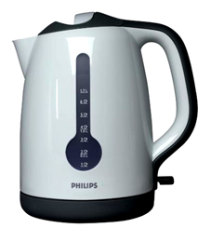
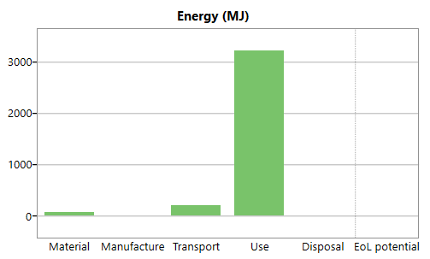
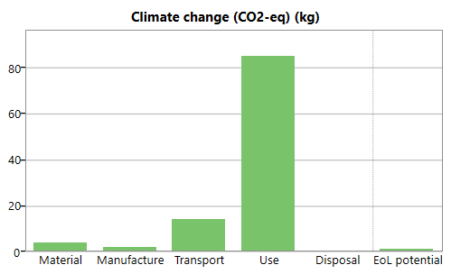
Ansys Granta EduPack software Eco Audit Tool
User inputs
Database
User interface
Bill of materials
Manufacturing process
Transport needs
Duty cycle
End of life choice
Eco data
Embodied energies
Process energies
Climate change (CO₂-eq)
Unit transport energies
Recycling / combustion
2 kW electric kettle
Eco Audit model
Outputs:
Full report
Data
Criticality
Hazard
Use is 88%
of life-energy
Notes:
19
The Eco Audit tool
This slide shows how the Eco Audit of a product works. The inputs are of two types. The first are drawn from a user-entered bill of materials, process choice, transport requirements, duty cycle (the details of the energy and intensity of use) and disposal route, shown at the top left.
Data for embodied energies, process energies, recycle energies and carbon intensities are drawn from a database of material properties; those for the energy and carbon intensity of transport and the use-energy are drawn from the Ansys Granta EduPack software database of eco-attributes of materials. The outputs are the energy or carbon footprint of each phase of life, presented as bar charts and in tabular form.

Slide 20
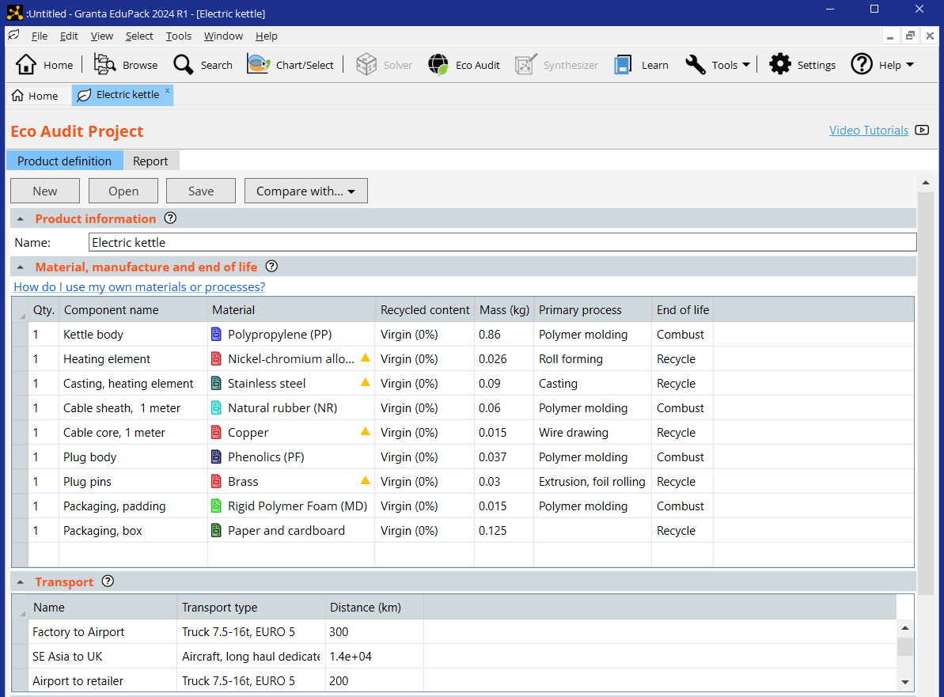
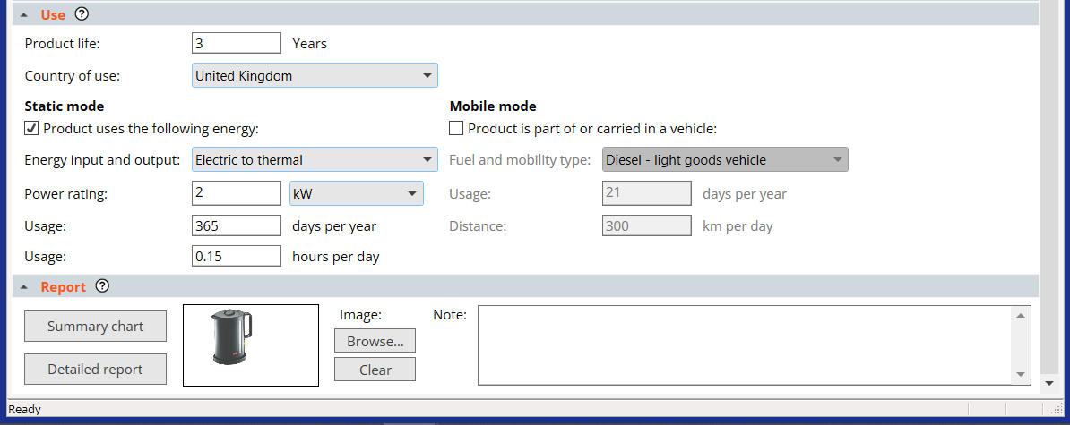
The Eco Audit input interface at Level 2
Useful for what-if?
> 5wt% critical material
End-of-Life
Landfill
Combust
Downcycle
Recycle
Re-manufacture
Reuse
None
Bill of Materials (Input or file)
Help at each step
Output data (Detailed info)
Notes:
20
Ansys Granta EduPack software Eco Audit tool in detail
The tool is opened from the Tools menu at the top of the Granta EduPack screen. Its use involves four steps, listed as 1 to 4 in the frame.
1. Each component is assigned a material (chosen from one of the Granta EduPack databases), a recycle content, a mass, a primary manufacturing process and an end of life choice.
Transport mode and distances are entered.
Use is treated by entering the duty cycle (the energy demands of use).
Clicking on “Report” then generates the bar charts of energy and carbon, and tables listing a break-down by component.
The following frames show the four steps in more detail. They use a simplified schematic of the interface shown above.

Slide 21
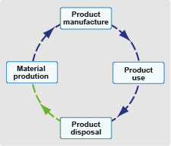
Eco Audit output for design
Need: Fast Eco Audit with sufficient precision to guide decision-making
1 resource – Embodied energy [MJ/kg]
1 emission – Climate change (CO₂-eq) [kg/kg]
Transport is separate
Distinguish life-phases
Life-energy
Audit: Energy
600
400
300
200
100
0
-100
Use
Energy
Material
Embodied energy (MJ)
Manufacture
Transport
Disposal
EoL credit
Potential benefits next life
Notes:
21
The idea of an approximate, but fast, Eco Audit
The strategy for guiding design is detailed here:
The first step is one of simplification, developing a tool that is approximate but retains sufficient discrimination to differentiate between alternative choices. A spectrum of levels of analysis exist, ranging from a simple eco-screening against a list of banned or undesirable materials and processes to a full LCA, with overheads of time and cost. In between lie methods that are less rigorous; they are approximate but fast.
We have chosen to select a single measure of emission. On one point there is some international agreement: the Kyoto Protocol and Paris agreement committed the nations that signed it to progressively reduce carbon emissions, meaning CO₂. At the national level the focus is more on reducing energy consumption, but since this and CO₂ production are closely related, they can be treated as equivalent. Thus there is a certain logic in basing design decisions on energy consumption or CO₂ generation; they carry more conviction than the use of a more obscure indicator. We shall follow this route, using energy as our measure.
Our strategy is to separate the contributions of the phases of life because subsequent action depends on which is the dominant one. If it is material production, then choosing a material with low “embodied energy” is the way forward. But if it is the use phase, then choosing a material to make use less energy-intensive is the right approach – even if it has a higher embodied energy.

Slide 22
Eco Audit output for design
Need: Fast Eco Audit with sufficient precision to guide decision-making
1 resource – Embodied energy [MJ/kg]
1 emission – Climate change (CO₂-eq) [kg/kg]
Distinguish life-phases
Audit: Energy, CO₂ or Cost
16
14
12
10
8
6
4
2
0
-2
600
400
300
200
100
0
-100
Carbon
Use
Cost
Material
Use
Material
Manufacture
Climate change (C0₂-eq) (kg)
Transport
Cost (US$)
Transport
Manufacture
Disposal
Disposal
Notes:
22
The idea of an approximate, but fast, Eco Audit
A new feature in the enhanced Eco Audit allows cost to be estimated over the life-cycle of the product.

Slide 23
Eco-informed selection: the strategy
The steps
Fast
Eco Audit
Analyse results,
Identify priorities
Explore options with “What if...”s
Use software to select
new Materials
and/or Processes
Recommend
actions & assess
potential savings
600
400
300
200
100
0
-100
When we did “what if’s” we were guessing
Initial and re-design
Material
Use
Can we do better? Be systematic?
Energy (MJ)
Click on bar for advice
Manufacture
Transport
Use Eco Audit or other tools
to explore design improvements
Disposal
EoL credit
Apply the selection methodology
Material
Minimize:
material in part
embodied energy
CO₂ /kg
Manufacture
Minimize:
process energy
CO₂/kg
Transport
Minimize:
mass
distance
transport type
Use
Minimize:
mass
thermal loss
electrical loss
End of Life
Select:
recyclable materials
non-toxic materials
Notes:
Responding to the Eco Audit
A systematic analysis of materials selection, targeting the most energy and carbon-intensive phases of life, starts with the output of the eco-audit. The eco-audit identifies the design objective that is a key input for the established materials selection methodology that is built into the Granta EduPack software.

Slide 24
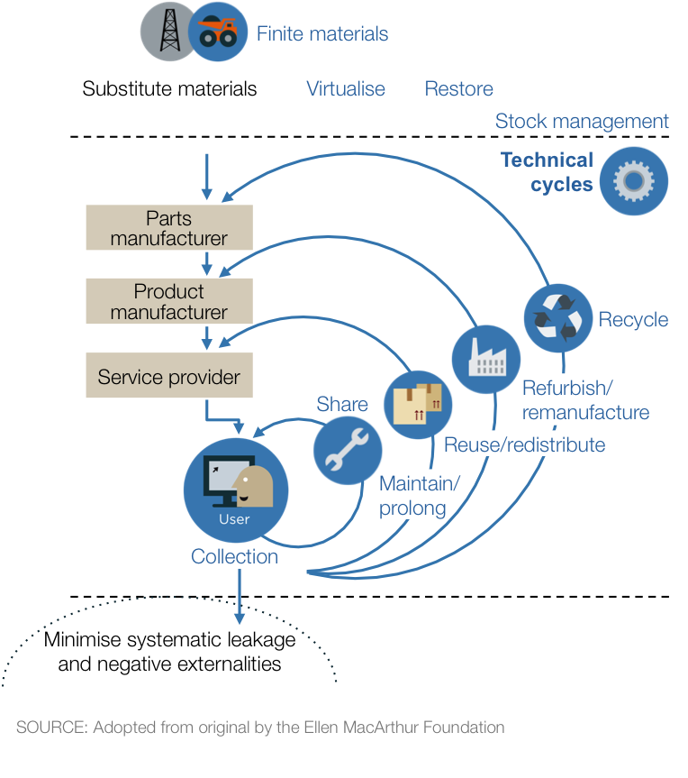
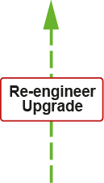
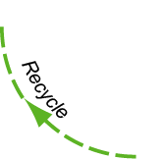



A closer look at Product disposal and End-of-life – phase 4
Landfill (not good – to avoid)
Combust (energy recovered but material lost)
Downcycle (non-functional)
Recycle (functional recycling)
Re-engineer/Upgrade (repair, modernize)
Re-use (second hand, inherit)
Sharing (carpool, electric scooters
Circularity – `next life:
The product life-cycle
Combust
Landfill

Slide 25
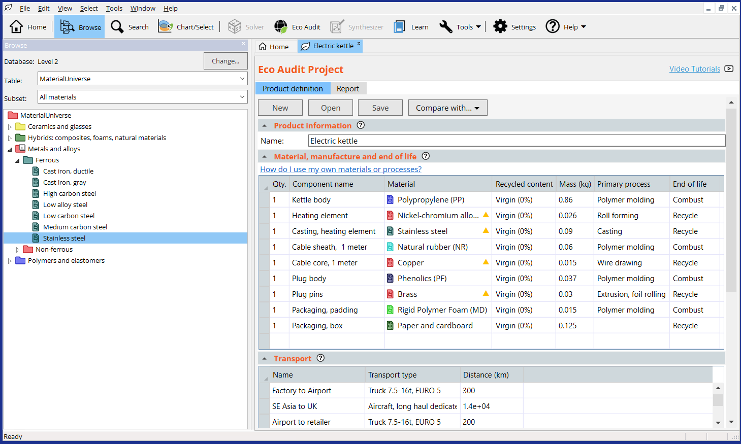
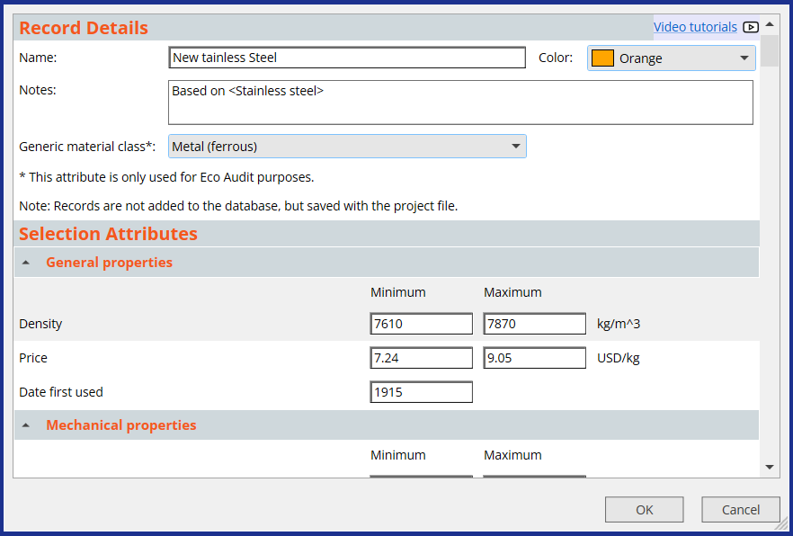
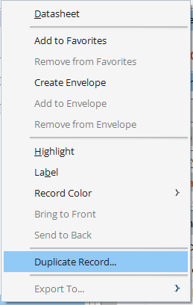
Add your own records, based on existing ones, to Eco Audit
Right-click
Notes:
Creating custom Granta EduPack Records
New materials or process records can be created via Add Record in the Tools menu, or by duplication of an existing record, via right-click. This record ca can then be modified and can be saved within a project file.

Slide 26
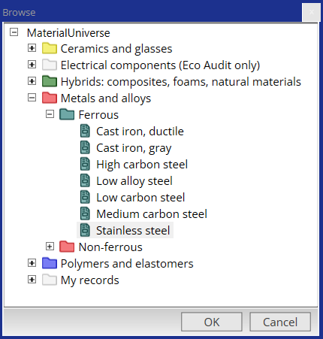
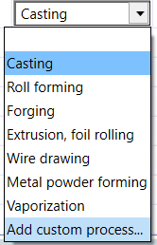
Both custom Materials and Processes can be included in Eco Audit
Notes:
User defined records in Eco Audit
From Granta EduPack 2023 R2 onwards, user defined records can be employed in an Eco Audit. They are added directly in the bill of materials by clicking on drop-down menus from the material or process box.

Slide 27
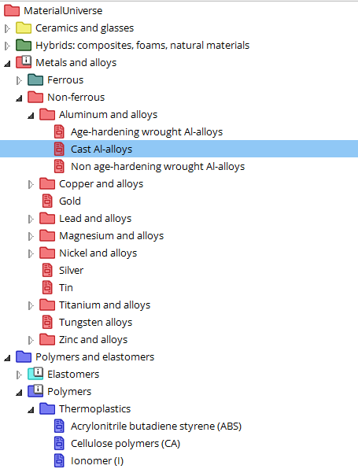
Glass bottle with cap: Step 1. Material and process energy / CO₂
Component name Material Process Mass (kg) End of life
Component 1
Aluminum alloys
Forging/Rolling
0.002
Recycle
Landfill
Downcycle
Recycle
Re-manufacture
Reuse
None
Casting
Forging / rolling
Extrusion
Wire drawing
Powder forming
Vapor methods
Granta EduPack
materials tree
End of life
options
Notes:
Step 1: enter the bill of materials and end-of-life choice
Materials, processes and end-of-life choice are entered in the way shown here. A bill of materials is drawn up, listing the mass of each component used in the product and the material of which it is made, as on the left. Data for the embodied energy (MJ/kg) and CO₂ (kg/kg) per unit mass for each material is retrieved from the database – here, the data sheets of Part 2 of this book, using the means of the ranges listed there (right hand side of the Table). Multiplying the mass of each component by its embodied energy and summing gives the total material energy – the first bar of the bar-chart.
The audit focuses on primary shaping processes since they are generally the most energy-intensive steps of manufacture. These are listed against each material, shown here. The process energies and CO₂ per unit mass are retrieved from the database. Multiplying the mass of each component by its primary shaping energy and summing gives an estimate of the total processing energy – the second bar of the bar-chart.
On a first appraisal of the product it is frequently sufficient to enter data for the components with the greatest mass, accounting for perhaps 95% of the total. The residue is included by adding an entry for “residual components” giving it the mass required to bring the total to 100% and selecting a proxy material and process: “polycarbonate” and “molding” are good choices because their energies and CO₂ lie in the mid range of those for commodity materials.
Finally, the end-of-life choice is selected from the list of 5 options, listed here.

Slide 28
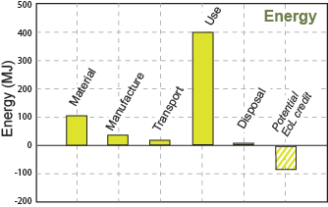
Glass bottle with cap: Step 2. Material and process energy / CO₂
Component name Material Process Mass (kg) End of life
Component 1
Aluminum alloys
Rolling
0.002
Recycle
Component 2 Glass Glass molding 0.45 Reuse
Total embodied energy
Total process energy
Total mass
Total end of life energy
Don’t forget to put the
number of each component
Notes:
Step 2: enter the bill of materials and end-of-life choice
Materials, processes and end-of-life choice are entered in the way shown here. A bill of materials is drawn up, listing the mass of each component used in the product and the material of which it is made, as on the left. Data for the embodied energy (MJ/kg) and CO₂ (kg/kg) per unit mass for each material is retrieved from the database – here, the data sheets of Part 2 of this book, using the means of the ranges listed there (right hand side of the Table). Multiplying the mass of each component by its embodied energy and summing gives the total material energy – the first bar of the bar-chart.
The audit focuses on primary shaping processes since they are generally the most energy-intensive steps of manufacture. These are listed against each material, shown here. The process energies and CO₂ per unit mass are retrieved from the database. Multiplying the mass of each component by its primary shaping energy and summing gives an estimate of the total processing energy – the second bar of the bar-chart.
On a first appraisal of the product it is frequently sufficient to enter data for the components with the greatest mass, accounting for perhaps 95% of the total. The residue is included by adding an entry for “residual components” giving it the mass required to bring the total to 100% and selecting a proxy material and process: “polycarbonate” and “molding” are good choices because their energies and CO₂ lie in the mid range of those for commodity materials.
Finally, the end-of-life choice is selected from the list of 5 options, listed here.

Slide 29
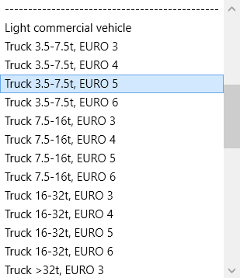
Step 3. Transport
Eco Audit assumes
optimal (fully) loaded
transports
Transport stage Transport type Distance (km)
Stage 1
Truck 3.5-7.5t, EURO 5
350
Stage 2 Sea, bulk carrier 12 000
Transport energy
Transport CO_{2 Eq}
Table of transport types:
MJ / tonne.km
CO₂ / tonne.km
Notes:
29
Step 3: enter the transport details
This step estimates the energy for transportation of the product from manufacturing site to point of sale. The energy demands of chosen transport in 0.9 MJ/tonne.km, retrieved from a look-up table in the Granta EduPack software, is multiplied by the mass of the product and the distance travelled to give the travel energy. Carbon footprint is calculated in a similar way.

Slide 30
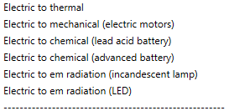
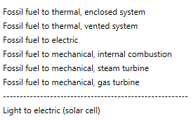
Step 4. Use phase – static mode
Energy input and output
Electric to mechanical
Power rating
1.2
kW
Energy input and output
Usage
365
days per year
W
kW
MW
hp
ft.lb/sec
kCal/yr
BTU/yr
Usage
0.5
hours per day
Total energy or
CO2-eq for use
A fridge has electric to
mechanical energy losses,
due to the compressor
Notes:
30
Step 4: enter the use pattern
The use phase requires a little explanation. There are two different classes of contribution.
Most products require energy to perform their function: electrically powered products like hairdryers, electric kettles, refrigerators, power tools and space heaters are examples. Even apparently non-powered products like household furnishings or unheated buildings still consume some energy in cleaning, lighting and maintenance. The first class of contribution relates to the power consumed by, or on behalf of, the product itself.
The second class is associated with transport. Products that form part of a transport system or are transported add to its mass and thereby augment its energy consumption and CO₂ burden. This carries an energy and CO₂ penalty per unit weight and distance. Multiplying this by the product weight and the distance over which it is carried gives an estimate of the associated use-phase energy and CO₂.
All energies are related back to primary energy, meaning oil, via oil-equivalent factors for energy conversion. Retrieving these and multiplying by the power and the duty cycle – the usage over the product life – gives an estimate of the oil-equivalent energy of use.

Slide 31
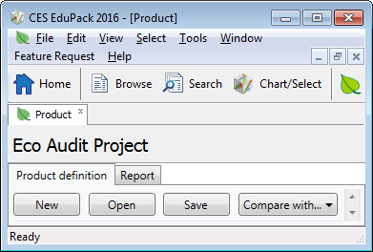
New example. Bottled water in PET (100 units)
1 litre PET bottle with PP cap
Blow molded
Filled in France, transported 550 km to UK
Refrigerated for 2 days, then drunk
Product name:
PET bottle
Number Name Material Process Mass (kg) End of life
100 Bottles PET Molding 0.04 Recycle
100 Caps Polypropylene Molding 0.001 Landfill
100 Water 1.0
Transport
Stage 1
Truck 7.5-16t, EURO 5
550 km
Survey charts
Use - refrigeration
Electric to mechanical
0.12 kW
2 days
24 hrs/day
Full report
Notes:
31
A simple example
Here is an extremely simple example to illustrate how the Eco Audit tool works. One brand of bottled water – we will call it Alpure – is sold in 1-liter PET bottles with polypropylene caps. One bottle weighs 40 grams; its cap weighs 1 gram. The bottles and caps are molded, filled with water in the French Alps and transported 550 km to London, England, by 14 tonne truck. Once there, they are refrigerated for 2 days, on average before consumption. We use these data for the case study, taking 100 bottles as the unit of study, requiring 1m³ of refrigerated space. At end of life the bottles are recycled.

Slide 32

Change the materials
1 litre glass bottle with aluminum cap
Copy of current project
New project
Saved project
Glass molded
Filled in France, transported 550 km to UK
Refrigerated for 2 days, then drunk
Product name:
PET bottle
PET bottle
Glass bottle
Number Name Material Process Mass (kg) End of life
100 Bottles PET Molding 0.04 Recycle
Soda glass
Glass molding
0.45
100 Caps Polyprop Molding 0.001 Landfill
Aluminum
Forging/Rolling
0.002
100 Water 1.0
Transport
Stage 1
Truck 7.5-16t, EURO 5
550 km
Use - refrigeration
Electric to mechanical
0.12 kW
2 days
24 hrs/day
Notes:
32
Change of material
This frame shows a change of material. The “Compare with...” brings up a copy of the inputs, which can now be edited. Here is the material of the bottle has been changed to glass, entering the mass of a typical 1-liter glass wine bottle (0.45 kg). The material of the cap has been changed to aluminum, again using a typical mass for one cap.

Slide 33
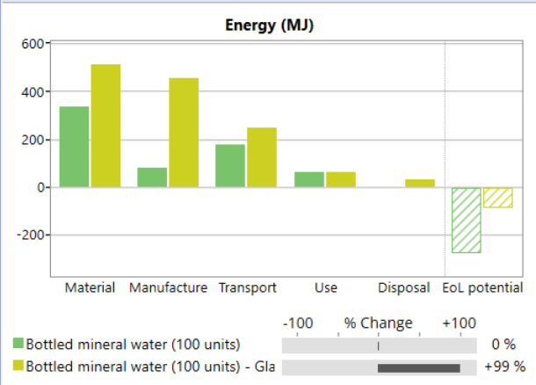


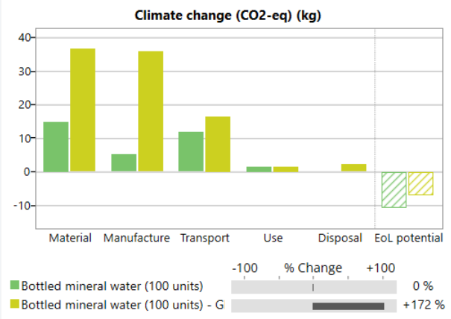
Actions and comparisons
The fast comparison allows design decisions on-the-fly
Reducing impact
Actions
Use as large a 'recycled content' in the material as possible.
=
Can explore:
Material choice
Recycle content
Transport mode
Transport distance
Use pattern
Electric energy mix
End of life choice
Virgin PET
=
Glass
Many projects are available as project files.
Notes:
33
Actions and comparisons
This is the output of the comparison. Bars for the original PET bottle are shown in green, those for the glass bottle in yellow. The glass bottle is more energy intensive and carries greater CO2 emissions than the PET bottle.
Clicking on the Material bar brings up suggestions for improvement. One is to use recycled materials. Using the “Compare with…” facility a second time allows this to be tried. The next frame shows the results.

Slide 34
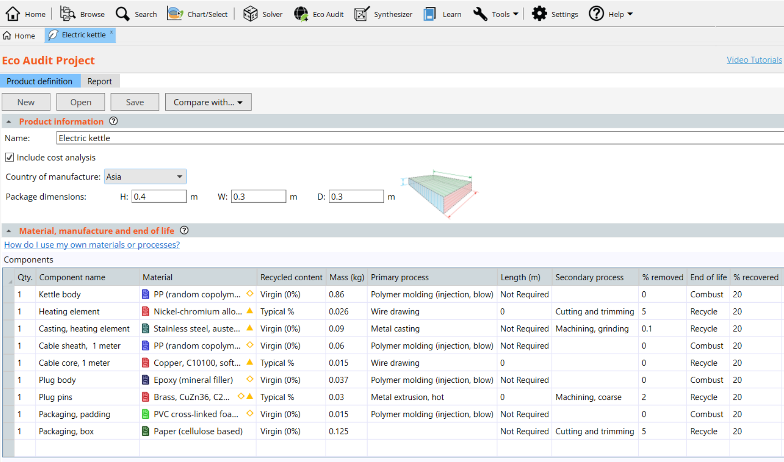
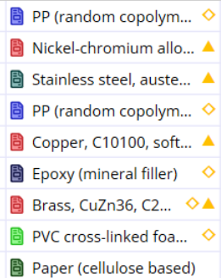
The Enhanced Eco Audit tool
Cost Audit
Secondary Processes
“Restricted” risk flags
Joining and Finishing
May.............Will damage
Notes:
34
Granta EduPack Advanced Eco Audit tool in detail
The Enhanced Eco Audit is available within the Sustainability database at Level 3. It enables Cost Audits by ticking this option above the Bill of Materials (B.O.M.) It highlights materials with considerable content of critical elements as well as restricted or hazardous substances.
It allows secondary processes to be added and an additional step of Joining and Finishing of the product, all using simple drop-down menus.

Slide 35
Summary
The Ansys Granta EduPack software has two resources to help explore the materials dimension of environmental design
1. Selection strategies allows selection to re-design products using eco-properties and employ systematic methods.
2. The Eco Audit tool allows students to implement quick, approximate “portraits” of energy / CO_{2 Eq.} character of products.
Eco Audits reveal the eco-fingerprint of products and suggest approaches to making them less environmentally damaging. The Enhanced Eco Audit gives Cost information and flags restricted or critical materials risk
Notes:
35
Summary
This final frame summarizes the points made in this Unit. More can be found in the textbook Materials and the Environment, and in the Granta Edupack documentation. For more information, see www.ansys.com/education-resources

Slide 36
Ansys Education Resources Feedback Survey
Here at Ansys, we rely on your feedback to ensure the educational content we create is up-to-date and fits your teaching needs.
Please click the link below to fill out a short survey (~7 minutes) to help us continue to support academics around the world utilizing Ansys tools in the classroom.
Feedback Survey Link
Notes:
Feedback Survey link for copy-paste method → https://ansys.typeform.com/to/jcattJI5

