Slide 1
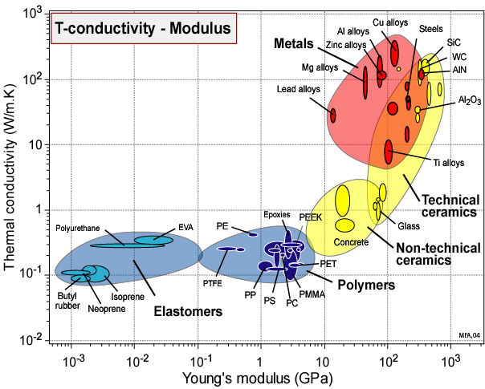
Designing new materials:
Filling the materials-property space
Mike Ashby
Department of Engineering,
University of Cambridge

Slide 2
Learning objectives for this lecture unit
Ansys software mentioned | Ansys Granta EduPack™­, a teaching software for materials education
Intended Learning Outcomes
Knowledge and Understanding | Knowledge about structural and architecture materials
Skills and Abilities | Ability to fill holes in the property space of materials
Values and Attitudes | Realization of the potential for material development
Resources
Text: “Materials Selection in Mechanical Design”, 5th edition by M.F. Ashby, Butterworth Heinemann, Oxford, 2016, Chapters 12-13
Notes:
Learning Objectives
These Intended Learning Outcomes are based on a taxonomy of knowledge and understanding as the basis, skills and abilities as necessary for the practical use of knowledge and understanding, followed by acquired values and attitudes enabling assessments and responsible use of these abilities.
Combined with a suitable assessment, they should be helpful in the context of accreditations or for the CDIO Syllabus.
The Texts listed are from books authored or co-authored by Mike Ashby but other texts are also referred to in the Science Notes.

Slide 3
Outline
History of structural materials
Holes in material property space
Fundamental limits
Hybrid materials as a way forward
Notes:
Outline
This is the fifth Unit of a course on Material and Process Selection. The Units link closely to the Text listed on the previous frame but can equally by used in conjunction with texts such as Callister, Budinski, Askeland and others. The relevant chapters of the Texts are listed on the Outline frame of each Unit. The methods developed in the course are implemented in the Ansys Granta EduPack software, which is structured to evolve in pace with the student throughout a four-year engineering program. This first Unit introduces materials and processes, and the way in which information about them can be classified, stored, retrieved and explored.

Slide 4
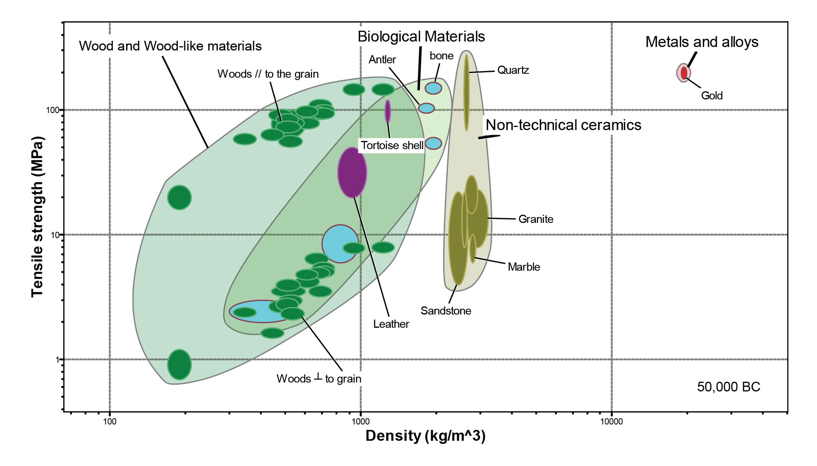
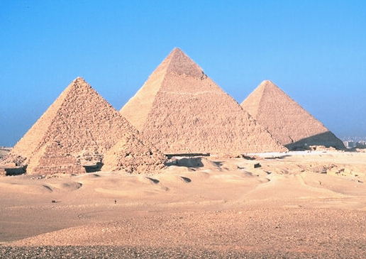
The evolution of structural materials
Egyptian Pyramids
Notes:
Time evolution
It is worth looking back to see the way in which the filled parts of material property space have expanded over time. We take the σ_{y} – ρ section as an example.
The (animated) chart is plotted for six successive points in historical time, ending with the present day. The materials of pre-history, shown at (a), cover only a tiny fraction of this strength-density space. By the time of the peak of the Roman empire, around 50 BC (b), the area occupied by metals has expanded considerably, giving Rome critical advantages in weaponry and defence. The progress thereafter was slow: 1500 years later (c) not much has changed, although, significantly, cast iron now appears. Even 500 years after that (d) expansion of the occupied area of the chart is small; aluminium only just creeps in. Then things accelerate. By 1945 the metals envelope has expanded considerably and a new envelope – that of synthetic polymers – now occupies a significant position. Between then and the present day the expansion has been dramatic. Much of the space is now filled and the filled area starts to approach fundamental limits (not shown here) beyond which it is not possible to go. Glass, pottery, natural mats and gold have been around since at least 50,000 BC.

Slide 5
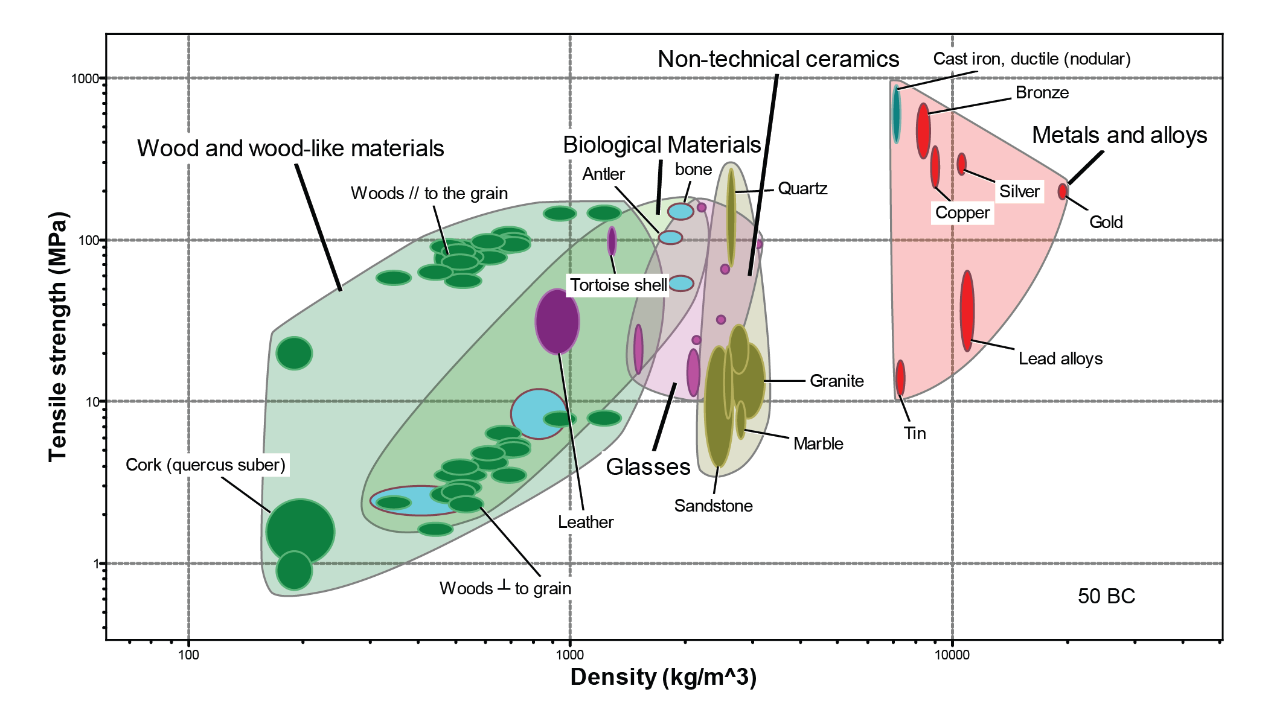

The evolution of structural materials
Roman Temples
Notes:
Time evolution
It is worth looking back to see the way in which the filled parts of material property space have expanded over time. We take the σ_{y} – ρ section as an example.
The (animated) chart is plotted for six successive points in historical time, ending with the present day. The materials of pre-history, shown at (a), cover only a tiny fraction of this strength-density space. By the time of the peak of the Roman empire, around 50 BC (b), the area occupied by metals has expanded considerably, giving Rome critical advantages in weaponry and defence. The progress thereafter was slow: 1500 years later (c) not much has changed, although, significantly, cast iron now appears. Even 500 years after that (d) expansion of the occupied area of the chart is small; aluminium only just creeps in. Then things accelerate. By 1945 the metals envelope has expanded considerably and a new envelope – that of synthetic polymers – now occupies a significant position. Between then and the present day the expansion has been dramatic. Much of the space is now filled and the filled area starts to approach fundamental limits (not shown here) beyond which it is not possible to go. Glass, pottery, natural mats and gold have been around since at least 50,000 BC.

Slide 6
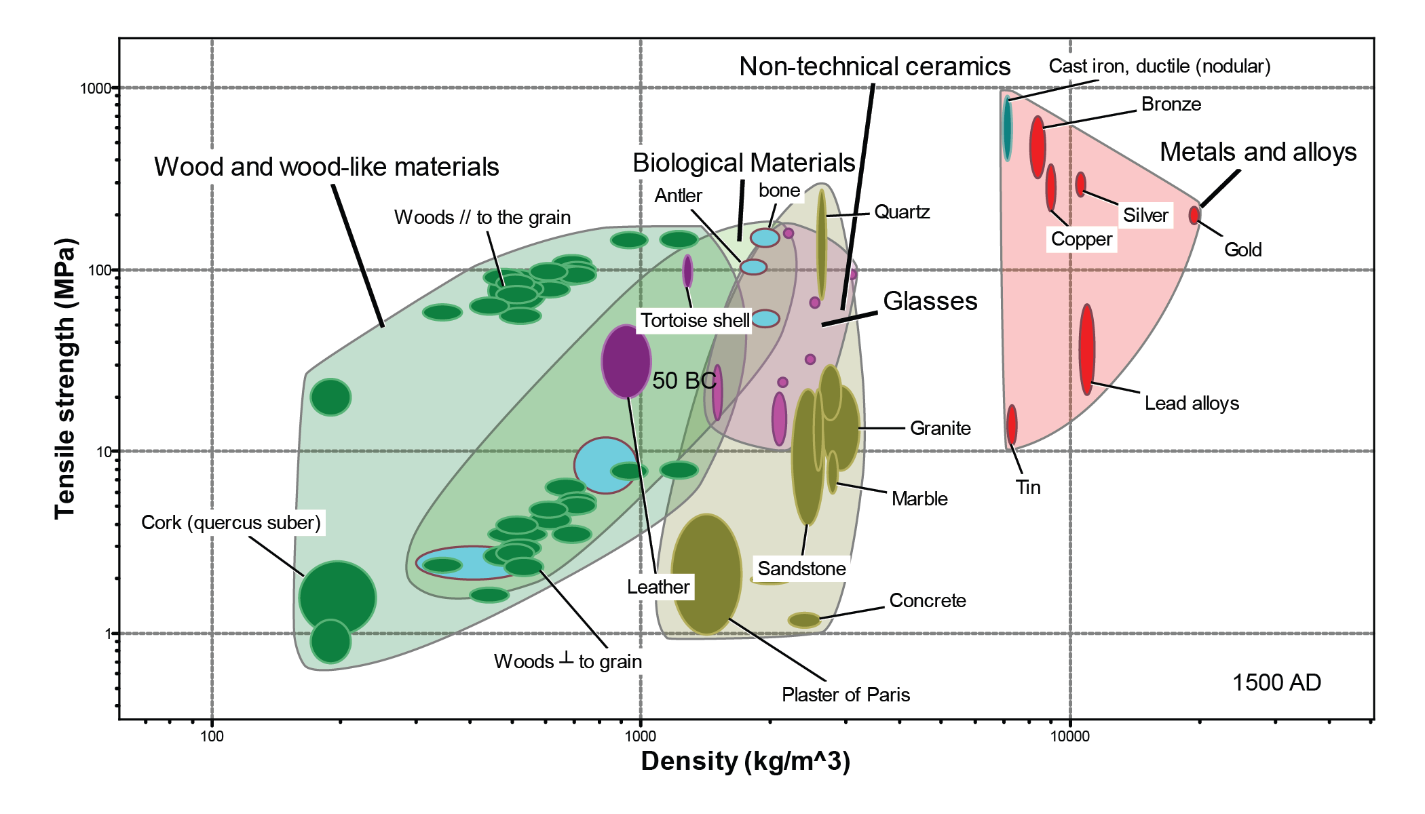

The evolution of structural materials
Medieval Castles
Notes:
Time evolution
It is worth looking back to see the way in which the filled parts of material property space have expanded over time. We take the σ_{y} – ρ section as an example.
The (animated) chart is plotted for six successive points in historical time, ending with the present day. The materials of pre-history, shown at (a), cover only a tiny fraction of this strength-density space. By the time of the peak of the Roman empire, around 50 BC (b), the area occupied by metals has expanded considerably, giving Rome critical advantages in weaponry and defence. The progress thereafter was slow: 1500 years later (c) not much has changed, although, significantly, cast iron now appears. Even 500 years after that (d) expansion of the occupied area of the chart is small; aluminium only just creeps in. Then things accelerate. By 1945 the metals envelope has expanded considerably and a new envelope – that of synthetic polymers – now occupies a significant position. Between then and the present day the expansion has been dramatic. Much of the space is now filled and the filled area starts to approach fundamental limits (not shown here) beyond which it is not possible to go. Glass, pottery, natural mats and gold have been around since at least 50,000 BC.

Slide 7
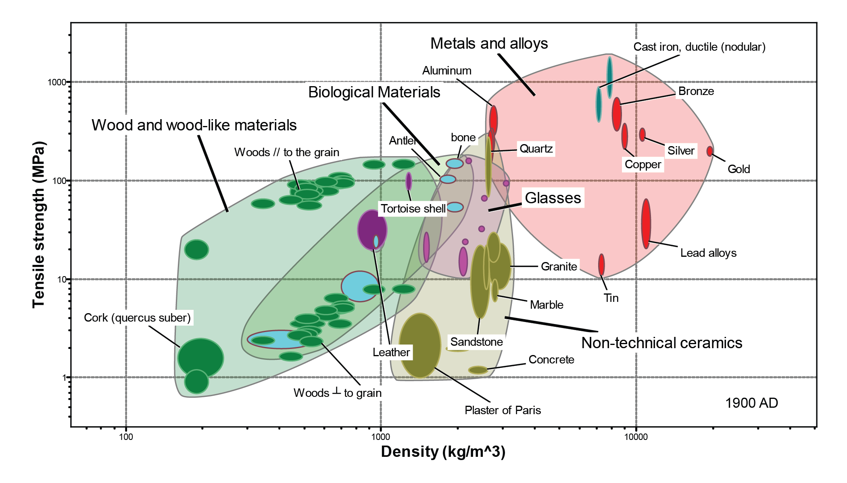

The evolution of structural materials
Art Nouveaux
Notes:
Time evolution
It is worth looking back to see the way in which the filled parts of material property space have expanded over time. We take the σ_{y} – ρ section as an example.
The (animated) chart is plotted for six successive points in historical time, ending with the present day. The materials of pre-history, shown at (a), cover only a tiny fraction of this strength-density space. By the time of the peak of the Roman empire, around 50 BC (b), the area occupied by metals has expanded considerably, giving Rome critical advantages in weaponry and defence. The progress thereafter was slow: 1500 years later (c) not much has changed, although, significantly, cast iron now appears. Even 500 years after that (d) expansion of the occupied area of the chart is small; aluminium only just creeps in. Then things accelerate. By 1945 the metals envelope has expanded considerably and a new envelope – that of synthetic polymers – now occupies a significant position. Between then and the present day the expansion has been dramatic. Much of the space is now filled and the filled area starts to approach fundamental limits (not shown here) beyond which it is not possible to go. Glass, pottery, natural mats and gold have been around since at least 50,000 BC.

Slide 8
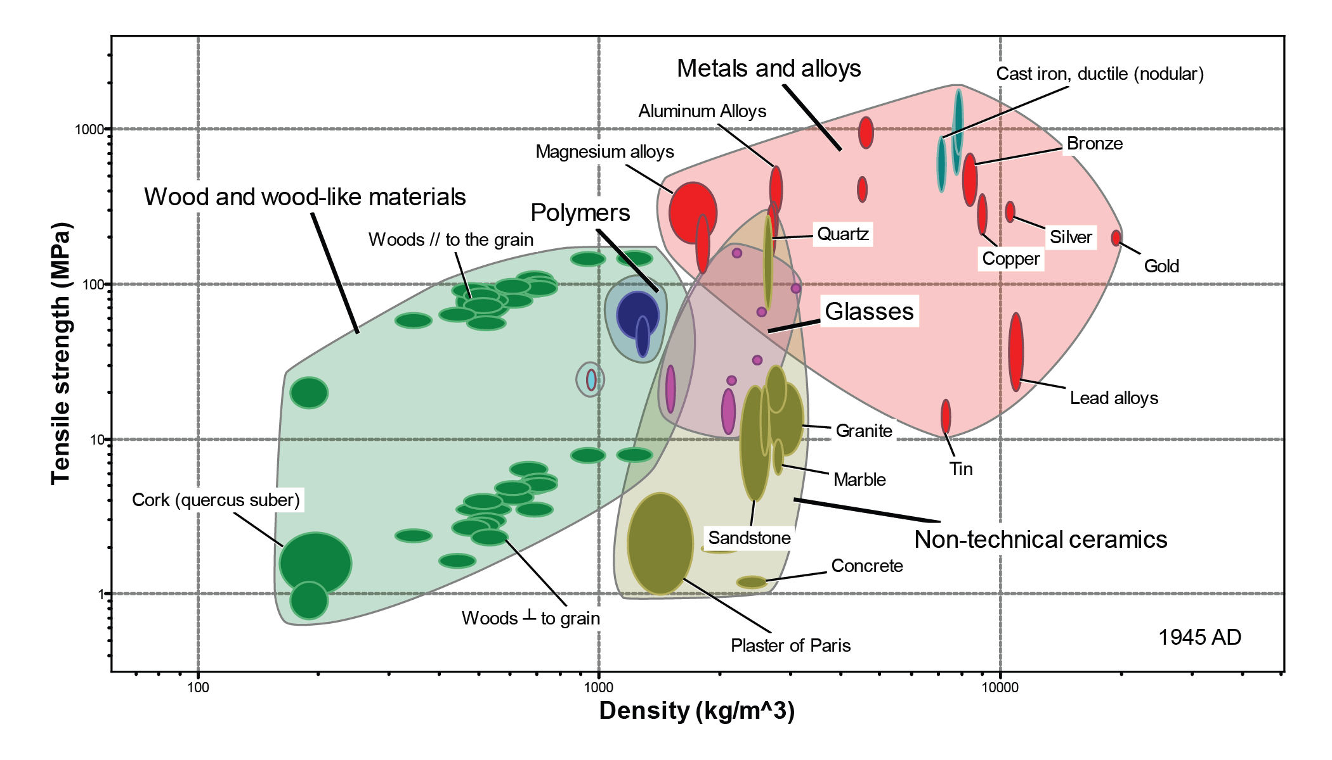

The evolution of structural materials
Skyscrapers
Notes:
Time evolution
It is worth looking back to see the way in which the filled parts of material property space have expanded over time. We take the σ_{y} – ρ section as an example.
The (animated) chart is plotted for six successive points in historical time, ending with the present day. The materials of pre-history, shown at (a), cover only a tiny fraction of this strength-density space. By the time of the peak of the Roman empire, around 50 BC (b), the area occupied by metals has expanded considerably, giving Rome critical advantages in weaponry and defence. The progress thereafter was slow: 1500 years later (c) not much has changed, although, significantly, cast iron now appears. Even 500 years after that (d) expansion of the occupied area of the chart is small; aluminium only just creeps in. Then things accelerate. By 1945 the metals envelope has expanded considerably and a new envelope – that of synthetic polymers – now occupies a significant position. Between then and the present day the expansion has been dramatic. Much of the space is now filled and the filled area starts to approach fundamental limits (not shown here) beyond which it is not possible to go. Glass, pottery, natural mats and gold have been around since at least 50,000 BC.

Slide 9

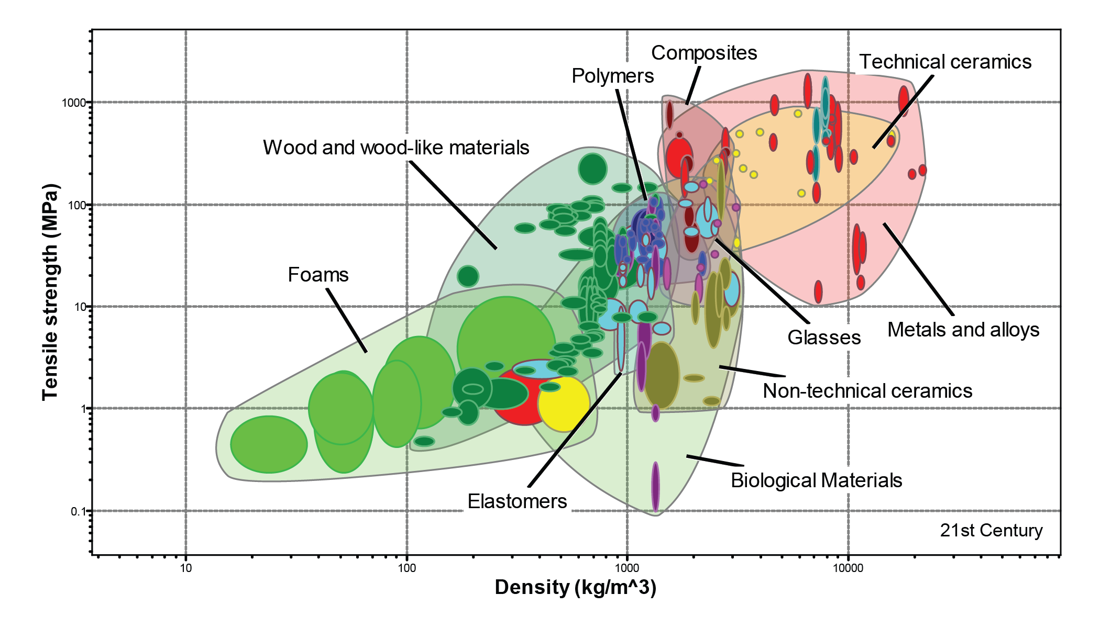
The evolution of structural materials
21st Century
Notes:
Time evolution
It is worth looking back to see the way in which the filled parts of material property space have expanded over time. We take the σ_{y} – ρ section as an example.
The (animated) chart is plotted for six successive points in historical time, ending with the present day. The materials of pre-history, shown at (a), cover only a tiny fraction of this strength-density space. By the time of the peak of the Roman empire, around 50 BC (b), the area occupied by metals has expanded considerably, giving Rome critical advantages in weaponry and defence. The progress thereafter was slow: 1500 years later (c) not much has changed, although, significantly, cast iron now appears. Even 500 years after that (d) expansion of the occupied area of the chart is small; aluminium only just creeps in. Then things accelerate. By 1945 the metals envelope has expanded considerably and a new envelope – that of synthetic polymers – now occupies a significant position. Between then and the present day the expansion has been dramatic. Much of the space is now filled and the filled area starts to approach fundamental limits (not shown here) beyond which it is not possible to go. Glass, pottery, natural mats and gold have been around since at least 50,000 BC.

Slide 10
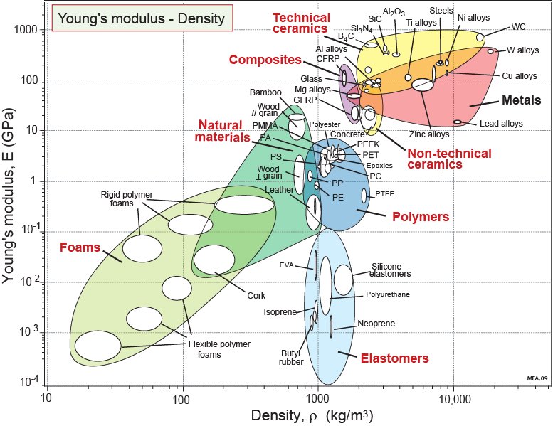
Modulus and density
HOLE
Vector for
material development
HOLE
Contours of
Notes:
Stiffness vs Density
Materials have many properties. Think of them as the axes of a multi-dimensional material-property space. The property charts are sections through this space. Here is the familiar E-ρ section. Any such section has areas that are filled with materials and areas that are empty: holes. Two are shown here. Is anything to be gained by developing materials (or material-combinations) that lie in these holes? The material indices show where this is profitable. A grid of lines of one index – E/ρ – is plotted on this chart. If the filled areas can be expanded in the direction of the arrow (i.e. to greater values of E/ρ ) it will enable lighter, stiffer structures to be made. The arrow lies normal to the index lines. It defines a vector for material development.

Slide 11
Limits: modulus - density
Notes:
Stiffness vs Density
How much further can this filling go? There are some fundamental limits, sketched here. Limits on density are set by the mass of and size of atoms. Osmium (density 22,500 kg/m³ ) is the element with the highest density that is stable and solid at room temperature. Lithium (density 535 kg/m³ ) is the element with the lowest. A “solid” with a density lower than lithium is porous: a foam or a lattice. The limit on strength is set by the breaking load and packing density of atomic bonds – this, too, can be quantified.
Thus, some parts of material property space are accessible, others are not. The figure shows that there remain some unfilled regions of this section that, in principle, could be filled.

Slide 12
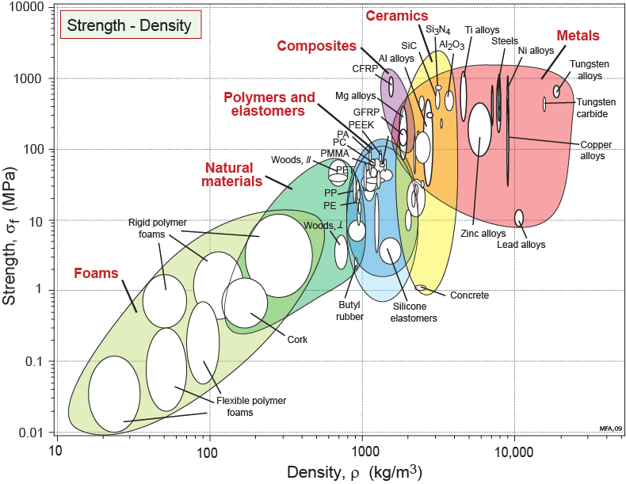
Strength - density
HOLE
Vector for
material
development
Contours of
HOLE
Notes:
Strength vs Density
This is the Strength-Density chart. Like the Modulus-Density chart, part of the space is filled by materials and part is not.

Slide 13
Limits: strength - density
Notes:
Strength vs Density
Thus some parts of the Strength-Density space are accessible, others are not. The figure suggests that there remain some unfilled regions of this section that, in principle, could be filled.

Slide 14
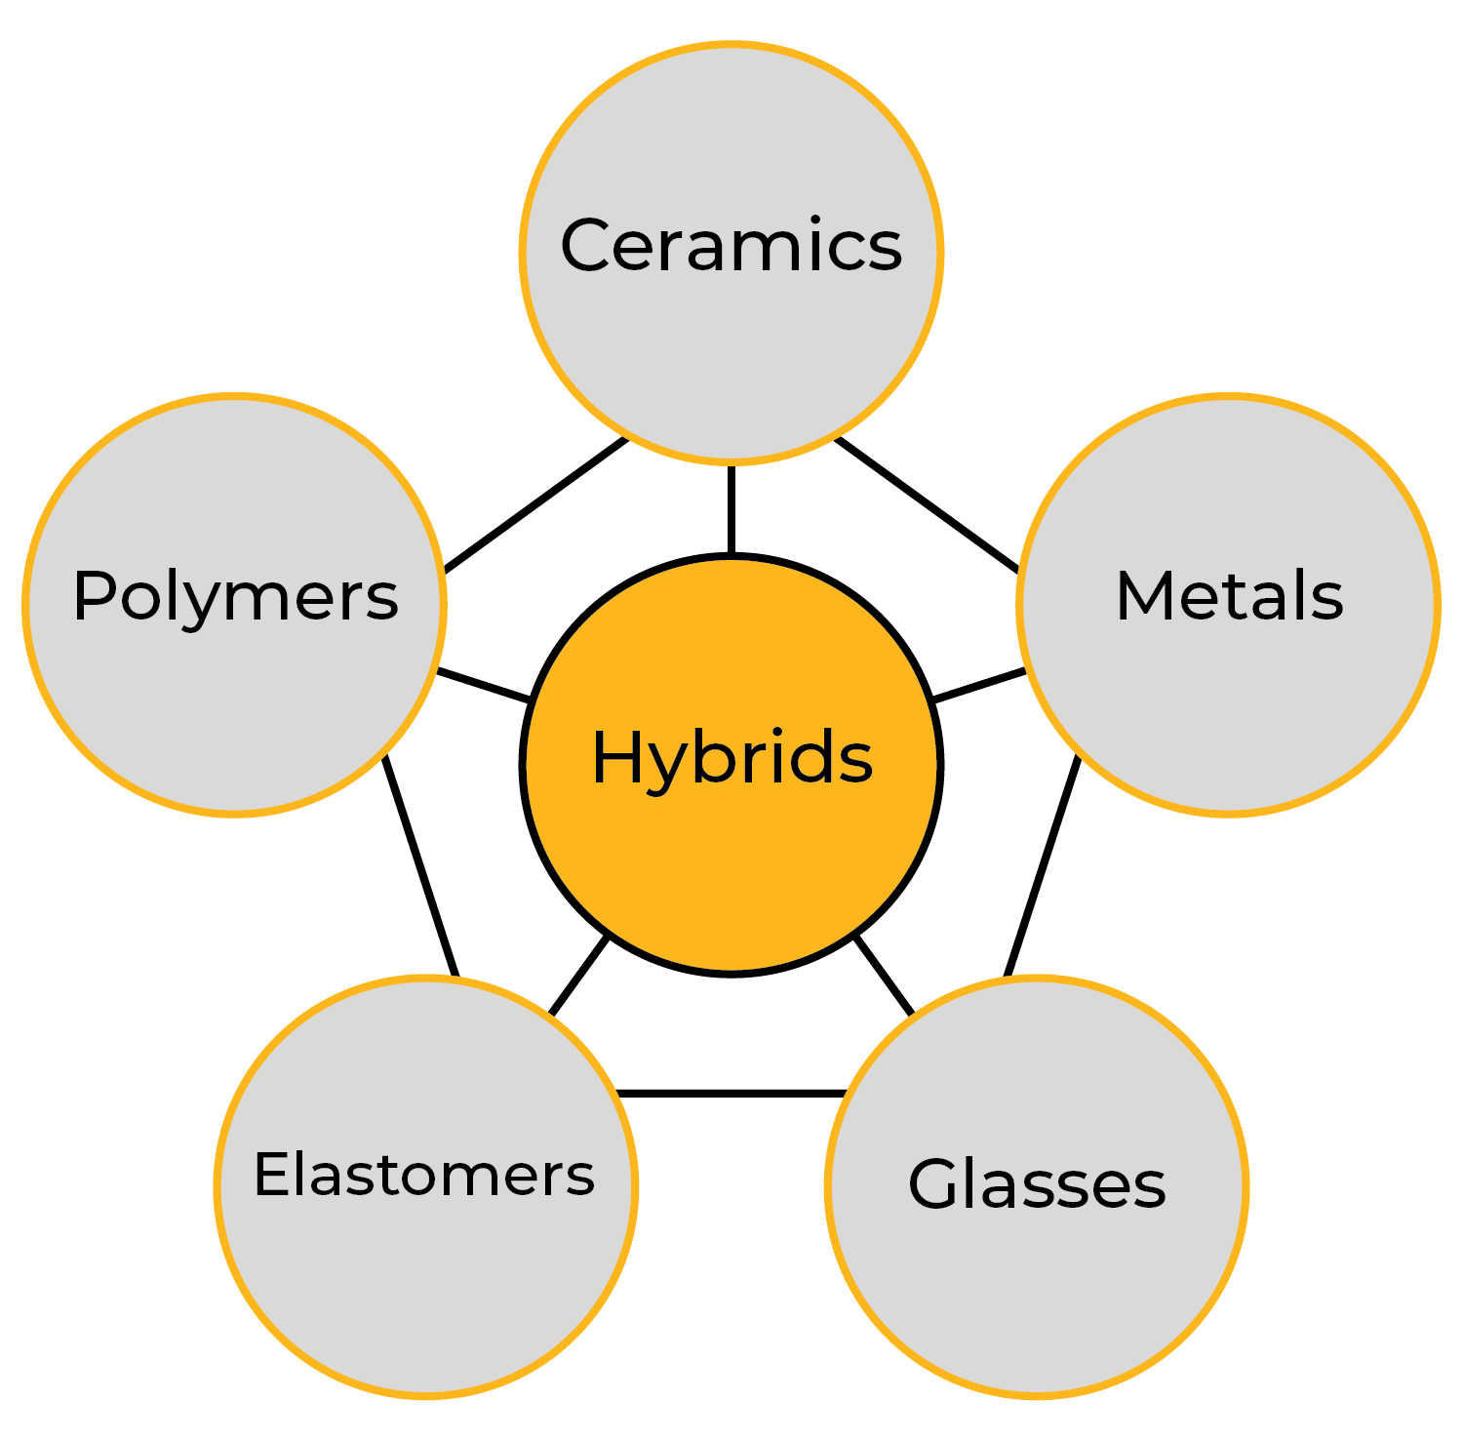
Hybrid materials
Design variables:
Choice of materials
Volume fractions
Configuration
Connectivity
Scale
Notes:
Hybrids
This image summarizes the families of materials, with examples, that make up hybrids: Metals Polymers, Elastomers, Ceramics and Glasses. A number of design variables will determine the properties of the resulting hybrid material. Mainly composition, microstructural parameters and architecture.

Slide 15

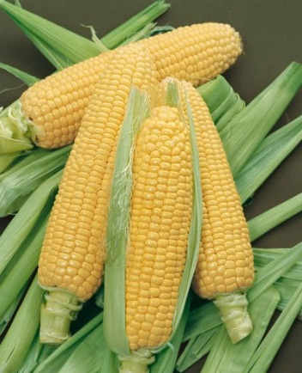

The good and the bad about Hybrids
Hybrid corn
Hybrid cars
Improved yield, hardiness
Low fuel consumption, emissions
…… but… Infertile
…… but… Expensive
Notes:
Pros and Cons of hybrids
Hybrids are combinations of two or more materials, with the aim to benefit from the attractive properties of each material and minimize their drawbacks. As such, we can say little about their composition, which is determined by their components. But of those man-made hybrids used in engineering, the most familiar are composited in which a polymer matrix is reinforced by fivers of glass, carbon or Kevlar.

Slide 16

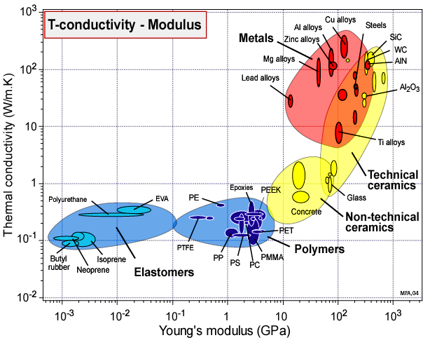
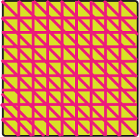
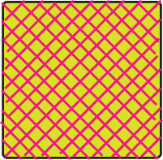


Using Hybrids to fill holes
COPPER
HOLE
30%
Cu
10%
Cu
5%
Cu
RUBBER
Notes:
The Design-driven approach
Here is an example of a section with an enormous hole. How could materials be created to fill it? The traditional routes of materials science are not much help: alloy development cannot lower Young’s modulus of metallic conductors much below 10 GPa; and making new polymer compositions or blends cannot increase the thermal conductivity above about 1 W/m.K.
The answer is to make hybrids: mixtures of two materials in a configuration and relative fraction that gives both low modulus and high conductivity.

Slide 17

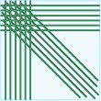
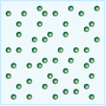
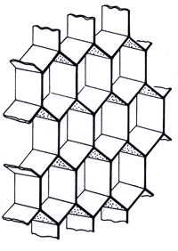

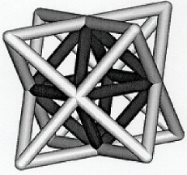


Familiar architectures
Composites
Unidirectional
Quasi-isotropic
Particulate
Cellular structures
Foams
Honeycombs
Triangulated lattices
Sandwich structures
Symmetric sandwiches
Many more
Notes:
Structural hybrids and composites
A number of established structures with well-known models for estimating resulting properties are available.

Slide 18
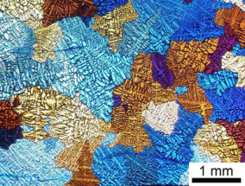
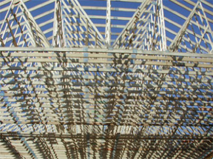
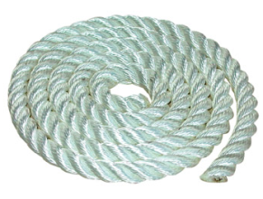
Designing hybrid materials
Combine:
Materials – relate properties to microstructure: controlled nature, scale through alloy design and processing.
Mechanics – accept properties as “given”, optimise the geometry
Textile technology – exploit unique strength and blending properties of fibers
Notes:
Strategies for design
Traditional approaches to optimizing components for structural applications, there have followed two paths.
The approach of materials science: material development to improve the intrinsic properties.
The approach of mechanics: to assume a set of intrinsic properties and optimize the geometry .
To these we add a third: that of adapting the techniques of textile technology to exploit the exceptional properties of thin fibers.

Slide 19
Bending and stretch dominated structures
Bending-dominated structures
Stretch-dominated structures
Lock joints in a mechanism prevents rotation, deformation by bending
Notes:
Deformation modes
This frame explains the difference between bend and stretch-dominated structures. Maxwell’s equations (not shown) could be used to express the condition for stretch dominated behaviour. Stretch dominant structures are much stiffer and stronger that those that are bending dominated.

Slide 20
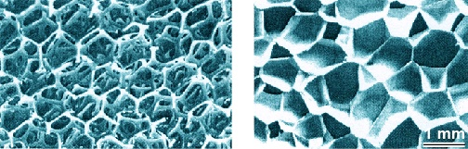
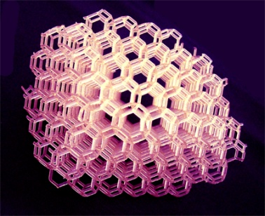
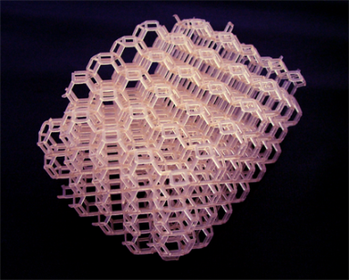
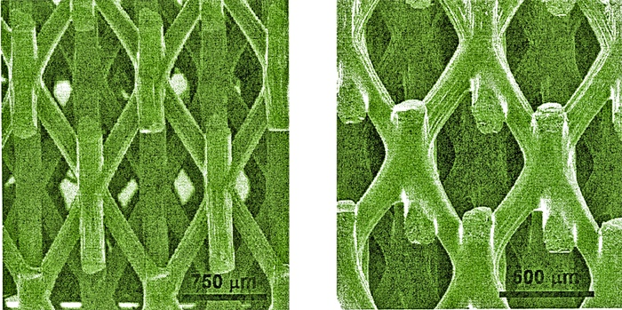
Foams and micro-lattices
Polymer foams
Bending-dominated
micro-lattices
2mm
Stretch-dominated
micro-lattices
500μm
Notes:
Cellular and lattice structures
Foams and lattices, when on a small scale, can be thought of as “materials”, just as we think of wood as a material. Their mechanical properties – stiffness, strength, toughness etc – depend critically on the connectivity of the lattice.

Slide 21
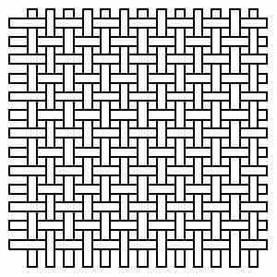
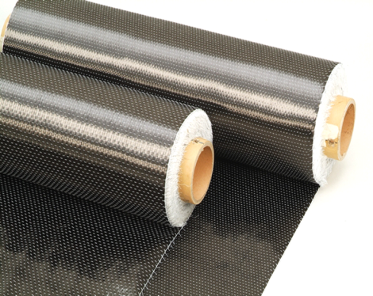

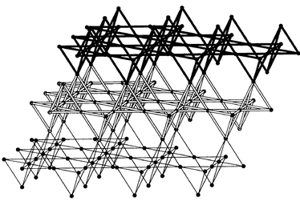
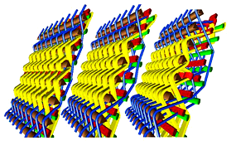
Combining textile technology, mechanics and material
(a) Simple weave
Woven carbon fiber
CFRP product
(b) 3-dimensional weaving
(c) The kagome weave
Notes:
Inspiration from textiles
These are examples of combining textile technology with mechanics and material.
Carbon fiber weave formed to a stiff composite shell
Examples of 3-D weaving now being adapted to advanced composite design
A Kagome lattice with a structure derived from a textile weave

Slide 22
Foams and lattice structures
HOLE
Alu micro-lattices
Alu foams
Plus:
multifunctionality
Notes:
Specific stiffness
Almost all foams are bending dominated. Their value of E/ρ are not exceptional. The E/ρ values for stretch-dominated lattices, by contrast, lie in the hole – they are exceptional. The frame illustrates the areas occupied by aluminum foams and lattices.

Slide 23
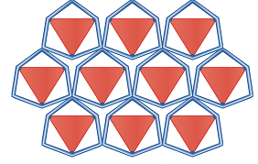
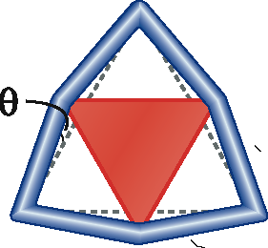
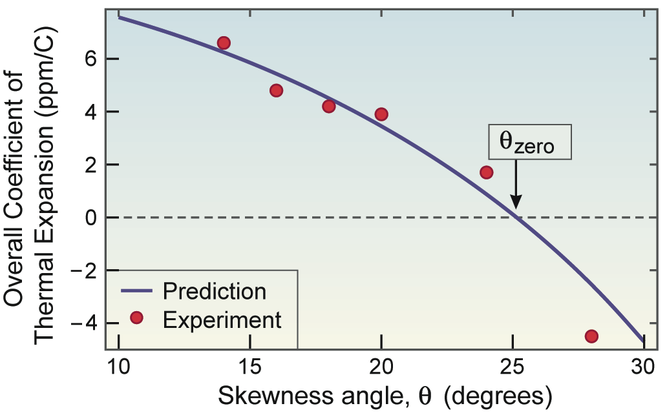
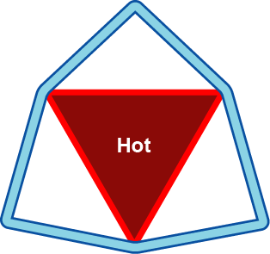
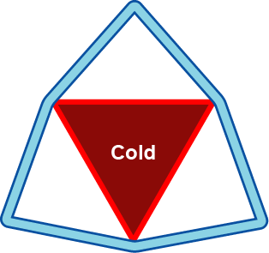
Configuration: controlling expansion
Notes:
Thermal expansion
Almost all solids expand when heated. This frame shows how a hybrid design can be tuned to give zero overall thermal expansion by combining mechanics with material properties.

Slide 24
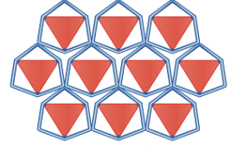
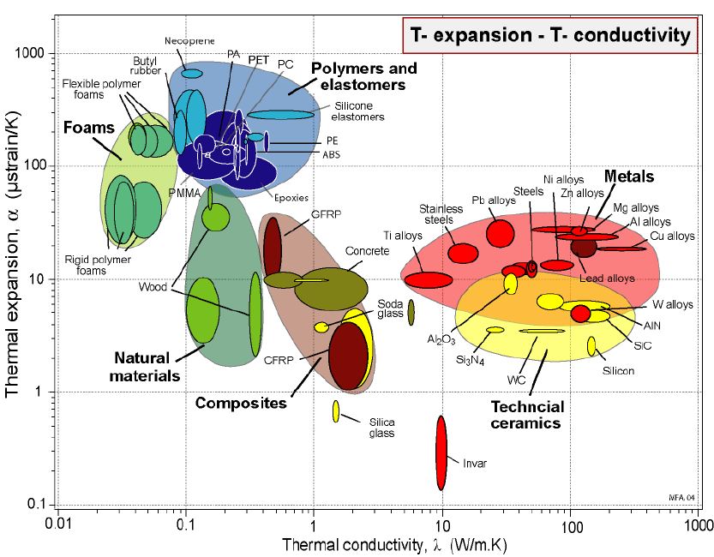
Material-property space: α and λ
Contours of
the index
HOLE
Notes:
Thermal performance
This is where the low expansion hybrid made from aluminum triangles in a nickel frame lies in α – λ space.

Slide 25
Summary
Multi-dimensional material-property space
Only part-filled by monolithic materials
True of mechanical, thermal, electrical, magnetic and optical properties
Material development strategies
Classical (classical alloy development, polymer chemistry….)
“Nano” (sub-micron) scale (exploiting scale-dependence of properties)
Hybridization (exploiting materials, configuration and connectivity)
The strategy:
  Map out the filled areas
  Explore the ultimate boundaries
  Explore ways of filling the empty space.
  Hybrids, exploiting potential of novel configurations, have potential for this
Notes:
Summary
Here are the main points of the presentation.

Slide 26
Ansys Education Resources Feedback Survey
Here at Ansys, we rely on your feedback to ensure the educational content we create is up-to-date and fits your teaching needs.
Please click the link below to fill out a short survey (~7 minutes) to help us continue to support academics around the world utilizing Ansys tools in the classroom.
Feedback Survey Link
Notes:
Feedback Survey link for copy-paste method → https://ansys.typeform.com/to/jcattJI5

