Slide 1
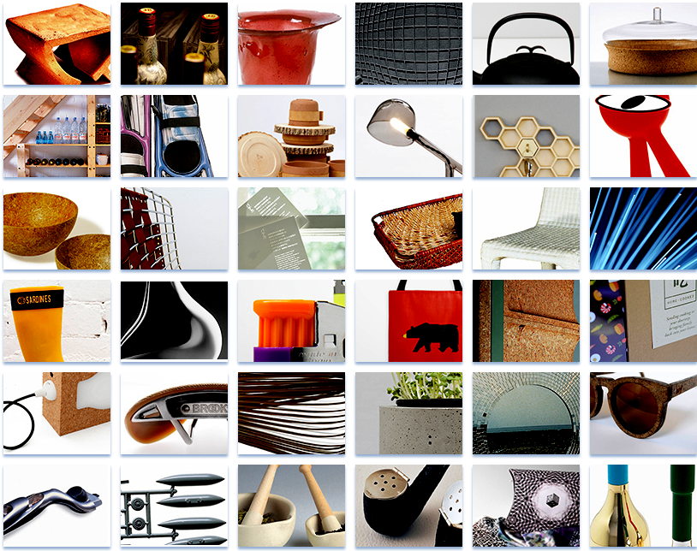
The Design database for products
Mike Ashby
Department of Engineering,
University of Cambridge

Slide 2
Learning objectives for this lecture unit
Ansys software mentioned | Ansys Granta EduPack™­, a teaching software for materials education
Intended Learning Outcomes
Knowledge and Understanding | Understanding of materials and processes properties through products
Skills and Abilities | Ability to find design and engineering data from products
Values and Attitudes | Appreciation of the relationships between Products, Materials and Processes.
Resources
Text: “Materials and Design: The Art and Science of Material Selection in Product Design”, 3rd edition by M. Ashby and K Johnson, Butterworth Heinemann, Oxford, 2014
Paper: The Design Database
Notes:
Learning Objectives
These Intended Learning Outcomes are based on a taxonomy of knowledge and understanding as the basis, skills and abilities as necessary for the practical use of knowledge and understanding, followed by acquired values and attitudes enabling assessments and responsible use of these abilities.
Combined with a suitable assessment, they should be helpful in the context of accreditations or for the CDIO Syllabus.
The Texts listed are from books authored or co-authored by Mike Ashby but other texts are also referred to in the Science Notes.

Slide 3
Outline
Why a Product-Centered database
Products at the center of attention
The Designer’s and Engineer’s view
The role of Materials in Designs
Aesthetic properties
Notes:
Outline
In this presentation we show why materials and processes are important to the design process and how products can be at the centre of this. We also elaborate on the role of materials in product design and introduce aesthetic or sensorial properties into the picture.

Slide 4
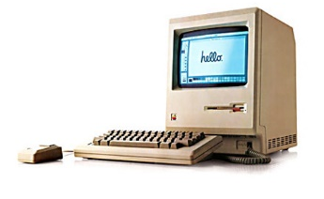
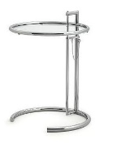
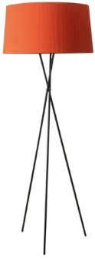
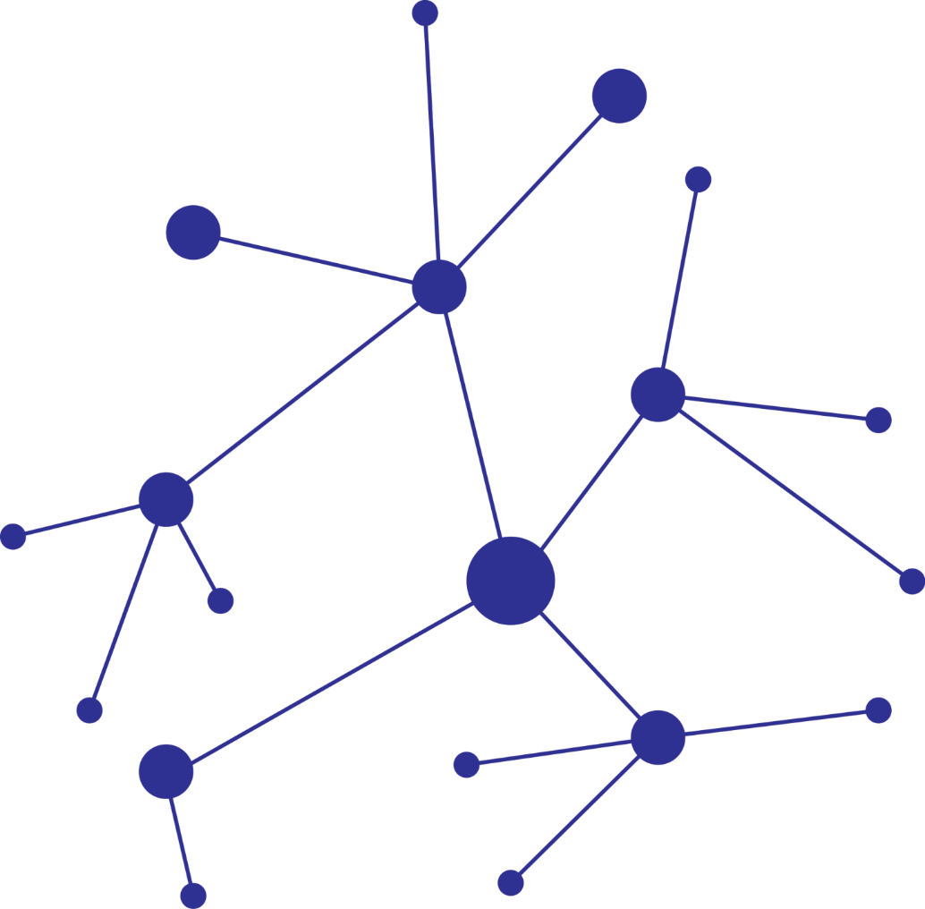
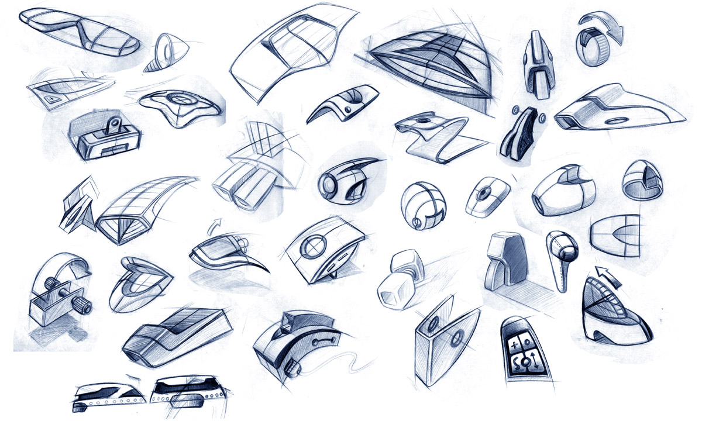
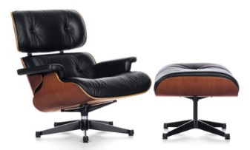
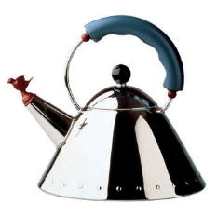
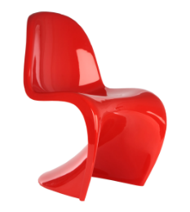
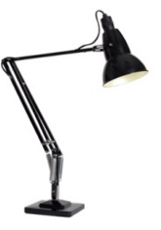
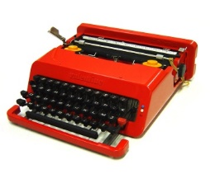
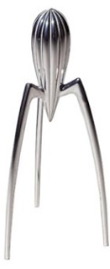
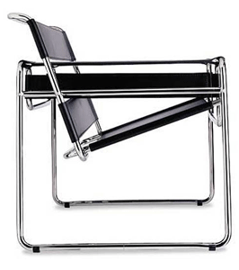
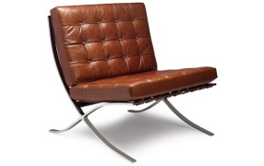

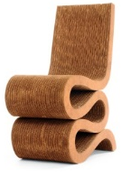
The design database: products, materials and processes
Products as gateway to innovation and design with materials and processes
Notes:
What?
The software is visual and interactive, which makes it easy to use and engaging
The structure of the information is intended to facilitate and inspire innovation and design

Slide 5
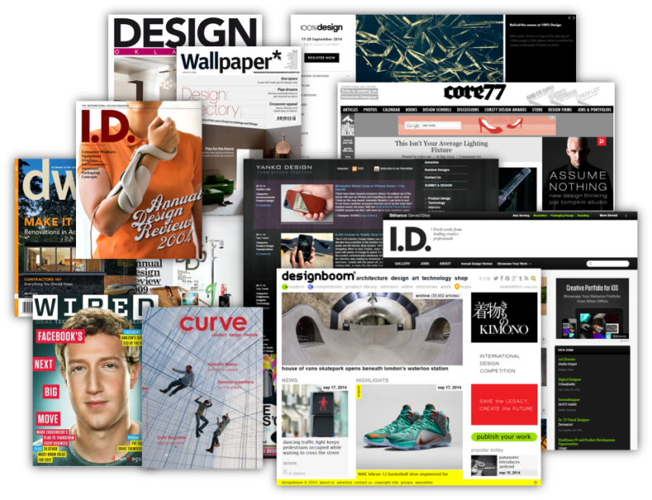
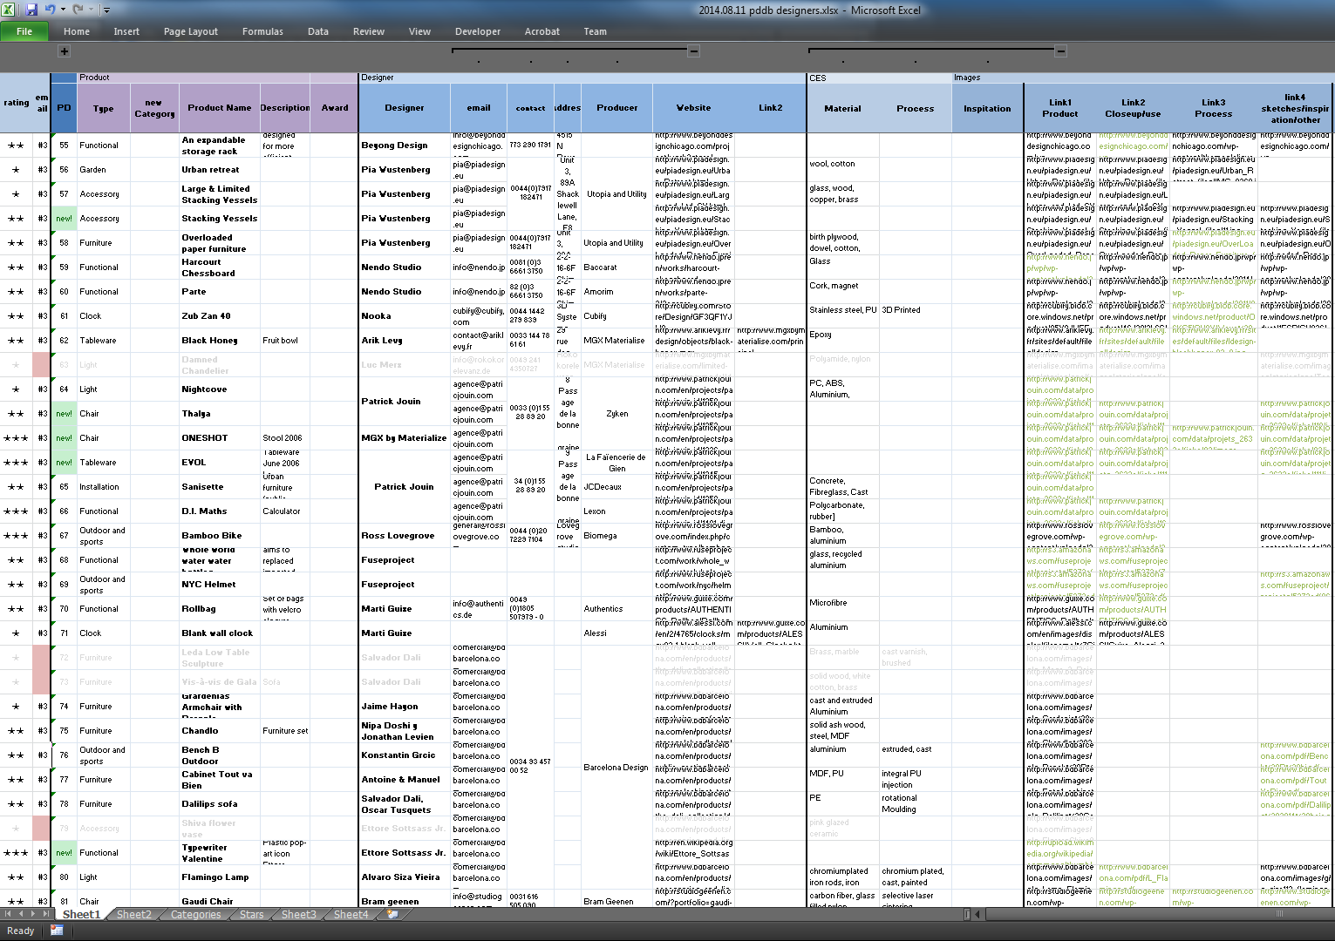
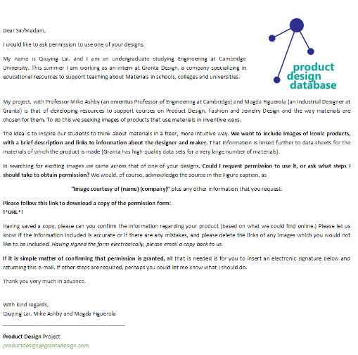
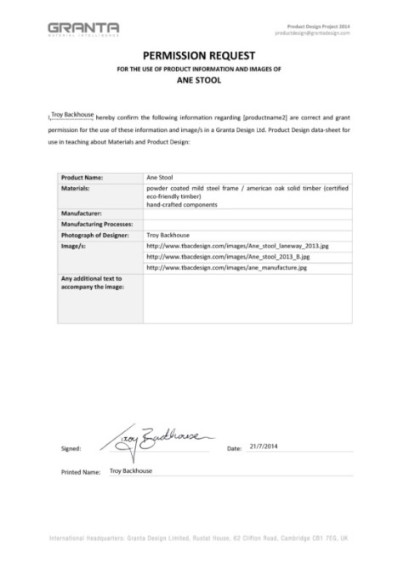
How did we choose the products for the database?
1. Collected Designs
2. Selected best examples of Products
3. Obtained Permissions from Designers
Notes:
Database background- How?

Slide 6
Finding products to engage across disciplines
Materials
Materiality
Consumer products
Iconic products
Innovative products
Complex/technical
products
Interesting to engineers
Interesting to designers
Everyday products
“Cool” products
products that can
inspire both groups
Notes:
Database background- Why?
The idea behind this database is to use products to teach and inspire engineers and designers
The use of materials and manufacturing processes in products is relevant to both engineers and (industrial) designers

Slide 7
The Design Database
What can you do with it?
Engage in the visual, material and manufacturing aspects of products and industrial design.
Visualize how materials create product character, desirability.
Show how new materials stimulate innovation: the evolution of materials in products.
Excite interest in materials through products.
Understand how products and their components are manufactured.
Notes:
Database background- What can you do with it?
The data (high quality) in the Ansys Granta EduPack platform and the software tools facilitate several outcomes
The links between the products, materials, manufacturing and the designers enable better understanding

Slide 8
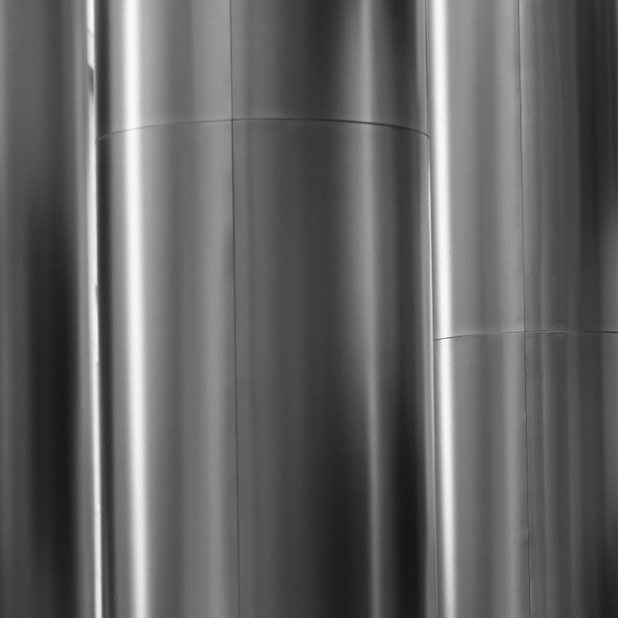
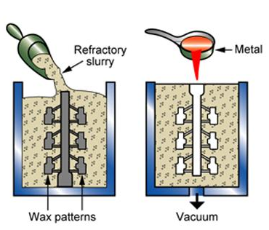
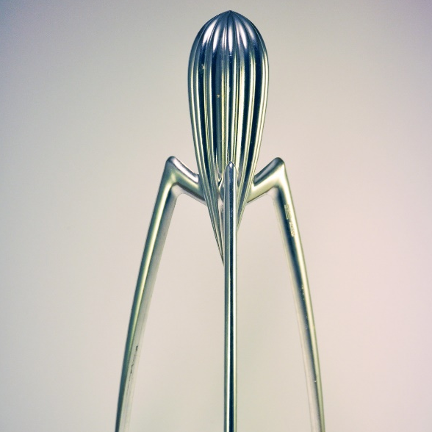



Product-centred structure of the database
Investment casting
Cast Al-alloys
Material
Process
Juicy Salif
Records in the database
Product
Philippe Stark
Manufacturer
Designer
Notes:
Structure
There are more than 180 products currently in the database, divided into 6 different product families: Interior, Tech, Packaging, Fashion etc.
The products are linked to 4 other data-tables containing information about Materials, Manufacturing processes, Manufacturers and the Designers behind the products

Slide 9
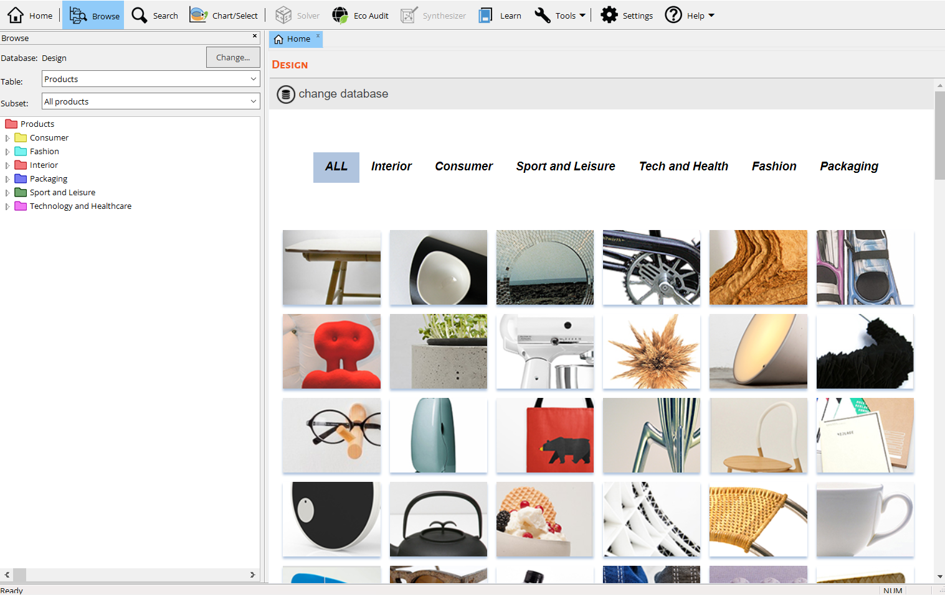
Starting the Design database: the Home page
All families of the products, clickable
All products in the database, clickable
Notes:
The home page
When starting the Ansys Granta EduPack software Design database, the home page shows a random selection of clickable product images
These products are organized into 6 different families, or datatables, that can also be explored directly by clicking

Slide 10
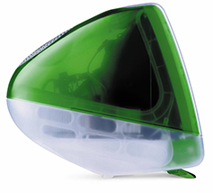
Product datasheet
iMac G3
by Jonathan Ive for Apple
Designer
Jonathan Ive
Manufacturer
Apple
Materials
Polycarbonate (PC)
Description
The iMac was dramatically different from any previous mainstream computer. It was made of translucent "Bondi Blue"-colored plastic and was egg-shaped around a 14-inch (35.5 cm) CRT display. The keyboard and mouse were redesigned for the iMac with translucent plastics and a Bondi Blue trim.
Tags
Designer’s description
Consumer, household, home, kitchenware, food, washing up, clean, hygiene, designer, classic.
Links
Materials
Processes
Designer
Manufacturers
Links to further data-tables
Notes:
Datasheets
Clicking a product takes you into its datasheet, which contains product information and clickable links.
These links take you to further data-tables on Materials, Processes, Designers and Manufacturers of the products.

Slide 11

Insights directly from the designer
Name
Jonathan Ive
Studio
Apple
Education
Industrial Design, Northumbria University
Description
Sir Jonathan Ive is an English designer and was the Senior Vice President of Design at Apple Inc.
Courtesy of Apple Inc
Links
Products
Inspiring background information adds to the understanding
Notes:
Designer
Behind every product is a Designer, who provides a human dimension and background. Here the British designer that helped shape many Apple products

Slide 12




The materials data-table: catering for dual needs
Alternative Materials views
Engineering view
Designer view
Notes:
Different views
Following up on the link to the materials data-table, we can choose between two alternative views
The Engineer’s view and the Designer’s view (which is the default) are available through a dropdown menu

Slide 13
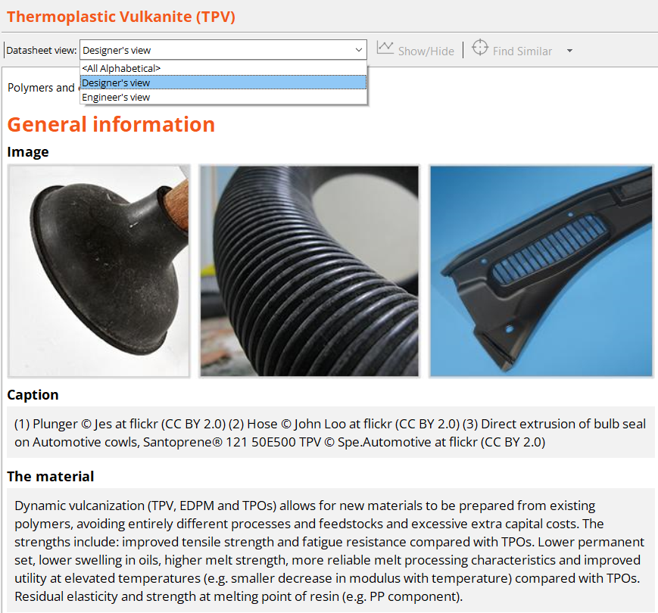
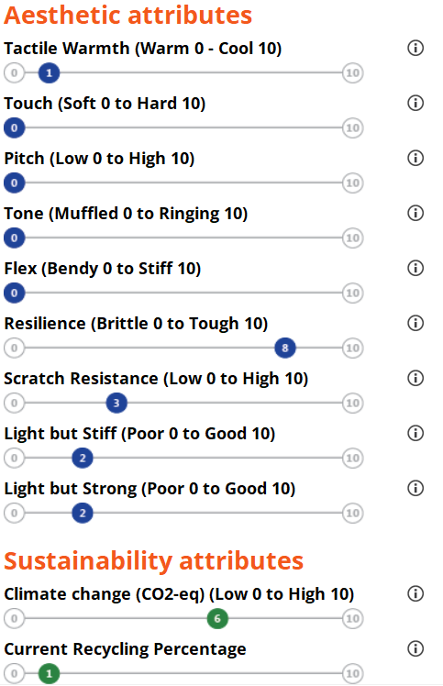
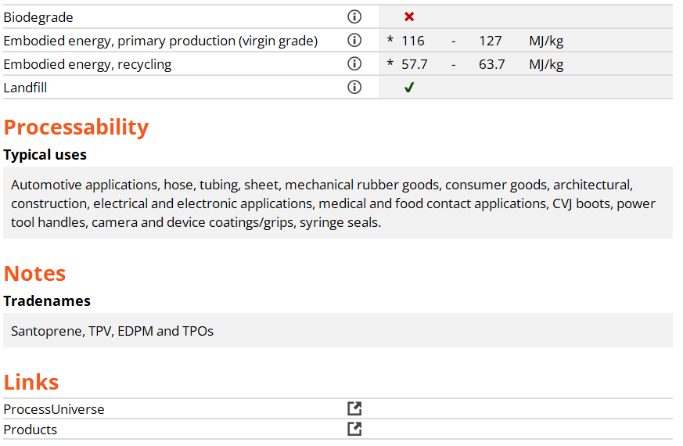
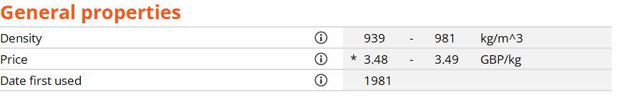
Typical material record: designer’s view
Aesthetic data
Sustainability data
General text + data
Notes:
Designers view
The Designer’s view contains a simplified set of the main properties,
A more visual presentation of data is given for the Aesthetic Attributes and some Sustainability data
Comments and definitions regarding the scales and attributes are given via the ⓘ-buttons

Slide 14
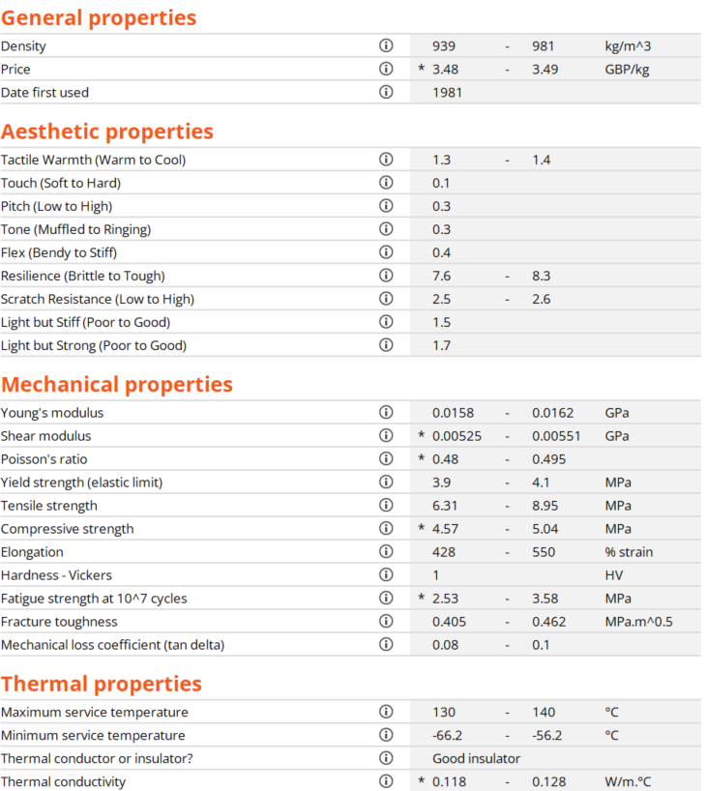
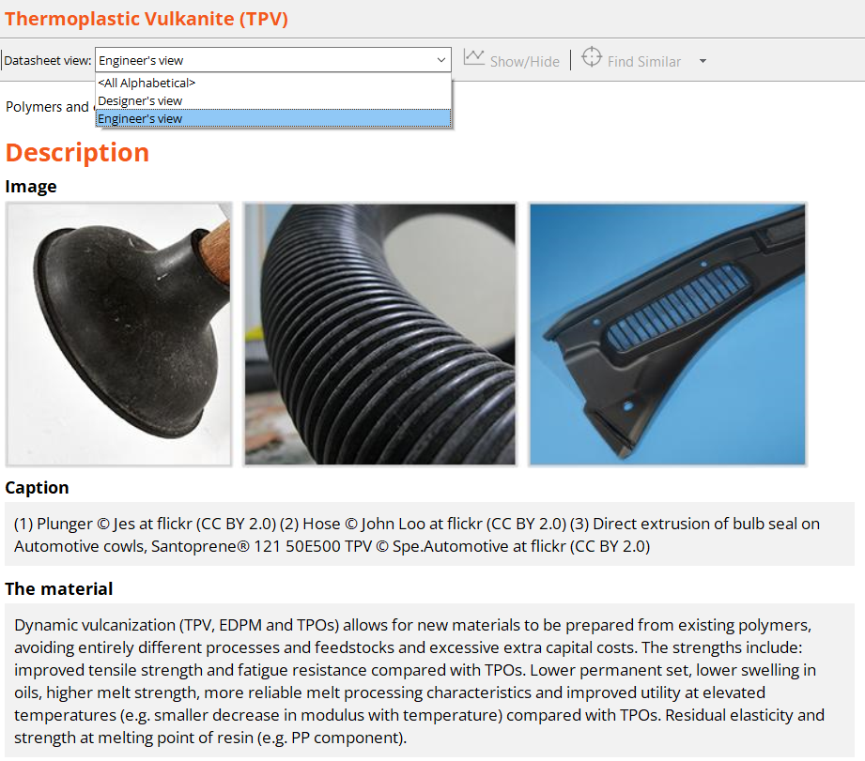
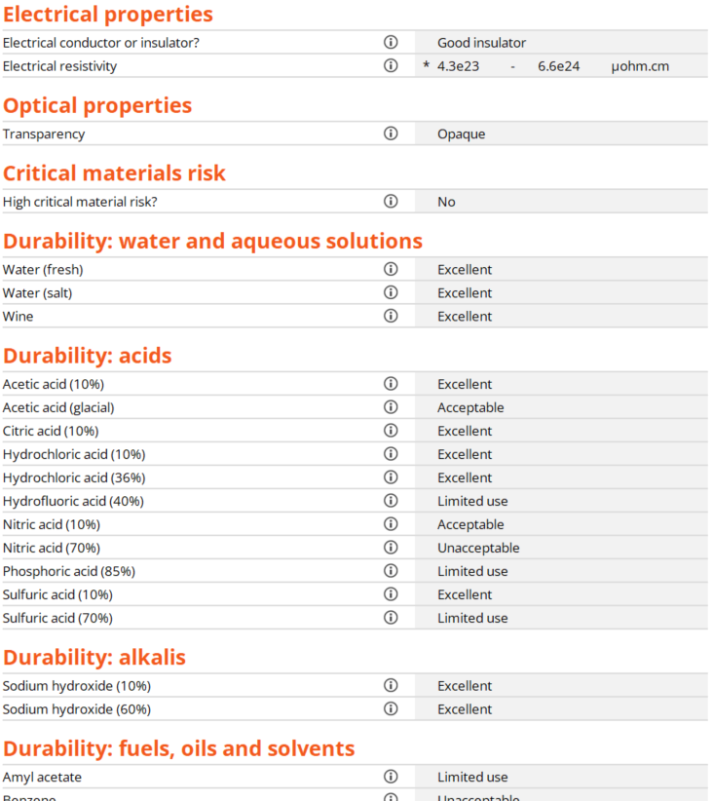
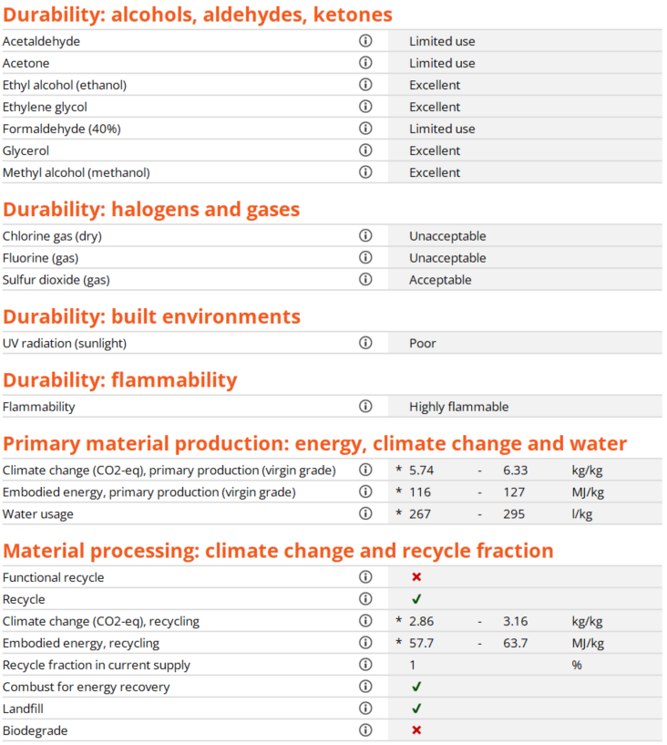
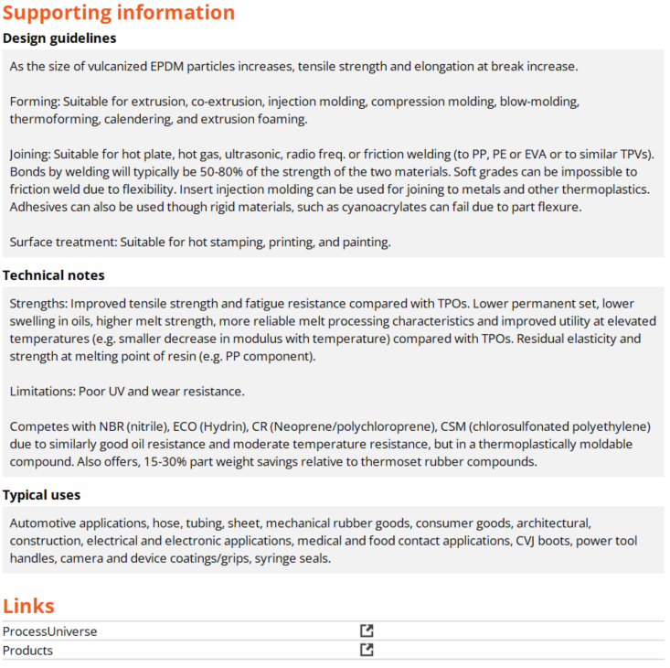
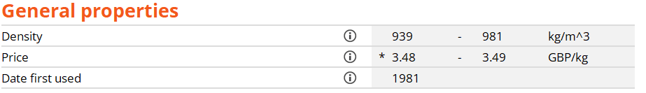
Typical material record: engineer's view
Full engineering property data
Links to related data records
Notes:
Engineers view
The Engineer’s view contains the full set of numerical data (same display of images, material description and General properties)
The links from a material record give all manufacturing processes that can be applied to this material or all products in the database containing it.

Slide 15
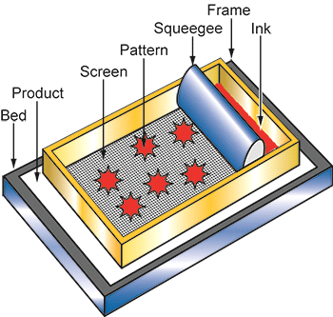
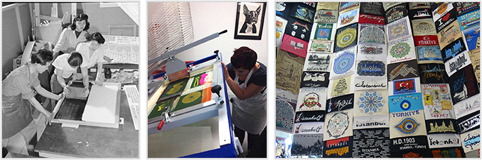
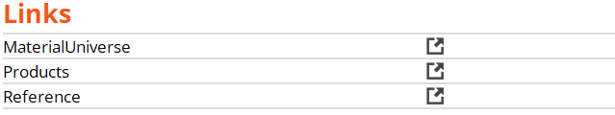
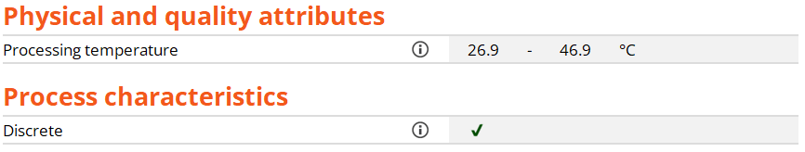
Manufacturing processes of products
Silk screen printing
Process schematic
Guidelines and Typical uses
Image Caption
(1) Poster production by silk-screen printing © U.S. National Archives and Records Administration at Wikimedia Commons [Public domain] (2) Screen print squeegee hand bench © Scrud123 at Wikimedia Commons (CC BY-SA 3.0) (3) T-Shirts design patters © Survivor at Pixabay
Design guidelines
The process can be applied to polymers, glass, metals, wood, textiles and of course paper and board. Flat and cylindrical objects can be printed. Multiple colors can be printed, but each requires a separate screen.
The process
Silk screen printing has its origins in Japanese stenciling. During the First World War in America screen printing took off as an industrial printing process; but it was the invention of the photographic stencil in the 1930s that revolutionized the process. It is now a $5 billion per year industry.
Typical uses
Posters, stickers, ticketing, shelf strips, banners, exhibition panels, ring binders, mouse-mats, site boards, signs, T-shirts, control panels and badges for computers.
General text + data
Notes:
Manufacturing processes
Manufacturing processes are inevitably linked both to products and materials
Each data record contains information on Design guidelines and typical uses

Slide 16

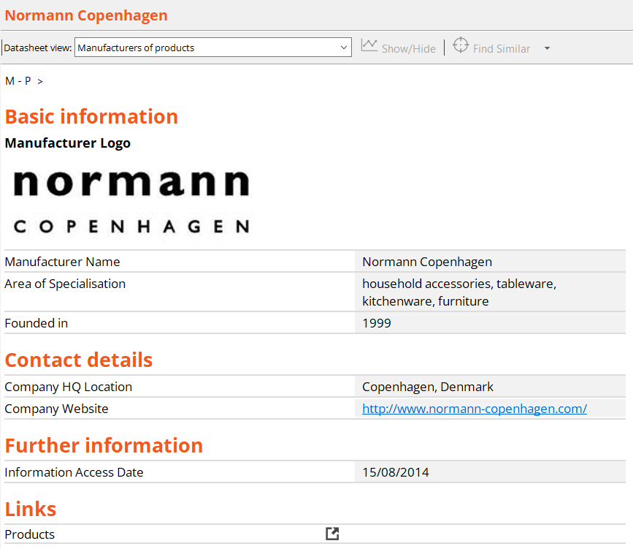
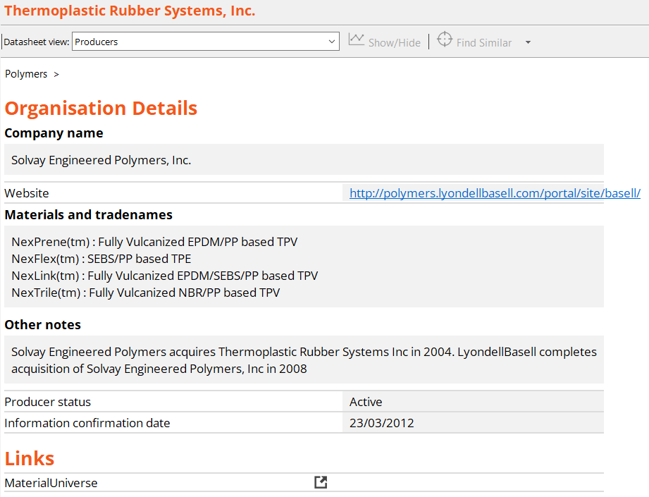
Manufacturers and suppliers
Important auxiliary information adds to the realism in projects
Product manufacturer ≠ Material suppliers!
Notes:
Manufacturers and suppliers
The Design database for products contains not only Products, Materials and Processes, but also auxiliary data that facilitates realistic projects
Manufacturers of products have their own data-table, as does suppliers of materials
Suppliers can be accessed directly from a data-table or from a material datasheet
Manufacturers can be found via the links from a product record
Some companies are present in both these data-tables but Manufacturers and Suppliers have fundamentally different roles

Slide 17



Using the database
The tool buttons
Browse
Search
Chart / Select
Notes:
Main tool buttons
There are three main tool buttons: Browse, Search and Chart/Select
We will now look at each of these tool features

Slide 18
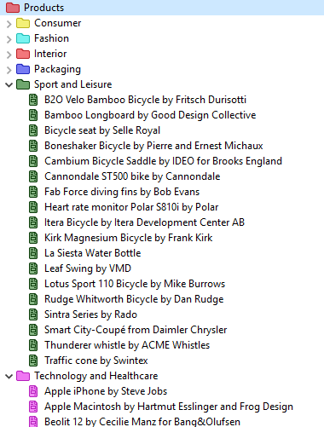
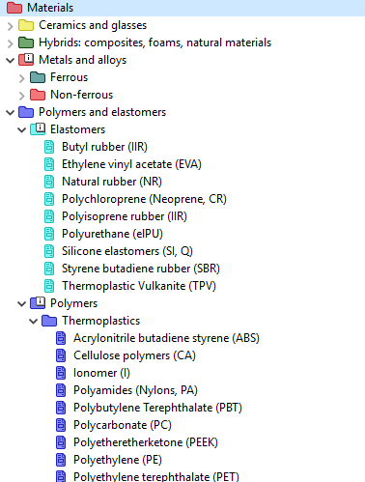
Browse to explore products
Browse
Browse
Browse
Database:
Design
Database:
Design
Table:
Products
Table:
Materials
Subset:
All products
Subset:
All materials
Tree
Notes:
Browse Mode
The Design database for products opens, by default, in the Products data-table set to the Browse mode.
Thumbnail images identifying products allow browsing of datasheets.
The products are organized in categories, or families, as shown
Material records are organized by material class: Metals, Polymers, Ceramics, and Hybrids.
Process records are organized under the headings Shaping, Joining, and Surface Finishing.
Designers and Manufacturers are organized alphabetically.

Slide 19
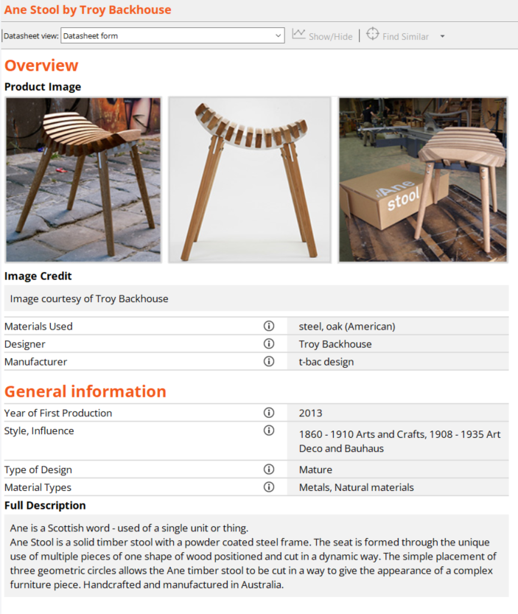

Search on keywords
Search
Database: Design
Search string
Furniture AND Wood
Furniture
Designers (31)
Manufacturers (18)
Materials (29)
Processes (6)
Products (60)
Suppliers (2)
Designers (2)
Manufacturers (1)
Materials (19)
Processes (3)
Products (12)
Records found
Full text search of entire database:
Not case-sensitive but sensitive to spelling
Notes:
Search Mode
The Search mode allows a full-text search of all the records in the database.
Entering a search string such as “Furniture” delivers the results shown
Logic operators such as AND can also be used.
Records from the other data-tables than products appear because they too contain the string used in the search.
As can be seen, both manufacturers and suppliers appear in the results

Slide 20

Chart / Select to plot and screen data
Selection Project
Chart / Select
1. Selection Data
Database:
Design
Make charts
Selected from:
Products
Select by screening
2. Selection Stages
Chart
Limit
Tree
General properties
Tree Materials
Property 1
Min
Max
Ceramics and glasses
Hybrids: composites, foam
Metals and alloys
Polymers and elastomers
Density
Price
Date of use
Property 2
Notes:
Chart/Select Mode
Materials and manufacturing processes need to be selected to fit the design of your product
The Ansys Granta EduPack software allows selection by several different routes.
There are three selection tools: Graph, Limit, and Tree
To use them the user must first choose the data-table from which the selection is to be made: e.g.,
To select Products, choose the Products data-table.

Slide 21
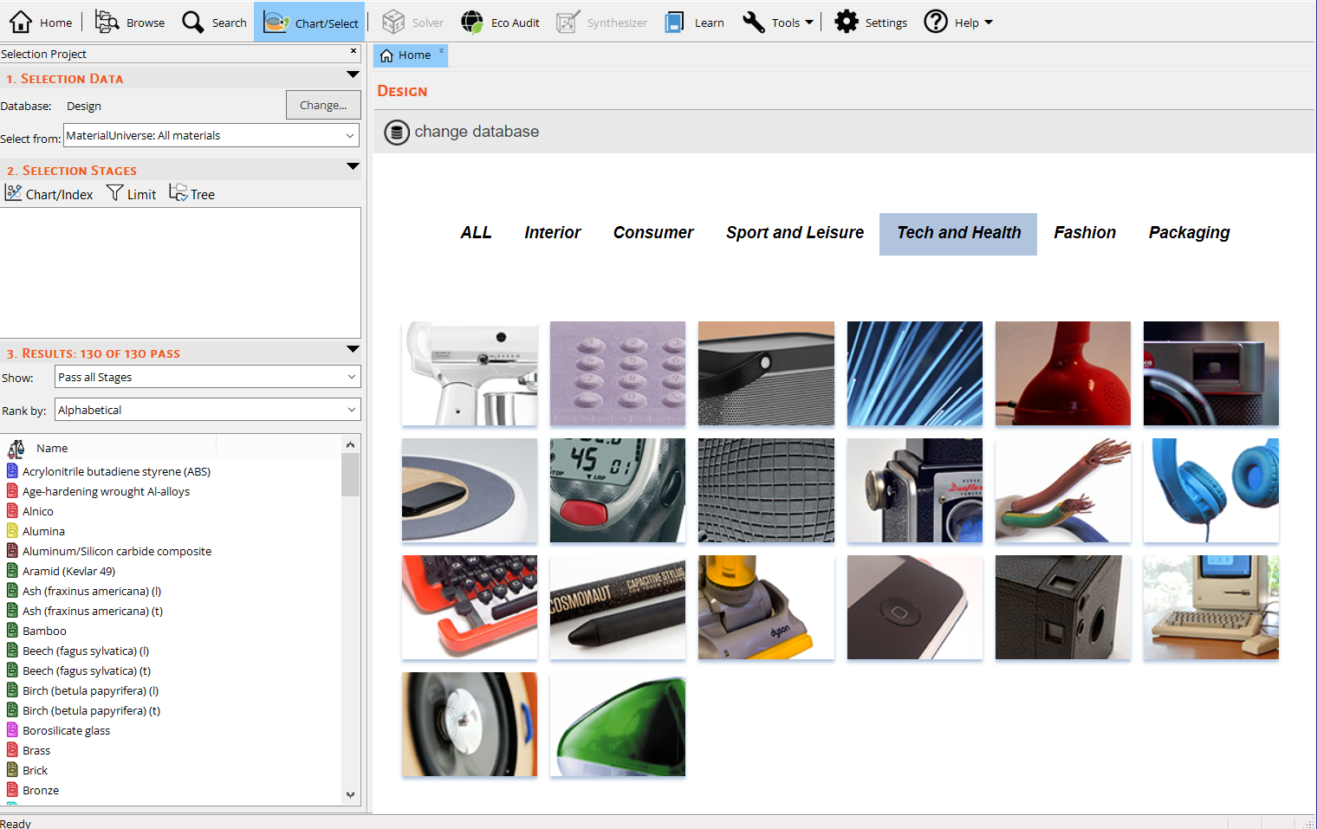
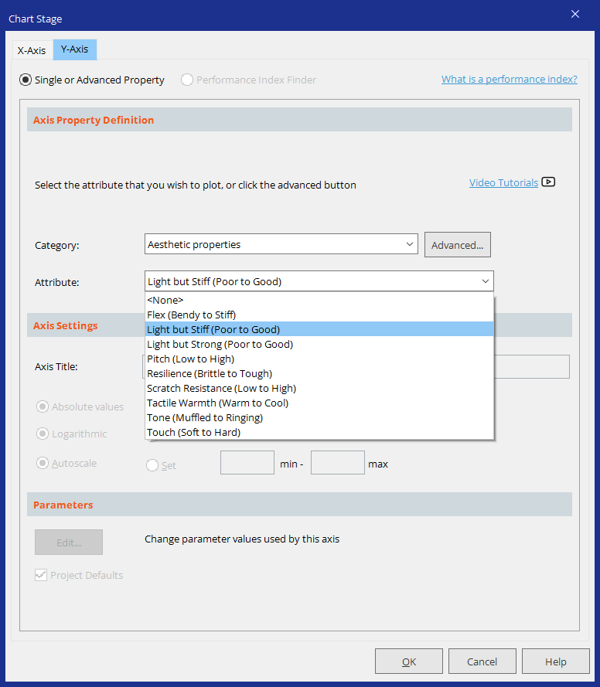
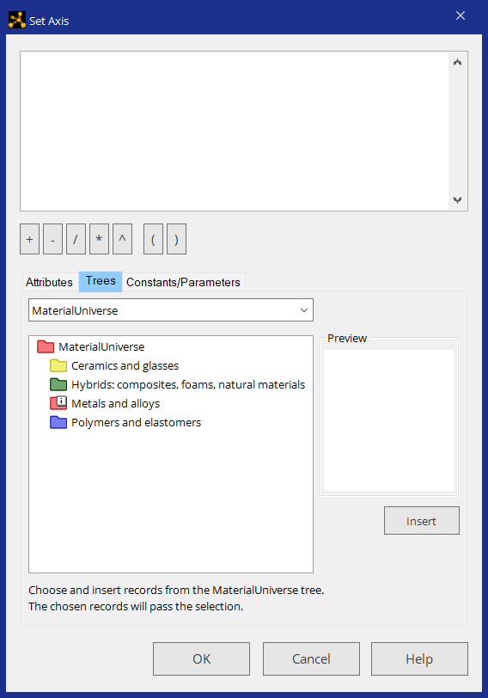
Making advanced product chart – combining stages
Notes:
Making a product chart
A simple example of how to make a product Chart and use it is to plot Style, Influence against Material type
If the property is discreet (Awarded: Yes/No, or Style: Art Deco) then the numbers in the database appear

Slide 22
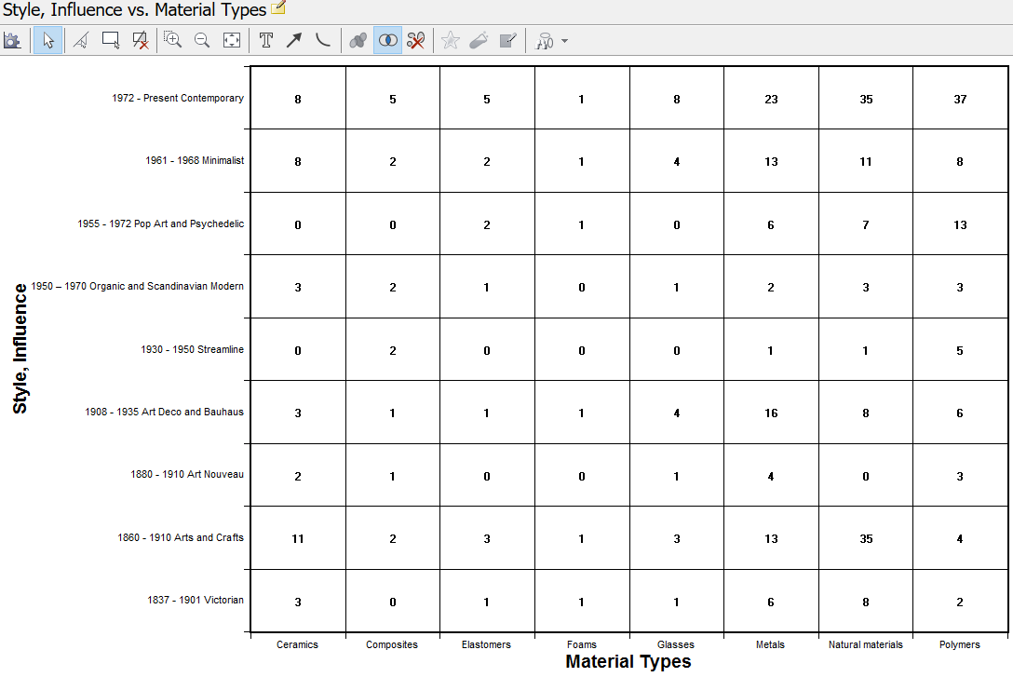
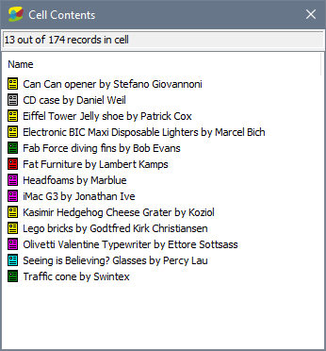
Examples of Product Charts
Examples
Today
8 | 5 | 5 | 1 | 8 | 23 | 35 | 37
8 | 2 | 2 | 1 | 4 | 13 | 11 | 8
0 | 0 | 2 | 1 | 0 | 6 | 7 | 13
3 | 2 | 1 | 0 | 1 | 2 | 3 | 3
0 | 2 | 0 | 0 | 0 | 1 | 1 | 5
3 | 1 | 1 | 1 | 4 | 16 | 8 | 6
2 | 1 | 0 | 0 | 1 | 4 | 0 | 3
11 | 2 | 3 | 1 | 3 | 13 | 35 | 4
3 | 0 | 1 | 1 | 1 | 6 | 8 | 2
Notes:
How to use product charts
This Chart shows the number of products from the PMP database in each style and material
It is easy to find products from the Arts and Craft style made of naturel materials, for example
Natural materials are also popular in the contemporary products of the database
Polymers are also prominent in contemporary products and, of course in Pop Art and Psychedelic style
Clicking on this number results in a list of products

Slide 23
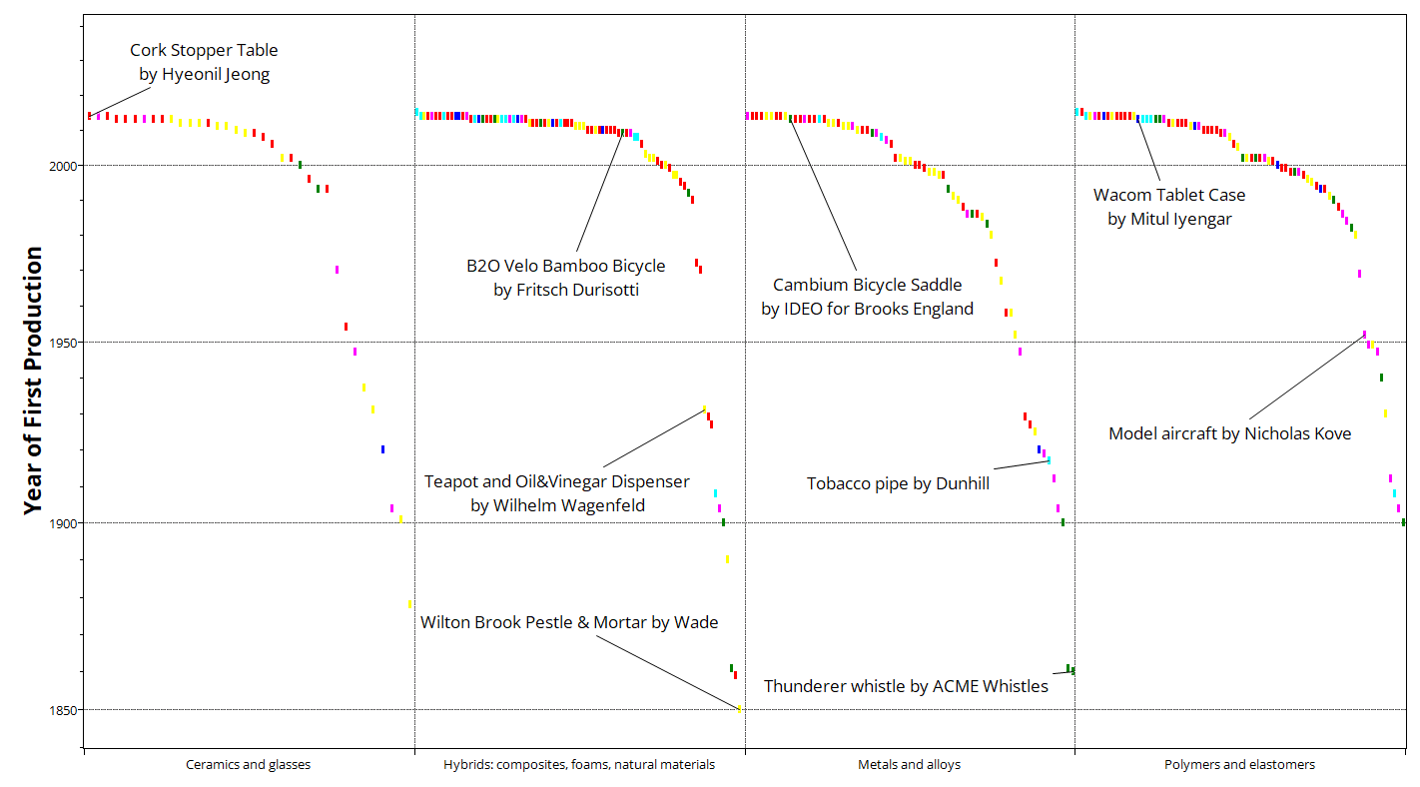
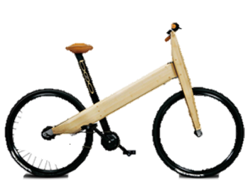








Other charts – products over time
Examples
Notes:
Products over time
Here is another example of how you can visualize properties and then add pictures from the database
These images are added manually with copy-paste

Slide 24






New materials and processes enable new designs
Ash, Iron, Sawn, forged 1862
Mild steel Rolled, brazed 1900
Aluminum, Heat treated 1983
Plastic, Molded 1983
Magnesium, Die cast 1986
Carbon, Lay-up 1992
Notes:
New designs
The images and the data in the database can be used also to show the evolution of products
New materials and processes enable new designs

Slide 25

Chart / Select on material properties
Index Line = Relation between Density/ Yield strength
Lighter, Stronger
A materials chart
Notes:
Chart/ Select
Here is an example of an advanced material property chart, plotted as shown before using Chart/Select
Materials that are light and strong can be found above the line (upper left in diagram)

Slide 26





New materials enable innovation
li
Notes:
Enabling innovation
This kind of Chart can be used to illustrate how material performance links to products
The bicycle frame material can be found in the Chart and a selection line guides the performance evolution
A steel bicycle is stronger than an antique one, but heavier. An Al-frame performs better than a polymer one etc.

Slide 27







Materials influence both style and shape
Beech craftsmanship, quality
Polyethylene exuberant, pop-arty
Coconut eco-eccentric
Chair
Furniture
Designers (31)
Manufacturers (18)
Materials (29)
Processes (6)
Products (60)
Suppliers (2)
Designers (8)
Manufacturers (2)
Materials (7)
Processes (2)
Products (21)
One product, different materials
Steel cool statement
Cardboard gentle
Carbon fiber space-age
Notes:
Materials influence style and shape
Here we can see how material influence style and shape of products
Some shapes are entirely dependent on material performance

Slide 28







Materials and product character
Bamboo simple, environmental
Ceramic cold, technical
Lamp
Glass clinical
Furniture
Designers (31)
Manufacturers (18)
Materials (29)
Processes (6)
Products (60)
Suppliers (2)
Designers (2)
Manufacturers (1)
Materials (9)
Processes (2)
Products (10)
Another product search, different materials
Cork warm, natural
Wood stylish, crafted
Steel engineered
Notes:
Product character
The same product can be studied in terms of how the material affects its character
All of these materials and products are connected to manufacturing process descriptions

Slide 29
The Structure
Materials
Processes
?
Challenge
Products
Suppliers
Designers
Manufacturers
Notes:
Products at the centre
The Design database for products is unique in the Ansys Granta EduPack software, in that it centres around an entire product and its design. It gives the user an opportunity to explore the connection between the product and the material that it is made of and the main manufacturing processes involved as well as practical information about its design and manufacture.

Slide 30


Aesthetic properties
Warm / Cold
Density
Specific heat
Thermal conductivity
Soft / Hard
Modulus
Hardness
Notes:
Perceiving material properties
The Design database is unique in that it has Aesthetic properties, such as Sensorial ones
These are subjective but can actually be quantified by using other material properties
The feeling of warm and cold when you touch a material depends on thermal conductivity etc
How soft a material feels depends on hardness and stiffness, for example

Slide 31

Aesthetic properties
Plot GRAPHS
Notes:
Aesthetic properties
The Aesthetic (sensorial) properties of materials can be plotted in a property Chart
There are project files prepared for some example charts on the Teaching Resources website

Slide 32


Aesthetic properties - Example Warm / Cool
Warm to cool
Warm 0 – 3.9
Intermediate 4 – 5.9
Cool 6 – 10
Notes:
Color coding
The Charts can be color-coded to enhance information, this gives the chart an extra dimension.

Slide 33

Example eco materials
CO2 footprint
High < 1.9 kg/kg
Medium 2 – 9.9 kg/kg
Low > 10 kg/kg
Notes:
Eco materials
The database also contains data on Eco-properties, such as CO₂-footprint

Slide 34
Summary
Designers
Processes
Manufacturer
PRODUCTS
MATERIALS
Suppliers
The Design resources open a window on the role of material properties and manufacturing processes in product design.
Highlights the interaction between products, materials and processes and their role in creating style, product character, performance etc.
Suggests how a deeper understanding of products can enable innovation and inspire greater design.
Notes:
Conclusions
The Design database for products links manufacturer, designers, processes, materials and suppliers
With ease of navigation and sensorial properties in the Designers view, inspiration and understanding can be gained
A deeper understanding of products can enable greater design

Slide 35




Further resources
Textbook
White Paper
Exercises
Poster
Notes:
Educational Resources
There are several useful resources on the Ansys Education Resources to support teaching materials to product designers.
www.ansys.com/education-resources

Slide 36
Ansys Education Resources Feedback Survey
Here at Ansys, we rely on your feedback to ensure the educational content we create is up-to-date and fits your teaching needs.
Please click the link below to fill out a short survey (~7 minutes) to help us continue to support academics around the world utilizing Ansys tools in the classroom.
Feedback Survey Link
Notes:
Feedback Survey link for copy-paste method → https://ansys.typeform.com/to/jcattJI5

