Slide 1
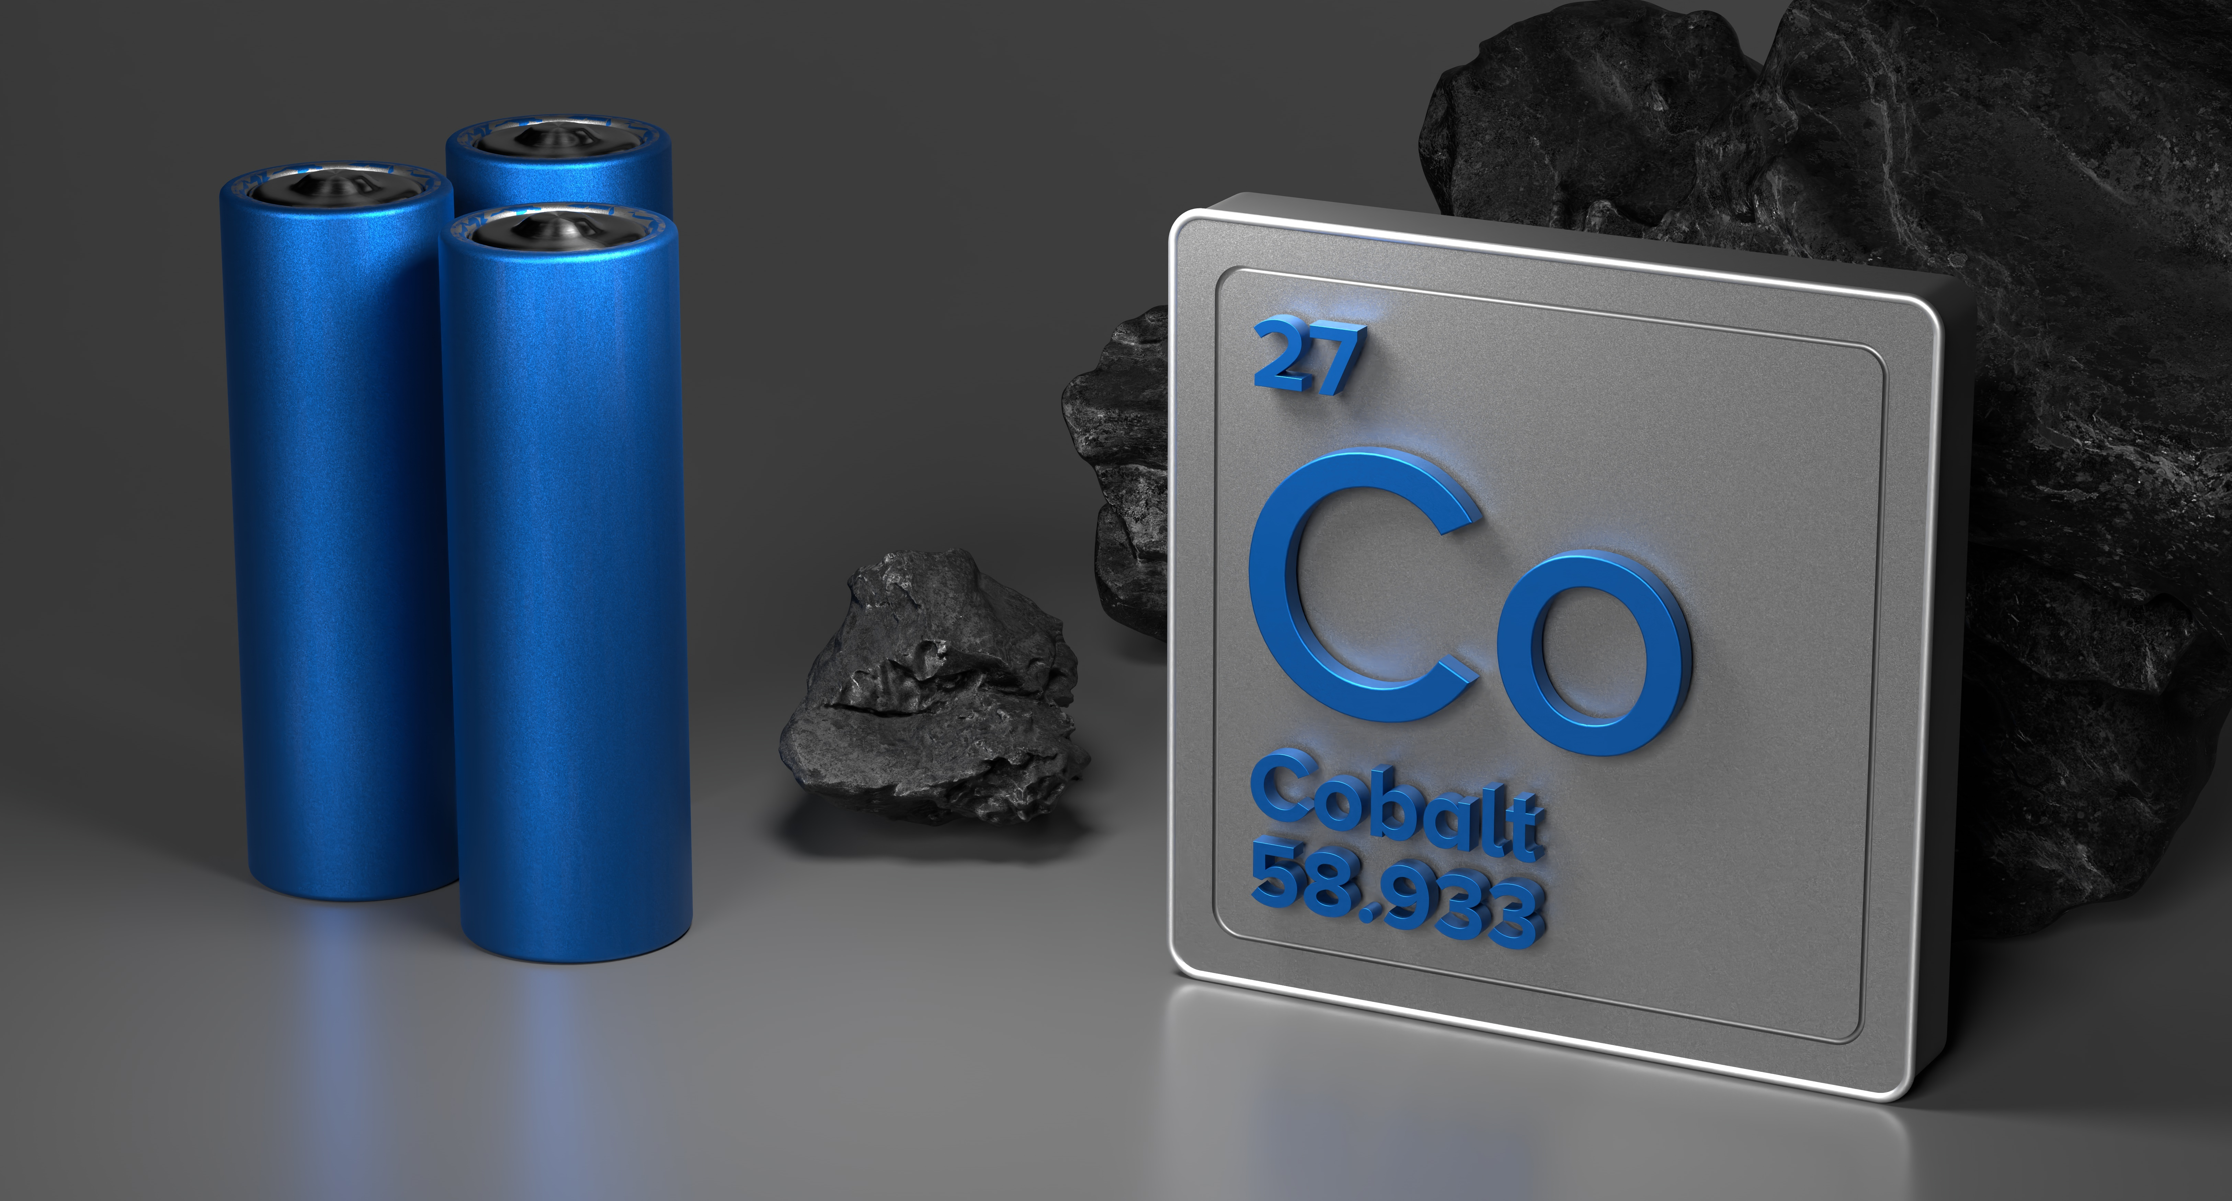
Exploring Critical Materials using Ansys Granta EduPack Software
Piers Ireland¹, Tatiana Vakhitova¹, and Alessandra Hool²
¹ Ansys Academic Development Team
² ESM Foundation

Slide 2
Learning objectives and contents
Ansys software mentioned | Ansys Granta EduPack™­, a teaching software for materials education
Intended Learning Outcomes
Knowledge and Understanding | Understanding of materials criticality concept and challenges with criticality assessment
Skills and Abilities | Ability to identify materials criticality and learn how to use the Ansys Granta EduPack software to help analysing it
Values and Attitudes | Insights into materials-related risk
Contents:
A brief history of critical raw materials
Critical Raw Materials and their importance
Criticality assessment
Exploring material risk with Ansys Granta EduPack software
CRM Example: Cobalt

Slide 3


The history of Critical Raw Materials (CRM)
Post WW1 US passed the 1939 Strategic and Critical Raw Materials Stockpiling Act
The Act established strategic materials supply reserves for the US common defence, industrial demands and military commitments.
The 1939 Act introduced three key initiatives to controlling Strategic material supplies:
Determine and develop domestic sources
Devise new methods of recycling and reuse
Develop substitutes for these materials
Developed using informative materials produced by SusCritMooc MOOC | SuscritMat
Notes:
Following World War 1 the need to quickly develop new technologies was clear. Despite having good access to resources, it was evident to the US that should another war begin, these supplies could become strained, a result of relying on imports from other nations. In 1939 the US passed the Strategic and Critical Raw Materials Sockpiling Act. The 1939 act established strategic materials supply reserves for the US common defence, industrial demands and military commitments. This included materials that were vital to the production and deployment of products related to these industries and capabilities. The US government set out a three-step approach to mitigating supply risk of these materials:

Slide 4
The years post WW2 in view of criticality Developed using informative materials produced by SusCritMooc MOOC | SuscritMat
1975-1980, Guidance released on managing resource supplies and CRMs but not looking at a wide range of materials.
1960s, World economy grows placing strain on resources and environment
btw ca. 2005 and 2015 an emergence of criticality assessment methodologies.
During WW2
geopolitical resource management
Modern age
from ca 2006 trade/armed wars with strategies to secure economic power and strategic autonomy.
1950s, growth limited by resource supply as new technologies need more materials
1970s, Growing world population, Oil/materials shortages, the notion of limits to growth.
1980-2000s
Technological revolution, climate change & sustainability, a start of resource nationalism
Notes:
In the 1980s the notion of resource nationalism came to light, countries began to control and evaluate their own supply however, assessments that were carried out were not expansive enough.

Slide 5
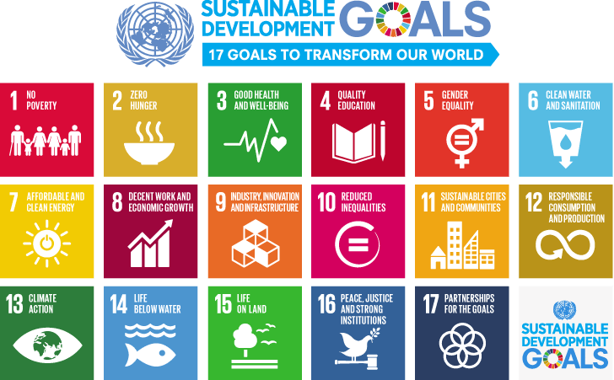



Challenges to today’s society
Sustainability Framework in industrial context
UN: the way forward
Tripple-bottom-line
Social
Economy
Environment
Yet, we must ask how are these goals achieved?
In part, each goal can be achieved via technological solution.
Notes:
Current challenges faced by society can be broken down into three distinct categories:
Social
Economic
Environmental (Ecological)
Acknowledging this the UN developed 17 sustainable development goals. These aim to improve each aspect of the triple bottom line.

Slide 6
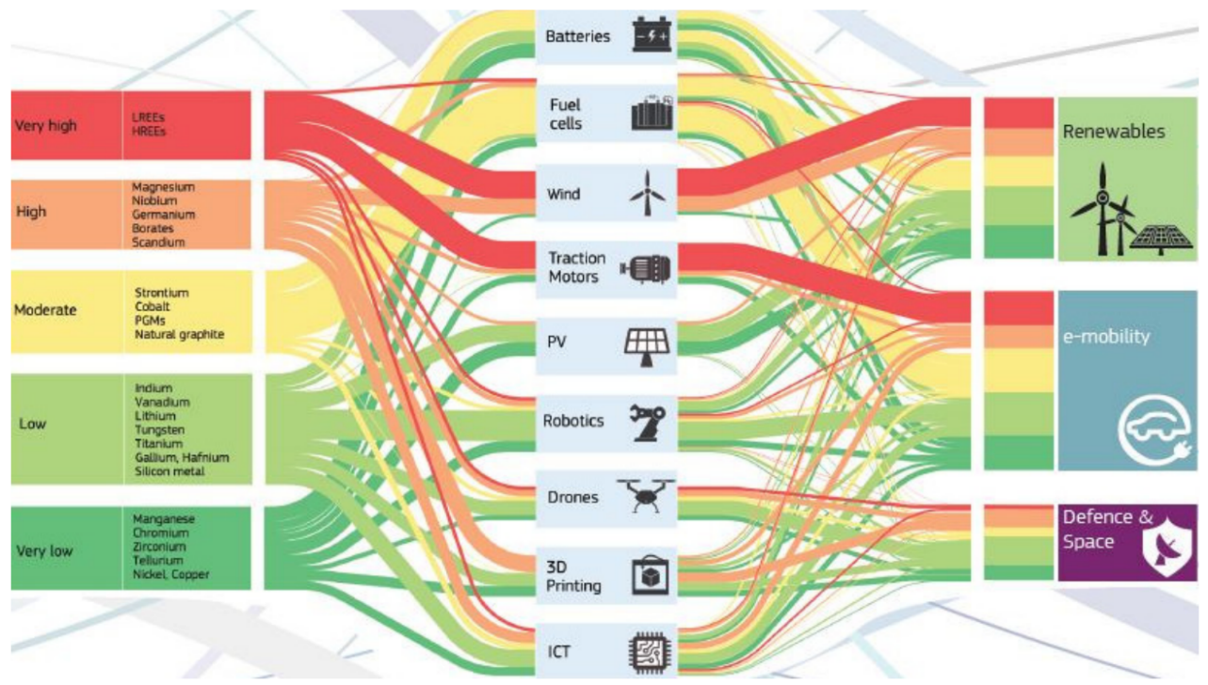
Material flows in strategic technology
LREE - La, Ce, Pr, Nd, Sm
HREE - Eu, Gd, Tb, Dy, Ho, Er, Tm, Yb, Lu, Y
There are now many materials that are key to the deployment of technology that will help to solve these problems. These are often referred to as technology materials.
Each group of materials in the figure has an associated supply risk. We can see that some of these groups, notably the Heavy Rare Earth Elements (HREEs) and Light Rare Earth Elements (LREEs), are high risk.
How do we categorise these materials and how can we mitigate these risks without sacrificing technological capability and efficiency?
Fig 1 European Commission, Critical materials for strategic technologies and sectors in the EU – a foresight study 2020
These are just a few examples of how these materials are used in technology. They are used much more extensively in practice.
Notes:
The REE are split into two groups, the Light Rare Earth Elements (LREE - La, Ce, Pr, Nd, Sm) and Heavy Rare Earth Elements (HREE - Eu, Gd, Tb, Dy, Ho, Er, Tm, Yb, Lu, Y), both for physico-chemical and commercial reasons. For more see here, for instance, Rare Earth Elements | CRM Alliance

Slide 7
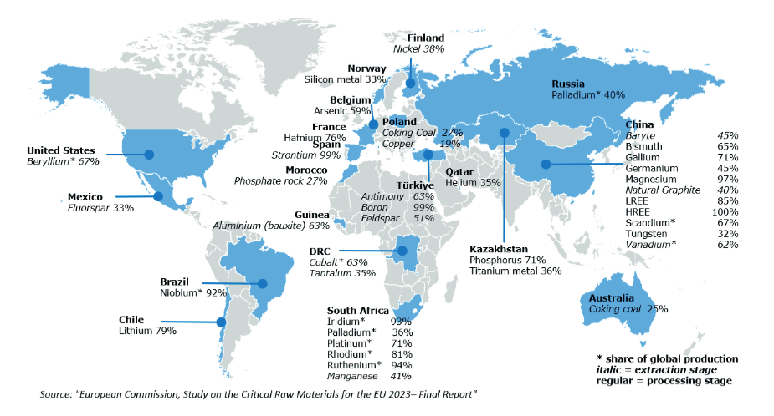
Critical Raw Materials
There is an inherent risk to the supply of any material. In order to be able to continue developing and deploying key technologies it is vital to mitigate or avoid this.
Countries and other entities began creating lists of materials that had a high associated supply risk and were also of high economic importance.
Groups of materials of particularly high economic importance and supply risk are referred to as Critical Raw Materials (CRMs). Different countries have different lists of CRMs depending on access to domestic supply, geopolitics and economic strength nationally. Such lists are reviewed every 3-4 years.
“Strategic Raw materials” and “Critical Raw materials” are sometimes used interchangeably. Often, however, “strategic” refers more to military purposes or how relevant they are for “strategic technologies”. Copper and Nickel do not meet the CRM thresholds but are on the CRM list as Strategic Raw Materials (European Critical Raw Materials Act 2023).
Notes:
Economic importance is not strictly evaluated based on GDP but rather the contribution to the economy the material creates both directly and indirectly.
“Strategic raw materials” and “Critical raw materials” are sometimes used interchangeably. Often, however, “strategic” refers more to military purposes.
Important: In the EU, it is not the same! “Strategic raw materials” are a subset of critical raw materials that are, amongst others, defined by their expected demand growth and their relevance for “strategic technologies”

Slide 8
Criticality broader view
The scope for criticality assessment can be different, be that at a level of economy, sector, technology, company, product. For an individual company in the EU the whole list of critical raw materials might not be applicable.
The level of criticality depends on the probability of the supply disruption and vulnerability to supply disruption (or economic importance), which can be influenced by geopolitical, geological, economic, technical, social and environmental factors.

Slide 9
Example of Rare Earth Elements (REE) strategy in Japan
Developed production processes that decrease the use of CRMs.
Reliance on Chinese REEs exports fell from 85% (2009) to 58%
in 2018.
By 2025 it is on track to reduce its single country import reliance for materials to 50%. As well as increasing its self-sufficiency in meeting Cobalt demand to 50%.
Resource shortages in 1980.
Nationalise resource reserves.
Relied heavily on China for REEs.
In 1983 stockpiled 7 key resources.
2010 Chinese REE embargo on Japan and an increase in export tax and VAT.
Invested in R&D to explore substitutions for CRMs particularly REEs
Domestic ocean supply exploration.
Signed a progressive deal with EU to share a joint CRM strategy (2023).
Increased reuse and recycling of CRMs.
Developed using informative materials produced by SusCritMooc MOOC | SuscritMat
Notes:
In the mid 1980 with demand growing and domestic supplies waning many countries began to nationalise resource reserves.
Japan, a country that relied heavily on China for resource exports, recognised the potential impact that reduced resource supply could have.
As a result, in 1983 Japan began to stockpile 7 resources including, Cobalt, Tungsten and Vanadium. The Chinese also increased export taxes on REEs.
In 2010 China placed an REE embargo on Japan, a result of tensions surrounding the Diaoyu Islands and the detention of a Chinese boat captain.
Reaction: Japanese government cooperated with companies to focus on mitigating the impact of import over reliance. As a result companies such as Toyota and Mitsubishi began to focus on decreasing the use of CRMs and looking for substitutes. They also created strategies to reuse and recycle materials as well as establishing domestic supplies. Recently, submarine exploration found and have established 6 deposits of CRMs in the ocean.
Results: In 2018 Japan had decreased its reliance on Chinese REEs from 85% in 2009 to 58%. By 2025 it is on track to reduce its single country import reliance for materials to 50% as well as increasing its self-sufficiency in meeting Cobalt demand to 50%. It has also increased its reserves to 180 days of domestic consumption from 60 and recently signed a deal with the EU to collaborate in meeting CRM challenges.

Slide 10
Result of CRM control to the Triple-bottom-line
Japan
Tripple-bottom-line
Economy
Social
Environment
Diversified resource supply reduces risk of material shortages. e.g. Japanese supply REEs from Australian mine - Lynas Rare Earth.
Innovative technology with less CRMs can increase competitiveness
Lessened reliance on single exporters stabilises industrial economies as commodity volatility and production bottlenecks (a result of supply shortage) are reduced.
Exploration of new technologies domestically helps engagement of local communities.
Mining conditions in another industrialized country, such as Australia are under scrutiny of international and local regulations - an impact on workers can be better controlled.
More stable supply of technology materials (CRMs) in Japan means less risk of disruption for production of sustainable/green technologies.
Seabed mining is in exploratory stage, while an idea of bringing more reliable domestic supply is a very attractive one, can cause environmental disruption.
Recycling and reuse reduces strain on environment.

Slide 11
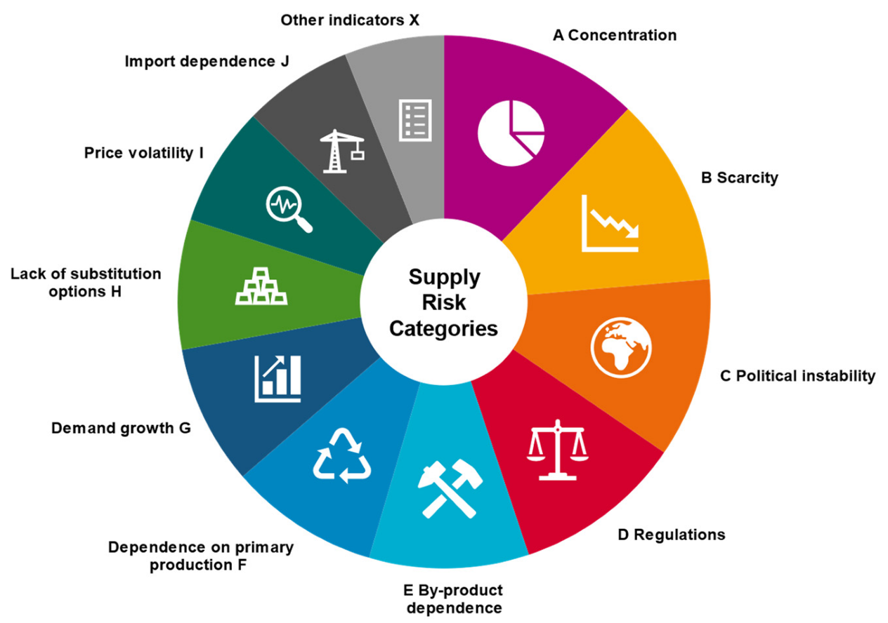
Assessing criticality
Criticality assessments are developed to raise awareness of CRMs and carried out by governments, companies and even individuals.
If a company uses its own criticality assessment, each company-specific mitigation steps influences the individual criticality score; if it e.g. uses a national list as a reference, this is not necessarily the case.
The EU evaluates the criticality of a material by aggregating into single values of supply risk and the economic importance. A threshold is then defined for both axes. If a material is found to be above both thresholds – it is considered critical.
Supply risk categories in Raw Material Supply Risk Assessments
- more information in Helbig C. et al (2021, 3)

Slide 12
Challenges with criticality assessment
“Raw material criticality is the field of study that evaluates the economic and technical dependency on a certain material, as well as the probability of supply disruptions, for a defined stakeholder group within a certain time frame”. (Schrijvers et al, 2020, 2).
Issues with criticality evaluation:
Differences in goals and scope, leading to different priorities and indicators, not always transparent enough and limited by availability of quality data, yet also reflect individual cases.
Comprehensive review of criticality assessment methods is provided here: (Schrijvers et al, 2020)
Comparison of CRM lists for the US, EU and Japan
- more information in (Nakano J., 2021).

Slide 13




Methods of mitigating criticality
There are multiple methods of reducing our reliance on CRMs. It should be noted though that at times, CRMs have to be used as there are no alternatives.
Increase domestic supply
Reduced use in technology
Diversify supply chains
Circular economy
Notes:
Reduces reliance on specific exporting nations. This means potential risk of governance and negative social impact are reduced.
By investing in domestic supply the need to import materials from other nations is decreased.
Materials can either be reintegrated into the same technology by recycling or reused for different purposes in a degraded form.
Recycling can reduce supply risk, yet is not easy to increase recycling of certain elements as they are found in small quantities and their recycling rates are low at the moment.
Yet, a recycled content declaration requirement would apply from 1 January2027, for instance, to industrial, EV and automotive batteries containing cobalt, lead, lithium or nickel in active materials with mandatory minimum levels of recycled content from 2030. These targets should encourage market of secondary materials.
Regulation (EU) 2023/ of the European Parliament and of the Council of 12 July 2023 concerning batteries and waste batteries, amending Directive 2008/98/EC and Regulation (EU) 2019/1020 and repealing Directive 2006/66/EC (europa.eu)
The quantity of a material used could be reduced; examples include cathode technologies that now can use significantly less Cobalt.

Slide 14
Evaluating criticality with Ansys Granta EduPack software data
Can check to see if an element is on either the EU or US critical raw material list in the Element record.
Can also see if more than 5% of a material contains critical elements in the Material record.

Slide 15
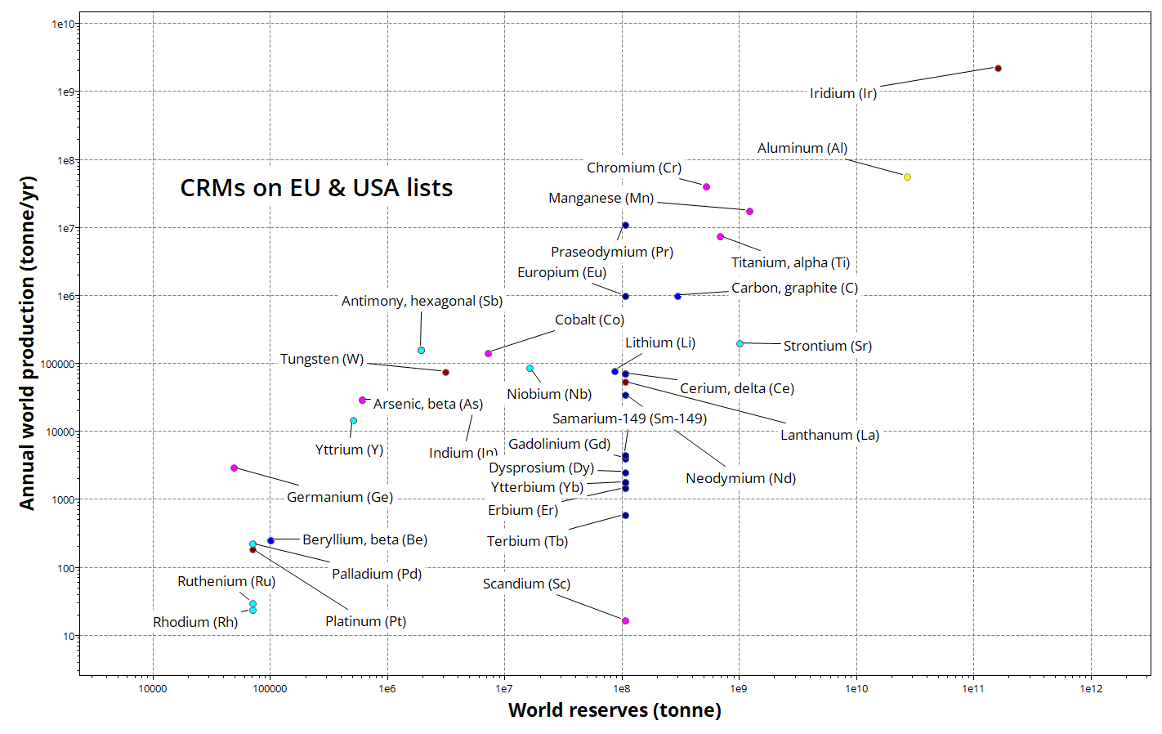
Analyzing CRMs data with Ansys Granta EduPack Software
Notes:
Slide is prepared with the 24R1 Ansys Granta EduPack software release– no noticeable change in data with the 25R1 Granta EduPack release

Slide 16
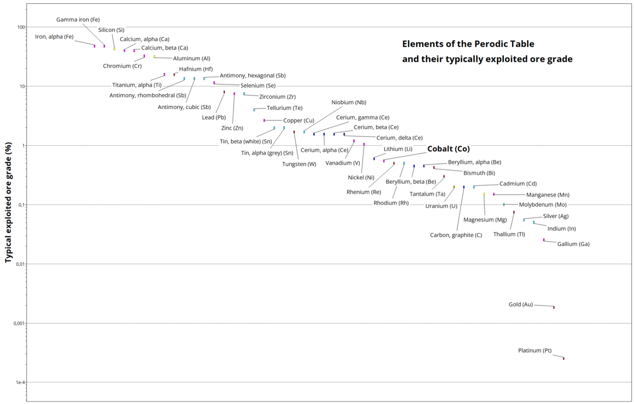
Ore grades & Elements in Ansys Granta EduPack software
Notes:
The ore grade is an indicator for the abundance of each element in the extracted rock. Cobalt has a varied grade and is difficult to extract and process.
Slide is prepared with the 24R1 Granta EduPack release– no noticeable change in data with the 25R1 Granta EduPack release

Slide 17
The many uses of Cobalt
Used in medicine due to their high biocompatibility, high corrosion and wear resistance.
Extensively used as a component of the cathode in batteries.
Used in Superalloys in aviation given its high temperature strength
Can be magnetised, when alloyed with Al or Ni makes powerful magnets
Cobalt-based cathode technology important for electric transport/renewable energy storage
Co
Cobalt
27
Component of vitamin B12
Can be turned into a blue colour for pigments and inks.
Electrical components in circuits and semi-conductors.
Electroplating as it is hard and resistant to oxidation.
Also used as a catalyst in the photochemical and plastic industries.
https://www.omlus.com/wp-content/uploads/2017/12/Cobalt-Institute-60-yrs-1024x561.png - a modified figure from this source
Notes:
Cobalt (Co) is critical for many high-tech applications, in particular, high-strength materials, magnets and rechargeable batteries. The majority of world cobalt output arises as a by-product of extracting other metals, such as nickel (Ni) and copper (Cu). Significant differences in cobalt ores makes it challenging to develop a single extraction or a single treatment process.
Quentin Dehaine, Laurens T. Tijsseling, Hylke J. Glass, Tuomo Törmänen, Alan R. Butcher,
Geometallurgy of cobalt ores: A review,
Minerals Engineering,
Volume 160,
2021,
106656,
ISSN 0892-6875,
https://doi.org/10.1016/j.mineng.2020.106656.

Slide 18
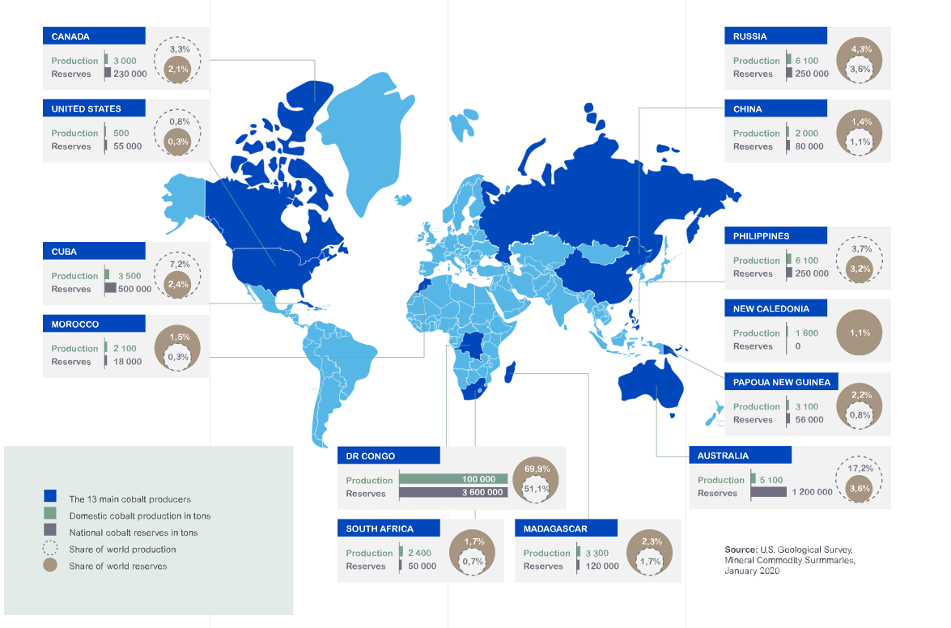
World Cobalt production and reserves in 2019
https://www.cobaltinstitute.org/about-cobalt/cobalt-life-cycle/

Slide 19
The problems with Cobalt
The DR Congo relies heavily on ‘artisanal’ mining. This essentially refers to:
Child Labor
Slave Labor
Extremely low salary
Use of hands or pickaxe and shovel
No safety equipment
Cobalt has a wide range of applications and is used extensively in sustainable technologies. Demand has significantly increased year-on-year.
The DR Congo has more Cobalt deposits than every other nation combined.
Co mines in the DRC are mostly owned by foreign companies; China dominates refining (2/3 of world production).
Cobalt is a gamma emitter and is therefore, radioactive. Complications of unsafe extraction conditions have been shown to include:
Cancer
Thyroid issues
Vomiting and heart complications
Asma and pneumonia
Damage to water supply and ecology

Slide 20
The breakdown
It is important to note that here the supply risk is not a result of the limited reserves, but rather the risk of reliance on a country with poor governance and working conditions.
This creates reputational risk for companies, supplying materials from this region, affecting their brand value.
Issues:
Cobalt is a technology material, and it is therefore of economic importance. Demand has greatly increased.
Extraction grade material is sourced mainly from the DR Congo. The human rights abuses and poor governance in the DR Congo creates a supply risk and lead to negative social consequences.
Mitigation:
Technologies that are less reliant on Cobalt could be developed, e.g. substitution.
Diversification of supply chain and increase of its transparency, potentially via certification route.
Exploration of domestic supply.
Increase reuse (and recycling) and promote material circularity, decreasing demand of primary production.
Opportunities for social investments to combat negative social consequences.

Slide 21
Summary
Groups of materials of particularly high economic importance and supply risk are referred to as Critical Raw Materials (CRMs).
Different countries have different lists of CRMs depending on access to domestic supply, geopolitics and economic strength nationally.
There are different methods for criticality assessment, varied in goals and scopes, using different indicators.
The Granta EduPack software can help in visualising data on elements and CRMs, helping with presenting a bigger picture.
Example of Cobalt shows high importance of CRMs and complex challenges in many cases.

Slide 22
Ansys Education Resources Feedback Survey
Here at Ansys, we rely on your feedback to ensure the educational content we create is up-to-date and fits your teaching needs.
Please click the link below to fill out a short survey (~7 minutes) to help us continue to support academics around the world utilizing Ansys tools in the classroom.
Feedback Survey Link
Notes:
Feedback Survey link for copy-paste method → https://ansys.typeform.com/to/jcattJI5

Slide 23
References
MOOC | SuscritMat learning content was reused from the material, developed within the framework of SusCritMat MOOC project.
DocsRoom - European Commission (europa.eu)
Rare Earth Elements | CRM Alliance
EUR-Lex - 52020DC0474 - EN - EUR-Lex (europa.eu); Regulation (EU) 2023/ of the European Parliament and of the Council of 12 July 2023 concerning batteries and waste batteries, amending Directive 2008/98/EC and Regulation (EU) 2019/1020 and repealing Directive 2006/66/EC (europa.eu)
Nakano, Jane. The Geopolitics of Critical Minerals Supply Chains. Center for Strategic and International Studies (CSIS), 2021. JSTOR, http://www.jstor.org/stable/resrep30033. Accessed 4 Dec. 2023.
Christoph Helbig, Martin Bruckler, Andrea Thorenz, and Axel Tuma. “An overview of indicator choice and normalization in raw material supply risk assessments”. In: Resources 10.8 (2021)
Cobalt-Institute-60-yrs-1024x561.png (1024×561) (omlus.com) & Cobalt Life Cycle: From Extraction to Recycling (cobaltinstitute.org)
https://single-market-economy.ec.europa.eu/system/files/2023-03/Study%202023%20CRM%20Assessment.pdf
European Commission, Directorate-General for Internal Market, Industry, Entrepreneurship and SMEs, Grohol, M., Veeh, C., Study on the critical raw materials for the EU 2023 – Final report, Publications Office of the European Union, 2023, https://data.europa.eu/doi/10.2873/725585
Ansys Education Resources – Teaching Materials – education resources for teaching and learning
Schrijvers et al, A review of methods and data to determine raw material criticality, Resources, Conservation and Recycling, Volume 155, 2020, 104617, ISSN 0921-3449, https://doi.org/10.1016/j.resconrec.2019.104617.
Quentin Dehaine, Laurens T. Tijsseling, Hylke J. Glass, Tuomo Törmänen, Alan R. Butcher, Geometallurgy of cobalt ores: A review, Minerals Engineering, Volume 160, 2021, 106656, ISSN 0892-6875,https://doi.org/10.1016/j.mineng.2020.106656.

