Slide 1
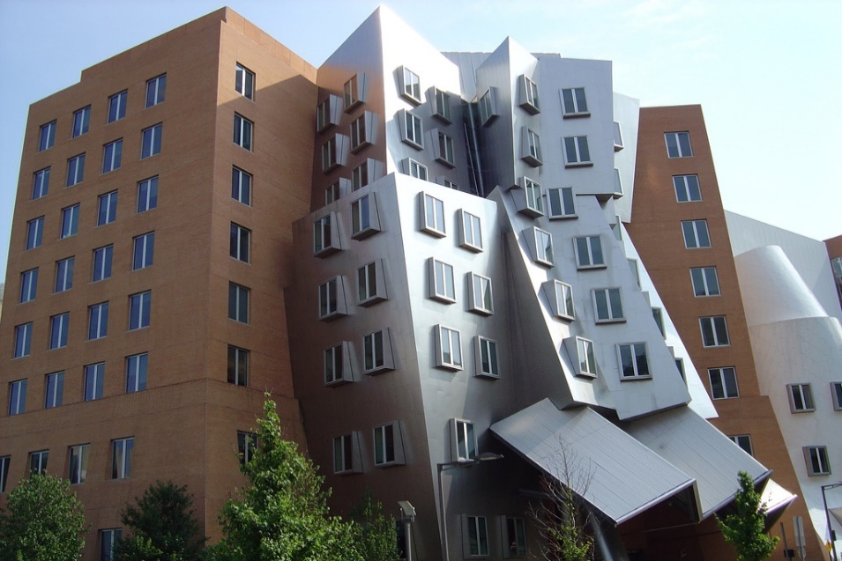
The Built Environment:
Materials for construction
Mike Ashby
Department of Engineering,
University of Cambridge
John Fernandez
Massachusetts Institute of Technology

Slide 2
Learning objectives for this lecture unit
Ansys software mentioned | Ansys Granta EduPack™­, a teaching software for materials education
Intended Learning Outcomes
Knowledge and Understanding | Understanding of the materials used in the built environment
Skills and Abilities | Ability to select materials to meet design criteria in built environment structures and interiors
Values and Attitudes | Insight into the diverse use and importance of materials in architecture and the built environment
Resources
Text: “Material Architecture – emergent materials for innovative buildings and ecological construction” by John Fernandez, Architecture Press, Elsevier, Oxford, UK, 2006 ISBN 0-7506-6497-5.
Software: Ansys Granta EduPack software Built Environment Database (www.ansys.com/products/materials/granta-edupack)
Notes:
Learning Objectives
These Intended Learning Outcomes are based on a taxonomy of knowledge and understanding as the basis, skills and abilities as necessary for the practical use of knowledge and understanding, followed by acquired values and attitudes enabling assessments and responsible use of these abilities.
Combined with a suitable assessment, they should be helpful in the context of accreditations or for the CDIO Syllabus.
The Texts listed are from books authored or co-authored by Mike Ashby and/or John Fernandez but other texts are also referred to in the Science Notes.

Slide 3
Outline of the lecture unit
Why are architects and engineers interested in materials?
Architecture and the Built Environment
The expanded Level 2 Built Environment database
Notes:
Outline
This Unit is about materials in Architecture. The Units link closely to the Text listed on the previous frame but can equally by used in conjunction with texts such as Callister, Budinski, Askeland and others.. The methods developed in the course are implemented in the Ansys Granta EduPack software, which is structured to evolve in pace with the student throughout an architecture or engineering program. Lecture Unit 1-2 introduces materials and processes, and the way in which information about them can be classified, retrieved and explored visually.

Slide 4
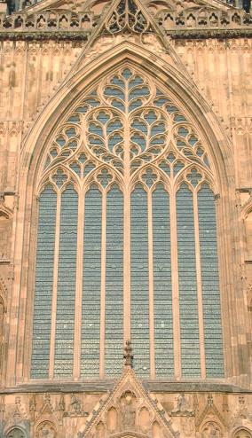
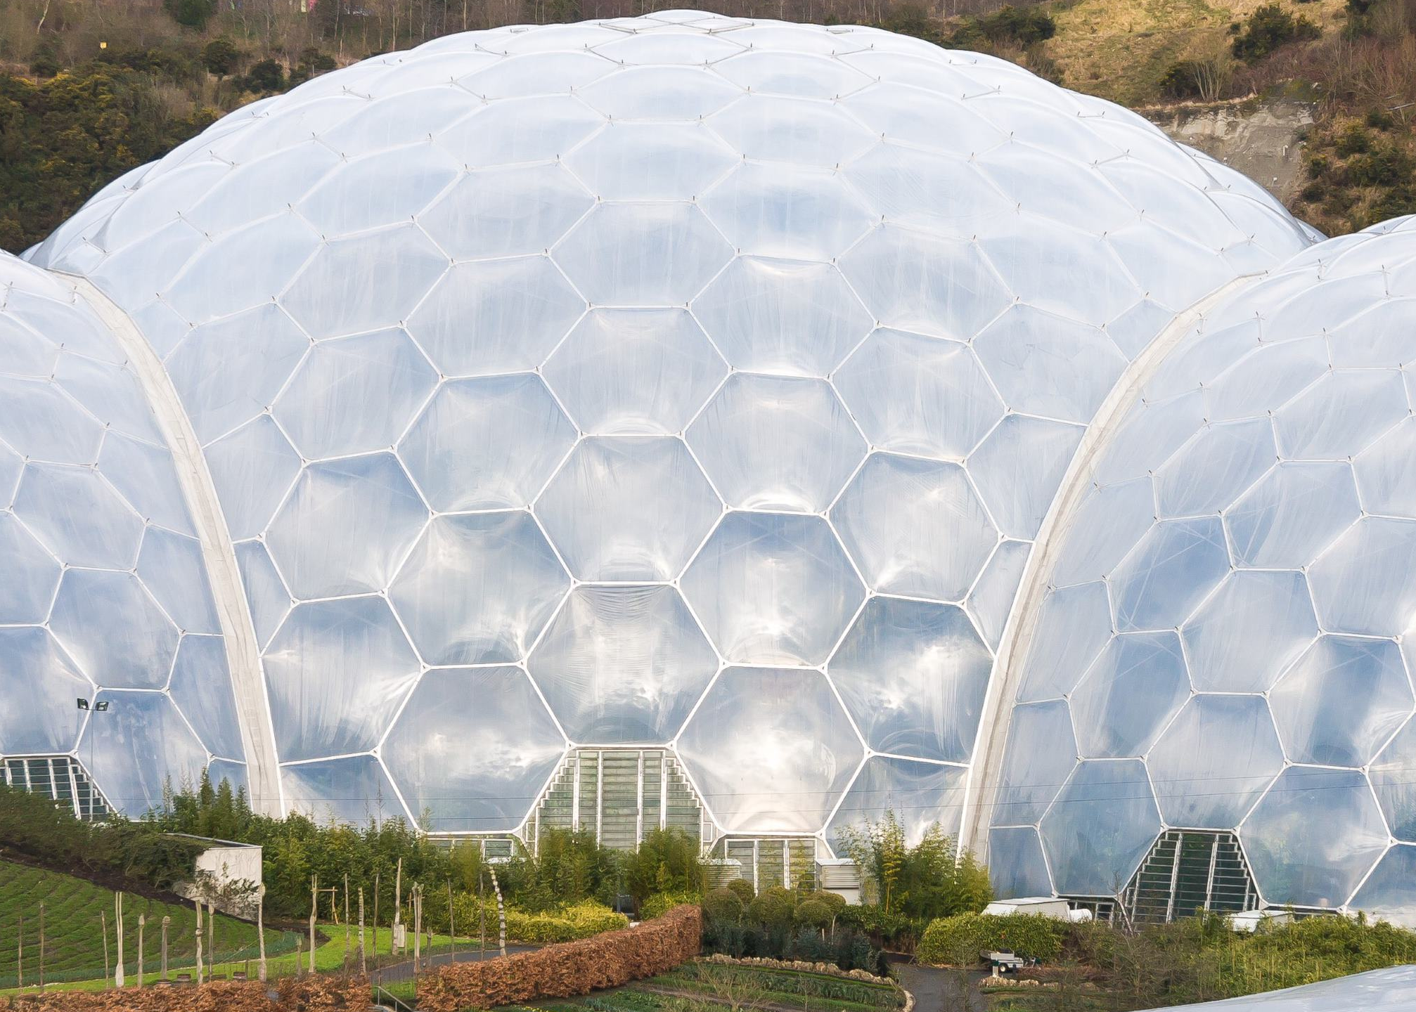
Why do engineers and architects need to know about materials?
Space Center, Leicester, UK.
N. Grimshaw
Architect
Pre-industrial revolution
Stone, wood, glass
York Minster,
York, UK.
Post-industrial revolution
ETFE (and thousands more)
Eden Project,
Cornwall, UK
Notes:
Why do architects and engineers need to know about materials?
The first reason is obvious: buildings, and the industry of construction, have changed dramatically over the past several hundred years. Among the changes are the many new materials available to be used in contemporary buildings; new aluminum alloys, composites, adhesives, synthetic polymers (like the ETFE in the photo above right), and others.

Slide 5

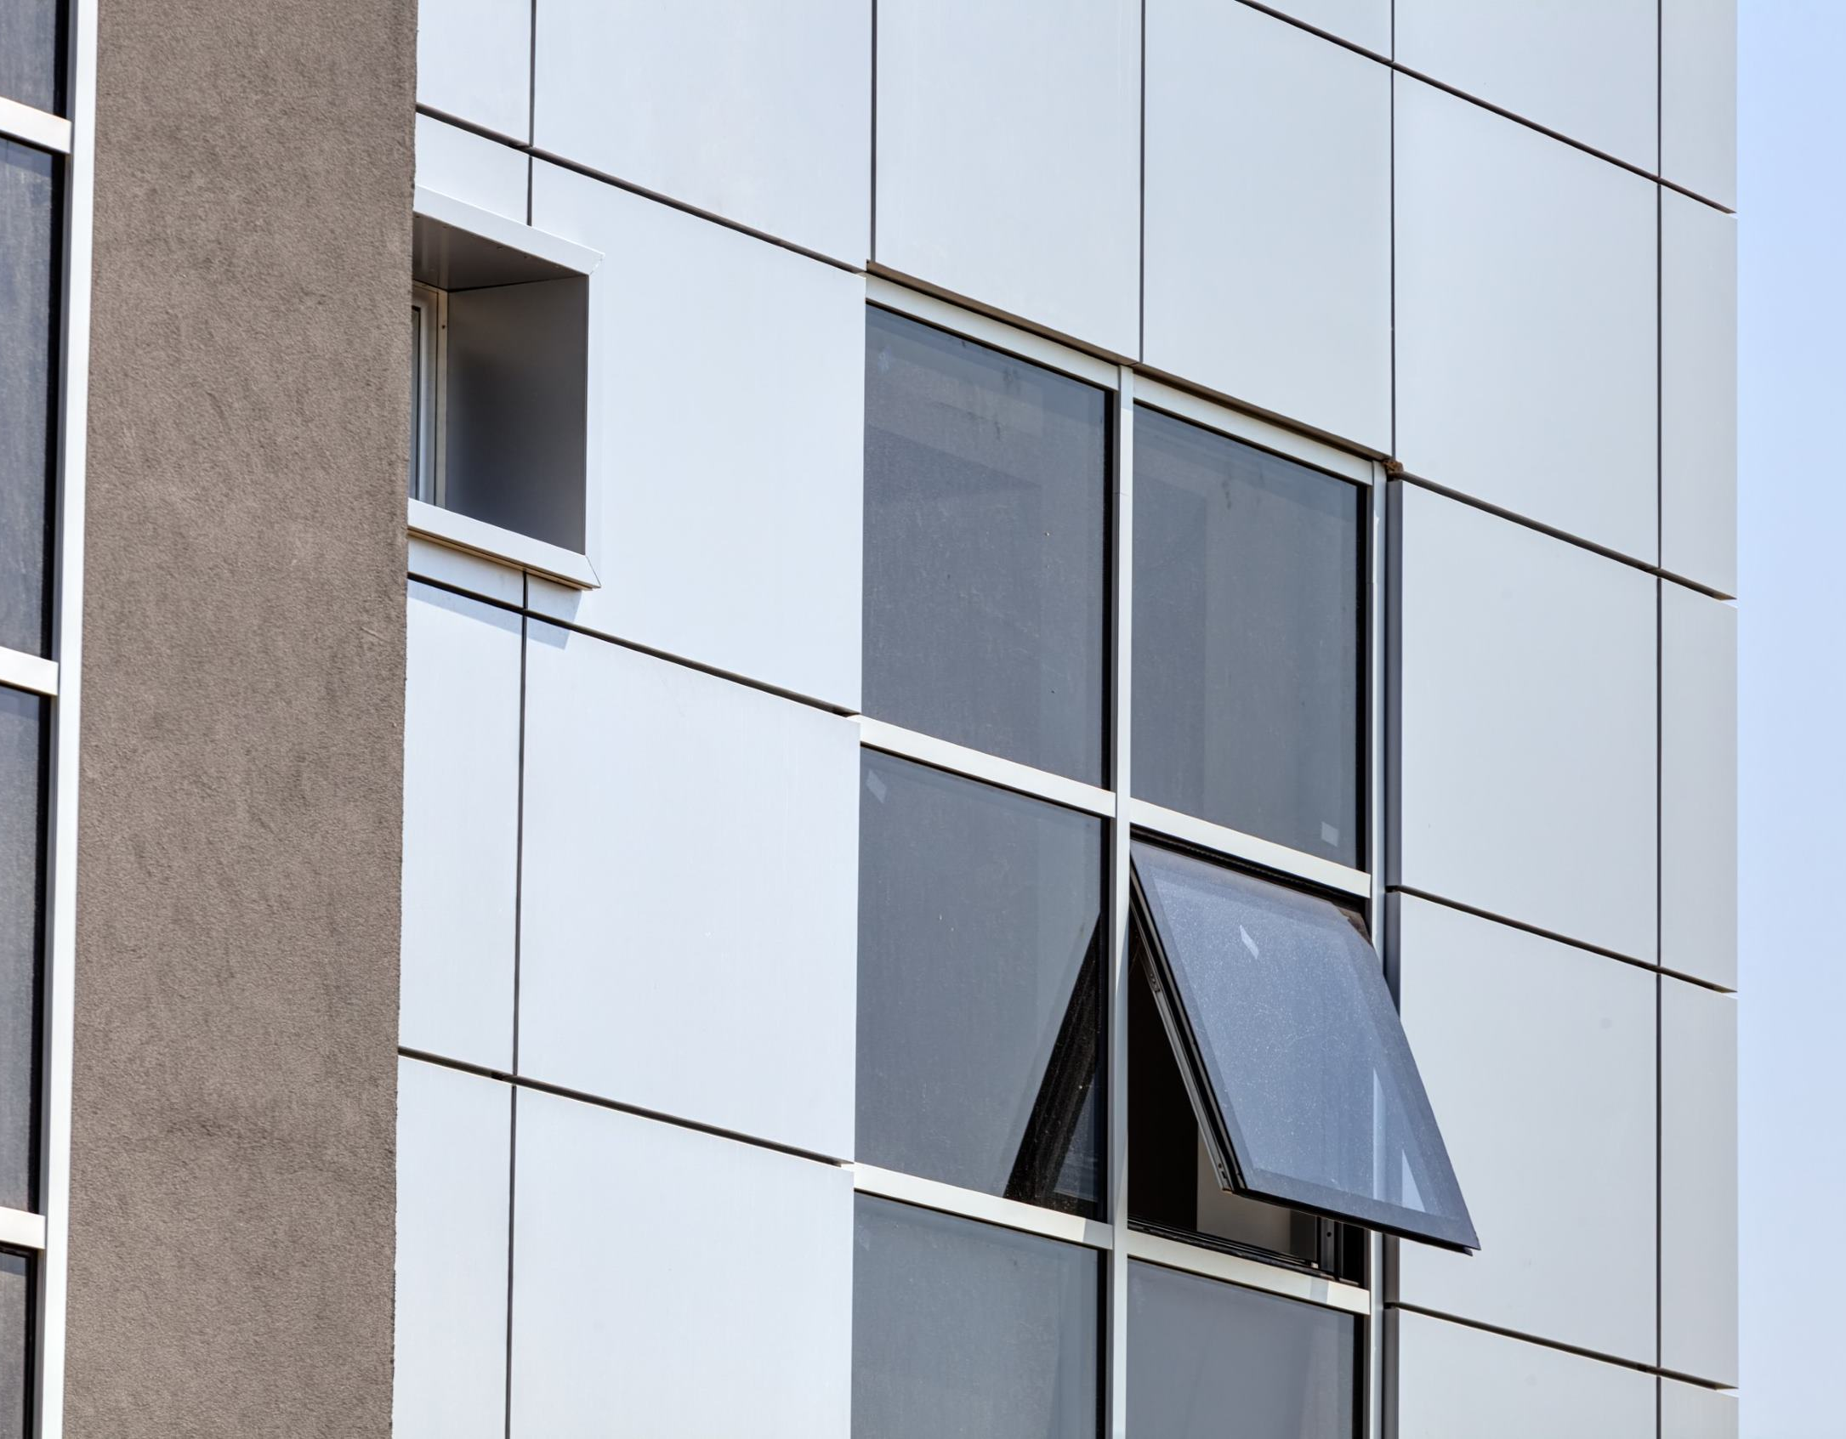
Products, not just materials?
Today, architects and structural engineers specify products, not just materials
Low-e laminated glass
Aluminum composite panels used as building ‘skins’
Notes:
Architects and Building Engineers deal principally with products, most of which combine several materials. The performance of these products depends on the properties of the materials of which they are made. A working knowledge of material properties can assist the designer in aligning anticipated behavior with functional needs – and ignorance of them can lead to missed opportunities and mistaken choices.

Slide 6

Unfamiliar materials used in new products
Angle selective glass
Institute of Contemporary Art, Boston, MA. Diller + Scofidio, Architect.
Notes:
New materials can provide the impetus for new architecture – but it takes knowledge on the designers’ part to take advantage of the potential of non-traditional materials. In this building the use of angle-selective glass surrounding the main gallery space of the cantilevered volume above leads to unique visual and functional behaviors.

Slide 7

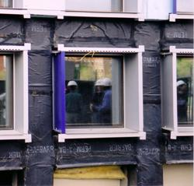
Unfamiliar materials used in new products
Many materials used in these products may be unfamiliar to designers.
Simmons Hall Student Dormitory, MIT, USA. Steven Holl, Architect.
Aluminum skin, covering…..
Waterproof, adhesive-backed EPDM
Notes:
Many new materials are now used in building systems and may be unfamiliar. Materials such as silicone sealants, organic coatings, composites, high strength concretes, etc. have their origins in corporate laboratories and are sold directly to the systems manufacturers. This frame shows photographs of the waterproof, adhesive-backed EPDM (right) that lies underneath the aluminum skin of the finished building (left).

Slide 8

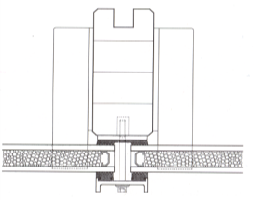
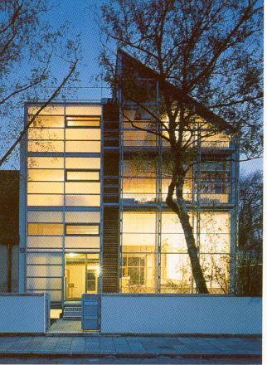
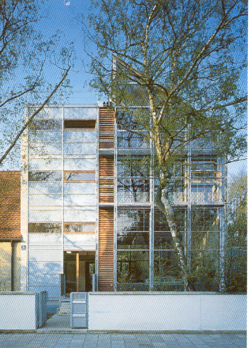
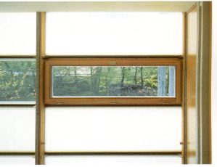
Unfamiliar materials used in new products
Apartment Building, Munich, Germany. Thomas Herzog, Architect.
Silica aerogels allowing….. translucent walls with high thermal resistance
Notes:
Some of these “new” materials have the potential to change the way we think about buildings and their systems. Silica aerogels, for example, are not only excellent thermal insulators but also translucent - allowing for the design and construction of a high-performance glass curtain-walls with high thermal resistance while providing daylight for occupants.

Slide 9
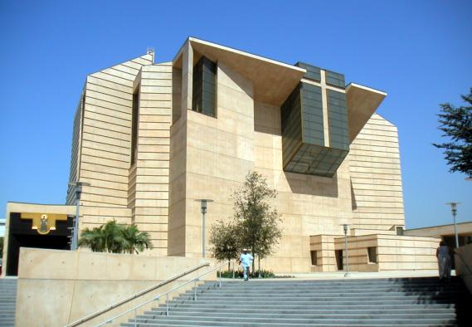
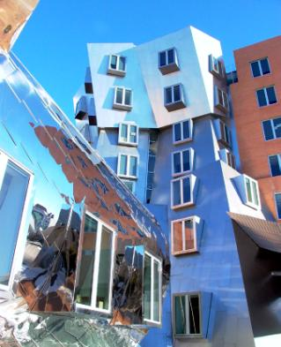
Unfamiliar materials used in new products
Cathedral of Los Angeles, USA. Rafael Moneo Architect
Stata Center, MIT, USA. F.O. Gehry Architect
High density concrete with stainless steel reinforcement
Stainless steel, zinc coated titanium,
polymer sealants
Notes:
Evolving needs include ecological and environmental performance indicators such as embodied energy, toxicity, recycle potential, renewability etc. The desire for very long-life buildings such as the Cathedral of Los Angeles, above, led to the choice of high-density concrete with stainless steel reinforcing bars that promise a no-maintenance service life of at least 500 years.
Building design is a restless discipline, engaged in a constant search for new forms and new processes to create them. The Stata Center above is an example of wildly personal forms achieved through the use of a diversity of stainless steels, zinc-coated titanium composite metal sheets and an array of polymer adhesives and sealants. In addition, the exterior envelope was substantially produced using a variety of Computer Assisted Manufacturing (CAM) methods that required the use of lightweight foams and other materials to reduce transportation weights of large window panels.

Slide 10




Different building systems require different materials
System
Functions
Materials
Transmit vertical loads to foundation
Resist dynamic loading from wind & seismic loads
Provide long term service
Steel reinforced concrete, stone
Cast iron and steel alloys
Timber
Brick, clay-based ceramics
Superstructure
Glass
Aluminum
Silicone, neoprene, epoxies, bitumen
Insulating fibers and foams
Control the transfer of air, heat, water, vapor
Regulate radiation
Provide acoustic separation
Enclosure
Wood particle boards
Polymer reinforced plaster
Resins and other polymers
Tiles, terracotta, brick
Delineate interior space and distinct climate zones
acoustically separate zones
Provide space for finished surfaces
Interiors
Galvanized sheet metals
Polymer electrical insulators
Heat exchange materials
Copper and PVC piping
Manage heating, cooling and ventilation
Regulate artificial and natural light
Provide water and waste removal
Building services
Notes:
The database differentiates between various building systems, their functions and typical materials used in those systems

Slide 11
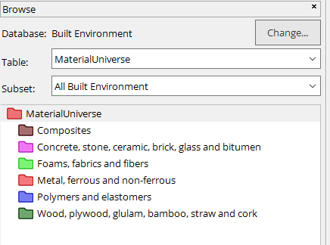
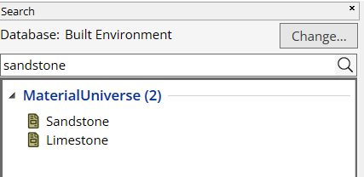
Ansys Granta EduPack software database for the built environment
Toolbar
Notes:
The Granta EduPack database has a Browse window that looks like this. Opening the tree-like organization of the material classification allows records to be accessed. Records can also be found by the use of the Search facility. Both Browse and Search are described fully in Unit 1.

Slide 12
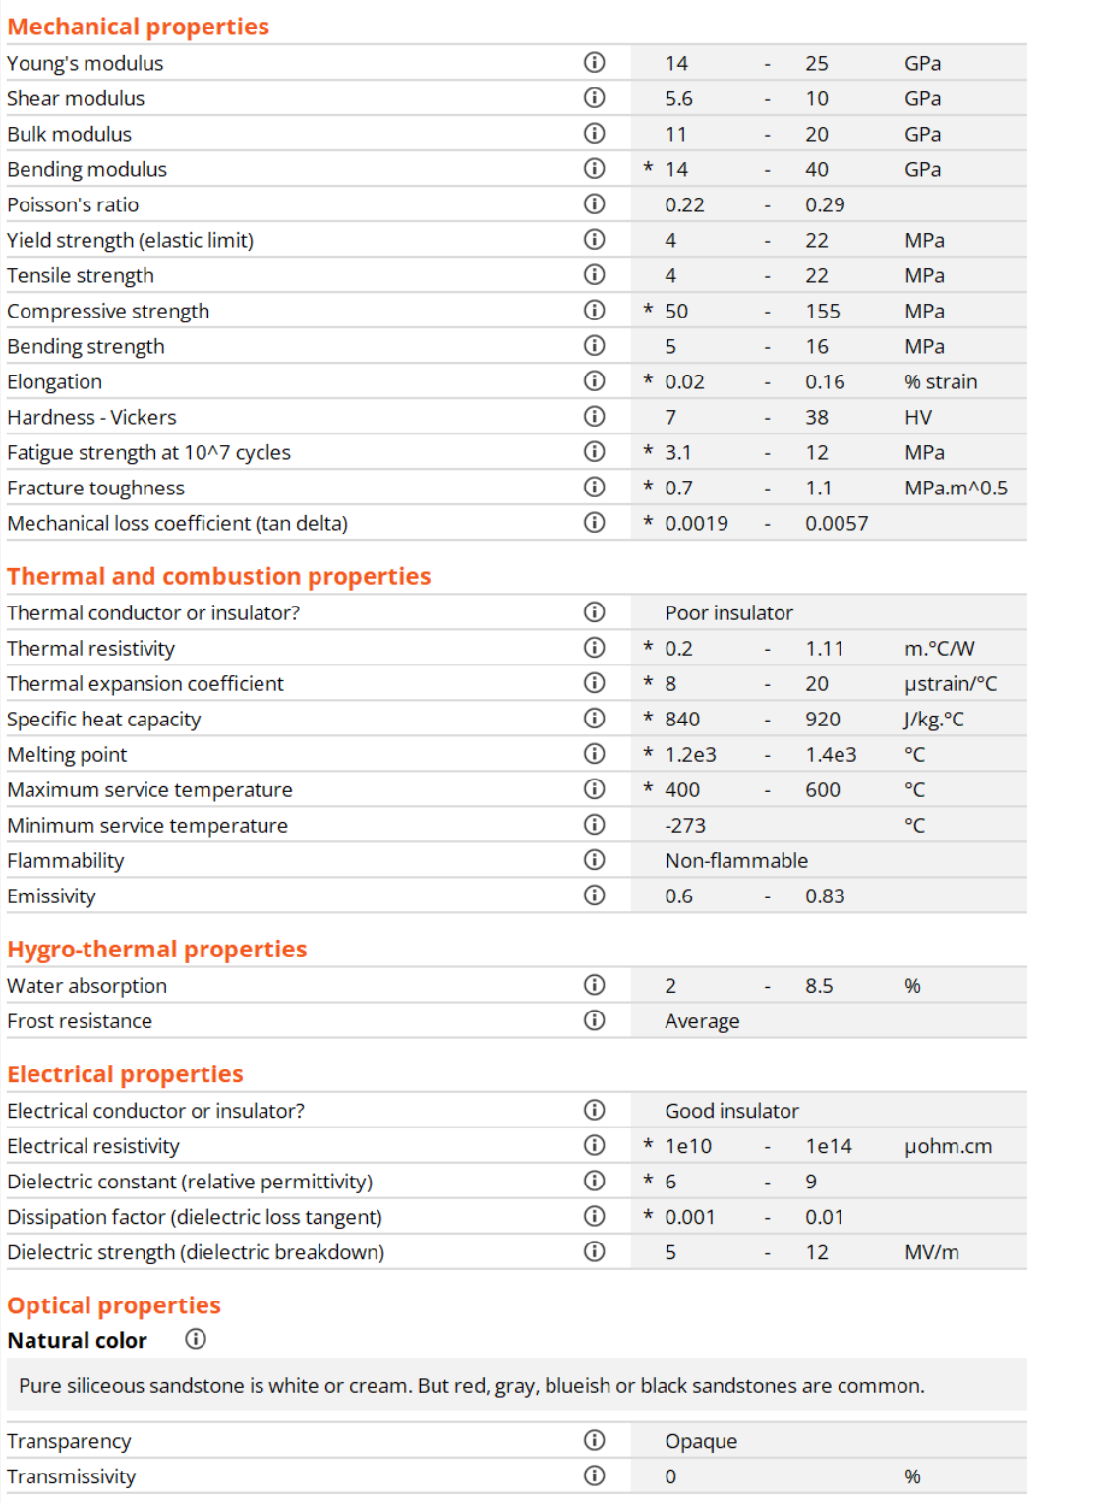
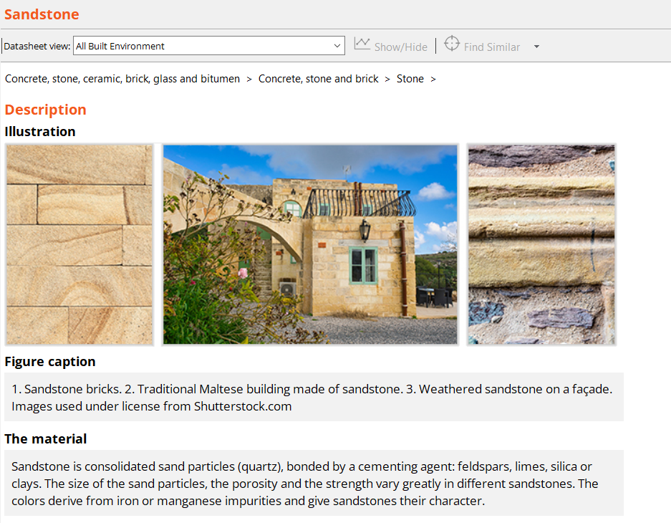
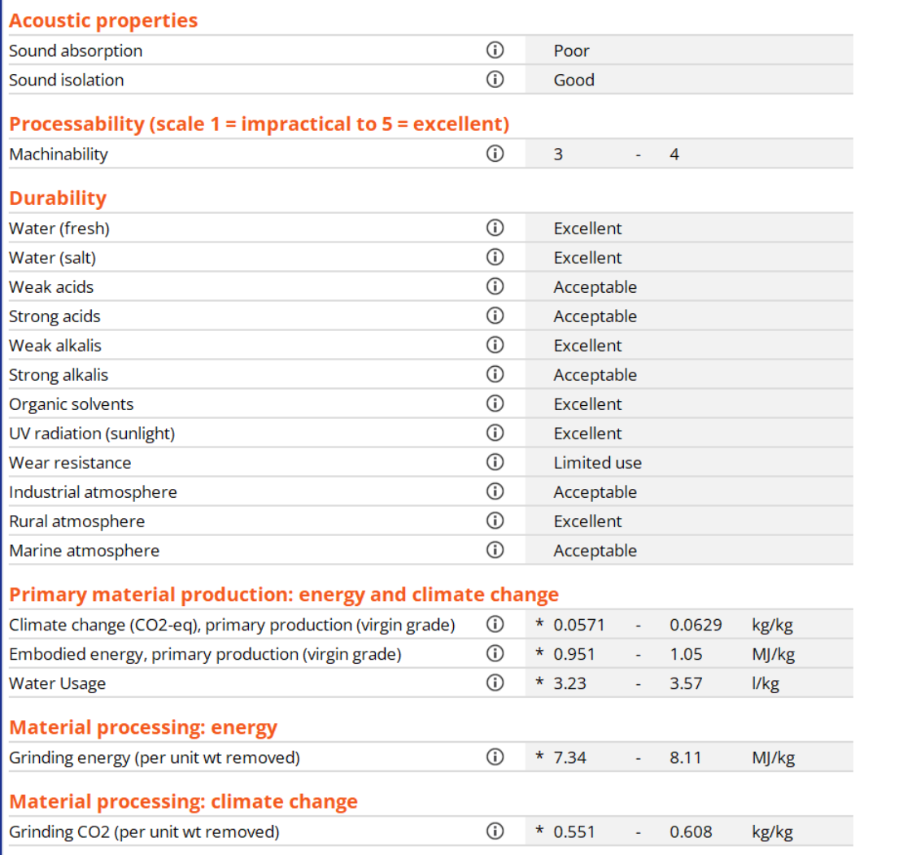
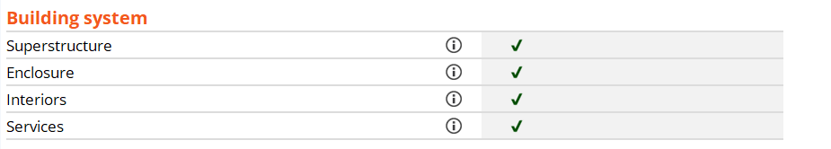
The Built Environment data records
A typical record: Sandstone
Some unique properties
Notes:
The Ansys Granta EduPack software Built Environment database contains 133 records for materials and 116 records for processes. The materials records, of which this is an example, are illustrated where possible with examples drawn from architecture, and contain properties of relevance for building design. There are records for all the “new” materials mentioned earlier – ETFE, EPDM – and many more. The properties unique to this database are ringed in red above.

Slide 13

The expanded Level 2 database
Images relating to the built environment where possible
133 records emphasising materials for the built environment
More classes of concrete
More classes of brick and tile
More fibers, particle and plywoods
More materials for insulation
Additional property fields
Mechanical properties in bending
Hygro-thermal properties
Acoustic properties
Millau Viaduct, France
Image used under license from Shutterstock.com
Notes:
The Ansys Granta EduPack software database for the Built Environment differs from the Granta EduPack Level 2 database in the ways listed here.

Slide 14
Ability to create property charts
Materials with high thermal resistivity
Results
5 out of 95 pass
Ranking
T-resistivity
Material 1 313
Material 2 300
Material 3 278
Material 4 247
etc...
Enables students to explore relationships
Carry out elementary selections (“Find materials with large thermal resistivity”)
Notes:
Granta EduPack software allows the construction of bar charts and bubble charts in the ways described in Unit 2. Here is a bar-chart of thermal resistivity, the reciprocal of thermal conductivity. It allows the selection of materials with exceptionally high resistivity by positioning a selection box as shown here.

Slide 15
Material selection project: cladding for buildings
Translate design requirements
Translation
Function
Protective cladding
Design requirements
Constraints
Form: sheet
Tensile strength > 50 MPa
Elongation > 2%
Durability in industrial environment: Excellent
Durability in rural environment: Excellent
Durability in marine environment: Acceptable
Durable, strong, ductile cladding
Available in sheet form
Environmentally friendly
As cheap as possible
Objectives
Minimize cost (and / or)
Minimize embodied energy
Free variable
Choice of material
Notes:
This frame sets up a case study. A material is sought for the cladding of a building. It must meet certain constraints, listed here
Availability in the form of sheet
Sufficient strength to support working loads – 50 MPa, the strength of typical of aluminum cladding is a good bench-mark
Sufficient ductility to allow bending to accommodate changing roof profiles
Durability in industrial, rural and marine environments
There are two objectives (objectives are discussed in Units 7 and 8):
To minimize material cost, and
The wish to use a material with the lowest possible embodied energy.

Slide 16
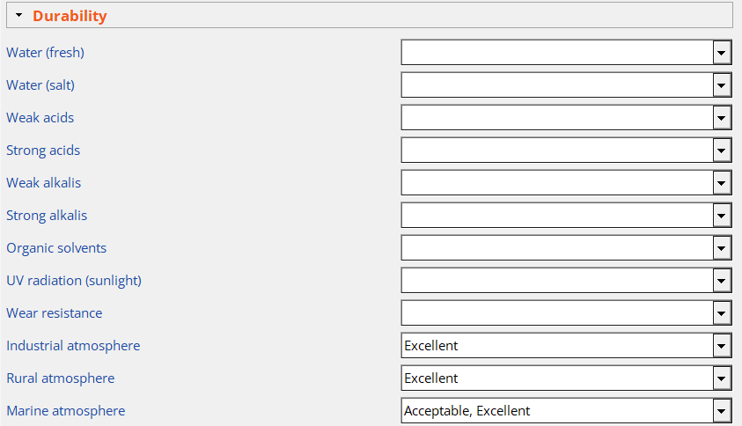
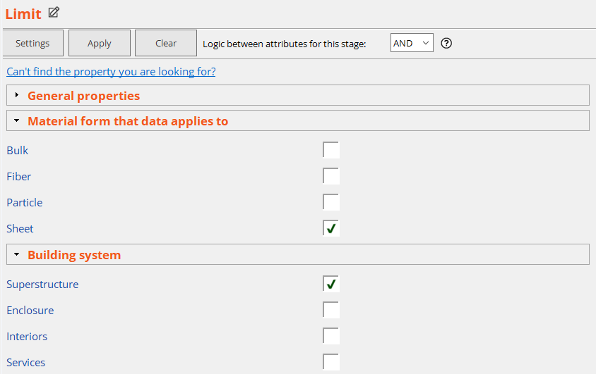
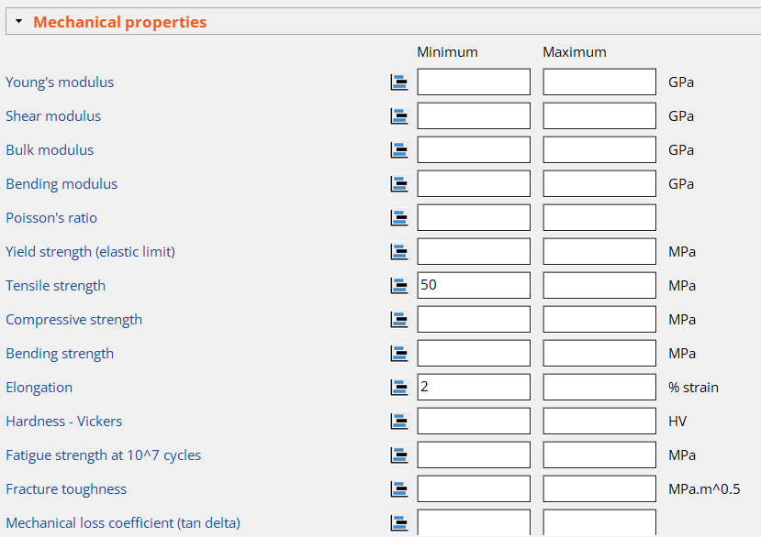
Material selection project: cladding for buildings
Apply constraints using a Limit stage
In addition to numerical constraints, additional qualitative properties may be screened
Notes:
The constraints are imposed using a Limit stage, as illustrated here.

Slide 17
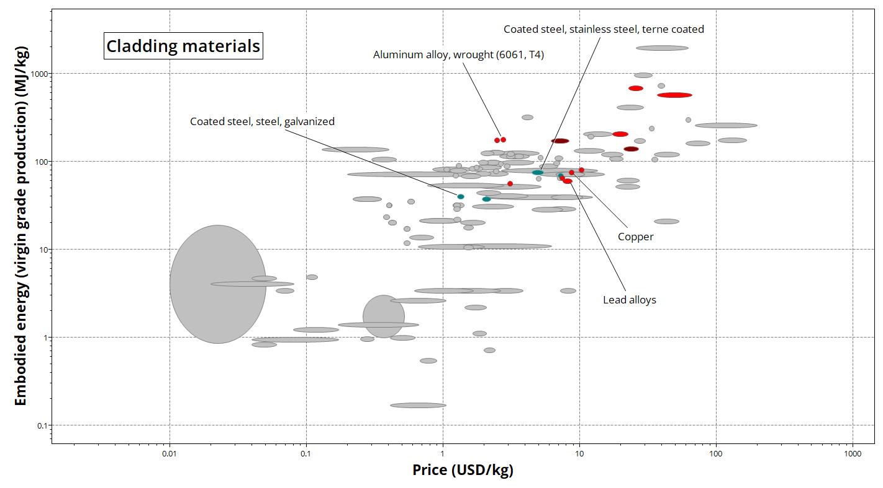
Material selection project: cladding for buildings
A graph stage to minimize cost and embodied energy after suitable constraints
Notes:
The objectives are applied in the way shown here. It is a bubble-chart of material price and material embodied energy – materials with low values of both lie towards the bottom left. Materials that failed to meet one or more of the constraints appear in grey, those that meet all the constraints remain colored. The one with the lowest price and embodied energy, meeting all constraints is Galvanized steel. Its data sheet is shown in the next frame.

Slide 18
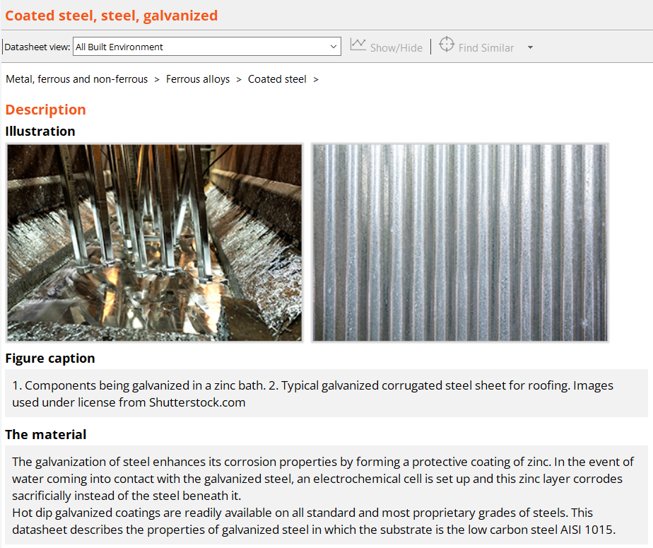
Material selection project: cladding for buildings
Result
Notes:
The Granta EduPack Selection screen lists the materials that meet the constraints in the Results window at the lower left. The main window shows the beginning of the record for Galvanized steel.

Slide 19
Summary
Engineers and architects get acquainted with new materials in a visual and engaging way
Environmental data is available for all materials in the database, sustainability concepts can easily be incorporated
Materials selection and substitution is facilitated

Slide 20
Ansys Education Resources Feedback Survey
Here at Ansys, we rely on your feedback to ensure the educational content we create is up-to-date and fits your teaching needs.
Please click the link below to fill out a short survey (~7 minutes) to help us continue to support academics around the world utilizing Ansys tools in the classroom.
Feedback Survey Link
Notes:
Feedback Survey link for copy-paste method → https://ansys.typeform.com/to/jcattJI5

