Slide 1
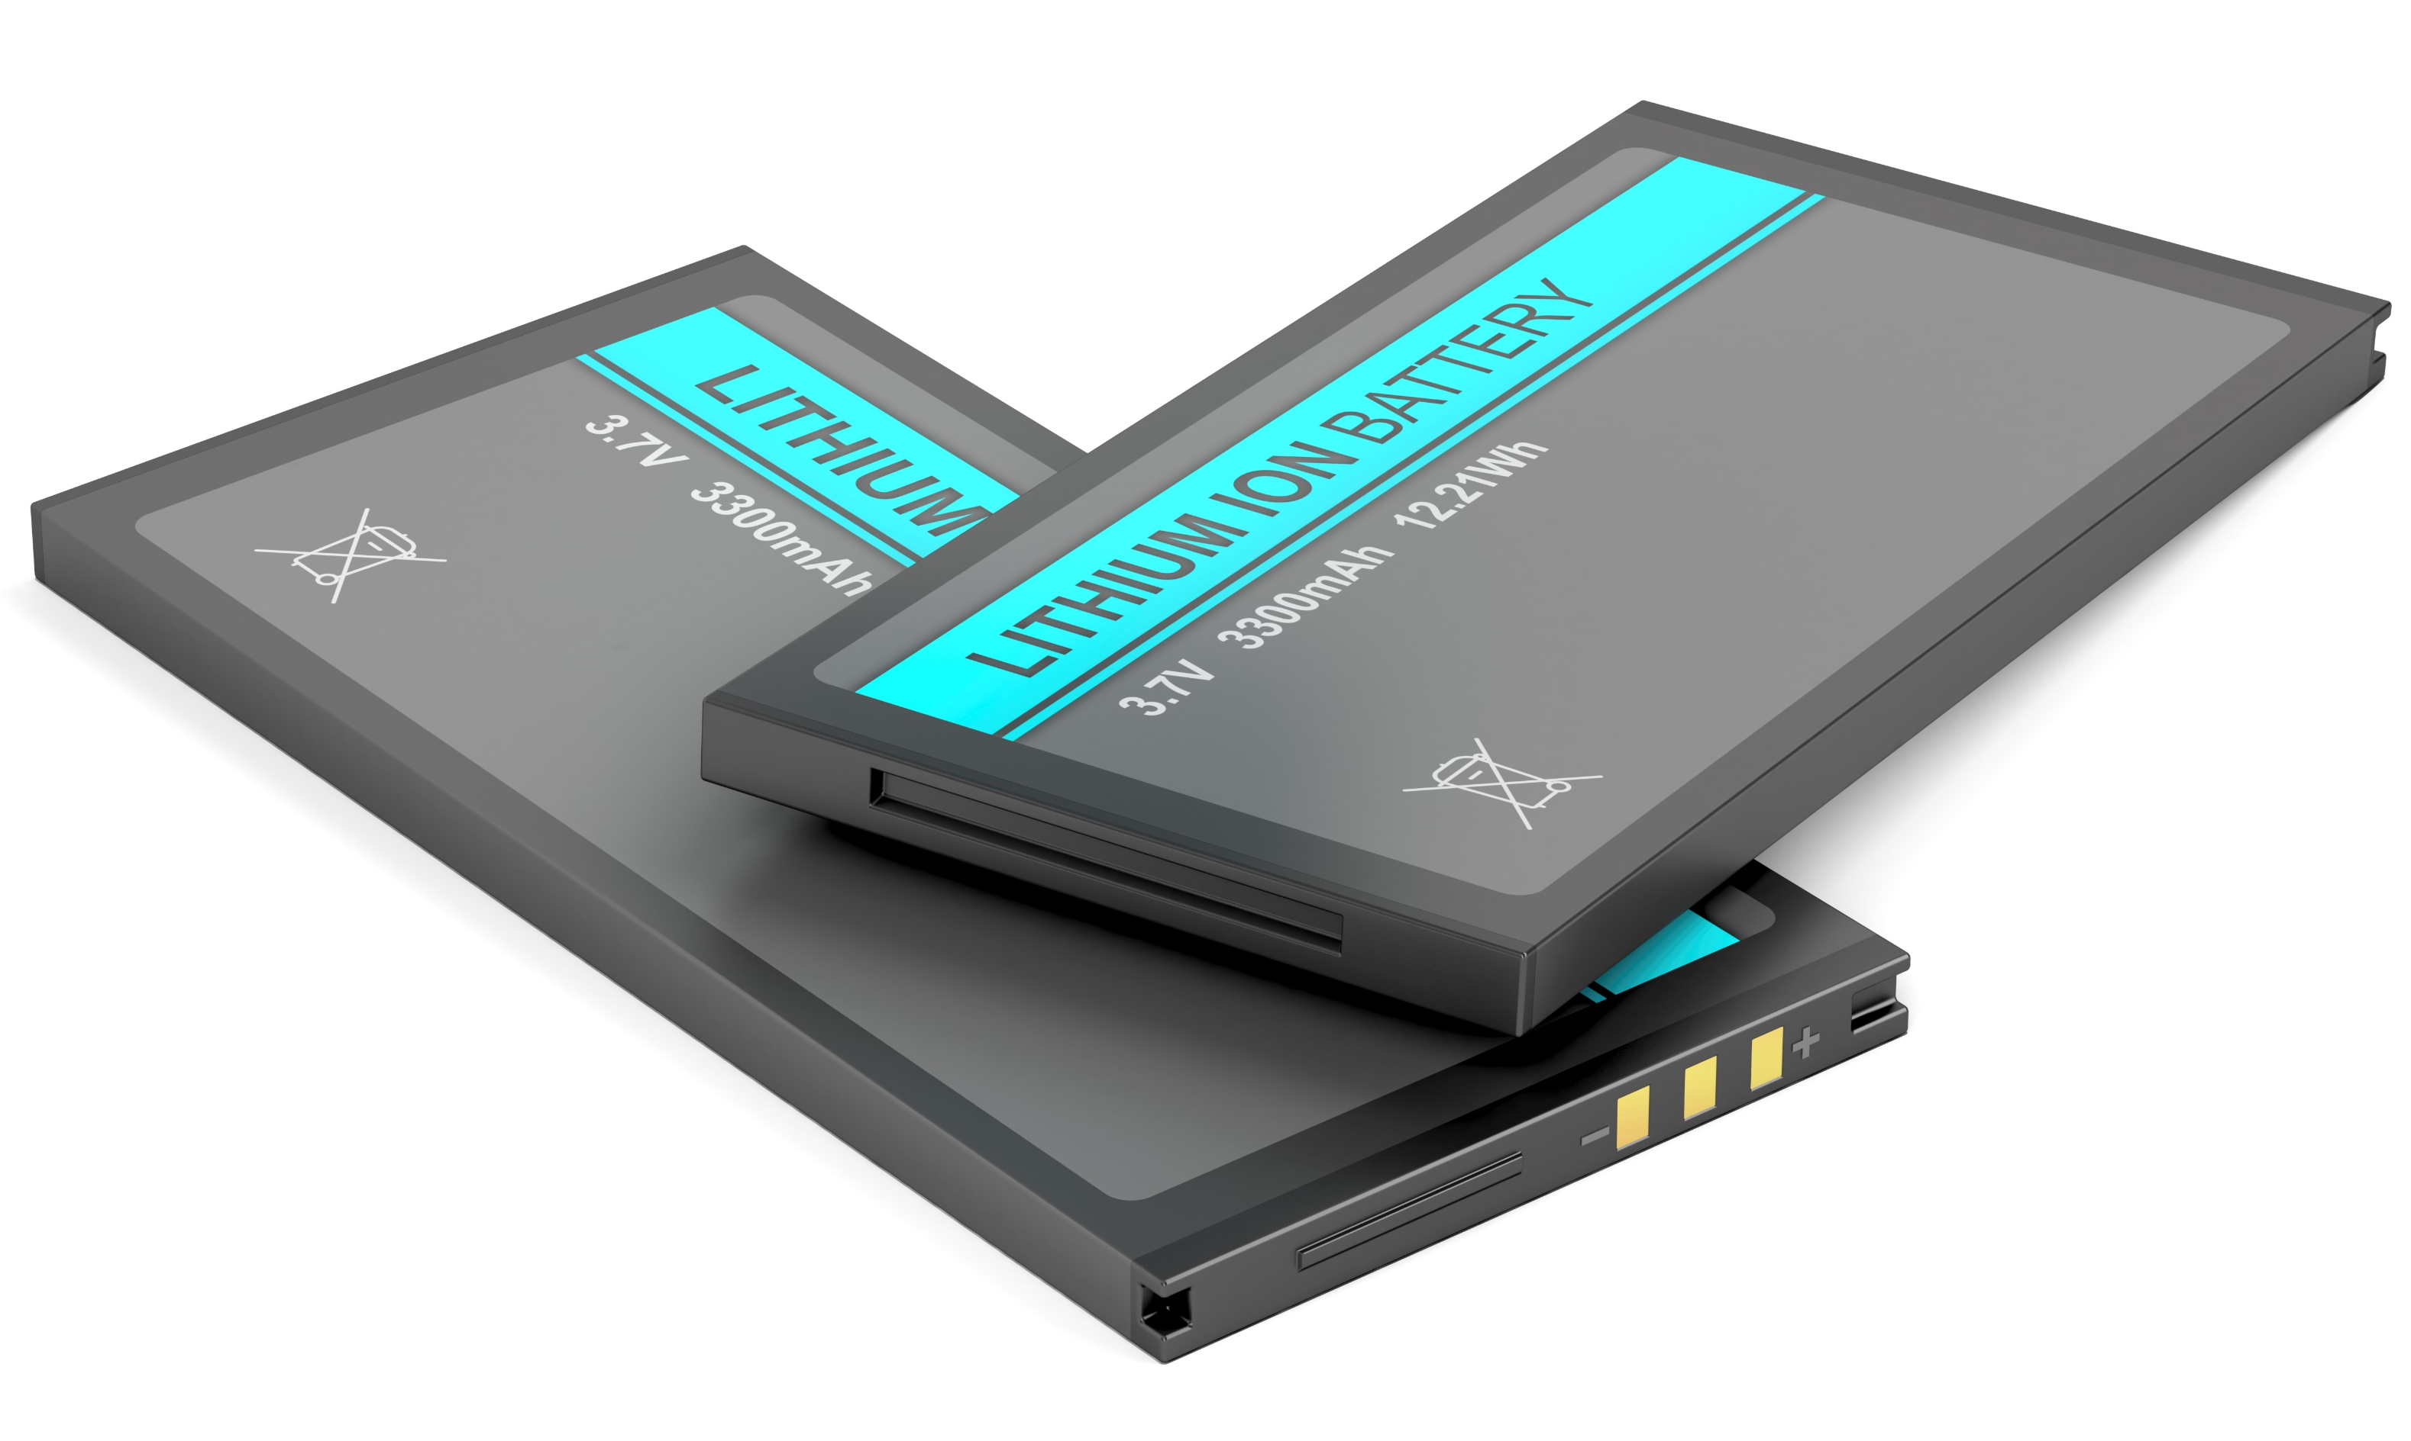
The Battery Designer Tool
Claes Fredriksson
Ansys Academic Development Team

Slide 2
Learning objectives for this Lecture Unit
Ansys software mentioned | Ansys Granta EduPack™­, a teaching software for materials education
Intended Learning Outcomes
Knowledge and Understanding | Knowledge of different battery cells and how they can be combined
Skills and Abilities | Ability to select battery cells to modules for applications
Values and Attitudes | Awareness of how battery performance changes with configuration and cell types
Resources
Paper: The Synthesizer Tool - Model Writer’s Guide
Level 3 Industrial Case Study: Battery Designer and Materials for Transportation

Slide 3
Outline of lecture unit
Background to batteries
Relevant data
Power Systems-Storage
Battery cells
Battery Designer synthesizer models
Cell to module
Module to pack
Example of module design: eScooter
Notes:
Summary
This lecture Unit introduced the hybrid materials and the Ansys Granta EduPack software Synthesizer Tool that lets you create records for their properties or estimate the cost of manufactured products. These properties can be compared directly with those of all the other materials in the Ansys Granta EduPack software databases, allowing selection that includes hybrids.

Slide 4
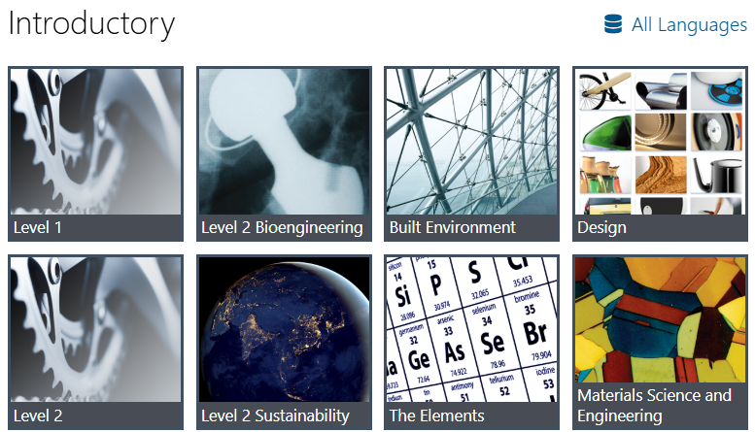
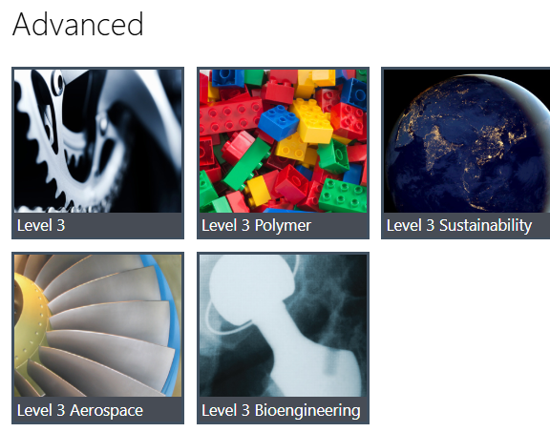
Granta EduPack databases with battery data
The Elements database – All relevant elements for batteries
Sustainability Level 3 – Energy Storage database
All four Specialized Advanced databases – Battery Cells data and The Battery Designer tool
Notes:
Databases for Batteries

Slide 5
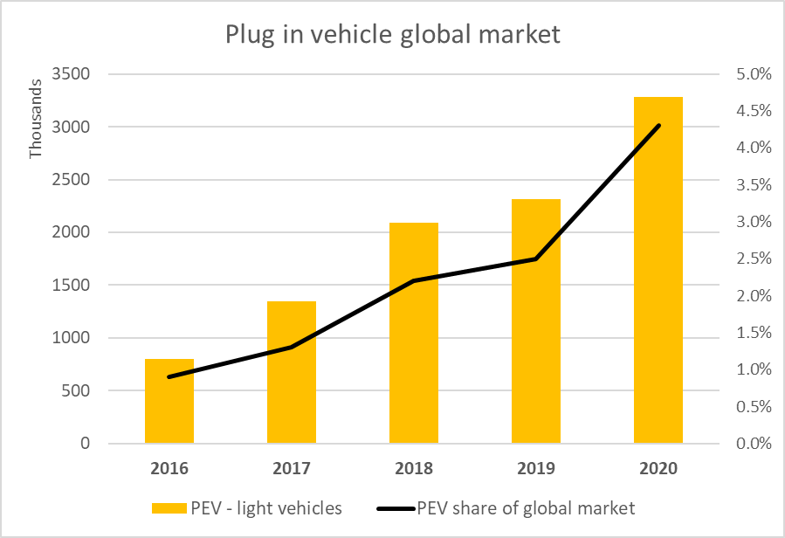
Background: materials for electrification of transport
Huge growth of electric and hybrid vehicles
Many battery types contain toxic elements:
Lead,
Cadmium
Mercury
Some contain critical elements:
Lithium
Cobalt
Most electric motors contain magnets
These have rare earth elements:
Neodymium
Samarium
Dysprosium
Top 5 Countries: China, Germany, USA, France, UK
Notes:
Electric transport systems
Electric transport systems in general, and plug in vehicles in particular, have increased significantly over the past few years
This trend comes from the a popular demand to reduce CO2 emissions, of course
But it is also possible because of recent improvements in the performance and cost of battery technology
The growth of electric vehicles globally puts pressure on material supply
In particular, there are issues with batteries and permanent magnets for electric motors
Traditional rechargeable batteries contain toxic heavy metals and the magnets contain rare earth elements

Slide 6
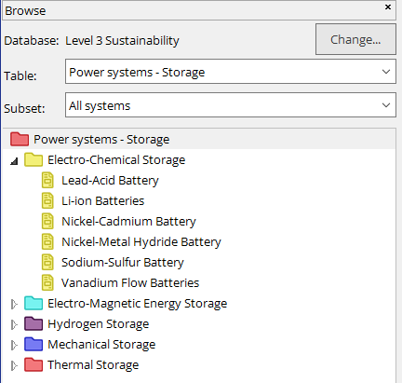
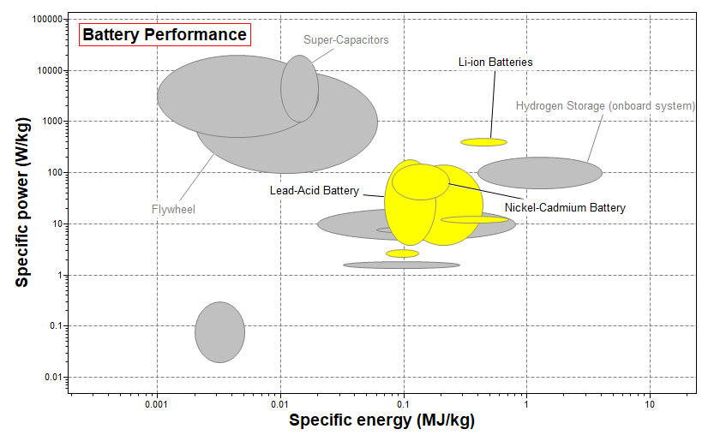
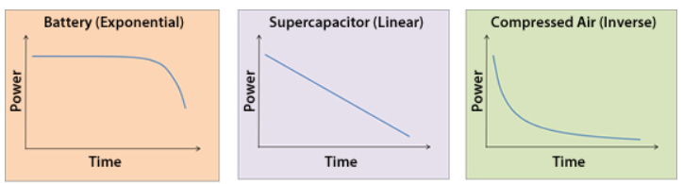
The Power Systems-Storage datatable
Specific power = power per mass, promotes acceleration
Specific energy = stored energy per mass, promotes range
Li-ion batteries perform better than others, but without the need for lead or cadmium
Notes:
Energy storage systems
There exists many engineering systems that can store energy for various power, load cycling, range and charging requirements
Electro-chemical storage systems, or batteries, are one of them, highlighted here in Yellow
If we focus on transport applications, batteries show very good specific power and energy, but also high energy density which means low space requirements
Li-ion batteries perform better than others, but without the need for lead or cadmium

Slide 7
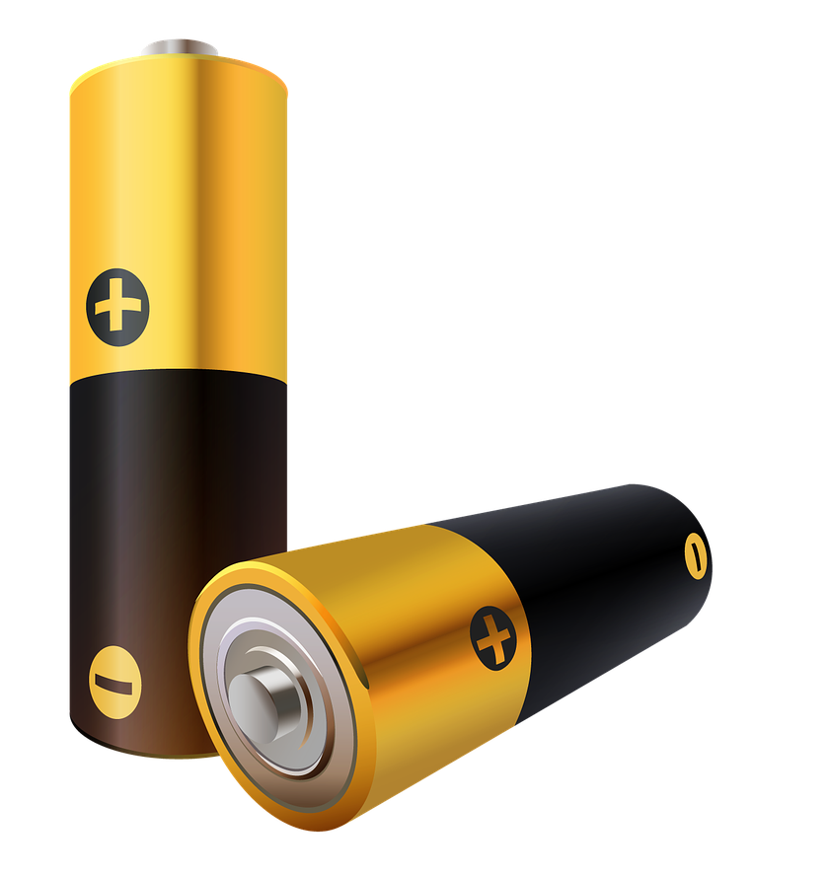
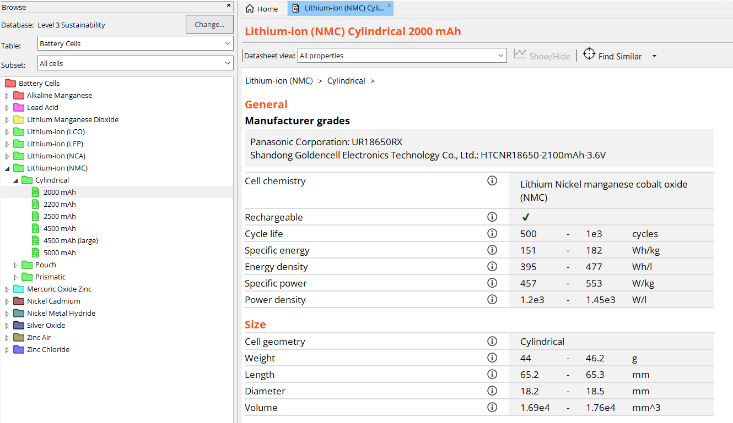

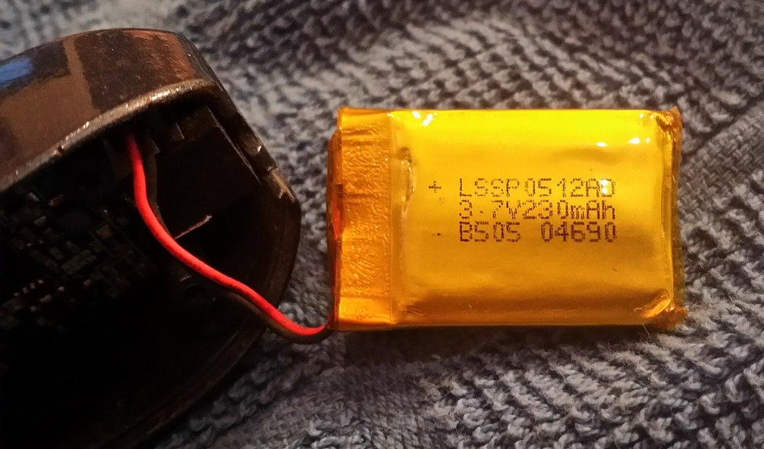
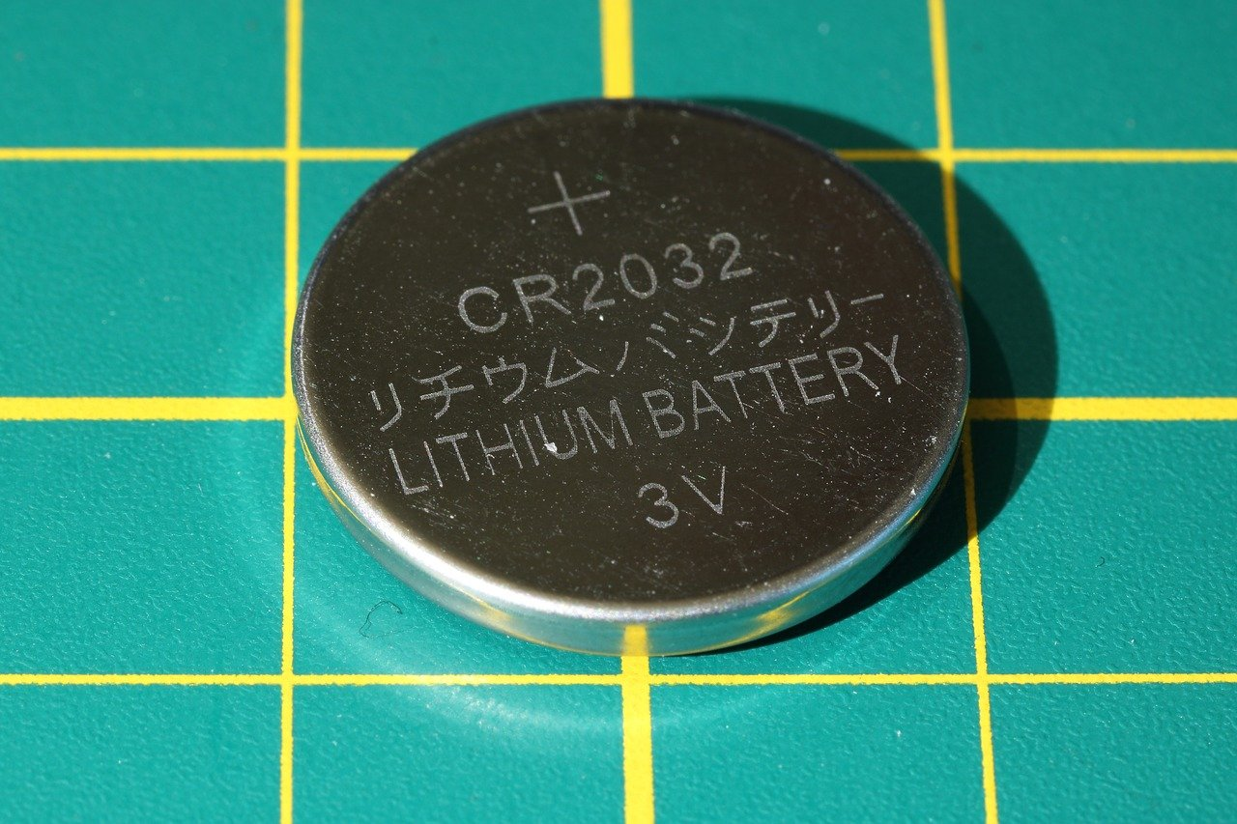
The Battery cells datatable
Cylindrical cell
Generally lower cost
High mechanical stability
Most commonly available
Used in EVs
Prismatic cell
High mechanical stability
High packing density
Used in phones
Pouch cell
Low mechanical stability
High packing density
Used in drones and R/C
Coin cell
Small
Inexpensive
Used in small appliances
Notes:
Battery cells
There are many types of batteries included in the battery cell data-table
The battery cells subset contains 128 records covering the most common chemistry families.
Primary and secondary (rechargeable) batteries of most relevant chemistries
Four types of cell geometries are available; Cylindrical, Prismatic, Pouch and Coin batteries.

Slide 8
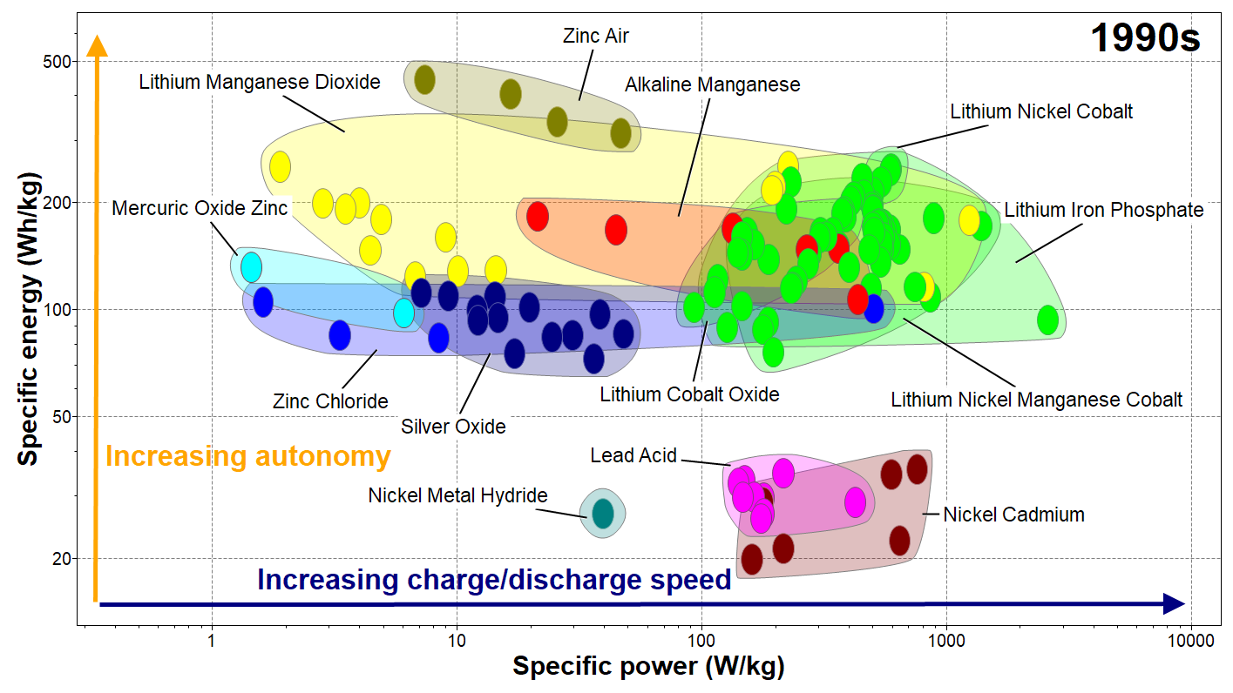
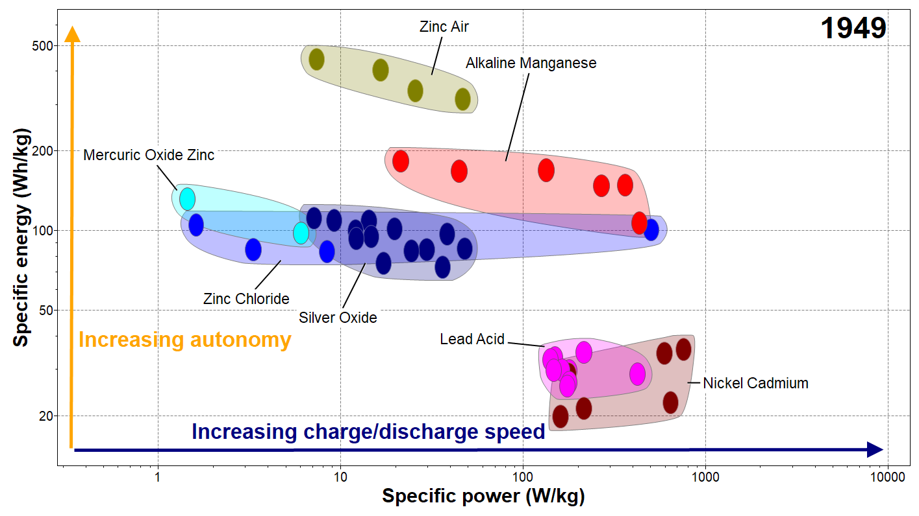
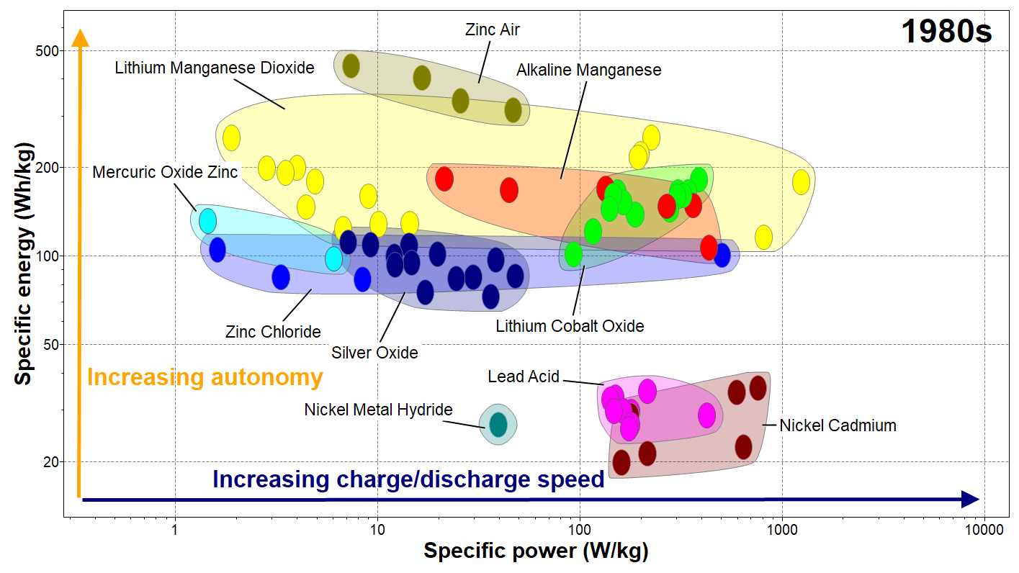
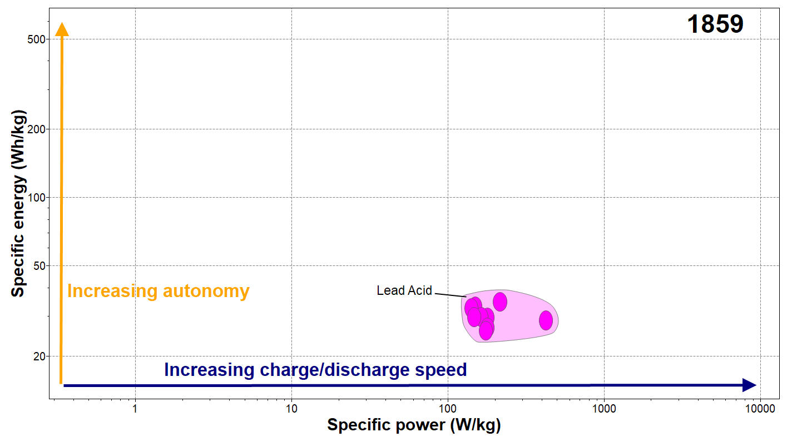
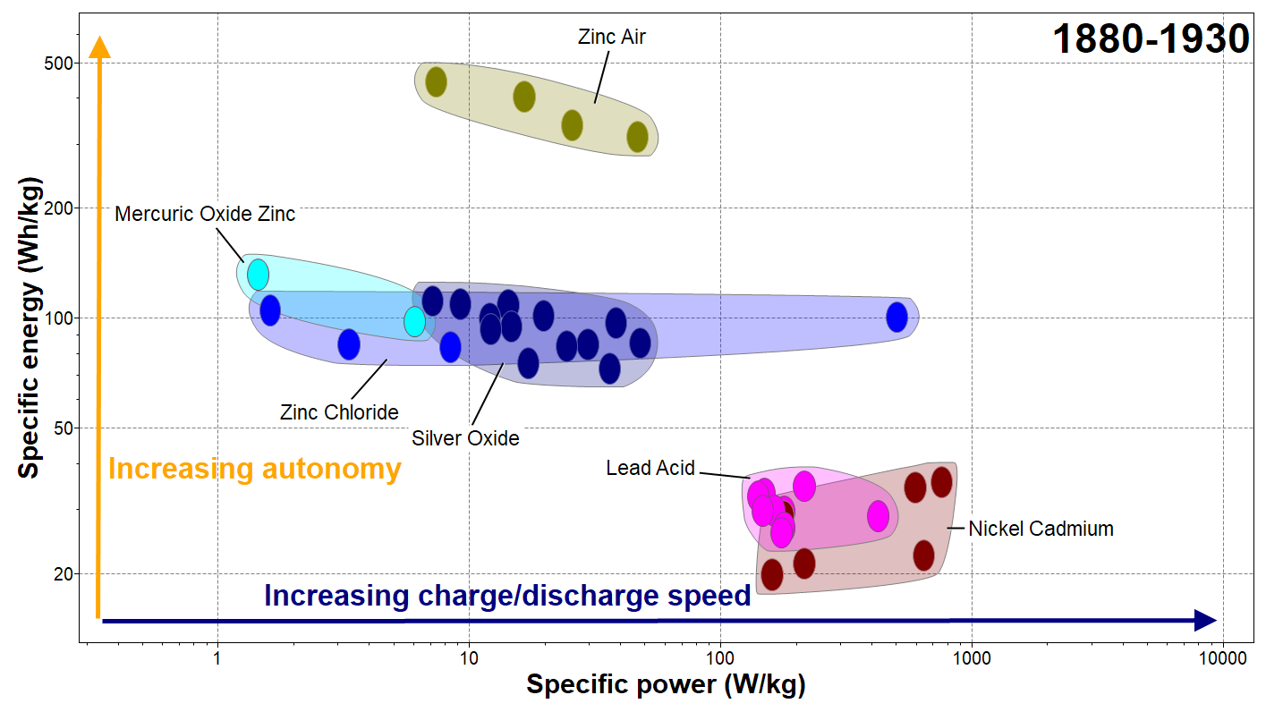

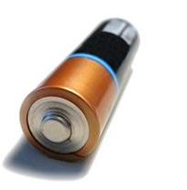
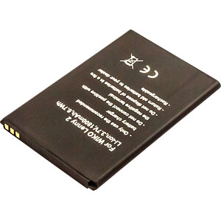
Battery cell technology – 200 years of development
The Ragone plot is suitable for comparing performance of energy-storage devices, as well as energy devices such as engines, gas turbines, and fuel cells. The vertical axis describes how much energy is available per unit mass, while the horizontal axis shows how quickly that energy can be delivered, the power per unit mass.
18650 - 18 mm diameter,
65 mm long
Images from Ansys Granta EduPack software
Notes:
Ragone plots and History
Battery cells have been around for more than 200 years. The first large volume application technology was Lead Acid batteries, developed in the mid 1800’s
Then over a period of 50 years, multiple discoveries occured with the families of Zinc-, Silver-, and Nickel Cadmium-based cells
1949 was another stepping stone with the invention of Alkaline Manganese, extremely popular nowadays with AA and AAA batteries
Since the 80’s, the Lithium-ion technology has been discovered, and many electrochemical materials have been developed
This breakthrough has been so significant that the inventors were awareded the Nobel Prize of Chemistry in 2019

Slide 9
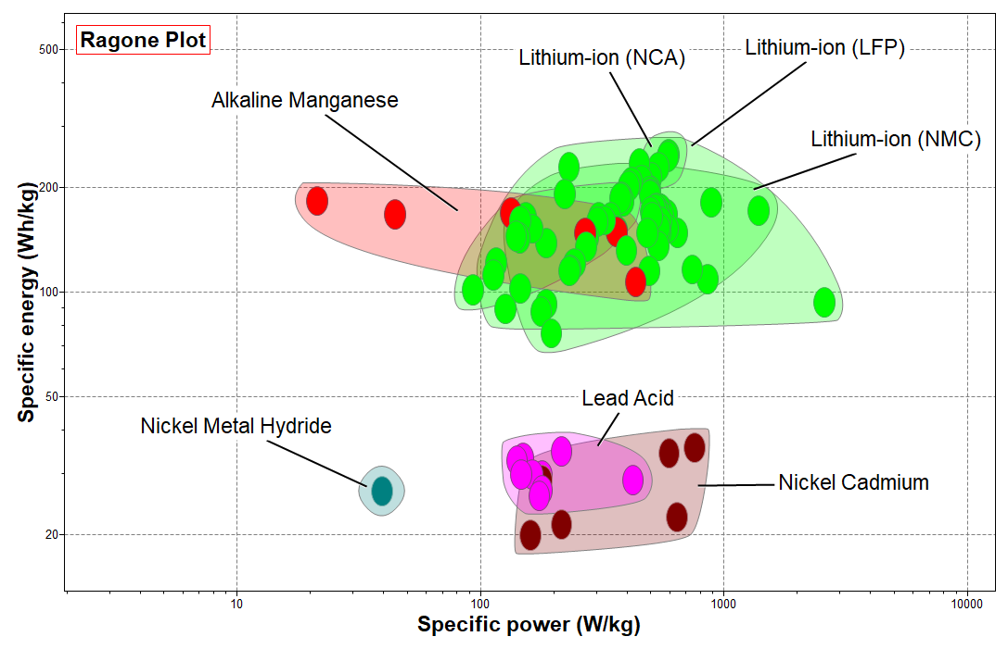
Ragone plots for rechargeable batteries
LCO=Lithium Cobalt Oxide
LFP=Lithium Iron Phosphate
NCA=Nickel Cobalt Aluminum Oxide
NMC=Nickel Manganese Cobalt
Lithium-ion type batteries are superior in both energy and power performance.
Heavy metal batteries have considerably less energy storage capacity per weight.
Lithium-ion (LCO)
Notes:
Rechargeable batteries
Ragone plots are a graphical way to visualize the performance of energy storage systems
They will be used them multiple times in this presentation, here showing the rechargeable battery types
Lithium technologies are superior to other types, both in energy storage and power capacity per weight

Slide 10
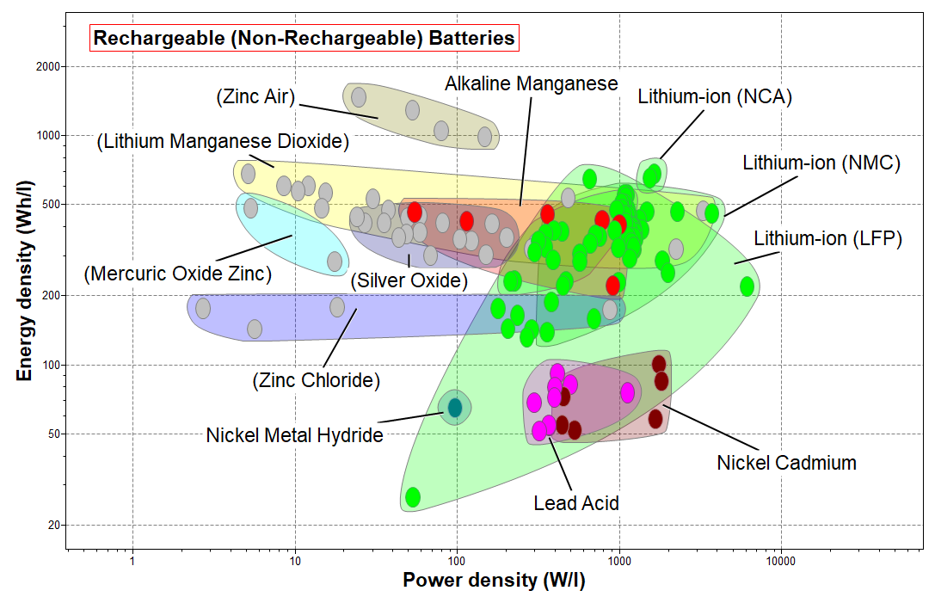
Energy density and Power density for rechargeable batteries
Notes:
Energy and power density
If weight is not essential, but volume is restricted, then Energy and power densities can be used
The picture is more or less the same as for performance per weight
Lithium chemistry is still superior among secondary battery types (rechargeable)

Slide 11
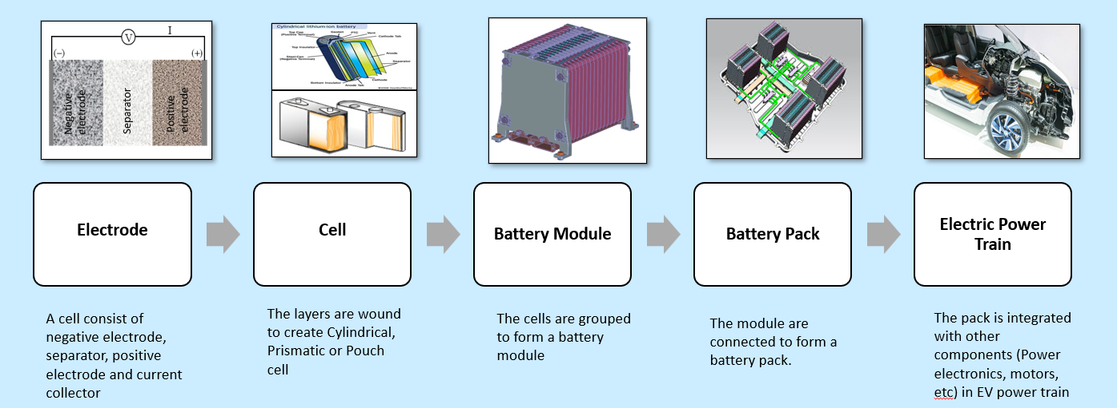
Battery Designer models and building blocks for transportation
Transport System
Notes:
Electrode to Battery Pack
This slide shows the typical building blocks for full scale battery design in transportation.
Ansys Granta EduPack software can help non-expert students to explore some of these aspects.
The battery cells subset contains 128 records of the most common battery typed.
For the later stages of design, the syntheizer tool now contains models to estimate properties of battery pack and battery modules
It does this by combining cell, geometry, casing material, and cooling system parameters.

Slide 12
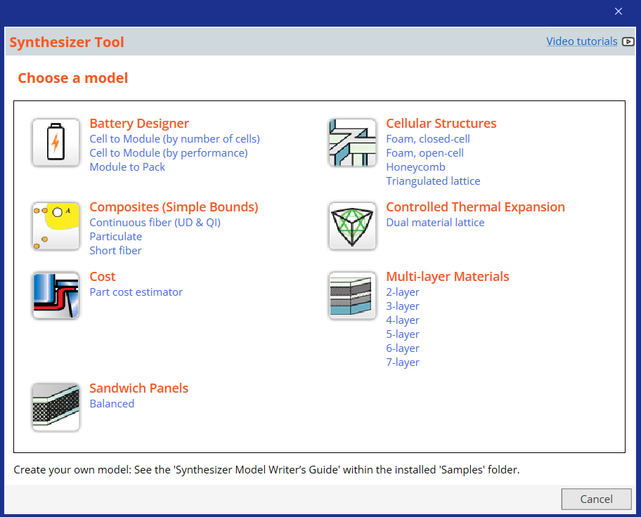
What is the Synthesizer tool?
Click on Synthesizer on the main toolbar and under
Battery Designer, click on the required model type:
Cell to Module (specified by number of cells)
Cell to Module (specified by performance)
Module to Pack
Notes:
The Synthesizer tool
The Granta EduPack Synthesizer Tool lets you create records and estimate properties based on data in the databases and user input, for example, properties of composite materials or the cost of manufactured products.
One of the available models is the Battery Designer, to explore bespoke cell configurations
It estimates electrical properties of battery packs and modules based on the battery cell data-table

Slide 13

Battery Designer: Assumptions and calculations
> Tools > Synthesizer Tool > Synthesizer Reference > Battery Designer: Assumptions and calculations
The equations used by the Synthesizer tool's Battery Designer, and full details of the assumptions the models make.
The models in the Battery Designer are heavily simplified and designed to allow rapid comparison between different cells, configurations and thermal management systems.
Assumptions used by model
Energy and Power calculations
Thermal Management model
Calculations used by model
Cell to Module calculations
Discharge, Energy and Power
Thermal Management
Module to Pack calculations
Summary of data and inputs required
Cell to Module (by number of cells)
Cell to Module (by performance)
Module to Pack (by number of modules)
Module to Pack (by performance)
Notes:
Transparency
As usual, the models used to calculate properties are available for students to investigate and discuss
The Granta EduPack Help function in the main menu bar shows the assumptions and equations for the Battery Designer and other models

Slide 14
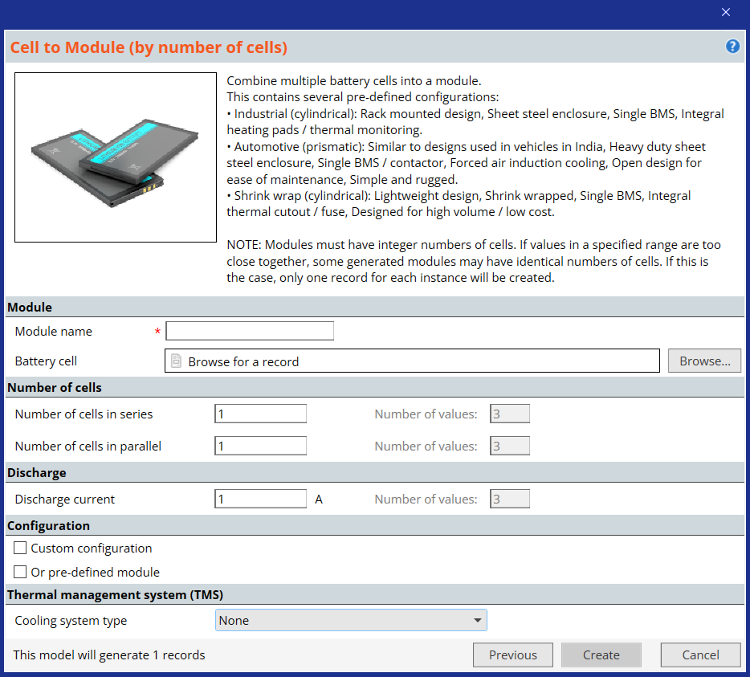
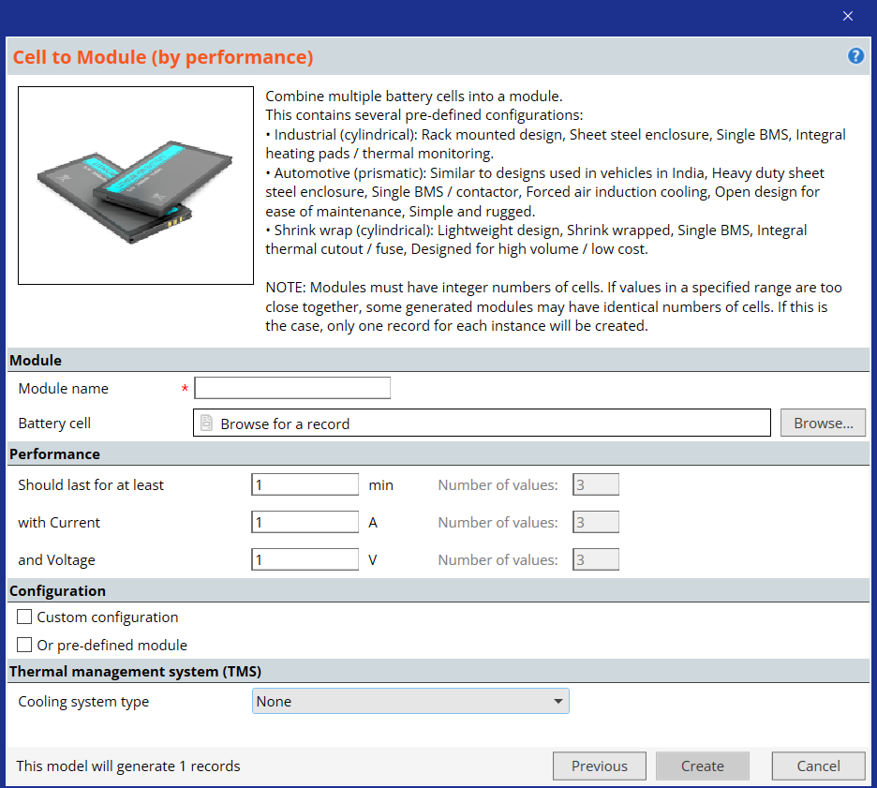
Synthesizer model: Cell to module options
① By number of cells
② By performance
Notes:
Cell to Module
There are two models for the creation of records from battery cells in the database to battery modules
Cell to module by number of cells, for different cell configurations, or by performance, for electrical constraints
Both these options have a clickable icon, marked by a question mark (?) to give further information

Slide 15
Synthesizer model: Cell to module specifications
Specify your required module properties, then click Create to synthesize the Module record(s).
The records will be added to the Battery Cells table under My Records > Synthesized > Modules.
Click Previous to go back and choose a different model.
Module
Enter a Module name; this is used to name the synthesized records.
Click Browse... to select a Battery cell from the Batteries datatable.
1. Cell to Module (by number of cells)
Enter the required Number of cells in parallel and Number of cells in series
Discharge
Enter the target Discharge current for the module.
You can enter a single value or a range (e.g. 0.1-0.2 A).
2. Cell to Module (by performance)
Enter the target Discharge time, Current and Voltage for the module. You can enter a single value or a range (e.g 12-20 V).
Notes:
Cell to module
The two main options are described here. The ranges are used to create several records in a series

Slide 16
Synthesizer model: Cell to module configurations
Configuration
Select the Pre-defined module checkbox to select one of the pre-defined configurations: Industrial, Automotive, or Shrink wrap.
Select the Custom configuration checkbox to specify module properties in the Packaging section.
If both checkboxes are selected, the Pre-defined configuration will be applied. If neither checkbox is selected, the Custom configuration will be applied.
Packaging
Click Browse... to select a Casing material and Insulation material, and enter the corresponding Wall thickness or Insulation thickness. Specify the Cell spacing within the module.
Thermal management system (TMS)
Select a cooling system from the list:
- None
- Passive air cooling
- Active air cooling
- Liquid cooling
- Dielectric cooling
Notes:
Cell to module
The options relating to cell and module configuration are shown on this slide

Slide 17
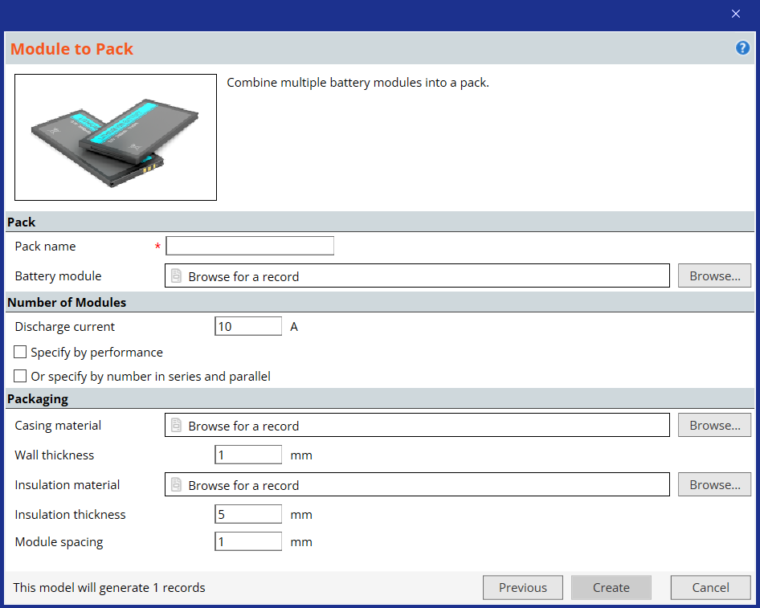
Synthesizer model: Module to pack
A Module consists of multiple connected cells in a casing with insulation and optional cooling system.
A Pack consists of multiple connected modules in a casing with insulation and optional cooling system.

Slide 18
Synthesizer model: Module to pack model
Specify your pack requirements, then click Create to synthesize Pack record(s).
The records will be added to the Battery Cells table under My Records > Synthesized > Packs.
Click Previous to to go back and choose a different model.
Pack
Enter a Pack name (this will be used to name the synthesized records), and click Browse... to select a Module
from the browse tree. You can use a cell record from the data-table, or your own synthesized Module record.
Number of Modules
To calculate number of modules from performance requirements:
Select the Specify by performance checkbox
Edit the target Voltage window, Discharge time and Discharge current as a single value or a range (e.g. 3.3-3.7 V)
To calculate pack performance from number of modules:
Select the Specify by number in series or parallel checkbox
Edit the Number of modules in series and Number of modules in parallel
Notes:
Module to pack
Select the Custom configuration checkbox to specify packaging materials and geometry.
Click Browse... to select a Casing material and Insulation material, and enter the corresponding Wall thickness or Insulation thickness.
Specify the Module spacing within the Pack.

Slide 19
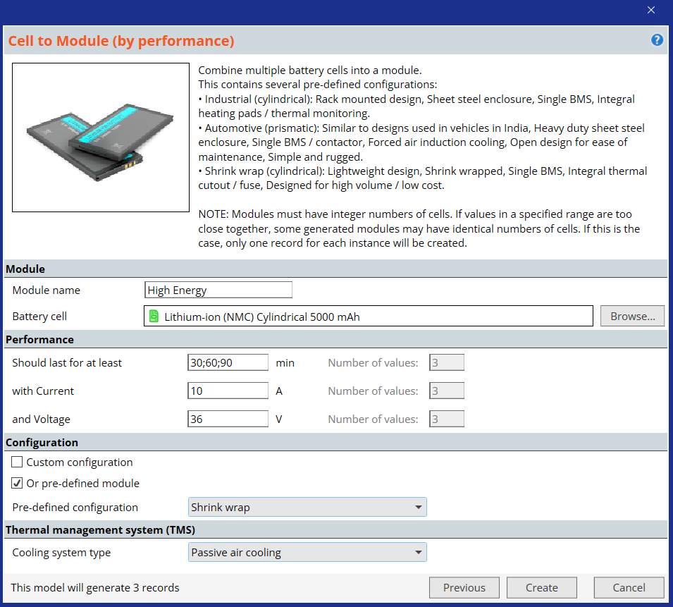
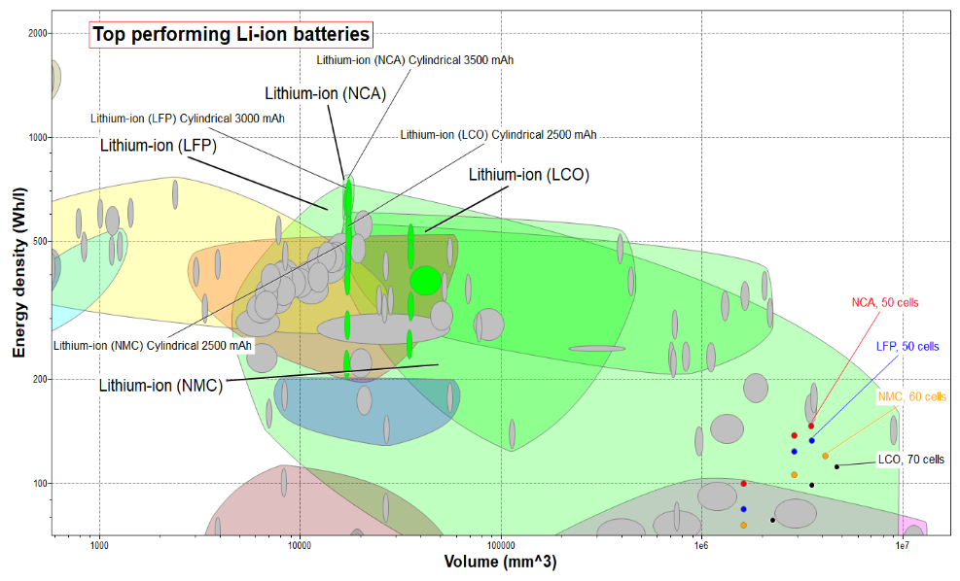
Example – Battery module for e-scooters
Objective: Maximize energy density, limited volume
Requirements:
Li chemistry cells, Geometry: Cylindrical
1000 cycles, 3yr life span (every day usage)
Supplies 36 V​, 10 A
30-90 minutes use
Notes:
Battery module for e-scooters
The top performing batteries from each Li-ion family that fulfill the constraints are: cylindrical 3500mAh NCA cell, 3000 mAh LFP cell, 2500 mAh LCO cell and 2500 mAh NMC cell.
The eScooter typically operates on 36 V with a maximum current of around 10 A, resulting in around 3-400 W of power for a module.
In order to obtain 36 V, the number of cells in series will be automatically assigned to stacks of 10
By requesting the charging time to be 30, 60 or 90 min the synthesizer will sweep different configurations of parallel stacks to fulfill requirements.
The pre-defined shrink-wrapped configuration (not the industrial or automotive) is the most suitable for this application, it is designed for high volume / low cost, passive air cooling is assumed here.
Four series of configurations were generated in the synthesizer tool by completing the boxes in the form and naming them after their respective cell chemistry.
As expected, the performance of the battery modules are scaled up with the stack sizes, but not in a linear fashion.
Click the help icon (?) for further general information, for example that the volume calculation assumes a cubic configuration of the cells.

Slide 20
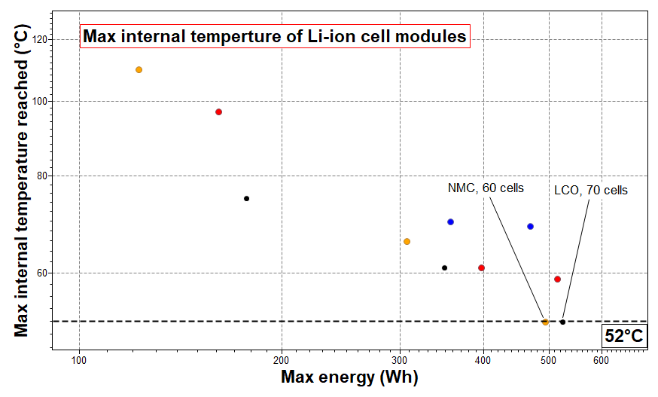

Example – Battery module for e-scooters
7 x 10-stack Li-ion
+ 36 V
Notes:
Battery module for e-scooters
The charging temperature of some modules with fewer parallel stacks is very high, around or even over 100°C.
Only two alternatives have realistic values for safe design, the 70 cell LCO module and the 60 cell NMC module.
Both have parallel stacks of 10 cells in series to generate 36-37 V and achieve their moderate temperatures by operating around 30%, as can be read in records generated by the synthesizer tool.
The volume calculated for the modules shown in the previous Ashby plot above is based on a crude model, resulting in a total volume of over 4 l for the 70 cell LCO solution of 18650 batteries.
A 7 x 10-stack configuration, shown to the right (end view), would fit within 653 x 100 x 30 mm which would be feasible. The 60 cell NMC solution would be somewhat smaller.

Slide 21
Summary
The Battery Designer is an early-stage battery pack design tool for initial comparisons across different module and pack configurations.
It uses simplified models and selection data from commercially available cell types to estimate key performance metrics, taking choice of cell, configuration, casing and insulation materials, and thermal management system into account.
A database of products, such as the battery cell one, will evolve with time and results will depend on which systems are available. It is also fundamentally different in selection than selection of materials based on material properties. Ashby charts and a performance index technique can still be used.
Additional materials considerations could be explored with the Ansys Granta EduPack software:
Material selection for lighweight of the structural casing
Quick Eco Audit of e-transport systems vs conventional power
Critical materials/supply chain risks of battery elements and their substitutes
The initial versions of Battery Designer and the Batteries data-table were developed as part of the MAT2BAT collaborative R&D project (Innovate UK, Faraday Challenge competition, Project no 133723), and subsequently further developed and integrated by Granta Design Limited, an ANSYS Inc. subsidiary. Thanks to Dr Billy Wu, Dr Samuel Cooper and Nathasha Gjerløv Fiig of Imperial College London for their contributions to the tool and data table schema.

