Slide 1
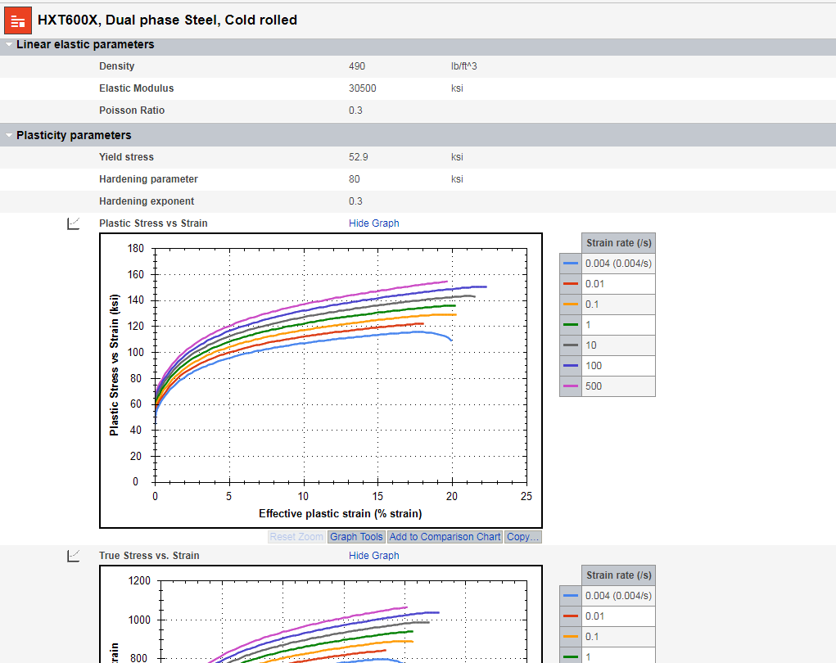
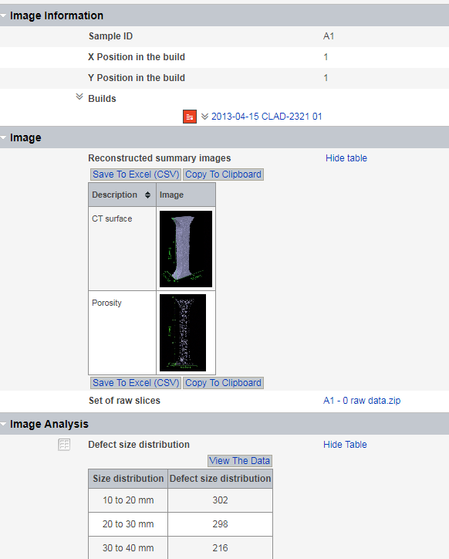
Introduction to Materials Data Management
David Mercier and János Plocher
Ansys Academic Development Team

Slide 2
Learning Objectives for This Lecture Unit
Ansys software mentioned | Ansys Granta MI® materials intelligence platform
Intended Learning Outcomes
Knowledge and Understanding | Broad knowledge of materials data and data management
Skills and Abilities | Ability to define different types of material data and to build materials databases
Values and Attitudes | Awareness of how materials data can be used and analyzed
Resources
White Paper: “Meeting the Materials Data Management Needs of Engineering Enterprises”
Paper: “Engineering Materials Informatics”, D. Cebon and M.F. Ashby (2006), doi: 10.1557/mrs2006.229
Paper: “Effective Materials Property Information Management for the 21st Century”, W. Ren et al. (2011), doi: 10.1115/1.4002925
Paper: “Materials science with large-scale data and informatics: Unlocking new opportunities”, J. Hill et al. (2016), doi:10.1557/mrs.2016.93
Paper: “The FAIR Guiding Principles for scientific data management and stewardship”, M.D. Wilkinson et al. (2016), doi: 10.1038/sdata.2016.18
Paper: “Accessing Materials Data: Challenges and Directions in the Digital Era”, J.R. Rumble Jr. (2017), doi: 10.1007/s40192-017-0095-2
Paper: “Innovative Data Management in advanced characterization: Implications for materials design”, N. Romanos (2019), doi: 10.1016/j.mtcomm.2019.100541
Notes:
Learning Objectives
These Intended Learning Outcomes are based on a taxonomy of knowledge and understanding as the basis, skills and abilities as necessary for the practical use of knowledge and understanding, followed by acquired values and attitudes enabling assessments and responsible use of these abilities.
Combined with a suitable assessment, they should be helpful in the context of accreditations or for the CDIO Syllabus.

Slide 3
Outline of This Lecture
Materials data
  Definition
  Origin and types
  Usage
Workflow for data management
  Workflow definition
  Materials Data Management System and Schemas
  Material Card and Material Passport
  Ansys Granta solutions
Some examples
Legal and ethical considerations
Summary
Notes:
Summary
This lecture Unit introduced the concept of Materials Data Management.

Slide 4



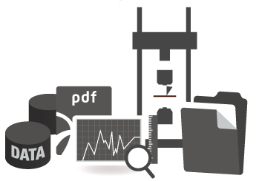
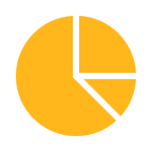







What is materials data?
Materials data is any information describing the properties and processing of the materials that labs or manufacturing organization uses to enhance materials, processes and products.
Data
Decision-Making
Numerical
Examination
…
Multimedia
Database
Data analysis
User
Text
Modelling
Statistics
…
Management
…
Notes:
What is materials data?
Materials data is any information describing the properties and processing of the materials that labs or manufacturing organization uses to enhance materials, processes and products.

Slide 5




The Indispensability of Materials Data
“Materials property data, and broader materials information, are essential to a wide range of people and functions in engineering enterprises – from stress engineers and designers needing the right property data for engineering simulations, to buyers aiming for optimal purchasing decisions, to managers concerned with regulatory compliance.” [1]
Engineer
Buyer
[1] – W. Marsden, S. Warde, A. Fairfull, Meeting the Materials Data Management Needs of Engineering Enterprises (2007), Granta Technical Paper, URL.
Designer
Manager
Notes:
The indispensability of materials data
“Materials property data, and broader materials information, are essential to a wide range of people and functions in engineering enterprises – from stress engineers and designers needing the right property data for engineering simulations, to buyers aiming for optimal purchasing decisions, to managers concerned with regulatory compliance.” [1]
[1] – W. Marsden, S. Warde, A. Fairfull, Meeting the Materials Data Management Needs of Engineering Enterprises (2007), Granta Technical Paper, URL.

Slide 6










Problem of the Digital Transformation for Materials Data
To avoid loss of data (human error, …) and to support usage of materials data, digitalization of materials data is required, but materials lags behind.
Why?
Technically complex domain
Ownership spread across multiple departments
If it exists, Materials department seen as a cost-center
What’s changing?
Digital transformation trends
Explosive data growth
Strategic materials technologies (e.g., Additive Manufacturing)
Materials
Digital transformation
Materials
Degree of digitalization
Agriculture
Construction
Healthcare
Oil and Gas
Product design / CAD
Human resources
Finance
Notes:
Problem, the digital transformation for materials data
Materials data digitalization refers to the process of converting physical properties and performance data of materials into a digital format for easy access, sharing, and analysis. The digitalization of materials data has become increasingly important in recent years due to the rise of Industry 4.0 and the demand for more efficient and sustainable manufacturing processes. Some of the key trends in materials data digitalization include:
Data standardization: The need for consistent and standardized data formats and structures to facilitate data sharing and analysis across different platforms and applications.
Cloud-based platforms: The use of cloud-based platforms for storing, managing, and sharing materials data to facilitate collaboration and access across different organizations and industries.
Machine learning and AI: The use of machine learning and artificial intelligence (AI) algorithms to analyze large datasets and extract insights that can help improve material performance and predict behavior.
Open data initiatives: The adoption of open data initiatives that encourage the sharing of materials data across different organizations, researchers, and industries to drive innovation and accelerate research.
However, there are also several challenges associated with materials data digitalization, including:
Data quality: The accuracy and consistency of materials data can be a challenge, especially when data is sourced from different locations and suppliers.
Data privacy and security: The protection of sensitive materials data from cyber threats and unauthorized access is a critical concern.
Data management: The management of large and complex datasets can be challenging and requires specialized expertise and tools.
Data ownership: The issue of data ownership and intellectual property rights can be complex, especially when data is shared across different organizations and industries.
Overall, materials data digitalization presents both opportunities and challenges, and requires careful consideration of data standards, privacy and security, and collaboration and data sharing initiatives.

Slide 7

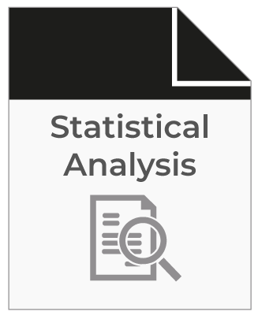
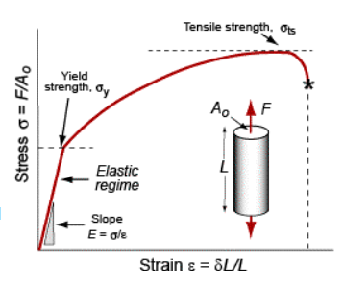


Materials Data is Everywhere
Results related metadata
→ Number of points, quality, size, format…
Measured or Calculated data
→ Young’s modulus, yield strength, work hardening coefficient, other calculations…
Material related data
→ Microscopical picture, grain size, chemical composition, material grade, processing information…
Extended data
→ Statistics, modelling, analytics…
Test related data
→ Standards, Reference papers, technical reports, presentations…
Other metadata
→ Date of experiment, equipment and method used, author(s), temperature test…
➔ From a simple tensile test, multiple data and metadata can be measured, derived or calculated.
Notes:
Materials Data is everywhere
Materials data is usually collected from observations, sensors, sensor networks, remote sensing, and more… and digitalized into many different file types and file formats.
While data can simply be a piece of information, a list of measurements, or observations, a story or a description of a certain entity, metadata specifies information about the original data which assists in identifying the nature and features of that data. For example, author, date created, date modified, and file size are examples of very basic document file metadata., while Young’s modulus, grain size… are data related to the tested materials.

Slide 8

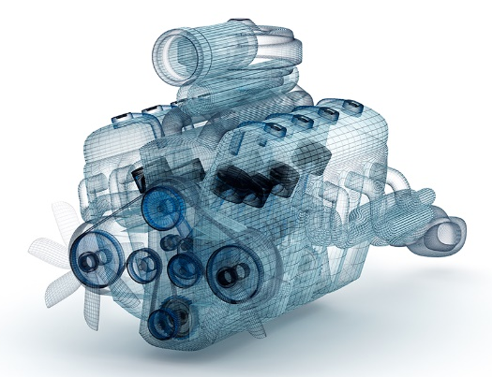
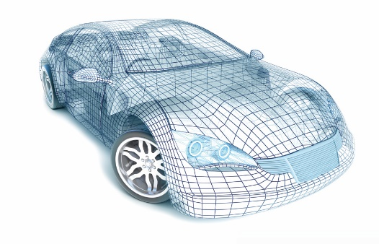


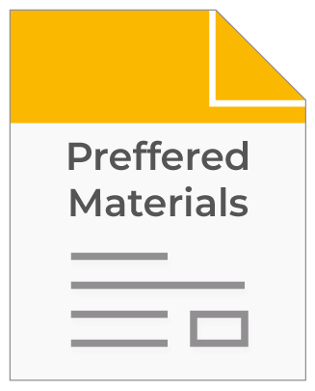

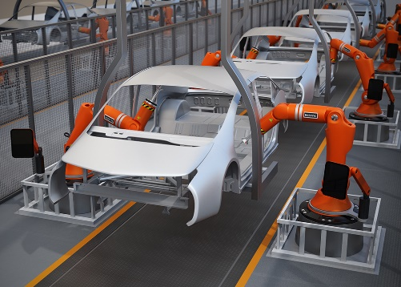
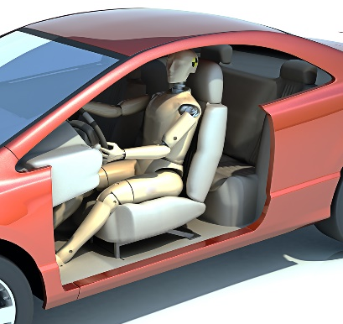

Source of Digitalized Materials Data
Concept
Engineering Design
Simulation
CAE models
Basic material properties
Detailed engineering properties
Aesthetic / Rendering
Testing and analysis
Compliance data
In-service data
Supplier specs
Customer
Manufacture
Prototyping
Notes:
Source of materials data
This data may come from a wide range of sources - e.g., technical documents, test reports, materials testing, quality assurance, or measurement of product performance.

Slide 9
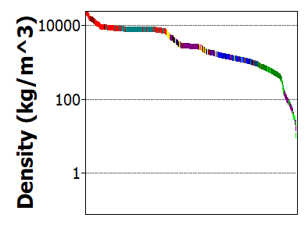
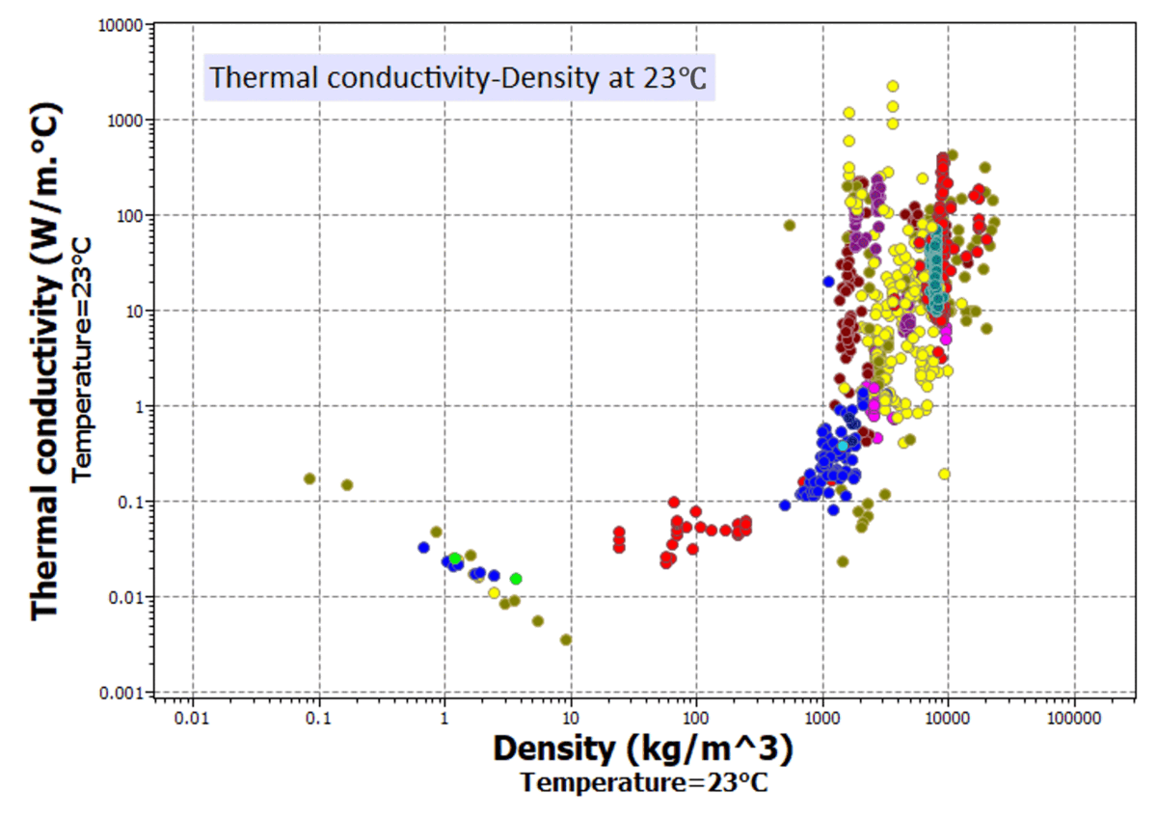
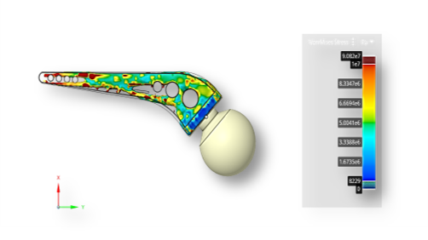
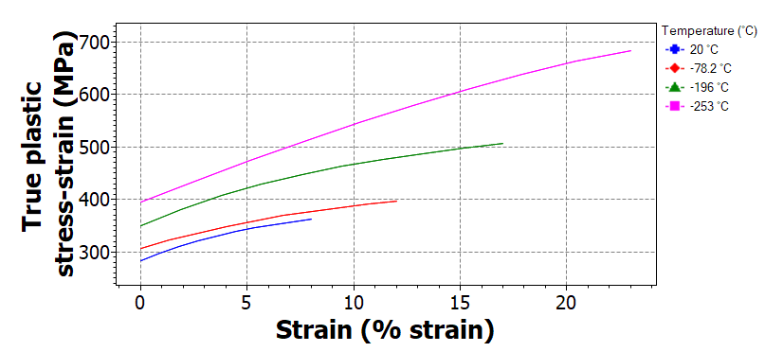
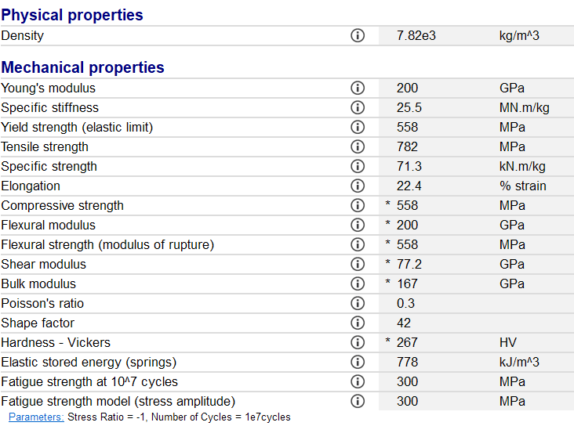
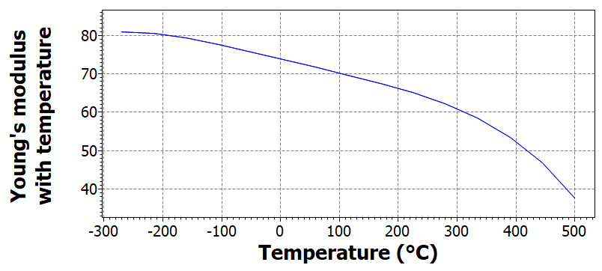
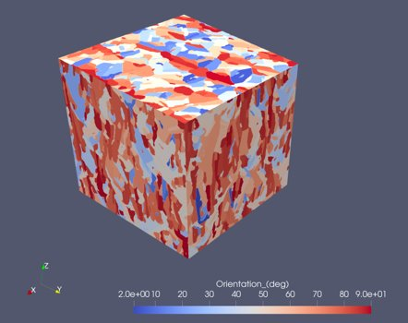
Type of Materials Data (1/2)
“1D Data”
“2D Data”
“3D Data and other data”
Maps, Parametrized data (f(T)…), Graphical data (Stress-Strain, Fatigue, Magnetic/Electronic…), Distribution/Statistical Data…
Dynamic 2D and 3D/4D maps, Spatial data, Tensors, Fields, Images/Videos, 2D/3D Microstructures, Overlay/Mix of Data,…
1D distribution, average values, text…
Complexity and Value of Data
Notes:
Type of materials data
Materials data is everywhere, either it is obtained from experiments or from simulations.
In this slide, you will see some examples and initially you can see « 1D data », when only 1 material property is represented. Then, by increasing the complexity of the data (let’s say « 2D data »), by representing for example 2 materials attributes on a map, by showing functional property evolution or by plotting some statistical distribution of a material property, it is easy to increase the value of some results. This can be very helpful to highlight some trends or some mecanisms. Finally, « 3D data », dynamic datasets and other material results (images, overlays…) it is possible to represent very complex materials data and to perform high level analysis. In other words, materials data can have different representation, and the more data is complex the more it is rich of information.

Slide 10


Type of Materials Data (2/2)
Numerical, Functional, tabular data like point, range, integer values or float functionals… (e.g. 20°C or 125MPa)
With Units
Medial and meta data like picture, file, hyperlink, date, boolean (e.g. File XYZ.jpg, www.xyz.com, 01/01/2023, « Free of copyrights data » = Yes or No...)
Text data like text, lists
(e.g. « True plastic stress strain* (MPa)) »
* Lecture Unit: Stresses and Strains with Ansys Discovery | Ansys
… but how and why is materials data used?
Notes:
Type of materials data
Materials data can be expressed in different format and be stored in different type of files (.xls, .txt, .jpg, .dat…), inlcuding:
Numerical, Functional, tabular data
Text data
Medial and meta data
(*Click*)
Further Reading:
Lecture unit on stresses and strains touches on true vs engineering values.
Next Slide:
The question of «How and why materials data is used? » will be adressed in the following slides.

Slide 11
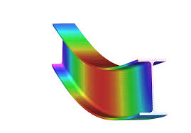
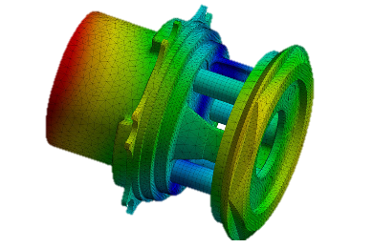
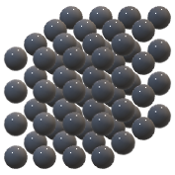
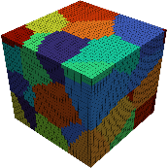
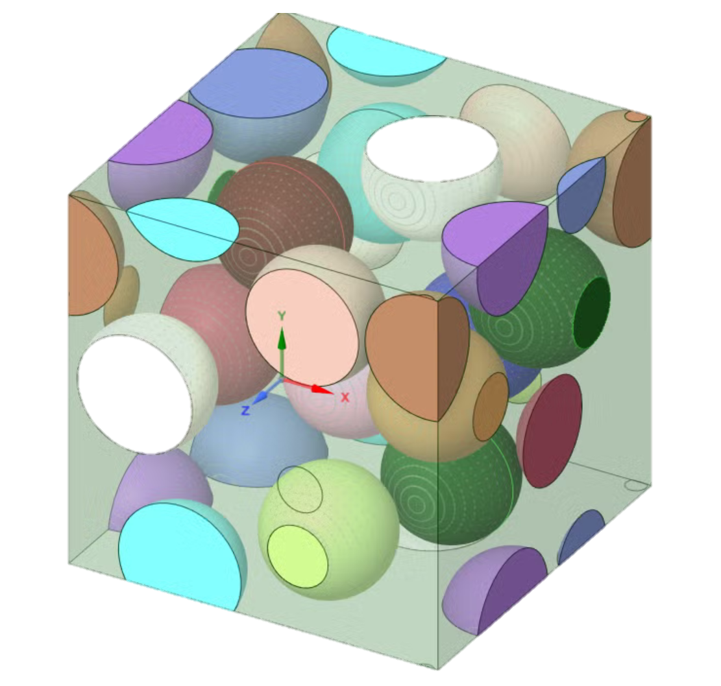
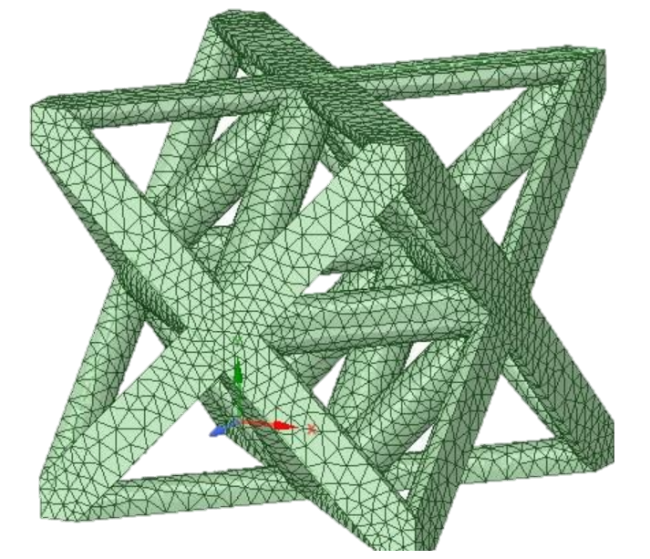
Materials Data = f(Scale)
Erik van der Giessen et al (2020) Roadmap on multiscale materials modeling
Number of inputs
Mesoscopic full-field
CPFEM
10²
Coarse grained microstructures
MD
DFT, ab initio MD…
Homogenized macro-models
10¹
Atomistic
Continuum
Design & Simulate “The” Material
Design & Simulate “with” Material
10⁻⁹
10⁻⁶
10⁻³
10⁰
Length scale (m)
Atoms
Polycrystals
Meso-scale
Single Crystal
Macro-scale
Notes:
Materials data = f(scale)
In materials modelling, the type and meaning of data depend on the observation scale. At the atomic scale, data describe atoms and bonds; at the microstructural scale, they describe grains and defects; and at the macroscopic scale, they describe effective material properties.
Choosing the right data for the right scale is essential to correctly represent material behavior.

Slide 12
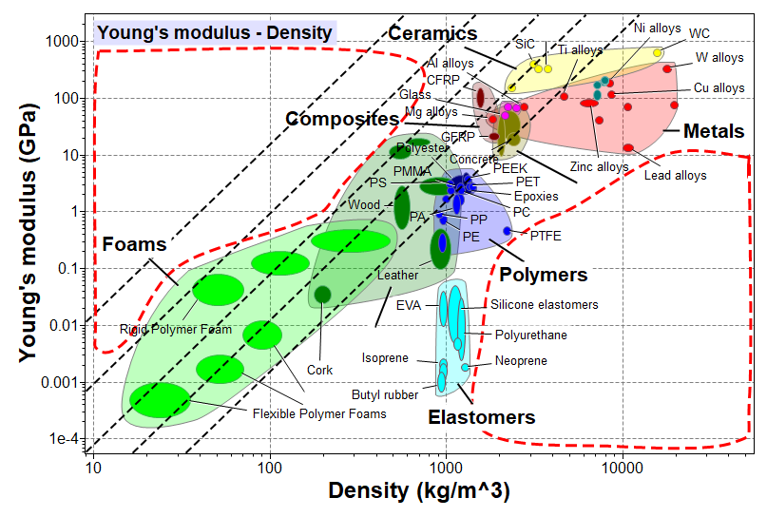




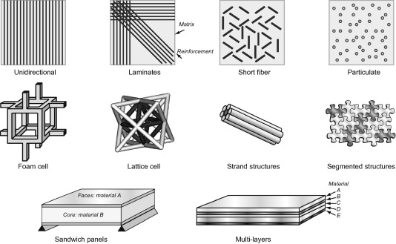
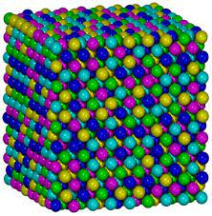
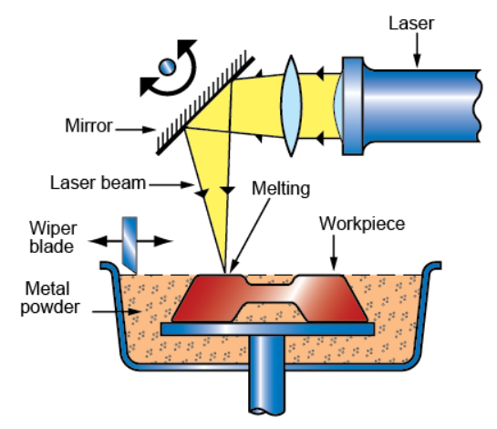
Materials Data Used in Material and Process Design
Motivation
How to fill the holes?
Contours of E^{1/3}/ρ
Al₂O₃
HOLE
Non-technical
Ceramics
Trial and Error Experiments + Characterization
Combinatorial synthesis*
…
Analytical Modelling
Ab initio, multiscale, numerical simulations
…
Natural
materials
HOLE
Graphic inspired by “Designing architectured materials” , M. Ashby (2013)
* Lecture Unit: The Synthesizer tool | Ansys
https://upload.wikimedia.org/wikipedia/commons/b/bf/Atomic_structure_model_of_fcc_CoCrFeMnNi.png
12
Notes:
Materials data are used in material/process design
Materials data play a crucial role in the design of materials and manufacturing processes. They provide critical information on the properties and behavior of materials, such as strength, elasticity, thermal and electrical conductivity, and corrosion resistance, which are essential in determining the suitability of a material for a specific application. In material design, materials data are used to identify the optimal material properties for a given application or performance requirement. This involves analyzing the properties of different materials and selecting the one that best meets the desired performance criteria. Materials data can also be used to predict the behavior of materials under specific conditions and to optimize their properties through the use of additives or processing techniques. In process design, materials data are used to determine the most appropriate manufacturing method for a given material. This involves analyzing the properties of the material and selecting the processing technique that will result in the desired properties and performance. Materials data can also be used to optimize the manufacturing process by adjusting parameters such as temperature, pressure, and time. In addition to design, materials data are also used in quality control and testing to ensure that materials and processes meet the required standards and specifications. This involves testing and analyzing materials properties and performance under various conditions to identify any weaknesses or areas for improvement. Overall, materials data are essential in the design and development of new materials and manufacturing processes. They provide critical information on material properties and behavior, and enable engineers and scientists to optimize performance and ensure quality and consistency.
Further Reading:
One option to fill the holes in Ashby charts, i.e. to tailor the material properties, is to combine different materials and alter the structural geometry (e.g. lattice structures). This can be explored using the in-build synthesizer tool in Ansys Granta tools like EduPack and selector.

Slide 13
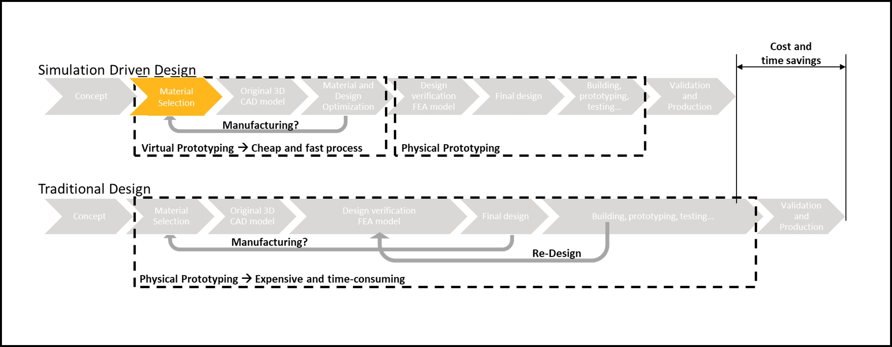
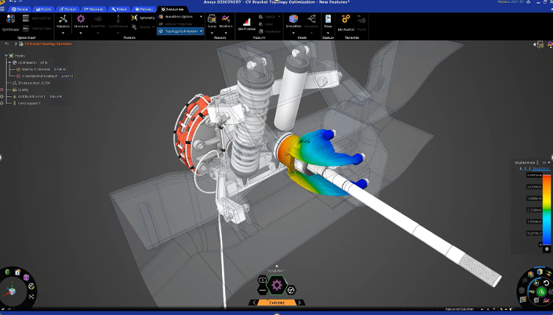
Materials Data in Simulation-Driven Design
Simulation Driven Design
L. Mohee and D. Mercier, NAFEMS proceedings 2021
Materials data are essential in simulation-driven design, which is an approach to product design that involves using computer simulations to optimize design performance and reduce the need for physical prototyping.
In simulation-driven design, materials data are used to create accurate models of material behavior and performance, which are then used in computer simulations to predict how a product will perform under different conditions.
Notes:
Materials data in simulation driven design
Materials data are essential in simulation-driven design, which is an approach to product design that involves using computer simulations to optimize design performance and reduce the need for physical prototyping. In simulation-driven design, materials data are used to create accurate models of material behavior and performance, which are then used in computer simulations to predict how a product will perform under different conditions. Materials data are used in simulation-driven design in several ways:
Material modeling: Materials data are used to create accurate material models, which are then used in simulation software to predict material behavior under different conditions. This includes modeling material properties such as elasticity, thermal conductivity, and fatigue behavior.
Finite element analysis: Finite element analysis (FEA) is a simulation technique that is used to analyze the behavior of complex products under different loads and conditions. Materials data are used to model the behavior of different materials and components, and to optimize the product design to minimize stress concentrations and improve performance.
Optimization: Materials data are used to optimize product designs by identifying the most suitable materials and manufacturing processes for each component or part of the product. This involves analyzing the properties of different materials and selecting the most appropriate material for each application, and designing the product to minimize weight and improve performance.
Virtual prototyping: Materials data are used in virtual prototyping, which involves using computer simulations to create a virtual prototype of a product before physical prototyping. Virtual prototyping allows engineers and designers to test and optimize product designs before committing to physical prototyping, which can save time and reduce costs.
Overall, materials data are essential in simulation-driven design, enabling engineers and designers to create accurate models of material behavior and performance, and to optimize product designs for improved performance and reliability. By using materials data in simulation-driven design, companies can reduce the need for physical prototyping, improve product performance, and accelerate time to market.

Slide 14
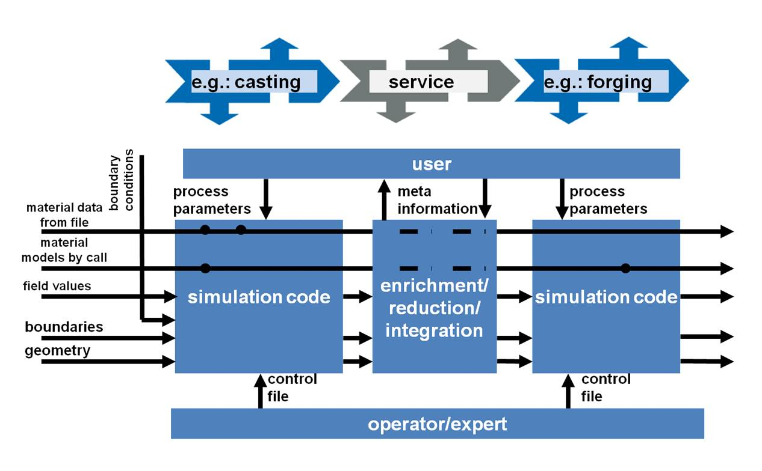
Materials Data in ICME
Integrated Computational Materials Engineering (ICME)
Integrated Computational Materials Engineering (ICME) is an approach to materials design and development that involves using computer simulations to model and optimize the entire materials development process, from material synthesis to product design.
Materials data play a crucial role in ICME, as they are used to create accurate models of material behavior and performance, which are then used to predict material performance under different conditions and to optimize the material design.
https://upload.wikimedia.org/wikipedia/commons/6/63/ICMEg_concept.jpg
Notes:
Materials data in ICME
Integrated Computational Materials Engineering (ICME) is an approach to materials design and development that involves using computer simulations to model and optimize the entire materials development process, from material synthesis to product design. Materials data play a crucial role in ICME, as they are used to create accurate models of material behavior and performance, which are then used to predict how a material will perform under different conditions and to optimize the material design. Materials data are used in ICME in several ways:
Material modeling: Materials data are used to develop accurate models of material behavior, which are then used in computer simulations to predict material performance under different conditions. This includes modeling the mechanical, thermal, and electrical properties of materials, as well as their microstructure and defect behavior.
Process modeling: Materials data are used to model the manufacturing processes used to produce materials, such as casting, forging, and additive manufacturing. Process models are used to predict the microstructure and properties of the material produced under different processing conditions, and to optimize the processing parameters to improve material performance.
Design optimization: Materials data are used to optimize the design of products and structures made from materials. Computer simulations are used to predict the performance of the product under different loads and conditions, and to optimize the product design to minimize weight, improve performance, and reduce costs.
Materials informatics: Materials data are used in materials informatics, which involves using data-driven approaches to materials development. Materials informatics uses machine learning and data analytics to analyze large datasets of materials data, and to identify relationships between materials properties, processing conditions, and performance.
Overall, materials data are essential in ICME, enabling engineers and scientists to develop accurate models of material behavior and performance, and to optimize material design and processing for improved performance and reliability. By using materials data in ICME, companies can accelerate the materials development process, reduce costs, and develop new materials with improved performance characteristics.

Slide 15




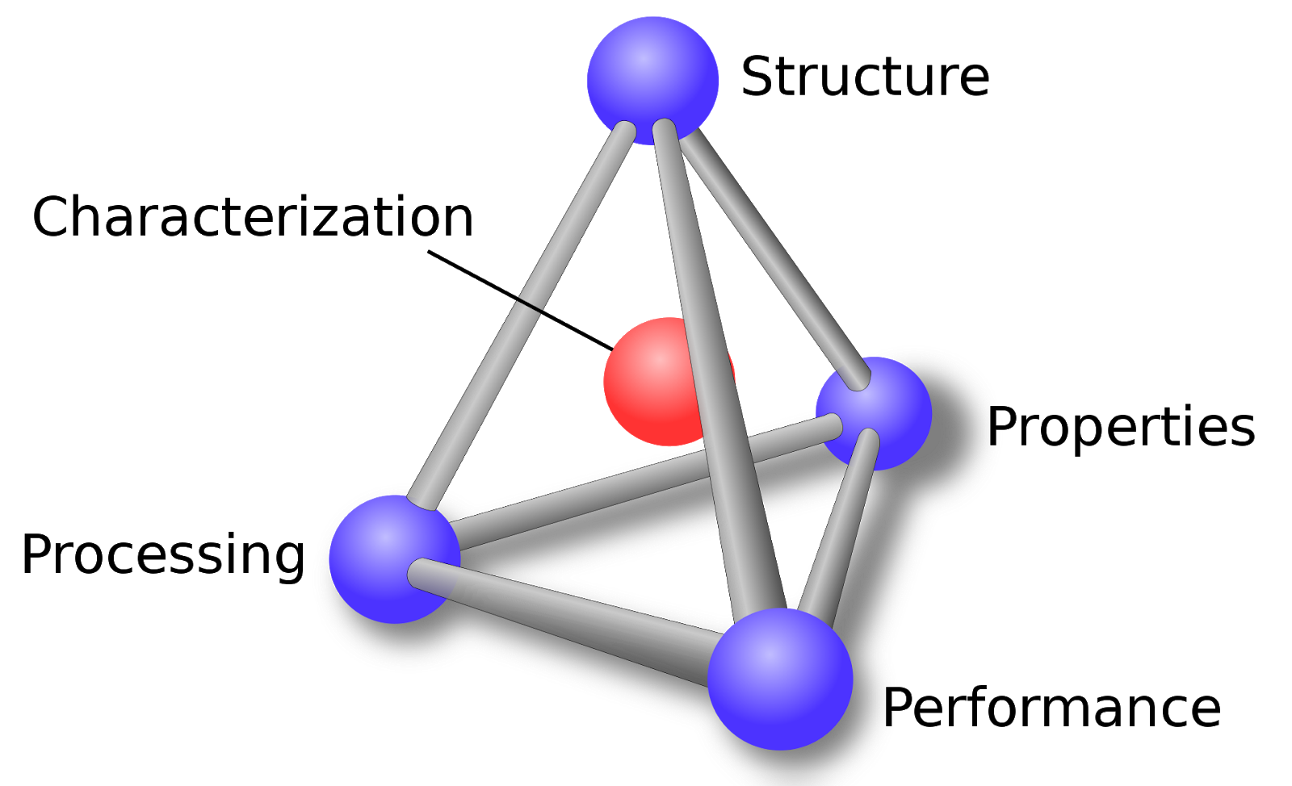



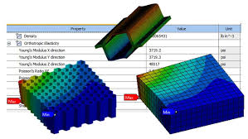
Materials Informatics
Experiments
Applications
Heterogeneous Materials Database
Knowledge
AI/ML
Property prediction
Structure quantification
Materials Design
…
Descriptors
Training
Validation
From Wikimedia Commons.
…
Simulation
Inputs
Modelling / Optimization
Outputs
Notes:
Materials informatics
Materials informatics uses data science and machine learning to discover patterns in materials data and accelerate materials design.
By combining experimental, computational, and literature data, it builds predictive models that link composition, processing, structure, and properties.
This approach helps guide experiments and simulations more efficiently than trial-and-error methods.
Materials informatics is applied across many domains, including alloy and steel design, battery and energy materials, semiconductors and electronics, polymers and composites, catalysts, and biomaterials.
It supports tasks such as property prediction, phase and microstructure optimization, process design, failure analysis, and accelerated discovery of new materials.

Slide 16
What is Materials Data Management?
I need a Materials Data Space
Materials data management is actions that contribute to effective storage, preservation and reuse of materials data and documentation throughout the research or product lifecycle.
For that, it is required to design and to implement a data management workflow or data management plan (DMP)
Data management workflow / Data management plan (DMP)
New Data to preserve
Data mining or data collection
Data cleaning/curing
(Standardization, homogenisation…….)
Data Leveraging (analysis, simulation, calibration, optimisation…)
Data storing
Database building
Materials/Processes or Product Design
Notes:
What is materials data management?
Materials data management is actions that contribute to effective storage, preservation and reuse of materials data and documentation throughout the research or product lifecycle.
A typical workflow in materials data management including the building of a database is described here. Such workflow can be a description of a data management plan (DMP), almost systematically required for any new starting project (in industry or in academia).

Slide 17

Materials Data Space (MDS)
Generate
Characterize materials and processes
Develop material models
Assess the material’s life-cycle and risk
Operate & Manage
Govern access,
Guarantee data exchange between (e.g. between CAE tools and PLM systems)
Ensure data traceability
Discover & Exploit
Develop data schemes (curated)
Data through visualization and filtering tools
Store & Document
Data in standardized repository (terminology, ontology, metadata)
Data with assigned digital identifiers and tags
Educational and training material
MDS
Leverage
Data through ML/AI to accelerate research
Data to accelerate digital engineering and the product lifecycle
Investigate
Links and interconnections between data entries
Raw data (e.g., machina data) & post-processing
Notes:
Materials Data Space
Materials Data Space (MDS) is a concept that refers to a digital infrastructure designed to store, manage, and exchange data related to materials and their properties. It aims to create a standardized platform where researchers, engineers, and scientists can access and share materials-related information.
MDS serves as a central repository for a wide range of data types, including
experimental data,
computational models,
simulation results, and
other relevant information about materials.
The primary goal of Materials Data Space is to facilitate the
discovery,
analysis, and
utilization
of materials data.
It provides a framework for capturing and organizing data from various sources, making it easier to search, integrate, and analyze materials-related information. By enabling data sharing and collaboration, MDS promotes knowledge exchange and accelerates materials research and development.

Slide 18

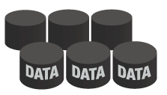

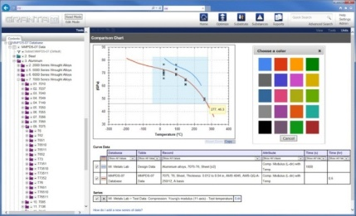
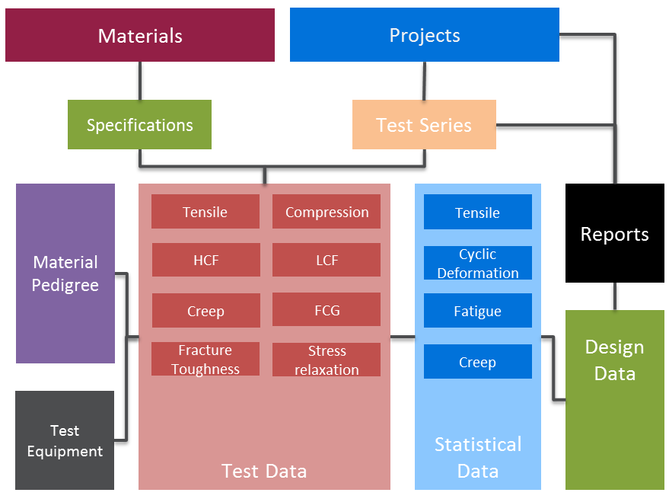
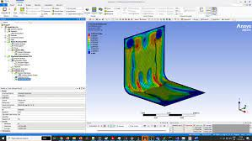
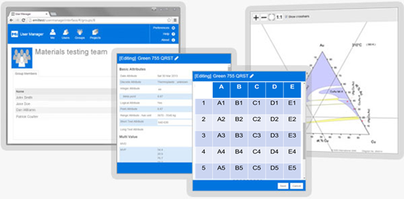

Materials Data Management System (MDMS)
Server side (cloud-based platform)
MDMS
Data search and retrieval
Data analysis and visualization
Data storage and organization
Data sharing and collaboration
Export tools
Data security and integrity
User side (web services, API, GUI)
3rd party materials
information
Proprietary
materials information
Materials Data Library
Critical system requirements:
Specialist materials data structures
Tools to manage the materials data lifecycle
Full traceability
Access and change control, workflow
Standardized process
Import tools
A schema is required to organize data in a MDMS!
Notes:
Materials Data Management System
A Materials Data Management System (MDMS) is a software tool or platform that is designed to manage and organize materials data, making it easier for scientists, engineers, and researchers to access, analyze, and share materials data. An MDMS provides a centralized repository for materials data, allowing users to store, manage, and share data related to materials properties, performance, synthesis, and processing. A Materials Data Management System typically includes the following features:
Data storage and organization: An MDMS provides a centralized repository for materials data, allowing users to store and organize data related to materials properties, performance, synthesis, and processing.
Data search and retrieval: An MDMS allows users to search for materials data based on specific parameters, such as material type, composition, or property. Users can retrieve data from the repository using various search tools, such as keyword search, filters, and metadata tags.
Data analysis and visualization: An MDMS provides tools for analyzing and visualizing materials data, allowing users to perform statistical analysis, create graphs and charts, and generate reports on material properties and performance.
Data sharing and collaboration: An MDMS allows users to share materials data with colleagues and collaborators, either within the organization or externally. Users can control access to data and collaborate on materials projects in real-time.
Data security and integrity: An MDMS ensures the security and integrity of materials data by providing data backup and recovery mechanisms, user authentication and authorization, and data versioning and auditing.
Overall, a Materials Data Management System plays a crucial role in materials research and development, providing a centralized repository for materials data, streamlining data management, and facilitating collaboration and data sharing. By using an MDMS, materials scientists and engineers can accelerate the materials development process, improve the quality of materials data, and make informed decisions about materials selection, design, and processing.

Slide 19
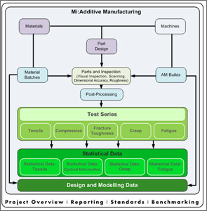
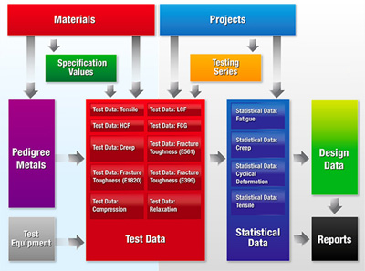
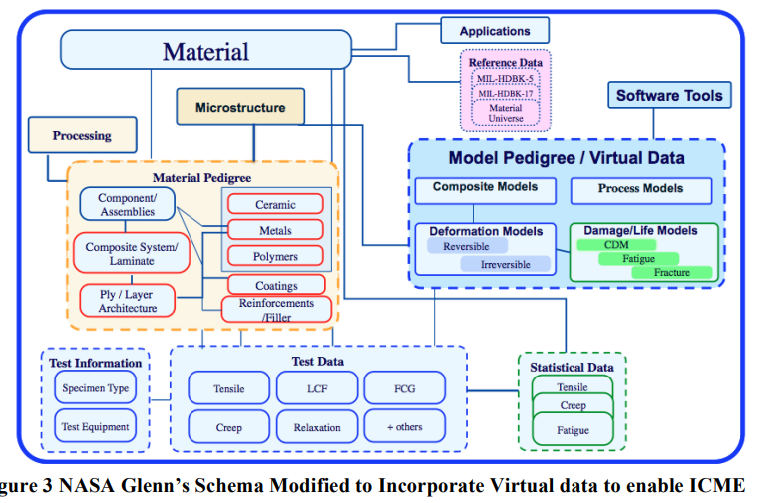
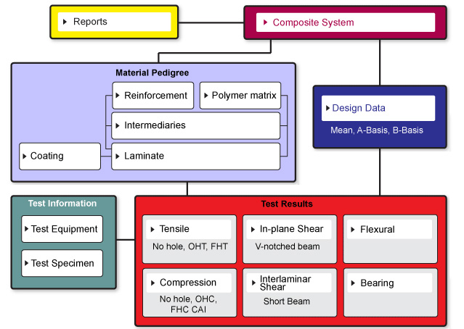
Building a Schema to Capture Data with Full Traceability
The right data structures to capture complex data & inter-relationships
Additive Manufacturing Schema
Material Pedigree
Metals Schema
Materials
Tensile
Compression
Tensile
LCF
Reports
Traceability:
Links ensure you know where data came from
HCF
Creep
Access control: secure your IP, ensure users only see appropriate data
Composite schema
Cyclic Deformation
Test Series
Design Data
Projects
Stress relaxation
A schema is a key element of Materials Data management.
Fatigue
FCG
Test Equipment
Creep
Specifications
Fracture Toughness
Notes:
Schema: Key element of Materials Data management
Materials data management requires a specialized approach to schemas to ensure that the unique properties and characteristics of materials are accurately captured and managed. Here are some of the key considerations for creating a schema for materials data management:
Identify the materials properties: The schema should define the specific properties of the materials being managed, such as chemical composition, physical properties, and mechanical properties.
Define the units of measurement: The schema should specify the units of measurement for each property, such as kilograms for mass and meters for length. This will help ensure consistency and accuracy when working with the data.
Define the materials hierarchy: The schema should define the hierarchy of materials being managed, such as raw materials, intermediate products, and finished goods. This will help ensure that materials are properly classified and tracked throughout their lifecycle.
Include quality control data: The schema should include fields for quality control data, such as test results and inspection records. This will help ensure that materials meet the necessary quality standards.
Include supply chain data: The schema should include fields for supply chain data, such as supplier information and shipping records. This will help ensure that materials are properly tracked and managed throughout the supply chain.
Consider data integration: The schema should be designed to integrate with other data management systems, such as enterprise resource planning (ERP) systems and product lifecycle management (PLM) systems. This will help ensure that materials data is properly integrated with other business processes and systems.
Overall, creating a schema for materials data management requires careful consideration of the unique properties and characteristics of materials, as well as the specific needs of the organization. By creating a well-designed schema, organizations can ensure that materials data is accurately captured, managed, and tracked throughout its lifecycle.

Slide 20



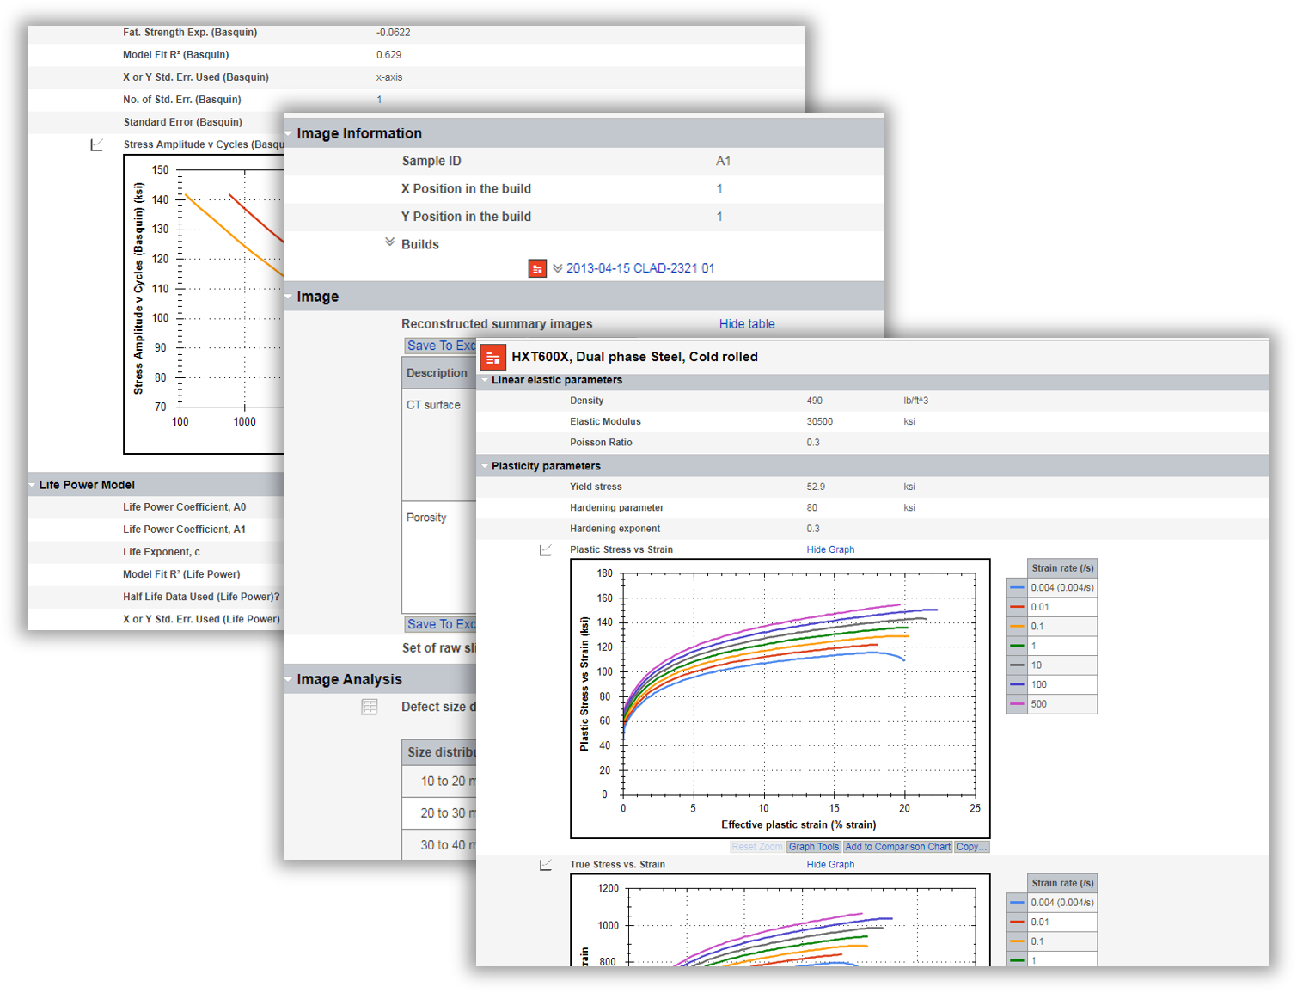
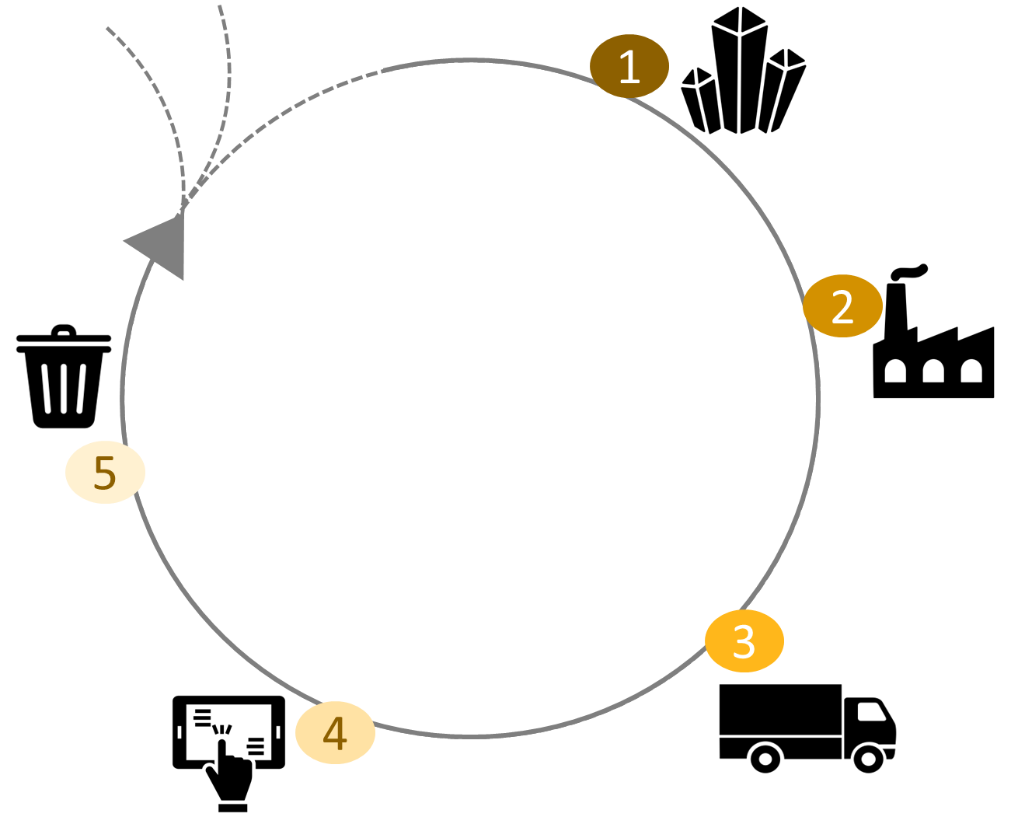



Standardized Format: Material Card and Material Passport
Material Card
Standardized format for reporting information on materials properties, characteristics, and performance.
Material Passport
Digital record of a material's composition, origin, and use, as well as its environmental and social impact.
Information on:
material's chemical composition
physical properties
mechanical properties
environmental properties
teste regime
Transparency
Complete and transparent picture of a material's history and impact
Digital Record
Lifecycle Management
Tracking
Make informed decisions about materials selection, use, and disposal.
Promote circular economy principles (reduce environmental impact
exported in standardized files to be reused (e.g. in simulations software)
Manufacturers,
designers, and other stakeholders
Manufacturers,
designers, and other stakeholders
Control
Control
Notes:
Material Card and Material Passport
A Material Card is a standardized format for reporting information on materials properties, characteristics, and performance. It is typically used in the field of materials science and engineering, and serves as a way to communicate data and information on materials in a consistent and standardized way. The Material Card may include information on the material's chemical composition, physical properties, mechanical properties, and environmental properties, as well as information on how the material was tested and characterized. Material cards can be exported in standardized files to be reused in simulations softwares for example.
A Material Passport, on the other hand, is a concept that goes beyond the Material Card and refers to a more comprehensive approach to tracking and managing materials data throughout their lifecycle. A Material Passport is a digital record of a material's composition, origin, and use, as well as its environmental and social impact. The goal of the Material Passport is to provide a complete and transparent picture of a material's history and impact, from its extraction and production to its use and disposal. The Material Passport can be used by manufacturers, designers, and other stakeholders in the materials industry to make more informed decisions about materials selection, use, and disposal. It can also help promote circular economy principles, by enabling materials to be tracked and reused more effectively and reducing waste and environmental impact.
In summary, a In summary, a Material Card is a standardized format for reporting materials data. A Material Passport is a more comprehensive approach to tracking and managing materials data throughout their lifecycle, with a focus on transparency and sustainability

Slide 21





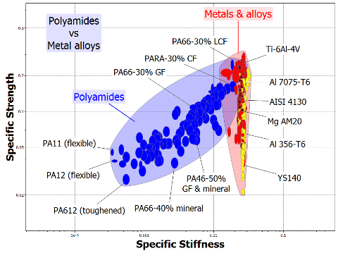
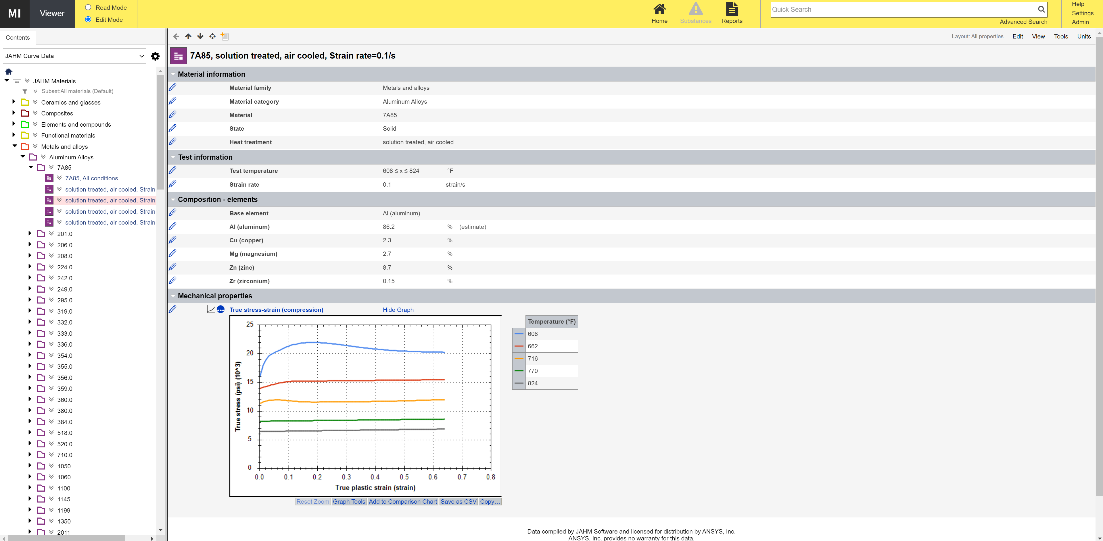
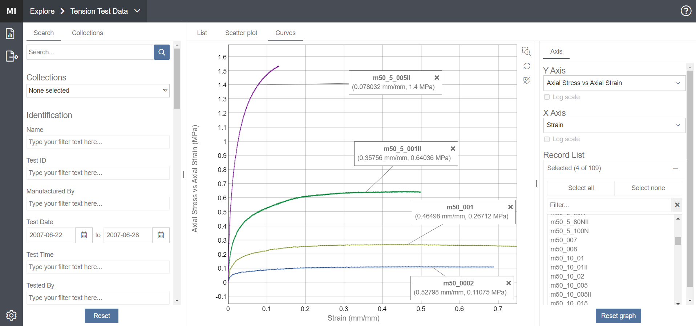
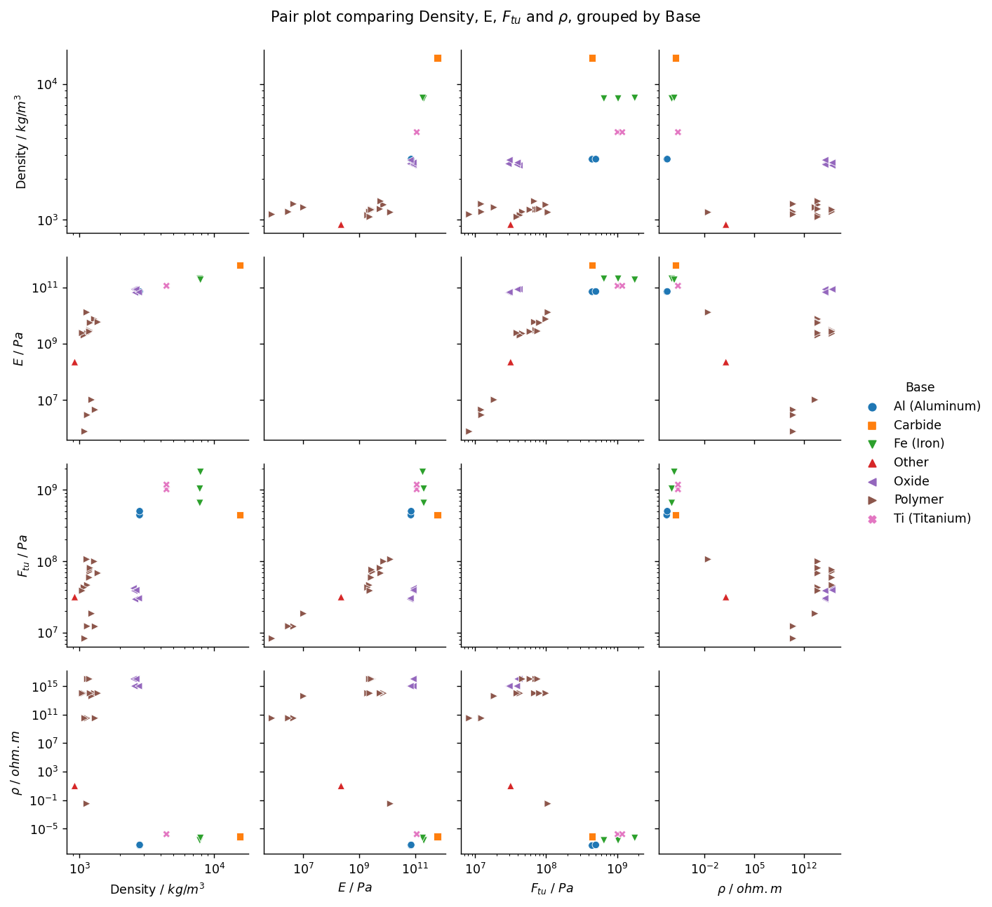
Solutions for Data Management & Data Analysis
Software-Driven Analysis of Materials Data
Software-Driven Management of Materials Data
Software-Driven Post-Processing of MD
Processing, scripting, import/export, search, visualization, filtering, and analysing data
Import/export, search, visualization, filtering, managing and analysing materials data
(usually shared installation / multiple users)
Visualization, filtering & analytical estimation tools of materials data.
(usually local installation / single user)
Degree of Customization & Automation
Notes:
Ansys Granta solutions for data management, data analysis...
Ansys offers multiple solutions to manage and analyze materials data with different levels of customization and automation:
1. Software-Driven Analysis of Materials Data
Granta EduPack (for education only) and Granta Selector (for research and industry), based on the methodology developed by prof. M. Ashby, to perform material selection (see other lecture units on this topic), using reference materials databases.
2. Software-Driven Management of Materials Data
Granta MI Software to build databases, to manage and to standardize materials data.
3. Software-Driven Post-Processing of MD
→ PyAnsys an open-source repository containing python libraries and python interfaces to interact with other Ansys softwares (for example Granta MI BoM analytics, MI python STK…).

Slide 22


Example of Materials Data Management in Research
How can I save time in analyzing easily tons of data from all my PhD students?
I need to get uniform and homogenized data from my academic partners
Academic Lab
Research Project Manager
Industrial Partner
Material Expert
Research Projects
(PhD thesis, Lab or Collaborative project, Industrial Partnership…)
I need to have digital materials inputs for my simulations
I don’t know how to capitalize all my data…
Academic Lab
PhD student
Academic Lab
Numerical Modelling Expert
Amount of data becomes huge to deal with and in any science fields: metallurgy, healthcare, sustainability...
Need to collaborate with other researchers (sharing data, control/versioning, traceability…)
Need to create bridges between different scales and different physics using different tools (interoperability)
Notes:
Example of materials data management in research
A number of different stakeholders are involved in a research project, such as:
Academic Lab
Professor
Research Project Manager
PhD Student, students…
Numerical Modelling Expert
…
Industrial Partner
Material Expert
Engineer
Lab technician
…

Slide 23



















Example of Institution-Wide Materials Data
EXTENDED TEAMS
PRODUCT
DEVELOPMENT
Design & CAD
Simulation
Risk & Compliance
Manufacturing
Test data management
Materials Data Management System
RESEARCH & DEVELOPMENT
Additive Manufacturing
Polymers
Materials Authority
Version + Access
API + Scripting*
Composites
Recycled
Materials
Field
Operations
PRODUCT
MANAGEMENT
SYSTEMS
Finishing & Surface Treatmeant
Metals
* PyAnsys — PyAnsys
PLM
SPDM
ERP
TDM
ALM
Notes:
Example of institution-wide materials data
A Materials Information Management System (MDMS) sits at the core, i.e. connects and guarantees interoperability between multiple areas, systems and teams, namely:
Product Development
Design & CAD
Simulation
Risk & Compliance Engineers
Manufacturing
Extended Teams
Test and data management
Materials authority
Field operations
Product Management Systems
PLM – Product Lifecycle Management
SPDM – Simulation Process and Data Management
ERP – Enterprise Resource Planning
TDM – Test Data Management
ALM – Application Lifecycle Management
Research and Development
Multiple different areas related to materials and processes
Due to the abundance of stakeholders, it is pivotal that an efficient and MDMS provides version and access control. This allows for consist, traceable and easily re-useable datasets, which is particularly important when collaborating with multiple departments, institutions or companies (Note, access control can include read or write rights or may be used to hide confidential data from certain collaborators). Furthermore, to effectively leverage the materials data space (MDS), scripting toolkits within the MIMS are becoming increasingly important (see also link to PyAnsys).

Slide 24
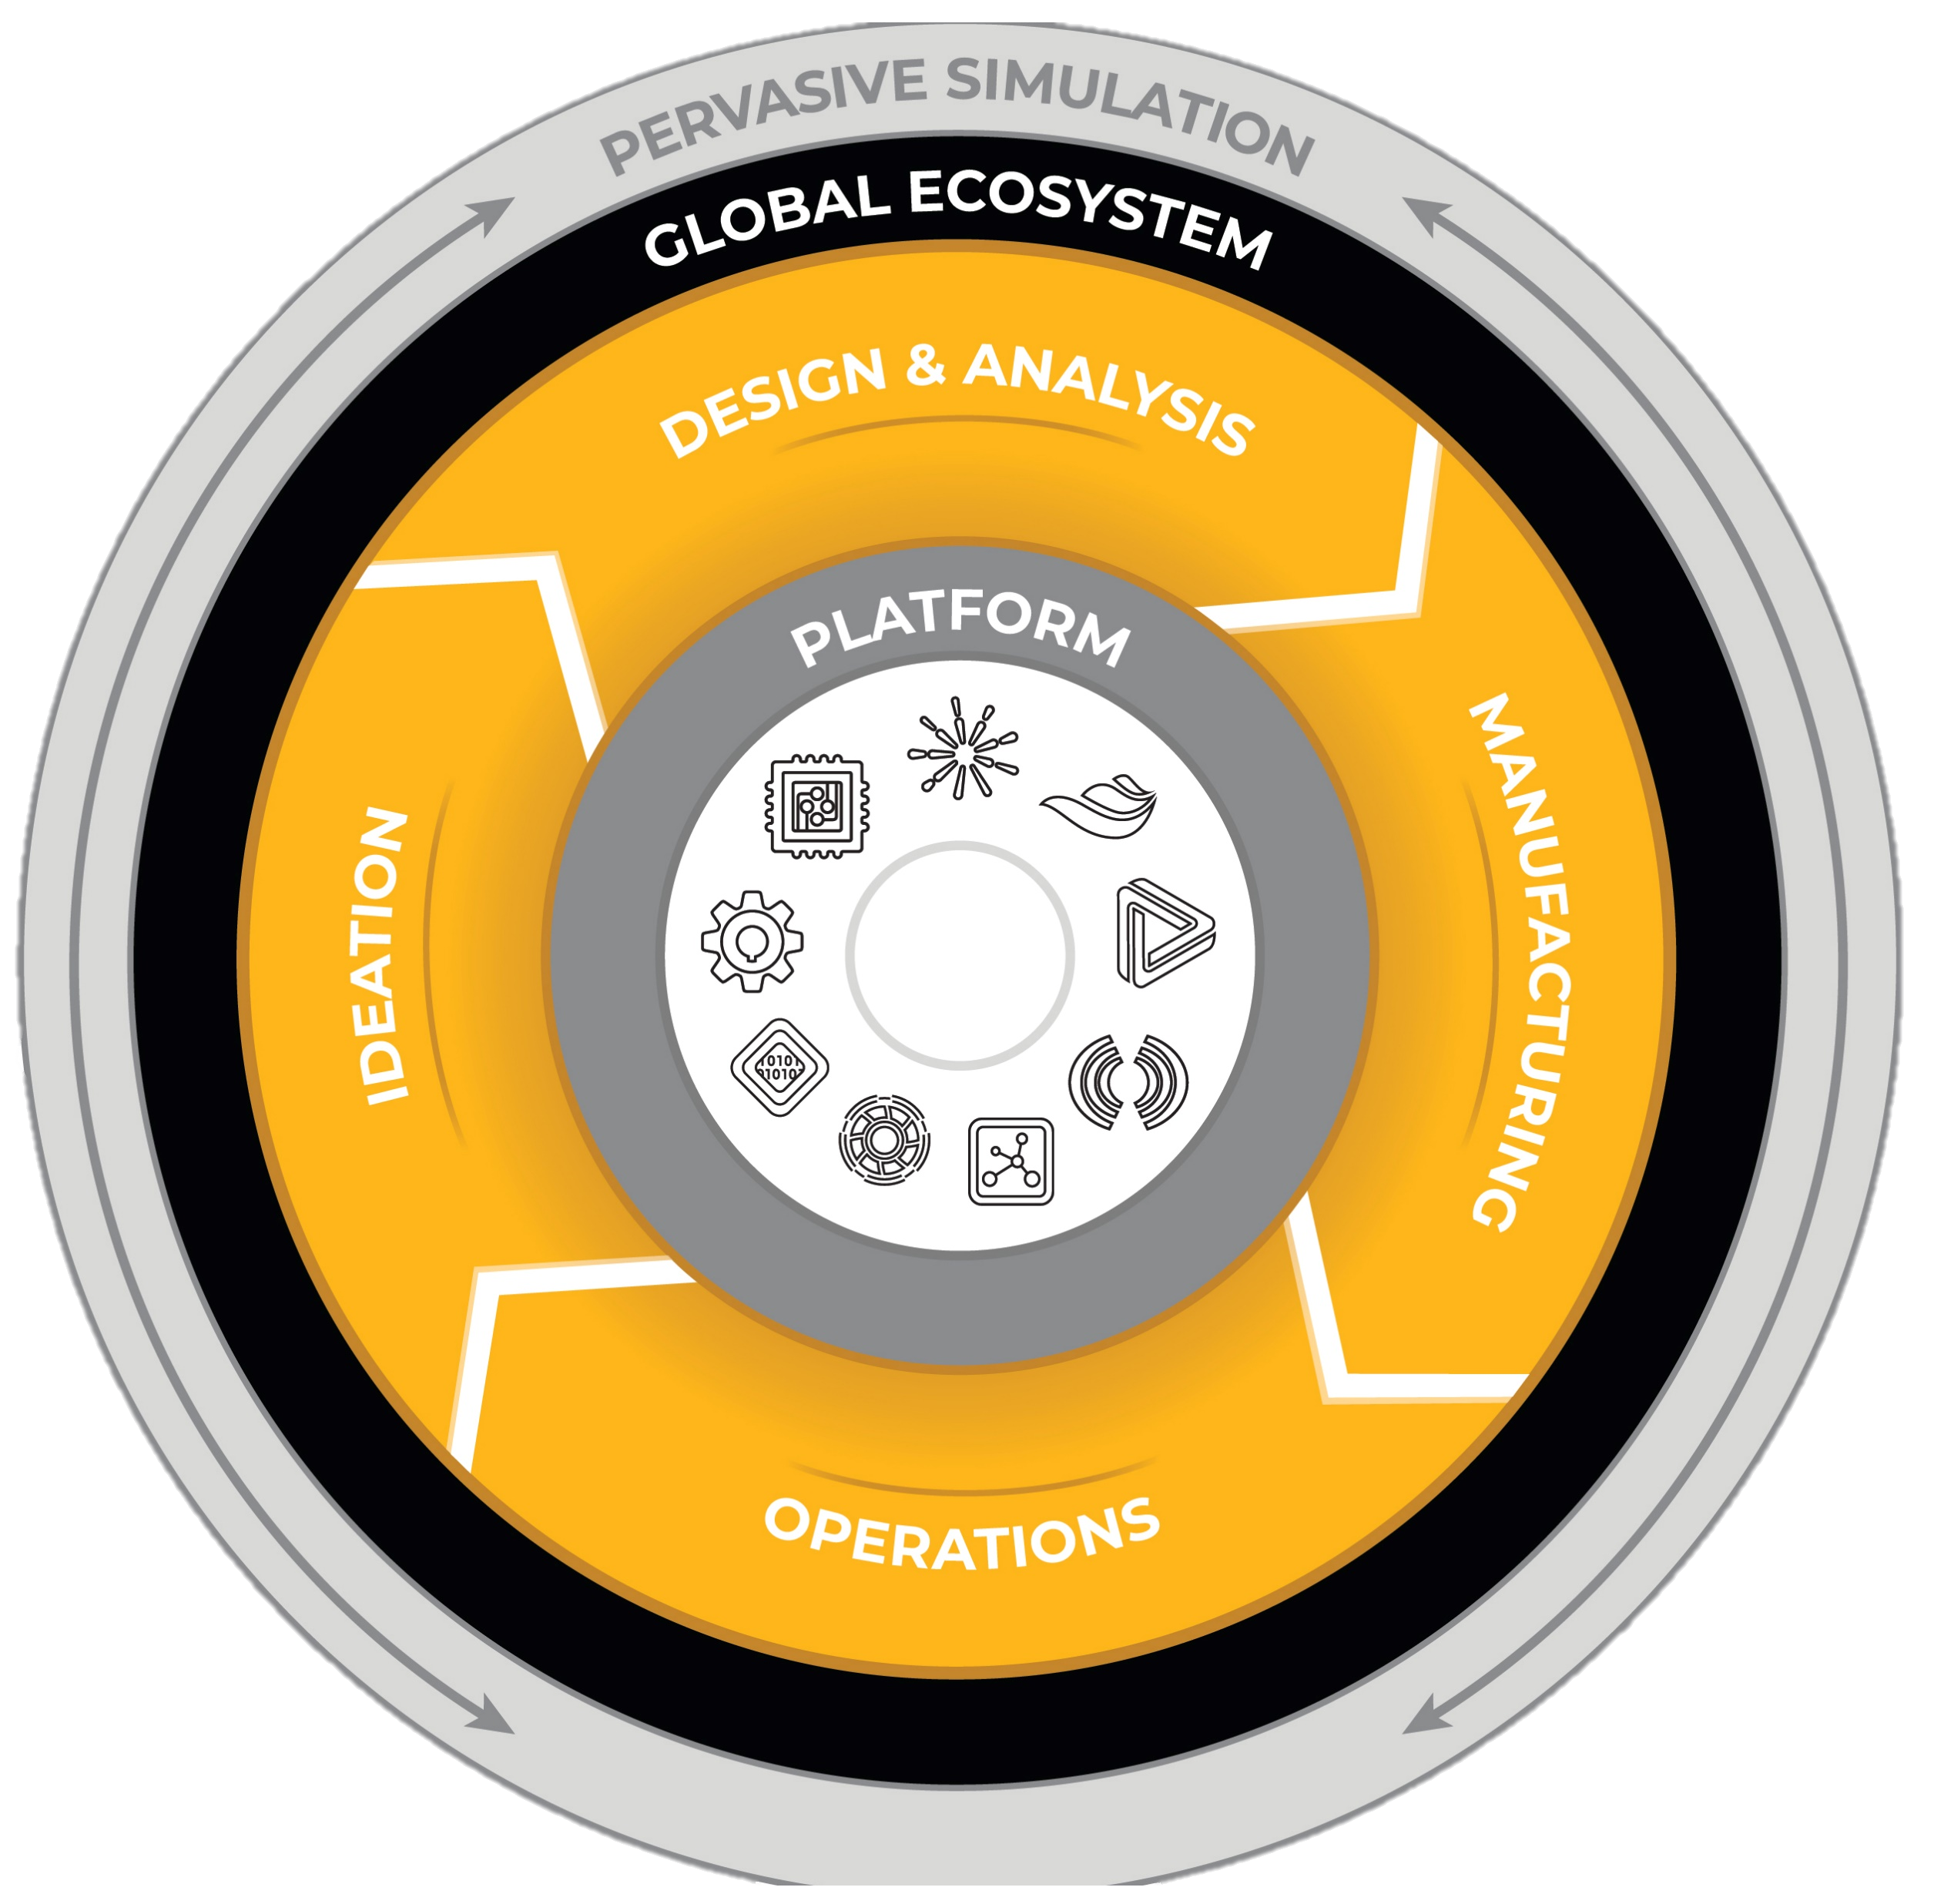
Materials Data Embedded in Digital Product Management Systems
Managing product from inception through development/engineering,
design and manufacturing until service, disposal
Total pervasion through digital data
Collaborative simulation and materials
information management and optimization
Digital material data infrastructure to
facilitate multiphysics simulation
Digital engineering
SDS
MDS
SMDMS
PLM
Simulation
Data Space
Materials
Data Space
Simulation and Materials
Data Management System
Product Lifecyle Management
Notes:
Example of Materials Data Embedded in Digital Product Management Systems
Product Lifecycle Management (PLM) is a strategic approach that focuses on managing the entire lifecycle of a product, from its conception to disposal. It involves the integration of people, processes, and systems to effectively manage product data, documents, and processes throughout the different stages of a product's life.
PLM encompasses various activities, including product design, engineering, manufacturing, quality control, maintenance, and support. It provides a centralized platform for cross-functional collaboration and data management, allowing teams to work together seamlessly and access up-to-date product information.
Key components of PLM typically include:
Product Data Management (PDM): PDM involves the storage, organization, and retrieval of product-related data such as CAD files, specifications, bills of materials, and engineering change orders. It ensures that accurate and current product data is available to the relevant stakeholders.
Design and Simulation Tools: PLM systems often integrate with design and simulation software to enable product development and validation. This integration allows for seamless data exchange between design tools and the PLM system, facilitating efficient collaboration and reducing errors.
Workflow and Process Management: PLM systems provide workflows and processes to streamline product development activities. These workflows define the sequence of tasks, responsibilities, and approvals required at each stage of the product lifecycle, ensuring that processes are followed consistently.
Collaboration and Communication: PLM platforms foster collaboration among teams by providing communication tools, document sharing capabilities, and real-time collaboration features. These enable geographically dispersed teams to work together effectively, improving efficiency and reducing time to market.
Change Management: PLM systems include change management functionalities that help track and manage product changes throughout the lifecycle. This ensures that all stakeholders are aware of and can assess the impact of proposed changes before implementation.
Analytics and Reporting: PLM systems offer reporting and analytics capabilities to provide insights into product performance, quality, and other key metrics. These insights can inform decision-making, support continuous improvement, and help identify opportunities for innovation.
In summary, PLM is a comprehensive approach to managing the lifecycle of a product, covering aspects such as data management, collaboration, workflow automation, and analytics. It aims to enhance productivity, reduce time to market, improve product quality, and optimize resource utilization throughout the entire product lifecycle.

Slide 25
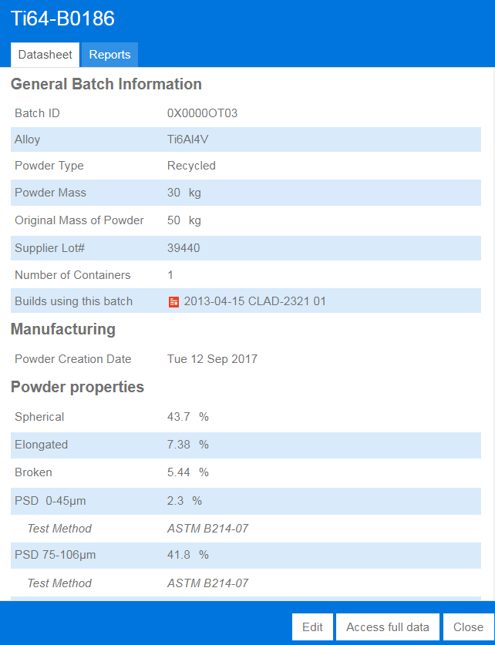


















Example of Digitalization Process in Additive Manufacturing
Txt, logs,
(any readable format)
CORPORATE
ADDITIVE
KNOWLEDGE
Extract
Digitalize
CSV
Examples of machines
PDF
Notes:
Example of digitalization process in additive manufacturing
In a nutshell, our current platform can import several data types and the machine-agnostic capabilities and the interconnectivity with a wider range of equipment, have been largely improved during the last decade throughout collaborative research projects. Ansys is creating new tools for automated data import and a digitalization of any type of information throughout manufacturing, to keep full traceability of data generation and data usage..

Slide 26




Technical, Legal and Ethical Considerations

Slide 27

Materials Data Quality
The quality of materials data refers to the accuracy, completeness, reliability, and consistency of information related to materials properties, characteristics, and performance.
Low quality data
High quality data
Missing information (no x-axis label, no reference or origin…)
Unique set of data not curated, not processed…
No unit
Black and white contraste with color-coded curves (not easy to link the right legend to the right curve)
Good accuracy with curated and consolidated data from multiple sources, tests…
Strong color contrast and use of symbols
Structurized and formatted datad and standardized units
Good tracilibity thanks to meta data (origin of the data, authors and date
From Ansys Granta Selector 2023 (David Mercier - 15/05/2023)
Notes:
Materials data quality
The quality of materials data refers to the accuracy, completeness, reliability, and consistency of information related to materials properties, characteristics, and performance.
Here are some key aspects that contribute to the quality of materials data:
Accuracy: The data should be free from errors, providing precise and reliable information about the material's properties, including physical, mechanical, thermal, and chemical attributes. Accurate data ensures that the materials perform as expected in real-world applications.
Completeness: The data should encompass a wide range of relevant properties and parameters, covering the material's behavior under different conditions, such as temperature, pressure, and environmental factors. Complete data helps researchers and engineers make informed decisions and predictions.
Standardization: Materials data should follow recognized standards and measurement protocols to ensure consistency across different sources and facilitate data exchange and comparison. Standardization helps in eliminating ambiguities and discrepancies in the data, enabling better collaboration and reliable analysis.
Traceability: It is crucial to track the origin and sources of materials data, including the experimental methods and equipment used for measurements. Traceability allows for verification, reproducibility, and identification of potential errors or biases in the data.
Data Governance: Implementing robust data governance practices ensures the long-term quality and integrity of materials data. This includes proper documentation, version control, data validation processes, and data curation to prevent data degradation over time.
Data Integration: Combining materials data from multiple sources and integrating it with other relevant datasets, such as simulation models or historical data, can enhance the quality and value of the information. Integration enables comprehensive analysis, validation, and optimization of materials properties and performance.
Data Sharing and Collaboration: Encouraging data sharing and collaboration among researchers, organizations, and institutions fosters the collective improvement of materials data quality. Open data initiatives, collaborative platforms, and data exchange standards promote transparency, data validation, and peer review processes.
Efforts are continually being made to improve materials data quality through the establishment of databases, standardization organizations, and data-sharing platforms. These initiatives aim to provide reliable and comprehensive materials data to support scientific research, innovation, and industrial applications.
Materials data files quality refers to the characteristics and attributes of digital files that store materials data. These files can contain various types of data, such as text documents, spreadsheets, databases, images, graphs, and simulation models. Ensuring high-quality materials data files is crucial for efficient data management, accessibility, and usability. Here are some key considerations for materials data files quality:
File Format: Choosing an appropriate file format is important to ensure compatibility, accessibility, and long-term preservation of materials data. Common formats for materials data include CSV (comma-separated values), XML (Extensible Markup Language), JSON (JavaScript Object Notation), HDF5 (Hierarchical Data Format), and proprietary formats specific to certain software or databases.
Data Structure: The structure of the data within the file should be well-organized and logically arranged. This includes using consistent naming conventions, appropriate data types, and clear delineation of data fields or columns. A well-structured file facilitates efficient data processing, analysis, and integration with other tools or systems.
Metadata: Metadata provides descriptive information about the materials data, such as the source, author, date of creation, units, and relevant parameters. Including comprehensive metadata enhances the understanding, traceability, and discoverability of the data. It enables efficient search, filtering, and sorting of files, ensuring the data's context and provenance are preserved.
Data Integrity: Maintaining data integrity is crucial to ensure that the files accurately represent the materials data. Implementing measures such as checksums, digital signatures, or data validation techniques helps detect and prevent data corruption or loss during storage, transfer, or manipulation.
File Size and Compression: Large materials data files can pose challenges in storage, transfer, and processing. Consider optimizing file sizes through compression techniques while ensuring minimal loss of data quality. Balancing file size with accessibility and computational requirements is important for efficient data handling.
Version Control: Managing different versions of materials data files is crucial, especially when updates, modifications, or corrections are made over time. Version control systems or file naming conventions that indicate the file's version can help track changes, maintain data lineage, and ensure reproducibility.
Documentation and Annotation: Providing comprehensive documentation or annotations within the files or accompanying documents enhances the understanding and usability of the materials data. This includes clear explanations of data sources, measurement methods, units, and any relevant assumptions or limitations.
Data Security and Privacy: Safeguarding materials data files against unauthorized access, data breaches, or loss is essential. Implementing appropriate security measures, access controls, encryption techniques, and backup strategies protects the integrity and confidentiality of the data.
Long-Term Preservation: Considering the long-term preservation of materials data files is vital to ensure their accessibility and usability over time. This includes utilizing open and non-proprietary file formats, adhering to archival standards, and implementing data backup and migration strategies to prevent data loss or obsolescence.
Adhering to these principles and best practices for materials data files quality promotes effective data management, collaboration, and reusability, ensuring that materials data remains valuable and reliable for future research and applications.

Slide 28

Data Storage and Versioning
In the field of material sciences, data storage and versioning refer to the management and organization of scientific data and the tracking of different versions of that data.
→ Storage management (cloud solution, virtual machines, on site servers…)
→ Example of versionning worflow (eg: git, svn…)
Your Work
Can be scripts, experimental results, materials data, modified, updated, analyzed by different users, teams…
V 0.1
V 1.0
V 1.1
Main
Curated and consolidated database
Another Person’s Work
Notes:
Data storage and versioning
In the field of material sciences, data storage and versioning refer to the management and organization of scientific data and the tracking of different versions of that data. Here's a brief explanation of these concepts:
Data Storage: In material sciences, researchers generate vast amounts of data through experiments, simulations, and other scientific methods. Data storage involves storing and preserving this data in a secure and accessible manner. It may include various types of information such as experimental results, numerical simulations, characterization data, images, and more. Proper data storage ensures that the data is available for future reference, analysis, and replication of experiments.
Versioning: Versioning refers to the practice of tracking and managing different versions of data or files. In material sciences, researchers often need to update and modify their data as new information becomes available, experiments are repeated, or errors are corrected. Versioning allows researchers to maintain a historical record of changes and iterations made to their data. It helps in preserving the integrity of the scientific process and enables traceability of data modifications.
Versioning systems can be implemented using different methods such as manual file naming conventions (e.g., appending version numbers or dates to file names), using version control software (e.g., Git), or utilizing databases specifically designed for scientific data management. These systems typically provide mechanisms to create branches, merge changes, and annotate data versions with relevant information, such as experimental conditions, analysis methods, and researcher contributions. By combining data storage and versioning, material scientists can effectively organize and preserve their research data, track changes over time, collaborate with colleagues, and ensure the reproducibility and transparency of their work. This facilitates knowledge sharing, data-driven discoveries, and the advancement of the field.

Slide 29

Reducing the Environmental Impact of Materials Data Storage
A gigabyte is enough data to save a few hundred high-resolution photos or an hour of video.
➔ Saving and storing 100 gigabytes of data in the cloud per year would result in a carbon footprint of about 0.2 tons of CO2, based on the usual U.S. electric mix.
Sustainable materials data refers to data that is collected, managed, and shared in a way that is environmentally, socially, and economically sustainable, throughout their lifecycle, including their production, use, and disposal. This means that the data is collected using methods that minimize harm to the environment and promote social and economic equity, and that it is managed and shared in a way that promotes sustainability and responsible use.
Notes:
Reducing the Environmental Impact of Materials Data Storage
In terms of storage and usage, sustainable materials data refers to data that is stored, managed, and used in a way that minimizes its environmental impact. This could include:
Energy-efficient storage: Sustainable materials data should be stored on energy-efficient servers and data centers that minimize energy consumption and greenhouse gas emissions. Cloud-based storage solutions that use renewable energy sources, such as wind or solar power, are one example of sustainable data storage.
Efficient data transfer: Sustainable materials data should be transferred using efficient and eco-friendly methods. This could include using low-power wireless networks or fiber-optic cables that consume less energy and produce fewer emissions compared to traditional network infrastructure.
Minimizing paper use: Sustainable materials data should be stored and shared electronically, in order to minimize paper use and waste. This could include using electronic lab notebooks, digital data storage and sharing platforms, and other online collaboration tools.
Sustainable data centers: Sustainable materials data should be stored in data centers that use sustainable and efficient cooling and ventilation systems, and that minimize water use and waste. Some data centers are designed to be carbon-neutral, using renewable energy sources and offsetting any remaining emissions. By following these sustainable storage and usage practices, researchers can help reduce the environmental impact of their materials data, and contribute to a more sustainable and responsible research culture.

Slide 30






Data Ownership and Copyrights
Data ownership refers to the legal and moral rights of an individual or organization to control and exploit the data they generate or possess. It includes the rights to access, use, share, modify, and dispose of the data.
Data copyrights refer to the legal protection of original works that are created through the collection, processing, and analysis of data. This can include a wide range of data-related products, such as databases, software, and data-driven content like news articles or research papers.
→ Multiple solutions to share your data?
Vs.
Commercial publishers
Open science platforms
Notes:
Data Ownership and Copyrights
Data ownership refers to the legal and moral rights of an individual or organization to control and exploit the data they generate or possess. It includes the rights to access, use, share, modify, and dispose of the data. Data ownership is linked to Intellectual Property (IP) Rights. Intellectual property rights encompass legal rights that individuals or organizations hold over creations of the mind, such as inventions, designs, or artistic works. In the context of materials characterization, IP rights may include ownership of data, processes, algorithms, or methodologies developed during the characterization process.
Research Institution Ownership: In the context of academic or research institutions, data ownership may be determined by institutional policies and agreements. In some cases, the institution may claim ownership of the data generated by its researchers or students, particularly if it was conducted using institutional resources or funding.
Collaborative Research Ownership: In collaborative research projects involving multiple parties, data ownership may be defined in agreements or contracts among the collaborators. These agreements outline the rights and responsibilities of each party concerning data ownership, access, and use.
Commercial Ownership: In industrial or commercial settings, materials characterization data ownership may be governed by employment agreements, contracts, or intellectual property clauses. The employer or the company funding the research may typically assert ownership rights over the generated data.It is important to note that data ownership in materials characterization can vary depending on the context, jurisdiction, and agreements between involved parties. Legal advice and specific contractual arrangements are necessary to establish clear guidelines regarding data ownership in a given situation.
Data copyrights refer to the legal protection of original works that are created through the collection, processing, and analysis of data. This can include a wide range of data-related products, such as databases, software, and data-driven content like news articles or research papers. Copyright law grants the owner of a work exclusive rights to control how that work is used, distributed, and reproduced. In the case of data copyrights, the owner of the copyright is usually the entity or individual who created the original work, such as a database or data-driven content. Data copyrights can be important for protecting the investment of time, resources, and creativity that goes into collecting, organizing, and analyzing data. They can also be used to prevent unauthorized use, reproduction, or distribution of data-related works, which can help to protect the intellectual property and financial interests of the copyright holder. However, the legal protection of data copyrights can also be complex, as data often involves the use of multiple sources or collaborations between different parties. Additionally, the use of data for research, analysis, or other purposes may be subject to fair use or other exceptions under copyright law. As such, it is important to carefully consider the legal implications of using and sharing data-related works, and to seek legal advice if necessary.

Slide 31


The FAIR Data Principles
The FAIR Data Principles (Findable, Accessible, Interoperable, and Reusable), published in Scientific Data in 2016, are a set of guiding principles proposed by a consortium of scientists and organizations to support the reusability of digital assets → FAIR Principles
By following the FAIR principles, materials researchers can ensure that their data is readily available to others in the field, which can help to accelerate research and promote collaboration.
From Jacobsson, T.J., Hultqvist, A., García-Fernández, A. et al. An open-access database and analysis tool for perovskite solar cells based on the FAIR data principles. Nat Energy 7, 107–115 (2022). https://doi.org/10.1038/s41560-021-00941-3
Notes:
The FAIR Data Principles
The FAIR principles are a set of guiding principles for making scientific data Findable, Accessible, Interoperable, and Reusable. These principles were developed to address the challenges of managing and sharing scientific data in a way that promotes collaboration, reproducibility, and data-driven discovery. When it comes to materials data, the FAIR principles are particularly important because materials data are often complex and heterogeneous and can be difficult to share and reuse. By making materials data FAIR, researchers can ensure that their data is available for reuse, validation, and integration with other data sources, which can help accelerate materials discovery and innovation. Let's take a closer look at each of the FAIR principles and how they apply to materials data:
Findable: Materials data should be easy to find for both humans and machines. This means that data should be assigned a persistent identifier, such as a DOI or URL, that can be easily located and cited. In addition, metadata should be provided that describes the data, including information such as the sample preparation methods, measurement techniques, and experimental conditions.
Accessible: Materials data should be open and accessible to anyone who wants to use it, subject to any necessary ethical and legal constraints. This means that data should be stored in a publicly accessible repository or data archive, and that access should be granted under an appropriate data access agreement or license.
Interoperable: Materials data should be structured in a way that allows it to be integrated with other data sources. This means that data should be described using standard vocabularies and formats, such as those provided by the Materials Project, which can be easily integrated with other data sources and tools.
Reusable: Materials data should be available for reuse and repurposing. This means that data should be provided under an appropriate license that allows others to use, modify, and redistribute the data. In addition, data should be well-documented and described in a way that makes it easy to understand and use. Overall, by following the FAIR principles, researchers can ensure that their materials data is of the highest quality and can be used by others to advance scientific knowledge and accelerate materials discovery and innovation.

Slide 32
Summary
Materials data refers to information and properties of materials used in various applications such as scientific research, engineering, and industrial manufacturing. This includes physical and mechanical properties, composition, and processes used to produce or manipulate materials. Collecting and analyzing materials data is crucial for developing new materials, improving the performance of existing materials, and designing and optimizing new products and technologies. The data is collected through various experimental techniques and computational modeling and simulation. Recent materials data deluge has created a surge of information that needs to be well-managed and made accessible.
Materials data management is the process of collecting, storing, organizing, and analyzing materials data in an efficient and effective manner. It involves the use of systems and tools to manage large volumes of data and ensure its quality and integrity. Effective materials data management is critical for organizations that rely on materials data to make informed decisions and develop new products and technologies. Materials data management systems can help streamline the data collection process, reduce errors, and improve data accuracy and consistency.
Well-managed materials data can result in re-use, integration & new science. If materials data are well organized, documented, preserved, accessible, verified…, the result is high quality data, easy to share and re-use, cost saving to science and industry.
Notes:
Summary
This final frame summarizes the points made in this Unit.

Slide 33
Ansys Education Resources Feedback Survey
Here at Ansys, we rely on your feedback to ensure the educational content we create is up-to-date and fits your teaching needs.
Please click the link below to fill out a short survey (~7 minutes) to help us continue to support academics around the world utilizing Ansys tools in the classroom.
Feedback Survey Link
Notes:
Feedback Survey link for copy-paste method → https://ansys.typeform.com/to/jcattJI5

