Slide 1

Parallel-Plate Capacitor Simulation using the Ansys Maxwell Software
Pratap Vangol and Dr. Saharnaz Baghdadchi
University of California, San Diego
Dr. Celia Gómez Molina
Academic Development team, Ansys
education@ansys.com

Slide 2



Learning Objectives
Ansys software mentioned | Ansys Maxwell®, an advanced electromagnetic field solver
Intended Learning Outcomes
Knowledge and Understanding | Fundamental principles of electrostatics and simulation workflows using the Ansys Maxwell software.
Skills and Abilities | Conducting simulations, visualizing electric fields, and validating results using industry-standard software.
Values and Attitudes | Emphasis on accuracy, validation, and bridging theory with real-world applications.
Resources
M. N. O. Sadiku, Elements of Electromagnetics, Oxford University Press, 2001.
Ulaby, Michielssen, and Ravaioli, Fundamentals of Applied Electromagnetics, Seventh Edition, Pearson Education, 2015.
Further reading/information
Ansys Academic
Ansys Innovation Courses
Ansys Education Resources
Built-in Assessment
Simulation instructions
Exercises

Slide 3

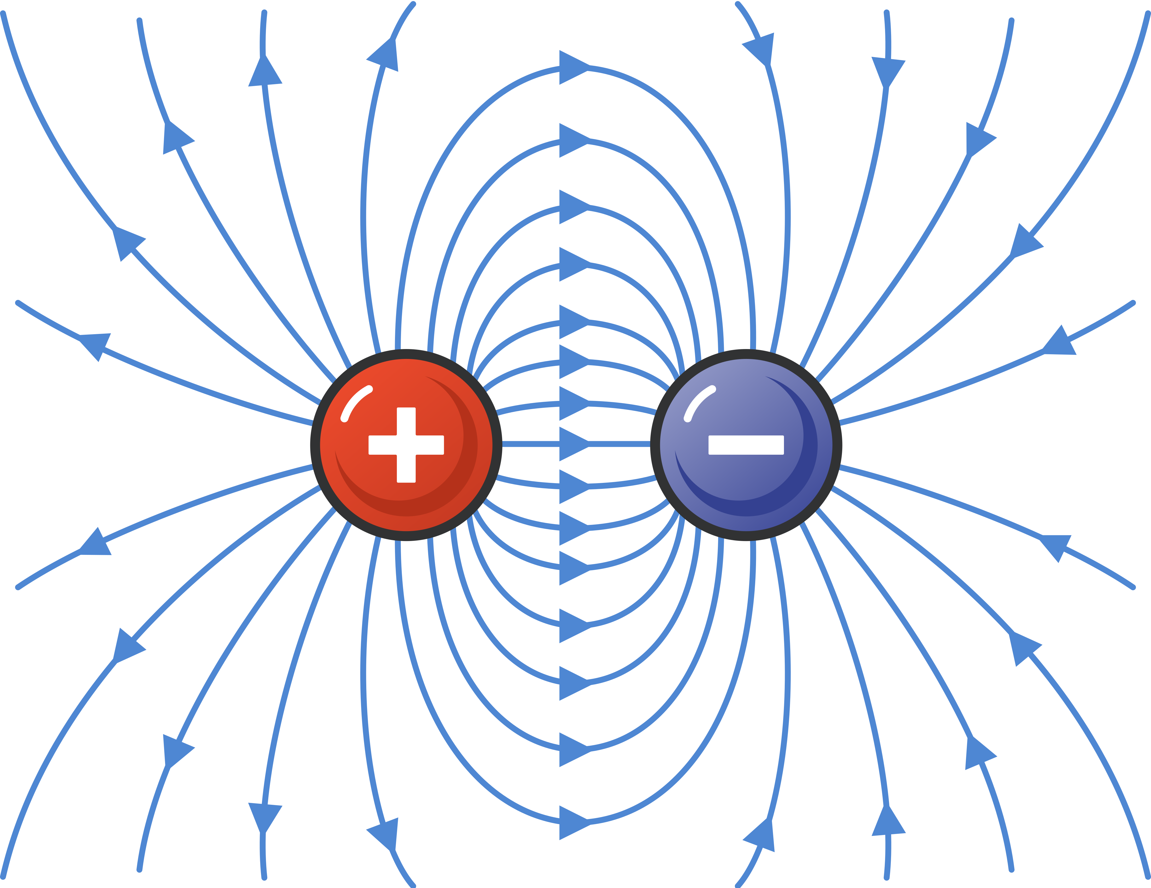
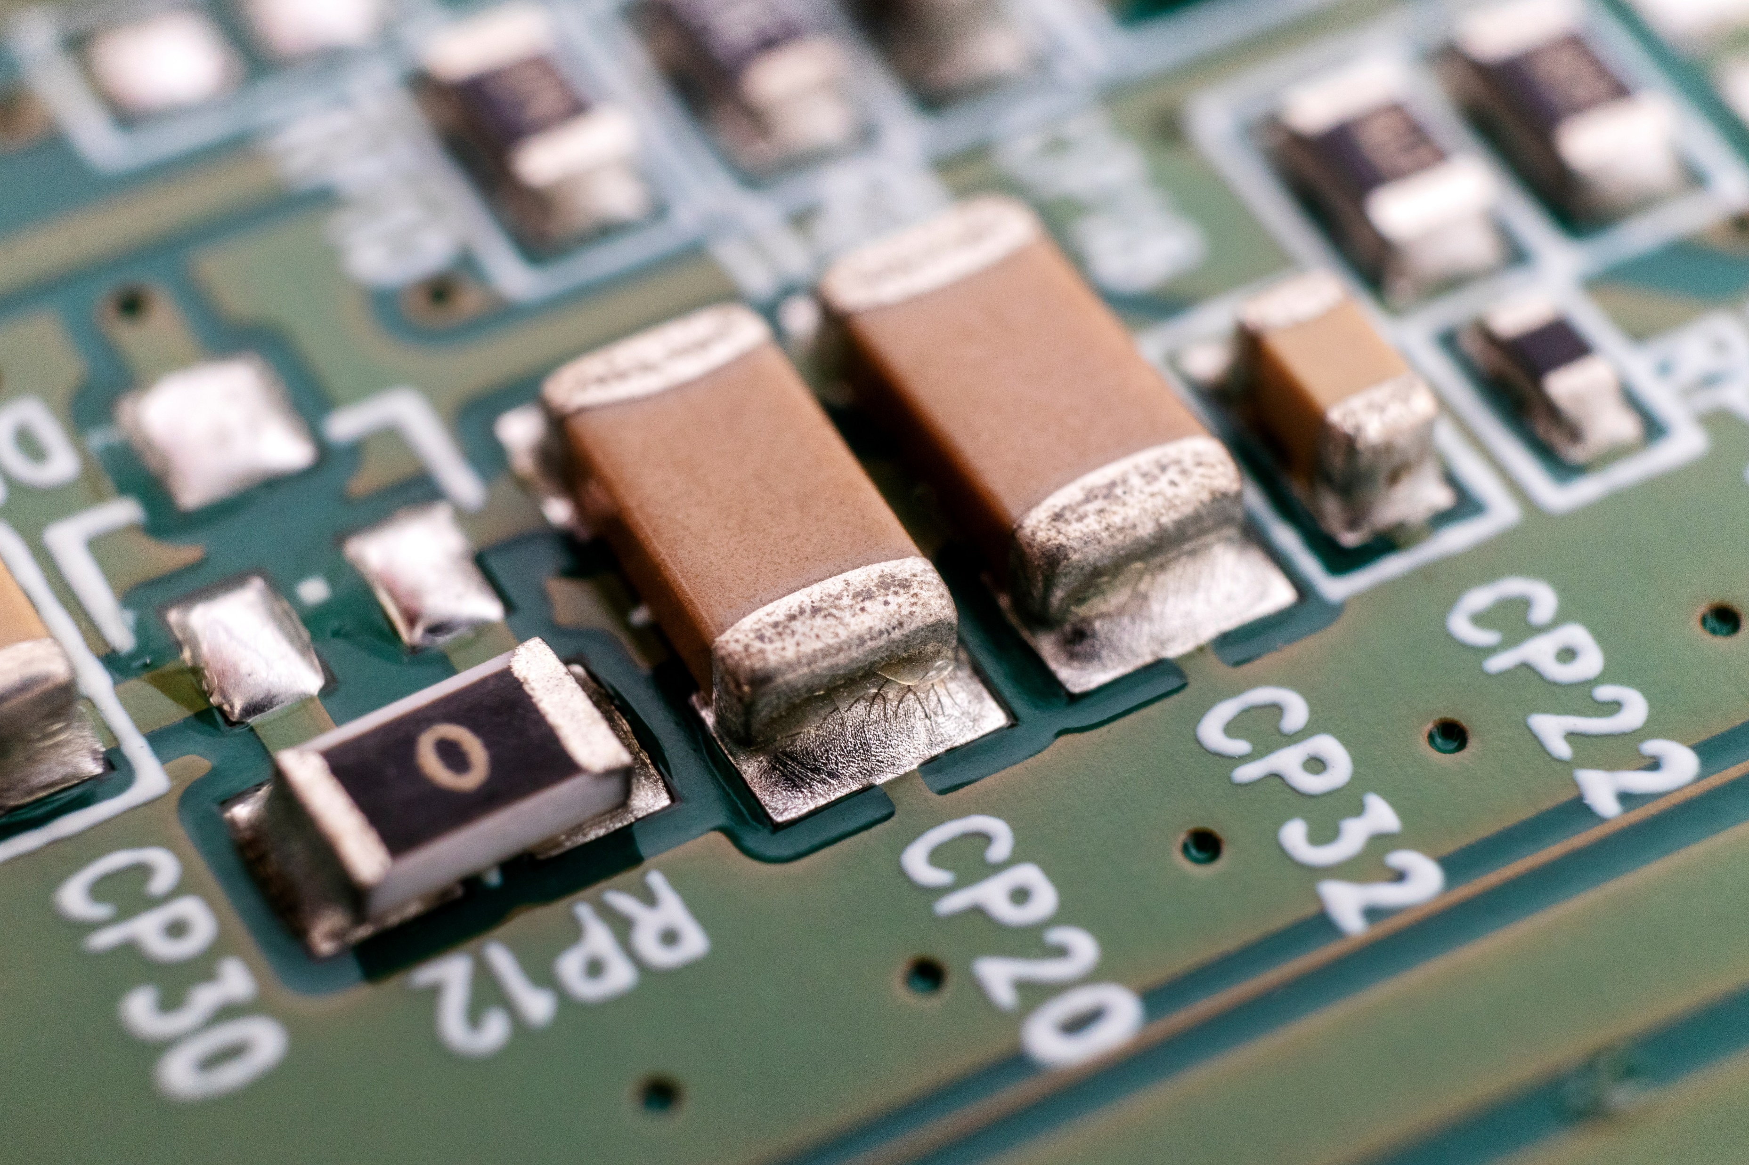
Electrostatics
Electric fields that do not change with time. Electrostatics studies the electric charges at rest, their interactions, and the electric fields and potentials they create.
In today’s lesson we will study the parallel-plate capacitor.
Electrostatic can be seen as special case of Maxwell's equations, when we assume that the charges are stationary and there are no time-varying magnetic fields.
Commonly sources that generate static electrostatic fields are point charges, distributed charges, or systems like dipoles and capacitors…
Applications: capacitors, micro-electromechanical systems (MEMS) like sensors and actuators, electrostatic lenses for beam focusing…

Slide 4

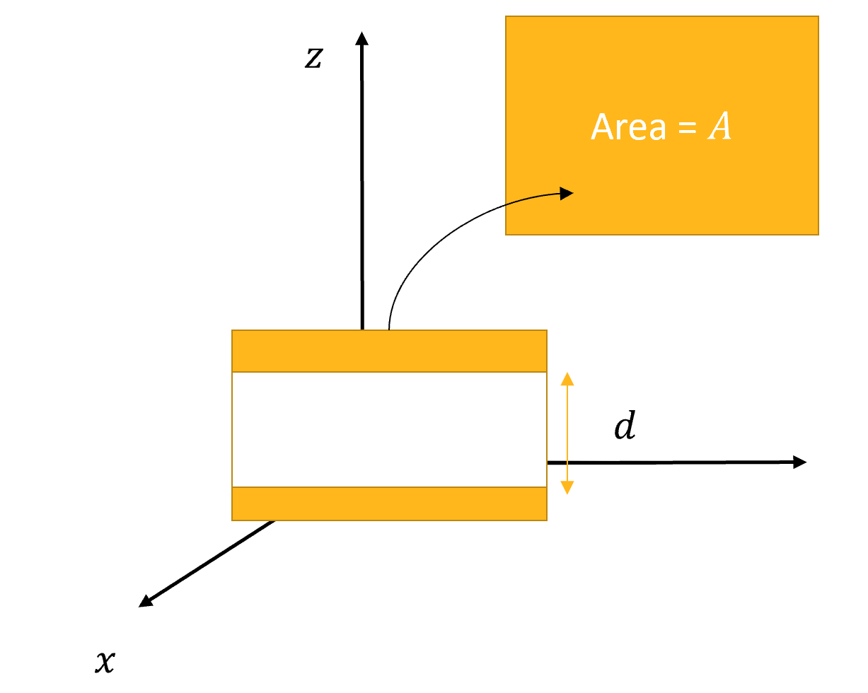
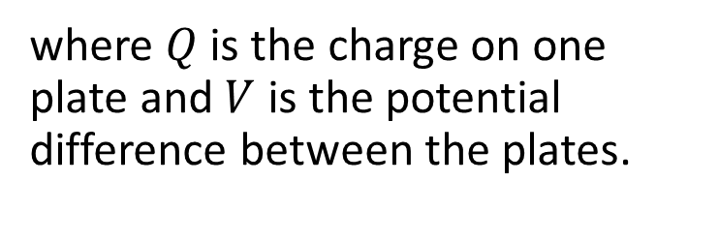
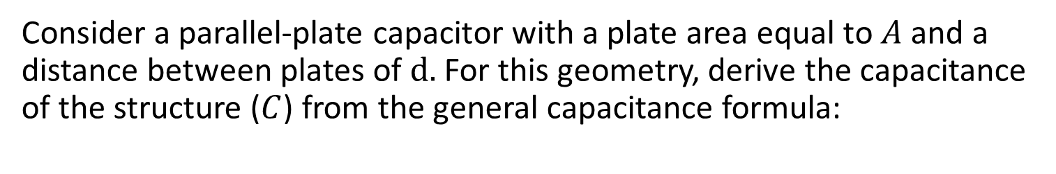
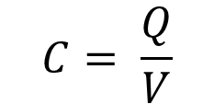
Analytical Assignment
Calculate the capacitance of a parallel-plate capacitor
Consider a parallel-plate capacitor with a plate area equal to $A$ and a distance between plates of $d.$ For this geometry, derive the capacitance of the structure ($C$) from the general capacitance formula:
$$C= \frac{Q}{V}$$
where $Q$ is the charge on one plate and $V$ is the potential difference between the plates.

Slide 5
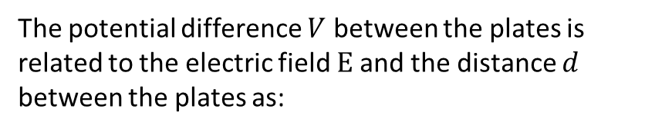




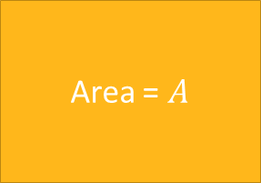
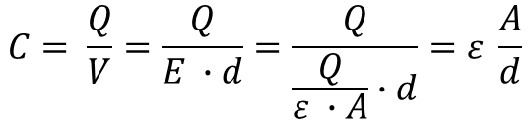



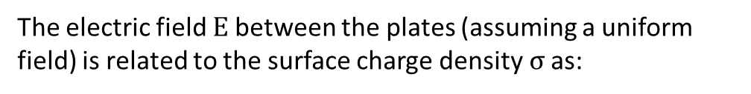
Theoretical derivations
The electric field $E$between the plates (assuming a uniform field) is related to the surface charge density$σ$ as:
The potential difference $V$ between the plates is related to the electric field $E$and the distance $d$ between the plates as:
$$E= \frac{σ}{ε}=\frac{Q}{ε ∙A}$$
where ε is the dielectric permittivity of the medium between the plates.
$$V=E ∙d$$
Using the definition of capacitance​, and substituting the previous equations:
$$z$$
Area = $A$
$$C= \frac{Q}{V}=\frac{Q}{E ∙d}=\frac{Q}{\frac{Q}{ε ∙A}∙d}=ε \frac{A}{d}$$
We can finally obtain the formulas to compute the capacitance and the electric field as:
$$d$$
$$C= ε \frac{A}{d}$$
(Farads)
$$E= \frac{V}{d}$$
(V/m)
$$x$$

Slide 6



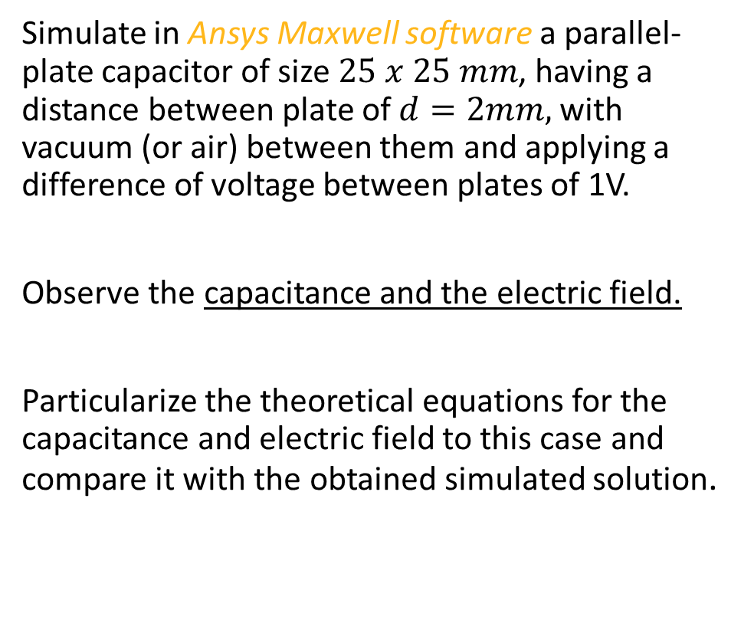





Problem statement
$$l=25mm$$
Simulate in Ansys Maxwell software a parallel-plate capacitor of size $25 x 25 mm$, having a distance between plate of $d=2mm,$with vacuum (or air) between them and applying a difference of voltage between plates of 1V.
Observe the capacitance and the electric field.
Particularize the theoretical equations for the capacitance and electric field to this case and compare it with the obtained simulated solution.
$$z$$
$$V_{2}$$
$$d=2mm$$
$$y$$
$$V_{1}$$
$V_{2}−V_{1}=1V$
$$x$$

Slide 7
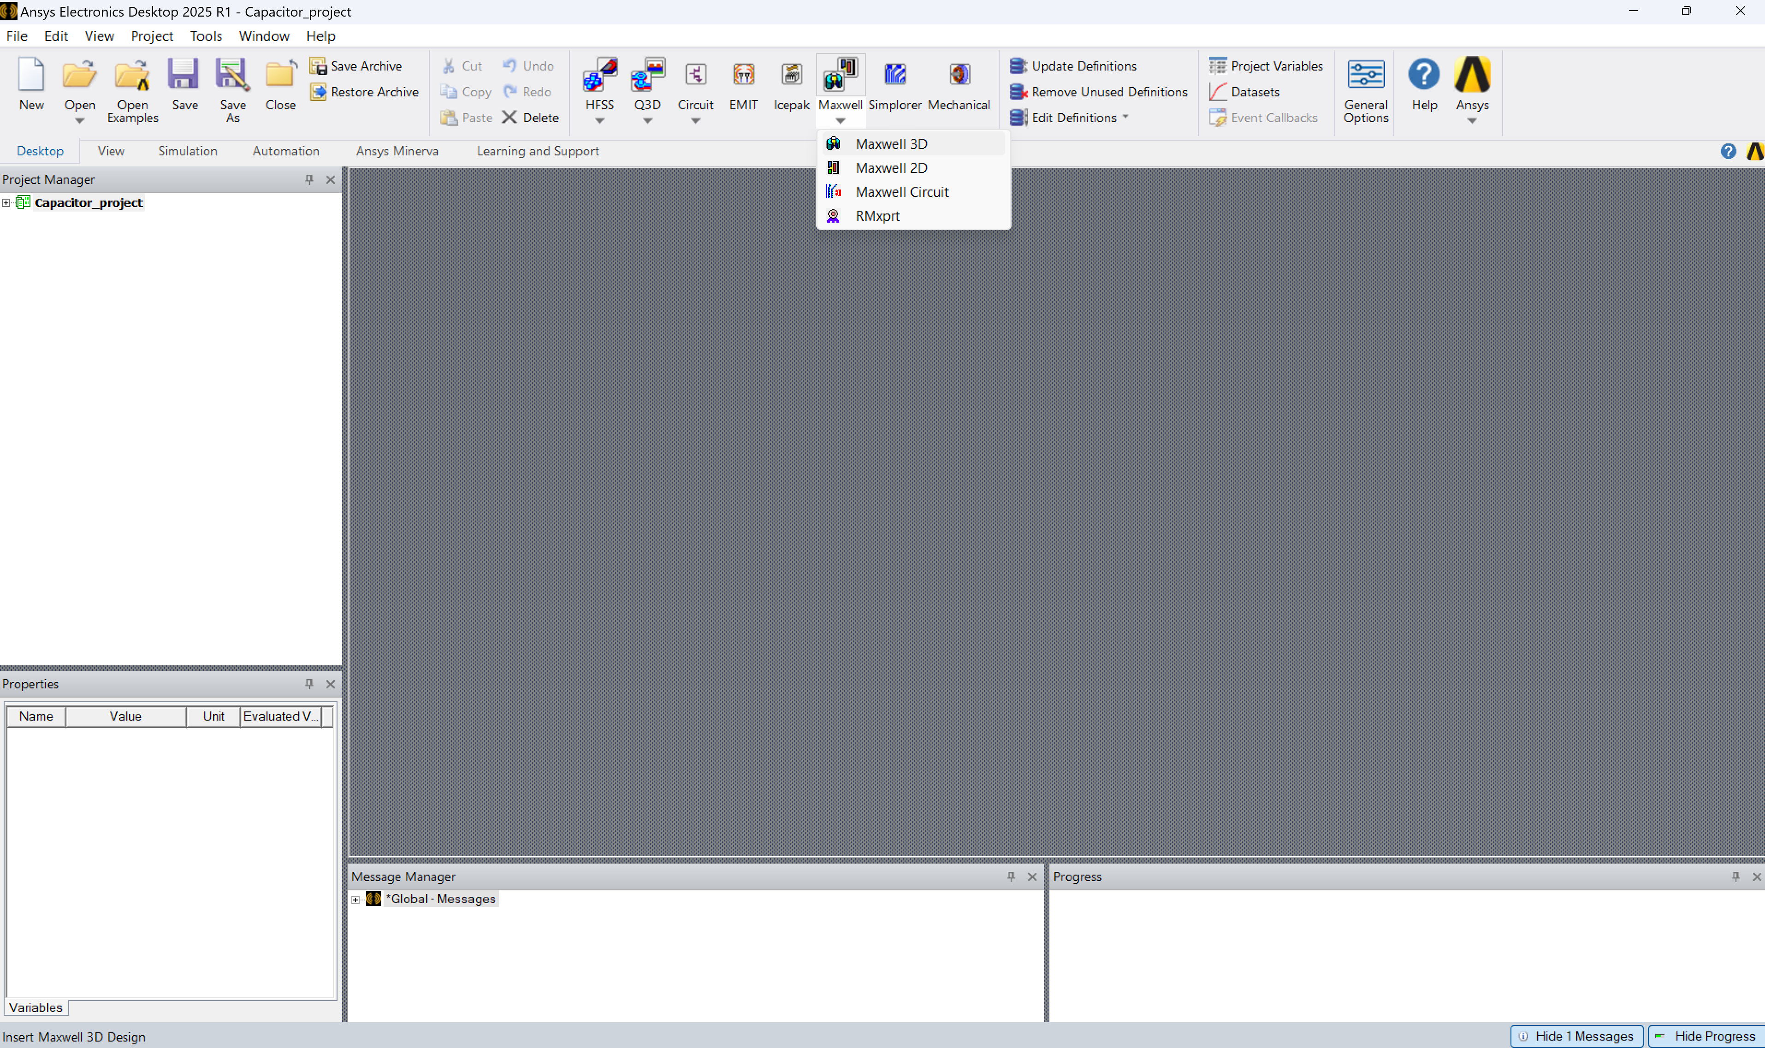
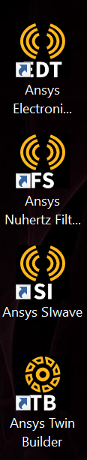
Software Setup

Slide 8
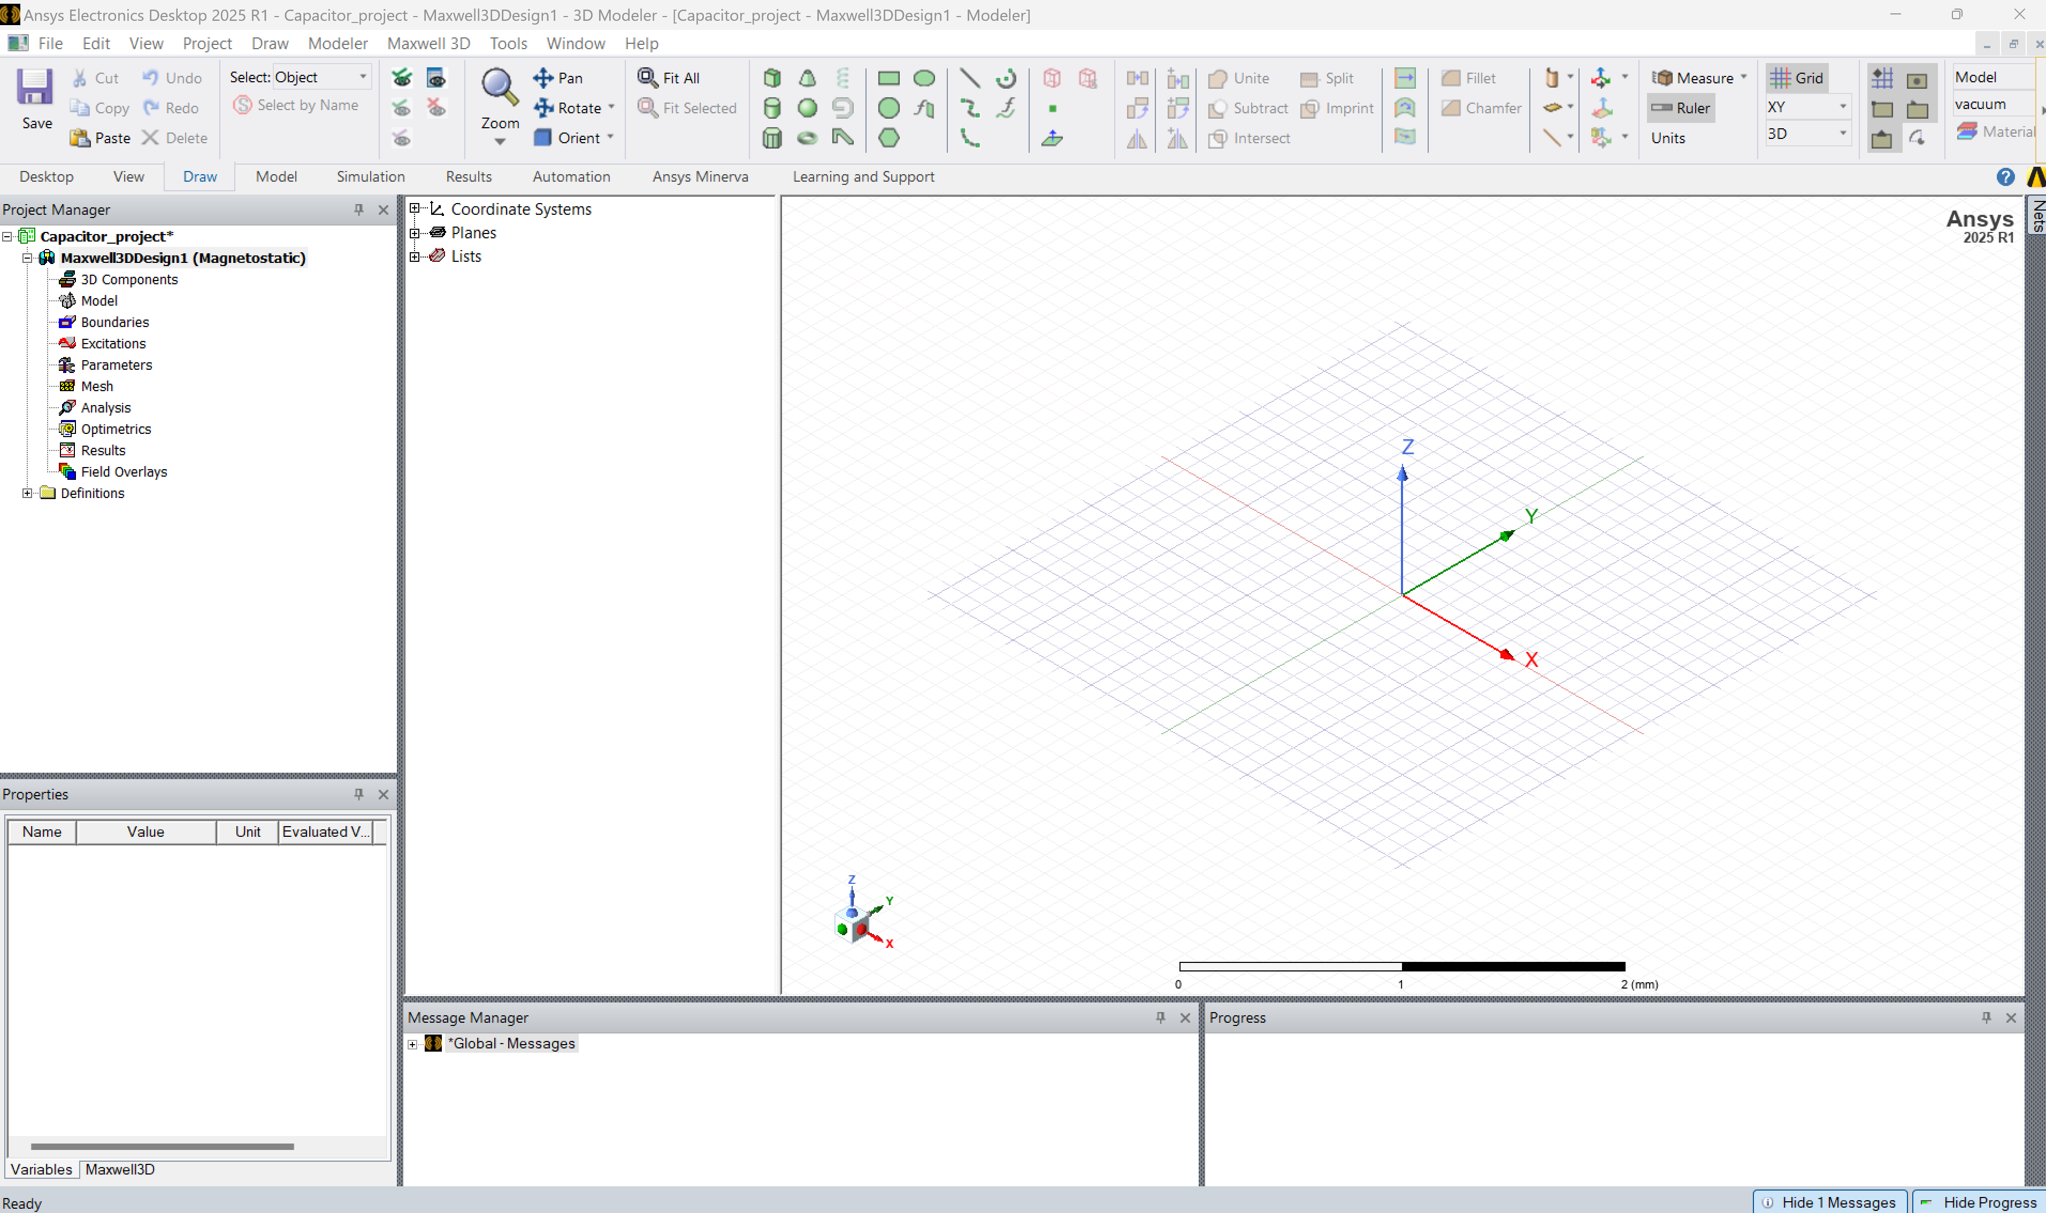
Familiarize yourself with the Ansys Maxwell Software Interface
3D Modeller Window
Draw 3D Objects
Draw 2D Objects
Project Manager window
Configuring the Simulation

Slide 9
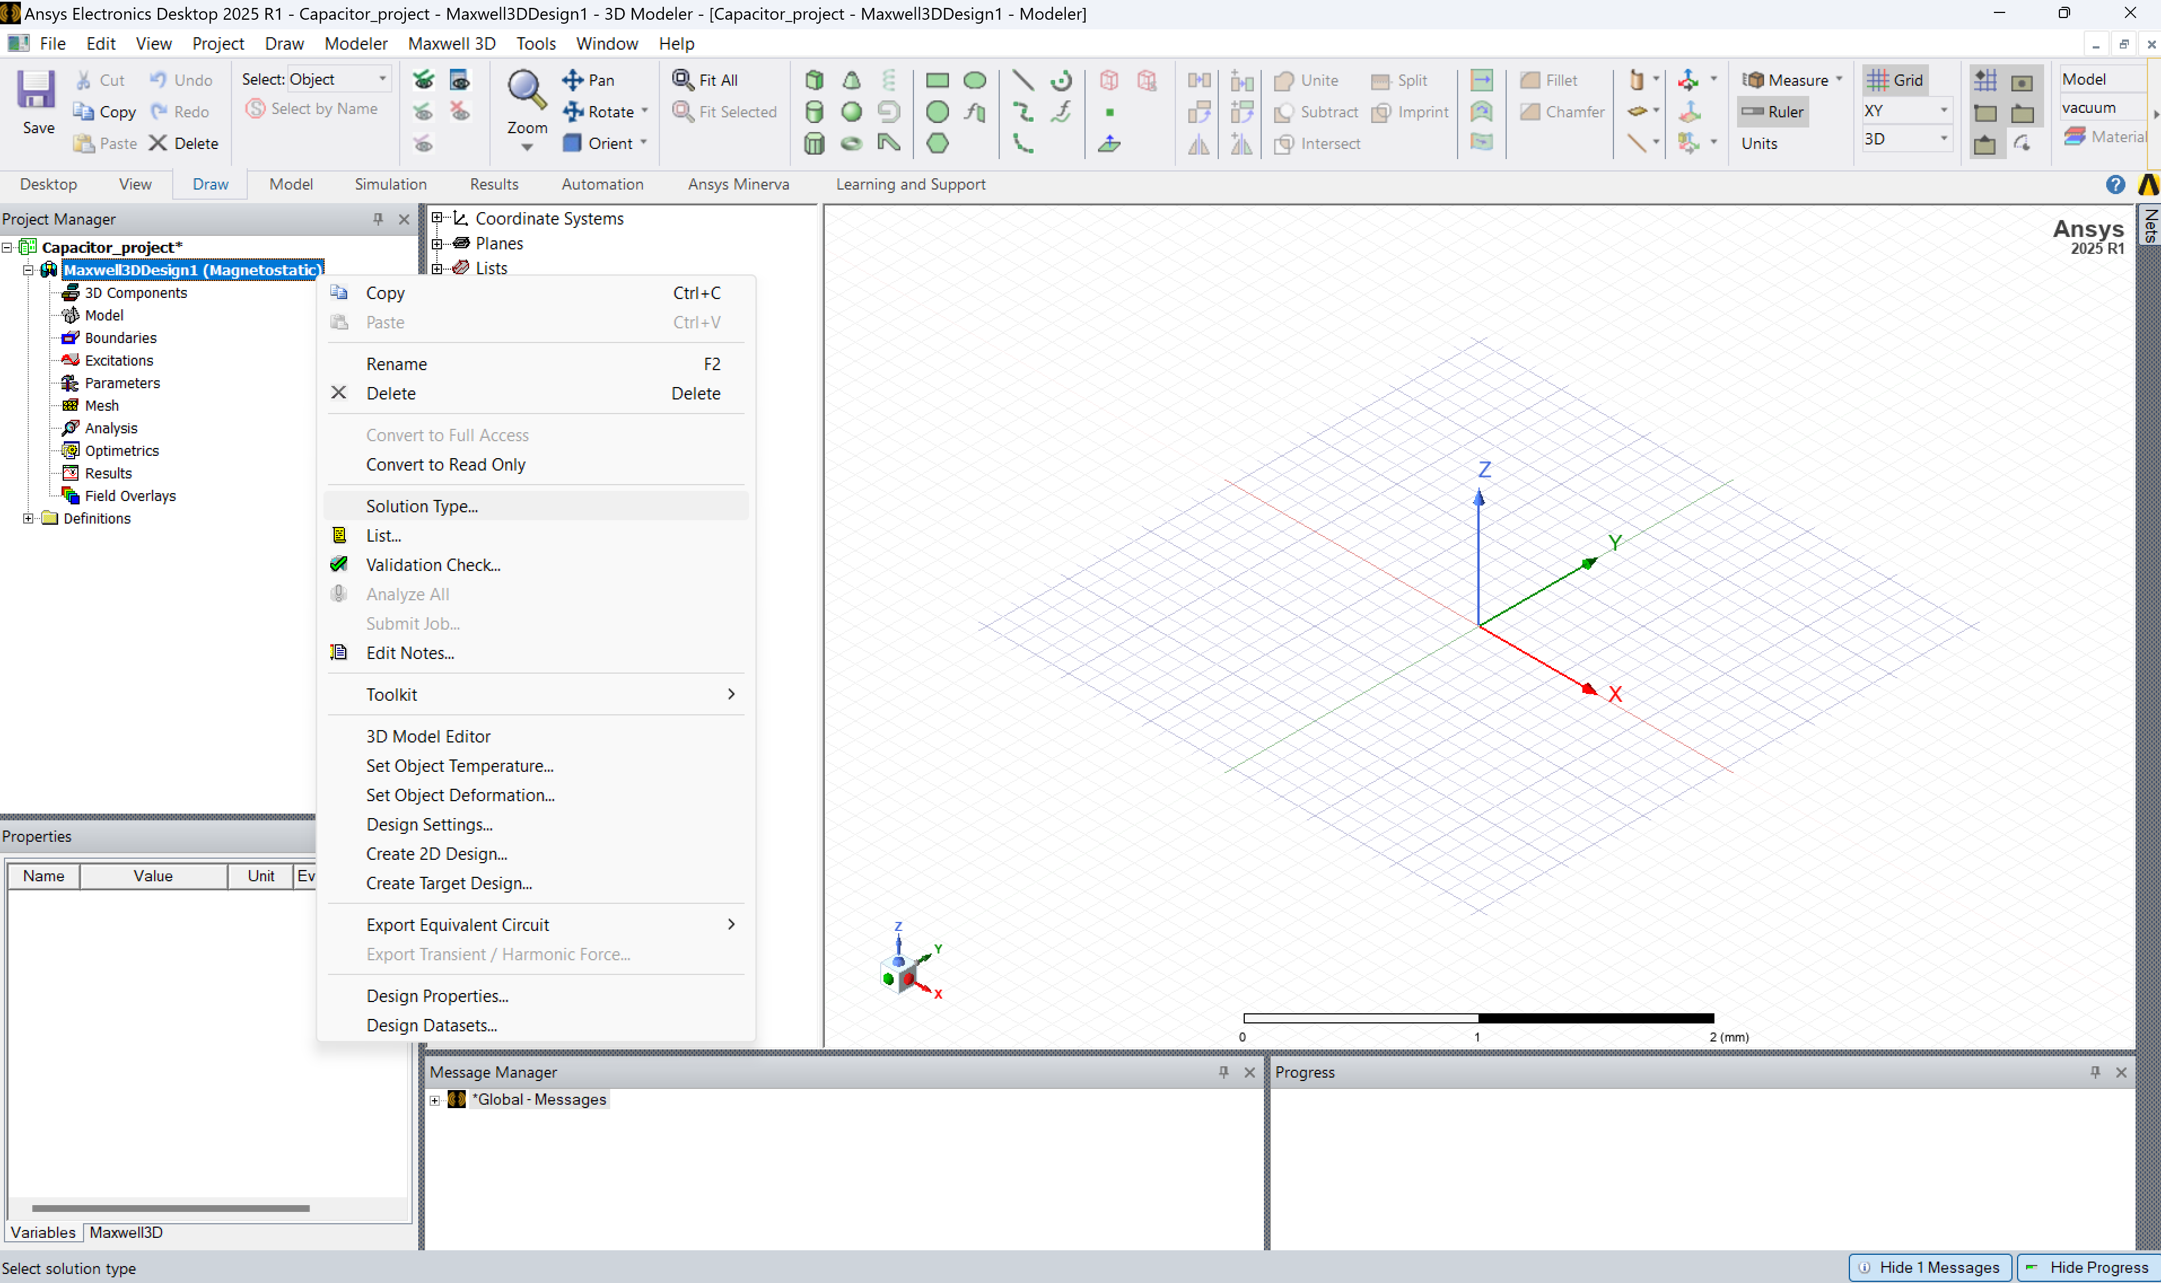
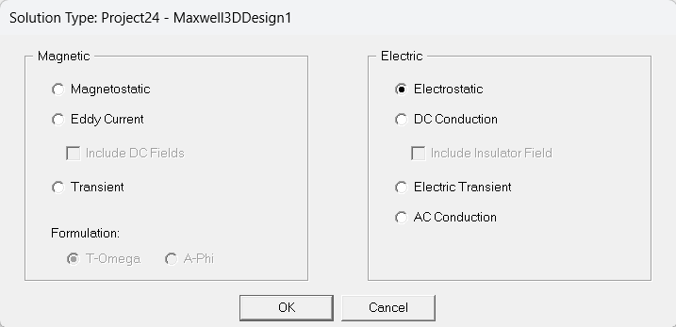
Configuration – solution type
Right +Click

Slide 10
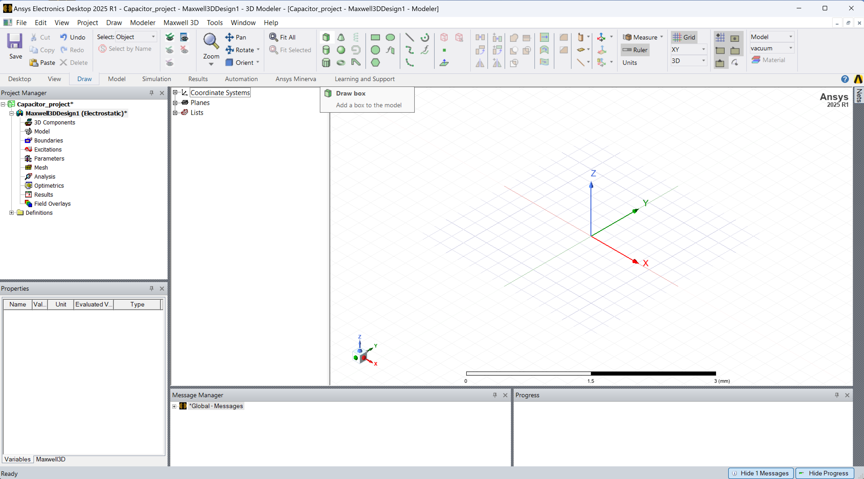
Step 1: Construct the Dielectric (1)
Click on the Draw Box

Slide 11
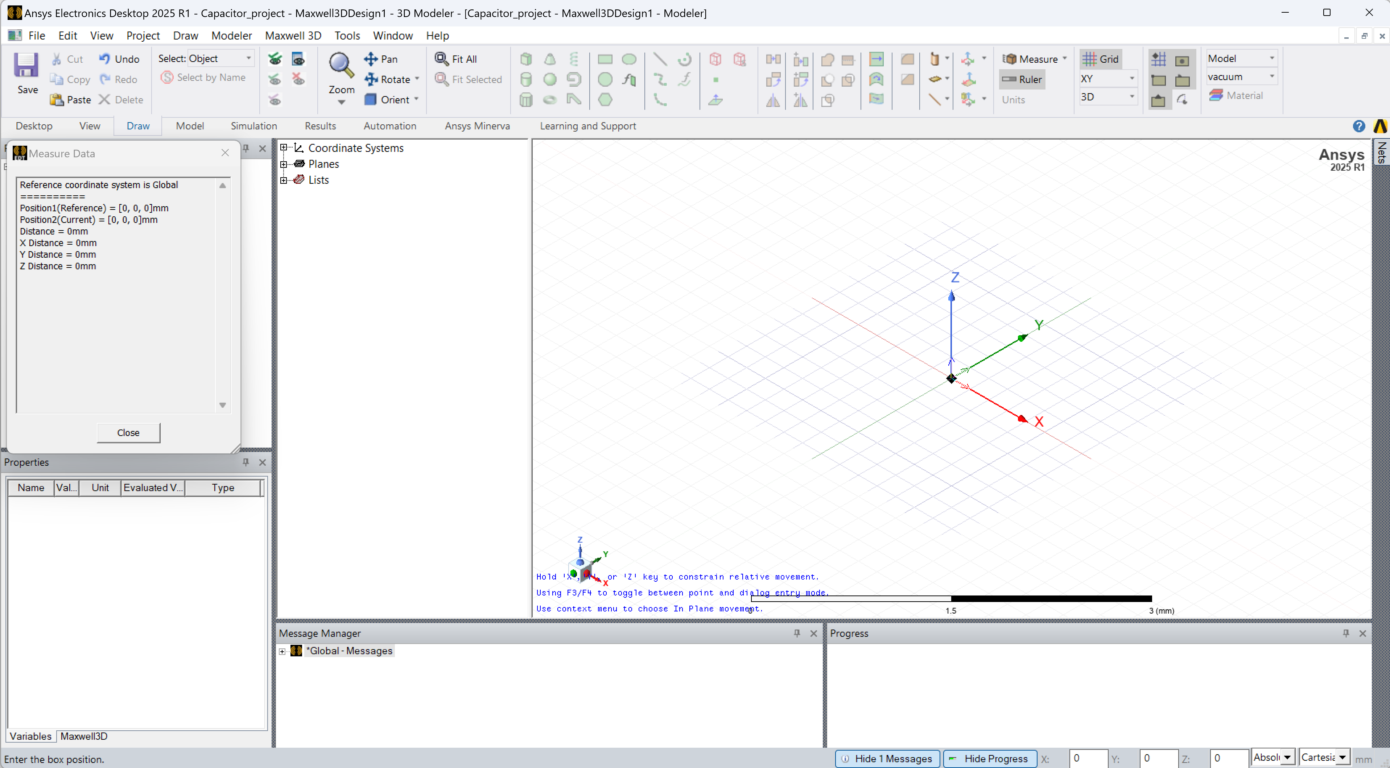
Step 1: Construct the Dielectric (2)
Left Click anywhere on the screen to define the lower left corner of the box
Move the mouse to another point and left click again to define the top right corner of the box
Move the mouse pointer above to define the height of the box and left click to finish defining

Slide 12

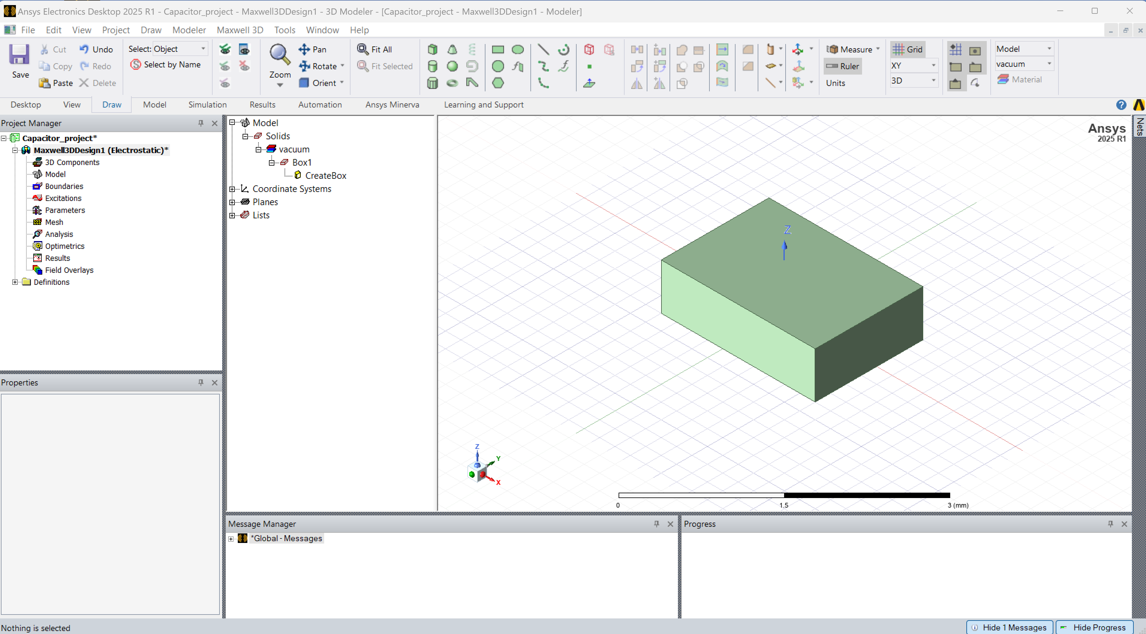
Step 1: Construct the Dielectric (3)
In the previous step, you made an arbitrary cuboid of random dimensions
The cuboid will look something similar to the adjoining image
In the next step, the dimensions of the cuboid will be changed to what we need

Slide 13
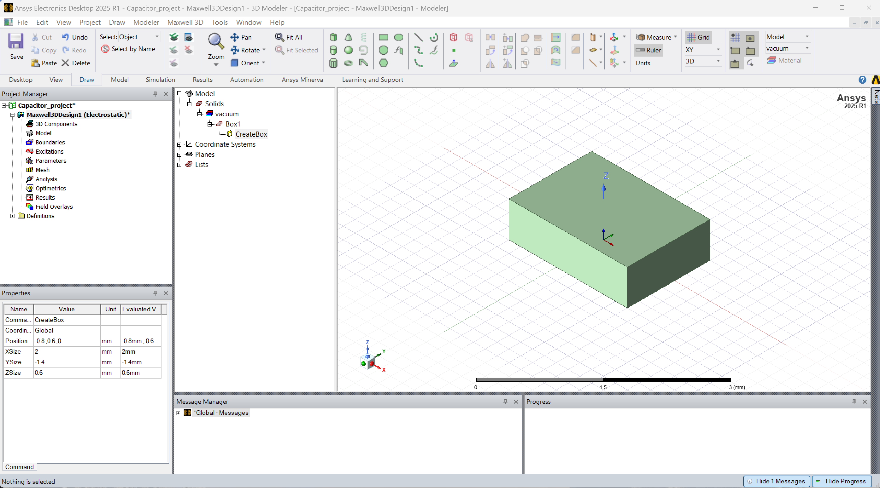
Step 1: Construct the Dielectric (4)
Double click

Slide 14
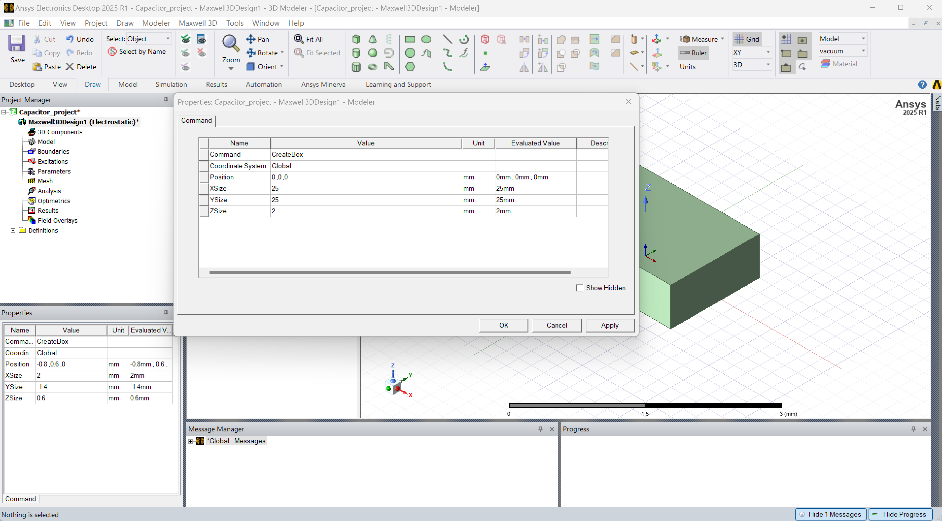
Step 1: Construct the Dielectric (5)
Defines the coordinates of the lower left corner of the bottom face of the cuboid
Modify the dimensions of the cuboid along the respective axis

Slide 15
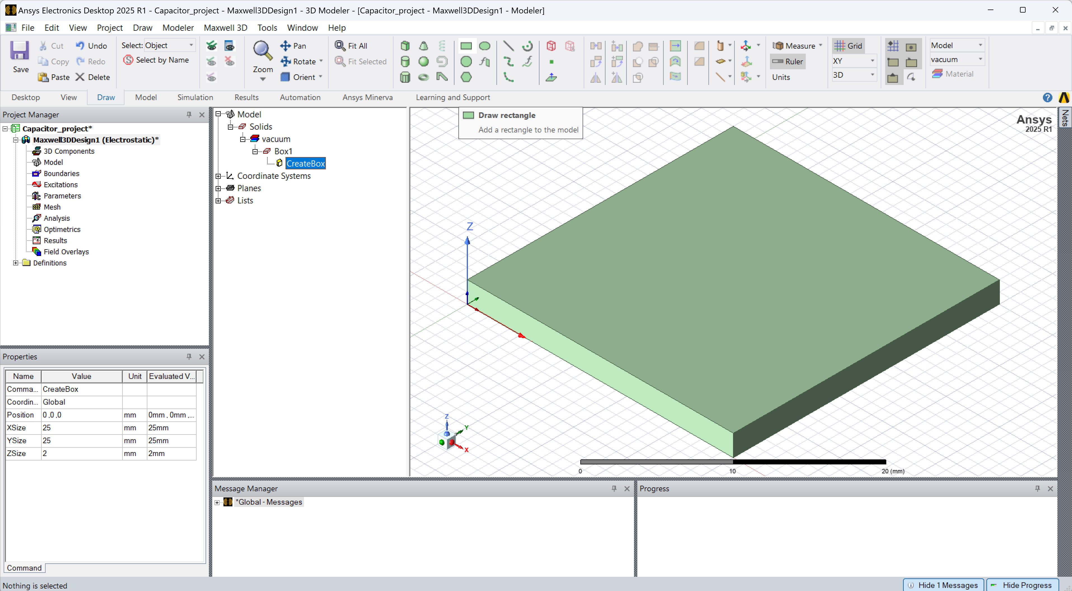
Step 2: Construct the Bottom Plate (1)
The final constructed dielectric slab should look similar to the adjoining figure
Now, we will define the parallel-plate. For that, click on the Draw Rectangle

Slide 16
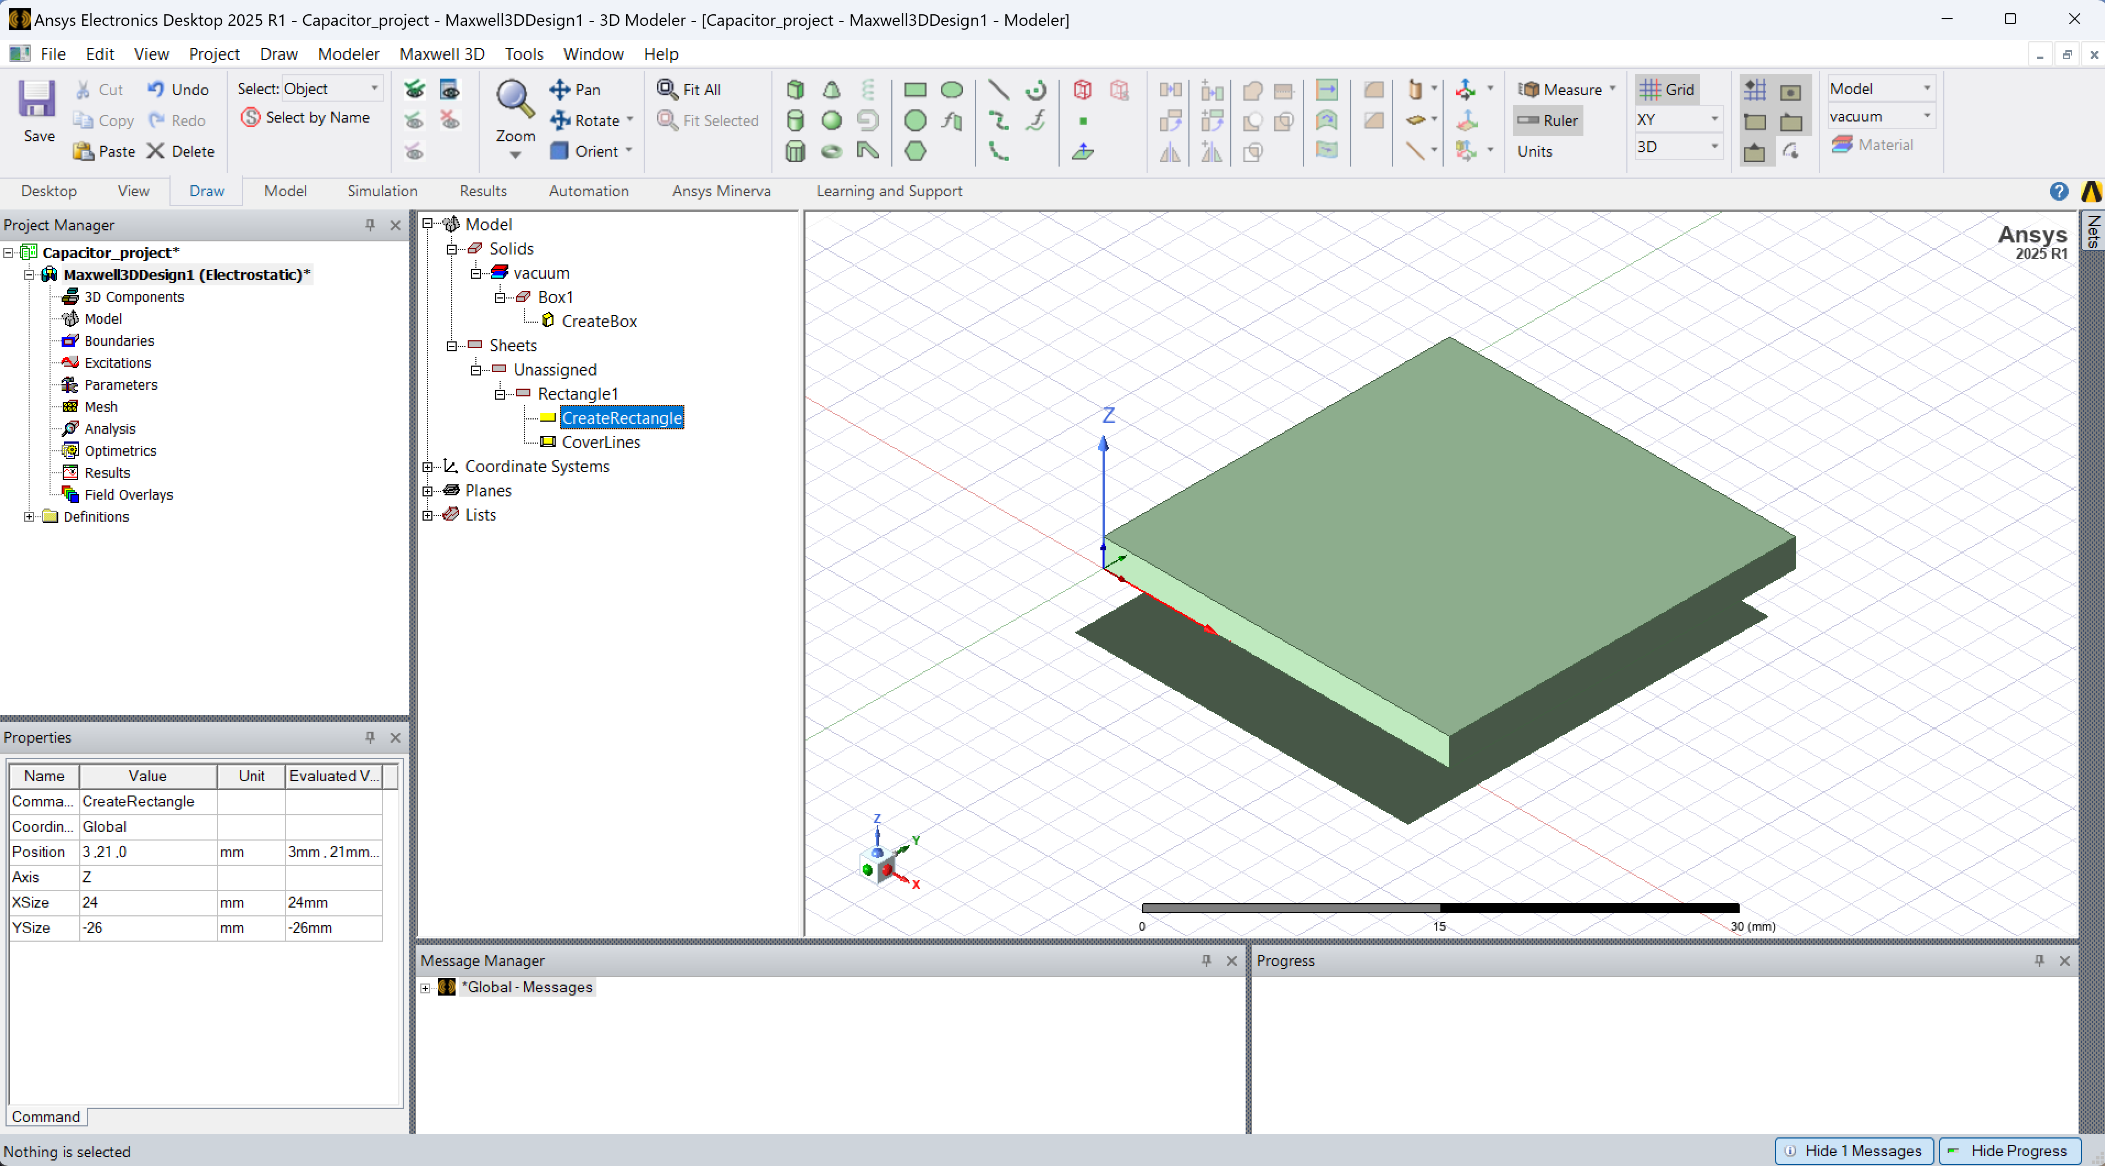
Step 2: Construct the Bottom Plate (2)
Similar to the 3D box, select 2 points on the plane to construct a random rectangle
Select and double click on the “Create Rectangle” option
On construction, the geometry should look similar to the adjoining image

Slide 17
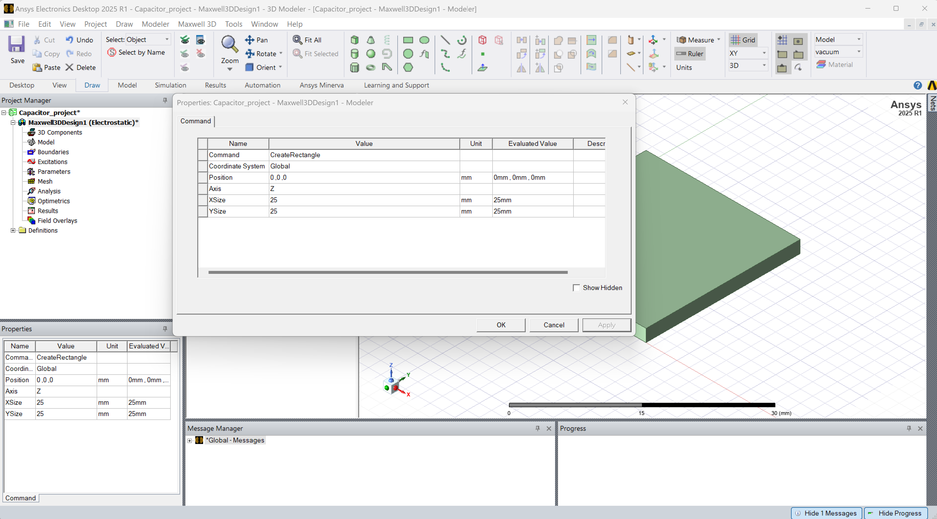
Step 2: Construct the Bottom Plate (3)
Defines the coordinates of the lower left corner of the rectangle
Dimensions of the rectangle along the respective axis

Slide 18
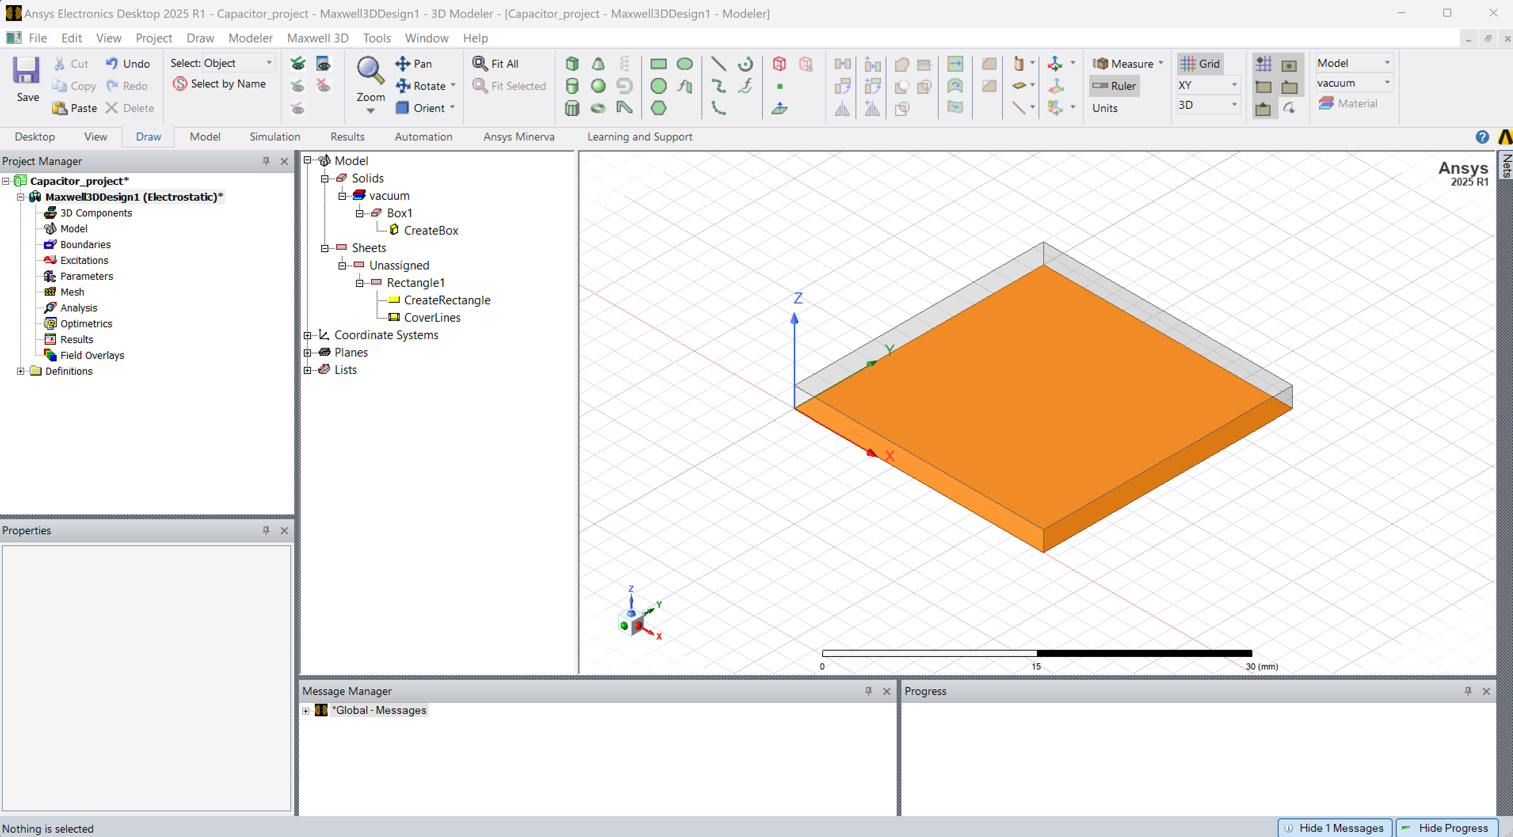
Step 2: Construct the Bottom Plate (4)
On modifying the dimensions of the bottom plate, the geometry should look similar to the adjoining figure
Note: For the adjoining figure, the transparency of the dielectric (air) is increased
Note: The color of the bottom plate is also changed for the figure

Slide 19
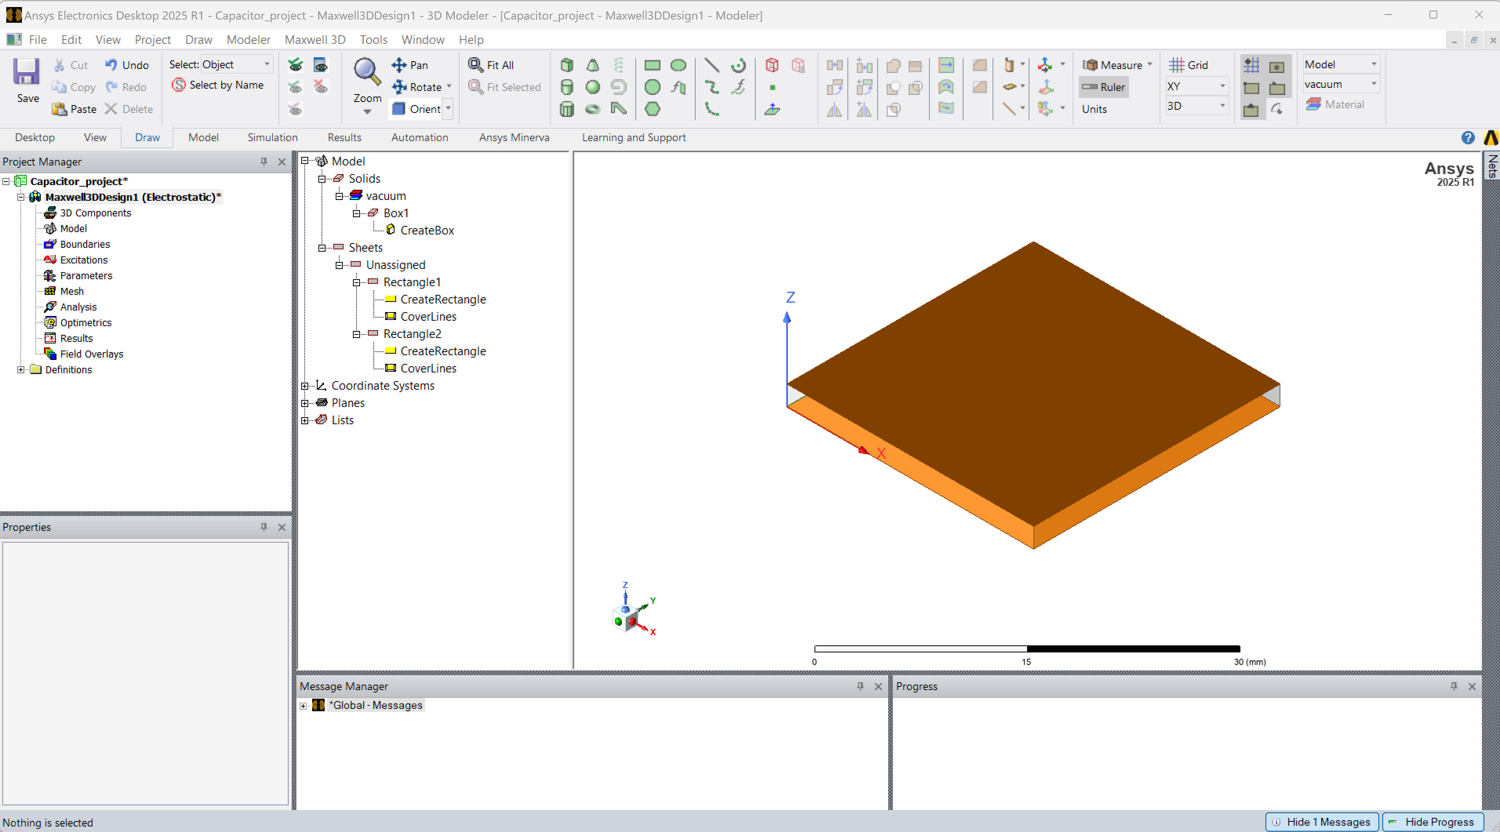
Step 3: Construct the Top Plate
Repeat step 3 with the dimensions of the top plate, at the appropriate coordinates
Top Plate
Dielectric Slab
The final geometry is as shown in the adjoining figure
Bottom Plate

Slide 20
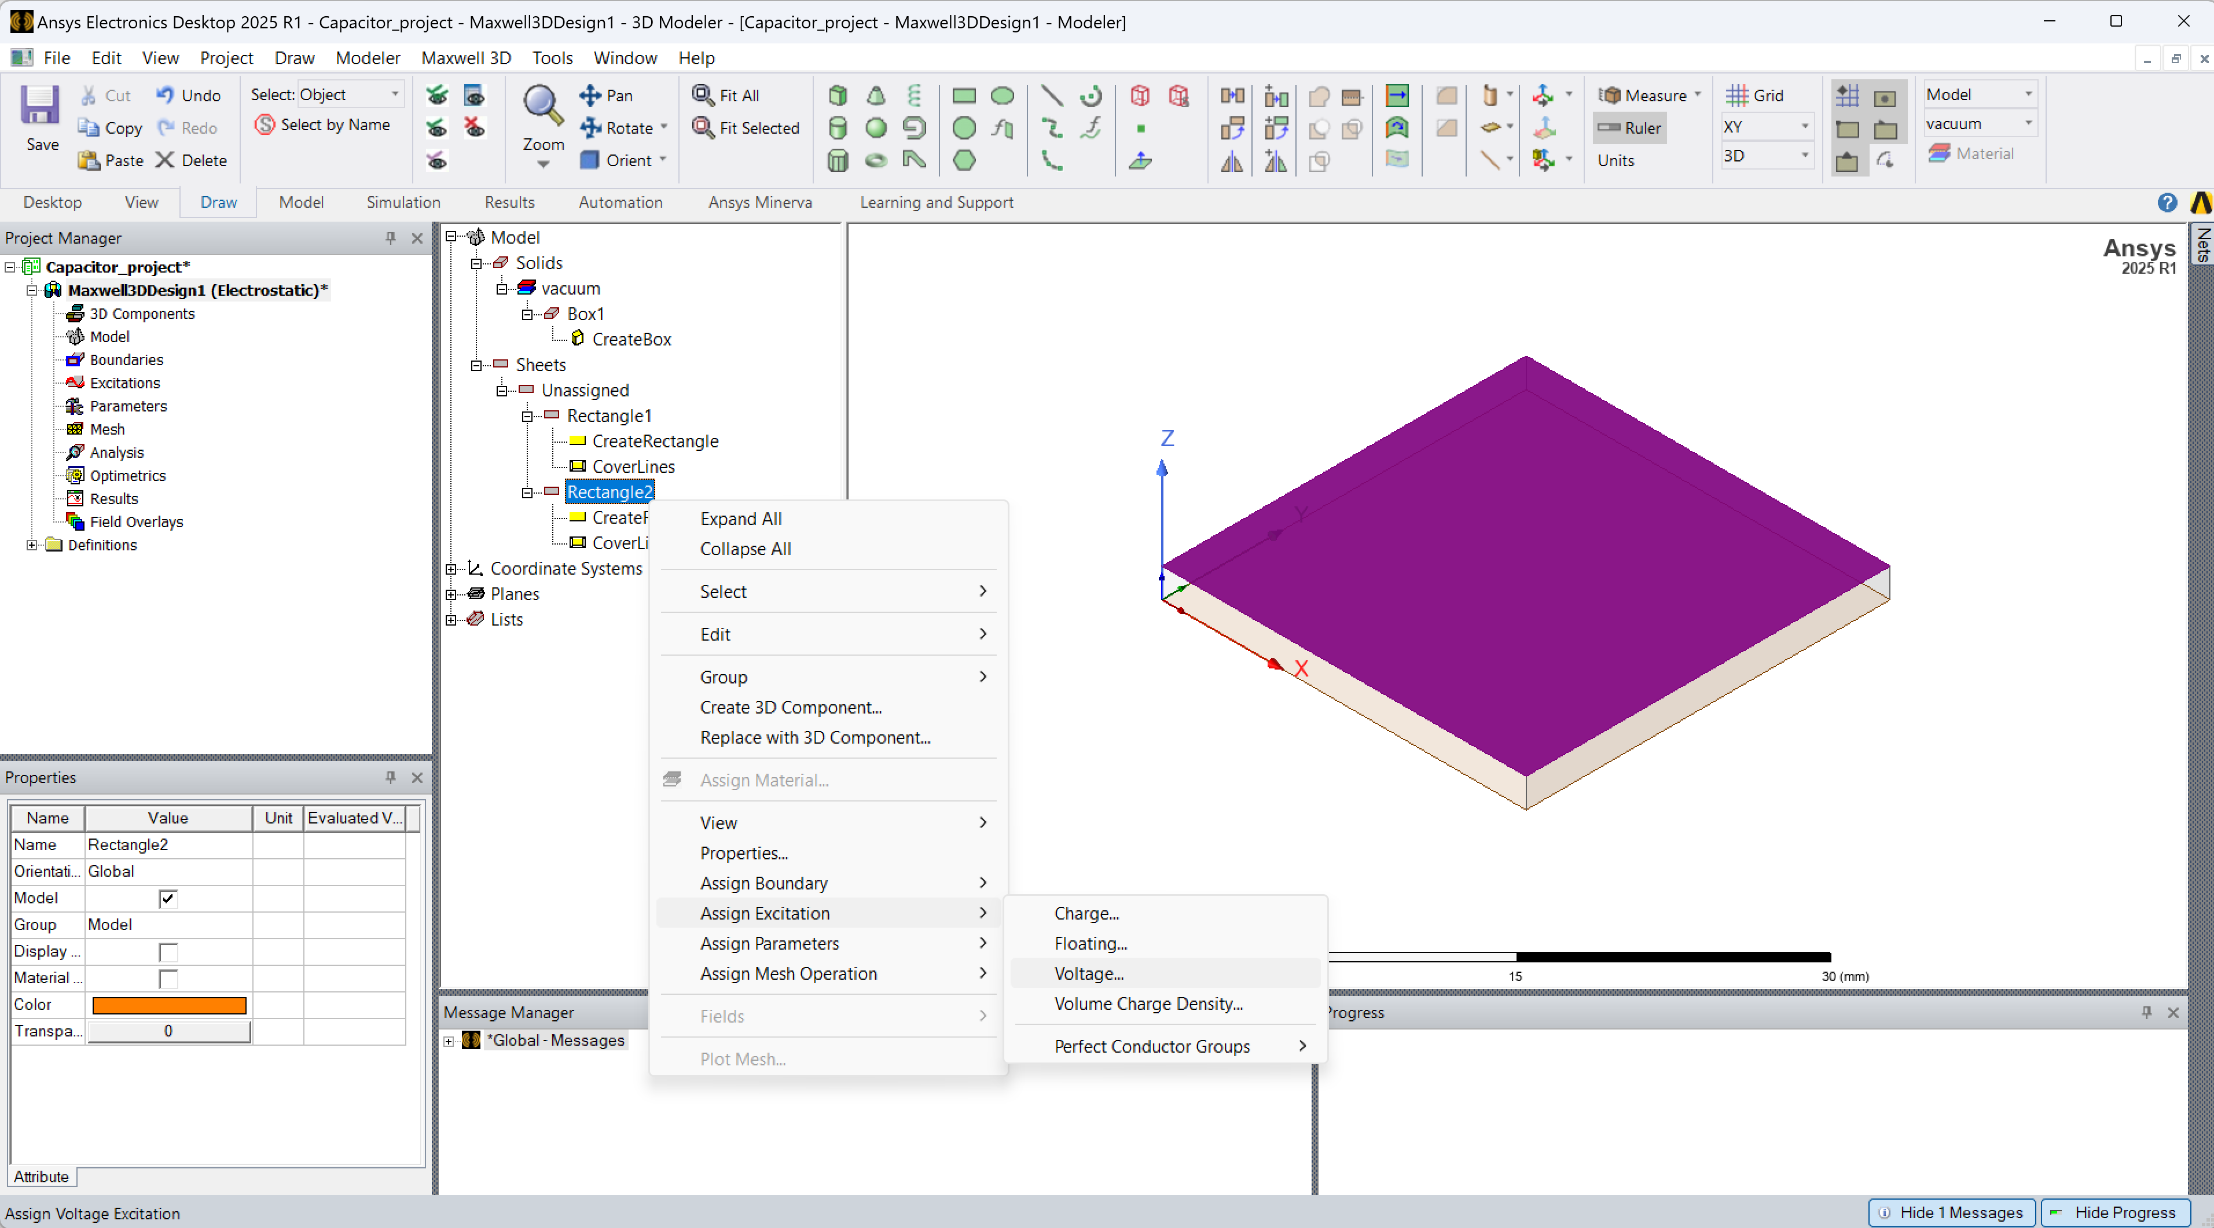
Step 4: Top Plate Boundary Assignment (1)
Now that the 3D model is created, we now need to assign the top and bottom plate to be carrying a Voltage
Select the top plate and Right+Click to assign the Voltage excitation type

Slide 21
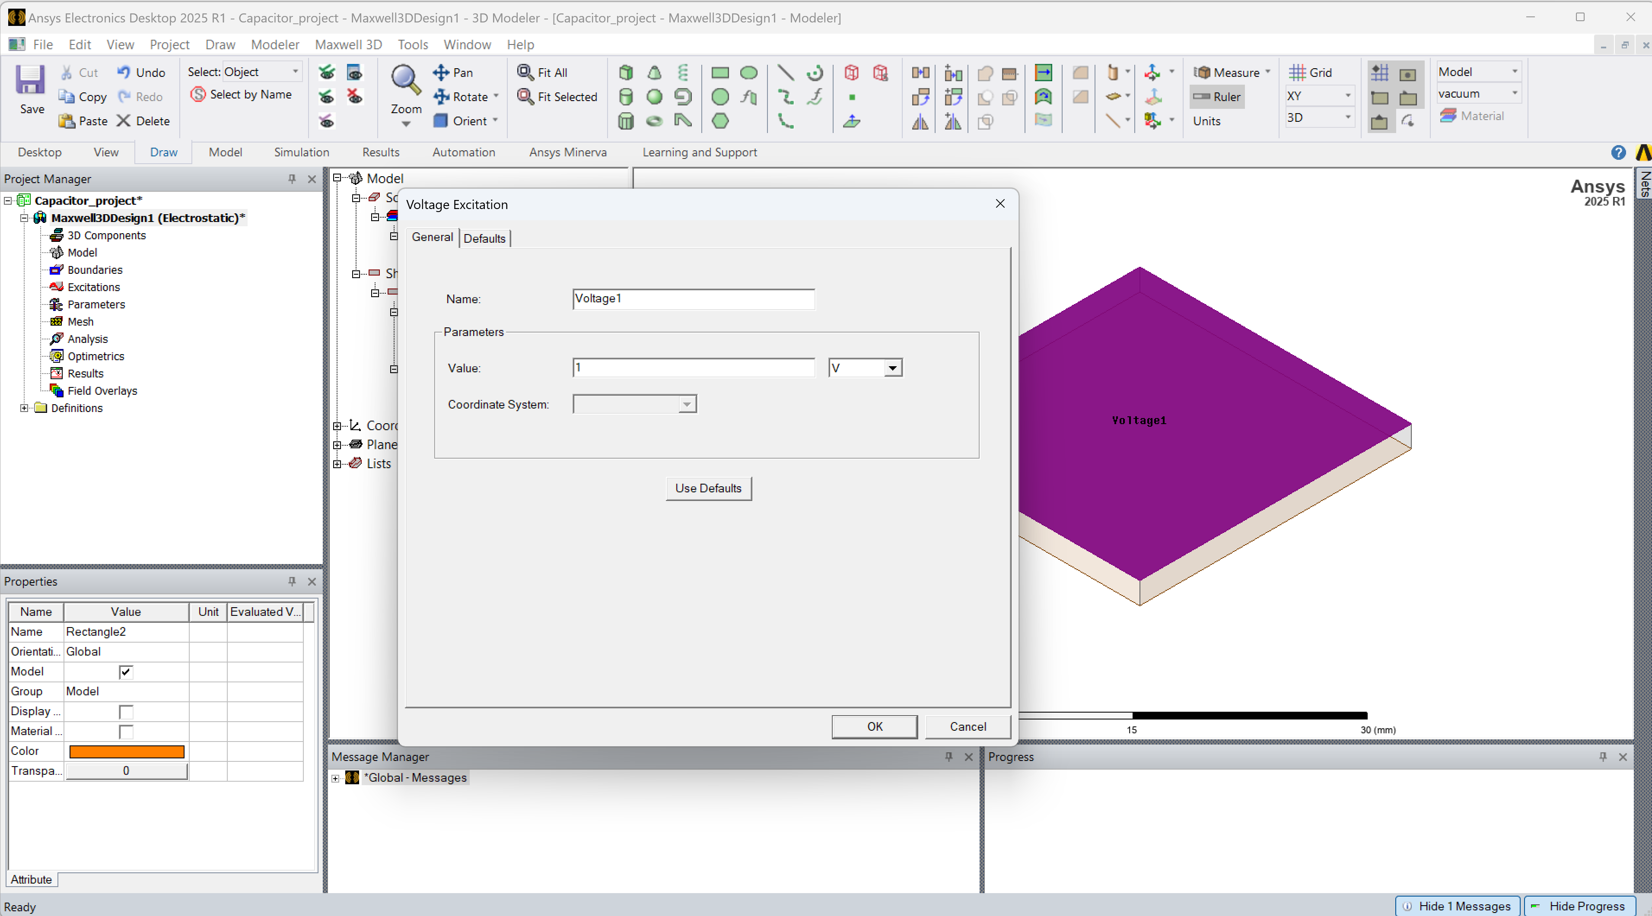
Step 4: Top Plate Boundary Assignment (2)
Change unit to V
Set 1V

Slide 22
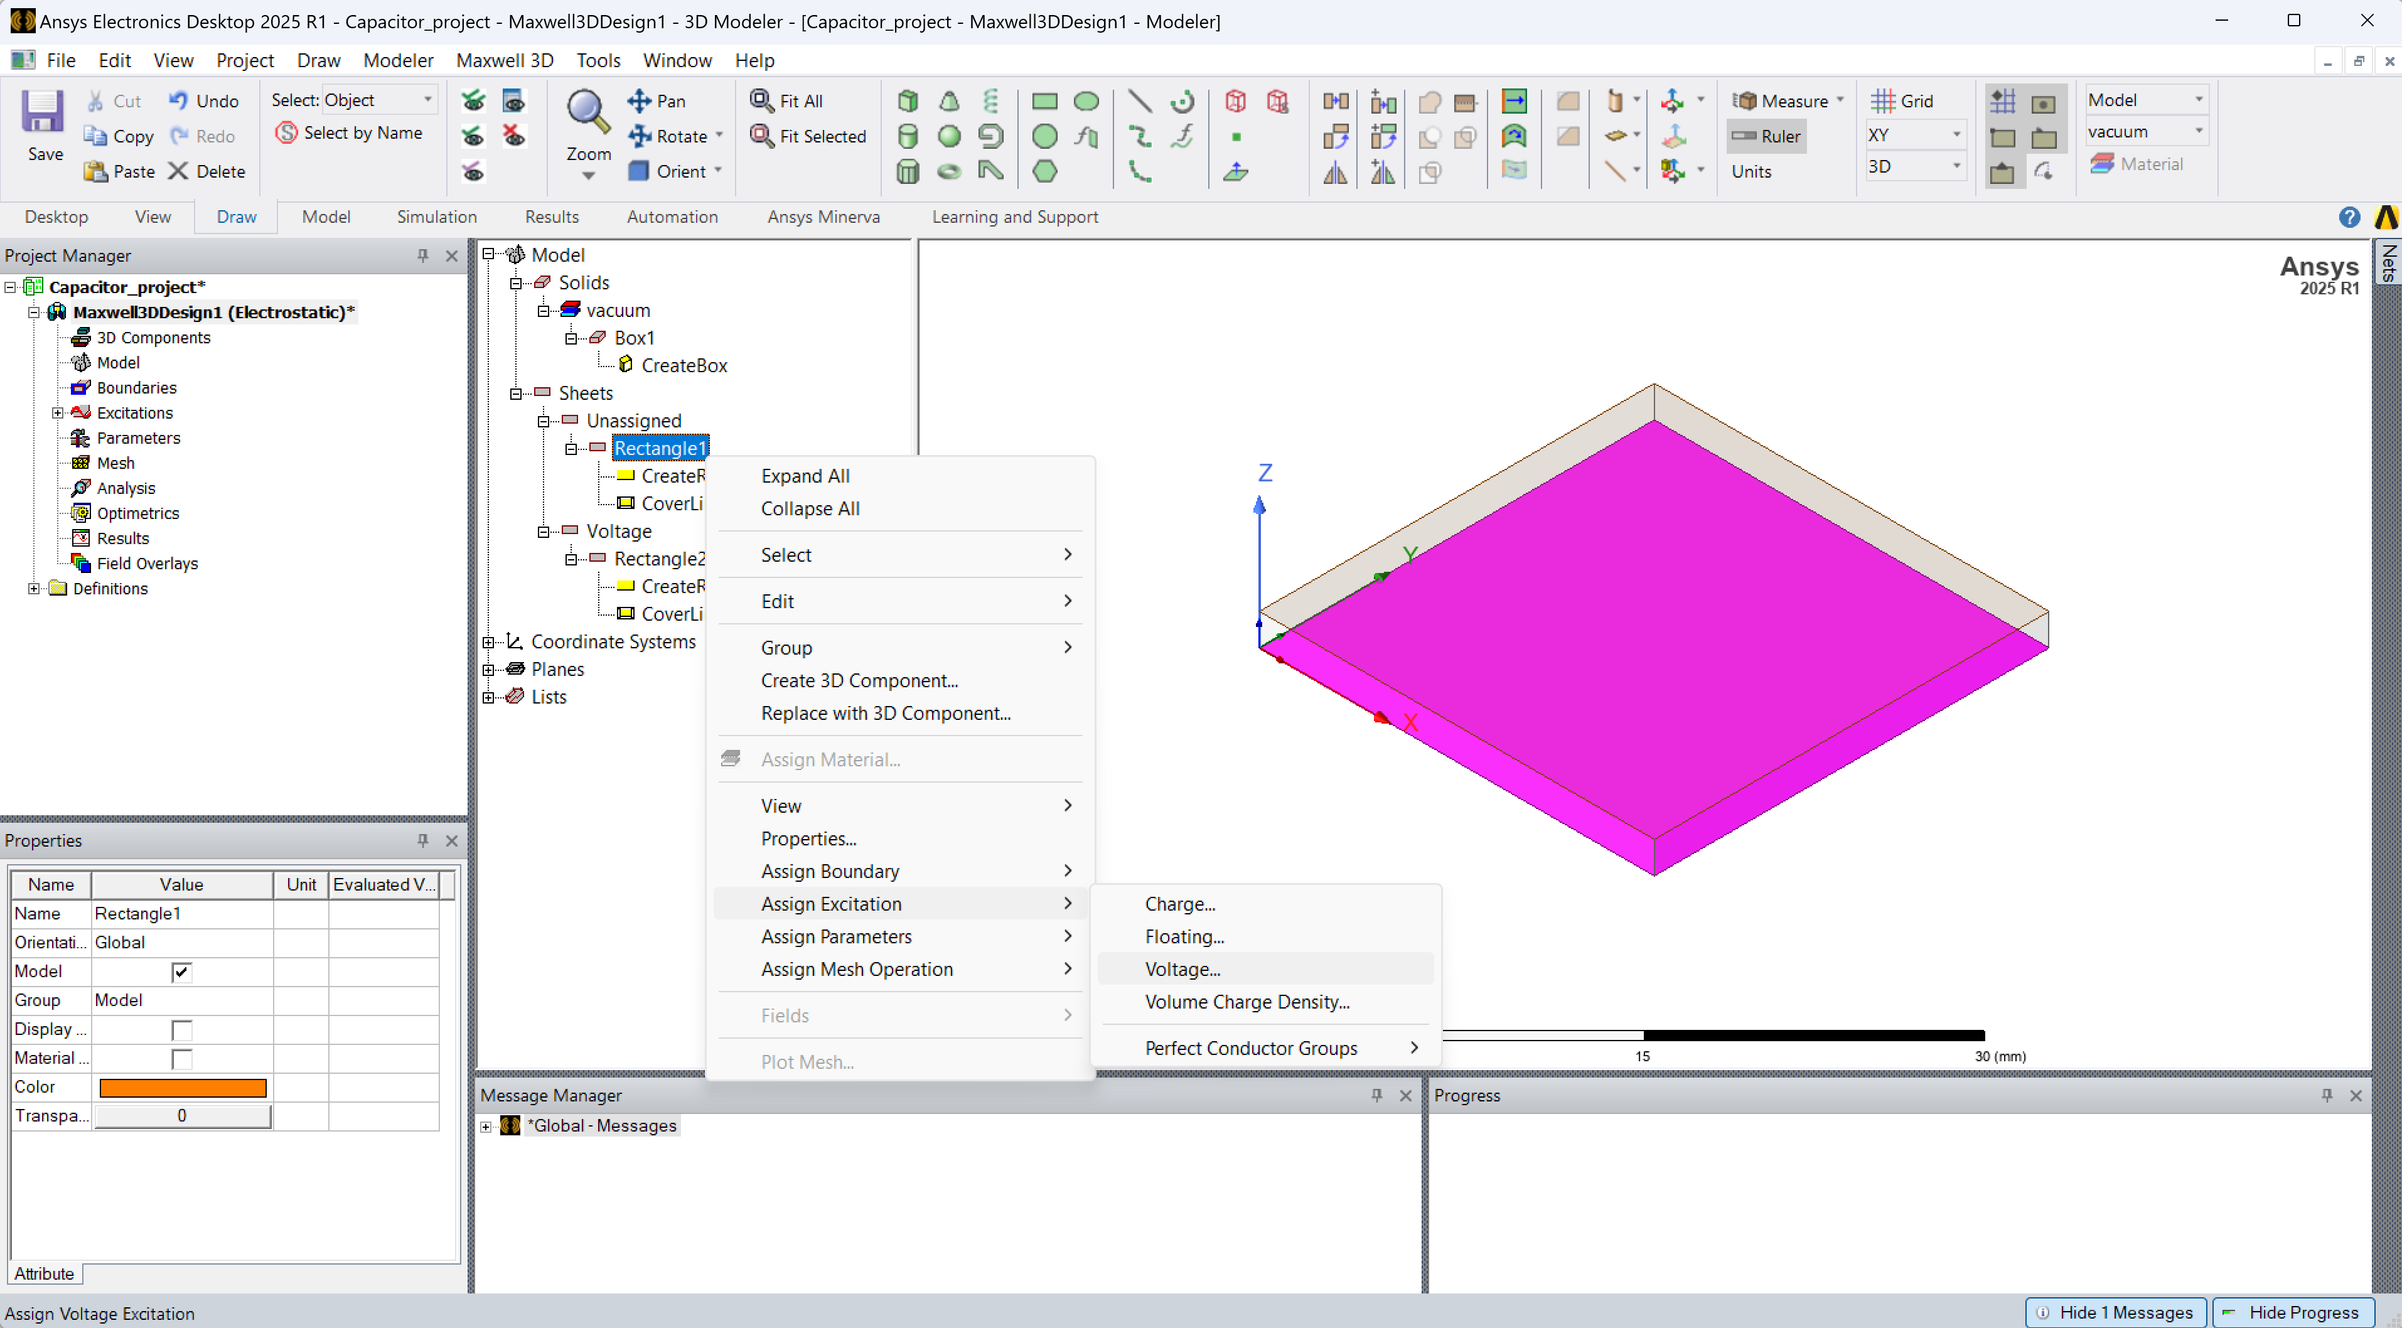
Step 5: Bottom Plate Boundary Assignment (1)
Now that the top plate has been set to the 1V potential, the bottom plate must be set to the reference ground 0V potential
Select the bottom plate and Right+Click to assign the Voltage excitation type

Slide 23
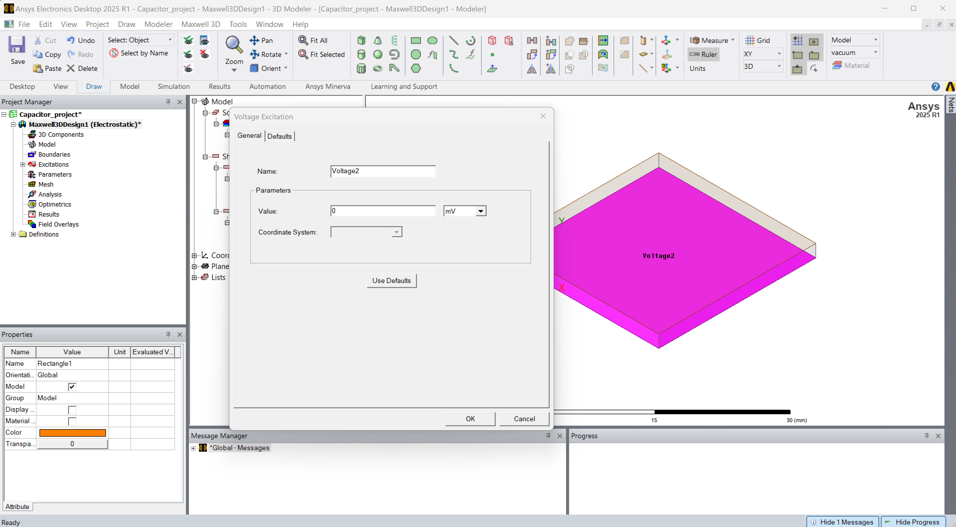
Step 5: Bottom Plate Boundary Assignment (2)
You may leave it at the default setting

Slide 24
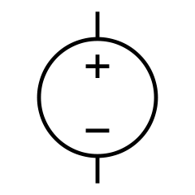
A Quick Recapitulation of the Previous Steps
1V

Slide 25

Step 6: Simulation Setup (1)
Now that the voltages have been set up, the settings for the simulation must be dialed in
Select Analysis -> Right+Click -> Add Solution Setup

Slide 26
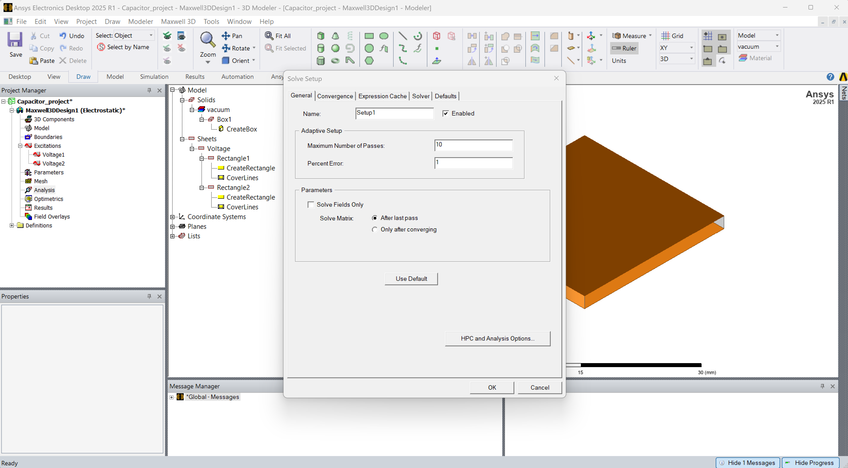
Step 6: Simulation Setup (2)
DO NOT edit the setup. The default settings are appropriate for this simulation
Directly click on okay

Slide 27

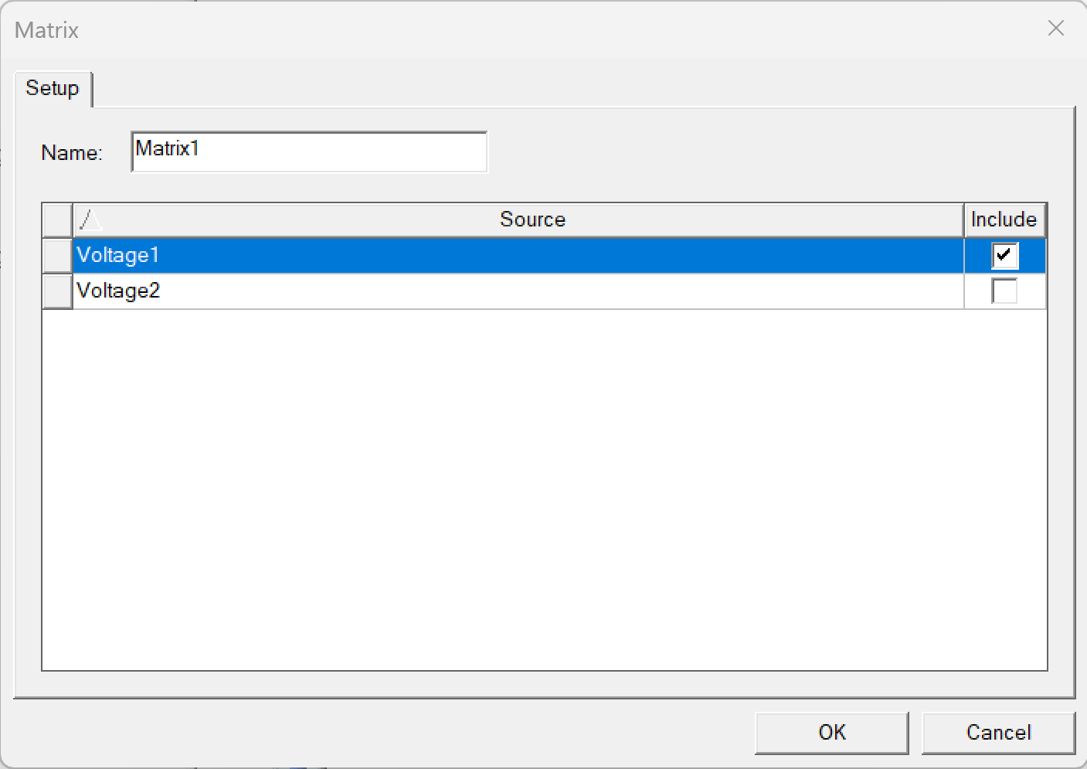
Step 7: Calculation Setup
Select and Right Click on the Parameters option in the Project Manager Window
Select Assign -> Matrix
Select this Checkbox

Slide 28

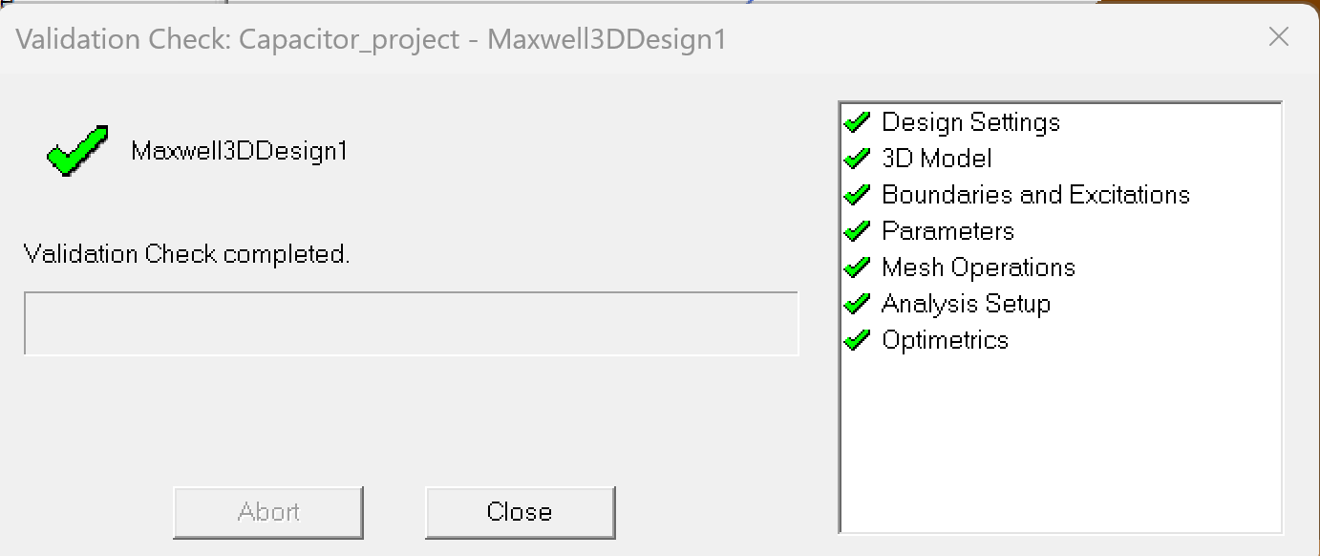
Step 8: Simulation Setup Validation
Follow the steps indicated in the adjoining image
(2)
The simulation setup validation checks and ensures that the Geometry and the Analysis setup have no errors
(1)
Ensure that the validation check has all green checks. In case there is an error, recheck to ensure that the above steps are followed correctly

Slide 29

Step 9: Running the Simulation
Click to run the simulation

Slide 30
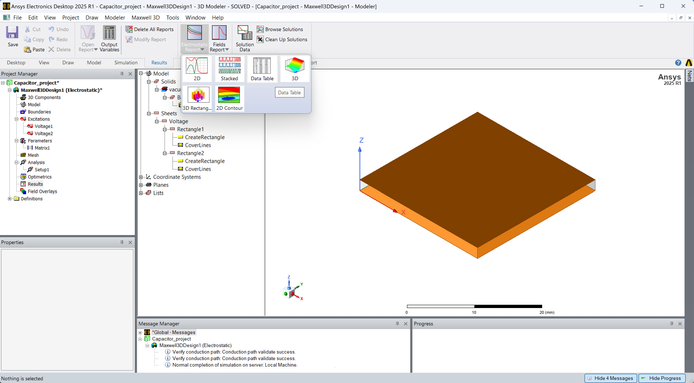
Step 10: Viewing the Result
Go to Results tab page and follow the steps in the adjoining image
Ensure that the simulation runs without any error

Slide 31
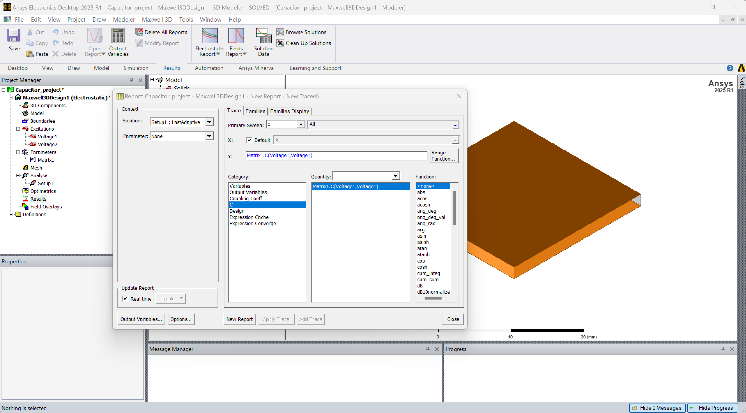
Step 10: Viewing the Result

Slide 32

Validation step
Does this value match your theoretical calculations?

Slide 33
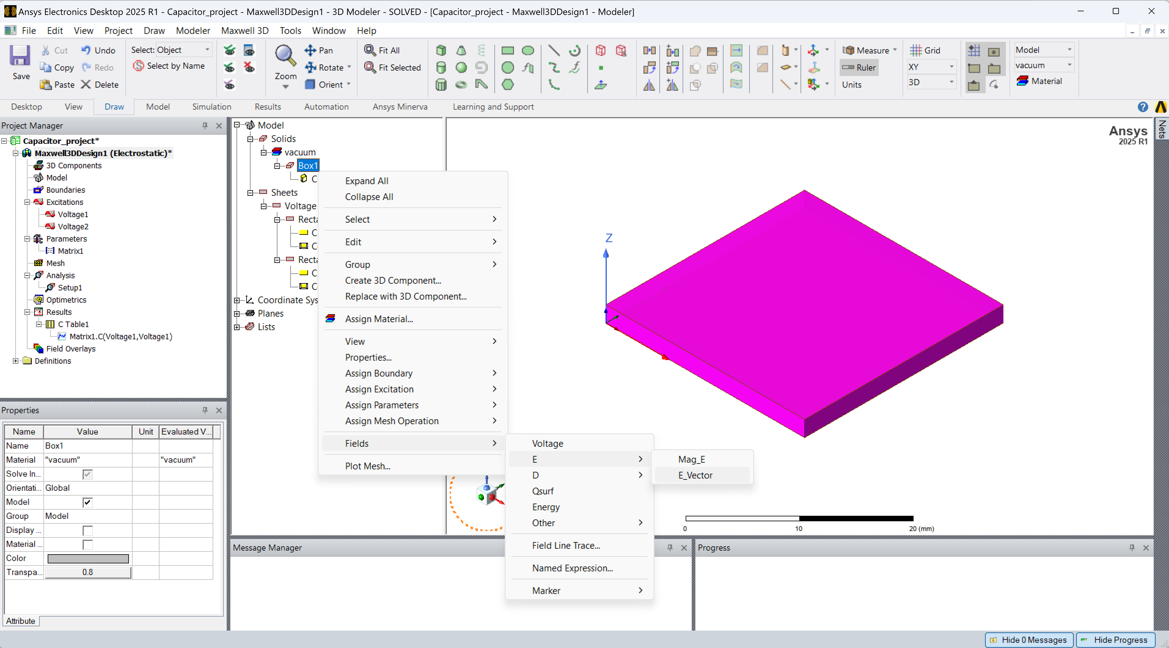
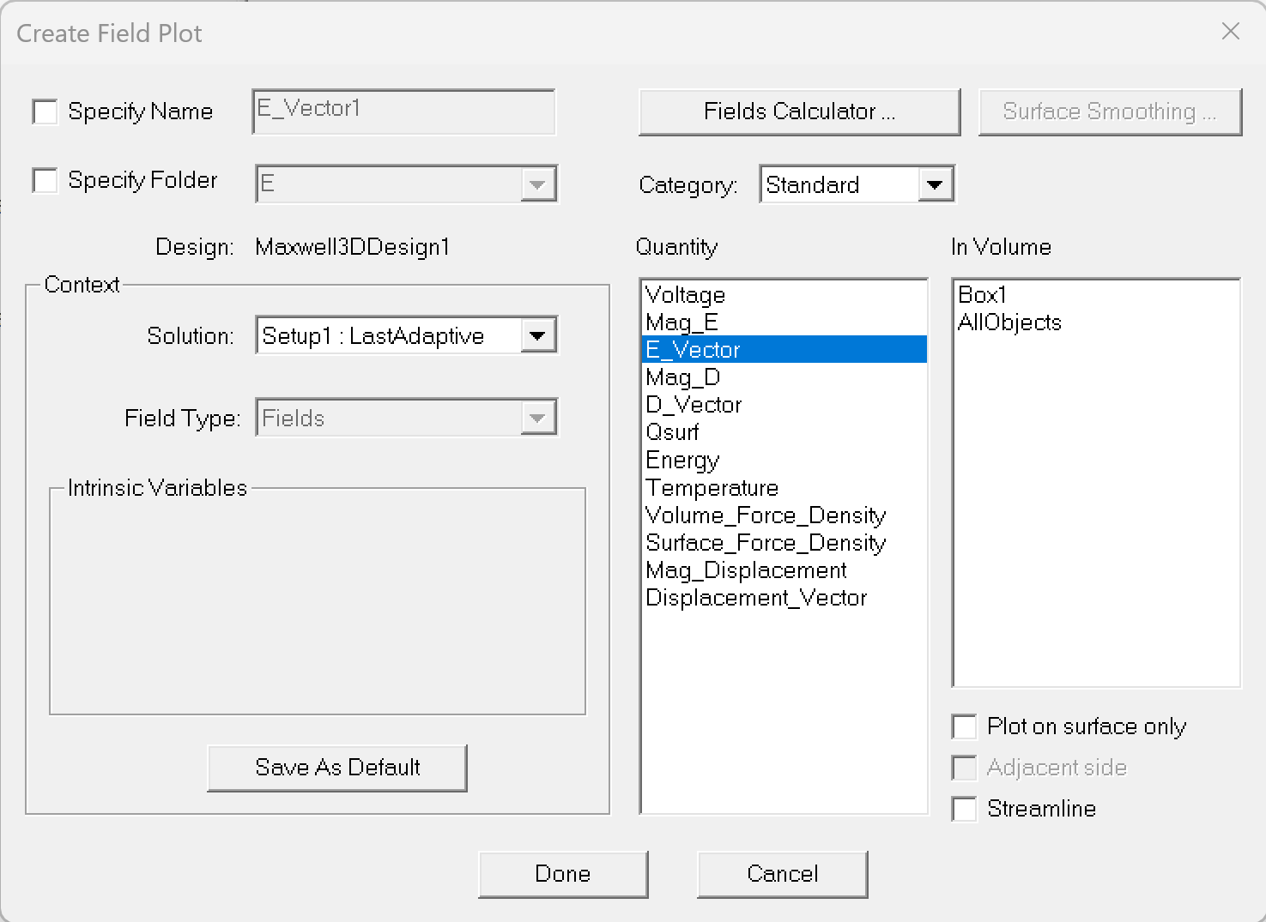
Step 11: Plot E-field
Right+Click on the Box and select Fields, E and E_vector
Then, click on Done

Slide 34
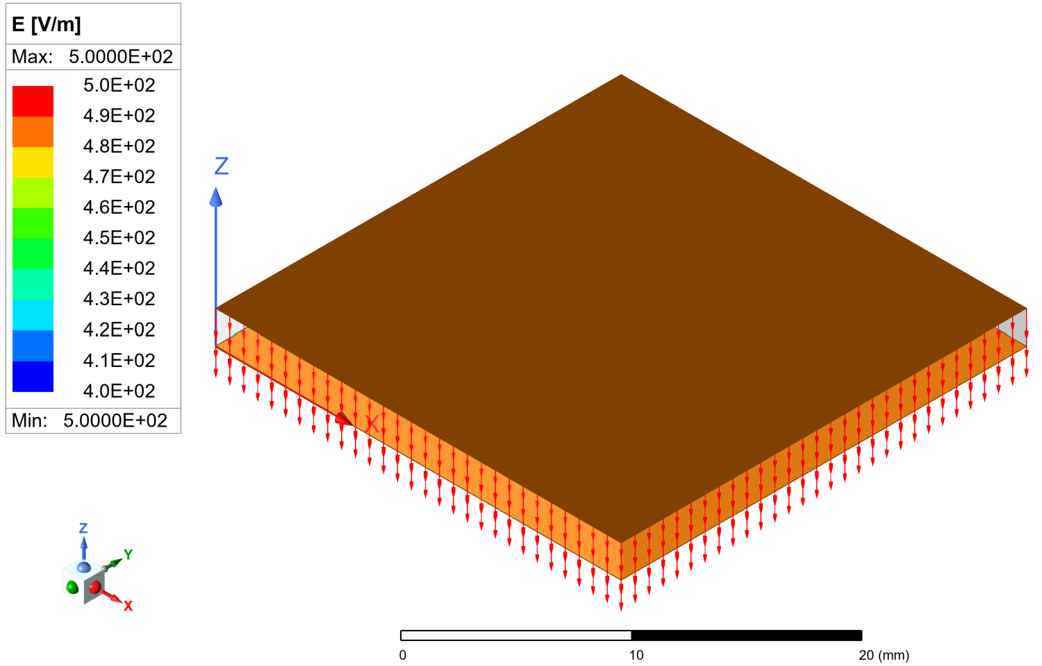
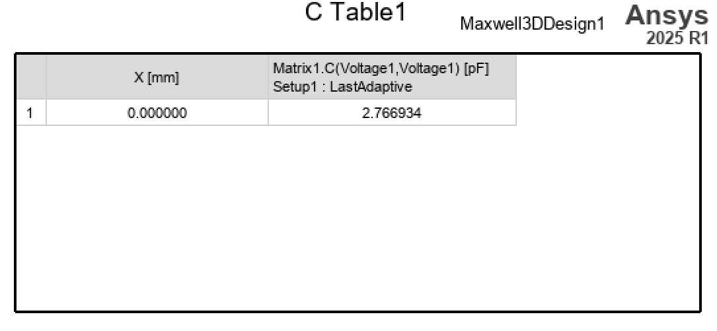
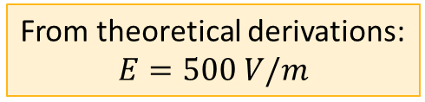
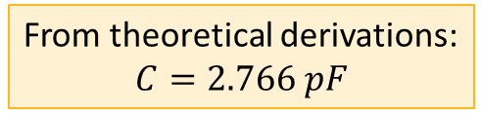
Results – Capacitance and electric field in a parallel-plate capacitor
From theoretical derivations:
$$C=2.766 pF$$
From theoretical derivations:
$$E=500 V/m$$

Slide 35
Questions
Does the capacitance depend on the applied voltage difference?
And the electric field? And what about the direction of the electric field?
How can you justify it from the theoretical and the computation point of view?

Slide 36
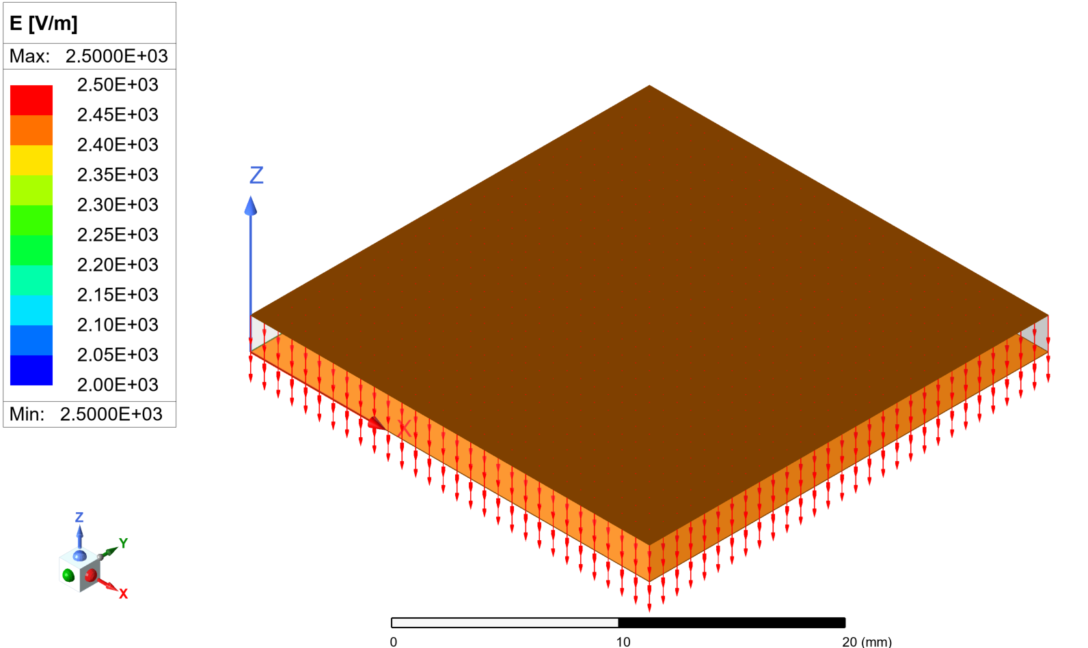
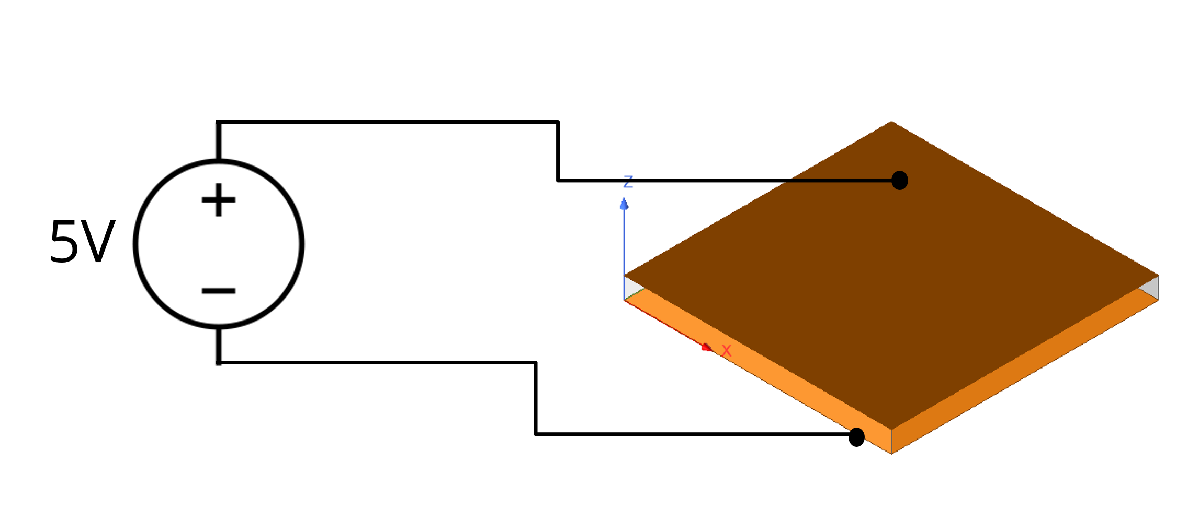
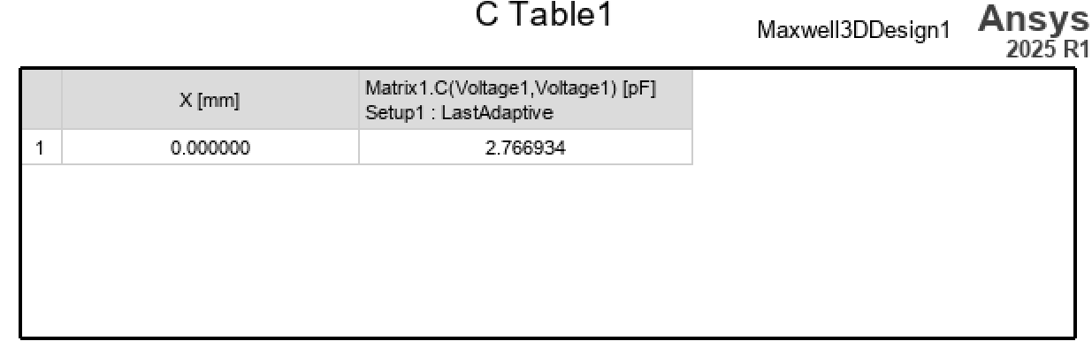

Same example with 5V difference
Compare and explain the differences with respect to the previous case

Slide 37
Final exercise: design the capacitor
How would you increase the capacitance?

Slide 38

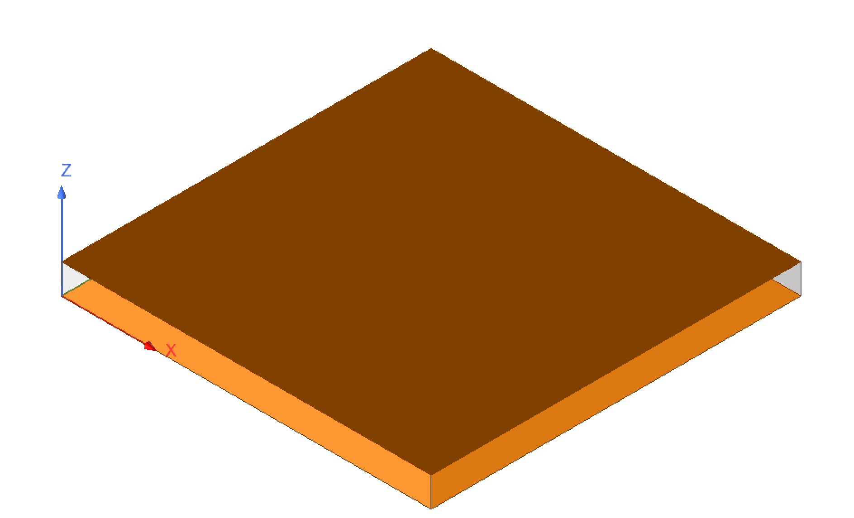


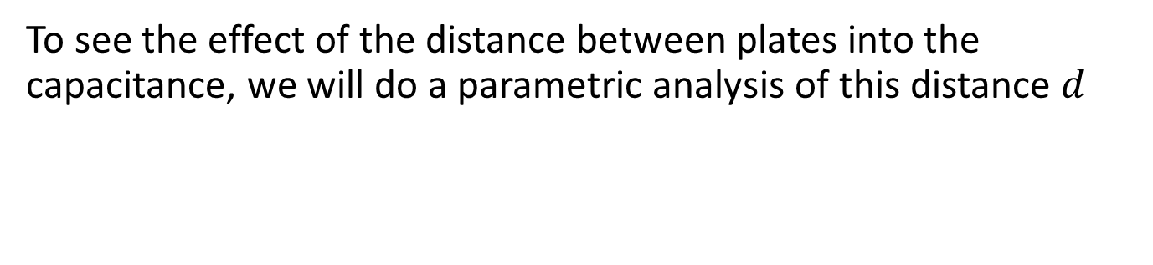
Design Exercise
Looking at the capacitance formula, we can increase the capacitance by increasing the area of the parallel-plates or decreasing the distance between them
$$C= ε \frac{A}{d}$$
(Farads)
To see the effect of the distance between plates into the capacitance, we will do a parametric analysis of this distance $d$
$$d$$

Slide 39
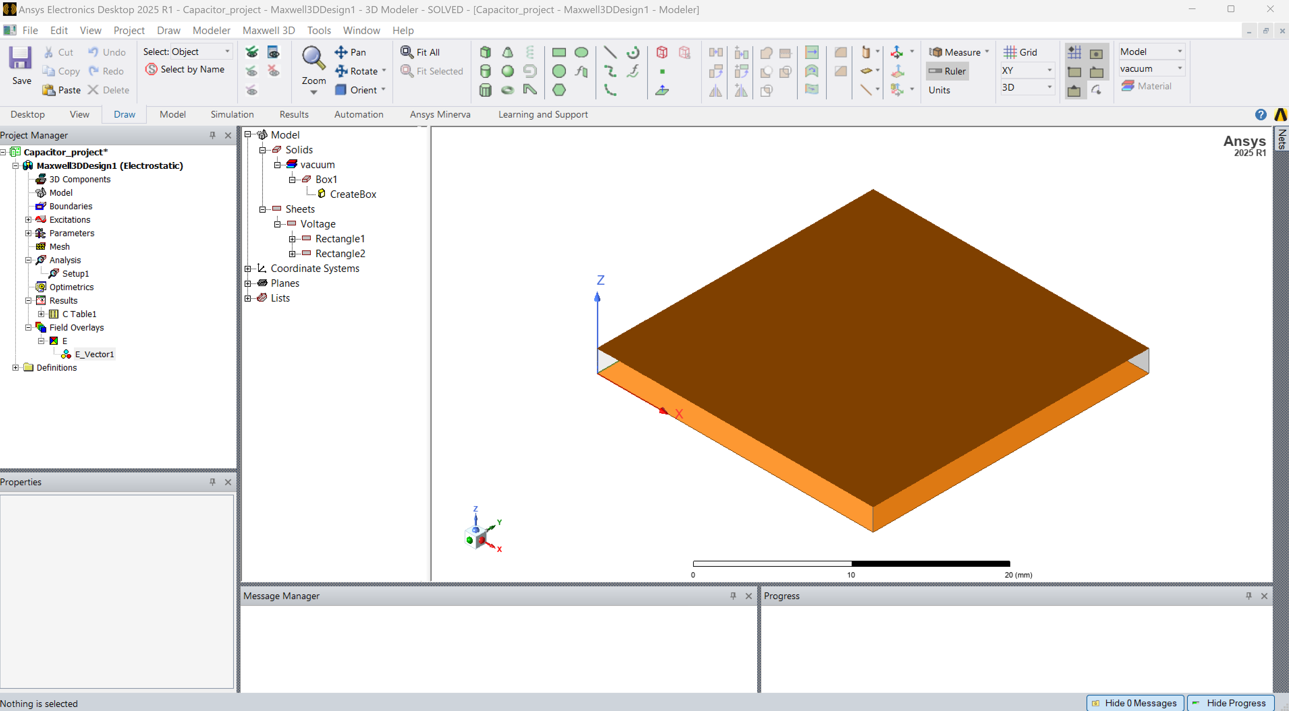
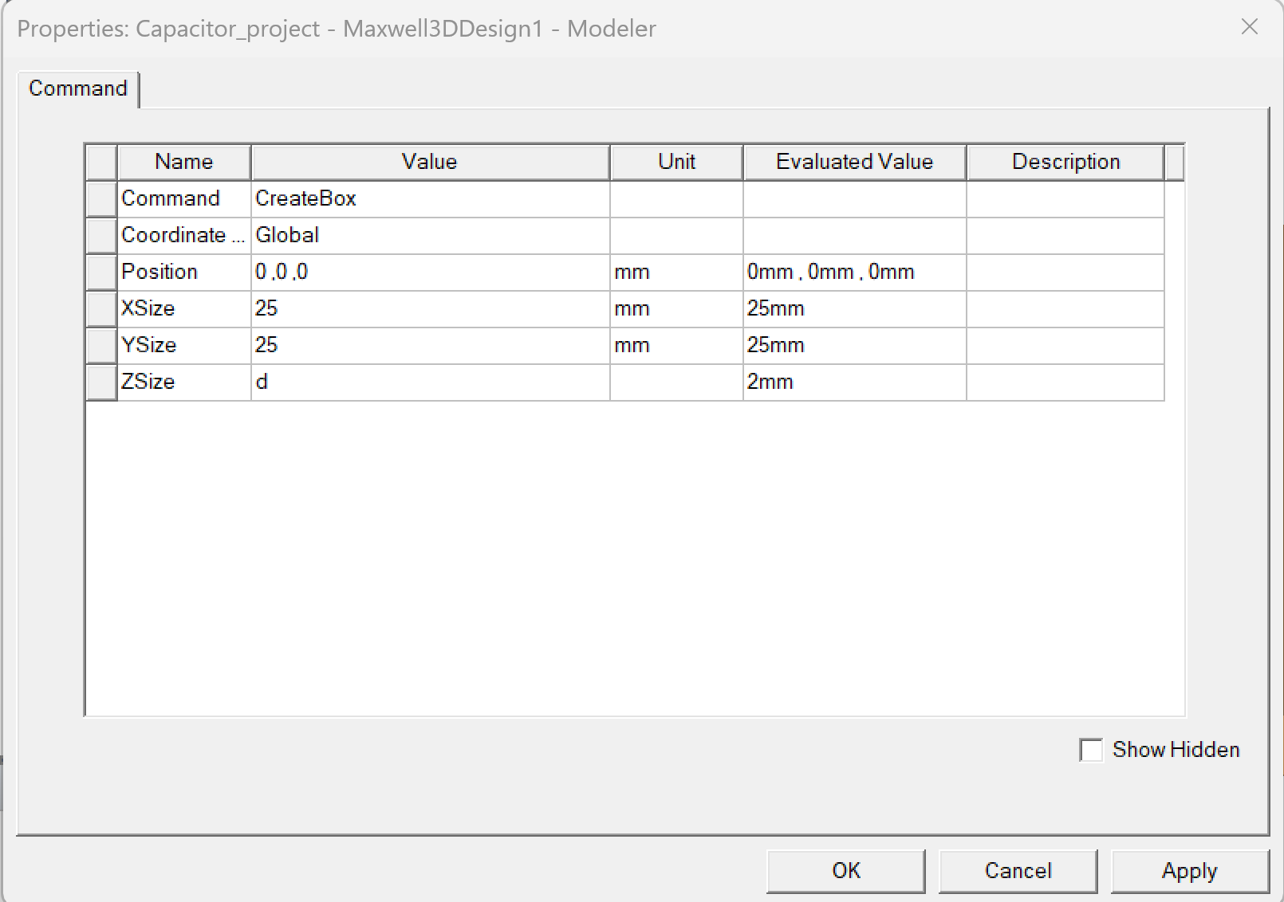
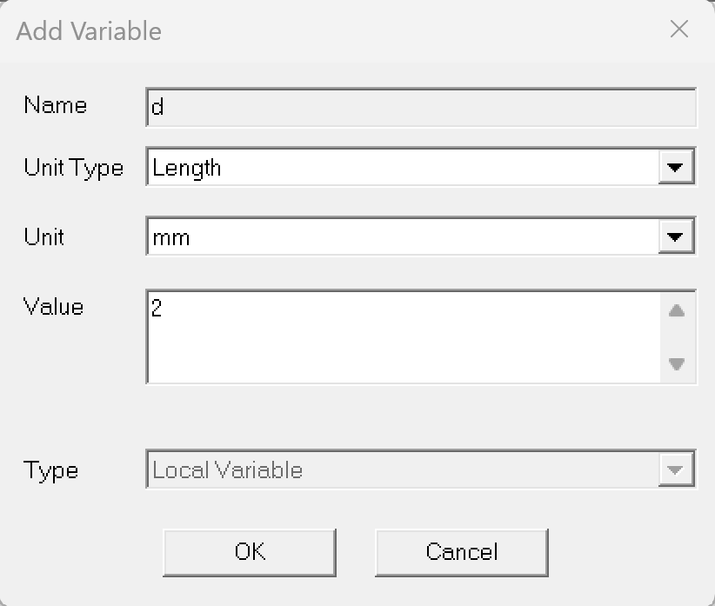
Step 12: Parametric Analysis (1)
Double click on the CreateBox to edit the geometry properties
Tap ‘d’ in the Zsize of the box to create a parameter
Then, define this parameter as Length with a value of 2 mm

Slide 40


Step 12: Parametric Analysis (2)
Repeat the same step for the position of the top plate, by double cliking on CreateRectangle in Rectangle2
Tap ‘d’ in the z coordinate of the position of the sheet
Now the model is parametrized and when we change ‘d’, it will change accordingly

Slide 41


Step 12: Parametric Analysis (3)
After define the distance between plates as a parameter ‘d’, we will do a parametric Analysis
Right-click on Optimetrics and select Add -> Parametric
Then, click on Add

Slide 42

Step 12: Parametric Analysis (4)
We are going to create a sweep from 0.5 to 5 mm in 5 step
Select linear count and introduce the start and stop, and the number of point
Then, click on Add

Slide 43

Step 12: Parametric Analysis (5)
Select and Right Click on the ParametricSetup and click on Analyze

Slide 44


Step 12: Parametric Analysis (6)
Go to Results tab page and follow the steps in the adjoining image to create a 2D graph

Slide 45




Results – Capacitance as a function of the distance
From the capacitance formula, we can see that the distance is inversely proportional to the capacitance.
$$C= ε \frac{A}{d}$$
(Farads)
$$d$$
$$C$$
Through simulation, we can see that when we increase the distance between plates, the capacitance decrease, what aligns perfectly with the theory

Slide 46



Real-world designs
While we studied a simple, square parallel-plate capacitor to understand the fundamentals, real-world capacitors often come in non-canonical shapes, include curved or layered structures and are embedded within complex systems.
In these cases, simulation becomes even more essential to accurately predict real-world complexities — such as parasitic effects, material properties, manufacturing tolerances, and mechanical constraints — helping engineers design capacitors that meet performance and reliability requirements in modern applications like power electronics, radiofrequency systems, and integrated circuits.

Slide 47
Ansys Education Resources Feedback Survey
Here at Ansys, we rely on your feedback to ensure the educational content we create is up-to-date and fits your teaching needs.
Please click the link below to fill out a short survey (~7 minutes) to help us continue to support academics around the world utilizing Ansys tools in the classroom.
Feedback Survey Link
Notes:
Feedback Survey link for copy-paste method → https://ansys.typeform.com/to/jcattJI5

