Slide 1
The Synthesizer Tool: hybrids and other models
Cellular structures
Composites
Mike Ashby
Department of Engineering,
University of Cambridge
Sandwich structures
Multi-layers
Part cost estimator
Battery Designer
Notes:
The PowerPoint Lecture Units For 2023
The Lecture Units developed for teaching in connection with Granta EduPack are listed at the end of this presentation.

Slide 2
Learning objectives for this lecture unit
Intended Learning Outcomes
Knowledge and Understanding | Understanding of the potential of hybrid materials
Skills and Abilities | Ability to use the synthesizer to explore material combinations
Values and Attitudes | Inspiration to combine properties to create new materials
Resources
Text: “Materials Selection in Mechanical Design”, 5th edition by M.F. Ashby, Butterworth Heinemann, Oxford, 2016, Chapters 12 - 13.
Software: Ansys Granta EduPack synthesizer tool, available in advanced subject databases
The Synthesizer Tool Model Writes Guide, available from the Ansys Education Resources Website
Notes:
Learning Objectives
These Intended Learning Outcomes are based on a taxonomy of knowledge and understanding as the basis, skills and abilities as necessary for the practical use of knowledge and understanding, followed by acquired values and attitudes enabling assessments and responsible use of these abilities.
Combined with a suitable assessment, they should be helpful in the context of accreditations or for the CDIO Syllabus.
The Texts listed are from books authored or co-authored by Mike Ashby but other texts are also referred to in the Science Notes.

Slide 3
Outline of lecture unit
Cellular structures
Composites
Holes in material-property space
Hybrids materials – expanding the filled space
Sandwich structures
Example 1 – cellular materials
Example 2 – sandwich structures
Multi-layers
New developments – Part cost estimator
Part cost estimator
Add your own Synthesizer model
Battery Designer
Notes:
Outline
This is the second Unit of a course on Material and Process Selection. The Units link closely to the first two Texts listed on this frame but can equally by used in conjunction with texts such as Callister, Budinski, Askeland and others. The relevant chapters of the Texts are listed on the Outline frame of each Unit. The methods developed in the course are implemented in the Granta EduPack software, which is structured to evolve in pace with the student throughout a four-year engineering program. This first Unit introduces materials and processes, and the way in which information about them can be classified, stored, retrieved and explored.
This lecture unit does NOT cover the battery designer module– this can be explored via a separate lecture unit in this series (https://www.ansys.com/academic/educators/education-resources/lecture-unit-the-battery-designer1)

Slide 4
Advanced systems use hybrid materials
Sails – Kevlar + Nylon mixed weave
With thermally bonded PET skin
Mast and boom –
CFRP, filament wound
Hull – sandwich construction,
carbon fibre/PMAA foam core
Notes:
Examples of hybrid materials
Advanced sports equipment make extensive use of hybrid materials.

Slide 5
Accelerating new material development
Current internationally:
ICME - Integrated Computational Materials Engineering
MGI - The Materials Genome Initiative
AMD - Accelerated Material Development…………. more
Vision: Materials Informatics
Use today’s ability to store, process and retrieve information
to accelerate material development
Almost all “bottom-up”: sub-atomic → nano → micron → mm scale
Can envisage “top-down”: Design requirements → Architecture?
Notes:
The push for advanced material development
A number of large government sponsored programs seek to stimulate and accelerate the development of new materials – the US Integrated Computational Materials Engineering and the Materials Genome Initiative are examples. Almost all “bottom-up”, following the progression sub-atomic → nano → micron → mm scale. There is an alternative ”top down” approach, explored here, that starts with existing well-established materials and combines them in innovative architectures to create new “materials”.

Slide 6
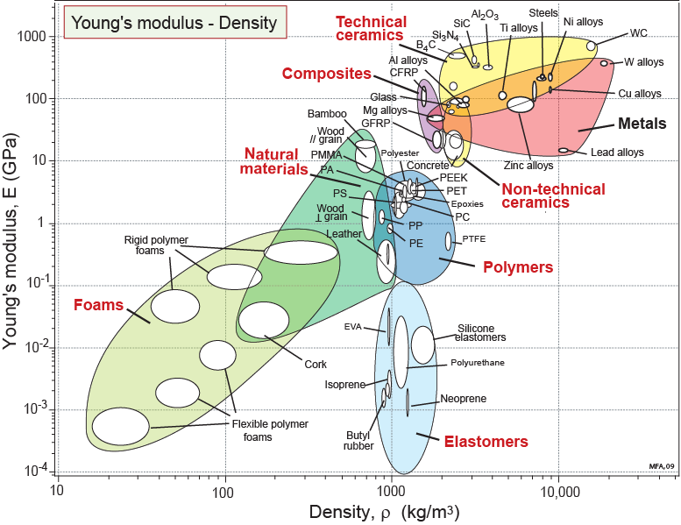
Modulus and density
Vector for
material development
HOLE
Contours of
Notes:
6
Stiffness vs Density
Materials have many properties. Think of them as the axes of a multi-dimensional material-property space. The property charts are sections through this space. Here is the familiar E-ρ section. Any such section has areas that are filled with materials and areas that are empty: holes. Two are shown here. Is anything to be gained by developing materials (or material-combinations) that lie in these holes? The material indices show where this is profitable. A grid of lines of one index – E/ρ – is plotted on this chart. If the filled areas can be expanded in the direction of the arrow (i.e. to greater values of E/ρ ) it will enable lighter, stiffer structures to be made. The arrow lies normal to the index lines. It defines a vector for material development.

Slide 7
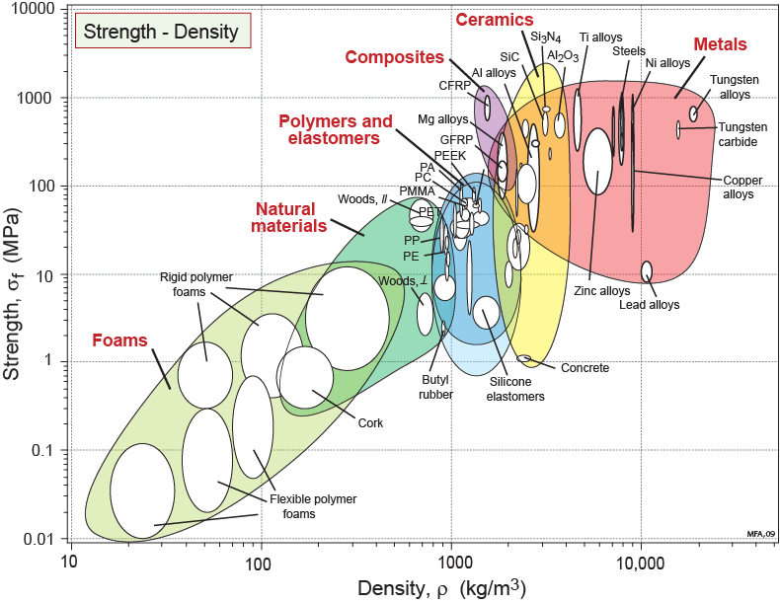
Strength - Density
Vector for
material
development
HOLE
Contours
of
Notes:
7
Strength / Density
Here is a second section though material property space – the Strength / Density section. It too has holes. If materials could be devised that lay in the hole in the upper left, it would allow lighter, stronger structures to be built.

Slide 8
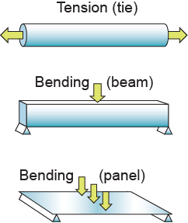
Criteria of excellence: material indices
Material index = combination of material properties that limit performance
Objective
minimise mass
Constraints
Stiffness Strength
Notes:
The criteria of excellence
The material properties listed in handbooks – density, modulus and so on – are those that are measured to characterize the fundamental properties of materials – the physicists’ view of materials, one might say. The performance of an engineering component depends on the values of these, but it usually depends not on one property but on a combination of two or more – it is these that we call material indices. They, too, are material properties; they are the ones that characterize engineering performance – the engineers’ view of materials, so to speak. The ones highlighted in the red box of this frame all depend on density ρ and modulus E. They provide criteria of merit that allow the merit of a new hybrid to be assessed and compared with existing materials.

Slide 9
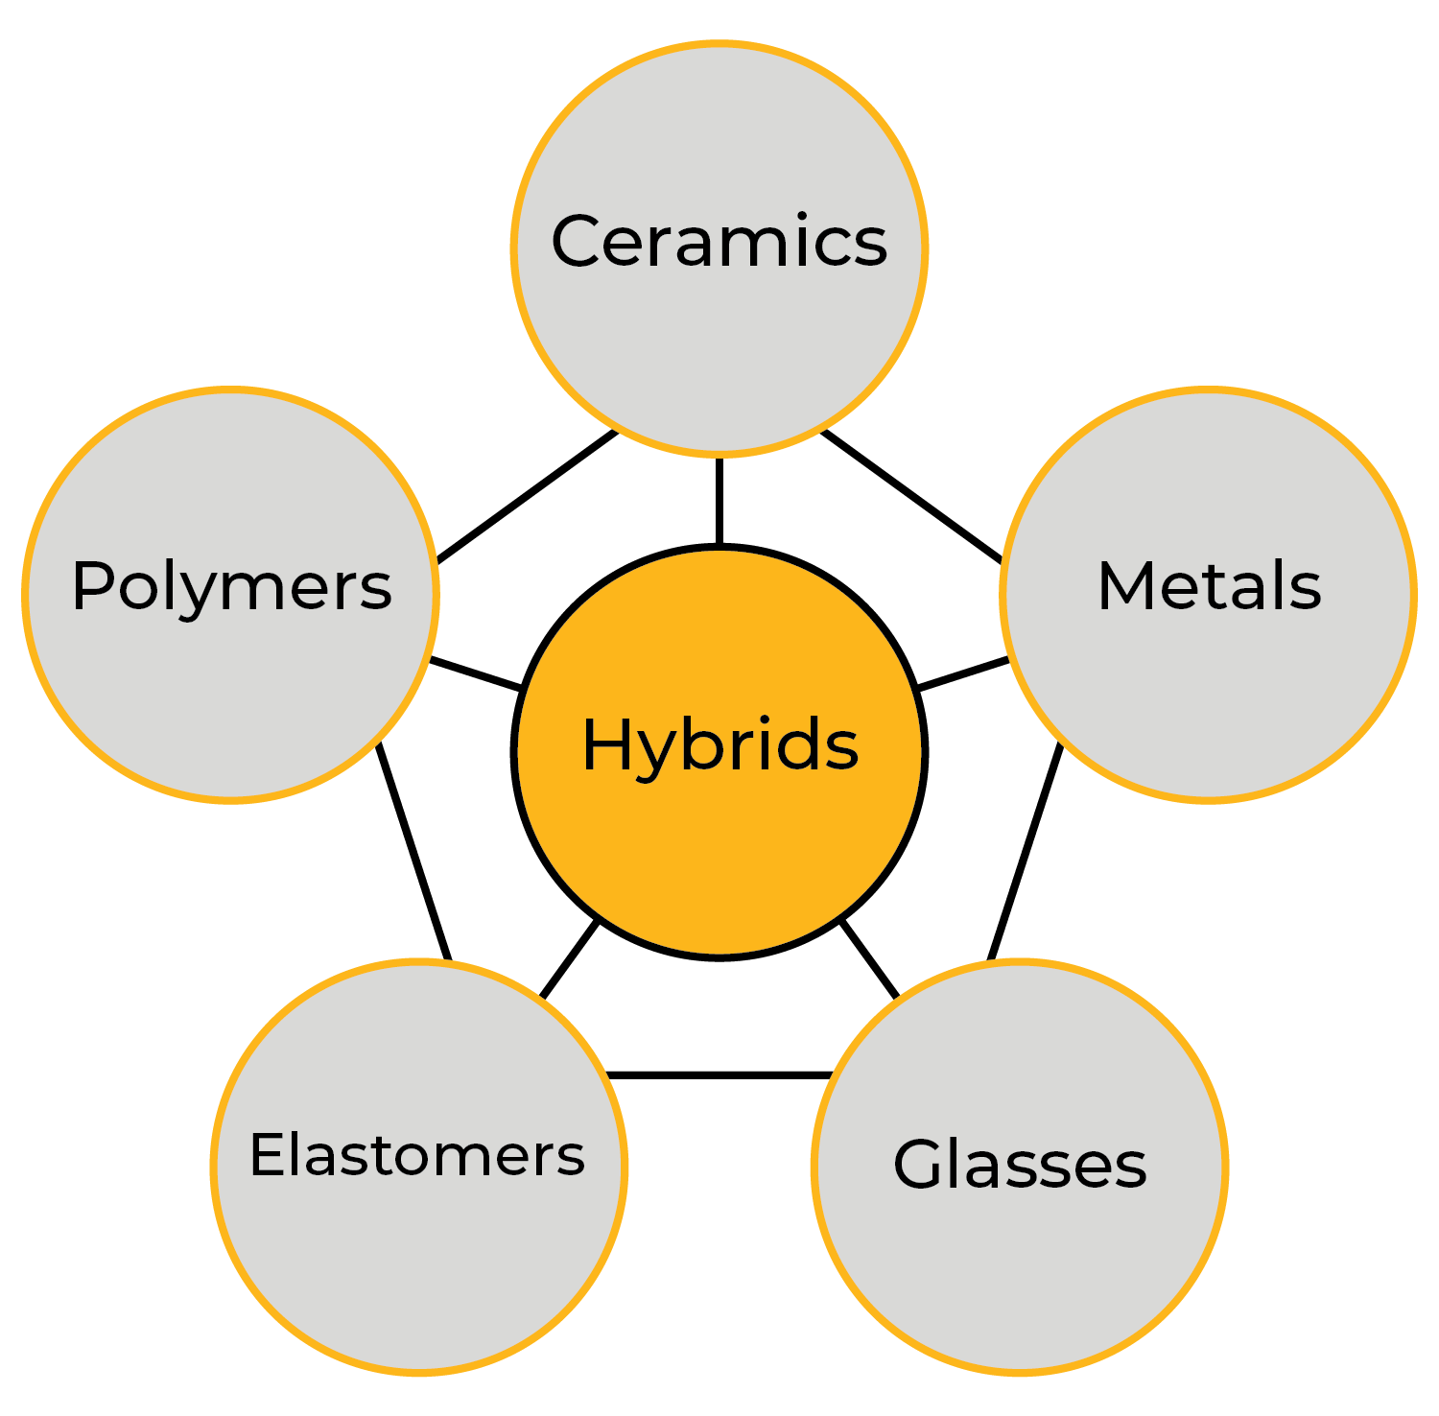
Hybrid materials
Cellular structures
Design variables:
Choice of materials
Volume fractions
Configuration
Connectivity
Scale
Composites
Sandwich structures
Multi-layers
Notes:
Hybrid materials
Hybrids are combinations of two or more materials assembled in such a way as to have attributes not offered by either one alone. Particulate and fibrous composites are examples of one type of hybrid, but there are many others: sandwich structures, lattice structures, segmented structures and more. Their properties depend the choice of the components, their configuration, their relative volume fraction and their scale. The new variables expand design space, allowing the creation of new “materials” with specific property profiles.

Slide 10
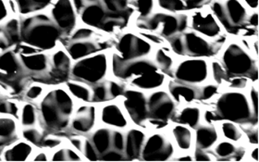
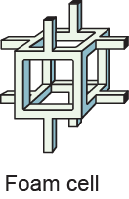
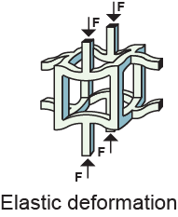
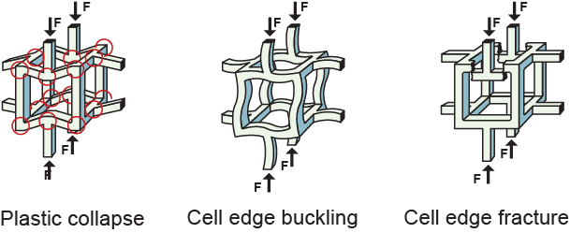
Configuration: Foam – property models
Mechanical
response
Plus thermal and electrical properties
Notes:
Models for foams and lattices.
As an example, the models for Foams and for Lattice structures include elastic deformation, plastic collapse, cell-edge buckling and cell-edge fracture, plus further models for thermal and electrical properties.

Slide 11
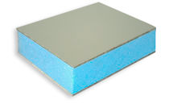
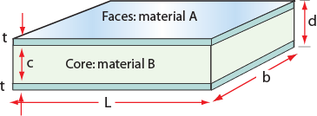
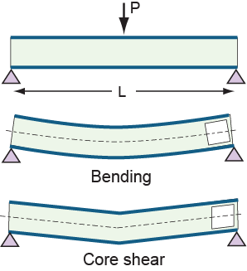
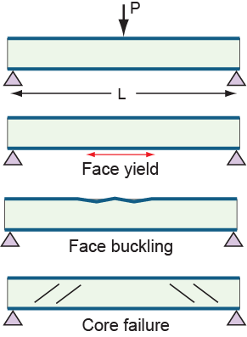
Configuration: Sandwich panel – property models
Elastic
response
Collapse
response
Plus thermal and electrical properties
Notes:
Models for sandwich panels
Here is a second example, this time for Sandwich structures. The models include simple bending, core shear, face yield, face buckling and core failure, plus further models for thermal and electrical properties.

Slide 12
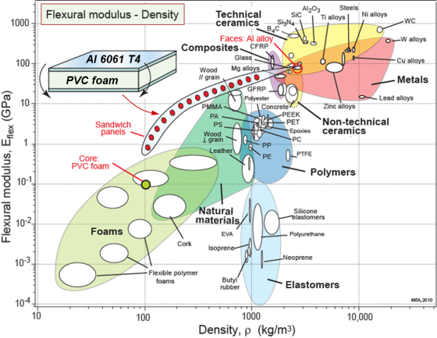
Structure of a hybrid synthesizer
Models for
configuration props.
Moduli
Strength
Thermal props
Electrical props
User interface
Choose:
Configuration
Components
Volume fractions
Choose:
Configuration
Components
Volume fractions
Calculate hybrid
properties and scan
Data for
component props.
Moduli
Strength
Thermal props
Electrical props
Data sheet for
proposed hybrid
Moduli
Strength
Thermal props
Electrical props
Notes:
The structure of the Hybrids Synthesizer
How are we to compare a hybrid like a sandwich with monolithic materials like – say – polycarbonate or titanium? To do this we must think of the sandwich not only as a hybrid with faces on one material bonded to a core of another, but as a “material” in its own right, with its own set of equivalent properties; it is these that allow the comparison.

Slide 13
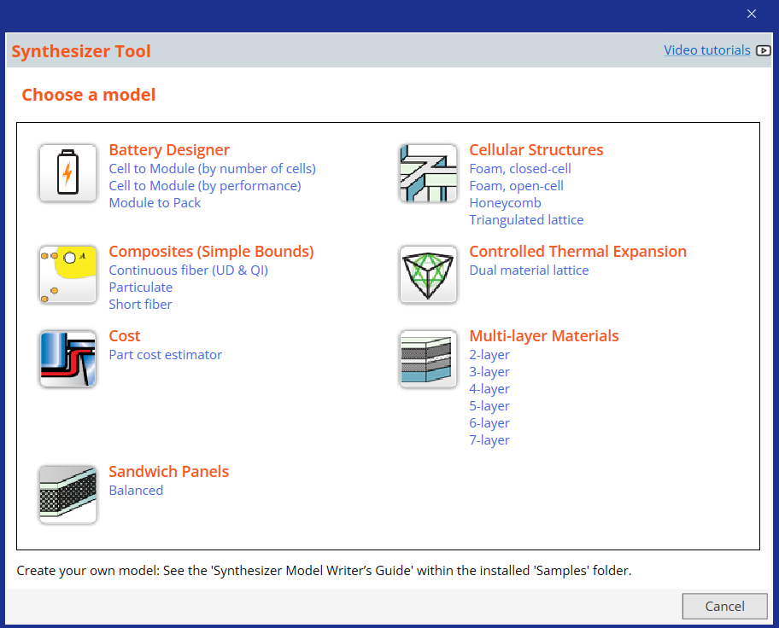
The Synthesizer tool and its models
Select:
Configuration
Materials
Control parameters
Click “Create”
Notes:
The Hybrid Synthesizer
The Hybrid synthesizer is opened from the Tools button in the main tool-bar of Granta EduPack. Doing so allows the choice of configuration:
Cellular structures (with option of Foams or Lattice structures)
Sandwich structures
Composites (with options of uni-directional, quasi-isotropic or particulate)
To use the synthesizer you select a configuration, choose materials from a pull down of the MaterialUniverse tree, enter the control parameters, and click “Create”.

Slide 14
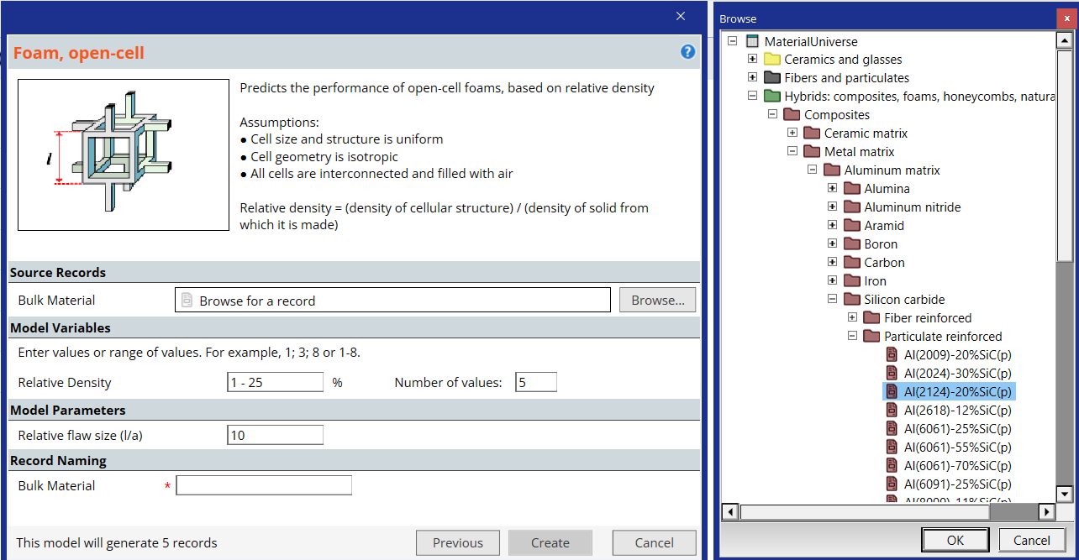
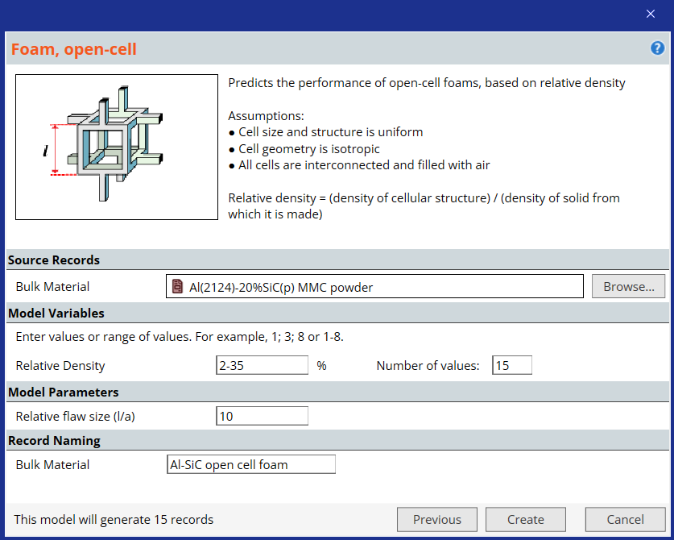
Exploring metal foams - inputs
Aluminum 20% SiC (p)
Browse
2
35
%
15
Previous
Create
Cancel
Notes:
The user input interface for cellular materials
This is a representation of the user interface of the synthesizer when the configuration Foam is selected. The Browse button opens the materials tree of whichever database (Levels1, 2 or 3) that is chosen when Granta EduPack is first opened. The material for the foam is selected from it. The control parameters, which the user now chooses, determine the number of relative densities (here 15) and the range they should cover. On clicking “Create” the synthesizer creates 15 records covering the chosen range of relative density.

Slide 15
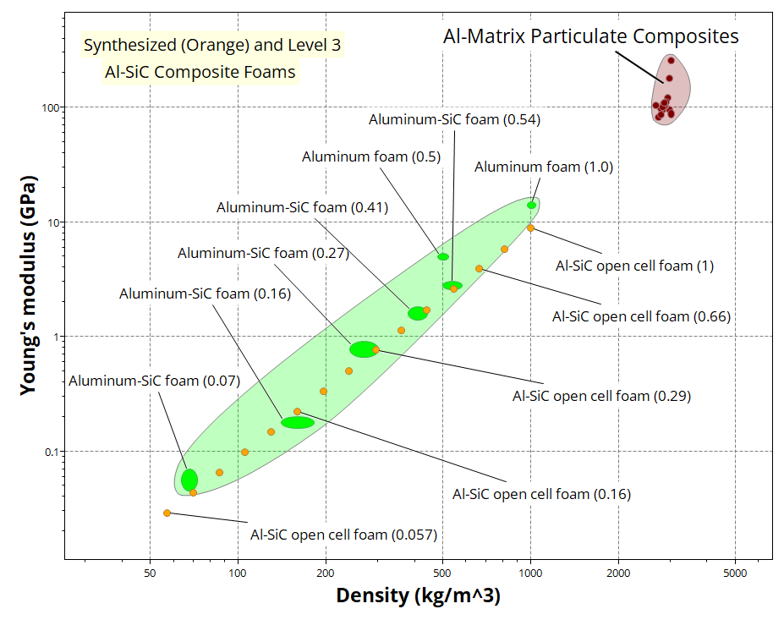
Aluminum SiC composite foams
Notes:
Typical output: predicted foam properties compared with data for real foams
Here an example, plotted on axes of Modulus and Density, of the properties of a set of Foams and of Lattice structures made from aluminum 20% particulate silicon carbide. The foams (yellow dots) can be compared with the properties of real aluminum-SiC foams (larger red ellipses) to get an idea of the precision with which the synthesizer predicts the properties. The criterion of excellence for a light stiff beam is plotted as broken lines. The lattices extend to higher values of the criterion.

Slide 16
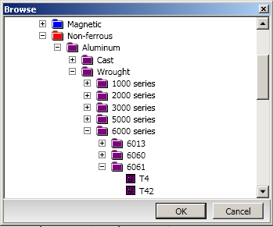
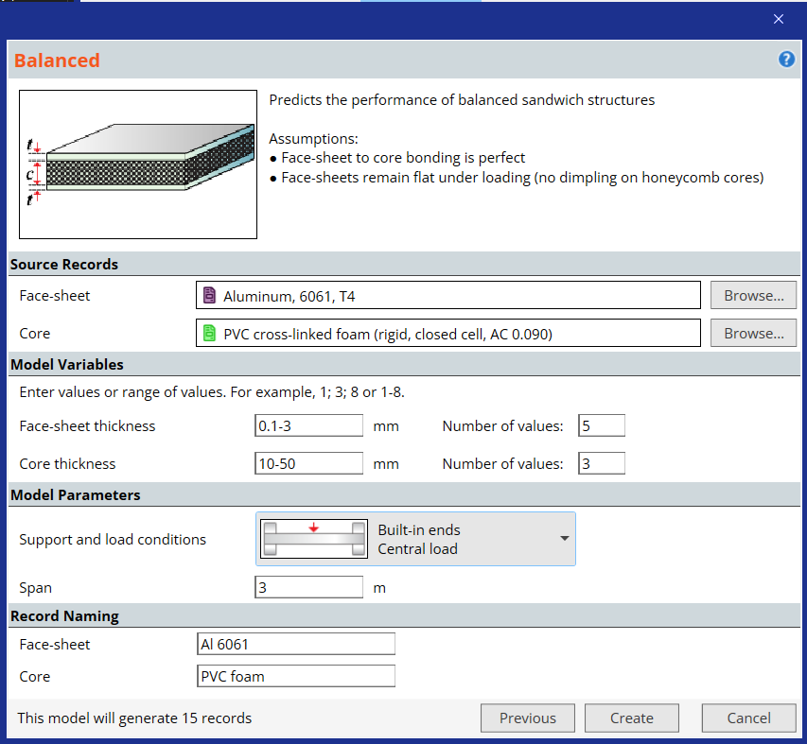
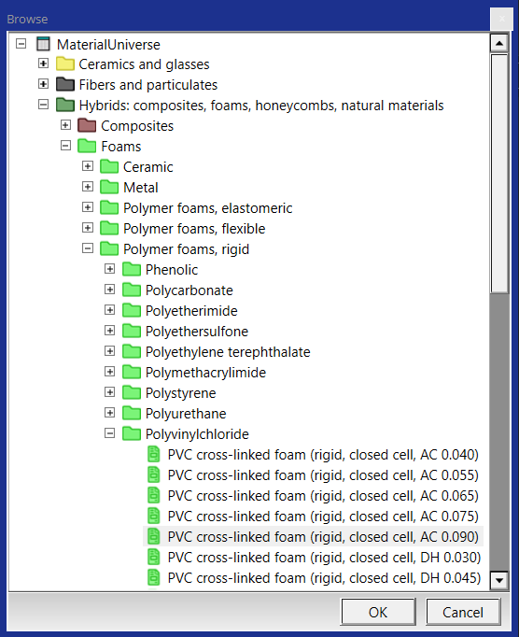
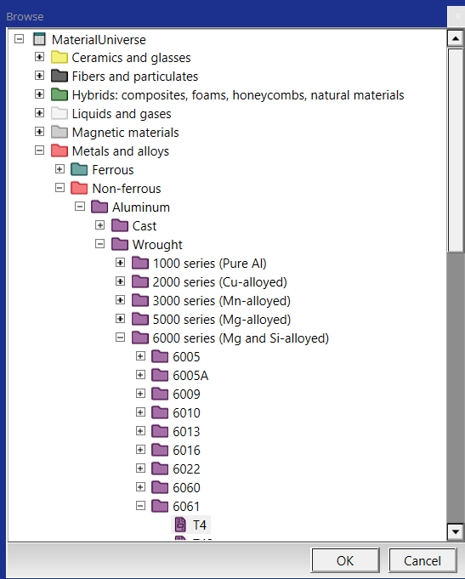
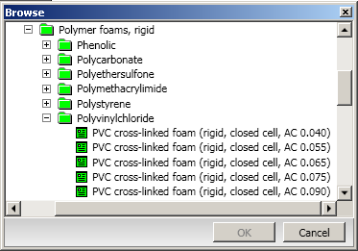
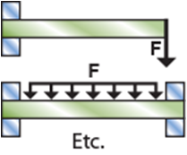
Sandwich panels - inputs
Sandwich Panel
Source material
Face sheet
Aluminum 6061 T4
Browse
Core
PVC cross-linked rigid foam (0.09)
Browse
Model variables
0.1 - 3 5
Face-sheet thickness mm Number of values
Core thickness - mm Number of values
10 - 50 3
Model parameters
Support and load conditions
Span m
3
Model
Previous
Create
Cancel
Notes:
16
Using the Synthesizer to synthesize sandwich panels
This is a representation of the user interface of the synthesizer when the configuration Sandwich panel is selected. The Browse button opens the materials tree of whichever database (Levels 1, 2 or 3) that is chosen when Granta EduPack is first opened. A material for the face sheet and a material for the core are selected from it. The control parameters, which the user now chooses, determine the number of face sheet thicknesses and core thicknesses and the ranges they should cover. On clicking “Create” the synthesizer creates records covering the chosen ranges.

Slide 17
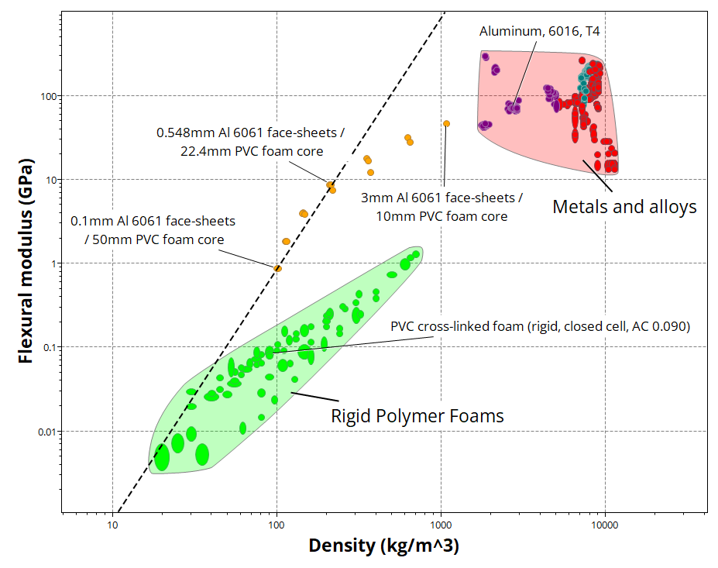
Stiff sandwich panels
Enhanced
performance
Optimize
Slope 3
Notes:
Typical output: Flexural modulus and Density for sandwich panels
Here is an example of the properties, plotted on axes of Flexural modulus and Density, of a set of sandwich panels with aluminum 6061 faces and PVC foam cores with a foam density of 0.1 kg/m³. The yellow dots show the flexural stiffness of the panels.

Slide 18
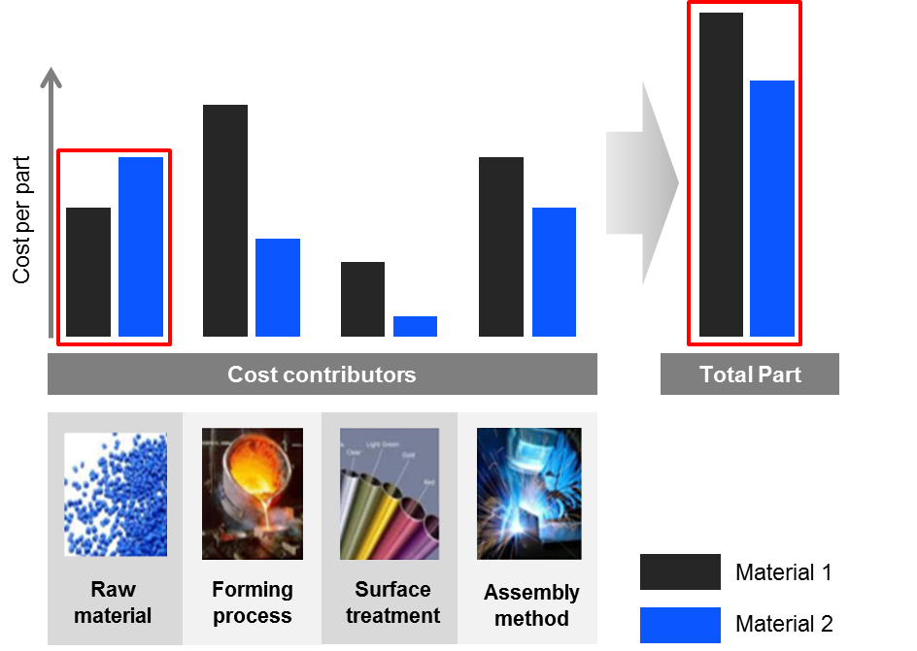
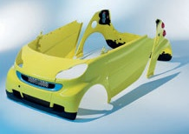
Synthesizer model for part cost
PP-20% mineral filled door panel
15% saving in door weight, but what about cost?
Quickly estimate the cost to manufacture a component
Compare different classes of materials and processing routes
Notes:
New Synthesizer model
What can you do with the part cost estimator? This includes both material cost and cost of manufacturing.

Slide 19
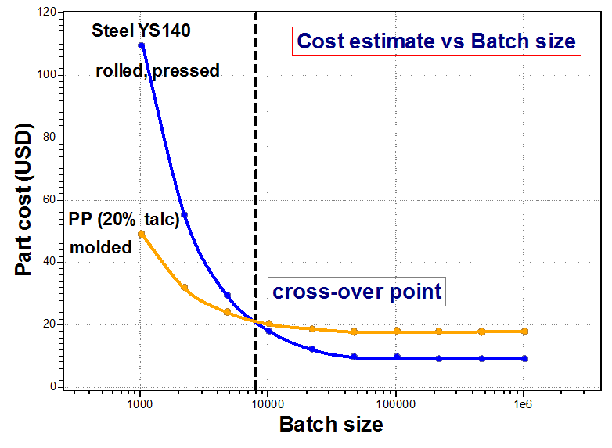
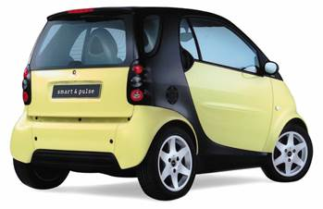
Part cost comparison: Door panel
Notes:
Door panel Example
We have seen how the Synthesizer tool and its hybrid models can be used to estimate properties for some interesting material structures. The Synthesizer tool can also be used for estimation of other manufacturing and materials-based properties, using EduPack data. The part cost estimator allows you to study and compare manufacturing costs. We will use the car door panel from the previous case study as an example…

Slide 20
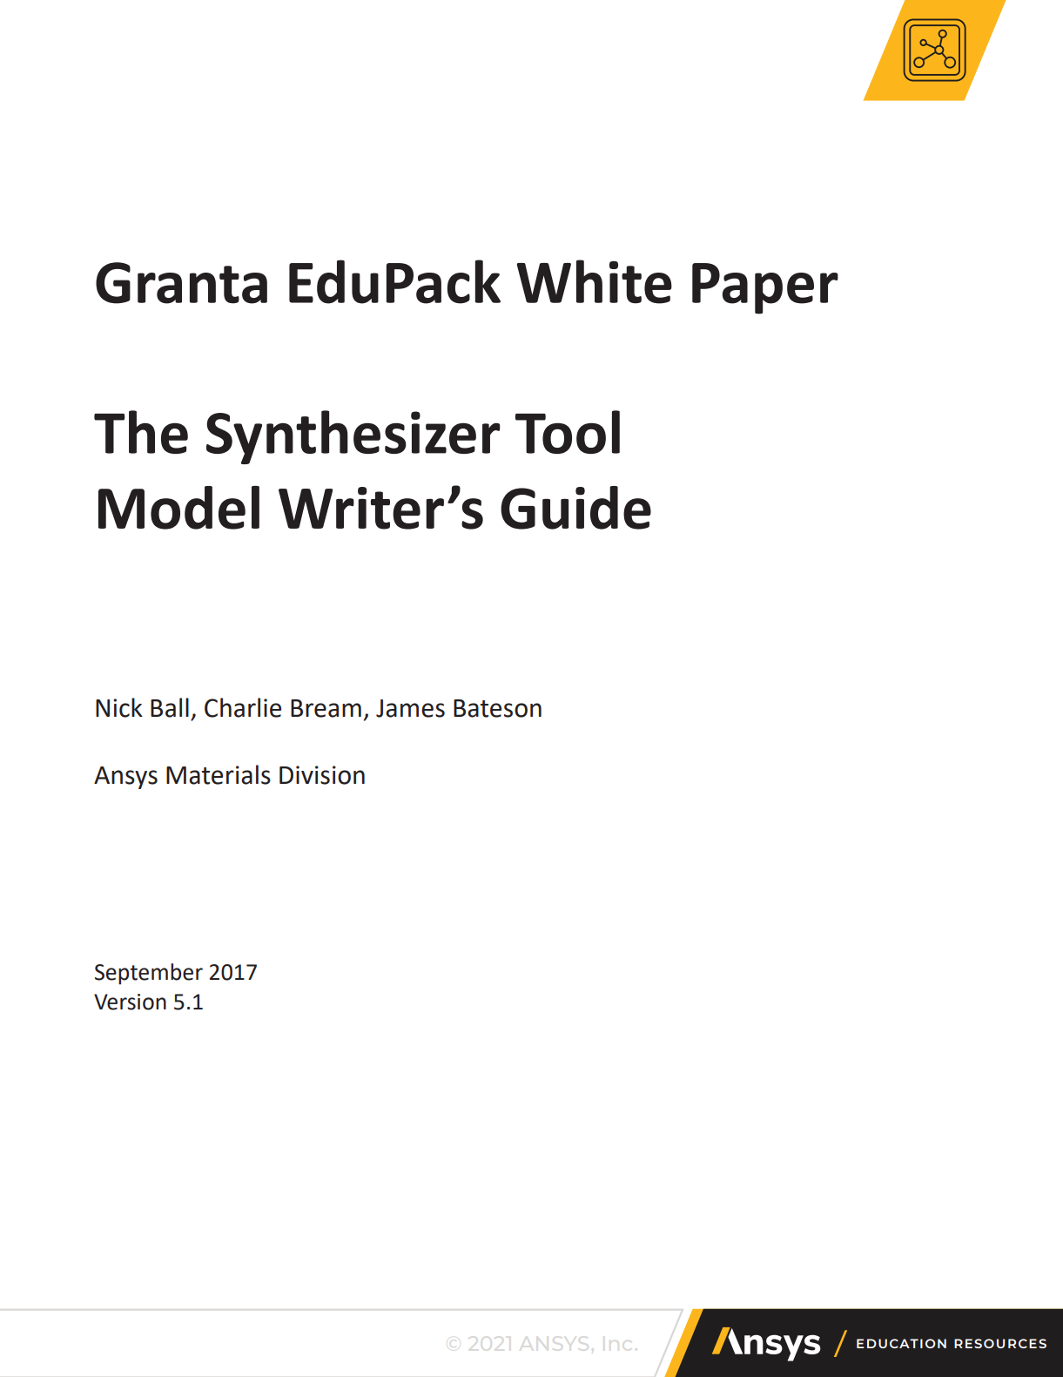
Enter your own models
Notes:
Summary
For people that are interested in adding their own synthesizer models, based on user input and Granta EduPack data, a guide has been produced, available from within the Granta EduPack HELP or the Ansys Education Resources website

Slide 21
Outline of a model in code (C#)
You need: Microsoft Visual Studio (the community edition is free)
Administrator rights on your PC in order to copy your model
Details of your model calculations.
[Export("Granta.HybridModel")]
[BindableDisplay(Name = "Simple Model (C#)", Description = "A simple example model.", GroupName = "Examples")]
public class ExampleModel
{
}
Notes:
Your own Synthesizer model
The Synthesizer Tool uses a plugin system that allows new models to be added. These models are written using Microsoft’s .Net, in either C# or Visual Basic, but they have been designed to require minimal programming knowledge.
Granta EduPack Synthesizer Tool includes the model guide and some example models, in both Visual Basic and C#.
The guide has a simple model that just takes up one page of code so you can adapt it for your own calculations.
Each Synthesizer Tool model must be created using a programming structure known as an object or a class.
The example model above has markup that lets the system know it is a model, and markup for the name, description, and the group that the model will appear in when it is run in EduPack.
These are the only lines of code you need for your model to appear in the Synthesizer Tool! But it won’t do anything as it stands. If you pick this model, you’ll get an empty input screen. You’ll also need to flesh out the model with source materials, user inputs, and calculations.

Slide 22
Summary
The synthesizer stimulates
Imaginative exploration of novel material combinations
Interest in materials modelling
Direct comparison of hybrids with the standard materials of engineering
Exploration of structured-structures
Does not advise on manufacture of hybrids, but…
Can be used to estimate part manufacturing costs
Enables you to enter your own materials-based models
Notes:
Summary
This lecture Unit introduced the hybrid materials and the Granta EduPack Synthesizer Tool that lets you create records for their properties, or estimate the cost of manufactured products. These properties can be compared directly with those of all the other materials in the Granta EduPack databases, allowing selection that includes hybrids.

Slide 23
Lecture unit series
PowerPoint lecture units, as well as many other types of resources, can be found in the Ansys Education Resources webpage.
Finding and Displaying Information
Unit 1 | The materials of engineering
Unit 2 | Material property charts: mapping materials
Unit 3 | The Elements database: properties, relationships and resources
Material Properties
Unit 4 | Manipulating properties: composition, microstructure, architecture
Unit 5 | Designing new materials: filling the materials-property space
Unit 6 | Materials Science and Engineering
Selection
Unit 7 | Material selection: translation, screening, ranking, documentation
Unit 8 | Objectives in conflict: trade off methods and penalty functions
Unit 9 | Material and shape: materials for efficient structures
Unit 10 | Manufacturing processes and cost modeling
Unit 11 | Eco-informed material selection
Unit 12 | Eco design and the Eco Audit tool
Sustainability
What is a sustainable development? A materials perspective
Exploring Critical Materials using Ansys Granta EduPack
Special Topics
The Built Environment: materials for construction
Structural sections: shape in action
Materials in industrial design: Why do consumers buy products?
The Design database for Products
The Medical Devices database
The Battery Designer tool
Advanced Teaching and Research
Advanced databases: a lightning tour
The Aerospace edition
The Polymer edition
The Synthesizer tool: hybrids and other models
Materials for Bioengineering
www.ansys.com/education-resources
Notes:
Lecture Units Series
This is a list of the Lecture Units available for teaching with the Ansys Granta EduPack. These PowerPoint presentations and more information can be found on the Ansys Education Resources webpage:
www.ansys.com/education-resources.

