Slide 1
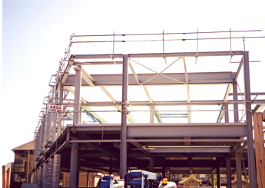
Structural sections: shape in action
Mike Ashby
Department of Engineering,
University of Cambridge
Notes:
The PowerPoint Lecture Units For 2024
The Lecture Units developed for teaching in connection with Ansys Granta EduPack are listed at the end of this presentation.

Slide 2
Learning objectives for this lecture unit
Intended Learning Outcomes
Knowledge and Understanding | Understanding of how to explore and optimize mechanical design structures
Skills and Abilities | Ability to select structural sections for prescribed design requirements
Values and Attitudes | Appreciation of how shape and material properties interact
Resources
Text: “Materials Selection in Mechanical Design”, 5th edition by M.F. Ashby, Butterworth Heinemann, Oxford, 2016, Chapters 10-11.
Software: The Ansys Granta EduPack Structural sections data-table and the Built Environment Level 2 database
Notes:
Learning Objectives
These Intended Learning Outcomes are based on a taxonomy of knowledge and understanding as the basis, skills and abilities as necessary for the practical use of knowledge and understanding, followed by acquired values and attitudes enabling assessments and responsible use of these abilities.
Combined with a suitable assessment, they should be helpful in the context of accreditations or for the CDIO Syllabus.
The Texts listed are from books authored or co-authored by Mike Ashby but other texts are also referred to in the Science Notes.

Slide 3
Outline of the lecture unit
Structural sections and their attributes
The Granta EduPack data-table for Structural sections
Content and use of the database
Notes:
This is the outline of the Unit.

Slide 4
Structural sections
When materials are loaded in bending, in torsion, or are used as slender columns, section shape becomes important
Shape = cross section formed to a
Tube
I-section
Hollow box
Ansys Discovery
All increase
Second moment of area I
Section modulus Z
Bending stiffness E I
Failure moment σ_{y} Z (called YZ in the database)
Notes:
Structural sections
When components carry bending, torsion or compressive loads, both the area of the cross-section and its shape are important. By shape we mean that the cross-section is formed to a tube, I-section or the like. Efficient shapes use the least material to achieve a given stiffness or strength – they have high values of the second moment of area, I, section modulus, Z, and other moments. It might seem that the way forward is to first choose the shape, then form the material into that shape. But some materials are routinely made into efficient shapes and some are not, either because of manufacturing difficulties or because they buckle too easily. So material and shape are coupled, requiring a method of choosing them together.

Slide 5
Data organization: structural sections
Standard
prismatic sections
Universe
Family
Material and Member
Attributes
Steel Hot Rolled Joist
General properties: ρ, E, σ_{y}
Dimensions: Max depth, width,...
Section: Area, I, Z, K, Q ...
Structural: EI, σ_{y} Z, ...
Angle
Channel
I-section
Rectangular
T-section
Tube
Aluminium
Glass Vinyl Ester
Steel
Structural sections
Hot Rolled Steel
A record
Notes:
Structural sections
Standard sections are widely available in structural steel, extruded aluminum alloy, pultruded GFRP and wood. They have the shape shown here – rectangular, box, cylinder, tube, I-sections, U-sections and angles. A good way to get a feel for how shape efficiency is used in practice is to examine these. The Granta EduPack structural sections data-table contains 1881 records covering the full range of standard sections. The data organization is shown here. The first level – the families – refers to shape. The choice of shape, it will be remembered, is dependent on the way the section will be loaded: I, L an U-sections are good in bending but poor in torsion; closed circular and box sections carry both torsion and bending well. The second level of the tree is the material – here we list the three for which standard sections are widely available. Each of these comes in many different sizes, and for each size there is a set of attributes. The records in the database detail these attributes: material properties, dimensions, section properties such as I and Z, and structural properties such as E.I and σ_{y}.Z.

Slide 6
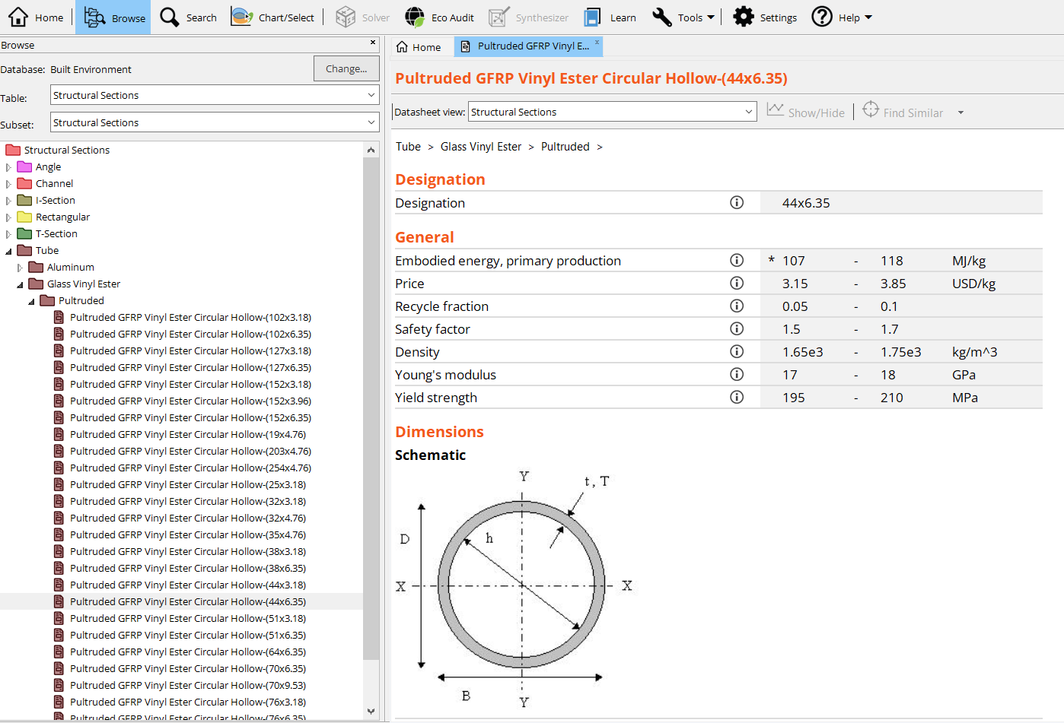
Granta EduPack database for the Built Environment
Records for
1881 sections

Slide 7
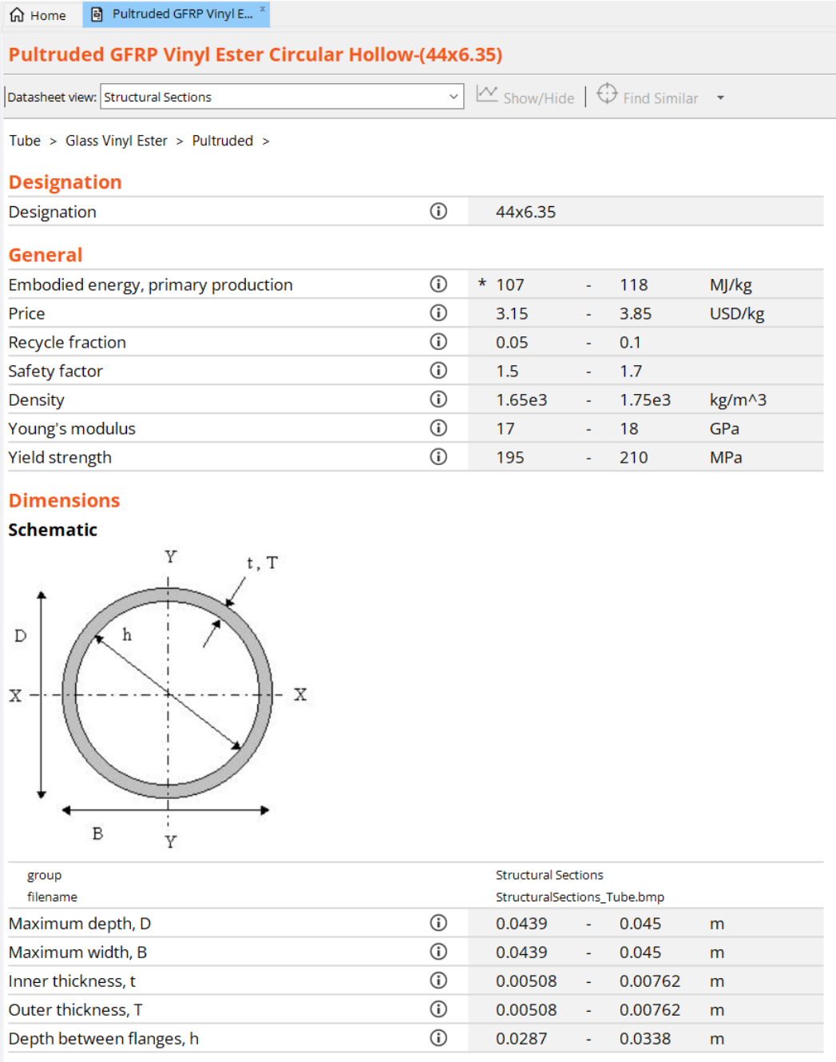
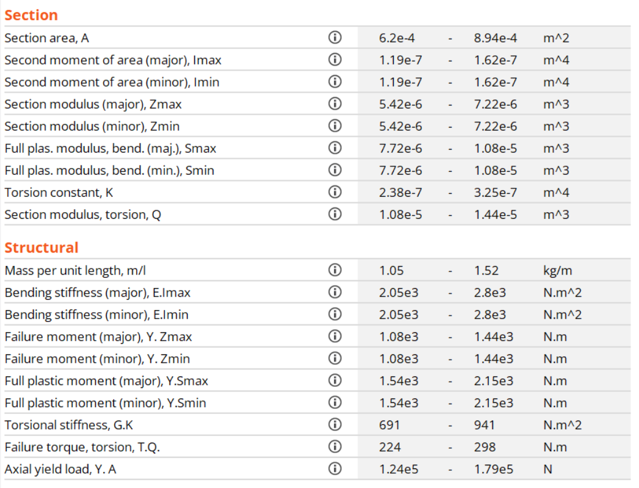
Part of a record for a structural section
Pultruded GFRP Vinyl Ester Circular Hollow-(44 x 6.35)
*A selection of attributes are shown
Notes:
Example
This shows part of a typical record – one for a pultruded GFRP tube. The fields are defined, the units are listed and values are given. The record lists material properties, section dimensions, section properties like I and Z, and structural properties like EI and YZ.

Slide 8
Example: selection of a beam
Specification
F
B
Custom Subset
Structural SubSections
D
Function
Beam
D = beam depth
B = width
I = second moment of area
E = Young’s modulus
Z = section modulus
σ_{y} = yield strength (Y in database)
Constraints
Required stiffness:
E I_{max} > 10⁵ N.m²
Required strength:
σ_{y} Z > 10³ N.m
Dimension
Width B < 150 mm
Depth D < 200 mm
Notes:
Example
The database can be used to find sections that meet a set of constraints, and to select from among these the lightest, the cheapest or the one with the lowest embodied energy. A specification is listed here. There are constraints on minimum bending stiffness E.I and strength σ_{y}.Z (called YZ in the database), and on the maximum dimensions of the depth and the width. The best approach is to apply all the constraints using a limit stage, then, in a graphical stage, apply a selection line that isolates those with the lowest mass per unit length or cost per unit length or embodied energy per unit length.
To access the Structural Subset in the software for graphing, you can use either the Tree Stage function or create a Custom subset within the data selection screen.

Slide 9
Applying constraints with a Limit stage
Dimensions Minimum Maximum
Max depth, D m
Max width, B m
Structural Attributes
Bending stiffness E.I_{max} N.m²
Failure moment Y. Z_{max} N.m
5
15
0.2
0.15
100000
1000
Custom subset of Structural Section
Result : 294 sections out of 1881 meet these constraints
Objectives
(a) Find lightest beam
(b) Find cheapest beam
(c) Find beam with lowest embodied energy
That meets the constraints
Notes:
Constraints
Constraints are most easily applied in a limit stage, illustrated here for the example of the last frame.

Slide 10
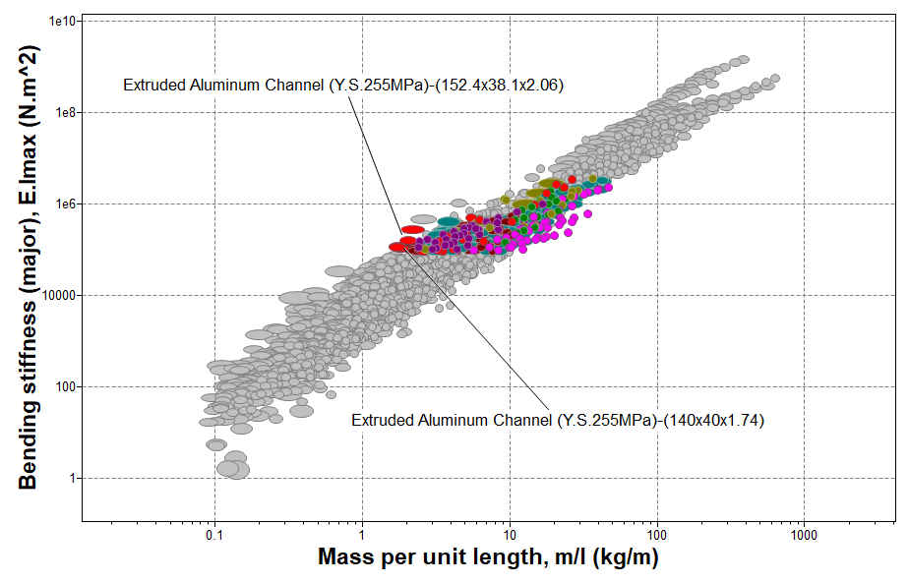
Minimizing mass for given EI_{max}
Bending Stiffness EI vs.
mass per unit length
Results
Extruded Aluminum Channel (140x40x1.74)
Extruded Aluminum Channel (152.4x28.6x1.75)
Extruded Aluminum Channel (130x50x1.82)
Notes:
Minimizing mass
Optimization requires a graphical stage with mass/length, m/l, on one axis. Here is one way to do it. The bending stiffness E.I has been used as the other axis. The limit stage has a minimum set at E.I = 100,000 Nm², which is one of the constraints. The “Results” window, shows the intersection of this stage and that of the preceding limit stage, where a few best candidates can be identified (towards the left on the chart). If the scale of m/l is replaced by one of price/kg x m/l (giving the cost in pounds per unit length), the cheapest beam meeting all the requirements is found. The result is shown on the next frame.

Slide 11
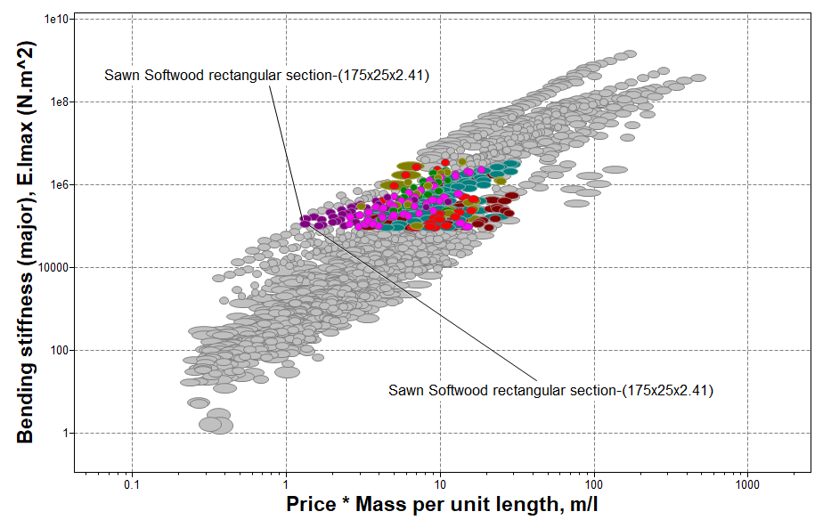
Minimizing cost for given EI_{max}
Bending Stiffness EI vs.
price per unit length
Results
Sawn Softwood section-(175x25x2.41)
Sawn Softwood section-(200x22x2.42)
Sawn Softwood section-(200x25x2.75)
Notes:
Minimizing cost
Here the selection is for the beam with the lowest price that meets all the constraints. The price per unit length is plotted by multiplying the price per unit weight by the mass per unit length, using the Advanced facility in the axis-choice dialog box (it is described in full in Lecture Unit 2).

Slide 12
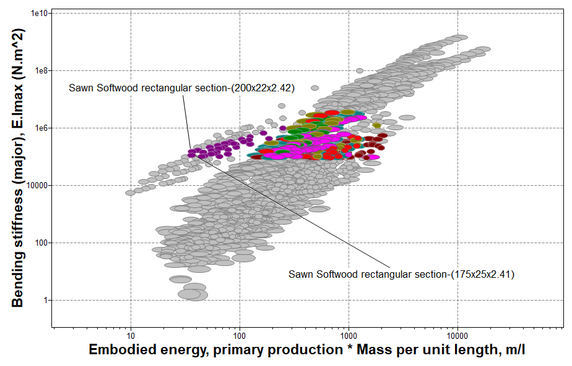
Minimizing embodied energy for given EI_{max}
Bending Stiffness EI vs.
Embodied energy per unit length
Results
Sawn Softwood section-(175x25x2.41)
Sawn Softwood section-(200x22x2.42)
Sawn Softwood section-(200x25x2.75)
Notes:
Minimizing embodied energy
Here the selection is for the beam with lowest embodied energy that meets all the constraints, following a procedure like that in the previous frame. Not surprisingly, solid wood sections are the optimum choice.

Slide 13
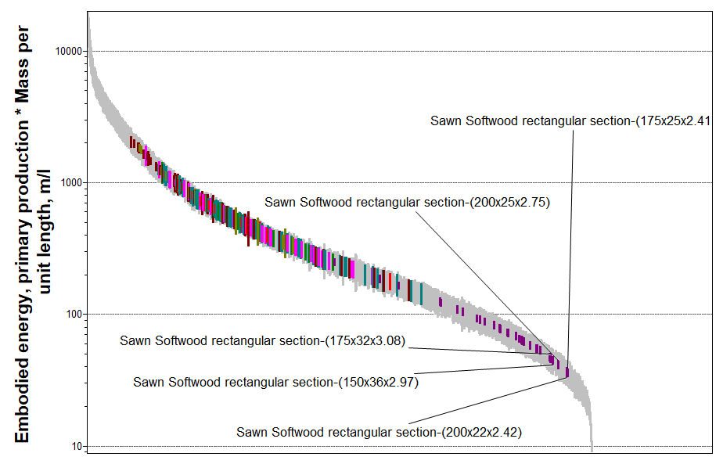
Minimizing embodied energy for given EI_{max}
Results
Sawn Softwood section-(175x25x2.41)
Sawn Softwood section-(200x22x2.42)
Sawn Softwood section-(200x25x2.75)
Sawn Softwood section-(150x36x2.97)
Notes:
There is an alternative way to find the optimize by any one the three objectives. It is to plot the objective as a bar chart, as shown here for embodied energy per unit length. Each colored bar describes a section that meets all of the constraints – those that fail have been hidden using the Hide-failed materials tool. The optimum choice is then the subset that lie lowest on this chart.

Slide 14
Summary
The Granta EduPack Structural sections data-table and the Built Environment database allows standard sections to be explored and selected to meet multiple constraints
It introduces the idea of choice to optimize weight, price or environmental impact
Notes:
A summary of the main points

Slide 15
Lecture unit series
PowerPoint lecture units, as well as many other types of resources, can be found in the Ansys Education Resources webpage.
Finding and Displaying Information
Unit 1 | The materials of engineering
Unit 2 | Material property charts: mapping materials
Unit 3 | The Elements database: properties, relationships and resources
Material Properties
Unit 4 | Manipulating properties: composition, microstructure, architecture
Unit 5 | Designing new materials: filling the materials-property space
Unit 6 | Materials Science and Engineering
Selection
Unit 7 | Material selection: translation, screening, ranking, documentation
Unit 8 | Objectives in conflict: trade off methods and penalty functions
Unit 9 | Material and shape: materials for efficient structures
Unit 10 | Manufacturing processes and cost modeling
Unit 11 | Eco-informed material selection
Unit 12 | Eco design and the Eco Audit tool
Sustainability
What is a sustainable development? A materials perspective
Exploring Critical Materials using Ansys Granta EduPack
Special Topics
The Built Environment: materials for construction
Structural sections: shape in action
Materials in industrial design: Why do consumers buy products?
The Design database for Products
The Medical Devices database
The Battery Designer tool
Advanced Teaching and Research
Advanced databases: a lightning tour
The Aerospace edition
The Polymer edition
The Synthesizer tool: hybrids and other models
Materials for Bioengineering
www.ansys.com/education-resources
Notes:
Lecture Units Series
This is a list of the Lecture Units available for teaching with the Ansys Granta EduPack. These PowerPoint presentations and more information can be found on the Ansys Education Resources webpage:
www.ansys.com/education-resources.

