Slide 1



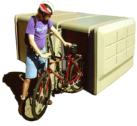
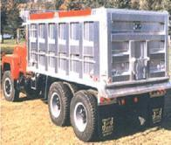
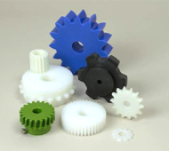

Unit 1.​
The materials of engineering​
Mike Ashby
Department of Engineering,
University of Cambridge
Notes:
The PowerPoint Lecture Units For 2023
The Lecture Units developed for teaching in connection with Granta EduPack are listed at the end of this presentation.

Slide 2
Learning objectives for this lecture unit
Intended Learning Outcomes
Knowledge and Understanding | Understanding of what is meant by material and process properties
Skills and Abilities | Ability to find material property data and scientific background to these
Values and Attitudes | Appreciation of the classification and organization of materials information
Resources
Text: “Materials: engineering, science, processing and design” 4th edition by M.F. Ashby, H.R. Shercliff and D. Cebon, Butterworth Heinemann, Oxford, 2019, Chapters 1-2
Text: “Materials Selection in Mechanical Design”, 5th edition by M.F. Ashby, Butterworth Heinemann, Oxford, 2016, Chapters 1-2
Texts: Callister, Budinski, Askeland and others – recommended reading in records
Software: Ansys Granta EduPack
Notes:
Learning Objectives
These Intended Learning Outcomes are based on a taxonomy of knowledge and understanding as the basis, skills and abilities as necessary for the practical use of knowledge and understanding, followed by acquired values and attitudes enabling assessments and responsible use of these abilities.
Combined with a suitable assessment, they should be helpful in the context of accreditations or for the CDIO Syllabus.
The Texts listed are from books authored or co-authored by Mike Ashby but other texts are also referred to in the Science Notes.

Slide 3
Outline of lecture unit 1
Background: the motivation
Materials: classification and properties
Granta EduPack: structure and content
Notes:
Outline
This is the first Unit of a course on Material and Process Selection. The Units link closely to the first two Textbooks listed on the previous slide but can equally by used in conjunction with texts such as Callister, Budinski, Askeland and others.
The relevant chapters of the Texts are listed in each Unit. The methods developed in the slides are implemented in the Granta EduPack software, which is structured to evolve in pace with the student throughout a four-year engineering program. This first Unit introduces materials and processes, and the way in which information about them can be classified, stored, retrieved and explored.

Slide 4
Teaching materials to engineering students
The starting point
Engineers make things. They make them out of materials, using processes.
What do they need to know?
  Perspective of the world of materials and processes
  Understanding material properties
  An ability to select
  Information and tools
Granta EduPack: resources to achieve this
- a tool for later profession (like CAD or FE)
Notes:
What do engineering students need to know about materials?
This methodology takes a design-led approach to the selection of materials and manufacturing processes. The philosophy is outlined in this frame.
Engineering students need to know how to choose and shape materials to meet a set of design requirements; developing new alloys, polymer blends and the like is the job of the materials scientist, who also needs to understand material properties.
The methods developed here give students tools for design. The underlying science is not ignored but is introduced where relevant to the understanding of the design-limiting attributes of materials.

Slide 5

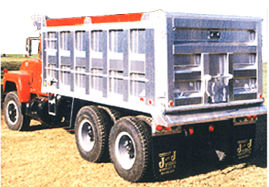
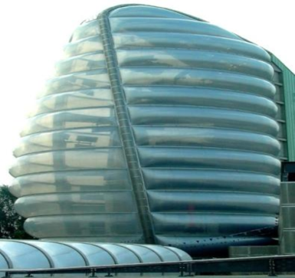


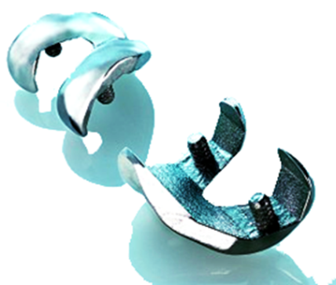
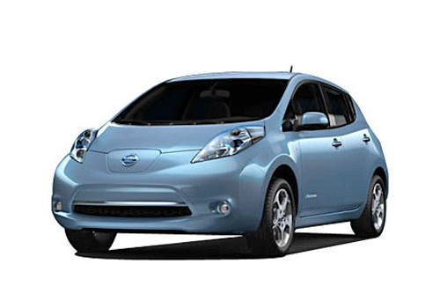

Which courses? Campus-wide?
Materials science General engineering Polymer engineering
Aerospace engineering Architecture Bioengineering
Product design Environmental engineering Sustainability assessment
Notes:
The range of courses supported by the Granta EduPack
The Granta EduPack offers databases for Materials Science, for General Mechanical Engineering and for more specialized courses, among them Polymer and Aerospace Engineering, Architecture and Bioengineering. It also has tools ranging from estimating composite and structural hybrid properties to battery design.

Slide 6
Organizing information
Select on material properties
The
database
Select on process properties
References
data-table
DATA FOR
Metals & alloys
Polymers
Ceramics & glasses
Hybrids
DATA FOR
Joining
Shaping
Surface treatment
Materials
data-table
Links
Processes
data-table
Suppliers
data-table
Select on links
Notes:
Database structure
This overhead shows the basic structure of the Granta EduPack database. It contains 4 linked data-tables:
Materials: metal, polymers, ceramics and hybrids
Processes for shaping, joining and finishing materials
References to more information about any given record in the data-tables
Supplier information for materials or processes
Each record in the Materials data-table contains data for material properties, and is linked to similar records for the processes that can shape, join and finish it. Each record in the Process data-table is similarly linked to the materials it can treat and to reference and supplier information. This allows selection of materials by specifying required properties, or by specifying how it can be processed. In the next frame the Materials data-table is expanded.
The Advanced tools (Eco Audit tool, the Hybrid Synthesizer tool and the Sustainable Development Assessment methodology) have more complex structures described in the relevant PowerPoint Lecture Units and White Papers.

Slide 7
Organizing information: the Materials Tree
MaterialUniverse
Family
Class
Member
Attributes
Ceramics
& glasses
Metals
& alloys
Polymers
& elastomers
Hybrids
Al 6463
Density
Mechanical props.
Thermal props.
Electrical props.
Optical props.
Corrosion props.
Documentation
-- specific
-- general
Al 6060
Density
Mechanical props.
Thermal props.
Electrical props.
Optical props.
Corrosion props.
Documentation
-- specific
-- general
Steels
Cu-alloys
Al-alloys
Ti-alloys
Ni-alloys
Zn-alloys
1000
2000
3000
4000
5000
6000
7000
8000
Al 6061
Density
Mechanical props.
Thermal props.
Electrical props.
Optical props.
Durability props.
Documentation
-- specific
-- general
Materials
data-table
Material records
Notes:
The Hierarchical structure of records of the Materials data-table
Here we show a tree-like classification for materials, one typifying that used in handbooks and in the software described in a moment. The Universe of materials contains the four families shown earlier. That for metals is partly expanded to show classes, each of which contains sub-classes (not shown) and – at the tips of the branches of the tree – members. Each member is characterized by a set of attributes – the numeric, non-numeric properties and supporting information that describes it.. A listing of these attributes makes up a record for that material. Some of it is numeric and can be structured into tables. Some is in the form of text, images or graphs and cannot be organize in the same way. We refer to this as unstructured data.

Slide 8

Structured information for ABS*
Acrylonitrile-butadiene-styrene (ABS)
*Excerpts from Granta EduPack Level 2
General properties
Mechanical properties
Thermal properties
Electrical properties
Optical properties
Processability
Eco properties
Density |  | 1.03e3 | - | 1.06e3 | kg/m^3
Price |  | * 1.69 | - | 2.47 | USD/kg
Date first used |  | 1937
Electrical conductor or insulator? |  | Good insulator
Transparency |  | Opaque
Refractive index |  | 1.53 - |  | 1.54
Young's modulus |  | 2.07 | - | 2.76 | GPa
Yield strength |  | 34.5 | - | 49.6 | MPa
Tensile strength (elastic limit) |  | 37.9 | - | 51.7 | MPa
Elongation |  | 5 | - | 60 | % strain
Hardness - Vickers |  | 10 | - | 15 | HV
Fatigue strength at 10^7 cycles |  | 15.2 | - | 20.7 | MPa
Fracture toughness |  | 1.46 | - | 4.29 | MPa.m^{1/2}
Castability |  | 1 | - | 2
Moldability |  | 4 | - | 5
Machinability |  | 3 | - | 4
Weldability |  | 5
Embodied energy, primary production |  | * 88.9 | - | 98.3 | MJ/kg
CO2 footprint, primary production |  | * 3.41 | - | 3.77 | kg/kg
Recycle
Maximum service temperature |  | 62.9 | - | 76.9 | °C
Thermal conductivity |  | 0.253 | - | 0.263 | W/m.°C
Specific heat capacity |  | 1.69e3 | - | 1.76e3 | J/kg.°C
Thermal expansion coefficient |  | 74 | - | 123 | µstrain/°C
Links to Processes
Notes:
Structured (numeric, tabular) data for a material
This is an example structured data, here for ABS. Numeric properties are reported as ranges (material properties have permitted range of values because of latitude in permitted compositions and methods of production). Non-numeric properties are shown as rankings here: very poor, poor, average, good, very good. Ideally, structured data should contain no “holes” – missing data – because this compromises its use for selection. (The Granta EduPack databases have no holes.) Links provide the connections to processes that can be applied to ABS.

Slide 9
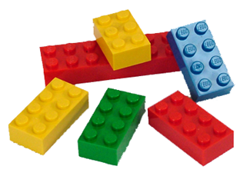
Unstructured information for ABS*
*Excerpts from Granta EduPack Level 2
The material. ABS (Acrylonitrile-butadiene-styrene ) is tough, resilient, and easily molded. It is usually opaque, although some grades can now be transparent, and it can be given vivid colors. ABS-PVC alloys are tougher than standard ABS and, in self-extinguishing grades, are used for the casings of power tools.
Design guidelines. ABS has the highest impact resistance of all plastics. It takes color well. Integral metallics are possible (as in GE Plastics' Magix.) ABS is UV resistant for outdoor application if stabilizers are added. It is hygroscopic (may need to be oven dried before thermoforming) and can be damaged by petroleum-based machining oils.
ABS can be extruded, compression moulded or formed to sheet that is then vacuum thermo-formed. It can be joined by ultrasonic or hot-plate welding, or bonded with polyester, epoxy, isocyanate or nitrile-phenolic adhesives.
Technical notes. ABS is a terpolymer - one made by copolymerising 3 monomers: acrylonitrile, butadiene and styrene. The acrylonitrile gives thermal and chemical resistance, rubber-like butadiene gives ductility and strength, the styrene gives a glossy surface, ease of machining and a lower cost. In ASA, the butadiene component (which gives poor UV resistance) is replaced by an acrylic ester. Without the addition of butyl, ABS becomes, SAN - a similar material with lower impact resistance or toughness. It is the stiffest of the thermoplastics and has excellent resistance to acids, alkalis, salts and many solvents.
Typical uses. Safety helmets; camper tops; automotive instrument panels and other interior components; pipe fittings; home-security devices and housings for small appliances; communications equipment; business machines; plumbing hardware; automobile grilles; wheel covers; mirror housings; refrigerator liners; luggage shells; tote trays; mower shrouds; boat hulls; large components for recreational vehicles; weather seals; glass beading; refrigerator breaker strips; conduit; pipe for drain-waste-vent (DWV) systems.
Environmental notes. The acrylonitrile monomer is nasty stuff, almost as poisonous as cyanide. Once polymerized with styrene it becomes harmless. ABS is FDA compliant, can be recycled, and can be incinerated to recover the energy it contains.
Notes:
Unstructured (text, image) data for a material
This is the other half of the story: unstructured data. It is text and image based, providing design guide-lines, environmental information, typical applications and warnings. The images capture a lot of information: that ABS can be brightly colored and accept a high finish, that – since Lego is designed for small children – it is totally non-toxic and strong and wear resistant enough to survive the worst that children can do to it. All this is of primary use to the designer seeking a material for a new application.
The record provides Design guidelines, Technical notes, Typical uses, Environmental notes and Trade-names.

Slide 10
Organizing information: the ProcessUniverse
The
database
References
data-table
DATA FOR
Metals & alloys
Polymers
Ceramics & glasses
Hybrids
DATA FOR
Joining
Shaping
Surface treatment
Materials
data-table
Links
Processes
data-table
Suppliers
data-table
Notes:
The content of the Process data-table
Each record in the Process data-table is similarly linked to the materials it can treat and to reference and supplier information. This allows selection of materials by specifying required properties, or by specifying how it can be processed. The next frame shows some of the content of the process data-table.

Slide 11
Organizing information: the Process Tree
ProcessUniverse
Family
Class
Member
Attributes
Casting
Deformation
Molding
Composite
Powder
Rapid prototyping
RTM
Material
Shape
Size Range
Min. section
Tolerance
Roughness
Economic batch
Documentation
-- specific
-- general
Blow molding
Material
Shape
Size Range
Min. section
Tolerance
Roughness
Economic batch
Documentation
-- specific
-- general
Compression
Rotation
Injection
RTM
Blow
Injection molding
Material
Shape
Size Range
Min. section
Tolerance
Roughness
Economic batch
Documentation
-- specific
-- general
Joining
Shaping
Surfacing
Processes
data-table
Process records
Notes:
The Hierarchical structure of records of the Process data-table
Each material can be processed in a number of different ways. The manufacturing process records, like the Materials records, are organize in the hierarchical Process tree, shown here. The Process Universe is divided into families. That for shaping is partly expanded to show classes: casting, molding and so on. In this schematic one of these – molding – is expanded to show members. Each member has certain attributes: the materials it can handle, the shapes it can make, their size, precision and cost. A list of these attributes makes up a record for the process.

Slide 12
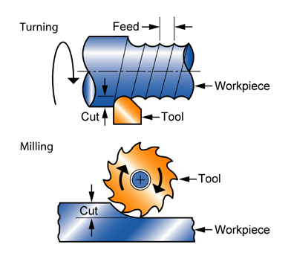
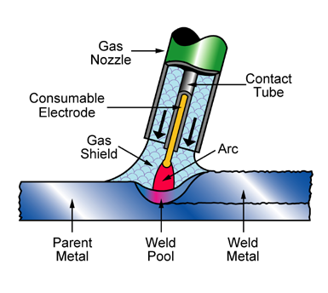
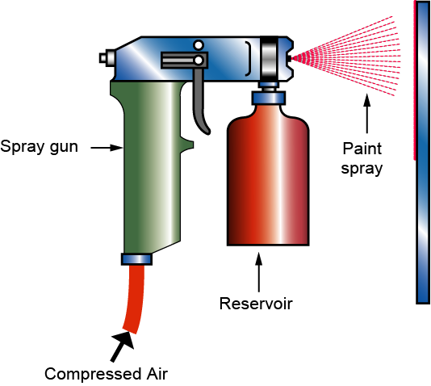
Organizing info: manufacturing processes
Primary
shaping
Secondary
shaping
Injection moulding
Machining
Surface
treating
Joining
Welding
Painting
Notes:
Examples of processes
These schematics introduce the three families of manufacturing processes:
those that create shape, subdivided into primary and secondary (shape modifying processes – principally machining methods)
those that join shapes together, and
those that coat, treat or finish the surface.
These are explored in more depth in Unit 10

Slide 13
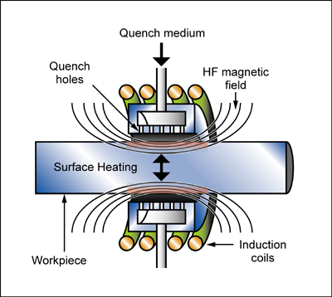
A surface-treatment record*
Induction and flame hardening
*Excerpts from Granta EduPack Level 2
Take a medium or high carbon steel -- cheap, easily formed and machined -- and flash its surface temperature up into the austenitic phase-region, from which it is rapidly cooled from a gas or liquid jet, giving a martensitic surface layer. The result is a tough body with a hard, wear and fatigue resistant, surface skin. Both processes allow the surface of carbon steels to be hardened with minimum distortion or oxidation. In INDUCTION HARDENING, a high frequency (up to 50kHz) electromagnetic field induces eddy-currents in the surface of the work-piece, locally heating it; the depth of hardening depends on the frequency. In FLAME HARDENING, heat is applied instead by high-temperature gas burners, followed, as before, by rapid cooling.
Function of treatment
Hardness
Wear resistance
Fatigue resistance
Economic compatibility
Physical and quality attributes
Relative tooling cost |  | low
Relative equipment cost |  | medium
Labor intensity |  | low
Surface roughness (A=v. smooth) |  | A
Coating thickness |  | 300 | - | 3e3 | µm
Processing temperature |  | 454 | - | 521 | °C
Typical uses
The processes are used to harden…
Links to Processes
Notes:
The key steps in choosing a surface treatment process
This frame shows structured and unstructured data for a surface treatment process. The most critical attributes are the function that the treatment is required to provide and the materials to which it will be applied, accessed via the links.
The key constraints when selecting a surface treatment process are the material to be treated and the function of the treatment.

Slide 14






Ansys Granta EduPack and education resources
Software + Knowledge
www.ansys.com/education-resources
And more…
Video tutorials ● Getting Started Guides ● Charts and posters ● Project Files ● Additional Databases ●
Data Booklets ● Eco Audit Files
Notes:
The content of the Granta EduPack
Now the Granta EduPack itself. It has a number of components, pictured here.
The Granta EduPack software, which implements the methods developed in the Textbooks (see below), enables self-teaching and project work, both elementary and advanced.
Access to PowerPoint Units, with notes
Access to White Papers describing databases, teaching methods, with notes
Access to the Ansys Education Resources site with over 200 resources, continually updated, organised by Subject, Type, Level etc.
The Text “Materials: Engineering, Science, Processing and Design” 4th Edition provides an introduction to the ideas, methods and software for the teaching of materials and process selection.
The Text “Materials Selection in Mechanical Design” 5th edition (ISBN: 978-0-08-100599-6) develops methods for material selection for engineering design.
The Text “Materials and the Environment” 2nd edition (ISBN 978-0-12-385971-6) focuses on eco-informed materials choice.
The Text “Materials and Design, the Art and Science of Product Design” 2nd Edition (ISBN-10: 0750655542) focuses on the industrial design aspects of materials.
The Text “Materials and Sustainable Development” (ISBN 9780081001769) provides a structure and framework for assessment and analysis of sustainable developments focusing on the role of materials.
All five texts are available from Butterworth Heinemann, Oxford.

Slide 15
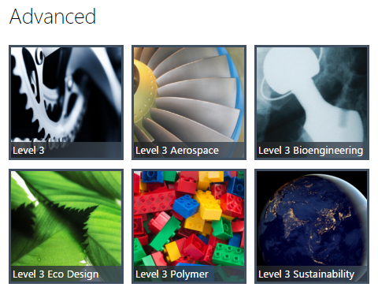
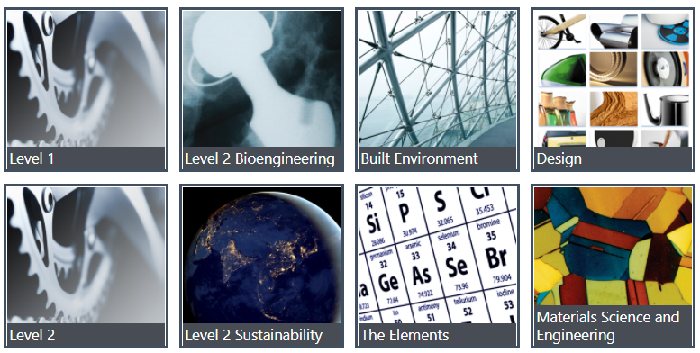
Granta EduPack 2023R2
Databases
Level 1, general
Schools, 1st year college
69 materials, 74 processes
Level 3, general
3rd-4th year, masters and research
4000+ materials, 225+ processes
Level 2, general
1st-3rd year students of Engineering, Materials Science and Design
100 materials, 116 processes
The Elements Database
Schools-University students
149 records, periodic table
Notes:
The opening screen
The EduPack opening screen displays the available databases. On the left are the Introductory databases. Level 1 General Engineering is intended for an introductory course on materials. It contains records for 69 common structural materials and 74 processes. Level 2 General engineering has records for 100 materials and 116 processes with much more extensive data for each, including technical notes, design guidelines, environmental and economic notes. A database on the Elements is useful for most applications as a reference. It also contains Geo-economic and Eco-data of general interest. New from 2020 is the Medical Devices and Design databases.
On the right are the more advanced databases. Level 3 General Engineering has approximately 4200 materials (with records for specific grades in specific states of heat treatment) and 247 processes. It allows real design problems to be tackled. Additionally, there are specialized databases for Bioengineering, Architecture, Polymers, Aerospace materials, Energy-related materials and for the teaching of Eco Design and Sustainability.
All three levels provide supporting information through the Help Menu

Slide 16
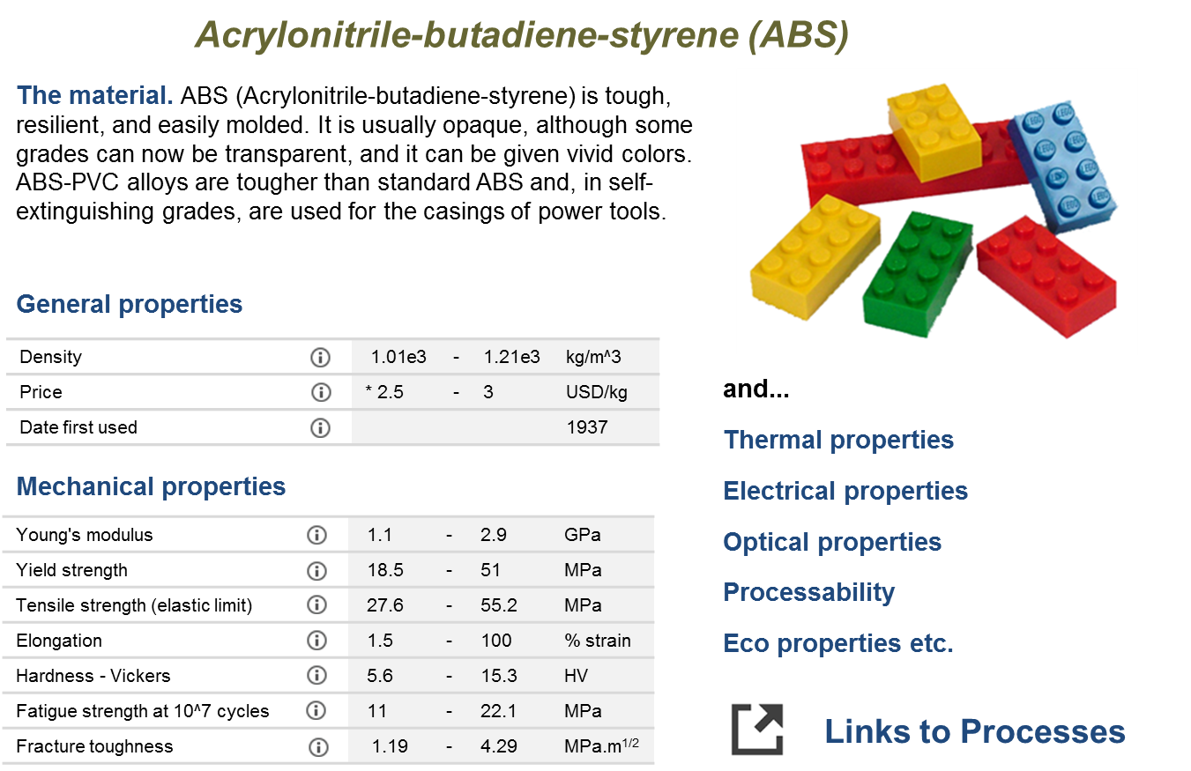
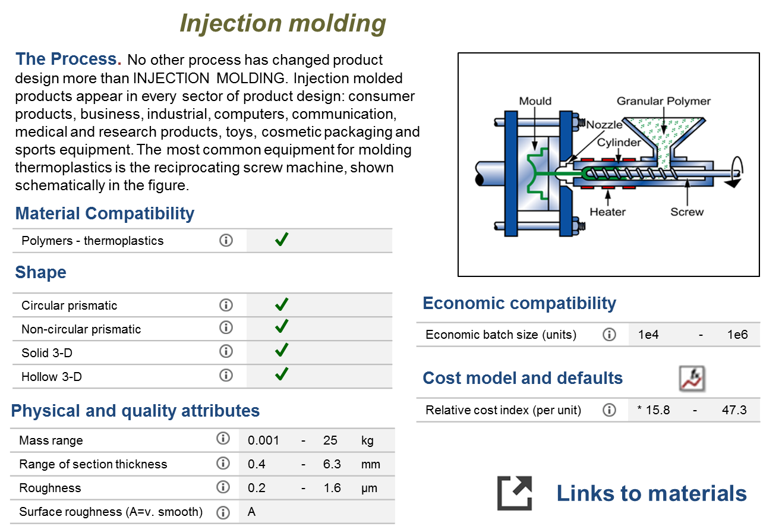
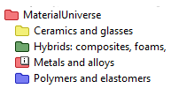
Tools to find information
Table:
MaterialUniverse
Subset:
All materials
Class
Member
ABS
Polyamides
Polycarbonate
Polyethylene
PET
Polypropylene
PMMA
PTFE
Elastomers
Thermoplastics
Thermosets
Notes:
The three primary navigation tabs
Three buttons – Browse, Search and Chart/Select – open the three ways to access information and selection tools.
Clicking on the Browse button on the main toolbar it is possible to use Granta EduPack very much like an interactive textbook. Here we will look at the record for ABS at level 1. You can see that the property information is stored as a range. At Levels 1 and 2 there is only one record available for ABS so as not to overwhelm the student; at Level 3, there are many, describing different grades and blends. The Level 1/2 record shown here effectively summarizes the range of property values for all the standard grades of ABS available.
Scrolling down the record we can see that a limited number of mechanical, thermal, electrical, optical and eco properties are included along with typical uses. At the very bottom of the record there are links to the other data-tables. Clicking on the ProcessUniverse link takes you through to all the processes at Level 1 & 2 that can be applied to ABS. Here we will look at one of the primary shaping processes, Injection Molding.

Slide 17
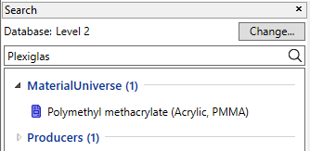
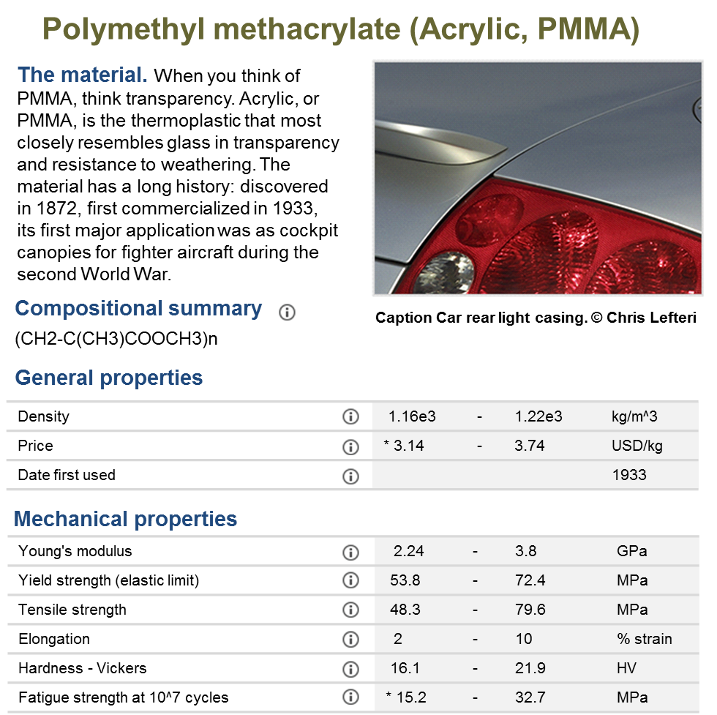
The Search function
About the search function:
Not sensitive to CASE but to spelling
Searches all data-tables
Operators AND, OR, NOT, * …
Categorizes all results
Highlights search term in datasheet
Notes:
The Search engine
The second button on the main toolbar opens a powerful and fast Search engine. The user enters a search term or string at the top of the Search window. The Search engine carries out a full-text search of all the records in the database, listing its findings in the window. This allows searches on both the technical and the trade-names of materials or process, on applications and on conditions.

Slide 18
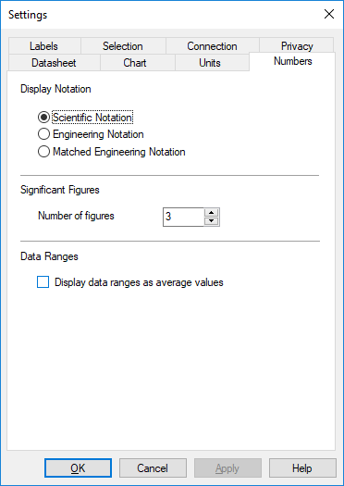
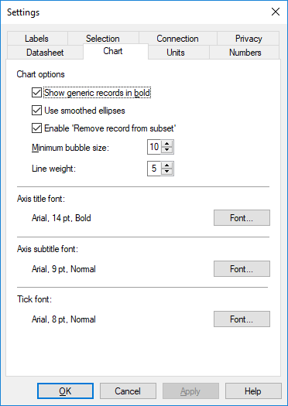
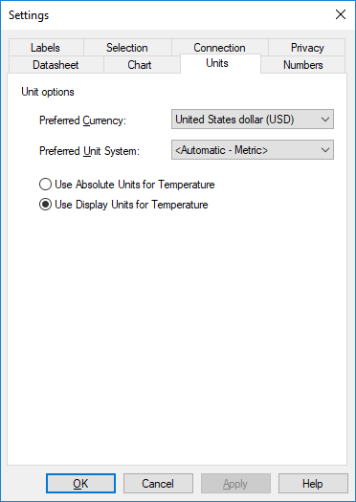
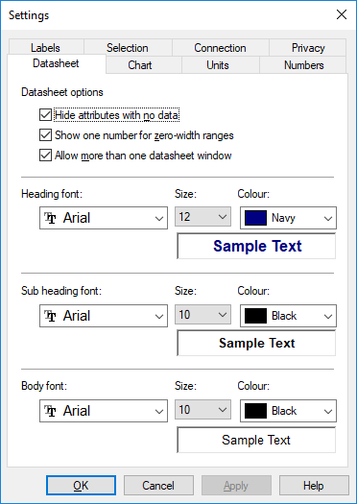
Changing the data settings (units etc.)
Notes:
Changing the Units and adjusting Fonts, Labels and Graphs
All UNITS can be changed. Currency units are selected from pull down menus offering an international range of currencies. The base rate in the software is the US dollar; all others are calculated using exchange rates, upgraded annually. Data units are selected from a second pull down menu offering Metric, SI, US Imperial and UK Imperial.
Temperature can be show in absolute units (Kelvin) or in the display units of the chosen units system: Centigrade in Metric, Fahrenheit in Imperial.

Slide 19

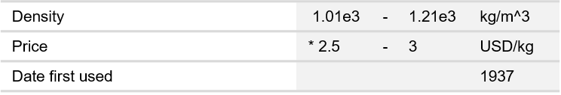
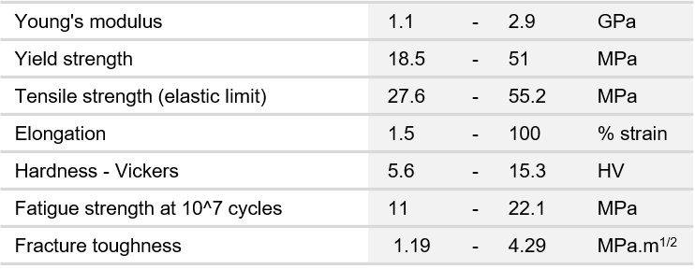
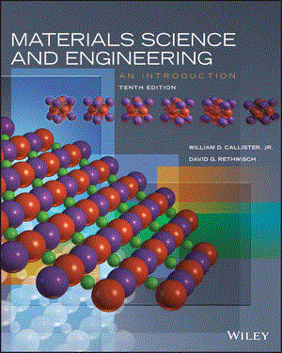
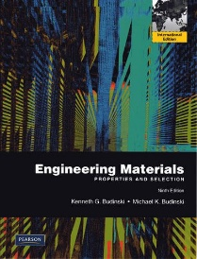
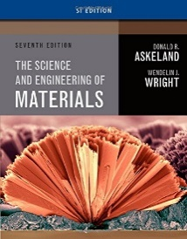
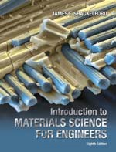
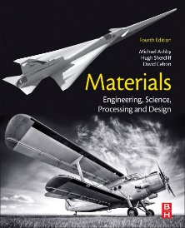
Adding the science
Acrylonitrile-butadiene-styrene (ABS)
Young’s modulus
The material. ABS (Acrylonitrile-butadiene-styrene) is tough, resilient, and easily molded. It is usually opaque, although some grades can now be transparent, and it can be given vivid colors. ABS-PVC alloys are tougher than standard ABS and, in self-extinguishing grades, are used for the casings of power tools.
Definitions and measurement. Figure 1 shows a typical tensile stress-strain curve. The initial part is linear (Hooke’s law), and it is elastic, meaning that the strain is recoverable – the material returns to its original shape when the stress is removed. Stresses above the elastic limit cause permanent deformation or fracture
………
The origins of moduli. Atoms bond together, some weakly, some strongly. If they bind strongly enough they form solids; the stronger the bond, the higher is the melting point of the solid. Think of the bonds as little springs (Figure 3). The atoms have an equilibrium spacing ; a force pulls them apart a little, to , but when it is released they jump back to their original spacing.
. ……….
General properties
Mechanical properties
Author Title Chapter
Callister “Materials Science and Engineering: an Introduction” 6
Budinski “Engineering Materials: Properties and Selection” 2
Askeland “The Science and Engineering of Materials” 6
Shackelford “Introduction to Materials Science for Engineers” 6
Ashby et al “Materials: Engineering, Science, Processing, Design” 4, 5
and...
Thermal properties
Electrical properties
Optical properties
Processability
Eco properties etc.
Links to Processes
Notes:
Accessing the science behind the properties
Each attribute name in a record for a material is linked to pages of Science notes; text and figures explaining what the property is, how it is measured and introducing the Materials Science behind the property. Each note ends with references to chapters in standard Materials Science texts in which more information about the property can be found. The GRANTA EduPack can thus be used as an adjunct to courses based on these texts.

Slide 20
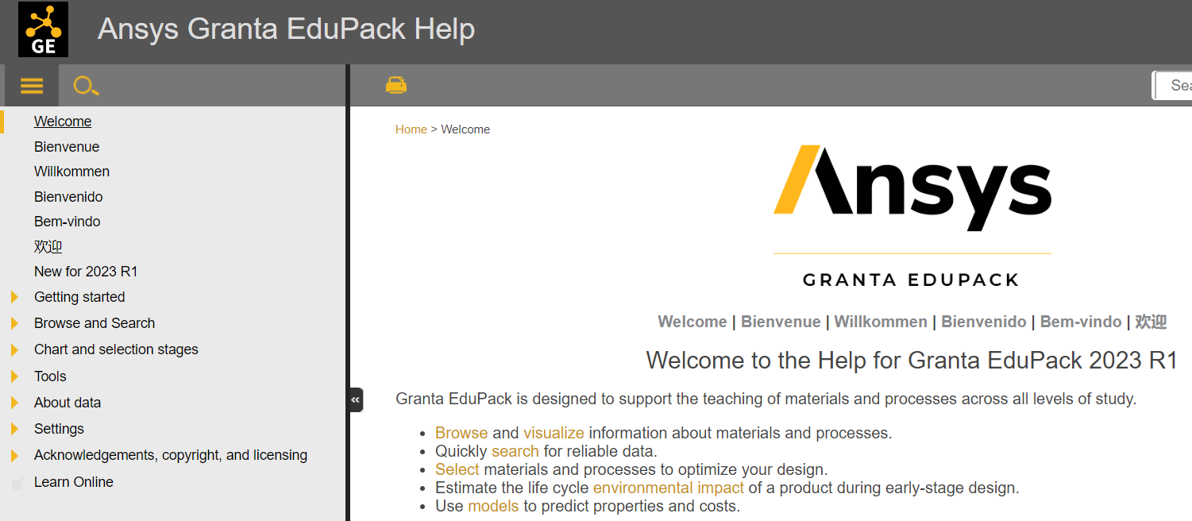
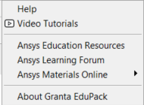
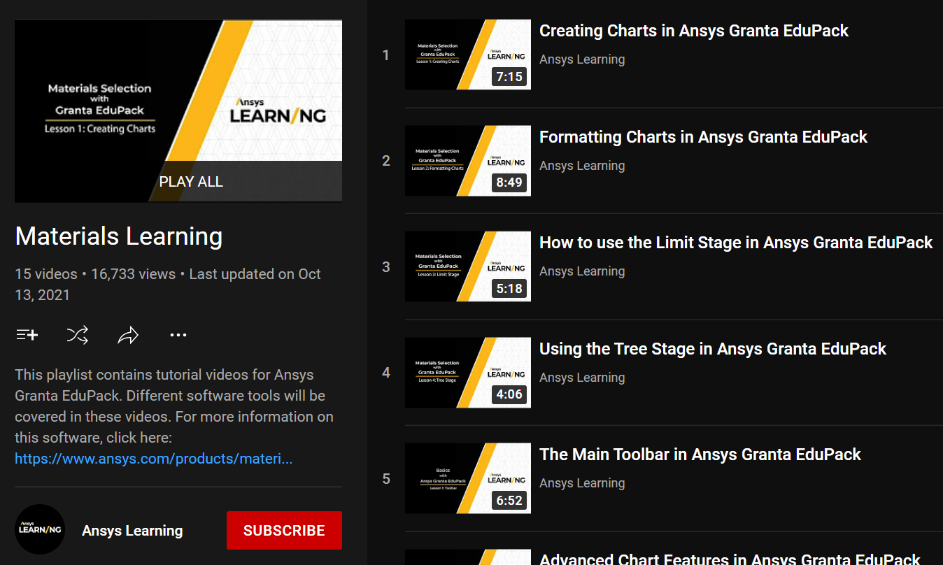
HELP! Video tutorials, White Papers… more
Notes:
Navigating the HELP facility
Extensive context-dependent Help is available both from the Help menu, within records and in dialog-windows for selection.
A comprehensive set of Video-Tutorials introduces the Databases, and demonstrates Browsing, Searching and Selecting
A “Getting Started” guide, down-loaded as a PDF, gives students a quick start
White Papers, documenting the Granta EduPack databases and methods, can be printed or downloaded as PDFs
Lists of Material Indices and much more can be down-loaded as pdf files from within Help

Slide 21


Ansys Education Resources for EduPack
Browse 200+ teaching resources
by Resource Type, Software, Key Discipline,
Specialty Topic, & Language
Exercises with Worked Solutions
PowerPoint Lecture Units
Case Studies
White Papers
Recorded Webinars
Posters
www.ansys.com/education-resources
Notes:
Ansys Education Resources
Ansys Education Resources Website aims to support teaching of materials-related courses in Engineering, Science and Design. The resources come in various formats and are aimed at different levels of student; primarily undergraduate level.
The website also contains resources contributed by Granta EduPack users.
The teaching resource website contains both resources that require the use of Granta EduPack and those that don’t.
Many resources are open access, these resources can also be accessed by students. Other resources are only accessible by educators with an active Ansys software license. Simply fill out the form on the related resource page to get access. For questions, please reach out to the Ansys Academic Development Team at education@ansys.com.

Slide 22
Summary
Classification lets materials data be organized and retrieved
Data take two broad forms:
(a) Numeric, non-numeric data that can be structured
(b) Documentation, usually in the form of text, graphs and images
Granta EduPack allows access to data via
  Browse or Search
Underlying science provided via
  Science notes linked to material property names
  White Papers accessed via Help
  References to leading texts
Notes:
Final summary
The two key concepts here are those of classification (an essential step in organizing information of any sort) and structured and unstructured data for both materials and processes. This unit introduced these and the ways in which the records in the Granta EduPack can be Browsed and Searched.

Slide 23
Lecture unit series
These PowerPoint lecture units, as well as many other types of resources,
can be found in the Ansys Education Resources webpage.
Finding and Displaying Information
Unit 1 | The materials of engineering
Unit 2 | Material property charts: mapping materials
Unit 3 | The Elements database: properties, relationships and resources
Material Properties
Unit 4 | Manipulating properties: composition, microstructure, architecture
Unit 5 | Designing new materials: filling the materials-property space
Unit 6 | Materials Science and Engineering
Selection
Unit 7 | Material selection: translation, screening, ranking, documentation
Unit 8 | Objectives in conflict: trade off methods and penalty functions
Unit 9 | Material and shape: materials for efficient structures
Unit 10 | Manufacturing processes and cost modeling
Unit 11 | Eco-informed material selection
Unit 12 | Eco design and the Eco Audit tool
Sustainability
What is a sustainable development? A materials perspective
Materials for low carbon power
Special Topics
Architecture and the built environment: materials for construction
Structural sections: shape in action
Materials in industrial design: Why do consumers buy products?
The Design database for Products
The Battery Designer tool
Advanced Teaching and Research
Advanced databases
The Aerospace database
The Polymer database
The Synthesizer tool: hybrids and other models
Bioengineering and Medical Devices
www.ansys.com/education-resources
Notes:
Lecture Units Series
This is a list of the Lecture Units available for teaching with the Ansys Granta EduPack. These PowerPoint presentations and more information can be found on the Ansys Education Resources webpage:
www.ansys.com/education-resources.

