Slide 1
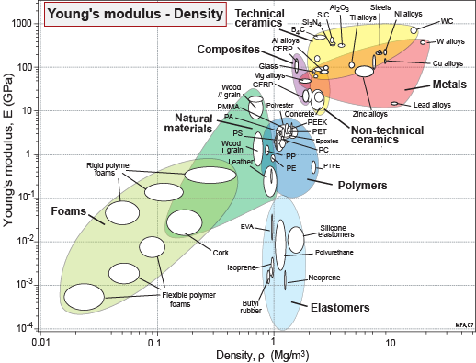
Unit 2.
Material property charts:
Mapping materials
Mike Ashby
Department of Engineering,
University of Cambridge
Notes:
The PowerPoint Lecture Units For 2024
The Lecture Units developed for teaching in connection with Ansys Granta EduPack are listed at the end of this presentation.

Slide 2
Learning objectives for this lecture unit
Intended Learning Outcomes
Knowledge and Understanding | Understanding of material families and their property relationships
Skills and Abilities | Ability to create material property charts for specific purposes
Values and Attitudes | Grasping a broad view of materials information, the big picture
Resources
Text: “Materials: engineering, science, processing and design” 4th edition by M.F. Ashby, H.R. Shercliff and D. Cebon, Butterworth Heinemann, Oxford, 2019, Chapters 1-2
Text: “Materials Selection in Mechanical Design”, 5th edition by M.F. Ashby, Butterworth Heinemann, Oxford, 2016, Chapters 1-2
Texts: Callister, Budinski, Askeland and others – recommended reading in records
Software: Ansys Granta EduPack
Notes:
Learning Objectives
These Intended Learning Outcomes are based on a taxonomy of knowledge and understanding as the basis, skills and abilities as necessary for the practical use of knowledge and understanding, followed by acquired values and attitudes enabling assessments and responsible use of these abilities.
Combined with a suitable assessment, they should be helpful in the context of accreditations or for the CDIO Syllabus.
The Texts listed are from books authored or co-authored by Mike Ashby but other texts are also referred to in the Science Notes.

Slide 3
Outline of lecture unit 2
Exploring relationships: property charts
Making charts
Custom subsets, adding your own materials
Report writing
Notes:
Outline
This is the second Unit of a course on Material and Process Selection. The Units link closely to the first two Texts listed on the previous frame but can equally by used in conjunction with texts such as Callister, Budinski, Askeland and others. The relevant chapters of the Texts are listed on the Outline frame of each Unit. The methods developed in the course are implemented in the Granta EduPack software, which is structured to evolve in pace with the student throughout a four-year engineering program. This first Unit introduces materials and processes, and the way in which information about them can be classified, stored, retrieved and explored.

Slide 4
Bar charts
Data sheets = numbers, words
We want meaning
Property charts
Bar chart
10³
Steel
WC
Copper
10²
CFRP
10
Aluminum
Alumina
Zinc
Young’s modulus, GPa
Lead
Glass
GFRP
1
Many
decades
PEEK
PP
Fibreboard
10⁻¹
PTFE
10⁻²
10⁻³
Metals Polymers Ceramics Hybrids
Log scale
Notes:
Bar charts - schematic
Browsing or searching work well if you know which material or process you want. But they give no comparison or perspective of materials or processes in the database. The simplest way to compare materials is with bar-charts. Here each bar spans the range of the property (Young’s modulus, E, in this schematic). It brings out the differences between material families, and – within a family – between its members.
The values of most properties of engineering materials span a total range of many decades; Young’s modulus, for instance, spans 6 decades (a factor of 10⁶). For that reason a logarithmic, rather than a linear scale is used here.

Slide 5
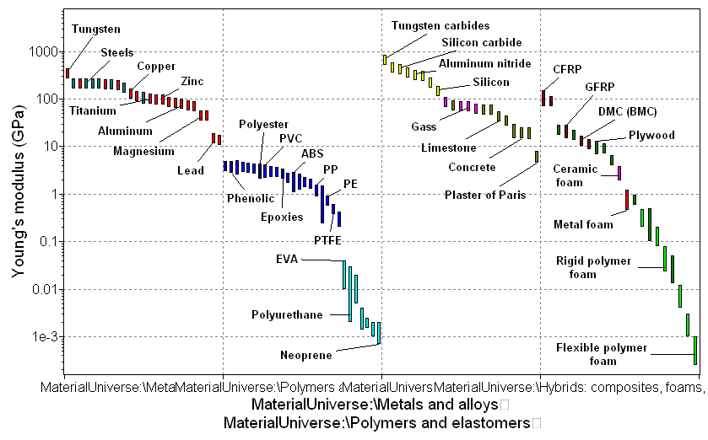
Bar-chart created with Granta EduPack
Materials
with high
modulus
Metals
Polymers
Elastomers
Materials
with low
modulus
Metals Polymers Ceramics Hybrids
Notes:
A real bar chart
Here is the same bar-chart, created using the Granta EduPack software. The software allows the user to create bar-charts for any chosen property (or group of properties), to label the bars and to retrieve records for any material appearing on it. Bar-charts enable the simplest sort of selection – here it is possible to read-off materials that have a given value of E. Because Granta EduPack contains all families of material and all records are full (no missing data, or “holes”), none are overlooked in the selection.
You will find bar charts for many properties in the textbooks listed on the first frame of this unit.

Slide 6

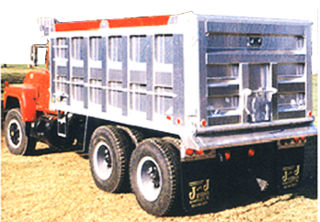



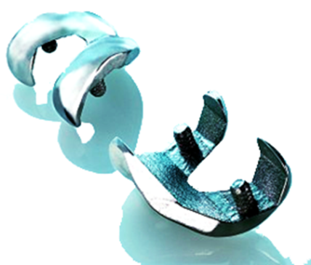

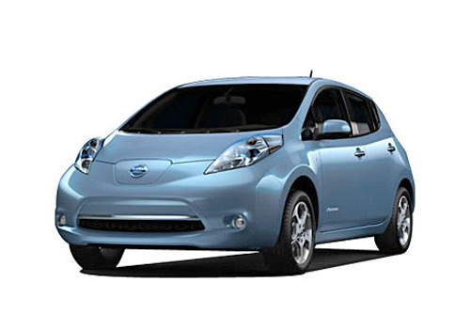
Which courses? Campus-wide?
Materials science General engineering Polymer engineering
Aerospace engineering Architecture Bioengineering
Product design Environmental engineering Sustainability assessment
Notes:
The range of courses supported by the Granta EduPack
The Granta EduPack offers databases for Materials Science, for General Mechanical Engineering and for more specialized courses, among them Polymer and Aerospace Engineering, Architecture and Bioengineering. It also has tools ranging from estimating composite and structural hybrid properties to battery design.

Slide 7
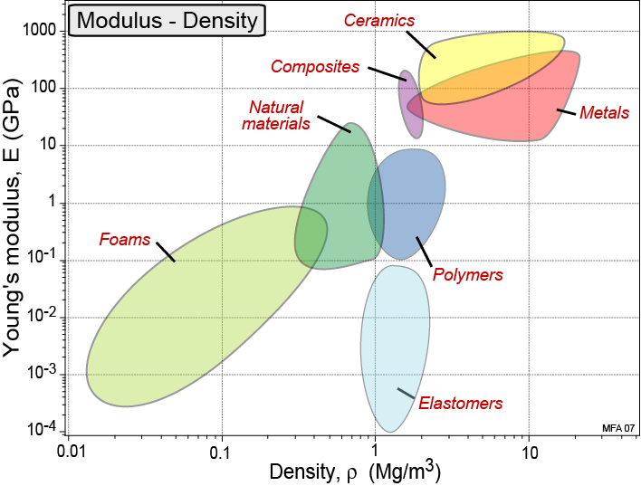
Bubble charts
Bubble
chart
Families occupy discrete fields
Log scales
Notes:
Bubble charts - schematic
The bubble-charts or material property charts allow you to mine the data for patterns. One is shown in this schematic. Here two properties are plotted: Young’s modulus and Density, again using logarithmic scales. When this is done it is found that each family of materials occupies a particular area of the plot – metals near the upper right, foams at the lower left, polymers low central, and so on.

Slide 8
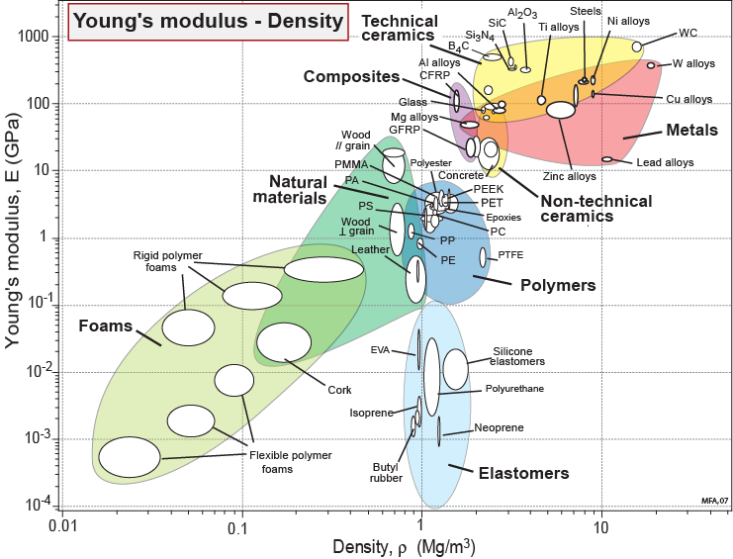
Bubbles chart created with Granta EduPack
Display Box:
Materials with high Modulus and Density
Display line:
Materials
with constant specific stiffness [E/ρ]
Notes:
A real bubble chart
This is a real material property chart (plotted with the Granta EduPack) with the same axes as the schematic of the last frame. Material families are enclosed in large bubbles, within which the material classes appear as smaller bubbles. Each occupies a characteristic area of the chart. This chart, made with the Level 1 Granta EduPack database, has around 70 materials plotted on it. A chart made with Level 3, with around 4000 materials, has the same features.
Even at this early stage the student has a tool: one allowing identification, from hard-copy charts like these, of materials with certain properties or combinations of properties. The charts also help develop a perspective of the materials world, building knowledge of where given material families and classes lie in material property space.
You will find bar charts for many properties in the texts listed on the first frame of this unit.

Slide 9
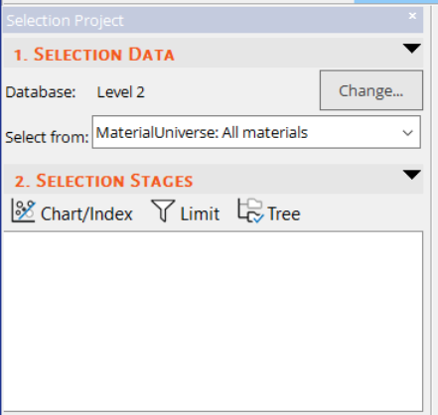
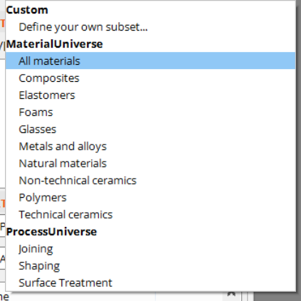
Creating Charts – choosing materials to plot

Slide 10
Creating Charts – single property charts
Bar chart
Property
Choose:
X-Axis
Y-Axis
Y-Axis
Bubble chart
List of properties
Density
Yield strength
Young’s modulus
etc.
Property 1
Property 2

Slide 11
Creating Charts – advanced property charts
Bar chart
Modulus / Density
Modulus / Density
Choose:
+
-
/
*
^
(
)
X-Axis
Y-Axis
List of properties
Density
Yield strength
Young’s modulus
etc
List of properties
Advanced
Density
Yield strength
Young’s modulus
etc.
Bubble chart
Modulus / Density
Yield strength / Density

Slide 12


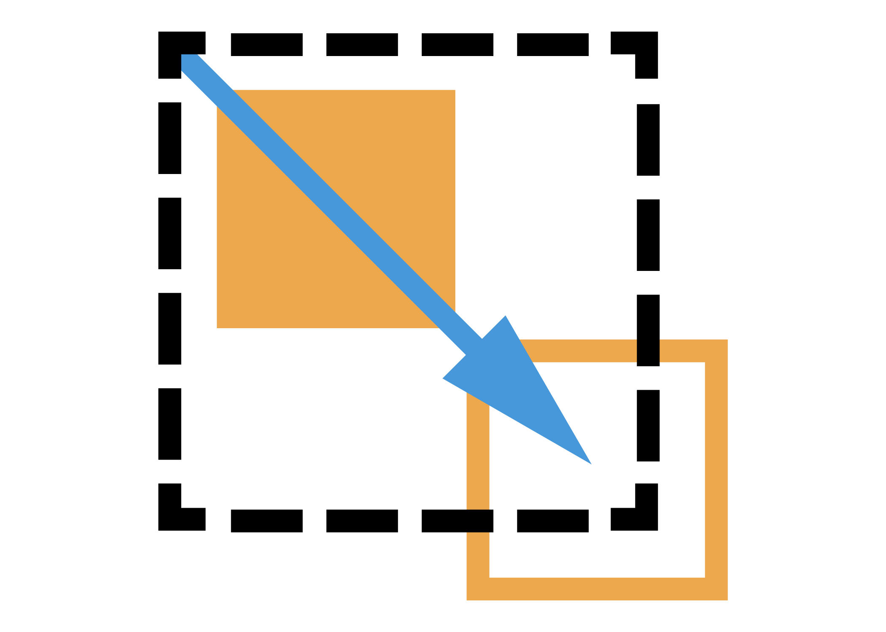
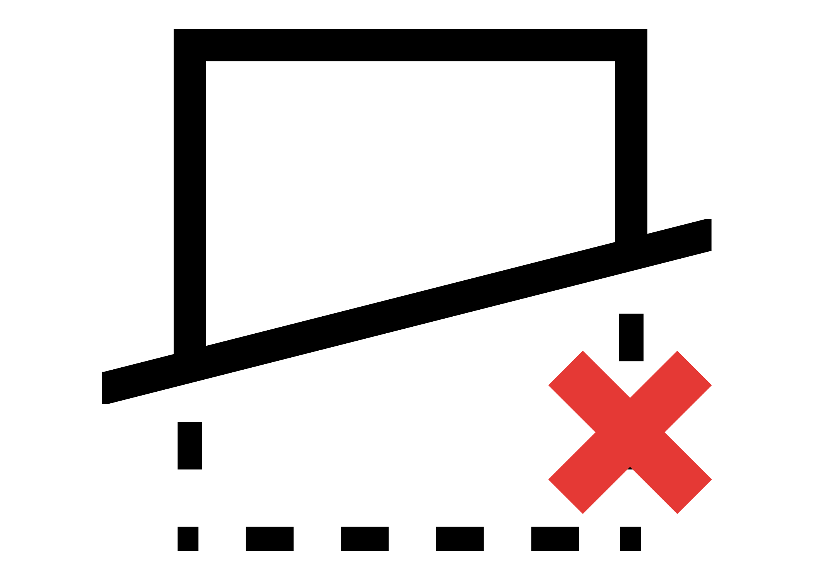








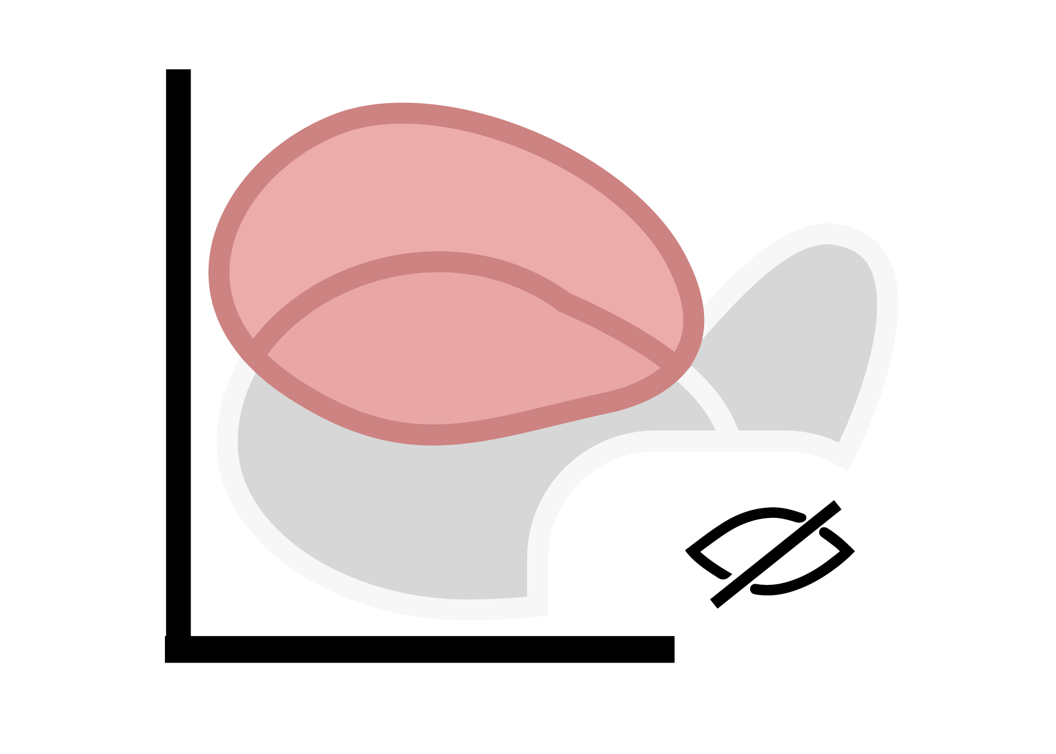

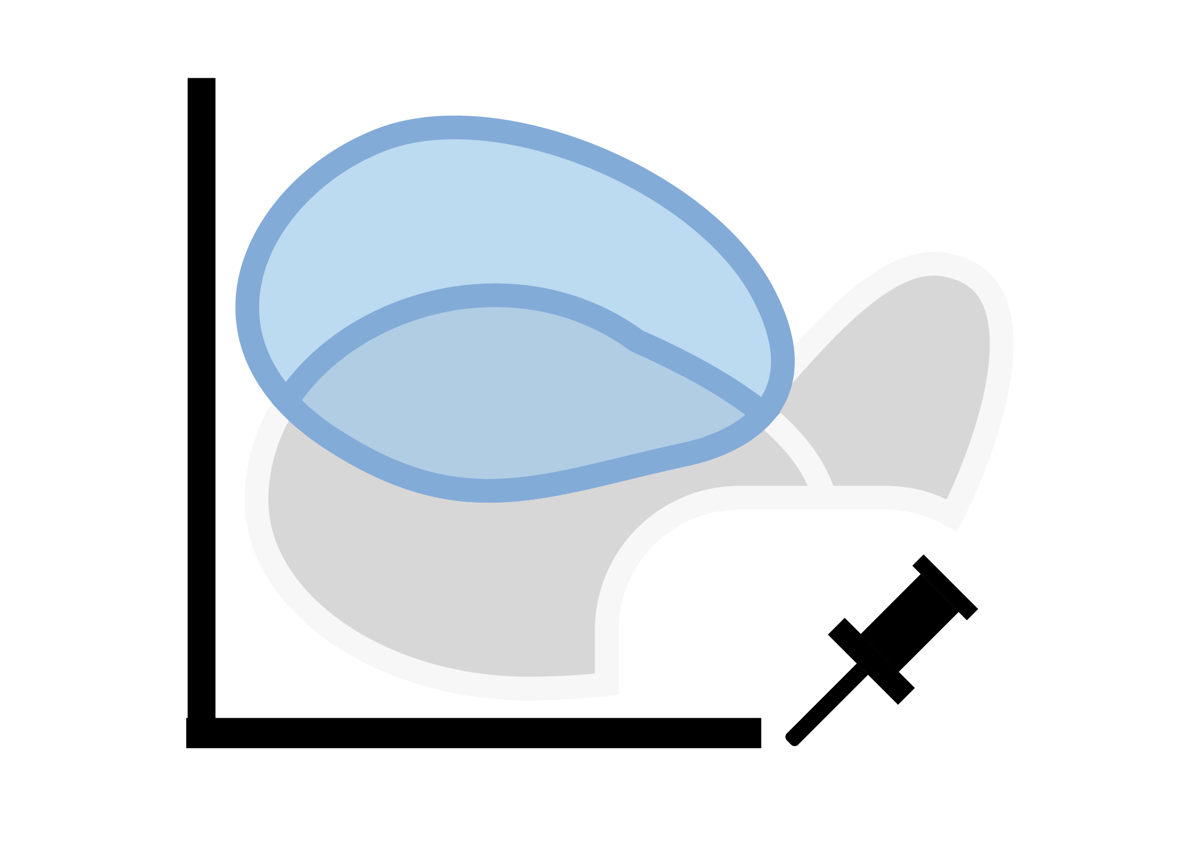


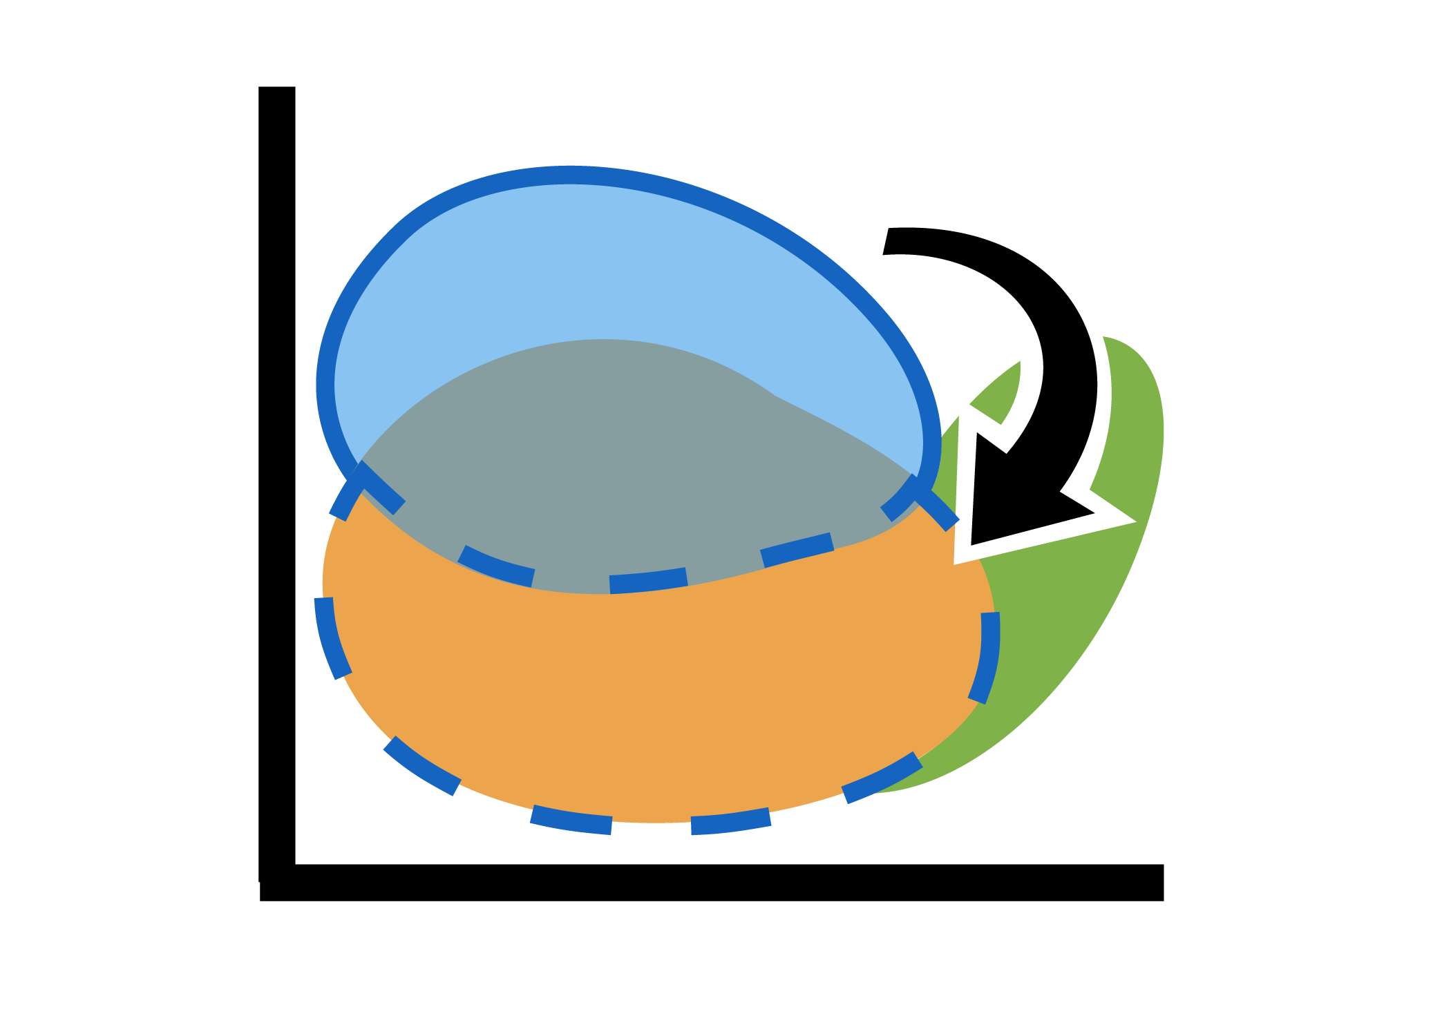
The Chart tool bar
Materials Selection Tools
Chart Annotation Tools
Data highlight tools*
Delete lines & boxes
Curve
Change to nearby record
User defined records
Box selection
Arrow
Synthesized records
Index line
Text
Reference Record
Favorite records
Zoom in
Show family
envelopes
Hide failed results
Chart settings
Zoom out
*these icons will be grayed out unless (1) record type is available in project or
(2) single material is selected on chart
Cursor
Autoscale
Show results from all enabled stages
Chart Scale
Tools
Choosing data shown in chart
Notes:
Selection and Chart Customization tools
All the charts shown in these Units were made with the Granta EduPack software. When a chart is created the chart management tool bar appears across its top edge.
The chart management tool bar provides tools for:
Exploration – of the chart by zooming into selected areas of it
Selection – applying a box or line selection, and removing it again
Customization – of the chart by adding text labels, adding envelopes round the families of materials, making materials that have failed other selection stages appear in grey or disappear altogether
Curve and Arrow annotation can be added to aid comments on the charts

Slide 13
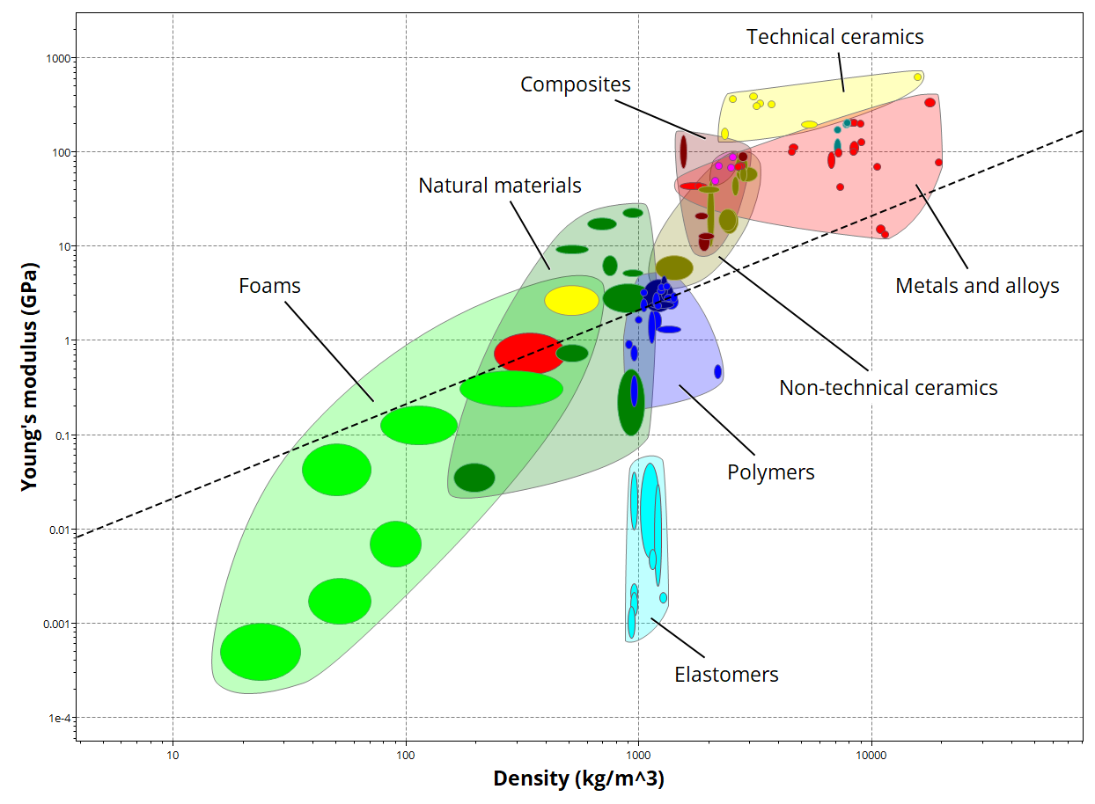
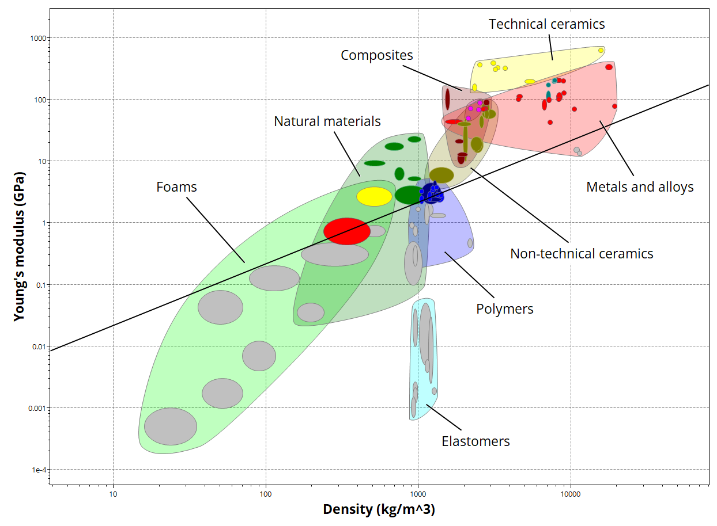
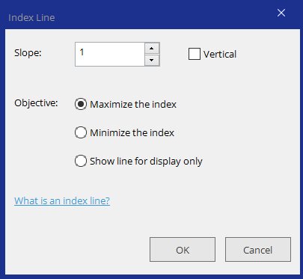
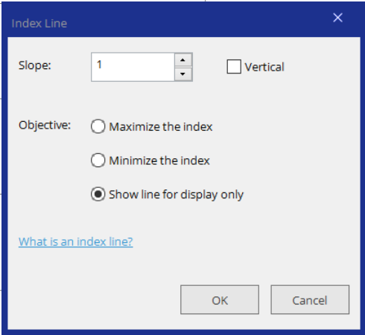
Materials selection chart tools- line and box
For annotation, click “Show line for display only”
For selection, choose maximize or minimize
Notes:
Boxes and Lines can be added using the corresponding buttons on the tool-bar. These can be for selection (screening) or display only.

Slide 14
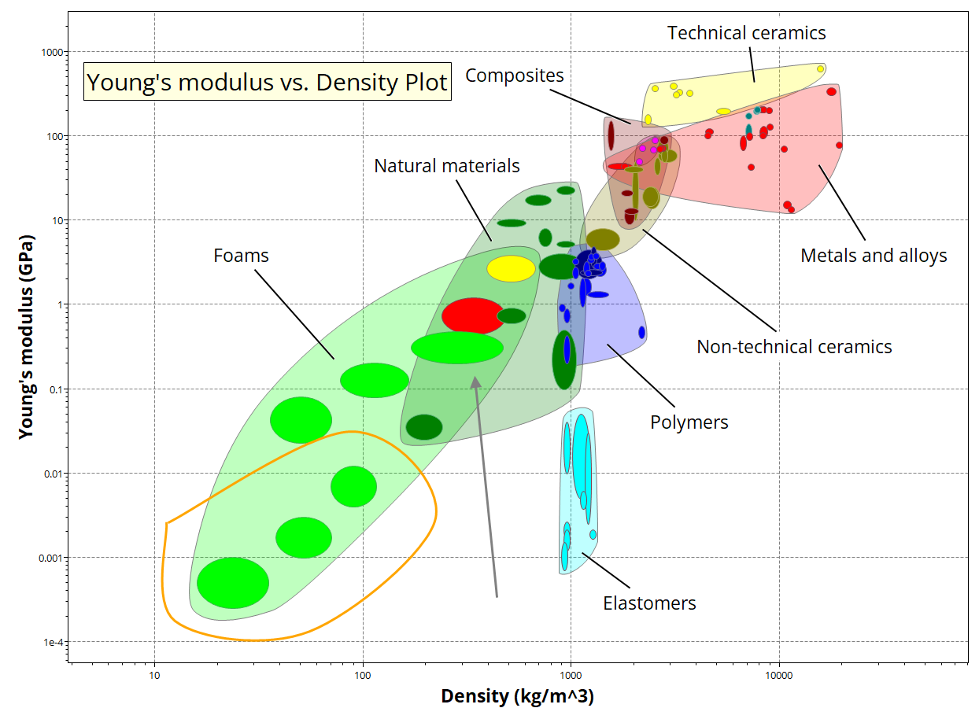
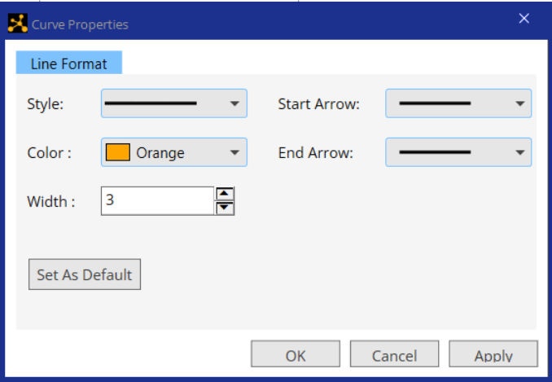
Annotation tools- curve, arrow, and text
Use text, arrows, and curves to increase clarity of information presented
Right click to format line/text
Notes:
Curves and Arrows can be added or edited in the charts. Draw points by clicking and double click on the same point to end the curve. Arrowheads can be edited afterwards.

Slide 15
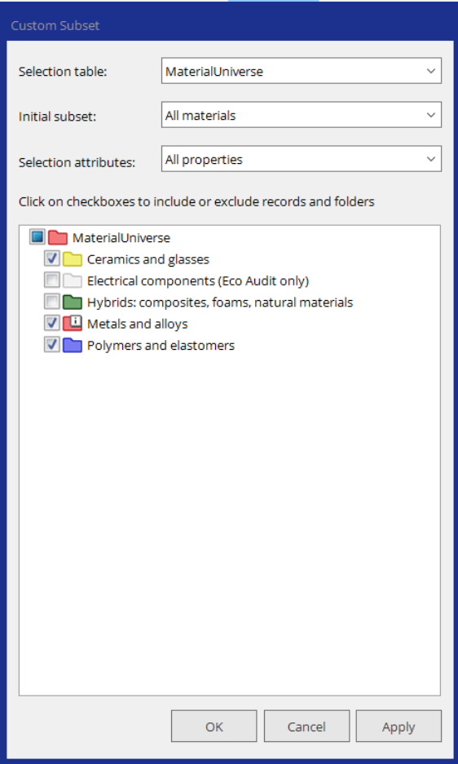
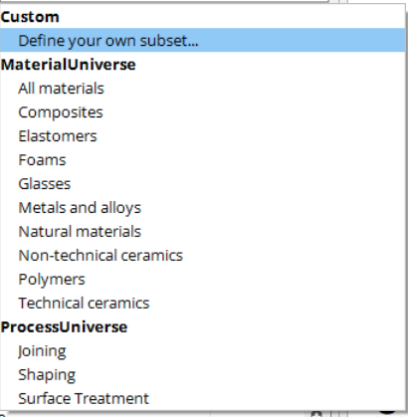
How to make a custom material subset for a selection project
Notes:
Sometimes, we already know that certain material families are not relevant for a given design. Granta EduPack allows you to select a custom subset to start your project with.

Slide 16
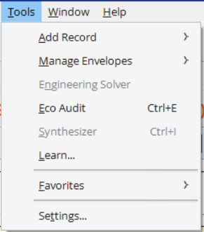
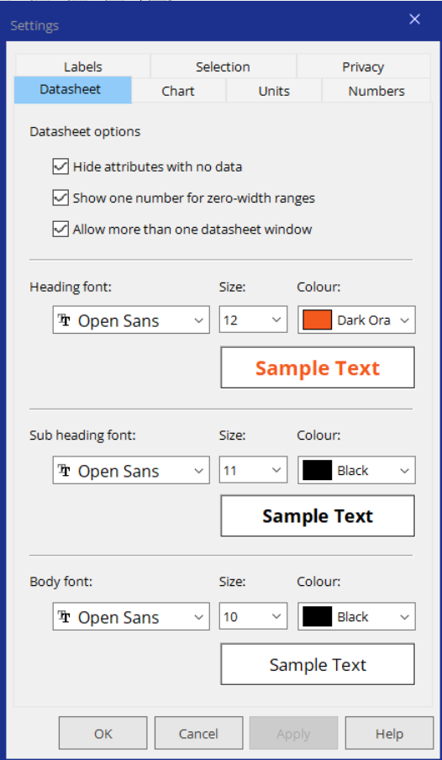
Changing the chart settings (labels etc)
Notes:
Changing the Charts and Labels
All Charts can be customized visually using the Settings button, to edit Fonts, Styles and Colors etc. Both bars and bubbles can be adjusted for visibility and labels can be tailored for your needs.

Slide 17
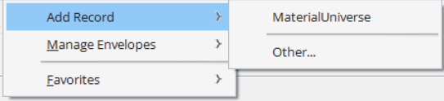
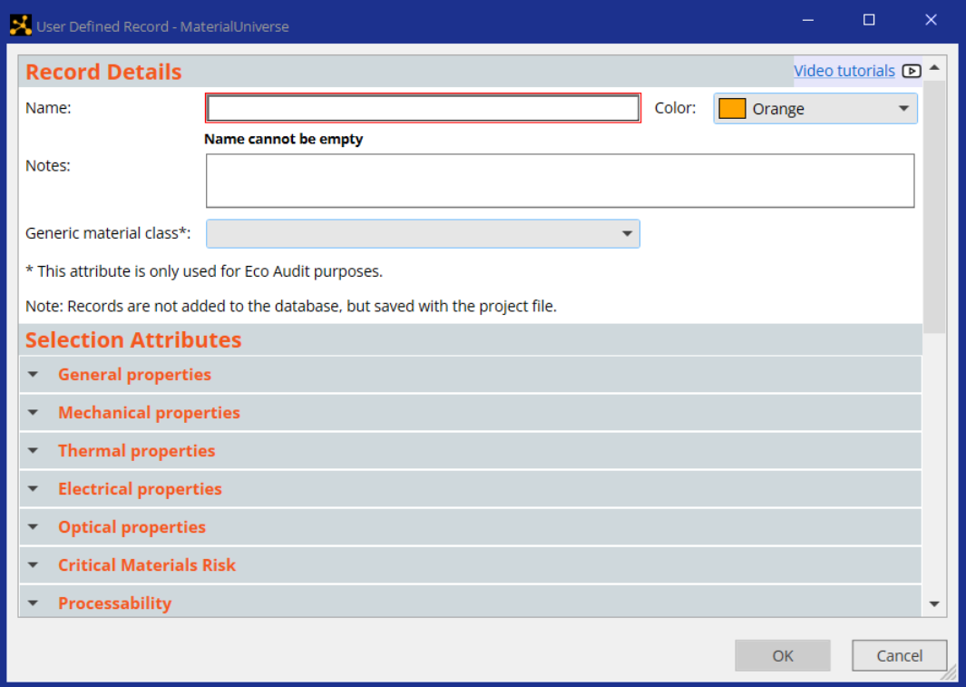
Making your own records in Tools and other ways
Can also right-click on a chart to add records, but will only be able to add the attributes from that chart!
Notes:
Creating a new record for a material
You can add records to the database and populate the properties with your own data. Selecting “Add Record” from the Tool menu, then MaterialUniverse, opens a blank record (one with no values for any of the properties). Simply add a title and data where you have it. The new material will now appear on bar charts and bubble charts together with those already in the database. If you save the project, the new record is saved with it. You can also reach this blank record from the “Other” option, then MaterialUniverse, or from the Tools option in the main menu. Using the “Other” option enables other records than materials to be added. A shortcut to add data directly into a materials chart is by right-clicking in the chart and adding just the relevant properties for that particular diagram.

Slide 18


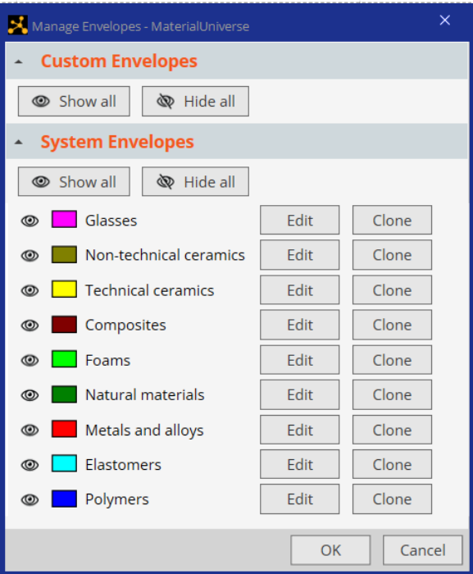
Manage your charts in Tools
Notes:
Creating or modifying material envelopes
You can redefine and modify the default chart envelopes in the property chart within the Tools menus (like Add Record). Selecting “Manage Envelopes” then MaterialUniverse lets you delete certain materials from your envelope. The new envelope can be given a different color. If you save the project, the new record is saved with it. A shortcut to create, add to or remove envelopes in a chart is by right-clicking the materials in the list and selecting the relevant action for your particular diagram.

Slide 19
Saving projects, report writing
Paste
Open project
Save project
Print …….
Cut
Copy
Paste….
Copy - Paste
Clip-board
To
WORD
For best results
Paste Special -
Device Independent Bitmap.
Notes:
Report writing.
Above the principal tool bar are smaller buttons for the pull down menus. The first two are File and Edit, just as in most word-processing or drawing packages. Projects can be saved and reloaded later when wanted. Records and charts can be Copied and Pasted into Word editors, PowerPoint or Adobe Illustrator, etc. To ensure maximum resolution of the charts, use Paste Special and select Device Independent Bitmap in the menu. This facilitates report-writing, allows editing and enables the preparation of professional-quality presentations. The page shown on the right is a copy of a Word document made from the record for ABS in Level 1 of the software.

Slide 20
Summary
Material property charts gives meaning to data
The texts contain many charts – you can copy them for teaching
Project files for many charts can be downloaded from the Granta website
Granta EduPack lets you make any chart you want
You can visualize any database, and add your own records
Comprehensive report-writing facilities
Data
Visualization
(understanding the data)
Selection
(using the data)
Notes:
Summary
The central point of this Unit is the visual presentation of material data and what can be learnt from it, both about the science of the material and about selection for design.

Slide 21
Lecture unit series
PowerPoint lecture units, as well as many other types of resources, can be found in the Ansys Education Resources webpage.
Finding and Displaying Information
Unit 1 | The materials of engineering
Unit 2 | Material property charts: mapping materials
Unit 3 | The Elements database: properties, relationships and resources
Material Properties
Unit 4 | Manipulating properties: composition, microstructure, architecture
Unit 5 | Designing new materials: filling the materials-property space
Unit 6 | Materials Science and Engineering
Selection
Unit 7 | Material selection: translation, screening, ranking, documentation
Unit 8 | Objectives in conflict: trade off methods and penalty functions
Unit 9 | Material and shape: materials for efficient structures
Unit 10 | Manufacturing processes and cost modeling
Unit 11 | Eco-informed material selection
Unit 12 | Eco design and the Eco Audit tool
Sustainability
What is a sustainable development? A materials perspective
Exploring Critical Materials using Ansys Granta EduPack
Special Topics
The Built Environment: materials for construction
Structural sections: shape in action
Materials in industrial design: Why do consumers buy products?
The Design database for Products
The Medical Devices database
The Battery Designer tool
Advanced Teaching and Research
Advanced databases: a lightning tour
The Aerospace edition
The Polymer edition
The Synthesizer tool: hybrids and other models
Materials for Bioengineering
www.ansys.com/education-resources
Notes:
Lecture Units Series
This is a list of the Lecture Units available for teaching with the Ansys Granta EduPack. These PowerPoint presentations and more information can be found on the Ansys Education Resources webpage:
www.ansys.com/education-resources.

