Slide 1
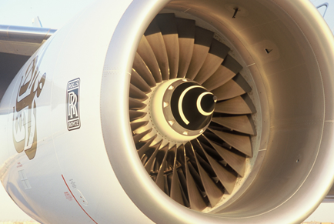
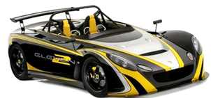
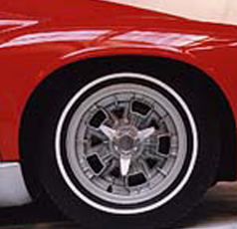
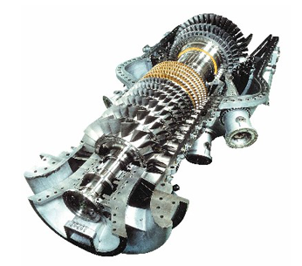
The Aerospace Database
Mike Ashby
Department of Engineering,
University of Cambridge
Notes:
The PowerPoint Lecture Units For 2024
The Lecture Units developed for teaching in connection with Granta EduPack are listed at the end of this presentation.

Slide 2
Learning objectives for this lecture unit
Intended Learning Outcomes
Knowledge and Understanding | Knowledge about relevant datasets for aerospace materials
Skills and Abilities | Ability to find data for aerospace materials, including temperature dependency
Values and Attitudes | Appreciation of complexities and highly specific data of aerospace applications
Resources
  Software: Ansys Granta EduPack Aerospace Database
  A number of Advanced Industrial Case Studies available via the Ansys Education Resources Website
    Ex.- Level 3 Industrial Case Study: Mars Lander Heat Shield
Notes:
Learning Objectives
These Intended Learning Outcomes are based on a taxonomy of knowledge and understanding as the basis, skills and abilities as necessary for the practical use of knowledge and understanding, followed by acquired values and attitudes enabling assessments and responsible use of these abilities.
Combined with a suitable assessment, they should be helpful in the context of accreditations or for the CDIO Syllabus.
The Texts listed are from books authored or co-authored by Mike Ashby but other texts are also referred to in the Science Notes.

Slide 3
Outline of the lecture unit
What are aerospace materials?
The Granta EduPack Aerospace Database
Content and use of the database
Notes:
The Aerospace database
This unit introduces the Granta EduPack Aerospace Database.
In this presentation we will go through a number of topics. We will start with distinguishing between what we call aerospace materials and the rest.
We will then look at the content of the aerospace edition and its most interesting features.
The presentation will end with an exercise on conflicting objectives using this database.

Slide 4
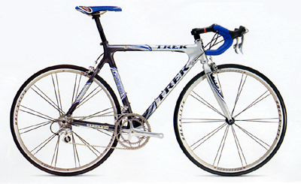
What are aerospace materials?
“Aerospace” materials are those lighter, stronger materials for use in aerospace, motorsport and other high performance fields
These generally comprise light alloys (aluminum, titanium and magnesium) and composites (like CFRP)
Materials for very low or very high temperature (like Ni-alloys or ceramics) can also be part of this group

Slide 5
The quest for lighter and cheaper
Lighter and cheaper materials are typically the goal
However, these are usually conflicting objectives
Data will help you resolve this conflict
Granta EduPack Aerospace Database provides support
Notes:
Optimization
Nowadays we are always looking for a trade/off between weight and cost.
Going for performance means that weight will be preferred over cost and for Aerospace applications this is usually what happens. In most other applications, however, it is very difficult to draw this line. When this is the case, having access to data is extremely important to make informed decisions, and this is exactly where Granta EduPack can help: it provides high quality data and structured methods to decide which materials are suitable for each application.

Slide 6
Level 3 Aerospace Database
MaterialUniverse
  750+ records in ‘Aerospace materials’ subset with many showing temperature dependent mechanical properties
MMPDS¹ – Metals
  The preeminent US source for aerospace.
  2500+ records of statistically-derived design data for aerospace alloys, temperature dependence of mechanical properties, fatigue curves, and corrosion rankings.
  400+ pairs of materials and adequate fasteners from the same source.
MIL-HDBK-17² – Composites
950+ records of test data for polymer matrix, metal matrix, and ceramic matrix composites.
PMP-HDBK Design and Graphical Data
¹ Metallic Materials Properties Development and Standardization ² Composite Materials Handbook – US Deptartment of Defense
Notes:
Level 3 Aersopace database
There are several independent datatables in the Aerospace Database, apart from the usual MaterialUniverse (MU) and ProcessUniverse (PU) datatables.
A special subset of Aerospace materials provides temperature dependent mechanical properties.
MMPDS 'Metallic Materials Properties Development and Standardization’
The records contain statistically based design data, corresponding to the tabular data in the Handbook, and graphical data, i.e. x-y data plots, corresponding to the figures in the Handbook.
The tree structure of the database is based on that in the handbook itself. The tree branches in the following way:
Alloy – Temper/Condition – Form – Dimension – Statistical Basis
MIL-HDBK-17
Data from the US Department of Defence Military Handbook, Mil-HDBK-17 "Composite Materials Handbook", has been compiled into a Granta EduPack database. This comprises of two data tables; MIL-HDBK-17 Handbook Data has 950+ records containing test data from the MIL-HDBK-17 document. This also has MIL-HDBK-17 Summarized Data table which has 91 records, some of which contain graphical data, e.g. stress-strain and fatigue charts.

Slide 7
Granta EduPack Aerospace database structure
The
database
PMP-HDBK
Shape
data-table
References
data-table
MMPDS
Materials
data-table
Processes
data-table
Links
Suppliers
data-table
Structural Sections
data-table
MIL-HDBK-17
Aerospace
Database
Specific Data
Notes:
Granta EduPack Aerospace Database structure
The structure of the database is very similar to the others of EduPack Level 3, although the wealth of data is sometimes overwhelming.
It relies on the proven MaterialUniverse, ProcessUniverse, Shape and Structural sections data-tables linked together, plus the MMPDS and MILL-HDBK-17 data-tables connected to the Material

Slide 8
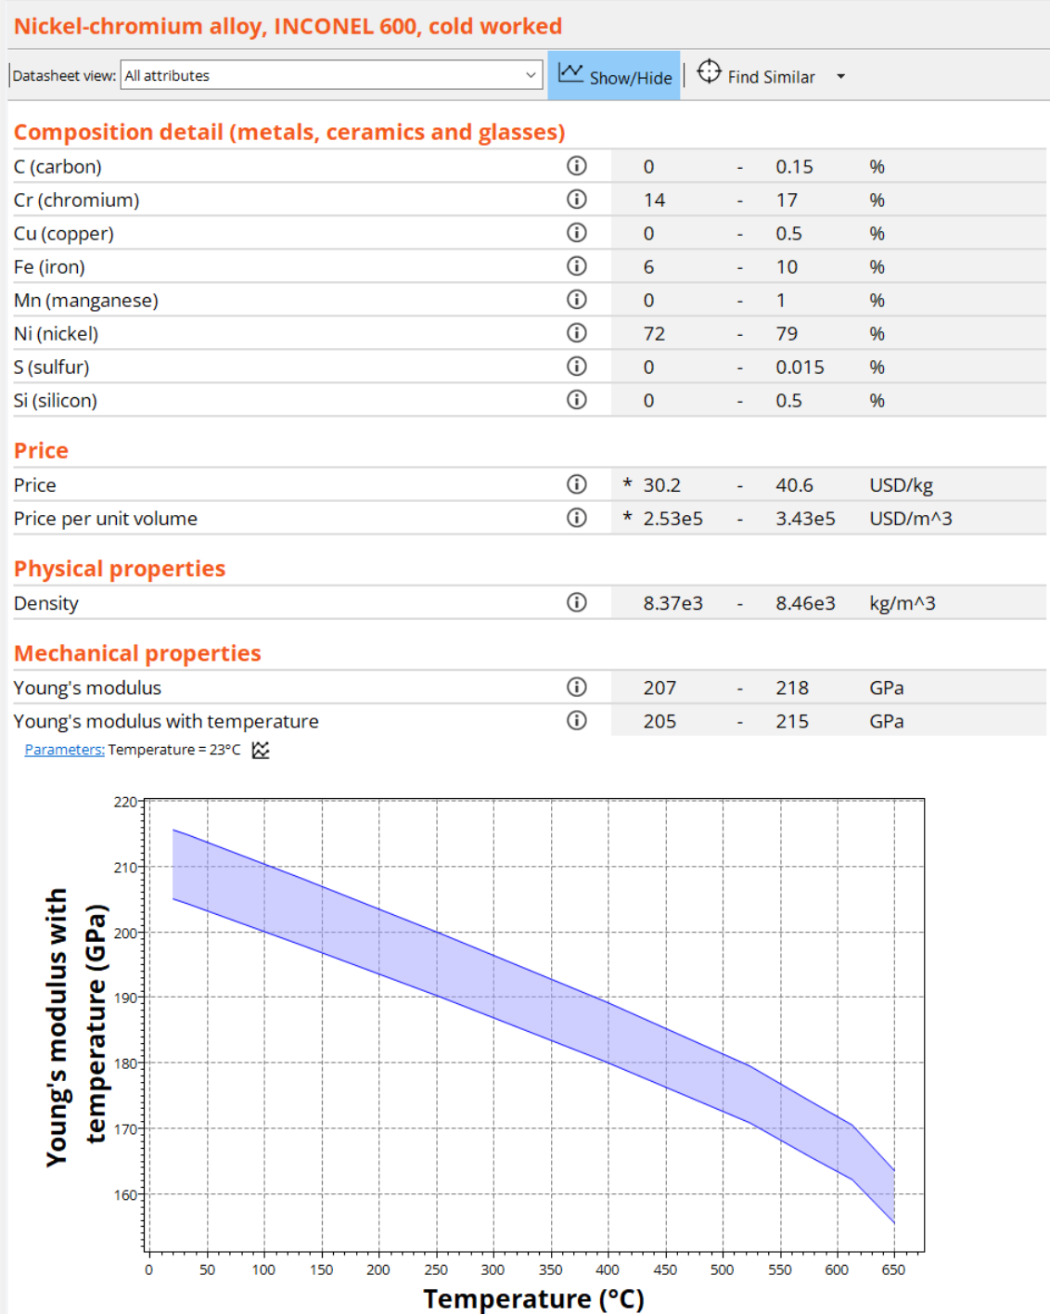
Materials Universe – Aerospace subset
Each material in the Aerospace subset links to the MMPDS (metals) or MIL-HDBK-17 (composites) tables.
Each record has all the attributes of the 'All bulk materials' subset, as well as additional temperature dependant functional data.
It allows materials comparisons and selection on a database with no holes.
Notes:
Aerospace subset
Each material in this subset can either be found in MMPDS or MIL-HDBK-17. Each record within this subset has all the attributes of the 'All bulk materials' attribute group, as well as additional temperature dependant functional data attributes.
You can set the temperature at which you would like to view the temperature related data. Selections will use data at the temperature you set to measure the material against any criteria you set for the temperature dependant properties. Any graphs created with the temperature related data will be correct for the temperature you have set in the parameters dialog box.

Slide 9
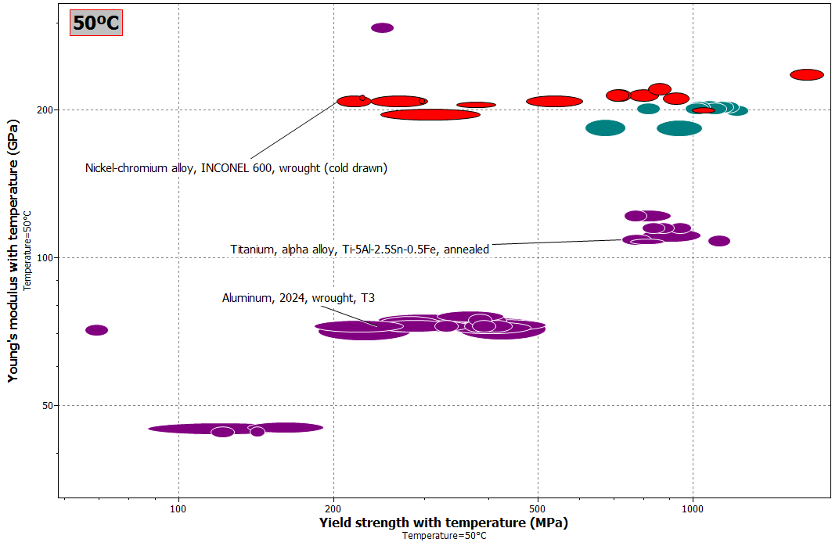
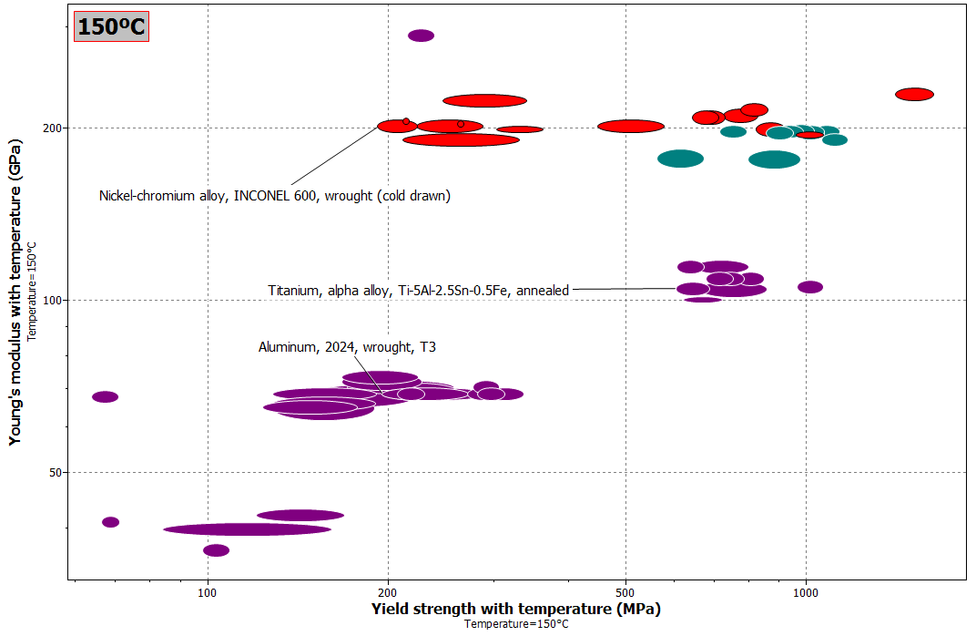
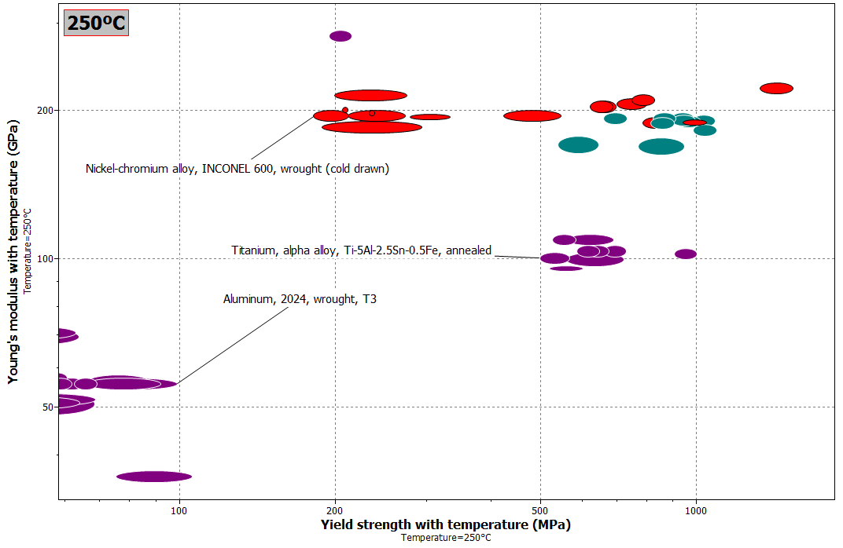
Temperature dependence
Sequences can be “animated” manually
Notes:
Temperature dependence
The temperature dependence of properties can be illustrated with charts.
Looking at the three material bubbles shown (Inconel, Titanium and Aluminum) in a plot of Young’s modulus against yield strength at various temperatures, you will see the materials moving from the top right to the bottom left as temperature increases.
This can be obtained by simply defining the parameter “Temperature”, and the plots will be automatically refreshed in the software.

Slide 10
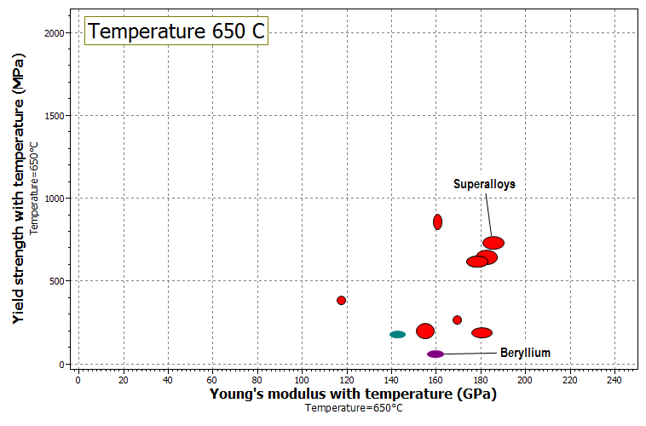
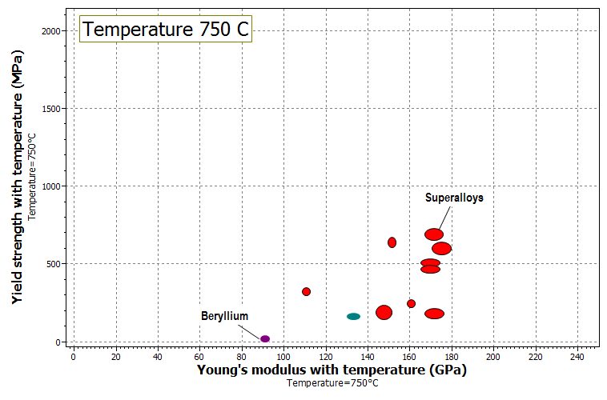
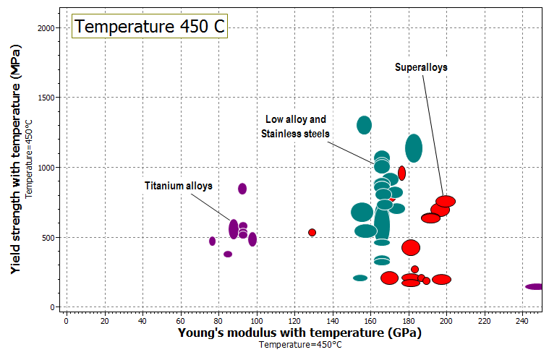
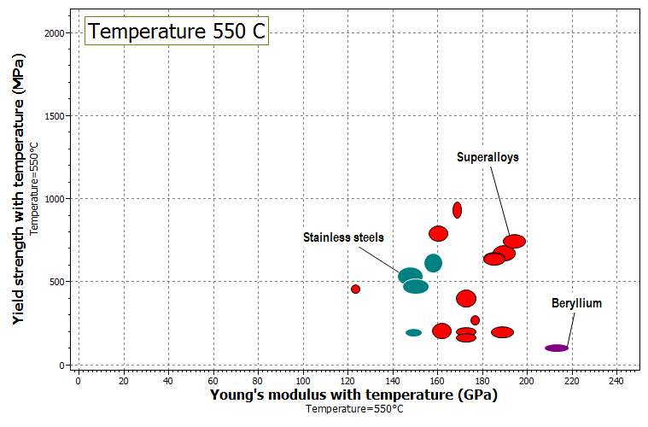
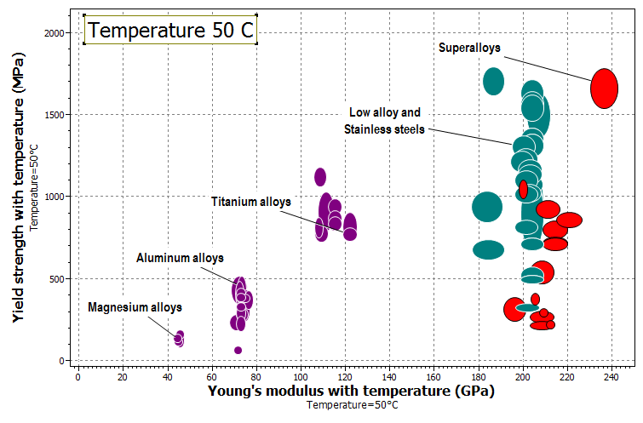
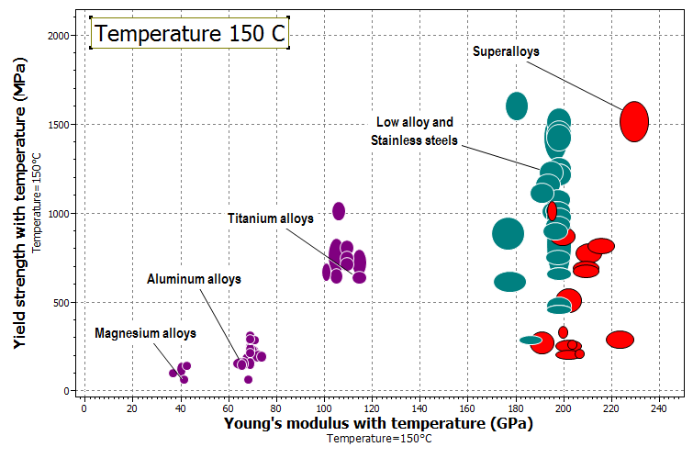
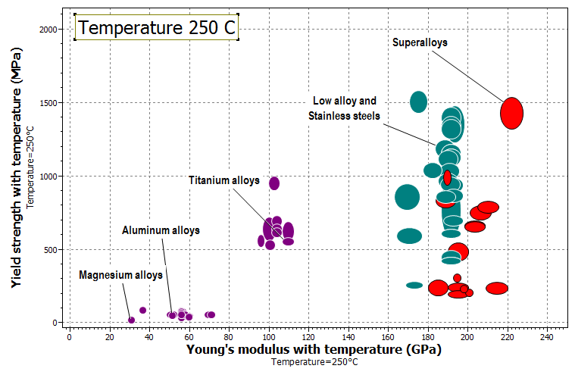
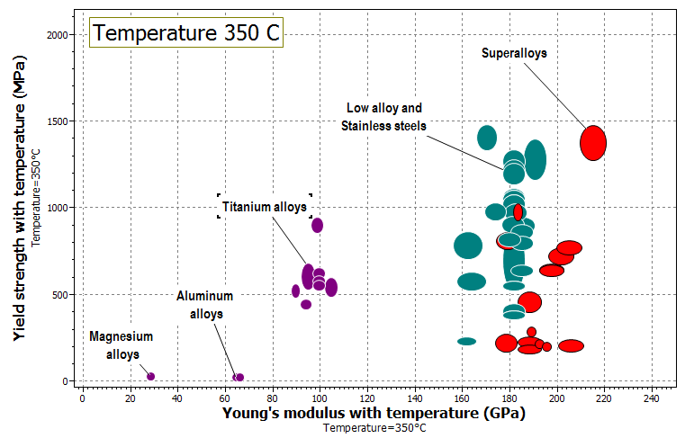
Temperature dependence
Notes:
Temperature dependence
The temperature dependence of properties can be illustrated with charts.
Looking at the three material bubbles shown (Inconel, Titanium and Aluminum) in a plot of Young’s modulus against yield strength at various temperatures, you will see the materials moving from the top right to the bottom left as temperature increases.
This can be obtained by simply defining the parameter “Temperature”, and the plots will be automatically refreshed in the software.

Slide 11
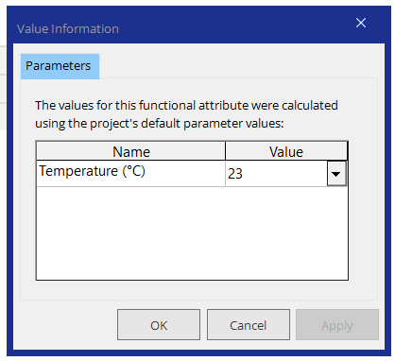
Inconel Level 3 record (MaterialUniverse)
Notes:
Example
Browsing for one of the Inconel records in MaterialUniverse will show the following data.
You can set the temperature at which you want the property ranges to appear.
Clicking on the icons on the right will give a graph of the range of variation of each property with temperature.
Data on durability, corrosion and enviromental impact is also available

Slide 12
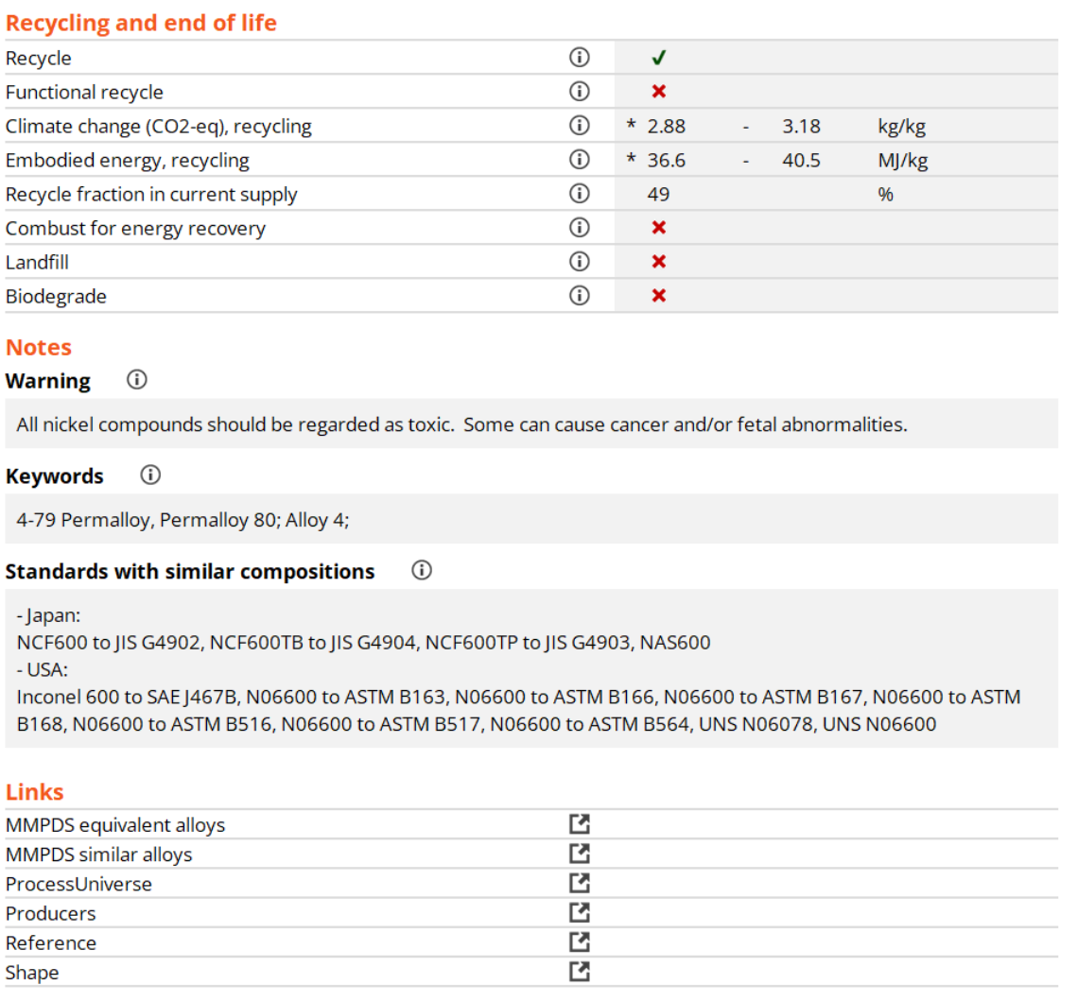
Inconel Level 3 record (MaterialUniverse)
Notes:
Example
At the end, further notes are provided.
In this particular case a warning is made about the toxicity of Nickel.
Links to either the MMPDS (for metals) or the MIL-HDBK-17 (for composites) gives you extra high quality data on certified materials, usable for design calculations.

Slide 13
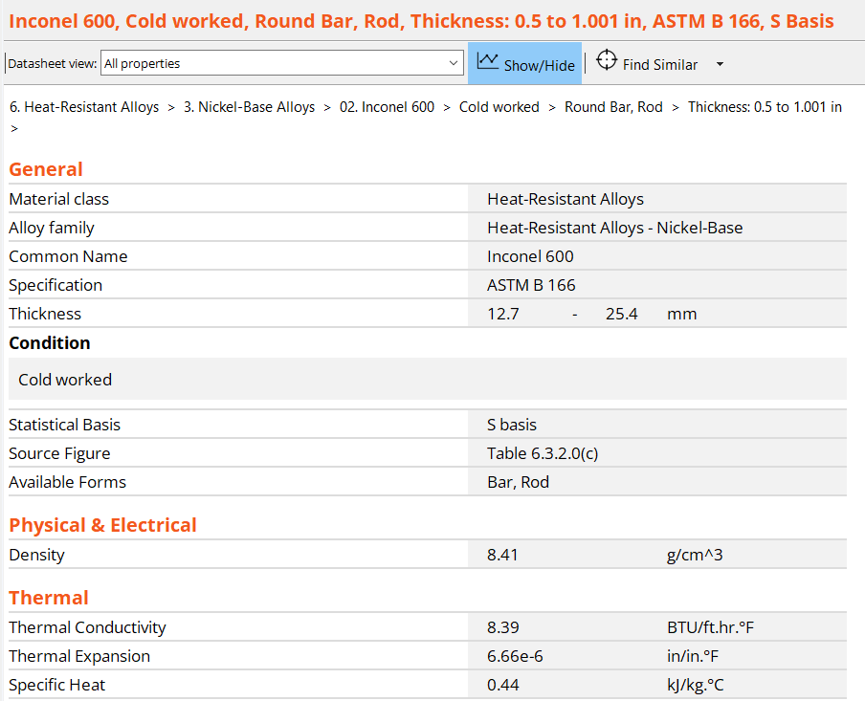
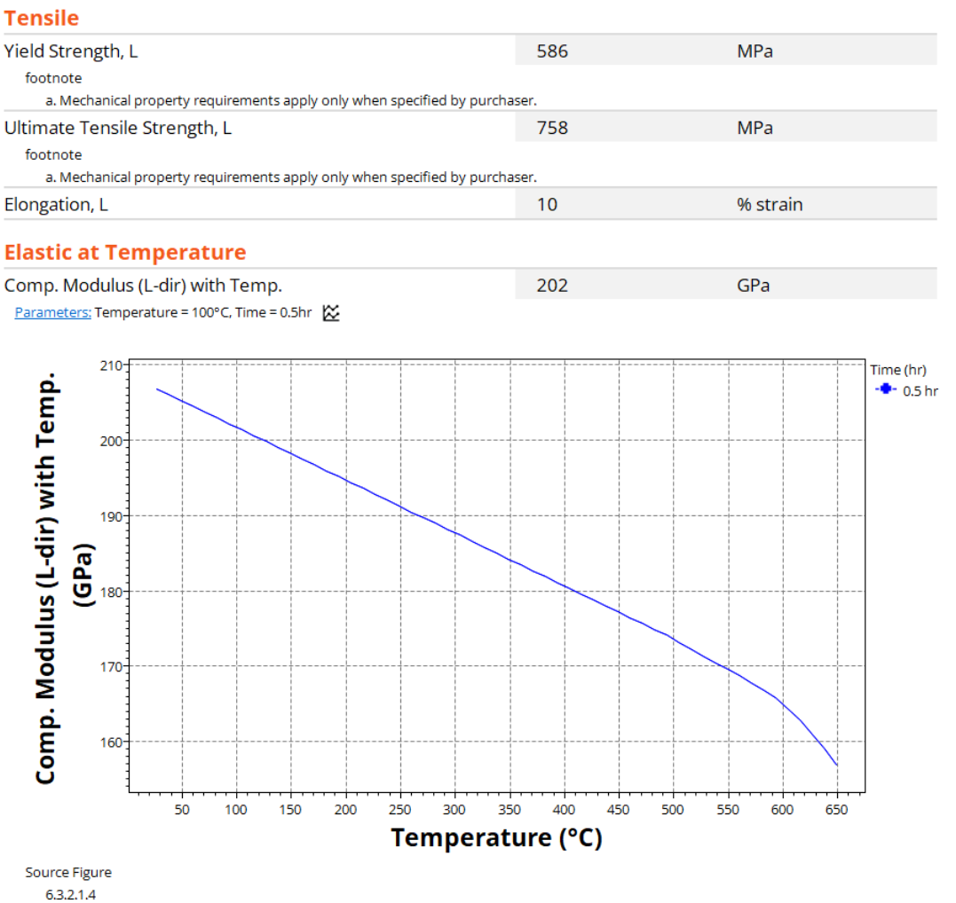
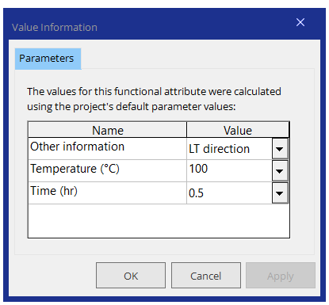
The MMPDS data record (Inconel 600, Cold drawn)
Notes:
MMPDS data record example
The MMPDS datatable is organized in the same way as in the printed edition of this handbook.
Each family (corresponding to a chapter in the handbook) deals with Steel, Aluminum, Magnesium, Titanium, Heat resistant alloys and other miscelaneous and hybrids.
Going deeper into the Titanium family will eventually bring you to a single material record like this one. Some genaral information, physical, elastic, thermal, tensile, compression, shear and bearing properties are presented. “L” in these properties means that they were measured in the direction of drawing (longitudinal) of the material, this being a record for cold drawn tubing.
Scrolling down, a number of other properties appear, with temperature dependence. You can show or hide the graphs for temperature-dependent properties with the button by the data.
For these properties, you can get their numerical value for a particular temperature by choosing the appropriate parameters, or you can view the graph for the entire range of temperatures available. Notice that in this case, the graph shows a line, not a band of values. This means that the data provided has no range of variation, it is accurate (statistically).
Let’s now see what comes up when you search for an Inconel in MMPDS. Looking deeper into one of the Inconel records in MMPDS will show the following data.

Slide 14
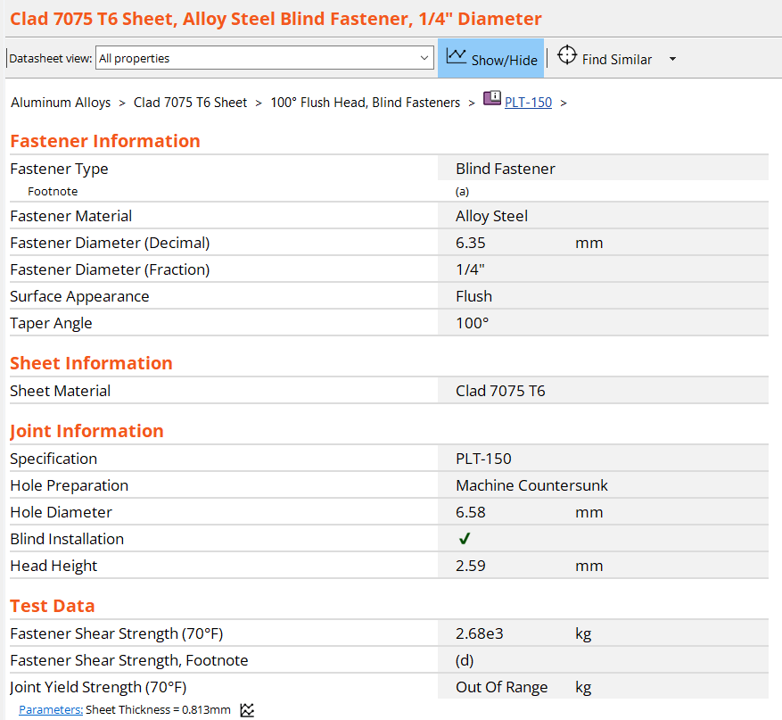
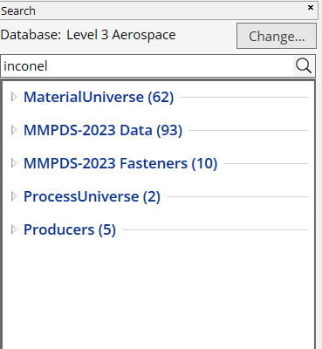
Searching for Inconel in MMPDS
Notes:
Search: Inconel
Searching for Inconel will yield 60+ different Ni-Cr alloy records in the MaterialUniverse and 90+ in MMPDS.
The MMPDS has two independent datatables: one for data (the one typically shown) and another for Fasteners.
The latter provides information about fastener types and the materials they are used with.
Looking for Inconel in the Fasteners datatable will give you 10 records for fasteners made of Inconel.

Slide 15
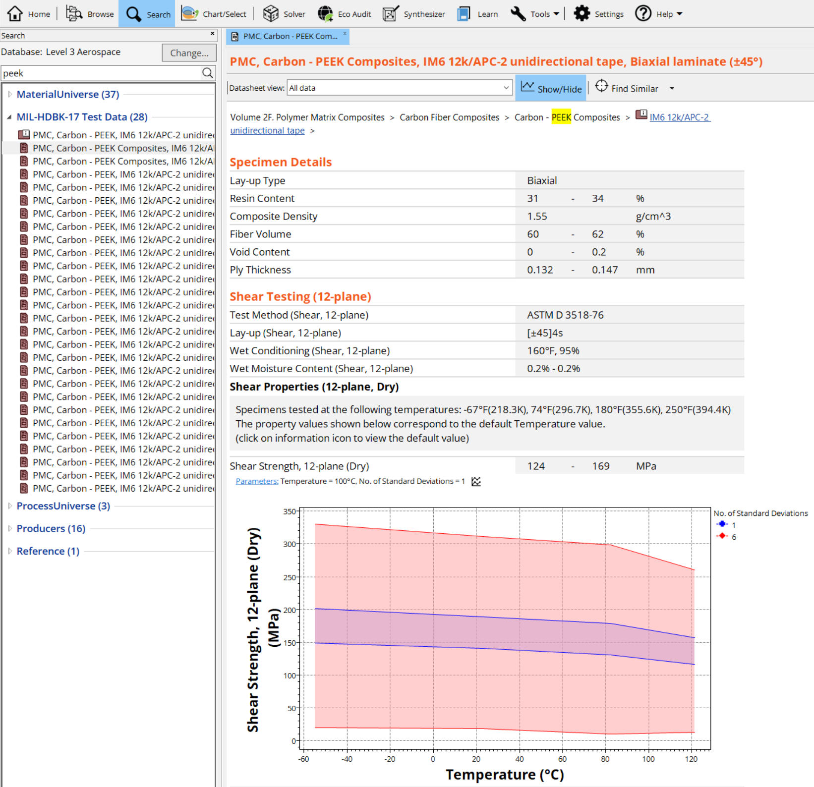
Information on PEEK in MIL-HDBK-17
Notes:
PEEK
Searching for PEEK, a thermoset resin commonly used in composites with carbon fibres for aeronautical applications, will yield 28 records as shown.
This is a record for a carbon/PEEK composite. This one in particular is for unidirectional tape prepeg, tested in tension along the axis of the fibers. The specimen details and test settings are described and the statistical results are shown for ultimate strength, modulus and Poisson’s ratio. Note also that the statistical parameters are clearly shown.
This data helps in design, as composites are made by stacking layers of tape like this one in various orientations, and the designer needs to know the mechanical properties of each lamina to be able to predict the global properties of the composite.
The designer can do all the calculations or he/she can use instead the Hybrid Synthesizer tool built into the software.
In this table there are also some “folder level” records, that have general information applicable to all the records bellow their level.
They are easily identifiable by a different icon, and they represent a set of records, not a single record. The folder level records have general supplier information and a variety of other topics like the tests performed or the ply thickness and fiber volume fraction.
They frequently appear when search for keywords, but be aware that they are not “material records” as such, they just contain general information on the material records they encompass.

Slide 16
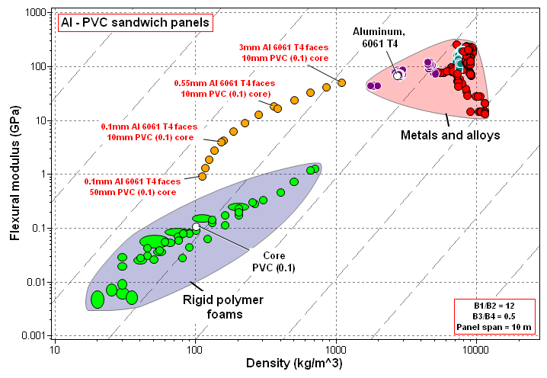


The Synthesizer tool for hybrid materials
If you want to model new composites you can use the Hybrid Synthesizer tool included in Granta EduPack Aerospace Database
This tool helps you create virtual composites and compare them with those available in the database for a number of physical, mechanical, thermal and electrical properties
Build your own foams, sandwich structures or composite laminates
Further information is available from Lecture Unit Hybrid synthesizer
Enhanced
performance
$$Material Index \\ E^{1/3}/ρ$$
Slope 3
Notes:
Hybrid synthesizer
The Hybrid Synthesizer tool helps you model new particle - or fiber-reinforced polymers, foams and sandwich structures, and compare their physical, mechanical, thermal and electrical behavior with the existing materials in the database.
Further information is available from Lecture Unit: The Synthesizer Tool of this lecture series, but a very brief summary of what the tool can do is seen in this plot.
Here you can see the modeling (the orange dots) of sandwich panels with Aluminium 6061 T4 face sheets with PVC foam core, on a plot of flexural modulus versus density. If a panel of this material is loaded in bending, its performance surpasses the performance of both face and core materials, effectively bridging the gap between the two materials.

Slide 17

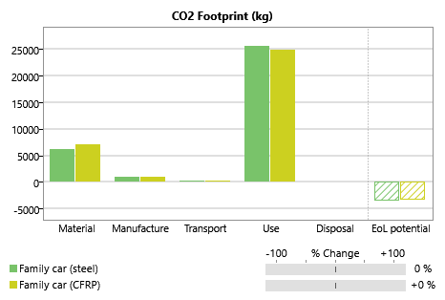
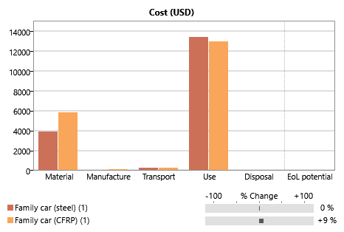
The Eco Audit tool
Can explore:
Material choice
Recycle content
Transport mode
Transport distance
Use pattern
Electric energy mix
End of life choice
Carbon
Cost
You can assess the environmental impact of products with the Eco Audit tool included in Granta EduPack Aerospace Database
Compare the influence of using different materials and manufacturing processes on the various phases of life of a product
Further information is available from Lecture Unit 12 of this series
Selected Steel body panels – 100 kg
Replacement: Carbon-epoxy – 50 kg
Distance driven 100,000 km
Notes:
Eco Audit tool
Another useful tool is the Eco Audit tool.
This tool allows you to assess the environmental impact of products in different phases of life, and compare “what-if” scenarios very quickly, at an early design phase.
Again, further information is available from Lecture Unit 12 of this lecture series, but a very brief summary of what the tool can do is seen in this plot.
Different materials and manufacturing processes, together with different recycled material contents are compared, for a bottle of water. The output is done in the form of Energy consumption and CO2 emissions, and useful tips are given to tackle each of the phases of life.
The tool provides the opportunity for in-class discussion of different scenarios and to roughly assess what are the influences of particular design decisions in the entire life cycle of products.

Slide 18
Using the aerospace database
MaterialUniverse
  Designed for primary, broad materials selection. Enables generic candidates (resin and filler type) to be easily identified
MMPDS and MIL-HDBK-17
  Access information on certified materials for aerospace use (metals and composites) but also very useful in other design environments
  Information on temperature dependence of mechanical properties is particularly important
Notes:
External Databases

Slide 19
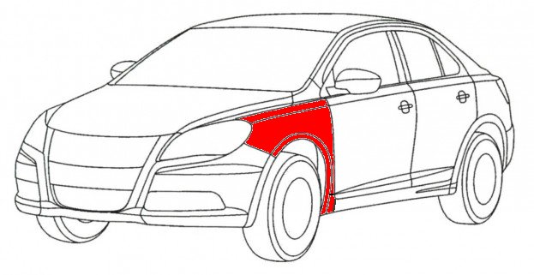
Example: trade-off between cost and weight
The scenario:
  Select a material for an exterior panel of a vehicle
  It must be as light and cheap as possible
  Stiffness is the most important constraint
Define locally-linear
Penalty function Z
Z = α m + C
Seek solution with smallest Z ⁽¹⁾
  α: how much are you willing to pay for each extra kg (exchange constant)?
⁽¹⁾ More detailed information in the Lecture Unit Addressing Objectives in Conflict using Ansys Granta EduPack
  Granta EduPack
Notes:
Example
Now for an exercise on how to use EduPack to select materials for an exterior panel of a vehicle.
The panel must be as light and as cheap as possible, which is a difficult trade-off, and it should not deform too much, so it’s a stiffness limited design.
Let us now define a penalty function, Z.
This penalty function is a kind of cost over the lifetime of the panel. It has a certain upfront cost and for every extra kg of mass that is transported over the life time of the vehicle, the vehicle owner is willing to pay (alpha), the exchange constant, or trade-off constant.
But before going into the software, let us consider what are the potential values for this exchange constant in the transportation sector in the next slide.

Slide 20
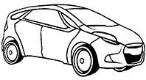


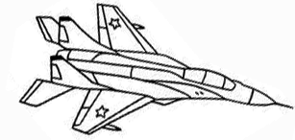
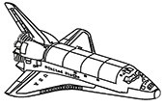
The exchange constant α for transport
Transport system
α ($ per kg)
Family car 3 to 6
Truck 5 to 20
Civil aircraft 100 to 500
Military hardware 500 to 2000
Space vehicle 3000 to 10,000
How to get values of α?
Full life costing: fuel saving, extra payload
Analysis of historic data;
Interviews, surveys
Notes:
Exchange constant, α
The table lists approximate values for the exchange constant α for transport systems, based on the economic benefit of a reduction in structural mass of 1kg, all other things remaining the same. For the family car it is calculated from the fuel saving over a life of 100,000 km. For the truck, aircraft and spacecraft it is calculated from the value of an additional 1kg of payload over the operating life.
The values vary widely. The value of weight saving in a car is small; that is one reason that it is difficult to replace steel with a lighter metal in cars – the weight (and thus fuel) saving does not compensate for the higher cost of the material. But in space it is different: here, because launch costs per kg are so enormous, the saving of mass is valued highly, making it economic to use even very expensive materials if they save weight.
These values for exchange constants are based on engineering criteria. Sometimes, however, value is set in other ways. The perceived value of a product is an important factor in marketing. It is measured – or estimated – by market surveys, questionnaires and the like.

Slide 21
Summary
Temperature dependance of mechanical properties is hard to come by in a way that is comparable across multiple material families
Lightweighting is a current trend to which reinforced plastics and high strength steels and alloys are very strong contributers – trade-offs between cost and price usually come into play (see Lecture Unit 8 of this series)
Reliable data is needed for design-build innovative projects in various fields like Mechanical Engineering, Aerospace, Motorsport and Transportation in general
Granta EduPack Aerospace Database offers a structured approach to selection, enabling access to autoritative resources like MMPDS and MIL-HDBK-17 and data tables
Notes:
Summary

Slide 22
Lecture unit series
These PowerPoint lecture units, as well as many other types of resources,
can be found in the Ansys Education Resources webpage.
Finding and Displaying Information
Unit 1 | The materials of engineering
Unit 2 | Material property charts: mapping materials
Unit 3 | The Elements database: properties, relationships and resources
Material Properties
Unit 4 | Manipulating properties: composition, microstructure, architecture
Unit 5 | Designing new materials: filling the materials-property space
Unit 6 | Materials Science and Engineering
Selection
Unit 7 | Material selection: translation, screening, ranking, documentation
Unit 8 | Objectives in conflict: trade off methods and penalty functions
Unit 9 | Material and shape: materials for efficient structures
Unit 10 | Manufacturing processes and cost modeling
Unit 11 | Eco-informed material selection
Unit 12 | Eco design and the Eco Audit tool
Sustainability
What is a sustainable development? A materials perspective
Exploring Critical Materials using Ansys Granta EduPack
Special Topics
The Built Environment
Structural sections: shape in action
Materials in industrial design: Why do consumers buy products?
The Design database for Products
The Battery Designer tool
Bioengineering and Medical Devices
Advanced Teaching and Research
Advanced databases
The Aerospace database
The Polymer database
The Synthesizer tool: hybrids and other models
www.ansys.com/education-resources
Notes:
Lecture Units Series
This is a list of the Lecture Units available for teaching with the Ansys Granta EduPack. These PowerPoint presentations and more information can be found on the Ansys Education Resources webpage:
www.ansys.com/education-resources.

