Slide 1
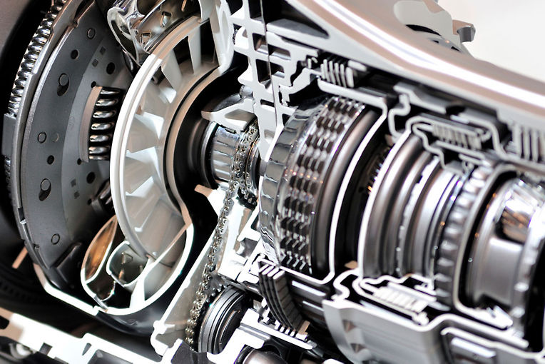
Case Study
Analyzing noise emitted by rotating machines – such as engines – and their industrial problems
Alexandre Bouthéon, Ansys R&D
Edited by Dimitris Tzagkas,
Ansys Academic Development Team
education@ansys.com
Notes:
Learning Objectives
This lecture unit aims at introducing elementary notions of Audio Digital Signal Processing and illustrate the theory with the help of the Ansys’ “Sound Analysis & Specification” Software.
Through out this lecture unit, links will be present to relevant resources to supplement the learning, together with exercises and small quizzes to verify that the learning outcomes have been met.
Extra content has also been added through some bonus slides which are available after the end of the lecture unit.
Be aware that it’s an introductory course, it won’t delve into details nor mathematical aspects

Slide 2
Learning objectives for this Case Study
Intended Learning Outcomes
Knowledge and Understanding | Understanding what kind of noises can be emitted by rotating machines (such as engines) and what industrial problems can be associated with such noises.
Skills and Abilities | Ability to use Ansys Sound to analyse and process audio signals issued from rotating machines
Values and Attitudes | Awareness of the importance of simulation in engineering design
Resources
Text: “Understanding Digital Signal Processing” – R. Lyons
Software: Ansys Sound v23R2 (please note that all project files are available in the downloaded resource folder)
Further reading/information
Ansys Academic
Ansys Innovation Courses
Ansys Education Resources
Built-in Assessment
Simulation exercises
Quizzes
Notes:
Learning Objectives
This lecture unit is aimed at teaching the fundamental concepts associated with audio digital signal processing and consolidates their understanding by employing Ansys’ Sound Analysis & Specification software.
Through out this lecture unit, links will be present to relevant resources to supplement the learning, together with exercises and small quizzes to verify that the learning outcomes have been met.
Extra content has also been added through some bonus slides which are available after the end of the lecture unit.
If you have any questions on accessing Ansys “Sound Analysis & Specification” please contact the education team at education@ansys.com

Slide 3
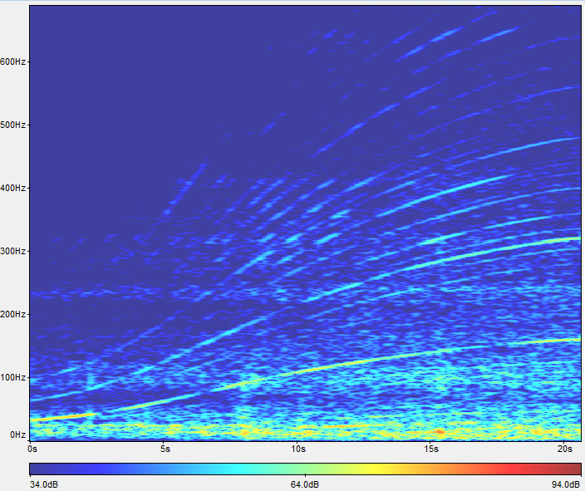
Outline of case study
Introduction and context
Rotating machines
Real industry problems
A bit of theory
Rotations per minutes
Orders
Case Study – Analysing an engine noise
Context
Part 1 – Getting Started
dBA Level
Part 2 – Time-Frequency Analysis
Part 3 – Order Isolation
Part 4 – dBA Level Attenuation
Conclusion
Part 5 – To go further
Solution
Notes:
This lecture Unit is separated in two main parts :
Definition of Audio Digital Signal Processing and the sampling theory
Main tools used in Audio DSP and a simple explanation on how they work (Fourier Transform, Spectrograms and Filters)
Several exercises are proposed along this lecture unit and also some appendixes.

Slide 4
Section 1: Introduction and Context

Slide 5
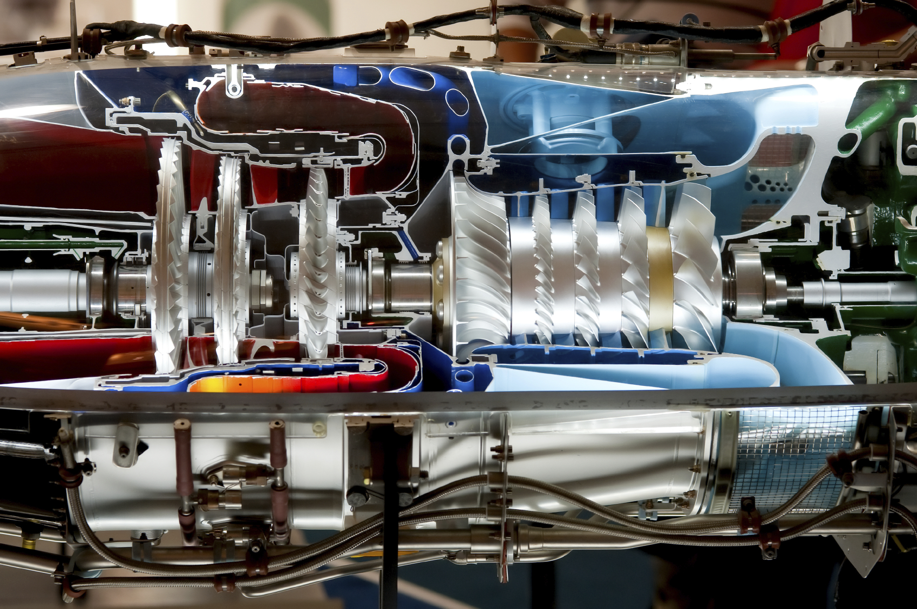
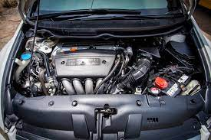
What are rotating machines ?
Very broad definition : A machine with a rotating component that transfers energy to a fluid or vice versa
Characterized by their “Revolution per minutes” RPM
Used both in our everyday life and in specific industrial contexts
Examples:

Slide 6
Industrial Context
Such engines generate noise
Noise can be problematic for industrial manufacturers for several reasons:
User comfort
Loud washing machine
Car’s engine too noisy
Etc.
Noise regulation imposed by countries/regulating authorities
For example :Aircraft noise is regulated by EASA in Europe (EASA Certification Noise Levels | EASA (europa.eu))
Can induce machine fatigue and damage
Noise → Vibrations, and vibrations can mechanically stress some components of the machinery, which will lead to damages and possible repairs
→ Noise is an important topic for industrial manufacturers in several areas (automotive, transports, household electronics etc.) and need to be dealt with seriously

Slide 7
Section 2: A bit of theory

Slide 8
Revolutions per minutes - RPM
RPM = Revolutions Per Minutes = Unit of rotational speed for rotating machines, expressed in $r.min^{−1}$
For a washing machine : number of rotations the main cylinder will do within a minute
RPM and frequency are related with the following relation :
$$f=\frac{RPM}{60}$$

Slide 9
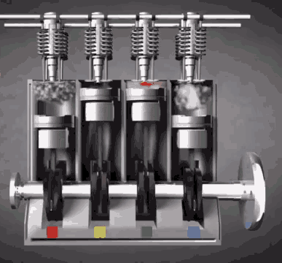
Orders
What’s an order ?
→ Orders are harmonic components, multiple of the fundamental frequency of an engine
→ Harmonic orders appear because of the different components of the engine that have different RPMs. These components might have different number of rotations which produces the harmonics.
→ Fundamental frequency is given by $f=\frac{rpm}{60}$
Order Analysis ?
→ Order analysis can be used to track the contribution of an individual order in the resulting sound produced by a rotating machine

Slide 10
Section 3: Case Study – Analyzing the noise produced by an engine in Sound SAS

Slide 11
Context
You are a car manufacturer
Your engineers are designing a new engine
While developing this engine, you want to make sure that :
It’s not too noisy
It respects regulations
Vibrations generated by the engine won’t damage other parts in the car
Your team provided you a recording of the sound produced by the engine when increasing its RPM, it’ll be your starting point to analyze the engine’s noise.
In order to tackle this problem, you’ll be using Ansys Sound Software. Even though the exercises are guided, don’t forget to read and use the product documentation via Help

Slide 12
Simple Digital Signal Processing Overview
Hereafter is a simple workflow overview on how to use the tools available in Ansys Sound to convey some simple Audio Digital Signal Processing Operations
Converting the signal from frequency domain back to the time domain
Time Domain Signal
Fourier Transform
Frequency Domain Analysis
Inverse Fourier Transform
Filtering
Listening to our signal in the time domain and viewing its waveform
Converting the signal from time domain to frequency domain, using DFT or STFT
Removing / Extracting / Amplifying specific frequencies in the signal
Studying Spectrums and/or Spectrograms to analyse the frequency components of a signal

Slide 13
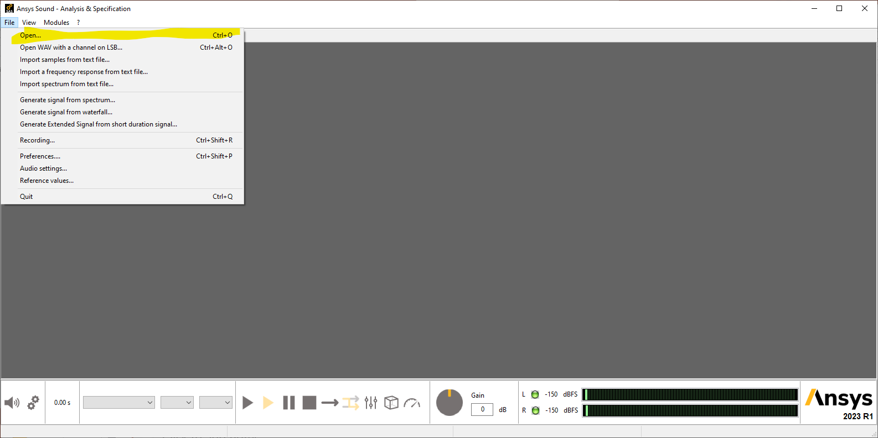
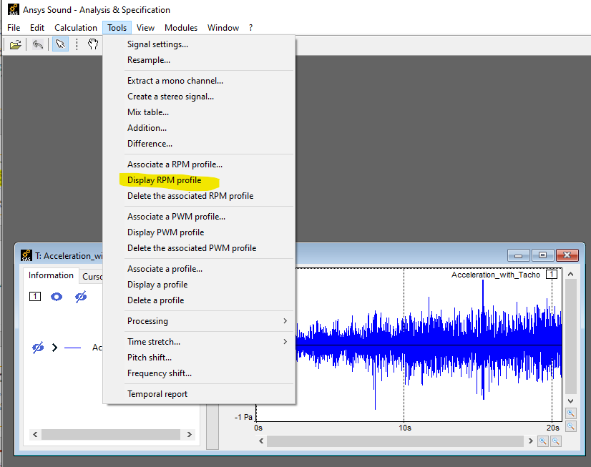
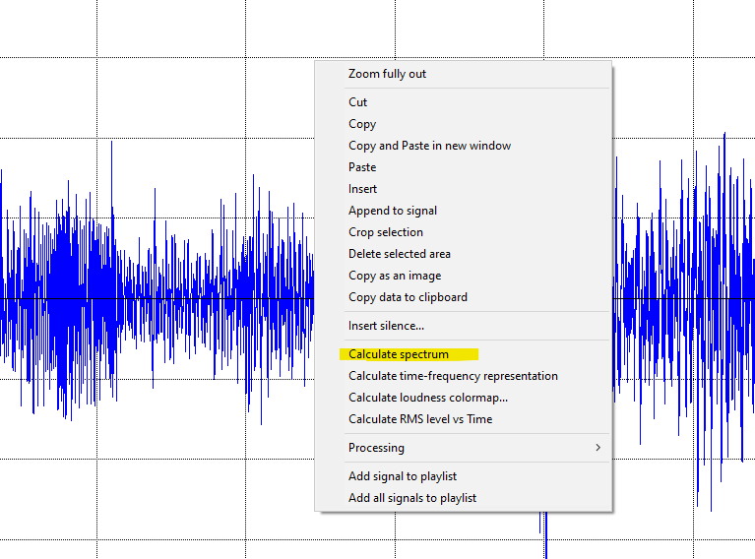
1. Getting Started
Time Domain Signals | In Ansys Sound SAS, Open the signal “acceleration_with_tacho.wav” provided with this case study using the File > Open… menu Listen to the time signal using the playback controls in the bottom panel
RPM Profile Associated | The loaded sound has an RPM profile associated, it can be displayed by selecting Tools > Display Associated RPM profile Once the RPM profile is displayed, identify the minimum and maximum RPM value, what are the associated frequencies in theory ?
Displaying a spectrum | Plot the Spectrum of the signal (Right click > Calculate Spectrum) Look for the frequencies previously computed, what can be seen at these values ?
Notes:
13

Slide 14
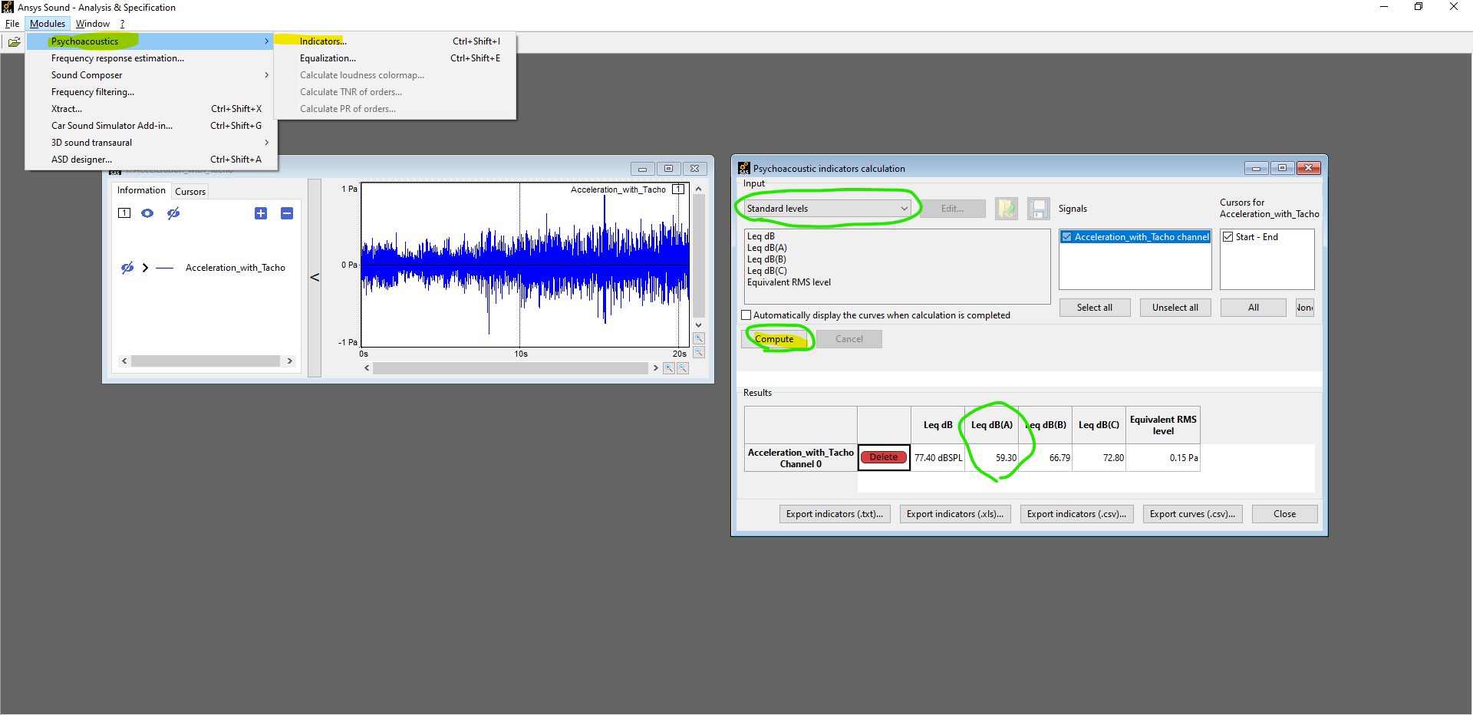
dBA Level
After this first analysis, you decide to compute the dBA level of your signal.
This can be done by using Modules > Psychoacoustic > Indicators > Standard Levels and then computing the results. (Cf. Screenshot on the right-side)
You notice that the dBA level is at 59.3 dB(A). Unfortunately, regulations impose you to have this level below 58 dB(A).
→ You need to investigate how you can reduce this level.

Slide 15
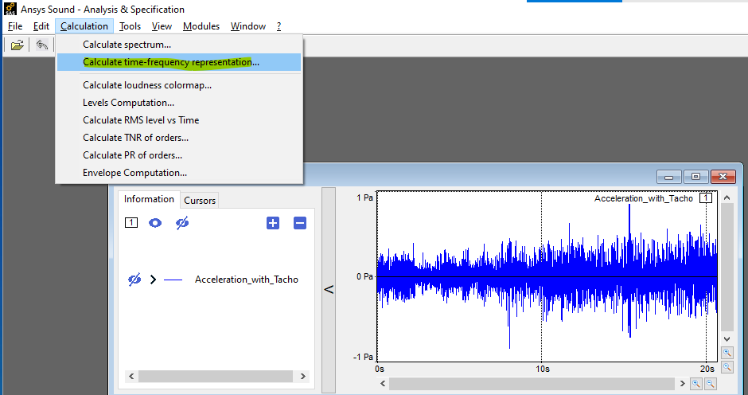
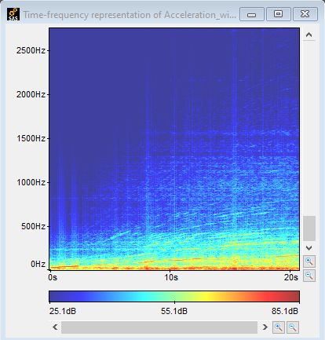
2. Time-Frequency Analysis
Computing Time-Frequency Representation | To gather more information, you need to plot the time-frequency representation of the signal. This can be done by using Calculation > Calculate Time-Frequency Representation Try to use different parameters in the “Advanced Settings” window, see how they influence the time-frequency representation
Analyzing the Time-Frequency representation | Once you’ve plotted the time-frequency representation, analyse it and try to identify what are the orders, how are they evolving ? Compare to the Spectrum computed previously, can you find similarities ? What about the peak previously found at approx. 16 kHz ? Tip 1 : Use the zoom on the Y axis ! Tip 2 : Use “view > Current Display and Tools Settings” to modify the display Tip 3 : Try to use other right-click and toolbar features, for example “Right click > Amplify Selected Area”
Notes:
15

Slide 16
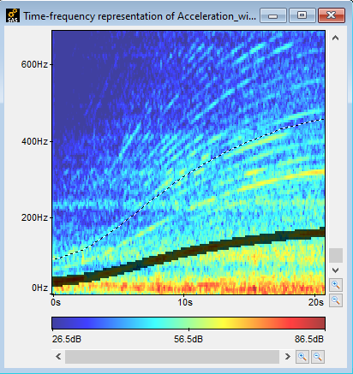
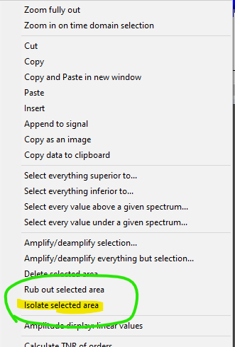
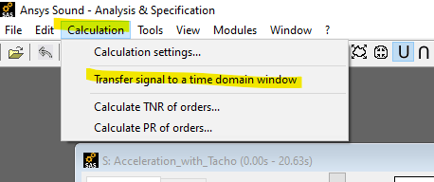
3. Order Isolation
Order Isolation | On the time-frequency representation, orders can be selected by using the menu bar “RPM Harmonics selection by number”. Choose the order number that you want to isolate, a black line will be plotted on the TF representation. Then, use “right click > Isolate Selected Area” and you’ll obtain the time-frequency of the isolated order. This signal can be listened to, by using, in the menu bar, “Calculation > Transfer to a time domain window” Isolate different orders and listen to them, is there one that seems louder than the other ? Compute their dBA levels using the psychoacoustic module as explained in the previous slide.
Notes:
16

Slide 17
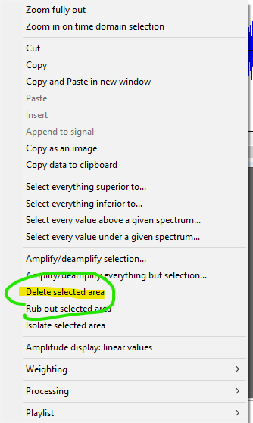
4. dBA Level Attenuation
Order Suppression | Your goal is to reduce the total dBA level of the overall signal. In order to achieve this, you can try to remove some specific orders from the signal and assess how it impact the dBA level. To remove an order, follow the steps already explained in the previous slide but instead of using right click > Isolate selected area, you’ll use right click > Delete selected area. This will set to 0 dB the order (or more generally, the area) that you’ve selected. You can then transfer the signal to a time domain window and compute its dBA level in the psychoacoustic module. Based on your previous finding, try to remove as few orders as possible to reach the target of 58 dBA. There’s several way to achieve that target, try to listen to the output and evaluate how it sounds when specific orders are removed)
Notes:
17

Slide 18
Conclusion
Starting from a recorded signal of the engine evolution with its associated RPM signal, you managed to :
Identify the different orders existing in the signal
Compute the overall dBA level
Perform a time and frequency analysis
Proposed a way to reduce the overall target level in order to meet regulations
Such a process is only one step in the whole production chain. Identifying which orders can be removed in order to decrease the dBA level is a valuable input for the designing team of the engine, who can find mechanical ways to suppress these harmonic orders.

Slide 19
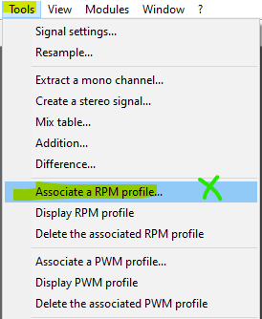
5. To go further
Do it yourself ! | Is there a rotating machine in your laboratory / university / home that you can analyse ? Ideally, you should know the RPM evolution of your device. You can proceed as follow : Record the sound produced by the machine (with a real microphone, if possible, otherwise with a smartphone) Export the audio file to your computer and convert it to a .wav file Open it in Ansys Sound SAS Save your RPM data in a text file with two columns (one for the time indexes and the other for the associated RPM values) and import it in Ansys Sound SAS using Open > Import samples from text file… Associated the RPM value to your signal using Tools > Associate A RPM profile… Perform the same analysis as done in the previous slide to characterize your engine
Example text file for the RPM input, the first list is optional
Importing text samples in SAS
Notes:
19

Slide 20
What would an expert do?

Slide 21
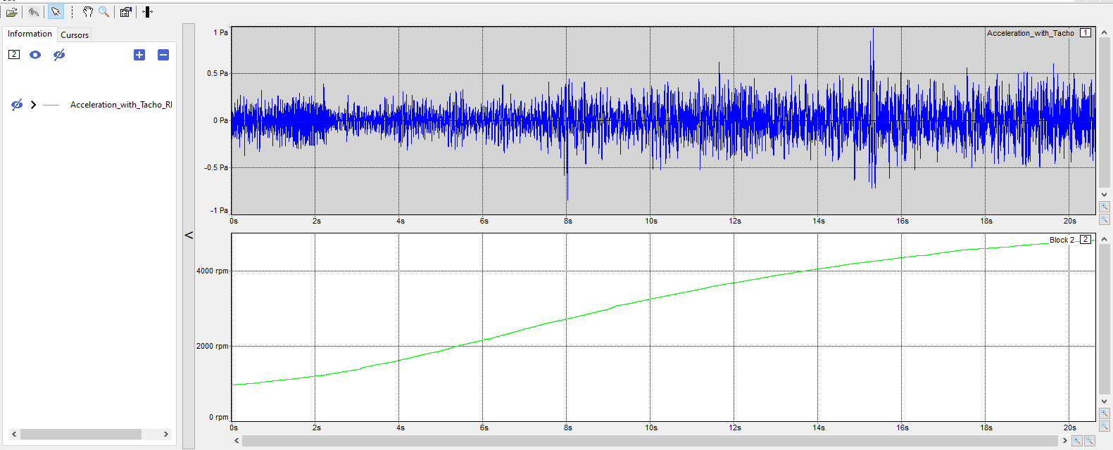
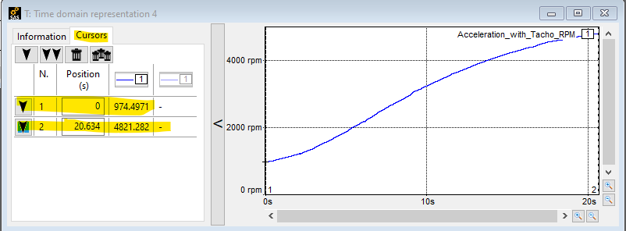
Solution – Part 1 – Getting Started (1/2)
To display a profile, you should use “Tools > Display RPM Profile” and it will appear in a new block (Green curve on the right)
(Optional) Once the profile is displayed, you can extract it to a new window by using “right click > Copy and Paste in a New Window”
Cursors can be used to determine values of the curves. Here we obtain :
$RPM_{min} ≅974 rpm$
$RPM_{max} ≅4821 rpm$
From this we deduce the associated frequencies :
$F_{min} ≅$ $\frac{RPM_{min}}{60}≅16.2 Hz$
$F_{max}≅\frac{RPM_{max}}{60}≅80.3 Hz$

Slide 22
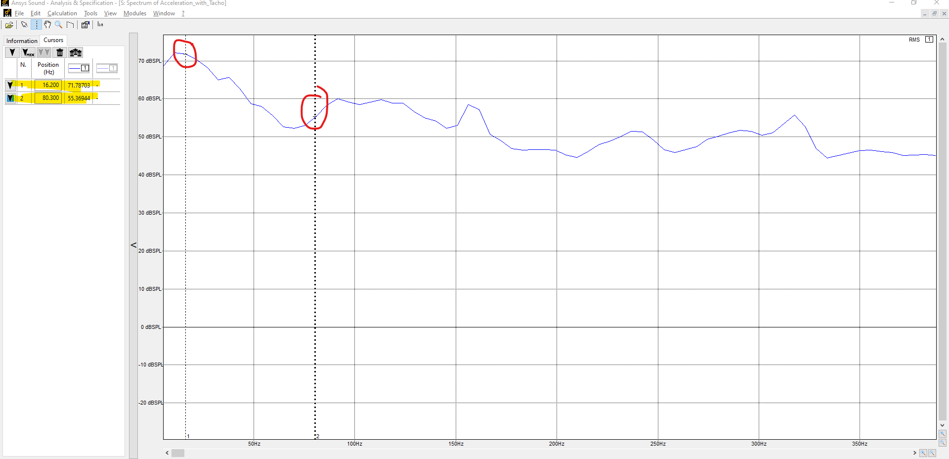
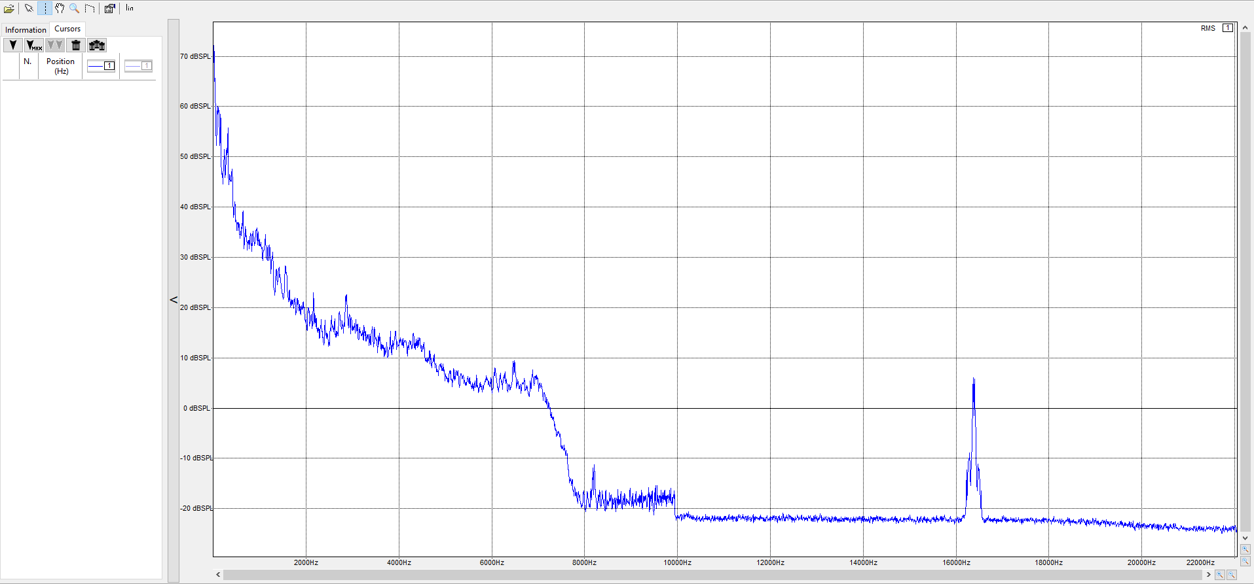
Solution – Part 1 – Getting Started (2/2)
The Spectrum can be obtained by using “Right Click > Calculate Spectrum”
By zooming on the X – axis and looking at the frequencies previously computed, we can only notice that these values are high compared to higher frequencies but they do not appear as peaks still.
One noticeable thing is the peak at approx. 16.3 kHz

Slide 23
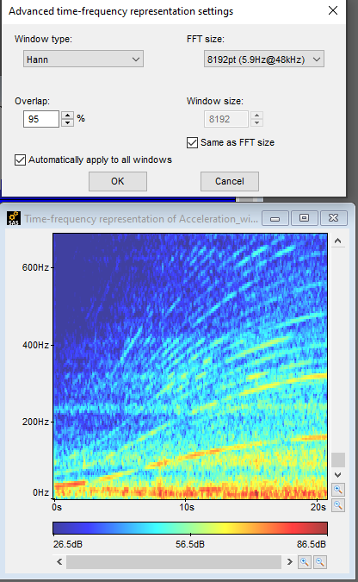
Solution – Part 2 – Time-Frequency Analysis (1/3)
When computing the time-frequency representation, several parameters can be specified
Number of FFT points
Window used
Overlap in %
Each of them influence the time-frequency representation
In our case, the parameters on the right provide a good representation

Slide 24
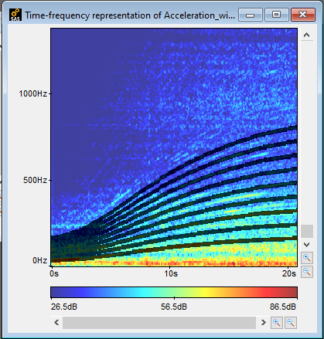
Solution – Part 2 – Time-Frequency Analysis (2/3)
Orders are the evolving lines that you can see on the time-frequency representation
They can be automatically detected by using “RPM Harmonics selection by number” in the menu bar → we obtain the plot on the right with the black lines. Note that not ALL orders have been selected and you can still see evolving lines above 800 Hz with less amplitude

Slide 25
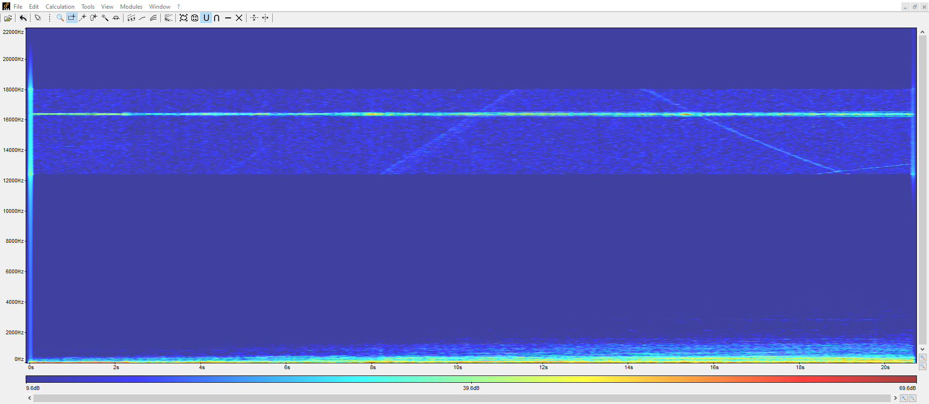
Solution – Part 2 – Time-Frequency Analysis (3/3)
Regarding similarities between the spectrum and the time-frequency representation, they’re not easy to spot even tough the frequency range of the first harmonics is with $F_{min}$ and $F_{max}$ established earlier
One interesting thing is the peak at 16 kHz found in the spectrum. It can be find in the Time-Frequency representation by Amplifying the region around 16 kHz
The plot below is the same as before except that the region around 16 kHz has been amplified by 50 dB. You can notice a straight line at approx. 16.3 kHz that has a greater amplitude that the rest…

Slide 26
Solution – Part 3 – Order Isolation (1/2)
Different order can be used by following the procedure indicated in the corresponding slide
The idea here is to use different approaches to analyze orders:
First, with your ears, which one sounds louder ?
Second, by computing the dBA level
Computing the first 10 orders for this signal is enough, you can easily notice that order number 4 is the loudest with a dBA level of 51.86 dB(A)

Slide 27
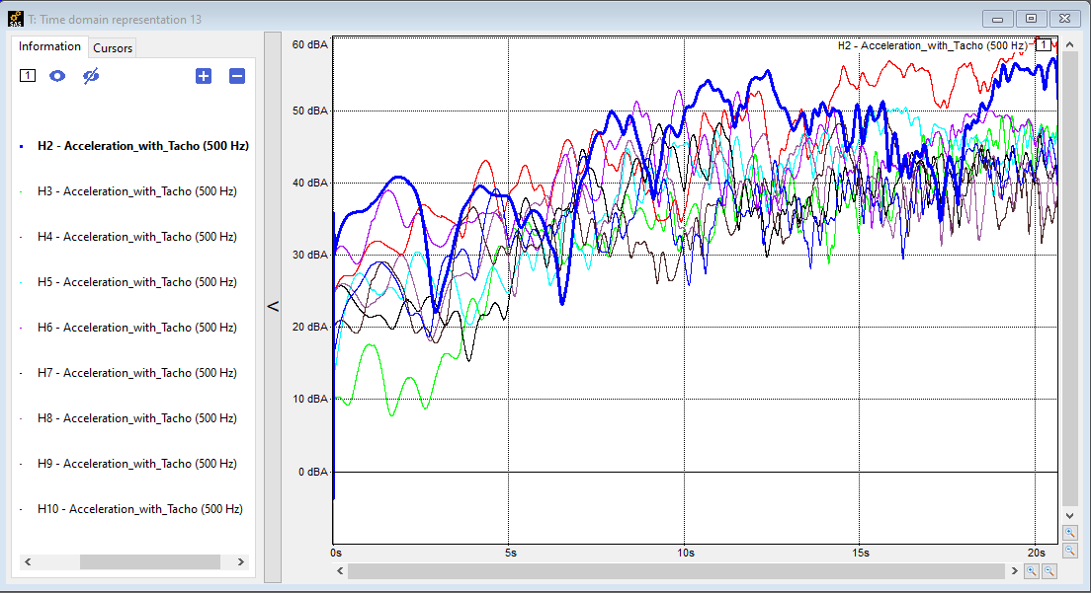
Solution – Part 3 – Order Isolation (2/2)
Another way to analyze order is to switch the display to “Time-Order” when using the spectrogram
Then “Right Click > Order Analysis…”
More information on the user guide

Slide 28
Solution – Part 4 – dBA Level Attenuation
For this part, the idea is to assess how removing one order will impact the overall dBA level as well as the sound itself.
There’s no “right way” to do it, one solution is to remove orders 4 to 6 and the new signal will have a level of 57.8 dB
It is interesting to note that removing the “16 kHz peak” won’t affect the output dBA level. This peak seemed to be loud but was weak in comparison to the orders.

Slide 29
Further Information and Resources
Ansys Academic | Simulation Software for Educators, Researchers and Students.
Ansys Innovation Courses : Free to Access to courses covering a variety of physics and software.
Ansys Education Resources: Specifically developed for Educators.
Ansys Learning Forum: Ask questions to the Ansys Community!
Ansys Learning : Ansys YouTube Channel with dedicated video playlists.

