Slide 1
Introduction to Explicit Dynamics
Dr. Wojciech Danek¹ and Madhumita Saravana Kumar²
¹Assistant Professor at Silesian University of Technology, Senior Application Engineer at Symkom (Ansys Channel Partner)
²Ansys Academic Development Team

Slide 2
Learning objectives for this Lecture Unit
Intended Learning Outcomes
Knowledge and Understanding | Knowledge and understanding of the concept of explicit dynamics
Skills and Abilities | Ability to recognize what type of simulation method to implement for a dynamic process
Values and Attitudes | Awareness of the importance of simulation in dynamic problems
Resources
Software: Ansys LS Dyna
Appendix Bonus Slides: Material Models
B
Further reading/information
Ansys Academic
Ansys Innovation Courses
Ansys Education Resources
In-Built Assessment
Exercises:
Quizzes

Slide 3
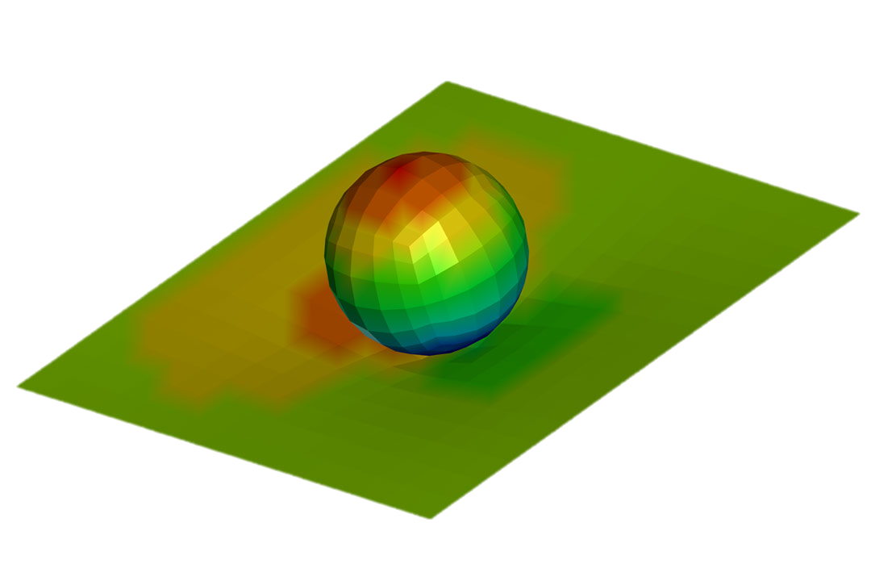
Agenda
Introduction
Examples of Dynamic Simulations
Ansys LS Dyna
Application of Implicit vs. Explicit Methods
Equations of Motion and Solution Methods
Explicit vs Implicit Characteristics
Time
Energy Summary
Hourglassing
Mass Scaling
Summary
Bonus Slides – Material Models

Slide 4
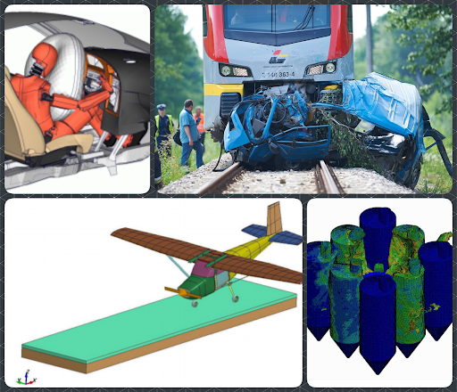
Introduction
Numerical simulations make it possible to analyze the course of events that have already occurred and to predict the behavior of the system in emergency situations and their impact on the environment.
This allows us to design things that are increasingly efficient and safe.
Notes:
Numerical simulations make it possible to analyze the course of events that have already occurred and to predict the behavior of the system in emergency situations and their impact on the environment. This allows us to design things that are increasingly efficient and safe.

Slide 5
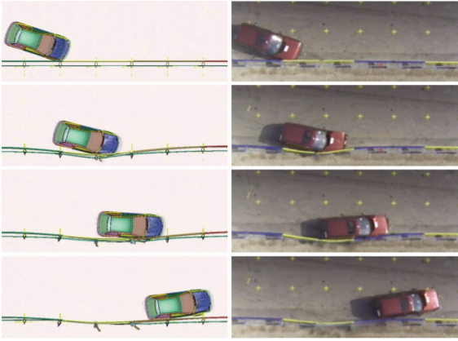
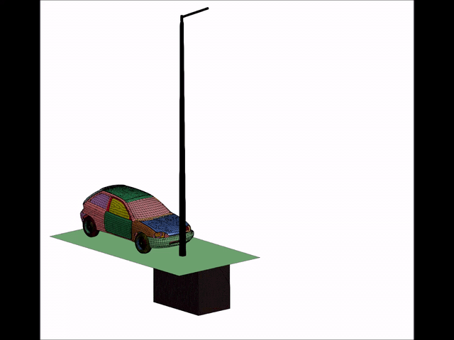
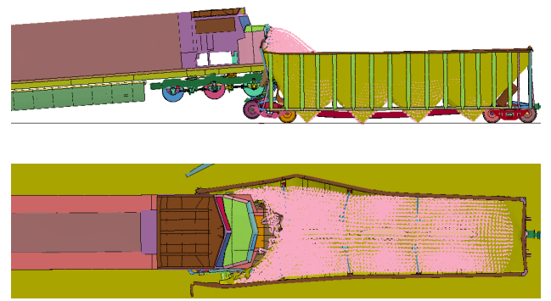
Examples of dynamic simulations – crash tests
A crash test is a form of destructive testing usually performed in order to ensure safe design standards in crashworthiness and crash compatibility for various modes of transportation or related systems and components.
[Wikipedia]
Vesenjak, M., Borovinsek, M., Ren, Z.: Computational simulation of road safty barriers using LS-DYNA, 6. LS-DYNA Anwenderforum, Frankenthal, 2007
Xin, X., Parida, B.K., Zaouk, A.K., Dana, N.: Impact Analysis of an Innovative Shock Energy Absorber and Its Applications in Improving Railroad Safety, 12th International LS-DYNA Users Conference
Crash test - kompozytowy słup oświetleniowy Alumast - YouTube
Notes:
We will now look at some examples of dynamic simulations. A good example would be a crash test. A crash test is a form of destructive testing usually performed in order to ensure safe design standards in crashworthiness and crash compatibility for various modes of transportation or related systems and components.

Slide 6
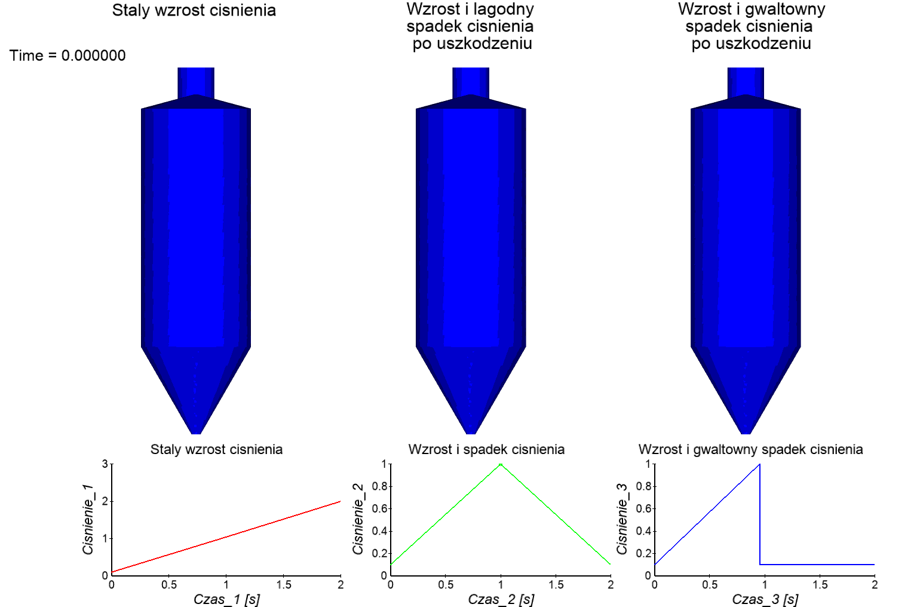
Examples of dynamic simulations - critical incidents
When critical events occur, it is essential to determine their cause and effect.
Thanks to numerical simulations, it is possible to see what can happen in a crisis situation without putting anyone in danger.
Yu, Z,X., Zhao, L., Guo, L.P., Liu, Y.P., Yang, C., Zhao, S.C.: Full-Scale Impact Test and Numerical Simulation of a New-Type Resilient Rock-Shed Flexible Buffer Structure, Shock and Vibration, 2019
Notes:
Another example where dynamic simulations are used is in the case of critical events. When critical events occur, it is essential to determine their cause and effect. With the help of simulation, it is possible to see what can happen in a crisis situation without putting anyone in danger.

Slide 7
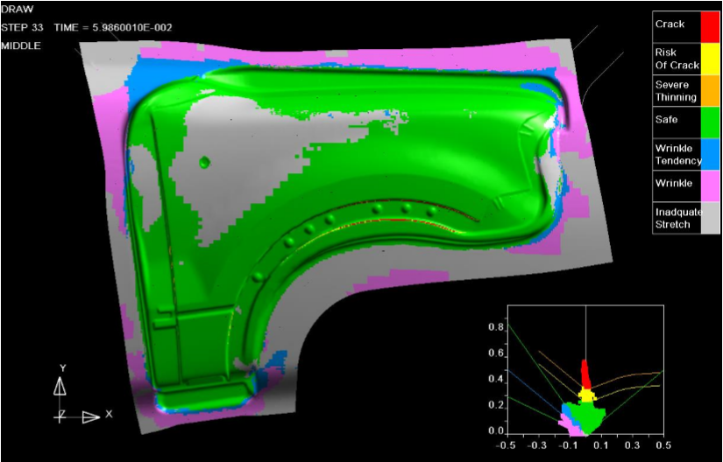
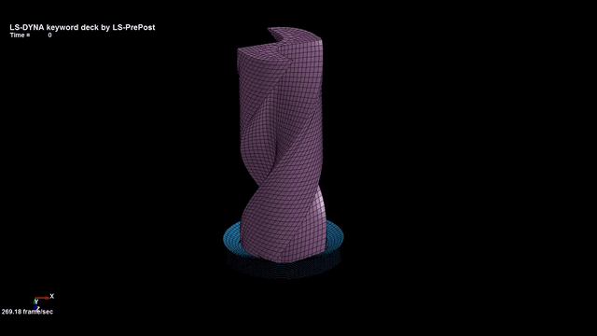
Examples of dynamic simulations - material processing
Materials processing is a series of operations that transform industrial materials from a raw-material state into finished parts or products.
Modeling the process drilling in the ls-dyna - YouTube
Notes:
Another application of dynamic simulation is materials processing. This isa series of operations that transform industrial materials from a raw-material state into finished parts or products.

Slide 8
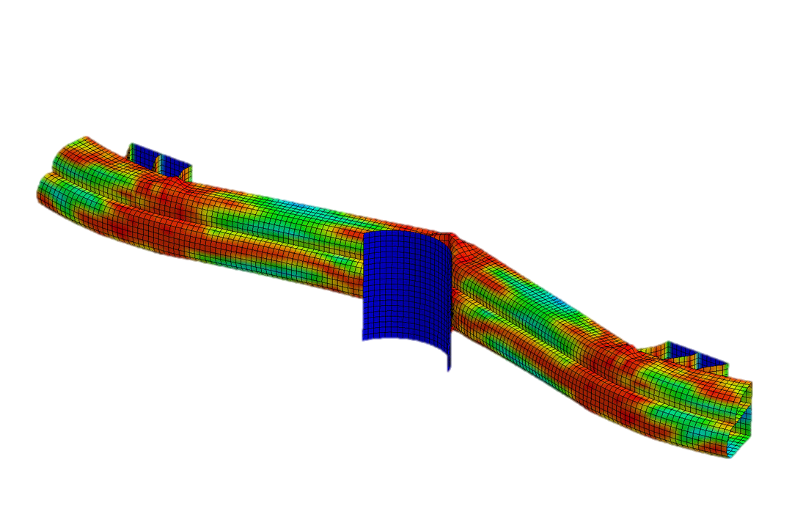
Ansys LS-DYNA
WHAT IS ANSYS LS-DYNA?
Ansys LS-DYNA is the world's most-utilized explicit simulation program, capable of simulating the response of materials to short periods of severe loading.
Applications include…
Automotive | aerospace | incompressible fluids | compressible fluids and shock waves | electromagnetics
FREE STUDENT DOWNLOAD
ANSYS LEARNING FORUM
Notes:
Ansys LS-DYNA is an industry-leading explicit simulation software used for applications like drop tests, impact and penetration, smashes and crashes, occupant safety, and more.
Although LS Dyna software is identified with Explicit simulations, it allows various types of simulations. In addition to mechanical analyses, it is possible to perform fluid flow, electromagnetic, thermal or frequency domain analyses

Slide 9
Application of Implicit vs. Explicit Methods
Time Integration - ANSYS Innovation Courses
Notes:
This slides showcases suitable applications of explicit and implicit methods based on the duration of the process we would like to simulate.
Explicit analyses work well for issues which the duration of the phenomenon is very short, usually less than 1 second. In the case of Implicit analyses, the greater the number of nonlinearities present in the model, the more difficult it is to obtain a result in a satisfactory time. Therefore, strongly nonlinear models work very well with the Explicit method.

Slide 10
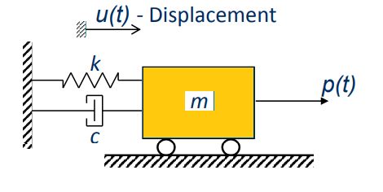
Equations of motion
The mathematical model of the dynamics of the system is described by a system of ordinary differential equations with appropriate initial conditions.
Solving these equations requires integrating them with respect to time for which approximation methods are used, which determine the approximation only at certain moments of time.
$$M.\ddot{u}\left(t\right)+C\dot{.u}\left(t\right)+K. u\left(t\right)=p(t)$$
$u−$Displacement
$\dot{u}−$Velocity
$\ddot{u}−$ Accelearation
These equations can be solved in two different ways viz., using Implicit or Explicit methods
Notes:
Let us now discuss equations of motion involved in implicit and explicit methods. The mathematical model of the dynamics of the system is described by a system of ordinary differential equations with appropriate initial conditions. Solving these equations requires integrating them with respect to time for which approximation methods are used, which determine the approximation only at certain moments of time.
These equations can be solved in two different ways viz., using Implicit or Explicit methods

Slide 11
Equation of motion
Implicit
Explicit
Explicit and implicit methods are approaches used in numerical analysis for obtaining numerical approximations to the solutions of time-dependent ordinary and partial differential equations, as is required in computer simulations of physical processes.
One of the most commonly used method for Implicit analysis is Newmark Method. In case of Explicit analysis the most commonly used method is Central Difference Method
Notes:
Explicit and implicit methods are approaches used in numerical analysis for obtaining numerical approximations to the solutions of time-dependent ordinary and partial differential equations, as is required in computer simulations of physical processes.
One of the most commonly used method for Implicit analysis is Newmark Method. In case of Explicit analysis the most commonly used method is Central Difference Method.

Slide 12
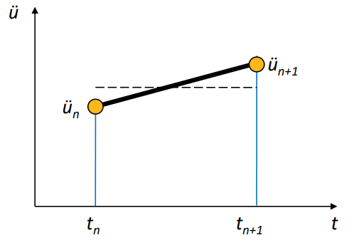
Newmark Method
For implicit methods, the equation of motion for the yet unknown state is introduced into the time integration algorithm at time ti+Δt. Therefore, non-linear systems of equations can arise.
An advantage of implicit methods is that they can be absolutely stable. This allows larger time steps as compared to explicit methods.
[Technische Universität München]
In the case of Single DOF response can be obtained with:
$${\dot{u}}_{n+1}={\dot{u}}_{n}+\left(1−γ\right)∆t{\ddot{u}}_{n}+γ∆t{\ddot{u}}_{n+1}$$
$$u_{n+1}=u_{n}∆t{\dot{u}}_{n}+\left(\frac{1}{2}−β\right)∆t^{2}{\ddot{u}}_{n}+β∆t^{2}{\ddot{u}}_{n+1}$$
$u−$Displacement
$\dot{u}−$Velocity
$\ddot{u}−$ Accelearation
Parameters β and γ are used to control the stability and accuracy in this method.
Notes:
Starting with the Newmark method, we can see a brief description of this method on the slide.

Slide 13
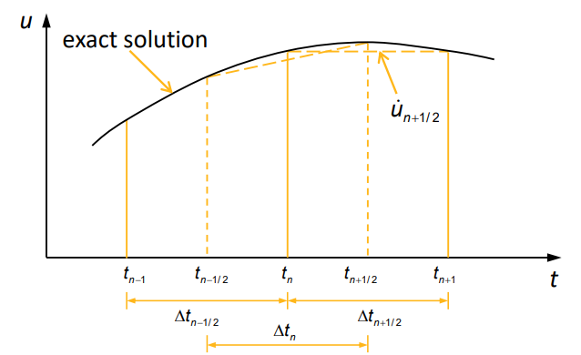
The Central Difference Method
For an explicit method, the equilibrium of a system is formulated at the beginning of the respective time increment (time ti) with the known quantities of motion. The motion quantities at time t_{i}+1=t_{i}+Δt can be determined directly by solving a system of equations.
[Technische Universität München]
$$\dot{f}\left(x_{i}\right)=\dot{y_{i}} \sim \frac{y_{i+1}−y_{i+1}}{2h}$$
$u−$Displacement
$\dot{u}−$Velocity
$\ddot{u}−$ Acceleration
$$\dot{u_{n}}\frac{1}{2∆t}(−u_{n−1}+u_{n+1})$$
$$\ddot{u_{n}}=\frac{1}{∆t^{2}}(u_{n−1}−2v_{n}+u_{n+1})$$
Notes:
Let us now look at the central difference method shown on this slide.

Slide 14
Explicit vs Implicit - Characteristics
Explicit | Implicit
No iterations | If nonlinearity occurs, then method need iterative approach
Stability of the solution depends on time step size | Unconditionally stable
Low memory requirements | Memory demanding due to need of inversion of stiffness matrix
Notes:
While the Explicit and Implicit approaches can be used to solve equations of motion, each method has certain characteristics as shown on the slide

Slide 15
Time Step
Time Integration - ANSYS Innovation Courses
It is a segment of time of finite length, which must be adjusted to the speed of wave propagation. The size of the time step is determined by the CFL (Courant-Friedrich-Levy) criterion for each element.
The size of the time step to be used in the simulation is determined by the relationship:
Solution time step = min(all element time steps)
$L −$characteristic length
$c−$wave speed in the material
$E−$ Young’s Modulus
$ρ−$ density
Notes:
Now that we have discussed the differences, let us now look at how appropriate time steps are chosen.
Time step is a segment of time of finite length, which must be adjusted to the speed of wave propagation. The size of the time step is determined by the CFL (Courant-Friedrich-Levy) criterion for each element. The size of the time step to be used in the simulation is determined by the relationship:
Solution time step = min(all element time steps)
To learn more about this you can use the Ansys Innovation Course mentioned in the link on this slide

Slide 16
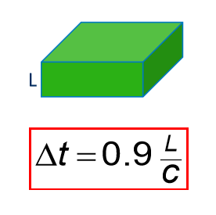
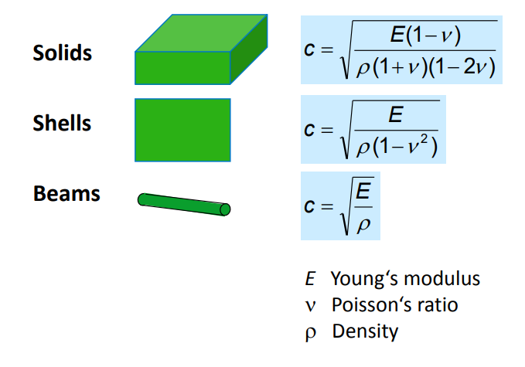
Time Step Calculation
For a solid element, the time step is calculated from the relationship:
Where:
L - characteristic dimension (shortest edge or height)
c - speed of sound
The speed of sound will depend on the type of finite element used in the simulation and the properties of the material.

Slide 17
Time Step - Courant-Friedrichs-Levy condition
A necessary condition for the stability of difference schemes in the class of infinitely-differentiable coefficients. Let Ω(P) be the dependence region for the value of the solution with respect to one of the coefficients (in particular, the latter might be an initial condition) and let Ωh(P) be the dependence region of the value uh(P) of the solution to the corresponding difference equation. A necessary condition for uh(P) to be convergent to u(P) is that, as the grid spacing h is diminished, the dependence region of the difference equation covers the dependence region of the differential equation, in the sense that
$$Ω\left(P\right)⊂\overline{\lim_{h→0}{ }}Ω_{h}(P)$$
[Encyclopedia of Mathematics]

Slide 18
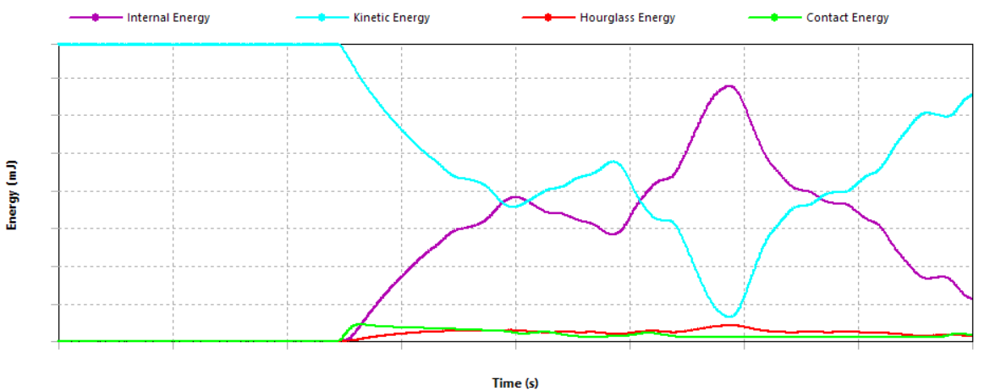
Energy Summary
A graph showing the change in energy values is called an energy balance. Based on it, we are able to initially verify the correctness of our model.
The total energy in a system includes the following types of energy:
kinetic
internal
contact
hourglassing
damping
Notes:
Energy summary of a model can be used as a method to verify the correctness of a model in the initial stages. It is important to maintain energy balance. In the above graph we see the energy balance maintained in the model over time.
The total energy in a system includes the following types of energy:
kinetic
internal
contact
hourglassing
damping
In this presentation we will be focusing on hourglassing.

Slide 19
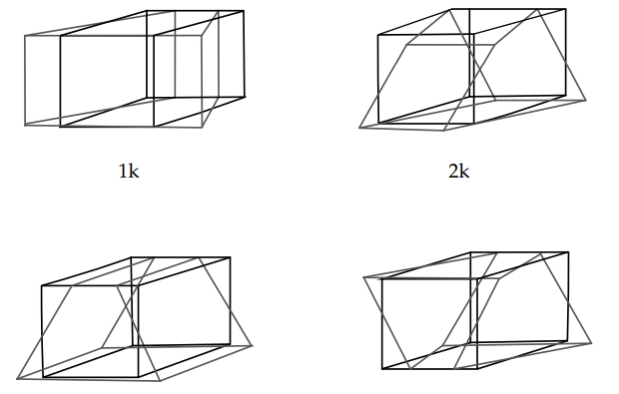
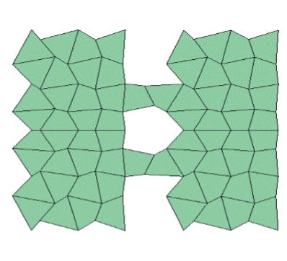
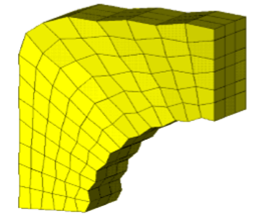
Hourglassing
Hourglass (HG) modes are nonphysical, zero-energy modes of deformation that produce zero strain and no stress.
Hourglass modes occur only in under-integrated (single integration point) solid, shell, and thick shell elements.
LS-DYNA has various algorithms for inhibiting hourglass modes. A total of twelve modes exist.
Hourglass energy shouldn’t exceed 5% to 10% of internal energy
The hourglass modes of an eight-node element
Notes:
Hourglass (HG) modes are nonphysical, zero-energy modes of deformation that produce zero strain and no stress. Hourglass modes occur only in under-integrated (single integration point) solid, shell, and thick shell elements. LS-DYNA has various algorithms for inhibiting hourglass modes. A total of twelve modes exist.
Hourglass energy shouldn’t exceed 5% to 10% of internal energy

Slide 20
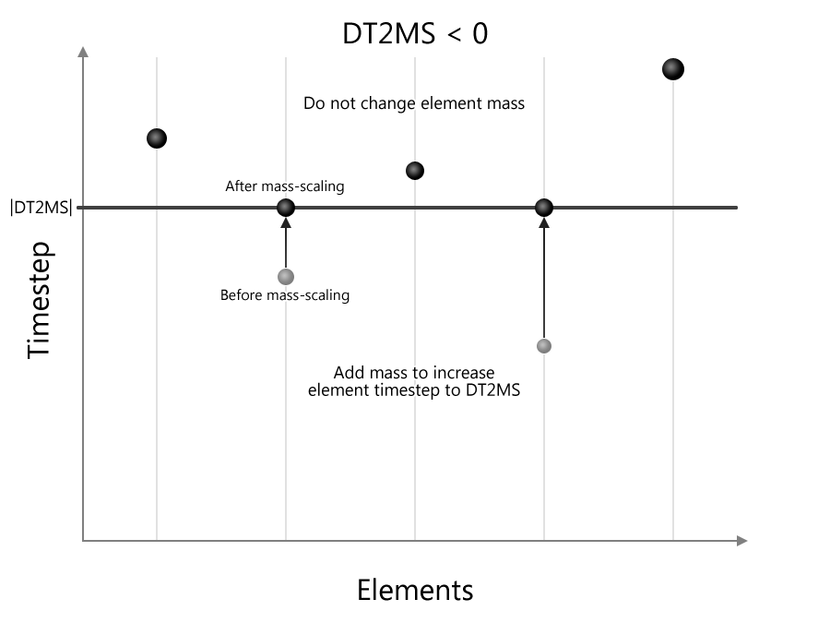
Mass Scaling
Mass scaling — Welcome to the LS-DYNA support site
Mass-scaling refers to a technique whereby nonphysical mass is added to a structure in order to achieve a larger explicit timestep.
This is pure numerical approach, ensure the constant time step.
Mass scaling affects on inertia load but not on body load.
Notes:
Mass Scaling is another important concept to understand in the case of dynamic simulations.
Mass-scaling refers to a technique whereby nonphysical mass is added to a structure in order to achieve a larger explicit timestep. Anytime you add non-physical mass to increase the timestep in a dynamic analysis, you affect the results (think of F=m*a). Sometimes the effect is insignificant and, in those cases, adding nonphysical mass is justifiable. Examples of such cases may include the addition of mass to just a few small elements in a noncritical area or quasi-static simulations where the velocity is low, and the kinetic energy is very small relative to the peak internal energy.
This is pure numerical approach, ensure the constant time step
Mass scaling affects on inertia load but not on body load.

Slide 21
Summary
Numerical simulations make it possible to analyze the course of events that have already occurred and to predict the behavior of the system in emergency situations and their impact on the environment. This allows us to design things that are increasingly efficient and safe.
Equations of motions can be solved using both implicit and explicit methods.
The choice of implicit or explicit analyses is based on the type of the simulation and the duration of it. Explicit analyses work well for processes with a short duration.
Time step size plays an important role in the stability of explicit analyses.
While evaluating the correctness of simulation results, it is important to the energy summary of the model.

Slide 22
Important Links
Time Integration - ANSYS Innovation Courses
LS-Dyna Product Page
Ball Impact on a Plate Using Ansys LS-Dyna
Lecture Unit: Stresses and Strains with Ansys Discovery | Ansys

Slide 23
Bonus Slides – Material Models

Slide 24
Material Models
σ
A material model is called a model that describes the behavior of a material under load.
Among the most popular material models used in numerical simulations, we can include:
linear
bi-linear
multi-linear
ε
σ
σ_{y}
ε
σ
σ_{y}
ε

Slide 25
Quiz
What happens when ball impacts the plate?
the ball bounces
the plate will undergo plastic deformation
the ball will pass over the plate

Slide 26
Answer
It depends on the material model!

Slide 27
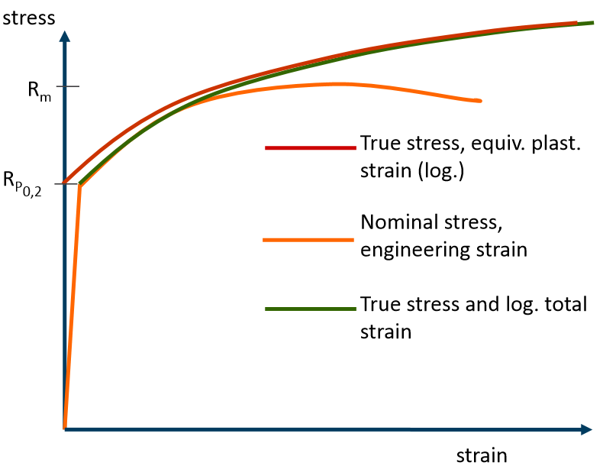
Material Models
In the case of experimental testing of materials, we get engineering results where parameters such as stresses and strains are determined with reference to initial values which is insufficient in the case of numerical simulations.

Slide 28
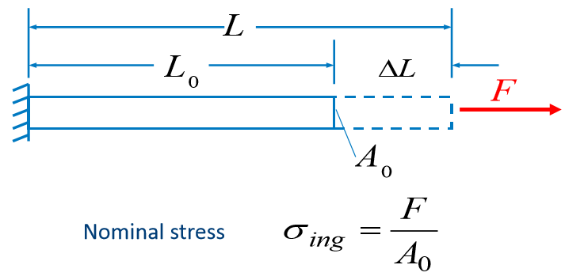
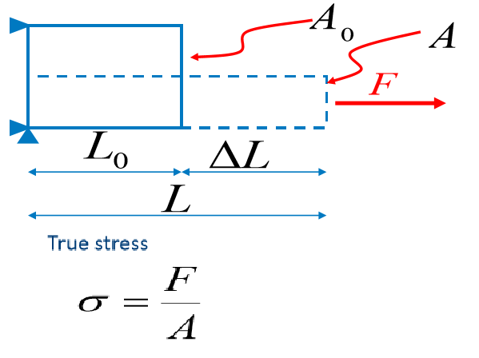
Material Models – Engineering Stress vs True Stress
From experimental studies, we obtain stress values obtained by dividing the acting force by the initial cross-sectional area of the specimen, but for numerical simulations, we are interested in how the stresses will change with the actual cross-section of the specimen.

Slide 29
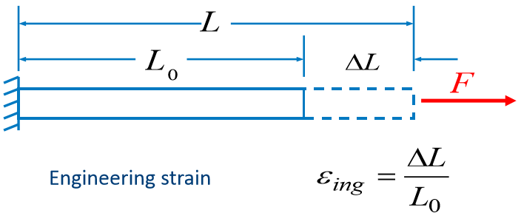
Material Models – Engineering Strain vs True Strain (log)
In the case of strains, the situation is analogous to that of stresses; based on experimental tests, we obtain a strain value obtained by dividing the change in specimen length by the initial length. This value needs to be converted to real strain in the plastic range.

Slide 30
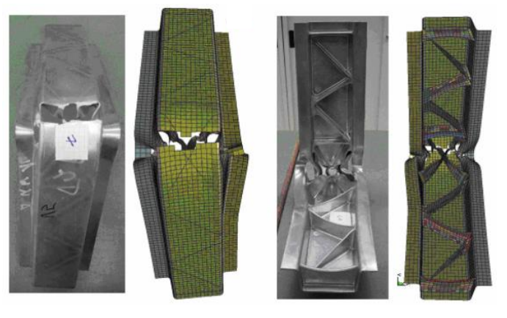
Material Models – damage criterion
If the strength of the material is exceeded, its failure occurs. For numerical simulations using the Explicit solver, it is possible to define a failure/damage criterion. When the conditions associated with the failure/damage criterion are met, individual elements are removed from the model.
Erhart, T., Andrade, F.: News about the add-on failure and damage models in LS-DYNA, Germa LS-DYNA Forum, 2018

