Slide 1
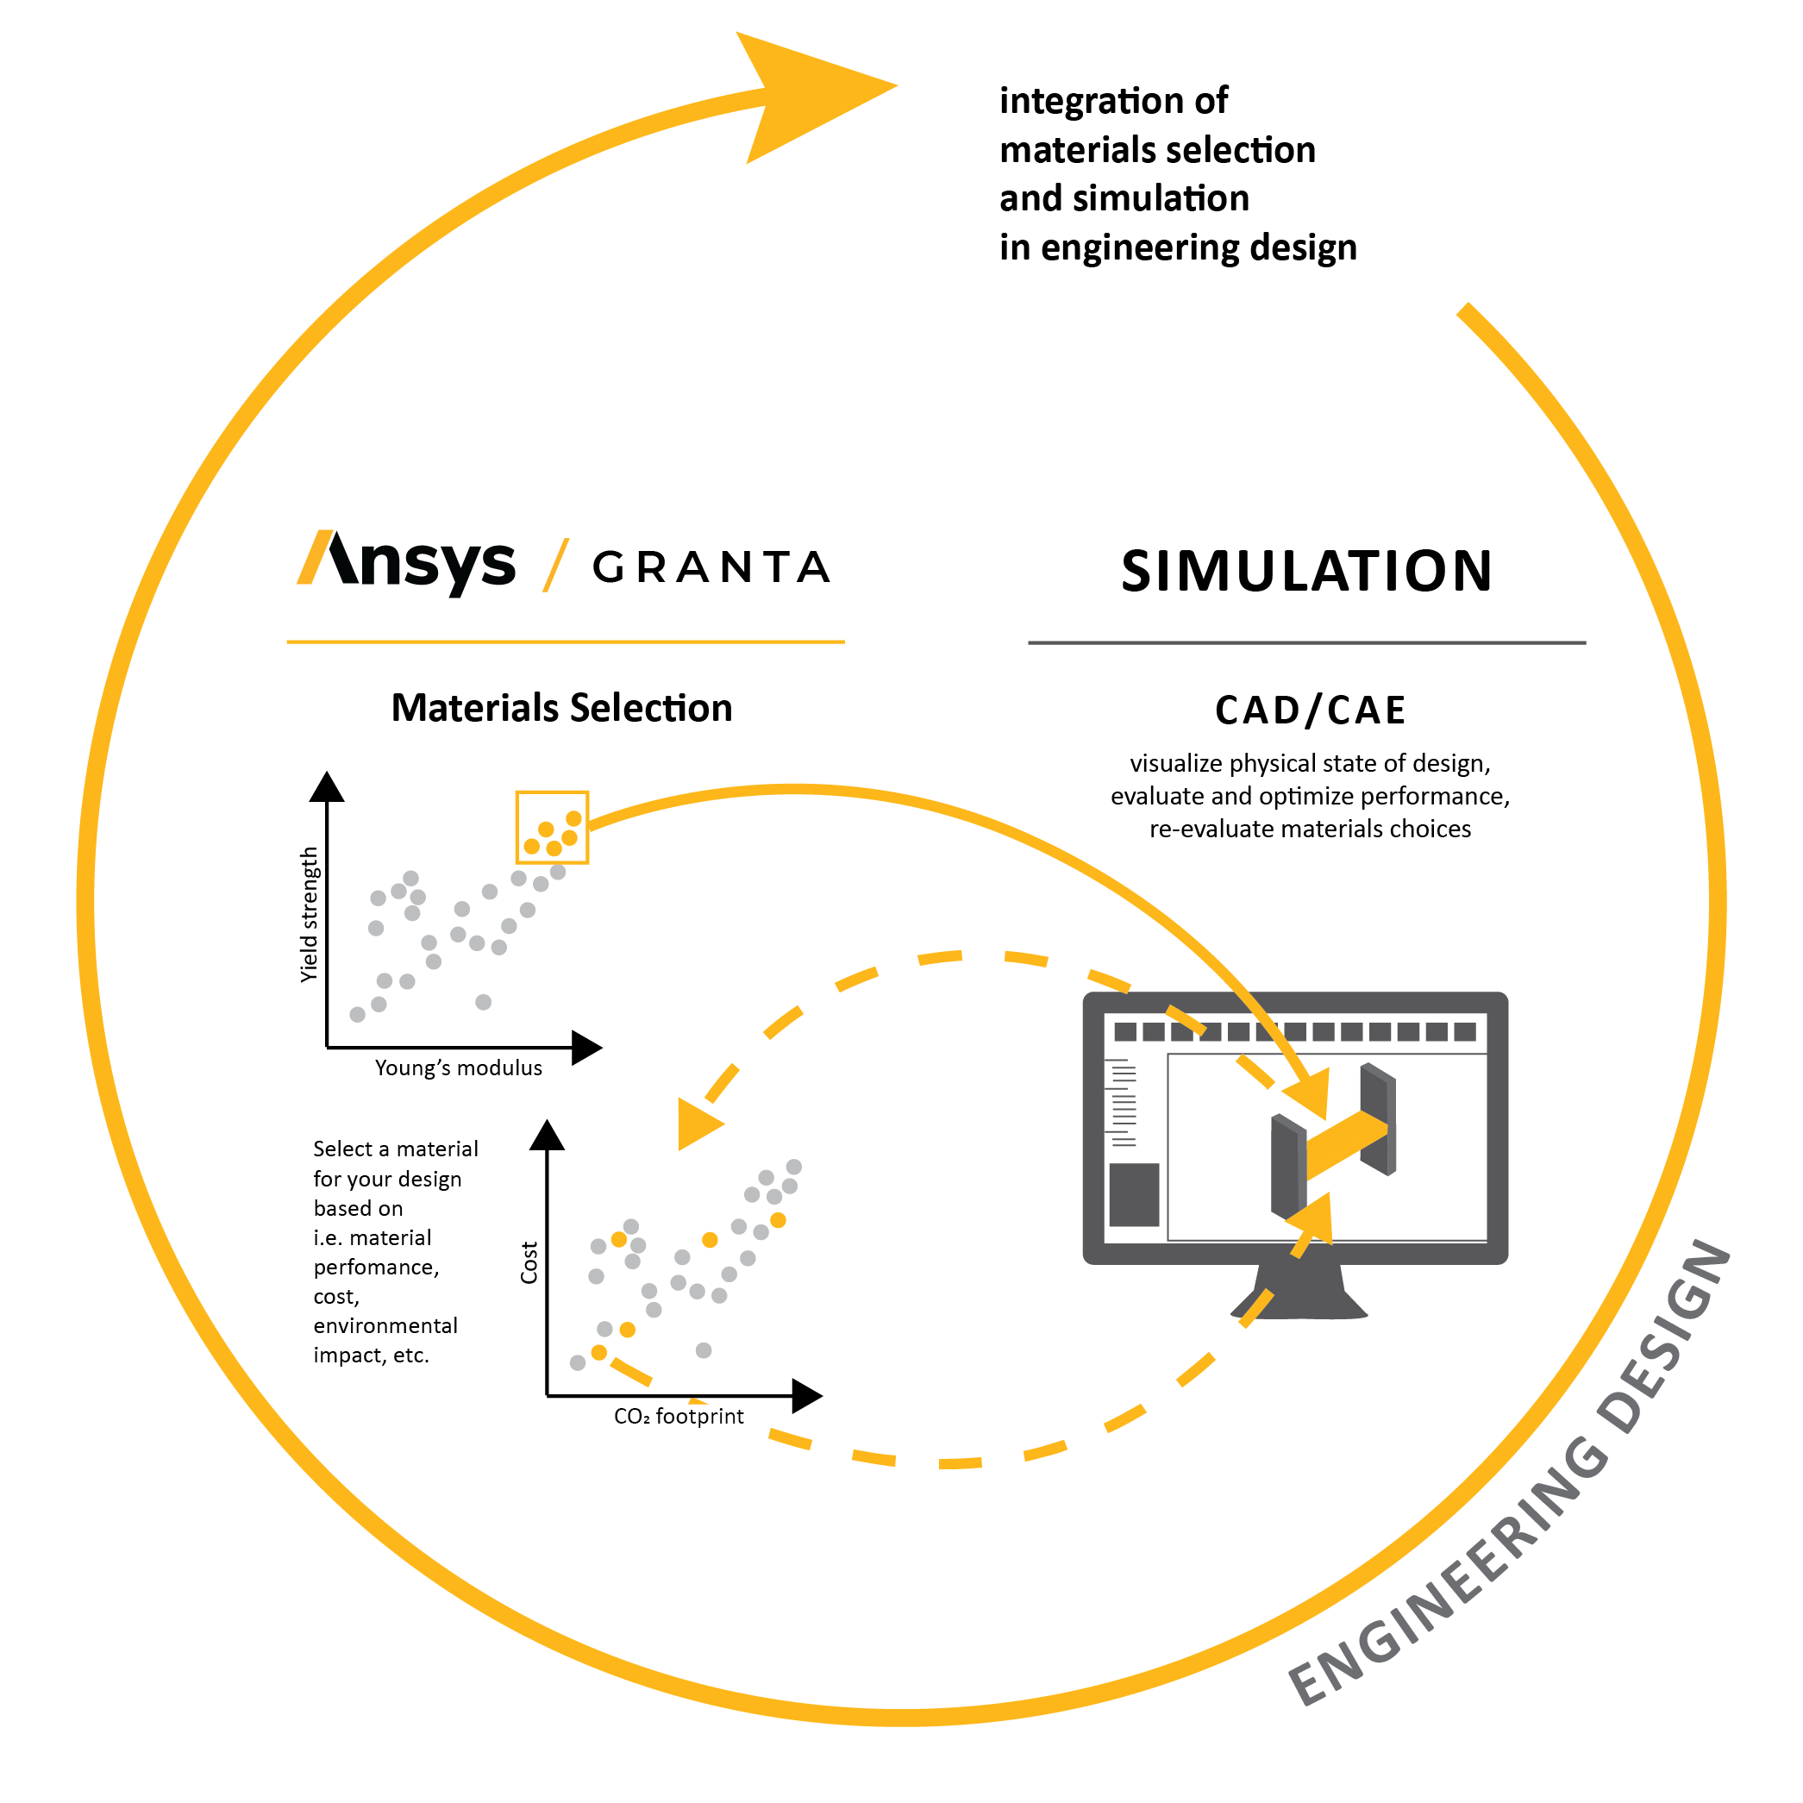
Utilizing Materials Selection and Simulation in Design
Kaitlin Tyler
Ansys Academic Development Team
education@ansys.com
Notes:
This lecture unit is focused on introducing a Sustainable Product Design Methodology to support including both materials selection and simulation in product design projects/thinking

Slide 2
Learning objectives for this lecture unit
Intended Learning Outcomes
Knowledge and Understanding | Understand how materials selection and simulation relate to one another during the product design
Skills and Abilities | Ability to choose the correct Ansys software product at various stages of the design process
Values and Attitudes | Awareness of how both materials data and simulation results can influence the product design cycle
Resources
Text: “Materials Selection in Mechanical Design”, 5th edition, by M.F. Ashby, Butterworth Heinemann, Oxford, 2016.
Article: Tyler, K., & Stefani, N., & Mohee, L. (2022, August), Teaching Engineering Design with Materials Selection and Simulation through Case Studies: A Work in Progress Paper presented at 2022 ASEE Annual Conference & Exposition, Minneapolis, MN. https://peer.asee.org/41465
Notes:
Learning Objectives
These Intended Learning Outcomes are based on a taxonomy of knowledge and understanding as the basis, skills and abilities as necessary for the practical use of knowledge and understanding, followed by acquired values and attitudes enabling assessments and responsible use of these abilities.
Combined with a suitable assessment, they should be helpful in the context of accreditations or for the CDIO Syllabus.
The Texts listed are from books authored or co-authored by Prof. Mike Ashby but other texts are also referred to in the Science Notes.

Slide 3

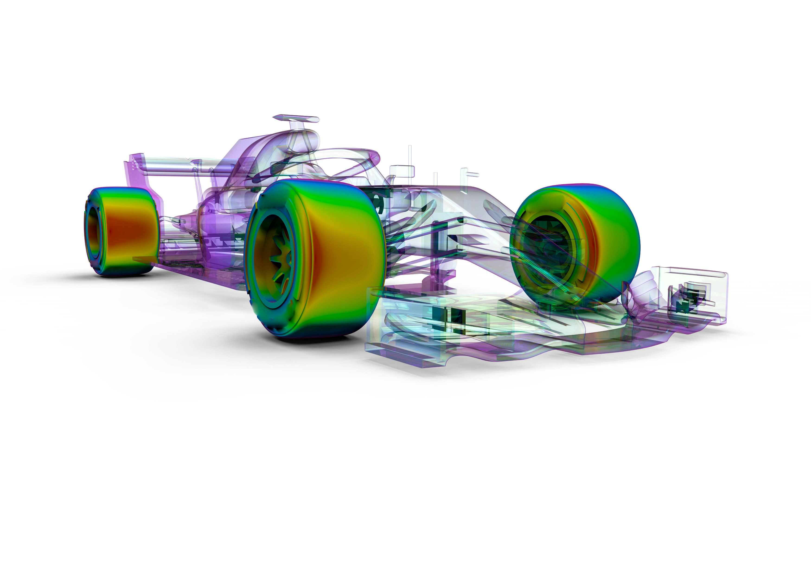
Outline
The importance of simulation and materials selection during design
Sustainable Product Design Methodology (SPDM)-new Design workflow using Ansys software
  Workflow breakdown
  Expansion of the Ashby Selection Methodology
  Achieving balance of accuracy and complexity
In-class activity: designing a longboard deck
Notes:
The goal of this presentation is to emphasize the synergy between materials and simulation in design and showcase a methodology that utilizes various Ansys software products to conduct the steps.
An in-class exploration of this expanded methodology is shown at the end, using a longboard deck as the product of interest.

Slide 4
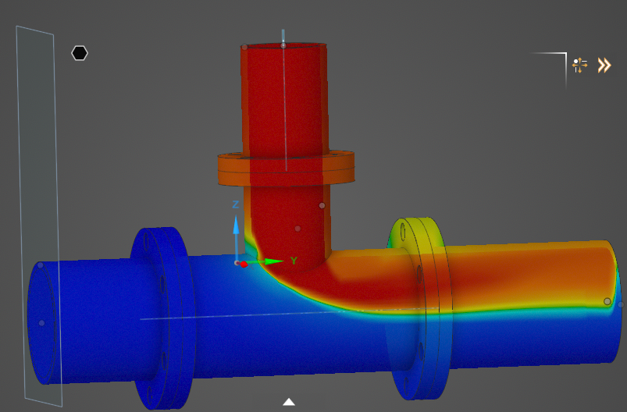
Design-focus problems
Designing products requires an understanding of:
  Product dimensions
  Possible forces, thermal conditions, etc. experienced by the product during use
Computer Aided Engineering (CAE) and simulation can improve understanding of these factors before the prototyping stage
  Saving time and money
Problem: Not optimizing the optimal design if the material is not considered!
Notes:
Design problems are, inherently, design focused! Computer Aided Engineering (CAE) and simulation are very beneficial in exploring designs quickly before prototyping.
But many engineering students focus on the physical dimensions and loading conditions of the product only. Everything physical is made out of a material, and the material chosen could have significant impacts on the loads a part can experience, etc.

Slide 5
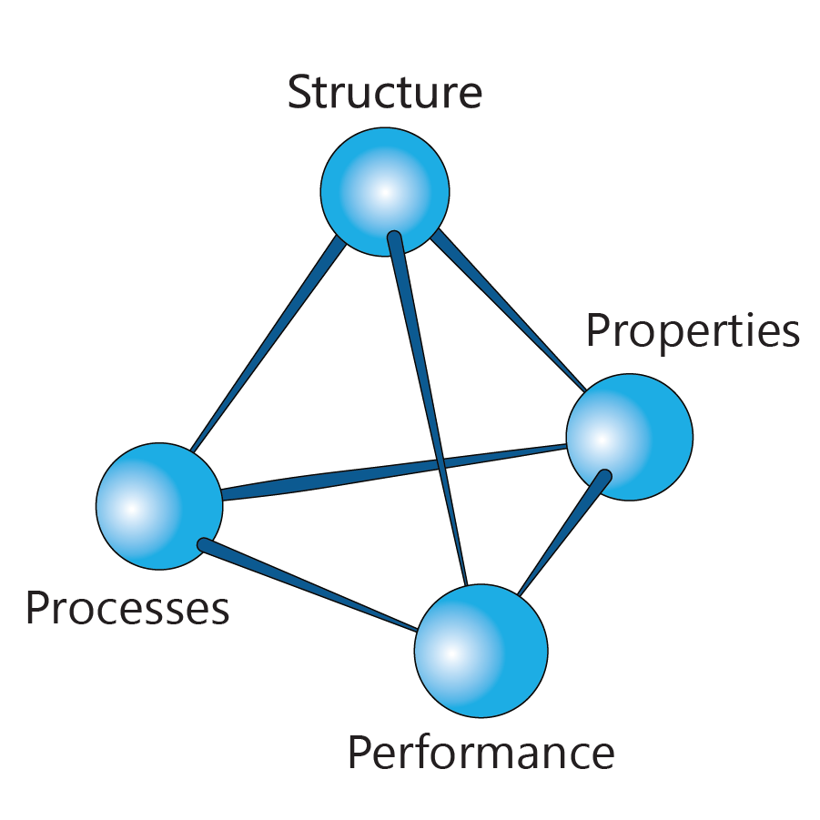
Materials-focus problems
Materials perform differently depending on their structure, processing, and properties
Understanding the link between these key aspects and how they relate to material performance aids in selecting materials during the design process
Problem: need to know design specifications to properly identify key material performance to optimize!
Notes:
On the flip side, in materials engineering/materials science and engineering departments, design projects are often starting by thinking of the material used in the final product. This ties into the materials science tetrahedron, where a materials performance is directly impacted by structure, processing, and properties.
During design, materials engineers can leverage these elements to select the optimal material for the performance needed.
But one needs to understand the design specifications, such as loading and physical environment, to truly know what performance to optimize.

Slide 6

Challenge: how to integrate both emphasis in design projects?
Notes:
Here in lies the challenge we look to address today: how do we ensure both of these key elements of design – CAD/simulation and materials selection – are addressed during student design projects?

Slide 7
Design workflow with Ansys software
Notes:
At Ansys, we support both materials selection and simulation across our product portfolio and recognize the importance of these two elements working in synergy during design.
But dealing with multiple software platforms while also tackling design challenges as a young engineer can be challenging, so we wanted to make that easier.

Slide 8




Building on the Ashby Selection Methodology
The Ashby Selection Methodology is widely used to logically break down design requirements into:
Function
Constraints
Objectives
These can then be implemented using Granta EduPack to identify top material candidates and processes
But how does this connect to simulation?
All materials/Processes
Breakdown design requirements into:
Function – What does the component do?
Constraints – What essential conditions must be met?
Objectives – What is to be maximized or minimized?
Screen on constraints – ‘Go/’no-go’ criteria Rank on objectives – Ordering of materials that ‘go’
Top candidate materials/processes
Ashby’s Methodology
M.F. Ashby - Materials Selection in Mechanical Design 5th Edition, 2016
Explore the Ashby Selection Methodology in our
Basic Systematic Materials Selection Ansys Innovation Course
Notes:
One of our products, Ansys Granta EduPack, was originally created by Profs. Mike Ashby and Dave Cebon. Professor Ashby is famous for his Ashby Selection Methodology, shown on the screen. This logical workflow helps break down design requirements into different elements of design : function, constraints, objectives, and free design variables. These elements can then be applied to large number of materials to screen out unsuitable materials and rank the remaining based on what performance is key to optimize for a specific design. Granta EduPack makes this process easier through its large amount of reliable materials data and visual material data plotting capabilities.
But this methodology is focused solely on materials, not elements of design like optimal product shape for a given load. What can we do to expand this?

Slide 9



Building on the Ashby Selection Methodology (2)
All materials/Processes
Select design
Simulation set-up and benchmarking follow a workflow, just like the selection methodology
By conducting materials selection first
and then starting the simulation workflow,
Leading to a portfolio of viable results considering both design and materials from which to select the final design!
Breakdown design requirements into:
Function – What does the component do?
Constraints – What essential conditions must be met?
Objectives – What is to be maximized or minimized?
Portfolio of viable results (design + material)
Simulation Set-Up and Benchmarking
Geometry of part or assembly (CAD)
Boundary conditions, loads, etc.
Design
Pre-Processing
Screen on constraints – ‘Go/’no-go’ criteria Rank on objectives – Ordering of materials that ‘go’
Numerical analysis & optimization (structural, thermal fluid flow) through FEA and CFD
Validation
Method
Sanity-check (plausibility, expectations, fidelity, etc.)
Post-Processing
Top candidate materials/processes
Evaluation of state variables (output results)
Ashby’s Methodology
M.F. Ashby - Materials Selection in Mechanical Design 5th Edition, 2016
Notes:
At the end of the Ashby Selection Methodology, we are left with a small number of top material candidates. These are perfect to plug into a simulation, so that is where we go next in what we are calling the Sustainable Product Design Methodology or SPDM.
Here, we plug into the cyclic simulation set-up and benchmarking workflow, illustrated here. This can be used for many types of simulation, such as mechanical, thermal, and fluid.
By following this widely used simulation process, while also utilizing the top material candidates identified by the Ashby methodology, you can be sure you are considering all aspects of the design during the simulation and truly be optimizing the best design.

Slide 10

Building on the Ashby Selection Methodology (3)
All materials/Processes
Select design
A last step is to conduct a
trade off analysis to consider:
Mechanical properties
Ecological properties
Economic properties
Social aspects
Breakdown design requirements into:
Function – What does the component do?
Constraints – What essential conditions must be met?
Objectives – What is to be maximized or minimized?
Trade-Off Analysis:
Portfolio of viable results (design + material)
Life-Cycle-Assessment – What are the embodied energies and CO₂ footprints?
Simulation Set-Up and Benchmarking
Geometry of part or assembly (CAD)
Boundary conditions, loads, etc.
Mechanical properties
Design
Pre-Processing
Ecological properties
Numerical analysis & optimization (structural, thermal fluid flow) through FEA and CFD
Screen on constraints – ‘Go/’no-go’ criteria Rank on objectives – Ordering of materials that ‘go’
Economic properties
Validation
Method
Social aspects (S-LCA)
Sanity-check (plausibility, expectations, fidelity, etc.)
Post-Processing
Top candidate materials/processes
Evaluation of state variables (output results)
Ashby’s Methodology
M.F. Ashby - Materials Selection in Mechanical Design 5th Edition, 2016
Explore this expanded methodology using our bike crank case study!
Notes:
We have our final design. Surely we are done now, right?
Before moving to the prototype stage, it is best practice to do a trade-off analysis for the design to consider factors such as environmental impact and social impact (think where do the materials come from, where would this be manufactured, etc.)
Granta EduPack has a significant amount of data focused on sustainability, including data on materials and nations of the world. The Eco Audit tool allows for a simplified LCA analysis of products as well, which can allow for quick identification for areas of improvement within the design.
By completing this final trade off step, the design is well and truly vetted from multiple angles and can move on to further processes.

Slide 11
The Sustainable Product Design Methodology (SPDM)
All materials/Processes
Select design
Breakdown design requirements into:
Function – What does the component do?
Constraints – What essential conditions must be met?
Objectives – What is to be maximized or minimized?
Trade-Off Analysis:
Portfolio of viable results (design + material)
Life-Cycle-Assessment – What are the embodied energies and CO₂ footprints?
Simulation Set-Up and Benchmarking
Geometry of part or assembly (CAD)
Boundary conditions, loads, etc.
Mechanical properties
Design
Pre-Processing
Ecological properties
Numerical analysis & optimization (structural, thermal fluid flow) through FEA and CFD
Screen on constraints – ‘Go/’no-go’ criteria Rank on objectives – Ordering of materials that ‘go’
Economic properties
Validation
Method
Social aspects (S-LCA)
Sanity-check (plausibility, expectations, fidelity, etc.)
Post-Processing
Top candidate materials/processes
Evaluation of state variables (output results)
Ashby’s Methodology
M.F. Ashby - Materials Selection in Mechanical Design 5th Edition, 2016
Notes:
Here we have our complete methodology, clear of animations if needed

Slide 12
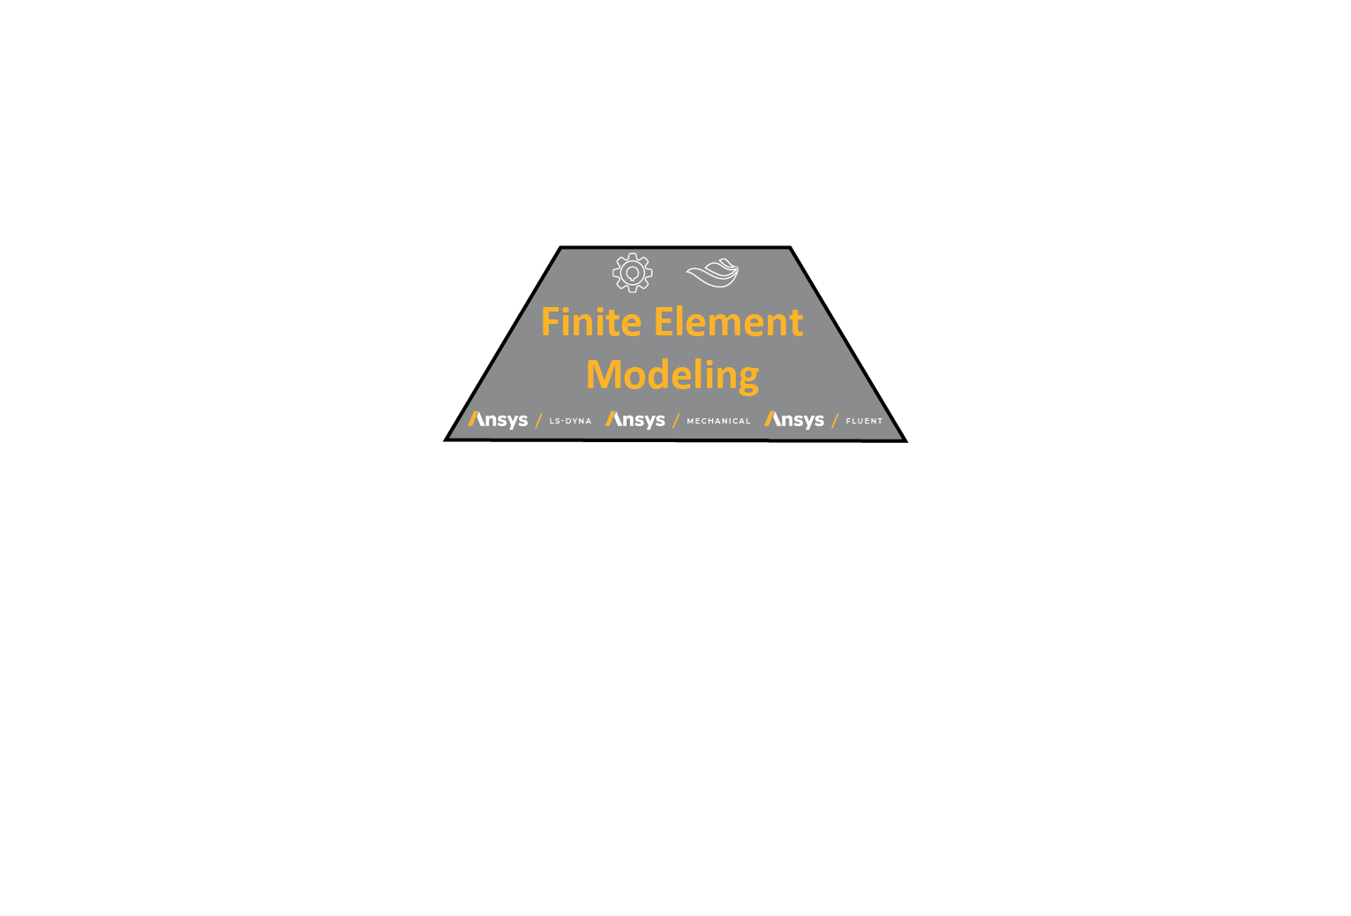
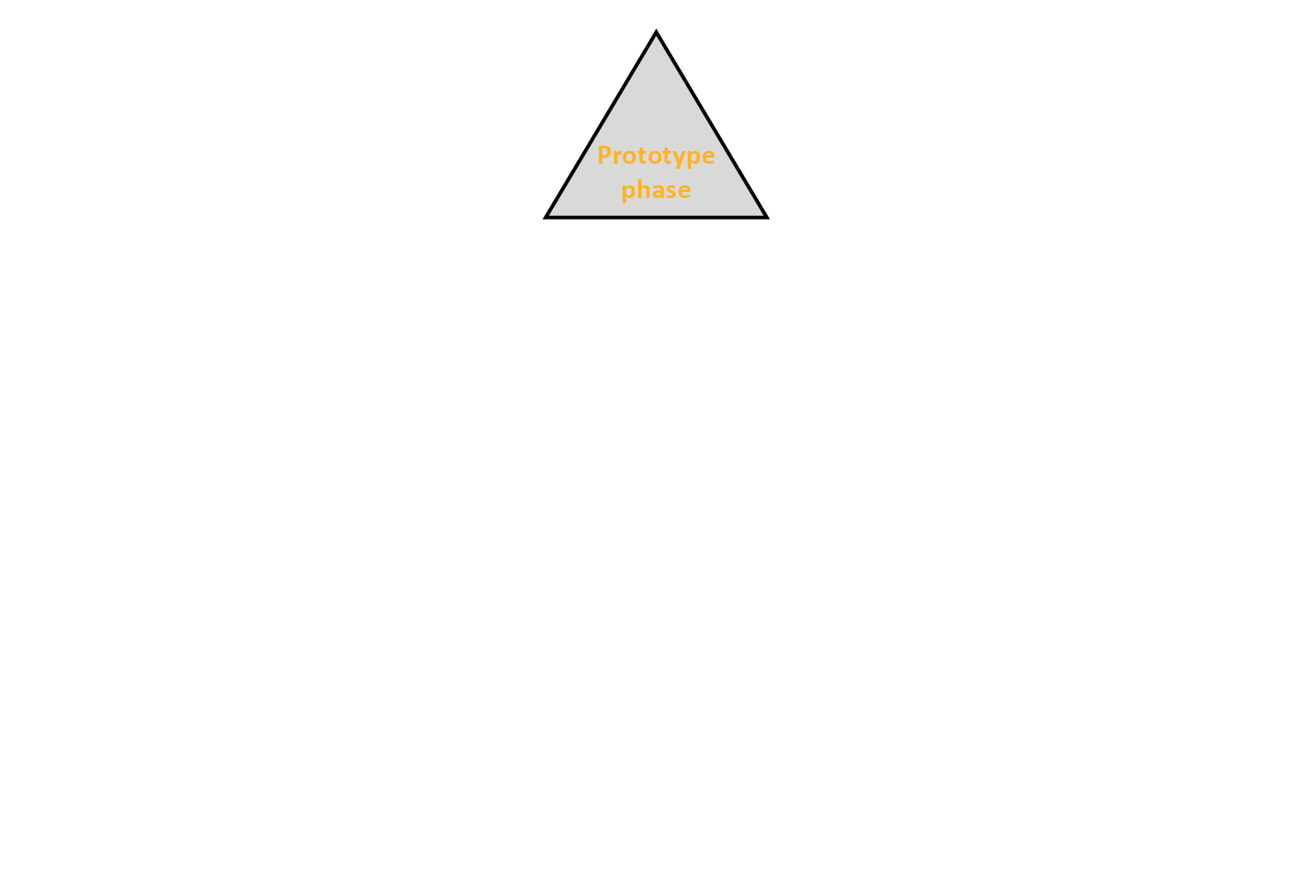
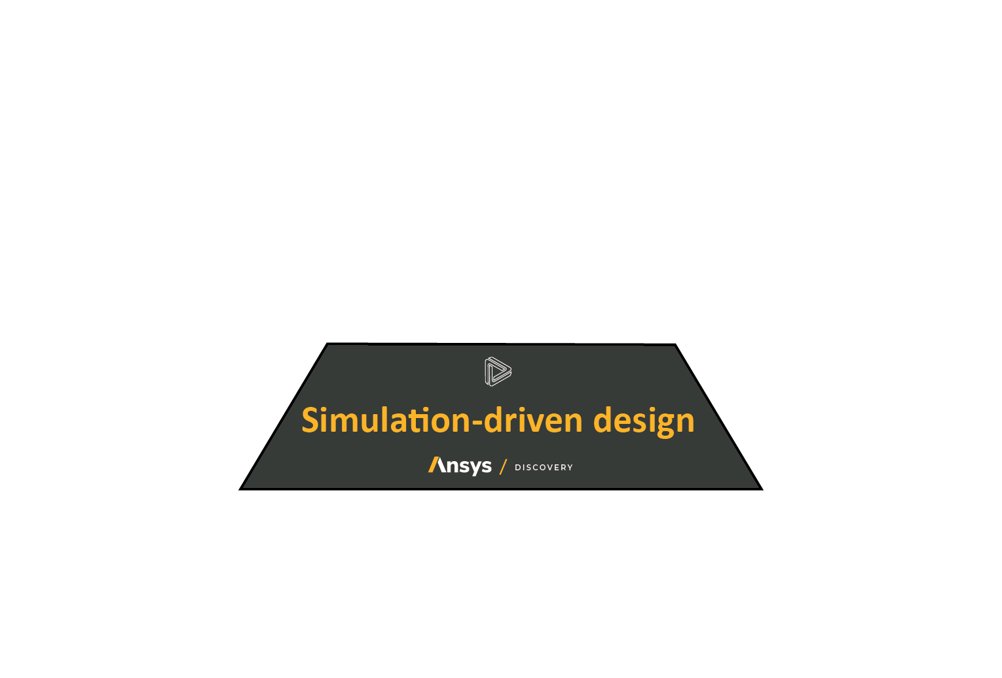

Building step-wise complexity in design
The steps of the Sustainable Product Design Methodology allow for us to build complexity in our design, both from a results perspective and a software tool perspective. We can think of each level of information like a pyramid.
Complexity
1. The foundation of the design is the analytical modeling that occurs during materials selection. Even the most advanced simulation results are incorrect if the material properties are wrong.
2. Simulation-driven design, using tools such as Ansys Discovery, are very accessible to use but have limitations (i.e. for non-linear results)
3. Flagship Ansys products, such as Ansys Mechanical and Fluent, give highly precise simulation results but are complex to operate
4. The prototype stage involves manufacturing and other tools, which are ultimately the most complex
Notes:
Especially if students are unfamiliar with using software tools during design, asking them to jump into using Industry-standard tools right away can be challenging.
The Sustainable Product Design Methodology builds up the complexity of both design results and software skills throughout, allowing for students to really gain some understanding of why each step is being done and what value it is adding to the processes as well as gaining software skills gradually.
The pyramid shown here illustrates how materials are truly the foundation on which we build the rest of the design and how starting with simpler simulation tools, such as Discovery, allows for this growth.

Slide 13
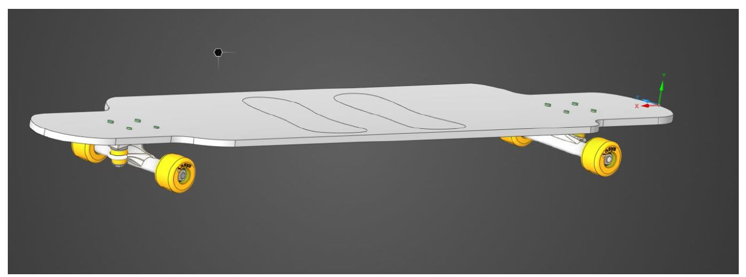
In-class example: designing a longboard deck
Notes:
This activity can be used in class or assigned as a homework– links to relevant case studies for both materials and simulation exploration of a longboard deck can be found on the Ansys Education Resources website (ansys.com/education-resources) or linked on later slides.
Now to see this methodology put into practice. Our goal? Design a deck for a longboard.
*consider polling students in class to see how many of them have ridden a longboard before and if they know what they are made of*

Slide 14
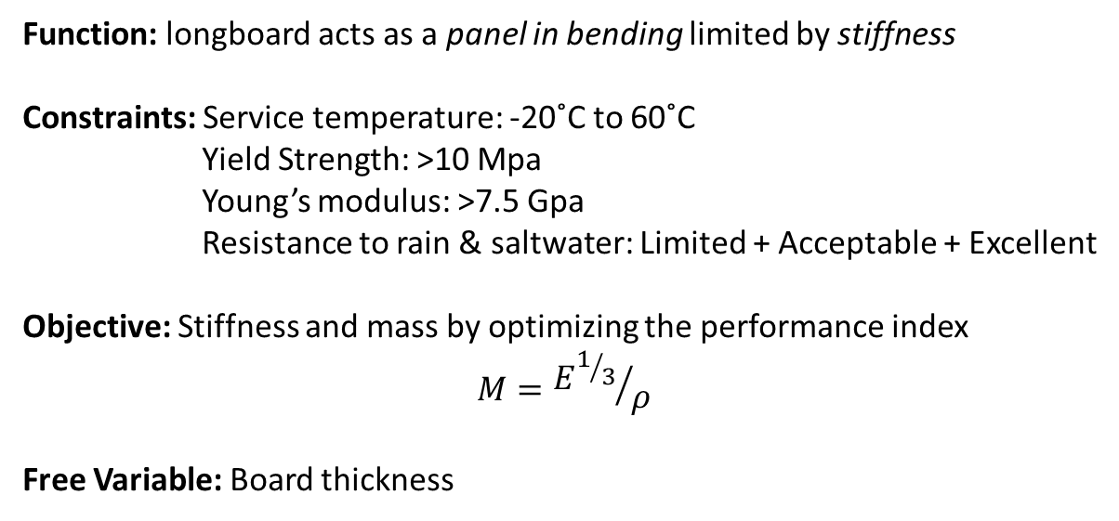
Step 1: Materials selection
Function: longboard acts as a panel in bending limited by stiffness
Constraints: Service temperature: -20˚C to 60˚C
Yield Strength: >10 Mpa
Young’s modulus: >7.5 Gpa
Resistance to rain & saltwater: Limited + Acceptable + Excellent
Objective: Stiffness and mass by optimizing the performance index
$$M={E^{1/3}}/ρ$$
Free Variable: Board thickness
All materials/Processes
Breakdown design requirements into:
Function – What does the component do?
Constraints – What essential conditions must be met?
Objectives – What is to be maximized or minimized?
Screen on constraints – ‘Go/’no-go’ criteria Rank on objectives – Ordering of materials that ‘go’
Top candidate materials/processes
Ashby’s Methodology
Explore this example written up in our
Longboard Materials Case Study
Notes:
Our first step is to perform our materials selection. The translation of design requirements into the function, constraints, objectives, and free design variables can be seen here.
Questions for students:
Why such a large range of temperatures? (outdoor mode of transportation)
Why do I care if the board is lightweight? (I still have to carry it around while indoors, even if it is a mode of transportation)

Slide 15
Screening and ranking via Granta EduPack
Selection performed in the Level 2 database
See the methodology applied in this example in the
Intro to Performance Indices Ansys Innovation Course
Notes:
Here is the selection chart after the constraints and objectives are applied using Level 2 Granta EduPack. If possible, have students run through this in class and identify the top 6 materials if plywood is a reference.
Why would we not consider Boron Carbide?

Slide 16
Top Material Choices
Based on additional research, three top material candidates were chosen:
Plywood (reference material)
Carbon fiber reinforced composites (CFRPs)
Bamboo
But these are generic material records– are they accurate enough for simulation?
→To ensure accurate results, we recommend using specific material grade data for simulations. This can be found in and exported from Level 3 databases
The top 3 material candidates for our simulation steps are:
Plywood (3 ply. Beech), parallel to face layer
Epoxy/HS carbon fiber resin infused woven fabric, biaxial lay-up
Bamboo (longitudinal)
Notes:
While there were multiple wood options, we chose plywood as a reference and bamboo for its possible ecological benefit, as well as a carbon fiber composite as our top three candidates.
HOWEVER when performing a simulation, we should be using data from individual material grades. This type of data can only be found in Level 3 databases in Granta EduPack. The equivalent level 3 records are shown in the yellow box.
Data from Level 3 databases can be exported to various simulation software tools.

Slide 17

Step 2: Simulation Workflow
Set up (a) the geometry and (b) the mesh
Select design
Portfolio of viable results (design + material)
Simulation Set-Up and Benchmarking
Geometry of part or assembly (CAD)
Boundary conditions, loads, etc.
Apply (a) boundary conditions and (b) loads
Design
Pre-Processing
Numerical analysis & optimization (structural, thermal fluid flow) through FEA and CFD
Validation
Method
Sanity-check (plausibility, expectations, fidelity, etc.)
Post-Processing
Evaluation of state variables (output results)
Explore this example written up in our
Longboard Simulation Case Study
Notes:
Now that we have our top 3 candidates, we can move on to Step 2- our simulation workflow
CAD and simulation files for this exercise can be found in the longboard simulation case study, linked on this slide.
Here is a great time to explore geometry set-up, the importance of meshing, identifying and applying boundary conditions, and exploring the loads applied in this simulation

Slide 18

Parametric analysis
Ansys Workbench allows for a series of simulations to be run back-to-back, allowing for easy analysis of the impact of various parameters (such as deck thickness and material)
Material | Optimal Thickness (mm) | Weight (kg)
Plywood (3 ply) | 13 | 2.36
Epoxy/HS carbon fiber | 1.75 | 0.65
Bamboo | 11.5 | 2.36
Tweaking the thickness values to ensure a Safety Factor>1 gives the following results:
Notes:
We took advantage of the parametric analysis capabilities of Ansys Workbench to explore multiple thicknesses per material to figure out the optimal thickness (and therefore weight) of the longboard deck for each material
NOTE all results in the final table have a Safety Factor >1. Discuss with students why this is important

Slide 19
What is the optimal Design for the Longboard deck?
From EduPack we know that:
Bamboo and CFRP are good candidates, with Plywood as a reference
Bamboo $1.64/kg, 0.327 CO₂kg/kg
CFRP : $55.7/kg, 47.8 CO₂ kg/kg
Plywood : $0.579/kg, 0.65 CO₂ kg/kg
From Simulation we know that:
11.5mm Board (1.93 Kg) is optimal for Bamboo
1.75mm Board (0.65 Kg) is optimal for CFRP
13mm Board (2.36 Kg) is optimal for Plywood
Three possible designs:
Bamboo Board: 1.93 kg, $3.17, 0.63 CO 2 kg
CFRP Board: 0.65 kg, $36.21, 31.7 CO 2 kg
Plywood Board: 2.36 kg, $1.37, 1.53 CO 2 kg
No optimal design but Trade off
How much are you willing to PAY for the extra weight savings?
Notes:
We now move on to the final step- trade off analysis
Here we have pulled both price and CO2 footprint data from Granta EduPack for each material. Using the weight and thickness data from Ansys Workbench, we can calculate the cost and kgs of CO2 for each board material option.
It is clear there is not one winner- discuss with the class what tradeoffs we are making here and have them vote on their personal choice. Ask them to justify why.
Examples of other factors that may impact design choice: material processing method used, a specific business case (professional vs. amateur)

Slide 20
Conclusions
Addressing design problems from a design perspective or materials perspective only can lead to key elements missing from the final product
By combining materials and simulation with the Expanded Methodology, Ansys supports the complete design cycle across various software platforms
Design problems of various types, such as a longboard deck, can be explored via this methodology
Notes:
We hope this lecture presentation has emphasized the impact of addressing both simulation and materials selection during design.
Our expanded methodology allows for students to explore both elements using various Ansys simulation tools, as shown by the longboard deck example.

