Slide 1
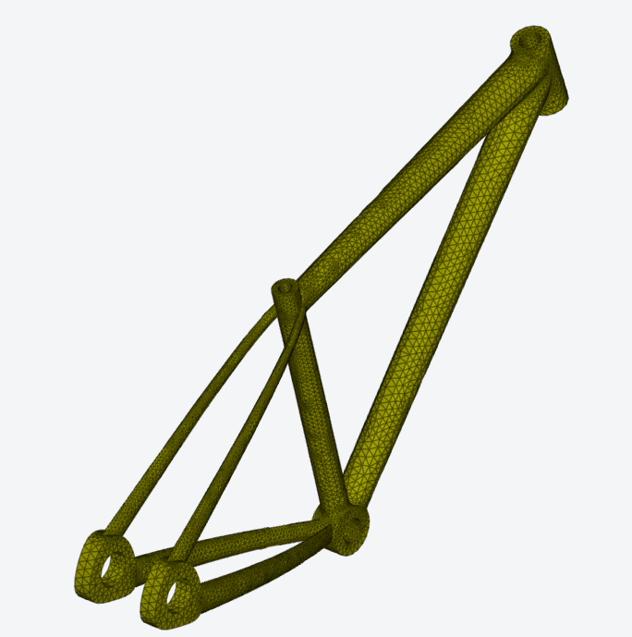
Lecture Unit
Introduction to Meshing using Ansys OnScale
Developed and Curated by the Ansys Academic Team
Madhumita Saravana Kumar
education@ansys.com

Slide 2
Learning Objectives
Intended Learning Outcomes
Knowledge and Understanding | Knowledge and understanding of basics of FEM, meshing and effect of mesh refinement
Intended Target | 1st or 2nd year engineering students learning about simulation
Skills and Abilities | Ability to use OnScale to set up a structural simulation
Values and Attitudes | Awareness of the importance of meshing in simulation
Resources
Text: Lecture Unit: Structural Analysis of Beams with Ansys Discovery | Ansys
Software: OnScale Solve
Further reading/information
Ansys Academic
Ansys OnScale Simulation Tutorials
Ansys OnScale Webinars
Ansys OnScale Blogs
Ansys Innovation Courses
Ansys Education Resources

Slide 3
What is Simulation?
Simulation is the process of virtually emulating a physical process that occurs in real life. It is used to verify the efficacy of a design or product.
It involves the following steps:
Pre-processing
Method of Solution
Post-processing
Geometry and Material
Validation
Geometry (e.g. shape, cross-sections, assemblies) and material (e.g. steel, rubber, wood, etc.)
Setting up the model through mesh generation and
boundary conditions
Sanity check (i.e.
do the results match the expectation, are the results plausible?) E.g. Does the output indicate a need in change of geometry or material?
Numerical methods used to solve the model
What is Simulation? - ANSYS Innovation Courses
Evaluation of outputs (e.g. displacement, stresses and strains)
Notes:
Before we talk about meshing using OnScale let us first briefly talk about what simulation is and why it is needed. Simulation is the process of virtually emulating a physical process that occurs in real life. It is used to verify the efficacy of a design or product.
Simulation can be generally be broken down into the following steps:
The process starts off with designing the geometry and defining the material of the model
Pre-processing involves steps like defining boundary conditions and generating the mesh. We will discuss more about mesh generation in the following slides.
The next step is to choose an appropriate method to solve the problem. In this presentation we will be focusing on the Finite Element Method.
Once the problem has been solved, we move on to postprocessing. Here the required outputs like displacement, stress and strain can be evaluated.
The last but important step is to validate the resulting outputs and check if they make sense. For example, are the magnitude of the results in the expected range or are they too large or too small, does the analytical solution and numerical solution match?

Slide 4
Why do we need Simulation?
Theoretical formulae cannot always be used to solve complex problems.
Physical experiments can be time consuming and expensive.
Simulation allows many different design options to be evaluated quickly and efficiently.
Notes:
Let s now discuss, why we need simulation.
While there are theoretical solutions available to simple problems like a beam in bending. Most processes in the real world are complex and far from ideal so simulation is necessary to solve and understand such complex processes.
Physical experiments can be used to understand these complex processes, but they are time consuming and expensive when compared to simulation. Employing simulation reduces the need for expensive experiments. Nowadays most products are developed using a combination of experiments and simulation, this helps decrease product development to manufacturing time.
Simulation allows many different design options to be evaluated quickly and efficiently.

Slide 5
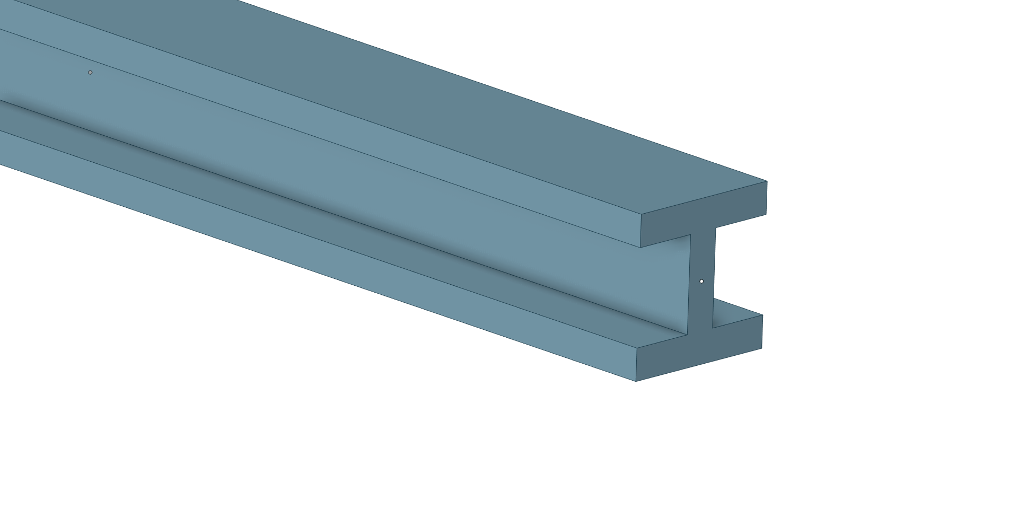
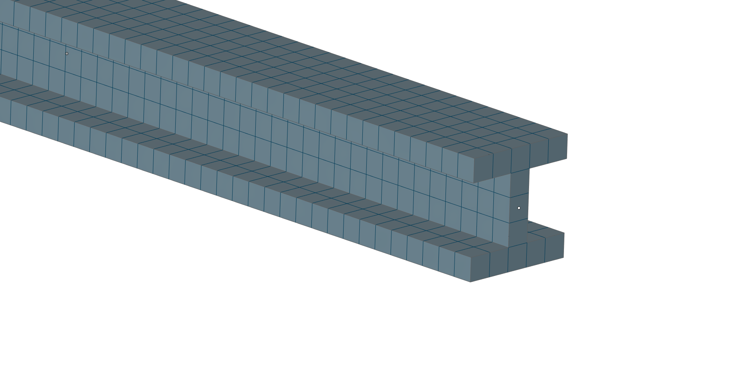
What is FEM?
FEM (Finite Element Method) is a widely used method of numerically solving engineering problems by dividing the model into smaller elements and solving a set of algebraic equations for each of those elements.
Each geometry is divided into small elements which can have different shapes ranging from 2D (triangular, quadrilateral, etc.) to 3D (tetrahedral, hexahedral, etc.) elements through a process called discretization or meshing.
A set of algebraic equations are then solved for each of these elements in order to calculate reaction force, stress, strain, etc.
This is an iterative method where the accuracy of the results depends on the mesh quality, type of solution algorithm, etc.
Notes:
To understand meshing, it is important to understand what FEM (Finite Element Method) is. In this method the geometrical model is divided into smaller elements and set of algebraic equations are solved for each of those elements.
Each geometry is divided into small elements which can have different shapes ranging from 2D (triangular, quadrilateral, etc.) to 3D (tetrahedral, hexahedral, etc.) elements through a process called discretization or meshing.
A set of algebraic equations are then solved for each of these elements in order to calculate reaction force, stress, strain, etc.
This is an iterative method where the accuracy of the results depends on the mesh quality, type of solution algorithm, etc.
It is important to note the results obtained from this method must always be validated as this is an approximation method that have dependencies on the mesh, the types of contacts between different components, etc. When the solution does not appear realistic a sanity check needs to be carried out from the input to the output stage.

Slide 6
FEM Basic Equations in Structural Analysis
Equilibrium
Constitutive Laws
Compatibility
Internal stresses and must be in equilibrium everywhere which presupposes a local equilibrium (i.e. the sum of all forces is zero).
The constitutive material behavior (e.g. linear relation between stresses and strains for linear-elastic material) must be satisfied
Apart from cracks in a structure, displacements/strains must be continuous if the structure is continuous
†
Body and surface forces
Displacements
Stresses
Strains
*
$$\left\{F\right\}=\left[K\right]\left\{U\right\}$$
* Lecture Unit: Stresses and Strains with Ansys Discovery | Ansys
Note: Capital letters generally refer to the global and lowercase letters to the element matrix.
† Intro to Material Elasticity - ANSYS Innovation Courses
Notes:
In order to solve a structural solid mechanics problem, the three basic equations must be satisfied:
Equilibrium,
Constitutive Laws and
Compatibility.
The equilibrium condition states that the sum of all forces must be zero, i.e. the internal stresses of a component are in equilibrium. Here, the body and surface forces are being considered and linked to the stresses and strains.
The constitutive laws define/approximate the stress-strain relationship of materials (Young’s and bulk modulus, Poisson’s ratio, yielding, hardening, etc.) as a result of an applied force. These relations can be phenomenological (derived from experiments) in nature or derived from first principles (also assumptions or postulates).
The compatibility condition ensures that a continuum body is deformed continuously, meaning compatibility is guaranteed between displacements and strains (i.e. displacements are obtained by integration of the strains).
The system of equations for a structural analysis is directly based upon those basic equations and relates the applied force vector F to the stiffness matrix K and displacement vector u. Note, the use of capital and lowercase letters in this equation is used to denote global or elemental (nodal) values.
Further reading & Equilibrium Condition: Additional free online courses/lecture notes on material elasticity and stresses and strains are linked.

Slide 7
1D FEA – Spring System (single spring)
Nodes | i, j
Nodal displacements | u_{i}, u_{j} [mm]
Nodal forces | f_{i}, f_{j} [N]
Stiffness (spring constant) | k [N/mm]
k
Force equilibrium at the nodes:
i
j
i
j
f_{i}
u_{i}
u_{j}
f_{j}
f_{i}
F
f_{j}
F
x
Considering the linear relationship between the spring force F and the elongation $∆$:
Spring stiffness in matrix form:
F
linear
$$F=kΔ$$
non-linear
$$\left[\begin{matrix}k & −k \\ −k & k\end{matrix}\right]\left\{\begin{aligned}&u_{i} \\ &u_{j}\end{aligned}\right\}=\left\{\begin{aligned}&f_{i} \\ &f_{j}\end{aligned}\right\}$$
$$\text{[}\text{k}\text{]}\text{\{}\text{u}\text{\}}\text{= }[F]$$
k
$$Δ=u_{j}−u_{i}$$
$$∆$$
k = element stiffness matrix
u = element nodal displacement vector
f = element nodal force vector
Considering the equilibrium condition regarding the forces of the spring at the nodes:
Node i:
Node j:
$$f_{i}=−F=−k\left(u_{j}−u_{i}\right)$$
$$f_{j}=F=k\left(u_{j}−u_{i}\right)$$
Note: This discretized version of the solution is an approximate one and is dependent on the size of the $∆$ or in other words the mesh.
$$=ku_{i}−ku_{j}$$
$$=−ku_{i}+ku_{j}$$
Notes:
Let us now look at the example of 1D spring and how it is solved using this concept
The spring system is described using the basic equations (i) Equilibrium, (ii) Compatibility and (iii) Constitutive Laws as introduced earlier.
To convey the basic underlying concept of FEA, a simple spring element (i.e. 1D case) is considered, in which two nodes (i,j) at the ends of the spring are defined by displacements and forces. Based on the spring’s stiffness and boundary conditions different forces and displacements may be recorded for each node.
The spring system is considering a linear elastic relationship, meaning force and displacement are proportional.
Now, the force equilibria at the two nodes can be defined.
By reassembling the two expressions, the spring stiffness in matrix form is defined.
Note: This discretized version of the solution is an approximate one and is dependent on the size of the $∆$ or in other words the mesh.

Slide 8
FEM Basic Equations in Structural Analysis
Element Stiffness Matrixes are combined into global stiffness matrix:
Important to note:
Size of Stiffness matrix (nxn) depends on the number of nodes and their degrees of freedom.
A finer mesh corresponds to a larger matrix and thus more computational time.
In the case of 3D analysis, it is possible to have n>10⁵
Elements of $\left[K\right]$ depend on material properties and the chosen mesh element type.
Some elements of the force and displacement vectors are already known through boundary conditions (e.g. Fixed Support -> u_{i}=0).
$\left[K\right]\left\{U\right\}$ $= \left\{F\right\}$
Stiffness
Matrix
Displacement
Vector
Force
Vector
$$\left[\begin{matrix}k_{11} & k_{11} & . \\ . & k_{22} & . \\ \begin{aligned}. \\ k_{n1}\end{aligned} & \begin{aligned}. \\ .\end{aligned} & \begin{aligned}. \\ .\end{aligned}\end{matrix} \begin{matrix}. & . & k_{1n} \\ . & . & . \\ \begin{aligned}. \\ .\end{aligned} & \begin{aligned}. \\ .\end{aligned} & \begin{aligned}. \\ k_{nn}\end{aligned}\end{matrix}\right]\left\{\begin{aligned}&u_{1} \\ &u_{2} \\ . \\ . \\ . \\ u_{n}\end{aligned}\right\}=\left\{\begin{aligned}&f_{1} \\ &f_{2} \\ . \\ . \\ . \\ f_{n}\end{aligned}\right\}$$
Notes:
Let us now look at the stiffness equation for a more complex system. Individual element stiffness matrices are combined to form a global one as shown on the slide.
Important to note:
Size of Stiffness matrix (nxn) depends on the number of nodes and their degrees of freedom.
A finer mesh corresponds to a larger matrix and thus more computational time.
In the case of 3D analysis, it is possible to have n>10⁵
Elements of $\left[K\right]$ depend on material properties and the chosen mesh element type.
Some elements of the force and displacement vectors are already known through boundary conditions (e.g. Fixed Support -> u_{i}=0).
Let us now talk about meshing.

Slide 9
Importance of Meshing
Meshing involves dividing a geometry into elements and nodes.
It plays a key role in determining the accuracy of the results obtained from the FEM model.
The smaller the mesh size (also known as a finer mesh), the more accurate the solution.
A fine mesh leads to increased computational effort to run the simulation.
Engineers carry out convergence studies to find a good balance between accuracy and run time in order to solve the problem.
A typical solution that is used is to create a finer mesh in areas of interest (e.g. around stress concentration areas) or finer geometry in the model and coarser meshes in other areas.
node
element
Exact solution
Results
Numerical solution**
Number of elements
**This is a generic representation and there are exceptions to this rule in cases like locking or stress singularities
Meshing in FEA: Mesh convergence | OnScale
Notes:
Meshing plays an important role in FEM. It involves dividing a geometry into elements and nodes.
It plays a key role in determining the accuracy of the results obtained from the FEM model.
Smaller the mesh size (also known as a finer mesh), the more accurate the solution.
A fine mesh leads to increased computational effort to run the simulation.
Engineers carry out convergence studies to find a good balance between accuracy and run time in order to solve the problem. This can be seen in the graph on the right. The accuracy increases considerably in the beginning with a finer mesh but at some point, the results remain constant. There are however exceptions to these cases (E.g. locking or stress singularities) where creating a finer mesh leads to improbable results
A typical solution that is used is to create a finer mesh in areas of interest (e.g. around stress concentration areas) or finer geometry in the model and coarser meshes in other areas.

Slide 10
Types of Elements
1D:
Important to note:
Choosing the right type of element is dependent on the type of scenario that is being simulated.
It is key to choose elements that would solve the numerical equations accurately.
2D:
3D:
Notes:
There are different types of elements that are available in FEA. The simplest classification would be to categorize them into 1D, 2D and 3D.
1D elements can be in the form of lines, curves or splines.
2D elements have simple forms like triangular and rectangular but can also have more complicated geometry as shown in the diagram based on the type of function they serve.
The same goes for 3D elements.
It is important to note that 3D elements have higher computational effort than 1D or 2D. The higher the number of nodes the higher the computational effort but the greater the accuracy of results.
Choosing the right type of element is dependent on the type of scenario we are trying to simulate. For example in the case of 2D planar stress condition or an axisymmetric model, 2D elements can be used.
It is key to choose elements that would solve the numerical equations accurately. More complex simulations like crack propagation or fluid flow required higher order elements.
We will learn more about this in the next slide.

Slide 11
Choosing the right mesh size
Complex analysis like crack propagation require finer mesh than static analysis.
Factors to be considered
Type of analysis
Areas of Interest
Determining importance of small dimensions
Element quality
Accuracy of solution
Computational effort
Finer meshes require higher computational time.
Areas of interest like high stress regions should have a finer mesh compared to less relevant areas.
Generally, finer the mesh, the more accurate the solution.
Not all dimensions in the model are relevant. E.g., small holes or filets can sometimes be omitted from the mesh in areas undergoing very negligible stress
Elements that are distorted or warped cause numerical errors and instability in the model.
Notes:
Choosing the right mesh is a very important part of FEM. Let us briefly discuss some important factors to be considered during mesh generation:
Type of analysis plays an important role. Complex analysis like crack propagation require a finer mesh when compared to static analysis.
Areas of interest like stress concentration regions or impact regions require a finer mesh than that of the less relevant or unaffected areas.
It is important to note that not all dimensions in a model are relevant. In order to save computational effort, irrelevant geometries like holes and filets are ignored in the model while creating a mesh.
It is important to check the element quality as distorted or warped elements cause numerical errors and instability in the model. One quality check that is typically used is the aspect ratio of the element which is the ratio of the largest dimension to the smallest dimension of the element. Another quality check that is often used is skewness of the element which identifies how close to an ideal geometry (i.e. equiangular) is the element.
Generally, finer the mesh, the more accurate the solution.
Finer meshes require higher computational time. Therefore, it is important to find a good balance between accuracy and computational effort.

Slide 12
Why higher mesh refinement leads to more accurate solution
State variable
(e.g. Temperature or Displacement)
1 mesh
Element
Continuous Variation
(Reality)
4 mesh
Elements
Discretised
Variation (Approximated)
14 mesh
Elements
1D variation
Important to note: The sharper and more complex the gradient of the real solution, the more refinement is needed to capture it.
Notes:
Here is a more detailed explanation as to why a more refined mesh leads to more accurate solutions. In the graph above we can see how with increased number of elements the discretized solution can better emulate the behavior of the state variable.
Important to note: The sharper and complex the gradient of the real solution, the more refinement is needed to capture it.
Let us now look at the features that are available to us with OnScale.

Slide 13
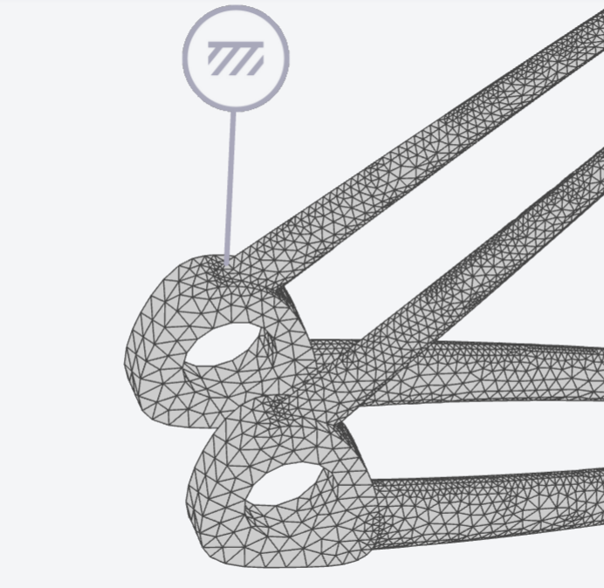
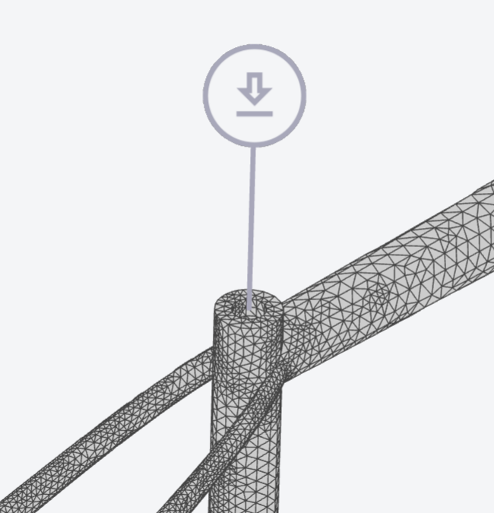
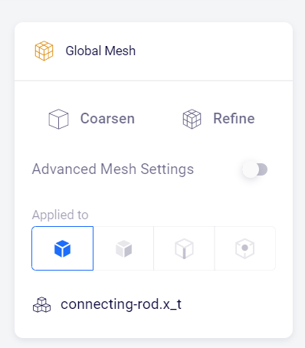
Advantages of Automatic Meshing
Most FEM software offers automatic meshing features. Ansys OnScale has the following ones:
Automatic optimization of mesh cell quality – minimizing skewness and aspect ratio
Automatic mesh adjustments to areas of applied boundary conditions
Higher mesh densities in areas with curved features
Automatic edge refinement
Mesh can be coarsened or refined based on the user’s preference. This can be done for the part as a whole or in specific areas of interest.
CAD Validation & Meshing with OnScale Solve™ | OnScale
Notes:
OnScale has been developed with automatic meshing features to make the life of the user easier when carrying out a simulation. Some of the most important features include:
Automatic optimization of mesh cell quality – minimizing skewness and aspect ratio.
Automatic mesh adjustments to areas of applied boundary conditions. This can be observed in the images at the top.
Higher mesh densities in areas with curved features. This can be observed in the image at the top right. The curved edges have a finer mesh.
Automatic edge refinement. This can be observed in the image to the top left when there is a change in the geometry and the edges have been refined with a finer mesh.
Mesh can be coarsened or refined twice based on the user’s preference. This can be observed in the bottom image. The coarsen or refine buttons can be used twice.
To read more about this you can read the blog at the link mentioned in the bottom of the slide

Slide 14
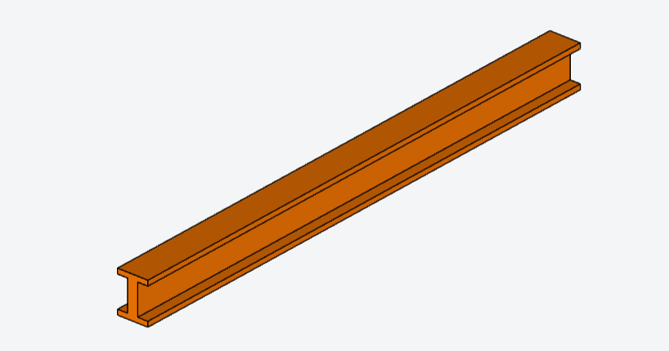
Example Exercise 1: I-Beam
Simulate the I-beam of length 1m made of structural steel and define fixed boundary conditions on either end and a force of 10 kN applied on the top surface.
Compare the results to the analytical results (Young’s Modulus (E) = 200GPa; Moment of area (I)= $3.32∗{10}^{6}{mm}^{4}$)
10kN
1m
Notes:
Note: If students would like to get some hands-on experience with meshing and simulation, the next few slides will walk them through simulating a simple I-beam in the online simulation platform Ansys OnScale

Slide 15
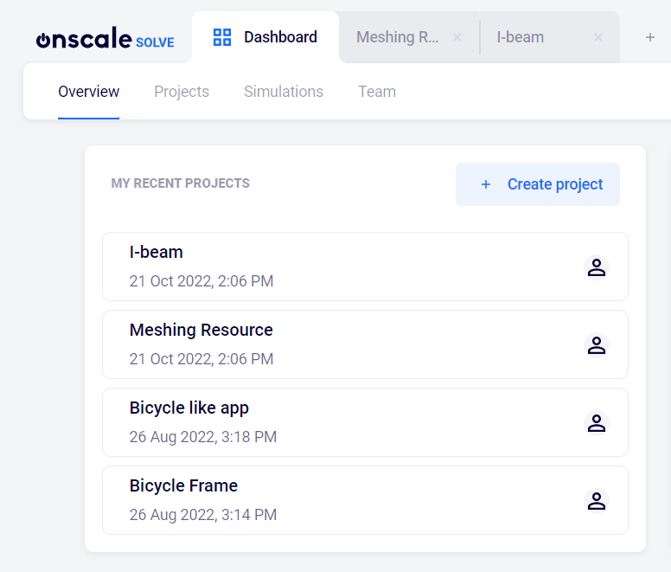
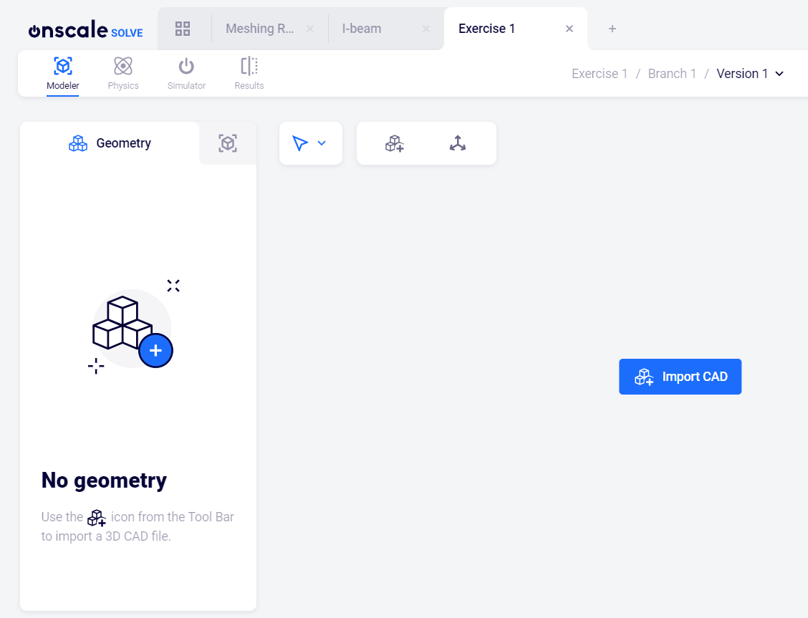
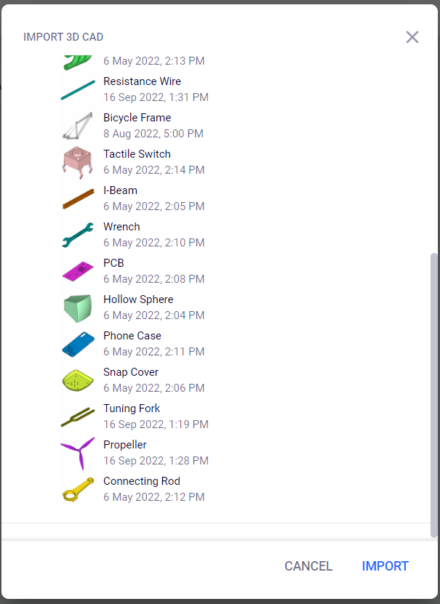
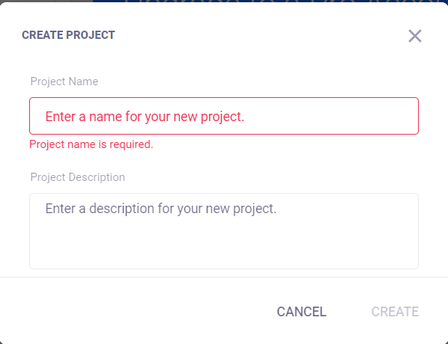
Solution: Setting up the model (1/4)
Step 1: Creating a new project
Step 2: Import Geometry
Click create project
Select I-Beam and click Import
Click Import CAD
Enter Project name and description and click Create

Slide 16
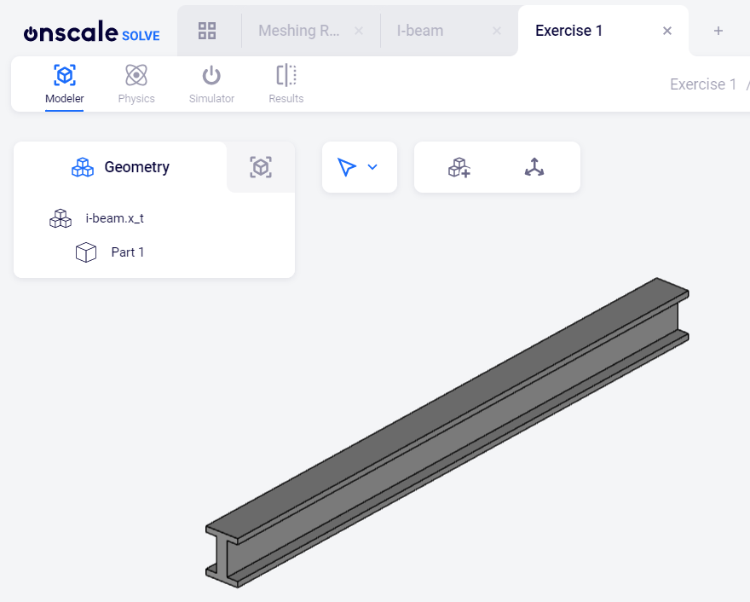
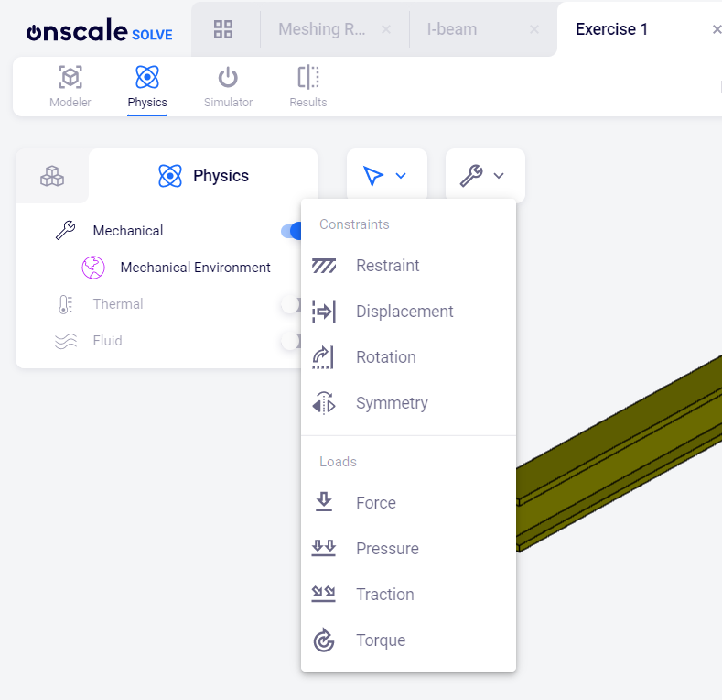
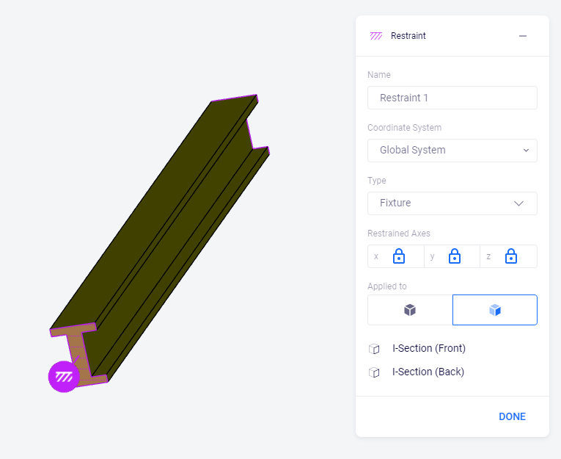
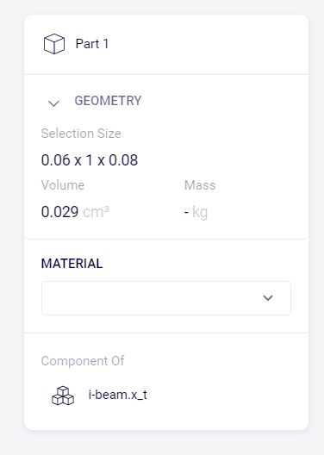
Solution: Setting up the model (2/4)
Step 3: Assign material
Step 4: Assign boundary conditions – fixed supports
Click the mechanical button and select restraint from the drop down
Click Part 1
Select Structural Steel from the drop down
Select the front and back cross section of the beam and click done

Slide 17
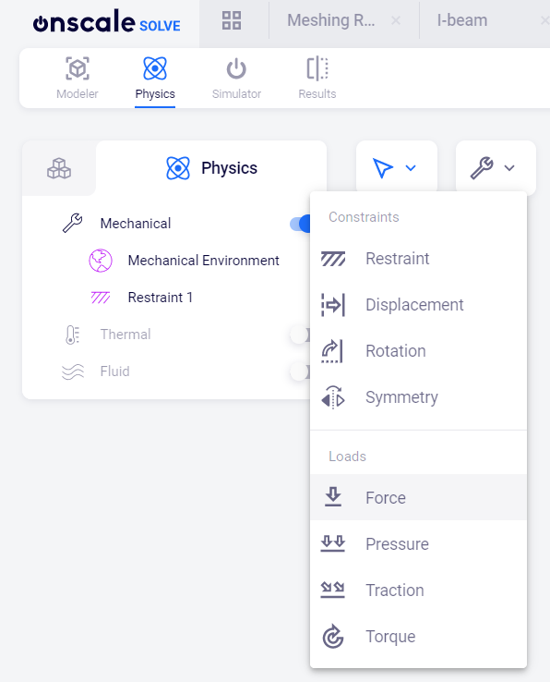
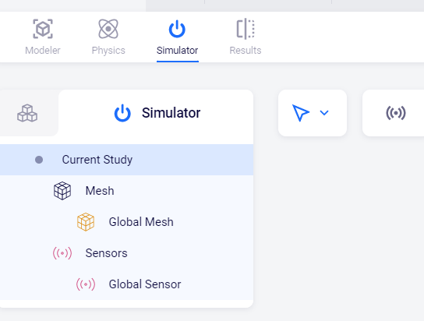
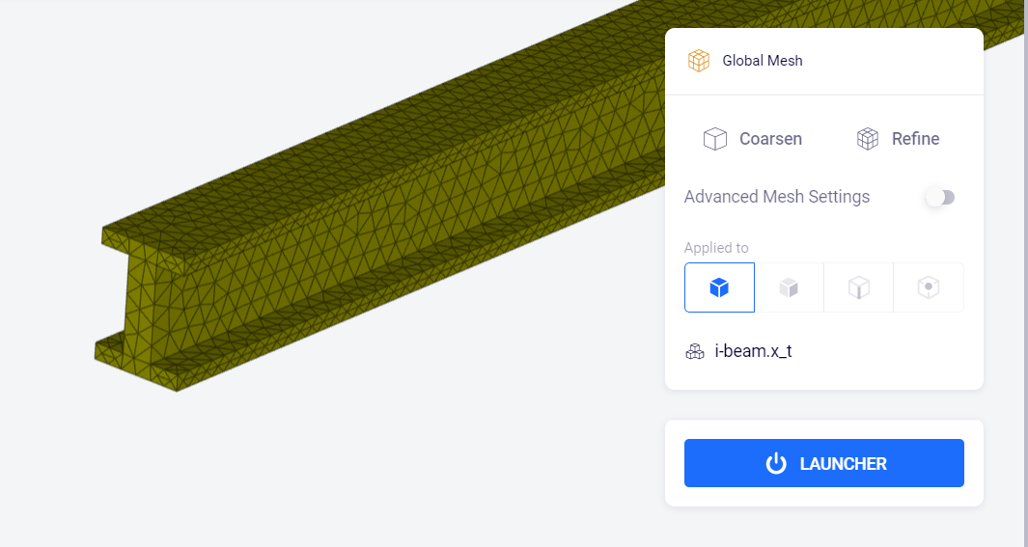
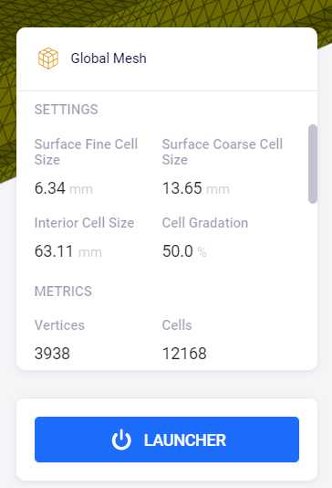
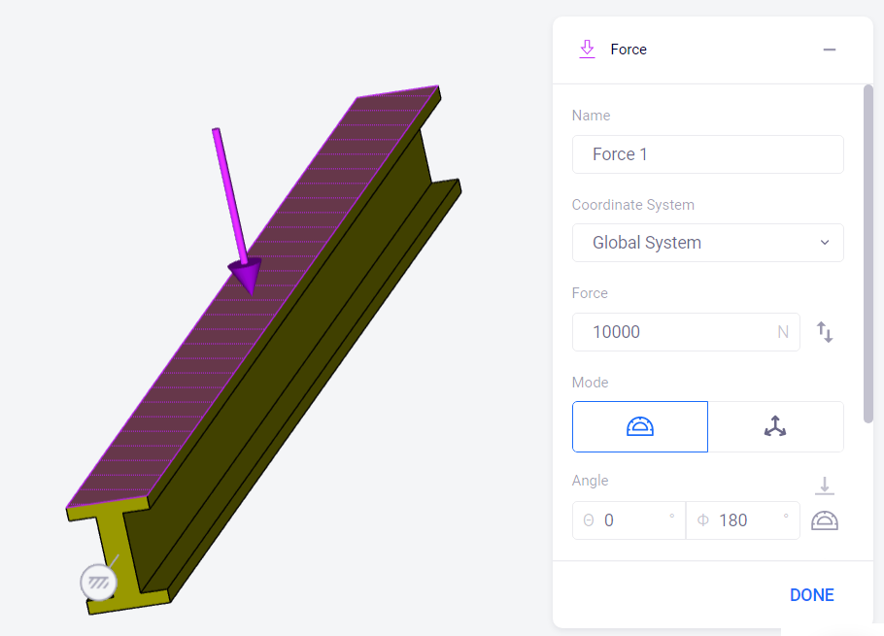
Solution: Setting up the model (3/4)
Step 5: Apply Force Load
Step 6: Meshing
Click the mechanical button and select force from the drop down
Activate the simulator tab and then click on global mesh
Note: The mesh setting can be observed here.
Select the top surface of the beam and type in 10000 as the value of force
Activate the advanced mesh setting
Click the Launcher button

Slide 18
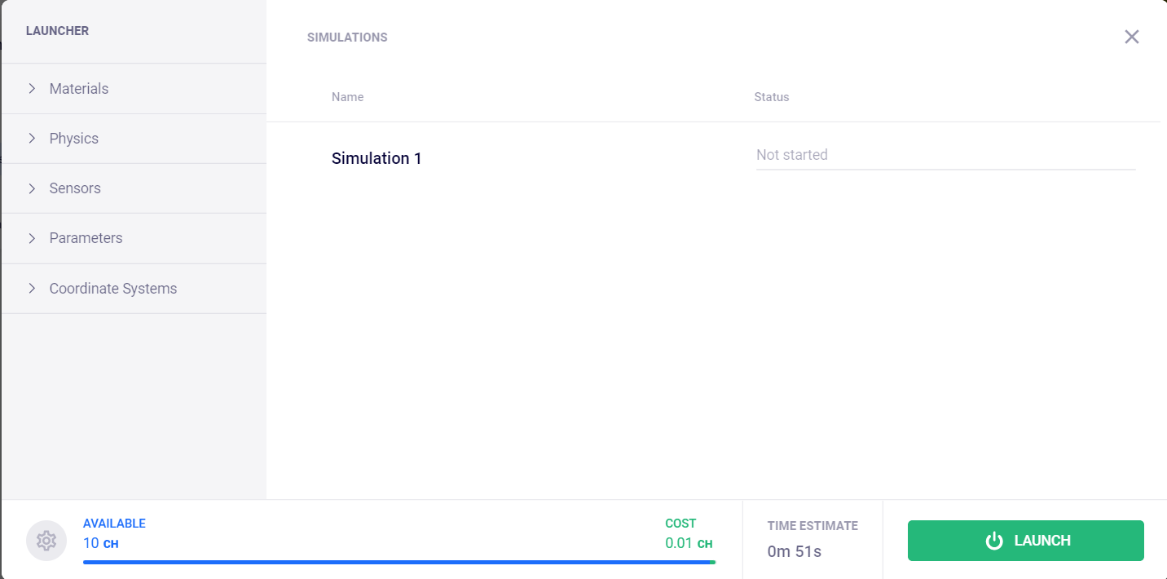
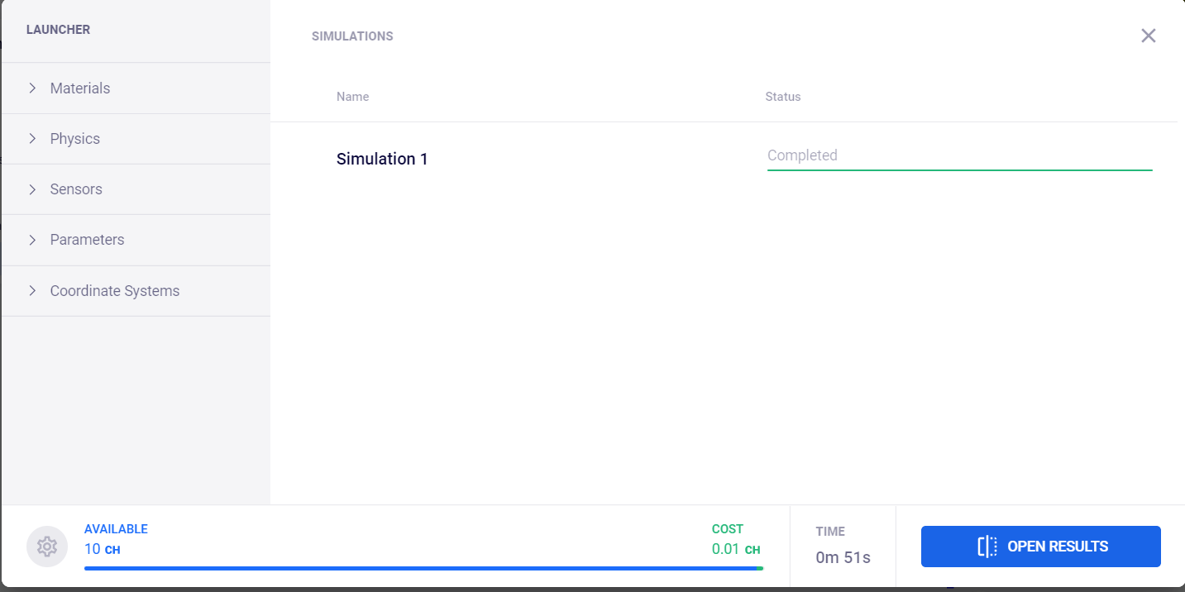
Solution: Setting up the model (4/4)
Step 7: Running the simulation
Step 8: Open results
Click Launch
Click open results
Note: the launcher initially runs a time estimate of the run time of the simulation and when this is done the Launch button gets activated
Important to note:
The simulation runs on the cloud for the estimated time and the results can be viewed on completion. Therefore, no special computational hardware is required to run these models.

Slide 19
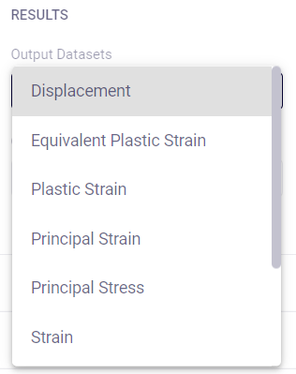
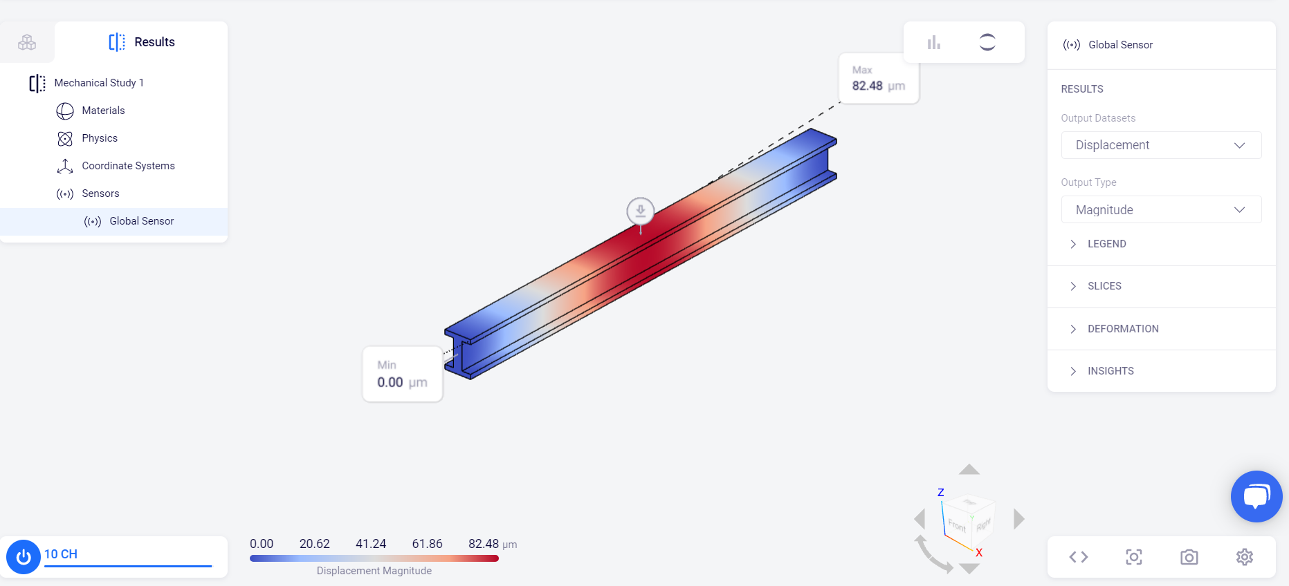
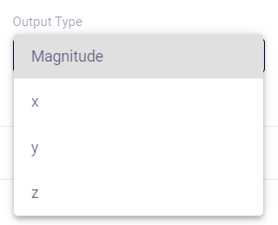
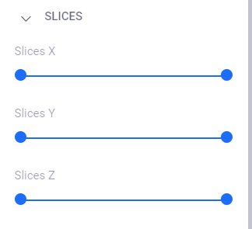
Solution: Visualizing Deformation
Select the desired output results
Select the intended value: total or directional
Select the intended value: total or directional
The desired visuals can be adjusted using the settings button

Slide 20
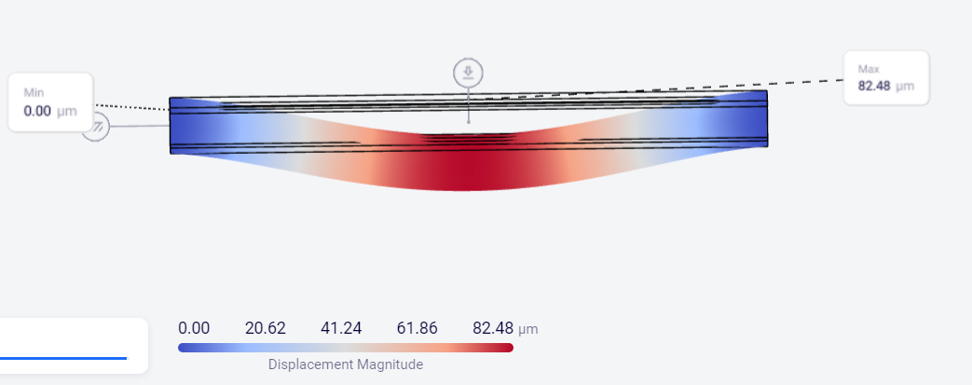
Solution: Comparing analytical and simulation results
10kN
1m
$$δ_{max}=\frac{FL^{3}}{192EI}$$
$$δ_{max,sim}=82.48μm=0.082mm$$
$$=\frac{10000N∗{(1000mm)}^{3}}{192∗200000\frac{N}{{mm}^{2}}∗3320000{mm}^{4}}=0.078mm$$
$$Error=5\%$$
Notes:
5% error is a very acceptable error percentage for this type of application.

Slide 21
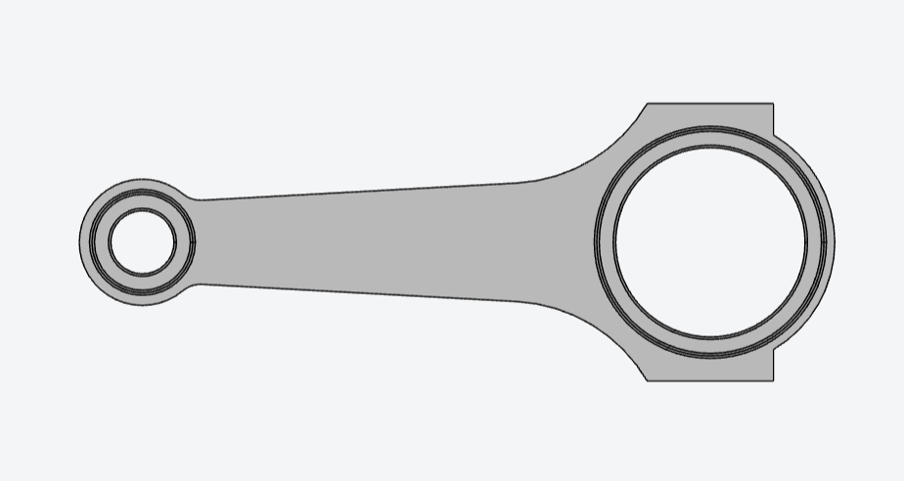
Example Exercise - 2
Simulate the connecting rod made of aluminum undergoing a compressive pressure load of 20 MPa as shown in the diagram.
Visualize the von-Mises stress
Is the design a safe one?
Does refining the mesh have an influence in the area marked in blue

Slide 22
Solution: Setting up the model (1/2)
This exercise is an example of a more advanced problem, and the model cannot be solved with analytical equations. Thus, simulation is quick and cost-effective method of analyzing the problem.
Steps 1-3: Follow the same steps as in exercise one to create a project and import the connecting road and assign aluminum as the material.

Slide 23
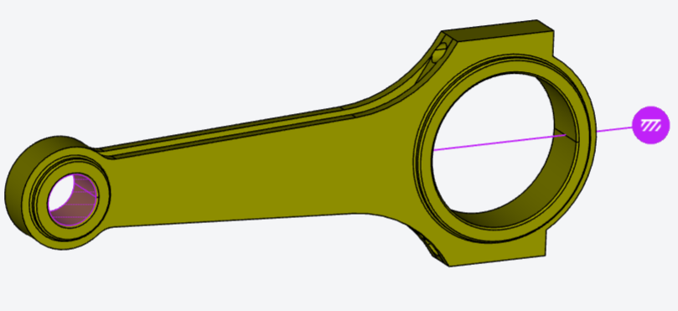
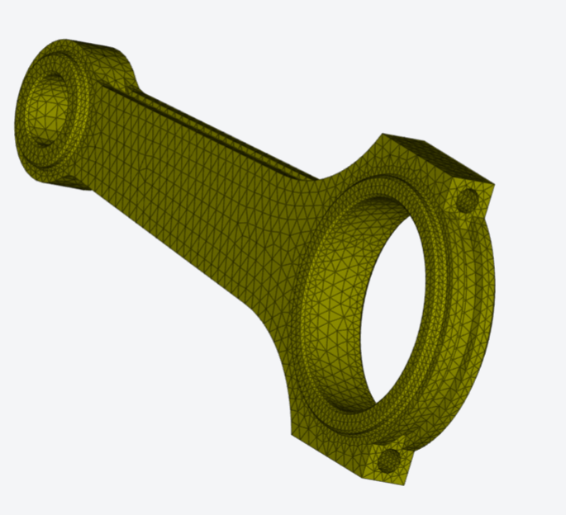
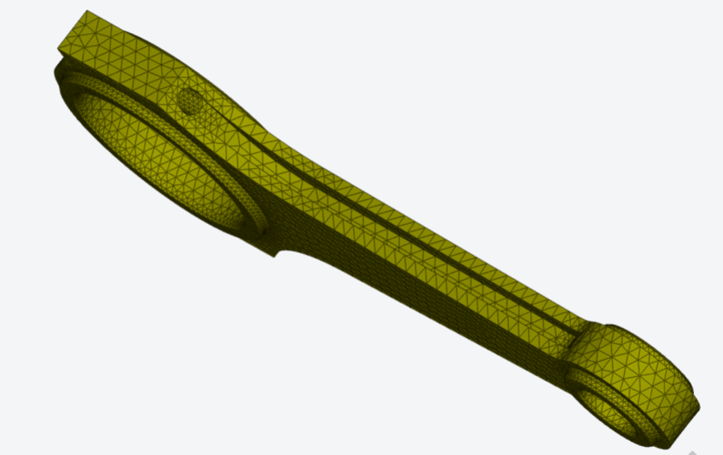
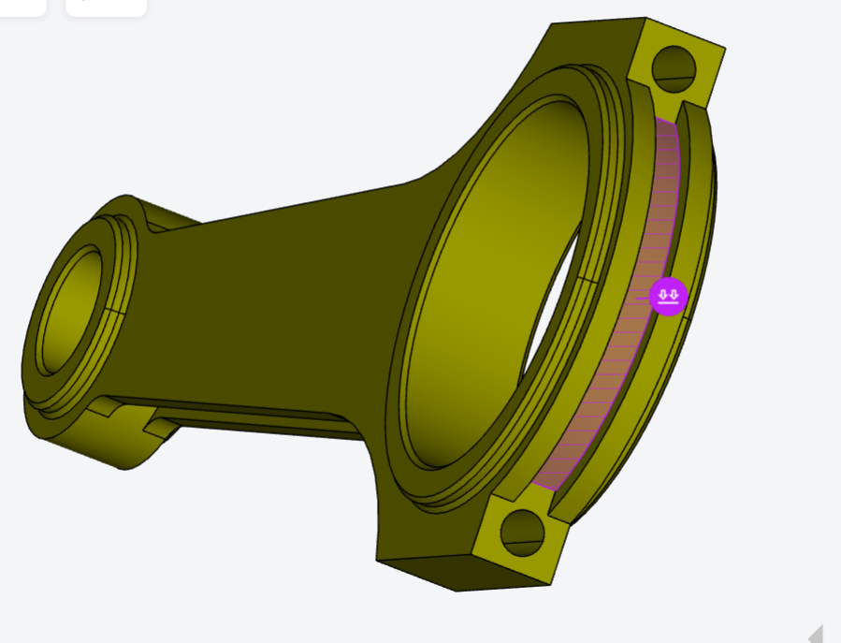
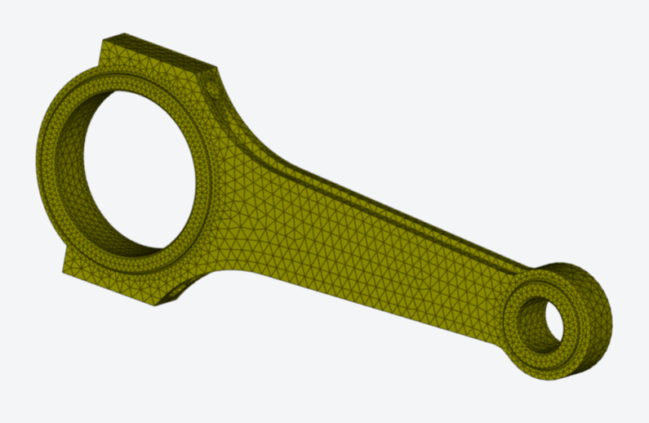
Solution: Setting up the model (2/2)
Steps 4-5: Assign boundary conditions.
Steps 6-8: Mesh and run the model.

Slide 24
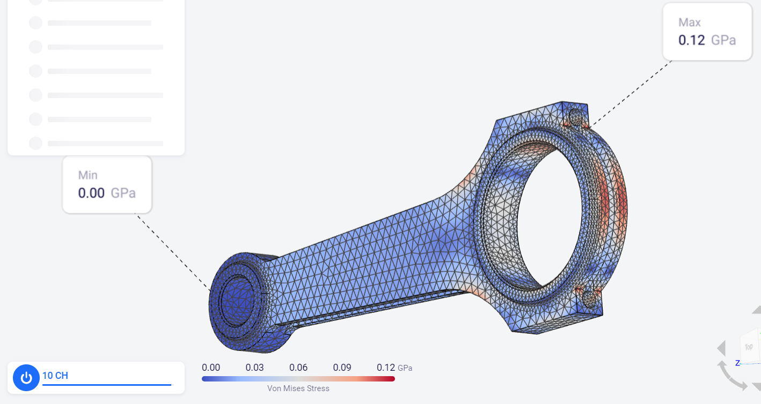
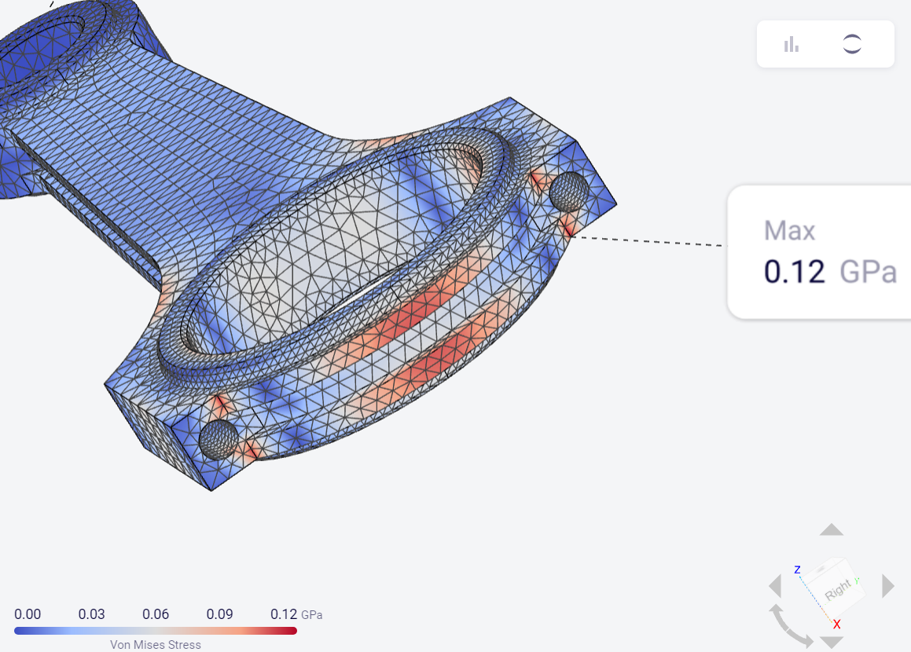
Visualize the stress
The max stress is at a stress concentration area caused due to the sharp corner. Since the yield strength of Aluminum is in the order of 70MPa, this design under this loading condition is not safe as the safety factor is less than 1 (i.e. the material will yield).
$$Safety Factor=\frac{σ_{y}}{σ_{max}}=0.58$$
$$σ_{y} →yield strength$$
$$σ_{max}→max.{stress in the design}$$
Can you think of ways to make the design safer?
Notes:
The max stress is at a stress concentration area caused due to the sharp corner. Since the yield strength of Aluminum is in the order of 70MPa, this design under this loading condition is not safe as the safety factor is less than 1 (i.e. the material will yield).
Generally, for a design to be considered safe the safety factor should be at least 1.5.
Answer to quiz question: Some possible solutions to improving the design are changing the material and removing sharp corners.

Slide 25
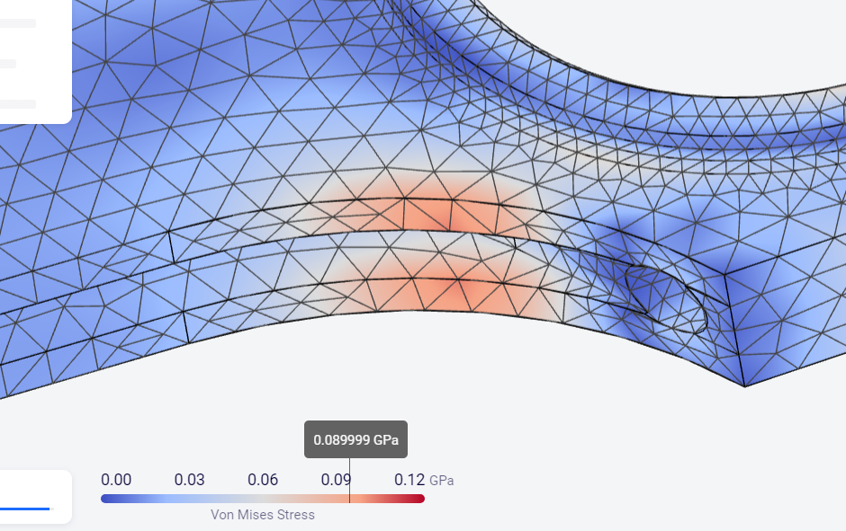
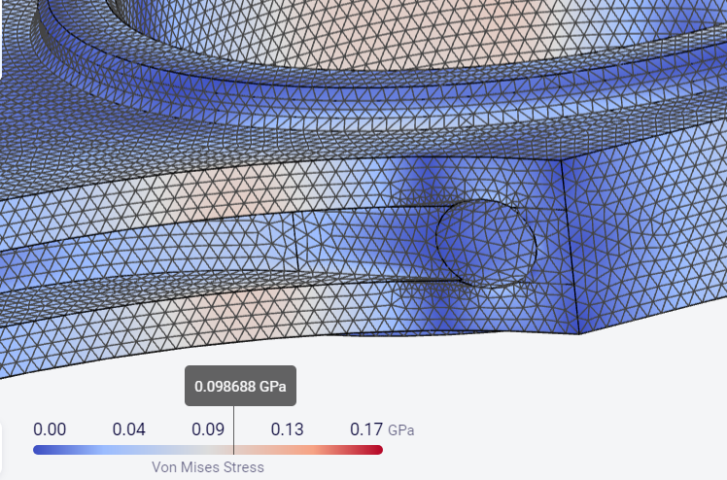
Influence of the mesh
90MPa
99MPa
On refining the mesh, the stress increases in the highlighted area. This is likely to be a more accurate result, since a finer mesh can better represent the real angles and curvature of the component. However, this comes at the cost of increased computational time.
Notes:
On refining the mesh, the stress increases in the highlighted area. This is likely to be a more accurate result, since a finer mesh can better represent the real angles and curvature of the component. However, this comes at the cost of increased computational time.

Slide 26
Summary
Simulation is the process of virtually emulating a physical process that occurs in real life. It is used to verify the efficacy of a design or product.
Using simulation, complex products can be designed and analyzed quickly and efficiently by reducing the need for experiments.
Meshing plays a key role in ensuring the accuracy of the results obtained from the FEM model.
As a general rule, the finer the mesh, the more accurate the solution.
A finer mesh requires increased computational effort compared to that of a coarser mesh.
It is important to find a good balance between accuracy and run time in order to solve the problem.
OnScale has an automatic meshing feature that optimizes mesh cell quality, mesh adjustments around boundary conditions and mesh refinement at edges and curvatures. The user can then coarsen and refine this mesh based on their needs.
Notes:
Let us now briefly summarize what we have learnt in this presentation
Simulation is the process of virtually emulating a physical process that occurs in real life. It is used to verify the efficacy of a design or product.
Using simulation complex products can be designed and analyzed quickly and efficiently by reducing the need for experiments.
Meshing plays a key role in determining the accuracy of the results obtained from the FEM model.
Finer the mesh, the more accurate the solution.
A finer mesh requires increased computational effort compared to that of a coarser mesh.
It is important to find a good balance between accuracy and run time in order to solve the problem.
OnScale has an automatic meshing feature that optimizes mesh cell quality, mesh adjustments around boundary conditions and mesh refinement at edges and curvatures. The user can then coarsen and refine this mesh based on their needs.

Slide 27
Further Information and Resources
What is Simulation? - ANSYS Innovation Courses
CAD Validation & Meshing with OnScale Solve™ | OnScale
Meshing in FEA: Introduction to meshing | OnScale
Meshing in FEA: Meshing considerations | OnScale
Meshing - Why You Never Have To Worry About It Again | OnScale
Meshing in FEA: Mesh convergence | OnScale
How to Run a Simulation in OnScale Solve™ | OnScale

