Slide 1
Automotive Door Panel 2022
Claes Fredriksson and Nicolas Martin
Notes:
This case study is based on one of our Advanced Industrial Case Studies for Granta EduPack.
These are intended to inspire, for example, engineering educators, and facilitate materials-related teaching.
Today’s topic is automotive door panels and we will be revisiting an elaborating on an earlier lightweighting case study
The idea is to look at exterior car door panels and compare traditional metals with polymer and composite options

Slide 2
Agenda
Introduction
Advanced Industrial Case Study
Automotive lightweighting
Material overview
Benchmarking door panel performance
The Performance Index finder
Natural fiber composites
Part Cost Estimator
Q&A
Community Update
Claes Fredriksson and Nicolas Martin from Ansys Education Team

Slide 3
Advanced Industrial Case Studies on the Ansys website
Notes:
We have a number of Advanced Industrial Case Studies on our website
You will find powerpoint presentation slides with notes, as well as a short case study paper with details there

Slide 4
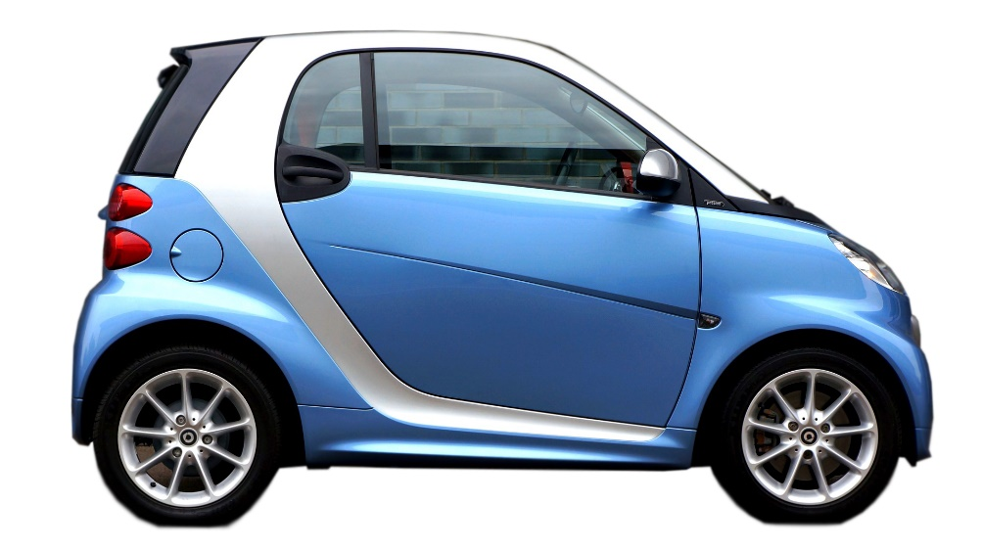
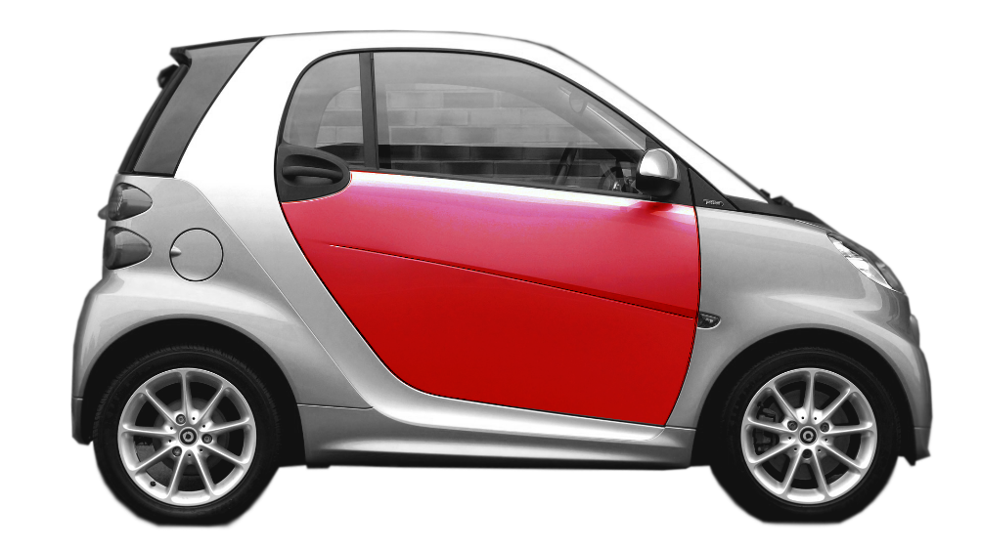
Software capabilities and reference textbooks
Granta EduPack provides an excellent platform for teaching and discussing materials decisions:
Granta EduPack supports systematic material selection with data and tools
Read more in textbooks by M. Ashby
Undergraduate
Advanced
Notes:
4
This Case Study will be using the concepts developed by Prof Mike Ashby and co-workers in Cambridge
Granta EduPack provides an excellent platform for teaching and discussing materials decisions
The methodologies are described in greater detail in the books of Mike Ashby, particularly the ones that you can see to the right
Here, we will benchmark material options for a door panel using charts and assess them using their performance index
We will show a range of features that you can use in your teaching including the new performance index finder.
The Polymer database at Level 3 contains the synthesizer tool and will be used in this case study

Slide 5
Workflow
1. Overview of material properties
- Density vs Cost for All bulk materials, first screening
2. Performance indices for Benchmarking
- Panel in bending, limited by stiffness
- The new performance Index Finder
3. Exploring Natural fiber composites for improvements
- Lighter, renewable material, good damping
4. Part Cost Estimator
- Steel vs polymer alternatives
5. Reality Check
Notes:
EduPack is used to first show an overview plot of materials and discuss a first screening
Then, the performance of materials in a door panel is demonstrated using the new Performance Index finder.
After this demonstration, the synthesizer tool is used to create new composite records
Several alternatives are compared using the Part cost estimator within this tool

Slide 6
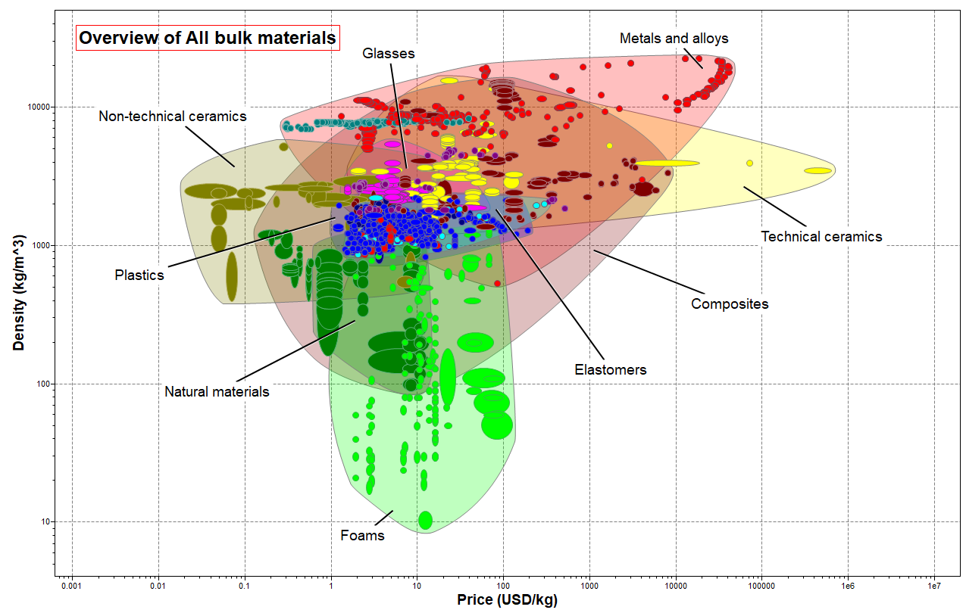
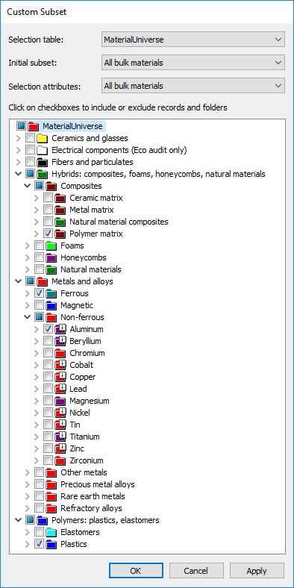
Door panel material overview
too expensive
too brittle
too soft
Notes:
This is an overview plot, including the main bulk material candidates, shown in the chart.
You can see that all materials are not suitable for the door application
Some are too brittle and some are too soft. Many of them are also too expensive to be considered
We will address this by including only realistic classes of materials in the initial subset at the start of the selection,
This starting point can be considered part of the screening but the main selection is specified on the next slide.

Slide 7
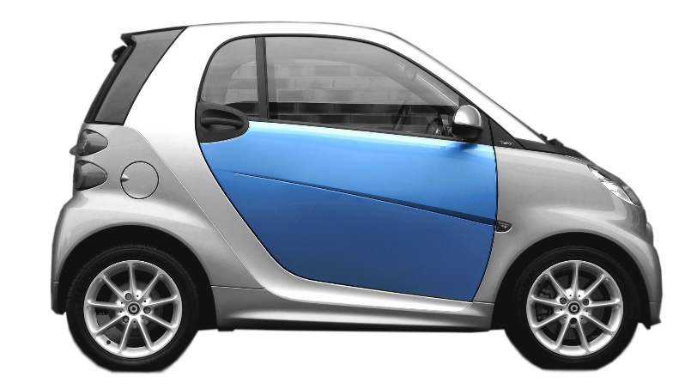
Advanced selection information
Function:
Exterior skin for a car door panel
Non-steel options for concept car
Panel loaded in bending
Stiffness-limited design
Length, width specified
Thickness free
Constraints:
Maximum Service Temperature (+90°C or more)
Minimum Service Temperature (-20°C or less)
Adequate Yield strength > 22.4MPa
Fracture toughness >1.17MPam^0.5
Resistant to (acceptable/excellent): rain (water), petrol (organic solvents)
Manufactured by composite forming,sheet deformation or molding processes
Objectives:
Minimize mass
Minimize cost
http://www.plasteurope.com/news/detail.asp?id=209550
Notes:
Following the Ashby systematic selection methodology, these important aspects of the project are specified
The objectives will be to minimize weight but also to look at cost
Information about the actual polymer door material for smart cars is shown at the end (see link)

Slide 8
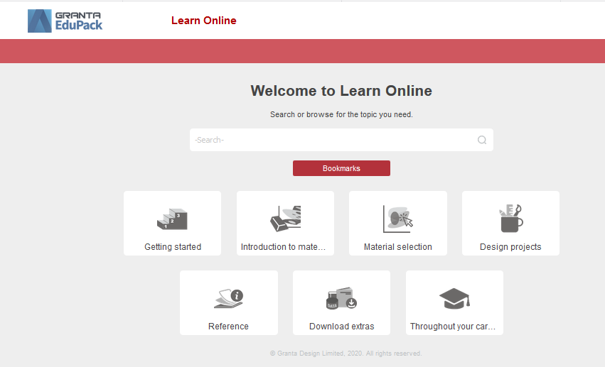
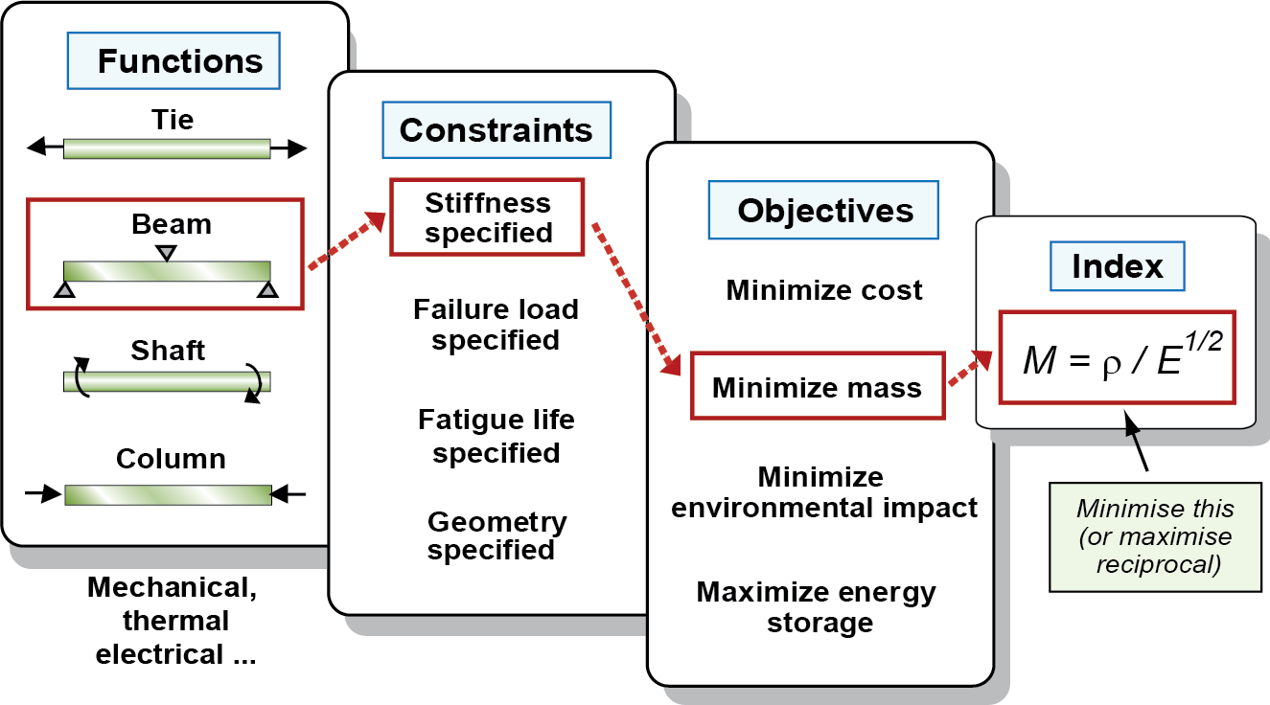
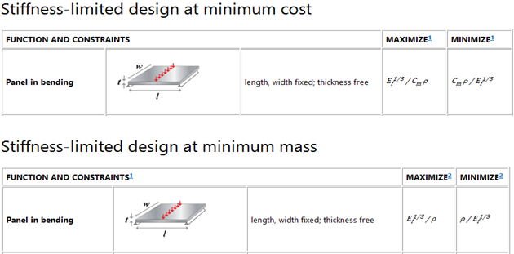
Performance Index for benchmarking
Stiffness-limited design minimize mass/cost:
Or Performance Index Finder:
Notes:
Although a simple chart plotting cost on one axis and density on the other will give you an overview of material properties, benchmarking needs to be done in relation to the relevant performance index of the specific application.
For a panel in bending, with the objective to minimize mass, the indices will be combinations of properties, limited by stiffness, in this case.
The appropriate performance index is found under Learn, or by the Performance Index Finder
You can now plot these performance indices for a panel in bending in EduPack using the Chart Stage.

Slide 9
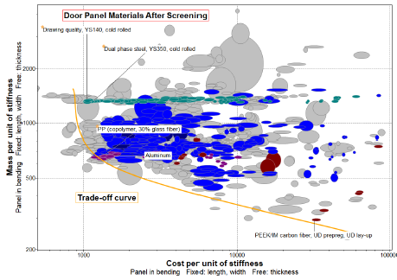
Demo
Steel or polymer?
Notes:
It is now very easy to make a trade-off plot of mass and cost minimization for a stiffness-limited design
It is difficult to beat steels in cost performance but Al, polymers and composites perform better concerning mass
Only few composites appear but what about other options? => Use the Synthesizer tool to explore more options

Slide 10
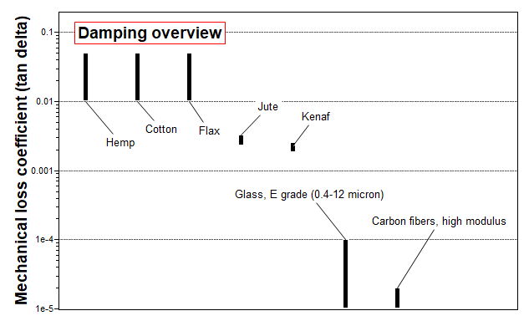
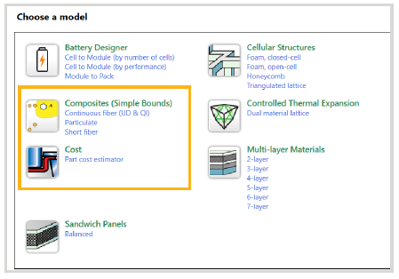
Natural fiber reinforced polymers
Natural fibers:
Can be used as reinforcements in composites (strong and light)
Renewable resource (sustainability)
Hemp and Flax have good damping properties
Notes:
Natural fibers can be used in composites for lightweighting (strong and light)
Renewable resource, biodegradable etc considered more sustainable alternative
Also the damping properties are very good, perfect for door panels
This suggests a natural fiber composite, which can be explored using Granta Edupack

Slide 11
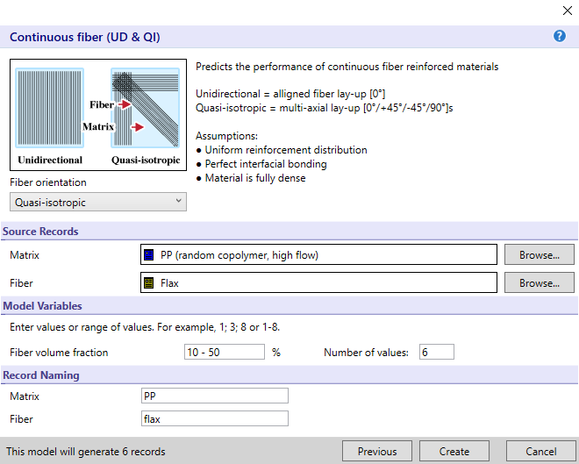
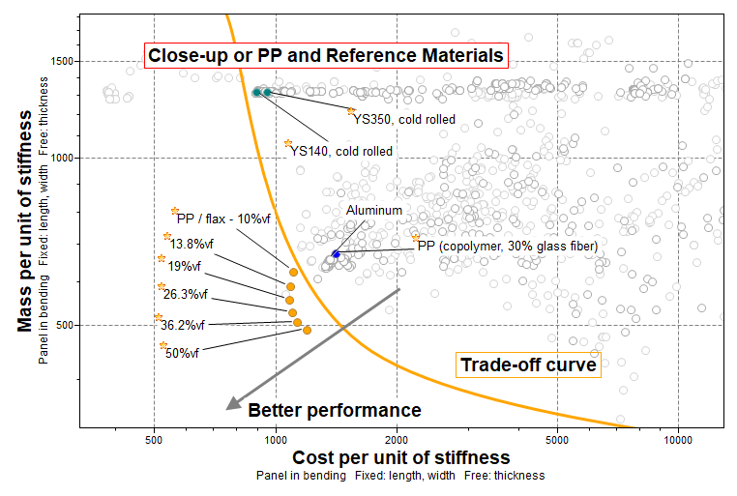
Natural fiber composites in the Synthesizer tool
Create Flax/PP composite:
Minimize mass
Minimize cost
Notes:
The Simple Bounds model is used to model your own fiber-reinforced composite
Continous fiber (UD & QI) can be used and we investigate a range of mixtures
All the Flax fiber reinforced composites are better than the PP with glass fiber (cost and mass performance)

Slide 12
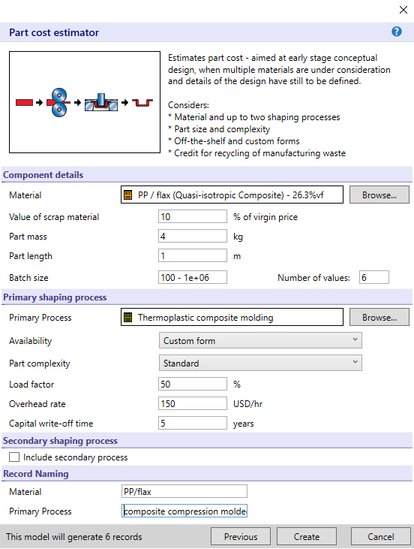
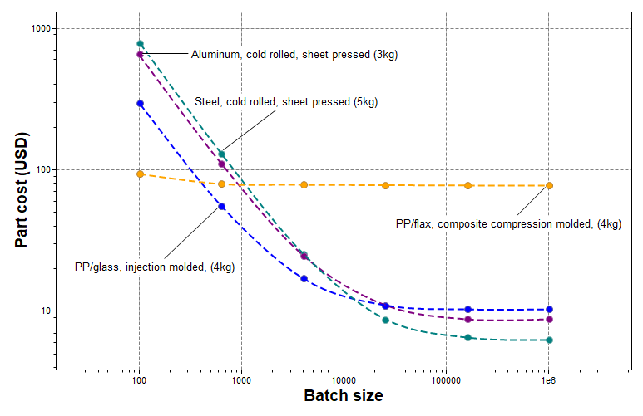
Demo Part cost estimator results
Notes:
At a batch size of 100, the PP composites are cheaper than Steel and Aluminium per item.
The part cost for the flax composite (orange) is lower than for PP/glass (blue) up to a batch size of a few hundred.
The cost of all four materials decreases as the batch size increases due to a fixed tooling cost.
At a batch size of about 10 000, the part cost of Steel falls below the PP composite and just after that, Aluminum follows.
The part cost for the four materials eventually flattens out and remains constant near their material cost, Steel being lowest.
For small series, the PP composites remain the most economic option.

Slide 13
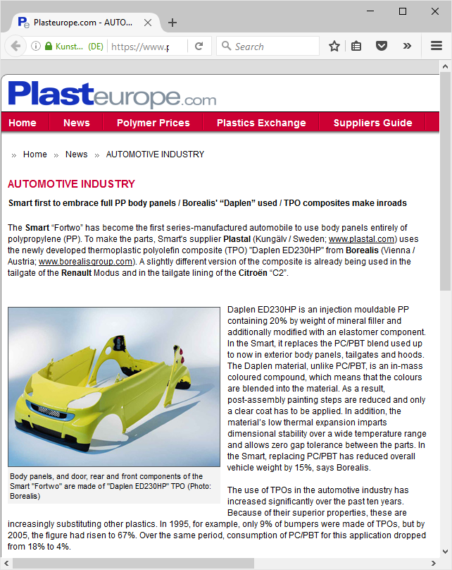
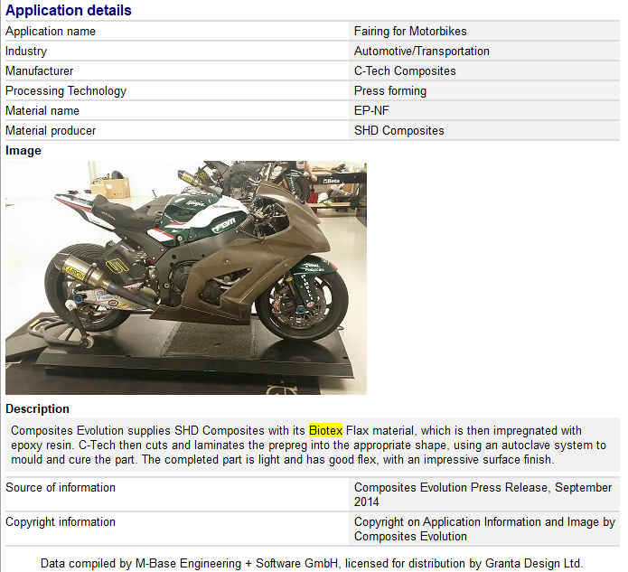
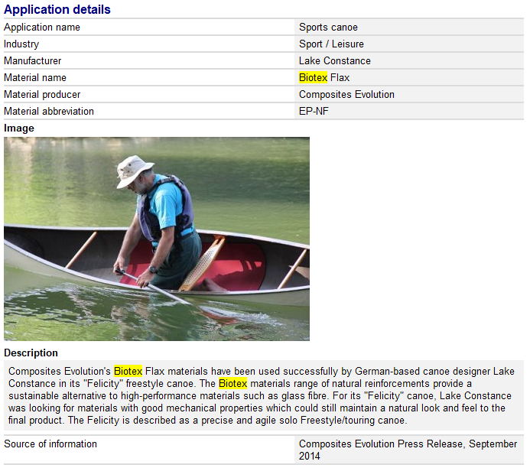
Reality check
Real products (Selector)
Smart body panels made of PP+20% mineral filler (Talc)
Canoe and Motorbike fairing made with Flax-reinforced polymer (Biotex Flax)
Notes:
Glass fiber filled PP (or our synthesized PP/Flax composite) seems to be the most adequate polymer option for car door panels.
This is relatively close to the actual polymer chosen for the Smart car depicted to the left.
A PP material was indeed developed by Borealis, for door panels. This is a 20% mineral filled grade (Talc),
Perhaps this was chosen for a better surface finish or manufacturing properties than fiber filled PP.
Surface finish and other practical aspects are, of course, very important and must be considered in the selection process.
Biotex Flax, which is a Flax-reinforced commercial polymer is also used in real products, e.g., Canoes and Motorbike fairings

Slide 14
Summary
The rational materials: Al, and PP composites all compare favorably to the steel reference materials with regards to mass performance but have considerably higher cost for large series.
Glass fiber-filled polypropylene copolymer is the best light and cheap option for polymers, but FEA calculations are needed to more accurately estimate the total weight reduction.
Flax fiber reinforced PP, a virtually created material, is lighter than the others but is only cheaper than glass fiber reinforced PP for very small series (up to a few hundred) and would also require FEA calculations for accuracy.

