Slide 1
Case Study Webinar Session:
Truck Trailer Lightweighting
Claes Fredriksson
Originally presented 2017
Updated 2021
Republished 2021

Slide 2
Agenda
Introduction
Advanced Industrial Case Study
  Truck Trailer Lightweighting
  Wood subset overview
  Benchmarking of sandwich panel
  Synthesizer tool
  Eco Audit
  Reality Check
Q&A

Slide 3
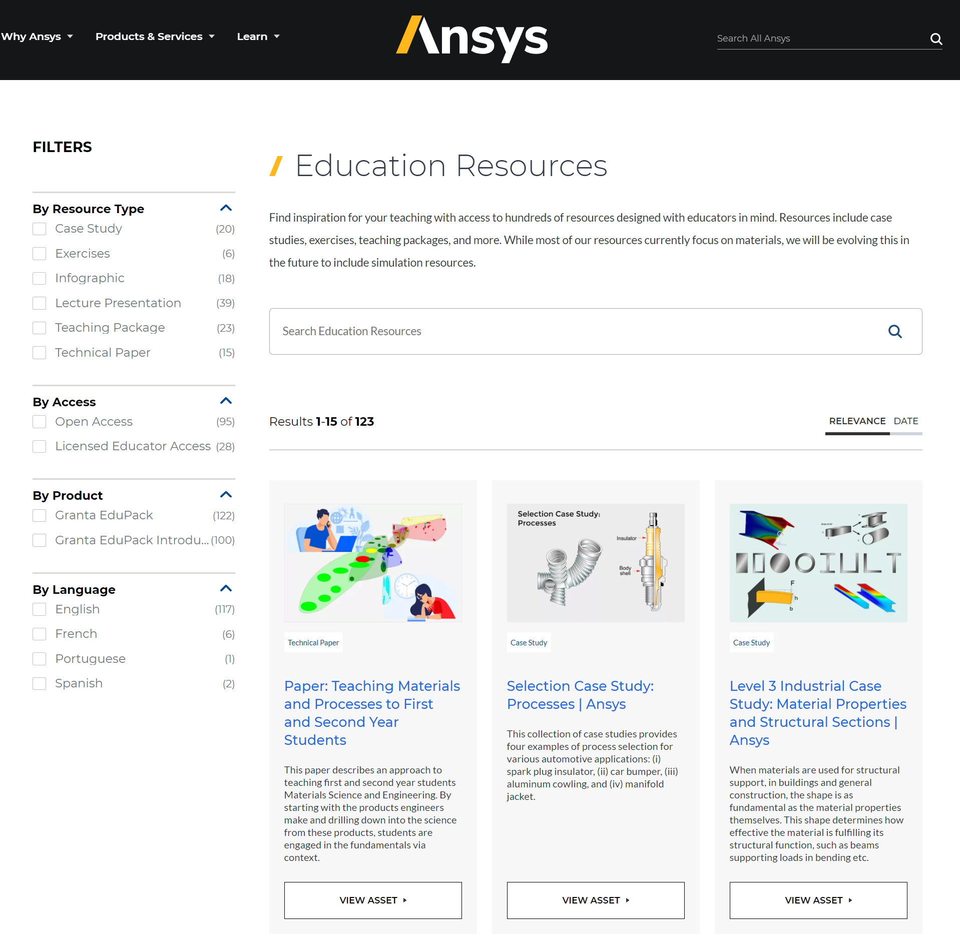


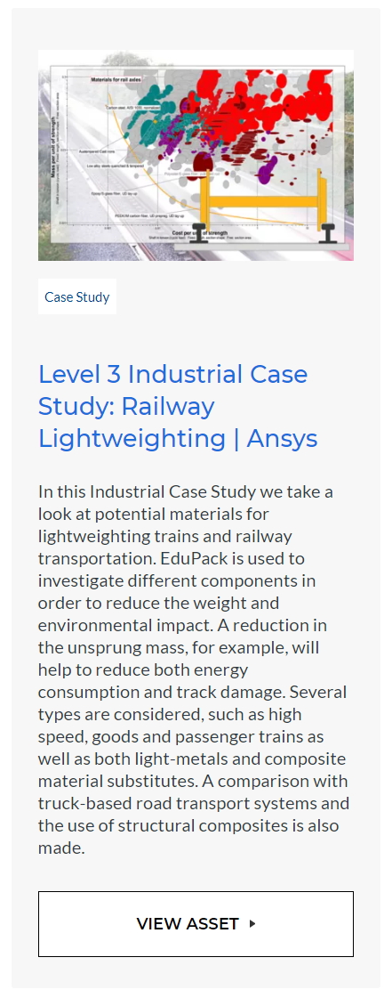
What are the Advanced Industrial Case Studies?
www.teachingresources.grantadesign.com/Type/casestudies
Notes:
Several Advanced Industrial Case Studies exist in the form of short papers, available on the Ansys Education Resources site
These are at Level 3 and make use of advanced functionality and data for a certain application of interest to students and educators

Slide 4
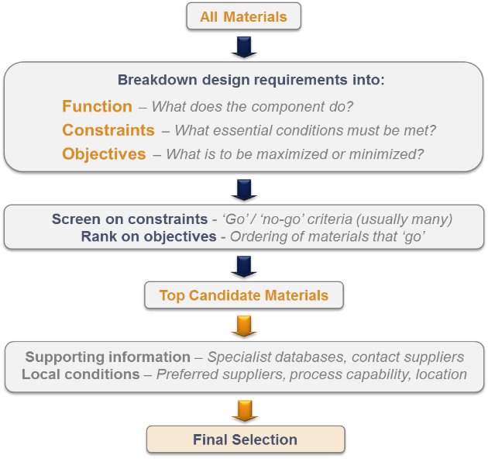


Selection Methodology and Reference textbooks
Elementary
Design-led textbooks
Advanced
Notes:
4
Most of the Case Studies will be using the systematic methodology for material selection developed by Prof Mike Ashby and co-workers in Cambridge.
It is based on translation of the selection task into Function, Constraints and Objectives.
Then screening material candidates on the constraints, to remove unsuitable materials.
Finally Ranking the remaining candidates based on the performance index (material index) related to each objective.
This methodology is described in greater detail in the books of Mike Ashby that you can see to the right.

Slide 5

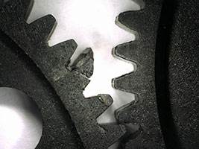






Material selection scenarios in industry
    Drop-in replacement
    Fixed
    Design
Most
Frequent
Which material should I use?
    Improve
    performance
    Constrained
    Design
°C
kg
m/s
    New
    product
    Unconstrained
    Design
Least
Frequent
Notes:
If we look at material selection scenarios in industry, though, wee see that simple drop in replacements are very common (new, better or cheaper suppliers)=>fixed design
In product development, it is very common to work with improved performance of existing products (new regulations, eco-properties)=>constrained design
What most students dream of is, of course, to start from scratch and use systematic materials selection to find the best material=>unconstrained design
Our case study is about improving the performance of an existing product by lightweighting, which means making a decision within a constrained design

Slide 6
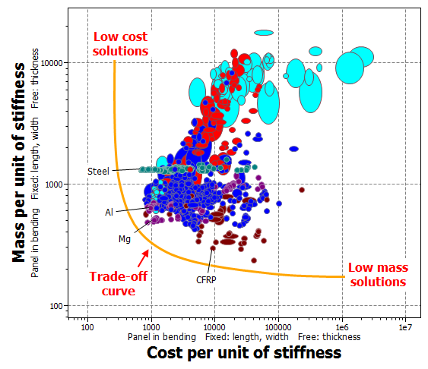
Trade-off of multiple objectives
Mass vs Cost
Notes:
In advanced material selection, we often come across conflicting objectives, for example, high performance against low cost.
In Granta EduPack we can handle two conflicting objectives by plotting the performance index for minimization on one axis each, than using a trade-off curve.
The performance indices can be found in tables under the Help Menu of Granta EduPack, which we will show later.
In this example, we look at minimizing mass and cost for the performance indices of a stiffness-limited panel in bending.
The best material candidates are near the trade-off curve towards the lower, left hand side of the diagram.
The ultimate decision will depend on which objective is the most important and how much you are willing to sacrifice the other.

Slide 7

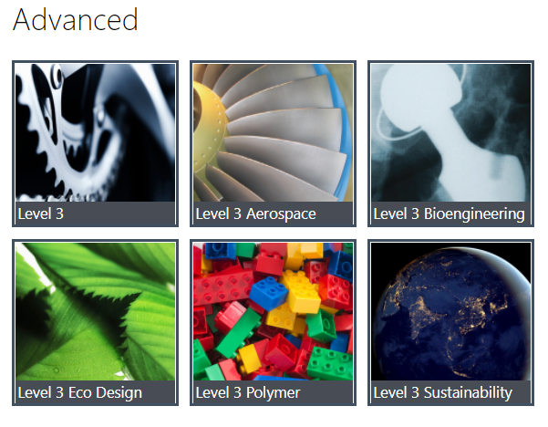
The Sustainability database
Notes:
The Sustainability database at Level 3 is used for this Case, which contains all the ~4000 standard engineering materials of the MaterialUniverse.
This also has the Synthesizer tool (for sandwich panel) and Enhanced Eco Audit (for life-cycle cost estimation) which are also used.

Slide 8
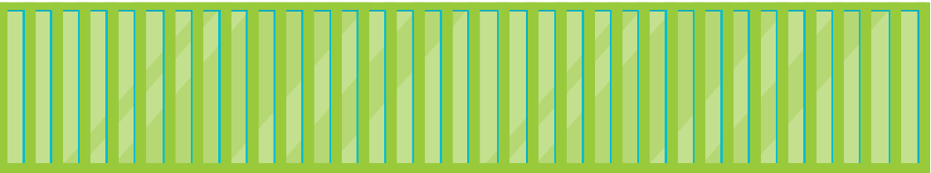

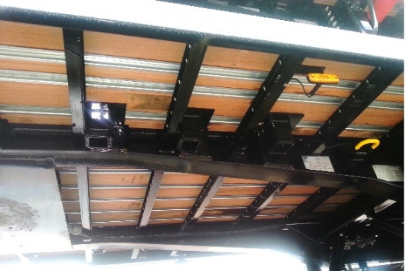
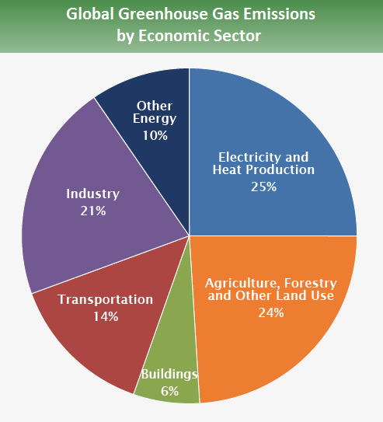
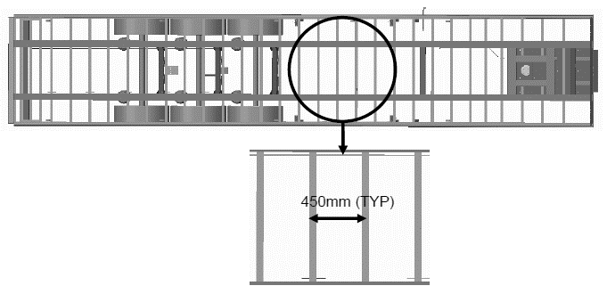
Transportation: Truck Trailers
❶Truck
❷Trailer
❸Transport load
Notes:
A typical European-style Heavy goods vehicle is made up of a truck (1) which can attach to a trailer (2) carrying the transport load (3).
We will not investigate the truck or the transport load in great detail, but focus on a 6-wheel trailer, typically 13.6 m long and covered with wooden decking (27 m²).
The decking is typically coated plywood boards or hardwood planks.

Slide 9
Optimum Payload...
Optimum density to fill 40 Tonne truck
Glaeser, K. “Performance of articulated vehicles and road trains regarding road damage and load capacity”, in 11th International Symposium on heavy Vehicle Transportation Technology, Melbourne, Australia, 2010.
Notes:
Logistically, the volume of the load is somewhat flexible but the maximum weight is not. The payload may be increased by the weight saved if the trailer weight is decreased.
Some typical values of payloads are given in the diagram. The optimum density of the payload is typically somewhere between boxes of filled and empty beer bottles.
Since the maximum weight of the load may increase by the weight saved on the trailer, the direct energy and emission reduction will come from the mileage of empty load.

Slide 10
Truck trailer components by weight
Trailer component | Approx. mass, kg | Approx. mass, %
Chassis beams and Structure | 1800 | 44
Wheels and tyres (6) | 270 | 6
Running gear system (bogie) | 1200 | 29
Decking | 700 | 17
Scrub plate | 150 | 4
Galos, J.L., “Lightweight Composite Trailer Design”, Doctoral Thesis (Cambridge University, 2017). https://doi.org/10.17863/CAM.8922
Notes:
Pie Chart: An approximate list of the composition of a trailer, with data taken from a real UK example.
The Decking constitutes a significant part of the trailer unladen weight and is relatively easy to replace.

Slide 11
Workflow
Overview of suitable woods
Benchmarking of Sandwich panel
Synthesizer tool
Eco Audit assessment
Notes:
First, EduPack is used to make an overview plot of suitable wood materials for decking.
Then we will benchmark a suggested sandwich panel with existing decking materials.
Improvement hybrid suggested by research is: End-grain Balsa core with GFRP faces.
We will use the Synthesizer tool in Granta EduPack to estimate the properties of this candidate and show you how to do this
Finally, we will assess the sandwich panel using the Eco Audit tool and also look at the estimated economic benefits

Slide 12
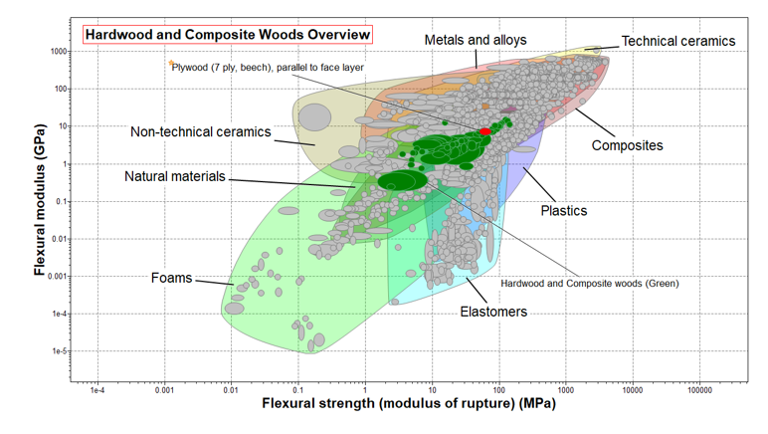
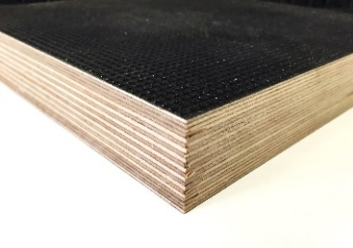
Making a relevant overview
Notes:
Starting our exploration into trailer decking, we first want to have an overview of relevant materials. Starting with mechanical properties: Flexural modulus (stiffness) and Flexural strength.
This plot is at Sustainability Level 3, All bulk materials (in the background), Limit stage with Composition overview: Hardwoods, Composite woods (green), Then highlight plywood as a reference material.
Plywood compares relatively well with other woods and other materials.

Slide 13
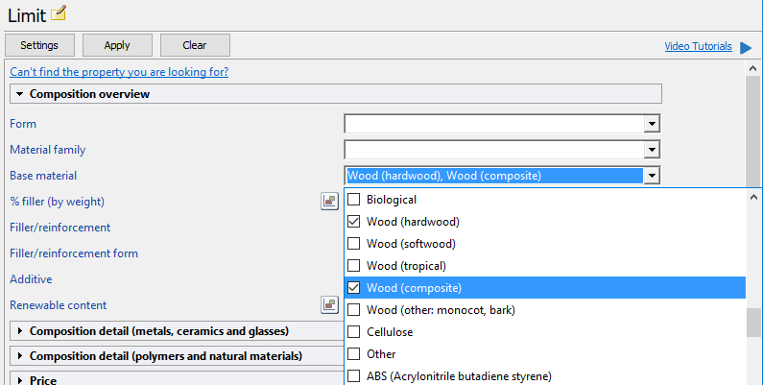
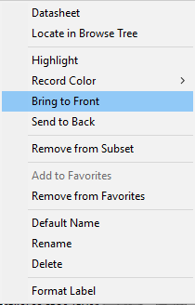
Displaying a relevant subset for overview
Notes:
We could use the wood subset already existing in EduPack but if we want a slightly more accurate subset, the composition overview can be used in a limit stage.
This filter, applied to all bulk materials allows you to include more specific classes of wood and board (hardwood, composite wood).
Search: Plywood 7 ply (l)+Right-click to: Favourite+Label+Colour Red+Bring to front.

Slide 14
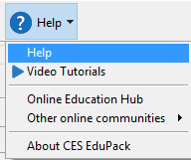
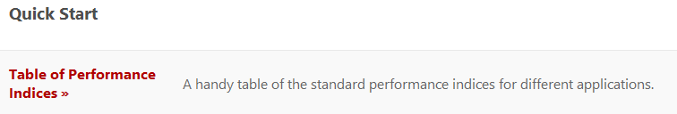
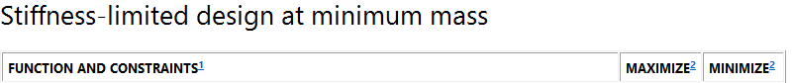
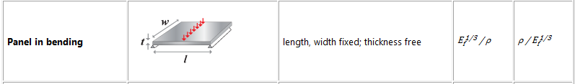
Performance benchmarking
Basic Selection information
Function: Panel in bending, thickness free
Constraints: Existing deck or proposed structure
Objective: Minimize mass, stiffness-limited design
Notes:
EduPack is used to make a more specific plot of wooden materials for decking and benchmark a sandwich panel against these.
If you want to look at the performance in terms of the Ashby selection methodology, these are the essentials.
The performance indices for a panel in bending can be found via the Help menu and Quick start.
We will use the Synthesizer tool in Granta EduPack to estimate the properties of this candidate.

Slide 15
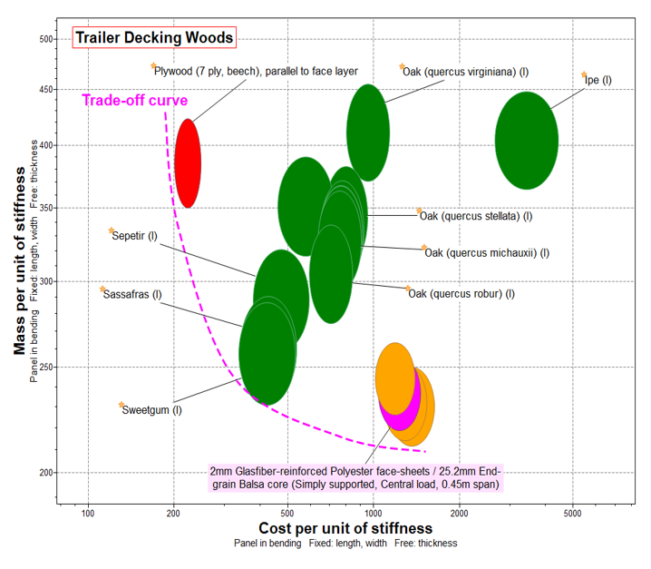
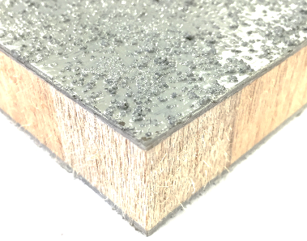
Benchmarking of realistic options
Notes:
This is a more specific chart for benchmarking purposes.
We have narrowed down the selection of woods to include only the ones that actually appear as truck flooring material in the datasheets.
We have plotted the performance indices for minimum mass (Y-Axis) and minimum cost (X-Axis) for a panel in bending.
New project: Check that plywood is still a favourite. A search for Truck floors renders 24 wood and 8 aluminum records, add (l) gives 12, add these to Favourites.
A custom subset is made from the Favourites.
Material indices for panel in bending (help) is used to make a plot of minimum mass vs minimum cost.
After that, synthesize sandwich records.

Slide 16

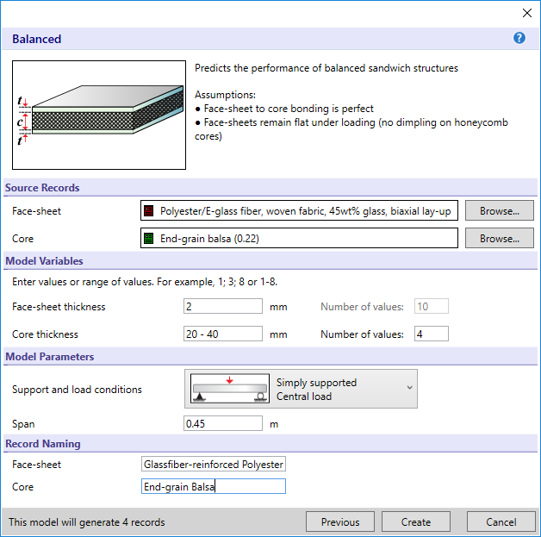
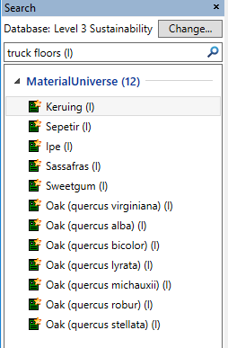

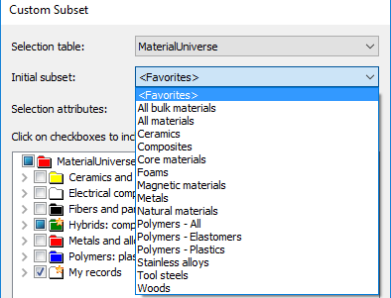
Creating the hybrid structure
Notes:
A thickness of 2 mm is good not to crush the soft Balsa core.
Synthesize an End Balsa Core Sandwich panel with 20-40 mm core (4 records).
The load conditions simulates a fork lift on the deck panels with real values for the support.

Slide 17
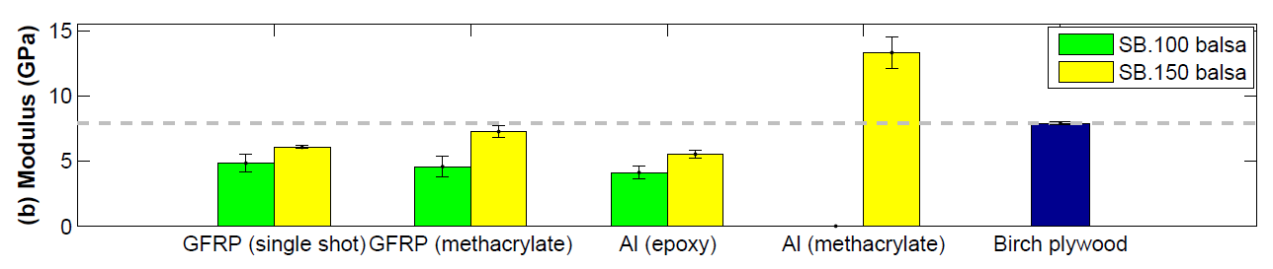
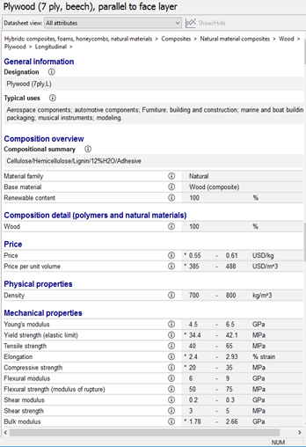
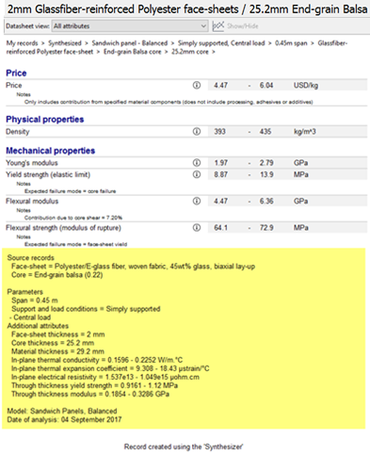
Reality check: Quality of data
Lab test data:
Notes:
Our data for plywood and Sandwich panel compares well with my measured data (2 datasheets).
Birch plywood is very similar to the beech plywood we have used in EduPack: Flexural modulus=6-9 GPa.
The synthesized record for 25.2 mm core agrees well with the test data from a real 1 inch End-grain balsa core sandwich with 2 mm GFRP faces: Flexural modulus=4.47-6.36 GPa.
This shows that the quality of data in EduPack is good and agrees with real values in this case.

Slide 18

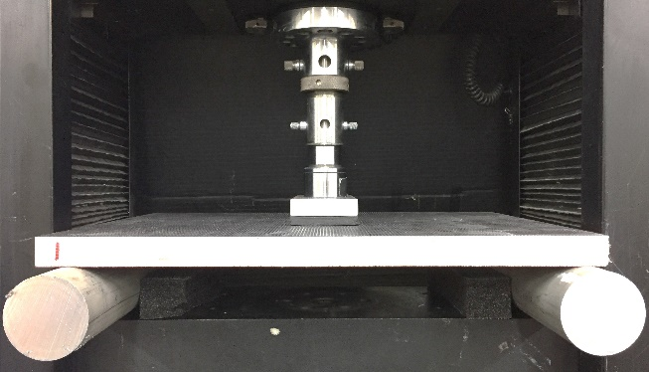

Reality check: lab tests
Sandwich
Plywood
Forklift wheel load
Notes:
ISO standard 1496, deals with a scenario resulting from the wheel load of a fork lift on a container floor.
Test description, concluding in that our 1-inch sandwich panel fails after the established plywood, verifying sufficient strength.

Slide 19
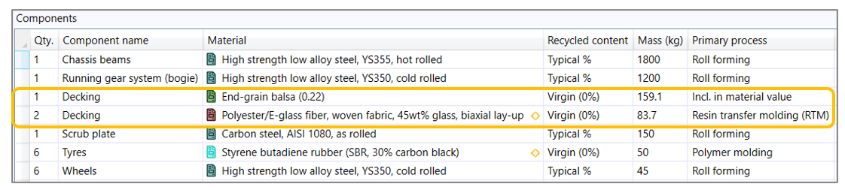

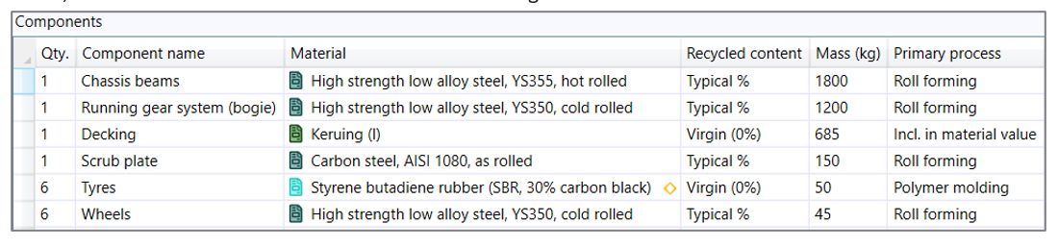
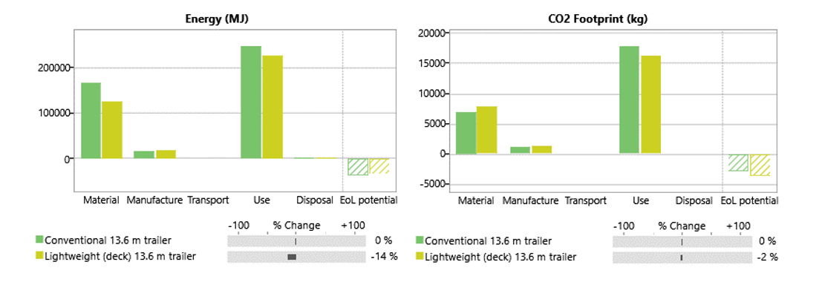
Estimated benefit the first year
Transport:- Country of use: Europe, Life: 1 year, Usage: 300 days, Distance: 200 km
Lightweight
Trailer BOM
Conventional
Trailer BOM
Notes:
In the last part, the life-cycle properties of the new sandwich decking are assessed. We have considered a real transport case in Europe, with deliveries to a supermarket chain in the UK.
First year case, 300 days/year, 200 km empty transport per day Bill of materials from the composition earlier: Use phase dominates.
Adding a compare with for the lightweight sandwich panel shows a small energy benefit, already the first year (2%) and CO2 same picture.

