Slide 1
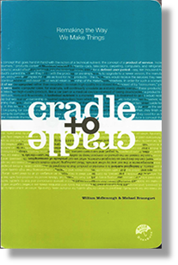
Sustainability Case Study:
Plastic Books
Mike Ashby¹ and the Ansys Education Division²
¹ Department of Engineering, University of Cambridge
² Ansys

Slide 2
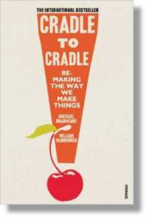
Plastic Books: background
Cradle to Cradle by William McDonough and Michael Braungart :
“This book is not a tree. It is…a product that can be broken down and circulated infinitely in industrial cycles. The use of (plastic) expresses our intention to evolve away from the use of wood fibers for paper”.
Plastic edition:
Weight 562 grams
Price $ 27
Paper edition:
Weight 157 grams
Price $ 13
Printed in China
Reference: https://en.wikipedia.org/wiki/Cradle_to_Cradle:_Remaking_the_Way_We_Make_Things

Slide 3
Step 1: Objective, scale, and functional unit
Objective: Reduce demand for a natural resource by printing books on plastic
Size scale: 2.2 million titles per year, average print run 3000 = 6.6 x 10⁹ books
Time scale: 10 years?
Functional unit: per 1000 books
Facts needed : Can plastics be recycled more times than paper?

Slide 4
Step 2: Stakeholders and concerns
Stakeholders
Stakeholder diagram
Publishers
– impact on costs, sales and margins
Printers
– material and shipping costs
Recyclers
– viability of recycling printed plastic
Environmentalists
– relative energy and carbon footprint of plastic and paper
Authors
– reaching a wide readership
Readers
– price, weight, feel of book
Little Influence / Power Great
Printers
Publisher
Readers
Authors
Green
lobby
Recyclers
Little Interest Great
Facts needed

Slide 5
Step 3: Fact-finding– materials and recycling
Materials
The paper: wood-fiber paper
The plastic: proprietary, but probably a CaCO₃ filled polypropylene
Demand per year
 | Average book weight, kg | Mass per 1000 books (kg) | Mass per 6x10⁹ books (tonnes) | % of global production
Paper | 0.2 | 200 | 1.3 x 10⁶ | 0.3
Plastic | 0.6 | 600 | 4x10⁶ | 6.7
Recycling
Paper: globally, 65%
Plastic: globally, 5%
Data from the Materials Data-table of the
Granta EduPack Sustainability DB

Slide 6
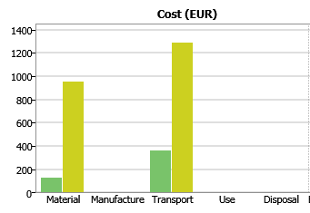
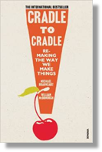
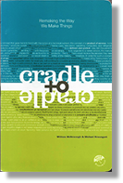
Step 3: Fact-finding– Cost
100 books | Material | Weight kg | Energy MJ/kg | CO₂ kg/kg | Cost $/kg
Paper edition | Paper | 157 | 52 | 1.2 | 1.1
Plastic edition | CaCO₃ filled PP | 562 | 55 | 2.4 | 2.2
Paper edition
Plastic edition
Data from the Eco-audit tool of the
Granta EduPack Sustainability DB

Slide 7
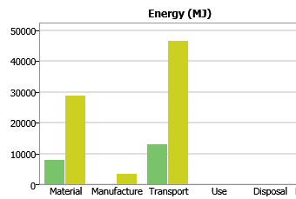
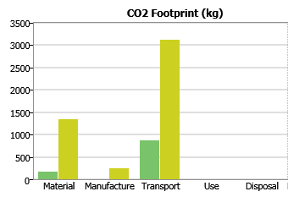
Ste[ 3: Fact-finding– Energy and carbon
Paper edition
Plastic edition
Data from the Eco-audit tool of the
Granta EduPack Sustainability DB

Slide 8
Step 4: Impact on the Three Capitals (overview)
Natural capital
× No energy or carbon saving
× Based on non-renewable resource
× No evidence that recycling is improved
Manufacture capital
× More expensive, heavier than paper book
× Printing on plastic requires new technology
Human capital
× Book retailers face higher cost of both book and delivery
✓ Possible that the reading public might find durability attractive

Slide 9
Step 5: Reflection
Cold assessment
Contribution of plastic books to all three capitals is negative or neutral
More reflective assessment
McDonough and Braungart are making a point: that product redesign can allow materials to be reuse
Alternative strategies?
Best to stick with paper

