Slide 1
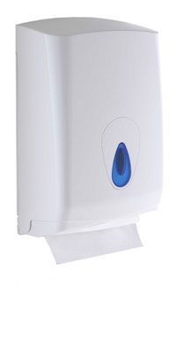
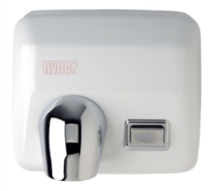
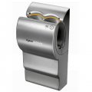
Sustainability Case Study:
Electric Appliances– Which hand dryer?
Mike Ashby¹ and the Ansys Education Division
¹ Department of Engineering, University of Cambridge

Slide 2
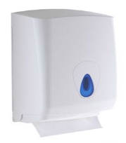

Which hand dryer: Background
Unhygienic
Legislation requires hygienic hand drying facilities at place-of-work
(The Health and Safety at Work etc. Act 1974)
Duty cycle: 5 hand-drys per person per working day, 230 days per year, for 10 years
Too slow
Small company (150 employees) has 5 washrooms, each with a hand-dryer
What is the best choice, based on economics, eco-impact and employee preference?

Slide 3

Step 1: Objective, scale, and functional unit
Objective: Provide economic, acceptable, eco-efficient hand drying
Size scale: 5 dries per employee per day for 230 days per year
Time scale: Decision needed now
Paper towels
Functional unit: 1000 pairs of dried hands
Hi-speed electric
Facts needed
What is cost and eco-impact of hand drying?
What do the employees think?

Slide 4

Step 2: Stakeholders and concerns
Stakeholders
Stakeholder diagram
Health authorities
– hygienic hand-drying provision
Makers of hand dryers
– capturing market share, effective promotion
Providers of washroom facilities
– minimizing cost while meeting requirements
Environmentalists
– waste associated with used paper towels
Users
– speed, hygiene, convenience and flexibility
Little Influence / Power Great
Health
authority
Users
The
company
Makers
of dryers
Green
lobby
Little Interest Great
Facts needed

Slide 5

Step 3: Fact-finding– Dryer characteristics
Characteristic | Paper towels | Hi-speed dryer
Power, kW | 0 | 1.6
Drying time, s | 10 | 12
Fixture cost (+ bin), $ | 32 | 910
Materials and weight, kg | Injection molded ABS 1.3 kg | See bill of materials 14 kg
Consumables, price and weight | Paper, $ 8.4 and 3.2 kg per 1000 towels | Electric power, $0.12 per kW.hr

Slide 6
Step 3: Fact finding– Cost and Carbon
Contribution | Paper towels | Hi-speed dryer
Cost, equipment per 1000 dries | $0.02 | $0.53
Cost, consumables per 1000 dries | $16.8 | $2.2
Total cost per 1000 dries | $16.8 | $2.7
CO_{2,} _{equ,} equipment per 1000 dries | 0.02 kg CO_{2,} _{equ,} | 0.64 kg CO_{2,} _{equ,}
CO_{2,} _{equ,} consumables per 1000 dries | 7 kg CO_{2,} _{equ,} | 2.2 kg CO_{2,} _{equ,}
Total CO_{2,} _{equ,} per 1000 dries | 7 kg CO_{2,} _{equ,} | 3.4 kg CO_{2,} _{equ,}
Assuming equipment cost amortized over 10 years, 0.5 kg CO₂ per kW.hr, power at $0.12 per kW.hr
2 paper towels per dry, carbon footprint of paper 1.1 kg/kg
Conclusion: Hi-speed dryer is cheaper and has lower carbon footprint over 10 years
Data from the Eco-audit tool of the
Granta EduPack Sustainability DB

Slide 7


Step 4: Impact on the Three Capitals (overview)
Natural capital
Hi-speed dryer has lowest CO₂ per dry
× Paper towels require disposal
Manufacture capital
✓ Hi-speed dryer has lowest cost per dry
× Hi speed dryer requires large up-front investment, long pay-back time
Human and social capital
✓ Paper towels dry face or spills as well as hands
× Hi-speed dryer lacks flexibility

Slide 8

Step 5: Reflection
Short term – 4 years
Paper towels cheaper because of high up-front cost of hi-speed electric dryer and preferred by users
Long term – 10 years
Hi-speed electric dryer cheaper in the long term, but inflexible
Alternative strategies
Hi-speed electric in the wash-rooms, one paper towel dispenser in public area?

