Slide 1
Advanced Industrial Case Study:
Electric Cars: Sustainability and Eco Design
Claes Fredriksson and Hannah Melia
Originally broadcast 2018, this update 2021
Notes:
Introduction
These Case Study Sessions are based on our Advanced Industrial Case Studies for Granta EduPack.
This is our fourth quarterly online training session for EduPack users, the topic is electric cars: Sustainability and Eco Design
These are intended to inspire, for example, engineering educators, and facilitate materials-related teaching.

Slide 2
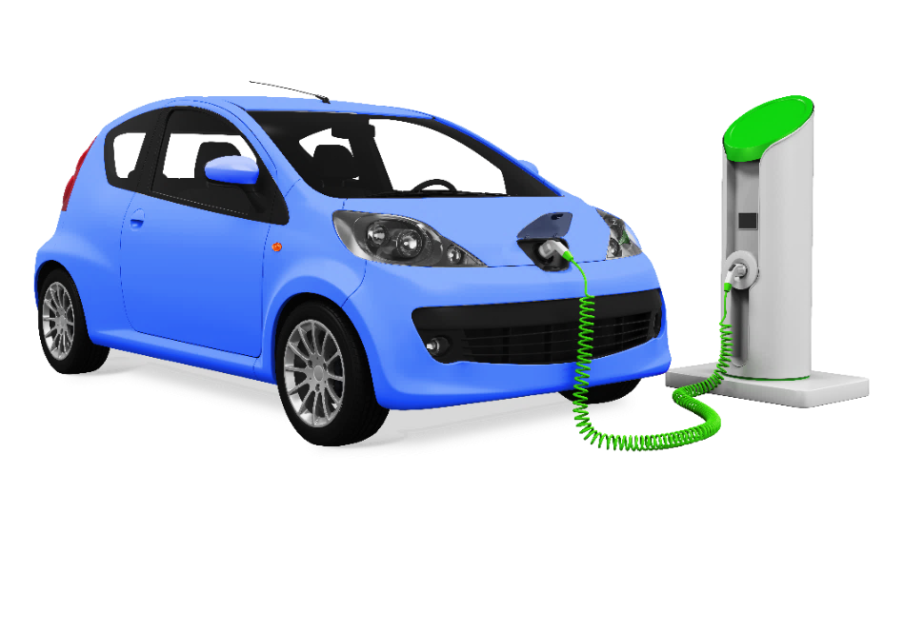
Agenda
Introduction
Advanced Industrial Case Study
- Electric vehicles
- Eco Audit on powertrains
- Battery performance
- Critical materials
- Electric motor performance
Claes Fredriksson
Hannah Melia
Notes:
Agenda
We will start with an introduction to the case study and give some background to electric cars and our software
Then we will be showing how you can use Granta EduPack to compare different powertrains using an Eco Audit
Next, we will see how visualization of data in the EduPack can be used to understand battery performance
Moreover, we will show how the Sustainability Database can help to track critical materials in design
Finally, we investigate the performance of the electric motors and why rare earth elements are important

Slide 3
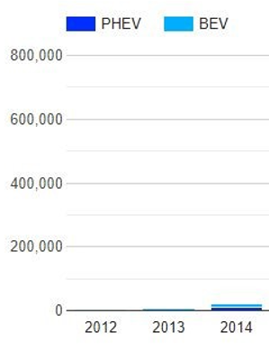
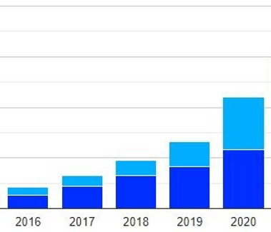
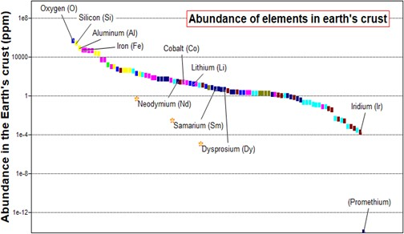
Challenges for Electric vehicles
Huge growth of electric and hybrid vehicles
Many battery types contain toxic elements:
Lead,
Cadmium
Mercury
Some contain critical elements:
Lithium
Cobalt
Most electric motors contain magnets
These have rare earth elements:
Neodymium
Samarium
Dysprosium
Registrations of plug-in (PHEV) and battery electric vehicles (BEV) in the UK (Source: SMMT, OLEV, DfT).
Notes:
Teaching Resources
As we go through the next several slides, we will see that Granta EduPack can be applied to a broad spectrum of engineering subjects as well as in interdisciplinary areas that are linked to material education
The software also comes with more than 350 teaching resources covering various levels of materials education
Specifically, you can find case studies on electric cars and other transportation as well as on sustainability

Slide 4
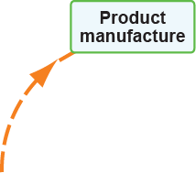
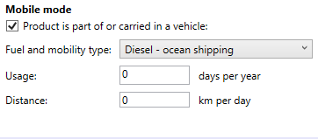
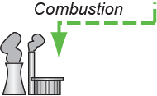
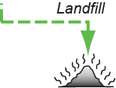
What can Granta EduPack do?
Eco Audit tool for
Life-cycle investigations
Main players:
CO₂
Notes:
Data and Tools
Here are all the different databases that make up our Granta EduPack. These are divided into introductory and advanced
We also have Eco-audit, Phase Diagram and Synthesizer tools – more about the Synthesizer tool later
We will be using the Advanced level for this case study and the Sustainability Level 3 database
This contains all the engineering materials and processes of the level 3 database and all advanced tools

Slide 5
Workflow: Eco Audit
Life-cycle comparison of total energy use (Europe):
4 scenarios, from gasoline (ICE) to fully electric (EV), #1 - 4
Use embedded sample Eco Audit project as starting point:
C:\Program Files (x86)\Granta EduPack\[Release#]\Samples\eco_ audit\en Modify Bill-of-Materials (BOM) to fit the situation, gasoline is reference:
Bill-of-materials (BOM) (#1)
Level 3 - Family car
Add: hybrid (#2), plug-in hybrid (#3) and fully electric (#4) by Compare with... copy of current product and modify BOM as you go
Notes:
Performance index and free design parameter
Let’s first briefly introduce the systematic material selection methodology introduced by Mike Ashby and co-workers here in Cambridge, UK
The basic steps are shown schematically in the flowchart to the right but it is based on material properties
In the database of battery cells, there are no general material properties, but rather specifics on each battery (weight, not density)
There is also not a free geometric design parameter that can be used to enable a choice of options
The bigger batteries are usually better performing than the smaller ones
You can use specific energy or power as well as energy or power density as performance index for cell selection

Slide 6
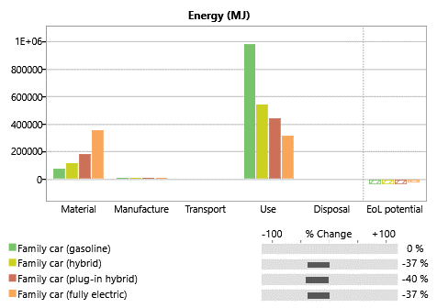
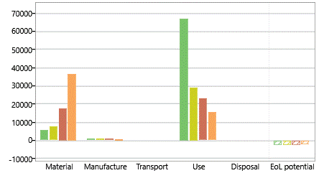
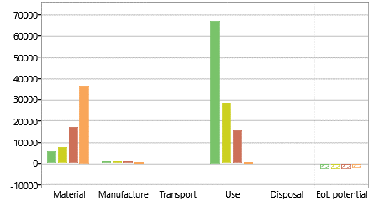
Demo: what can Granta EduPack do?
Life-cycle comparison of total energy use (Europe) by Eco Audit Level 3
CO2 footprint (Europe)
CO2 footprint (Norway)
Model | Golf ICE | Golf GTE | e-Golf
Battery capacity | - | 8.7 kWh | 24.2 kWh
Battery weight | - | 120 kg | 318 kg
Car weight | 1318 kg | 1515 kg | 1540 kg
Notes:
Summary of results

Slide 7
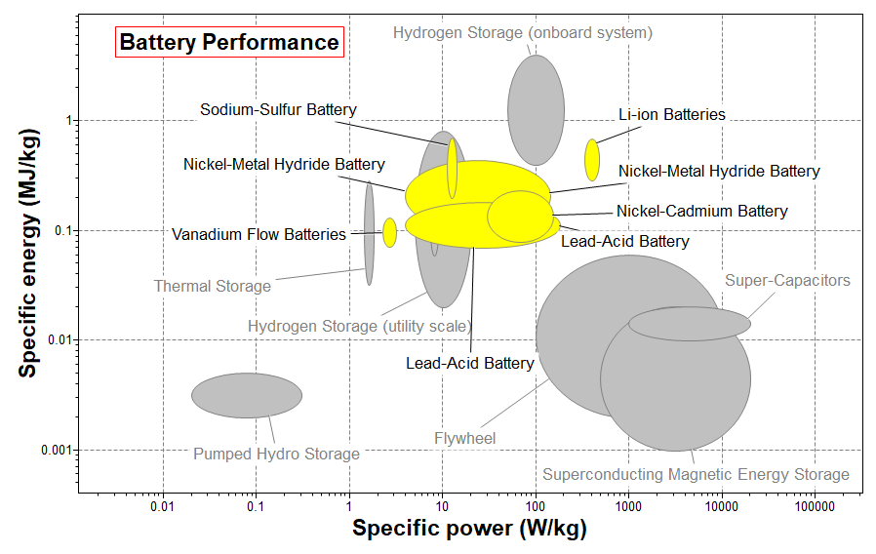
Electrochemical energy storage (i)
Specific power = power per mass, promotes acceleration
Specific energy = stored energy per mass, promotes range
Li-ion batteries perform better than others, but without lead or cadmium
Notes:
Performance visualization 1
In the Power system data-table, there is useful data on energy storage (including flywheel, super capacitors, compressed air etc)
You can plot relevant energy properties for electric vehicles and filter on Electrochemical storage
We need to think about the mass of the battery as that will affect fuel efficiency and we need to make sure that, within a reasonable mass, the car can accelerate as needed and go longer enough to reach another charging point.
We are therefore interested in Specific Power and Specific Energy.
Li-ion batteries perform better than others, but without the need for lead or cadmium

Slide 8
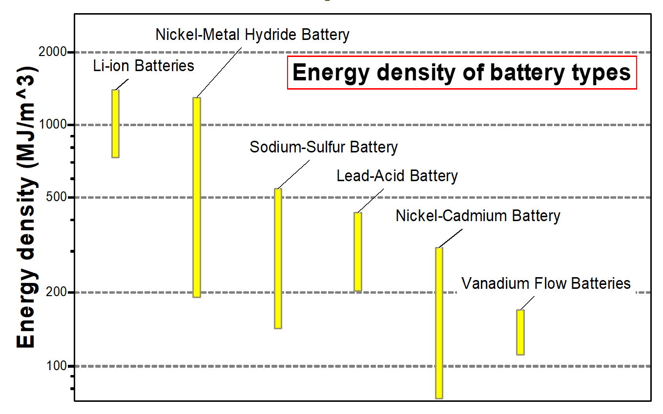
Electrochemical energy storage (ii)
Another important consideration is battery space:
Energy density = stored energy per volume, aids design and comfort
Notes:
Performance visualization 2
Another important consideration is battery volume, we don’t want the car to be bigger than the average vehicle
This relates to the Energy density of the battery, how much energy you can accommodate per volume
The definition of specific power/energy, energy density etc can be found under the “i” icons in the datasheets

Slide 9
Lithium and Cobalt in batteries
Cathode LiNi_{0.8}Co_{0.15}Al_{0.05}O₂ (Gaines) LiMn₂O₄ (Gaines) LiNiMnCoO₂ (Richa) LiCoO₂ (Wang) LiFePO₄ (Wang)
Metals mass% mass% mass% mass% mass%
Winslow, Kevin M., Steven J. Laux, and Timothy G. Townsend. "A review on the growing concern and potential management strategies of waste lithium-ion batteries." Resources, Conservation and Recycling 129 (2018): 263-277.
Vaalma, Christoph, et al. "A cost and resource analysis of sodium-ion batteries." Nature Reviews Materials 3 (2018)18013.
Notes:
Battery reality-check
Batteries for modern electric cars (and many electronic devices) are based on Li-ion technology
Here are some of the most common ones. The most important one is probably the LiNiMnCoO2
This one has just a bit over 1 weight% Lithium and 8-9 weight% Cobalt
This may not seem much, but it translates to around half of all industrial use of both these metals for batteries, globally

Slide 10
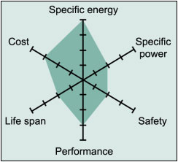
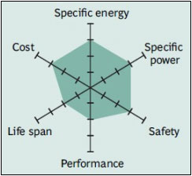
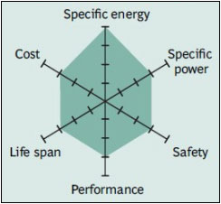
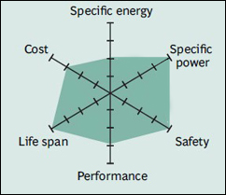
Li-ion types of batteries
Lithium Cobalt Oxide (LCO)
Lithium Manganese Oxide (LMO)
Lithium Nickel Manganese Cobalt Oxide (LiNiMnCoO₂ or NMC)
Lithium Ferrite Phosphate (LFP)
http://batteryuniversity.com/learn/article/types_of_lithium_ion
Notes:
Battery reality-check
Here we can see why this type of battery is so popular. It has very good overall performance, but, in particular, specific energy
There is more product-related information in the link: batteryuniverse.com

Slide 11
Demo: tour around useful data tables
Power
Sources
Energy
Storage
Elements
Materials
Processes
Nations
Regulation
Notes:
The sustainability database
The Sustainability database has easy access to several data-tables to support materials-related design decisions
Energy storage systems (Li-ion batteries)
Legislation and regulations (battery directive etc)
Elements affected (Cobalt and Lithium)
Nations mining this element (Congo, Democratic Republic of the) > Problematic!

Slide 12
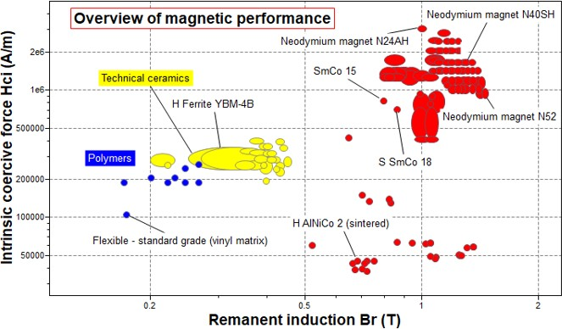
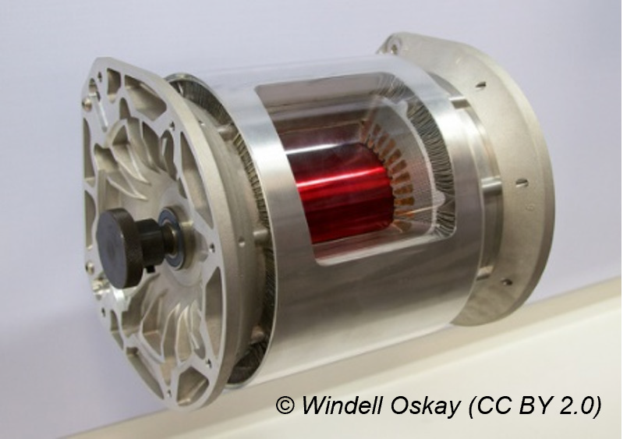
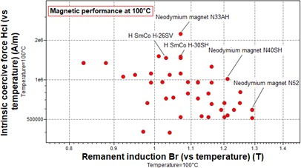
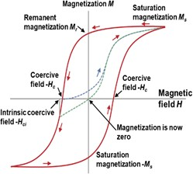
Demo: Magnetic performance
Notes:
Magnetic performance
Granta EduPack has magnetic data that enables visualization of performance related to electric motors
The performance is determined by a combination of two major material properties
The Intrinsic Coercive Force, which is a measure of how well the magnet resists demagnetization
The remanent induction, or remanence, that describes the strength of the magnet
Since the application in electric vehicles. in particular hybrid vehicles, the temperature will be elevated
In the magnetic subset of the Level 3 database, there is temperature-dependant data, both for coercive force and remanence
The charts show that the Neodymium-based magnets are superior and that they can retain their performance at high temperature

Slide 13
Critical materials in vehicles: Rare Earths
Mayyas, Ahmad, et al. "Vehicle's lightweight design vs. electrification from life cycle assessment perspective." Journal of Cleaner Production 167 (2017): 687-701.
Notes:
Vehicle materials
The fraction of traditional materials have decreased over time, in favour of, electronic material and others

Slide 14
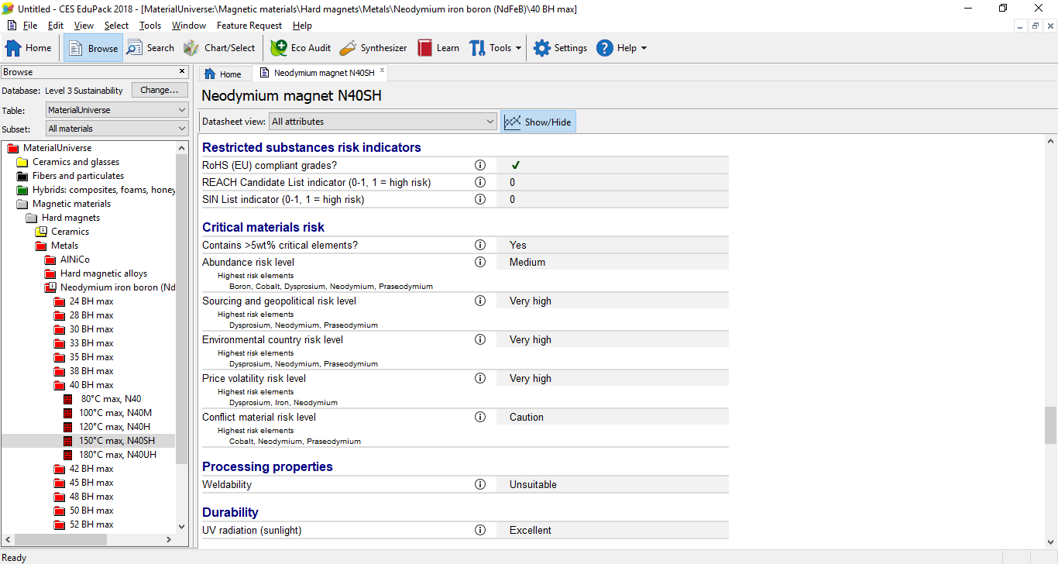
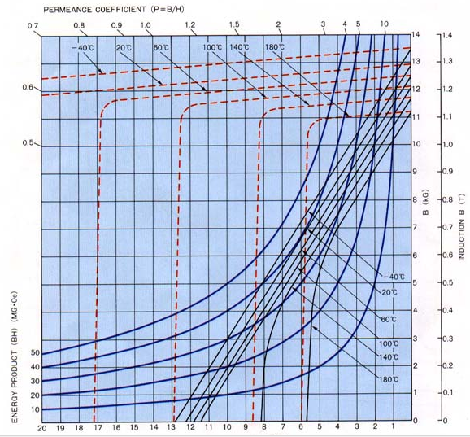
Critical materials and RoHS risk
Notes:
Magnetic data
Example of a record of a Hard magnet: Neodymium Iron Cobalt N40SH
The composition can be found under Composition overview
There is also useful information in the folder-level record (marked with an i in the browse tree) for neodymium iron boron magnets
This contains definitions and temperature denominations (SH= up to 150°C) and point out high risks etc
Neodymium and other rare earth elements are on both the EU and US critical lists

Slide 15
Conclusions
Electric cars is an increasingly relevant and interesting topic to use in materials-related teaching
When developing products, It is important to look at the whole life-cycle as early as possible, Eco Audit facilitates this
The Sustainability database has a large number of materials and processes, organized into useful subsets, including criticality and other sustainability-related data.
The visualization tools let us to have a quick overview of properties to compare different options, for example, showing that the Li-ion battery has a very competitive performance.
With Granta EduPack, we have successfully explored energy storage data-tables for batteries and magnetic materials for electric motors.
Notes:
Conclusions

