Slide 1
Advanced Industrial Case Study:
Battery Designer and Materials for Transportation
Claes Fredriksson and Nicolas Martin
June 9, 2021

Slide 2
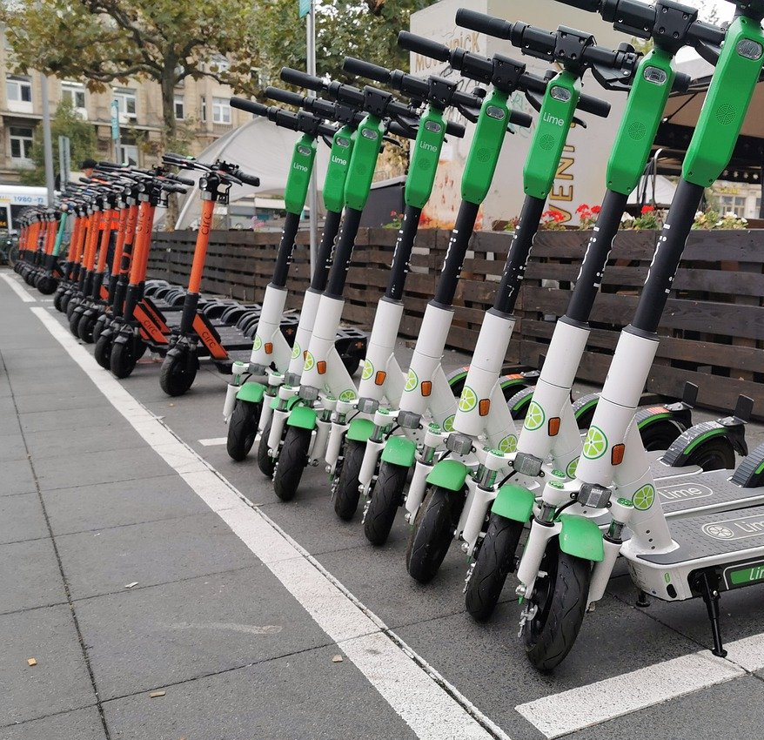
Agenda
Introduction
EduPack, Battery Data and Selection
Battery Technologies
Advanced Industrial Case Study
- e-Scooters
- Drones
Reality Check
Q&A
Claes Fredriksson
Nicolas Martin
Notes:
Agenda
We will start with an introduction to EduPack and the relevant information that we have
Furthermore, we will discuss the developments in battery technology
Then we will be showcasing how to use the data and tools of EduPack to explore battery design
We have three simple examples of applications that we want to highlight and a quick reality check
For those of you that attend this session live, we will have a Q&A session at the end

Slide 3
Granta EduPack: More than a Software
Software
Teaching and Learning Resources
+
www.ansys.com/education-resources
Developed specifically for undergraduate materials-related education
across engineering, design and science.
Notes:
Teaching Resources
As we go through the next several slides, we will see that Granta EduPack can be applied to a broad spectrum of engineering subjects as well as in interdisciplinary areas that are linked to material education
The software also comes with more than 350 teaching resources covering various levels of materials education
Specifically, you can find case studies on electric cars and other transportation as well as on sustainability

Slide 4
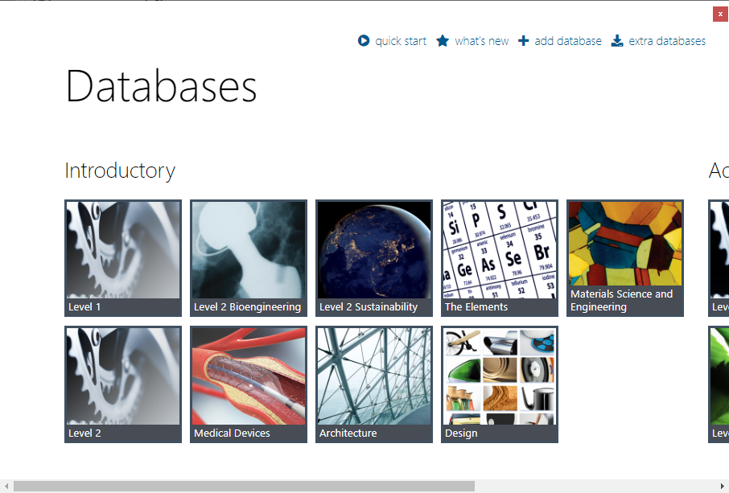
Granta EduPack - Different Tools in Different Levels
Level 1: First year (Freshman) students
69 materials
74 processes
Level 2: Second- and Third-year students (Sophomore, Junior) Around 100 materials
116 processes
Level 3: Senior, graduate and research students
4000+ materials, 246 processes
Notes:
Data and Tools
Here are all the different databases that make up our Granta EduPack. These are divided into introductory and advanced
We also have Eco-audit, Phase Diagram and Synthesizer tools – more about the Synthesizer tool later
We will be using the Advanced level for this case study and the Sustainability Level 3 database
This contains all the engineering materials and processes of the level 3 database and all advanced tools

Slide 5
The systematic material selection methodology
All Materials
Granta EduPack supports systematic material selection with data and tools
Read more in textbooks by M. Ashby
Breakdown design requirements into:
Function – What does the component do?
Constraints – What essential conditions must be met?
Objectives – What is to be maximized or minimized?
Undergraduate
Advanced
Screen on constraints – ‘Go/’no-go’ criteria (usually many)
Rank on objectives – Ordering of materials that ‘go’
Top Candidate Materials
Supporting information – Specialist databases, contact supplier
Local conditions – Preferred suppliers, process capability, location
Final Selection
Notes:
Performance index and free design parameter
Let’s first briefly introduce the systematic material selection methodology introduced by Mike Ashby and co-workers here in Cambridge, UK
The basic steps are shown schematically in the flowchart to the right but it is based on material properties
In the database of battery cells, there are no general material properties, but rather specifics on each battery (weight, not density)
There is also not a free geometric design parameter that can be used to enable a choice of options
The bigger batteries are usually better performing than the smaller ones
You can use specific energy or power as well as energy or power density as performance index for cell selection

Slide 6
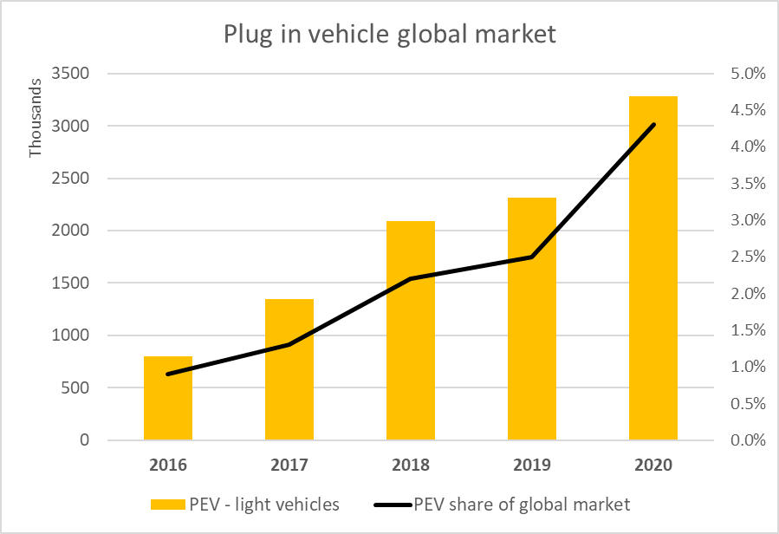
The electrification of transport systems
Huge growth of electric and hybrid vehicles
Many battery types contain toxic elements:
Lead,
Cadmium
Mercury
Some contain critical elements:
Lithium
Cobalt
Most electric motors contain magnets
These have rare earth elements:
Neodymium
Samarium
Dysprosium
Top 5 Countries: China, Germany, USA, France, UK
Notes:
Electric transport systems
Electric transport systems in general, and plug in vehicles in particular, have increased significantly over the past few years
This trend comes from the a popular demand to reduce CO2 emissions, of course
But it is also possible because of recent improvements in the performance and cost of battery technology
The growth of electric vehicles globally puts pressure on material supply
In particular, there are issues with batteries and permanent magnets for electric motors
Traditional rechargeable batteries contain toxic heavy metals and the magnets contain rare earth elements

Slide 7
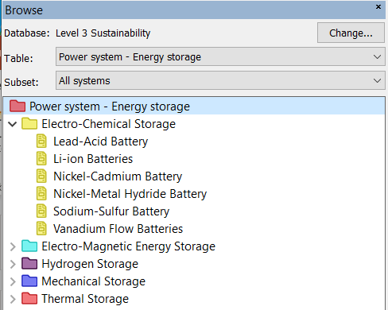
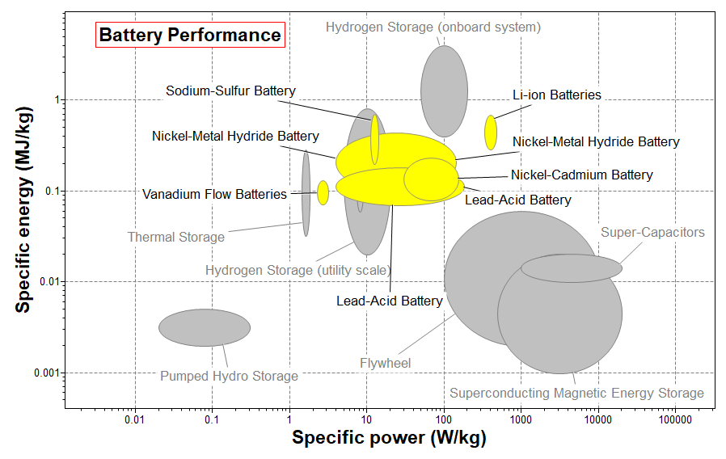
The Power system - Energy storage data-table
Specific power = power per mass, promotes acceleration
Specific energy = stored energy per mass, promotes range
Li-ion batteries perform better than others, but without lead or cadmium, see plot
Notes:
Energy storage systems and the benefits of batteries
There exists many engineering systems that can store energy for various power, load cycling, range and charging requirements
Electro-chemical storage systems, or batteries, are one of them, highlighted here in Yellow
If we focus on transport applications, batteries show very good specific power and energy, but also high energy density which means low space requirements
Li-ion batteries perform better than others, but without the need for lead or cadmium

Slide 8
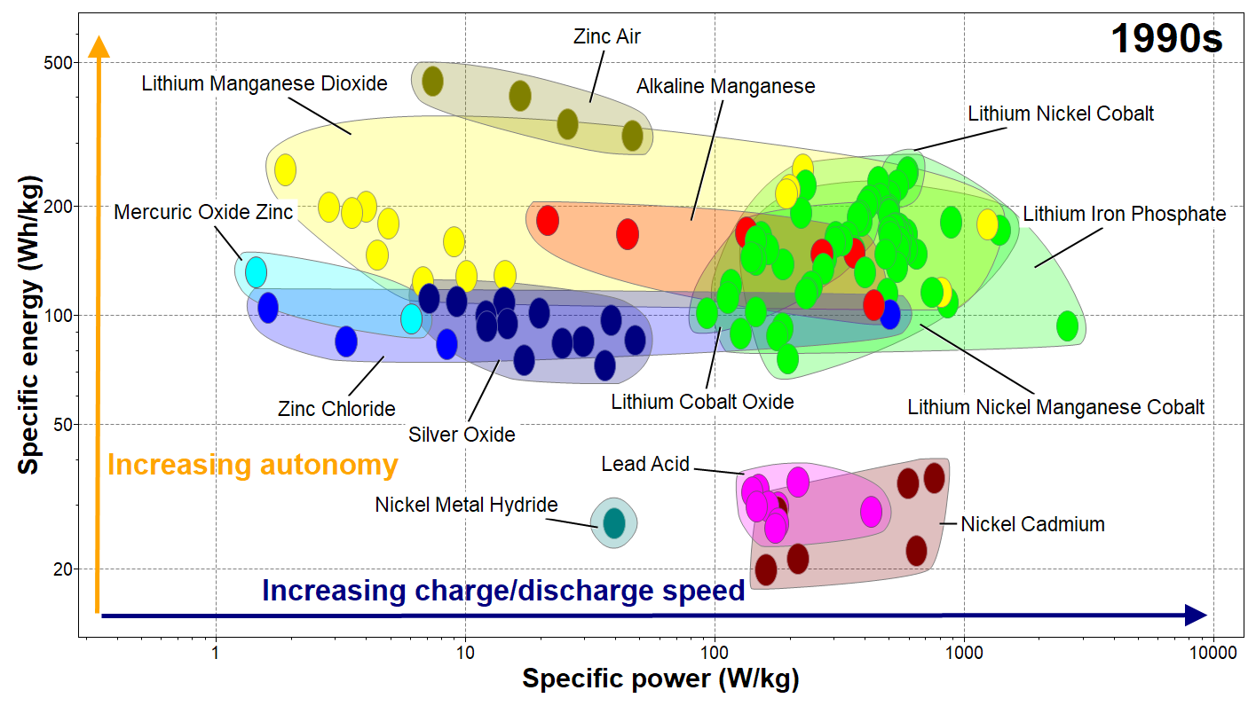
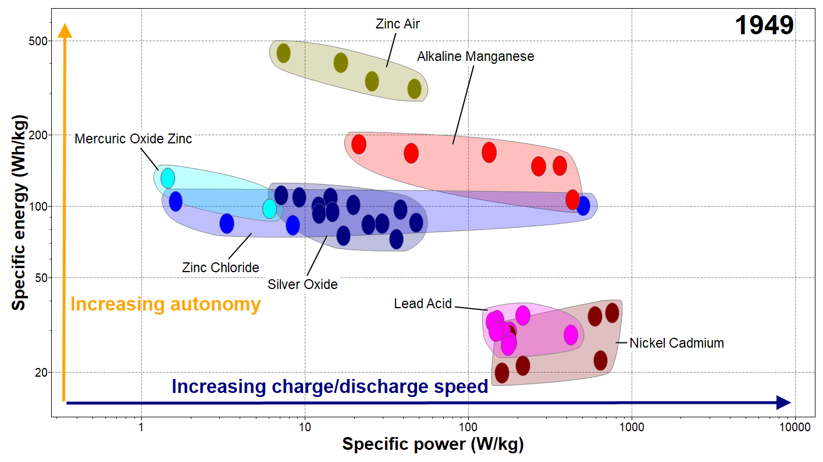
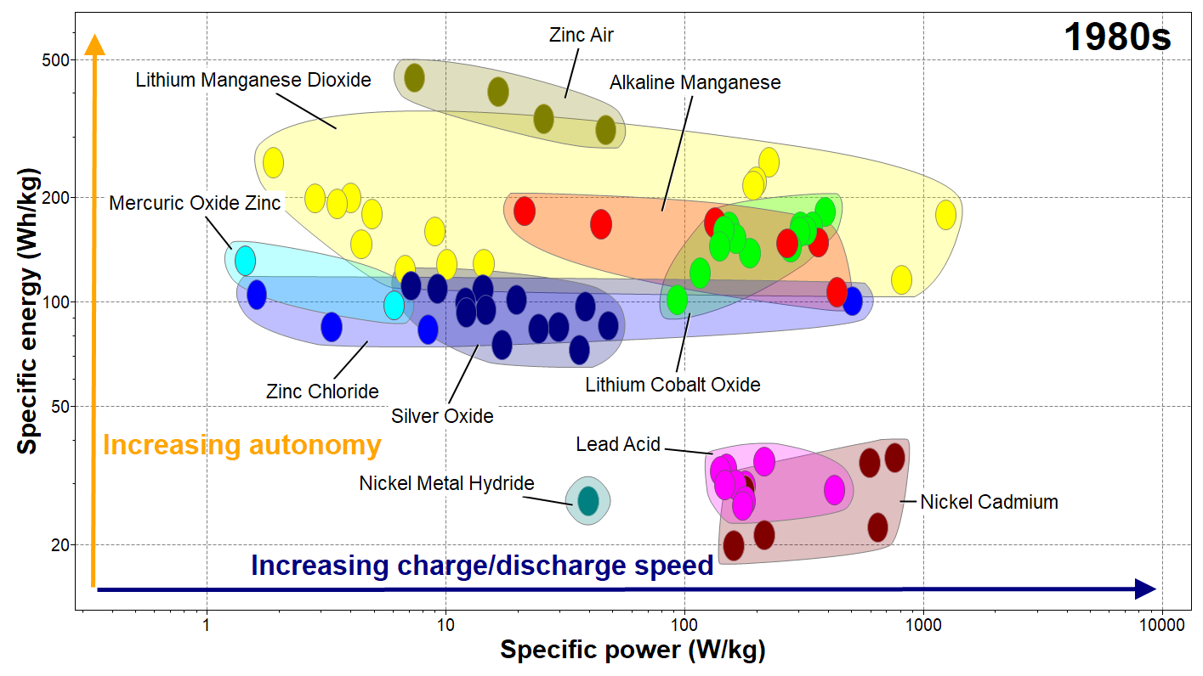
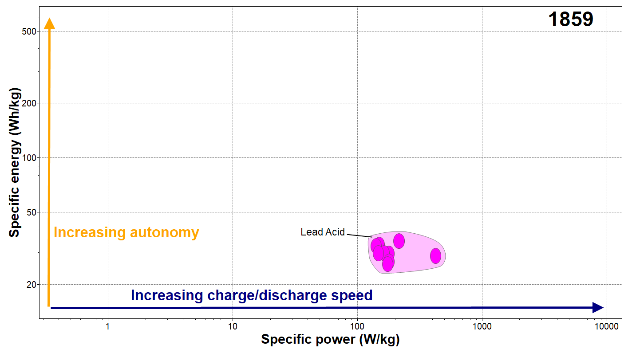
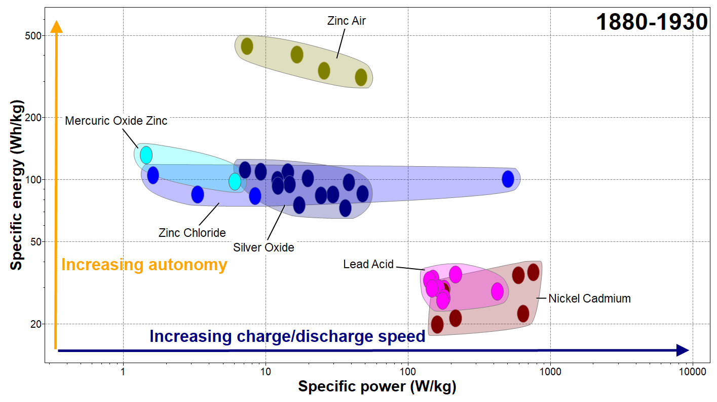
Battery cell technology through time – the Battery Designer
The Ragone plot is suitable for comparing performance of energy-storage devices, as well as energy devices such as engines, gas turbines, and fuel cells. The vertical axis describes how much energy is available per unit mass, while the horizontal axis shows how quickly that energy can be delivered, the power per unit mass.
Picture taken from Ansys Granta EduPack
Notes:
Ragone plots and background
Battery cells have been around for more than 200 years. The first large volume application technology was Lead Acid batteries, developed in the mid 1800’s
Then over a period of 50 years, multiple discoveries occured with the families of Zinc-, Silver-, and Nickel Cadmium-based cells
1949 was another stepping stone with the invention of Alkaline Manganese, extremely popular nowadays with AA and AAA batteries
Since the 80’s, the Lithium-ion technology has been discovered, and many electrochemical materials have been developed
This breakthrough has been so significant that the inventors were awareded the Nobel Prize of Chemistry in 2019

Slide 9
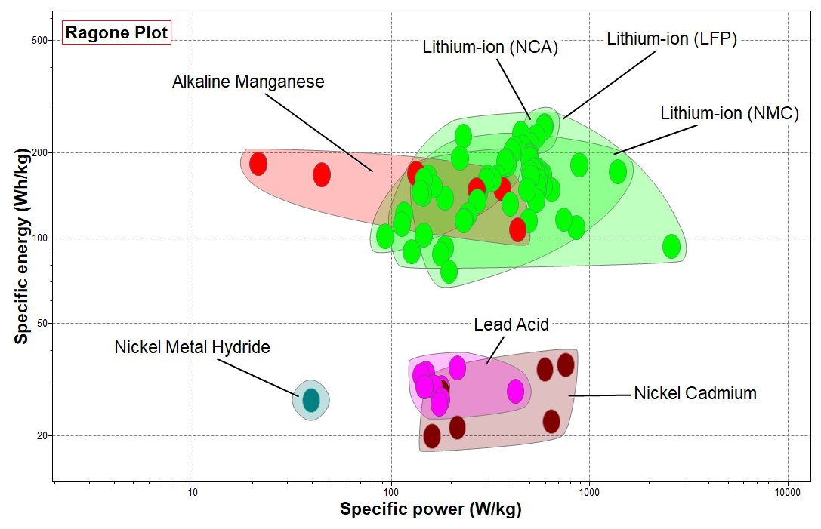
Ragone plots for rechargeable batteries
Lithium-ion type batteries are superior in both energy and power performance.
Heavy metal batteries have considerably less energy storage capacity per weight.
LCO=Lithium Cobalt Oxide
LFP=Lithium Iron Phosphate
NCA=Nickel Cobalt Aluminum Oxide
NMC=Nickel Manganese Cobalt
Notes:
Rechargeable batteries
Ragone plots are a graphical way to visualize the performance of energy storage systems
We will be using them multiple times in the presentation, here showing the rechargeable battery types
Lithium technologies are superior to other types, both in energy storage and power capacity per weight

Slide 10
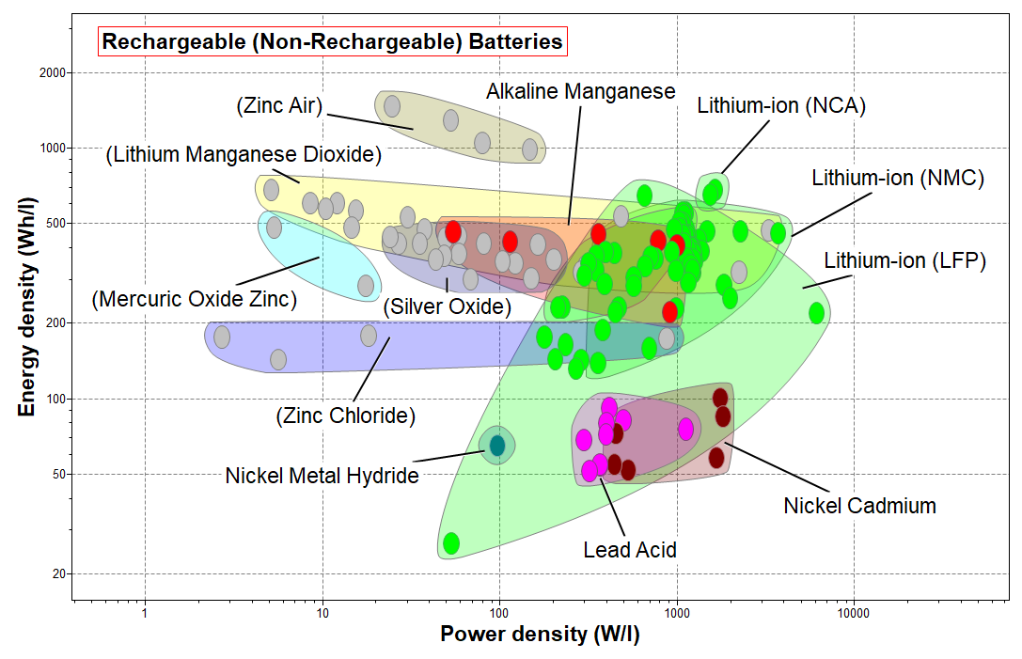
Energy density and Power density for rechargeable batteries
Notes:
Energy and power density
If weight is not essential, but volume is restricted, then Energy and power densities can be used
Lithium chemistry is still superior among secondary battery types (rechargeable)

Slide 11
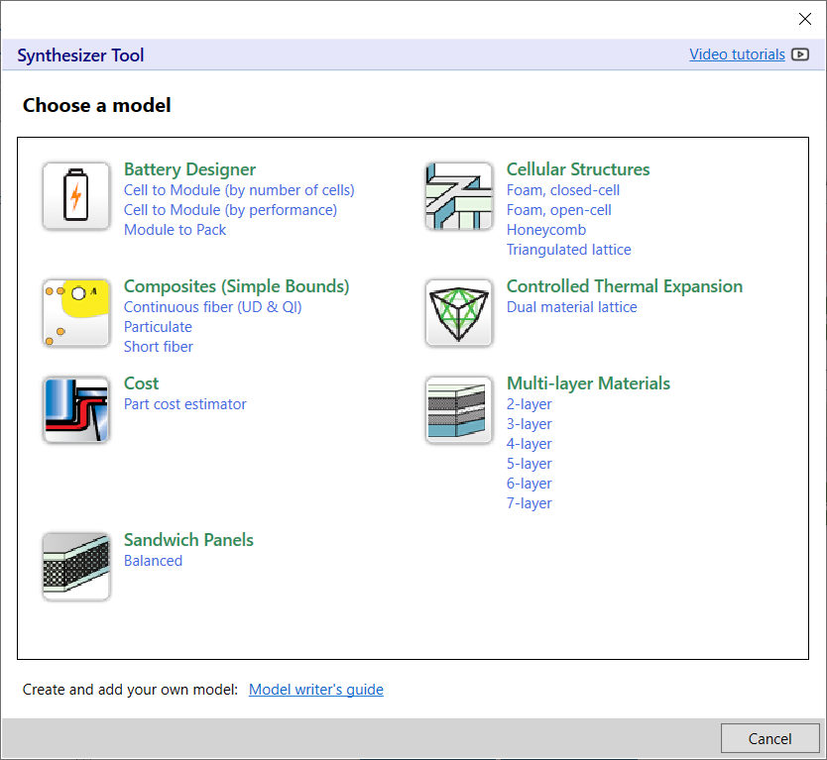
What is the Synthesizer tool?
The Synthesizer tool can be used to estimate properties based on parameter ranges and data in the software.
For example, mechanical properties of composites and structural hybrids or part costs in manufacturing.
The new Battery Designer model estimates electrical properties of battery packs and modules based on the battery cell data-table.
Notes:
The Synthesizer tool
One of the available tools in Advanced EduPack is the Synthesizer tool to estimate properties in bespoke configurations
This contains the new battery designer module that estimates electrical properties of battery packs and modules based on the battery cell data-table

Slide 12
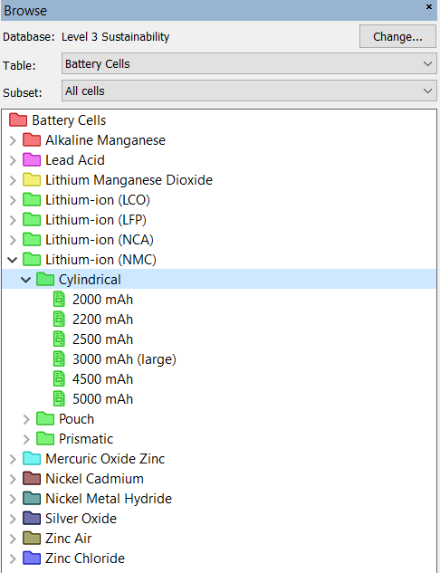
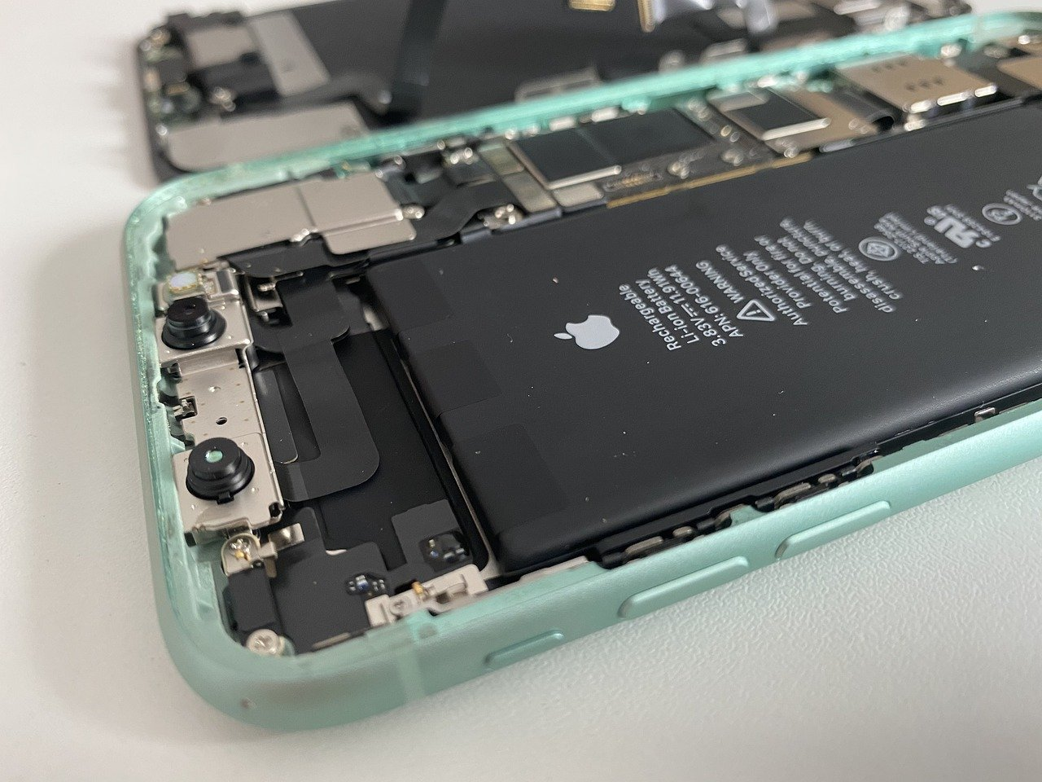
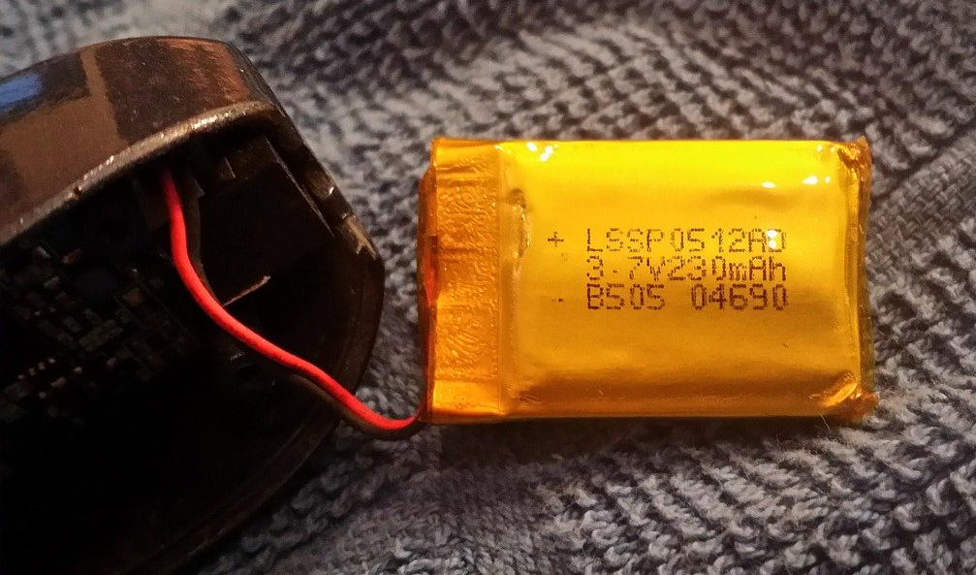
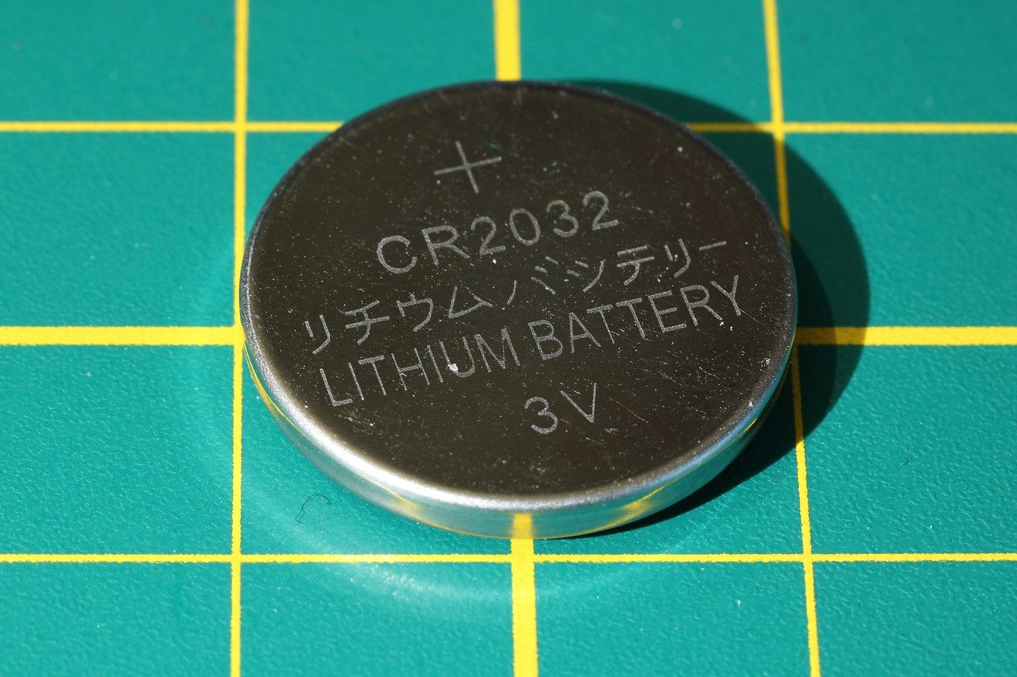
The Battery cells data-table
Cylindrical cell
High mechanical stability
Generally lower cost
Most commonly available
Used in EVs
18650 - 18 mm diameter, 65 mm long
Prismatic cell
High mechanical stability
High packing density
Used in phones
Pouch cell
Low mechanical stability
High packing density
Used in drones and R/C
Coin cell
Small
Inexpensive
Used in small appliances
Images from: www.pixabay.com
Notes:
Battery cells in the battery designer
There are many types of batteries included in the battery cell data-table
Primary and secondary (rechargeable) batteries of most relevant chemistries
Four types of cell geometries are available; Cylindrical, Prismatic, Pouch and Coin batteries

Slide 13
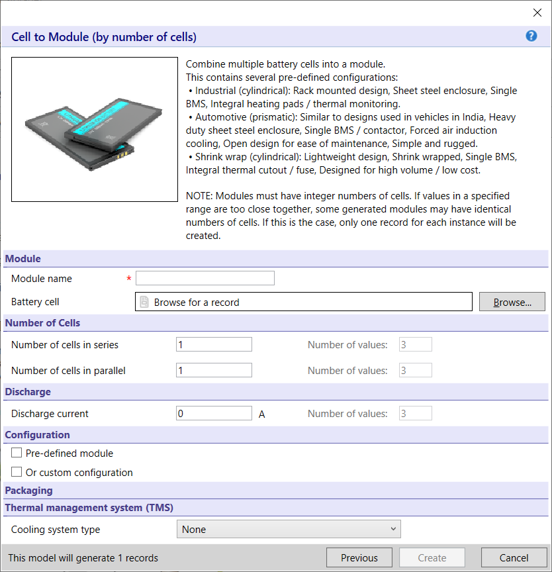
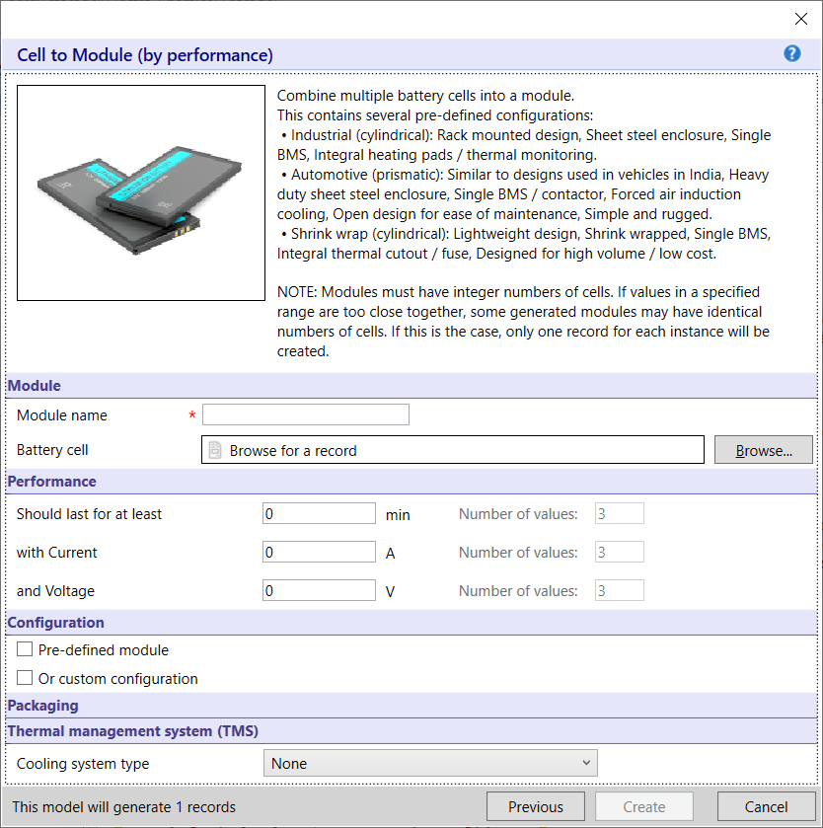
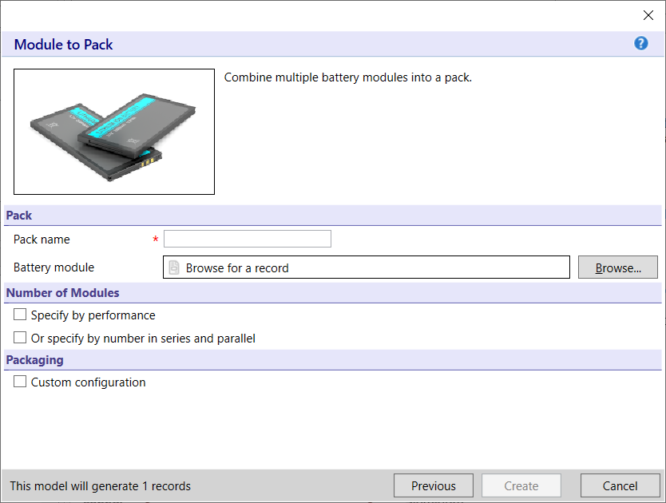
Synthesizer model: Cell to module + Module to pack
Notes:
Battery Designer models
When the Battery Designer has been chosen in the Synthesizer tool, three options appear
These are Cell to Module, based on number of cells or on performance
Or Module to Pack used for heavier applications, where many modules are needed

Slide 14
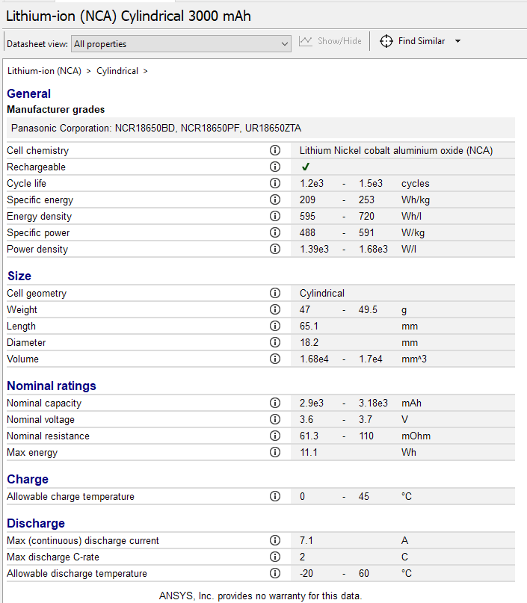
Battery Designer models and building blocks for transportation
Transport System
Generic data table on 128 types of cells classified by their chemistry
Attributes and science notes
Notes:
Electrode to Battery Pack (part 1)
This slide shows the typical building blocks for full scale battery design in transportation.
Granta EduPack can help non-expert students to explore some of these aspects.
The battery cells subset contains 128 records covering the most common chemistry families.
This Li NCA 3000 mAh datasheet displays attributes including max discharge Crate, nominal voltage or cycle life with their science notes.

Slide 15
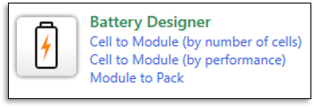
Battery Designer models and building-blocks for transportation
Transport System
Simplified models to estimate key performance metrics
Notes:
Electrode to Battery Pack (part 2)
For the later stage of design, the syntheizer tool now contains models to estimate properties of battery pack and battery modules
It does this by combining cell, geometry, casing material, and cooling system parameters.

Slide 16
Industrial case study
- e-Scooters
- Drones

Slide 17
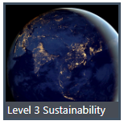
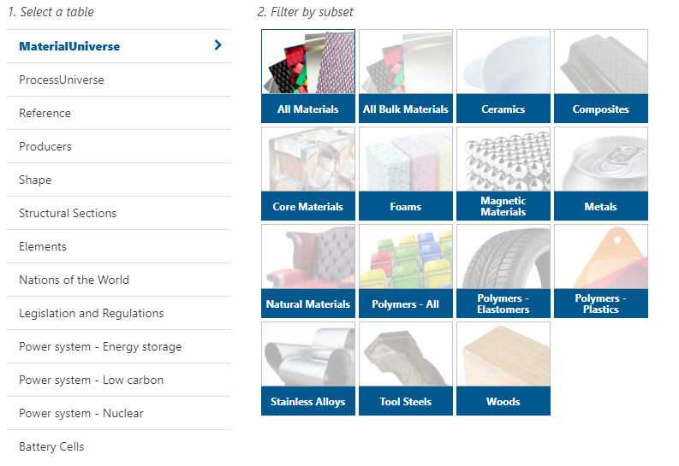
The sustainability level 3 database
4181 material datasheets​
247 Manufacturing processes​
Power systems
Elements of the periodic table
Nations of the world database
Battery Cells
Notes:
Nicolas
For both the transportations included, the advanced, Level 3 Sustainability database is used
This has easy access to the energy storage data-table, as well as the Elements and Resource data from Nations of the world
It also contains the Battery cells data-table and the Battery Designer model in the Synthesizer tool

Slide 18
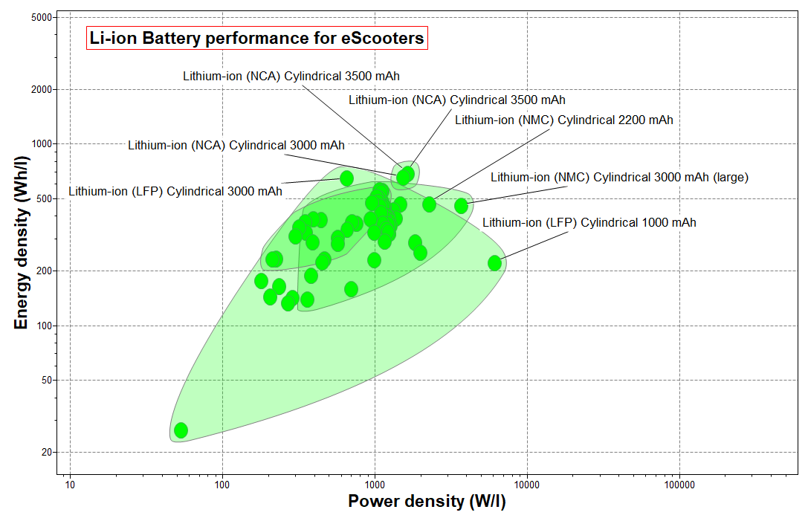
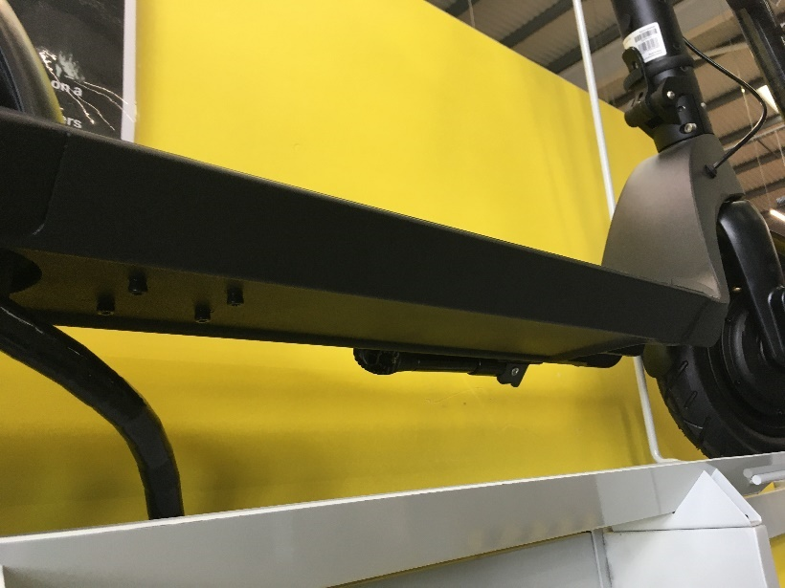
Case 1 – eScooter: max energy density, limited volume (demo)
Objective: Maximize energy density,
Requirements:
Li chemistry cells, Geometry: Cylindrical
1000 cycles, 3yr life span (every day usage)
Supplies 36 V​, 10 A
30-90 minutes use
Notes:
Case 1 - eScooter
Demonstration of module design to meet requirements for energy/volume ratio

Slide 19
Case 2 – Drone: max specific energy, limited weight (demo)
Objective: Maximize specific density,
Requirements:
Small drone typically a few thousand mAh, free volume
Drone batteries are typically pouch type, around 3.7 V
Can we find prismatic alternative to small pouch battery?
One cell assumed to be enough for small drones
www.pixabay.com/photos/drone-flight-flying-start-hobby-4144154/
Notes:
Case 2 - Drone
Demonstration of how to improve battery design for energy/weight ratio

Slide 20
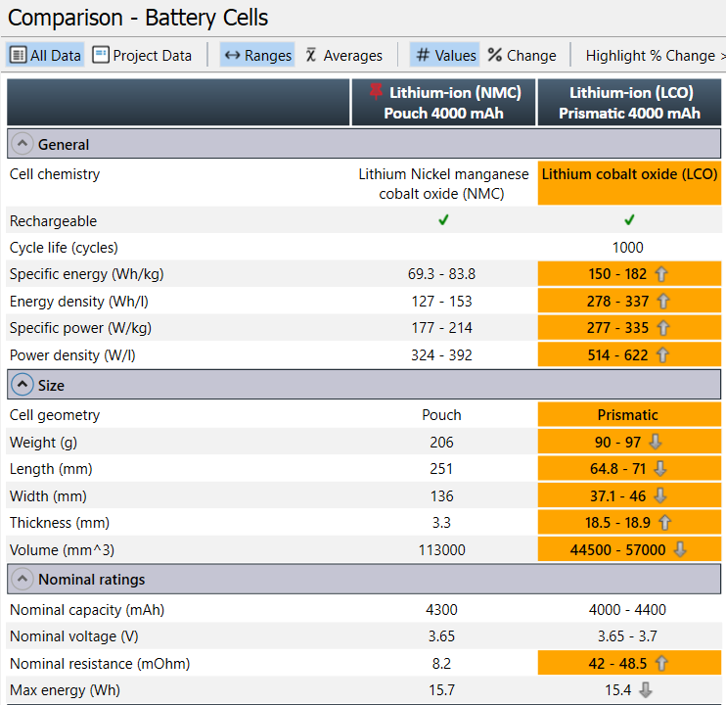
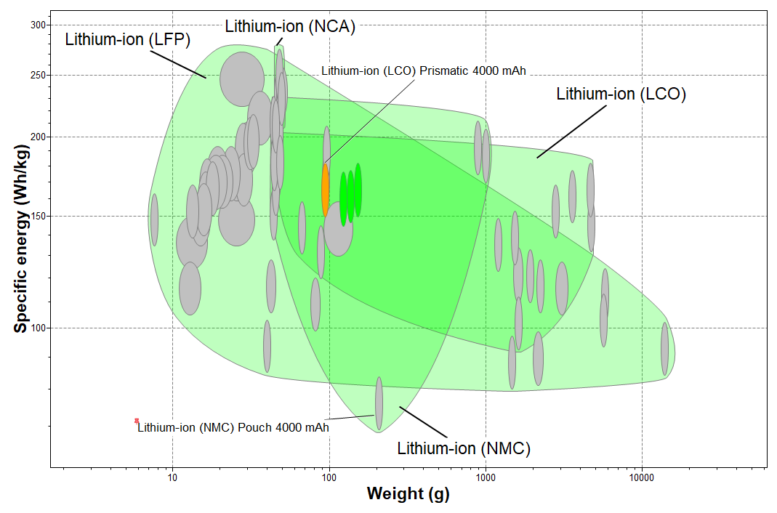
Can the pouch battery performance be improved by prismatic cell?
Notes:
Comparison Table
The reference function and comparison table can be used for benchmarking

Slide 21
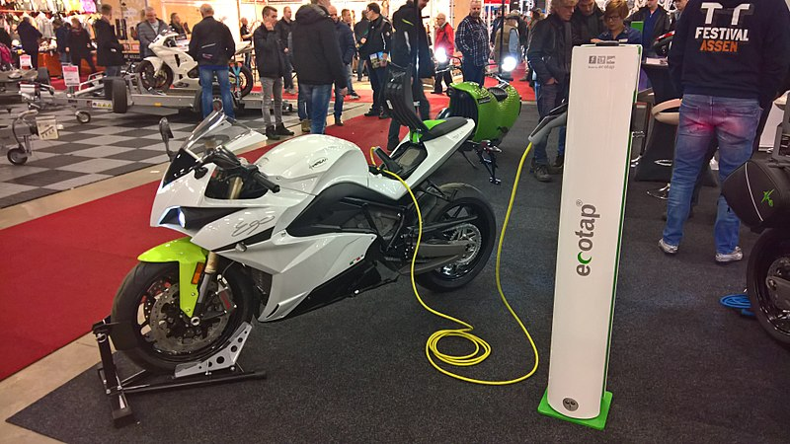
Future case – eRacing Motorbike: max power density, limited weight
Objective: Maximize specific power
Requirements
Limited weight for battery pack
92 V, Min 20 kWh, fast charging
Supplies at least 30 min of use, 40 km
https://commons.wikimedia.org/wiki/File:Electric_motorcycles_stand_at_the_TT-Hall_motor_show,_Assen_(2018)_01.jpg, CC BY-SA 4.0, Donald Trung
Notes:
To be continued…

Slide 22
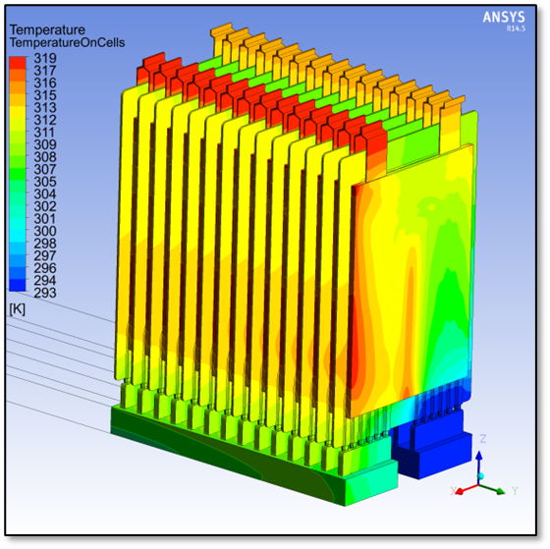
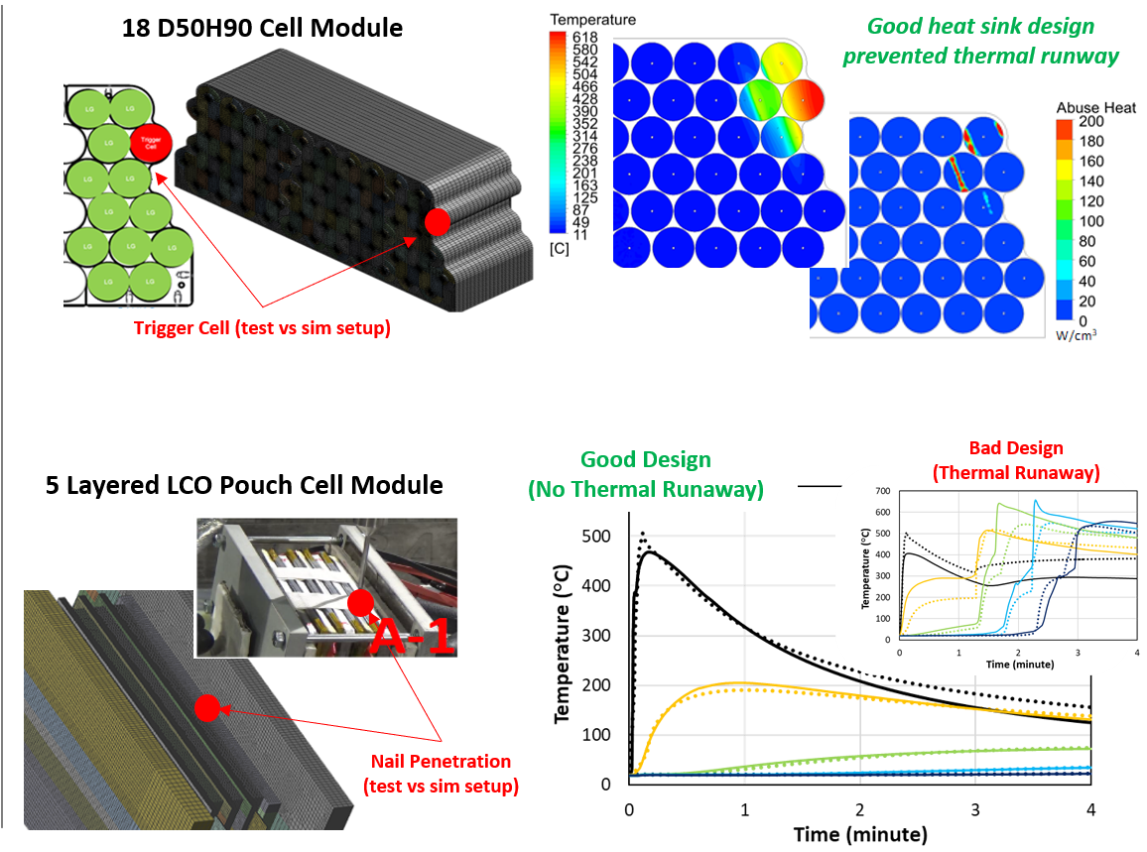
Reality check – predicting battery failure in transportation
Thermal-electrical-fluid multiphysics simulation with Ansys Fluent:
Adress battery thermal management challenges
Reducing the risk of thermal runaway propagation
Notes:
Reality Check
Battery designs have to be tested before use, since modern batteries contain extremely high energy densities
One option to make sure that safety is not compromised and save time is to use simulations
Ansys offers many solutions to simulate mechanical, thermal and fluid performances
The Battery Designer offers the possibility to explore and reduce the number of tests and simulations needed

Slide 23
Summary of findings
The battery cell data and design models have helped to explore some key performance parameters of battery assemblies, based on simple concepts
Priorities in terms of energy and power have been discussed for 3 different cases – Lithium based chemistry is the top-performing cell type in all applications
Additional materials considerations could be explored with Ansys Granta EduPack:
- Material selection for lighweight of the structural casing
- Quick Eco Audit of e-transport systems vs conventional power
- Critical materials/supply chain risks of battery elements and their substitutes
Notes:
Summary

