Slide 1
Quarterly Case Study Session
Presented June 2020
Selection and Sustainability of High-Temperature Aerospace Materials
Claes Fredriksson and Luca Masi
Ansys Materials Education Division
Notes:
Introduction
These Case Study Sessions are based on our Advanced Industrial Case Studies for Granta EduPack.
Today’s topic is High-temperature aerospace materials and we will look at both selection and sustainability issues
These case studies are primarily intended to inspire educators and facilitate materials-related teaching
Recording of this Quarterly Case Study can be found here: https://www.ansys.com/resource-center/webinar/ansys-granta-edupack-case-study-selection-and-sustainability

Slide 2
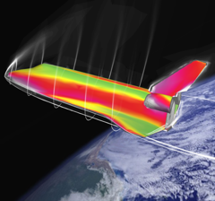

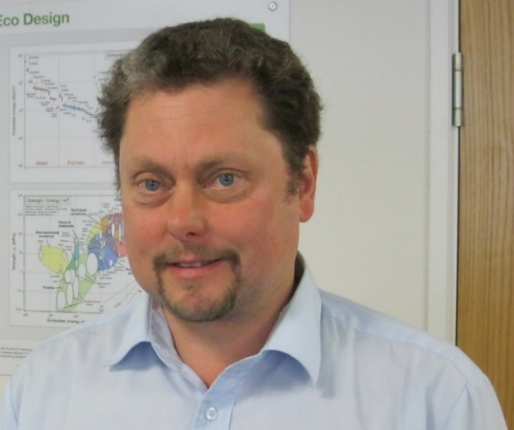
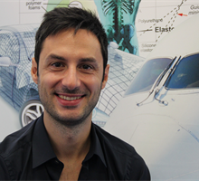
Agenda
Introduction
Advanced Industrial Case Study
  - Aerospace materials
  - Turbines
  - High-temperature superalloys
  - Sustainable Development
  - Reality Check
Q&A
Claes Fredriksson
Luca Masi
Notes:
Agenda
We will start with an introduction to the case study and give some background to aerospace materials
Furthermore, we will discuss the specific needs of turbochargers and jet turbines
Then we will be showing how you can use EduPack to explore and select materials for such high-temperature applications
We will also show how the Sustainability database, can be used to assess criticality and supply issues
Finally, we will do a reality check to see what NASA has published on similar topics

Slide 3






A brief history
1994
Granta Design founded by Professors Mike Ashby and David Cebon to commercialize a materials selection teaching project
Development of Cambridge Engineering Selector (CES) for academia and industry plus a new industry product GRANTA MI
2001
Investment from and strategic partnership with ASM International
2011
Education Division founded to support CES EduPack and the growth in Academic collaborations and Resource Development
2019
Granta Design acquired by ANSYS, Inc. the global leader in engineering simulation
2020
CES EduPack rebranded GRANTA EduPack
Notes:
Background to EduPack
Granta Design was founded in the early ’90 by Prof Ashby an Prof Cebon as spin-out of the university of Cambridge
In Feb 2019 Granta Design was acquired by ANSYS Inc, the global leader in engineering simulation
The CES EduPack software is now called Granta EduPack and includes more databases and tools to help educators teach the next generation of engineers

Slide 4
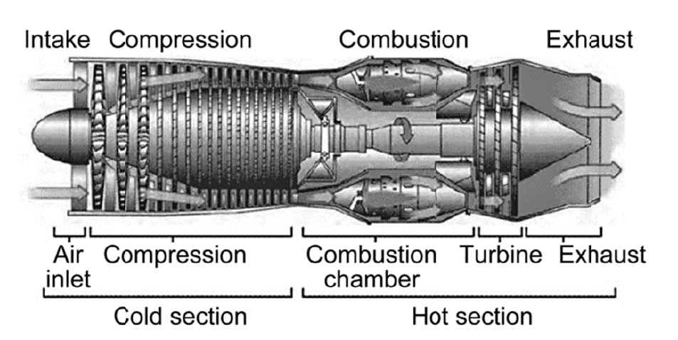
High-temperature aerospace materials: Jet Engine thermal zones
Notes:
Background Aerospace materials
Aerospace materials are frequently associated with metal alloys and composites that require exceptional performance
The challenges in general require them to be strong, durable, safe and sometimes sustain very low or high temperatures
As for most aerospace applications, light weighting is another key aspect. High power to weight ratio is usually very desirable.
This is an example of a jet engine schematic with a cold and a hot section but there are also high temperatures in aerospace and automotive turbocharger turbines.
Gas turbine blades operate in a very hostile environment: highly corrosive gases, temperatures usually above 1,000 °C, high centrifugal forces (hence high tensile loads), fatigue, just to name a few.
Nickel-based and cobalt-based superalloys are generally used for those applications.

Slide 5
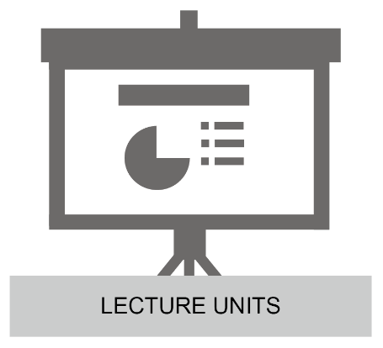
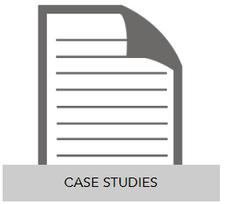




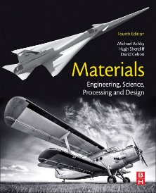
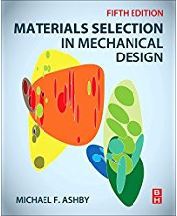
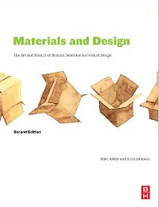
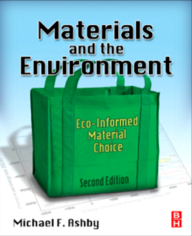
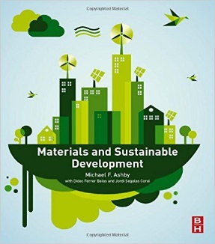
Granta EduPack and education resources
Software + Knowledge
Mars Lander
Aerospace Pressure Vessels
Turbine blades
University Textbooks
Undergraduate materials
Advanced selection
Materials and Design
Materials and the Environment
Materials and Sustainable Development
Notes:
Education resources and knowledge
We do not only sell software but also manage a lot of materials and education knowledge.
There are both powerpoint Lecture Units for educators and white papers that cover aerospace topics on our Education Hub
We have also developed three previous case studies for EduPack on aerospace applications
Mars Lander, Aerospace Pressure vessels and indeed, the first one was about materials for turbochargers
Our resources are complemented by a number of relevant textbooks by professor Mike Ashby

Slide 6
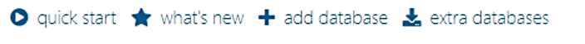
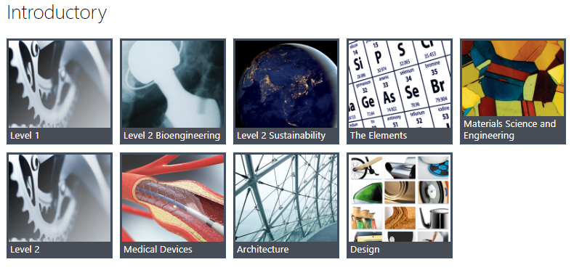
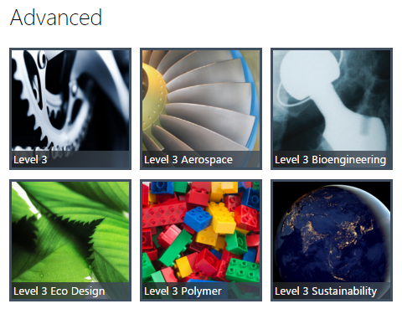
Granta EduPack 2020
Databases
The Elements Database
149 records, periodic table
Critical elements
Notes:
Databases used
Granta EduPack 2020 has a larger set of databases included than previous editions, 2 new introductory ones
For this case study, we will make use of the aerospace database for the selection part
We will also showcase the sustainability database in order to scrutinize critical elements in superalloys (Cr, Co)
This database contains a number of interesting subsets, such as the Elements database and nations of the world

Slide 7
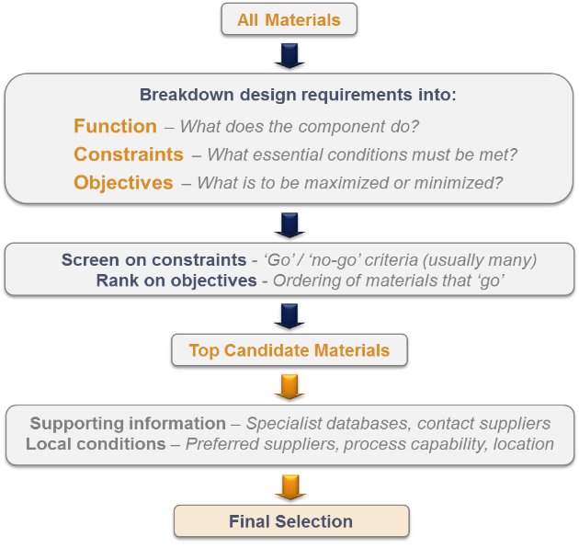
Systematic materials selection (Ashby, Cambridge University)
Notes:
Materials Selection
We are going to employ the systematic material selection methodology made popular by Prof. Mike Ashby
It involves identification of the mechanical load situation for the function, in our case a turbine blade, where we will neglect bending
The constraints are relatively straight-forward. It may be service temperature, corrosive environment or a certain class of materials. These are used for screening.
The objectives will depend on the function and the kind of performance that is desired and will be reflected in performance indices that are used for ranking.

Slide 8
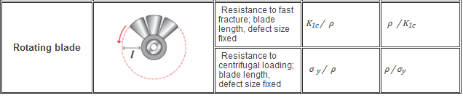
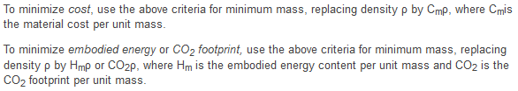

Performance Index Table under the Learn button
Material selection » Performance indices » Damage-tolerant design
Notes:
Performance Indices
The performance indices can be found under the Learn button in EduPack and are plotted in property charts for visual material selection
Fan blades are somewhat special and can be found under damage-tolerant design. The objectives concern fast fracture and centrifugal loading
As can be seen below the table, there are several options to represent strength. We will use Fatigue strength, for cyclic loads
The cyclic load does not refer to the rotations of the turbine, as one might think, but rather to the load caused by frequent and repetitive start/stops, thermal shocks etc.
In the demonstration, we will use the performance index finder to make it quick and easy

Slide 9
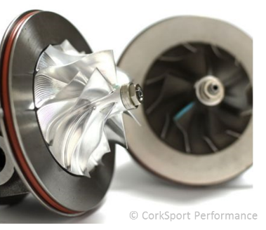
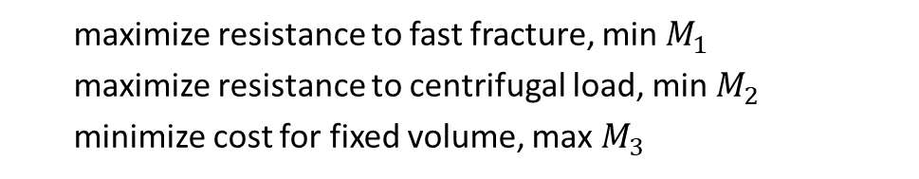
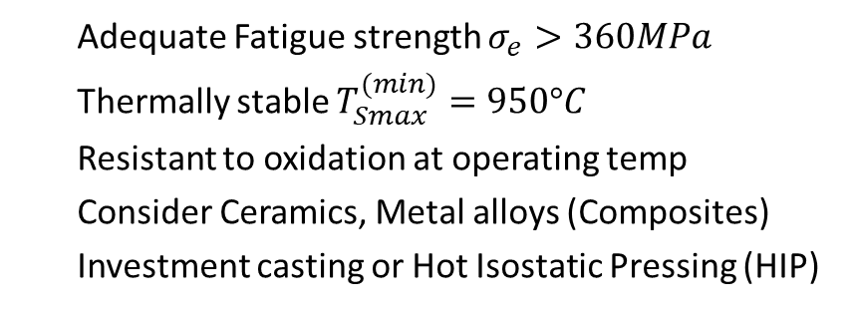

Radial turbine blades (turbochargers): Safety and cost
Function:
Rotating blade
Fixed blade length
Strength-limited design
Angular velocity free variable
Constraints:
  Adequate Fatigue strength $σ_{e}>360MPa$
  Thermally stable $T_{Smax}^{(min)}=950°C$
  Resistant to oxidation at operating temp
  Consider Ceramics, Metal alloys (Composites)
  Investment casting or Hot Isostatic Pressing (HIP)
Reference material: Inconel 713L
Objectives:
  maximize resistance to fast fracture, min $M_{1}$
  maximize resistance to centrifugal load, min $M_{2}$
  minimize cost for fixed volume, max $M_{3}$
$$M_{1}=\frac{ρ}{K_{IC}},M_{2}=\frac{ρ}{σ_{e}} ,M_{3}=\frac{1}{ρC}$$
Notes:
Selection for turbine blades
This is an example of materials selection for radial blades of turbochargers.
The power to weight ratio for engines is particularly important for high-performance automotive and aerospace applications.
The power of a piston engine is directly dependent upon the injected amount of air. The purpose of turbo-supercharging is to increase the inlet manifold pressure and density so as to increase the mass of air ingested into the cylinders during each intake stroke.
A turbocharger is a single-stage radialflow ("centrifugal") air compressor, which is driven by a single-stage radial-flow turbine.
This has been widely used in automotive engines since the 1970’s. Turboprop airplane engines can also have radial flow turbines while turbine jet engines have several types of axial-flow blades, operating at different temperatures: fan blades (low), compressor blades (midrange) and turbine blades (high temperatures).
All these technologies deliver high power to weight ratio and involve challenges to the design and material choices of turbine blades.

Slide 10
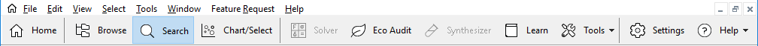
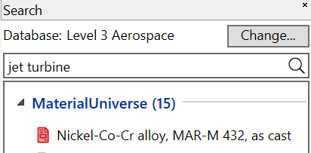
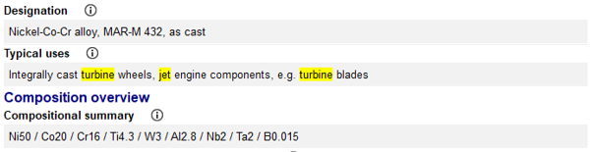
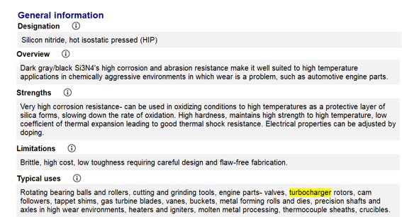
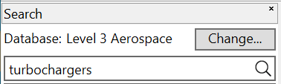
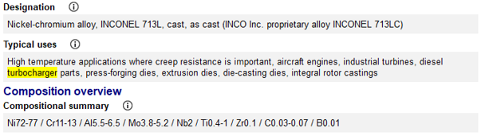
Which are the high-temperature candidates?
Notes:
Starting point
In order to find a good starting point and have some reference materials to benchmark, we can search e.g., “Jet turbine” and “Turbocharger”
Jet turbine results in some Ni-Co-Cr alloys, such as Mar-M 432 whereas Turbochargers results in Silicon nitride (HIP) and the Ni-Cr based alloy Inconel 713 (L)

Slide 11
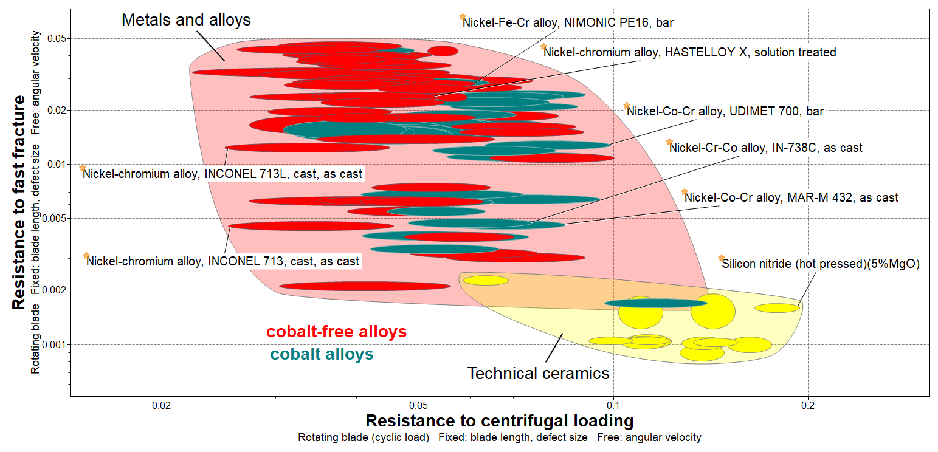
Demo: Radial turbine blades (turbochargers, 950°C)
Notes:
Damage tolerant design
This is the result from running this exercise in EduPack Aerospace database
Alloys containing cobalt have been coloured (teal) so that we can better identify them

Slide 12
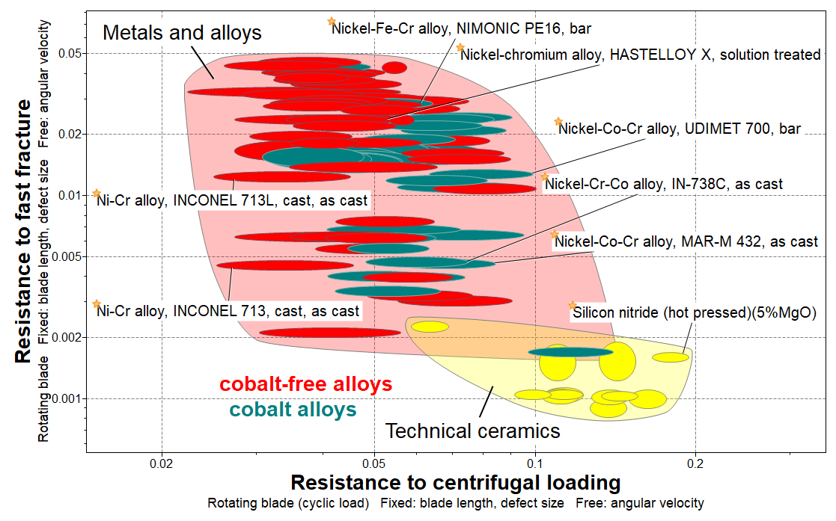
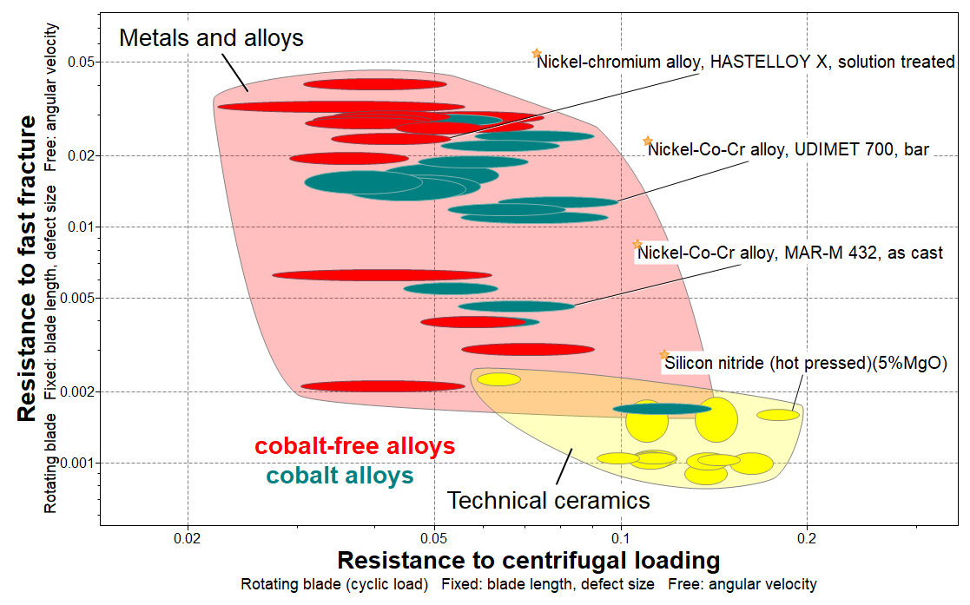
Radial turbine blades (turbochargers) at elevated temperatures
950°C
1100°C
Notes:
High-temperature materials
What changes if we increase the temperature to 1,100 °C?
As can be seen in the chart to the right, quite few cobalt-free alloys have disappeared, including our original Inconel 713L.
Mar-M 432 is actually often used for turbocharger when temperatures are higher than 950 °C.

Slide 13
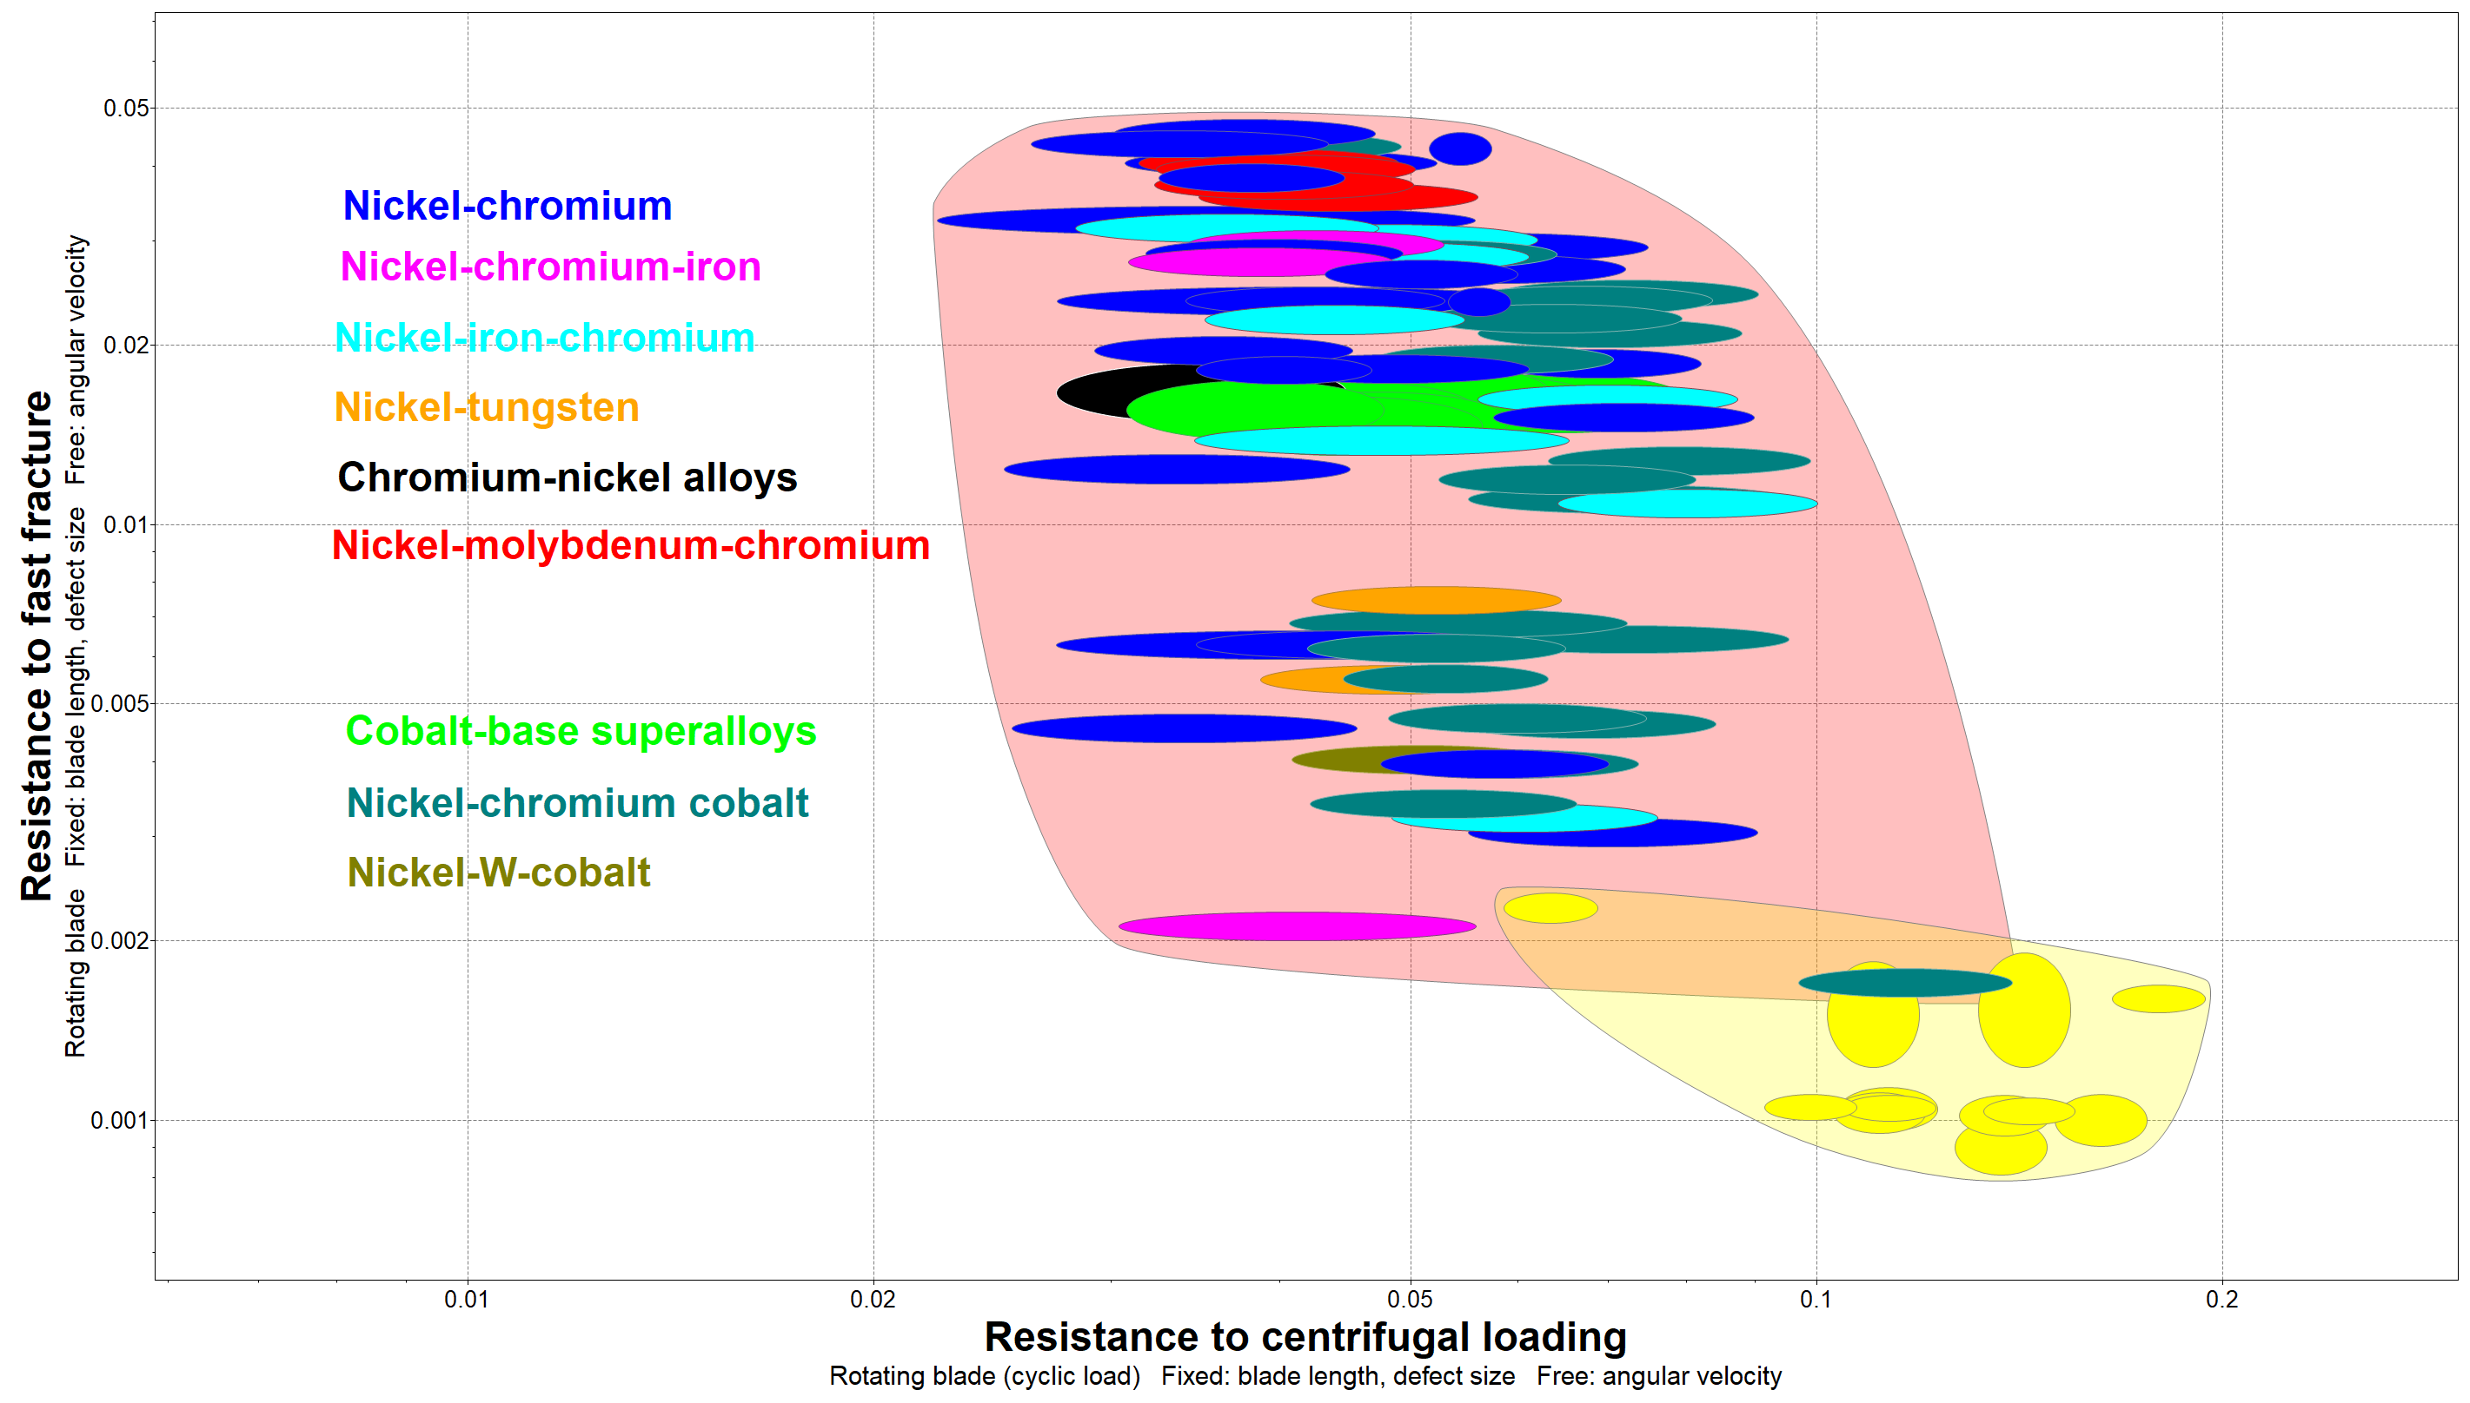
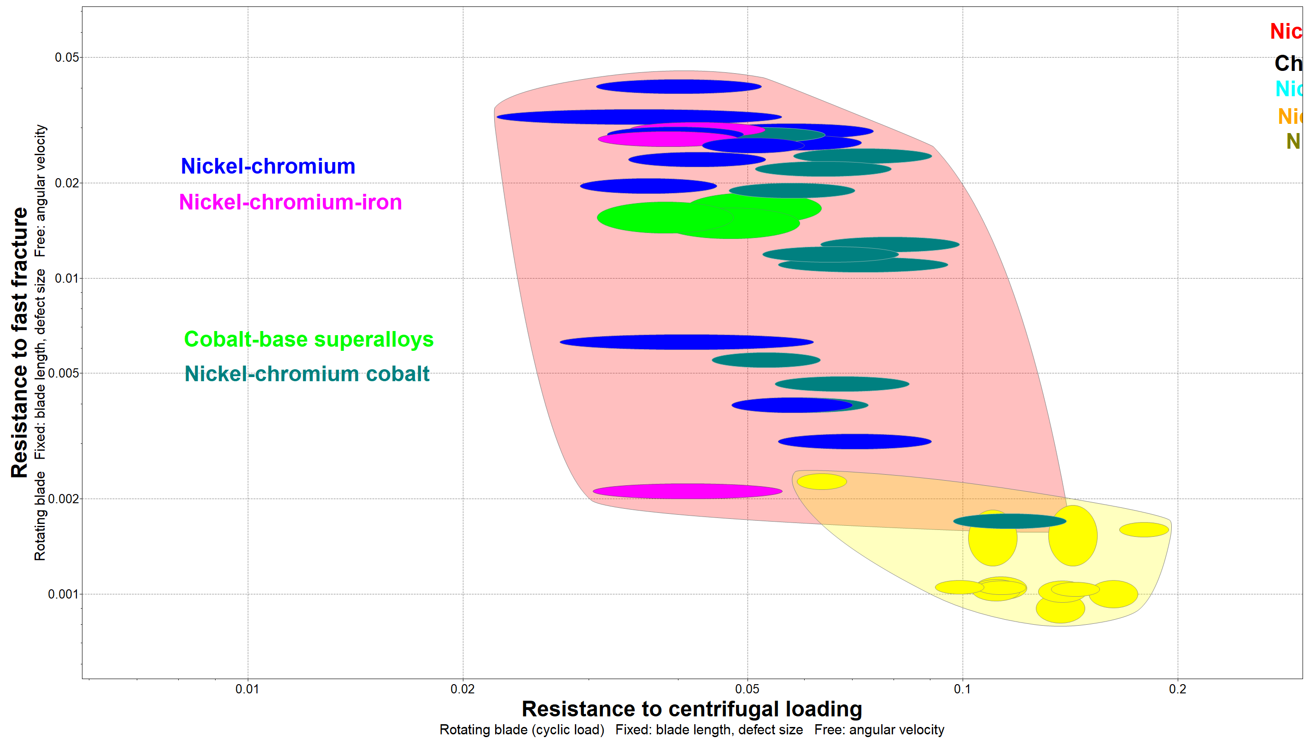

Radial turbine blades (turbochargers, 950°C vs 1100°C)
950°C
1100°C
Notes:
High-temperature materials
This is the same chart shown in the previous slide, but with a bit more level of detail in terms of composition
EduPack allows the user to customize charts to visually present results in the best way possible.
Nickel-tungsten, Chromium-Nickel, Nickel-molybdenum-chromium and Nickel-W-cobalt have disappeared at 1100°C

Slide 14
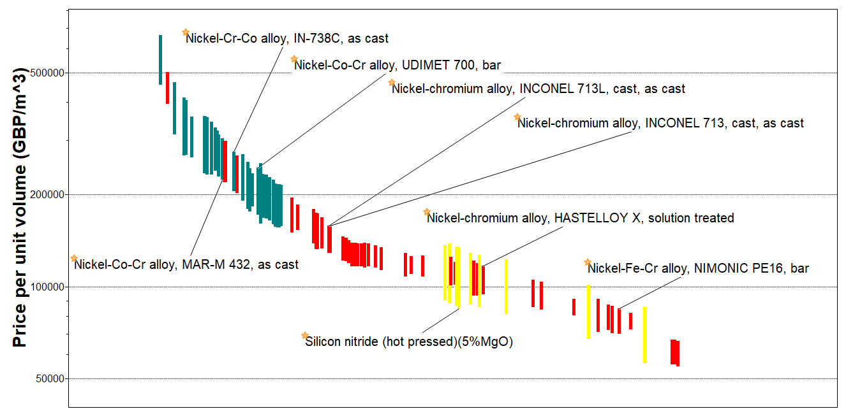
Price overview of high-temperature aerospace materials
Notes:
Cost overview
The third materials performance index explored concerns minimizing cost per unit volume
EduPack allows to make material selection or comparison based on cost. The data is updated once per year
Here we can see that Cobalt-alloys are generally more expensive than other superalloys and ceramics.

Slide 15
Visualizing and selecting based on eco-data
Notes:
Eco data overview
This chart, prepared at level 2, shows that it is also possible to visualize and select based on eco-data with EduPack
Here carbon emissions per kg of virgin material during primary productions
Eco data is a good starting point to introduce engineering students to eco-design and sustainable development thinking

Slide 16
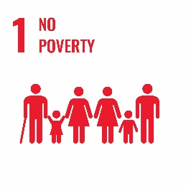
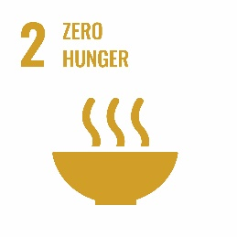

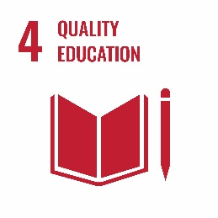
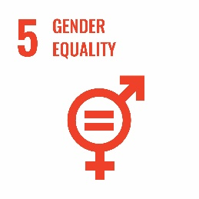

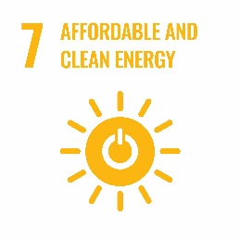
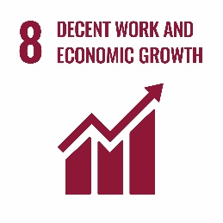
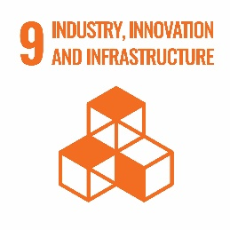
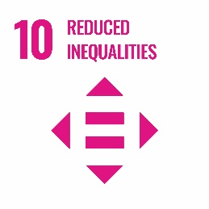
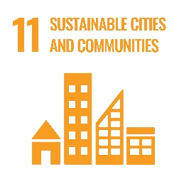
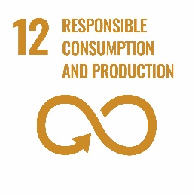
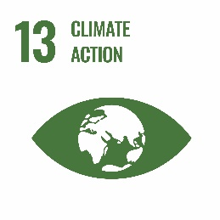
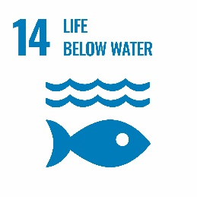
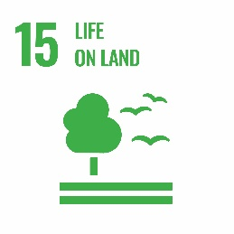

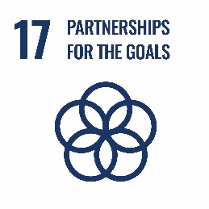
The UN Sustainable Development Goals (SDGs)
“Sustainable development is development that meets the needs of the present without compromising the ability of future generations to meet their own needs”
Report of the Brundtland commission of the UN, 1987
Notes:
Sustainable Development
As already seen, EduPack can guide decisions beyond mechanical performance
This is important for the engineers of the future, as can be seen in the global sustainability goals by the UN
There are social and economic aspects, as well as urgent environmental issues to consider

Slide 17



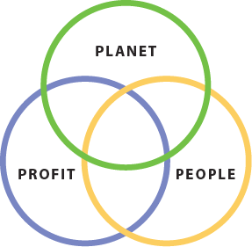
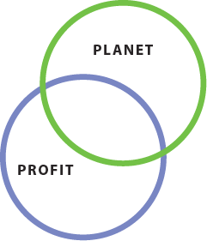
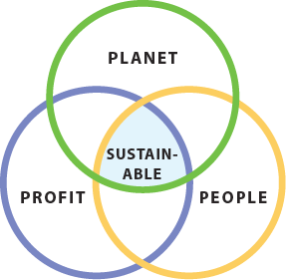
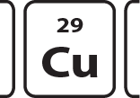




Granta EduPack sustainable development database
Natural
capital
_{Power}
_{Sources}
_{Energy}
_{Storage}
_{Elements}
_{Materials}
_{Data}
_{Processes}
_{Nations}
_{Society}
_{Legislation}
_{Regulations}
Manufactured
capital
Human and Social capital
Notes:
Suastainability in EduPack
There is a database available in Granta EduPack 2020 that is capable of contributing in all the three aspects of sustainability
These are sometimes referred to as the three P:s – People, Profit and Planet, which correspond to three types of global assets
The sustainability database has the standard engineering materials and manufacturing processes but also contain some additional ones
In this case study, the elements and the nations of the world subsets are showcased, that both are relevant to superalloys

Slide 18



Critical materials and elements
How do materials interact with geopolitics?
1) Import dependent countries strive to secure an adequate and affordable supply
2) Resource rich countries strive to secure adequate incomes from their resources
Definition (EduPack). A critical material is one that is of strategic importance in the economy or in defence procurement, is subject to supply risks and for which there are no easy substitutes. A critical element is an element that has the same constraints.
https://suscritmat.eu/geopolitical-aspects/
https://www.cobaltinstitute.org/
1970s:
energy
and material scarcity
1980s –
Tech revolution,
Climate threat, Resource nationalism
WWI: materials wins war
WWII: haves/ have nots
1950s:
sell more, sell fast
1960s:
environmental concerns grow
20th century timeline
Notes:
Critical Elements
Let’s first introduce the concept of critical materials and critical elements, which relates to resources
As can be seen, it pertains to scarce or strategic materials that are difficult to substitute
Granta has been part of a network over the past few years that deals with Sustainable Critical Materials aspects
There are a number of good educational resources, including some of ours, in the SusCritMat website
The timeline at the bottom represents how materials were very important during world war 1 and 2.
Some resources have become increasingly scarce and strategic, today, rare-earth metals for example
We will have a closer look at Cobalt, which is part of some of the most important superalloys
Co has been the topic for controversy, as seen in TV programs from BBC and others about working conditions, child labour etc.

Slide 19


Demo: Materials data for Nickel-Cobalt-Alloy
Notes:
Exploring material composition
The sustainability Level 3 database can be searched for MAR, for example
The composition shows: Ni 50%, Co 20% for Nickel-Co-Cr alloy MAR-M 432, as cast
There is Critical materials risk, as can be seen within the Geo-economic data for principal component (Nickel)
There is also a warning: toxicity of Ni, and further links to Elements and Nations of the world
Since we are interested in Cobalt, the Elements link can be explored

Slide 20


Cobalt eco-profile
Notes:
Critical Elements
We can see that Congo (Democratic republic of) is dominating production of this resource
It is on both the US and the EU critical list (partly for this reason)
At the bottom, there is a link to Nations of the world that mine this element

Slide 21


Cobalt main mining areas
https://www.cobaltinstitute.org/superalloys.html
Notes:
Social Sustainability
In this database, there is data on more or less all nations of the world, with data from official statistics, such as UN and the world bank
We can now see if there are problems with sourcing materials from this country
Thinking back to the UN sustainability goals, we see that there are several problems in the Human rights and good governance section
Very low levels of political stability, rule of law and control of corruption as well as ongoing conflict
To find out about serious suppliers, recycling efforts and ongoing work to improve the situation, the cobalt institute has good information to balance the negative reputation.

Slide 22




Jet Engine material mapping, from NASA Tech Brief
S. Arnold et al., Materials Selection for Aerospace System, NASA Tech Memorandum 2012-217411
www.grantadesign.com/teachingresource/case-studies
Notes:
Reality check
The NASA Tech Brief, shows a more detailed overview of high-temperature materials
In addition to nickle-based superalloys, Silicon Nitride may be useful, as discussed in our previous case study (top)
More case studies are found on the Education Hub

Slide 23

Join the Ansys conversation!
Read and comment.
Find the Ansys blog: ansys.com/blog

