Slide 1
Quarterly Case Study Session
Presented September 2019
Industrial Case Study:
Material Properties and Structural Sections-Architecture meets Engineering
Claes Fredriksson, David Mercier, Harriet Parnell
Ansys Materials Education Division

Slide 2



Agenda
Introduction
Structural Section Case Study
  Architecture meets Engineering
  The Structural Sections Data-table
  Shape Factors and Load
  Revised Performance Index
  Selector Engineering Solver
  Finite Element Simulations
Q&A
Community Update
Claes Fredriksson, David Mercier and Harriet Parnell from the Ansys Materials Education Team
Notes:
Agenda
We will start with a background to structural sections in the built environment and the content of our specialized data-table for structural sections
Then we will look at the relationship between shape and material relevant for structural sections
We will then see how to derive a performance index that takes shape into account and show some examples
Finally, we will look at how the systematic material selection methodology complements finite element simulations

Slide 3
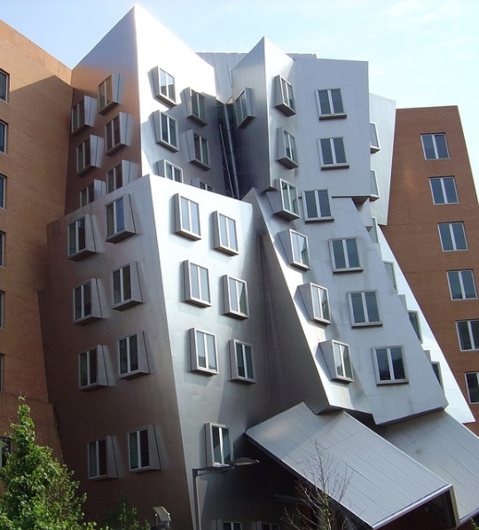
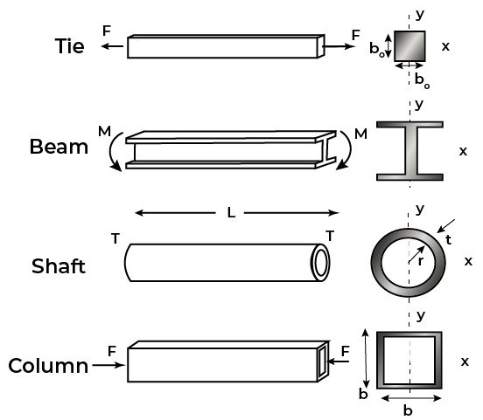
Architecture meets Engineering
The Stata Center, MIT (Cambridge MA), Concrete Structure (before) and Façade (after).
Notes:
The built environment
Structural sections are a design case where architecture meets engineering for the built environment.
Their application is connected to safety in buildings as well as minimizing material use and ultimately cost.
Materials used for structural support, such as in buildings and general construction, rely heavily on their shape.
The cross-section determines how effective the material is at fulfilling its structural function (e.g., supporting loads during bending)
Modern buildings are dependent on beams and columns and their shape are as important as the material properties themselves
We can see some examples of structural sections for different purposes here: Ties for tensile stress, Beams for bending, Shafts for torque and Columns for compression.

Slide 4
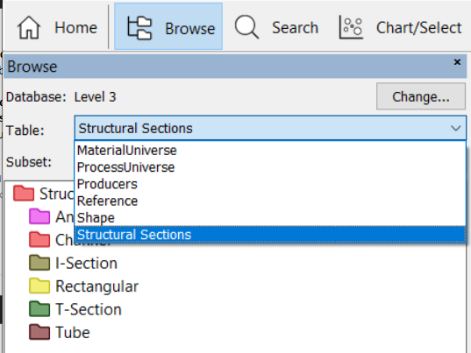
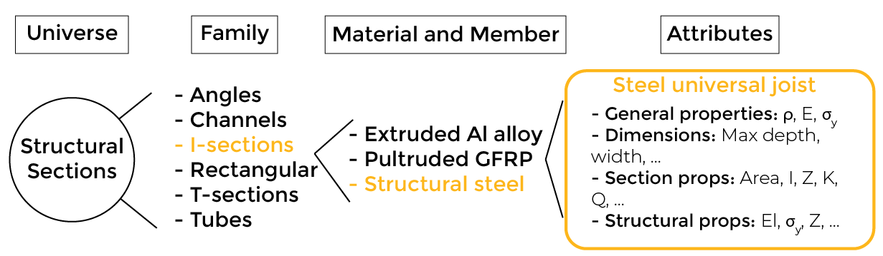
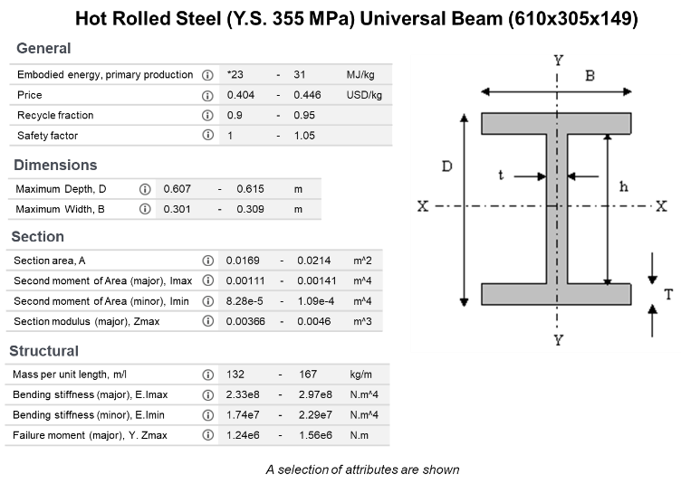
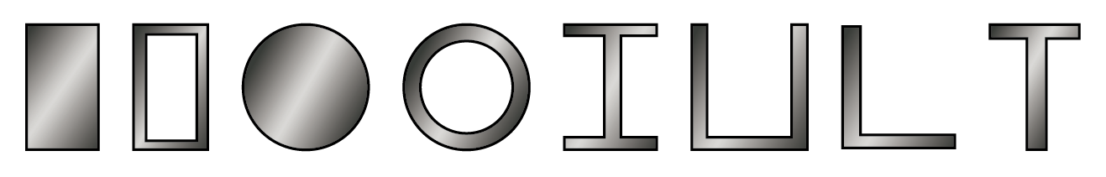
The Structural Sections Data-Table
Notes:
Materials for buildings
In Granta EduPack, there are a number of standard sections available, that all have their merits in terms of structural efficiency.
This reflects how well they perform in carrying loads compared to, say, a solid square beam as a reference.
There are nearly 2000 standard structural sections for selected materials available in a separate data-table
The data organization is in the same “Tree” style as the MaterialUniverse and ProcessUniverse.
The first level of the tree – the families – refers to shape. The second level is the material – we include only four for which standard sections are widely available.
Some attributes in the structural sections datasheet reflect material properties, such as Price ($/kg) or Yield strength, σ_{y} (MPa),
These can be plotted in charts in the usual way. However, most properties are specific to the structural section of the datasheet, Second moment of area etc.

Slide 5
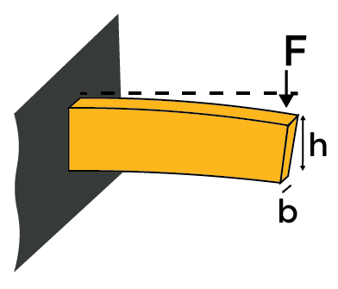
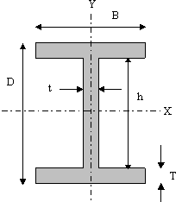
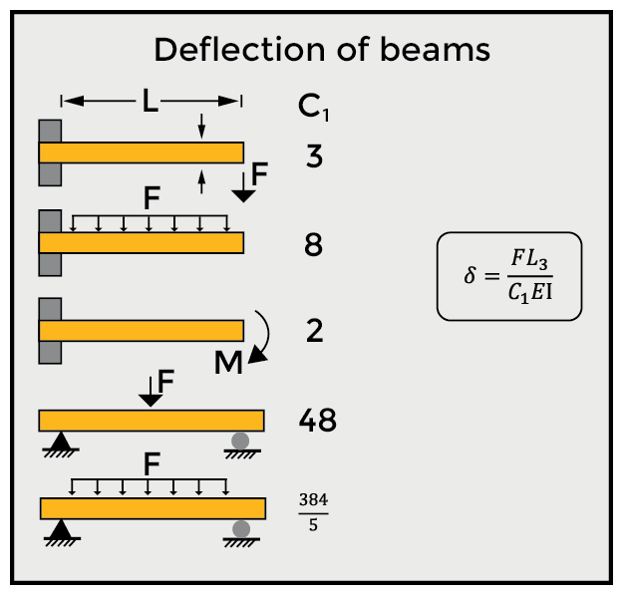
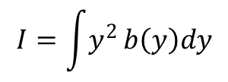
Structural Sections Loaded in Bending
Beams in bending is a universal use-case
I reflects the cross-section shape
$$I=\int{y^{2}}b\left(y\right)dy$$
Some useful definitions
A = cross-section area F = point force δ = deflection S = stiffness (F/δ) | E = Young’s modulus I = second moment of area C = constant (here, 3) This beam: δ = FL³/CEI= 12FL³/CEA
Notes:
Bending and compression
Two of the most important situations for structural sections in buildings are compressive load and bending in various forms.
One simple example is a cantilever, which is a fixed-end beam loaded in bending by vertical forces, as shown in the picture.
Strength is important, of course, but stiffness is the key performance-limiting property. The less deformation in a building (e.g., floor joists), the better it is.
In the summary to the left, you can see that the only factor which differs between these different loads is the constant (C₁) so it is a useful case for both point loads and distributed loads (and combinations thereof) on the beam.
This constant will not affect the selection outcome using material property charts, so the example is very general
We also note that a column in compression behaves similar to a beam in bending, for a stiffness-limited design, since it is prone to buckling at critical deflections (Euler)

Slide 6
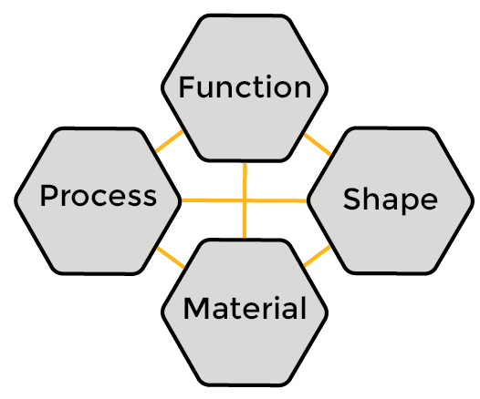
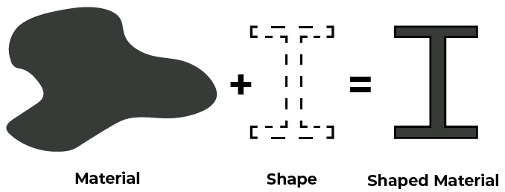
Materials and Shape
Charts of structural sections depend both on material properties and shape!
Notes:
Materials and shape
We usually assume that a main function can be identified and separated in the material selection (e.g. beam in bending)
So, a chart of pure material properties can normally be used to rank the options with respect to their performance objective.
This requires that the cross section shape is fixed (e.g. a square) and that a free design parameter, such as area, has been eliminated from the performance index, to be determined later.
But in the case of plotting the structural sections, the shape and size are not fixed but will influence the property chart
It is possible to use a limit stage to remove unsuitable sections in screening but difficult to make a decision about which one has the best performance, using such a chart. The shape factor, representing structural efficiency, must be taken into account.
Structural efficiency is obtained by combining material with macroscopic shape. While a material itself can be considered to have properties, it has no intrinsic shape. A structure, or a structural section, is a material made into a shape.
Shape factors are measures of the efficiency of material usage for a specific load case, such as bending.

Slide 7
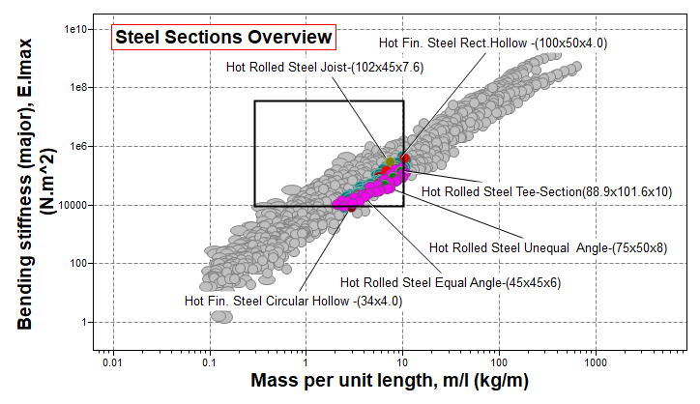
Overview of steel structure properties
Properties of all steel structural sections
Sections can be screened as usual
Wood rectangular sections (planks) have surprisingly attractive properties
Notes:
Overview (demo)
In the Browse mode, you can see a data-table of Structural Sections (not part of MaterialUniverse) and find, e.g., datasheet of a steel I-bar.
If you want to plot charts with structural sections, you need to select them as a custom subset under the Chart/Select button
It is then easy to plot overview charts of interesting properties, e.g., Bending stiffnes (in the major direction) vs Mass/length (not density)
It is possible to focus on certain materials (via tree) and to screen based on properties (limit)

Slide 8
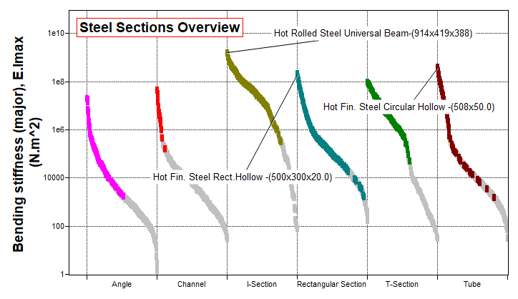
Bending stiffness per shape (all steel)
Re-define the X-axis:
Notes:
Structural section overview
Here is an alternative view, limited to steel and divided into shapes via the advanced > tree feature of the Chart stage

Slide 9
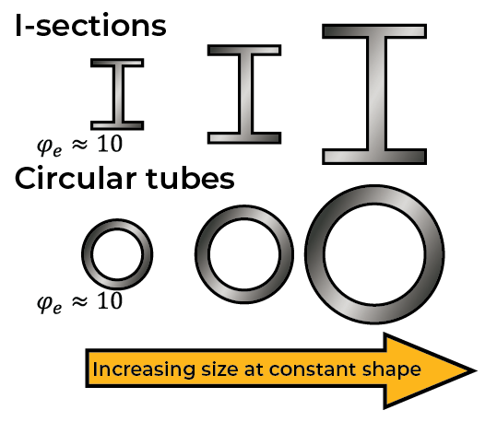
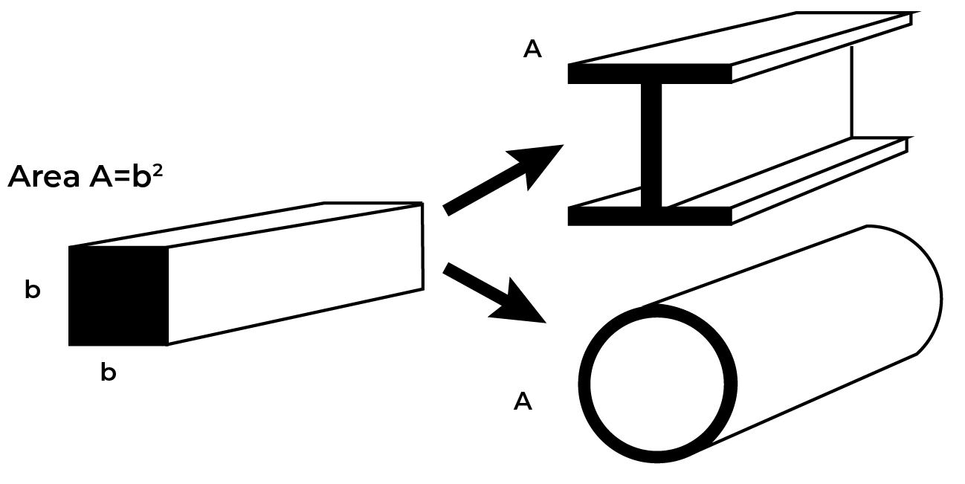
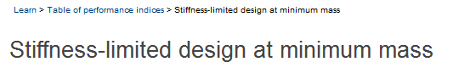
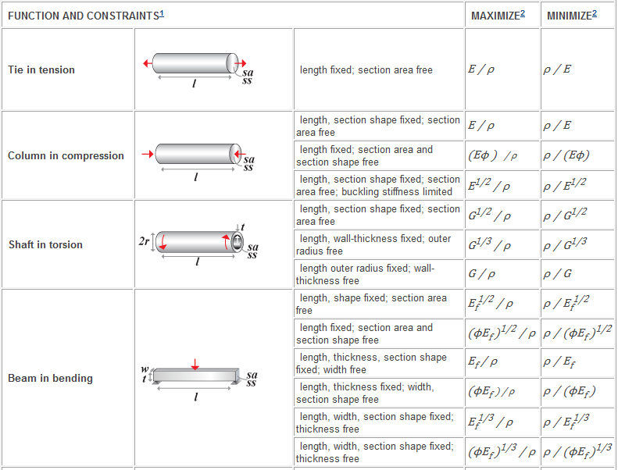


What does the shape factor mean
$$I_{o}=\frac{b^{4}}{12}=\frac{A^{2}}{12}$$
$$φ_{e}=\frac{S}{S_{o}}=\frac{EI}{EI_{o}}=12\frac{I}{A^{2}}$$
Shape factor:
ϕ_{e}=1
I-sections,
Circular tubes,
Notes:
How to handle shape factors
The parameter that reflects the relevant distribution of material in the cross-section is the second moment of the area
For a solid square beam, this is A²/12. This represents the reference shape factor, ϕ_{e}=1.
The elastic shape factor for stiffness in bending of any structural section is defined as the ratio: $φ_{e}=\frac{S}{S_{o}}=\frac{EI}{EI_{o}}=12\frac{I}{A^{2}}$ , where S is called the bending stiffness
It turns out that a solid circular beam of the same cross-section area as the square beam has nearly the same shape factor, ϕ_{e}=0.96.
If the same cross-section area is used in a hollow tube or an I-beam, instead of a square beam, it is around 10 times more efficient in bending stiffness.
A linear scaling of size does not affect the shape factor
By using the definition of ϕ_{e} and the values of I and A for the individual sections in the data-table, it is possible to plot an overview of shape factors

Slide 10
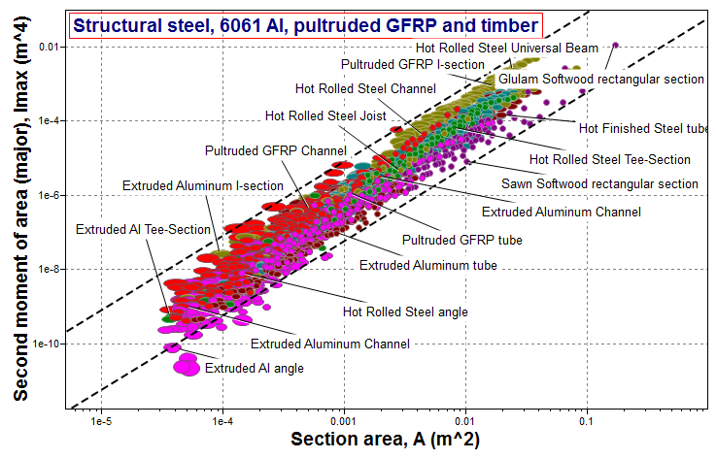
The range of shape factors
Notes:
Shape factor overview
We can use the logarithmic axis scale properties to visualize the shape factors of the structural sections
Starting with the expression for the elastic shape factor from the previous page, we can plot Imax vs ϕ_{e} on logarithmic axes.
The display lines show that these structural sections mainly have values between 1 and 100 for the shape factor

Slide 11
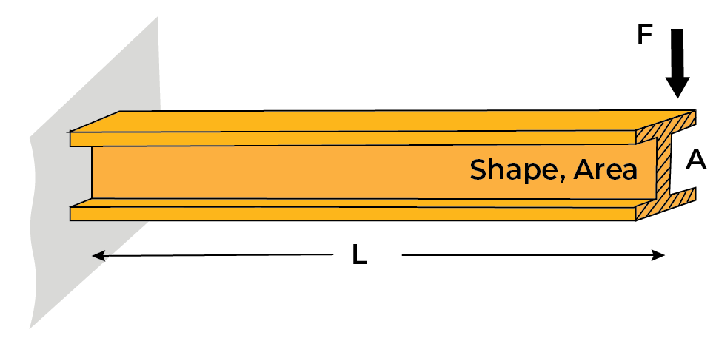
Performance Index that includes shape
Beam (shaped section).
Function
Constraint
Bending stiffness < S*
I is the second moment of area:
I
m = mass
A = area
L = length
S = stiffness
I = second moment of area
E = Youngs Modulus
A
Objective
Minimize mass, m, where:
Chose materials with smallest
Notes:
Derivation of shape-dependent performance index
The derivation here parallels that for a light stiff beam in bending. The only difference is that, for the square beam. The only difference is that for a shaped beam, the area expression will include the shape factor (derived from I = φ_{e} A²/12).
So that when we minimize the mass, we can substitute the are with an expression that contains the shape factor.
The resulting equation for the metric, m, shows how the mass of the beam depends on the mechanical constraint it must meet (S) on the section shape (φ_{e} ) and on the material of which it’s made (ρ/E^{1/2}). The quantity ρ /(φ_{e} E)^{1/2} can be thought as a “shaped-material index”.

Slide 12
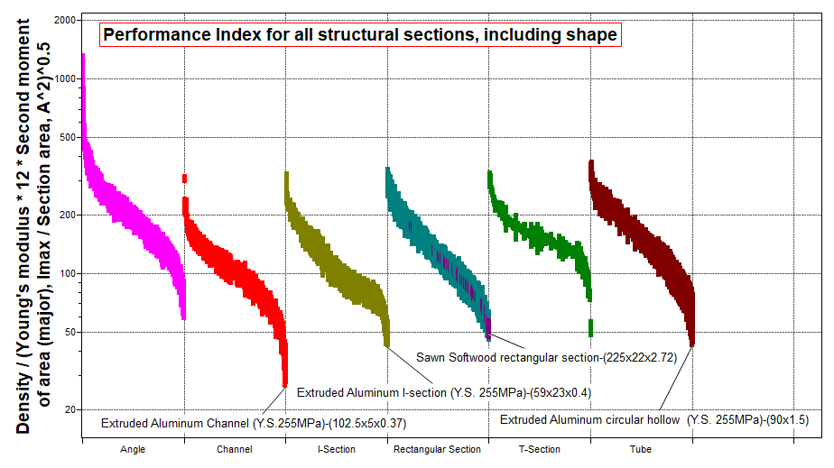
Material Selection Including Shape
Notes:
Using the revised Performance Index
It is now possible to rank and select materials for a structural section in bending using the revised performance index
Now, the shape factor is not one of the explicit attributes in the structural section data‑table, so it becomes somewhat indirect to express the actual shape factor for each individual record.
In the advanced option of the Chart stage, however, we can enter an expression for the full revised performance index to minimize.
The results, here by section type, show that Extruded Al and softwood planks are performing the best in this overview.

Slide 13
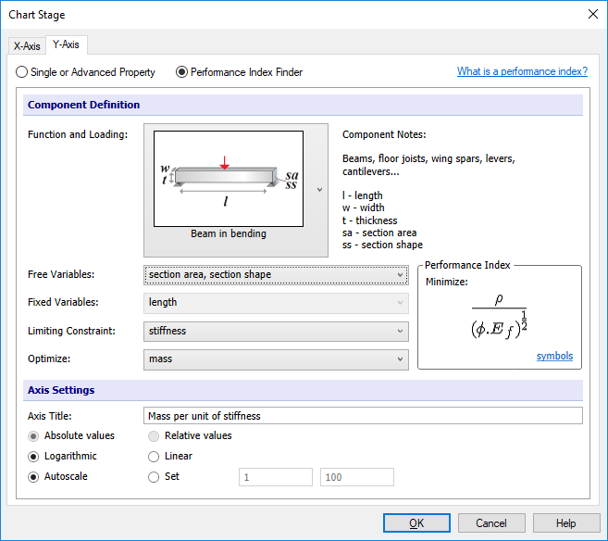
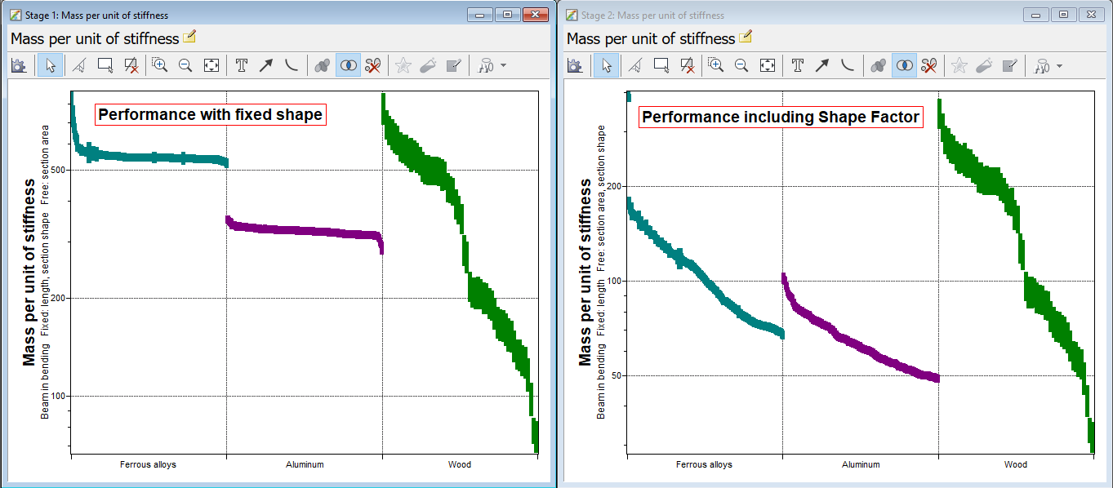
Shape Factors for Optimal Selection
Material (from Ashby) | Steels | Aluminum alloys | GFRP and CFRP | Unreinforced polymers | Wood
Max ϕ_{e} (Φ in CES) | 65 | 44 | 39 | 12 | 5
Max ϕ_{f} | 13 | 10 | 9 | 5 | 3
Notes:
MaterialUniverse selection
In the MaterialUniverse of Granta EduPack, selection is done by using an optimal elastic shape factor, Φ, listed in the datasheet of properties .
This shape factor is not considered a material property but, in our context, it provides an approximate value for the maximum shape factor for each material before localized buckling (relevant for a beam in bending).
Tile vertically charts with the performance index finder for beams in bending
Results from the MaterialUniverse show that woods (planks) give the best performance for a beam in bending in both cases
Al and steel show dramatic relative improvements in performance if the cross-section is optimized, since they can be made into I-beams and other very efficient hollow shapes

Slide 14
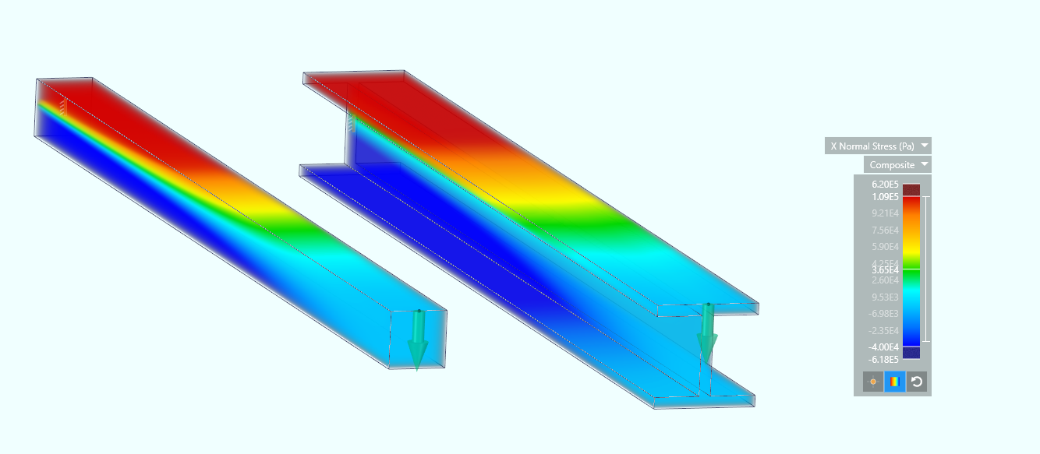
Finite Element Simulations
Can estimate the deflection caused by certain load
Map the stress within the geometry caused by this load
Provided the necessary material properties are given
Simulation of stress in beams (same area) for fixed material choice Ansys Discovery Live
Opportunity: Using Granta EduPack to screen and select top material candidates in combination with Finite Element simulation to optimize geometry, engineers and designers can reduce the number of material candidates to consider in structural design.
Notes:
FE Simulations
Can estimate the deflection caused by certain load
Map the stress within the geometry caused by this load, provided the necessary material properties are given
Using Granta EduPack to screen and select top material candidates in combination with Finite Element simulation to optimize geometry, engineers and designers can reduce the number of material candidates to consider in structural design

Slide 15
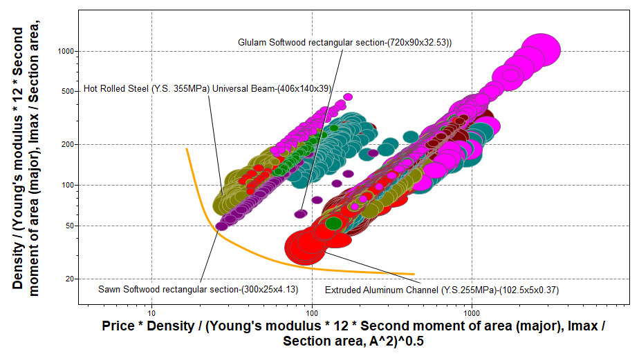

Material Selection and Simulation
For the design engineer, screening based on material properties, ranking by material-shape performance index and FE simulations to fix dimensions are complementary:
Performance Index Selection
Top candidates after screening
FE simulation of stress and deflection
Optimized geometries
Trade off curves for compromises
Equal performance candidates
Cost, Eco-properties, Durability, ...
Free design parameters
Von Mises stress maps
Deflection estimates
Notes:
Material selection generates synergy with structural simulations (Claes)
For the design engineer, screening based on material properties, ranking by material-shape performance index and FE simulations to fix dimensions are complementary
The output from Granta EduPack enables: Trade off curves for compromises, Equal performance candidates and enables to consider Cost, Eco-properties, Durability etc
The output from a FE Simulation gives: Free design parameters, Von Mises stress maps, Deflection estimates

Slide 16
Conclusions
The Structural Sections data-table in Level 3 and Level 2 Architecture
Shape factors and Revised Performance Index
The systematic material selection methodology generates significant synergy with structural simulations
Notes:
Conclusions
The Structural Sections data-table in Level 3 and Level 2 Architecture
Shape factors and Revised Performance Index
The systematic material selection methodology generates significant synergy with structural simulations

