Slide 1
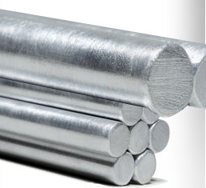
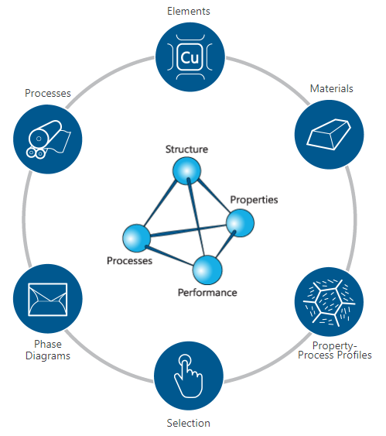
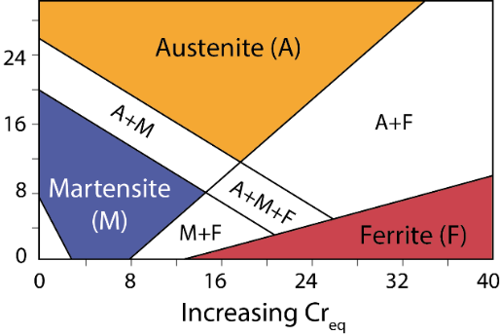
Quarterly Case Study Session
Presented March 2019
Structure and Properties
- The Science and Engineering of Stainless Steel
Claes Fredriksson and Harriet Parnell
Ansys Materials Education Division
Notes:
Introduction
This Case Study Session, which is based on one of our Industrial Case Studies for Granta EduPack.
This is our seventh quarterly online training session for EduPack users, today’s topic is Structure and Property relationships, focusing on Stainless Steels
It is a bit different than the previous ones because we have made a simplified case study (2 page) and use the new MS&E database, which is at an introductory level

Slide 2


Agenda
Introduction
Industrial Case Study
  Materials Science and Engineering
  Stainless Steels
  The Phase Diagram Tool
  Crystal structures
  Alloying systems
  Structure - properties
Claes Fredriksson and Harriet Parnell
Ansys Materials Education Division
Notes:
Agenda
We will start with a background to the case study and the content of our databases relating to stainless steels
Then we will be showing how you can use Granta EduPack to understand the phases and microstructures of stainless steel types
Finally, we will look at how properties are affected by these structures due to alloying and strengthening

Slide 3
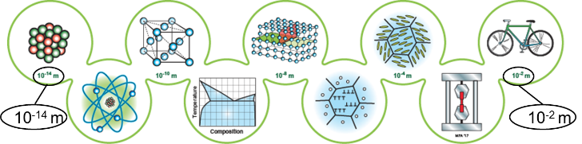
Materials Science and Engineering
Structure and properties
Science-driven approach
Design-driven approach
Notes:
MS&E background
Materials educators around the world have a wide mixture of backgrounds
Materials courses in mechanical engineering programs, for instance, are taught in a variety of ways
It therefore makes sense to treat this diverse subject area jointly as Materials Science and Engineering,
Without excluding either theoretical or applied aspects
This is the idea behind the new materials science and engineering edition and the database with the same name

Slide 4
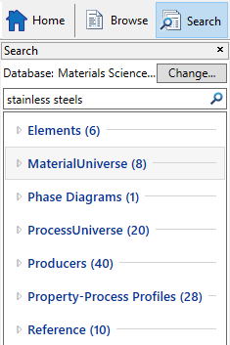
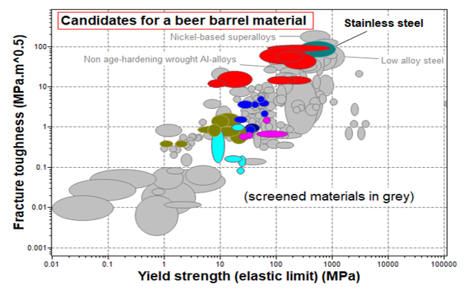
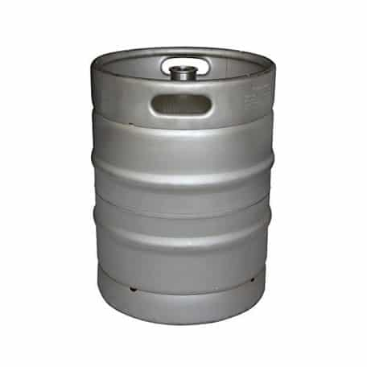
Stainless Steels
Stainless steel is one of the many vital materials that can be investigated using Granta EduPack and the MS&E database. Although carbon steel is by far the most common engineering metal, many ferrous alloys are prone to corrosion by rust etc. Therefore, if you want a robust material which will be in contact with liquids, say a beer barrel, this is a problem.
Notes:
Barrel case
Here, we are focussing on stainless steel, which are/is a pretty common material used in many products.
Although carbon steel is by far the most common engineering material, stainless steels are particularly useful as they resist corrosion and staining by rust.
An interesting example which we have used within our case study, is for beer barrels within the food and drink industry.
Transported from brewery to a pub/ bar, the container needs to be made of a robust material that doesn’t damage that easily.
Within the MS&E database you can find general information on stainless steels and, by considering some of the design requirements for a beer barrel, it is easy to make a property chart.
It has a definition and composition of the material. Note the excellent durability to water and other liquids. At the bottom it has Design guidelines and typical uses.
If you want a material for a beer barrel, you can plot an overview of relevant properties:
Fracture toughness and yield strength are connected to mechanical integrity and safety
You can screen for excellent durability to water and alcohol, probably also a price below, say $10/kg
Stainless steel is the top candidate for this application

Slide 5
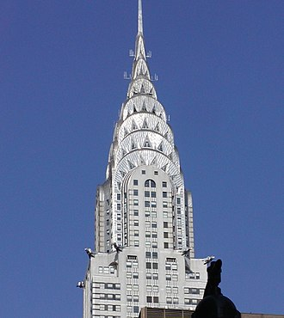
Background and use of stainless steel
Carbon steels are made highly resistant to corrosion primarily by adding 11-12% (or more) of chromium as an alloying element.
Nickel and molybdenum are other elements that also enhance corrosion resistance.
The corrosion resistance of iron-chromium alloys has been known for around 200 years, recognized by e.g, the French metallurgist Pierre Berthier, who suggested their use in cutlery.
The first patent of what we now call Stainless steel, a “Water Resistant Alloy”, was filed in Britain 1872 by John T. Woods and John Clark.
Notes:
Background+history
Carbon steels are made highly resistant to corrosion primarily by adding 11-12% (or more) of chromium as an alloying element.
The corrosion resistance of iron-chromium alloys has been known for around 200 years, recognized by e.g, the French metallurgist Pierre Berthier, who suggested their use in cutlery.
The first patent of what we now call Stainless steel, a “Water Resistant Alloy”, was filed in Britain 1872 by John T. Woods and John Clark.
The Chrysler Building in New York uses stainless steel extensively in its design, an austenitic alloy developed in Germany. It was the first major use of this "18-8 stainless steel”, composed of 18% chromium and 8% nickel.
Nirosta was used in the exterior ornaments, the window frames, the crown, and the needle. The steel was an integral part of the architect William Van Alen's design.
Stainless steel producers used the Chrysler Building to evaluate the durability of the product in architecture.
In 1929, the American Society for Testing Materials (ASTM) created an inspection committee to study the performance of the Chrysler Building and they examined the building's panels every five years until 1960.
The inspections were then cancelled because the panels had shown minimal deterioration.

Slide 6
Four types of Stainless Steels
The material
Stainless steels are alloys of iron with chromium, nickel, and - often - four of five other elements. The alloying changes plain carbon steel, from a material that would rust and is prone to brittleness below room temperature, into a material that does neither. Indeed, most stainless steels resist corrosion in most normal environments, and they remain ductile to the lowest of temperatures too.
Composition (summary)
Fe/<0.25C/16 - 30Cr/3.5 - 37Ni/<10Mn + Si,P,S (+N for 200 series)
Technical notes
Stainless steels can be classified into four categories:
the 400 series ferritic (Fe-Cr) alloys,
the 200 and 300 series austenitic (Fe-Cr-Ni-Mn) alloys,
the martensitic (Fe-Cr-C) alloys that also form part of the 400 series
the precipitation hardening or PH (Fe-Cr-Ni-Cu-Nb) alloys
Notes:
Definitions
In the datasheet, there is also Technical notes that contain definitions of four major types of stainless steel
The importance of microstructure is apparent in their names, three of them are named directly by crystal structure; ferritic, austenitic and martensitic stainless steels
the 400 series ferritic (Fe-Cr) alloys,
the 200 and 300 series austenitic (Fe-Cr-Ni-Mn) alloys,
the martensitic (Fe-Cr-C) alloys that also form part of the 400 series
the precipitation hardening or PH (Fe-Cr-Ni-Cu-Nb) alloys with designations starting with S

Slide 7
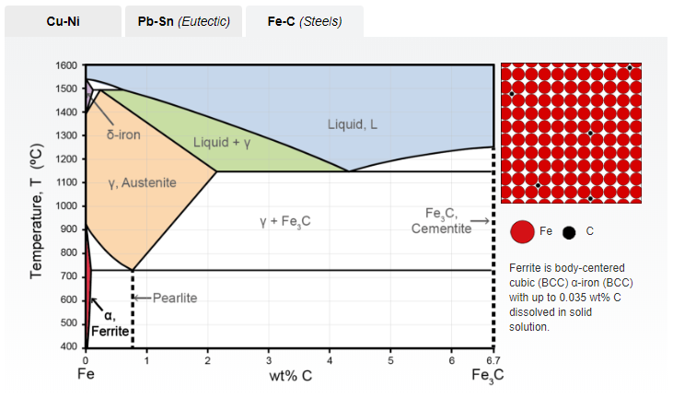
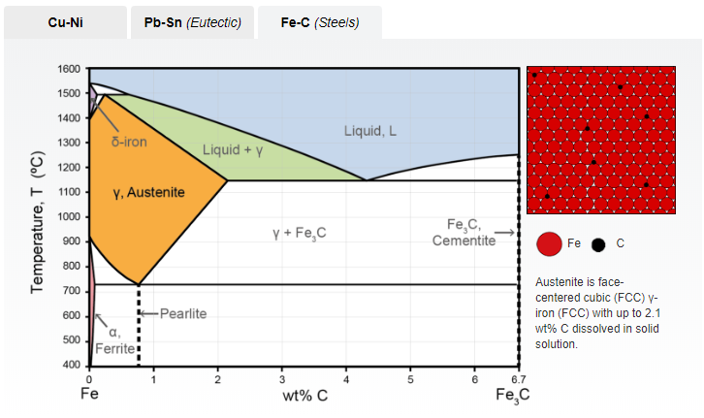
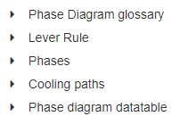
The Phase Diagram Tool
Ferritic alloys have the microstructure of low carbon steels at room temperature
Austenitic alloys have the microstructure of carbon steels at elevated temperatures >700°C
Notes:
Phase diagrams
Starting to explore the phases a bit further, we can use the Phase Diagram Tool for Iron-carbon systems
Ferritic alloys have the microstructure of low carbon steels at room temperature
Austenitic alloys have the microstructure of carbon steels at elevated temperatures >700°C

Slide 8
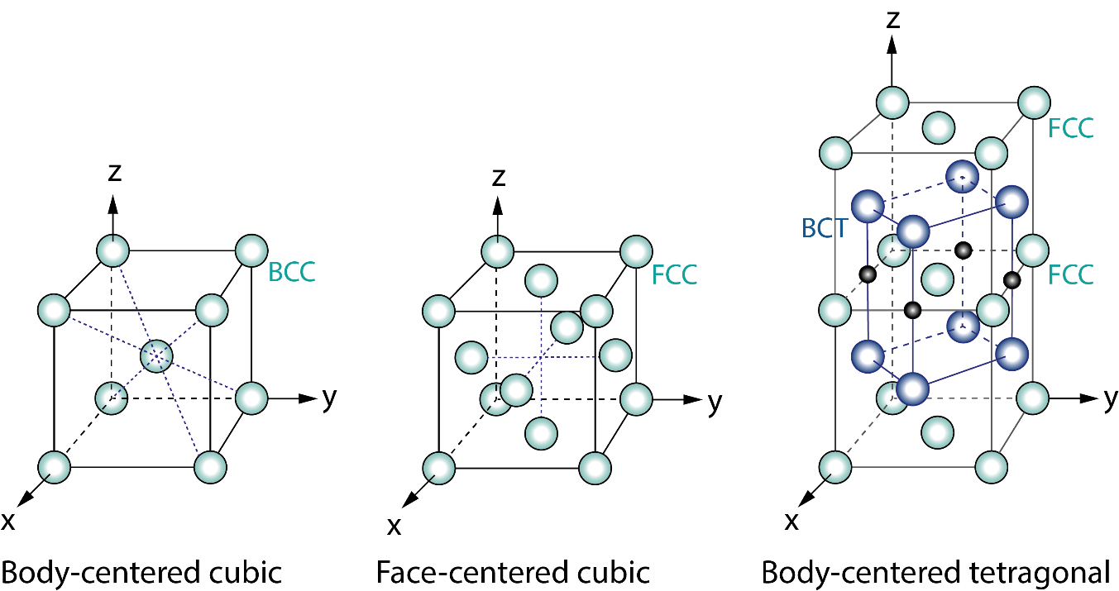
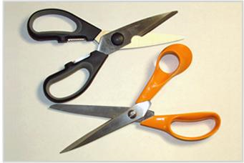
(i) Ferritic Stainless Steel
Overview: Ferritic stainless steels are low carbon steels, usually below 0.10 % carbon content. Like iron, ferritic stainless steel grades are magnetic. They are cheaper than other grades but are also less corrosion resistant.
Crystal structure: body-centered cubic (BCC)
Composition: Fe/10.5-30Cr/<0.1C with varying additions Ni, Si, Mn, Mo, P, S, Nb, N, Co, S, Ti, Ta, Al depending on the alloy
Effect of composition:
  Cr: improves corrosion and oxidation resistance
  Mo: improves resistance to pitting and crevice corrosion
Notes:
Phases/microstructures
Ferritic stainless steels rely on added Cr and contain small amounts of C, usually less than 0.10%.
These are the cheapest and are popular in, e.g., cutlery. Mo can be added for aggressive conditions such as sea water.
Ferritic steels are ductile but not as formable as Austenitic stainless steels.

Slide 9
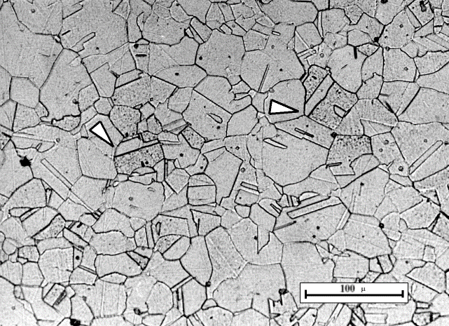
(ii) Austenitic stainless steels
Overview: Austenitic stainless steels are the most common type of stainless steel and are stable over a large temperature range when sufficient amounts of nickel are present. They are easily identified by their non-magnetic properties. *heat treatment*
Crystal structure: face-centered cubic (FCC)
Composition: Fe/<0.25C/16-26Cr/8-35Ni/0.5-15Mn with small additions of Si, S, P, Ti, N, Nb, Mo, V depending on the alloy.
Effect of composition:
  Ni: stabilises the austenitic microstructure
  Mn and N: can also be used to stabilise the austenitic microstructure in order to reduce costs
  Mo: enhance resistance to pitting and crevice corrosion.
© DoITPoMS Micrograph Library, University of Cambridge.
Used under Creative Commons Usage Guidance
Notes:
Phases/microstructures
Austenitic stainless steels are the most common ones, used everywhere from kitchen sinks to aerospace. The FCC microstructure at room temperature is achieved by the addition of Ni and/or Mn.
Corrosion resistance can still be enhanced by adding Cr. These steels cannot be hardened by heat treatment, but work hardened to high strength while still retaining some ductility and toughness.
The FCC structure can be found in the datasheet of Granta EduPack but the microstructure is from one of our close collaborators at Cambridge University (DoITPoMS)

Slide 10
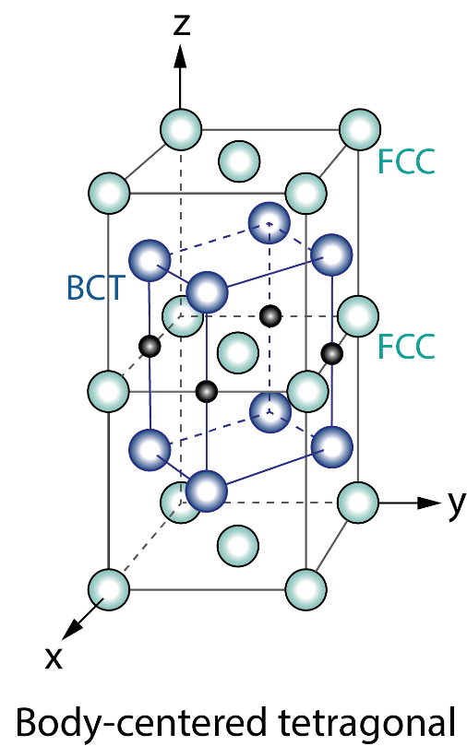
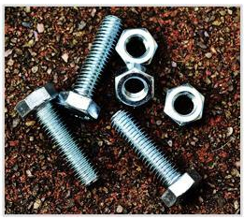
(iii) Martensitic stainless steels
Overview: Martensitic stainless steels have higher carbon content and lower chromium content which allows them to be strengthened by heat treatment. Through hardening and tempering they become magnetic with high strength.
Crystal structure: body-centered tetragonal (BCT)
Composition: Fe/10.5-18Cr/<1C/<1Mo/<1Mn/<1Si with small additions of S, P, Ni, V, W depending on the alloy.
Effect of composition:
  Cr: improves corrosion resistance
  C: desired strength and hardness can be achieved by altering the C content up to 1.2%.
Hex head cap screws and nuts, Alexas_Fotos at pixabay [Public Domain]
Notes:
Phases/microstructures
Martensitic stainless steels have higher C content, up to 1%, and can be strengthened by heat treatment. They are used, e.g., in bolts, nuts and screws
The BCT structure and this image the cannot be found in the datasheet of Granta EduPack

Slide 11
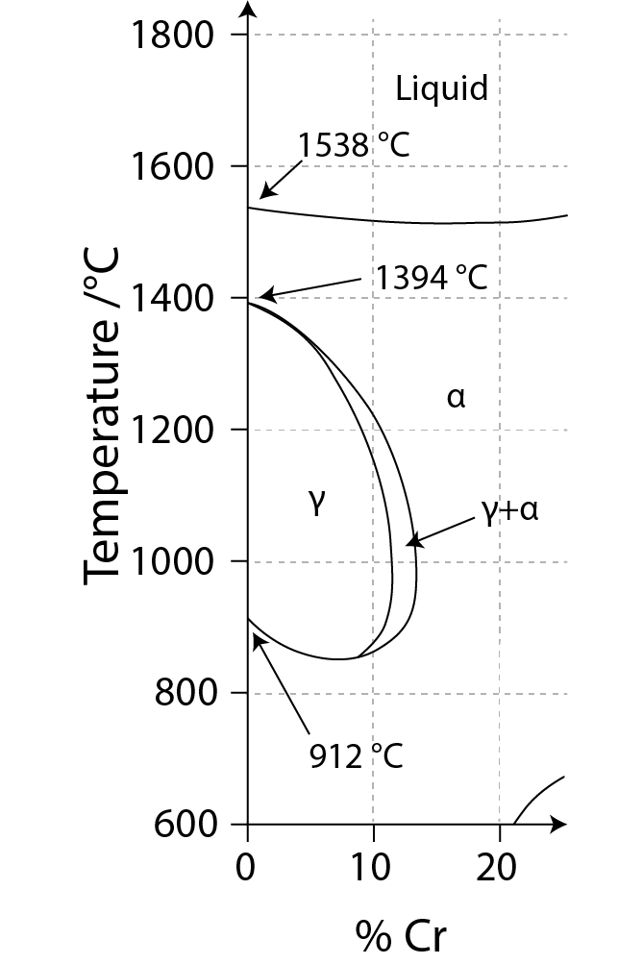
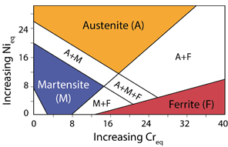
The Fe-Cr and Ni-Cr Alloying system
Fe-Cr
Schaeffler diagram
Notes:
Alloying systems
In most MS&E courses covering stainless steels, you would talk about alloying elements linked to phases
In the Iron Carbon phase diagram to the left, you can see that beyond 11-12% Cr, only the ferritic, or alpha phase is available at all temperatures
In the Schaeffler diagram to the right, the combined effect of Ni and Cr to the phases of steel

Slide 12
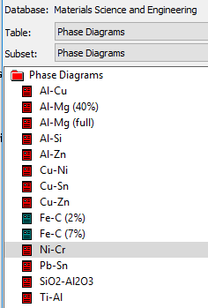
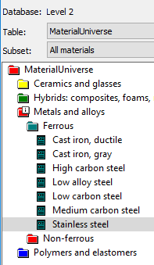
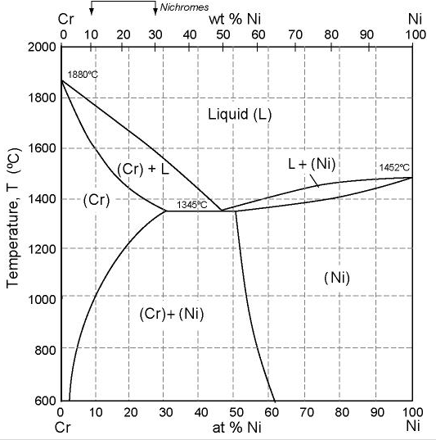
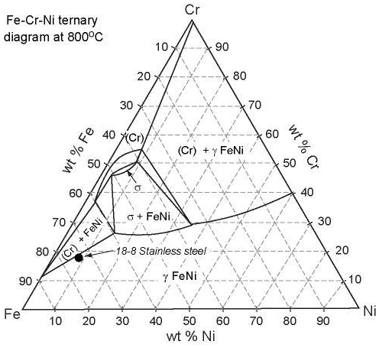
Nichromes and ternary phase diagrams
Ni-Cr (MS&E)
Fe-Ni-Cr (Level 2)
Notes:
Additional phase diagrams in EduPack
There are also a couple of related phase diagram of interest available in Granta EduPack
A Ni-Cr phase diagram is available in the separate phase diagram data-table of the MS&E database
There is also a ternary phase diagram (Fe-Ni-Cr) available in the datasheet for stainless steel in the regular Level 2 database

Slide 13
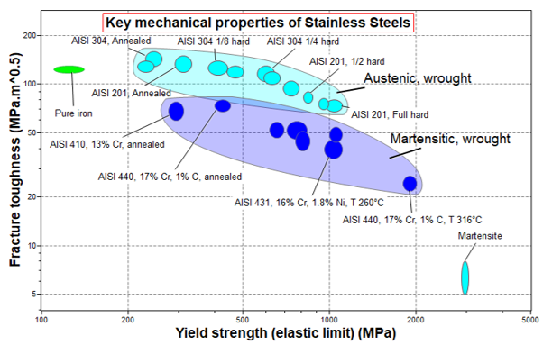
Structure - properties
Notes:
Structure-property relationships
The influence of microstructure on key mechanical properties can be seen in this plot
It is created using the extended set of material records in the Property-Process Profiles data-table
A custom subset including pure iron and martensite as well as some wrought Austenitic and Martensitic stainless steels is created

Slide 14
Precipitation-hardened and duplex steels
Precipitation-Hardening (PH) Stainless Steels
Duplex Stainless Steels
Corrosion resistance comparable to austenitic varieties, but can be precipitation hardened to even higher strengths than the other martensitic grades.
The most common, 17-4PH, uses about 17% chromium and 4% nickel.
Mixed microstructure with an aim of having half austenite and half ferrite, although in commercial alloys the ratio may be 40/60.
They have high chromium (19–32%) and molybdenum (up to 5%) and lower nickel contents than austenitic stainless steels.
Duplex stainless steels have approximately twice the strength compared to austenitic stainless steels.
Notes:
Concluding remarks
Precipitation-hardened stainless steels derive their properties from solid-solution strengthening, strain-hardening and martensitic transformation.
Even with low Carbon contents these are able to achieve high strengths.
More can be read about precipitation strengthening in the science notes, under the new structure section.
Duplex stainless steels are interesting, as they are formed from different phases which have been deliberately mixed together.
By controlling the composition and heat treatment, they aim to contain around 50 % ferrite and 50 % austenite.
This more complex structure gives them better mechanical properties, corrosion resistance, formability and weldability.

