Slide 1
Quarterly Case Study Session
Presented March 2020
Railway lightweighting
Claes Fredriksson and Susannah Cooke
Ansys Materials Education Division
Notes:
Introduction
These Case Study Sessions are based on our Advanced Industrial Case Studies for EduPack.
This is our eleventh quarterly online training session for EduPack users but the first using the Ansys-branded slides. You may notice that the slides are in widescreen format
These sessions are intended to inspire educators and facilitate materials-related teaching
In this short format Case Study, we take a look at potential materials for lightweighting trains and railway transportation.
Recording of this Quarterly Case Study can be found here: https://www.ansys.com/resource-center/webinar/transportation-railway-lightweighting

Slide 2
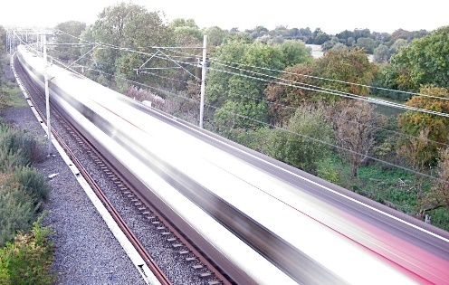
Agenda
Introduction
Advanced Industrial Case Study
-Transportation lightweighting
- Potential targets
- Mechanical load and stress
- Railway materials
- 3 examples
Reality Check
Claes Fredriksson and Susannah Cooke
from the Ansys Granta Education Team
Notes:
Agenda

Slide 3
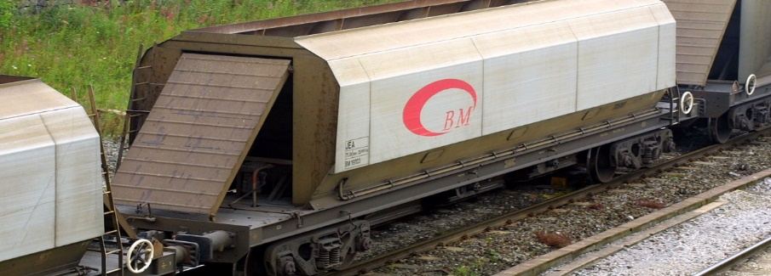
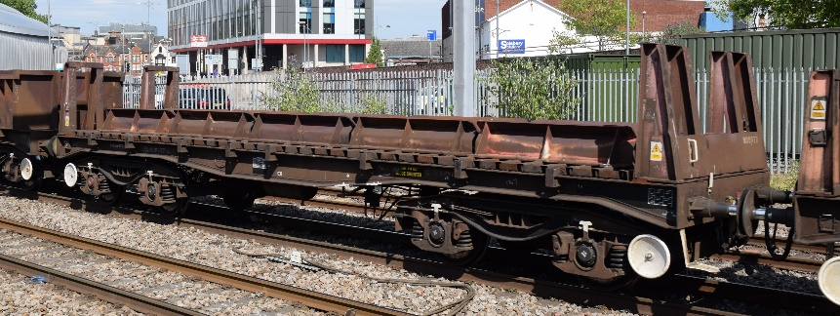
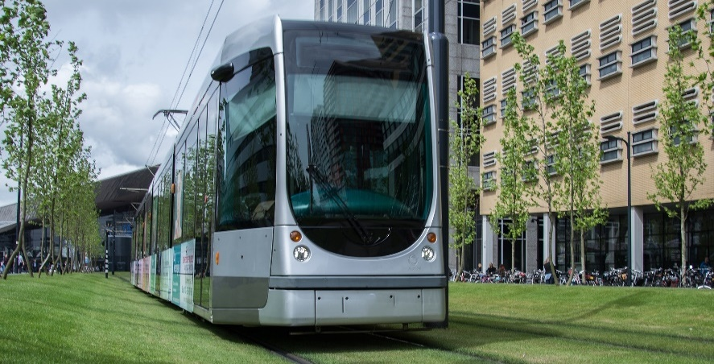
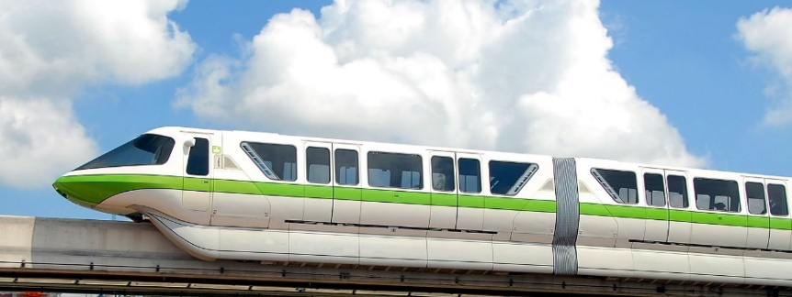
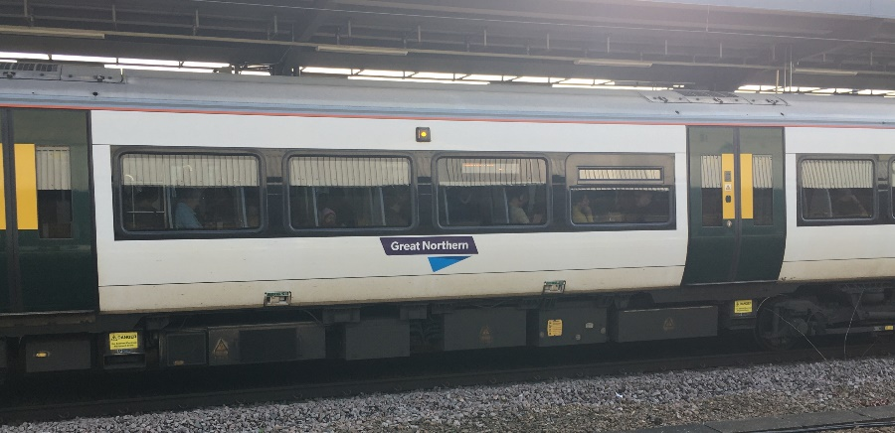
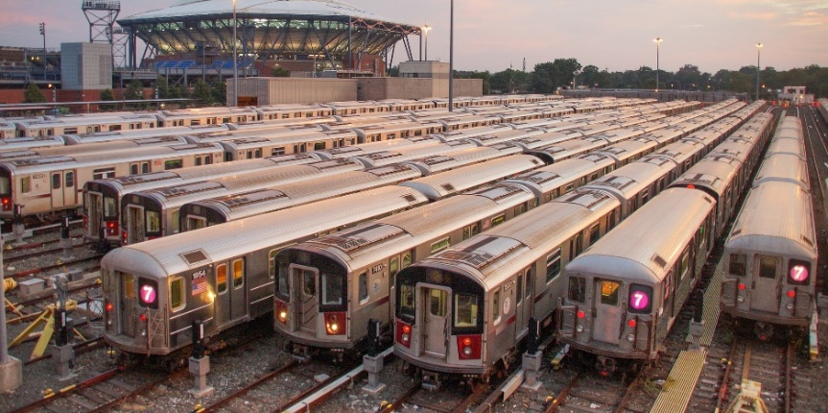
Railway transportation systems
Cargo
Open cargo
Light rail
Monorail
Intercity
Metro
Notes:
Railway systems
The basics of railway technology were first developed around 200 years ago during the industrial revolution.
Since then, trains have become ever more sophisticated, and the materials used to make them have developed according to the service requirements of each kind of train.
Here you can see examples of different types of trains, some developed for cargo haulage, some for passenger transport.
There are a very large number of railway vehicles in use, which makes even the slightest mass reduction important

Slide 4
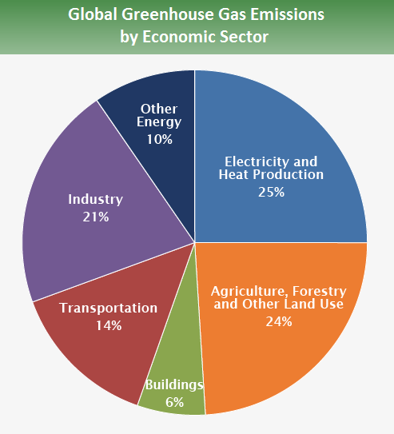
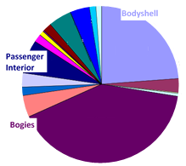
Benefits from lightweighting trains: metro vehicles
Source: IPCC, Climate Change 2014
Lightweight Design of Interior Components for Energy Efficient Metro Vehicles, J. Carruthers, NewRail
Notes:
Benefits
Lightweighting of trains is a benefit for many reasons. For the train operator, lower train mass means lower power usage and thus lower running costs.
In terms of wider impacts, lower power usage means lower carbon emissions, since trains either run on diesel or on electricity (which displaces the carbon emissions to power plants but does not remove them).
The transportation sector is a major contributor to global greenhouse gas emissions, and the railways play a part in that.
When looking at which areas of trains to lightweight, it is useful to consider where most of the mass of a train is concentrated.
As the pie chart on the right shows, the areas of most interest include the bodyshell (car body), interior passenger-facing components, and the bogies.
Bogies are the name for the running gear under the train which contain the wheels, axles, braking and suspension equipment.
This collection of components is extremely safety-critical as it is responsible for keeping the train on the track and applying braking when needed.
It is also exposed to the harshest environmental and load conditions, making it a challenging design area.

Slide 5
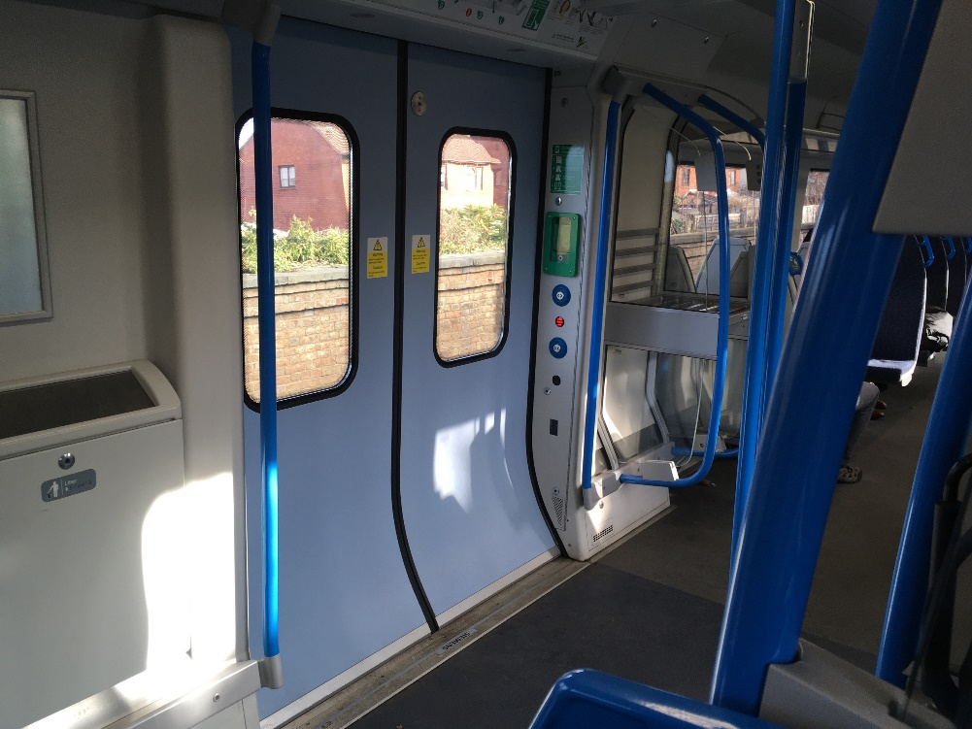
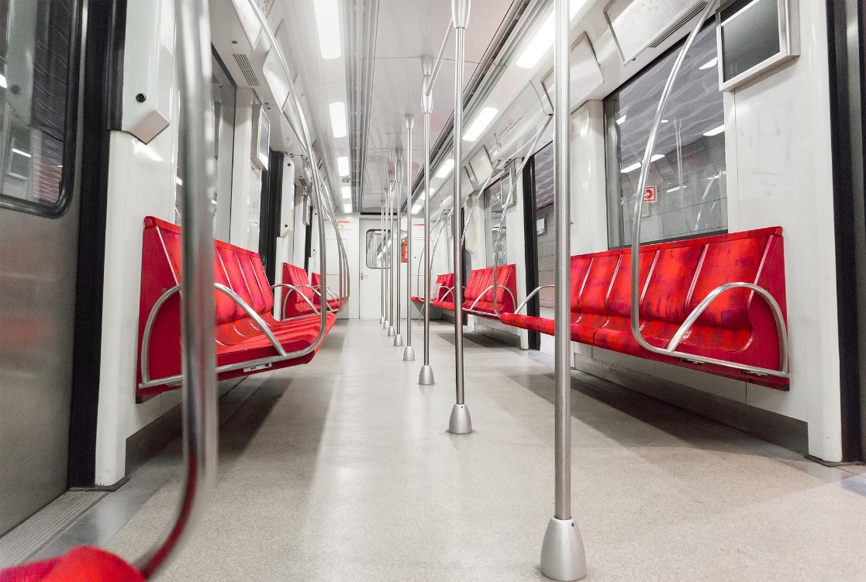
Potential for internal lightweighting
Interior panels
Seats
Handrails and grab poles
Many different materials
Extensive usage
Notes:
Internal components
Lightweighting some of the passenger-facing components in the interior of trains is perhaps one of the easiest challenges to tackle.
Most of these components are not extremely safety-critical and their design focuses on enhancing the passenger experience.
Interior panels, which line the walls inside trains, are there both for passenger comfort and to hide things such as wiring in the walls.
These panels are often made of metal at present but could potentially be made of lighter materials such as tough polymers.
However, it does need to be remembered that trains usually have a long lifespan – any new train entering service in the UK can be expected to run for 30 years or more.
Design choices including material selection must therefore consider longevity alongside all other requirements.

Slide 6
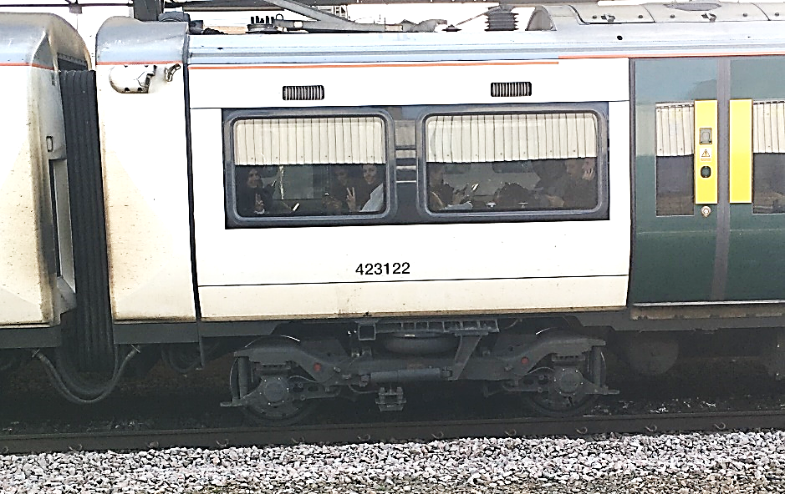
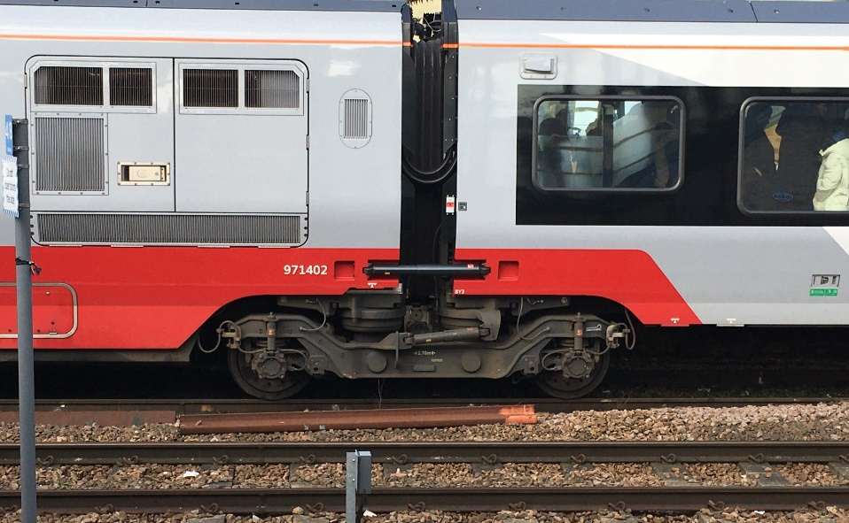
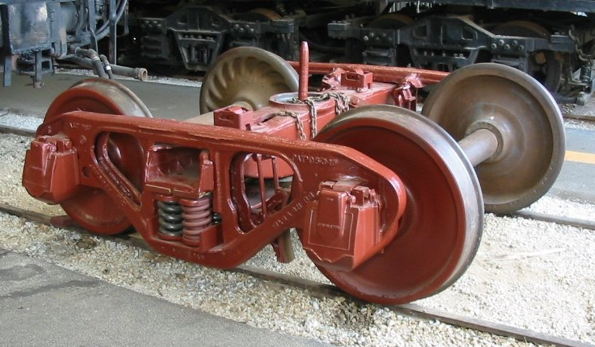
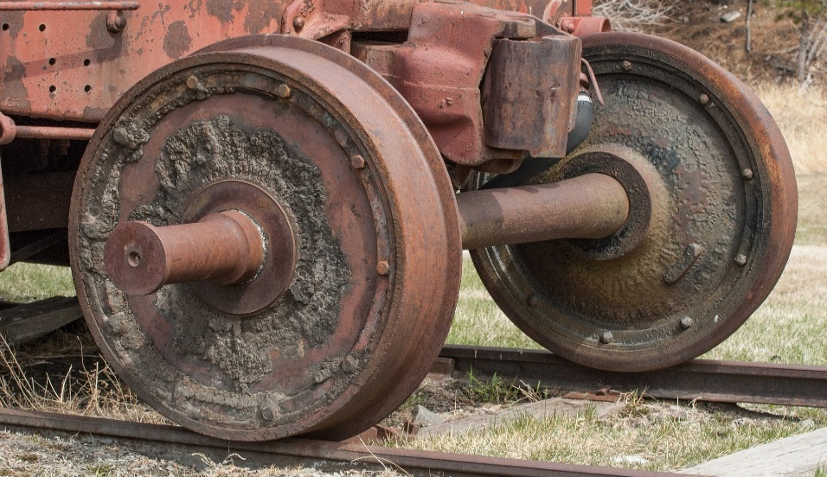
Potential for lightweighting external components
Bodyshell
Bogies
Wheelsets
Axles
Notes:
External components
For lightweighting of external components, some considerations are similar but there are important differences. The lifetime of the train is still an important consideration, but safety considerations now start to dominate design.
Most of the time, a train body needs to act merely as a protective shell against the weather, small items of debris, etc. However, in the case of a serious crash, it must also be designed to absorb as much energy as possible to protect passengers.
As previously mentioned, bogies are one of the most significant concentrations of mass in train design, and also one of the most safety-critical components as they keep the train on the track.
You can see here a few examples of bogies, some more complex than others. Bogies house the wheelsets (axles and wheels), primary and secondary suspension components, and braking equipment – as well as occasionally other components such as gearboxes, sanding equipment, speed sensors etc.
As such, they are subject to very complex loading conditions and are usually designed with the aid of advanced simulations.
The wheelset, however, is a much simpler component and most of its loads can be calculated analytically, allowing us to look at the top-level requirements for materials used in axles or wheels.

Slide 7
Mechanical load and stress
Curvature-induced difference in distance
Wheelset with wheels fixed to the axle
Axle is a solid beam but can be hollow
Must avoid fracture or large deflections
Exposed to track damage and environment
Torque
Shear load
Bending load
Notes:
Mechanical situation
The wheelsets and axles are mechanically interesting, not just for lightweighting
The wheels are fixed on to the axle, so they cannot roll independently.

Slide 8
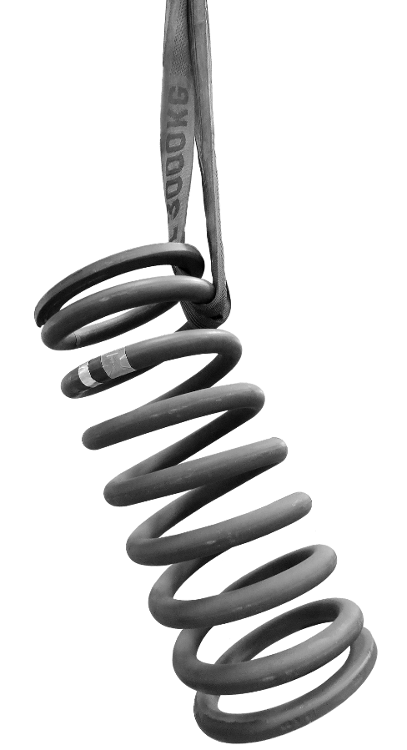
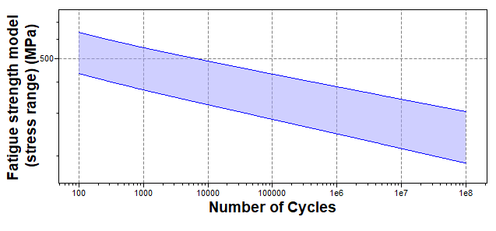
Railway materials
Railway materials are driven by safety standards
Low carbon steels, Aluminums are common metals
Many axles are made of EA1N grade railway steel
Axles are mostly solid rotating beams, can be hollow
Approximated by AISI 1030 normalised carbon steel,
Contains fatigue strength data for 10⁷ cyclic load
Notes:
Railway materials
European axles are typically manufactured by open die forging or a rolling process from vacuum-degassed EA1N grade railway steel.
This will be approximated by AISI 1030 normalised carbon steel, which contain fatigue data.
The numerical range for the fatigue strength is given for 10⁷ cycles, but there is a graph for 100-10⁸ cycles of this material
If each rotation is considered as one cycle, the number is considerably higher than 10⁸ during a lifetime
For the number of stop-starts, the value 10⁷ cycles is more realistic. This fatigue strength is lower than the yield strength

Slide 9
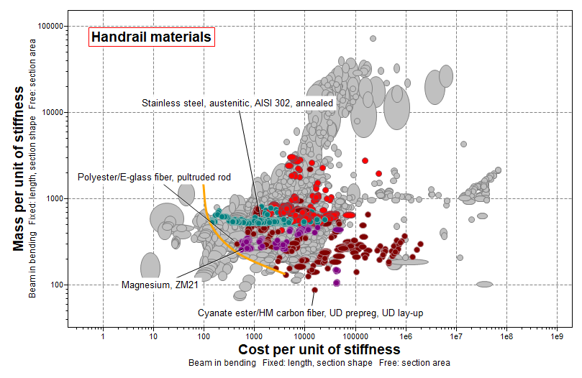
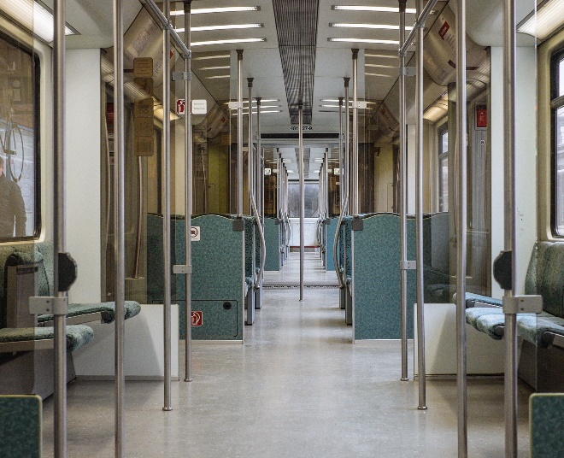
Handrail demo
Beam in bending
Stiffness-limited
Square and circular
Solid or hollow
GFRP better and cheaper than stainless steel
Railing material
Notes:
Handrail and Axle Demo

Slide 10
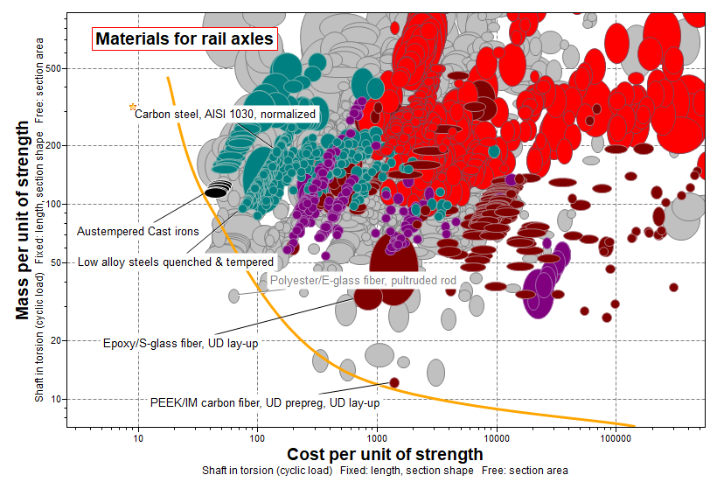
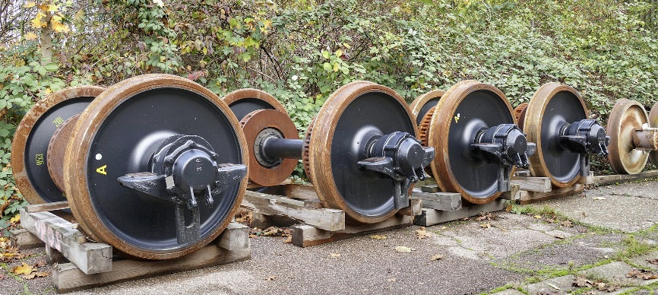
Axle demo
Shaft in torsion
Strength-limited
Cyclic load
Hollow and water resistant
Axle material
Notes:
Axle Demo

Slide 11
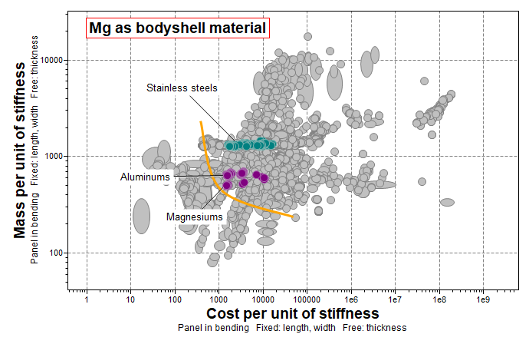
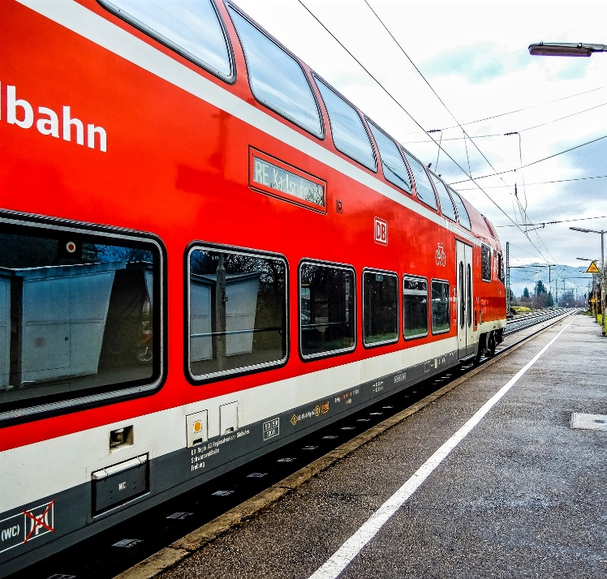
Bodyshell Demo
Panel in bending
Stiffness-limited
Magnesium considered
Now Stainless steel or Al
Bodyshell material
Notes:
Bodyshell Demo

Slide 12
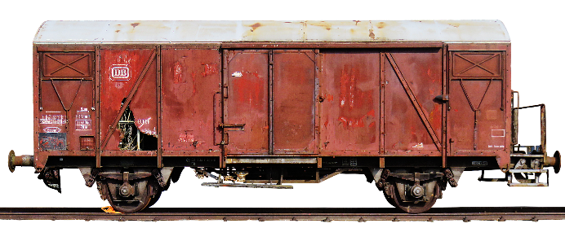
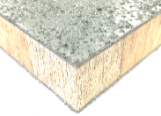
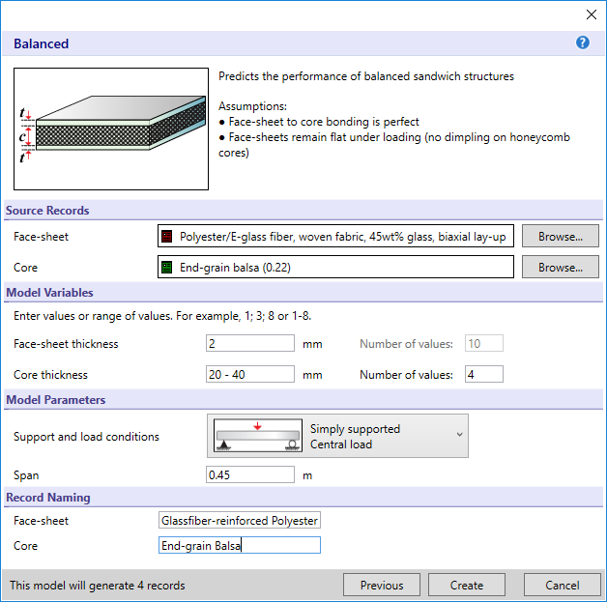
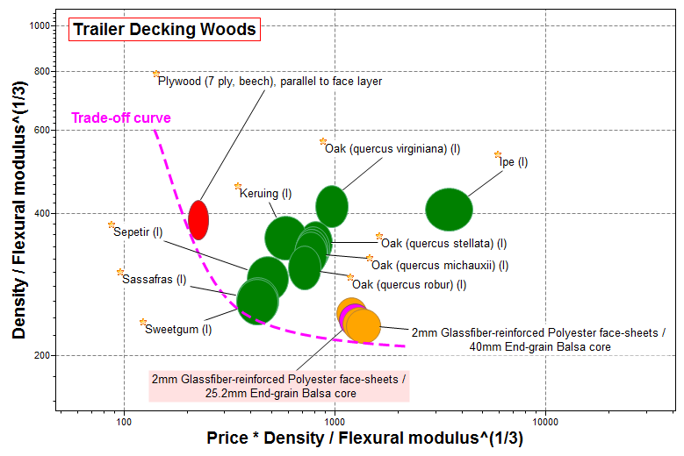
Deck Demo
Notes:
Decking Demo

Slide 13
Reality Check
Many options exist for lightweighting railway components
Some are already being implemented in advanced trains around the world
Incremental change is often easier in safety-dominated design
Proven technology is much easier to modify than design ‘from scratch’
There remains significant potential for lightweighting railway components
Shared bogie design
Notes:
Reality Check
Smart design: the train on the right shows an existing bogie design that has been adapted and moved to inter-carriage position rather than changing any of its materials.

Slide 14
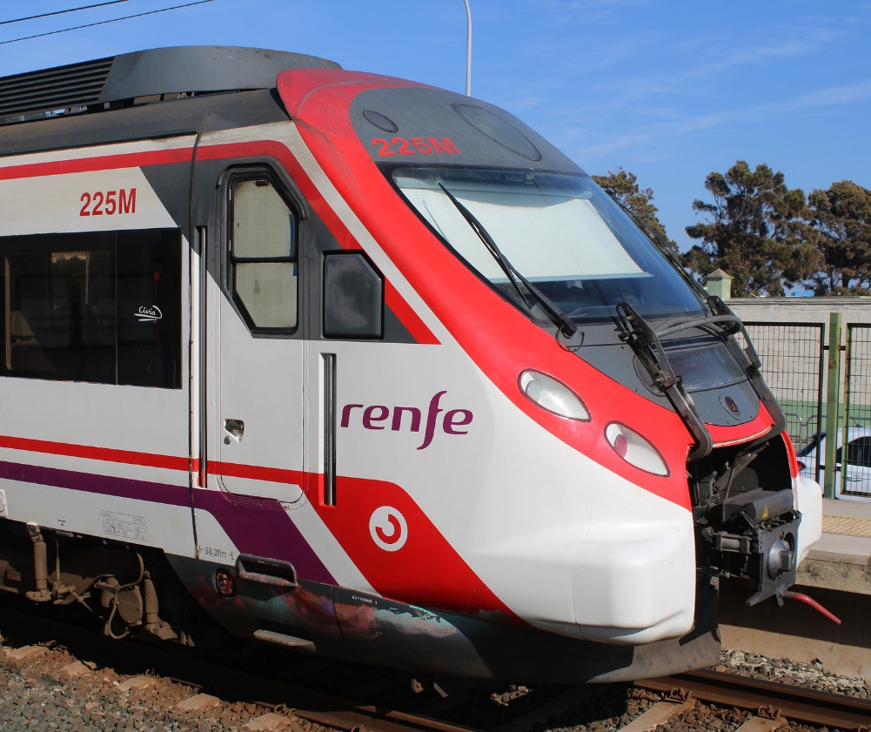
What did EduPack bring to the understanding
How to use EduPack for lightweighting in transportation with examples from railway components
Advanced use of the materials selection tools in EduPack and their application to typical mechanical engineering design
Insights into an interesting and important the trade-off between ideal engineering design and standards in safety-critical industries, such as railways
Notes:
Conclusions

