Slide 1
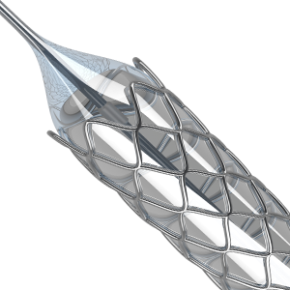
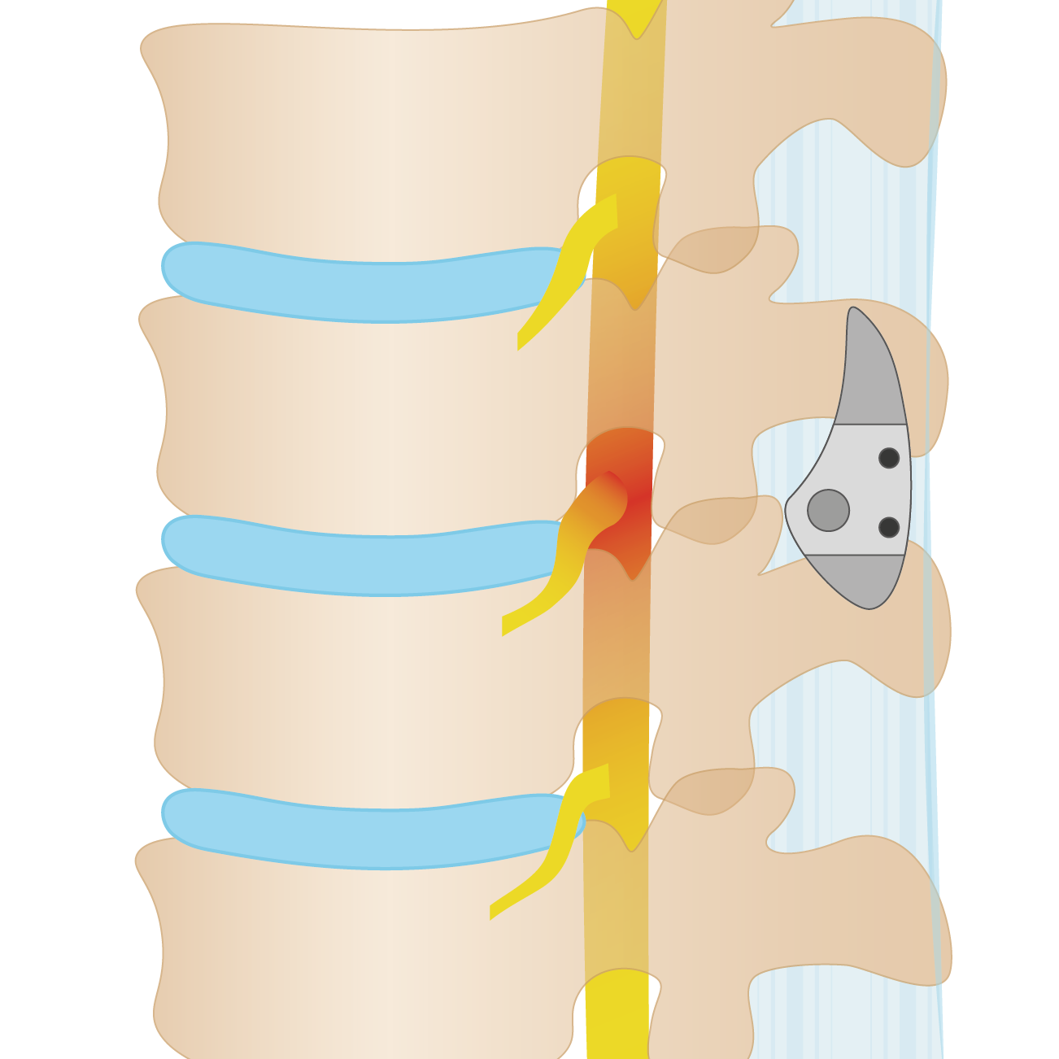
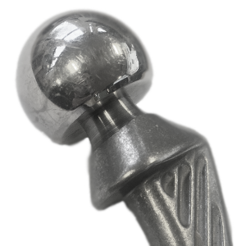
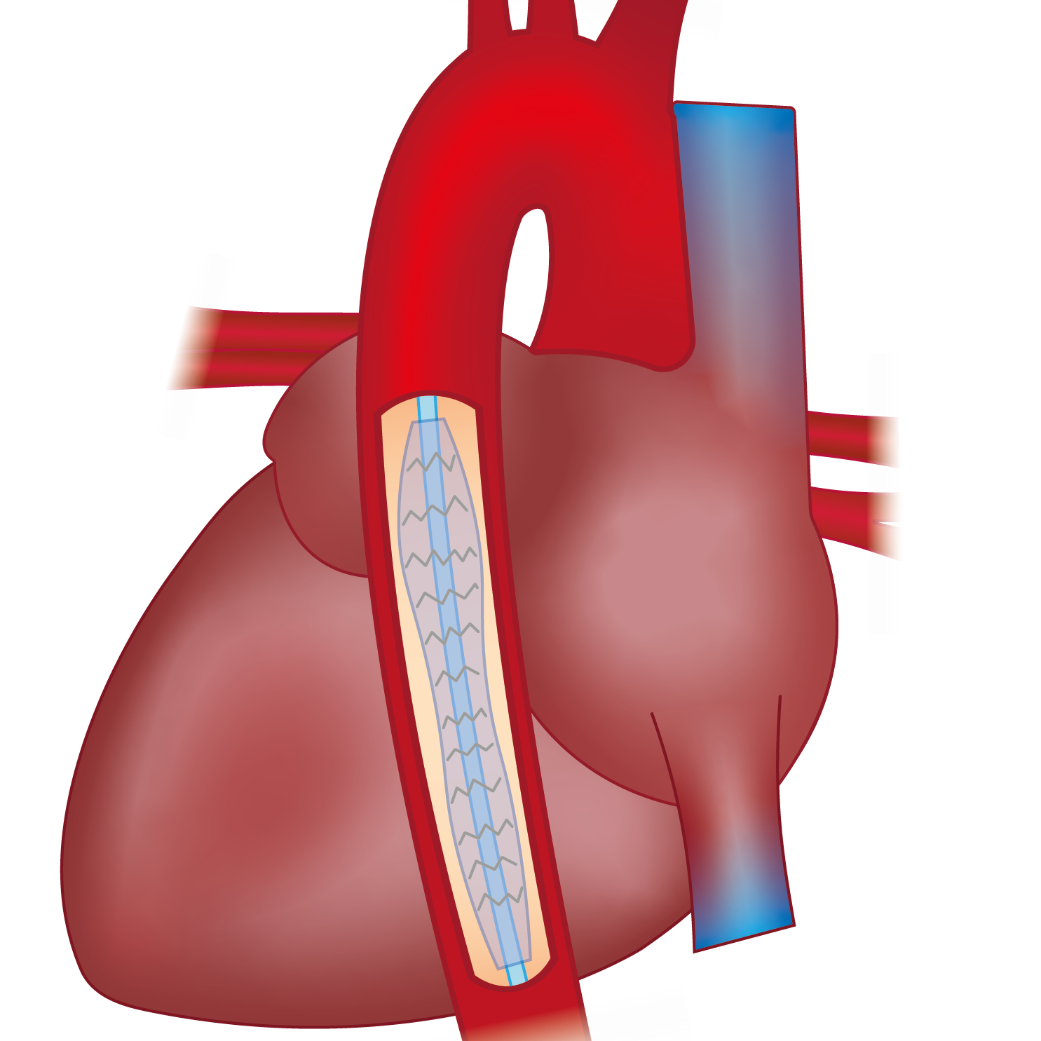
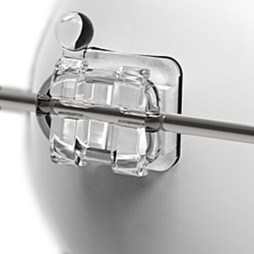
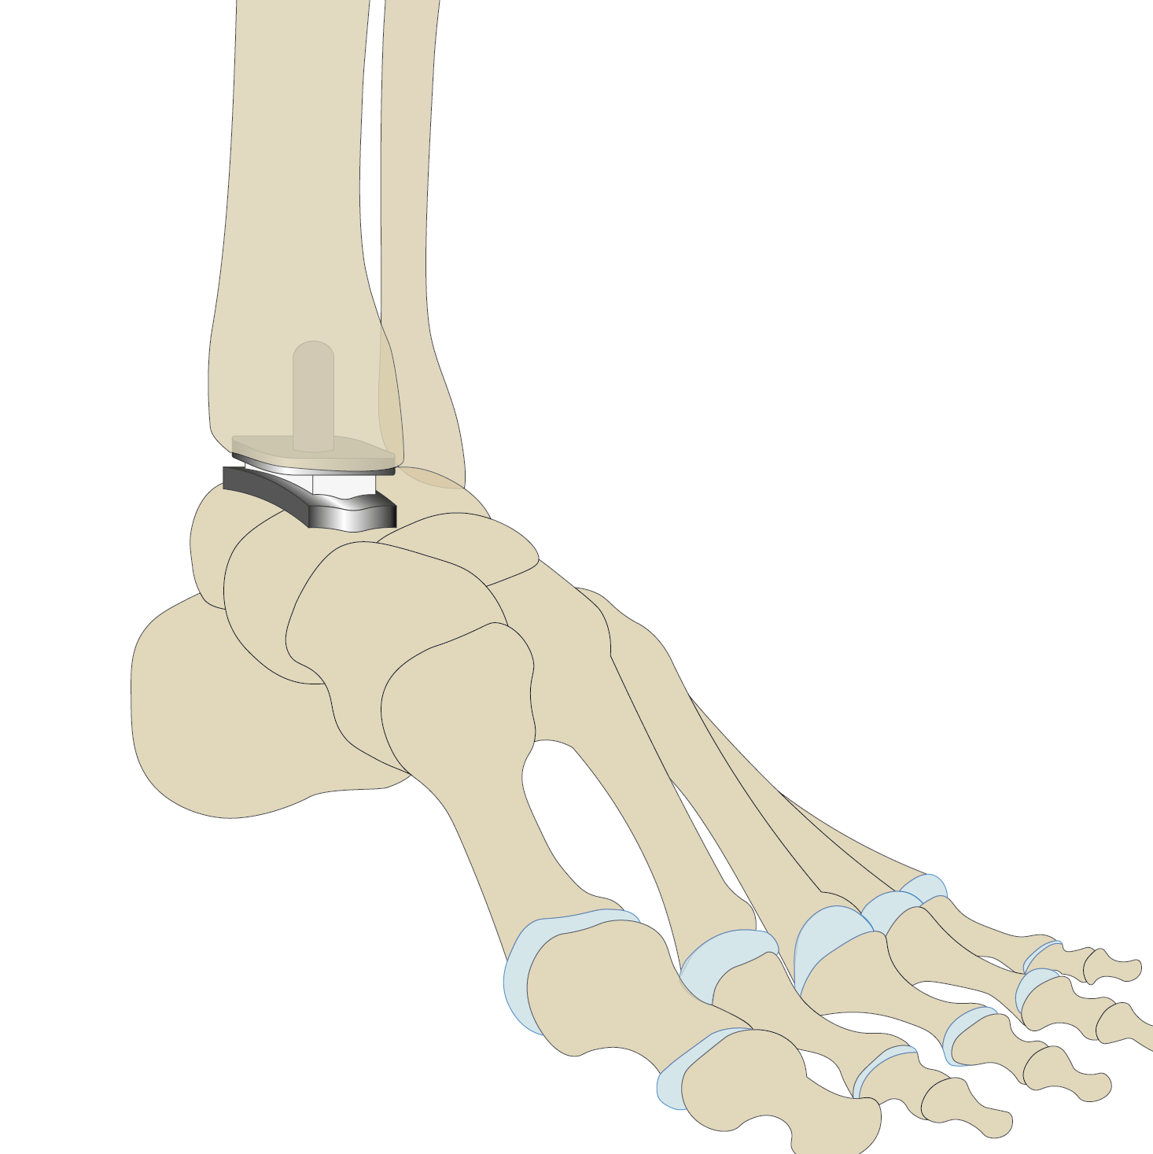
Medical Devices
Harriet Parnell¹ & Mike Ashby²
¹Ansys Academic Development Team
²Department of Engineering, University of Cambridge

Slide 2
Learning objectives for this lecture unit
Intended Learning Outcomes
Knowledge and Understanding | Understand what is meant by a ‘medical device’ and what information is available in Granta EduPack.
Skills and Abilities | Ability to select materials for biomedical engineering applications, giving real life examples.
Values and Attitudes | Awareness of different types of medical devices and general regulations that govern them.
Resources
White Paper: “Bio Engineering Database > Part 1: Introduction to Biological and Bio-medical materials”
White Paper: “Bio Engineering Database > Part 2: Bio-derived materials and example applications”
White Paper: “Medical Devices: biomedical applications of materials”
Poster: Wall chart of property maps for the materials of nature (download all three from www.ansys.com/education-resources)
Text: “Materials Selection in Mechanical Design”, 5th edition, by M.F. Ashby, Butterworth Heinemann, Oxford, 2016.
Notes:
Learning Objectives
These Intended Learning Outcomes are based on a taxonomy of knowledge and understanding as the basis, skills and abilities as necessary for the practical use of knowledge and understanding, followed by acquired values and attitudes enabling assessments and responsible use of these abilities.
Combined with a suitable assessment, they should be helpful in the context of accreditations or for the CDIO Syllabus.
The Texts listed are from books authored or co-authored by Prof. Mike Ashby but other texts are also referred to in the Science Notes.

Slide 3
Outline
Intro to Medical Devices and Biomedical Materials
Ansys Granta EduPack, Medical Device data
Ansys Granta EduPack, Material data and tools
Notes:
Outline
Outline as described above

Slide 4

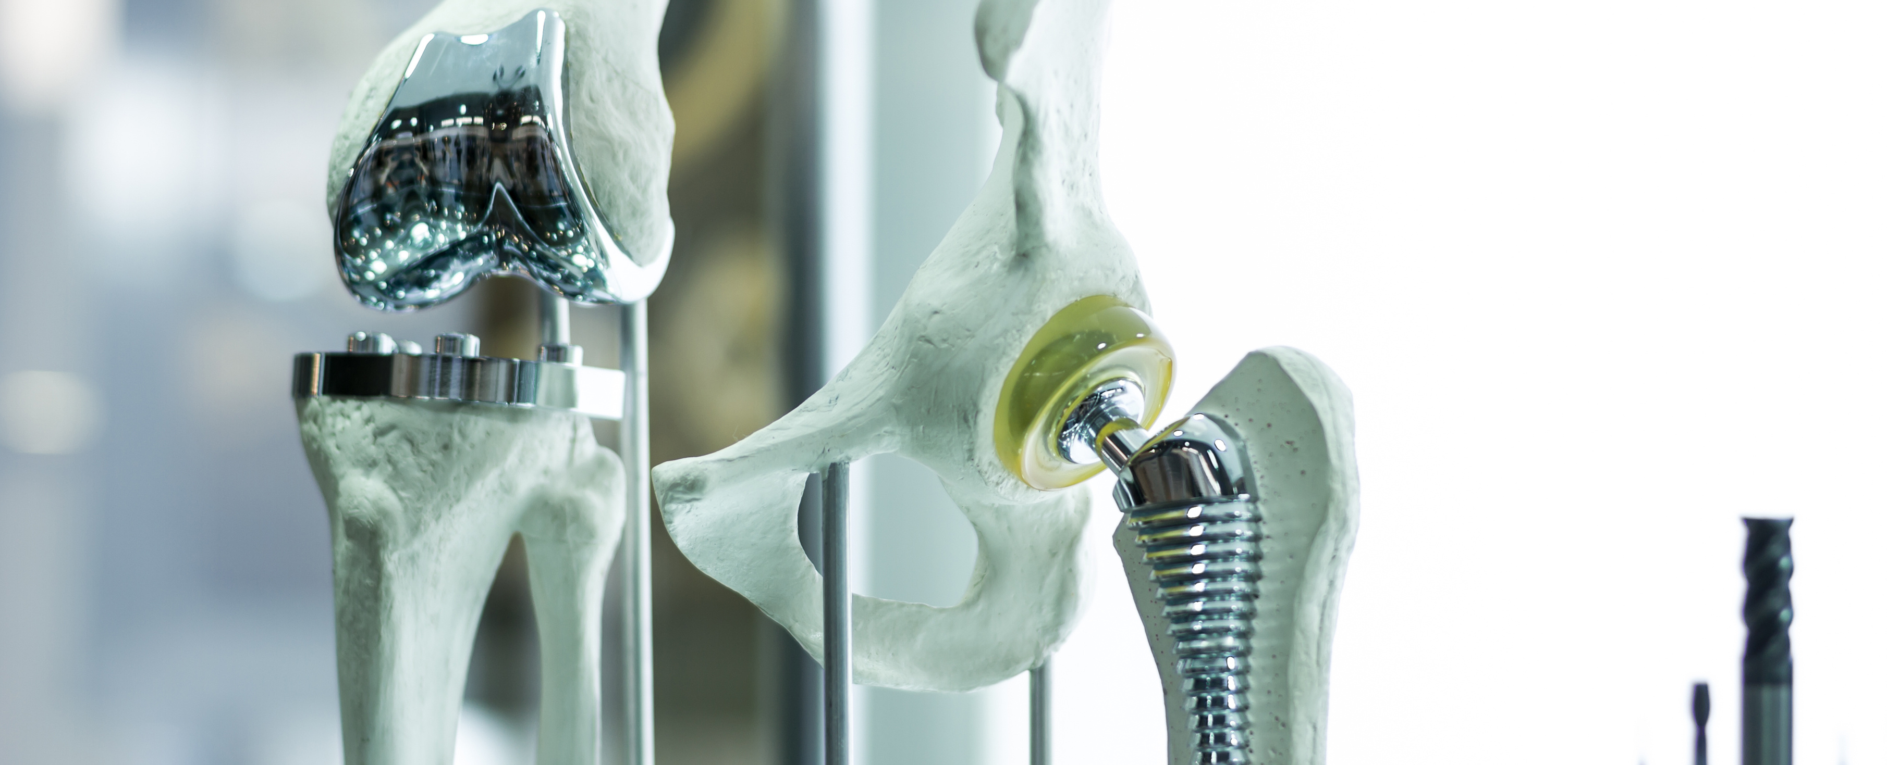
Part 1:
Introduction to Medical Devices and Biomedical Materials

Slide 5

What is a medical device?
According to the World Health Organization:
“A medical device means any instrument, apparatus, implement, machine, appliance, implant, reagent for in vitro use, software, material or other similar or related article, intended by the manufacturer to be used alone or in combination, for human beings, for one or more of the specific medical purpose(s) of:
Diagnosis, prevention, monitoring, treatment or alleviation of disease
Diagnosis, monitoring, treatment, alleviation of or compensation for an injury
Investigation, replacement, modification, or support of the anatomy or of a physiological process
Supporting or sustaining life
Control of conception
Disinfection of medical devices
Providing information by means of in vitro examination of specimens derived from the human body
…and does not achieve its primary intended action by pharmacological, immunological or metabolic means, in or on the human body, but which may be assisted in its intended function by such means.”
Notes:
What is a medical device?
The WHO define a medical device as stated on this slide. A Link to this definition can be found here: https://www.who.int/medical_devices/full_deffinition/en/

Slide 6
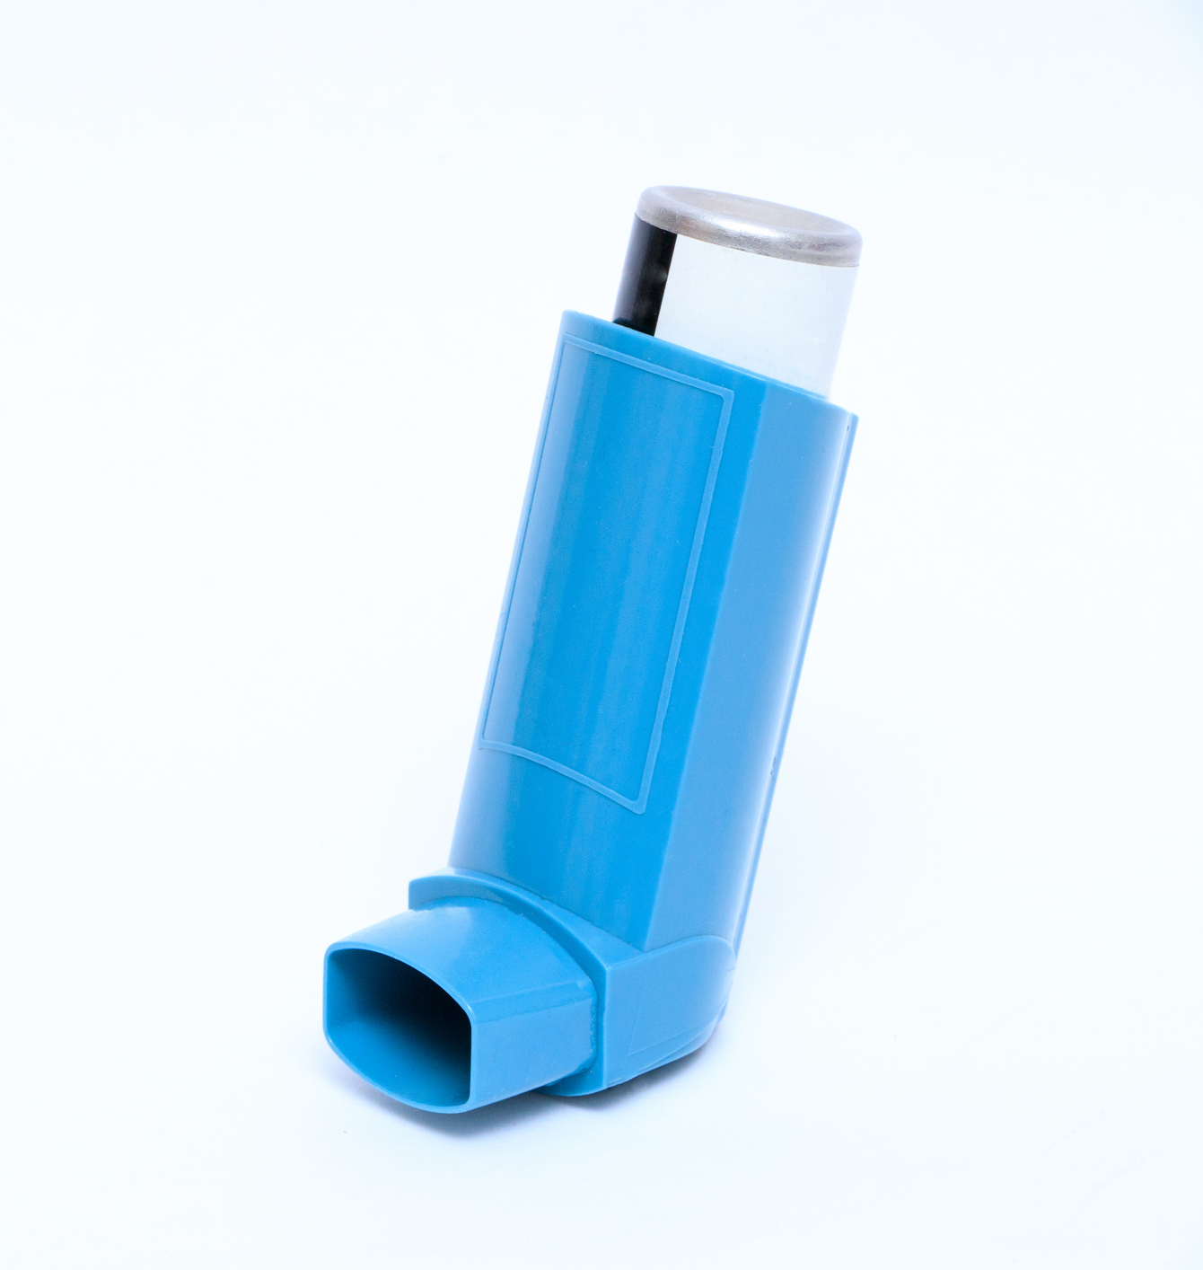
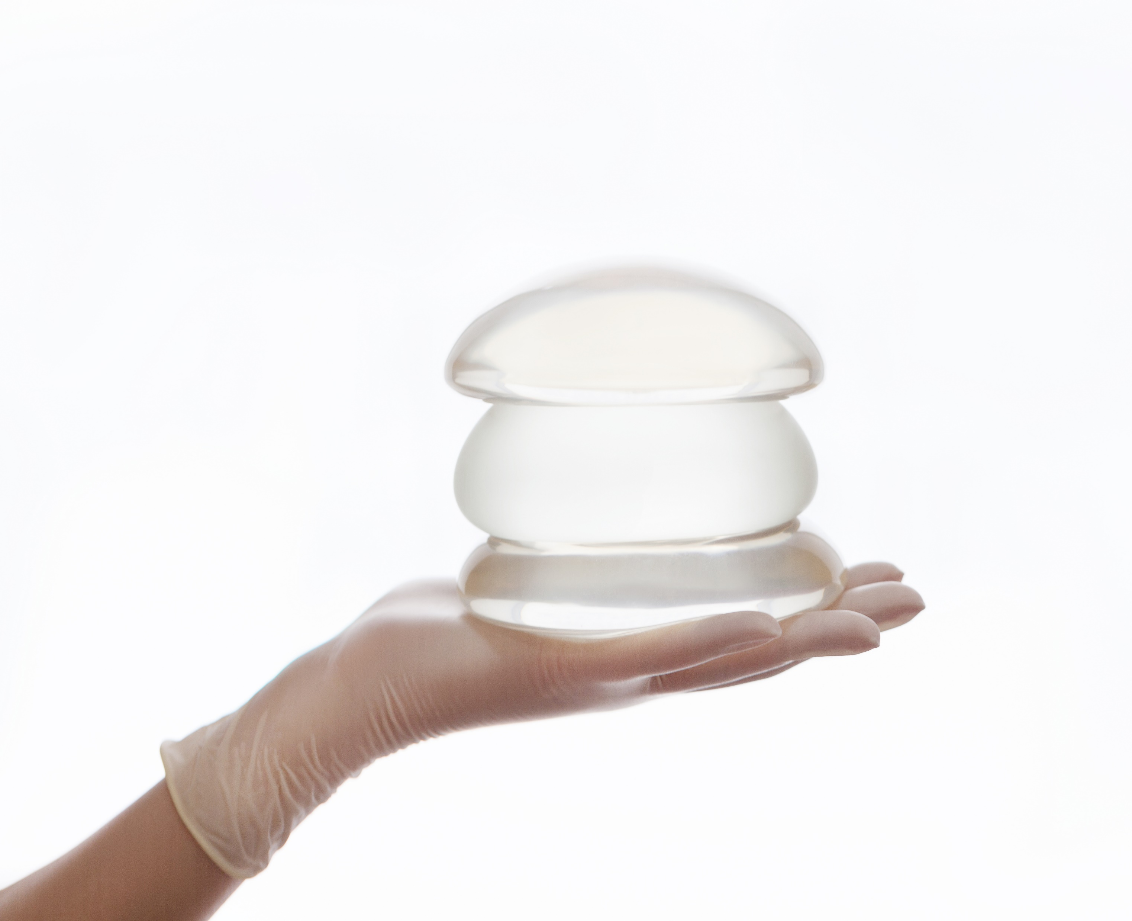
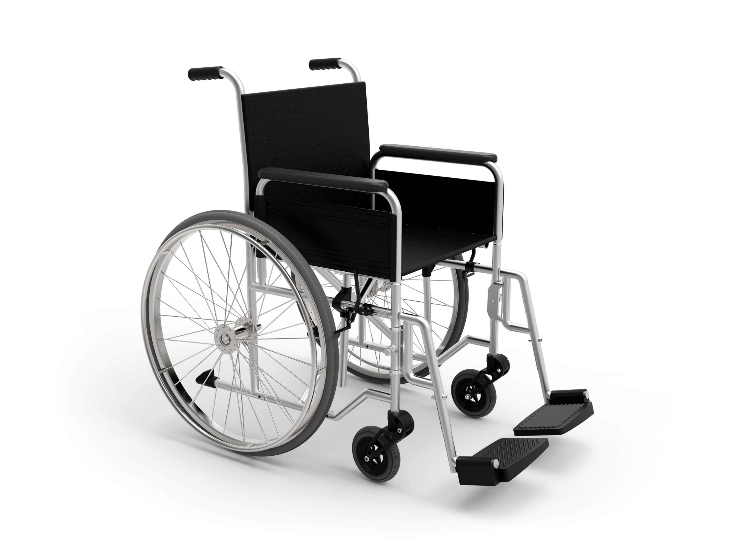
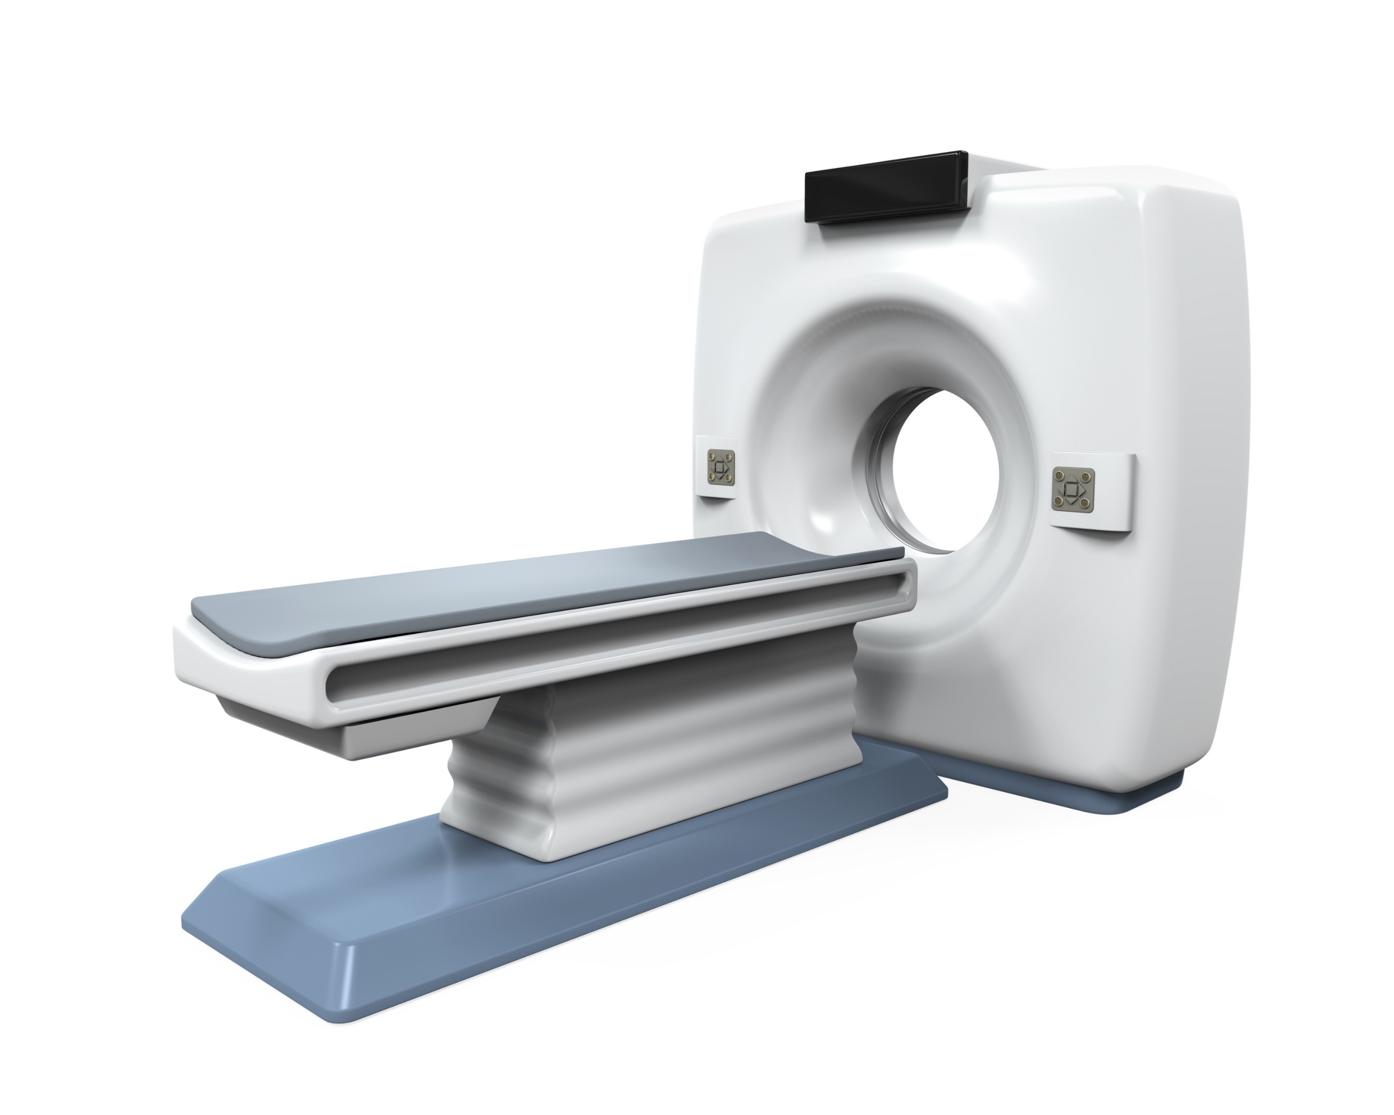
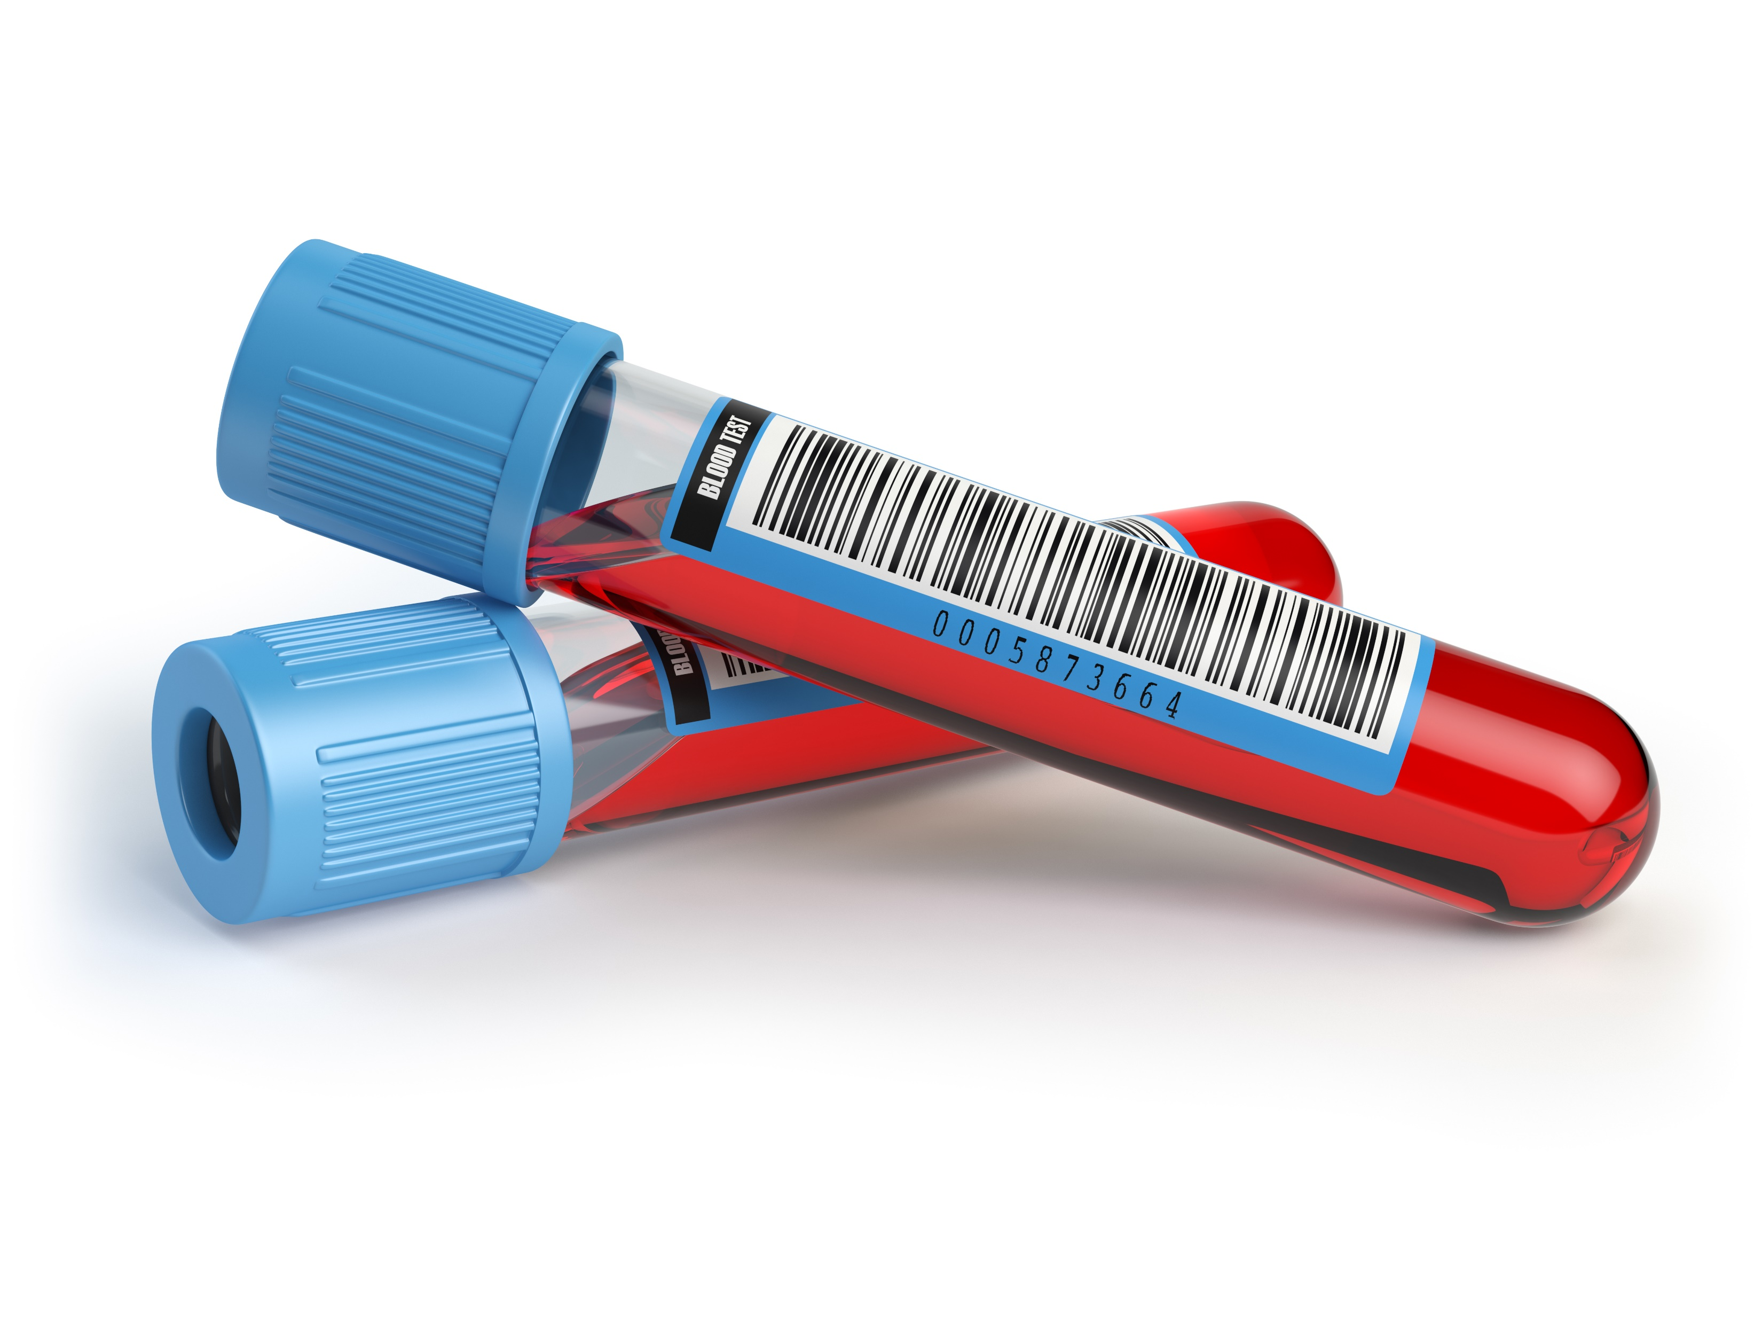
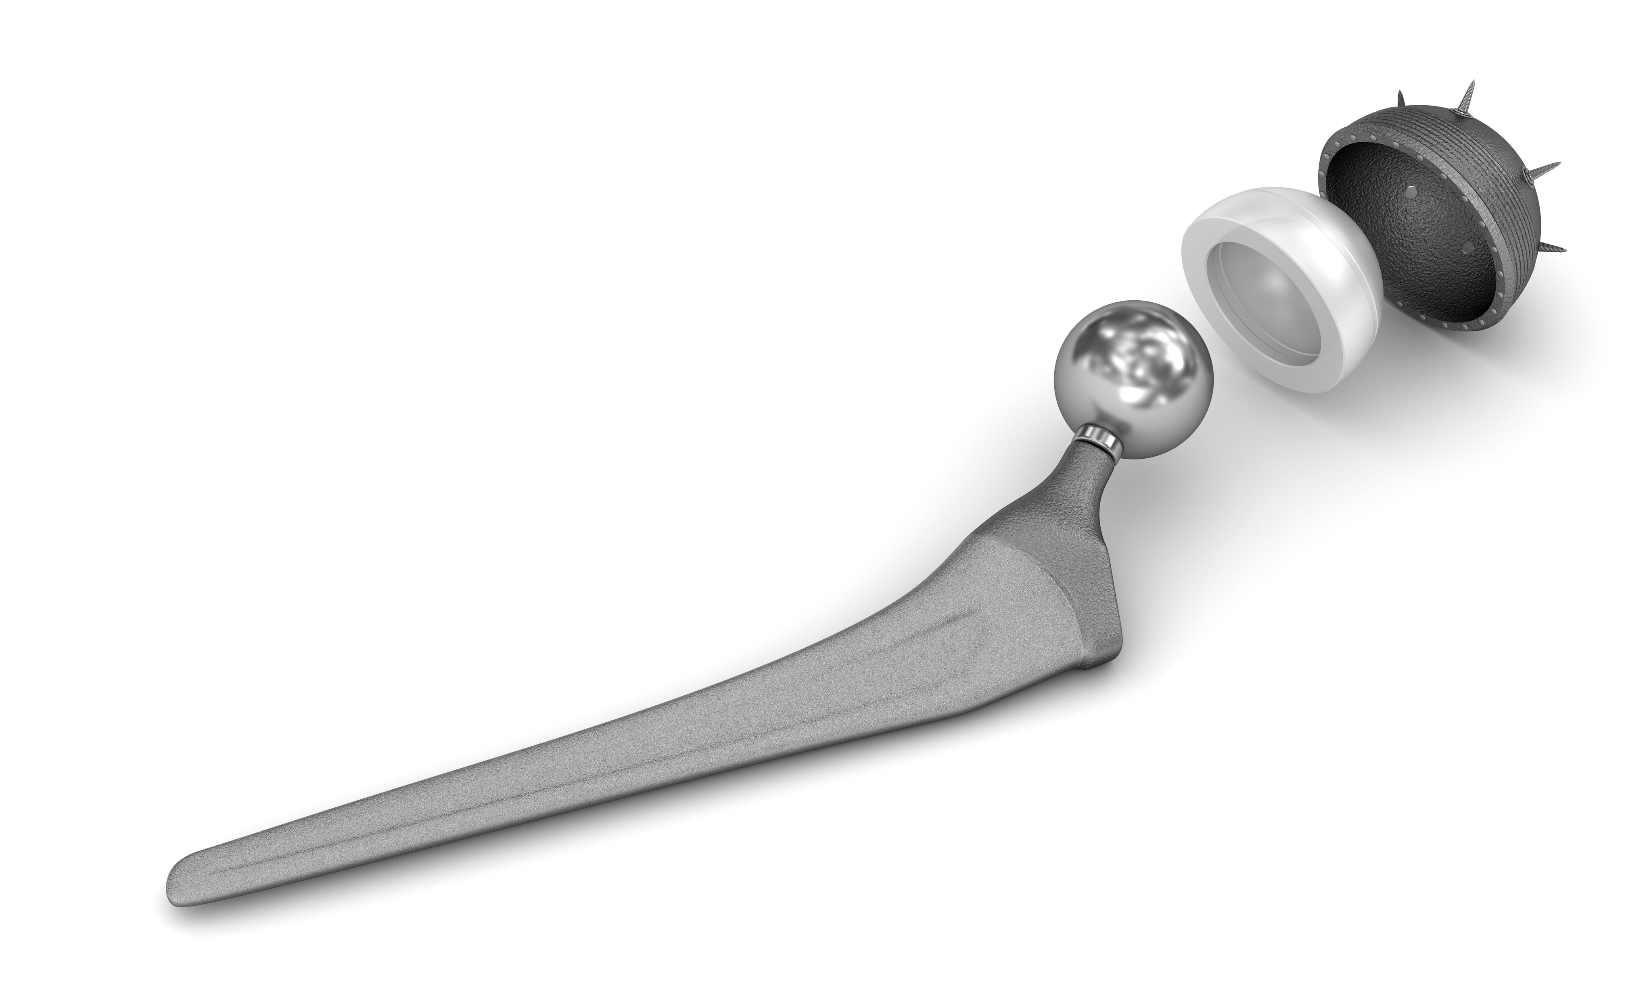
Medical Devices: a broad field
That means a medical device could be anything from a wheelchair to support rehabilitation; an inhaler for treatment delivery; an artificial hip replacement; or even a diagnostic MRI machine.
But what do all medical devices have in common?
…they are made from materials!
Notes:
Medical devices
The scope is broad. But what do all medical devices have in common? They’re all made from materials.

Slide 7
How are biomaterials used in current medical practice?
Medical implants e.g., heart valves, stents, and grafts; artificial joints, ligaments, and tendons; hearing loss devices; dental implants; and devices that stimulate nerves.
Promote human tissue healing e.g., wound closure using sutures, clips, and staples; dissolvable dressings.
Human tissue regeneration scaffolds, cells, and bioactive molecules can all be used to support host tissue growth.
Molecular probes and nanoparticles that break through biological barriers and support cancer imaging and therapy at the molecular level.
Biosensors use biological material, such as DNA, enzymes and antibodies, to detect specific biological, chemical, or physical and then transmits or reports this data.
Drug-delivery systems that carry and/or apply drugs to a disease target e.g., drug-coated vascular stents, implantable chemotherapy wafers for cancer patients.
Notes:
Materials in Bioengineering- application
Here are some examples of where biomaterials are used within medicine. This does not account for home healthcare i.e. prescription packaging.

Slide 8
Part 2:
Ansys Granta EduPack,
Medical Device data

Slide 9
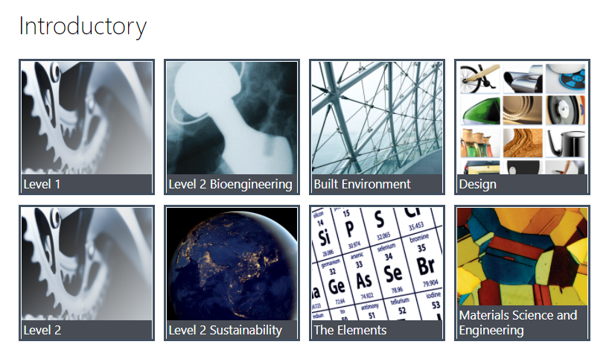
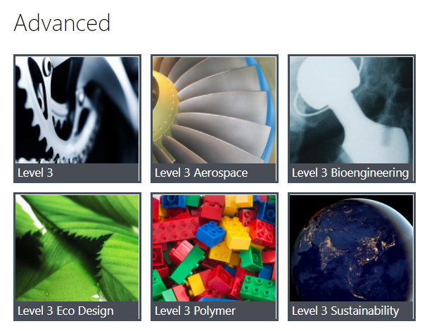
Ansys Granta EduPack
There are two databases relevant to biomedical engineering in Granta EduPack: Level 2 Bioengineering and Level 3 Bioengineering.
Both contain the same medical device data, but differ on the amount of materials data available.
Notes:
Granta EduPack: Bioengineering databases
There are two databases relevant for Biomedical Engineering/medical device teaching: Level 2 Bioengineering which is an introductory database and Level 3 Bioengineering which is an advanced database, thumbnails can be seen in Figure.

Slide 10

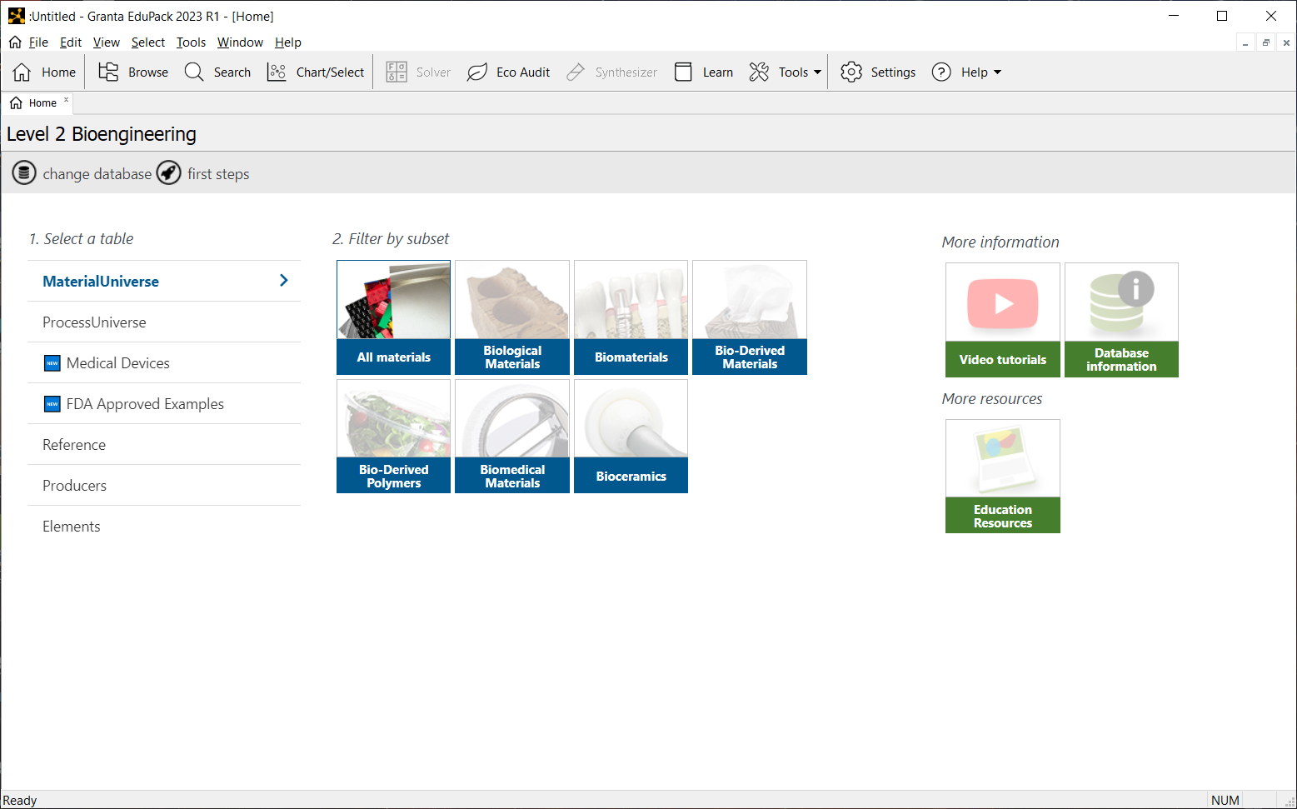
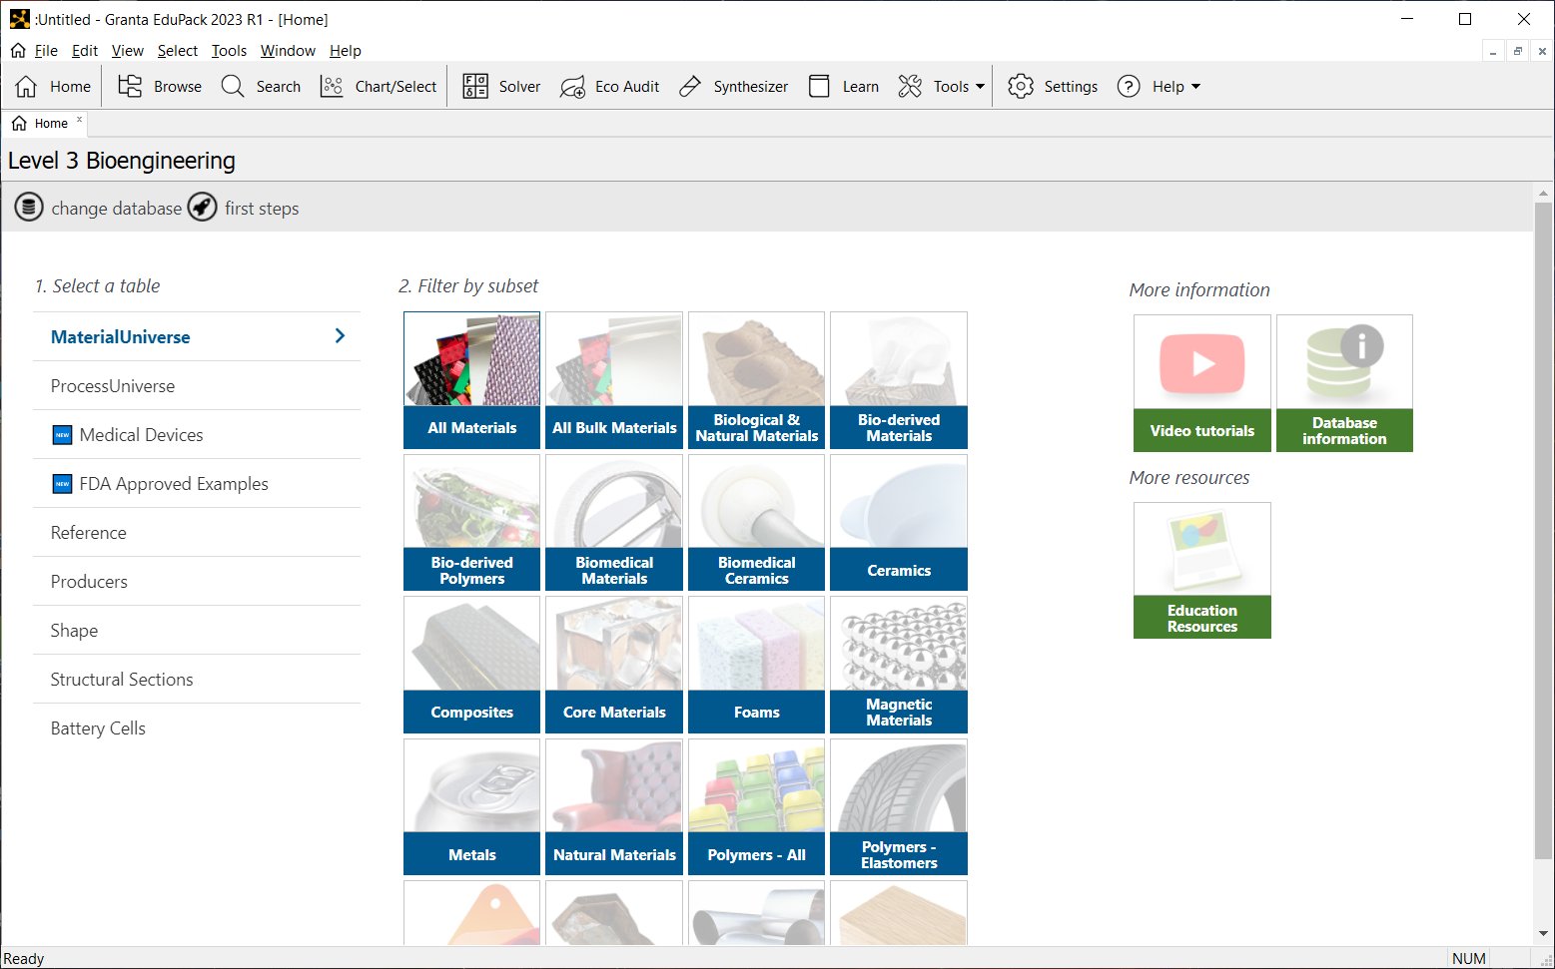
Bioengineering databases: contents overview
For an introduction to medical devices and relevant materials selection, we recommend using Level 2 Bioengineering. For advanced, more realistic projects, we recommend Level 3 Bioengineering.
Key content:
Key content:
62 Medical Devices and 117 FDA Approved Examples
321 Material records
Basic materials selection tools
62 Medical Devices and 117 FDA Approved Examples
4261 Material records
Advanced materials selection tools
Notes:
Bioengineering databases: contents overview
Here is a top-level overview of the similarities and differences between the two Bioengineering databases.

Slide 11


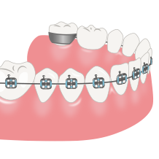

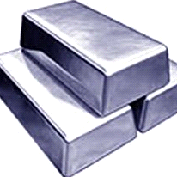
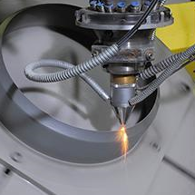
Database contents and structure
Granta EduPack is therefore an excellent source of material and medical device information.
But the structure of its datatables also allows students too explore specific links between medical devices and the materials that have been used to make them.
Medical Devices
Datatable
Links
Material Universe
Process Universe
FDA Approved Examples
The next three slides show an example from the medical devices, FDA approved examples, and MaterialUniverse datatables, as well as the links which connect them.

Slide 12

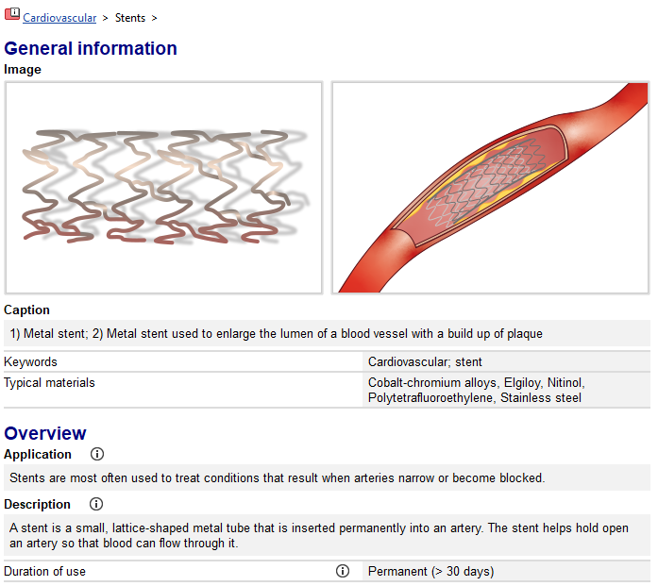
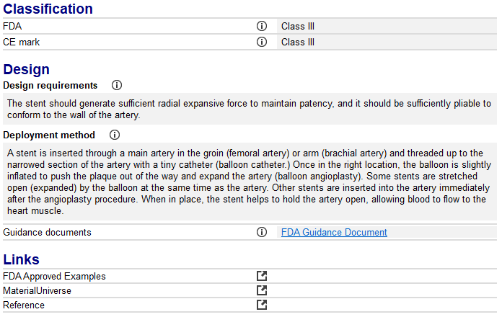

Record 1: Medical Device record
Easy links from this generic metal stent to real-life FDA Approved Examples; typical materials used for application and references.
Notes:
Medical Device Record
An example record from the Medical Devices datatable is shown here, specifically for a Bare Metal Stent.
All Medical Device records start with an image followed by information about its application, classification and design requirements etc.
Links to relevant datatables are shown.

Slide 13

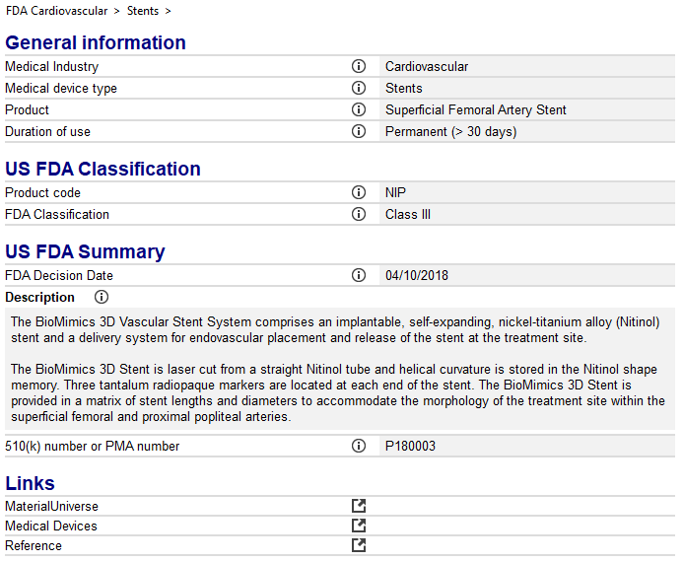

Record 2: FDA Approved Example
General introduction to the 16 medical specialties, referred to by the FDA as panels.
3 letter combinations which associate a device’s type with the product’s classification e.g. NIP (Stent, Superficial Femoral Artery)
Specific details about the device including physical characteristics, date it was approved by the FDA and it’s 510(k) or PMA number.
Notes:
FDA Approved Example Record
An example record from the FDA Approved Examples datatable is shown here, specifically for a BioMimics 3D Vascular Stent. This was one of the relevant records which can be easily linked to the generic medical device bare metal stent shown on the previous slide.
FDA Approved Example contain specific, real-life information on a medical device which is currently on the market.
Links to relevant datatables are shown at the end.

Slide 14

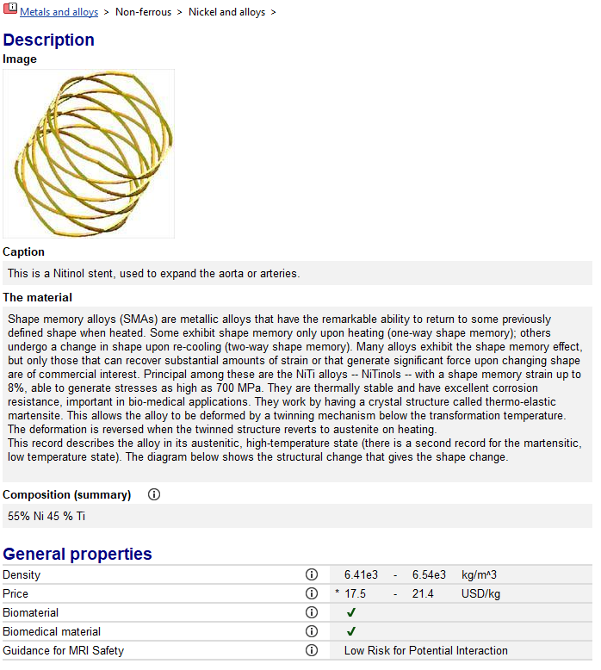
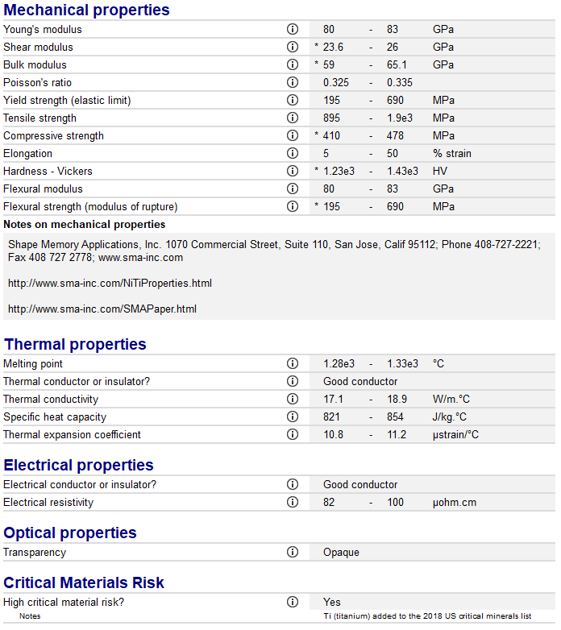
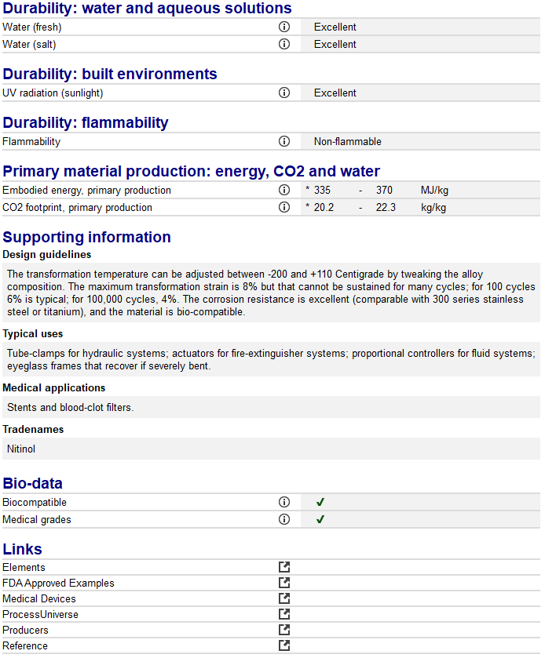

Record 3: MaterialUniverse record
Introductory databases in Granta EduPack provide information on non-grade specific materials. Therefore, this austenitic nitinol record provides a generic overview, with data ranges.
Notes:
MaterialUniverse Record
An example record from the MaterialUniverse datatable is shown here, specifically for Nickel Alloys.
All Material records contain information about its mechanical, thermal, electrical etc properties.
Links to relevant datatables are shown.

Slide 15



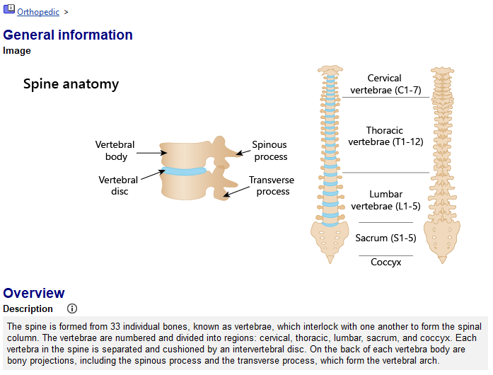
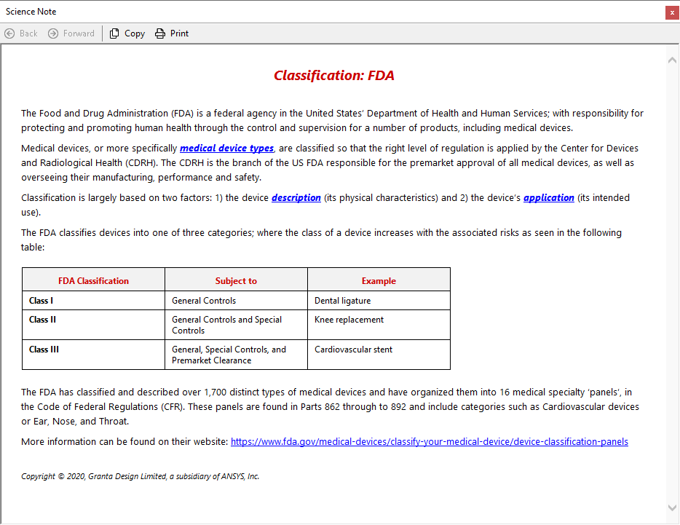
Support for self-guided learning
Folder-level records
Science Notes
Basic introduction to human anatomy, relevant for devices within that folder. In this case spinal devices.
New terminology defined, with external links out to further information e.g., FDA device classification
Notes:
Support for self-guided learning
Two example of built-in student support are shown on this slide.
1. Folder level records within the Medical Devices datatable, contain information about relevant human anatomy. Here the anatomy of the spine is shown.
2. Each property is accompanied by a ‘science note’. By clicking on the property name or the ‘i’ icon shown above, information about the attribute is displayed in a popup window.

Slide 16
Part 3:
Ansys Granta EduPack,
Materials data and tools

Slide 17
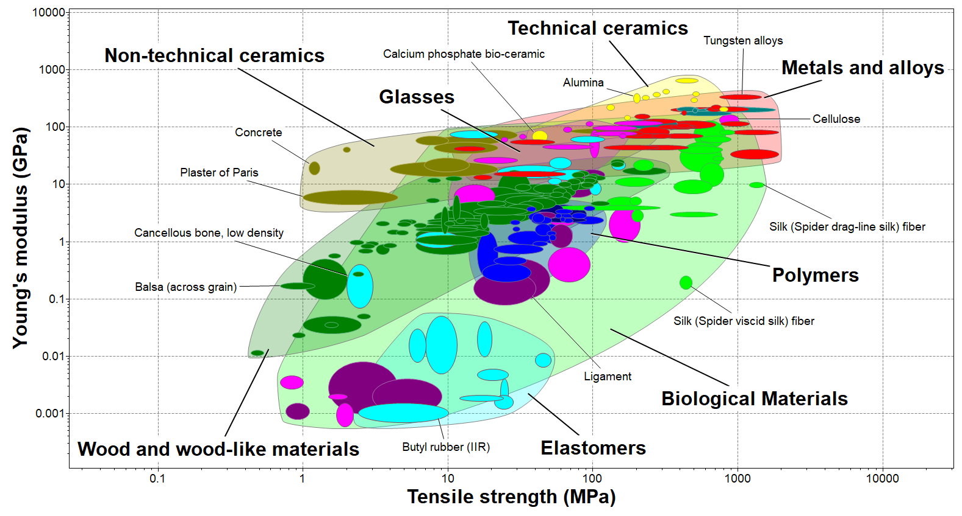
Materials property charts- all materials
Notes:
Material Property Charts- Part 1/4
As with all other Granta EduPack database, the Medical Devices database, also allows for materials to be plotted in Ashby Charts. Here natural and engineering materials are plotted on a Young’s modulus vs Tensile strength Chart.
Using Asbhy’s selection methodology, materials can be systematically chosen for various biomedical applications.

Slide 18
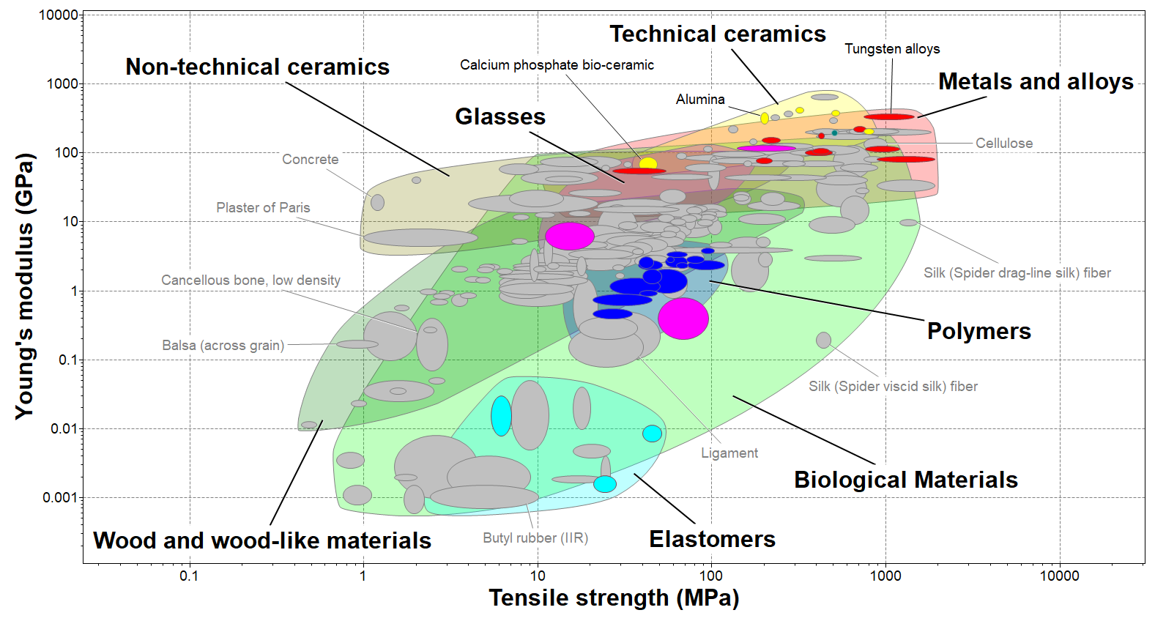
Materials property charts- biomedical materials
Notes:
Material Property Charts- Part 2/4
The selection methodology can be applied to biomedical projects which aim to identify suitable materials for cardiovascular, orthopedic and dental applications.
In this example, a Tree stage was initially used to filter material records which are currently used in a real-life ‘cardiovascular, orthopedic or dental’ application. Alternatively, a similar result could be found using a Limit stage by selecting ‘medical grade’ materials.
Materials which do not pass this stage, appear grey.

Slide 19
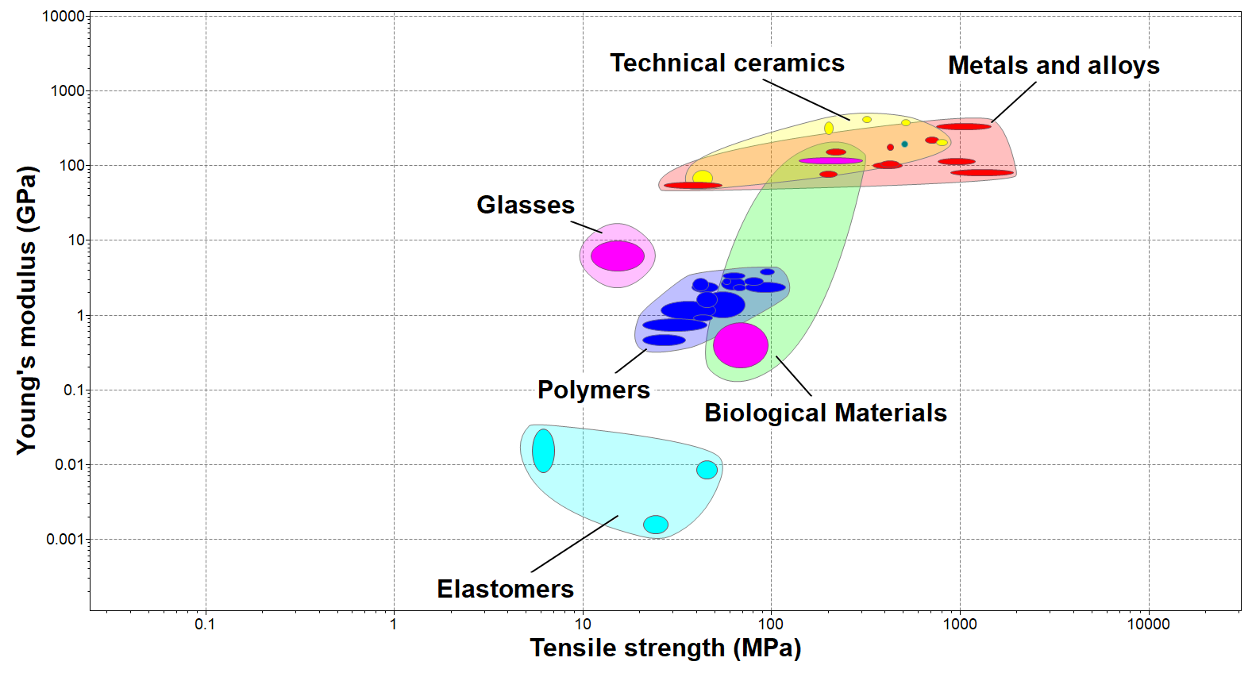
Materials property charts- only biomedical materials
Notes:
Material Property Charts- Part 3/4
For ease of understanding, materials which were unsuccessful during the first selection stage, can be removed from the Chart.
By copying and pasting (using Paste Special > Device Independent Bitmap), Ashby Charts can easily be incorporated into class reports.

Slide 20
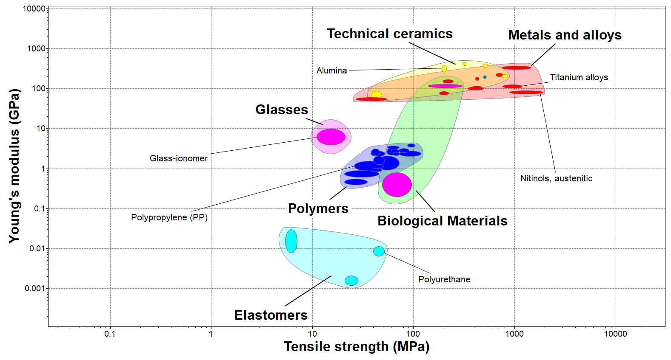

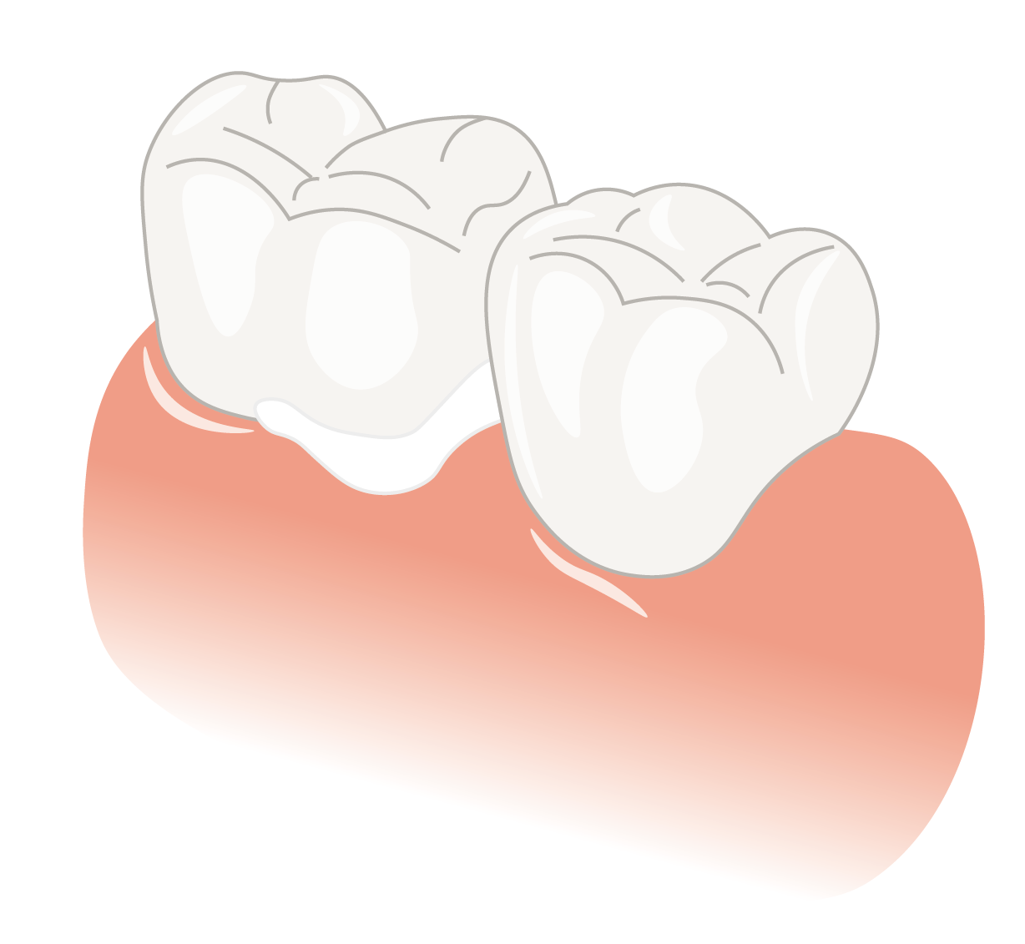
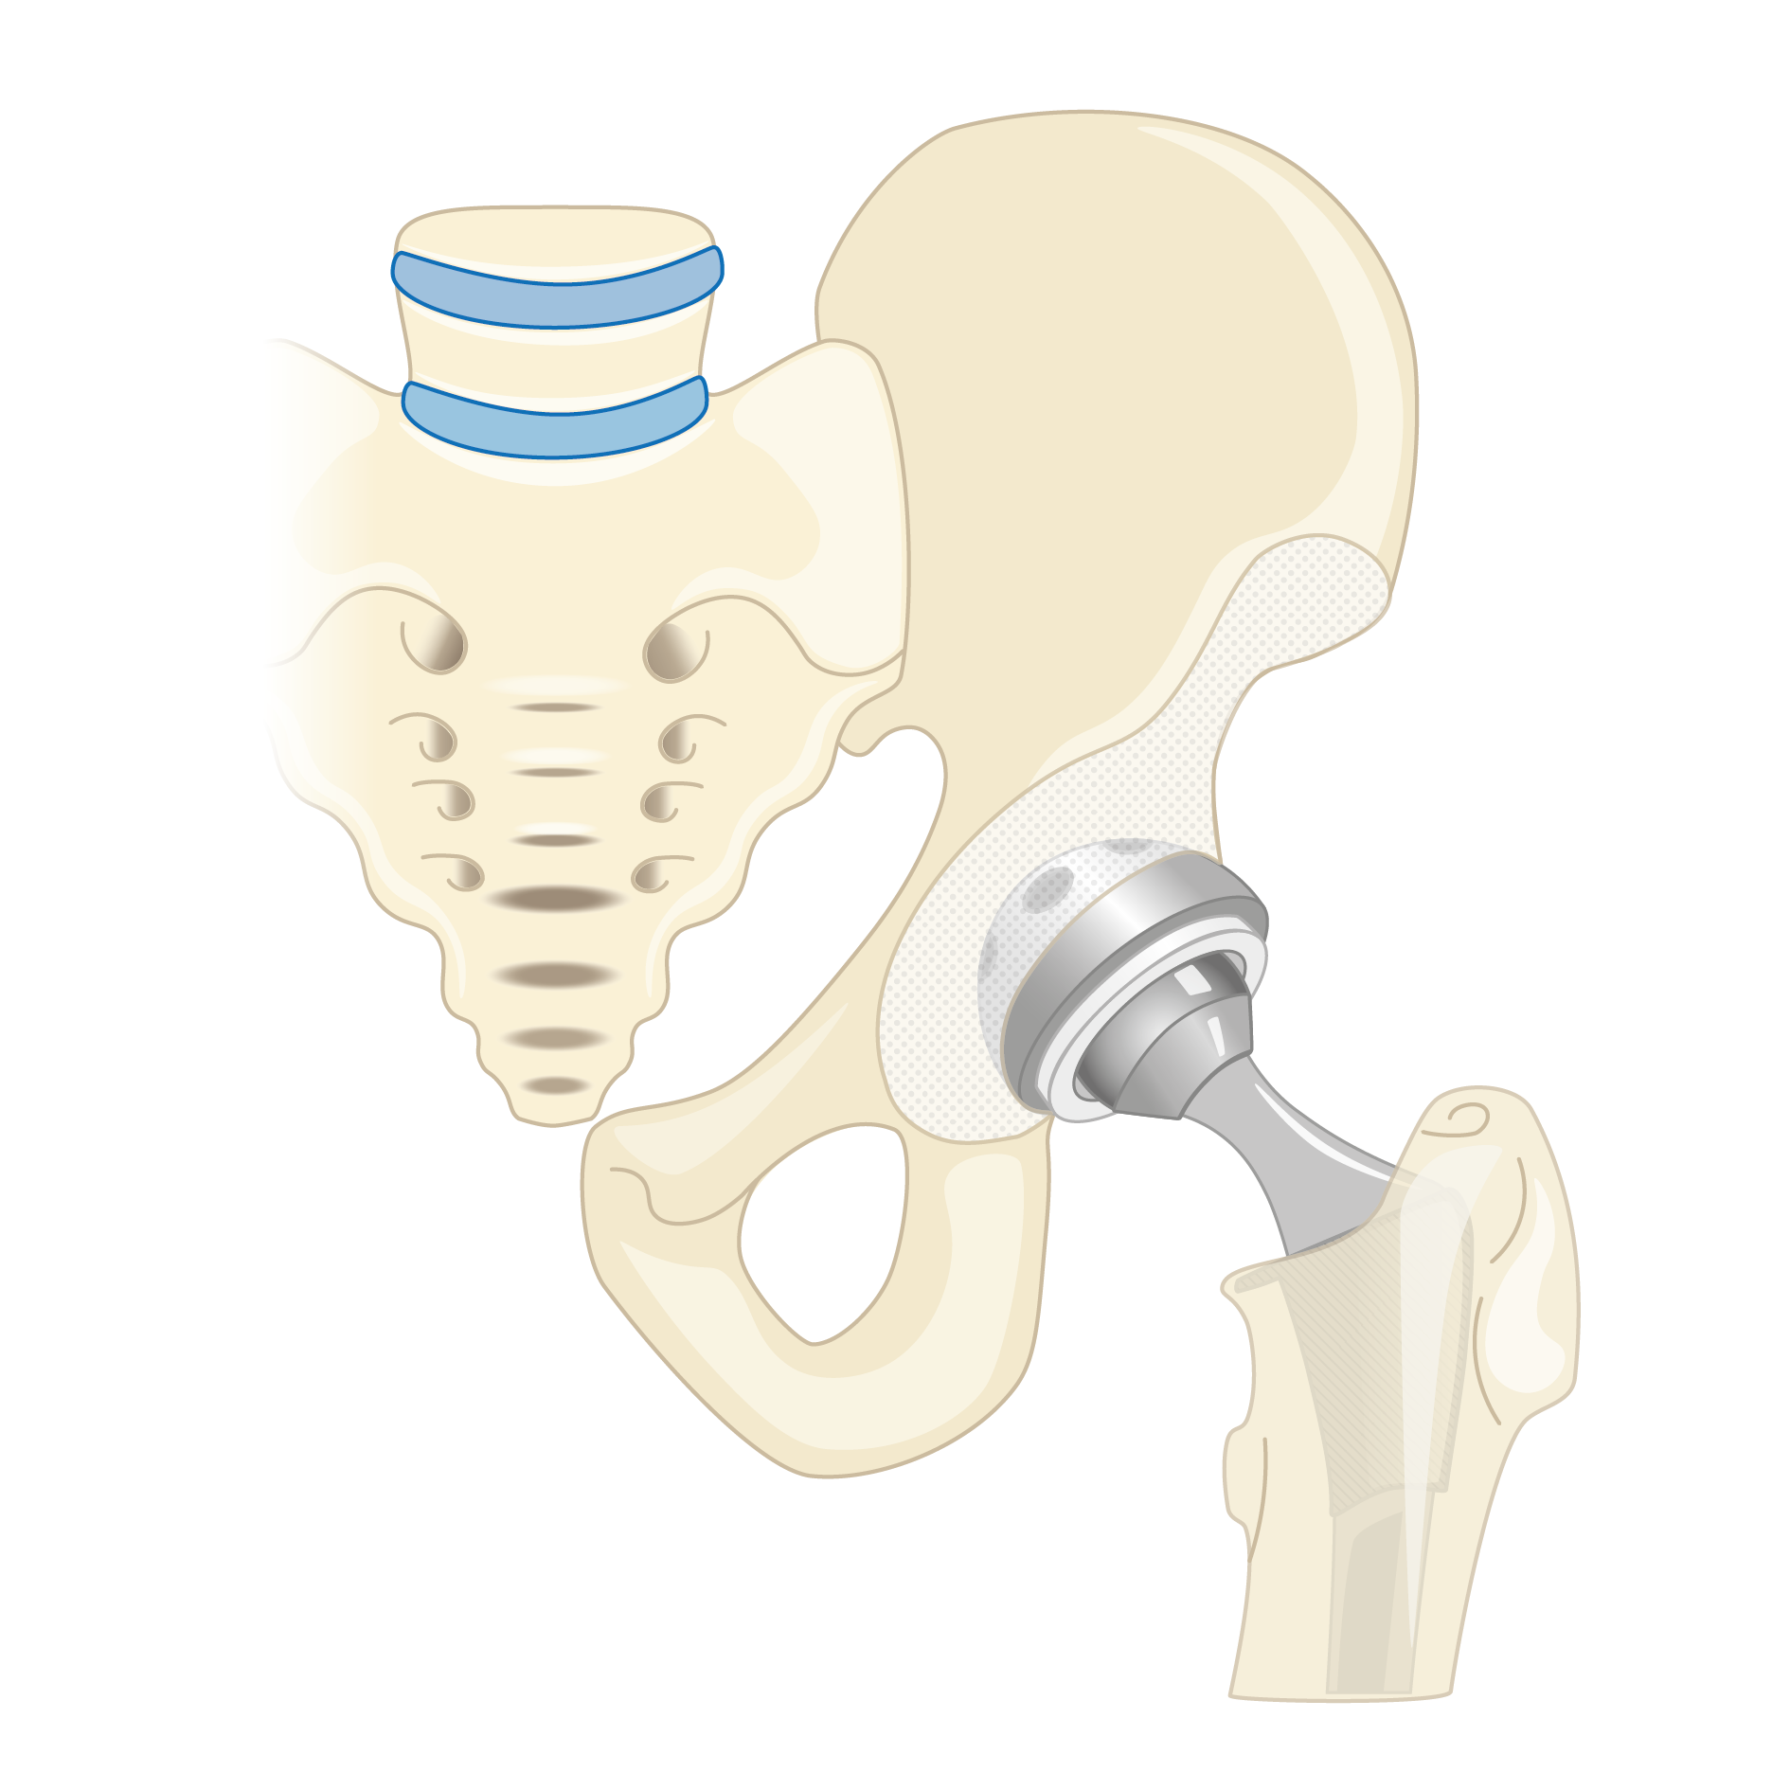
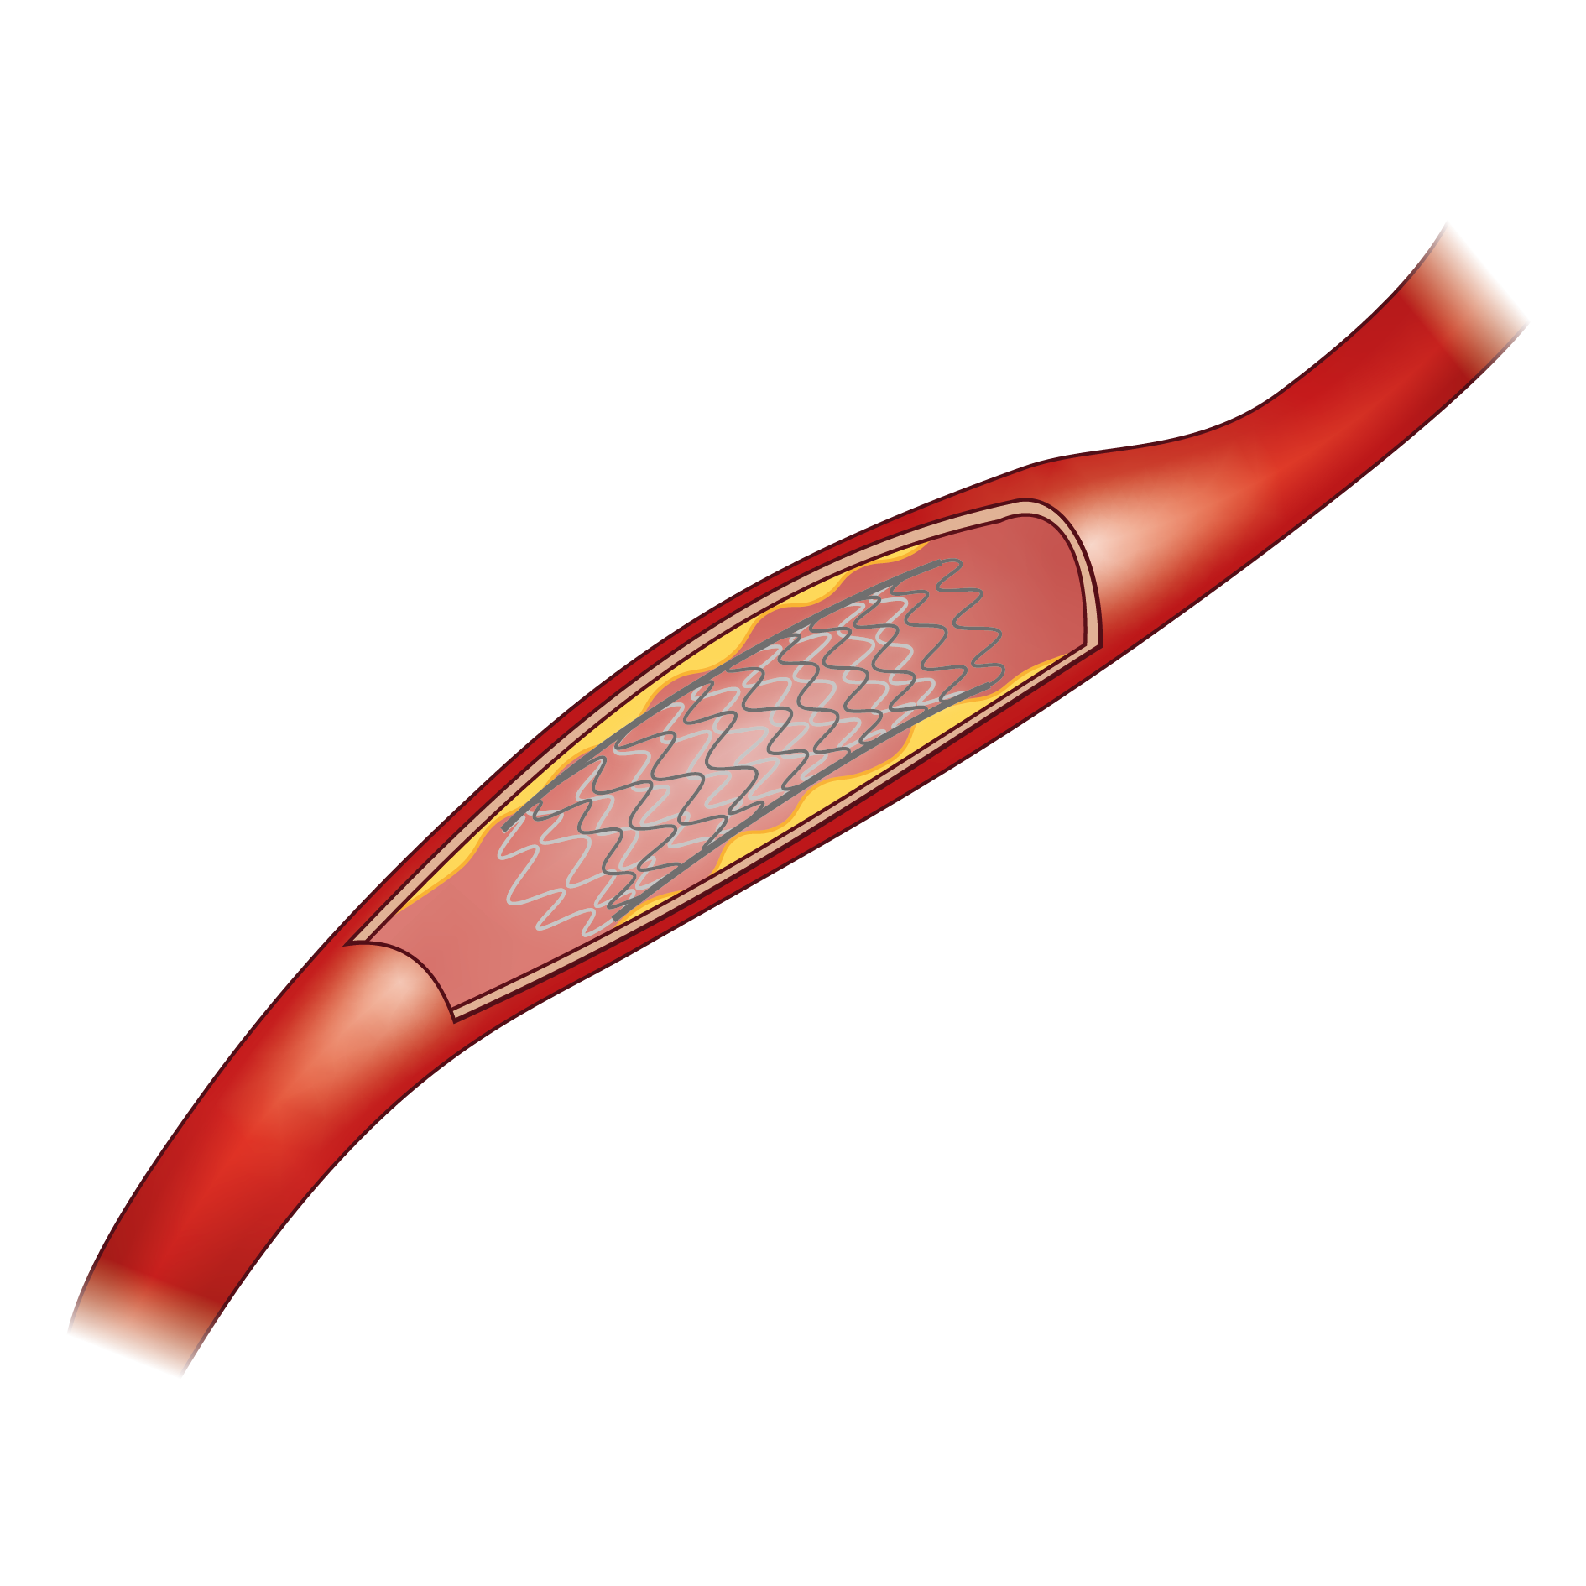
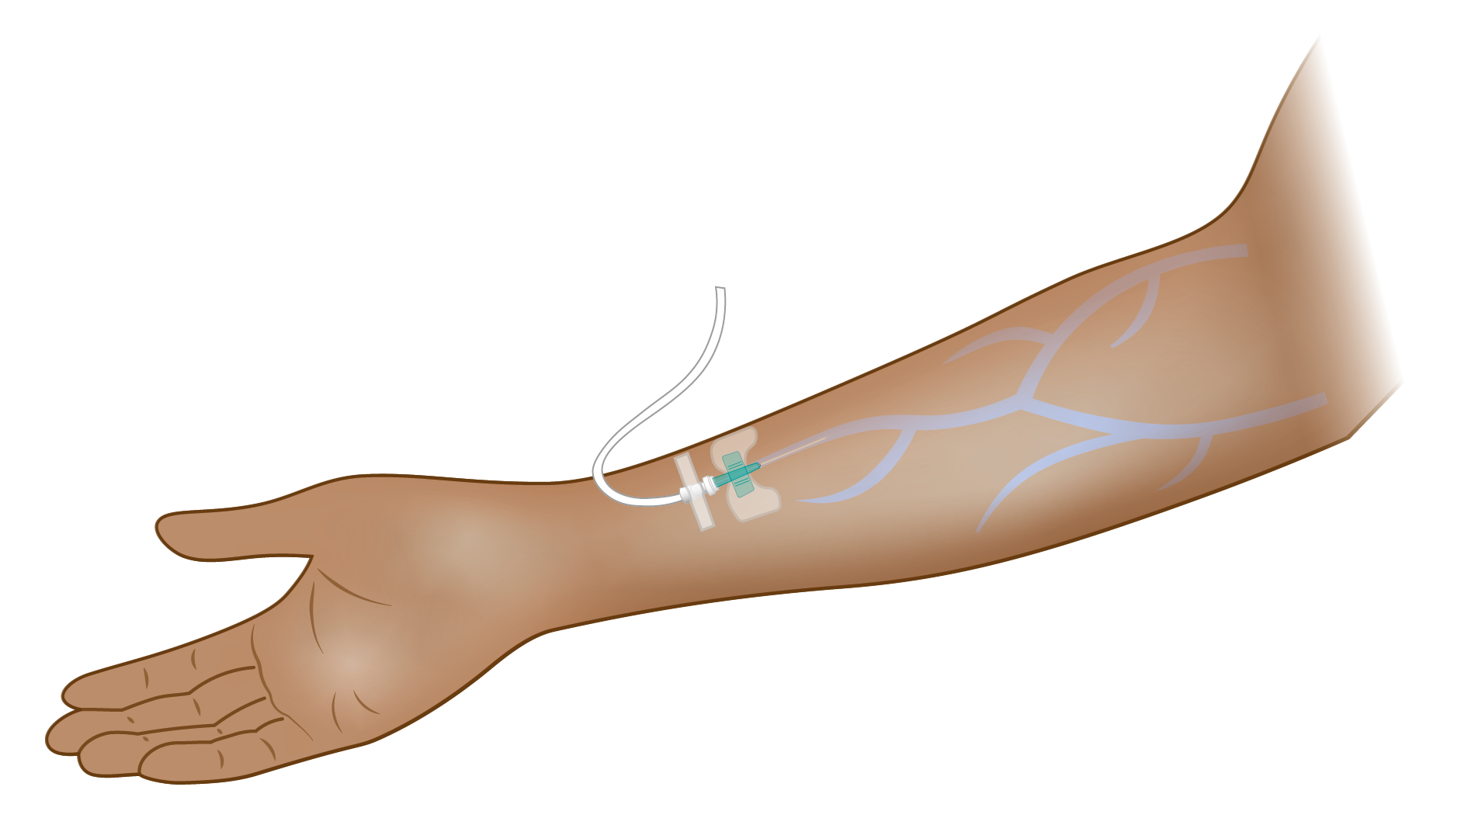
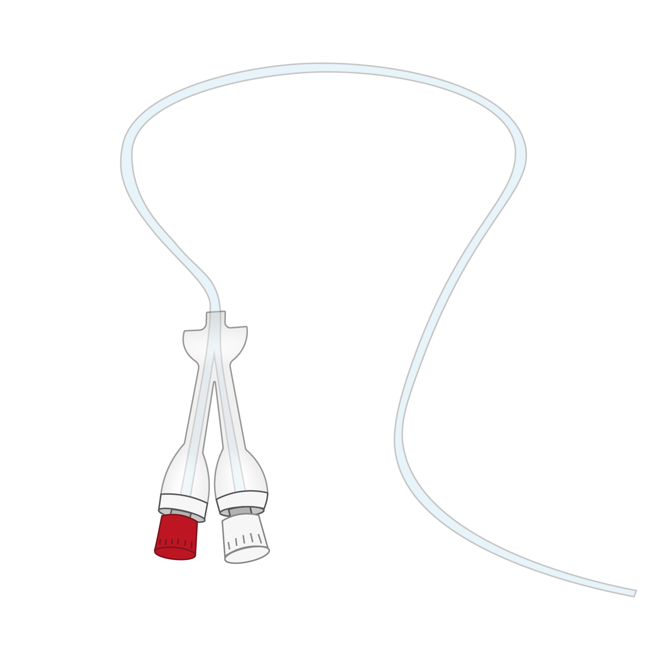
Materials Property Charts- only biomedical materials
Notes:
Material Property Charts- Part 4/4
By double clicking on the bubbles, material records can be opened which, in turn, link to medical device records.
Some biomedical material applications are shown here.
Based on these examples,

Slide 21
Part 4:
More support

Slide 22
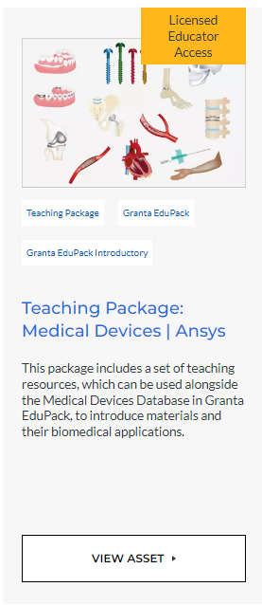
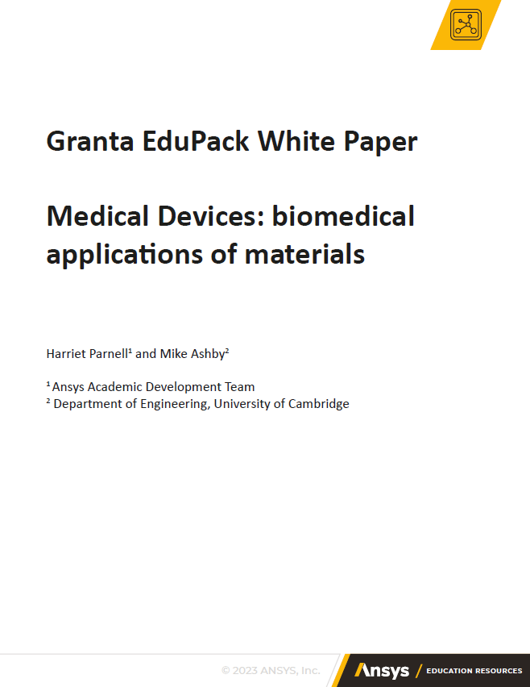

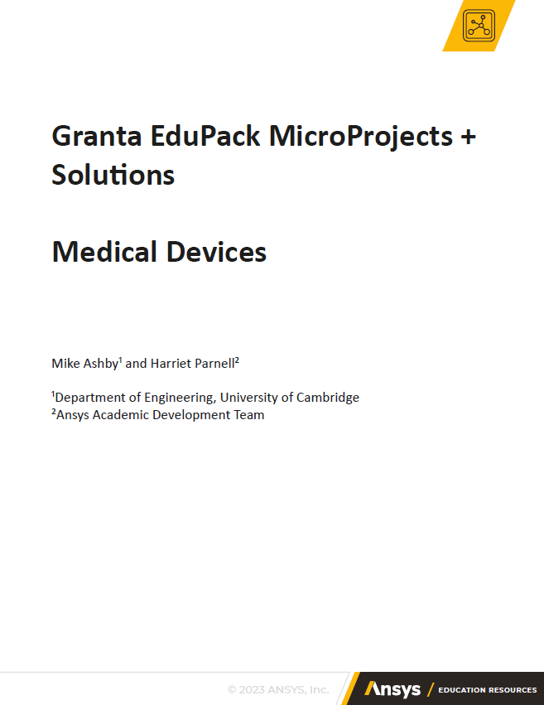
More medical device support
You can find more support through our Ansys Education Resources, including the full teaching package shown below.

Slide 23




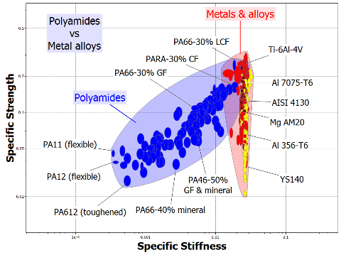
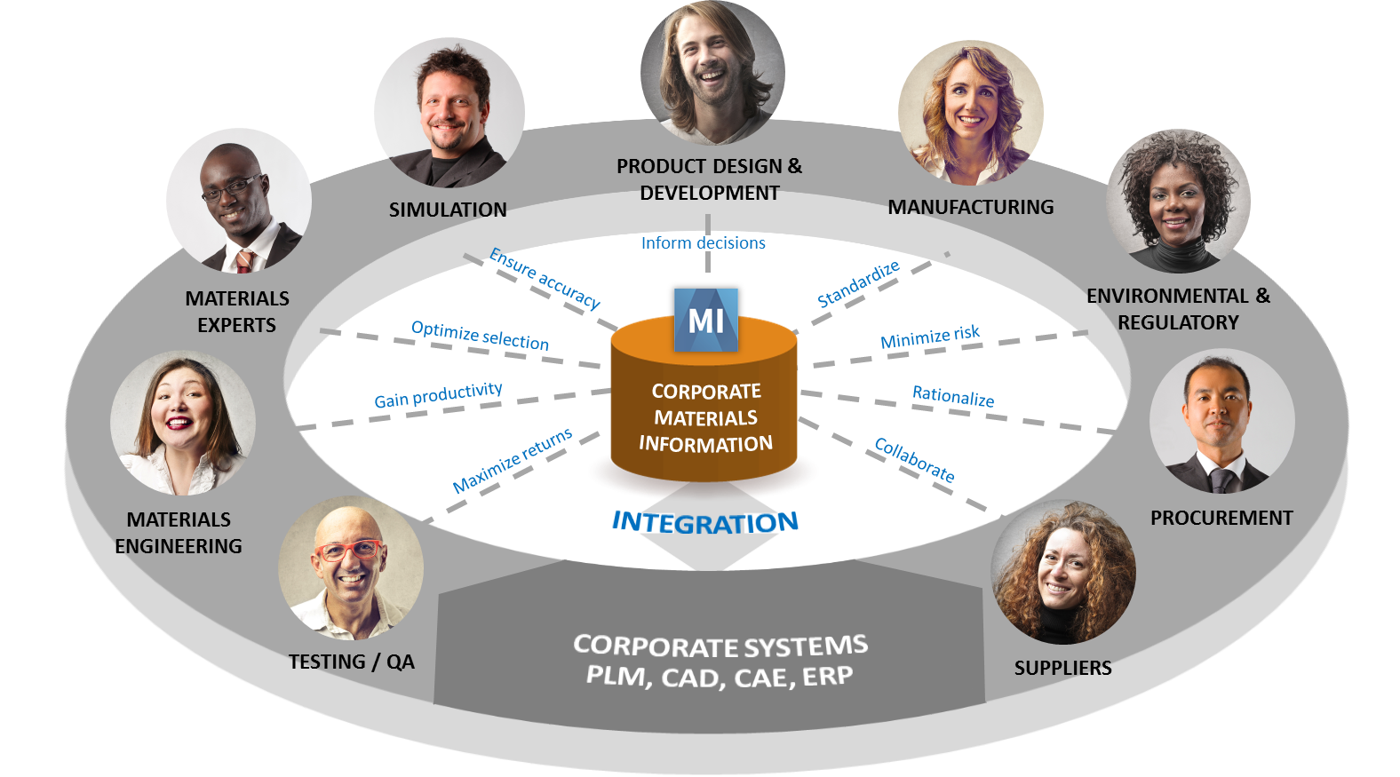
More Bioengineering resources
Bioengineering Level 2
Advanced Teaching
Research Online Database:
Bioengineering Level 3
Research
Human Biological Materials
Materials Selection
ASM Medical Materials Database
Undergraduate
Research / Industry
Notes:
Resource Overview
So far, we have seen the Medical Devices database within Granta EduPack which is used for undergraduate teaching.
Granta Selector is a more advanced version of EduPack and an industry-standard tool for materials selection and graphical analysis of materials properties. Usual for engineers and designers of medical devices.
Granta Mi is the corporate web-based platform used to handle more extensive material information.

Slide 24
Summary
The term ‘Medical Devices’ covers a wide range of products from bone scaffolds, metal stents, and dental implants to MRI scanners, wheelchairs and home diagnostic tests.
The Medical Devices datatable within Granta EduPack can be used to investigate both generic and real-life medical devices from the cardiovascular, orthopaedic and dental systems.
Using Granta EduPack, materials can be methodically selected for various biomedical applications.

Slide 25
Lecture unit series
These PowerPoint lecture units, as well as many other types of resources,
can be found in the Ansys Education Resources webpage.
Finding and Displaying Information
Unit 1 | The materials of engineering
Unit 2 | Material property charts: mapping materials
Unit 3 | The Elements database: properties, relationships and resources
Material Properties
Unit 4 | Manipulating properties: composition, microstructure, architecture
Unit 5 | Designing new materials: filling the materials-property space
Unit 6 | Materials Science and Engineering
Selection
Unit 7 | Material selection: translation, screening, ranking, documentation
Unit 8 | Objectives in conflict: trade off methods and penalty functions
Unit 9 | Material and shape: materials for efficient structures
Unit 10 | Manufacturing processes and cost modeling
Unit 11 | Eco-informed material selection
Unit 12 | Eco design and the Eco Audit tool
Sustainability
What is a sustainable development? A materials perspective
Materials for low carbon power
Special Topics
The Built Environment
Structural sections: shape in action
Materials in industrial design: Why do consumers buy products?
The Design database for Products
The Battery Designer tool
Bioengineering and Medical Devices
Advanced Teaching and Research
Advanced databases
The Aerospace database
The Polymer database
The Synthesizer tool: hybrids and other models
www.ansys.com/education-resources
Notes:
Lecture Units Series
This is a list of the Lecture Units available for teaching with the Ansys Granta EduPack. These PowerPoint presentations and more information can be found on the Ansys Education Resources webpage:
www.ansys.com/education-resources.

