Slide 1
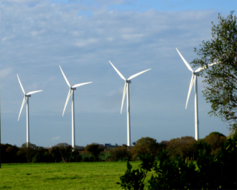
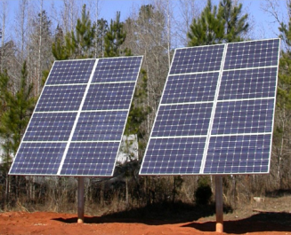
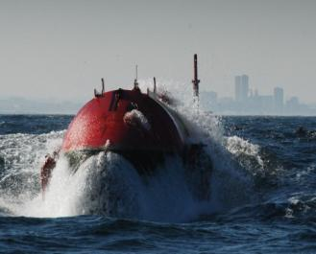
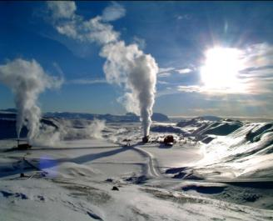
Materials for
low carbon power
Mike Ashby
Department of Engineering,
University of Cambridge
Notes:
The PowerPoint Lecture Units For 2023
The Lecture Units developed for teaching in connection with Granta EduPack are listed at the end of this presentation.

Slide 2
Learning objectives for this lecture unit
Intended Learning Outcomes
Knowledge and Understanding | Understanding of options for power generation and storage
Skills and Abilities | Ability to explore alternative energy strategies relating to materials
Values and Attitudes | Insights into the necessity and possibilities of lower carbon energy systems
Resources
Text: “Materials and the Environment”, 2nd Edition (2012) Chapters 1 – 10
Text: “Materials and Sustainable Development”, by Mike Ashby, Didac Ferrer Balas and Jordi Segalas Coral, Butterworth Heinemann (2015) Chapters 1, 9. 10, 12
Software: Ansys Granta EduPack with the Sustainability database
Notes:
Learning Objectives
These Intended Learning Outcomes are based on a taxonomy of knowledge and understanding as the basis, skills and abilities as necessary for the practical use of knowledge and understanding, followed by acquired values and attitudes enabling assessments and responsible use of these abilities.
Combined with a suitable assessment, they should be helpful in the context of accreditations or for the CDIO Syllabus.
The Texts listed are from books authored or co-authored by Mike Ashby but other texts are also referred to in the Science Notes.

Slide 3
Outline of the lecture unit
Generation: conventional, nuclear, renewable
Storage: chemical mechanical, thermal, electro-magnetic
Why is all this interesting?
Notes:
Low carbon power
If you want to make and use materials the first prerequisite is energy. The global consumption of primary energy today is approaching 500 exajoules (EJ)* derived principally from the burning of gas, oil and coal. This reliance on fossil fuels will have to diminish in coming years to meet three emerging pressures:
To adjust to diminishing reserves of oil and gas.
To halt the flow of carbon dioxide and other greenhouse gases into the atmosphere.
To reduce dependence on foreign imports of energy and the tensions these create.
The world-wide energy demand is expected to treble by 2050. The bulk of this energy will be electrical. How will it be generated when oil and gas reserves become depleted? And how much time will the transition take? The options are listed in on the right of this frame.
*1 MJ = 0.28 kW.hr = 948 Btu. 1 quadrillion (10¹⁵) Btu is called a “Quad”, symbol Q. Thus 1 EJ =~ 1 Q.

Slide 4
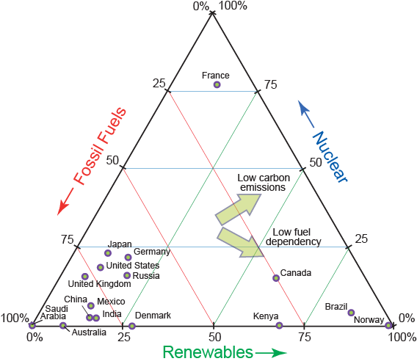
How much energy do we use now?
What’s the distribution of sources?
Power needs in 2050
OECD today: around 3 000 GW electrical
Rising population x Increasing GDP
means rapidly increasing needs
Redistribution from fossil to renewable
Notes:
Energy Use
The current OECD electric power-generating capacity is around 3 000 GW. At present about 2/3 of this derives from fossil fuels (IEA 2017). Electric power appears to be the future for almost everything except air and space transport. Before examining individual systems for generating it, we should look at the electric energy-mix to which individual nations have committed themselves. The fossil / nuclear / renewable triangle shown in this frame shows that this is diverse. The green arrows indicate the way changes of the mix reduce carbon emission or reduce dependence on fuels, fossil or nuclear.
In one way this is a reassuring picture. We are not all stuck in one corner. Nations particularly endowed with natural energy sources (Norway, Brazil, Canada, Iceland) have developed cost-efficient ways of using them. The high commitment to nuclear power in France demonstrates that it is a viable option. Most of the nations in the bottom-left corner have renewable or nuclear options, but few have large untapped hydro or geothermal resources, and even fewer have the confidence in nuclear technology on which France has built its energy-generating base.

Slide 5
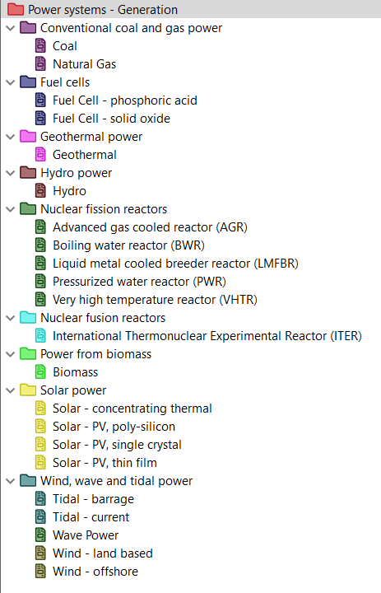
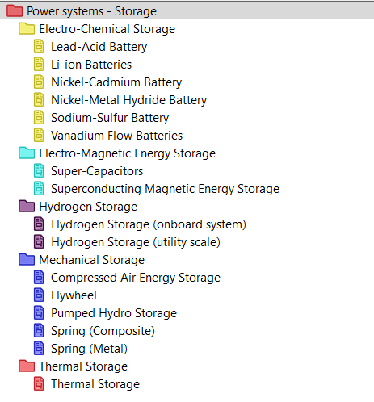
Power system data-tables in Level 3 Sustainability
Notes:
Data-tables

Slide 6
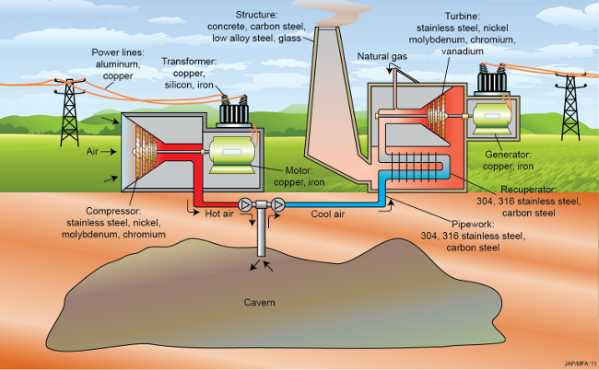
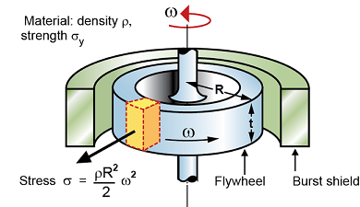
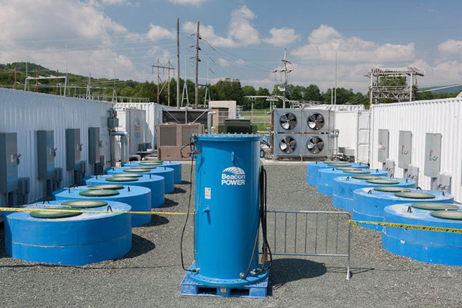
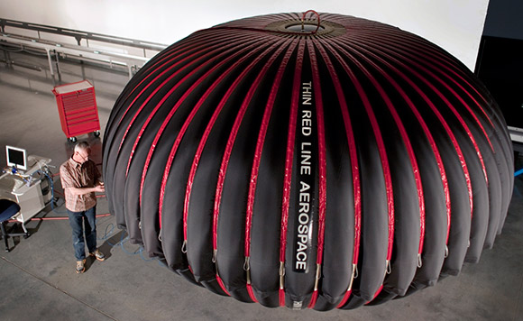
Materials for energy storage
Kinetic energy storage
Compressed air storage
Notes:
Energy storage
These are examples of the images from the datatable Power Systems-Storage. The schematic identifies the dominant materials.

Slide 7
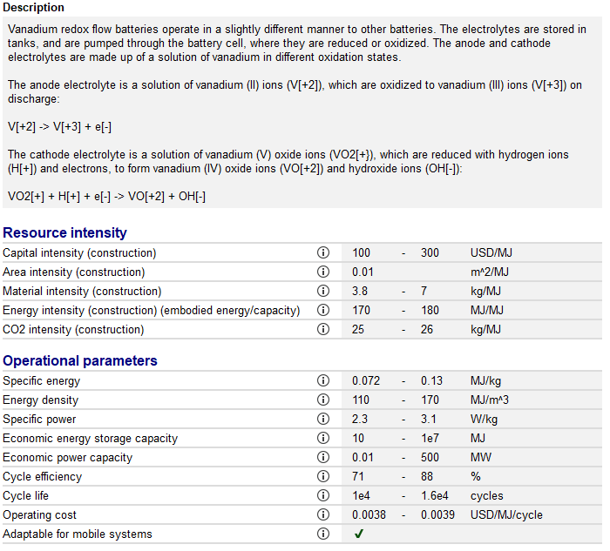
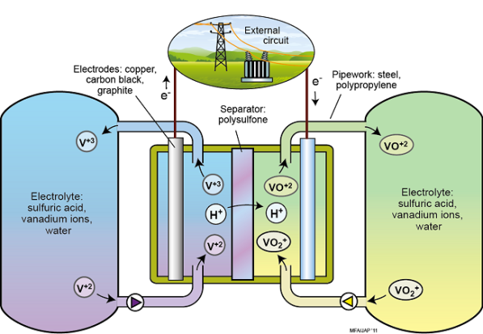
Record: materials for energy storage
Vanadium Flow Battery
Vanadium flow battery
Links to Materials
Excerpts from Granta EduPack Level 3 Sustainability
Notes:
Record example
This is an example of a record from the datatable Power Systems-Storage. The schematic identifies the dominant materials. The data includes resource intensities.

Slide 8
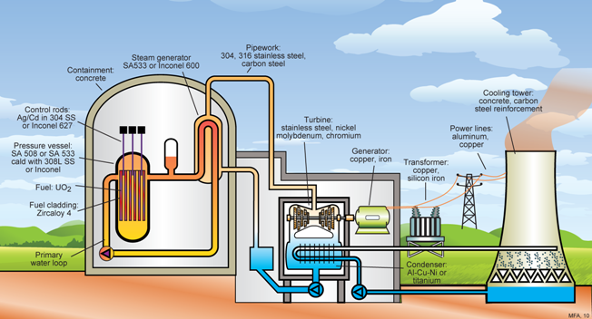
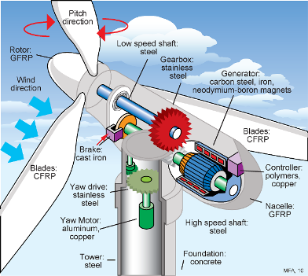
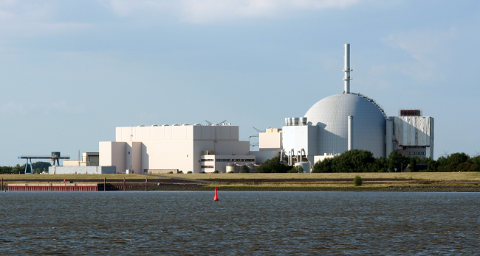
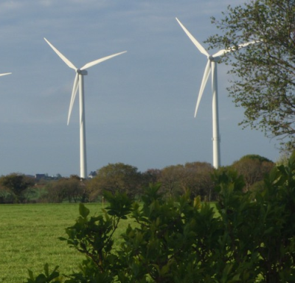
Materials for low carbon power
Materials for nuclear power
Materials for wind power
Notes:
Low Carbon Power
These are examples of the images from the datatable Power Systems-Generation. The schematic identifies the dominant materials.

Slide 9
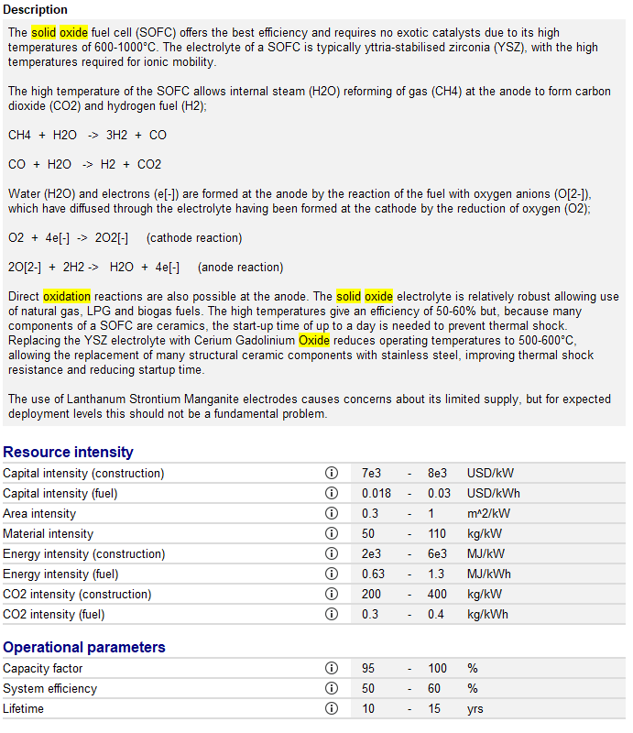
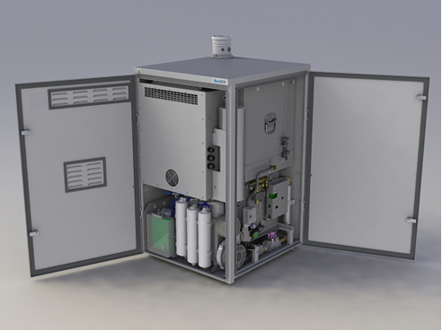
Record: materials for low carbon power
Solid Oxide Fuel Cells
Solid oxide fuel cell
Links to Materials
Excerpts from Granta EduPack Level 3 Sustainability
Notes:
Record example
This is an example of a record from the datatable Power Systems-Generation. The schematic identifies the dominant materials. The data includes resource intensities.

Slide 10
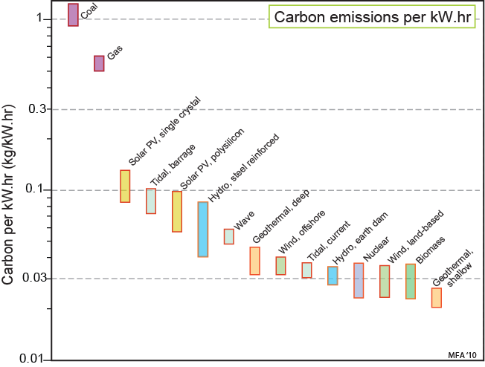
Is it really low carbon?
Nuclear
Hydro
Wind
Solar PV
Geothermal
Tide
Wave
Biomass
Notes:
Sources of low-carbon power
The sources are listed on the left. The carbon dioxide released during construction and operation of each system, pro-rated per kW.hr of delivered power, is plotted on the right, where it is compared with that of electrical power from fossil fuels.

Slide 11
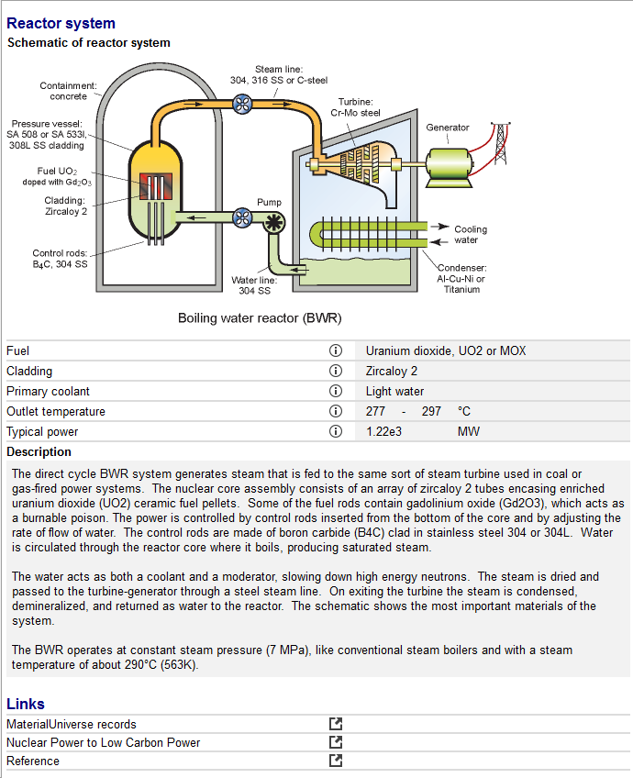
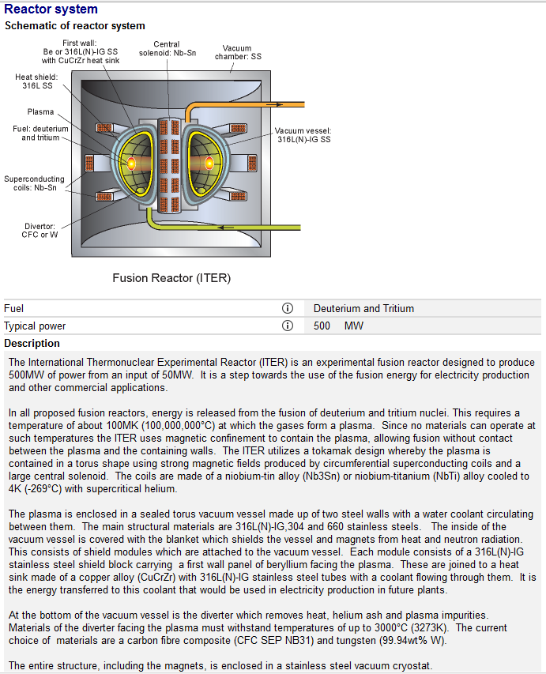
Records: nuclear power systems
Fission Reactors
Fusion Reactors
Notes:
Record example
The datatable Power Systems-Generation cover the two main types of reactors: Fission (conventional) and Fusion (experimental).

Slide 12
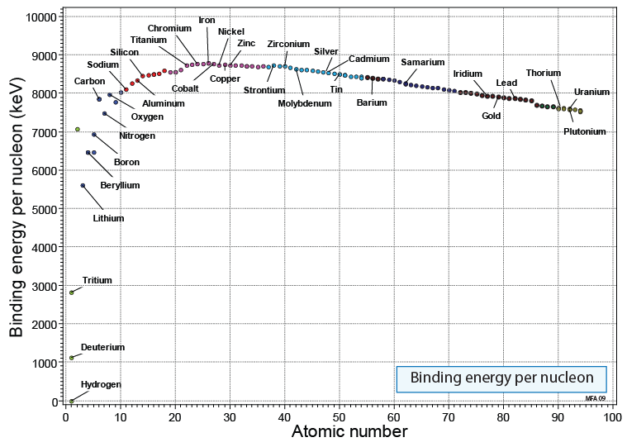
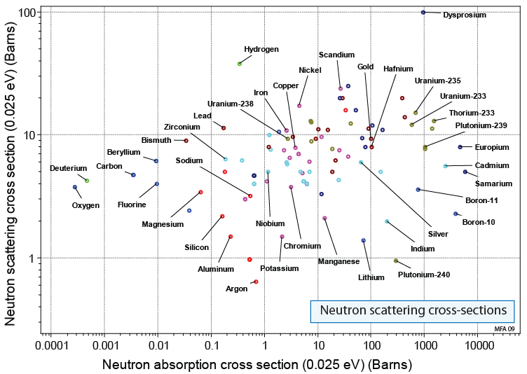
Nuclear properties in the Elements data-table
Moderator materials
High scattering, low absorption
Most stable elements
Fuels for
fission reactors
Fuels for
fusion reactors
Control rod materials
High absorption, low scattering
Notes:
Stability of the Elements and Cross-section
The nuclear stability of an element is measured by the binding energy per nucleon. The Graph shows the binding energy per nucleon against atomic number (choosing a linear scale for atomic number). Elements with the most stable nuclei and those that are potential fuels for fission reactors fusion reactors can be highlighted.
Moderators are materials that slow neutrons by scattering them, converting their kinetic energy into heat. Neutron absorption is undesirable because it causes transmutations into possibly radio-active species. So, one criterion for selecting moderator materials is that they should have a high scattering cross-section and a low absorption cross section.

Slide 13
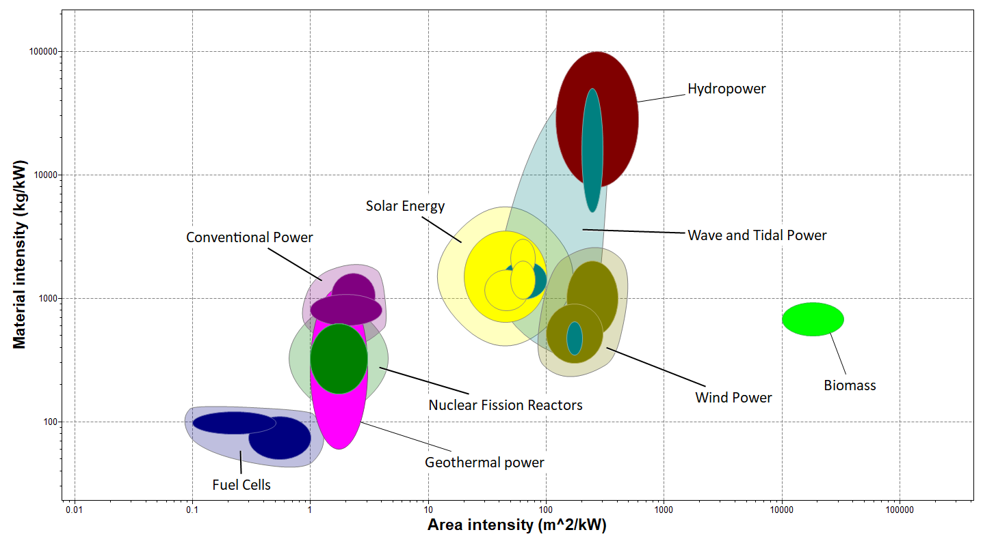
The big picture (1): space and materials
Concepts
Resource intensities
Capacity factor
Rated (nominal) power kW _{nom}
versus Actual power kW _{actual}
Notes:
The big picture
Low carbon power systems require resources of space, materials, construction energy and capital. We define “resource intensity” as the quantity of each resource per kW of nominal, power generating capacity, “nominal” meaning the power rating of the system. The actual power generated by the system is less than the nominal rating because the capacity factor – the fraction of time that the system operates at full power – is low. Thus for nuclear power the capacity factor is typically 50%. That for hydro power is about 55%, for off-shore wind about 35%, for land-based wind about 25% and for photo-voltaic solar power, about 10%.
This frame shows the material and area intensities. For a meaningful comparison the nominal power will not do; instead we need the intensities associated with the actual power output averaged over a year. To calculate these we divide each nominal intensity by the capacity factor expressed as a fraction to give “actual” material and area intensities, plotted here.
The most striking thing about the chart is enormous differences between the area intensities of different systems. Gas and coal-fired power stations, nuclear and geothermal have small footprints of around 3 m²/kW actual. All others require an area 50 to 500 times greater. For offshore wind and wave power this may not be a problem, but for land-based systems the loss of land that could be used for other purposes may present difficulties. Conventional, nuclear and geothermal systems also have lower material intensities than many of the others, but to understand the material implications of alternative power systems we must examine their bills of materials in more depth.

Slide 14
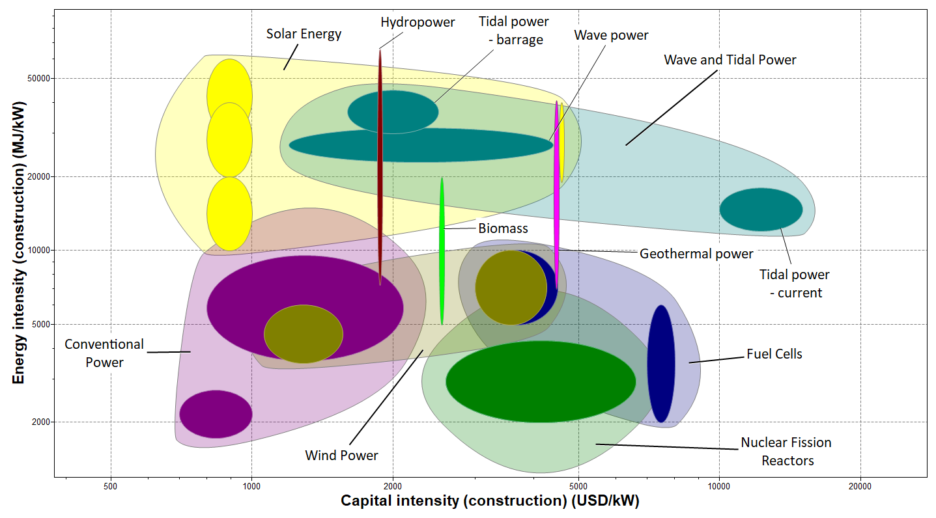
The big picture (2): energy and capital
Concepts
Low power density
High resource demand
Notes:
The Big Picture (2)
This frame shows the capital and energy intensities for the construction of the power systems. They are calculated, as with material and area, by dividing the nominal intensities by the capacity factor. The two actual intensities are approximately proportional. This arises partly because systems that are energy-intensive to construct are (inevitably) more expensive than those that are not, and partly because the actual power delivered by those with low capacity factors (like solar photovoltaics) is much less than the nominal rating of the system, inflating both intensities.

Slide 15
The scenario
Power needs in 2050
Today: 3 000 GW electrical
Rising population x Increasing GDP = Rapidly increasing needs
All built in the next 30 years
Global population
X
=
Global GDP
Global resource demand
2011 2050
2011 2050
2011 2050
The Paris agreement requires 70% reduction in CO₂ emissions by 2050
What are the obstacles?
What implications for materials?
Notes:
The Scenario
Rising global population, and the rising GDP and spending power per capita multiply to create steeply rising global resource demand, and with it, demand for electrical power. To explore the impact of this on materials, we explore the hypothetical scenario requirement that 2,000 GW of low carbon power is to be constructed globally in the next 10 years, comparing the demand that would place on supply of a given material with the current global production of that material. If the demand is just a small fraction of current production, we don’t anticipate problems. But if it exceeds current production, the supply chain will be under stress.

Slide 16
How much material?
Materials: PV power | Intensity (kg/kW_{nom})
Aluminum | 62.32
Antimony (dopant) | 0.10
Copper* | 0.8
EVA | 41.33
Gallium* (dopant) | 0.50
Galvanized mild steel | 40.67
Indium* | 0.08
Lead tin solder | 0.08
Silane (amorphous silicon) | 0.49
Silver* | 0.08
Stainless steel | 18.70
Tellurium* (dopant) | 0.10
Ytterbium* (dopant) | 0.10
Total mass, all materials | 165
Materials: nuclear power | Intensity (kg/kW_{nom})
Aluminum | 0.02 - 0.24
Boron | 0.01
Brass/bronze | 0.04
Cadmium | 0.01
Carbon steel | 10.0 - 65
Chromium* | 0.15 - 0.55
Concrete | 180 - 560
Copper* | 0.69 - 2
Inconel | 0.1 - 0.12
Indium* | 0.01
Lead | 0.03 - 0.05
Manganese* | 0.33 - 0.7
Nickel* | 0.1 - 0.5
PVC | 0.8 - 1.27
Silver* | 0.01
Stainless steel | 1.56 - 2.1
Uranium* | 0.4 - 0.62
Zirconium* | 0.2 – 0.4
Total mass, all materials | 170 - 625
Notes
These are masses per rated kW
Starred * materials are strategic
Notes:
How much material
These are examples of bills of materials, listing materials intensities, for PV power on the left, and for nuclear power on the right. The White Paper on Energy, containing Materials for Low Carbon Power Systems has more of these.

Slide 17
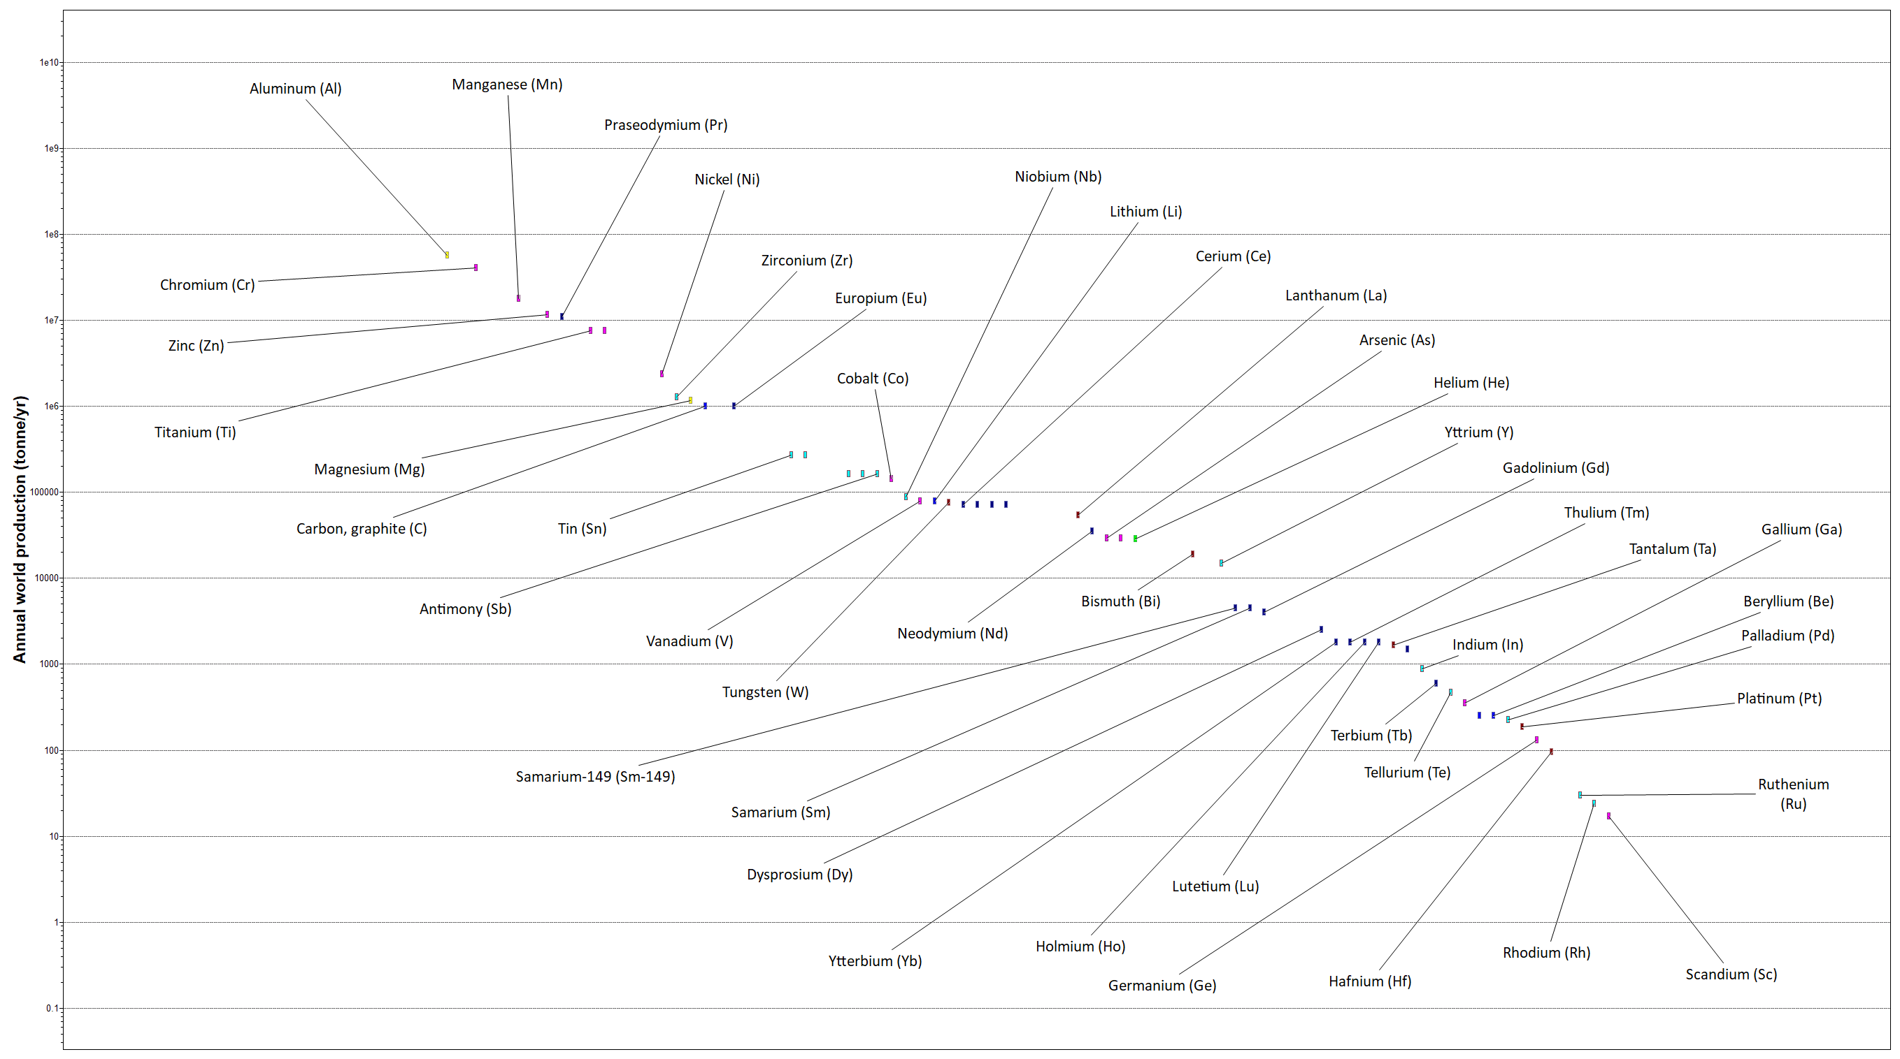
Strategic materials and world production
What are strategic materials ?
Ordinary materials that perform essential functions (e.g., Cr, Mn, W)
(can generally be recycled)
Rare or highly localized materials that enable new technologies (Nd, In, Pt)
(not easy to recycle)
Notes:
Critical materials
One concern that emerges is the demands made on materials deemed to be critical, either because the global supply is limited or because the main ore-bodies are localised in such a way that a free market does not operate or other strategic reasons. This frame shows the world production of thirty nine elements that are considered to be critical to the US. Later sections compare the demand of each power system for these elements with the world production, highlighting where material constraints are likely. To do this we examine a hypothetical scenario: that 2,000 GW were to be replaced by a given alternative power system over a period of 10 years. From this we calculate the fraction of current world production of each strategic material that would be required to make the replacement, revealing where material supply might be a problem.

Slide 18
Allowing a discussion…
Sustainable energy – without the hot air (MacKay)
free download: https://www.withouthotair.com/download.html
Materials of each system (White Paper & Granta EduPack)
Economics: material costs (Materials and the Environment book & Granta EduPack)
Society: objections, poorly-informed judgements (Materials and the Environment book)
Politics: domestic legislations and incentives (National Press)
Politics: international: politically motivated supply restrictions (National Press)
Supply-chain disruption (National Press, Materials and the Environment book)
Resource issues (Materials and Sustainable Development book)
Notes:
Discussion
The resources on listed on this frame allow the widening of the discussion to include the broader topics shown in this frame.

Slide 19
Summary
It appears inevitable that, at some point in the future, a transition to low-carbon power systems will be needed
Such systems release substantially less emissions to atmosphere per kW.hr, but make heavy demands on space, construction energy, capital and materials
Their deployment on a large scale will exert stress on the supply chain of certain critical materials
Anticipating these demands is an essential part of planning for future power
Notes:
Summary
This final frame summarised the points made in this Unit.

Slide 20
Lecture unit series
These PowerPoint lecture units, as well as many other types of resources,
can be found in the Ansys Education Resources webpage.
Finding and Displaying Information
Unit 1 | The materials of engineering
Unit 2 | Material property charts: mapping materials
Unit 3 | The Elements database: properties, relationships and resources
Material Properties
Unit 4 | Manipulating properties: composition, microstructure, architecture
Unit 5 | Designing new materials: filling the materials-property space
Unit 6 | Materials Science and Engineering
Selection
Unit 7 | Material selection: translation, screening, ranking, documentation
Unit 8 | Objectives in conflict: trade off methods and penalty functions
Unit 9 | Material and shape: materials for efficient structures
Unit 10 | Manufacturing processes and cost modeling
Unit 11 | Eco-informed material selection
Unit 12 | Eco design and the Eco Audit tool
Sustainability
What is a sustainable development? A materials perspective
Materials for low carbon power
Special Topics
The Built Environment
Structural sections: shape in action
Materials in industrial design: Why do consumers buy products?
The Design database for Products
The Battery Designer tool
Bioengineering and Medical Devices
Advanced Teaching and Research
Advanced databases
The Aerospace database
The Polymer database
The Synthesizer tool: hybrids and other models
www.ansys.com/education-resources
Notes:
Lecture Units Series
This is a list of the Lecture Units available for teaching with the Ansys Granta EduPack. These PowerPoint presentations and more information can be found on the Ansys Education Resources webpage:
www.ansys.com/education-resources.

