Slide 1
Biomedical waste:
Health vs Environment
Claes Fredriksson and Harriet Parnell
Notes:
The 25 PowerPoint Lecture Units For 2021
The Lecture Units developed for teaching in connection with Granta EduPack are listed at the end of this presentation.

Slide 2


Agenda
Introduction
Advanced Industrial Case Study
  -Biomedical waste
  -The Bioengineering databases
  -Circular economy
  -The Eco Audit tool
  -The Synthesizer Part Cost
  -Reality Check
Claes Fredriksson and Harriet Parnell
Ansys Materials Education Division
Notes:
Agenda
We will start with an introduction to the case study and give some background to Biomedical materials and waste
Furthermore, we will discuss the content of our Bioengineering databases...
Then we will be showing how you can use EduPack to compare and select materials for biomedical applications
We will also show how the Eco Audit tool, new to the Bioengineering databases, can be used to assess design and end-of-life scenarios for biomedical products
Finally, we will do a reality check to see what is being done to tackle the problem of biomedical waste in the UK with a local example from Cambridge

Slide 3
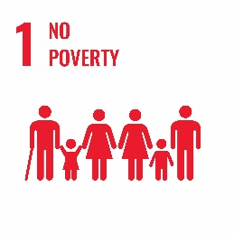
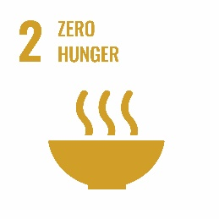




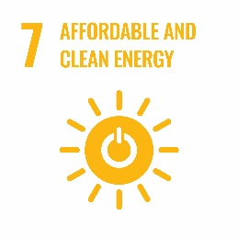


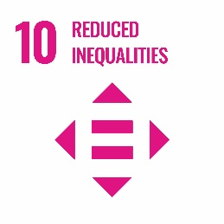

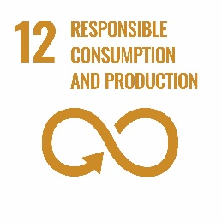
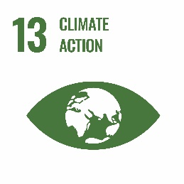
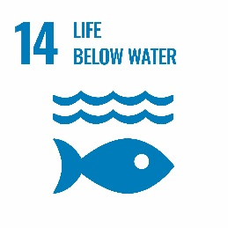


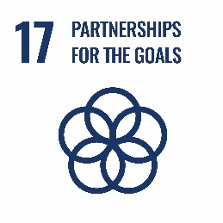
Sustainable Development Goals
Health vs Environment?
The aim of sustainable healthcare is to: provide better care for patients today without compromising health and care provision in the future.
Notes:
UN Sustainable Development Goals
The 17 Sustainable Development Goals, by the United Nations Members in 2015, provides a shared blueprint for peace and prosperity for people and the planet, now and into the future.
There are a number of goals specifically relevant for this case study, e.g., number 3 good health and wellbeing as well as number 7 affordable and clean energy and number 13 climate action.
Goals number 6, 11 and 12 also come into consideration in applications which are directly related to the environment.
In certain situations, the relationship between the promotion of health and environmental protection is constructive.
For example, cleaner air in urban areas also improves the health of the people living in these cities. Yet, there is often a great deal of conflict.
Unlike other service industries, hospitals work around the clock, consuming vast amounts of energy heating, cooling and lighting the complex buildings, as well as powering life-saving technologies.
In the UK, this equates to 18 million tonnes of CO2 entering our atmosphere. More often than not, hospitals will also provide catering options which in turn produces large quantities of food and packaging waste.
In addition, the healthcare sector faces some unique challenges including: the use of pharmaceutical and biological products with complex manufacturing processes, environmentally significant precursors and potentially toxic bodily by-products of medications.
There are also complex and hazardous solid, air and water emissions, including toxic, infectious and radioactive wastes.

Slide 4
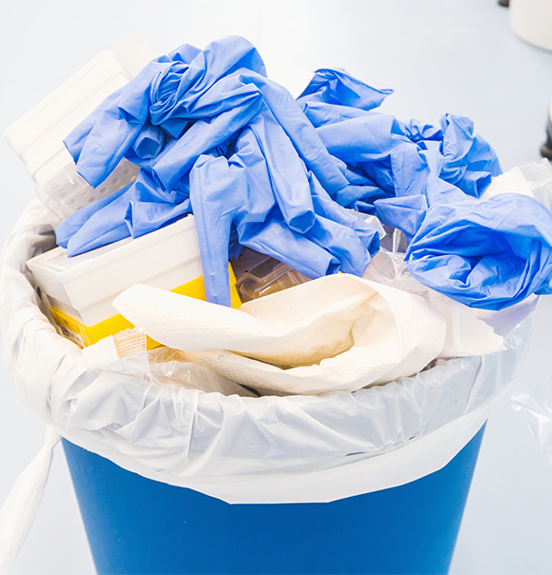
Large biomedical waste volumes
Healthcare generates enormous amounts of waste
In Europe it is around 3.3 – 3.6 kg (UK, France, Germany)
Home healthcare in the US contributes another 50 000 tonnes per year (Kaiser et al. 2001)
What devalues a product?
Physical life
Economic life
Legal life
Hygienic life
Notes:
Biomedical waste
The healthcare sector generates enormous quantities of waste
UK, France, Germany report around 3.5 kg waste per hospital patient every day.
US generate 8.4 kg/day but at the other end Mauritius generate only 0.44 kg/day.
In the US, the home healthcare is also substantial with another 50 000 tonnes per year.
This is a significant issue in healthcare but if we consider why a product is discarded, we understand the reasons behind.
In a linear economy, products are devalued for a number of reasons. Particularly relevant for the medical industry are:
- Physical life (the product no longer performs its intended function)
- Economic life (the product’s use is no longer profitable)
- Legal life (the product no longer meets the standards of new regulations)
- Hygienic life (the product no longer meets hygienic standards and is therefore discarded for safety reasons)
There is often good reasoning behind the waste but if we take a look at the numbers, the scale of the problem is alarming.

Slide 5
Types of waste in the healthcare system
Non-infectious
Infectious
Recycling
Domestic waste
Hygiene waste
Clinical waste
Hazardous waste
Carboard, paper, plastic
Packaging, tissues, disposable cups/ cans, sandwich wrappers
Sanitary protection e.g. colostomy bags, incontinence pads, nappies
Protective clothes not contaminated with bodily fluids
Gloves, dressings, bandages, apron contaminated with bodily fluids
Blood preserves, organs or body parts
Landfill, incineration or energy from waste
Recycled, deep landfill, incineration or energy from waste
Incineration or treatment prior to landfill
Recycling
Incineration
$190
per tonne
$187
per tonne
$317
per tonne
$444 - 602
per tonne
Notes:
Waste in the healthcare system
Healthcare waste is segregated into a number of streams according to how it needs to be treated or disposed of: Domestic waste, offensive (or hygiene) waste, clinical and hazardous waste.
Waste streams fit into two main categories: infectious or non-infectious.
Correct separation is crucial for waste management, as any failure could mean that the entire waste stream would need to be treated as infectious waste.
Infectious waste is defined as anything that may pose a risk of infection to any living thing that it may come into contact with and therefore requires incineration.
Clinical waste costs are typically 3.5 times higher than domestic waste since it requires expensive treatment prior to disposal.

Slide 6
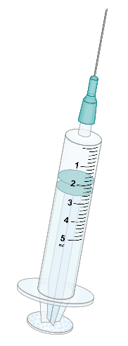


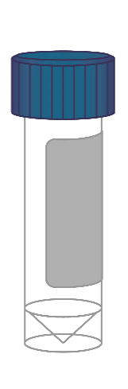
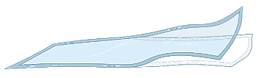
Single use products and typical materials
Basic materials in biomedical waste
Soda-lime glass
Polyethylene
Polypropylene
Polystyrene
Latex
Silicone
Cotton
Stainless steel
Paper
Syringe,
needles
Medical gloves
Sterile packaging
Sample bottle, vial
Notes:
Biomedical materials
Healthcare services rely on materials to deliver high quality, safe and efficient treatment.
By design, single use products such as those highlighted here, contribute a significant amount of medical waste since their one-time use helps to minimise the risk of infection and hence save lives.
Materials commonly used in these products are listed to the right and include a range of polymers e.g. PE, PP, and latex, as well as soda-lime glass, stainless steel and paper.
For lots of items like the syringe shown above, there are a range of materials used in the device which further complicates potential separation at the end of life.
Furthermore, even a simple item like the medical glove requires a complex manufacturing process which also has environmental consequences.

Slide 7
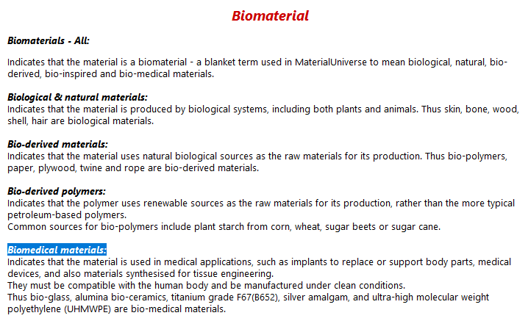
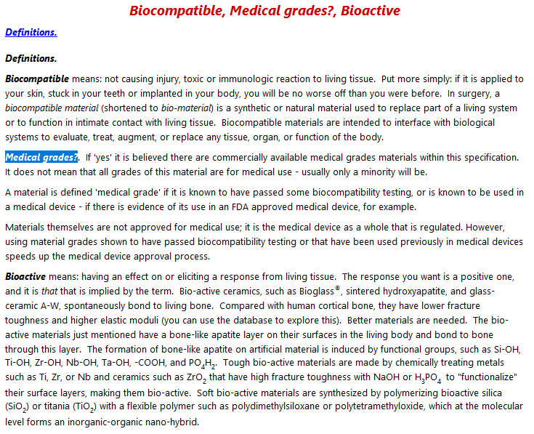
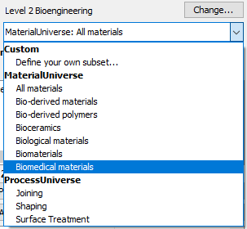
Biomedical materials
Biomaterials, synthetic as well as natural ones, are designed to be in contact with and interact with a biological system, such as the human body.
Biomedical materials are classified under biomaterials in EduPack.
Granta EduPack Science Note: Level 2 Bioengineering
Notes:
Definition of Biomedical materials
The Bioengineering databases have a comprehensive set of mechanical, thermal and electrical properties, as well as Eco Properties and Durability Information.
This is supplemented by records on “Bio” materials of all kinds; biological, bio-derived, natural and bio-medical. The records have extra data on their compatibility with the human body and whether they have been used in medical devices.
What we call biomaterials in the database is slightly different from traditional definition of biomaterials; it means all bio-related datasets/records.
The subgroup particularly relevant to this case study is the biomedical materials.
Biomedical materials are different from those that are labelled medical grade materials in the database

Slide 8
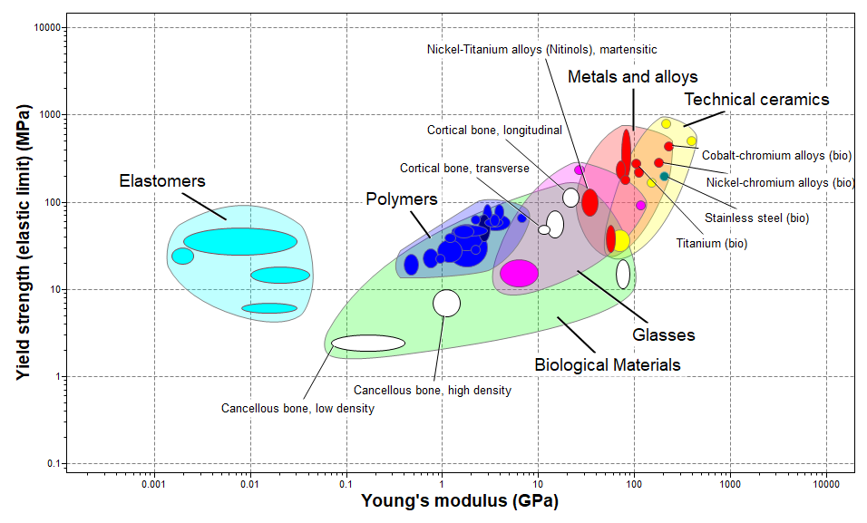
Level 2 has very useful information
Level 2 Bioengineering database: 251 Materials and 110 Processes
Biological or Biomedical Materials together with Engineering Materials
Notes:
Level 2 overview
The Bioengineering databases exist both at level 2 and at Level 3, to suit the needs of the students
The subset Biological Materials contains both relevant engineering materials and biological materials, such as Cortical bone, and Biomedical materials, such as biological grade Stainless steel and Titanium
The biomedical datasheets in bioengineering contain some unique extra properties, e.g., medical grades and biocompatibility information. Level 3 has many more, such as sterilization information.

Slide 9
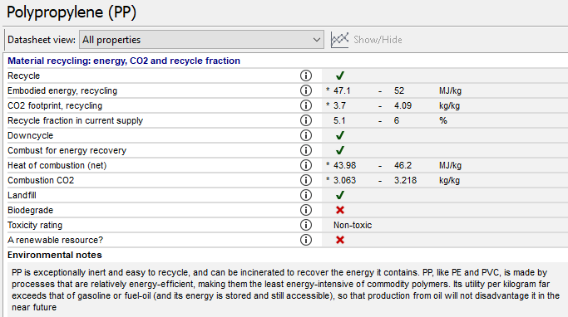
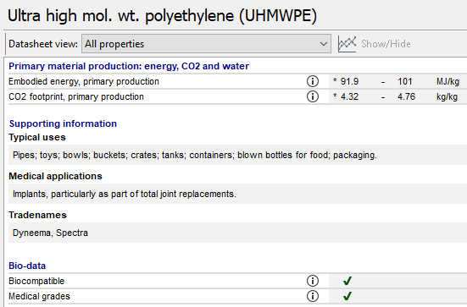
Eco-properties in datasheets
Notes:
Circularity-related properties
At Level 2, the materials have extensive information relating to end-of-life.
Recycling data as well as embodied energy and carbon footprint for both virgin and recycled material.
The added bio-related materials, such as the biomedical and biological ones have slightly reduced data, but retain the main eco-properties.

Slide 10
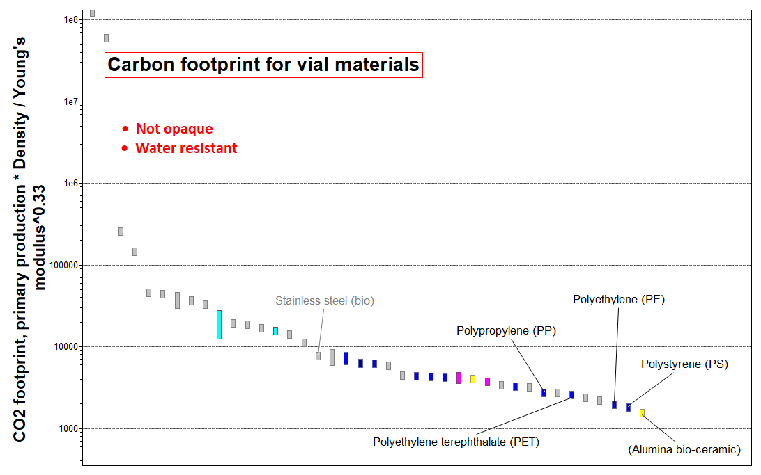
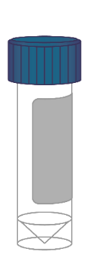
Biomedical material selection
PP
PS
Notes:
Material selection
The biomedical materials can be used for material selection, las usual. For example minimizing carbon footprint
A simple example of material selection for environmental design can be made for a biomedical vial
The vial is considered as a stiffness-limited design of a panel in bending with the performance index: [CO2/kg] * ρ / E^{1/3}
Starting with the subset of biomedical materials (around 40) is already very good candidates
We then add the constraints that the vial base needs to be transparent to function (PLA appears as a good candidate)
Finally, we need the material to be water resistant to function for liquids (PLA disappears)
We are left with three of the commonly used materials for disposable containers in healthcare; PP, PS and PE

Slide 11
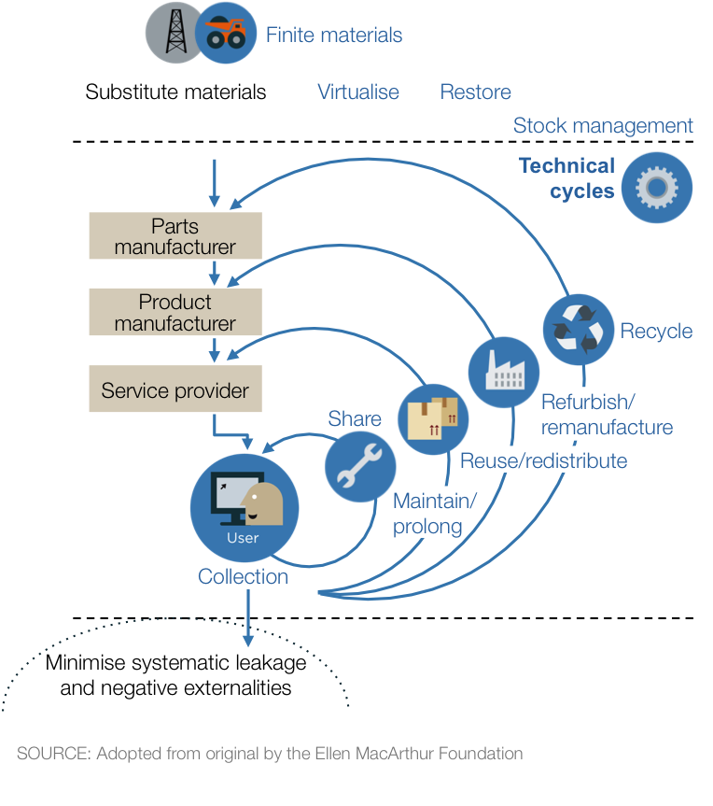
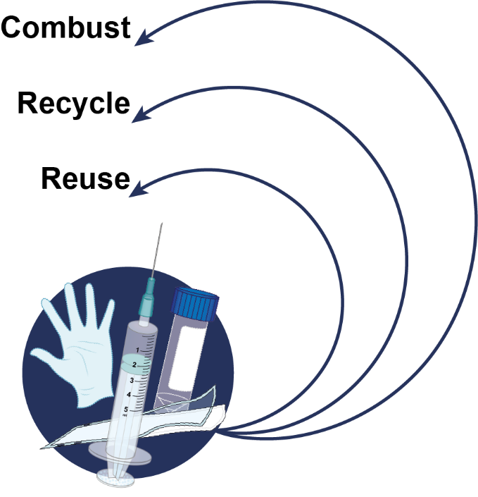
Product life cycle
Notes:
Circular economy
Circular economy, from the user perspective, can conceptually be described using the technical cycle from the traditional butterfly diagram by Ellen MacArthur Foundation
If we apply this thinking to the biomedical sector and our case study, we can adopt a product-centered approach
This is illustrated in the diagram where the relevant material flows for biomedical materials are indicated

Slide 12
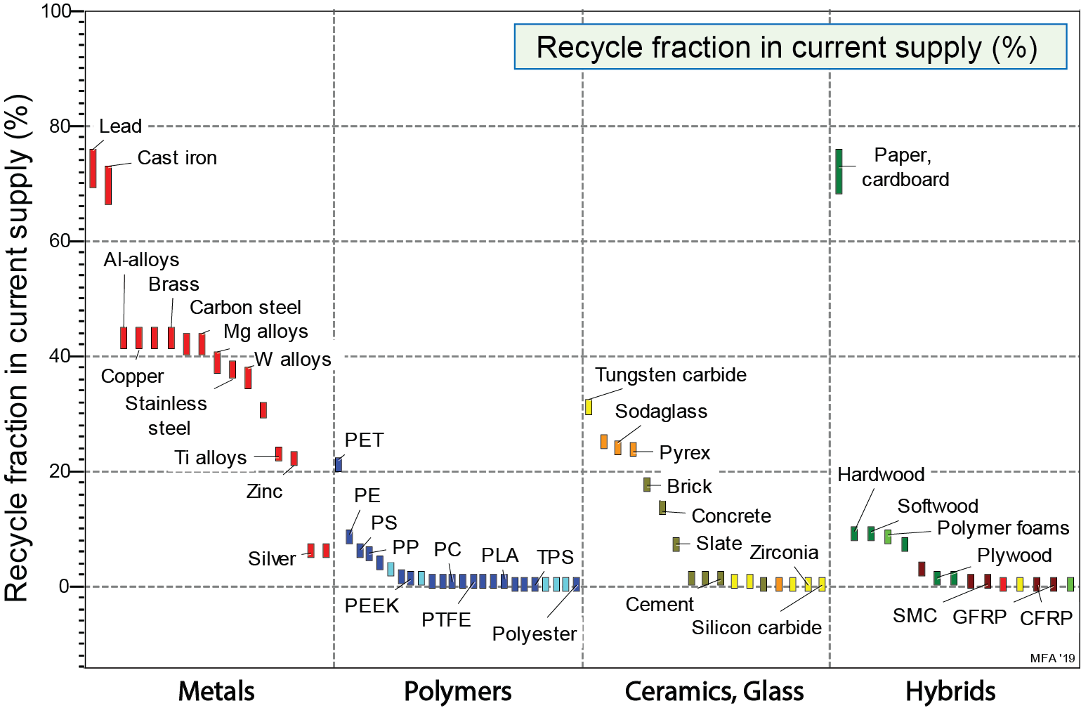
Low degree of recycling
Notes:
Low degree of recycling
For most materials in biomedical waste the recycled fraction is very low
Paper, cardboard, regular glass and Pyrex have around 25% or more recycled content
Only PET has a significant level of recycling out of the plastics

Slide 13
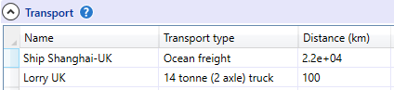
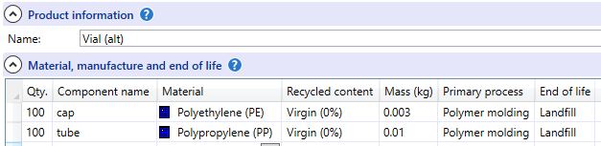
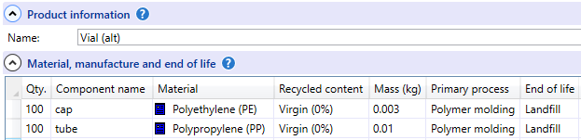
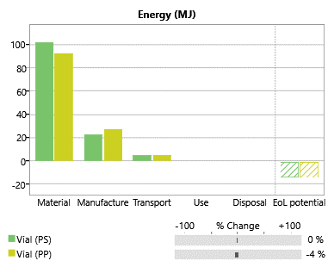
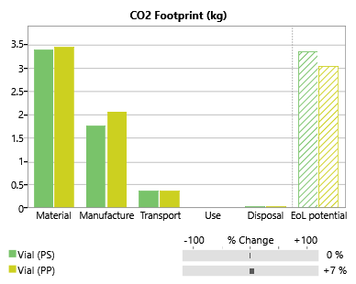
Eco Audit of Vials
PP
PE
PS
PP
Notes:
Eco Audit of vials
An Eco Audit can be set up easily from scratch or saved Eco Audit Project files.
For example, a standard vial made of polystyrene (10g) with a polypropylene cap (3g), both molded.
Assume manufacture in Shanghai, shipped to the UK, 2200 km, and transported to Cambridge (UK), ca 100 km with 2-axle 14t truck.
The results indicate that some energy could be saved by alternative materials PP base and HDPE cap.

Slide 14
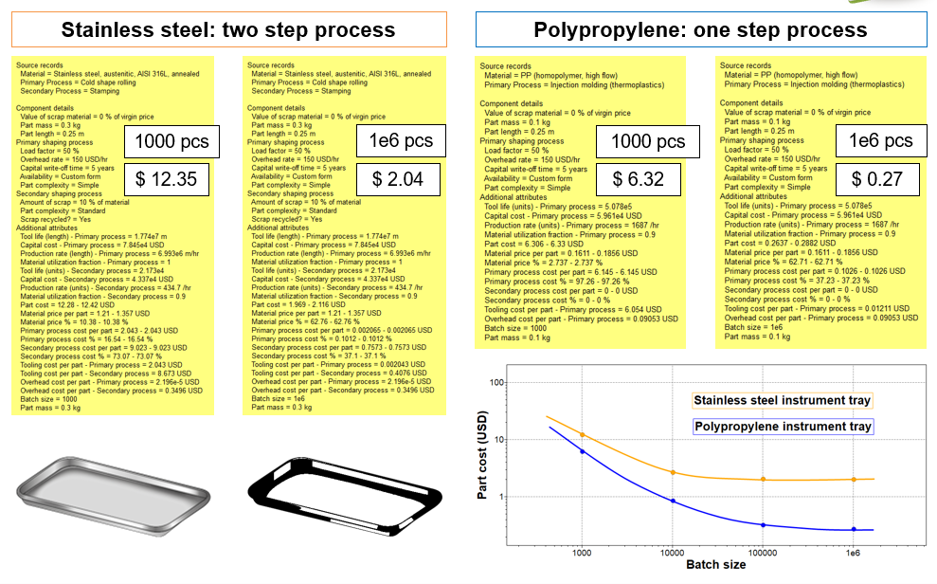
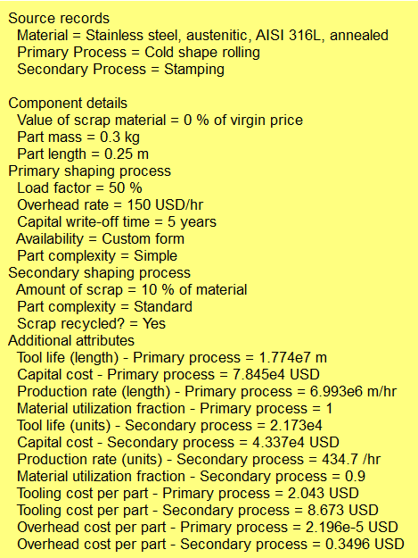
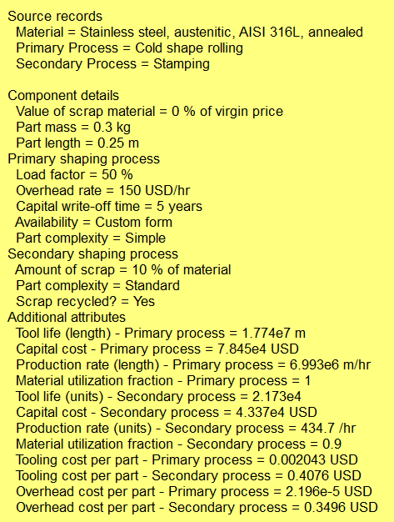
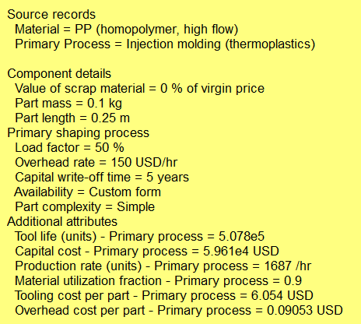
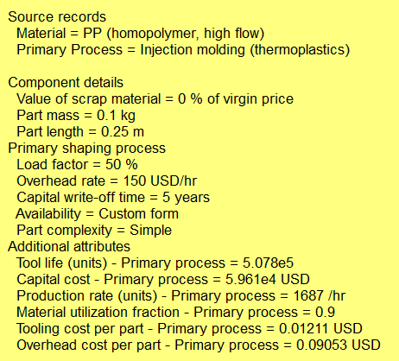






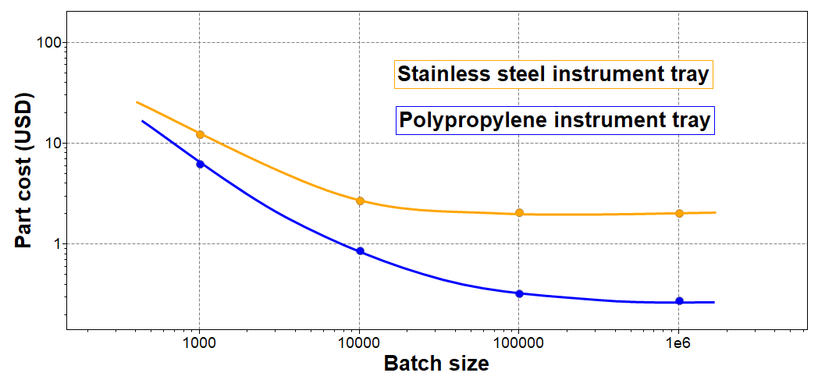
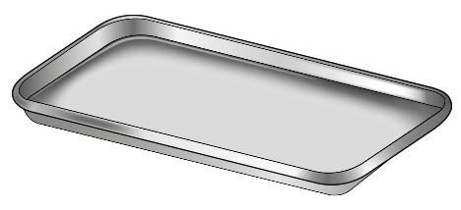
Part cost estimator: instrument tray
Notes:
Part cost estimator
The part cost estimator is particularly useful for the manufacturers since costs are an important driver in the healthcare sector.
It is aimed at early stage conceptual design, when multiple materials are under consideration and details of the design have still to be defined.
The estimates calculated by the tool are primarily of interest to medical device manufacturers. Which of course is part of the whole medical
Using this synthesizer tool you have flexible choice on:
- Type of material and up to two shaping processes
- Size of the part and complexity
- Off-the-shelf or custom forms
- Credit for recycling of manufacturing waste

Slide 15
What did EduPack add to the Understanding?
EduPack Bioengineering databases are useful to understand biomedical materials and their environmental properties
We have seen examples of how environmental aspects can be brought in for the design of biomedical products as well as investigating their end-of-life
Both health aspects and environmental aspects are covered (+cost)
The software was used to demonstrate how both the selection and the Eco Audit tools work as well as the part cost estimator of the Synthesizer tool at level 3
Notes:
Conclusions

Slide 16
Reality Check: Cambridge example
Cambridge University Hospitals NHS Foundation Trust, UK
The trust is one of the largest in the UK with a leading national centre for specialist treatment; a government-designated comprehensive biomedical research centre; one of only five academic health science centres in the UK; and a university teaching hospital with a worldwide reputation.
2013 – 2020 Sustainable Development Management Plan “Taking action for a sustainable future”
Waste Audits: Undertake waste audits to identify areas of non-compliance as well as identifying possibilities for improving waste management and recycling
Disposable curtains: Identify a more sustainable disposal route for used disposable curtains
Single use and reusable sharps items: Single use items are to be reviewed with infection control procurement and waste management. This is to identify where current single items can be purchased as a reusable item and sterilised for next use.
US Benchmarks
Kaiser Permanente: implemented reusable linens and patient gowns which can be washed and reused 60 times
Ascent Healthcare Solutions: by reprocessing single use medical devices, saving 2150 tons of waste going to landfill as well as $138 million in supply costs
Notes:
Cambridge University Hospital (CUH)
CUH aims to achieve excellence in everything which are reflected in this sustainable development management plan.
As part of the UK’s goal to reduce carbon emissions by 80 % by 2050, CUH outline specific targets for carbon reduction including particularly relevant ones:
- Waste audits: Undertake waste audits to identify areas of non-compliance as well as identifying possibilities for improving waste management and recycling
- Disposable curtains: Identify a more sustainable disposal route for used disposable curtains
- Single use and reusable sharps items: Single use items are to be reviewed with infection control procurement and waste management. This is to identify where current single items can be purchased as a reusable item and sterilised for next use.
The NHS aspires to be a world class commissioner and as part of that ambition, they benchmark themselves against private sector solutions.
Two examples from the US where single use items are replaced with reusable items are given in “Taking action for a sustainable future”.

Slide 17
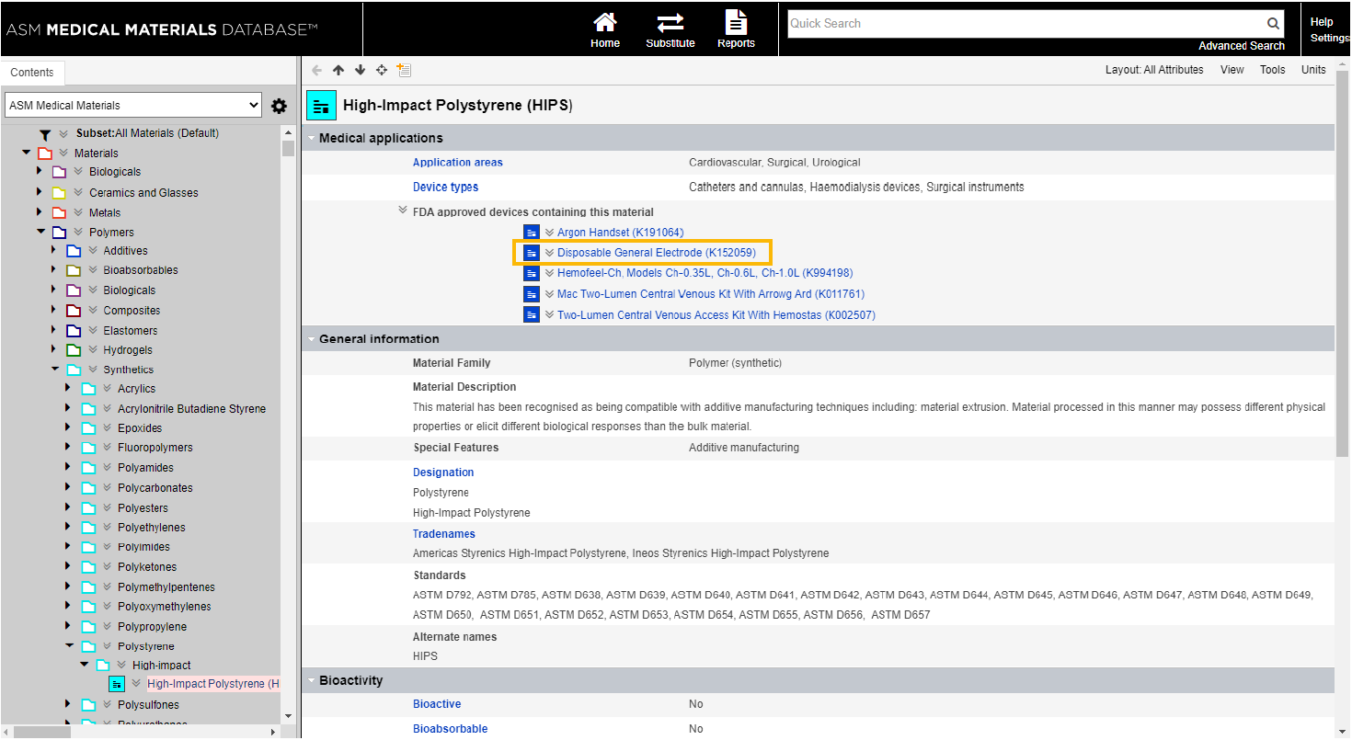
Reality Check: ASM links to High-Impact Polystyrene (PS)
Notes:
ASM Medical Materials
Some materials in the Bioengineering Level 3 database have direct links into ASM Biomedical Materials database
In order to access this, you need to have a subscription through your University
In this example, you can see how PS is already used in a FDA approved disposable medical device.

Slide 18
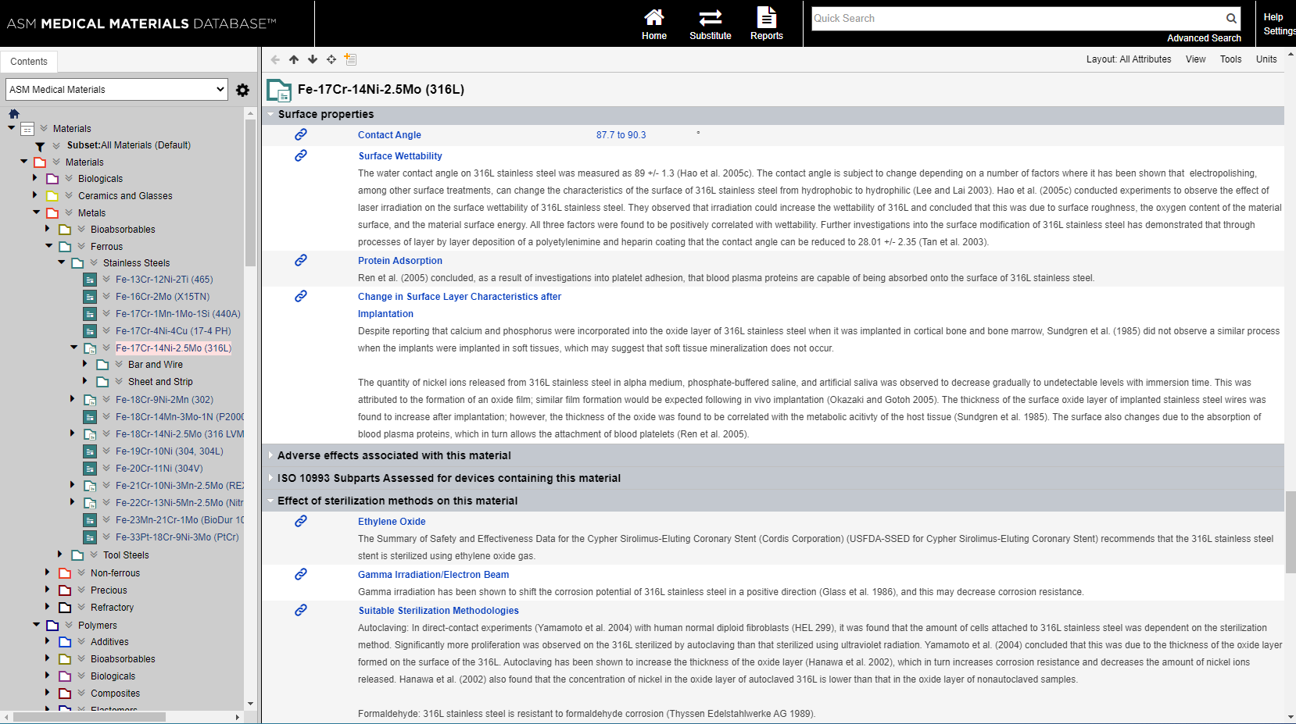
Reality Check: ASM links to SS
Notes:
ASM Medical Materials
Data that is relevant to more detailed discussions and selection can be accessed via ASM
In this datasheet, the contact angle and wettability for a standard Stainless steel is discussed
Advanced properties, such as protein adsorption and effects of sterilization can also be found

