Slide 1
Quarterly Case Study Session
Presented September 2020
Industrial Case Study:
Teaching EduPack Online with a Chainsaw
Claes Fredriksson, Ph.D.
Ansys Materials Education Division
Notes:
These slides were originally presented as part of a webinar. The webinar recording can be found here: https://www.ansys.com/resource-center/webinar/granta-edupack-teach-online-with-a-chainsaw

Slide 2
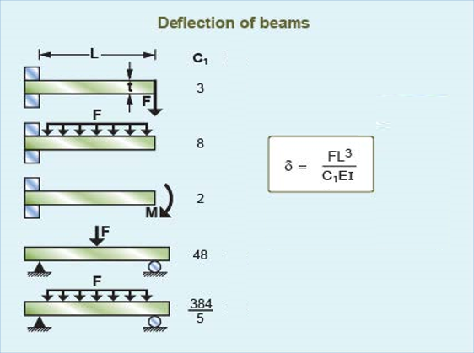
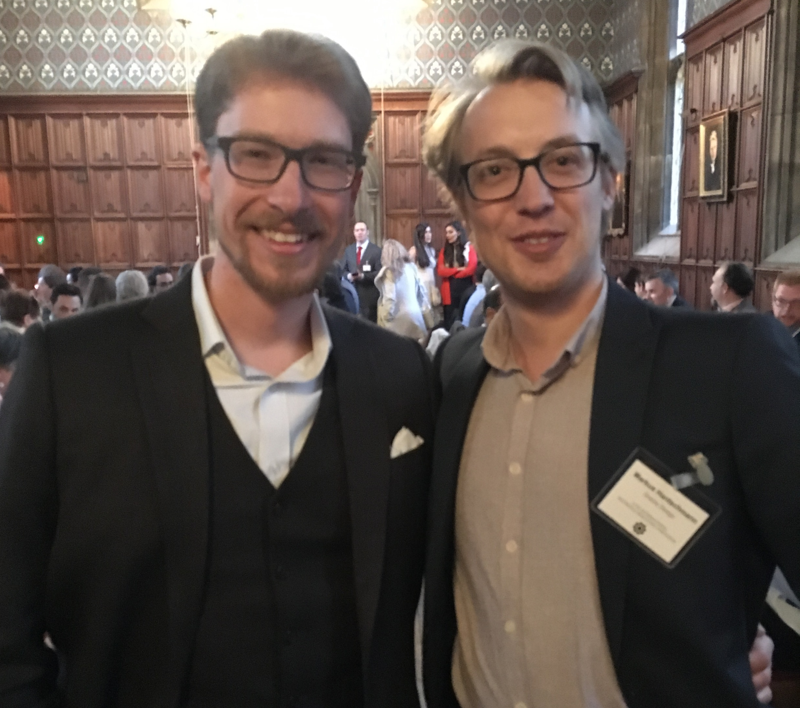
Agenda
Challenges of online teaching
EduPack resources for flexible learning
Industrial Case Study
Chainsaw blade design
Performance Indices
Material selection
Reality check
Auxiliary activities
Q&A
Markus Dumschat Markus Hantschmann
Claes Fredriksson
Notes:
Agenda (Claes)
We will start with an introduction to online teaching
Furthermore, we will discuss the specific advantages of EduPack and our resources for this situation
Then we will be showing how you can use EduPack to explore and select materials for a chainsaw blade
We will show in detail, how the performance indices are derived, which is described in the case study paper
Finally, we will do a reality check to see what real chainsaw blades are made of
There are also a number of auxiliary activities that could be added onto the case study, depending on your subject

Slide 3
A brief history
1994
Granta Design founded by Professors Mike Ashby and David Cebon to commercialize a materials selection teaching project
Development of Cambridge Engineering Selector (CES) for academia and industry plus a new industry product GRANTA MI
2001
Investment from and strategic partnership with ASM International
2011
Education Division founded to support CES EduPack and the growth in Academic collaborations and Resource Development
2019
Granta Design acquired by ANSYS, Inc. the global leader in engineering simulation
2020
CES EduPack rebranded GRANTA EduPack
Notes:
Background to EduPack (Harriet)
Granta Design was founded in the early ’90 by Prof Ashby an Prof Cebon as spin-out of the university of Cambridge
In Feb 2019 Granta Design was acquired by ANSYS Inc, the global leader in engineering simulation
The CES EduPack software is now called GRANTA EduPack and includes more databases and tools to help educators teach the next generation of engineers

Slide 4
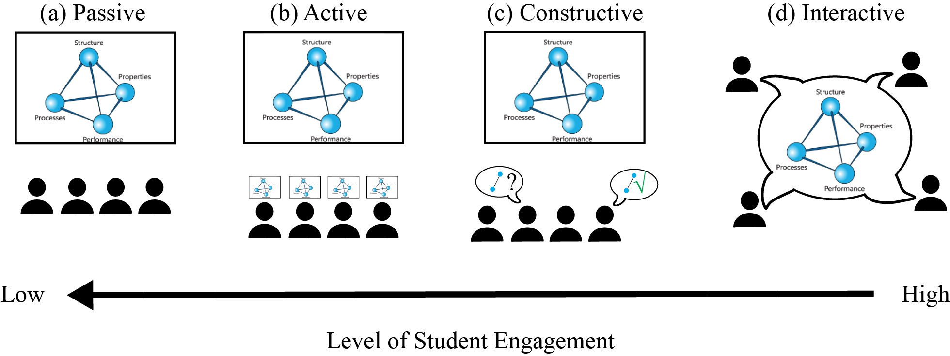
Student Engagement Levels
Tyler, K., & Fredriksson, C., & Tyler, K. (2020, June), Software Support for Materials-related Active Learning Paper presented at 2020 ASEE Virtual Annual Conference Content Access, Virtual On line . https://peer.asee.org/35197
Passive < Active < Constructive < Interactive
New information is presented to students in a non-engaging fashion
Ex: Lecture
Doing something, often physical
Ex: clickers, taking notes
Producing additional outputs beyond what is taught in class
Ex: Linking topics together, argumentation
Creating dialogue within a group around the topic
Ex: discussions with peers or instructors
Chi, M. T. H. Active‐constructive‐interactive: A conceptual framework for differentiating learning activities. Top. Cogn. Sci. 1, 73–105 (2009).
Notes:
Harriet

Slide 5
Does Active Learning work?
Active learning has been shown to have a positive impact on…
Short and long-term information retention
Concept understanding compared to traditional lectures
Student retention when incorporated into introductory courses
Student motivation and attitudes
Can software help support these efforts online?
Prince, M.. Does active learning work? A review of the research. J. Eng. Educ. 93, 223–231 (2004).
Notes:
Harriet
Short term retention was during free recall exams at the end of each lecture– write down as much as they could remember in 3 minutes
Long term retention– 65 MC test given 1.5 weeks after lectures ended

Slide 6
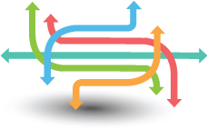
GRANTA EduPack Educational Capabilities
Online Learning
Quick to access, comparable, reliable data
Data Handling
Re-Design
Engaging
Visualization Tools
Trade-offs
Self-Study
Material Selection Tools
Sustainable Development
Assignments
Eco Audit Tool
Hybrid Synthesizer
Lectures
Senior Design
Projects
Course Projects
Accreditation
Notes:
Software Capabilities (Harriet)
The software that we will be talking about is a teaching resource, the fundamental taxonomy is this:
-It is a database with materials information, properties of all kind (mechanical, cost, eco etc)
-It can visualize material properties to enhance understanding
-You have good support for selecting materials in design and make informed choices
-There are additional tools for environmental assessments and hybrid materials

Slide 7
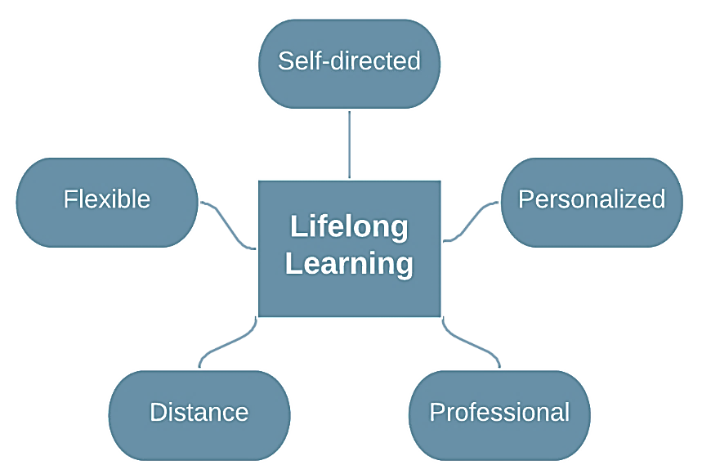
What are the prospects of online teaching with GRANTA EduPack?
Materials Data and Decision-making tool
GRANTA EduPack
Self-sufficiency (in help), support for tool utilization, tutorials and examples
Flexible Learn feature that provides e.g., embedded case studies, selection methodology and Science notes
Remote use enabled by University licensing and project file format facilitating visual communication
Personalised development via several advanced textbooks (Mike Ashby) and a range of teaching resources
Professional development in many fields relevant to Science, Engineering, Design and Sustainability
Online and life-long learning are similar:
Fredriksson, C. & Dwek, M. (2019, Sept), A Software Tool for Lifelong Learning in Engineering Education, Proceedings of the SEFI 47th Annual Conference, ISBN: 978-2-87352-018-2, p 423-432.
https://www.sefi.be/wp-content/uploads/2019/10/SEFI2019_Proceedings.pdf
Notes:
Teaching online using EduPack (Claes)
We have previously presented a paper about EduPack for life-long learning, which is highly relevant also here
We gathered feedback from 3 universities that have successfully used EduPack for online teaching
The paper summarizes experiences from Universities in Sweden, Spain and the Open University in the UK
The main benefits are that EduPack is: Self directed (technically), Flexible (when/where to learn), Distance-friendly (remote use), Possible to Personalise (content) and finally, useful for Professional development

Slide 8
Two ways to engage students remotely, and where to find it
1. Industrial Case Studies with exercises
Chainsaw
Aluminum Strengthening
Stainless Steels
Longboard
The Built Environment
2. Micro-projects for break-out sessions online (short group work)
Materials Science
Sustainability
Bioengineering coming soon…
www.grantadesign.com/teachingresources
Notes:
Promoting engagement (Claes)
When it comes to promoting engagement towards constructive and interactive learning, we will discuss two options
The first one involves using our Industrial Case Studies and associated exercises that can be found on the Education Hub. We currently have 5 ready to go and I will walk you through how to use the chainsaw case
The second one is to use our teaching/learning packages, found under their own tab on the Education Hub
They include so called micro-projects, designed for small student group-work, in three key areas
Of course you can use them as you want or develop then in a way that suits your class
This is where you find them (Claes shows)

Slide 9
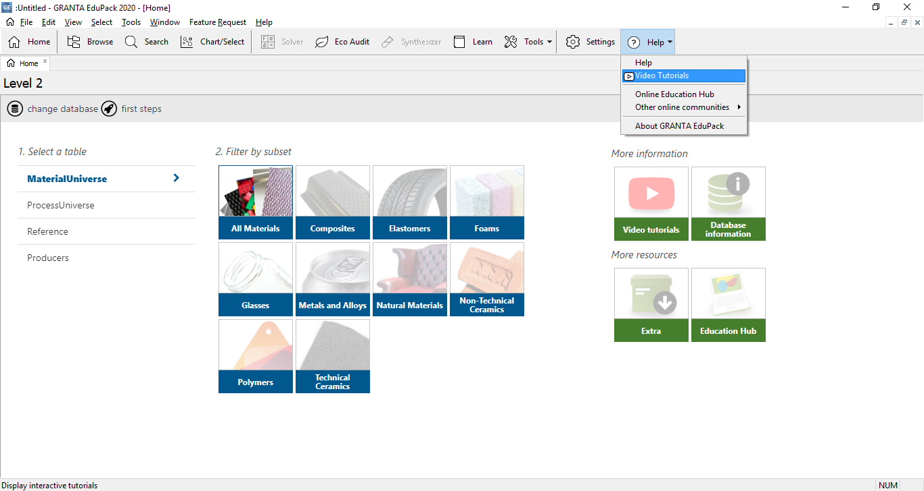
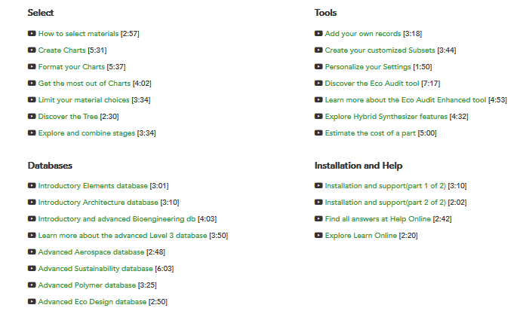
Playlist for self-learning embedded in the Help menu of EduPack
Notes:
Introduction to EduPack (Harriet)
For courses that need to introduce the software, students need to use the embedded Getting Started guide (Help or Learn) and the Video Tutorials

Slide 10
The Chainsaw Case Study example (blade design)
Distribute the Case Study via student learning platform
Add exercises, available on the Education Hub or your own, as assignment
Follow up with feed-back based on PPT Lecture slides, also available on the Education Hub
Elaborate with auxiliary tasks
Notes:
Workflow online (Claes)
We will now go through an example of an Industrial Case Study that is already available
We have a suggested workflow that allows you to teach students that are familiar with EduPack

Slide 11
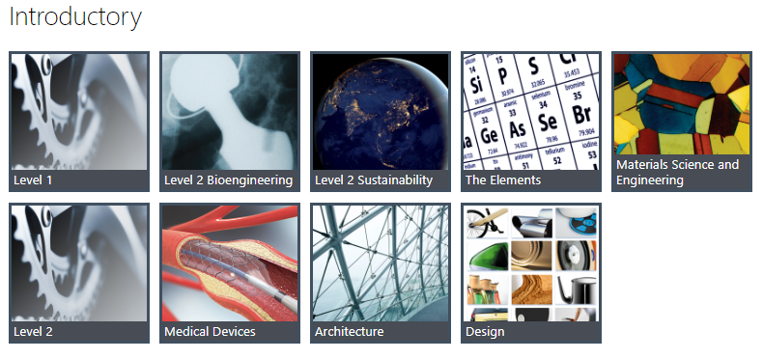
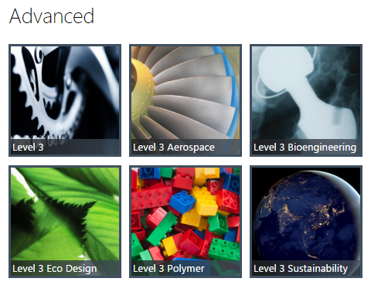
GRANTA EduPack 2020 Engineering Level 2 and 3
Databases
Notes:
Databases used (Claes)
The standard Granta EduPack 2020 has more databases included than previous editions
We have used the Engineering Level 2 database for the case study paper but it can be done in Level 3 too

Slide 12
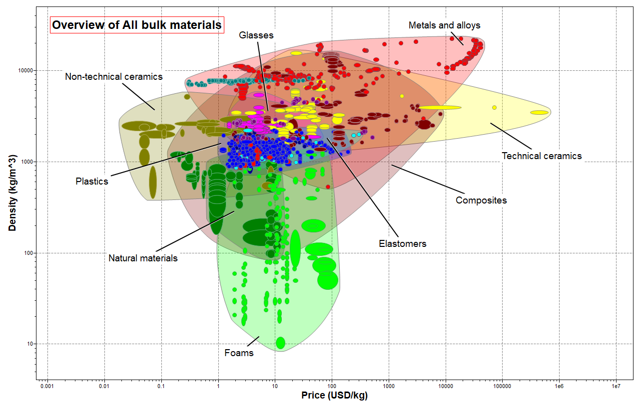
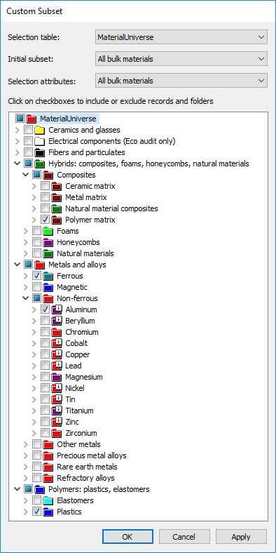
Material overview
Too expensive
Too brittle
Too soft
Notes:
Property overview (Claes)
Here is an overview of bulk materials from a Level 3 database
Both in Lavel 2 and Level 3 you can create a Custom subset with relevant materials.
Certain classes of materials can be screened out already here, foams are too soft, for example

Slide 13
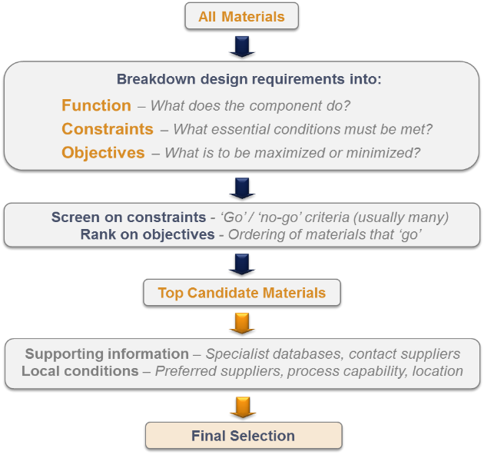
Systematic materials selection (Ashby, Cambridge University)
Notes:
Material Selection (Claes)
Our case studies make use of the systematic material selection methodology made popular by prof. Mike Ashby
It involves identification of the mechanical load situation for the function, in our case a chainsaw blade
The constraints are relatively straight-forward. It may be service temperature, corrosive environment or a a restricted subset of materials. These are used for screening.
The objectives will depend on the function and the kind of performance that is desired and will be reflected in performance indices that are used for ranking.

Slide 14
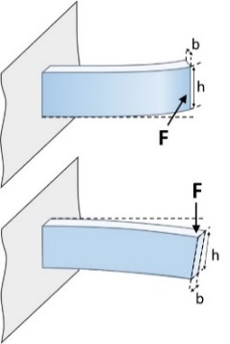
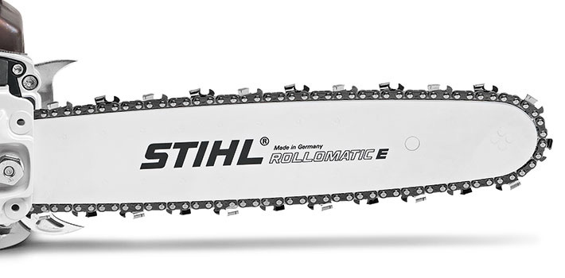
A model of the blade function: Beam in bending
The blade will be loaded in several directions during use, as can be seen in the photo.
The main directions are defined in the Figure to the right:
Horizontal bending (top)
Vertical bending (bottom)
Stiffness-limited design is relevant
Notes:
Blade model (Claes)
When we model the blade to determine the function, it is natural to consider it a beam in bending
The two main direction of the load we have called horizontal and vertical, as shown here

Slide 15
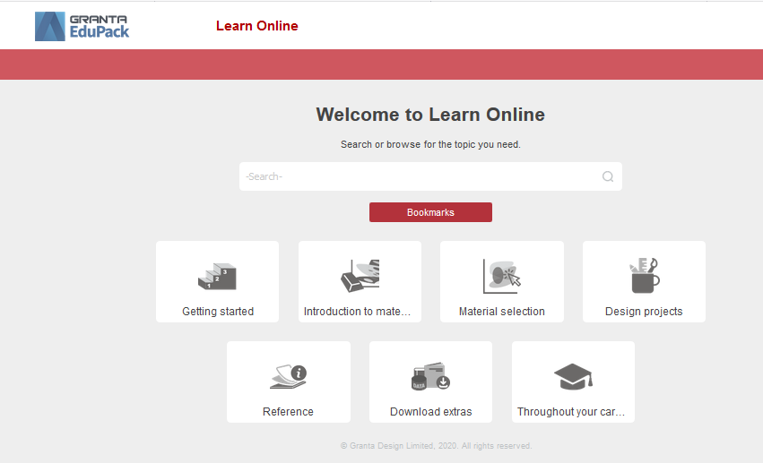
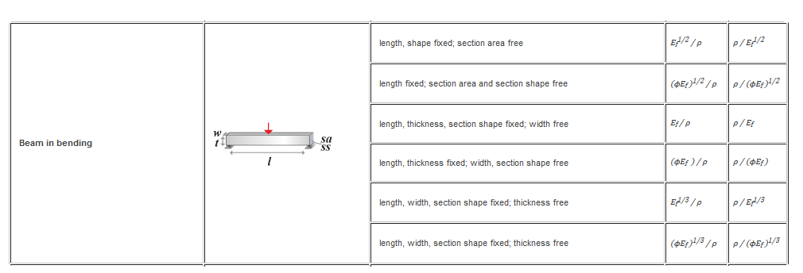
In the performance index tables of EduPack
To maximize performance:
First apply all constraints
Then select materials with the biggest or smallest index
maximize
minimize
Stiffness-limited design
(Horizontal)
(Vertical)
Notes:
Where to find PI (Harriet)

Slide 16
Summary of translation
Function: Beam of length L fixed at one end, Stiffness-limited design
Mechanical constraints on the bending stiffness can then be used to eliminate a free design parameter, which enables a selection based on material properties alone:
$$M=\left(\frac{E^{1/3}}{ρ}\right)$$
Constraints: Bending stiffness > S* (both directions)
(Stiffness-limited design)
Vertical
Slope=3
$$M=\left(\frac{E}{ρ}\right)$$
Slope=1
Design constraints are:
Min/Max service temperature: -40°C / +110°C
Resistance to water (fresh): excellent
Resistance to lubricating oil: excellent
Resistance to petrol (gasoline): excellent
No ceramics, foams or natural materials in the subset
Mechanical properties: considered separately
Horizontal:
Where:
m = mass ρ = density S = stiffness (F/δ) δ = deflection | This beam: δ = FL³/CEI C = constant (here, 3 to 8) E = Young’s modulus I = second moment of area (I = bh³/12 ↕ or b³h/12 ↔)
Notes:
Claes

Slide 17
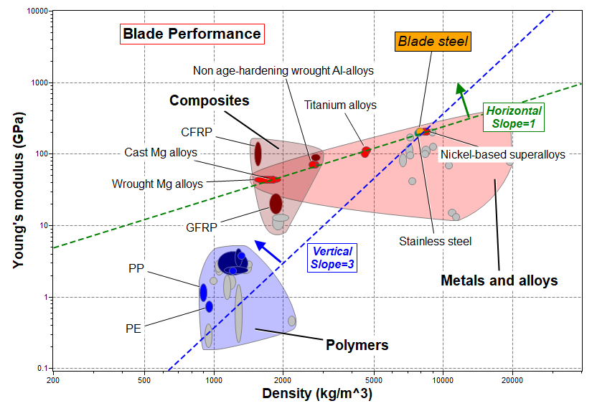
Visual result to discuss and compare at Level 2
Notes:
Demo (Claes)

Slide 18
Index for a stiff, light chainsaw blade (vertical load)
Stiff beam of length L fixed at end and minimum mass
Function
Beam
F
b
h
Section area
A = bh
δ
L
Constraints
Length L is specified, b fixed by chain width
Must have bending stiffness > S*
m = mass
A = area
L = length
ρ = density
S = stiffness (F/δ)
This beam: δ = FL³/CEI
C = constant (here, 3 to 8)
E = Young’s modulus
I = second moment of area
(I = bh³/12 ↕ or b³h/12 ↔)
S$\text{ =} \frac{ F}{δ}$ = $\frac{ CEI}{L^{3}}$ = $\frac{ CE {bh}^{3}}{12 L^{3}}$
h = (${\frac{ 12SL^{3}}{CEb})}^{1/3}$
Objective
Minimize mass m:
m = A L ρ = b h L ρ
Performance metric
$$m=L^{2}{\left(\frac{b^{2}12S^{∗}}{C}\right)}^{1/3}\left(\frac{ρ}{E^{1/3}}\right)$$
Chose materials
with largest
$$M=\left(\frac{E^{1/3}}{ρ}\right)$$
Notes:
Deriving a material index for a light, stiff beam in bending (Claes)
The most usual mode of loading of engineering structures is bending: wing-spars of aircraft, ceiling and floor joists of buildings, golf club shafts, oars, skis … all these structures carry bending moments; they are beams. The requirement here is for a beam of specified stiffness and minimum mass. The frame lays out the steps, leading to the index ρ/E^{1/2} ; it differs from the index for a light stiff tie-rod because the mode of loading is bending, not tension. Later frames show how these indices are used to rank materials.
A panel is a flat sheet of given length and width: a table top, for instance. It differs from a beam in that the width of the beam is a free variable, whereas the width of the panel is prescribed. Otherwise the method, given in this frame, is the same. It leads to the index ρ/E^{1/3}.

Slide 19
Index for a stiff, light chainsaw blade (horizontal load)
Stiff beam of length L fixed at end and minimum mass
Function
Beam
F
b
h
Section area
A = bh
δ
L
Constraints
Length L is specified, b fixed by chain width
Must have bending stiffness > S*
m = mass
A = area
L = length
ρ = density
S = stiffness (F/δ)
This beam: δ = FL³/CEI
C = constant (here, 3 to 8)
E = Young’s modulus
I = second moment of area
(I = bh³/12 ↕ or b³h/12 ↔)
S$\text{ =} \frac{ F}{δ}$ = $\frac{ CEI}{L^{3}}$ = $\frac{ CE b^{3}h}{12 L^{3}}$
h = $\frac{ 12SL^{3}}{CEb^{3}}$
Objective
Minimize mass m:
m = A L ρ = b h L ρ
Performance metric
$$m=\left(\frac{12S^{∗}L^{4}}{Cb^{2}}\right)\left(\frac{ρ}{E}\right)$$
Chose materials
with largest
$$M=\left(\frac{E}{ρ}\right)$$
Notes:
Deriving a material index for a light, stiff beam in bending (Claes)
The most usual mode of loading of engineering structures is bending: wing-spars of aircraft, ceiling and floor joists of buildings, golf club shafts, oars, skis … all these structures carry bending moments; they are beams. The requirement here is for a beam of specified stiffness and minimum mass. The frame lays out the steps, leading to the index ρ/E^{1/2} ; it differs from the index for a light stiff tie-rod because the mode of loading is bending, not tension. Later frames show how these indices are used to rank materials.
A panel is a flat sheet of given length and width: a table top, for instance. It differs from a beam in that the width of the beam is a free variable, whereas the width of the panel is prescribed. Otherwise the method, given in this frame, is the same. It leads to the index ρ/E^{1/3}.

Slide 20
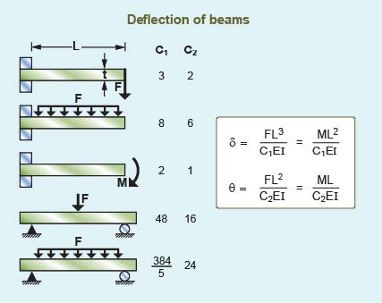
Exact load details does not affect the material index
The exact details of the load:
point force or distributed
position of load application
Doesn’t affect material properties
or the index, only the constants
Constants
$$m=L^{2}{\left(\frac{b^{2}12S^{∗}}{C1}\right)}^{⅓}\left(\frac{ρ}{E^{1/3}}\right)$$
Slope=3
$$m=\left(\frac{12S^{∗}L^{4}}{{C1b}^{2}}\right)\left(\frac{ρ}{E}\right)$$
Slope=1
Notes:
Claes

Slide 21
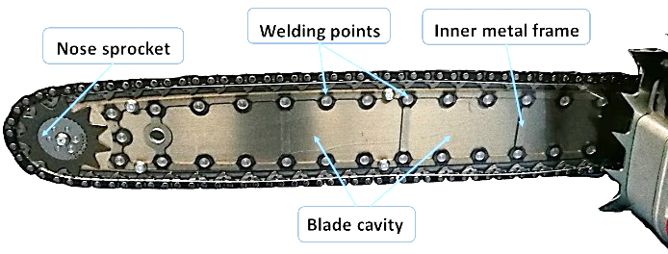
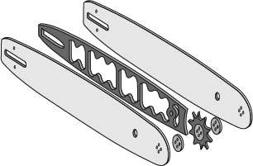
Reality Check: mechanical performance
Sandwich type blades with metal faces used for maximum bending stiffness
Hollow blades with Glassfiber-reinforced Polyamide core developed
FRP core
63 cm CFRP blade demonstrated 50% lower weight!
Metal faces
Notes:
Real blades (Claes)

Slide 22
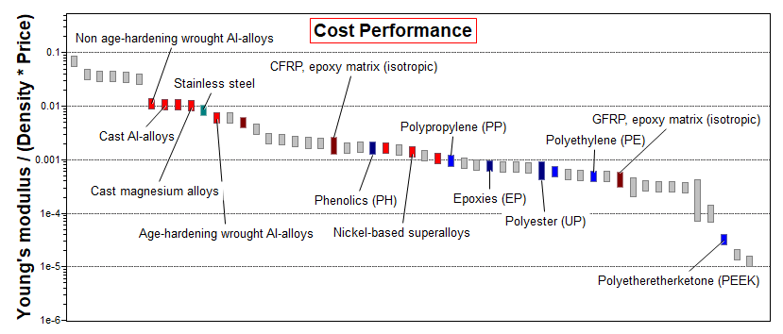
Reality Check: cost performance
A second selection stage can be added in combination with the first. The cost performance index to maximize for stiffness-limited design is: M = E / (c_{m}·ρ):
Notes:
Adding cost (Claes)

Slide 23
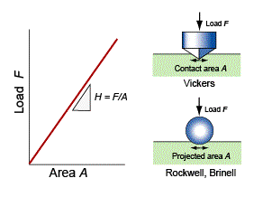
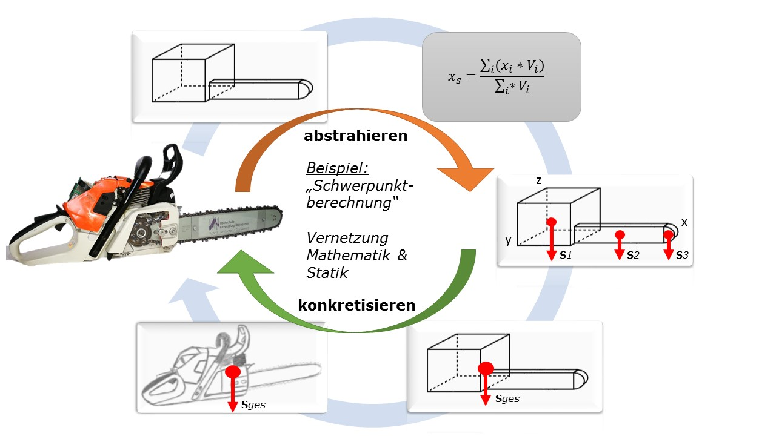
Auxiliary activities – strength, mechanics, manufacturing…
Manufacturing processes
Steel sheets
Stamping & cutting
Surface treatment
Quality control
Laser engraving
Notes:
Harriet

Slide 24
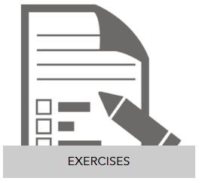
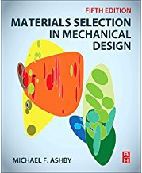
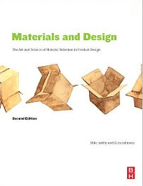
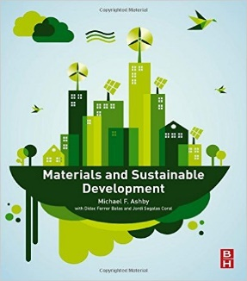
GRANTA education resources to support online teaching/learning
Software + Knowledge
University Textbooks
Undergraduate materials
Advanced selection
Materials and Design
Materials and the Environment
Materials and Sustainable Development
Notes:
Education resources and knowledge (Harriet)
We do not only sell software but also manage a lot of materials and education knowledge.
We have both powerpoint Lecture Units for educators and white papers that cover aerospace topics on our Education Hub
We have a number of previous industrial case studies for EduPack
Our resources are complemented by a number of relevant textbooks by professor Mike Ashby

Slide 25
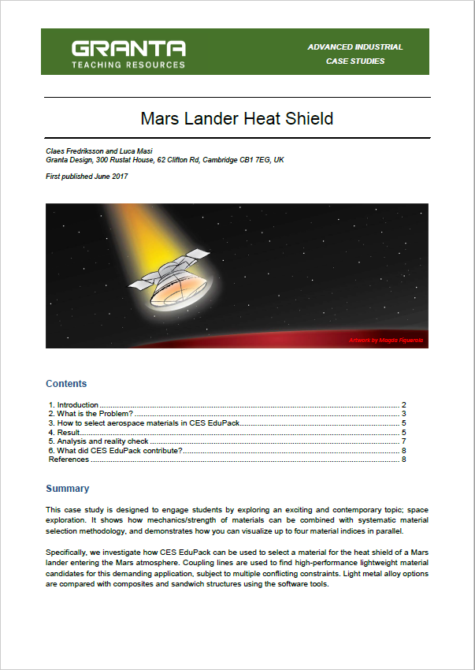
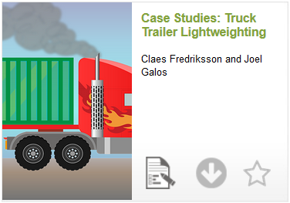
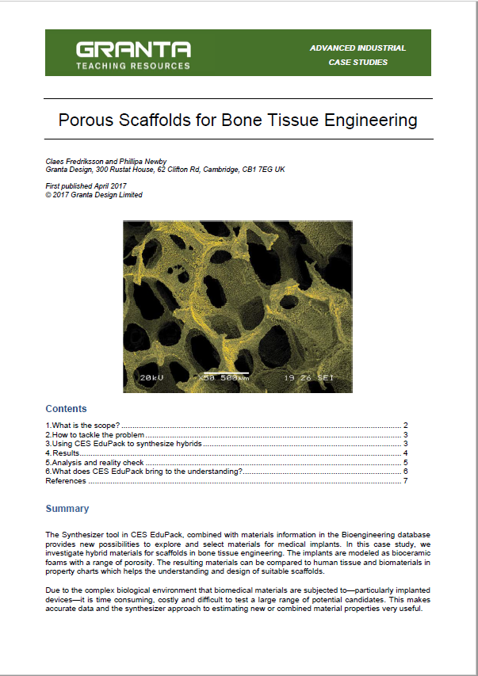
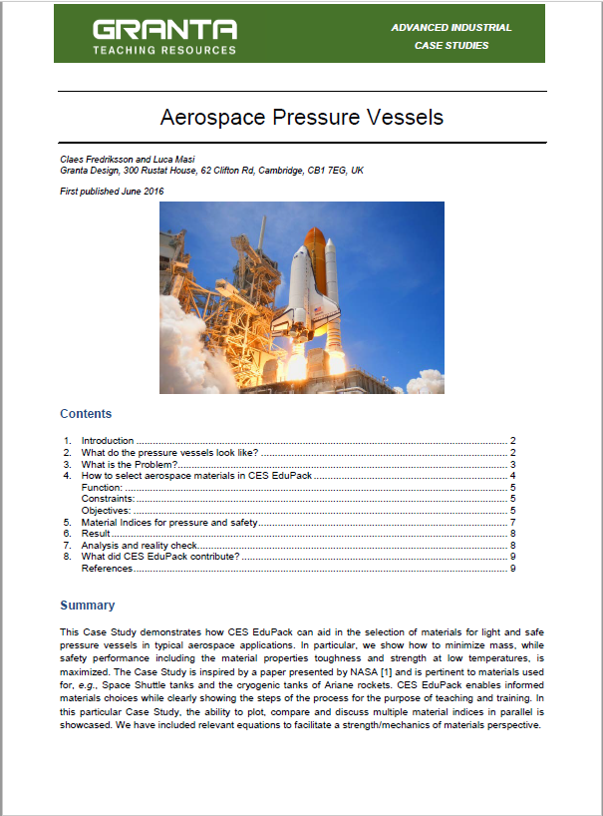
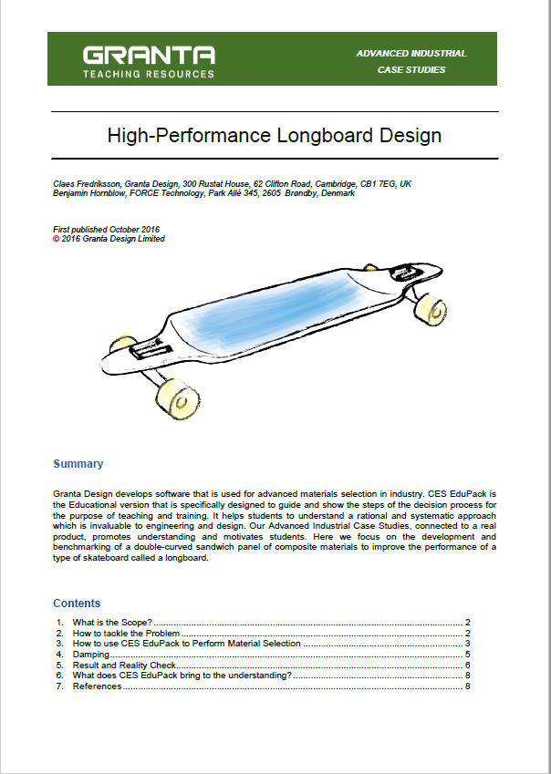
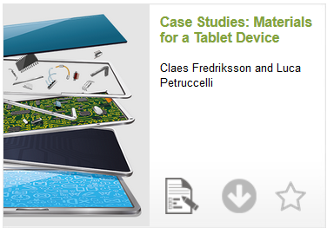
More Case Studies: Real world connection
Ansys GRANTA Case Study Resources:
Advanced Case Studies: 8-page investigations of a complex engineering problem
Level 2 Case Studies: 2-page investigations of a simple topic or materials selection problem
Level 2 | Advanced
Aluminum Strengthening | Aerospace and Automotive Turbine Blades
 | Biomaterials Selection for a Joint Replacement
 | Mars Lander Heat Shield
Chainsaw | Aerospace Pressure Vessels
 | High-Performance Longboard Design
 | Materials for a Tablet Device
Stainless Steels | Truck Trailer Lightweighting
 | Automotive Door Panels
 | Biomedical Waste: Health vs. the Environment
Longboard | Suture Anchor Implant
 | Porous Scaffolds for Bone Tissue Engineering
 | Railway Lightweighting
The Built Environment | Water Containers and Plastic Waste
 | Material Properties and Structural Sections
 | Electric Cars—Sustainability and Eco Design
Notes:
Harriet
But some students might not be motivated by the statement “go explore topic X”. So what else can we do to encourage their connection to the topics being covered in the classroom?

Slide 26
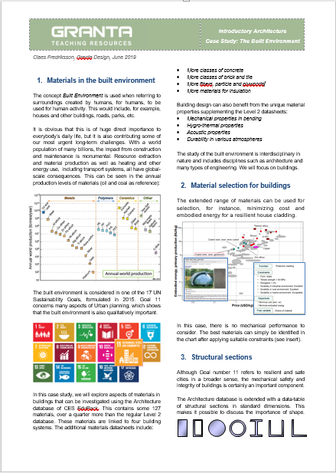
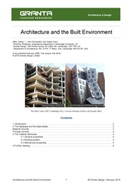
Conclusions
GRANTA EduPack can be used to support online learning
Has the necessary flexibility and self-sufficiency for e.g., professional development and continual education
In this simplified industrial case study, we have explored the systematic way to understand materials for a chainsaw blade using GRANTA EduPack. Considering materials like Ti, Al, Mg or CFRP may improve the performance of the chainsaw blade in terms of a stiffness-limited design. Engineering Design, however, is always a balance of various material properties, costs, manufacturing processes and degree of innovation.
Case Study Paper, project files, exercises and
other resources available on the Education Hub
www.grantadesign.com/education
Notes:
Conclusions (Harriet)
GRANTA EduPack can be used to select materials with additional building-specific materials and properties
The structural sections data-table links architecture with engineering.
The Eco Audit can be used to explore various aspects of a building when it comes to eco-properties in a life-cycle perspective
Energy use and CO₂ footprint, as well as options for logistics, recycling and end of life options can be investigated

Slide 27
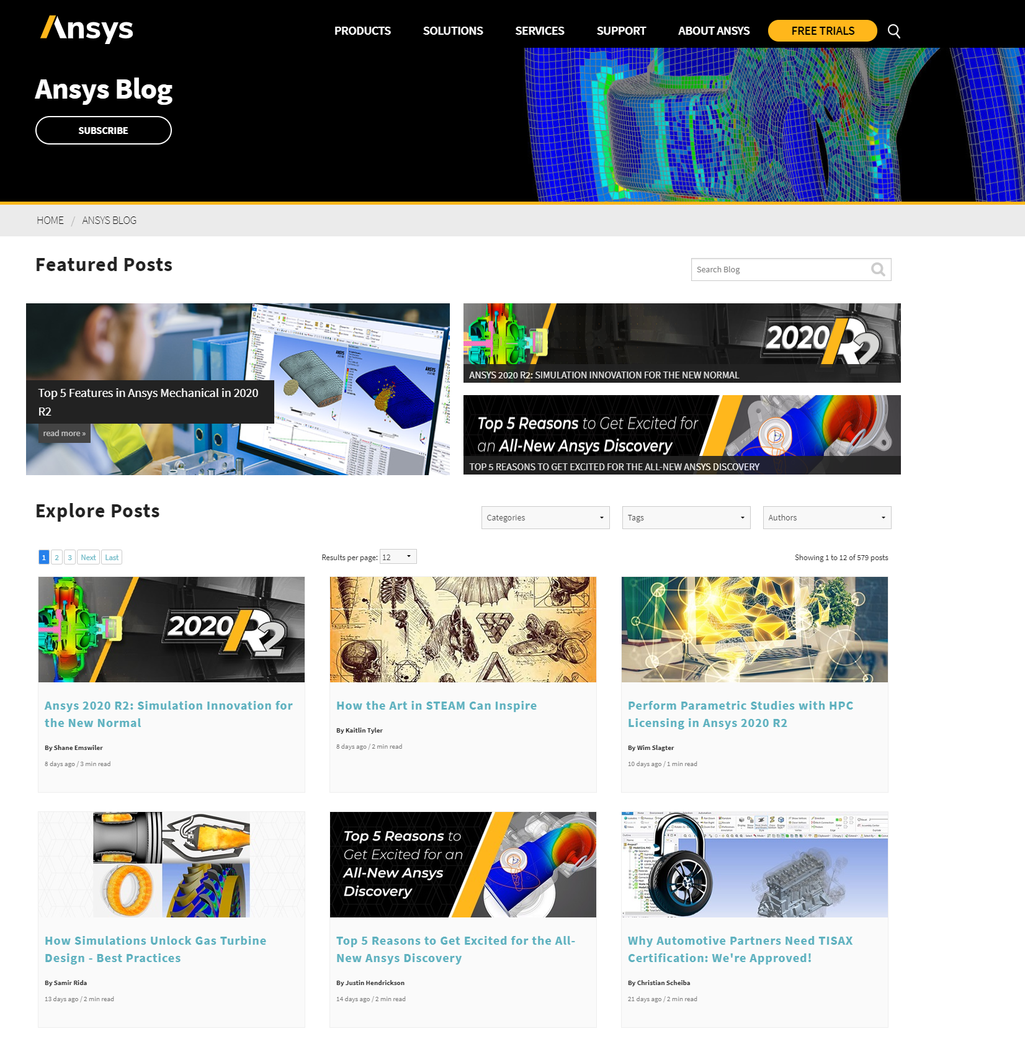
Join the Ansys conversation!
Read and comment.
Find the Ansys blog: ansys.com/blog

Slide 28
The Art of Simulation Image Competition: Enter Today!
Show us how YOU are using Ansys software to engineer what’s ahead!
Visit www.ansys.com/artofsim to learn more & click on ‘ENTER NOW’
Submit your best simulation image(s) before October 2, 2020 for the chance to be included in the public round of voting
Vote on the best images in each category & share the fun experience with your friends, family, colleagues and social media contacts
Winners will be determined by mid-November 2020 & will be publicly recognized and rewarded for their expert simulation skills!
Notes:
Ansys is running a simulation image competition, called the Art of Simulation — covering 16 dynamic categories — for our customers and student community to spotlight how they are leveraging Ansys software to engineer what’s ahead. Enter your submission before the deadline on October 2 and then help vote for the winner October 19 through November 13. Submit your entry for a chance to go down in the history books as an Ansys Art of Simulation champion! Learn more at ansys.com/artofsim

