Slide 1
Quarterly Case Study Session
Presented June 2019
The Built Environment - Materials and Sustainability of Buildings
Claes Fredriksson and Bridget Ogwezi
Ansys Materials Education Division

Slide 2
Agenda
Introduction
Architectural Case Study
The Built Environment
Materials in built environments
Material selection for buildings
Structural sections
Eco Audit of a house
Q&A
Community update
Claes Fredriksson and Bridget Ogwezi
from the Ansys Materials Education Division
Notes:
Agenda

Slide 3
Sustainability and the built environment
Notes:
The built environment
The concept Built Environment is used when referring to surroundings created by humans, for humans, to be used for human activity. This would include, for example, houses and other buildings, roads, parks, etc.
These are the spaces that we interact with and live our lives in, so their obviously of great significance, but they also contribute to some of our most urgent long-term challenges.
That’s why Sustainable cities and communities is one of UN’s 17 sustainable Development goals
This goal incorporates aspects of, safety and sustainability, which will be dealt with in this presentation

Slide 4
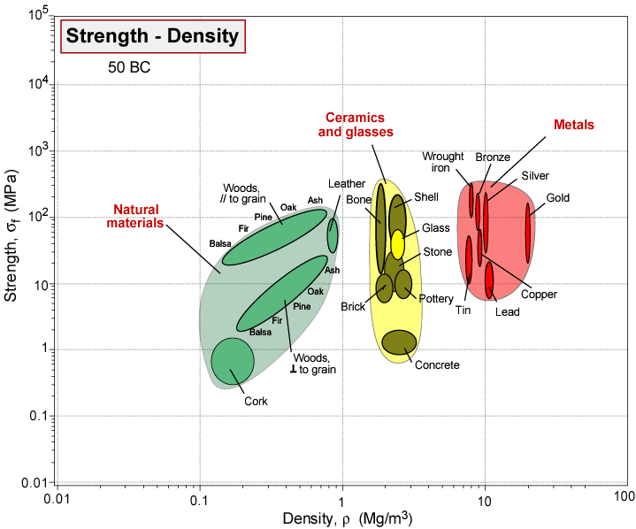
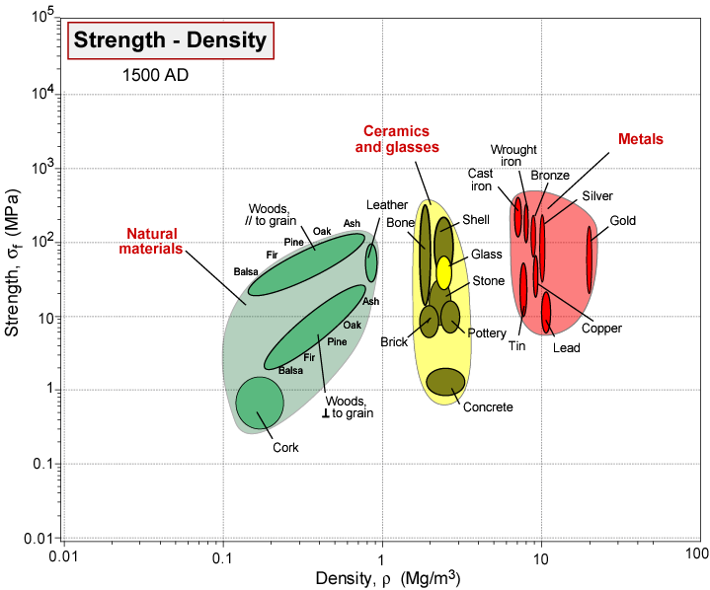
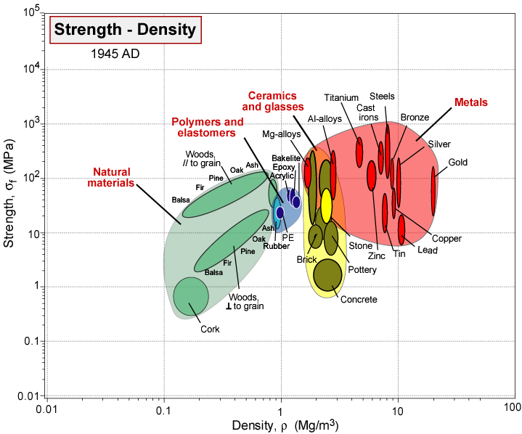
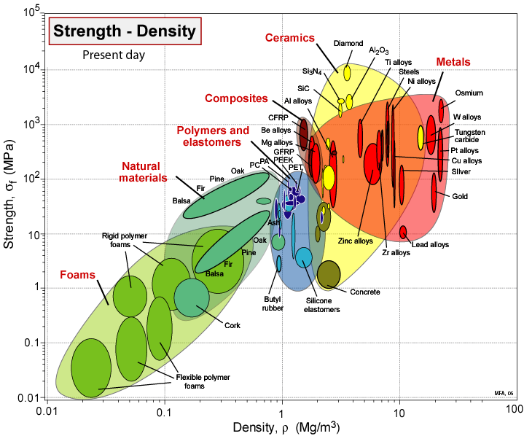
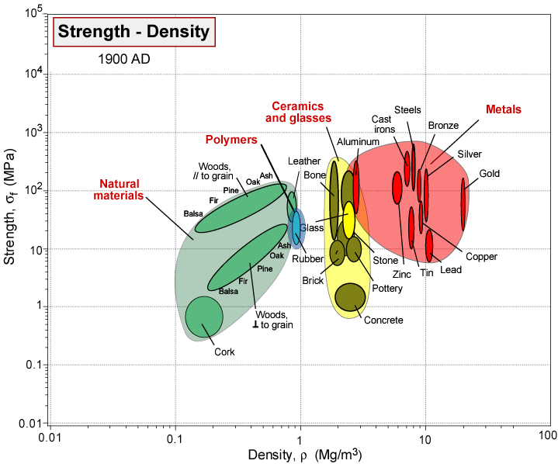
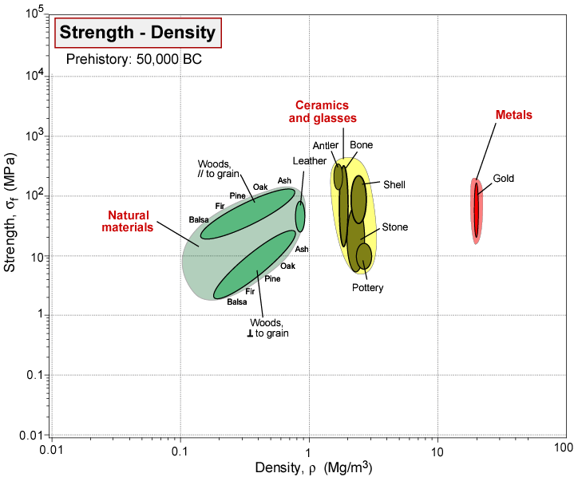
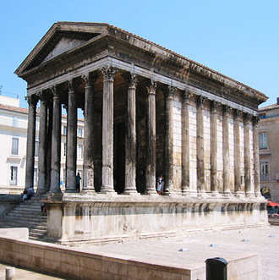
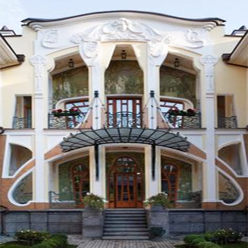
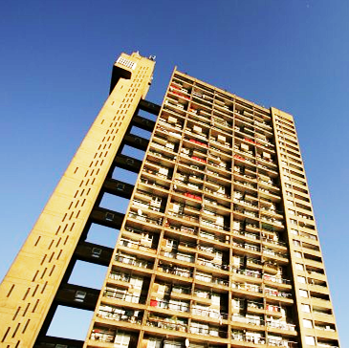
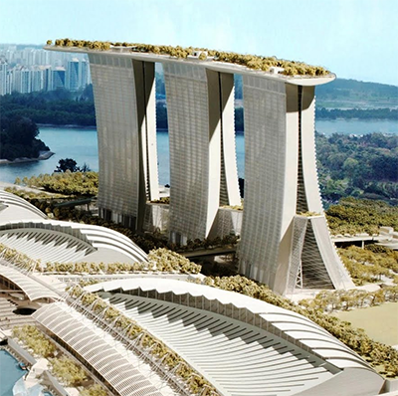
Evolution of Materials
Early history 3000 BC
Medieval, south India
Empire of Rome
Mid-20th century
Fin de siècle
21st century
Old Kingdom, Egypt
Notes:
Materials for buildings (animation)
Building materials have been used by humans since the beginning of mankind, starting with stone and wood.
Using the limit stage on the attribute in the regular Level 1 or 2: Date first used, we can show shows growing use of materials with time.
In Roman times, Concrete, Brick and Glass appear
Cast iron and Aluminum was around during the industrial revolution
Steel and polymers, like foams etc. have dominated the 20:th century
Today, of course, there are all sorts of composites and other advanced materials around

Slide 5
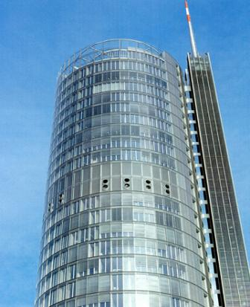
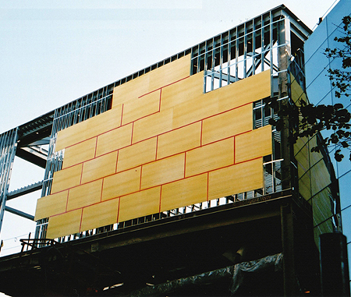
Why do architects need to know about materials?
Today, architects and structural engineers specify products, not materials
Low-e laminated glass
Gypsum and glass fiber composite board
used as exterior sheathing.
Notes:
Materials for architecture
Architects and Builders deal mainly with products, most of which combine several materials, some very advanced.
But the performance of these products depends on these material properties.
A working knowledge of materials can help the designer to match properties with functional needs – and ignorance can lead to missed opportunities or disasters.

Slide 6
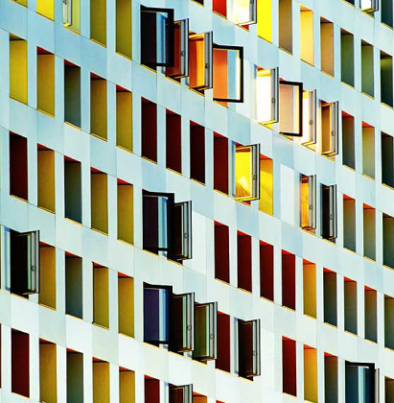
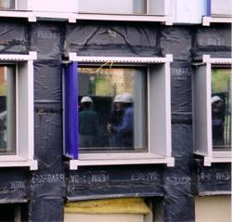
Unfamiliar materials used in new products
Many materials used in these products are unfamiliar to designers.
Simmons Hall Student Dormitory, MIT, USA. Steven Holl, Architect.
Aluminum skin, covering….. Waterproof, adhesive-backed EPDM
Notes:
Materials for buildings
Some materials in building systems are not very obvious. Materials such as silicone sealants, organic coatings, composites, high strength concretes, etc.
Many have been developed in corporate laboratories and are sold directly to the systems manufacturers, e.g., waterproof, adhesive-backed EPDM (right) that lies underneath the aluminum skin of the finished building (left).

Slide 7
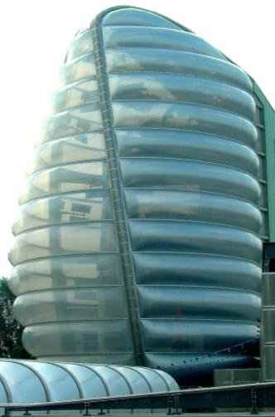
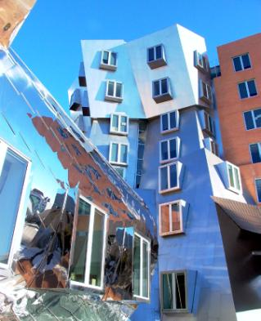
New advanced materials
Stata Center, MIT, USA. F.O. Gehry Architect
Space Center, Leicester, UK.
N. Grimshaw
Architect
Stainless steel, zinc coated
titanium, polymer sealants
Post-industrial revolution -
ETFE (and thousands more)
Notes:
Materials for buildings
Ecological and environmental performance indicators such as embodied energy, toxicity, recycle potential, renewability are increasingly important.
Architectural design is constantly in search for new forms and new processes to create them. The Stata Center at MIT is an example of wild design achieved through a diversity of stainless steels, zinc-coated titanium, composite metal sheets and an array of polymer adhesives and sealants.
The exterior envelope was substantially produced using Computer Assisted Manufacturing (CAM) methods that required the use of lightweight foams and other materials to reduce weights of large window panels.
Advanced polymers have also become more important as building material, as ETFE in the Space center which is outside Leicester

Slide 8
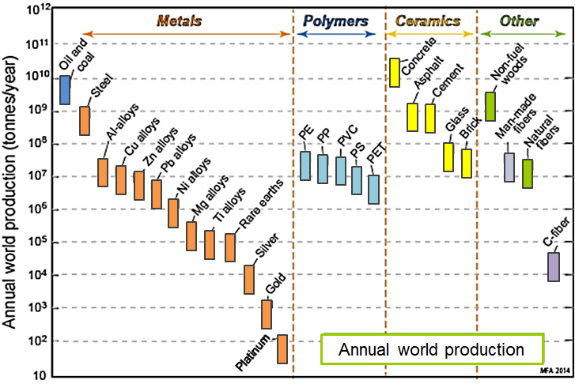
Materials world production
Notes:
Materials for buildings
The materials use in the world is enormous! The plot shows the annual world production (in tonnes per year) of several materials of the built environment. Oil and coal are shown on the left for comparison purposes.
The logarithmic scale of the axis is used to fit all these data in the same chart
Steel, concrete, asphalt, cement, glass, brick and wood are all at the top of global material use.

Slide 9
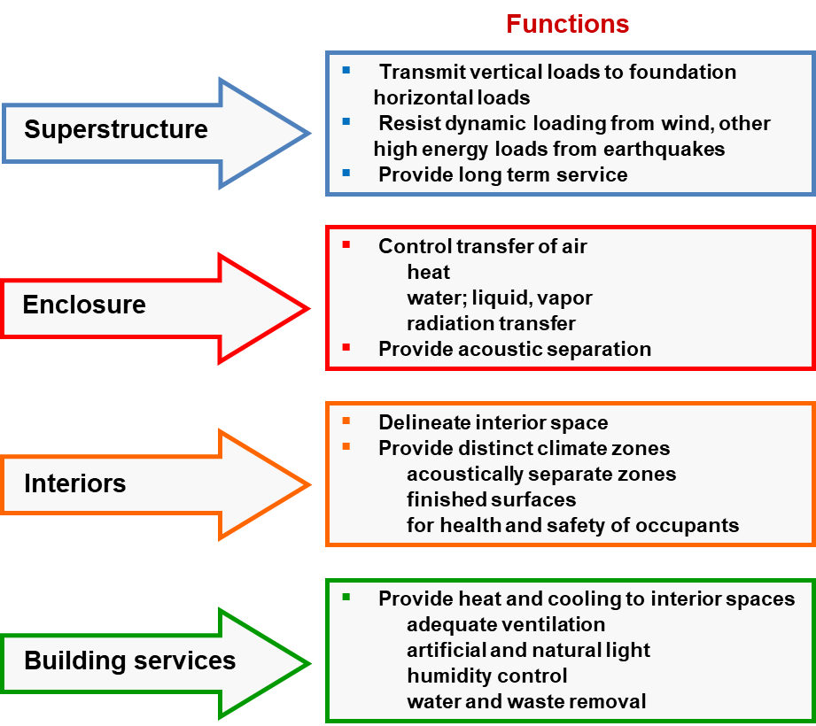
The Architecture Level 2 database
Content: Level 2, expanded
127 records emphasising materials for the built environment
The 4 semi-autonomous systems:
More classes of concrete
More classes of brick and tile
More fibers, particle and plywoods
More materials for insulation
Additional fields (67 properties, all with ⓘ)
Mechanical properties in bending
Hygro-thermal properties
Acoustic properties
Durability in various atmospheres
Notes:
Materials in the Architecture database
The Granta EduPack database for Architecture and the Built Environment differs from the Granta EduPack Level 2 database
It contains some 127 materials, over a quarter more than the regular Level 2, with more concretes, bricks and insulation materials
There are also some extra material properties that are unique to buildings, such as Hygro-thermal and acoustic properties
They are also tagged into 4 systems reflecting the different functions of a building
- Superstructure: to transmit dynamic and static loads to the foundation
- Enclosure: the typically non-structural environmental barrier
Interior: to separate internal spaces for function and define climate zones
Building services: materials used for application like ventilation systems and humidity control.

Slide 10
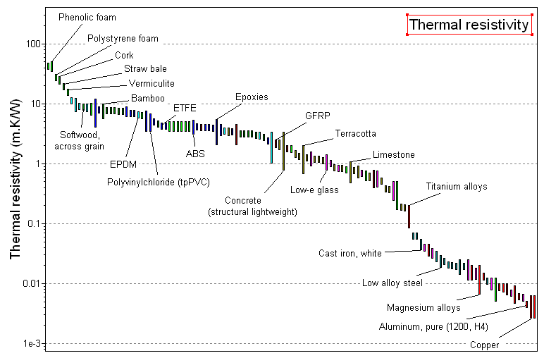
Ability to create property charts
Good Insulating Materials
Results
5 out of 95 pass
Ranking
T-resistivity
Material 1 313
Material 2 300
Material 3 278
Material 4 247
etc...
Bar charts of any property can be created in the usual way
Carry out material selections (“Find materials with large thermal resistivity”)
Notes:
Material selection for buildings
The Granta EduPack makes it easy to create bar charts and bubble charts in the usual way
Here is a bar-chart of thermal resistivity, the reciprocal of thermal conductivity, which reflects how well it insulates
This allows the selection of materials with exceptionally high resistivity by positioning a selection box.

Slide 11
Selection: cladding for buildings
Select materials for cladding for buildings.
Design requirements
Translation
Durable, strong, ductile cladding in the form of sheet.
As cheap as possible
Environmentally friendly
Function
Protective cladding
Constraints
Form: sheet
Tensile strength > 50 MPa
Elongation > 2%
Durability, water (fresh): Excellent
Durability, UV radiation (sunlight): Excellent
Durability in marine environment: Excellent
Objectives
Minimize cost
Minimize embodied energy
Notes:
Material selection for buildings
These design requirements represent an example where a material is sought for the cladding of a building. It must meet certain constraints, listed here
Availability in the form of sheet
Sufficient strength to support working loads (>50 MPa), the strength of typical of aluminum cladding is a good bench-mark
Sufficient ductility (>2%) to allow bending to accommodate changing roof profiles
Durability for rain, sun and, for example, to marine environments
There are two objectives: to minimize material cost, and to use a material with the lowest possible embodied energy.

Slide 12
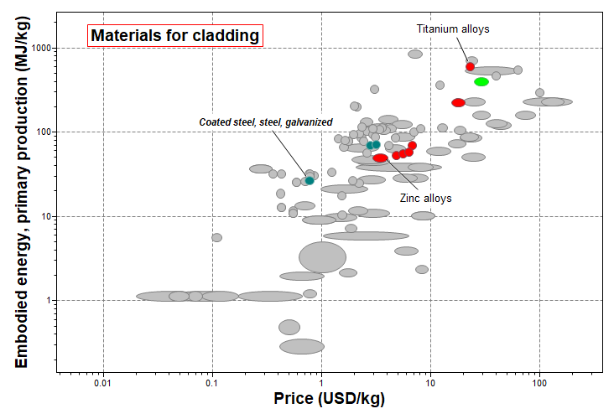
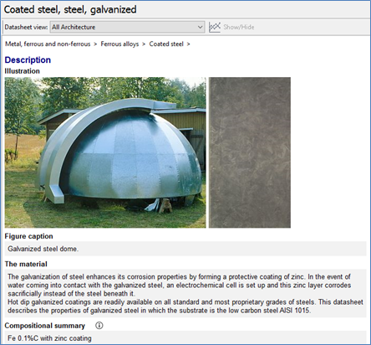
Demo: Material selection for Cladding
Notes:
Material selection for buildings
In a typical material selection, the objectives are applied in a bubble-chart of material price and material embodied energy – materials with low values of both lie towards the bottom left.
Materials that failed to meet one or more of the constraints appear in grey, those that meet all the constraints remain colored.
The one with the lowest price and embodied energy, meeting all constraints is Galvanized steel, Titanium is at the other end of the spectrum
The galvanized steel data sheet is shown in the insert.

Slide 13
The Structural sections data-table
Standard
prismatic sections
Universe
Family
Material and Member
Attributes
Angles
Channels
I-sections
Rectangular
T-sections
Tubes
Steel universal joist
General properties: ρ, E, σ_{y}
Dimensions: Max Depth, width,...
Section props.: Area, I, Z, K, Q ...
Structural props.: EI, σ_{y} Z, ...
Extruded Al alloy
Pultruded GFRP
Structural steel
Structural sections
A record
Notes:
Structural selections for buildings
There are also examples where architecture meets engineering for the built environment. This is connected to safety in buildings
There are nearly 2000 standard structural sections available in a separate data-table of the Architecture database
The materials are Structural steel, extruded aluminum alloy, pultruded GFRP and wood
They have the shapes shown here – rectangular, tube, I-sections, U-sections (Channels), L-shapes (Angles) and T-sections.
The data organization is shown here. The first level – the families – refers to shape. The choice of shape depend on the way the section will be loaded
I, U and L-sections are good in bending but poor in torsion; closed circular and box sections carry both torsion and bending well.
The second level of the tree is the material – here we list the three for which standard sections are widely available. Each of these comes in many different sizes, and for each size there is a set of attributes.
The records in the database contain: material properties, dimensions, section properties such as the second moment of area I and section modulus Z, or structural properties (such as E.I and σ_{y}.Z.)

Slide 14
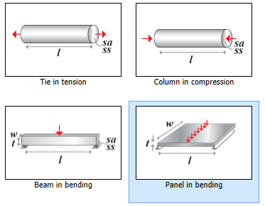
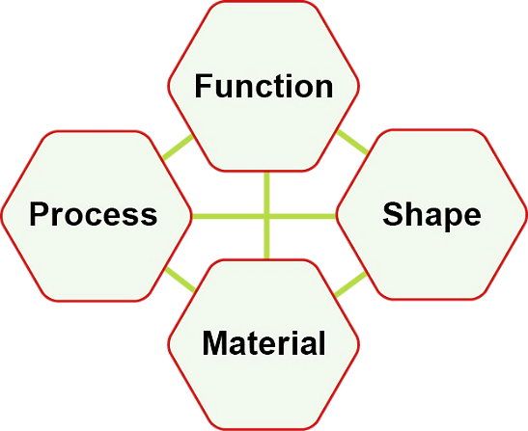
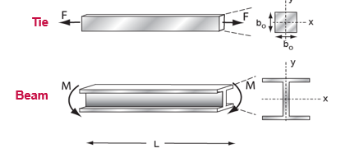
The Structural sections strongly rely on their shape
Function:
Panel loaded in bending
Stiffness-limited design
Length, width specified
Thickness free
Area A matters,
not shape
Area A and shape matter, I_{XX}, I_{YY}
Notes:
Structural selections for buildings
One thing to consider when using the structural sections data-table is that shape is very important
The function of the design will influence the material selection and processes will affect material properties
The shape of the design will also have a profound effect on the material choice and there are complex interactions between all of these 4 aspects
In a typical material selection using a property chart, the shape is fixed by the function and constraints
The free design parameter, for example the thickness of a panel in bending, is eliminated from the chart, so that only material properties matter to the performance. The design parameter is determined later in the design.
For structural sections, both the material and the shape is represented within the bubbles of the chart.

Slide 15
Shape efficiency: bending stiffness
Take ratio of bending stiffness S of shaped section to that (S_{o}) of a neutral reference section of the same cross-section area: a solid square with area A = b²
The second moment of area is I; stiffness scales as EI
Area A = b²
is constant
b
Define shape factor for elastic bending
b
Each of these is roughly 10 times stiffer in bending than a solid square section of the same cross-sectional area ( )
I-sections,
Circular tubes,
Increasing size at constant shape
Notes:
Structural selections for buildings
Structural sections exist also in the Level 3 engineering database and how to handle shape is a very interesting area, here, we will just briefly introduce some concepts.
The obvious way to measure the effect of shape, the shape efficiency is to compare the behavior of a shaped section with that of a standard section with the same area
EduPack takes the standard section to be a solid square. If the square section is reshaped into a tube or I-section, the cross section area stays the same but the bending stiffness increases.
The bending stiffness increases by the factor, which is around 10 for I-sections or circular tubes (φ_{e} = I/I₀ = 12 I/A²)
The elastic shape factor, φ_{e}, measures the efficiency of the shape when stiffness is the goal.
Similarly, the plastic shape factor, φ_{f} , measures the efficiency of the shape when strength is the goal.
Shapes with high φ_{e} have high φ_{f} as well. Other shape factors characterize stiffness and strength in torsion.

Slide 16
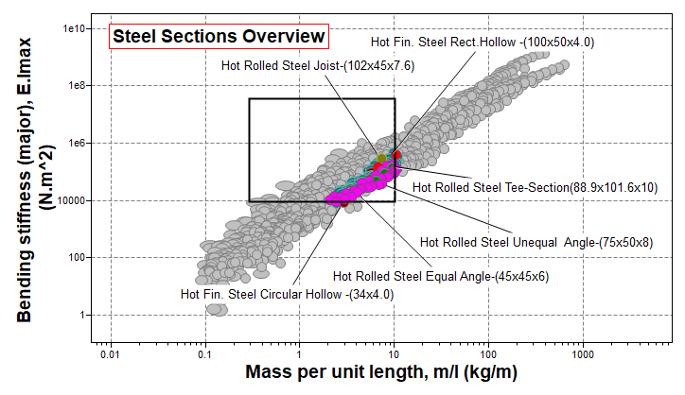
Demo: Overview of steel structure properties
Properties of all steel structural sections
Sections can be screened as usual
Wood rectangular sections (planks) have surprisingly attractive properties
Notes:
Structural selections for buildings
This chart shows two relevant properties for structural sections, bending stiffness vs. length density (major means in the direction of max stiffness)
Only steel sections are included, filtered in a Tree stage. The square represents constraints on the bending stiffness (>10000) and mass/length (<10)
The remaining structures have various size and shape, so they represent an overview, rather than material performance
Softwood rectangles (included for comparison), or planks, have surprisingly attractive properties, compared to steel

Slide 17
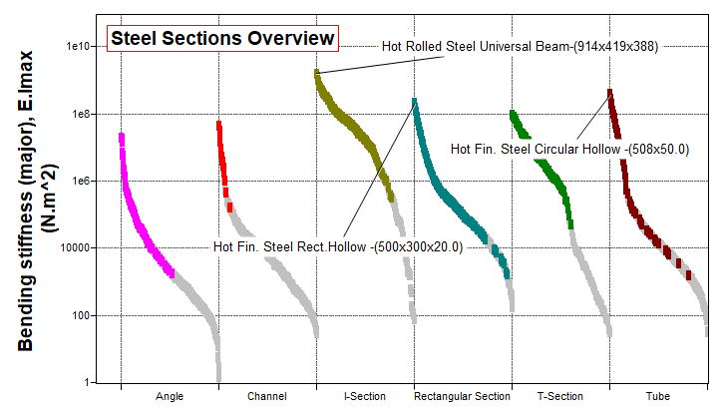
Bending stiffness per shape (all steel)
Re-define the X-axis:
Notes:
Structural selections for buildings
To study the effect of shape more explicitly, the X-axis can be modified by Advanced > Tree, where it can be divided into categories
I-sections and tubes offer high bending stiffness

Slide 18
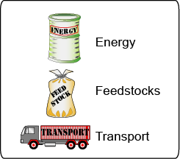
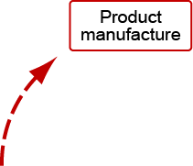
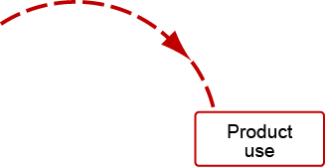
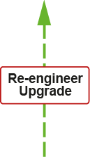
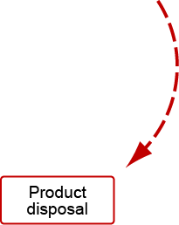
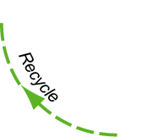
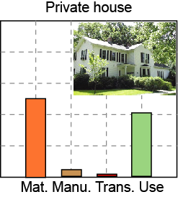
Eco Audit and life-cycle thinking for a house
Resources
Streamlined Life-cycle inventory:
Distinguish life-phases
1 resource – energy
1 emission – CO₂ equivalent
Combust
Landfill
Notes:
18
The life-cycle of materials for a building
Granta EduPack has an Eco Audit tool that can be used to estimate eco-properties over the life-cycle of a House
This is not a full LCA, but rather a streamlined Life-Cycle Inventory (LCI) but it considers all the usual 4 phases plus transports.
Ore and feedstock, drawn from the earth’s resources, are processed to give materials. These are manufactured into buildings that are used over a long life time, say 50 years.
Energy and materials are used at each phase of this cycle with an associated carbon emission
The embodied energy of the building and the use phase, or operational phase, are typically the most energy consuming for houses over their life cycle.
At the end of life (demolition), materials may be landfilled, incinerated, recycled/downcycled, repaired/renovated or reused as they are. These options are all available within the Eco Audit.

Slide 19
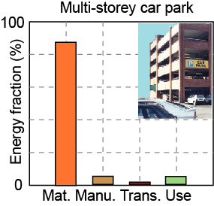
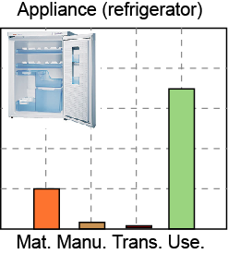
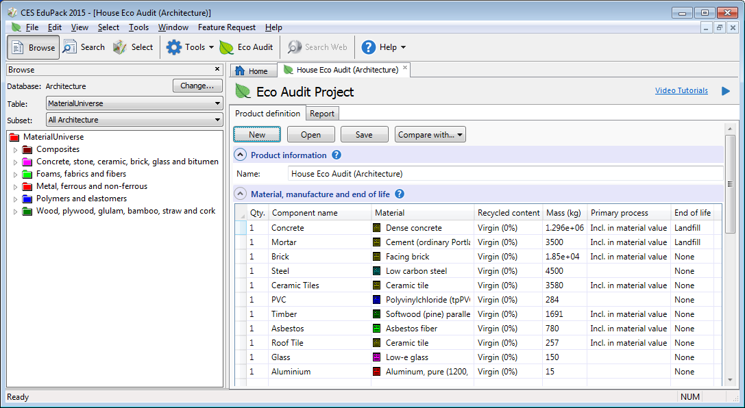
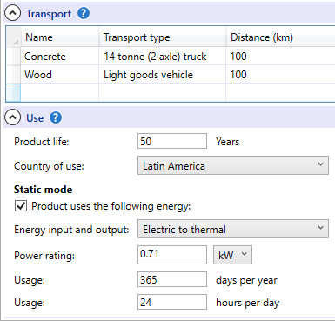
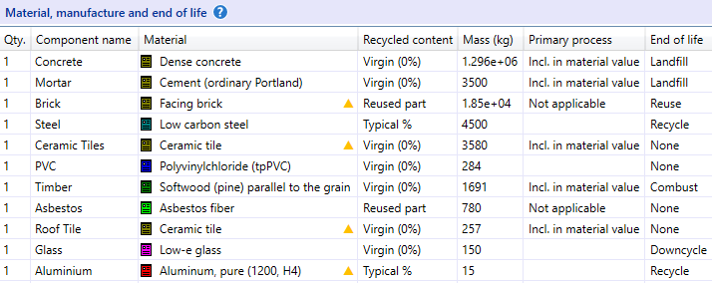
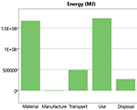
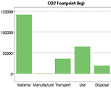
Demo: Eco Audit of a house
B.O.M for semidetached 1-2 story house built in Colombia with 140 sqm floor area, three bedrooms. Brick, concrete and steel. Data from Oscar Ortiz-Rodriguez et al.
http://www.researchgate.net/profile/Oscar_Ortiz-Rodriguez2/publications
Notes:
19
The Eco Audit for a building
Here we can see the breakdown of energy usage over the life of three products. For unheated buildings, materials is the dominant phase. For appliances and many modern conveniences, the use-phase dominates. A typical house has significant energy use both for materials and the living phase.
The relevant environmental load arises mainly from the carbon footprint of these two phases of the life-cycle.
To explore the influence of energy mix on the carbon footprint for a house used for 50 years, a bill of materials can be prepared and distributed to the class in the form of an Eco Audit Project file (different from other project files). Our data is adapted from Oscar Ortiz-Rodriguez et al. 2008, 2012. http://www.researchgate.net/profile/Oscar_Ortiz-Rodriguez2/publications
The results represent only an example, as a platform for discussion. We have entered arbitrary transport contributions.
By using the “compare with” function, various recycling options can be explored (typical/recycled/reused) as well as country of use (Latin America/North America). See case study paper.

Slide 20
Conclusions
Granta EduPack can be used to select materials for the built environment with additional building-specific materials and properties
The structural sections data-table links architecture with engineering (safe)
The Eco Audit can be used to explore various aspects of a building when it comes to eco-properties in a life-cycle perspective (sustainable)
Energy use and CO₂ footprint, as well as options for logistics, recycling and end of life options can be investigated (educational)
*Case Study Paper, project files, exercises and
other resources available on the Resource Hub
Notes:
Conclusions
Granta EduPack can be used to select materials with additional building-specific materials and properties
The structural sections data-table links architecture with engineering.
The Eco Audit can be used to explore various aspects of a building when it comes to eco-properties in a life-cycle perspective
Energy use and CO₂ footprint, as well as options for logistics, recycling and end of life options can be investigated

