Slide 1
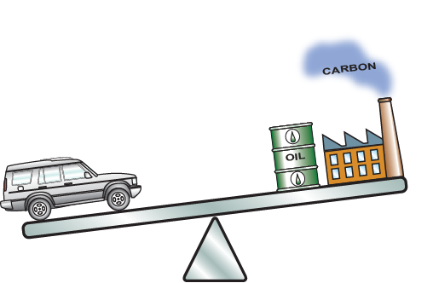
Unit 12.
Eco Design and the Eco Audit Tool
introducing students to life-cycle thinking
Mike Ashby
Department of Engineering,
University of Cambridge
Notes:
The PowerPoint Lecture Units For 2024
The Lecture Units developed for teaching in connection with Granta EduPack are listed at the end of this presentation.

Slide 2
Learning objectives for this lecture unit
Intended Learning Outcomes
Knowledge and Understanding | Knowledge and understanding of the material life-cycle
Skills and Abilities | Ability to use Eco Audits in the design process
Values and Attitudes | Awareness that environmental design objectives influence material selection
Resources
  Text: “Materials and the Environment”, 3rd Edition by M.F. Ashby, Butterworth-Heinemann, Oxford 2021, UK. Chapters 1-10
  Text: “Materials: engineering, science, processing and design”, 4th Edition by M.F. Ashby, H.R. Shercliff and D. Cebon, Butterworth Heinemann, Oxford 2019, Chapter 20
  Text: “Materials Selection in Mechanical Design”, 5th Edition by M.F. Ashby, Butterworth Heinemann, Oxford, 2016. Chapter 14
  White Paper: Granta EduPack Eco Audit Tool
  Poster: Eco Design
  Software: Ansys Granta EduPack with the Eco Audit tool
Notes:
Learning Objectives
These Intended Learning Outcomes are based on a taxonomy of knowledge and understanding as the basis, skills and abilities as necessary for the practical use of knowledge and understanding, followed by acquired values and attitudes enabling assessments and responsible use of these abilities.
Combined with a suitable assessment, they should be helpful in the context of accreditations or for the CDIO Syllabus.
The Texts listed are from books authored or co-authored by Mike Ashby but other texts are also referred to in the Science Notes.

Slide 3
Outline of lecture unit 12
The materials life-cycle
Eco Audits and the Audit tool
Case study: PET bottles from France
The Advanced Eco Audit tool
Case study: Cost Audit of car mass reduction
Notes:
Outline
This is the twelfth Unit of a course on Material and Process Selection. The Units link closely to the first three Texts listed on the previous frame but can equally by used in conjunction with texts such as Callister, Budinski, Askeland and others. The relevant chapters of the Texts are listed on the Outline frame of each Unit. The methods developed in the course are implemented in the Granta EduPack software, which is structured to evolve in pace with the student throughout a four-year engineering program. This first Unit introduces materials and processes, and the way in which information about them can be classified, stored, retrieved and explored.

Slide 4

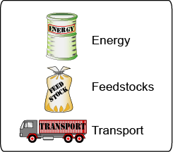

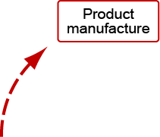
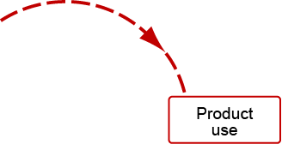
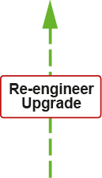


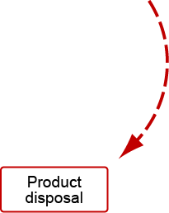

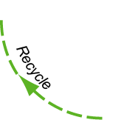

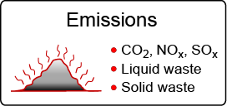



The product life-cycle
Life Cycle
Assessment (LCA)
Resources
Emissions and waste
Combust
Landfill
Notes:
4
The life cycle of products and the materials they contain
This frame shows the materials lifecycle. Ore and feedstock, drawn from the earth’s resources, are processed to give materials. These are manufactured into usable products, and at the end of their lives are discarded with only a fraction entering the recycling loop. The rest are committed to incineration or land-fill. Energy and materials are consumed at each point in this cycle (we shall call them “phases”), with an associated penalty of CO₂, SO_{x}, NO_{x}, and other emissions – heat, and gaseous, liquid and solid waste, collectively called environmental “stressors”. These are assessed by the technique of life-cycle analysis (LCA).
ISO 14000 and PAS 2050 of the International Standards Organization defines a family of standards for environmental management systems. ISO 14000 contains the set IS0 14040, 14041, 14042 and 14043 published between 1997 and 2000, prescribing broad procedures for conducting the four steps of an LCA: setting goals and scope, inventory compilation, impact assessment and interpretation. The standard is an attempt to bring uniform practice and objectivity into life-cycle assessment and its interpretation, but implementation is cumbersome and expensive.
PAS 2050 (2008) is a more recent set of draft standards for the carbon assessment of products.

Slide 5
Life cycle assessment (LCA)
ISO 14040 series
PAS 2050
Typical LCA output
Aluminum cans, per 1000 units
Bauxite 59 kg
Oil fuels 148 MJ
Electricity 1572 MJ
Energy in feedstock 512 MJ
Water use 1149 kg
Emissions: CO₂ 211 kg
Emissions: CO 0.2 kg
Emissions: NO_{x} 1.1 kg
Emissions: SO_{x} 1.8 kg
Particulates 2.47 kg
Ozone depletion potential 0.2 X 10⁻⁹
Global warming potential 1.1 X 10⁻⁹
Acidification potential 0.8 X 10⁻⁹
Human toxicity potential 0.3 X 10⁻⁹
Resource
consumption
Emissions
inventory
Impact
assessment
Full LCA is expensive, and requires great detail and experience – and even then is subject to uncertainty
How can a designer use these data?
Notes:
5
Life cycle assessment (LCA)
The upper part of this slide lists the typical output of an LCA that meets the ISO 14040 guidelines. A full LCA is time-consuming, expensive and it cannot cope with the problem that 80% of the environmental burden of a product is determined in the early stages of design when many decisions are still fluid.
There is a second problem: what is a designer supposed to do with this information? How are CO₂ and SO_{x} productions to be balanced against resource depletion, toxicity or ease of recycling when choosing a material? This question has led to efforts to condense the eco-information about a material into a single measure or eco-indicator, giving the designer a simple, numeric ranking. The use of a single-valued indicator is criticized by some. The grounds for criticism are that there is no agreement on normalization or weighting factors used in the calculations and that the method is opaque since the indicator value has no simple physical significance.

Slide 6
Design guidance vs product assessment
Market need
Problem statement
Alternative schemes
Layout and
materials
CAD, FE analysis,
optimization, costing
Concept
Design guidance
Embodiment
Eco Audit
ability
Detail
Product specification
Product assessment
Life cycle
assessment
Production
Notes:
A typical design process
Design starts with the identification of a market need. Concepts (general working principles) are identified to fill the need. The most promising of these are developed into sketches or diagrams indicating configuration, lay-out and scale (“embodiment”). One or more of these is selected for detailed development, analyzing performance, safety and cost. The output is a design enabling the construction of a prototype that, after testing and development, goes to manufacture.
Material information enters all stages of the design. At the concept stage the design is fluid, and all materials are candidates. Here the need is the ability to scan the entire MaterialsUniverse, but at a low resolution. As the design evolves and the requirements become sharper, so does the need for fewer materials at a higher level of precision. In the final, detailed stage when optimization and other analyses are undertaken, the need for data with just one or a very few materials at the highest precision is evident. The screening process narrows the initially wide material search space containing all materials ultimately leading to a final single choice.

Slide 7
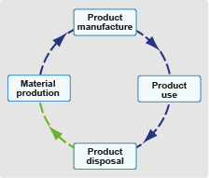
Eco Audit for design
Need: Fast Eco Audit with sufficient precision to guide decision-making
1 resource – energy (oil equivalent) – [MJ]
1 emission – CO₂ equivalent – [kg]
Transport
Distinguish life-phases
Life-energy
Audit: Energy
600
400
300
200
100
0
-100
Use
Energy
Material
Energy (MJ)
Manufacture
Transport
Disposal
EoL credit
Potential benefits
Notes:
7
The idea of an approximate, but fast, Eco Audit
The strategy for guiding design is detailed here:
The first step is one of simplification, developing a tool that is approximate but retains sufficient discrimination to differentiate between alternative choices. A spectrum of levels of analysis exist, ranging from a simple eco-screening against a list of banned or undesirable materials and processes to a full LCA, with overheads of time and cost. In between lie methods that are less rigorous; they are approximate but fast.
We have chosen to select a single measure of emission. On one point there is some international agreement: the Kyoto Protocol and Paris agreement committed the nations that signed it to progressively reduce carbon emissions, meaning CO₂. At the national level the focus is more on reducing energy consumption, but since this and CO₂ production are closely related, they can be treated as equivalent. Thus there is a certain logic in basing design decisions on energy consumption or CO₂ generation; they carry more conviction than the use of a more obscure indicator. We shall follow this route, using energy as our measure.
Our strategy is to separate the contributions of the phases of life because subsequent action depends on which is the dominant one. If it is material production, then choosing a material with low “embodied energy” is the way forward. But if it is the use phase, then choosing a material to make use less energy-intensive is the right approach – even if it has a higher embodied energy.

Slide 8
Eco Audit for design
Need: Fast Eco Audit with sufficient precision to guide decision-making
1 resource – energy (oil equivalent) – [MJ]
1 emission – CO₂ equivalent – [kg]
Distinguish life-phases
Audit: Energy, CO₂ or Cost
16
14
12
10
8
6
4
2
0
-2
600
400
300
200
100
0
-100
Carbon
Use
Cost
Material
Use
Material
Manufacture
C0₂ equiv (kg)
Transport
Cost (US$)
Transport
Manufacture
Disposal
EoL credit
Disposal
EoL credit
Notes:
8
The idea of an approximate, but fast, Eco Audit
A new feature in the enhanced Eco Audit allows cost to be estimated over the life-cycle of the product.

Slide 9
Eco-design: the strategy (1)
Fast
Eco Audit
Analyse
results, identify
priorities
Explore options with “What if…”s
Use EduPack to
select new Materials
and/or Processes
Recommend
actions & assess
potential savings
The steps
600
400
300
200
100
0
-100
600
400
300
200
100
0
-100
Initial and re-design
Initial design
Material
Use
Material
Use
Use Eco Audit to identify
Eco-design objective
Energy (MJ)
Energy (MJ)
Manufacture
Manufacture
Transport
Transport
Disposal
EoL credit
Disposal
EoL credit
Material
Minimize:
material in part
embodied energy
CO₂ /kg
Manufacture
Minimize:
process energy
CO₂/kg
Transport
Minimize:
mass
distance
transport type
Use
Minimize:
mass
thermal loss
electrical loss
End of Life
Select:
recyclable materials
non-toxic materials
Notes:
Identifying the stage of life that has the greatest impact
An initial Eco Audit of the product reveals the energy requirements and carbon emissions, identifying the phases of life that create the greatest burden. The tool then allows rapid “what if…?” exploration of alternative materials, transport mode, use pattern and end-of-life choices, revealing the consequences of a change in any one of these on the others.
The final step is a more systematic analysis of materials selection, targeting the most energy and carbon-intensive phases of life. The Eco Audit identifies the design objective that is a key input for the established materials selection methodology that is built into the Granta EduPack software.

Slide 10

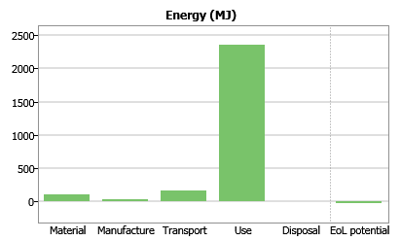
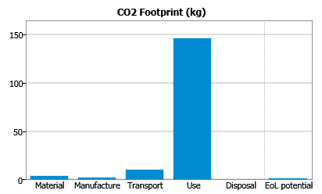
The Granta EduPack Eco Audit tool
User inputs
Database
User interface
Bill of materials
Manufacturing process
Transport needs
Duty cycle
End of life choice
Eco data
Embodied energies
Process energies
CO₂ footprints
Unit transport energies
Recycling / combustion
2 kW electric kettle
Eco Audit model
Outputs:
Full report
Data
Criticality
Hazard
Use is 88%
of life-energy
Notes:
10
The Eco Audit tool
This slide shows how the Eco Audit of a product works. The inputs are of two types. The first are drawn from a user-entered bill of materials, process choice, transport requirements, duty cycle (the details of the energy and intensity of use) and disposal route, shown at the top left.
Data for embodied energies, process energies, recycle energies and carbon intensities are drawn from a database of material properties; those for the energy and carbon intensity of transport and the use-energy are drawn from the Granta EduPack database of eco-attributes of materials. The outputs are the energy or carbon footprint of each phase of life, presented as bar charts and in tabular form.

Slide 11
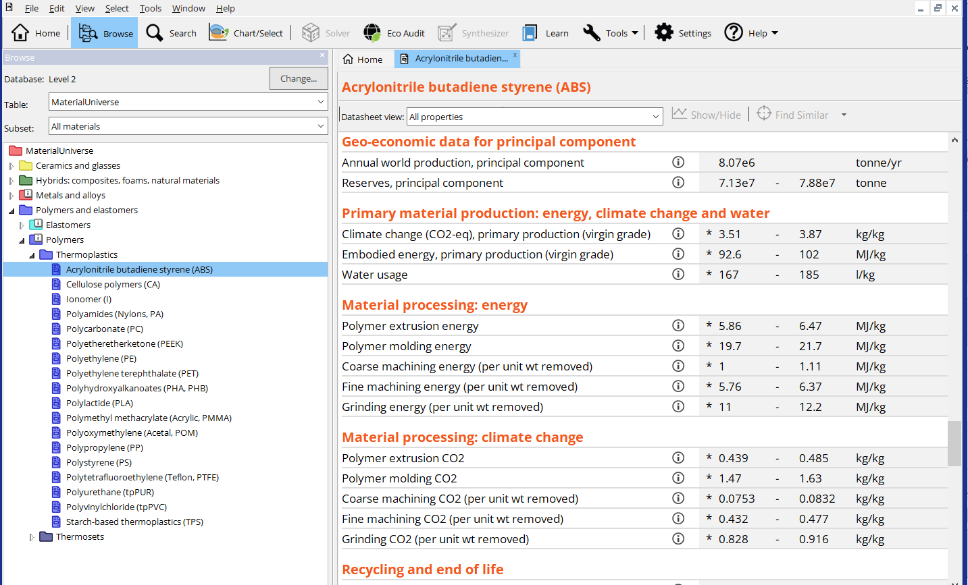
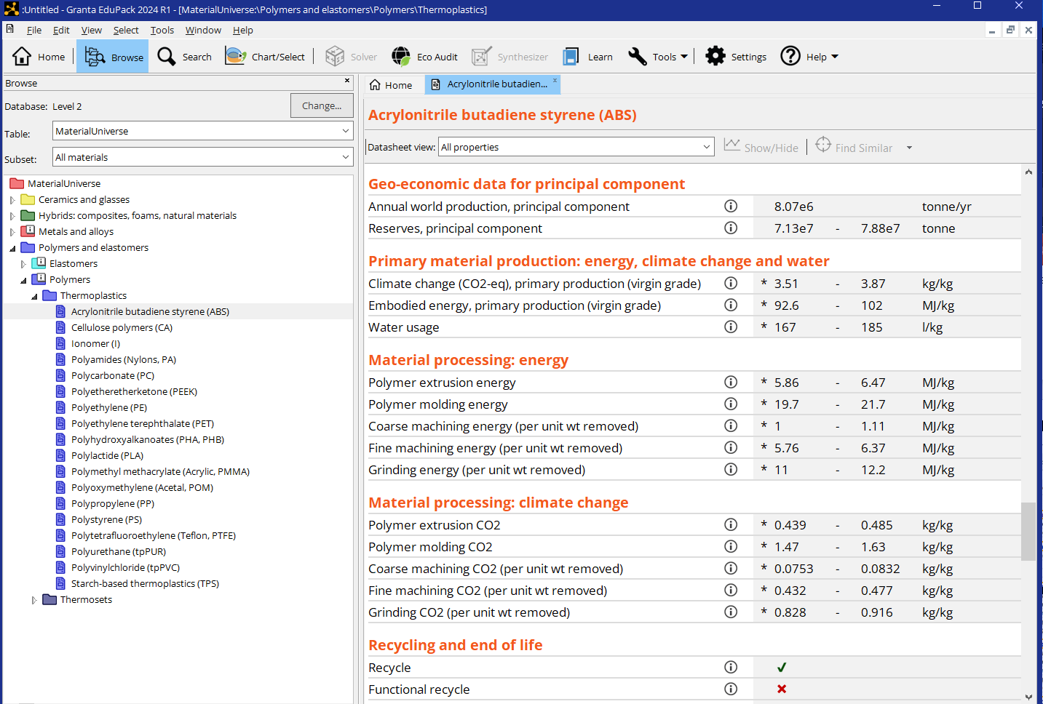

Typical record showing eco-properties
Notes:
The eco-data in the Granta EduPack records
This frame shows the eco-data contained in the records in the Granta EduPack software. Each record contains:
Geo-economic data – annual world production, reserves, etc.
Embodied energy and carbon footprint for the material
Processing energy and carbon emissions for manufacturing processes
Environmental data pertinent to the end-of-life
In addition there are tables of data for electronics, for transport, and for energy.

Slide 12
The Granta EduPack Eco Audit tool
User inputs
Database
User interface
Bill of materials
Manufacturing process
Transport needs
Duty cycle
End of life choice
Eco data
Embodied energies
Process energies
CO₂ _{Eq} footprints
Unit transport energies
Recycling / combustion
2 kW electric kettle
Eco Audit model
Outputs:
Full report
Data
Criticality
Hazard
Notes:
12
The Eco Audit tool
This slide shows how the Eco Audit of a product works. The inputs are of two types. The first are drawn from a user-entered bill of materials, process choice, transport requirements, duty cycle (the details of the energy and intensity of use) and disposal route, shown at the top left.
Data for embodied energies, process energies, recycle energies and carbon intensities are drawn from a database of material properties; those for the energy and carbon intensity of transport and the use-energy are drawn from the Granta EduPack database of eco-attributes of materials. The outputs are the energy or carbon footprint of each phase of life, presented as bar charts as well as tabular form.

Slide 13
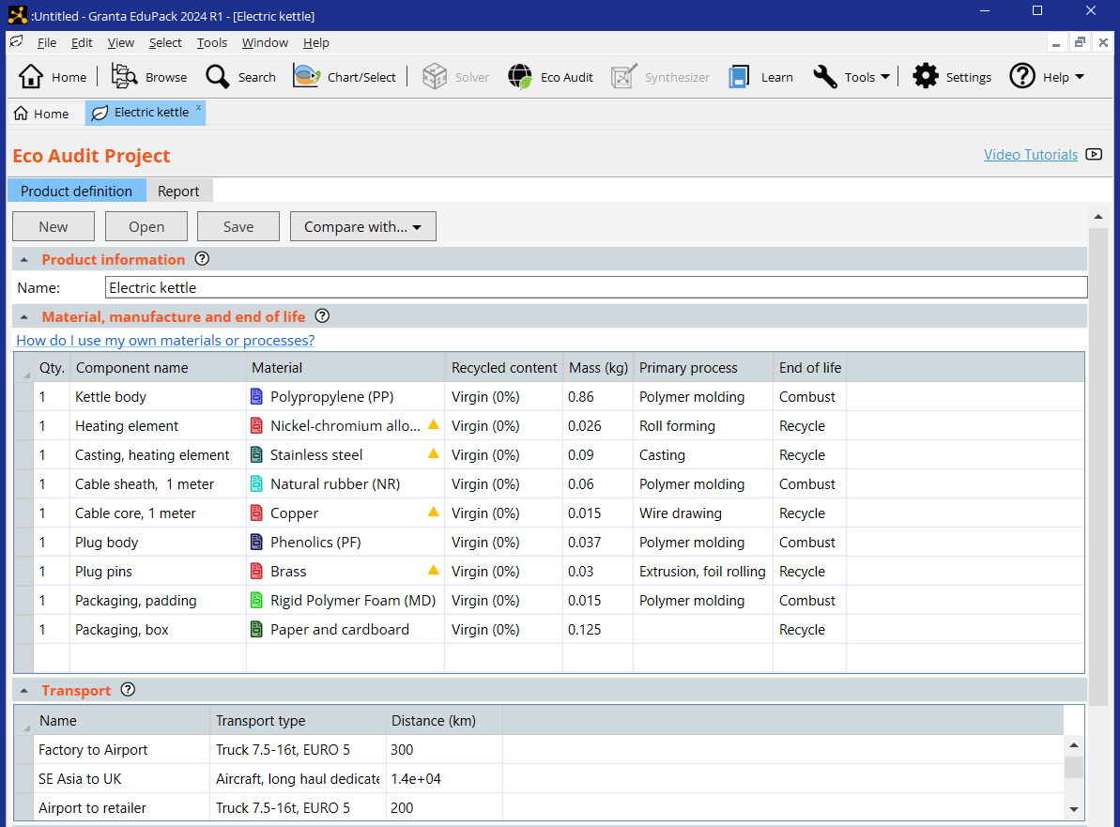
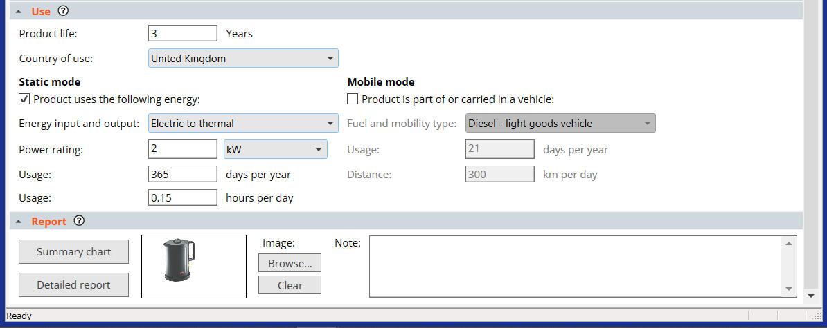
The Eco Audit tool at Level 2
Useful for what-if?
> 5wt% critical material
End-of-Life
Landfill
Combust
Downcycle
Recycle
Re-manufacture
Reuse
None
Bill of Materials (Input or file)
Help at each step
Output data (Detailed info)
Notes:
13
Granta EduPack Eco Audit tool in detail
The tool is opened from the Tools menu at the top of the Granta EduPack screen. Its use involves four steps, listed as 1 to 4 in the frame.
1. Each component is assigned a material (chosen from one of the Granta EduPack databases), a recycle content, a mass, a primary manufacturing process and an end of life choice.
Transport mode and distances are entered.
Use is treated by entering the duty cycle (the energy demands of use).
Clicking on “Report” then generates the bar charts of energy and carbon, and tables listing a break-down by component.
The following frames show the four steps in more detail. They use a simplified schematic of the interface shown above.

Slide 14
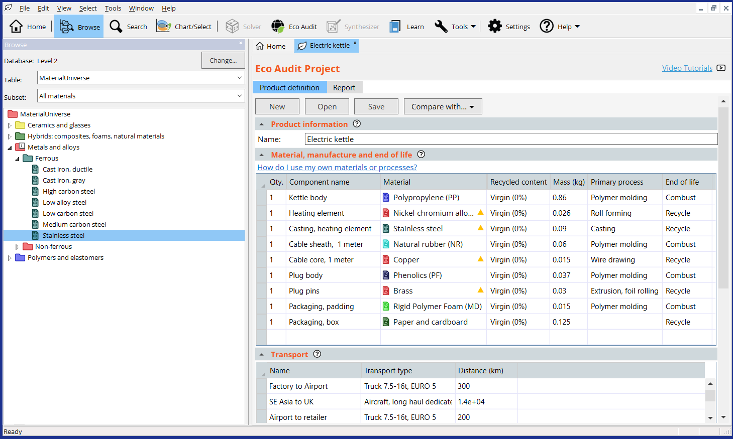
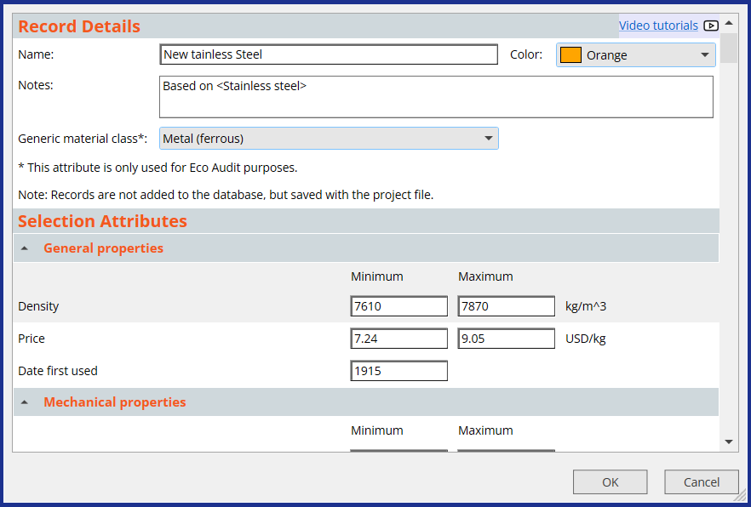
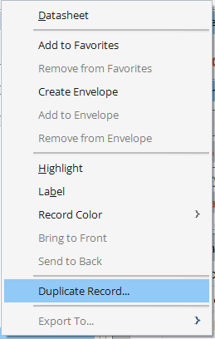
Add your own records, based on existing ones, to Eco Audit
Right-click
Notes:
Creating your own records in Granta EduPack
New materials or process records can be created via Add Record in the Tools menu, or by duplication of an existing record, via right-click. This record ca can then be modified and can be saved within a project file.

Slide 15
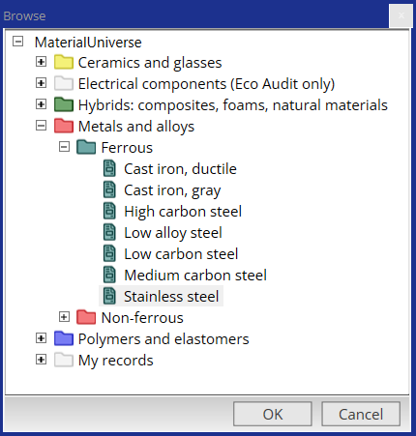
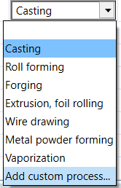
Both custom Materials and Processes can be included in Eco Audit
Notes:
User defined records in Eco Audit
From Granta EduPack 2023 R2 onwards, user defined records can be employed in an Eco Audit. They are added directly in the bill of materials by clicking on drop-down menus from the material or process box.

Slide 16
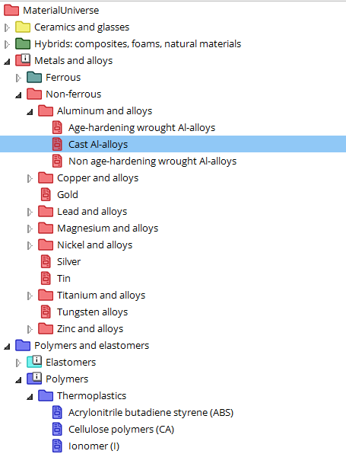
New example, Al: Step 1. Material and process energy / CO₂
Component name Material Process Mass (kg) End of life
Component 1
Aluminum alloys
Casting
2.3
Recycle
Landfill
Downcycle
Recycle
Re-manufacture
Reuse
None
Casting
Forging / rolling
Extrusion
Wire drawing
Powder forming
Vapor methods
Granta EduPack
materials tree
End of life
options
Notes:
Step 1: enter the bill of materials and end-of-life choice
Materials, processes and end-of-life choice are entered in the way shown here. A bill of materials is drawn up, listing the mass of each component used in the product and the material of which it is made, as on the left. Data for the embodied energy (MJ/kg) and CO₂ (kg/kg) per unit mass for each material is retrieved from the database – here, the data sheets of Part 2 of this book, using the means of the ranges listed there (right hand side of the Table). Multiplying the mass of each component by its embodied energy and summing gives the total material energy – the first bar of the bar-chart.
The audit focuses on primary shaping processes since they are generally the most energy-intensive steps of manufacture. These are listed against each material, shown here. The process energies and CO₂ per unit mass are retrieved from the database. Multiplying the mass of each component by its primary shaping energy and summing gives an estimate of the total processing energy – the second bar of the bar-chart.
On a first appraisal of the product it is frequently sufficient to enter data for the components with the greatest mass, accounting for perhaps 95% of the total. The residue is included by adding an entry for “residual components” giving it the mass required to bring the total to 100% and selecting a proxy material and process: “polycarbonate” and “molding” are good choices because their energies and CO₂ lie in the mid range of those for commodity materials.
Finally, the end-of-life choice is selected from the list of 5 options, listed here.

Slide 17
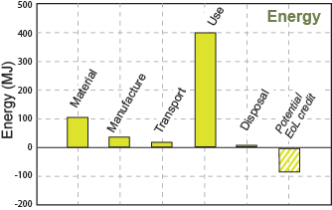
Step 2, add PP & Glass. Material and process energy / CO₂
Component name Material Process Mass (kg) End of life
Component 1
Aluminum alloys
Casting
2.3
Recycle
Component 2 Polypropylene Polymer molding 1.85 Landfill
Component 3 Glass Glass molding 3.7 Reuse
Total embodied energy
Total process energy
Total mass
Total end of life energy
Notes:
Step 1: enter the bill of materials and end-of-life choice
Materials, processes and end-of-life choice are entered in the way shown here. A bill of materials is drawn up, listing the mass of each component used in the product and the material of which it is made, as on the left. Data for the embodied energy (MJ/kg) and CO₂ (kg/kg) per unit mass for each material is retrieved from the database – here, the data sheets of Part 2 of this book, using the means of the ranges listed there (right hand side of the Table). Multiplying the mass of each component by its embodied energy and summing gives the total material energy – the first bar of the bar-chart.
The audit focuses on primary shaping processes since they are generally the most energy-intensive steps of manufacture. These are listed against each material, shown here. The process energies and CO₂ per unit mass are retrieved from the database. Multiplying the mass of each component by its primary shaping energy and summing gives an estimate of the total processing energy – the second bar of the bar-chart.
On a first appraisal of the product it is frequently sufficient to enter data for the components with the greatest mass, accounting for perhaps 95% of the total. The residue is included by adding an entry for “residual components” giving it the mass required to bring the total to 100% and selecting a proxy material and process: “polycarbonate” and “molding” are good choices because their energies and CO₂ lie in the mid range of those for commodity materials.
Finally, the end-of-life choice is selected from the list of 5 options, listed here.

Slide 18
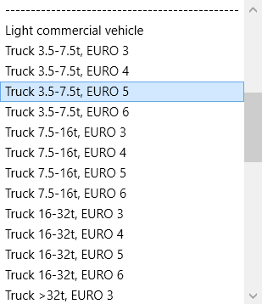
Step 3. Transport
Transport stage Transport type Distance (km)
Stage 1
Truck 3.5-7.5t, EURO 5
350
Stage 2 Sea, bulk carrier 12 000
Transport energy
Transport CO_{2 Eq}
Table of transport types:
MJ / tonne.km
CO₂ / tonne.km
Notes:
18
Step 2: enter the transport details
This step estimates the energy for transportation of the product from manufacturing site to point of sale. The energy demands of chosen transport in 0.9 MJ/tonne.km, retrieved from a look-up table in Granta EduPack, is multiplied by the mass of the product and the distance travelled to give the travel energy. Carbon footprint is calculated in a similar way.

Slide 19
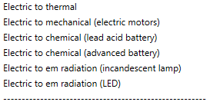
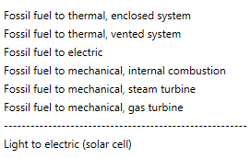
Step 4. Use phase – static mode
Energy input and output
Electric to mechanical
Power rating
1.2
kW
Energy input and output
Usage
365
days per year
W
kW
MW
hp
ft.lb/sec
kCal/yr
BTU/yr
Usage
0.5
hours per day
Total energy or
CO_{2 Eq} for use
Notes:
19
Step 3: enter the use pattern
The use phase requires a little explanation. There are two different classes of contribution.
Most products require energy to perform their function: electrically powered products like hairdryers, electric kettles, refrigerators, power tools and space heaters are examples. Even apparently non-powered products like household furnishings or unheated buildings still consume some energy in cleaning, lighting and maintenance. The first class of contribution relates to the power consumed by, or on behalf of, the product itself.
The second class is associated with transport. Products that form part of a transport system or are transported add to its mass and thereby augment its energy consumption and CO₂ burden. This carries an energy and CO₂ penalty per unit weight and distance. Multiplying this by the product weight and the distance over which it is carried gives an estimate of the associated use-phase energy and CO₂.
All energies are related back to primary energy, meaning oil, via oil-equivalent factors for energy conversion. Retrieving these and multiplying by the power and the duty cycle – the usage over the product life – gives an estimate of the oil-equivalent energy of use.

Slide 20

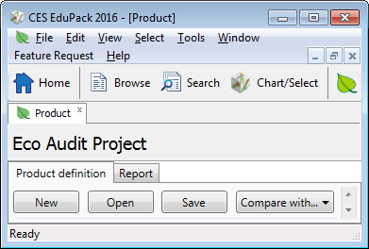
New example. Bottled water in PET (100 units)
1 litre PET bottle with PP cap
Blow molded
Filled in France, transported 550 km to UK
Refrigerated for 2 days, then drunk
Product name:
PET bottle
Number Name Material Process Mass (kg) End of life
100 Bottles PET Molding 0.04 Recycle
100 Caps Polypropylene Molding 0.001 Landfill
100 Water 1.0
Transport
Stage 1
Truck 7.5-16t, EURO 5
550 km
Survey charts
Use - refrigeration
Electric to mechanical
0.12 kW
2 days
24 hrs/day
Full report
Notes:
20
A simple example
Here is an extremely simple example to illustrate how the Eco Audit tool works. One brand of bottled water – we will call it Alpure – is sold in 1-liter PET bottles with polypropylene caps. One bottle weighs 40 grams; its cap weighs 1 gram. The bottles and caps are molded, filled with water in the French Alps and transported 550 km to London, England, by 14 tonne truck. Once there, they are refrigerated for 2 days, on average before consumption. We use these data for the case study, taking 100 bottles as the unit of study, requiring 1m³ of refrigerated space. At end of life the bottles are recycled.

Slide 21

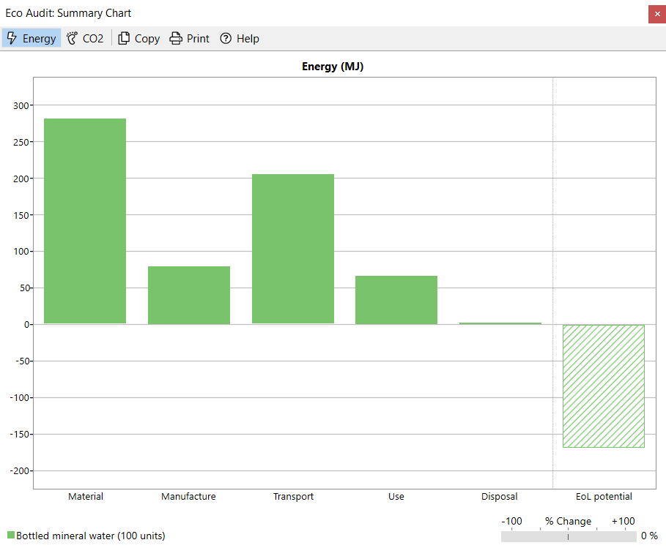
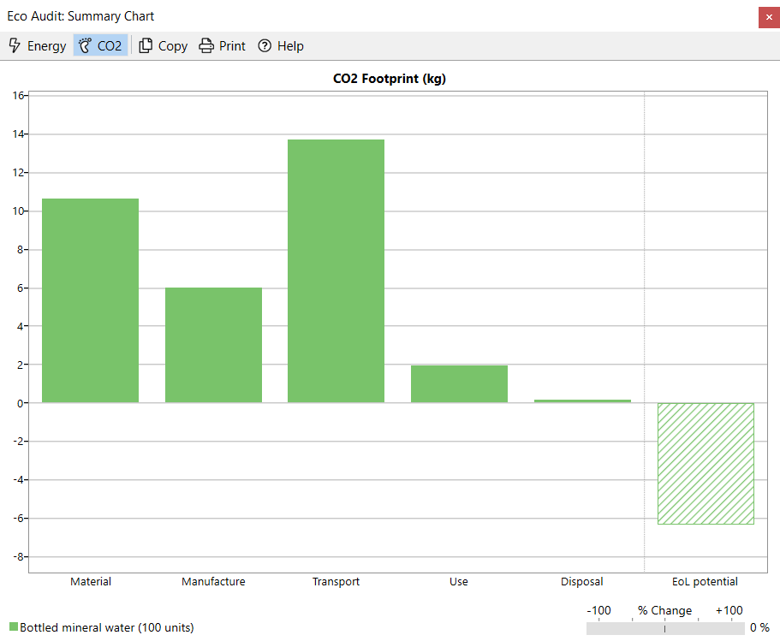
Output: summary charts
Toggle between energy
and carbon footprint
Copy or print
the chart
Which of the 4 non-transport phases has the largest CO₂-impact?
Materials!
Click on bar for help on impact reduction
Materials
Manufacture
Reducing Material-phase impact
Aim
Minimize embodied energy or CO₂
footprint per unit of function.
Use as large a “recycled content”
in the material as possible
Use as little material as possible while
Retaining enough redundancy for safety.
Conflicts
Watch out for conflict with the Use phase.
The material with the lowest direct
Eco-impact may not be the lightest or the
cheapest. Use trade-off methods to
resolve the conflict.
Transport
Use
End-of-life
potential
Disposal
Notes:
21
Graphical output and recommendations for improvement
The output of the tool includes bar-charts for the energy and for the carbon dioxide emissions associated with each phase of life. Tabular data gives details. Clicking on a bar brings up text sheets indicating ways in which that bar might be reduced in height, and warnings of possible unforeseen consequences.

Slide 22
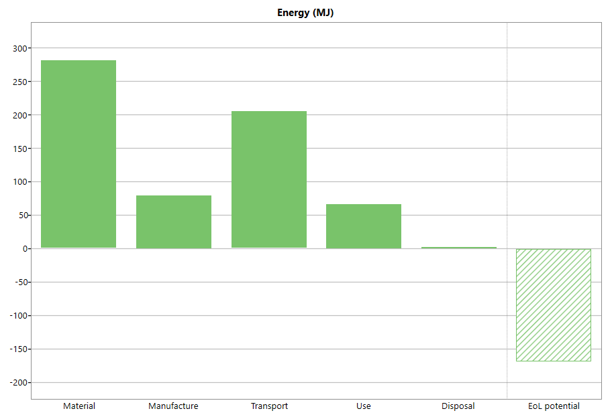

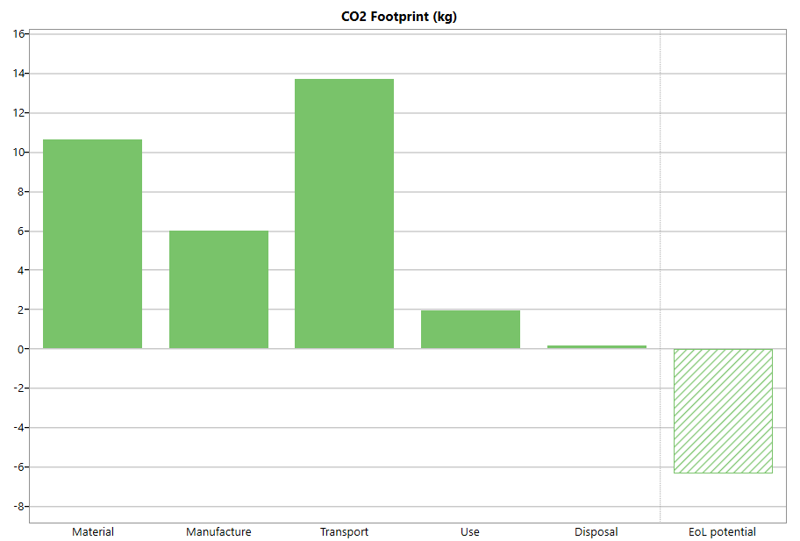

Actions and comparisons
The audit reveals the most energy and carbon intensive steps…
… and allows rapid “What if…”
PET Glass ?
Notes:
22
Making rapid “what if …” comparisons
The frame shows the graphic output for the PET water bottle. The largest bar is the first – that for the material. Could it be reduced in height by replacing PET by glass, remembering that the glass bottle is much heavier. The “Compare with…” facility allows the comparison, as shown on the next frame.

Slide 23

Change the materials
1 litre glass bottle with aluminum cap
Copy of current project
New project
Saved project
Glass molded
Filled in France, transported 550 km to UK
Refrigerated for 2 days, then drunk
Product name:
PET bottle
PET bottle
Glass bottle
Number Name Material Process Mass (kg) End of life
100 Bottles PET Molding 0.04 Recycle
Soda glass
Glass mold
0.45
100 Caps Polyprop Molding 0.001 Landfill
Aluminum
Rolling
0.002
100 Water 1.0
Transport
Stage 1
14 tonne truck
550 km
Use - refrigeration
Electric to mechanical
0.12 kW
2 days
24 hrs/day
Notes:
23
Change of material
This frame shows a change of material. The “Compare with...” brings up a copy of the inputs, which can now be edited. Here is the material of the bottle has been changed to glass, entering the mass of a typical 1-liter glass wine bottle (0.45 kg). The material of the cap has been changed to aluminum, again using a typical mass for one cap.

Slide 24
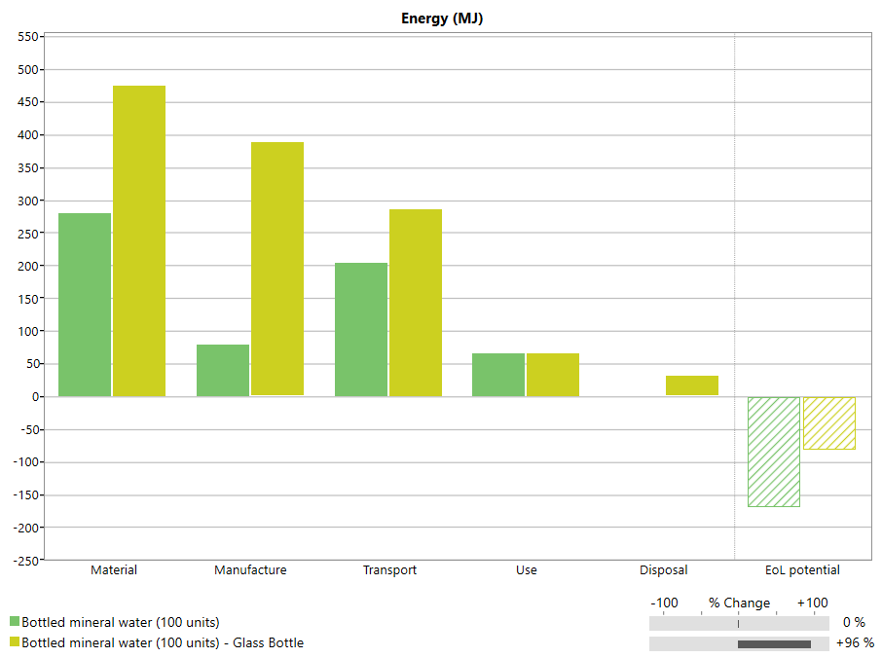

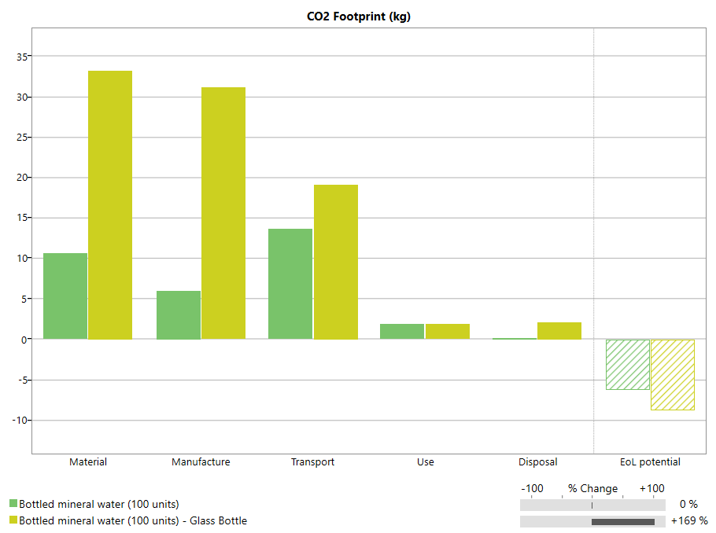
Actions and comparisons
The fast comparison allows design decisions on-the-fly
=
Reducing impact
Virgin PET
Actions
Use as large a 'recycled content' in the material as possible.
=
Glass
What if…….
100% recycled PET?
Notes:
24
Actions and comparisons
This is the output of the comparison. Bars for the original PET bottle are shown in green, those for the glass bottle in yellow. The glass bottle is more energy intensive and carries greater CO2 emissions than the PET bottle.
Clicking on the Material bar brings up suggestions for improvement. One is to use recycled materials. Using the “Compare with…” facility a second time allows this to be tried. The next frame shows the results.

Slide 25
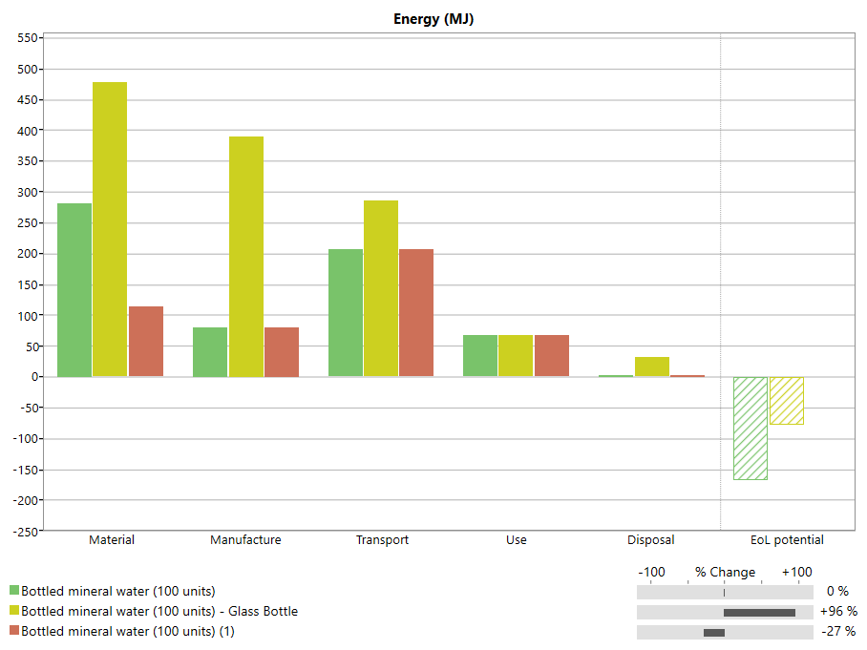
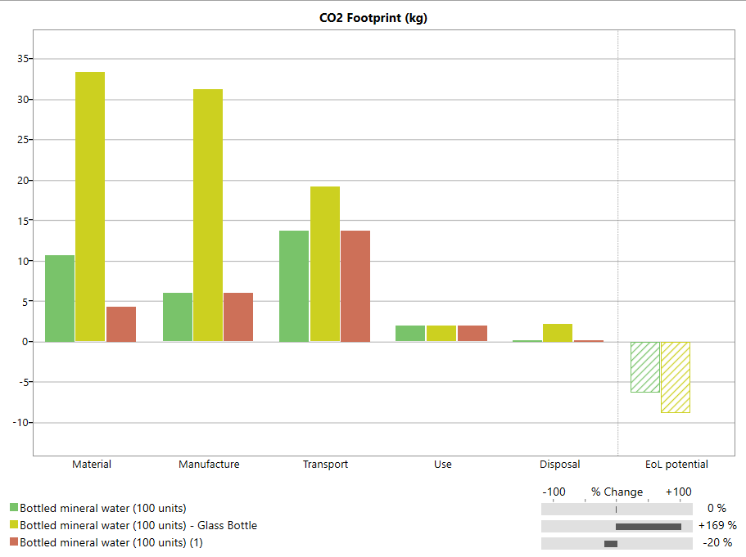

Actions and comparisons
Can explore:
Material choice
Recycle content
Transport mode
Transport distance
Use pattern
Electric energy mix
End of life choice
Click
Compare with….
Copy of current content
=
Set Recycle content to 100%
Virgin PET
=
Many projects are available as project files.
Glass
=
Recycled PET
Notes:
25
Further comparisons – add recycling
This is the output of the comparison. Bars for the original virgin PET bottle are shown in green, those for the glass bottle in yellow, those for recycled PET in red. Using recycled PET offers substantial energy and emissions savings.

Slide 26
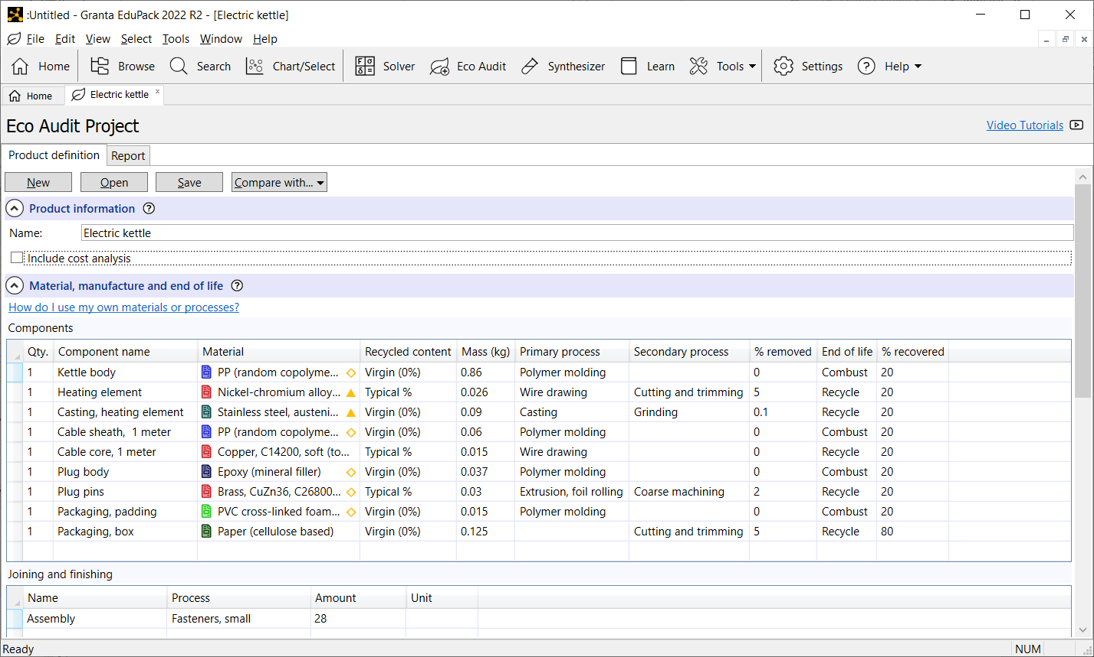
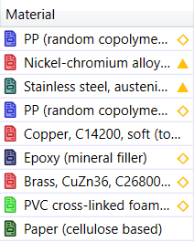
The Enhanced Eco Audit tool
Secondary Processes
Cost Audit
Joining and Finishing
“Restricted” risk flags
May.............Will damage
Notes:
26
Granta EduPack Advanced Eco Audit tool in detail
The Enhanced Eco Audit is available within the Eco Design and Sustainability databases at Level 3. It enables Cost Audits by ticking this option above the Bill of Materials (B.O.M.) It highlights materials with considerable content of critical elements as well as restricted or hazardous substances.
It allows secondary processes to be added and an additional step of Joining and Finishing of the product, all using simple drop-down menus.

Slide 27
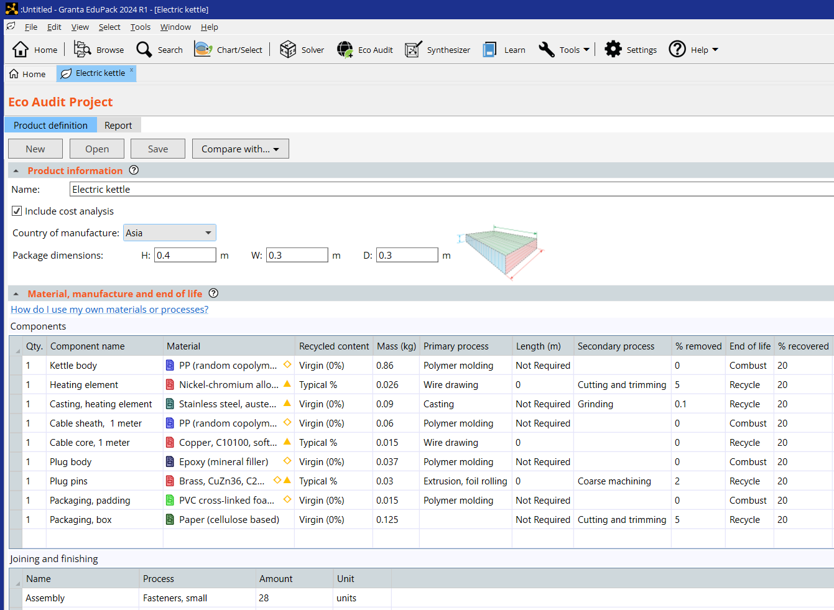
The Enhanced Eco Audit tool
Cost Audit
Secondary Processes
“Restricted” risk flags
Joining and Finishing
May.............Will damage
Notes:
27
Granta EduPack Advanced Eco Audit tool in detail
The Enhanced Eco Audit is available within the Eco Design and Sustainability databases at Level 3. It enables Cost Audits by ticking this option above the Bill of Materials (B.O.M.) It highlights materials with considerable content of critical elements as well as restricted or hazardous substances.
It allows secondary processes to be added and an additional step of Joining and Finishing of the product, all using simple drop-down menus.

Slide 28

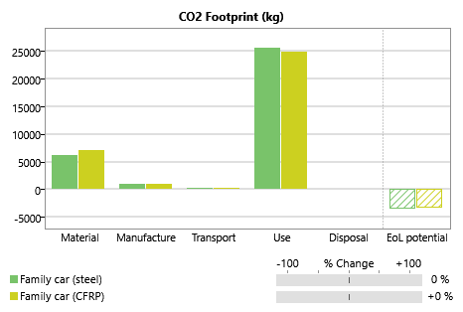
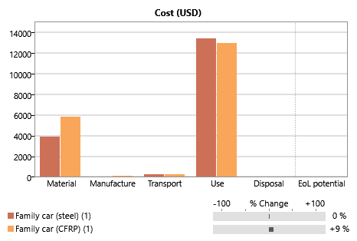
Cost in the advanced Eco Audit tool
Carbon
Cost
Steel body panels – 100 kg
Carbon-epoxy panels–50 kg
Distance driven 100,000 km
Notes:
Cost Audit
The effects of light-weighting redesign of a car. The total carbon footprint is about the same (less from the use and more from the material) but the cost is significantly increased in this example based on a component for a family car.

Slide 29
Summary
Granta EduPack has two resources to help explore the materials dimension of environmental design
1. The Eco Audit tool allows students to implement quick, approximate “portraits” of energy / CO_{2 Eq.} character of products. (This Unit)
2. Selection strategies allows selection to re-design products using eco-properties and employ systematic methods. (Lecture Unit 11: Eco-informed material selection)
Eco Audits reveal the eco-fingerprint of products and suggest approaches to making them less environmentally damaging. The Enhanced Eco Audit gives Cost information and flags restricted or critical materials risk
Notes:
29
Summary
This final frame summarizes the points made in this Unit. More can be found in the textbook Materials and the Environment, and in the documentation of Granta Edupack. For more information, see www.ansys.com/education-resources

Slide 30
Also available for eco design/sustainability
Eco-informed material selection
What is a Sustainable development
Materials for low carbon power
Exercises with Worked Solutions
Other Lecture Units
White Papers
Selection case studies
Poster
www.ansys.com/education-resources
Notes:
Materials, the Environment and Sustainable Development
The Granta EduPack has a number of resources for teaching about Materials, the Environment and Sustainable Development. They are described in the Sustainability Lecture Units listed in the next slide, and in the White Papers with the titles:
‘Granta EduPack Eco Audit tool’
‘Granta EduPack for Eco Design‘
'Materials for Low Carbon Power',
'Materials for Energy Storage Systems‘
‘Materials and Sustainable Development’

Slide 31
Lecture unit series
PowerPoint lecture units, as well as many other types of resources, can be found in the Ansys Education Resources webpage.
Finding and Displaying Information
Unit 1 | The materials of engineering
Unit 2 | Material property charts: mapping materials
Unit 3 | The Elements database: properties, relationships and resources
Material Properties
Unit 4 | Manipulating properties: composition, microstructure, architecture
Unit 5 | Designing new materials: filling the materials-property space
Unit 6 | Materials Science and Engineering
Selection
Unit 7 | Material selection: translation, screening, ranking, documentation
Unit 8 | Objectives in conflict: trade off methods and penalty functions
Unit 9 | Material and shape: materials for efficient structures
Unit 10 | Manufacturing processes and cost modeling
Unit 11 | Eco-informed material selection
Unit 12 | Eco design and the Eco Audit tool
Sustainability
What is a sustainable development? A materials perspective
Exploring Critical Materials using Ansys Granta EduPack
Special Topics
The Built Environment: materials for construction
Structural sections: shape in action
Materials in industrial design: Why do consumers buy products?
The Design database for Products
The Medical Devices database
The Battery Designer tool
Advanced Teaching and Research
Advanced databases: a lightning tour
The Aerospace edition
The Polymer edition
The Synthesizer tool: hybrids and other models
Materials for Bioengineering
www.ansys.com/education-resources
Notes:
Lecture Units Series
This is a list of the Lecture Units available for teaching with the Ansys Granta EduPack. These PowerPoint presentations and more information can be found on the Ansys Education Resources webpage:
www.ansys.com/education-resources.

